Slide 1

Effects of the H species in the HHFW performance in NSTX/NSTX-U
Nicola Bertelli
E.F. Jaeger (XCEL), R. W. Harvey (CompX), J.C. Hosea, E.-H. Kim, R.J. Perkins, G. Taylor, and E.J. Valeo, (PPPL)
APS-DPP 2017

Slide 2
Abstract
One of the goal of NSTX-U is to operate at full eld (B = 1 T). For this magnetic field, the first and second harmonics of hydrogen (H) are located at the high-field side and in the core plasma, respectively. In principle, part of the high-harmonic fast-wave (HHFW) injected power can be absorbed by the H population reducing the electron and/or the fast-ion heating. For this reason, full wave simulations results of NSTX-U scenarios with different H concentrations for wave frequencies of 30 and 60 MHz will be presented and discussed. Plasma scenarios with and without neutral beam injection (NBI) will be considered. Furthermore, the balance between the beam ion and electron power absorption will be analyzed comparing both NSTX and NSTX-U plasmas.

Slide 3
Outline
NSTX-U “Scenarios” considered
Antenna frequency = 30 MHz
  H Concentration scan
    w/ & w/o NBI
Antenna frequency = 60 MHz
  H concentration scan
    w/ and w/o NBI

Slide 4
NSTX-U “Scenarios” considered (1)
NSTX-U plasma
  B = 1T
  Ion species: D, H, C, D_{BEAM}
n_{e}
T_{e}
Z [m]
T [keV]
n [x 10¹⁹ m⁻³]
n_{D}
T_{D}
ρ_{pol}
ρ_{pol}
R [m]

Slide 5
NSTX-U “Scenarios” considered (2)
NSTX-U plasma
  B = 1T
H concentration scan:
  n_{H}/ n_{e} = 1%
  n_{H}/ n_{e} = 2%
  n_{H}/ n_{e} = 5%
  n_{H}/ n_{e} = 10%
w/ and w/o NBI
Two antenna frequencies
  30 MHz and 60 MHz
Three nphi values: -5, -12, -21
Employed full wave code AORSA

Slide 6
NSTX-U “Scenarios” considered (3)
NSTX-U plasma: B = 1 T and f = 30 MHz
D resonances
H resonances
Z [m]
Z [m]
R [m]
R [m]

Slide 7
NSTX-U “Scenarios” considered (4)
NSTX-U plasma: B = 1 T and f = 60 MHz
D resonances
H resonances
Z [m]
Z [m]
R [m]
R [m]

Slide 8
f = 30 MHz, H 1%, 2%, 5% and 10%
with NBI

Slide 9
Power absorption vs. toroidal wave number
H 1%
H 2%
Power abs [%]
Power abs [%]
nphi
nphi
Electron absorption increases with larger nphi
(Fast) Ion abs. decreases with larger nphi
Not significant H power absorption for H 1% & 2%

Slide 10
Power absorption vs. toroidal wave number
H 5%
H 10%
Power abs [%]
Power abs [%]
nphi
nphi
Not significant H power absorption for 5%
  except for nphi = |5| & H 10% and nphi = -5)
The “heating phase” (nphi = |21|) is quite good for electron absorption

Slide 11
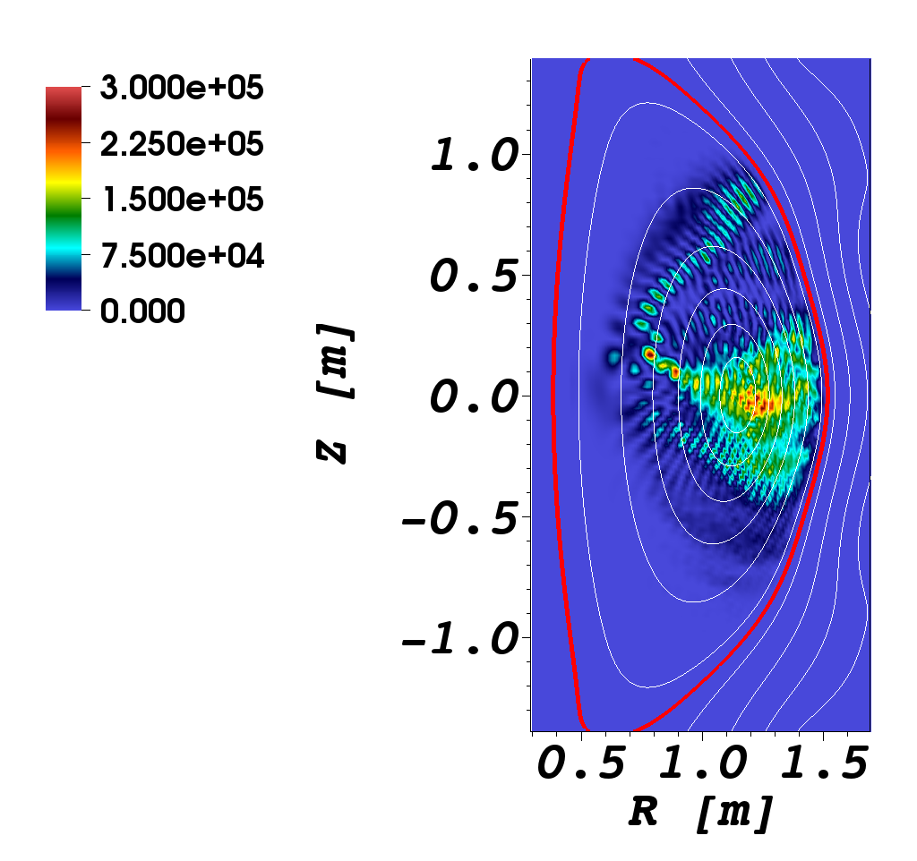
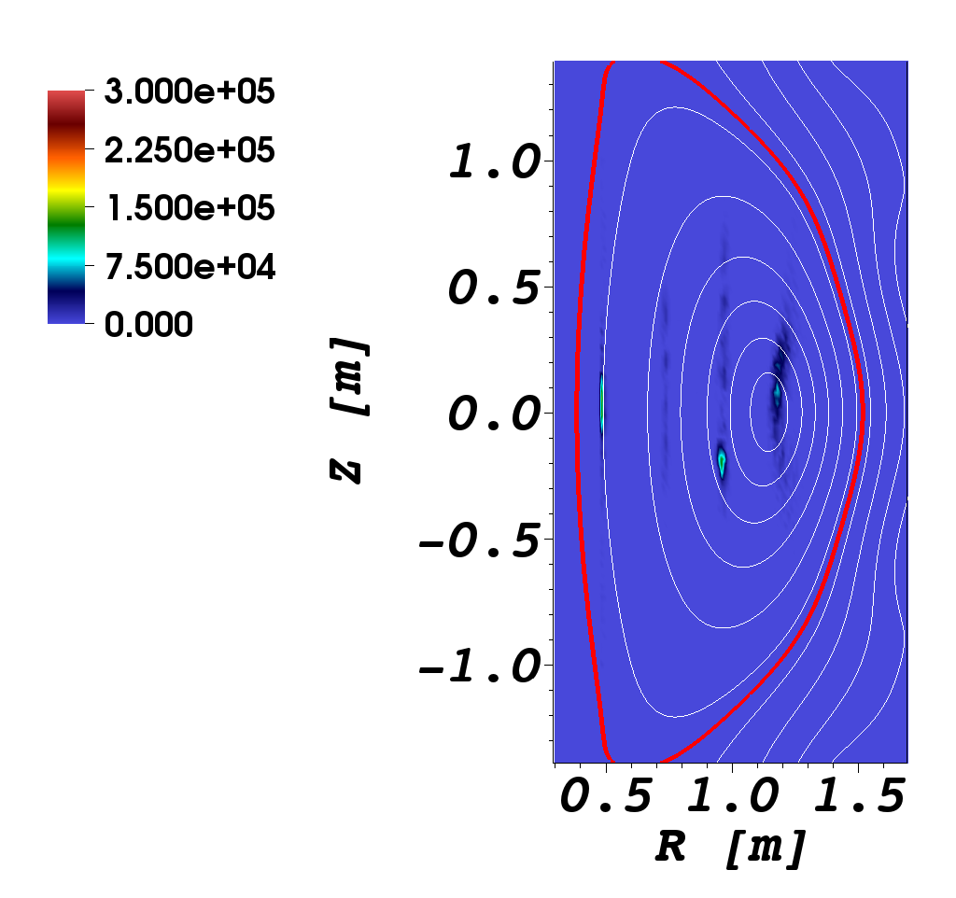
2D Power deposition profiles (1)
10% H concentration case & nphi = -12
Electron power deposition
D thermal power deposition
W/cm³/MW
W/cm³/MW

Slide 12

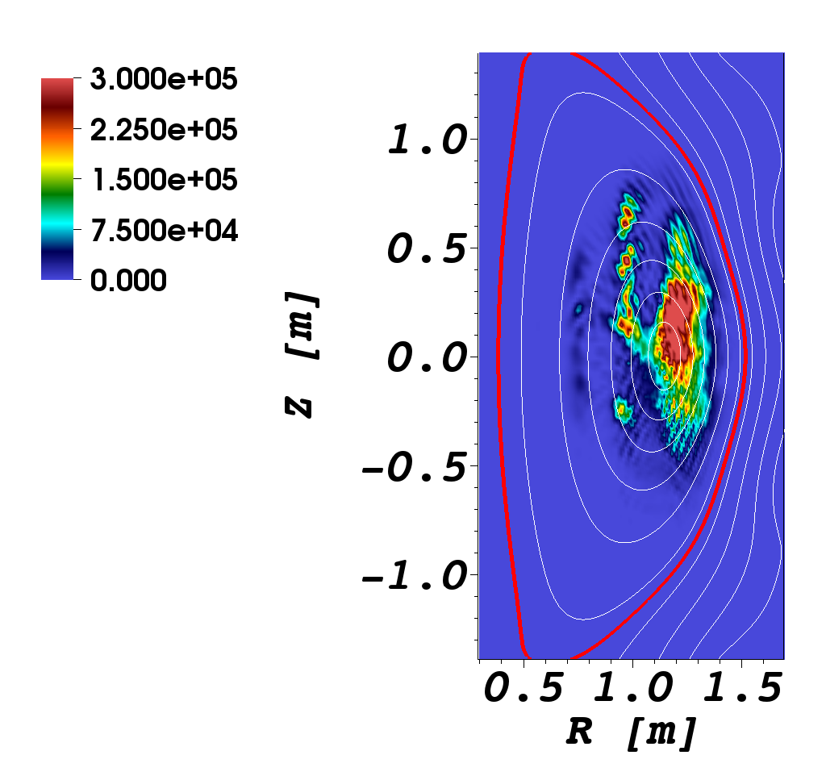
2D Power deposition profiles (2)
10% H concentration case & nphi = -12
H power deposition
D-NBI power deposition
W/cm³/MW
W/cm³/MW

Slide 13
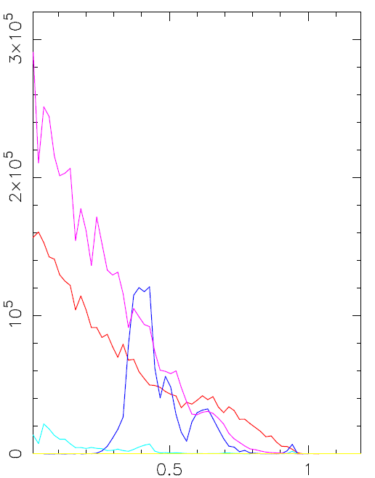
Flux surface avg deposition profiles
10% H concentration case & nphi = -12
Electron & D-NBI power
depositions peaked on
axis
H power deposition
localizedon 2nd H resonance
Thermal D & C are basically
negligible
D-NBI
Power density [W/m³]
electron
H
D
ρ_{pol}

Slide 14
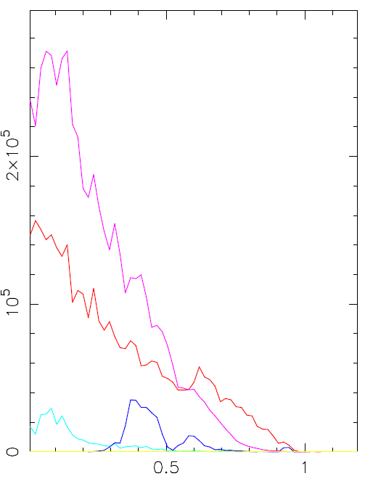
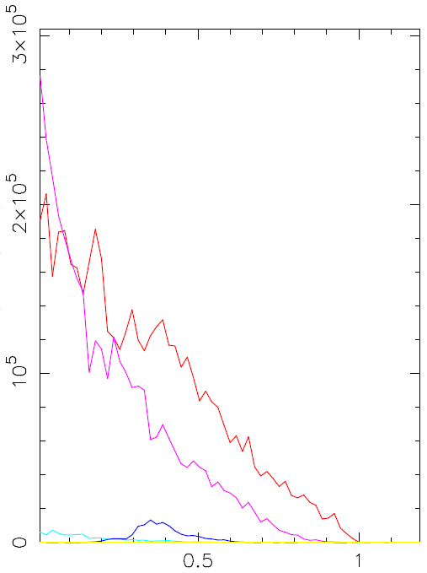
Flux surface avg. deposition profiles
2% H concentration
nphi = -12
nphi = -21
D-NBI
D-NBI
electron
electron
Power density [W/m³]
Power density [W/m³]
H
H
D
D
ρ_{pol}
ρ_{pol}

Slide 15
Power absorption vs. H concentration
nphi = -5
nphi = -12
nphi = -21
H concentration [%]
H concentration [%]
H concentration [%]
H power absorption increases with larger H concentration and decreases for larger nphi
In general, no significant impact by H concentration
  nphi = -21 case is basically independent from H concentration

Slide 16
f = 60 MHz, H 1%, 2%, 5% and 10%
with NBI

Slide 17
Power absorption vs. nphi
H 1%
H 2%
Power abs [%]
Power abs [%]
nphi
nphi
Similar conclusions as f=30 MHz case
  Electron absorption increases with larger nphi
  (Fast) Ion absorption decreases with larger nphi

Slide 18
Power absorption vs. nphi
H 5%
H 10%
Power abs [%]
Power abs [%]
nphi
nphi
H abs. increases with larger H concentration
nphi = -21 (“heating phase”) is quite good for electron abs.
No D & C contributions

Slide 19
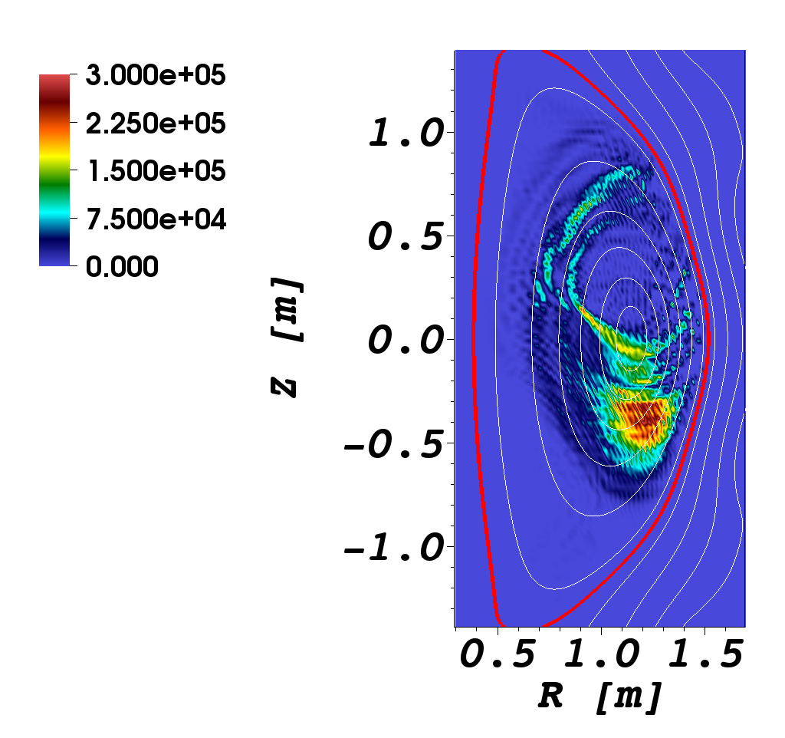

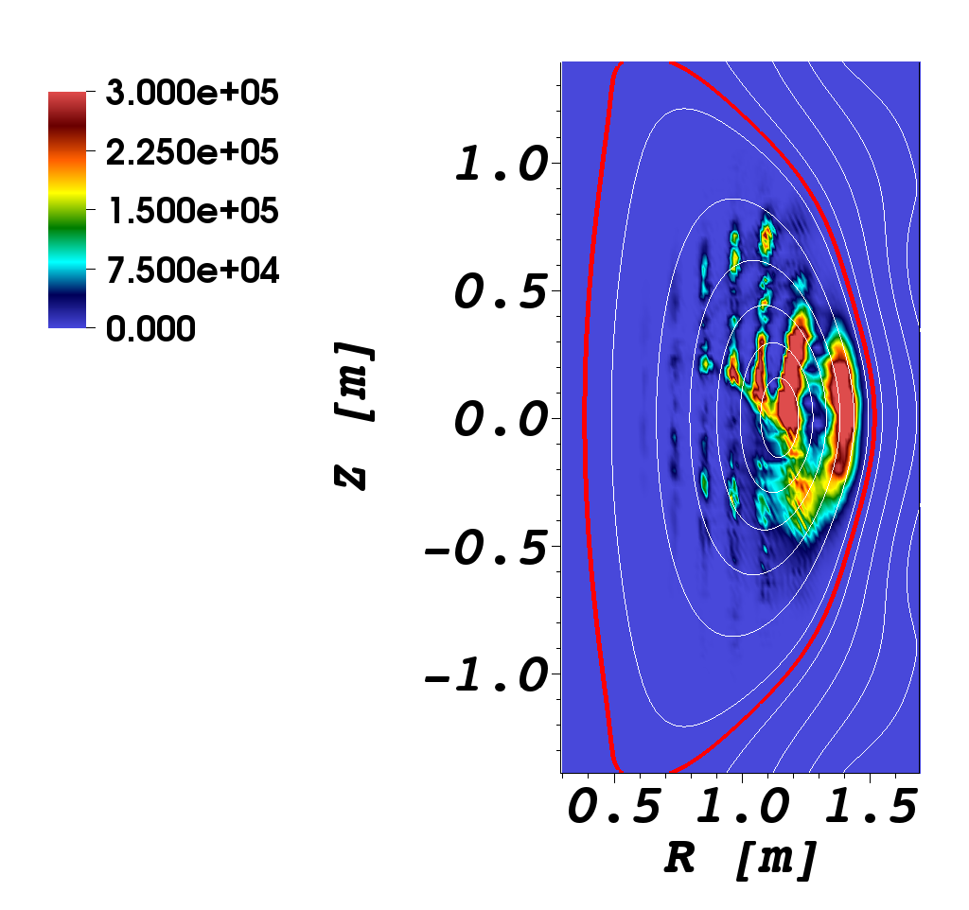
2D Power deposition profiles (1)
10% H concentration case & nphi = -12
electron
H
D-NBI
W/cm³/MW

Slide 20
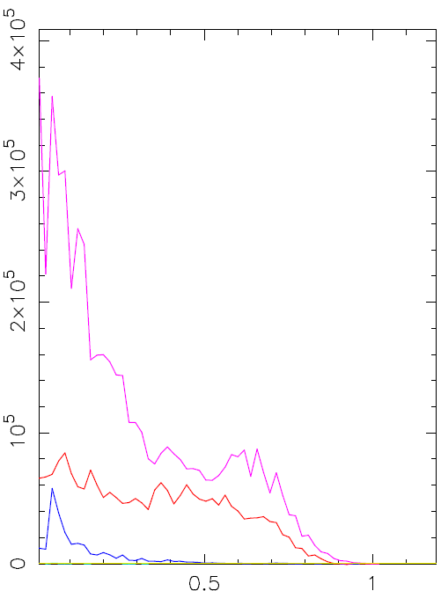
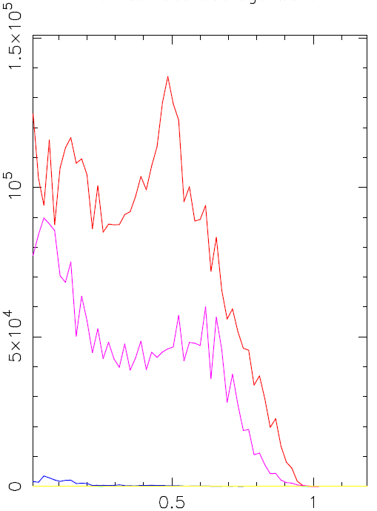
Flux surface avg. deposition profiles
2% H concentration
nphi = -12
nphi = -21
D-NBI
electron
Power density [W/m³]
electron
Power density [W/m³]
D-NBI
H
H
ρ_{pol}
ρ_{pol}

Slide 21
Power abs. vs. H concentration
H abs increases with larger H concentration and decreases for larger nphi
Power abs. is almost independent from H concentration

Slide 22
Comparison between f = 30 and 60 MHz
H 1%, 2%, 5% and 10%
with NBI

Slide 23
Power absorption vs. nphi
(f = 30MHz solid, f = 60MHz dashed curves)
H 1%
H 2%
Power abs [%]
Power abs [%]
nphi
nphi
60 MHz case has higher fast ion abs. than 30 MHz case for nphi = -5 and -12
For nphi = -21, power abs. very similar between two cases

Slide 24
Power abs. vs. nphi (f = 30MHz solid, f = 60MHz dashed curves)
H 5%
H 10%
Power abs [%]
Power abs [%]
nphi
Small H power absorption except for 10% concentration and lower nphi

Slide 25
Conclusions for f = 30 and 60 MHz with NBI
Current drive phase (i.e, nphi = - 5) it seems to be bad
Large electron damping for nphi = -21 (i.e. heating phase)
  however, ~30% of power to fast ions
  NO significant differences between f = 30 and 60 MHz
For nphi = -5 and -12, higher fast ions abs. for 60 MHz case than 30MHz case
H absorption is significant (~10-30%) at low nphi and high H concentration (> 5%)
In principle, HHFW might modify either the electron or the ion temperature (through H species)
  Could be interesting for transport studies
  See cases without NBI below

Slide 26
f = 30 MHz, H 1%, 2%, 5% and 10%
NO NBI

Slide 27
Power absorption vs. nphi
For nphi = -12 and -21:
dominant electron abs.
  Except for H 10%
Larger H absorption
for higher H concentration
Possible H ions
accelaration due to HHFW

Slide 28
f = 60 MHz, H 1%, 2%, 5% and 10%
NO NBI

Slide 29
Power absorption vs. nphi
Dominant electron abs.
for all cases

Slide 30
Comparison between f = 30 and 60 MHz
H 1%, 2%, 5% and 10%
NO NBI

Slide 31
Power abs. vs. nphi (f = 30MHz solid, f = 60MHz dashed curves)
Dominant electron abs.
for all nphi for 60 MHZ
case
Significant H abs. for
for nphi = -5 and -12 for
30MHz case

Slide 32
Conclusions for f = 30 and 60 MHz without NBI
Large electron damping for all nphi for 60 MHz
No significant differences between f = 30 and 60 MHz cases for nphi = -21
Dominant H absorption for nphi = -5 and for 30 MHz case
Dominant electron absorption for nphi = -12 and for 30 MHz case & H concentration < 5%

Slide 33
Future steps
Additional AORSA simulations for NSTX-U scenarios concentration scan
  B scan
  H concentration scan
  Temperature and density “scan”
  H plasma
  w/ & w/o NBI
  frequency = 15, 30, and 60 MHz
AORSA runs for NSTX cases (one or two cases)
  Temperature and density “scan”
  H concentration scan
  w/ & w/o NBI
Repeat simulations above with AORSA+CQL3D
  In case of H & NBI, consider both non-Maxwellian species

