Slide 1



Synthetic capability for the study of poloidal impurity asymmetries in NSTX-U
L. F. Delgado-Aparicio¹, R. E. Bell¹, M. Podestà¹, B. P. LeBlanc¹, A. Diallo¹, B. Stratton¹, S. Paul¹⁺, L. Morton², H. Yamazaki^{1,3}, Y. Takase³ and M. Ono¹
¹Princeton Plasma Physics Laboratory, Princeton, NJ, 08540, USA
²Oak Ridge Associated Universities, Oak Ridge, TN, 37831, USA
³The University of Tokyo, Graduate School of Frontier Sciences, Kashiwa 277-8561 Japan
59th Annual Meeting of the APS
Division of Plasma Physics,
October 23 - 27, 2017 • Milwaukee, Wisconsin

Slide 2
Abstract
A new synthetic capability has been built to compute the two-dimensional mapping of impurity density asymmetries in NSTX-U. This technique relies on flux-surface quantities like electron and ion temperature (T_{e,i}) and rotation frequency (ωφ), but finds the 2D electron, deuterium and carbon density profiles self-consistently assuming the presence of a poloidal variation due to centrifugal forces. The solution for the electrostatic potential for the measured carbon density (n_{C}) and central toroidal rotation using NSTX data will be shown and compared with the values derived using Wesson’s formalism which assumed that the main intrinsic impurity was in the trace limit. The presence of O, Ne, Ar, Fe, Mo and W are considered at the trace limit (n_{Z}<Z>²/n_{e}<1) with very small changes to quasineutrality and Z_{eff}. The few assumptions made considered a zero electron mass, a deuterium plasma, a trace impurity with charge “Z” given by coronal equilibrium (<Z>=<Z>(T_{e})) and equilibrated ion temperatures (e.g. T_{D}=T_{C}=T_{Z}). This synthetic capability will help in the understanding of asymmetries before tearing modes onsets as well as aid the design of new diagnostics (e.g. ME-SXR, XICS, Bolometers, XUV-spectrometers, etc) for NSTX-U.

Slide 3
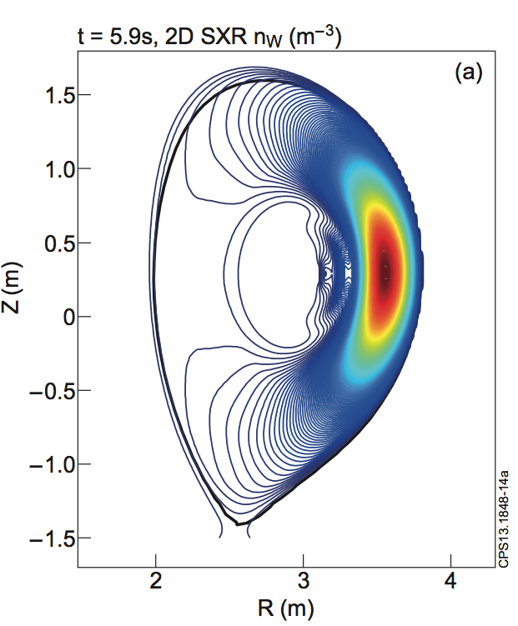
Background
With the selection of W for the divertor in ITER, understanding the sources, transport, confinement of high-Z impurities is crucial to ITER success.
It is imperative to address key issues associated with impurity sources, core transport and high-Z impurity accumulation.
Controlling Z-transport to avoid accumulation is necessary to achieve and maintain high fusion performance in the presence of high-Z PFCs.
JET, n_{W}
Understanding poloidal asymmetries and its role for the “outward convection” of impurities is highly desirable.
The impact of the plasma composition on the linear and non-linear stability of gradient driven modes on particle and heat transport has to be assessed, with particular emphasis on the role of the heavy impurities.

Slide 4
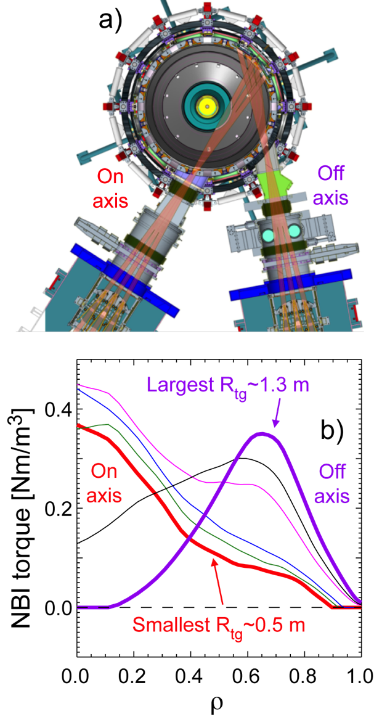
Motivation
Off-axis NBI have been implemented with the main goal of broadening J & p profiles and study effects on confinement and stability
Torque will be imparted also at mid-radius possibly increasing the MACH-corrections due to centrifugal forces
Understanding poloidal asymmetries and its role for the “outward convection” of impurities is highly desirable.
An electrostatic potential (Δϕ) is setup mainly between electron, deuterium ions and low-Z impurities (e.g. C, B).
The impact of a reduction in the underline turbulence due to the E_{Δϕ}xB shearing rates should be explored
Impact operation with high-Z PFCs.

Slide 5
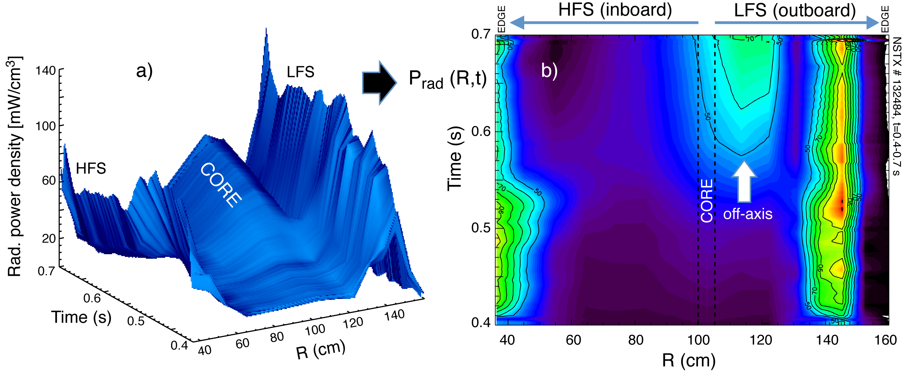
Asymmetry in the P_{rad} density with possible off-axis accumulation has been measured in NSTX
Experimental P_{rad} profile is asymmetric: off-axis peaking !
P_{rad} at the LFS is higher than @ core possibly due to C and Z’s accumulation
For t~0.7 s: P_{rad,0}~70 mW/cm³
P_{rad,edge}~60-140 mW/cm³ (most probably is much higher)

Slide 6
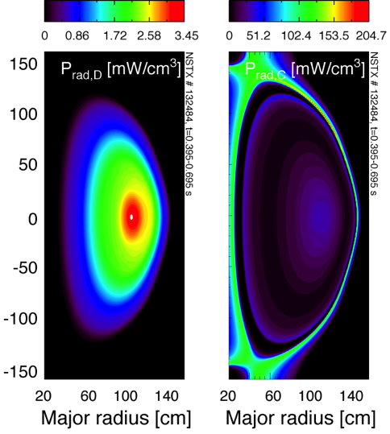
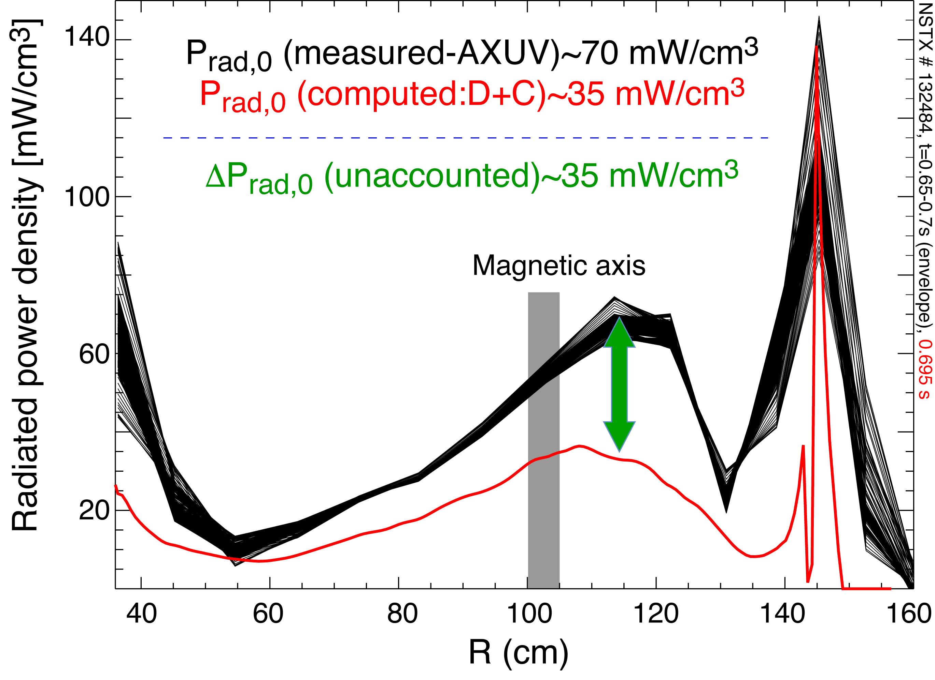
Measured power density and asymmetry can not be explained only as a function the D+C content
Computed P_{rad} profiles for H and C
P_{rad,C,0} ~10xP_{rad,H,0}
P_{rad,C,0} is slightly asymmetric
½ of the measured P_{rad} in the core is unaccounted for (shortfall of computed P_{rad,D}+P_{rad,C} )
Peaking factor is also stronger

Slide 7
Challenge and goals
Compute 2D mapping of flux-surface quantities like T_{e,C} and ωφ
Find n_{e},_{D},_{C}(R,t) self-consistently assuming presence of a poloidal variation due to centrifugal forces.
Estimate electrostatic potentials (Δϕ) and compare with derived using Wesson’s formalism.
Compute 2D mapping of n_{Z} asymmetries and P_{rad} in NSTX-U.
Contribute understanding of:
Medium- & high-Z asymmetries
Reduction of Z-peaking
Reduction of turbulence (E_{Δϕ}xB)
Radiation effects before TM-onsets
Aid the design of new NSTX-U diagnostics (e.g. ME-SXR, XICS, Bolometers, XUV-spectrometers, etc)
L. F. Delgado-Aparicio, et. al., RSI, 85, 11D859, (2014).
L. F. Delgado-Aparicio, et. al., in-prep., NF, (2017).

Slide 8
Formalism
The transport equations retaining strong rotation (V_{φ}~V_{th}) were first derived by Hinton and Wong [PoF’85] via extension of Hazeltine’s original NCLASS treatment [Plasma Phys.’73].
The density at a given flux surface ψ can be written as (see E. Belli, PPCF’09):
n_{j}(θ=0) is the impurity density profile at the equatorial-midplane
As a result of quasi-neutrality, Δϕ(θ) is a poloidal electrostatic potential generated to balance the density asymmetries (Δϕ(θ)=ϕ(θ)-ϕ(θ=0)).
STEPS:
Assume T_{j} and ω₀ are flux surface functions (ψ).
Find n_{D} profiles using the experimental values of n_{e} and n_{C} (@ midplane first)
Solve the quasi-neutrality condition for Δϕ(θ) sequentially at each value of θ
Assume arbitrary n_{Z} profiles at trace-limit (α_{Z}=δZ_{eff}=<Z>²n_{Z}/n_{e}≪1): n_{j}(θ=0)
Map particle density profiles asumming also <Z>=<Z>(T_{e})
Map radiated power density using: P_{rad}=n_{e}n_{Z}L_{Z}(T_{e})

Slide 9
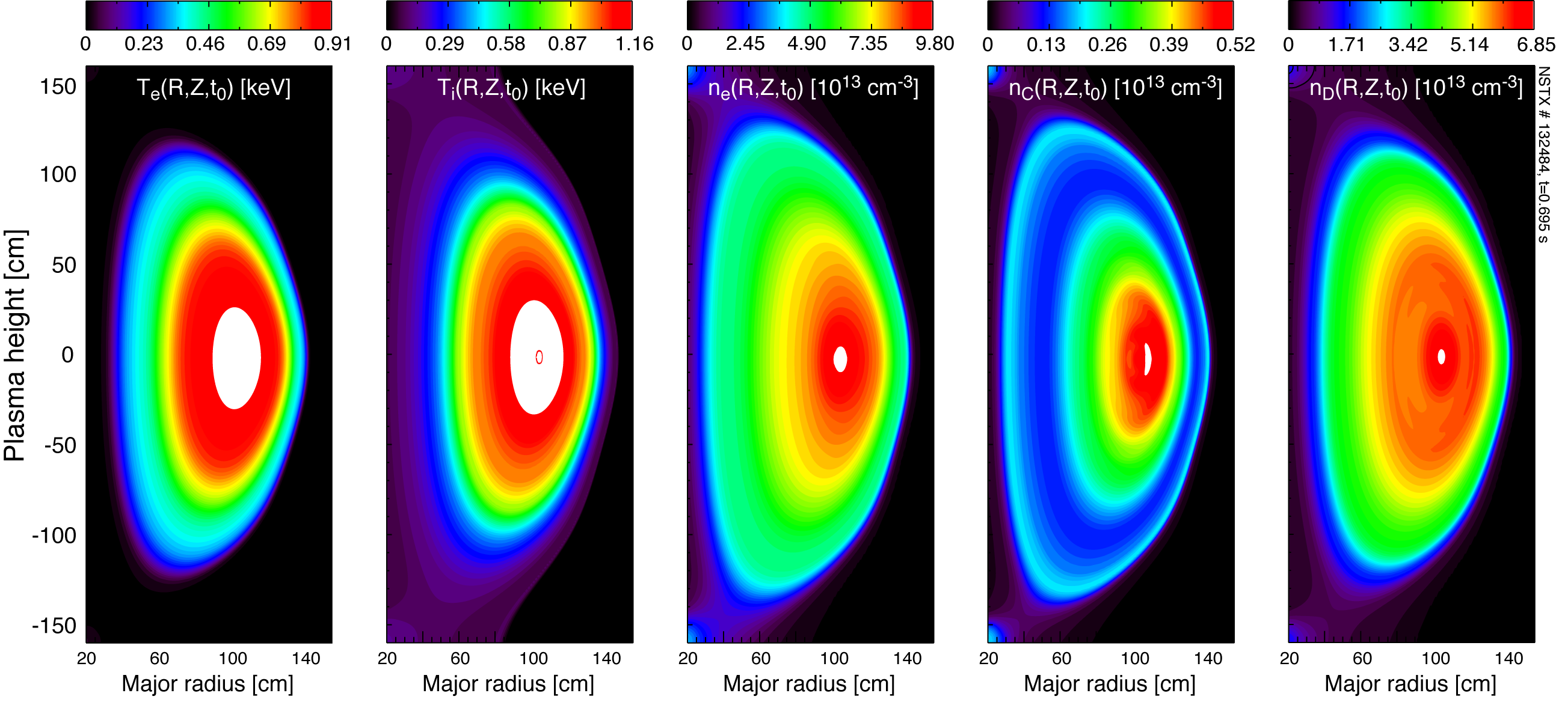
Mapping of mid-plane data in 2D (R,Z) is needed to account for centrifugal asymmetries in n_{Z}

Slide 10
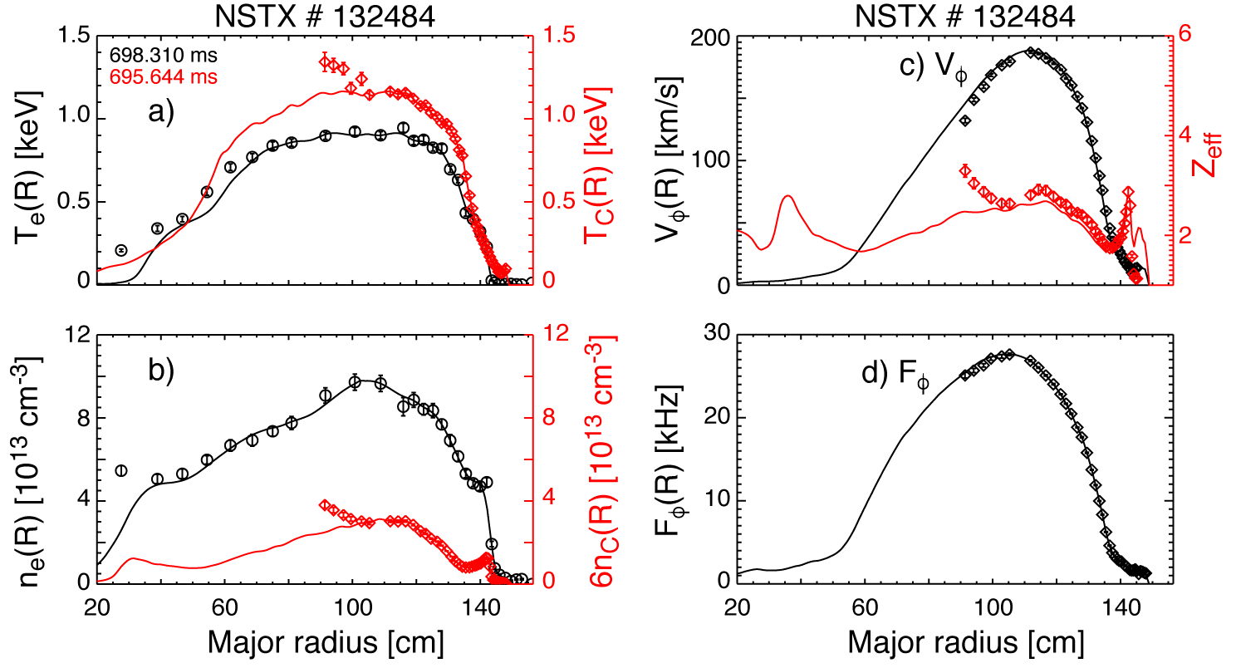
Mapping of mid-plane data agrees well with experimental MPTS and CHERS data
LRDFIT07
~MARFE
@ CS edge
MPTS: n_{e}, T_{e}
CHERS: n_{C}, T_{C}, V_{φ}

Slide 11
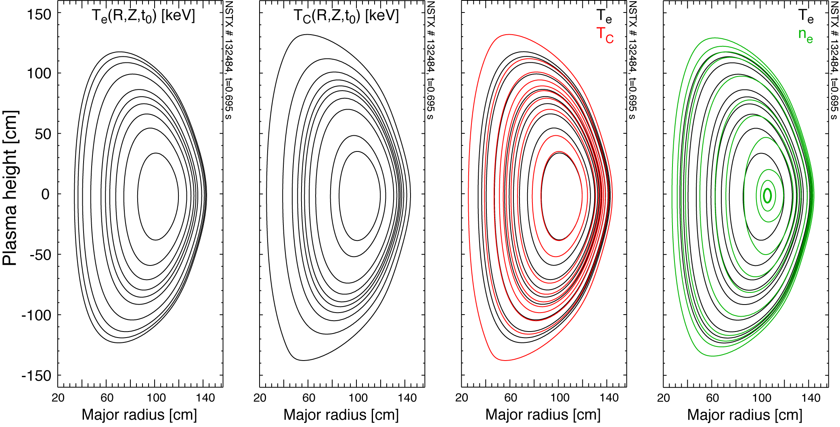
T_{e,C} are mapped on Ψ(R,Z) while n_{e} (MPTS) shows small asymmetry due to centrifugal effects
T_{e,C} are mapped on Ψ(R,Z)
SUPERIMPOSED
Core n_{e} departs from Ψ(R,Z)

Slide 12
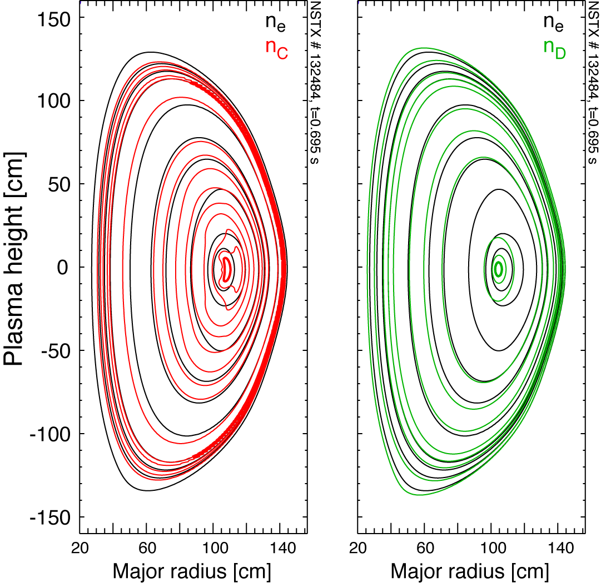
Measured n_{C} (CHERS) and inferred n_{D} (≈n_{e}-6n_{C}) show core effects from centrifugal effects
New capability at NSTX-U finds n_{e}, n_{D} and n_{C} profiles self-consistently assuming the presence of a poloidal variation due to centrifugal forces.
(considering a zero electron mass)

Slide 13
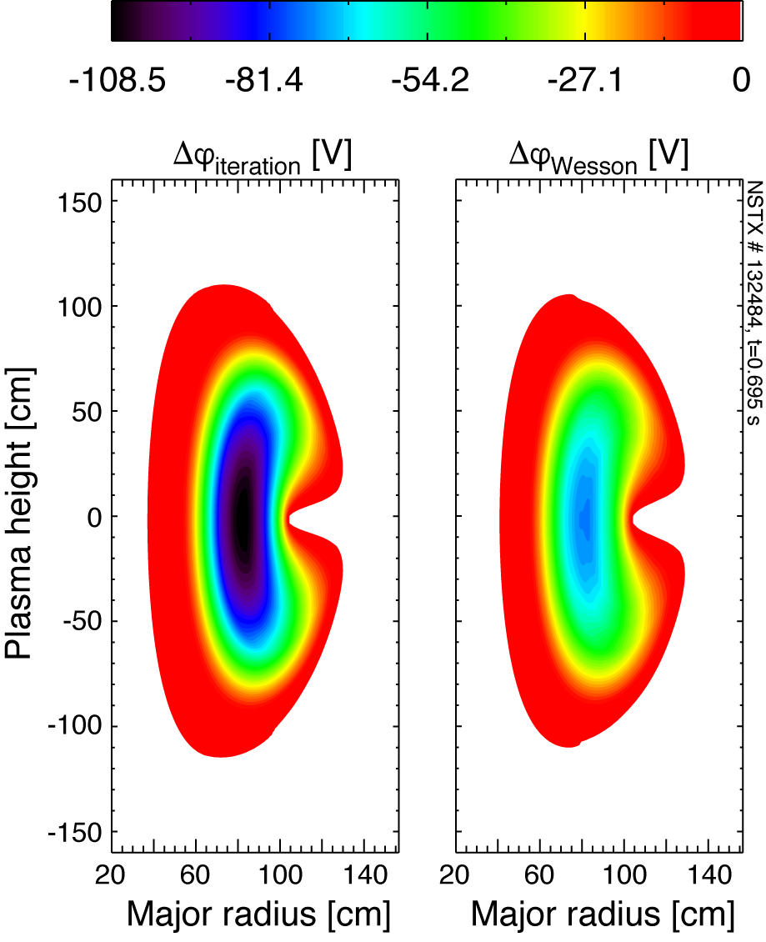
Electrostatic potential (Δϕ) from data is stronger than obtained using a trace-limit approximation
The electrostatic potential obtained assuming that the main intrinsic impurity (Carbon) is at the trace limit (α_{C}=36n_{C}/n_{e}≪1) reduces to:
In this limit the strongest Δϕ is of the order of -60 V.
Main intrinsic impurity is NOT at the trace-limit. Experimental value: α_{C,0}=36n_{C,0}/n_{e,0}≈1.57.
The Δϕ-inferred from the experimental data is nearly twice as strong (for Fφ~28 kHz).
Trace-limit
approximation

Slide 14
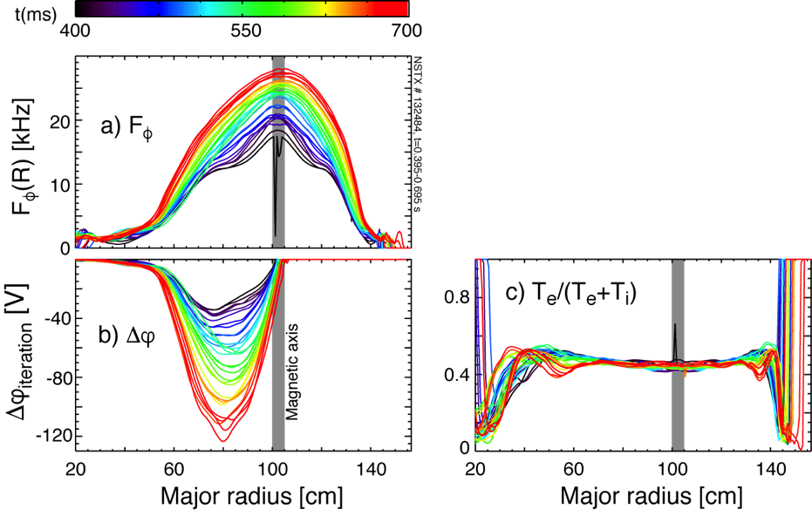
Time-dependent solution for Δϕ shows in/out asymmetry evolution with strong ω² scaling
The scaling of electrostatic potential with rotation frequency is not linear:
Experimental data (R=80 cm):
t=0.4 s, Fφ~12 kHz, Δϕ~-32 V
t=0.7 s, Fφ~22 kHz, Δϕ~-120 V
x2
x4

Slide 15
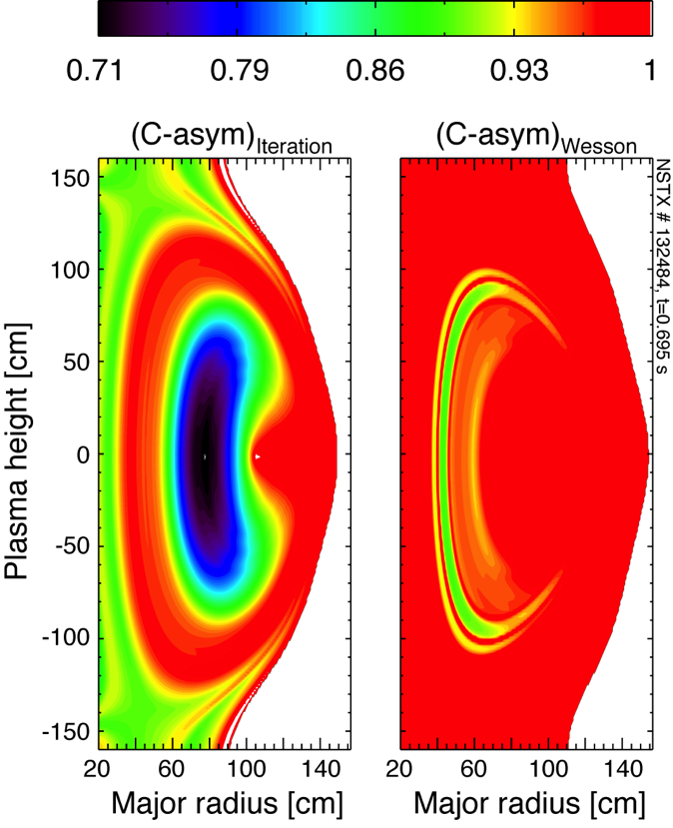
Carbon asymmetry is twice as strong as in the trace limit (α_{C}=36n_{C}/n_{e}≪1) approximation
In the trace limit approximation (α_{C}=36n_{C}/n_{e}≪1) and with T_{i}+T_{e}≈2T_{e}, the C-asymmetry reduces to:
In this limit the C-asymmetry must be of the order of 10-15%.
However, the main intrinsic impurity is NOT at the trace-limit.
Experimental values of α_{C}>1 (e.g. α_{C,0}=36n_{C,0}/n_{e,0}≈1.57).
The C-asymmetry is nearly three times stronger

Slide 16
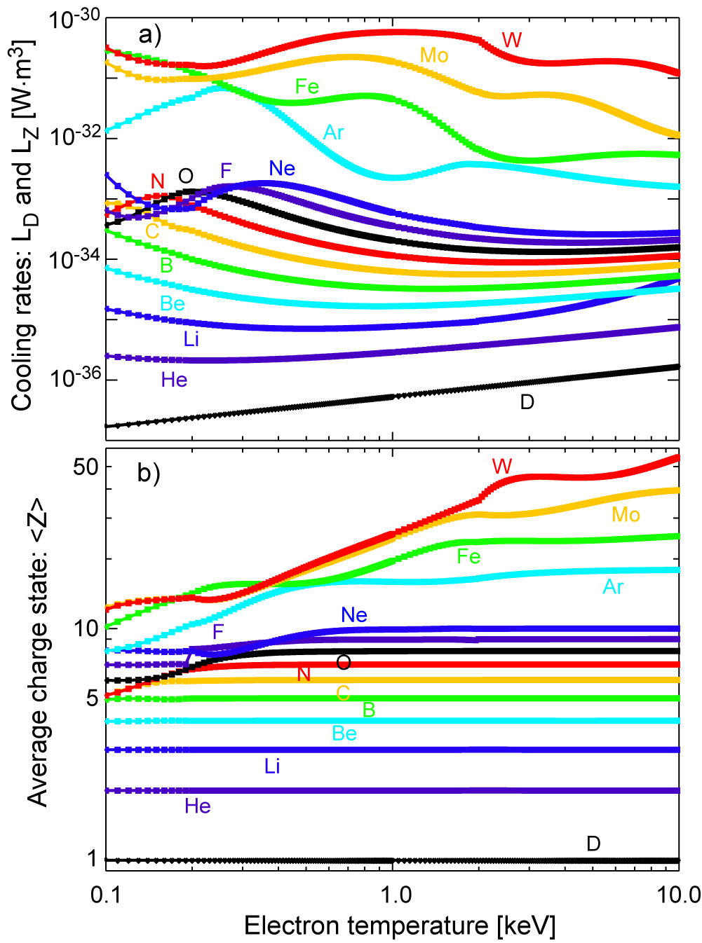
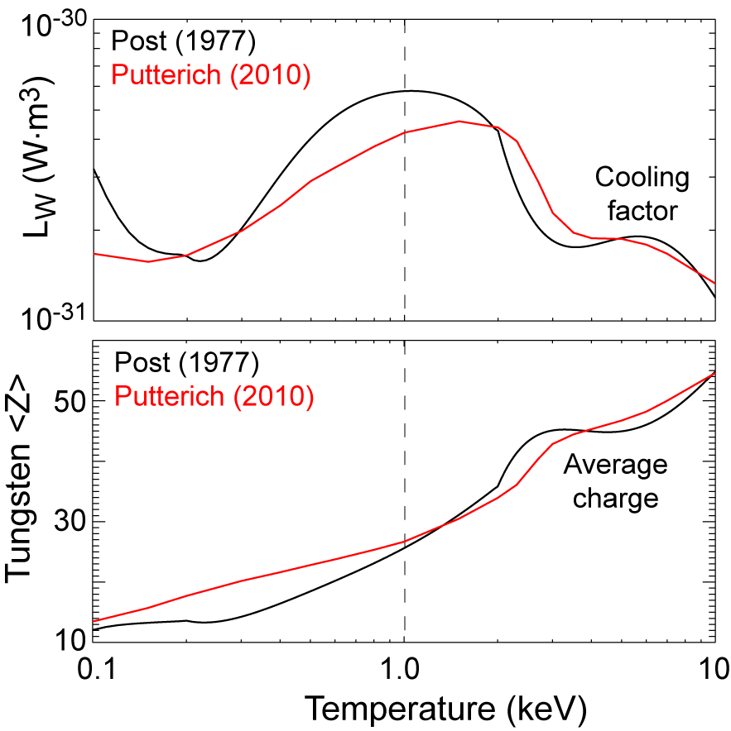
Estimates of average charge state <Z> and P_{rad} density can be done using coronal equilibrium
D. E. Post, et al., Atomic Data and Nuclear Data Tables, 20, 397-439, (1977).
Parameterizing equations of interest
for two-impurity plasma
Modern references for high-Z impurities include details of the electronic structure & excitation cross sections
L. Delgado-Aparicio, et al., to be submitted to PoP,(2017)

Slide 17
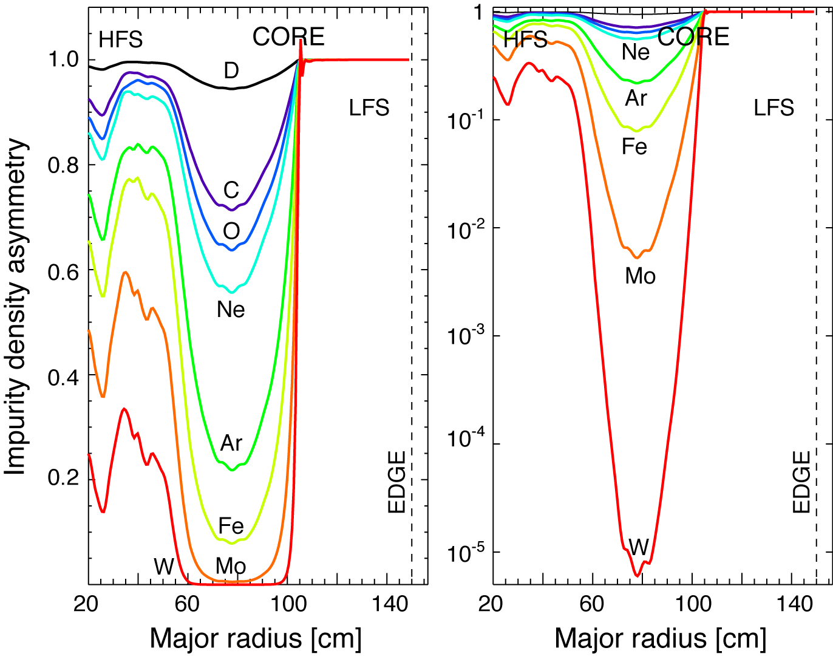
Density asymmetry & its mass-dependences can be estimated using <Z>≈<Z(T_{e})> and T_{Z}≈T_{C}
HFS vs LFS:
C: 70%
O: 65%
Ne: 55 %
Ar: 20%
Fe: 10%
Mo: 1%
W: <0.01%

Slide 18
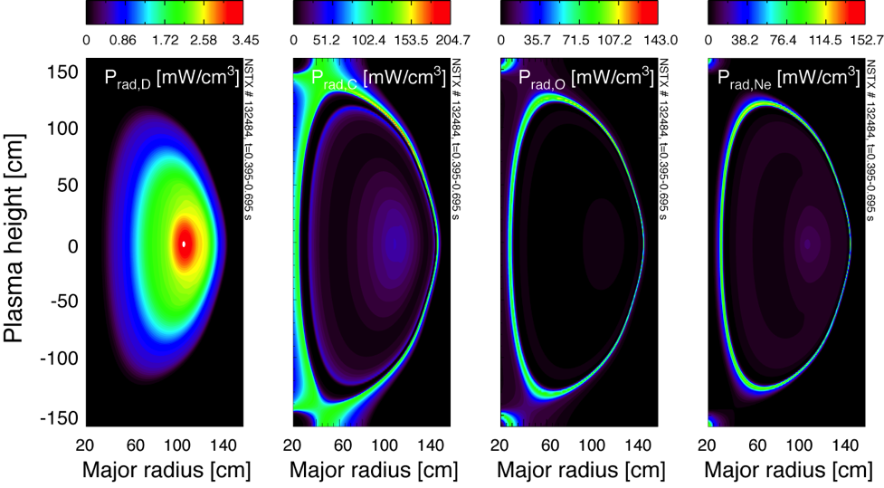
Core radiated power from low-Z ions (e.g. D, C, O, Ne) is small but show asymmetric radiation

Slide 19
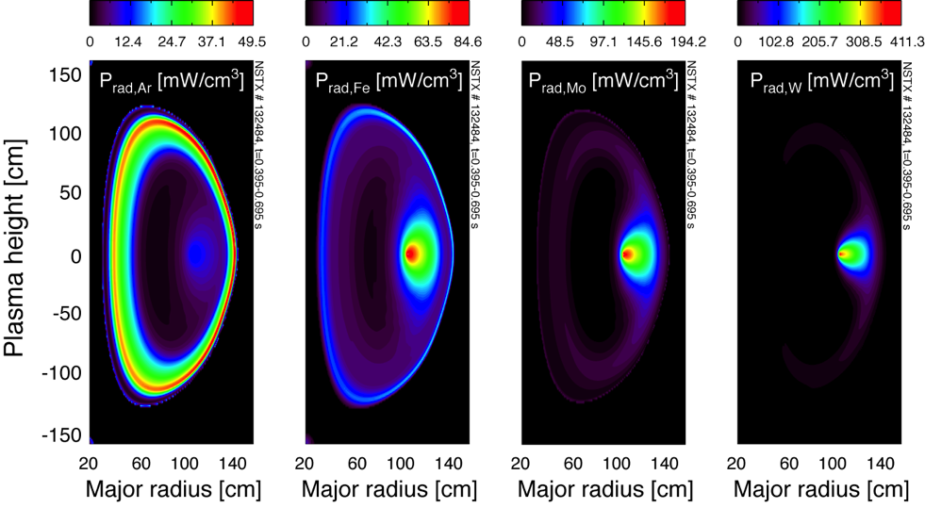
Core n_{Z} and radiation from medium- to high-Z’s will be strongly affected by centrifugal forces

Slide 20
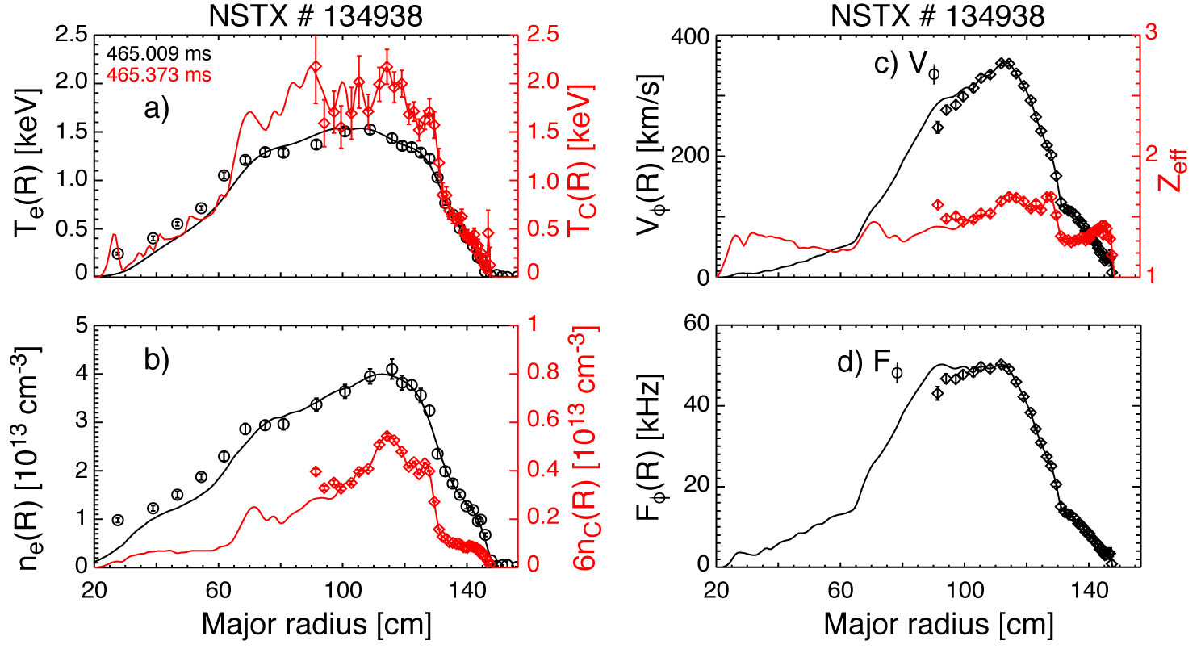
Applying new capability for fastest rotating plasma in NSTX (V_{φ,0}~360 km/s, F_{φ,0}~50 kHz)
EFIT02
MPTS: n_{e}, T_{e}
CHERS: n_{C}, T_{C}, V_{φ}

Slide 21
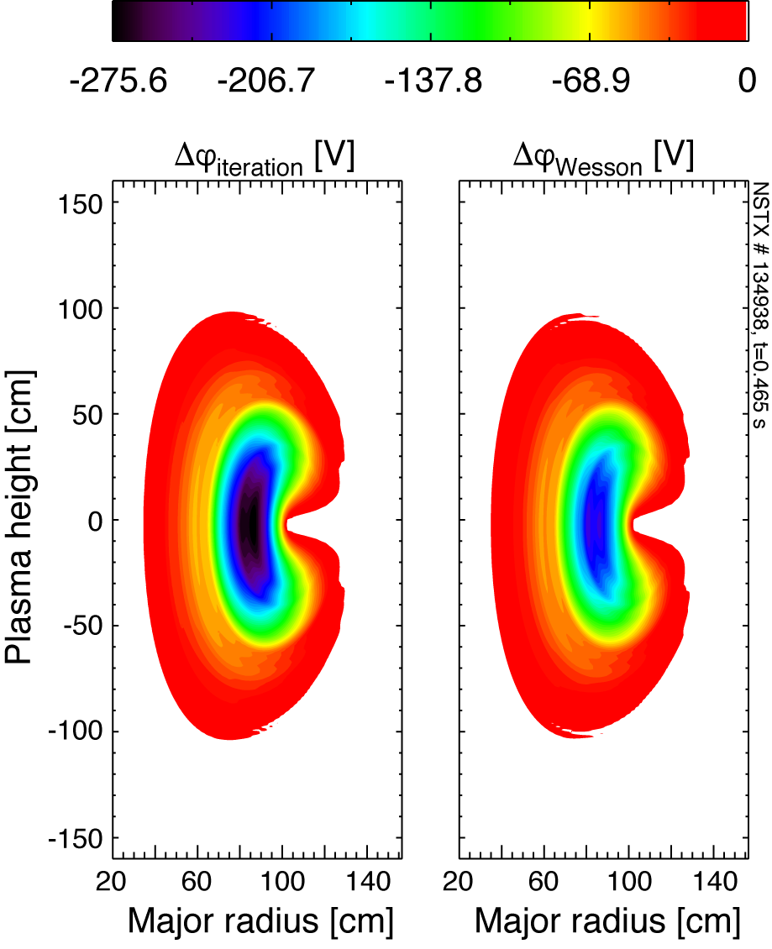
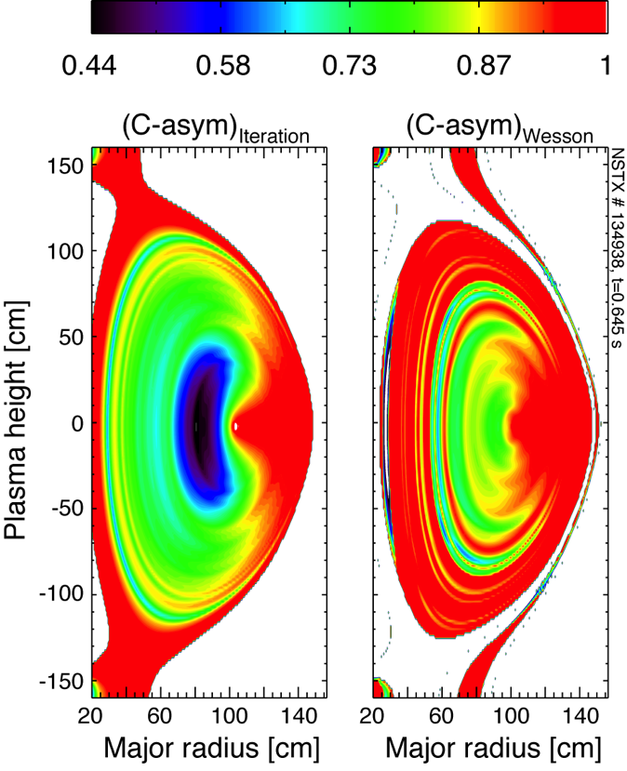
At 360 km/s the electrostatic potential increases to -275 V while C-asymmetry nearly doubles
Trace-limit
approximation

Slide 22
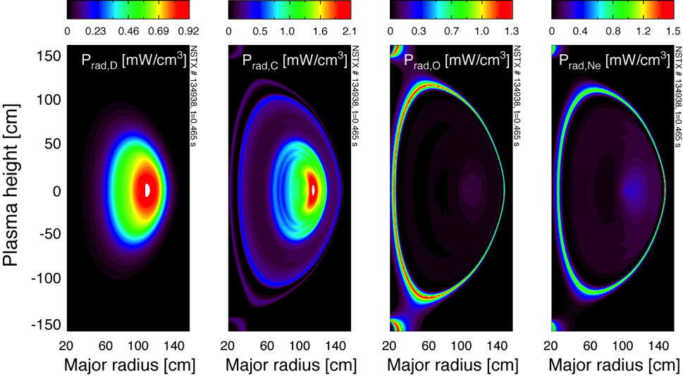
The degree of impurity and radiated power density asymmetry is now evident also for low-Zs

Slide 23
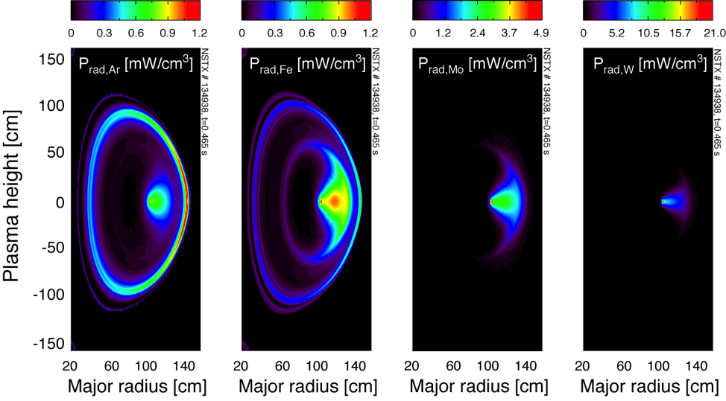
…asymmetry increases reducing the Fe, Mo and W radiated power to only the low-field-side (LFS)

Slide 24
Summary
A new capability has been built to compute the two-dimensional mapping of impurity density asymmetries in NSTX-U.
Compute 2D mapping of flux-surface quantities like T_{e,C} and ωφ
Find n_{e},_{D},_{C}(R,Z,t) self-consistently assuming poloidal variation due to centrifugal forces.
Estimate electrostatic potentials (Δϕ).
The presence of O, Ne, Ar, Fe, Mo and W are considered at the trace limit (n_{Z}<Z>²/n_{e}<1) with very small changes to quasineutrality and Z_{eff}.
The solutions for Δϕ and the C-asymmetry have been compared with the values derived using a theoretical approximation.
Computed mapping of particle and radiated power density asymmetries in NSTX for v_{φ,0}~100-400 km/s. Apply this new capability for NSTX-U!
This new tool will contribute understanding of:
Medium- & high-Z asymmetries and reduction of Z-peaking
Possible reduction of turbulence due to E_{Δϕ}xB effetcs
Radiation effects before TM-onsets
Aid the design of new NSTX-U diagnostics (e.g. ME-SXR, XICS, Bolometers, XUV-spectrometers, etc)

