Slide 1
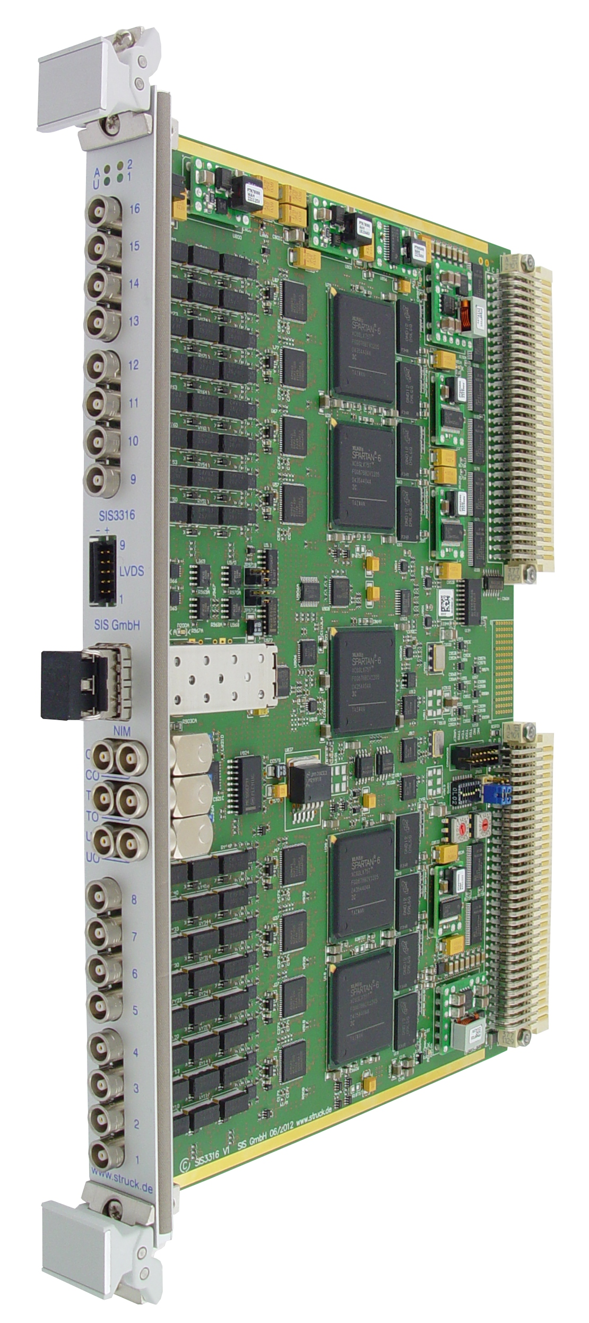
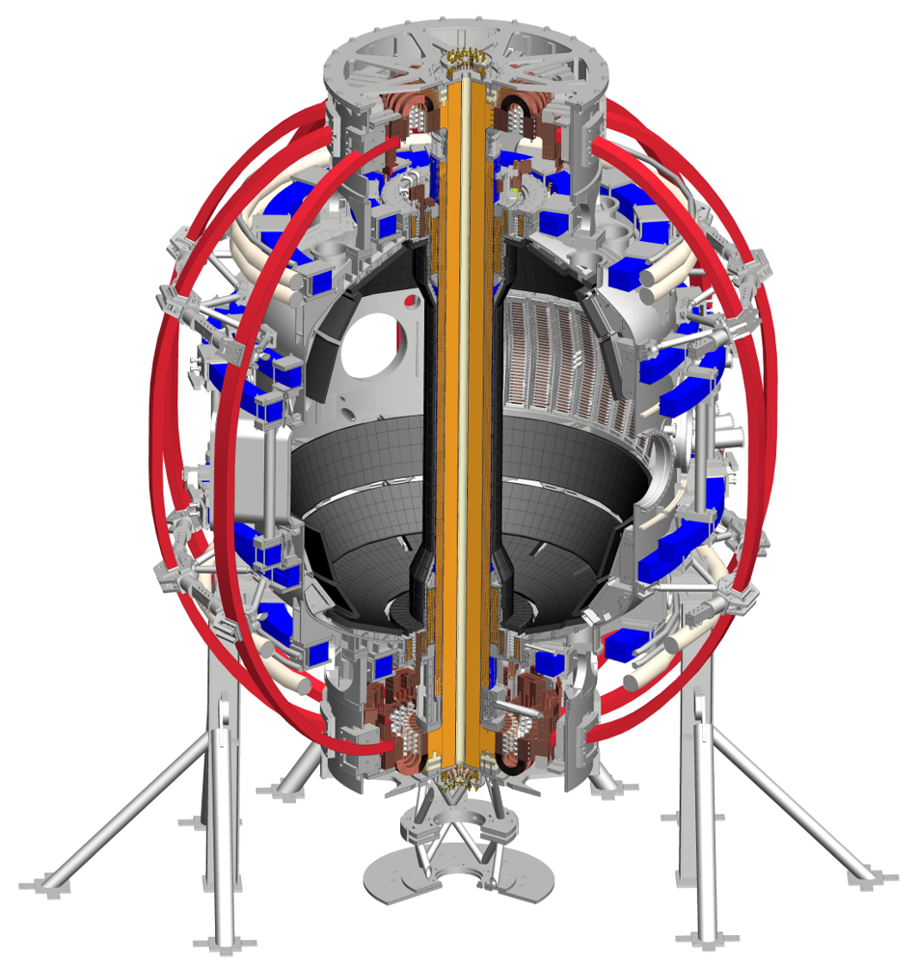
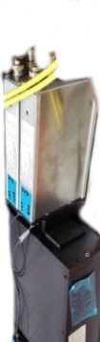
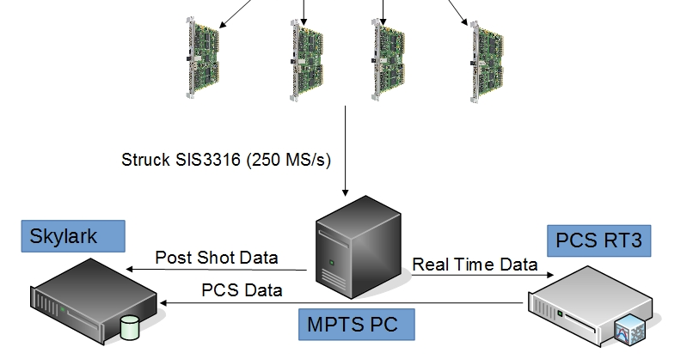
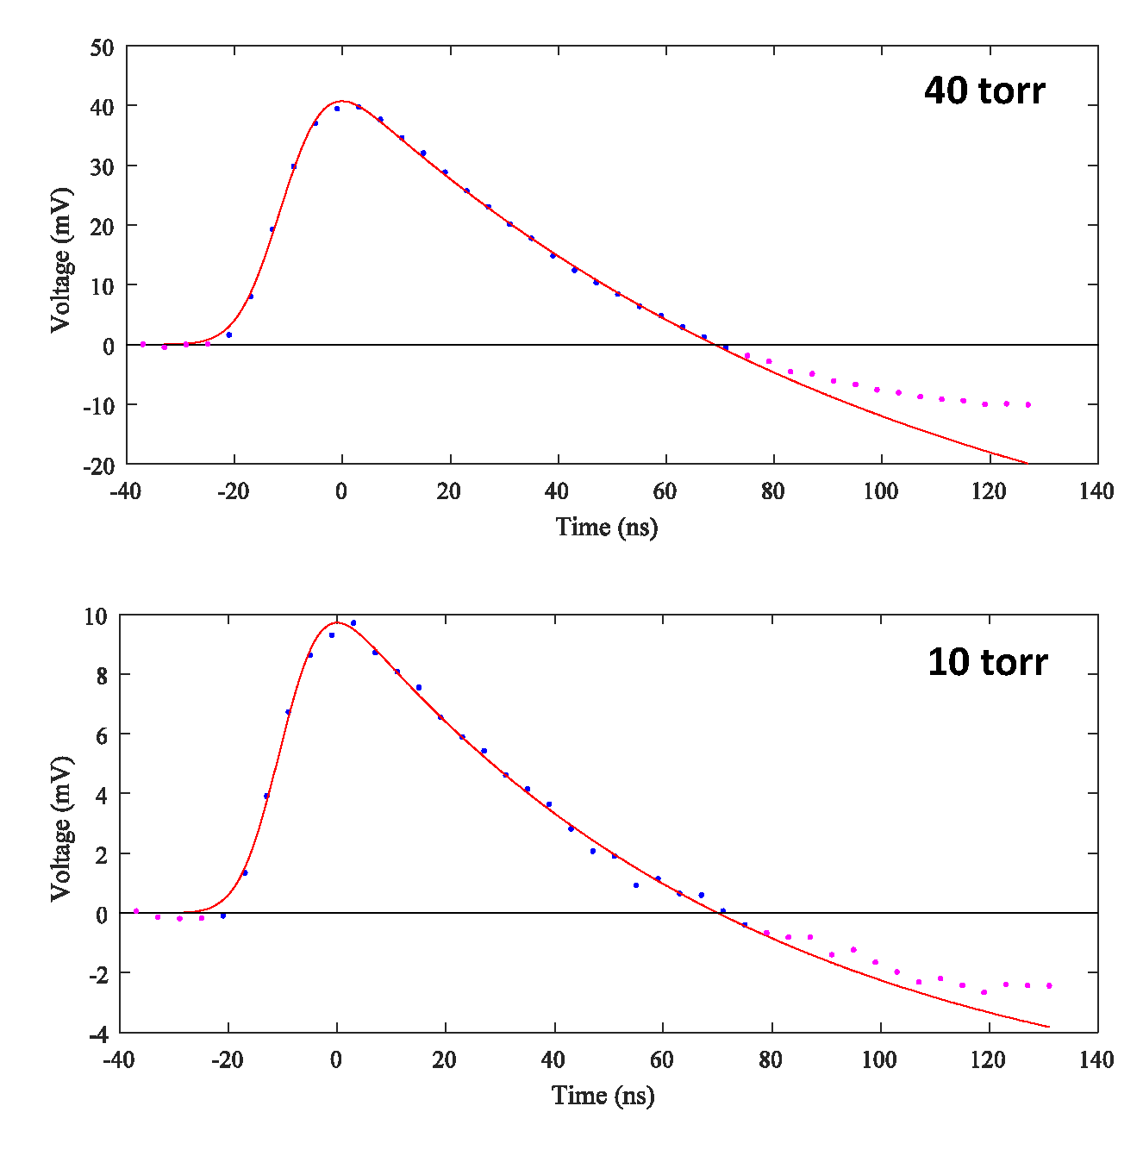
1. Motivation
3. Real-time hardware
5. Benchmark with post-shot analysis
Thomson scattering (TS) is a key diagnostic at the National Spherical Torus eXperiment Upgrade (NSTX-U):
  Electron density (n_{e}) and electron temperature (T_{e}) profiles measured at 42 spatial positions
    → Access to the electron pressure (p_{e}) profile
  Currently available after post discharge analysis
Real time (rt) availability would be beneficial for:
  Rt equilibrium reconstruction (rt-Efit) with pressure constraint
  Rt profile availability for control purposes [1]:
    → ELM control (timescale ~ 10 ms)
    → Transport (timescale > 10ms)
    → Resistive wall mode (timescale ~ 1 ms)
Rt-upgrade of the existing TS system at NSTX-U requires:
  Rt capable data acquisition (hardware)
  Rt TS analysis (software)
    → Similar rt TS system previously implemented on DIII-D [2]
Struck Innovative Systeme (SIS) 3316 digitizers for rt data acquisition
  16 channels
  250 MS/s per channel
  14-bit resolution
  Two programmable input ranges (2 V and 5 V)
  Readout in parallel to acquisition
  Pre/Post trigger capability
  Gigabit Ethernet readout
System setup
  8 polychromators with up to 6 filters & APDs
  4 SIS3316 digitizers
  Linux server (MPTS PC)
    → Rt analysis
    → Buffer for post-shot data
  Output to NSTX-U data storage (Skylark)
    → post shot (not rt critical)
  Output to plasma control system (PCS RT3)
    → Analog output interface
    → Rt critical
Computation time from post shot analysis decreased by a factor of 5
  With compiler optimization rt fit time roughly 2.5 ms per time point (post shot: 13.5 ms per time point)
    → Further manual optimization possible
    → Initial fit guesses can be also improved
T_{e} comparison
n_{e} comparison
polychromator
8x
APD amplifiers
Comparison of T_{e} and n_{e} outputs from rt and post shot fitting of two spatial channels (core and edge)
  Agreement within the uncertainties
    → Successful benchmark of the rt fitting
  χ² values slightly higher than for post shot
    → Relaxed convergence criteria applied
Lookup tables for expected signal intensity for spectral channels of one spatial channel
  Relative deviations appear only a low T_{e} at lower wavelength (small intensities expected)
χ² comparison
2. Thomson Diagnostic Setup at NSTX-U [3,4,5]
Currently 2 Nd:YAG lasers
  Total repetition rate ~60 Hz
  Horizontal beam path crossing the plasma from low field to high field side passing the center stack
42 fibers collecting the scattered light
  Spherical mirror focuses on fiber bundles
Polychromators and avalanche photodiode (APD) detectors [6] for spectral analysis
  32 polychromators with 6 filter & APDs
  10 polychromators with 4 filter & APDs
Boundary conditions for rt-upgrade
  Old system should be unaffected
    → Data access should be unaffected
  Additional laser with burst capability [7]:
    → 60 Hz repetition rate will increase to 90 Hz
    → Fast burst mode up to 10 kHz
4. Real-time software
Rt pulse detection
  Currently, peak amplitude (PA) detection
    → Pulse fitting possible in the future (red)
  Test laser pulses in the gas filled vessel
    → Raman scattering
Raman scattering
PA
Tabularized evaluation of the TS Selden model [8]
  Lookup tables save computational time
    → Reduction of computational time
Rt optimization for n_{e} and T_{e} as well as the corresponding errors
  χ²-optimization of spectral fit
    → Fast convergence
PA
6. Summary
Real-time MPTS setup for NSTX-U in progress and offline tested
  Hard- & software setup:
    First testing and benchmarking successful
      → Scalable, reliable and computationally deterministic setup
  Benchmark of rt code against post shot analysis code
    n_{e} and T_{e} values reproduced with in their uncertainties
      → Computational time reduced by a factor of 5 with compiler optimization
References
7. Outlook
[1] E. Kolemen, et al.
26th IAEA Conference, 2016
[2] B. Penaflor, et al.
25th SOFE Conference, 2013
[3] B. P. LeBlanc, et al.
Rev. Sci. Instrum. 74(3), 2003
[4] B. P. LeBlanc, et al.
Rev. Sci. Instrum. 83(10), 2012
[5] A. Diallo, et al.
Rev. Sci. Instrum. 83(10), 2012
[6] D. W. Johnson, et al.
Rev. Sci. Instrum. 72(1), 2001
[7] B. P. LeBlanc et al.,
this conference , PP11.00067, 2017
[8] A. C. Selden,
Phys. Lett. A, 79(5-6), 1980
  Full rt system testing (hard & software) with load under experimental conditions
  PBLS implementation and possible extension to further spatial channels in rt
    Full system availability
  PCS implementation
    Exploitation of rt data when NSTX-U is back in operation

