Slide 1

Overview of High-k Scattering Diagnostics on NSTX and NSTX-U
Y. Ren¹, E. Mazzucato¹,D.R. Smith², R. Barchfeld³,C.W. Domier³,
E. R. Scott³, N.C. Luhmann Jr.³, R. Kaita¹, R. Ellis¹, K.C. Lee⁴
1. PPPL 2. UW-Madison 3. UC-Davis 4. NFRI
59th Annual Meeting of the APS Division of Plasma Physics, Milwaukee, Wisconsin, October 23rd-27th, 2017

Slide 2
Outline
Introduction
  Why use scattering?
  How to achieve good radial localization?
High-k_{r} microwave scattering diagnostic on NSTX
  Diagnostic design and capabilities
  Electron-scale turbulence measurements
High-k_{θ} FIR scattering diagnostic on NSTX-U
  Design and present status
Summary

Slide 3
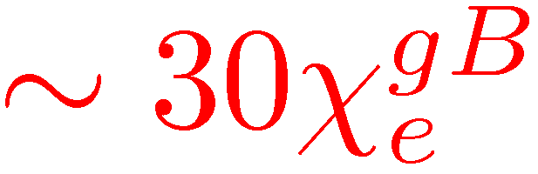
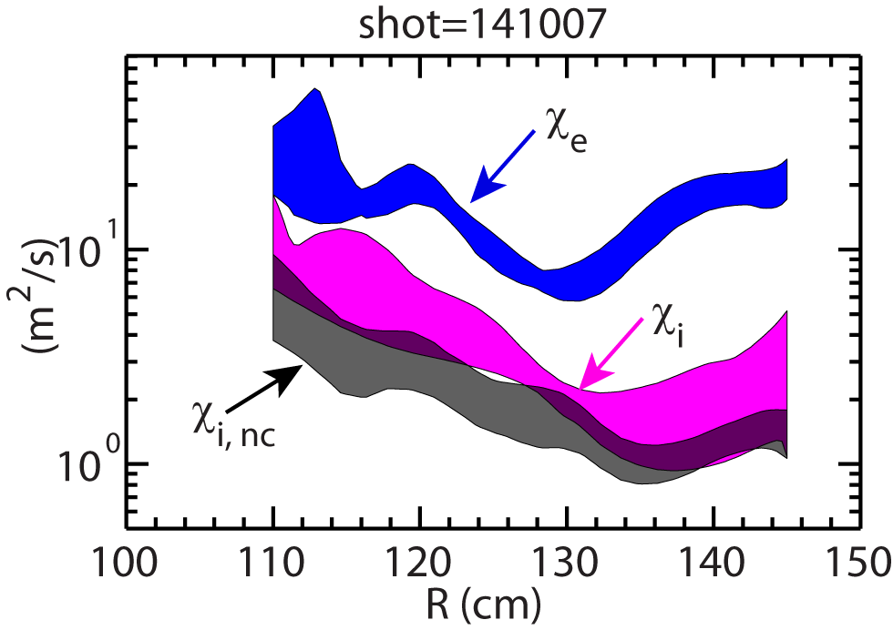
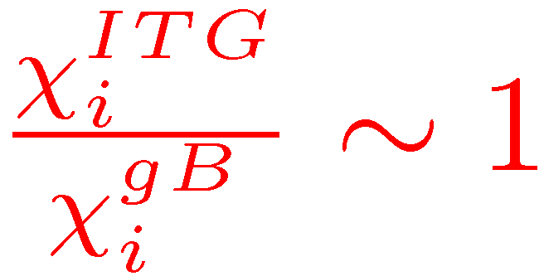
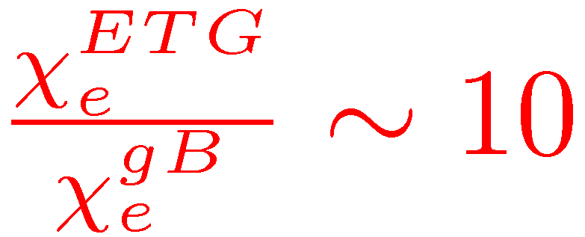
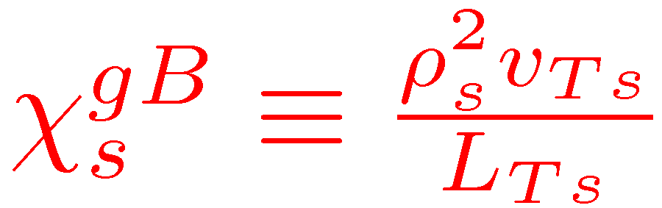
Measuring Electron Scale Turbulence is Crucial for NSTX and NSTX-U
Typical transport properties of NSTX NBI-heated H-mode plasmas
  Neoclassical level of ion thermal transport due to large ExB shear and low aspect ratio
  Dominant heat loss in the electron channel
ETG potentially important for NSTX
  Short wavelength on electron-gyro scale
  Large growth rate, surviving large ExB shear
  Can generate larger normalized thermal transport than ITG due to weaker electron-scale zonal flow and secondary instability
ETG may be important for conventional tokamaks as well
  e.g. DIII-D advanced hybrid scenarios and high-beta poloidal scenarios
Dorland et al., PRL 2000
Jenko et al., PoP 2001
Nevins et al., PoP, 2006

Slide 4
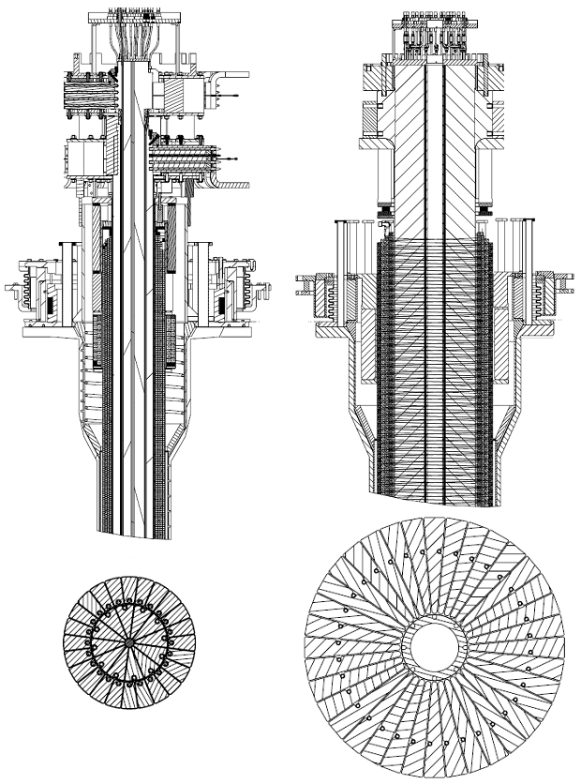
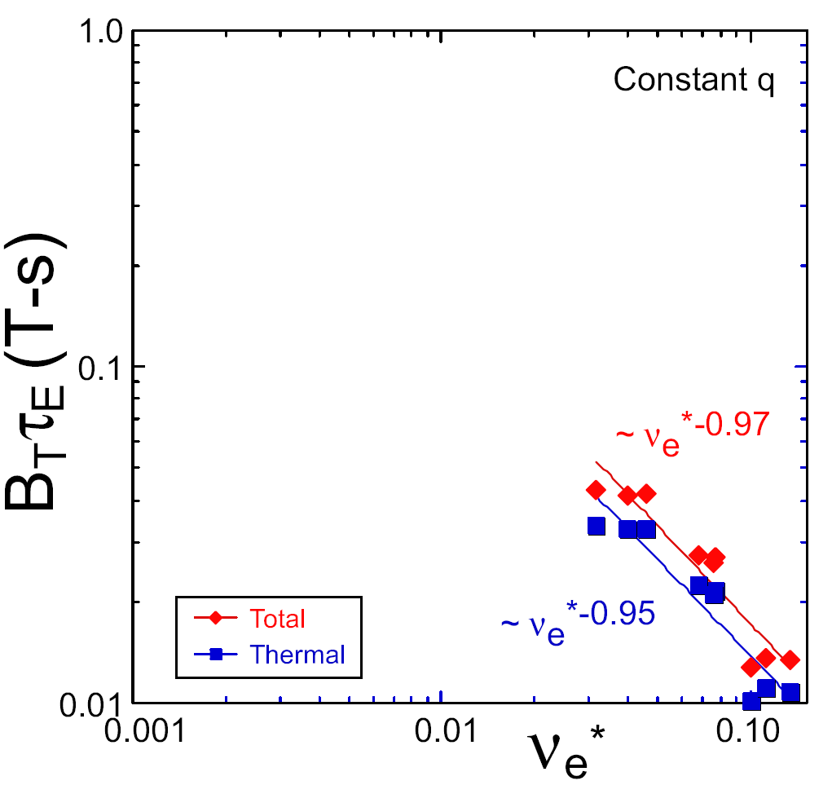
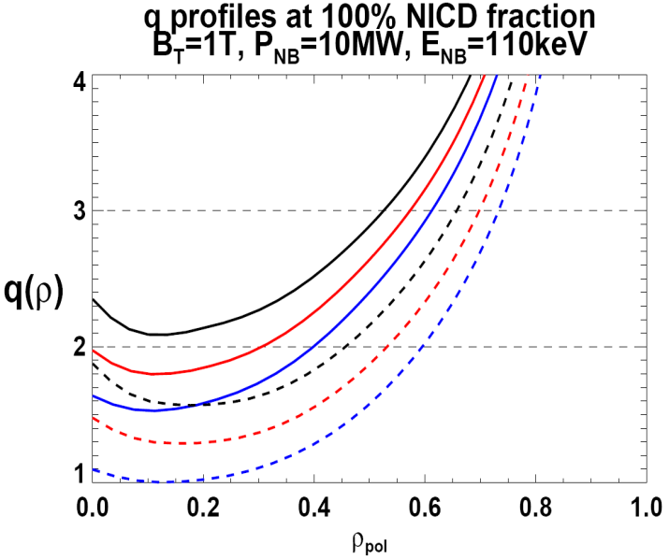
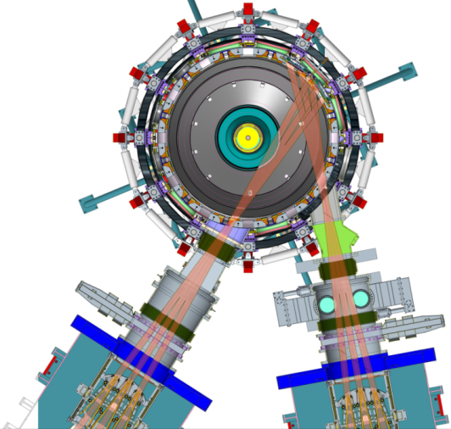

NSTX Upgrade Allows Exploring Transport and Turbulence in New Parameter Regimes through 2 New Capabilities
Previous
center-stack
New
center-stack
ST-FNSF
Reduces ν* → ST-FNSF values to understand ST confinement
  Expect 2x higher T by doubling B_{T}, I_{P}, and NBI heating power
  Provides 5x longer pulse-length
  q(r,t) profile equilibration
  Tests of NBI + BS non-inductive ramp-up and sustainment
constant q, β, ρ∗
NSTX Upgrade
?
ITER-like scaling
TF OD = 20cm
TF OD = 40cm
Normalized e-collisionality ν_{e}* ∝ n_{e} / T_{e}²
I_{P}=0.95MA, H_{98y2}=1.2, β_{N}=5, β_{T} = 10%
B_{T} = 1T, P_{NBI} = 10MW, P_{RF} = 4MW
  2x higher CD efficiency from larger tangency radius R_{TAN}
100% non-inductive CD with q(r) profile controllable by:
  NBI tangency radius
  Plasma density
  Plasma position (not shown)
R_{TAN} [cm]
__________________
50, 60, 70, 130
60, 70,120,130
70,110,120,130
Present NBI
New 2nd NBI

Slide 5
Measuring Electron-scale Turbulence Presents Challenges to the Diagnosis of Tokamak Turbulence
Remote sensing required in tokamaks with auxiliary heating
  Measurements with electromagnetic waves, e.g. imaging or scattering with visible light, Infrared, Far Infrared or mm-waves
Sub-mm electron gyroradius in present tokamaks
  Extreme spatial resolution needed in imaging diagnostics, very difficult if not impossible
  Direct measurements of electron-scale wavenumber spectrum possible with coherent scattering method
    Good spatial resolution achievable even for CO₂ laser scattering
    More strict validation of numerical codes
    Absolute calibration hard to achieve

Slide 6
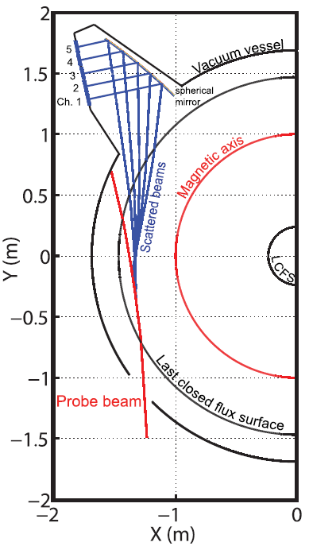
Tangential Scattering Scheme was Used for the High-k_{r} Microwave Scattering System on NSTX
280 GHz microwave is launched as the probe beam
  Beam refraction due to density gradient important
  Ray tracing using a C++ code with MATLAB interface
Coherent scattering by plasma density fluctuations occurs when the three-wave coupling condition is satisfied:
Bragg condition determines k_{p}:
k_{p}=2k_{i}sin(θ_{s}/2)
The scattering light has a frequency of:
ω_{s}=ω_{p}+ω_{i}
with ω_{s} and ω_{i} >> ω_{p}
k_{p}
θ_{s}
k_{s}
k_{i}
k_{s}
k_{p}
=
+
k_{i}

Slide 7
Tangential Scattering Scheme was Used for the High-k_{r} Microwave Scattering System on NSTX
High-k_{r} system capabilities
Measured quantity | r/a range | Spatial & temporal resolution
Density fluctuation | ~0.2-1 from core to edge (between shot) | 3 ≤ k┴ρ_{s} ≤ 12 ΔR ~ ±2 cm f~ 5 MHz

Slide 8
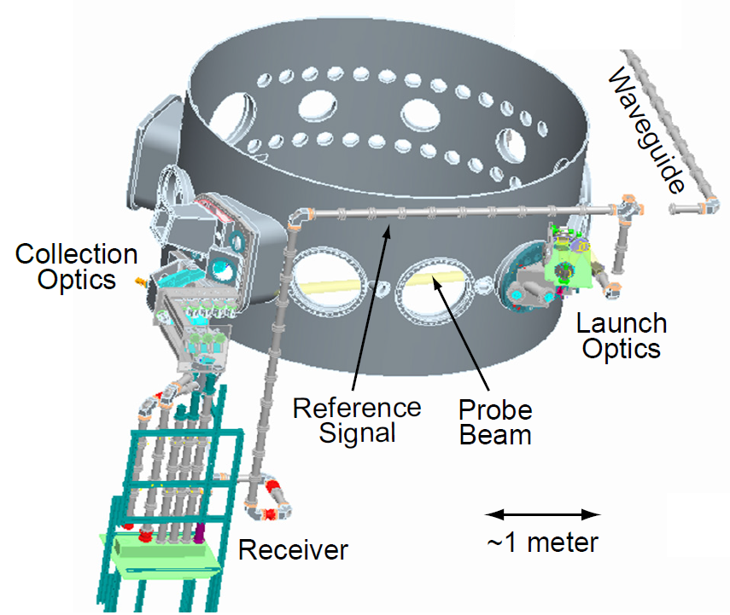
The High-k_{r} Microwave Scattering System was a High Priority Diagnostic on NSTX
D.R. Smith, PhD thesis, 2009

Slide 9
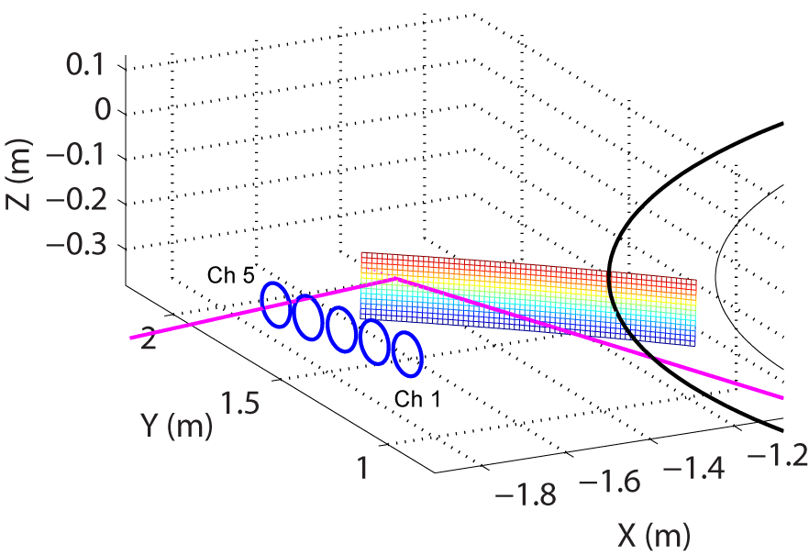
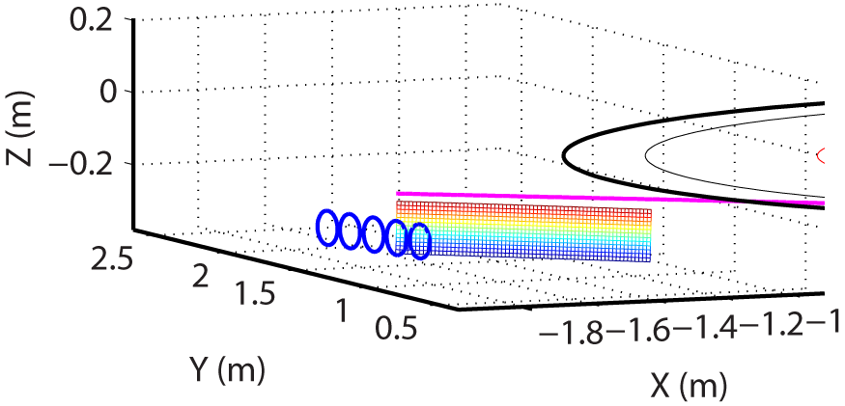
The High-k_{r} Microwave Scattering System was Improved through the Years
Improved scattering configuration allowing simultaneous operation of all five scattering channels
  The probe beam hits the spherical mirror and some of the channels have to be fully attenuated to protect detectors
    Simultaneously utilize at most three out of the five receiving channels
Launch the probe beam upward preventing it from directly hitting the mirror
  No channel has to be fully attenuated
  Stray radiation on all channels is reduced
Spherical mirror

Slide 10
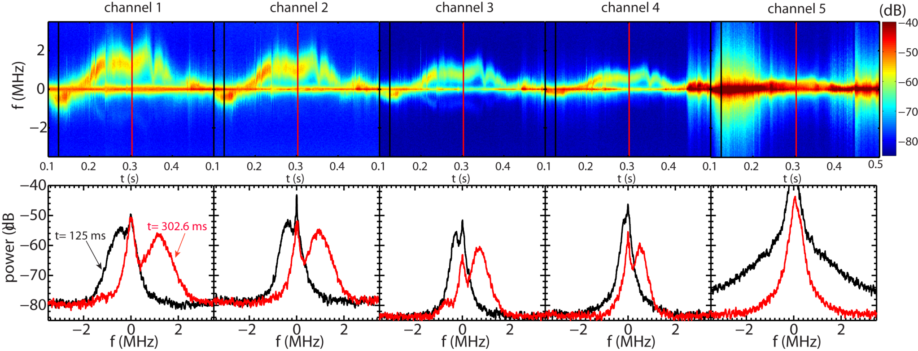
The High-k_{r} Microwave Scattering System was Improved through the Years
Improved scattering configuration allowing simultaneous operation of all five scattering channels
  The probe beam hits the spherical mirror and some of the channels have to be fully attenuated to protect detectors
    Simultaneously utilize at most three out of the five receiving channels
Launch the probe beam upward preventing it from directly hitting the mirror
  No channel has to be fully attenuated
  Stray radiation on all channels is reduced

Slide 11
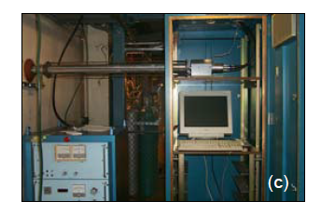
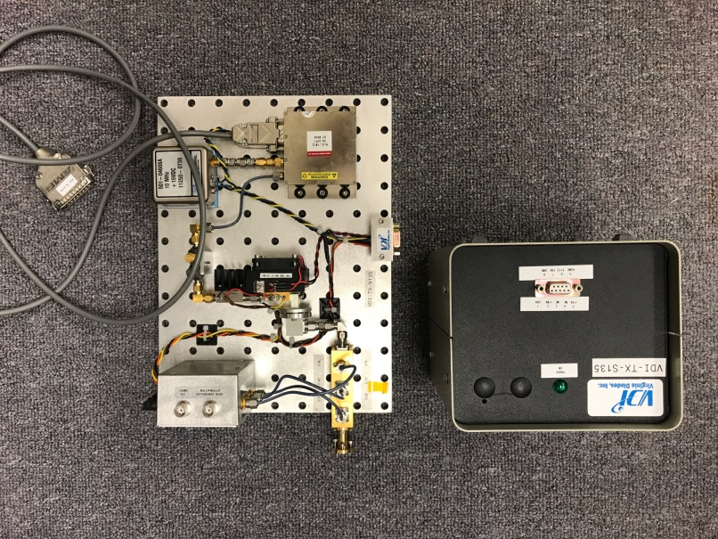
The High-k_{r} Microwave Scattering System was Improved through the Years
Significant improvement in remote control capabilities
  Between-shot change in probe beam launching angle and receiver aiming angle
  Radial scan and wavenumber matching
Microwave source upgraded from a BWO to a solid state source
  Significantly improved system reliability
  Much smaller footprint
  Power reduced from 100 mW to 24 mW, still adequate due to the sensitive mixers
BWO
Power supply
8”

Slide 12
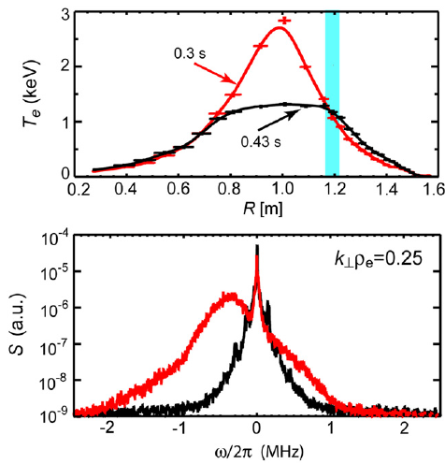
First Identification of ETG Turbulence in NSTX RF-heated L-mode Plasmas
The measured high-k turbulence is shown to be driven by electron temperature
  In RF-heated helium L-mode plasma (1.2 MW, 5.5 kG, 700 kA)
  Fluctuation propagates in the electron diamagnetic direction
  Clear reduction in turbulence spectral power at lower electron temperature gradient
$$k_{⊥}=14 {cm}^{−1},k_{⊥}ρ_{s}=8−10$$
Electron direction
Mazzucato et al., PRL 2008, NF 2009

Slide 13
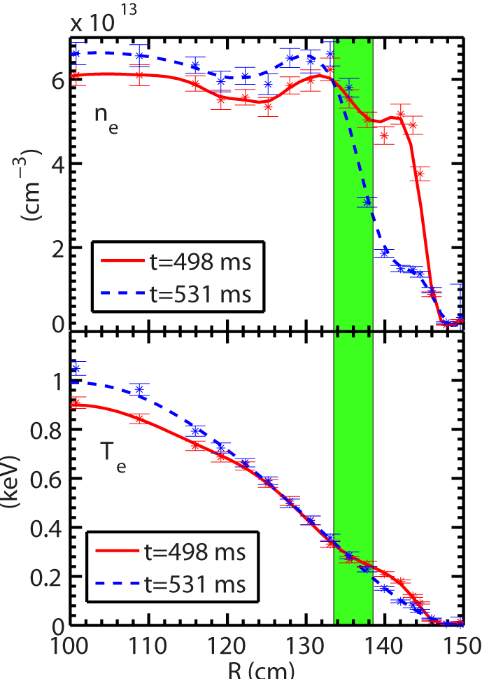
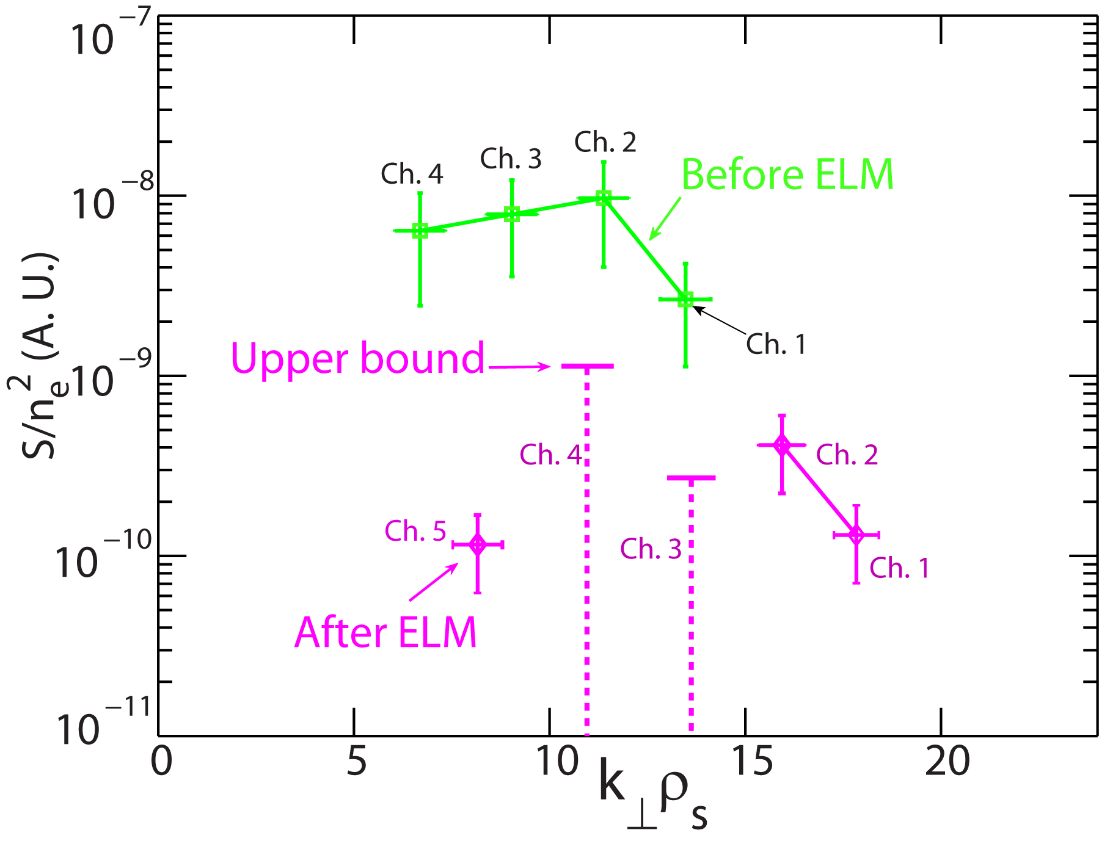
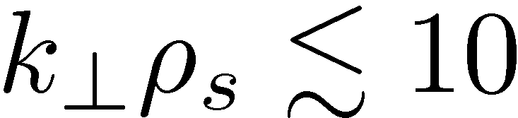
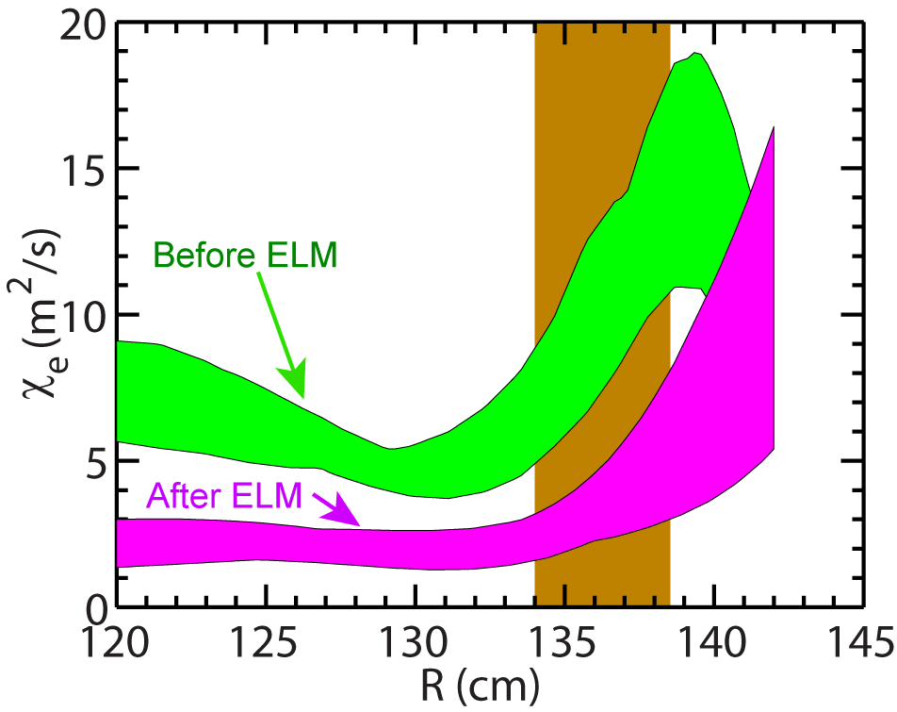
Density Stabilization of Electron-scale Turbulence
Shot=140620
High-k measurement region
Significant decrease in spectral power in electron-scale observed for
Electron thermal diffusivity is decreased by a factor of ~2 after the ELM event
Y. Ren et al., PRL 2011, PoP 2012

Slide 14
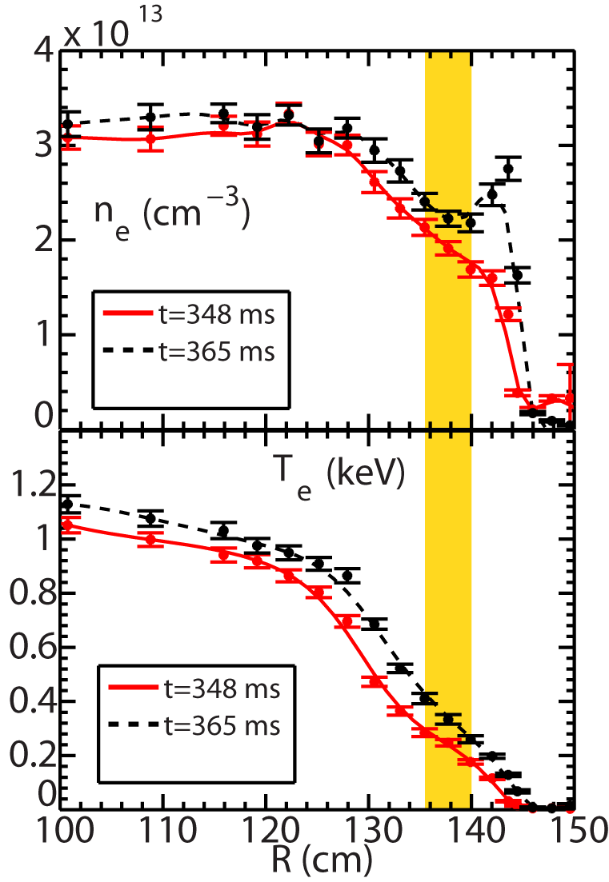
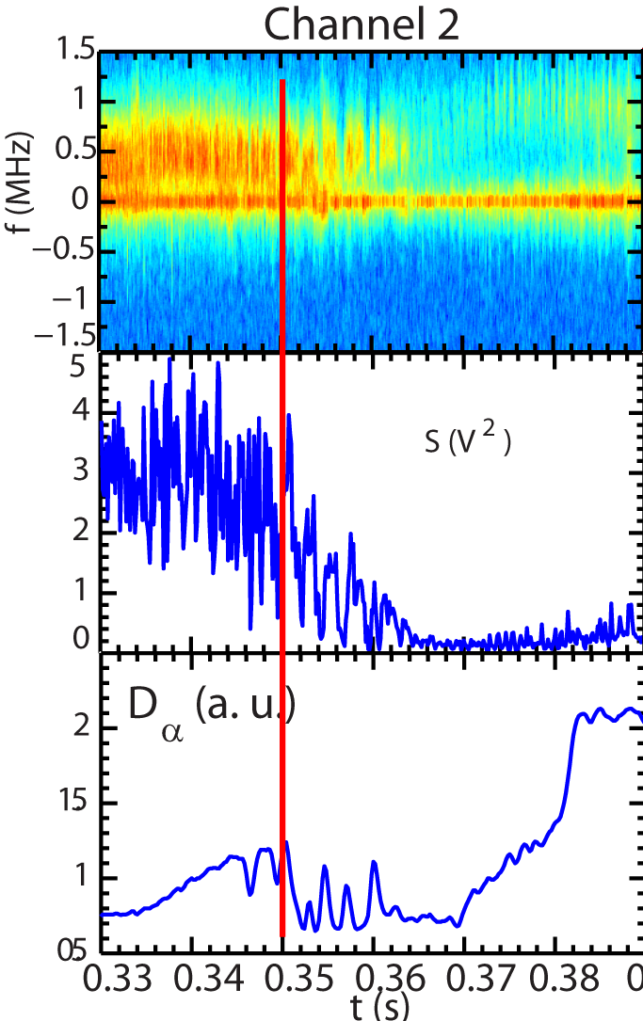
Electron-scale Turbulence Evolution across L-H Transition was Measured
High-k measurement region (r/a~0.7-0.8)
Clear H-mode density ear appears at t=365 ms, showing the establishment of ETB
  The density ear due to edge accumulation of carbon impurity
Dithering
Quasi-stationary turbulence before the L-H transition
Dithering in high-k spectral power observed after L-H transition
Significant suppression of high-k turbulence in 365<t<380 ms
Some increase in turbulence at t>380 ms
L-H transition

Slide 15
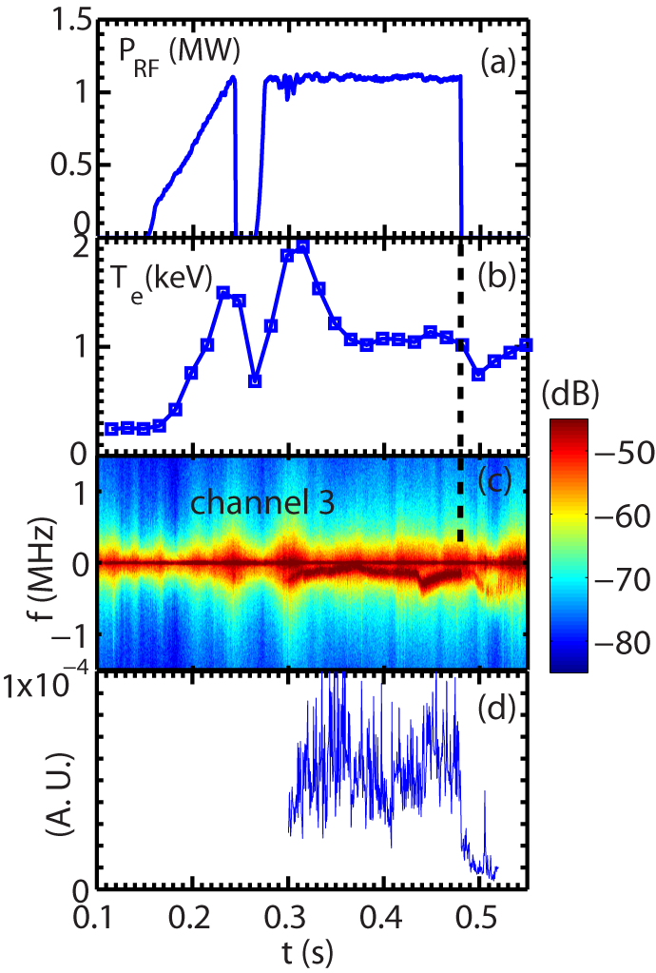
Fast Response of Electron-scale Turbulence to RF Heating Cessation was Identified
Shot=140301
Drop in turbulence frequency spectral power at the time of RF cessation
  The drop happens in 0.5 to 1 ms, much smaller than τ_{E} ~ 10 ms
Electron heat flux decreases by about a factor of 2 after the RF cessation
RF-heated L-mode plasma with
B_{T} =5.5 kG and I_{p}=300 kA
A sudden drop in spectral power
Y. Ren et al., PoP 2015

Slide 16
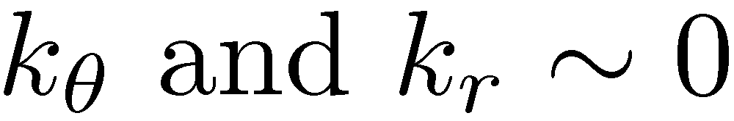
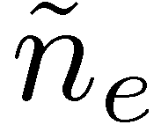
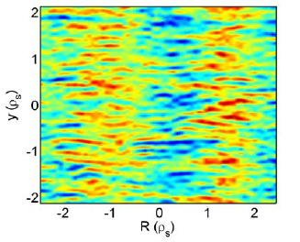
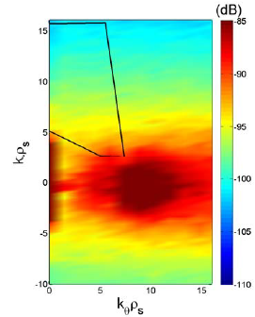
However, the High-k_{r} Scattering System Does not Capture the Predicted ETG Spectral Peak
ETG turbulence develops radially elongated streamers
  Important for driving anomalous electron thermal transport
  Corresponding to modes with finite
The high-k_{r} scattering system mainly measures k_{r} spectrum
Spectral coverage of the High-k_{r} Scattering System
ETG streamers

Slide 17
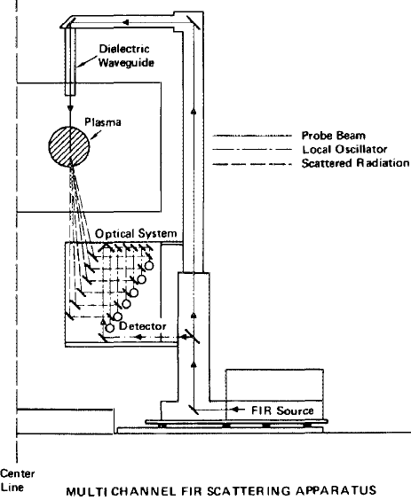
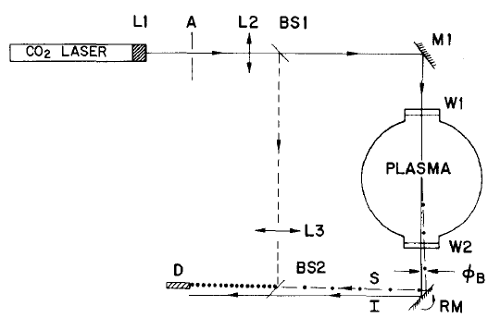
Previous Implementations of Measuring k_{θ} often Employ Vertical Launching
Measuring k_{θ} in the plasma center and k_{r} at the plasma edge
No such port access for NSTX-U
Strongest fluctuations predicted to be at outer mid-plane, where the bad curvature effect is strongest
Multi-angle FIR scattering system
λ~ 1.2 mm
Some spatial resolution
Small angle CO2 laser scattering system
No spatial resolution
Park et al., RSI, 1985
Slusher and Surko, PoF, 1980

Slide 18
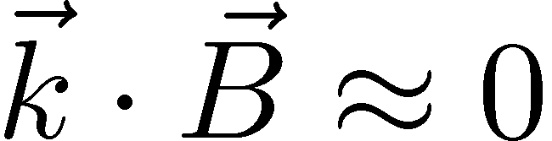
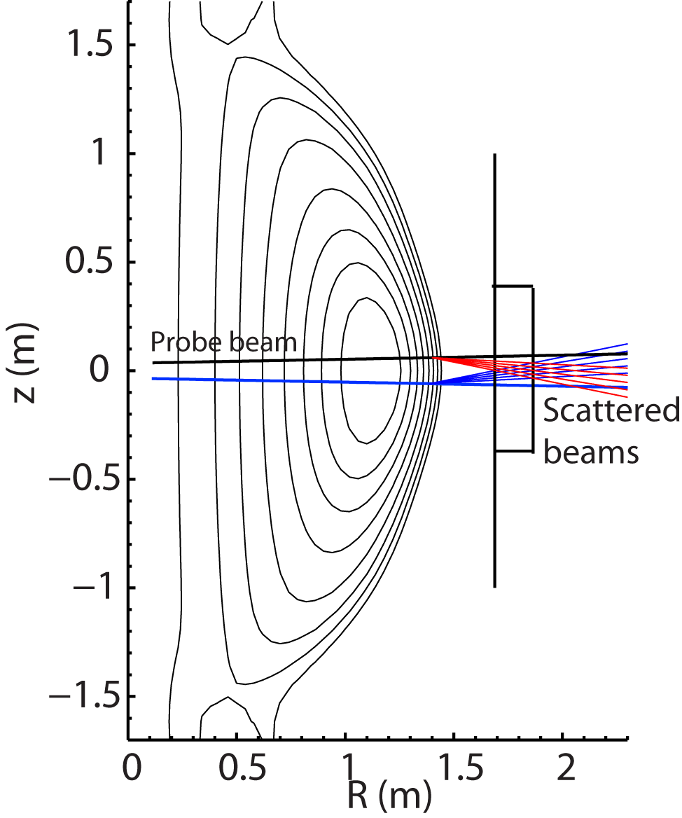
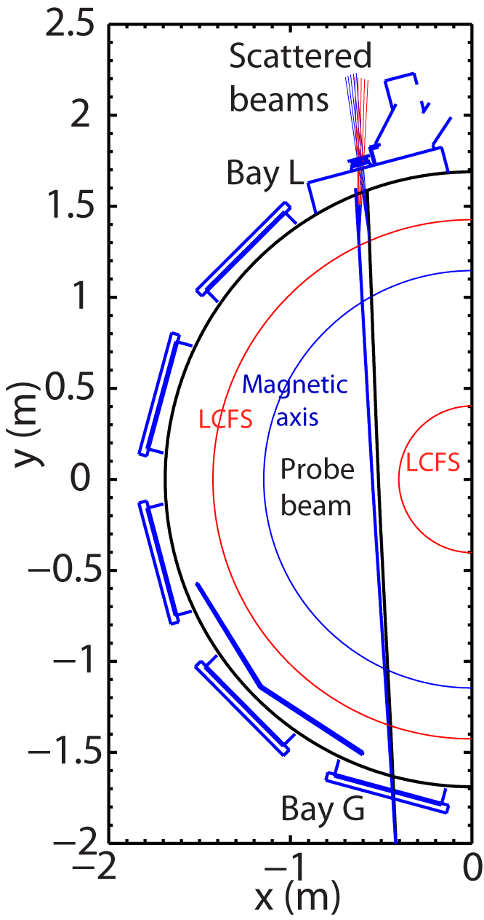
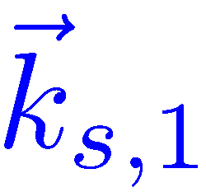
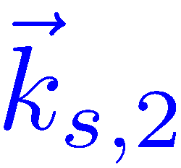


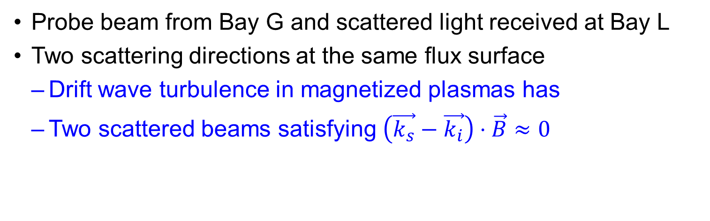
The NSTX-U High-k_{θ} Scattering System Employs the Perpendicular Scattering Scheme
Probe beam from Bay G and scattered light received at Bay L
  Two scattering directions at the same flux surface
  Drift wave turbulence in magnetized plasmas has
  Two scattered beams satisfying $\left(\vec{k_{s}}−\vec{k_{i}}\right)⋅\vec{B}≈0$
  $$\vec{k_{i}}$$

Slide 19
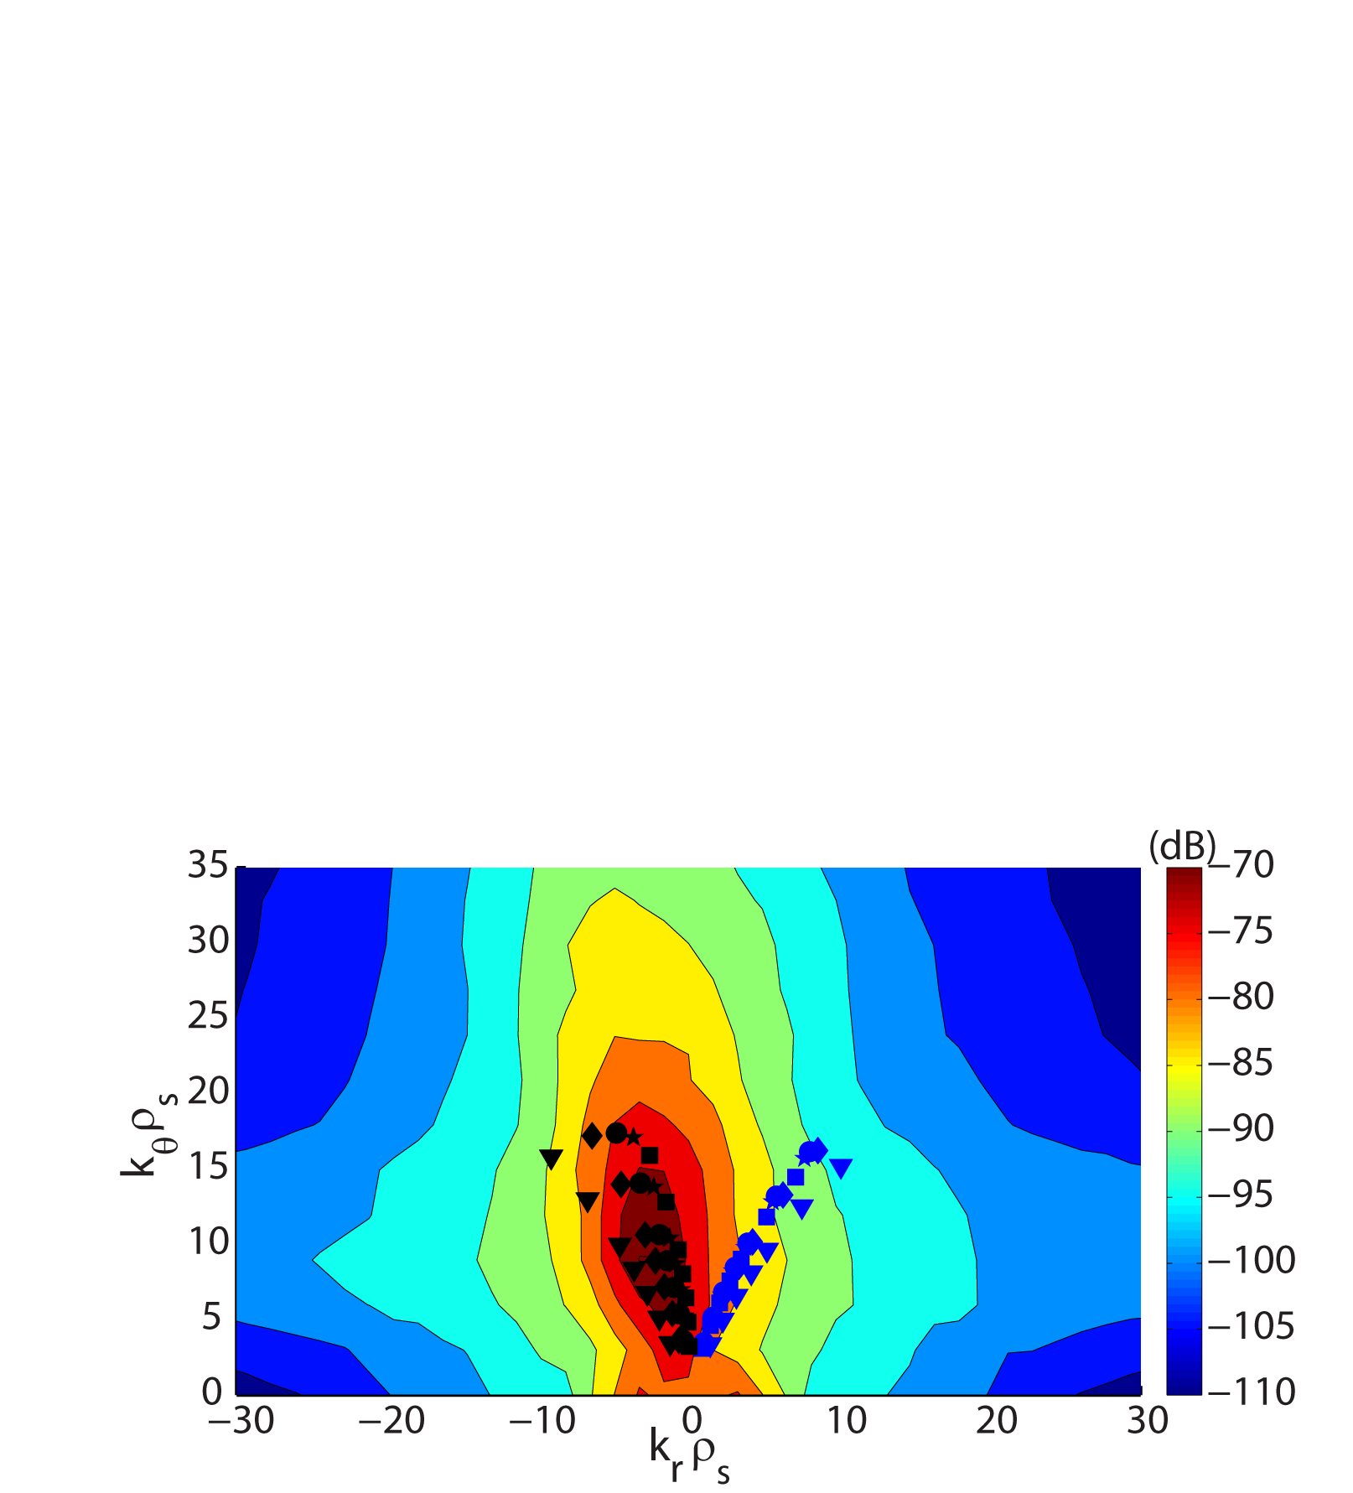
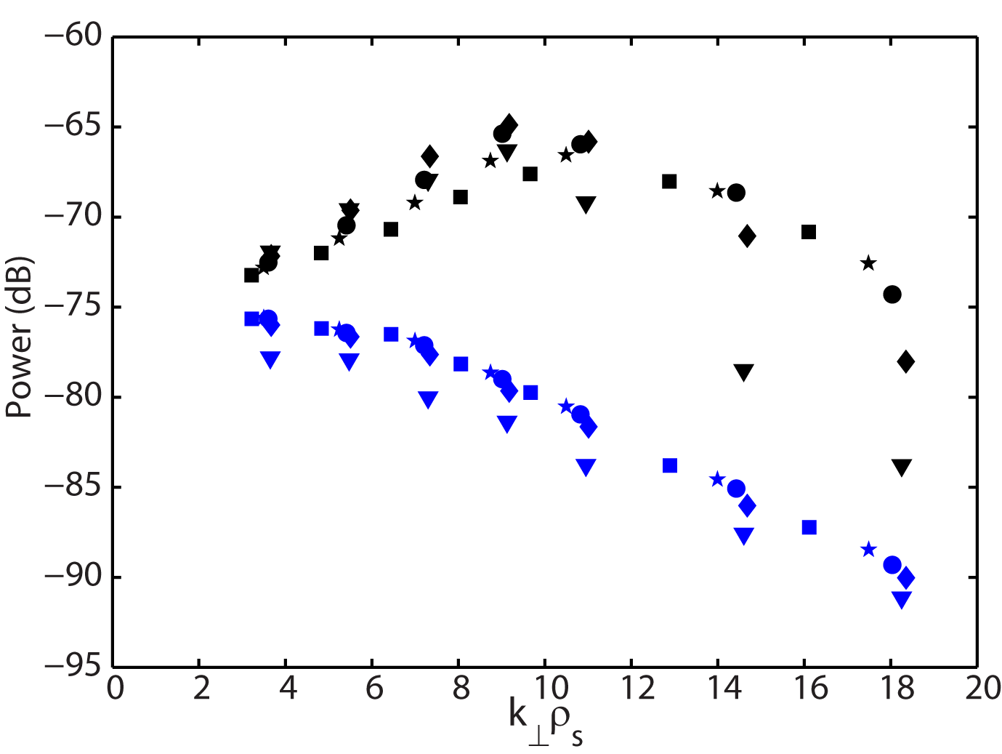

Two Scattering Schemes Cover Different Regions of the 2D k⊥ Spectrum
The downward scattering has k_{r}<0, and k_{θ}≈3|k_{r}|
The upward scattering has k_{r}>0, and k_{θ}≈1.5|k_{r}|
Resolvable spectral power difference between two scattering schemes, ~15-20 dB from a nonlinear ETG simulation
  Large power difference identifiable in experiment
  Based on the 2D ETG k spectrum of an NSTX H-mode plasma, calculated by the GYRO code
R
Downward scattering
Upward scattering
Symbols denote different radial position

Slide 20
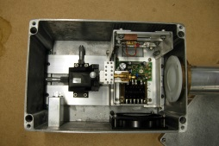
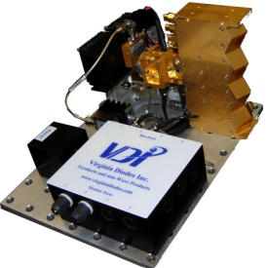
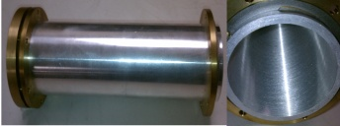
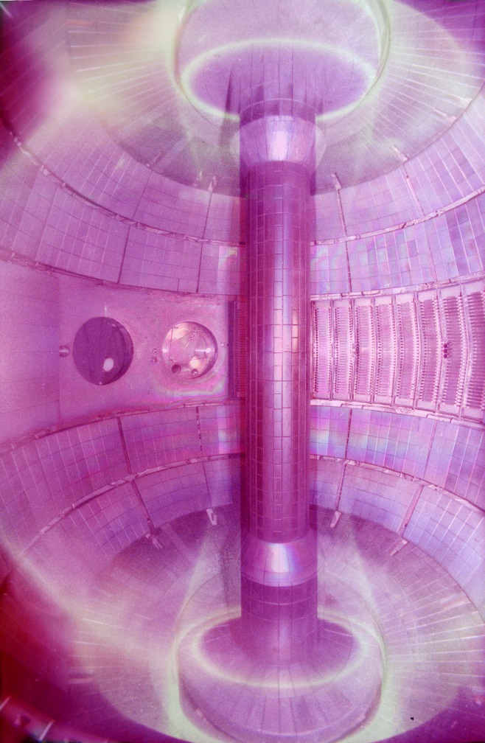
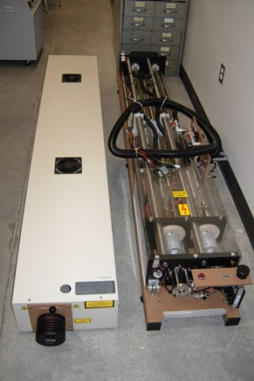
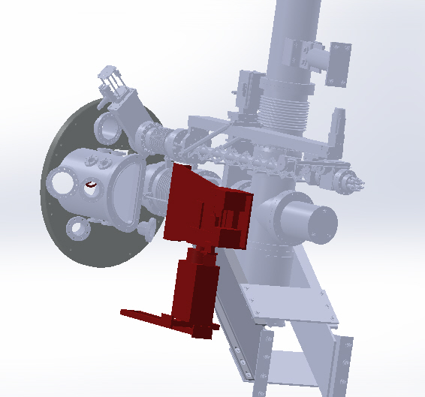
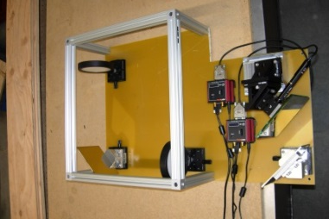
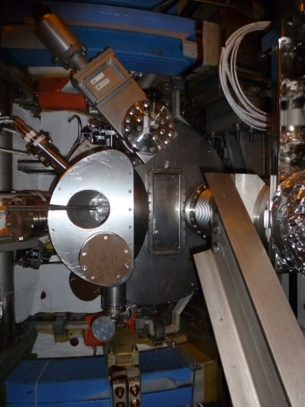
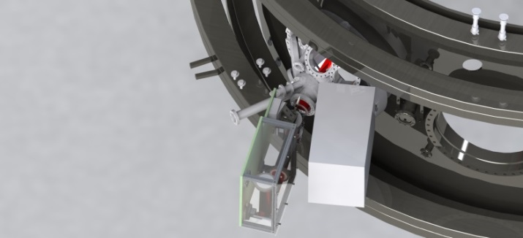
NSTX-U High-k_{θ} Scattering System is being Implemented by UC-Davis
Reference Channel
693 GHz subharmonic 4-pixel receiver array
FIR Laser System
20 m Corrugated Waveguide
NSTX
14 GHz LO x48
160 W CO₂ pump laser
88 mW FIR formic acid laser
Bay G launch optics
Bay L receiver optics
693 GHz probe beam
Bay L window
Receiver optics
  Remotely steerable elements
  Scattering angles 2˚ to 15˚
  Bay L 33 cm tall window permits k_{θ} detection
Launch Optics
Remotely steerable beam ± 2.5˚
HDPE lenses shape beam
Bay G
Bay L

Slide 21

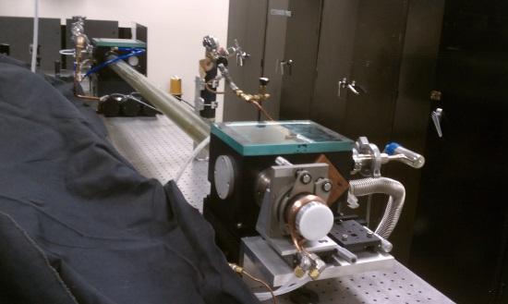
A 693 GHz FIR Formic Acid Laser is Used as the Probe beam
Optically pumped FIR formic acid laser
693 GHz (432 μm)
88 mW beam power
Mesh output coupler provides Gaussian beam profile
Edinburgh Instruments PL-6
CO₂ Laser
Grating tunable
160 W
Folded twin tube design
Solid state 1200 W power supply
Self contained chilled water circulation
88 mW FIR laser

Slide 22
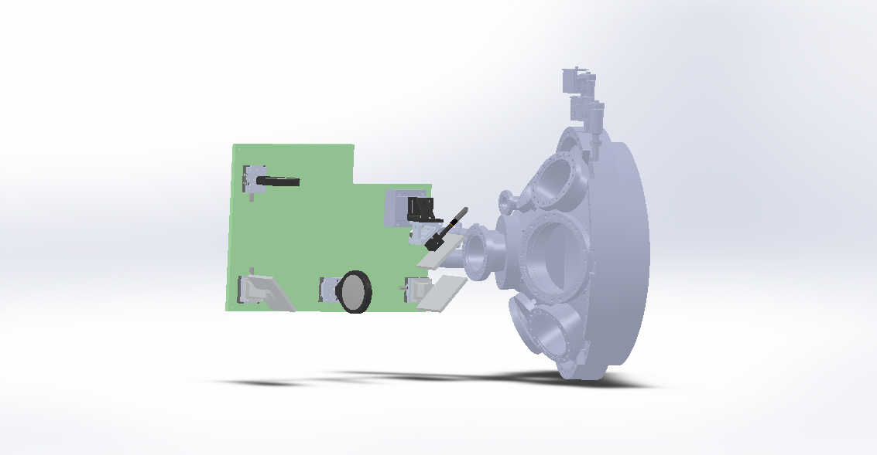
Remotely Steerable Launching System Provides Upward and Downward Scattering Capability
FIR beam emitted from waveguide
From waveguide
HDPE concave lens
Remotely steerable mirror
Launch mirror
G11 Backboard
Bay G port cover
Bay G window
Lens 2
Mirror
HDPE convex lens
Mirror
432 µm, Gaussian beam
Steerable ± 2.25˚ vertical and ± 1.0° horizontal
Beam waist 520 mm from receiver window

Slide 23
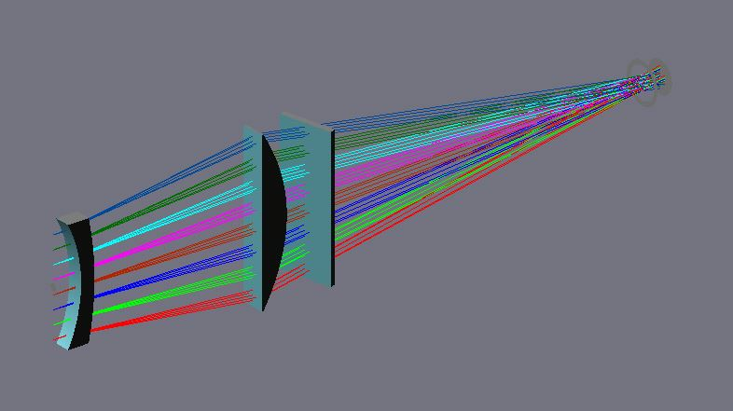

Four Scattering Channels are Planned Initially
HDPE focusing lens
HDPE meniscus lens
Bay L
Receiver optics
Window
Scattered signals
Receiver 4x1 mixer array
693 GHz Probe beam
Scattering volume
4 channel receiver (plans to expand to 8 channels)
Plasma core to edge coverage
5-axis receiver to locate scattering volume
k_{θ} coverage 7 to 40 cm⁻¹
Heterodyne receivers to distinguish the direction of propagation
5-axis receiver

Slide 24
Some Considerations of a Spatially-resolved High-k Scattering System on DIII-D
If employ perpendicular scattering scheme (measuring k_{θ} spectrum)
  DIII-D magnetic shear is too small (compare with NSTX) to provide sufficient help in improving scattering localization
  Small beam overlap in order to have radial localization
    mm microwave probably the best bet
  Large scattering angle-> large exit window required
If employ tangential scattering scheme
  Both k_{θ} and k_{r} spectra measurement possible
  Good radial localization achievable even with CO₂ laser scattering
    Only require small windows for a single radial location
    Multiple exit windows needed for more radial locations

Slide 25
Summary
The high-k_{r} microwave scattering diagnostic on NSTX was a success
  Good radial resolution, electron-scale wavenumber coverage and frequency response
  Provided insight into ETG physics in STs
  However, measuring k_{r} not optimal for assessing the relation with transport
A high-k_{θ} FIR scattering diagnostic is being implemented by UC-Davis for NSTX-U
  Able to measure wavenumber spectral peak of ETG turbulence
  Featuring two scattering schemes for probing ETG streamers

