Slide 1
Integrated Tokamak Modeling: when physics informs engineering and research planning
Francesca M. Poli
Princeton Plasma Physics Laboratory
Notes:
Transition between topics – summary of previous
Need to explain the figures: axes, plots.
Choice of words: non-axisymmetric instead of 3D
Write down more words to help me remember what I need to talk about
Self-consistent vs more comprehensive / complete
EP transport OR EP induced instabilities

Slide 2
For sending material for this tutorial, many thanks go to:
USA: N. Bertelli, M. Boyer, N. Ferraro, W. Guttenfelder, D. Pfefferle, M. Podesta (PPPL), I. Krebs (PPPL/IPP), V. Soukhanovskii (LLNL), D. Green, J-M Park (ORNL), S. Kruger, T. Jenkins (TechX), P. Bonoli, N. Howard, S. Shiraiwa, J. Wright (PSFC), T. Rafiq (Univ. Lehigh)
EU: J. Citrin (DiFFer), E. Militello Asp, F. Koechl (CCFE)
JAPAN: N. Hayashi (QST), A. Fukuyama (Univ. Kyoto)
ITER Organization: X. Bonnin, Y. Gribov, S-H Kim, R. Pitts

Slide 3
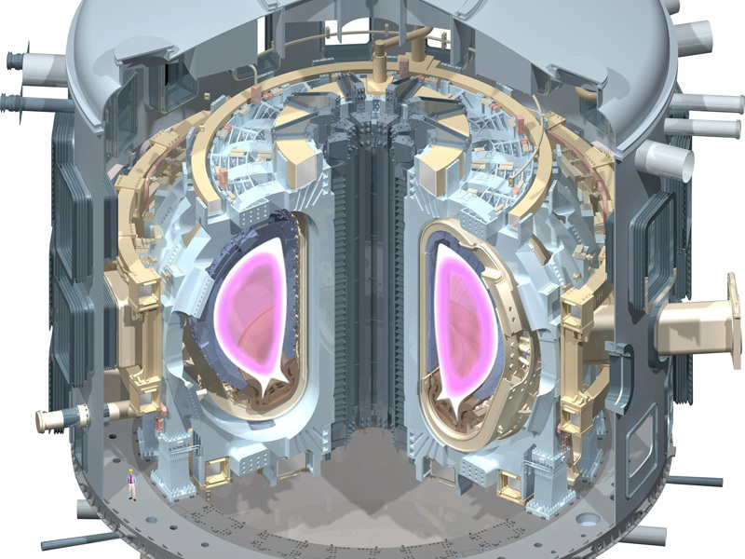
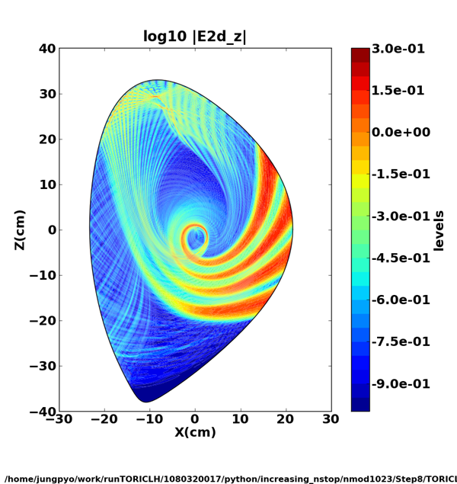
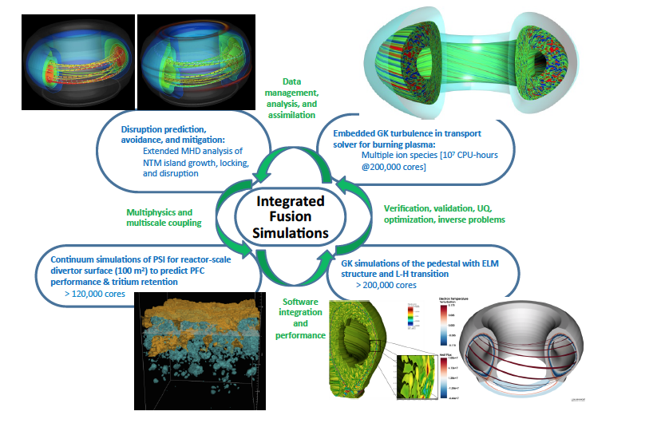
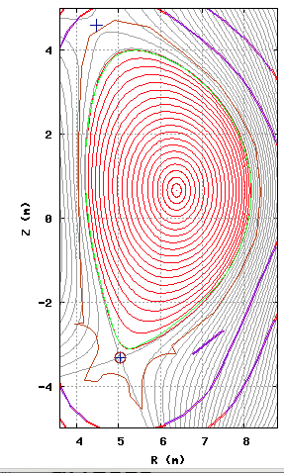
Fusion plasma physics encompasses a wide range of spatial and temporal scales
ω_{EC}⁻¹
ω_{LH}⁻¹
ω_{IC}⁻¹
τ_{A}
τ_{E}
τ_{R}
τ_{D}
ITER
time (s)
10⁻¹⁰
10⁻⁸
10⁻⁶
10⁻⁴
10⁻²
10⁰
10²
10⁴
10⁻⁶
10⁻⁴
10⁻²
10⁰
10²
space (m)
Macroscopic stability
Wave propagation
Transport current diffusion
Full wave solvers
<1M CPU Hours
Plasma turbulence
MHD codes
Equilibrium and
transport solvers
<10² CPU hours
Gyrokinetic codes
<10M CPU hours

Slide 4
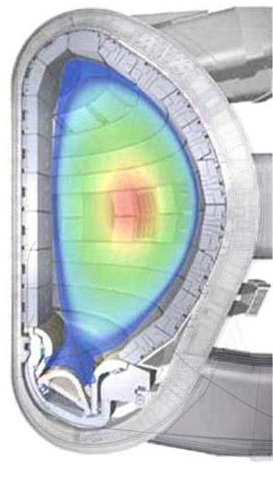
In a tokamak all temporal and spatial scales are coupled
Confined plasma
(closed magnetic field lines)
The plasma is surrounded
by solid structures:
Plasma-material interactions
MHD equilibrium/instabilities,
microturbulence,
energetic particles
External heating
Radiofrequency waves
Neutral beams
Scrape-Off Layer plasma (SOL)
(open field lines)
Microturbulence,
ionization, recombination
radiation
Fueling
Gas injection
Pellets

Slide 5
In a tokamak particles and energy are ‘confined’ by magnetic fields
Confined plasma
(closed magnetic field lines)
The plasma is surrounded
by solid structures:
Plasma-material interactions
MHD equilibrium/instabilities,
microturbulence,
energetic particles
External heating
Radiofrequency waves
Neutral beams
Scrape-Off Layer plasma (SOL)
(open field lines)
Microturbulence,
ionization, recombination
radiation
Fueling
Gas injection
Pellets

Slide 6
and they can also ‘flow’ along open magnetic field lines
Confined plasma
(closed magnetic field lines)
The plasma is surrounded
by solid structures:
Plasma-material interactions
MHD equilibrium/instabilities,
microturbulence,
energetic particles
External heating
Radiofrequency waves
Neutral beams
Scrape-Off Layer plasma (SOL)
(open field lines)
Microturbulence,
ionization, recombination
radiation
Fueling
Gas injection
Pellets

Slide 7
Plasmas in a tokamak are in contact with the ‘wall’
Confined plasma
(closed magnetic field lines)
The plasma is surrounded
by solid structures:
Plasma-material interactions
MHD equilibrium/instabilities,
microturbulence,
energetic particles
External heating
Radiofrequency waves
Neutral beams
Scrape-Off Layer plasma (SOL)
(open field lines)
Microturbulence,
ionization, recombination
radiation
Fueling
Gas injection
Pellets

Slide 8
Plasmas in a tokamak need to be ‘heated’
Confined plasma
(closed magnetic field lines)
The plasma is surrounded
by solid structures:
Plasma-material interactions
MHD equilibrium/instabilities,
microturbulence,
energetic particles
External heating
Radiofrequency waves
Neutral beams
Scrape-Off Layer plasma (SOL)
(open field lines)
Microturbulence,
ionization, recombination
radiation
Fueling
Gas injection
Pellets

Slide 9
Plasmas need frequent pit stops for ‘re-fueling’
Confined plasma
(closed magnetic field lines)
The plasma is surrounded
by solid structures:
Plasma-material interactions
MHD equilibrium/instabilities,
microturbulence,
energetic particles
External heating
Radiofrequency waves
Neutral beams
Scrape-Off Layer plasma (SOL)
(open field lines)
microturbulence,
ionization, recombination
radiation
Fueling
Gas injection
Pellets

Slide 10
A different perspective on integrated modeling: looking at a tokamak with the eye of an engineer
Goal: simulate an entire plasma discharge from startup to termination optimizing ACCURATE PHYSICS and FAST TURNAROUND
  High fidelity physics at the core of time-slice integrated modeling
  Verified and validated reduced models at the core of (time-dependent) integrated modeling
Notes:
Restricted range of applicability => this is where the verification enters and where the validation enters.

Slide 11
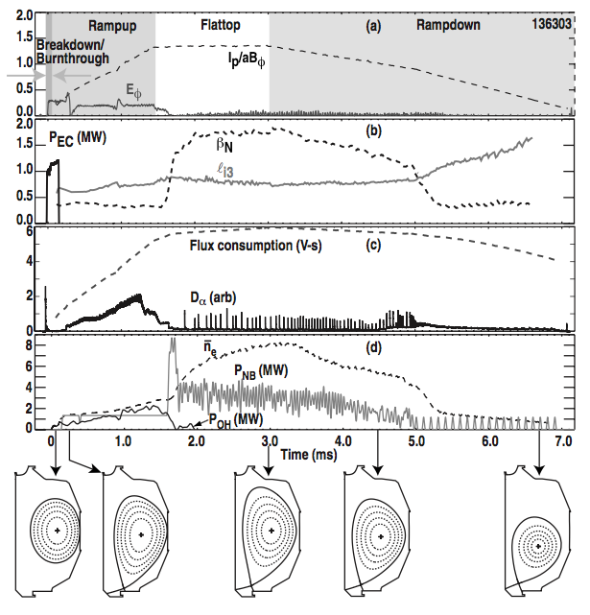
We model tokamaks to understand experiments and to design stable and reliable reactors
Experiment on DIII-D that simulates an ITER-like plasma
[Fig. 1 - G. Jackson et al, Phys. Plasmas 17 056116 (2010)]
Heating and current drive (10⁻¹¹-10⁻⁶s)
MHD instabilities/turbulence (10⁻⁶-10⁻²s)
Density evolution (10⁻⁶-10⁻²s)
Neutral Beams (10⁻⁶-10⁻¹s)
MHD equilibrium (10⁻⁶-10⁻²s)

Slide 12
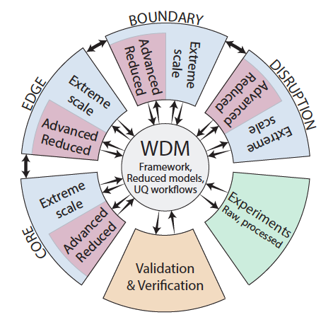
A Whole Device Model (WDM) is a comprehensive picture of the complexity involved in modeling a tokamak
Extreme scale
First principle (Vlasov eq.)
Gyrokinetic codes
Full wave solvers
uncertainty quantification
models and experiments
Validation
Experiments
verification
Advanced reduced
Fluid codes
Reduced full wave solvers
Reduced
Ray tracing codes
Neural networks
[FES Integrated Modeling Workshop Report, 2015]

Slide 13
A Whole Device Model (WDM) is a comprehensive picture of the complexity involved in modeling a tokamak
Extreme scale
First principle (Vlasov eq.)
Gyrokinetic codes
Full wave solvers
Computational time decreases:
millions CPU hours to minutes/seconds
Physics fidelity decreases
Verification/validation needed at each step
Time-slice
applications
Advanced reduced
Fluid codes
Reduced full wave solvers
Reduced
Ray tracing codes
Neural networks
Time-dependent
applications
Notes:
NN: mention that you can use them for real-time control

Slide 14
From high fidelity physics to reduced models
Combining two or more models for an integrated, converged solution on a time slice
Notes:
Every time we use different sets of equations, but we need boundary conditions and input assumptions.
Here expand the bullet =>

Slide 15
Confined plasma
(closed magnetic field lines)
The plasma is surrounded
by solid structures:
Plasma-material interactions
MHD equilibrium/instabilities,
microturbulence,
energetic particles
External heating
Radiofrequency waves
Neutral beams
Scrape-Off Layer plasma (SOL)
(open field lines)
microturbulence,
ionization, recombination
radiation
Fueling
Gas injection
Pellets

Slide 16
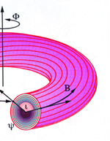
A plasma in equilibrium can be described by ideal MHD
Equilibrium condition:
j, B lie on nested surfaces
j, B, p are described by a flux function ψ
equilibrium entirely defined by:
[Credit, DIFFER website, The Netherlands]
Notes:
Credit: Differ (replace comma)

Slide 17
Confined plasma
(closed magnetic field lines)
The plasma is surrounded
by solid structures:
Plasma-material interactions
MHD equilibrium/instabilities,
microturbulence,
energetic particles
External heating
Radiofrequency waves
Neutral beams
Scrape-Off Layer plasma (SOL)
(open field lines)
microturbulence,
ionization, recombination
radiation
Fueling
Gas injection
Pellets

Slide 18
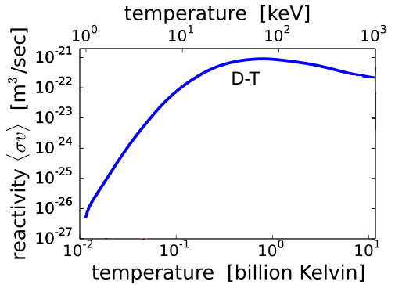
Ignited (burning) plasmas are dominated by alpha heating … but they need a boost from external sources before they can burn
n_{D} + n_{T}
50-50
3.5MeV
minimum temperature for ignition => 15 keV
alpha heating dominates at temperature >5-7 keV
ohmic heating can heat plasmas only up to 3-5 keV

Slide 19
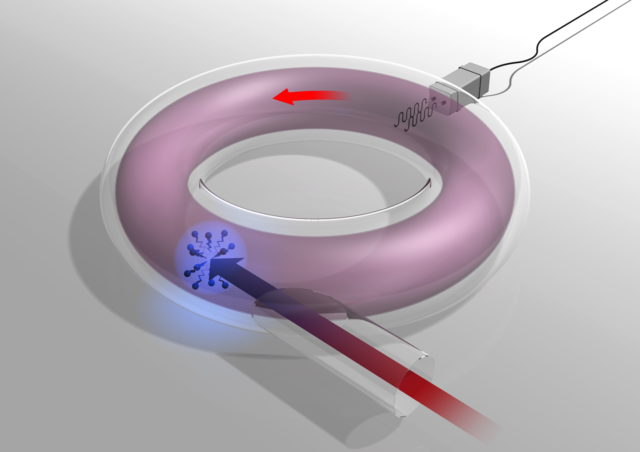
External sources do more than providing heating and current: they can provide momentum and control of MHD instabilities
RF antennas (IC, LH),
Gyrotrons (EC)
NB
IC
LH
collisions
EC
Neutral beams (NB)

Slide 20
Perturbation of equilibrium enables description of waves propagation by representing the plasma with a dielectric tensor
CMod plasma
density, temperature
Dielectric tensor
Heating, current
profiles
Magnetic equilibrium
full wave solver
(TORLH)
<10⁶ CPU Hours
[courtesy of S. Shiraiwa (PSFC), VI2.00003]

Slide 21
Ray-tracing equations are accurate (and fast) approximations of high frequency wave propagation
(another) CMod plasma
density, temperature
Dielectric tensor
Heating, current
profiles
Magnetic equilibrium
ray-tracing
(GENRAY)
<10 minutes
Ray-tracing equations
dispersion relation

Slide 22
Confined plasma
(closed magnetic field lines)
The plasma is surrounded
by solid structures:
Plasma-material interactions
MHD equilibrium/instabilities,
microturbulence,
energetic particles
External heating
Radiofrequency waves
Neutral beams
Scrape-Off Layer plasma (SOL)
(open field lines)
microturbulence,
ionization, recombination
radiation
Fueling
Gas injection
Pellets

Slide 23
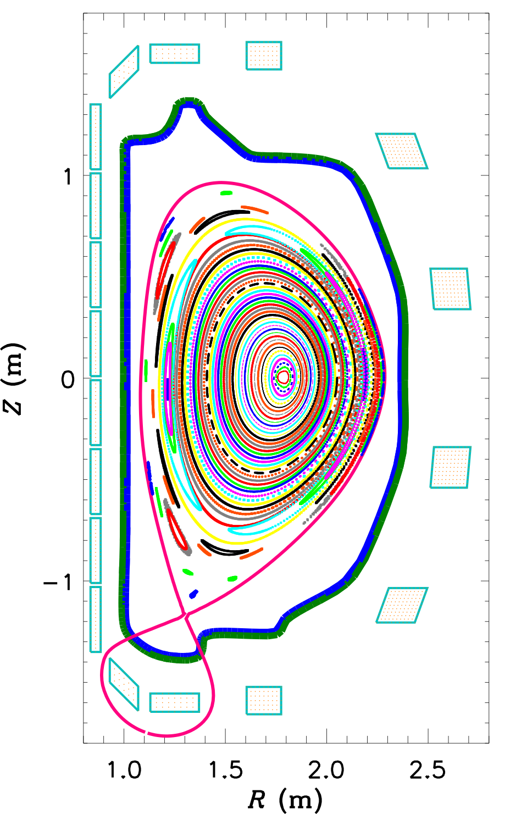
Plasmas develop instabilities that can degrade performance
M3DC-1
at specific locations (resonant surfaces)
they look like magnetic islands
they can be stabilized by
highly focalized beams of
high frequency (~100 GHz) waves
Courtesy of N. Ferraro (PPPL)

Slide 24

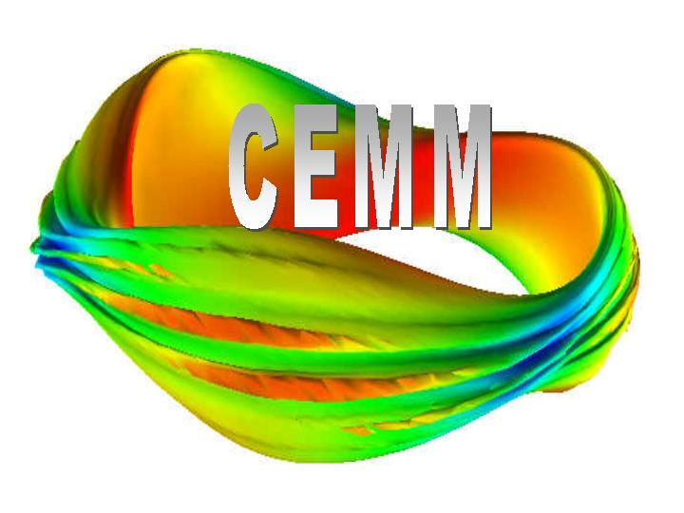

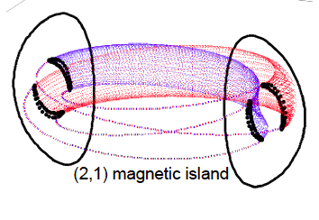
Self-consistent simulations of stabilization of magnetic islands can be done only in the framework of 3D nonlinear MHD
NIMROD/GENRAY
quasilinear corrections
to MHD equilibrium
to account for effect of waves
Ray tracing equations for
wave propagation
T. Jenkins (Tech-X)
Notes:
Need to mention why this is a problem and why this is important.
Add bullet with goals?
Suppress instabilities by means of injected waves.
The waves are supposed to drive localized current.

Slide 25
Reduced models are based on a Modified Rutherford Equation
Magnetic island evolution described by:
analytic expressions for instability threshold and driving
In a cylindrical approximation
Analytic expressions and fitting parameters for the stabilizing effect of RF waves
Notes:
Need to mention why this is a problem and why this is important.
Add bullet with goals?
Suppress instabilities by means of injected waves.
The waves are supposed to drive localized current.

Slide 26
Confined plasma
(closed magnetic field lines)
The plasma is surrounded
by solid structures:
Plasma-material interactions
MHD equilibrium/instabilities,
microturbulence,
energetic particles
External heating
Radiofrequency waves
Neutral beams
Scrape-Off Layer plasma (SOL)
(open field lines)
microturbulence,
ionization, recombination
radiation
Fueling
Gas injection
Pellets

Slide 27
Separation of scales enables representing (almost) any transport problem as a diffusion/convection-like problem
The goal is to obtain a set of diffusion-like equations of the form:
for a physical variable Q
identify the flux Γ
and the source and sink terms contained in S

Slide 28
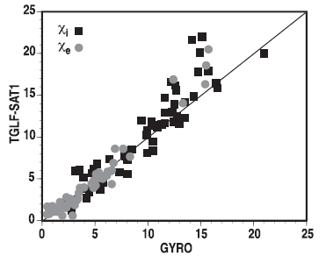
Understanding and modeling tokamak turbulent transport requires theory-based prediction of flux-gradient relationships
GYRO
6D Vlasov equations =>
5D nonlinear“gyrokinetic”
State-of-the-art multi-scale (ρ_{i}→ρ_{e})
~50M CPU-hrs for 3-point scan
[N. Howard, Nucl. Fusion (2016)]
Reduced gyrofluid model
TGLF
fluid eq. with right closure =>
Fit over limited set of GK
(< 1 sec with NN)
[Citrin NF 55 (2015), Meneghini, NF 57 (2017)]
G. Staebler, Phys. Plasmas (2016)
Gyrokinetic prediction
Notes:
Add scales involved
Describe figure

Slide 29
Confined plasma
(closed magnetic field lines)
The plasma is surrounded
by solid structures:
Plasma-material interactions
MHD equilibrium/instabilities,
microturbulence,
energetic particles
External heating
Radiofrequency waves
Neutral beams
Scrape-Off Layer plasma (SOL)
(open field lines)
microturbulence,
ionization, recombination
radiation
Fueling
Gas injection
Pellets

Slide 30
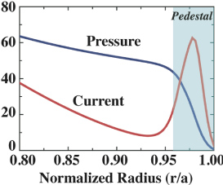
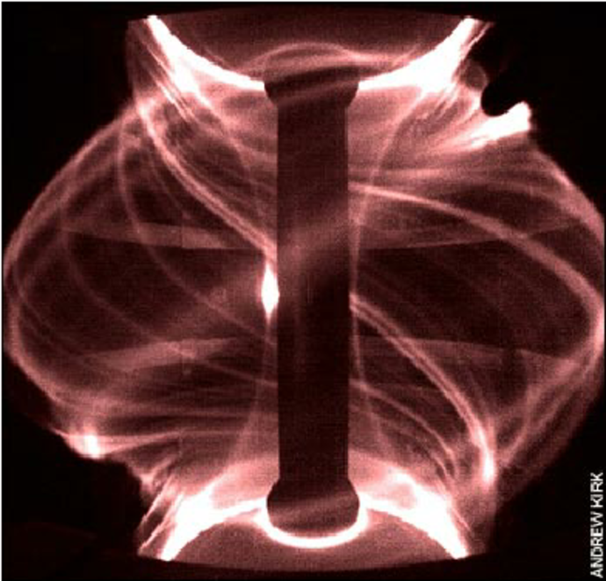
Steep gradient at the plasma edge drives MHD instabilities
Plasmas spontaneously develop a region (pedestal)
that encloses good confinement [P. Snyder FR1.00001]
Pressure (kPa)
Current (A/cm²)
MAST
The width and height of the pedestal can be determined
univocally by MHD calculations for a given value of density
Notes:
add reference.
Steep gradientS [...] drive ...

Slide 31

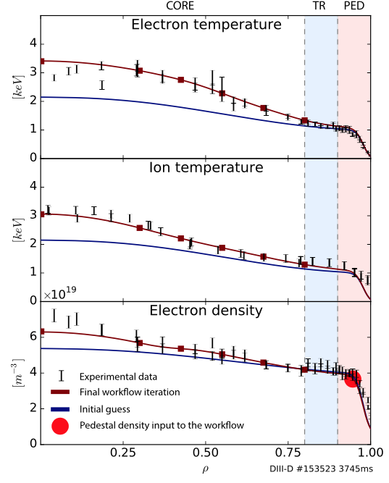
Efficient workflows allow combined solution of core transport and pedestal MHD stability
Core
transport
Electron temperature (keV)
equilibrium
700 cores
~minutes
Transition
region
Electron density (10¹⁹ m⁻³)
pedestal
Not yet a self-consistent solution:
model for pedestal density still missing
model for transition region that includes
microturbulence still missing
O. Meneghini, Phys. Plasmas 23 (2016)
Notes:
I’d say “enable” instead of “allow”

Slide 32
Replacing MHD stability pedestal calculations with a lookup table advantageous in time-dependent simulations
~6500 points cover the expected
ITER operational space
Plasma current
[task under international collaboration]
Pedestal pressure (kPa)
Pedestal density
A neural network has also been developed
[O. Meneghini, NF 57 (2017)]
Pedestal width (normalized poloidal flux)

Slide 33
Confined plasma
(closed magnetic field lines)
The plasma is surrounded
by solid structures:
Plasma-material interactions
MHD equilibrium/instabilities,
microturbulence,
energetic particles
External heating
Radiofrequency waves
Neutral beams
Scrape-Off Layer plasma (SOL)
(open field lines)
microturbulence,
ionization, recombination
radiation
Fueling
Gas injection
Pellets

Slide 34
Where the plasma meets the wall: the Scrape-Off-Layer (SOL)
Heat losses from the plasma can damage plasma facing components
SOL width determined by competition between parallel and perpendicular transport
R. Goldston, NF 52 (2012), PI3.00004
Courtesy of V. Soukhanovskii (LLNL)

Slide 35
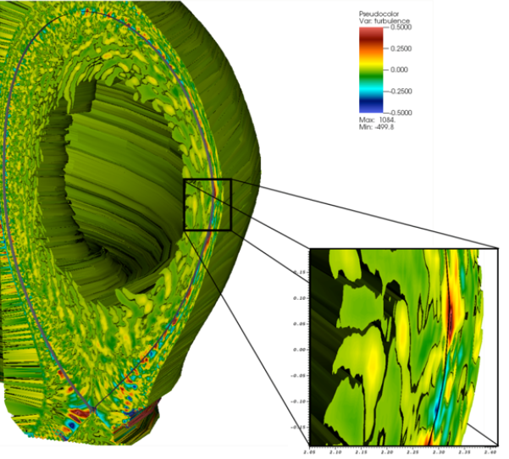
Gyrokinetics simulations that extend the computation domain to the wall needed to develop reduced models for the edge plasma
XGC
S-H Ku, DI2.00004
We need a better model for the plasma edge,
Including the region inside the pedestal,
Microturbulence
coherent structures (blobs)
Separation of ion and electron scales
Wall sources
Notes:
Mention time scales here.
Start text in bullets with capital letters

Slide 36
Confined plasma
(closed magnetic field lines)
The plasma is surrounded
by solid structures:
Plasma-material interactions
MHD equilibrium/instabilities,
microturbulence,
energetic particles
External heating
Radiofrequency waves
Neutral beams
Scrape-Off Layer plasma (SOL)
(open field lines)
microturbulence,
ionization, recombination
radiation
Fueling
Gas injection
Pellets

Slide 37
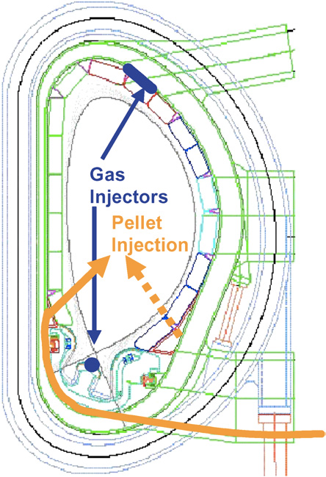
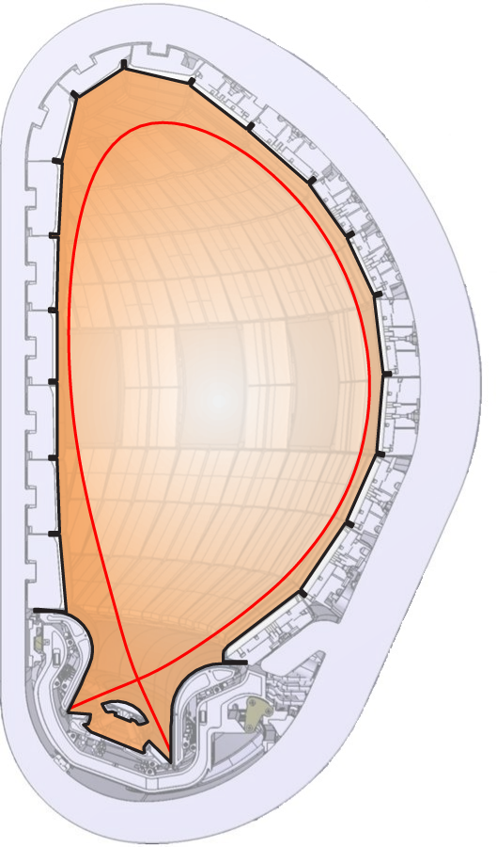
Edge transport and fuelling are critical ingredients to model the plasma evolution in burning plasma conditions
Heat conduction zone
P_{SOL}
Impurity radiation zone
H⁰/D⁰/T⁰ ionization zone
(T_{e}>5eV)
Neutral friction zone
Recombination zone
(T_{e}<1eV)
Courtesy of R. Pitts (ITER Organization)
Notes:
Fueling
put in backup
Correct text color to be consistent with figure (cartoon on the right)

Slide 38
Confined plasma
(closed magnetic field lines)
The plasma is surrounded
by solid structures:
Plasma-material interactions
MHD equilibrium/instabilities,
microturbulence,
energetic particles
External heating
Radiofrequency waves
Neutral beams
Scrape-Off Layer plasma (SOL)
(open field lines)
turbulence,
ionization, recombination
radiation
fueling
Gas injection
Pellets

Slide 39
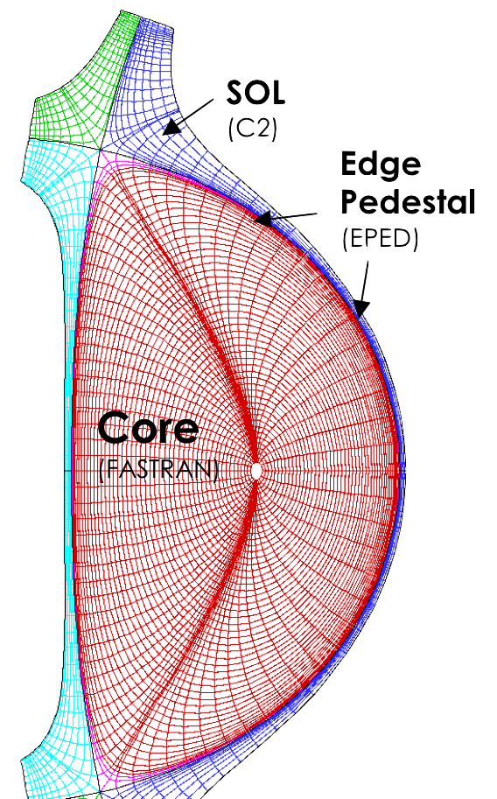
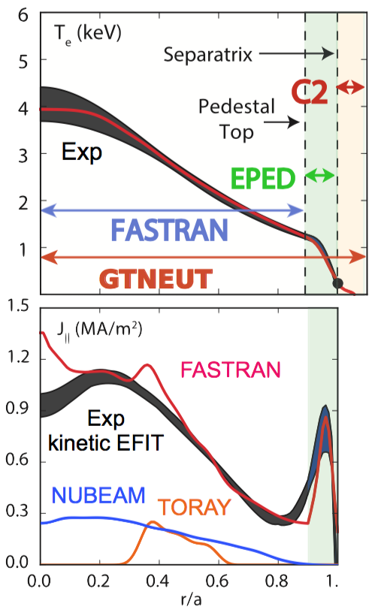
Modular coupling of 1.5D core and 2D edge transport implemented and validated on DIII-D steady-state plasma
AToM SciDAC
Wall sources
and sinks
equilibrium
SOL
  700 cores
  300 CPU-hr/iteration
  3-4 iterations
pedestal
Core transport
pedestal
Neutrals transport
Core
transport
J-M. Park, D. Green (ORNL)

Slide 40
Integrated modeling on single time-slice has led to great insight
On small scales dynamics and multi-scale couplings
On how to plug-in models to describe the plasma from axis to wall
... but plasmas in tokamaks are dynamical, nonlinear systems …

Slide 41
The other side of integrated tokamak modeling: an entire plasma discharge from startup to termination

Slide 42
The basics …
A tokamak is like a transformer, where the plasma is the secondary winding

Slide 43
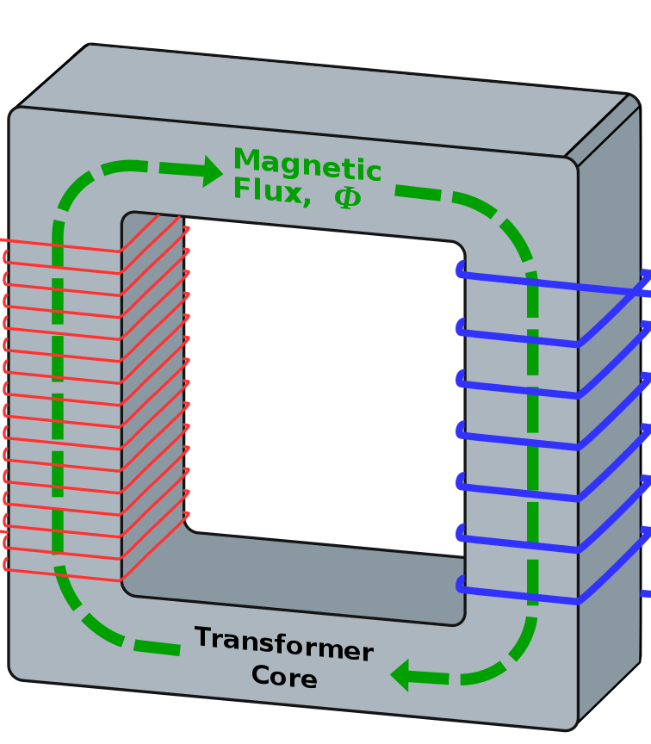
In a transformer the circuits are magnetically connected
I_{P}
I_{S}
+
+
In the primary: I_{P}(t) => B_{P}(t)
In the secondary: I_{S}(t) => B_{S}(t)
Total magnetic flux density: B(t)=B_{P}(t)+B_{S}(t)
V_{P}
V_{S}
-
-
Limitation: it is pulsed, cannot operate continuously in steady-state

Slide 44
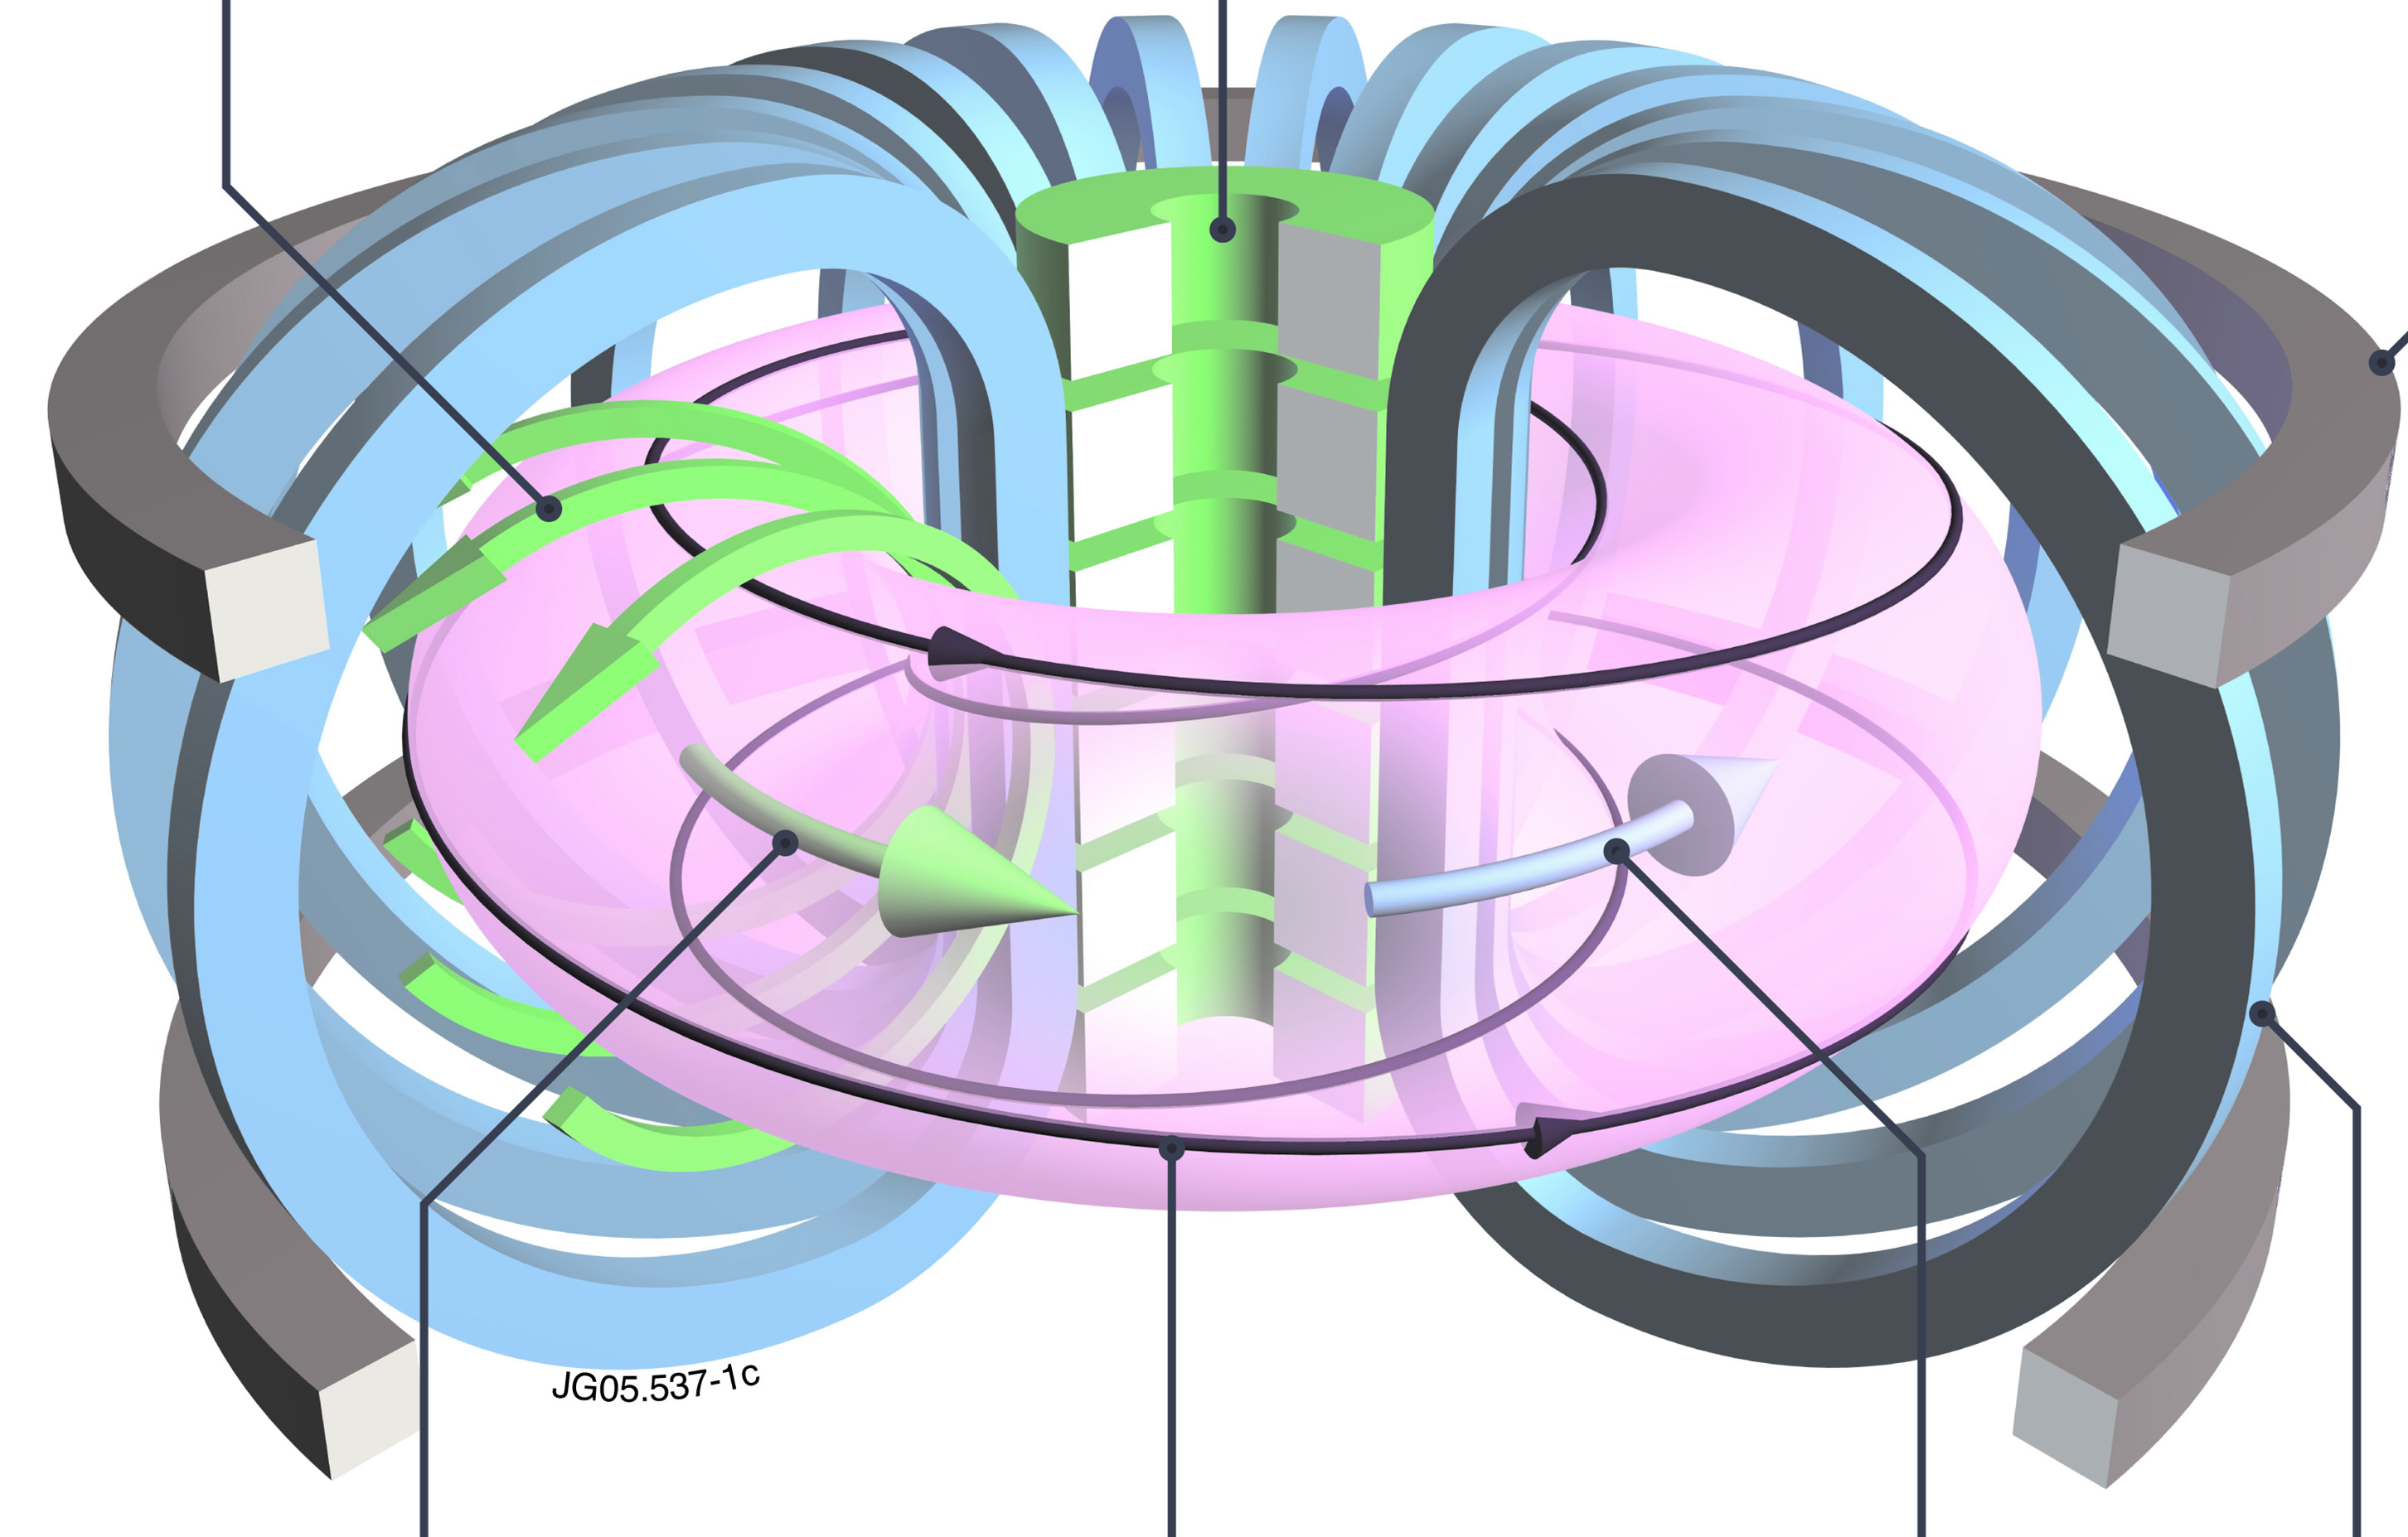
In a tokamak the secondary circuit is a conducting fluid …
… things get complicated
Transformer: source
of poloidal flux
Central solenoid
Primary circuit
Actuators (external)
Poloidal field
Plasma (internal)
Magnetic flux diffusion
Plasma current
Secondary circuit
transport
Helical field
Toroidal field

Slide 45
A tokamak simulator needs to connect fast (transport) and slow (current diffusion) time scales
Transformer: source
of poloidal flux
Auxiliary
H&CD
External
momentum
Fuelling
& pumping
H
Actuators (external)
Plasma (internal)
CD
α-heating
Self-generated
current
kinetic profiles
Magnetic flux
diffusion
Heat, particle &
Momentum fluxes
Conductivity
profiles
Wall sources
and sinks
Transport coefficients
Turbulent & neoclassical
adapted from Politzer NF 45 (2005)
Notes:
Fueling with 1 L
Change plasma (internal) color

Slide 46
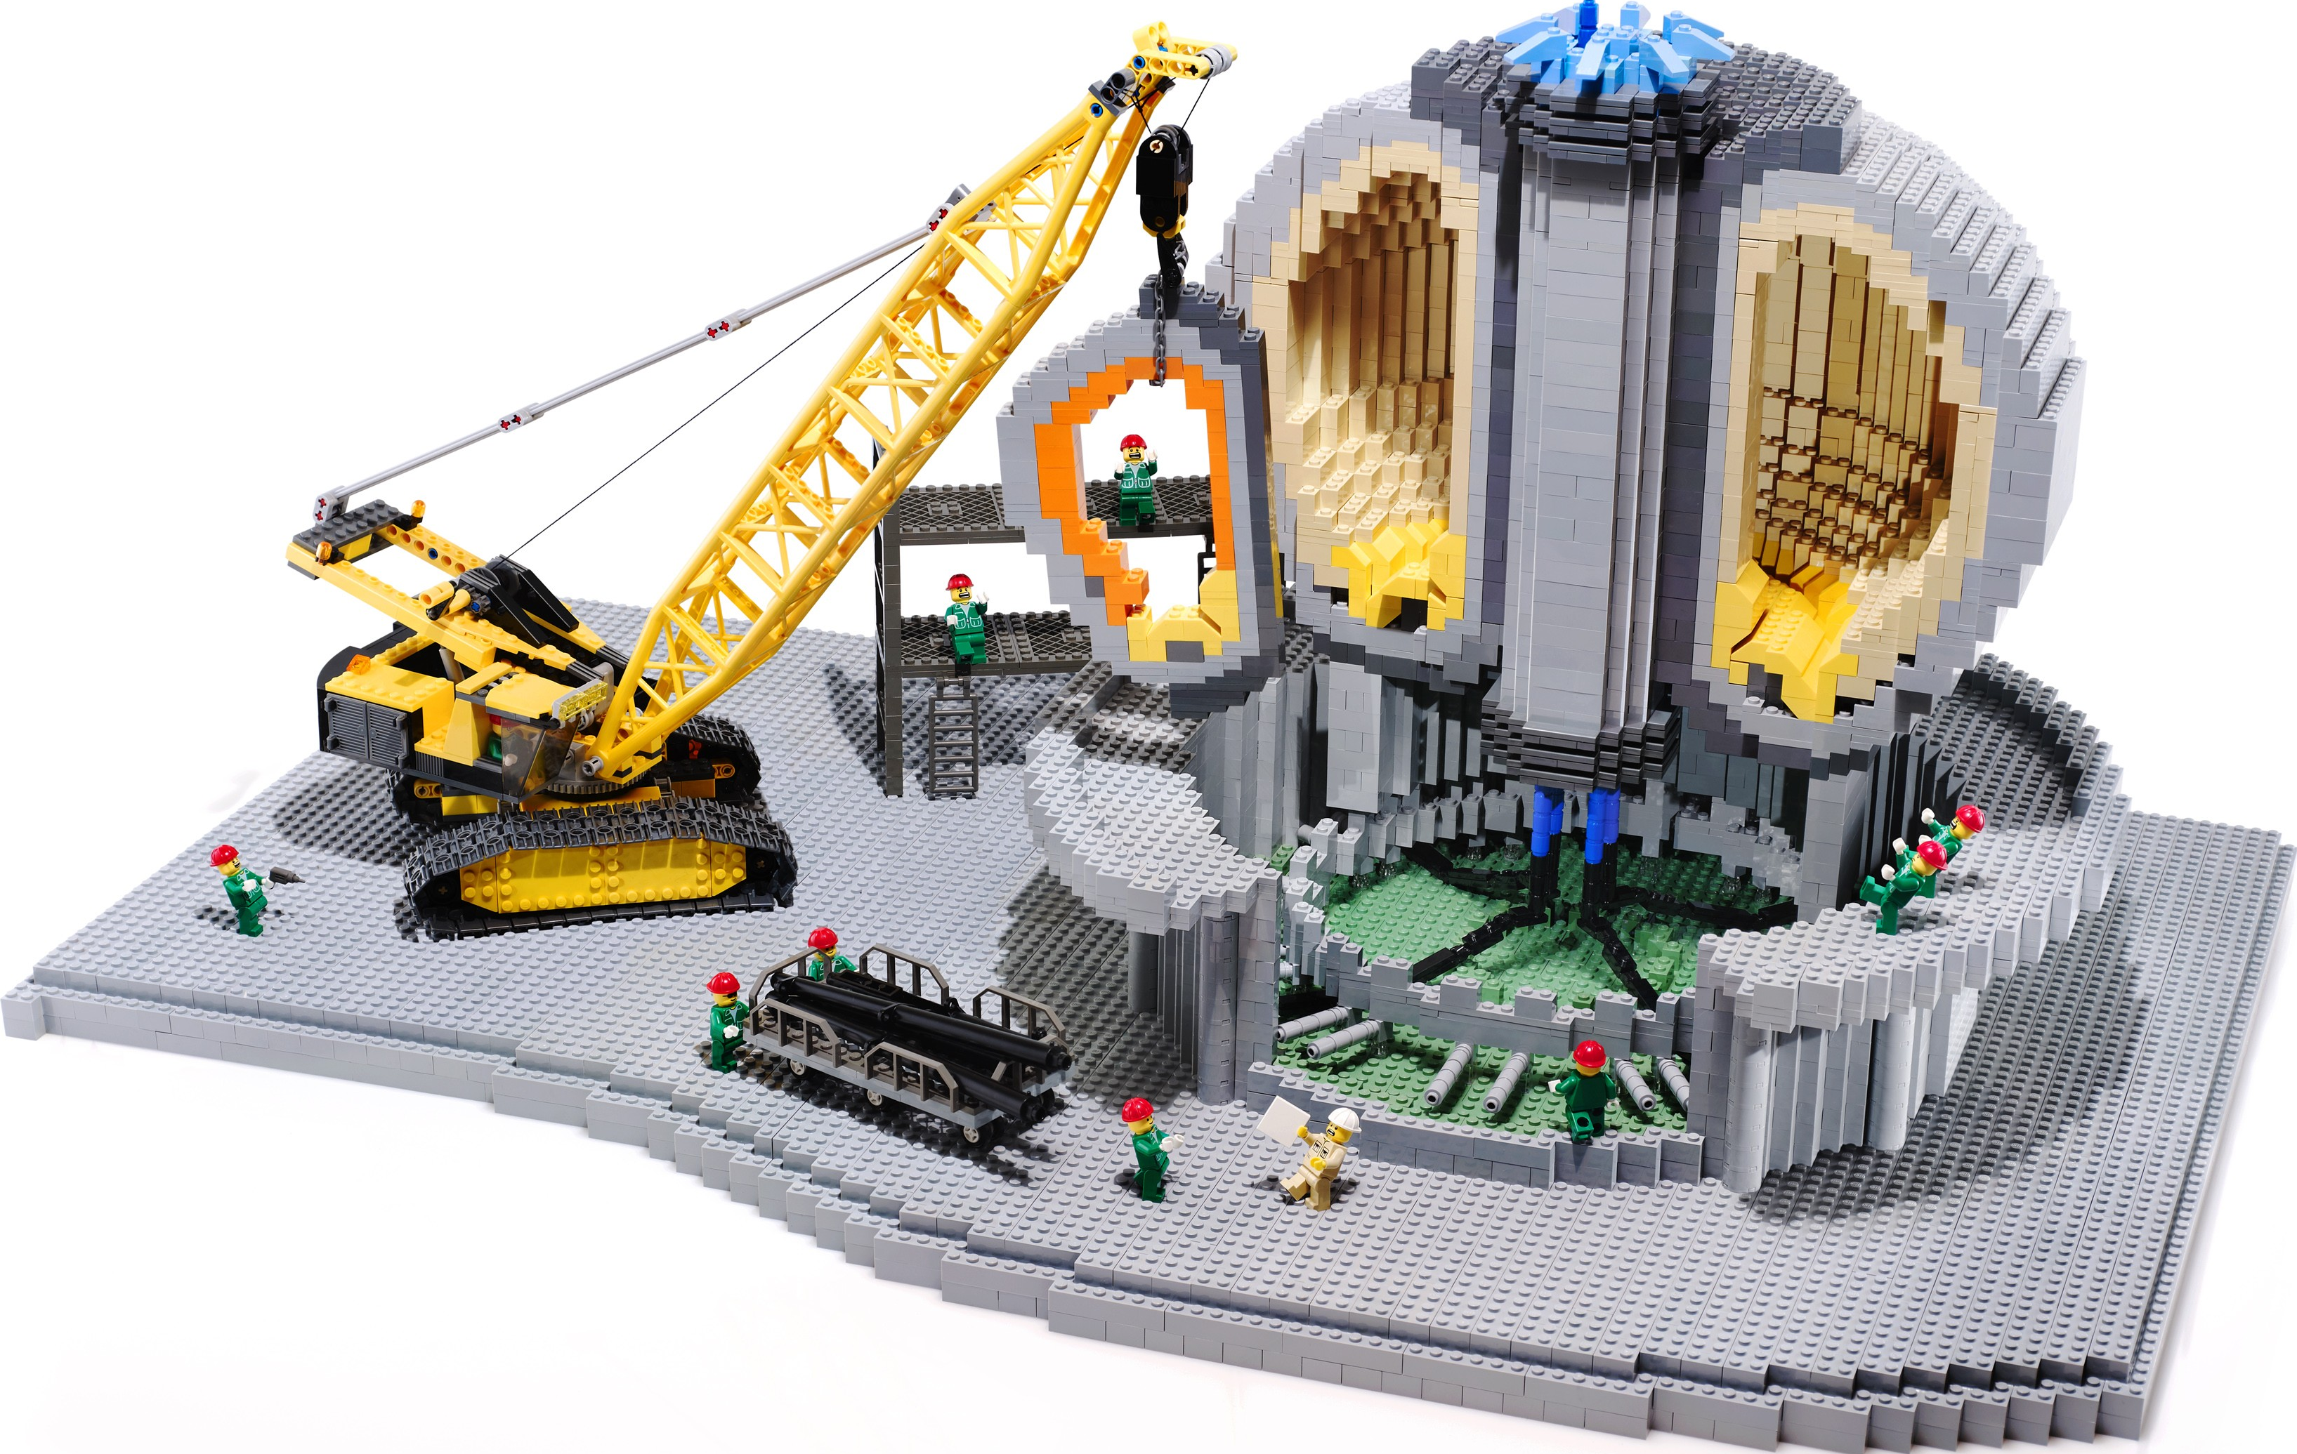
All the steps we take when we model an ITER plasma discharge
The goals of ITER: International Thermonuclear Experimental Reactor
Produce 500 MW of fusion power
Demonstrate integrated operation of technologies for a fusion power plant
Achieve a self-heated deuterium-tritium plasma
Test tritium breeding
Demonstrate safety of fusion devices
www.iter.org

Slide 47
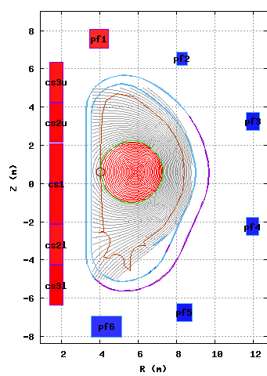

The first step is to get all coil currents and plasma shape right
A GOOD EQUILIBRIUM SOLVER
to evolve the plasma boundary in response to the plasma-coil coupling IS CRITICAL (= free boundary solver)
Heating & Current sources: analytic
Transport: semi-empirical, analytic
HIGH FIDELITY PHYSICS NOT NEEDED
Transformer source
of poloidal flux
Auxiliary
H&CD
External
momentum
Fuelling
& pumping
H
Actuators (external)
CD
Plasma (internal)
α-particle
heating
Bootstrap
current
P, T, n, v
profiles
Magnetic flux
diffusion
Conductivity
profiles
Heat, particle &
Momentum fluxes
Wall sources
and sinks
Transport coefficients
Turbulent & neoclassical
Notes:
Before running the movie describe what this is = let it go 5 seconds and then start talking

Slide 48
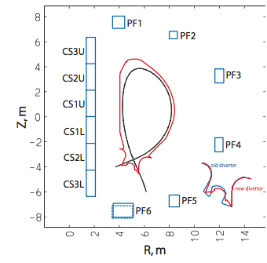
These simulations have been valuable to define and revise the ITER coil operational space and the plasma control capabilities
New poloidal field coils layout expands operational space:
Flattop burn duration
Operation with broader current profile
[C. Kessel et al, NF 49 (2009)]

Slide 49
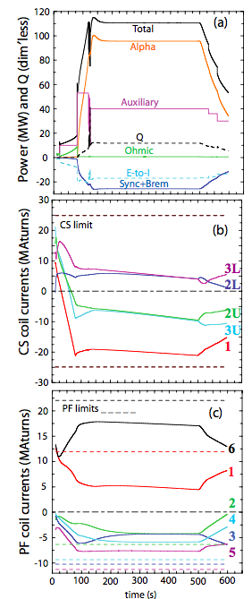
Simulations with simplified transport are designed to test engineering parameters, not to discuss physics
[T. Casper et al, NF 54 (2014)]
CORSICA
With assumptions on
transport, confinement to
satisfy target fusion power
Assessment of coil limits
Plasma termination is a critical area of ongoing research

Slide 50
Simulations with simplified transport do not inform on plasma dynamic response to external actuators and internal MHD stability
Can this plasma really achieve the target?
How additional physics constraints affect the results?

Slide 51
Physics-based models for thermal transport and current evolution can move the operational point away from target
TRANSP
alpha power P_{α} responds nonlinearly to
core transport and pedestal width and height
Alpha power (MW)
radiation (MW)
NB, IC, EC power (MW)
external power under feedback control
electron, ion temperature (keV)
global MHD stability included in evolution of temperature and current
current (MA)
Electron density (10¹⁹ m⁻³)
Plasma does not achieve the target of P_{α}=100MW
Notes:
“away from initial target”

Slide 52
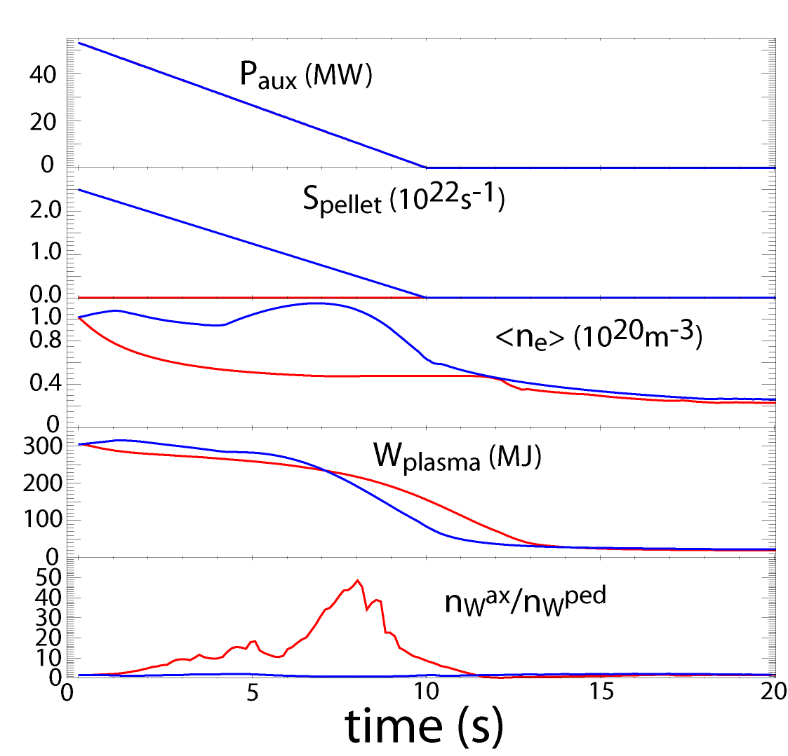
Simulations with fully integrated 2D edge transport plasma have indicated the importance of fueling during ITER plasma termination
JINTRAC
Pellet fueling at exit from H-mode needed to avoid accumulation of tungsten in the core
Model has been validated on JET, in dedicated ITER-like experiments.
A. Loarte IAEA-FEC (2016)
F. Koechl, NF 57 (2017)
w/o pellets
pellets
Time after start of ramp-down (s)
Notes:
Perhaps replace tags, e.g. Paux -> auxiliary power, Wplasma -> Plasma stored energy, nWax/nwped -> central accumulation of impurities, ...
Put labels “w/o and w pellets”
Big red arrow that points to Tungsten.
Be consistent in the references

Slide 53
The path forward to an all-inclusive tokamak simulator
Reduced models:
  from nonlinear 3D MHD stability
  for edge plasma turbulence induced transport
  for wave propagation in the Scrape-off-Layer
  for energetic particle induced transport
  Plasma startup (SNU, Univ. Kyoto)
Notes:
Simplify – “reduced models” only one

Slide 54
The path forward to an all-inclusive tokamak simulator
Reduced models from nonlinear 3D MHD stability
  Plasma response to external perturbations
  Disruptions (trigger)
  MHD instabilities (onset, control)
  global instabilities, like sawtooth cycle [CP11.00113]
Reduced models for edge plasma turbulence induced transport
Reduced models for wave propagation in the Scrape-off-layer
Reduced models for energetic particle induced transport
Notes:
List here what needs to be improved

Slide 55



Better models for prediction of plasma rotation needed for modeling plasma response to applied magnetic perturbations
3D
NB calculations
torque by high energy beam
Time dep.
1D transport
2D MHD equ.
Non-axysimmetric
MHD equilibrium
torque from non-axisymmetric applied magnetic field
Courtesy of N. Hayashi (QST)
M. Honda, NF 57 (2017)
Notes:
Torque from non-axisymmetric applied magnetic field

Slide 56
The path forward to an all-inclusive tokamak simulator
Reduced models from nonlinear 3D MHD stability
Reduced models for edge plasma turbulence induced transport
Reduced models for wave propagation in the Scrape-Off-Layer
Reduced models for energetic particle induced transport
Notes:
List here what needs to be improved

Slide 57
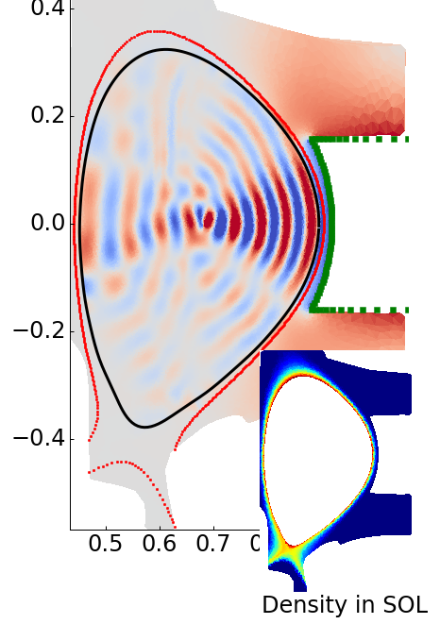
Hybrid approach to modeling of RF wave propagation is a promising avenue towards implementation in tokamak simulator
Core: Axisymmetric flux surface grid
  Hot plasma conductivity
  Dense Matrix Solver
Edge: Unstructured mesh with complicated geometry (either 2D or 3D)
  Cold plasma with collision.
Boundary: matching technique to build integrated solution
Would benefit from realistic model of SOL
S. Shiraiwa (PSFC) VI2.00003

Slide 58
The path forward to an all-inclusive tokamak simulator
Reduced models from nonlinear 3D MHD stability
Reduced models for edge plasma turbulence induced transport
Reduced models for wave propagation in the Scrape-off-layer
Reduced models for energetic particle induced transport
Notes:
List here what needs to be improved

Slide 59
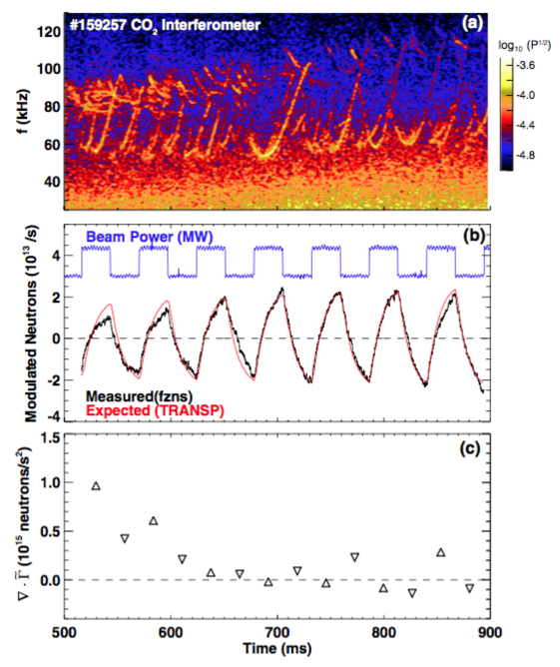
Fast particles can drive instabilities, like Alfvenic modes
[SciDAC project ISEP]
Instabilities eject fast particles (e.g. alphas)
  Decrease performance
  Cause localized losses and damage to wall
Challenges:
  Understand physics to develop scenarios not prone to instabilities
  Develop control tools to mitigate/suppress instabilities
C. Collins NF 57 (2017)

Slide 60
Experimental validation is critical

Slide 61
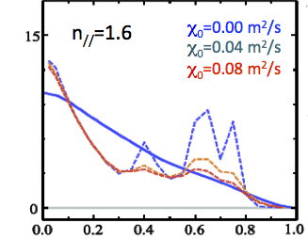
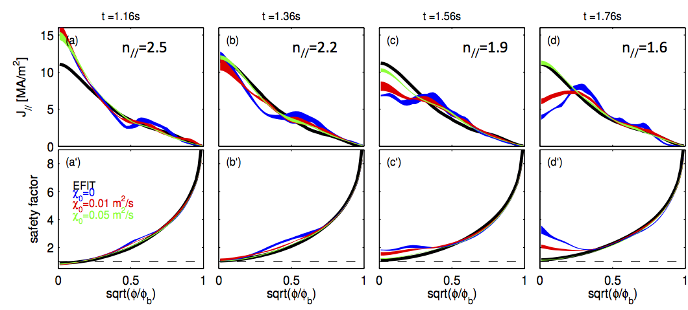
Time-dependent validation is critical for modeling of wave propagation in plasmas
J// [MA/m²]
GENRAY/CQL3D
D=0.00 m²/s
D=0.04 m²/s
D=0.08 m²/s
Standalone ray-tracing +Fokker-Planck solver
large off-axis current, not seen in experiments
J// [MA/m²]
D=0.00 m²/s
D=0.04 m²
D=0.08 m²/s
[R. Mumgaard, APS 2014)]
r/a
Time-dependent simulation
=> self-consistent evolution of wave field and magnetic equilibrium
[F. Poli, PPCF (2016)]
r/a
Notes:
Change title
Add labels: single time slice, time-dependent.
Add title to figure: “Parallel current density”
“... are critical to reproduce experimental measurements”
Perhaps split two long sentences into bullets?
Specify: standalone -> single time slice

Slide 62
Concluding remarks
Increasing computing capabilities allow to solve bigger problems
Efficient workflows allow to solve complex problems
The path forward for an all-inclusive tokamak simulator should focus on reduced models
Validation against experiments and verification against extreme scale calculations are critical to retain fidelity while reducing computational time

