Slide 1
Multi-Mode Plasma Response and Experimental Validation
by
Z.R. Wang¹,
with N.C. Logan¹, Y.Q. Liu²,
S. Munaretto², Y.W. Sun³, J.-K. Park¹, S. Gu³, J.M. Hanson⁴,
Q.M. Hu¹, T. Strait², and J.E. Menard¹
¹ Princeton Plasma Physics Laboratory
² General Atomics
³ ASIPP, China
⁴ Columbia University
Presented at the
60th Annual APS Meeting
Division of Plasma Physics
Portland, Oregon
November 5–9, 2018

Slide 2
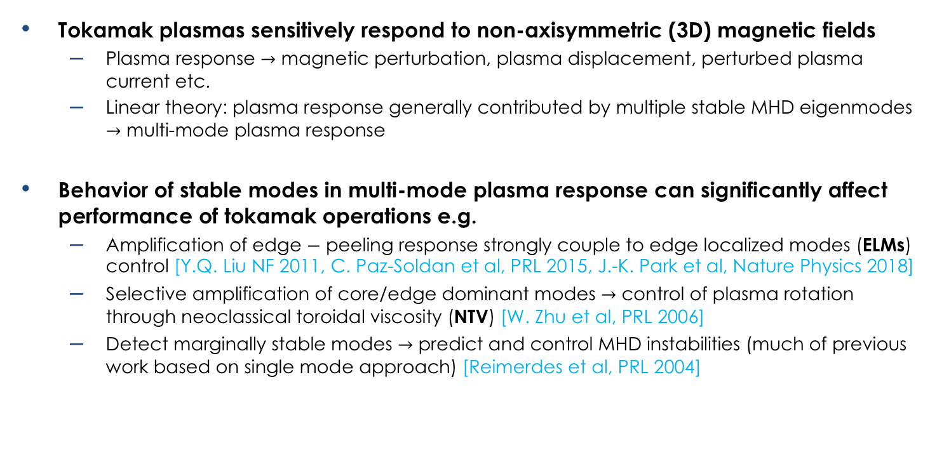
Understanding and Identifying Each Individual Eigenmode (Stability + Mode Structure) in Multi-Mode Plasma Response is Important for Tokamak Operation
Tokamak plasmas sensitively respond to non-axisymmetric (3D) magnetic fields
  Plasma response $→$ magnetic perturbation, plasma displacement, perturbed plasma current etc.
  Linear theory: plasma response generally contributed by multiple stable MHD eigenmodes $→$ multi-mode plasma response
Behavior of stable modes in multi-mode plasma response can significantly affect performance of tokamak operations e.g.
  Amplification of edge $−$ peeling response strongly couple to edge localized modes (ELMs) control [Y.Q. Liu NF 2011, C. Paz-Soldan et al, PRL 2015, J.-K. Park et al, Nature Physics 2018]
  Selective amplification of core/edge dominant modes $→$ control of plasma rotation through neoclassical toroidal viscosity (NTV) [W. Zhu et al, PRL 2006]
  Detect marginally stable modes $→$ predict and control MHD instabilities (much of previous work based on single mode approach) [Reimerdes et al, PRL 2004]

Slide 3
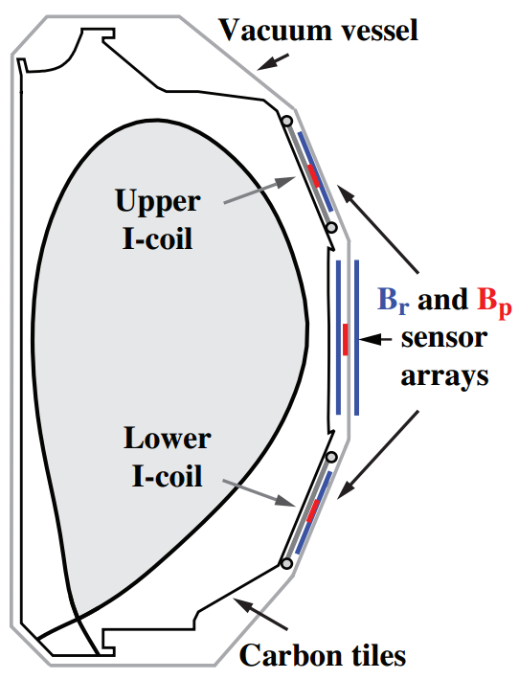
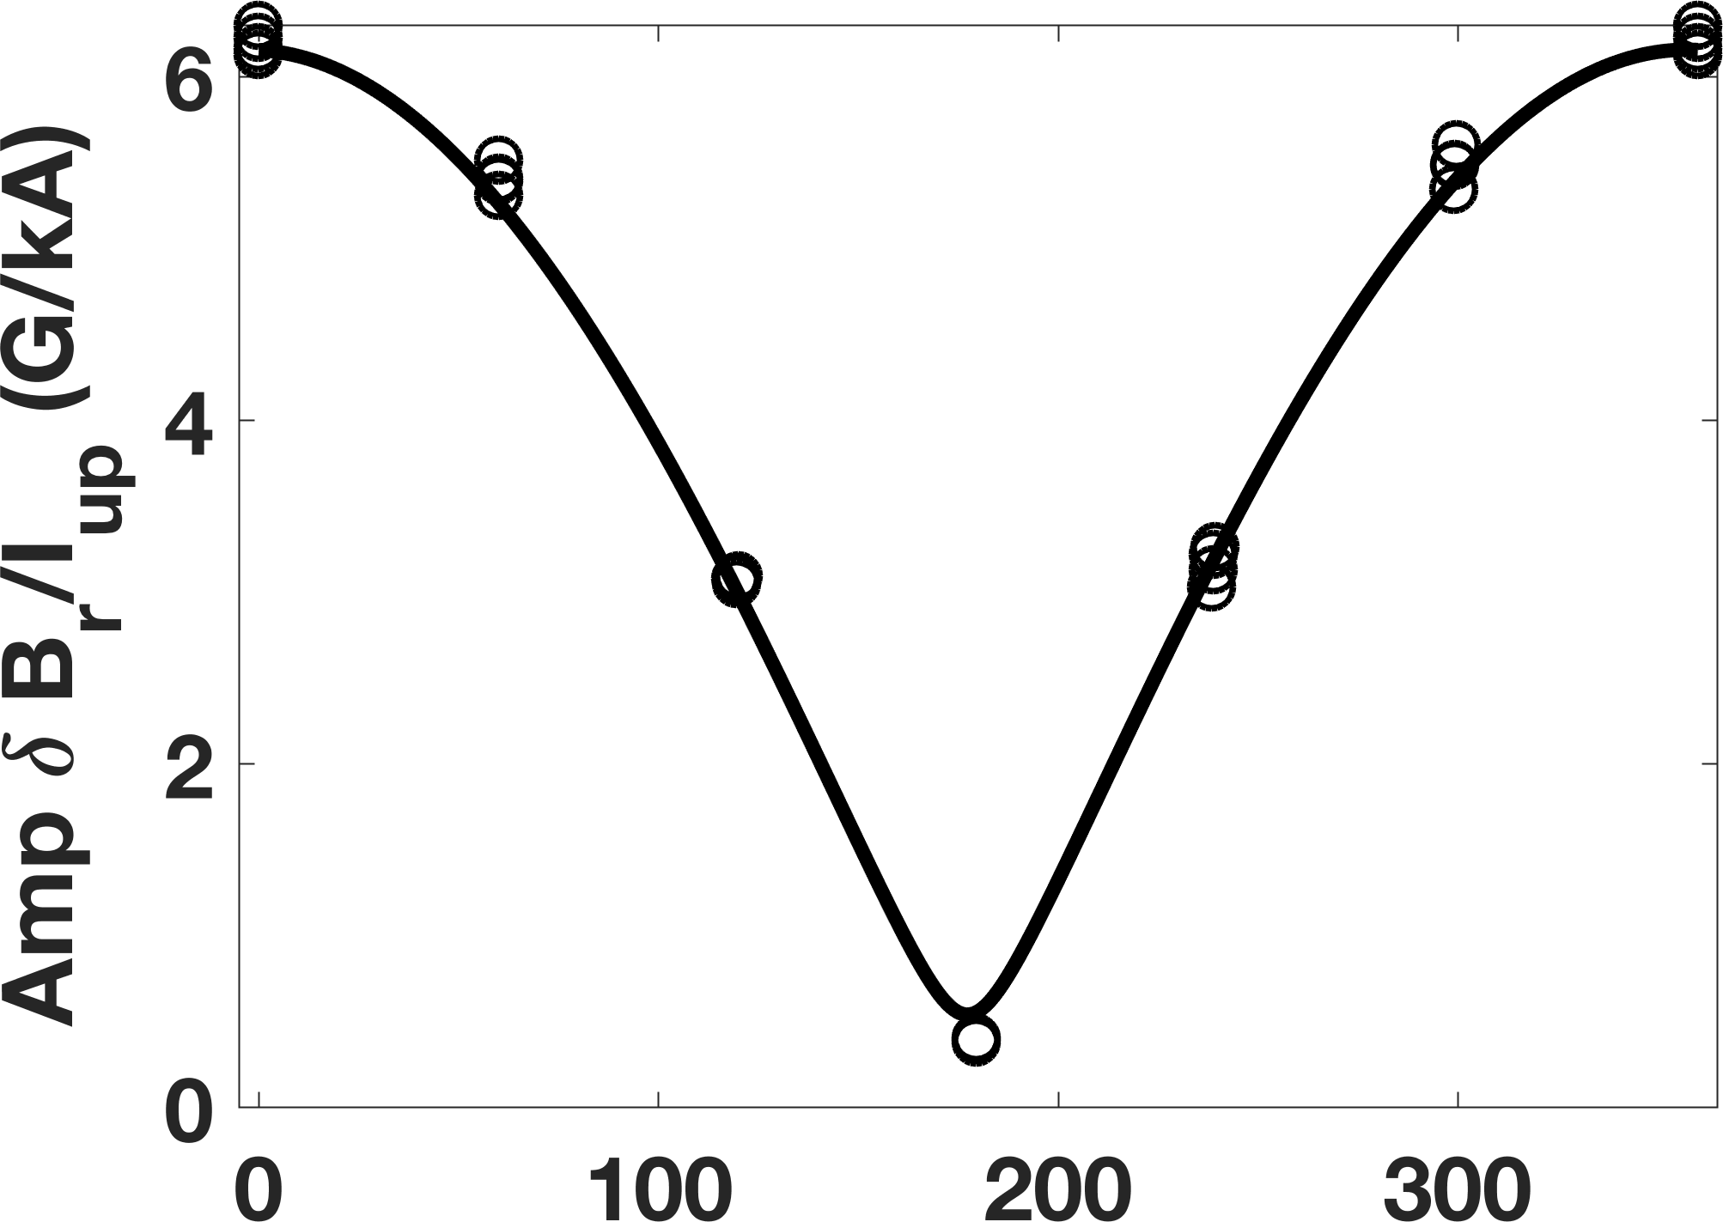
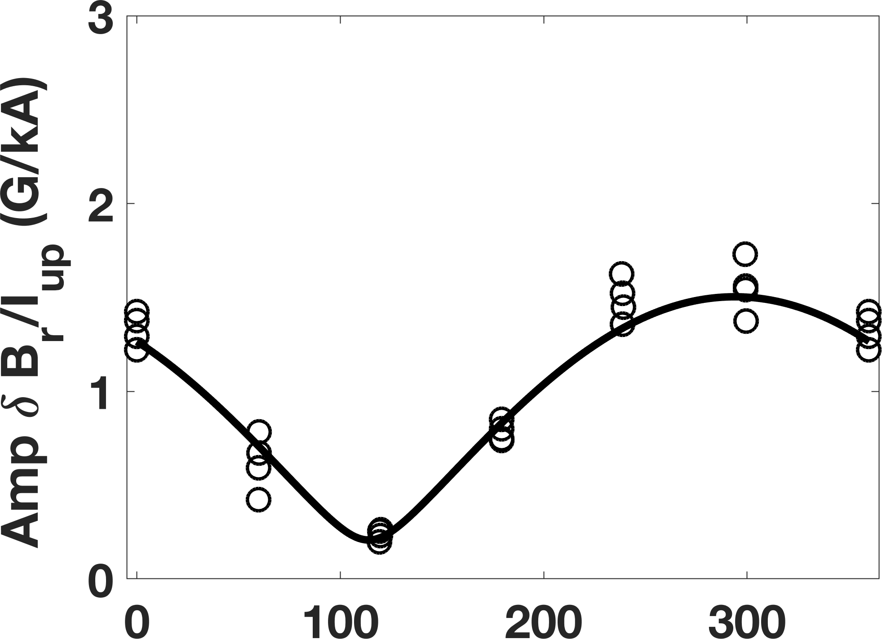




Understanding and Identifying Each Individual Eigenmode (Stability + Mode Structure) in Multi-Mode Plasma Response is Important for Tokamak Operation
Multi-mode plasma response has been qualitatively identified in DIII-D and EAST experiments.
C. Paz-Soldan et al, PRL 2015
N. Logan et al, Nucl. Fusion 2018
DIII-D n=1 plasma response
LFS $B_{r}$
o Exp.
How many dominant modes contribute to multi-mode plasma response?
How about stability and behavior of dominant modes in multi-mode plasma response?
$$B_{r}$$
Sensor
arrays
HFS
LFS
$$Δφ=180 deg$$
HFS $B_{r}$
Multi-mode response
Multi-pole transfer function model is developed to reveal characters of stable dominant modes.
$$Δφ=110 deg$$
$$Δφ=φ_{up}−φ_{low}$$

Slide 4

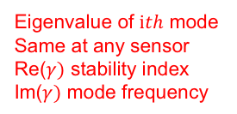


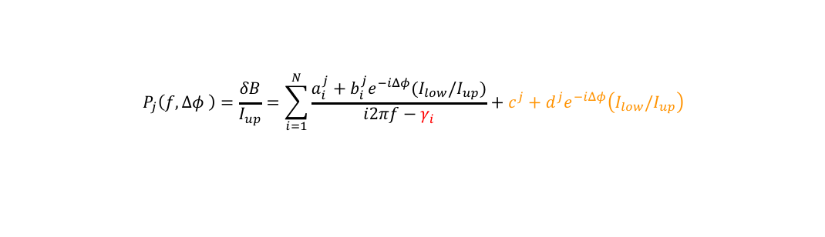



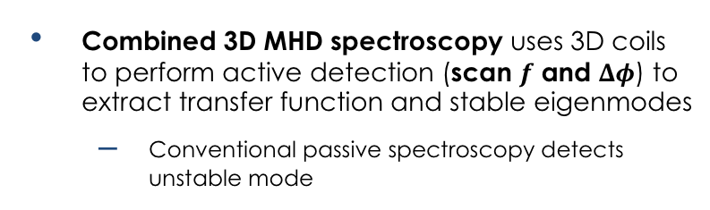



Multi-Pole Response Transfer Function is Developed to Extract Stable MHD Eigenmodes from Plasma Response
Multi-pole transfer function on 3D magnetic sensor measurement is systematically developed from generalized linear-MHD equation:
Represent dominant eigenmodes
$$P_{j}\left(f,Δφ \right)=\frac{δB}{I_{up}}=\sum_{i=1}^{N}{\frac{a_{i}^{j}+b_{i}^{j}e^{−iΔφ}(I_{low}/I_{up})}{i2πf−γ_{i}}+c^{j}+d^{j}e^{−iΔφ}\left(I_{low}/I_{up}\right)}$$
$f$: coil frequency
Measured response at $jth$ 3D sensor
$$Δφ\text{=}φ_{low}−φ_{up}$$
Coupling between coil and mode at $jth$ sensor
Eigenvalue of $ith$ mode
Same at any sensor
Re($γ)$ stability index
Im($γ)$ mode frequency
Residual of vacuum response when $|f|→∞$
DIII-D n=1 plasma response
LFS $B_{r}$
o Exp.
Combined 3D MHD spectroscopy uses 3D coils to perform active detection (scan $f$ and $Δφ$) to extract transfer function and stable eigenmodes
  Conventional passive spectroscopy detects unstable mode
$$B_{r}$$
Sensor
arrays
$$Δφ=180 deg$$
HFS
LFS
HFS $B_{r}$
Multi-mode response
$$Δφ=110 deg$$
$$Δφ=φ_{up}−φ_{low}$$

Slide 5
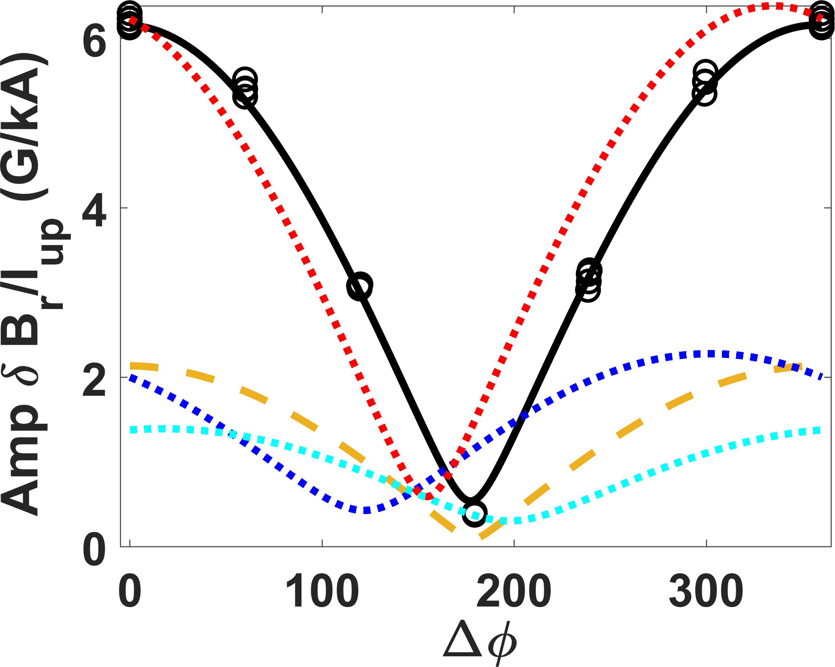
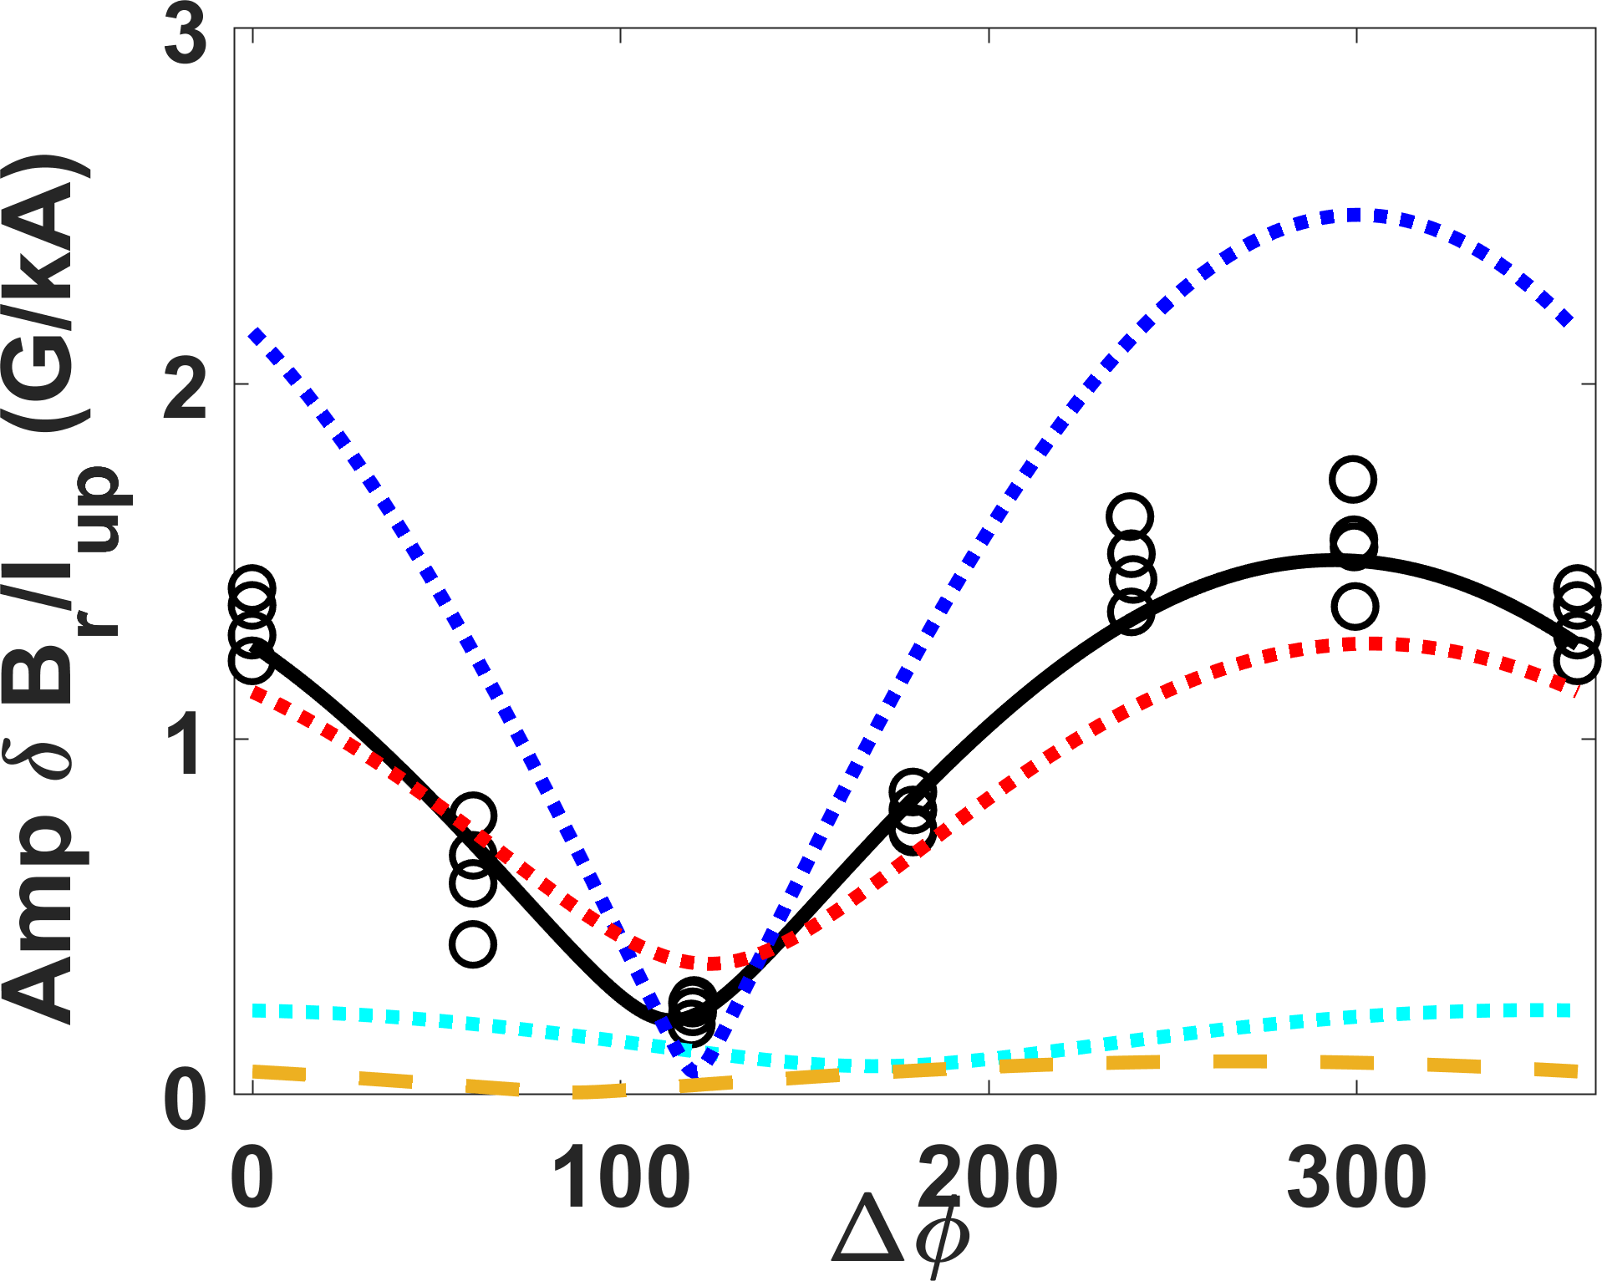




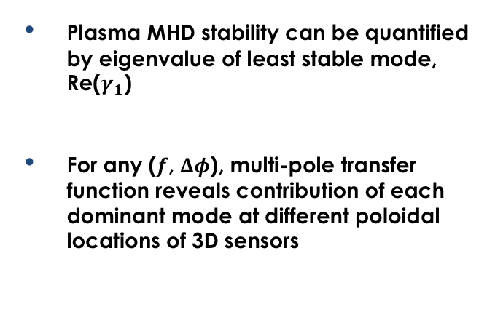



Multi-Pole Response Transfer Function Extracted from Experimental Data Reveals Three Dominant n=1 Modes in DIII-D Experiments
Multi-pole transfer function at 3D sensor is extracted in DIII-D experiments (Shot No. 170195-170220):
$$P_{j}\left(f,Δφ \right)= \frac{a_{1}^{j}+b_{1}^{j}e^{−iΔφ}}{i2πf−γ_{1}} + \frac{a_{2}^{j}+b_{2}^{j}e^{−iΔφ}}{i2πf−γ_{2}} + \frac{a_{3}^{j}+b_{3}^{j}e^{−iΔφ}}{i2πf−γ_{3}} + c^{j}+d^{j}e^{−iΔφ}\left(I_{low}/I_{up}\right)\text{,} Δφ\text{=}φ_{low}−φ_{up},\frac{I_{low}}{I_{up}}=1$$
$γ_{1}$ = – 85.32 – 23.12i rad/s
$γ_{2}$ = $−199.93−46.62i$ rad/s
$γ_{3}$ = $−277.72−181.33i$ rad/s
n=1 Transfer function extracted in DIII-D experiment
P($Δφ,f=−10Hz$)
LFS $B_{r}$
Plasma MHD stability can be quantified by eigenvalue of least stable mode, Re($γ_{1}$)
For any ($f$, $Δφ$), multi-pole transfer function reveals contribution of each dominant mode at different poloidal locations of 3D sensors
o Exp.
2nd mode
1st mode
Vacuum
$B_{r}, B_{p}$
Sensor
arrays
HFS
LFS
3rd mode
HFS $B_{r}$

Slide 6
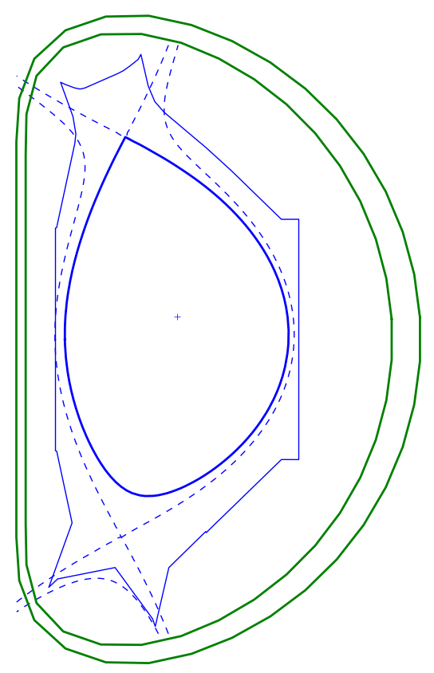
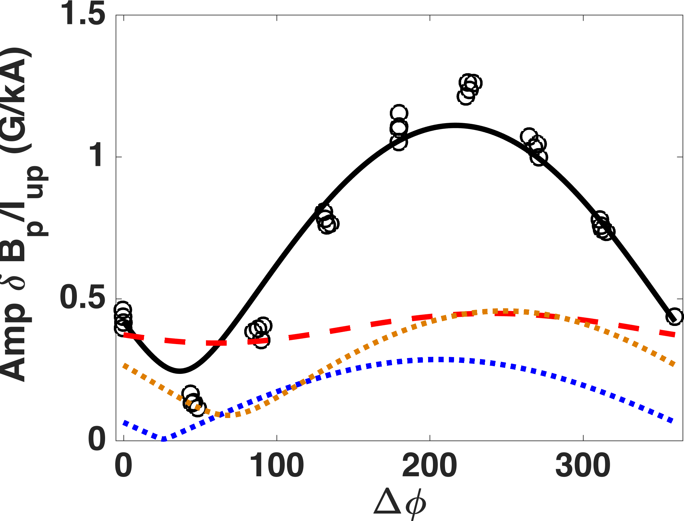
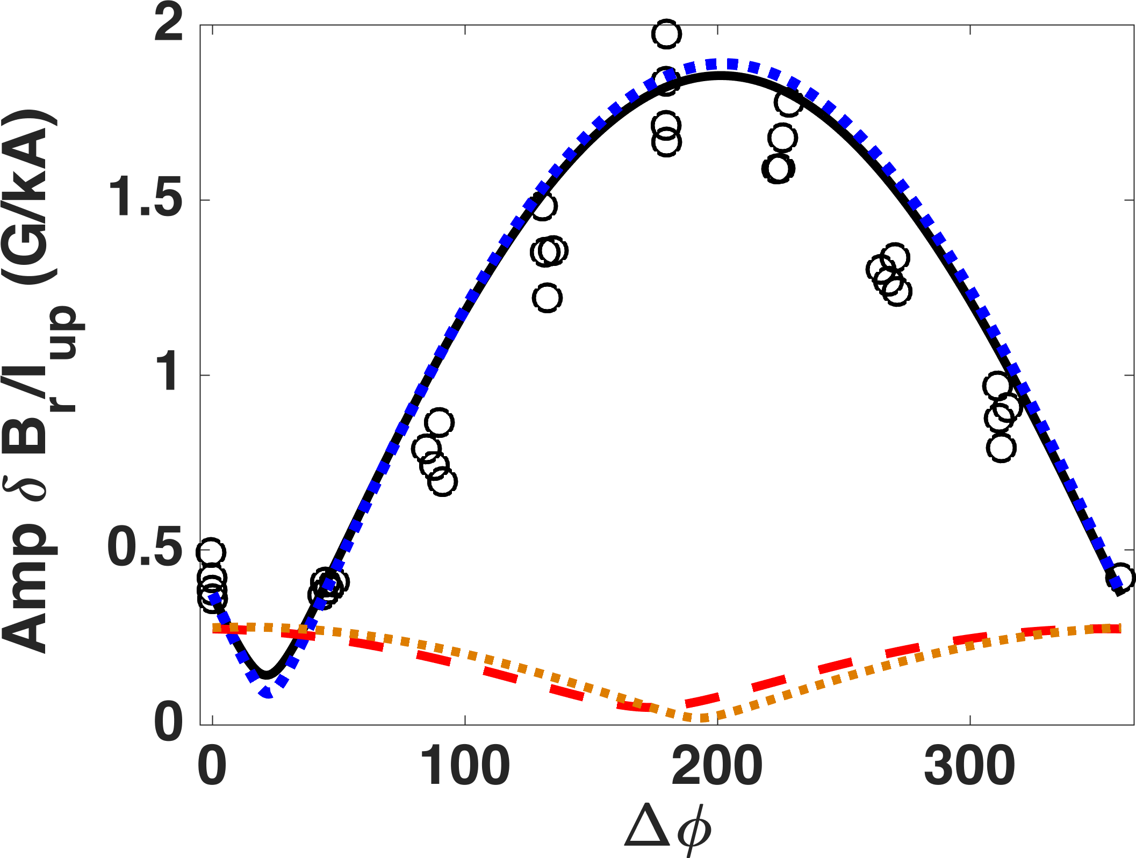






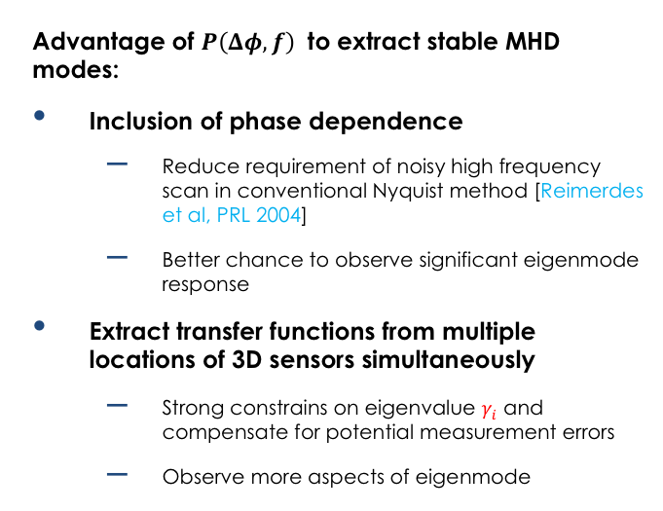


Multi-Mode Response Analysis for EAST Experiments Identifies Two Dominant n=1 Contributions
Experimental transfer function indicates two dominant eigenmodes in EAST experiment (shot No. 70617-70633):
$$P_{j}\left(f,Δφ \right)= \frac{a_{1}^{j}+b_{1}^{j}e^{−iΔφ}}{i2πf−γ_{1}} + \frac{a_{2}^{j}+b_{2}^{j}e^{−iΔφ}}{i2πf−γ_{2}} + c^{j}+d^{j}e^{−iΔφ}\left(I_{low}/I_{up}\right)\text{,} Δφ\text{=}φ_{low}−φ_{up},\frac{I_{low}}{I_{up}}=1$$
$γ_{1}$ = – 66.65 +0.06i rad/s
$γ_{2}$ = $−917.35−108.19i$ rad/s
n=1 Transfer function extracted in EAST experiment
Advantage of $P\left(Δφ,f\right)$ to extract stable MHD modes:
Inclusion of phase dependence
  Reduce requirement of noisy high frequency scan in conventional Nyquist method [Reimerdes et al, PRL 2004]
  Better chance to observe significant eigenmode response
Extract transfer functions from multiple locations of 3D sensors simultaneously
  Strong constrains on eigenvalue $γ_{i}$ and compensate for potential measurement errors
  Observe more aspects of eigenmode
P($Δφ,f=10Hz$)
o Exp.
LFS $B_{p}$
Upper coil
Amp $δB_{p}/I_{up}(G/kA$)
2nd mode
1st mode
Vacuum
Lower coil
LFS $B_{r}$
Amp $δB_{r}/I_{up}(G/kA$)

Slide 7
Outline
Theory of multi-mode plasma response model
Detection of n=1 modes in stable DIII-D plasma
Multi-mode plasma response model helps to understand n=2 mode locking in L-mode DIII-D plasma

Slide 8
Outline
Theory of multi-mode plasma response model
Detection of n=1 modes in stable DIII-D plasma
Multi-mode plasma response model helps to understand n=2 mode locking in L-mode DIII-D plasma

Slide 9








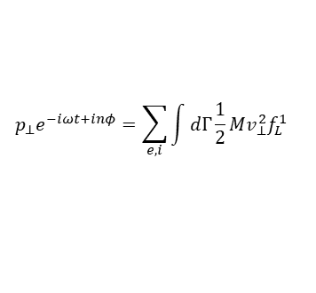




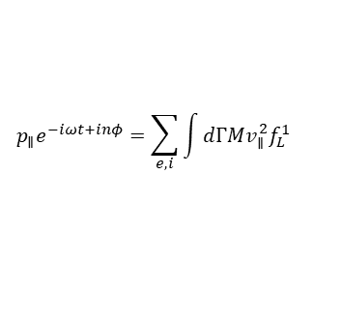










Multi-Mode Plasma Response Model is Systematically Derived From Generic Linear MHD Formulation
Linearized MHD equations including non-ideal effects
Any perturbations have form
$∂/∂t→γ$ eigenvalue
$$x(ψ,θ,φ)=x^{m}(ψ)e^{γt+imθ+inφ}$$
$$γ\vec{ξ}=−inΩ\vec{ξ}+\vec{v}+\left(\vec{ξ}⋅∇Ω\right)R^{2}∇ϕ$$
$$γ\vec{v}=−inΩ\vec{v}−ρ^{−1}∇⋅[\vec{ξ}⋅∇P_{0}\overset{⃡}{I}+p_{∥}\vec{b}\vec{b}+p_{⊥}(\overset{⃡}{I}−\vec{b}\vec{b})]+ρ^{−1}(∇×\vec{b})×{\vec{B}}_{0}+ρ^{−1}{\vec{J}}_{0}×\vec{b}+\left[2Ω\hat{Z}×\vec{v} −\left(\vec{v}⋅∇Ω \right)R^{2}\vec{∇}ϕ\right]−ρ^{−1}∇⋅\left(ρ\vec{ξ}\right)Ω\hat{Z}×{\vec{V}}_{0}$$
$γ\vec{b}=−inΩ\vec{b}+∇×\left(\vec{v}×{\vec{B}}_{0}\right)+\left(∇×\vec{b}⋅∇Ω\right)R^{2}∇ϕ−∇×(η∇×\vec{b}$)
Resistive term
Resistive wall
Vacuum
Kinetic pressure $p_{∥}$ and $p_{⊥}$
$$γb^{ψ}=\frac{d}{τ_{w}}\left(\left|∇ψ\right|Δ\frac{∂b^{ψ}}{∂ψ}−Δb^{θ}\frac{\left|∇ψ\right|}{∂θ}\right)$$
$$∇×\vec{b}=0$$
$$∇⋅\vec{b}=0$$
$$p_{∥}e^{−iωt+inφ}=\sum_{e,i}{\int{dΓMv_{∥}^{2}f_{L}^{1}}}$$
$$p_{⊥}e^{−iωt+inφ}=\sum_{e,i}{\int{dΓ\frac{1}{2}Mv_{⊥}^{2}f_{L}^{1}}}$$
$b^{1}=\vec{b}⋅∇ψ$ ,$Δ$ ~ wall jump
Y.Q. Liu et al, PoP 2008
Discretization of computation domain
$$X_{1}^{M}$$
$$⋯$$
$$X_{i}^{M}$$
$$⋯$$
$$X_{L}^{M}$$
Discretize $ψ$ direction
$$\vec{X} (ψ,θ) ={\left(\vec{ξ} (ψ,θ)\text{,}\vec{v} (ψ,θ)\text{,}\vec{b}(ψ,θ)\right)}^{T}$$
Fourier transformation
of $θ$ (poloidal direction)
$$ψ^{1}$$
$$⋯$$
$$ψ^{i}$$
$$⋯$$
$$ψ^{L}$$
Only in plasma domain
$$X_{N×1}={\left(X_{1}^{M},⋯,X_{i}^{M},⋯,X_{L}^{M}\right)}^{T}$$
$$X_{i}^{M}={\left({\vec{ξ}}_{i}^{M}\text{,}{\vec{v}}_{i}^{M}\text{,}{\vec{b}}_{i}^{M}\right)}^{T}$$

Slide 10


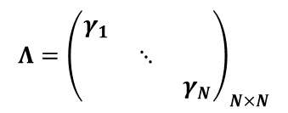
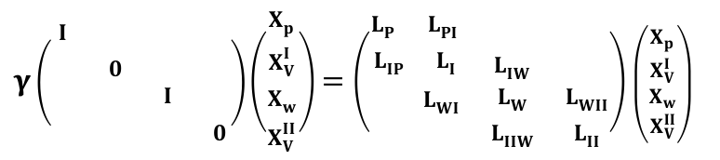






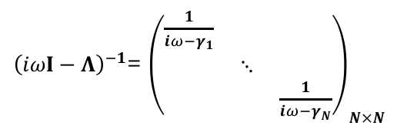


Multi-Mode Plasma Response Model is Systematically Derived From Generic Linear MHD Formulation
Matrix form of equations
$A: N×N$ full rank matrix
$$X_{N×1}={\left(X_{1}^{M},⋯,X_{i}^{M},⋯,X_{L}^{M}\right)}^{T}$$
$$γIX=AX$$
Vacuum transformation
between two surfaces
plasma
$γ\left(\begin{matrix}\begin{matrix}I & \end{matrix} & & \\ \begin{matrix} & 0\end{matrix} & & \\ \begin{aligned}\begin{matrix} & \end{matrix} \\ \begin{matrix} & \end{matrix}\end{aligned} & \begin{aligned}I \\ \end{aligned} & \begin{aligned} \\ 0\end{aligned}\end{matrix}\right)\left(\begin{matrix}X_{p} \\ \begin{aligned}X_{V}^{I} \\ X_{w} \\ X_{V}^{II}\end{aligned}\end{matrix}\right)=\left(\begin{matrix}\begin{matrix}L_{P} & L_{PI}\end{matrix} & & \\ \begin{matrix}L_{IP} & L_{I}\end{matrix} & L_{IW} & \\ \begin{aligned}\begin{matrix} & L_{WI}\end{matrix} \\ \begin{matrix} & \end{matrix}\end{aligned} & \begin{aligned}L_{W} \\ L_{IIW}\end{aligned} & \begin{aligned}L_{WII} \\ L_{II}\end{aligned}\end{matrix}\right)$ $\left(\begin{matrix}X_{p} \\ \begin{aligned}X_{V}^{I} \\ X_{w} \\ X_{V}^{II}\end{aligned}\end{matrix}\right)$
$$A=QΛQ^{−1}$$
vacuum
$${\vec{b}}_{s1}^{M}=T{\vec{b}}_{s2}^{M}$$
Eigenvalue matrix
wall
Reduce
vacuum equations
$$Λ={\left(\begin{matrix}γ_{1} & & \\ & ⋱ & \\ & & γ_{N}\end{matrix}\right)}_{N×N}$$
vacuum
3D Coil equations and inhomogeneous plasma response equations
$$γIX=QΛQ^{−1}X$$
coil frequency
$$γ=iω=i2πf$$
Upper and lower coils
$$Q(iωI−Λ)Q^{−1}X=J^{up}I_{up}e^{iφ_{up}}+J^{low}I_{low}e^{iφ_{low}}$$
$$∇×\vec{b}={\vec{j}}_{coil}$$
$$∇⋅{\vec{j}}_{coil}=0$$
$J_{N×1}^{up}{I_{up}e}^{iφ_{up}}$, $J_{N×1}^{low}{I_{low}e}^{iφ_{low}}$
${\left(iωI−Λ\right)}^{−1}$= ${\left(\begin{matrix}\frac{1}{iω−γ_{1}} & & \\ & ⋱ & \\ & & \frac{1}{iω−γ_{N}}\end{matrix}\right)}_{N×N}$
$$X=Q^{−1}{\left(iωI−Λ\right)}^{−1}{Q(J}^{up}{I_{up}e}^{iφ_{up}}+J^{low}{I_{low}e}^{iφ_{low}})$$

Slide 11
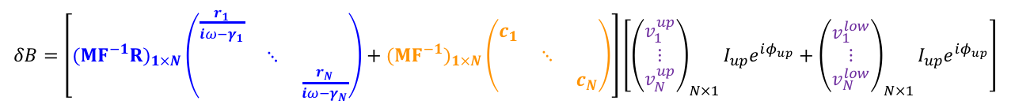





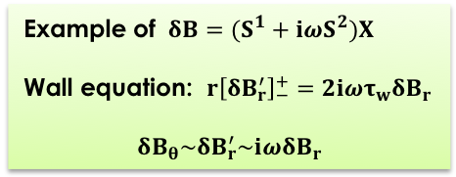
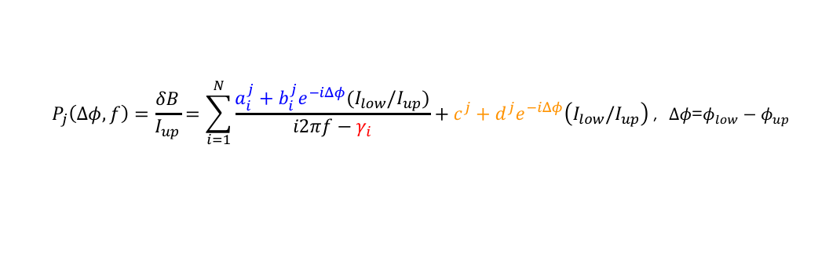
Multi-Mode Plasma Response Model is Systematically Derived From Generic Linear MHD Formulation
$$X_{N×1}={Q{\left(iωI−Λ\right)}^{−1}Q}^{−1}{(J}^{up}I_{up}e^{iφ_{up}}+J^{low}I_{low}e^{iφ_{low}})$$
Example of $δB=(S^{1}+iωS^{2})X$
Wall equation: $r{\left[δB_{r}^{′}\right]}_{−}^{+}=2iωτ_{w}δB_{r}$
$$δB_{θ}\sim δB_{r}^{′}\sim iωδB_{r}$$
$δB=\left(S^{1}+iωS^{2}\right)TX$: sensor surface
Plasma mode - Coil coupling
$$δB=(R{\left(iωI−Λ\right)}^{−1}+C)({Q^{−1}J}^{up}I_{up}e^{iφ_{up}}+Q^{−1}J^{low}I_{low}e^{iφ_{low}})$$
Vacuum-Coil coupling $ω→∞$
$F_{N×N}^{−1}$: inverse Fourier transformation
$M_{1×N}$: sensor measurement
$δB=$ $\left[(MF^{−1}{R)}_{1×N}\left(\begin{matrix}\frac{r_{1}}{iω−γ_{1}} & & \\ & ⋱ & \\ & & \frac{r_{N}}{iω−γ_{N}}\end{matrix}\right)+(MF^{−1})_{1×N}\left(\begin{matrix}c_{1} & & \\ & ⋱ & \\ & & c_{N}\end{matrix}\right)\right]\left[{\left(\begin{matrix}v_{1}^{up} \\ ⋮ \\ v_{N}^{up}\end{matrix}\right)}_{N×1}I_{up}e^{iφ_{up}}+{\left(\begin{matrix}v_{1}^{low} \\ ⋮ \\ v_{N}^{low}\end{matrix}\right)}_{N×1}I_{up}e^{iφ_{up}}\right]$
Sensor transfer function including coil frequency $ω=2πf$ and phasing $Δφ$ :
Mode-Coil coupling
$$P_{j}\left(Δφ,f\right)=\frac{δB}{I_{up}}=\sum_{i=1}^{N}{\frac{a_{i}^{j}+b_{i}^{j}e^{−iΔφ}(I_{low}/I_{up})}{i2πf−γ_{i}}+c^{j}+d^{j}e^{−iΔφ}\left(I_{low}/I_{up}\right)}\text{,} Δφ\text{=}φ_{low}−φ_{up}$$
mode eigenvalue
(same for each sensor)
Residual of vacuum response when $f→∞$

Slide 12
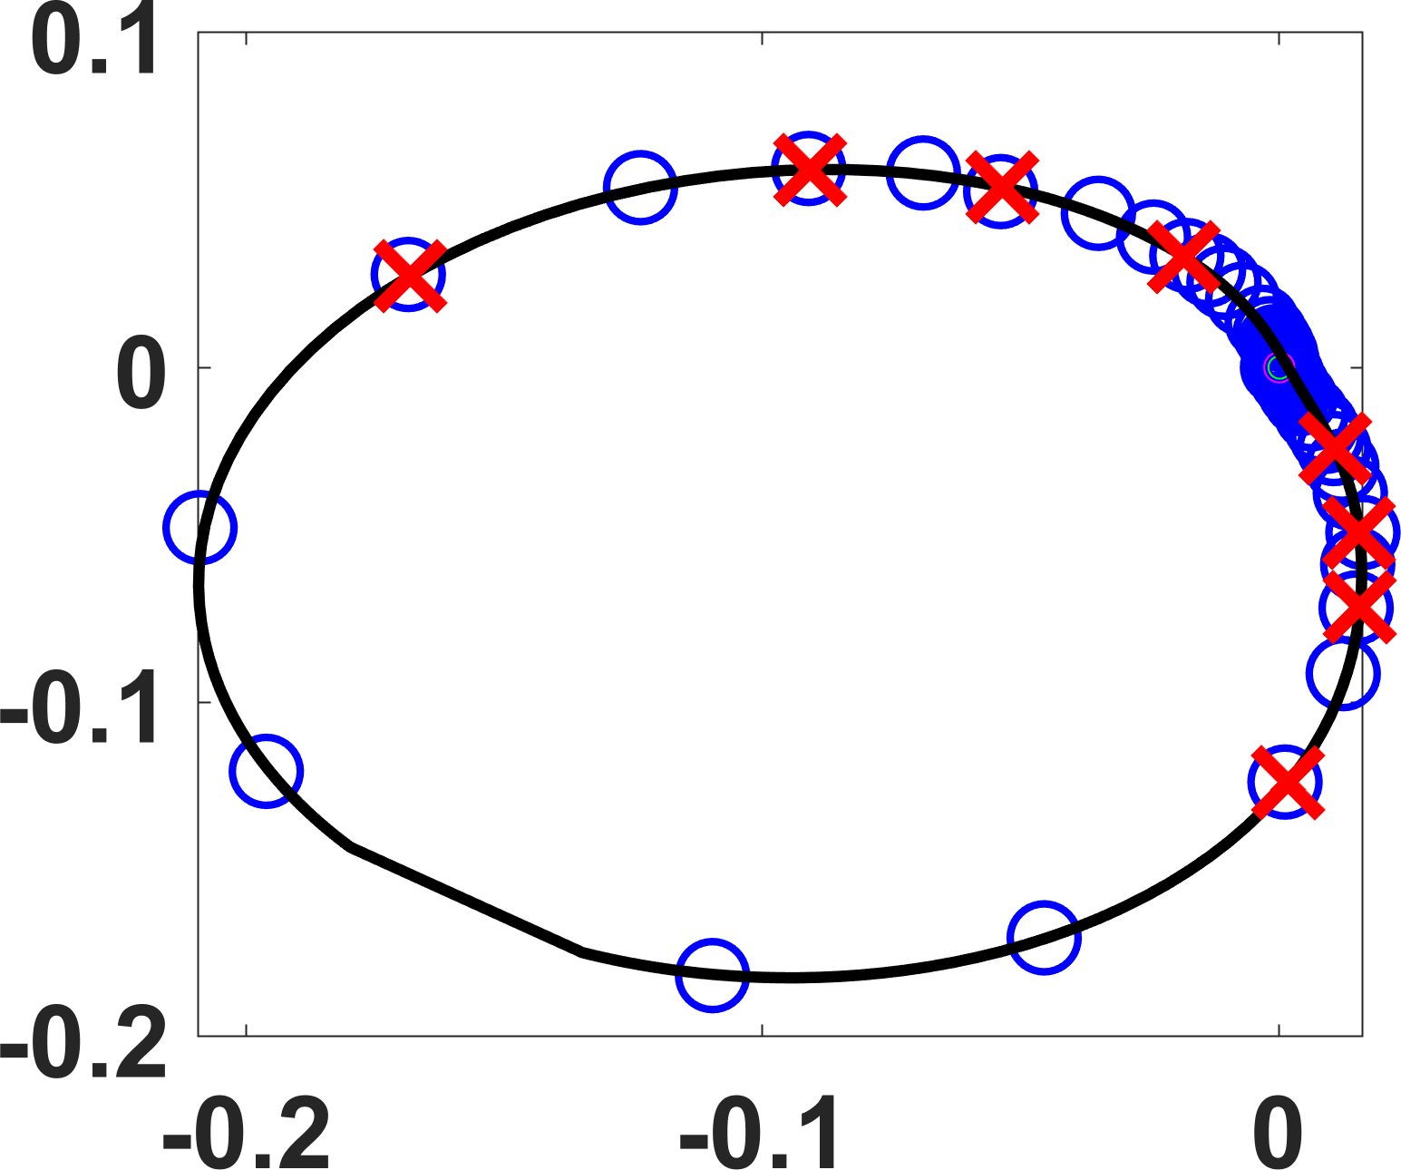
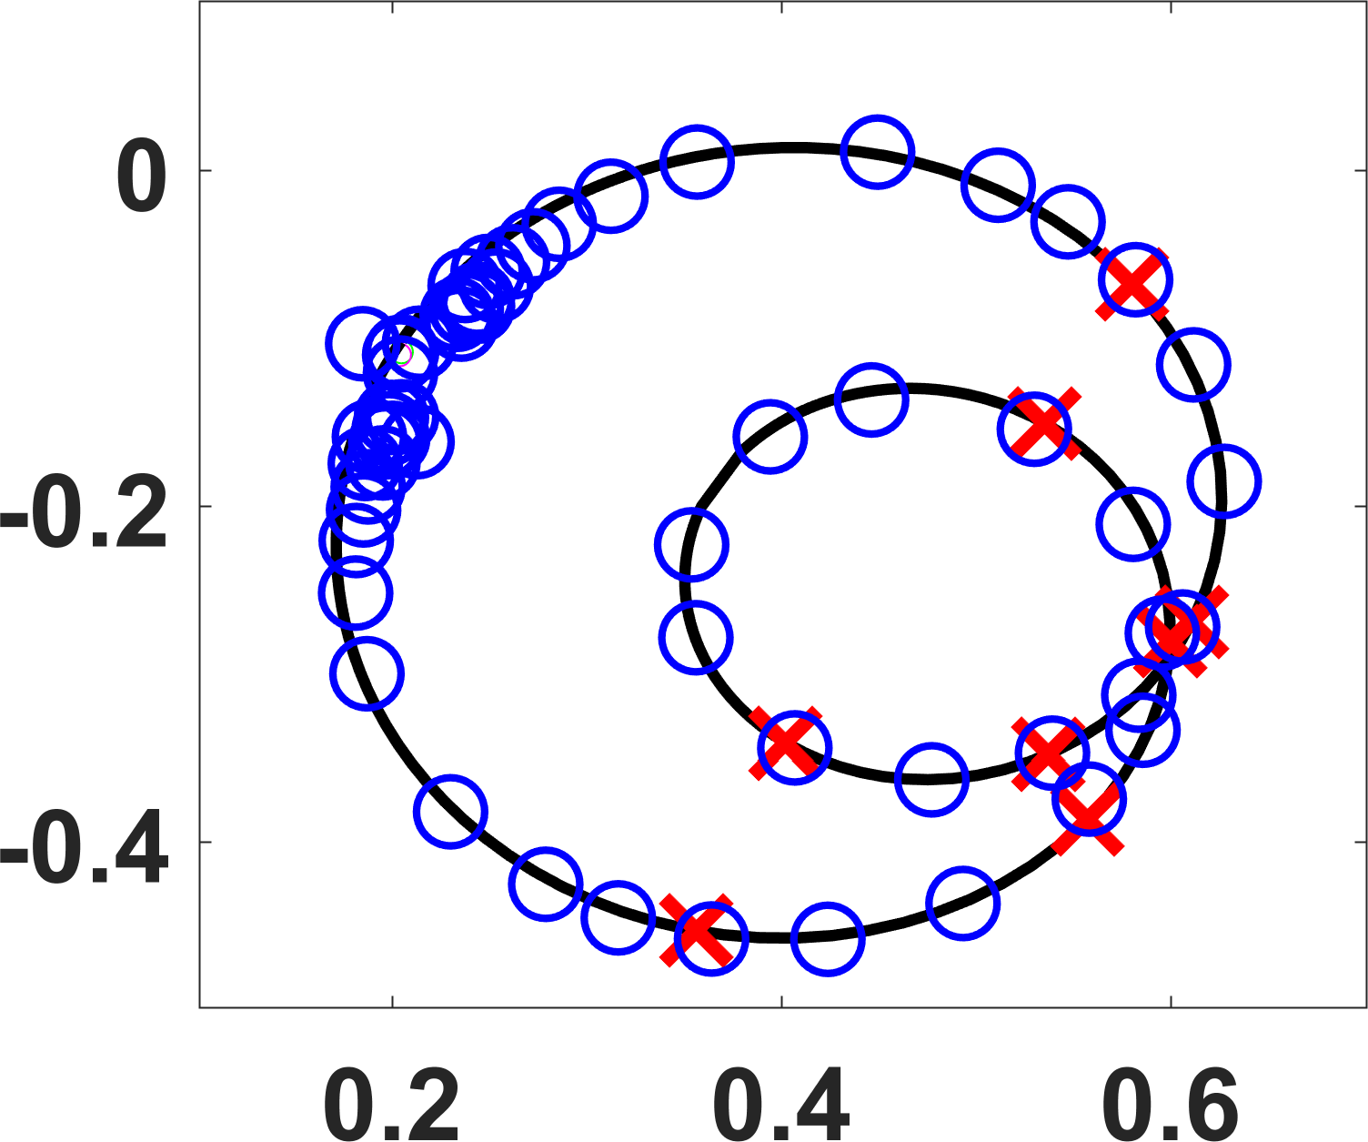


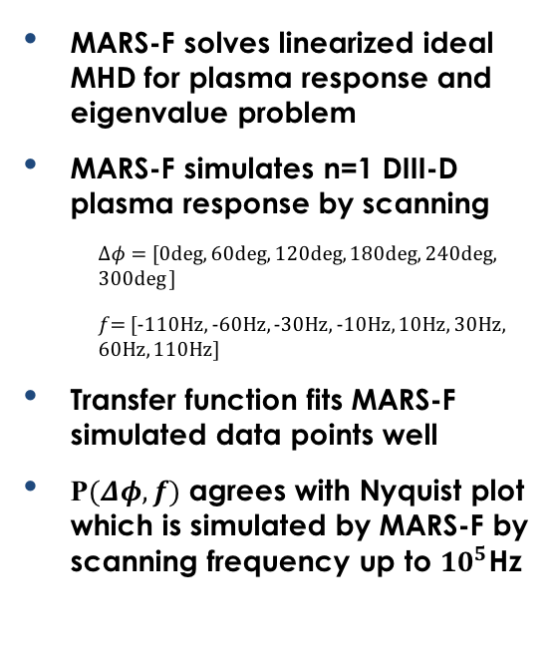


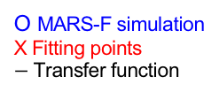


Proof of Principle Based on Simulated Response Data: Constructed Transfer Function Using Low-Frequency Data Recovers High-Frequency Data
MARS-F solves linearized ideal MHD for plasma response and eigenvalue problem
MARS-F simulates n=1 DIII-D plasma response by scanning
  $Δφ=$ [0deg, 60deg, 120deg, 180deg, 240deg, 300deg ]
  $f$= [-110Hz, -60Hz, -30Hz, -10Hz, 10Hz, 30Hz, 60Hz, 110Hz]
Transfer function fits MARS-F simulated data points well
P$(Δφ,f)$ agrees with Nyquist plot which is simulated by MARS-F by scanning frequency up to ${10}^{5}$Hz
MARS-F simulation of n=1 DIII-D plasma response
$q_{0}=1.03$, $q_{95}=3.06$, $β_{N}=1.73$
P($Δφ=240deg,f$)
P($Δφ=240deg,f$)
$Imag$ ($δB_{r}/I_{up}$) (a.u.)
O MARS-F simulation
X Fitting points
$−$ Transfer function
$Imag$ ($δB_{p}/I_{up}$) (a.u.)
$B_{r}, B_{p}$
Sensor
arrays
$Real$ ($δB_{r}/I_{up}$) (a.u.)
$Real$ ($δB_{p}/I_{up}$) (a.u.)
HFS Br
LFS Bp

Slide 13

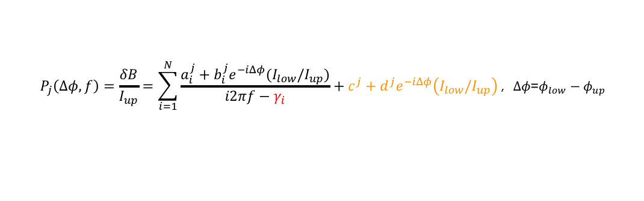


Multi-Pole Transfer Functions can be obtained from both Experimental and Numerical Data
Multi-pole transfer function on 3D sensors is developed from generalized linear-MHD theory:
$$P_{j}\left(Δφ,f\right)=\frac{δB}{I_{up}}=\sum_{i=1}^{N}{\frac{a_{i}^{j}+b_{i}^{j}e^{−iΔφ}(I_{low}/I_{up})}{i2πf−γ_{i}}+c^{j}+d^{j}e^{−iΔφ}\left(I_{low}/I_{up}\right)}\text{,} Δφ\text{=}φ_{low}−φ_{up}$$
Eigenmode behavior at 3D sensors
Plasma response simulation
Experimental measurements
$$P_{j}\left(Δφ,f\right)$$
Eigenvalues ($γ_{i}$)
stability index
$$P_{j}\left(Δφ,f\right)$$
Simulation
(e.g. MARS code)
Detailed comparison between experiment and numerical modelling.
Selective amplification of eigenmode
Eigenvalue problem solver
Easy
Full solution of dominant eigenmode
Difficult

Slide 14
Outline
Theory of multi-mode plasma response model
Detection of n=1 modes in stable DIII-D plasma
Multi-mode plasma response model helps to understand n=2 mode locking in L-mode DIII-D plasma

Slide 15
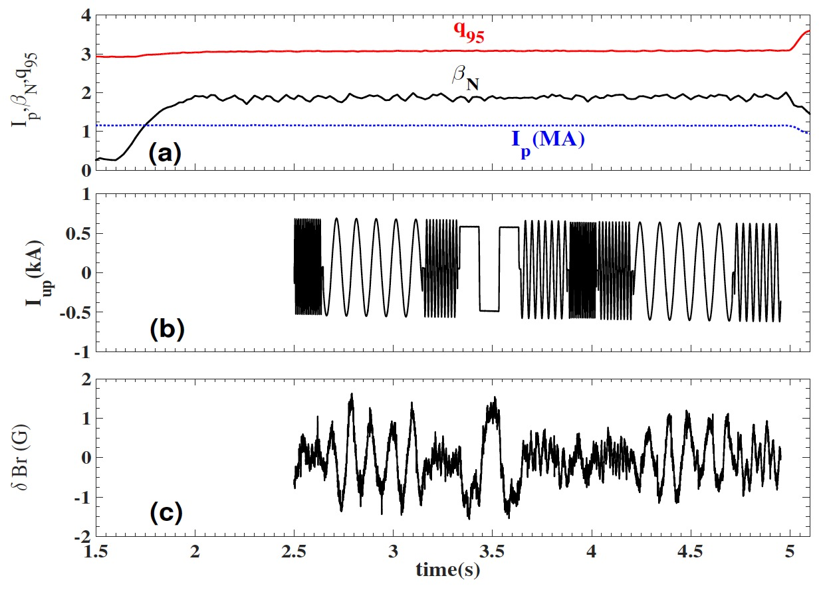


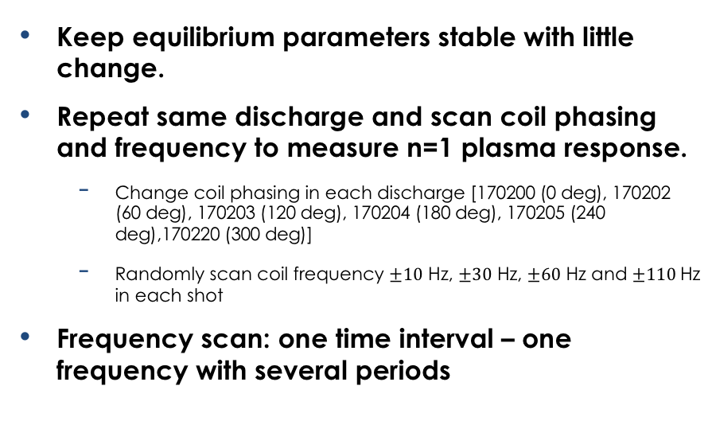

Combined 3D MHD Spectroscopy: Scanning both Coil Phasing and Frequency to Extract Multi-Pole Transfer Function from DIII-D Experiments
Keep equilibrium parameters stable with little change.
Repeat same discharge and scan coil phasing and frequency to measure n=1 plasma response.
  Change coil phasing in each discharge [170200 (0 deg), 170202 (60 deg), 170203 (120 deg), 170204 (180 deg), 170205 (240 deg),170220 (300 deg)]
  Randomly scan coil frequency $±10$ Hz, $±30$ Hz, $±60$ Hz and $±110$Hz in each shot
Frequency scan: one time interval – one frequency with several periods
DIII-D Shot No. 170220, $β_{N}\sim 1.9\text{,} q_{95}\sim 3.1$
Coil $I_{up}$(kA)
MID-LFS
$δB_{r}$ (G)
Extracted response at 3D sensor (Mid-LFS: $δB_{r}$, $δB_{p}$; Mid-HFS: $δB_{r}$, $δB_{p}$):
$δB=Ae^{i(2πft+φ−nφ_{tor})}$

Slide 16
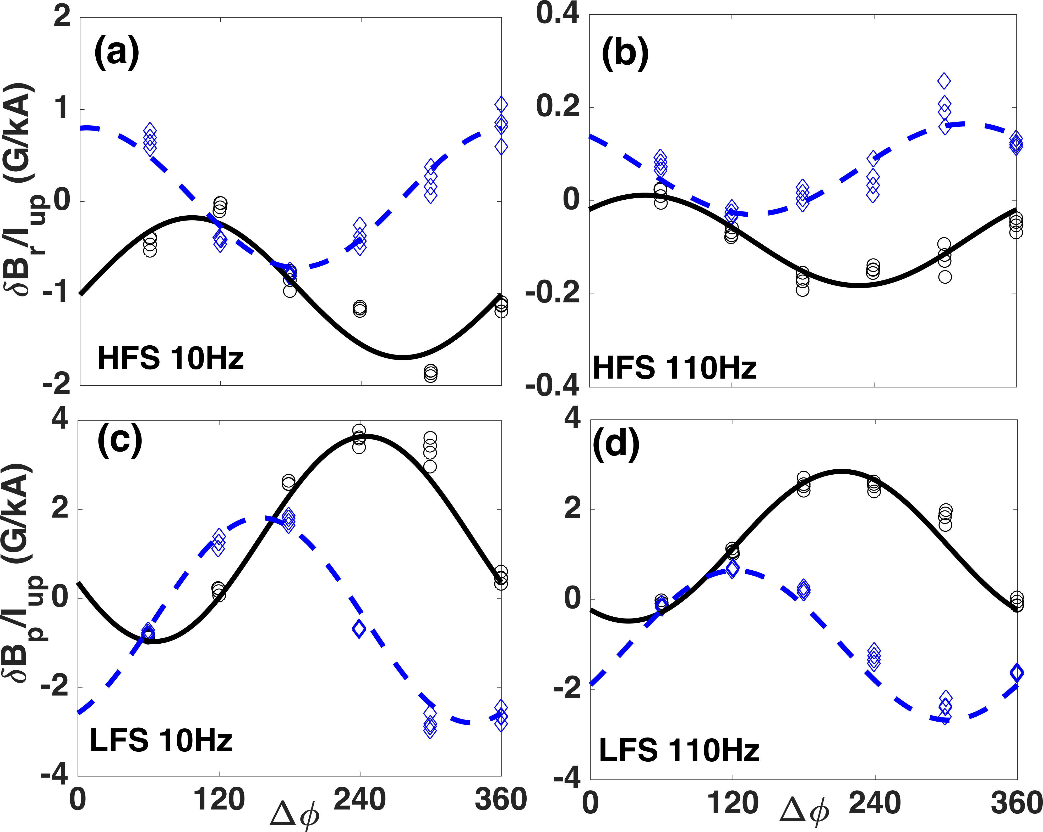
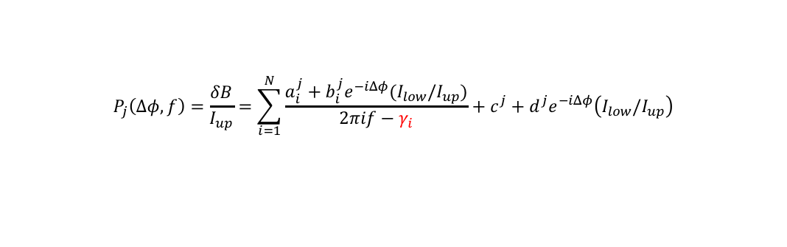


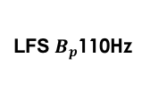

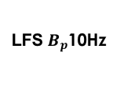
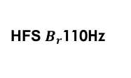
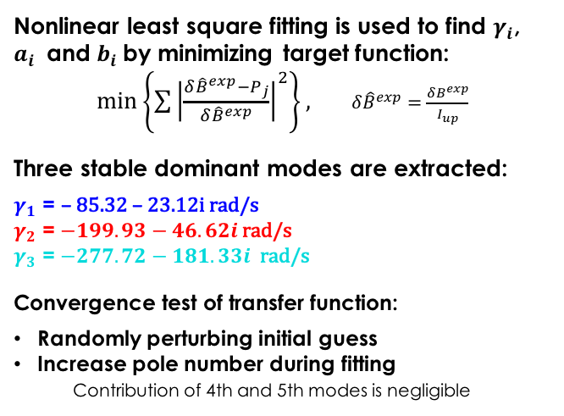

Combined 3D MHD Spectroscopy: Response Extracted by Simultaneous Fitting of DIII-D Data from Multiple Sensors
Multi-pole response transfer functions fit to multiple sensor measurements at Mid-HFS ($B_{r}$ and $B_{p}$) and Mid-LFS ($B_{r}$ and $B_{p}$)
$$P_{j}\left(Δφ,f\right)=\frac{δB}{I_{up}}=\sum_{i=1}^{N}{\frac{a_{i}^{j}+b_{i}^{j}e^{−iΔφ}(I_{low}/I_{up})}{2πif−γ_{i}}+c^{j}+d^{j}e^{−iΔφ}\left(I_{low}/I_{up}\right)}$$
Nonlinear least square fitting is used to find $γ_{i}$, $a_{i}$ and $b_{i}$by minimizing target function:
$\min\left\{\sum{{\left|\frac{δ{\hat{B}}^{exp}−P_{j}}{δ{\hat{B}}^{exp}}\right|}^{2}}\right\},$ $δ{\hat{B}}^{exp}=\frac{δB^{exp}}{I_{up}}$
Three stable dominant modes are extracted:
$γ_{1}$ = – 85.32 – 23.12i rad/s
$γ_{2}$ = $−199.93−46.62i$ rad/s
$γ_{3}$ = $−277.72−181.33i$ rad/s
Convergence test of transfer function:
Randomly perturbing initial guess
Increase pole number during fitting
Contribution of 4th and 5th modes is negligible
Experiment
real (o)
imag(◊)
$χ^{2}$=16.5
Im($P_{j}$)
Qualitative index of MHD modes’ stabilities
Re($P_{j}$)
HFS$B_{r}$10Hz
HFS$B_{r}$110Hz
LFS$B_{p}$10Hz
LFS$B_{p}$110Hz

Slide 17
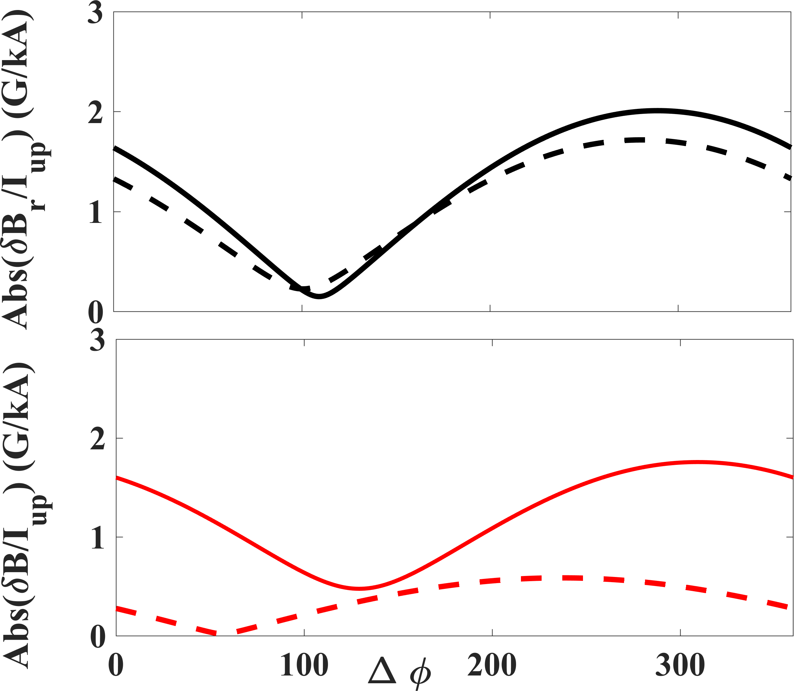
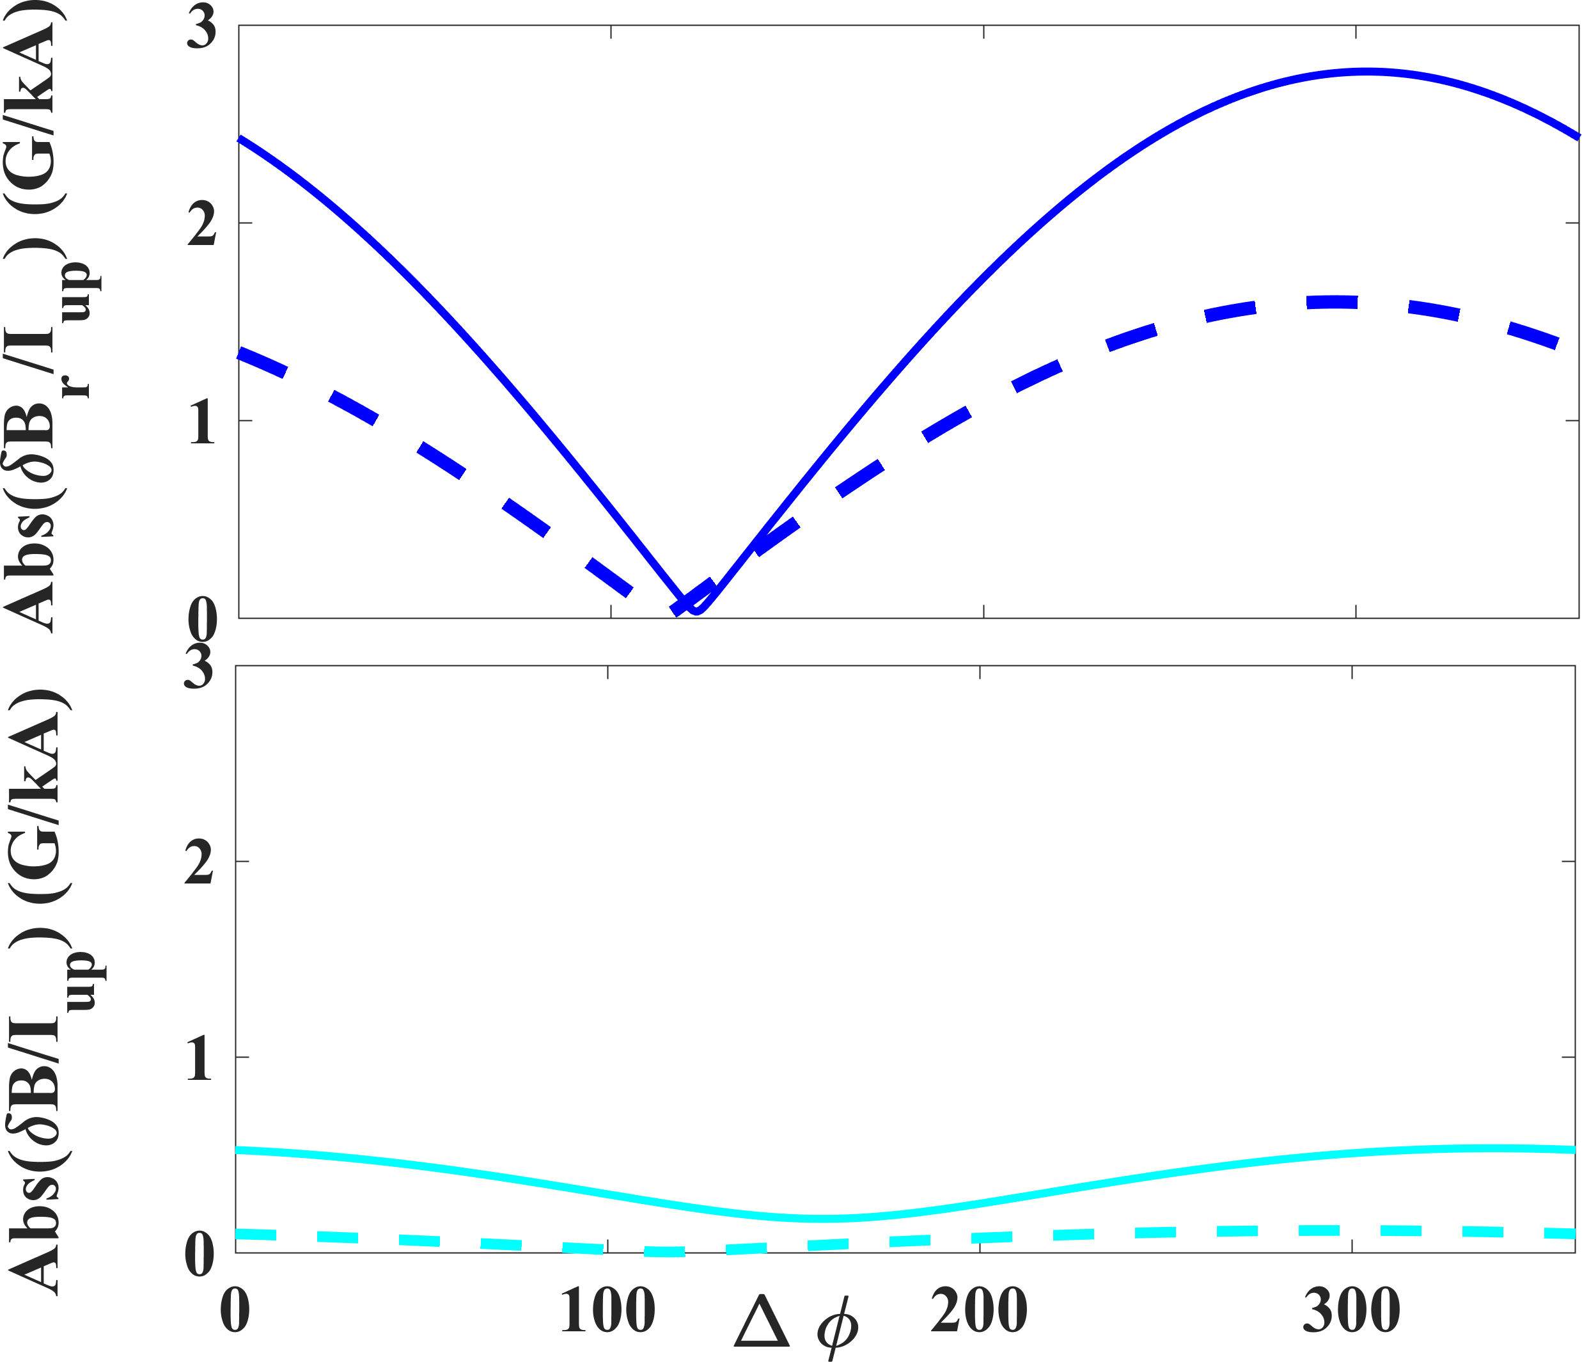

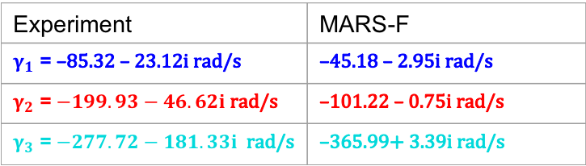
Construction of Transfer Functions from Both Measured and Simulated Response Data Allows Direct Comparison of Each Individual Mode
Experiment | MARS-F
$γ_{1}$ = –85.32 – 23.12i rad/s | –45.18 – 2.95i rad/s
$γ_{2}$ = $−199.93−46.62i$ rad/s | –101.22 – 0.75i rad/s
$γ_{3}$ = $−277.72−181.33i$ rad/s | –365.99+ 3.39i rad/s
Transfer function can be extracted from MARS-F simulation by performing same phasing and frequency scan as experiments
Each dominant eigenmode can be compared separately between experiments and simulations
  General behavior of each mode is similar between experiment and simulation
$$P(Δφ,f=0Hz)$$
Experiment
Exp.
HFS Br
Total
Response
1st mode
MARS-F
MARS-F
Exp.
2nd mode
MARS-F
Exp.
3rd mode
MARS-F

Slide 18
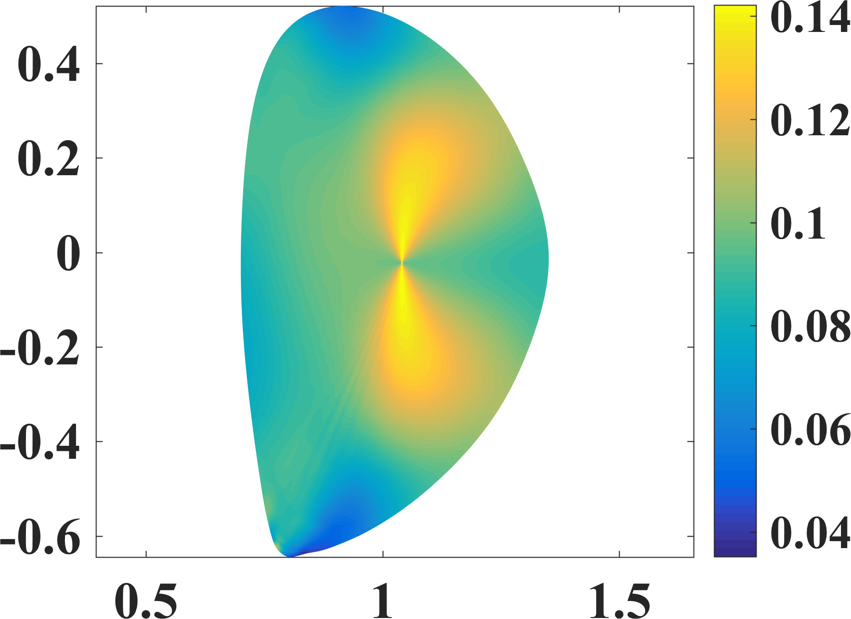
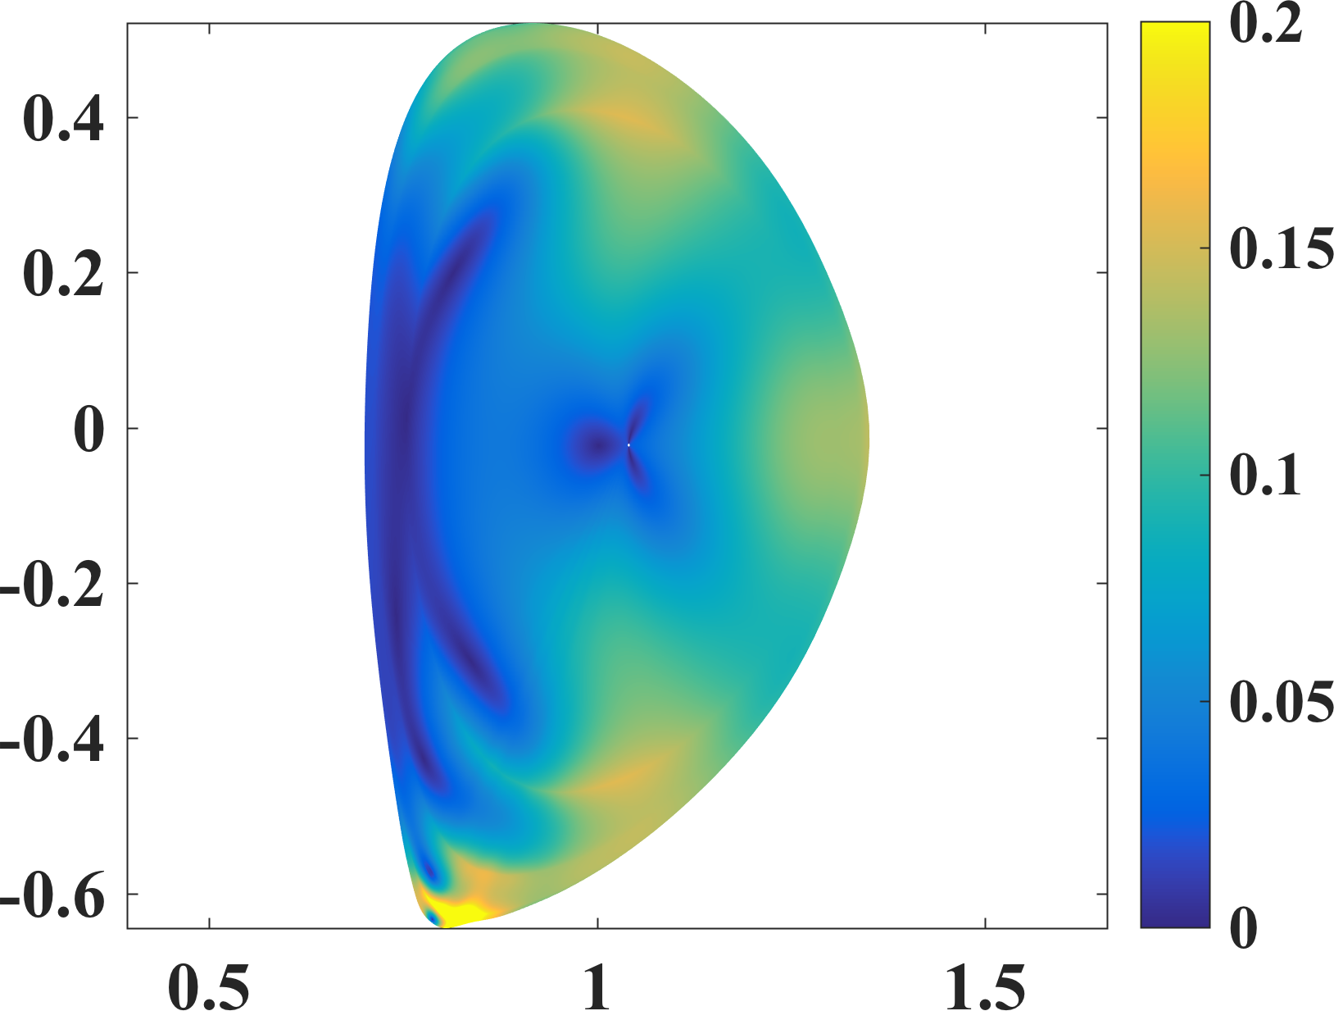
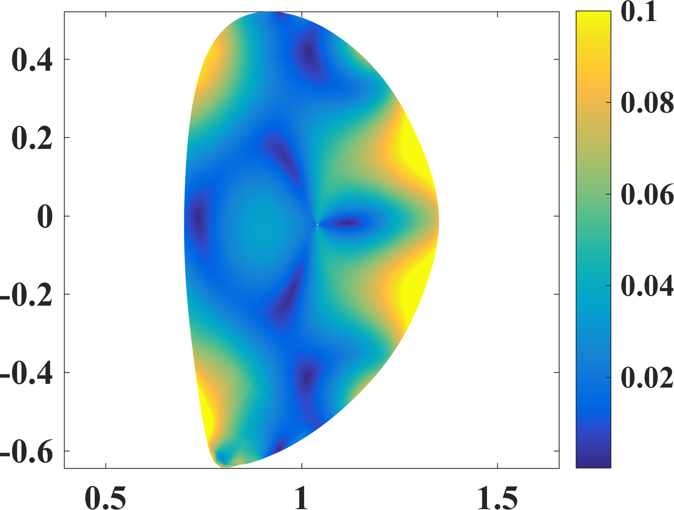

Reconstructed Stable Poles Are Used to Guide Eigenvalue Solver to Directly Compute Eigenmode Structure for 3 Dominant Modes
Eigenvalues from simulated transfer function, as initial guess of eigenvalue problem solved by MARS-F , help to find converged solutions.
Different eigenmode structure has potential for different application purpose.
  1st mode: core rotation control through NTV torque
  3rd mode: help edge island open for ELM suppression
1st mode
(a.u.)
2nd mode
(a.u.)
3rd mode
(a.u.)
$$|δB⋅n|$$
Z (m)
R (m)
R (m)
R (m)
Core dominant
Divertor dominant
Edge dominant

Slide 19
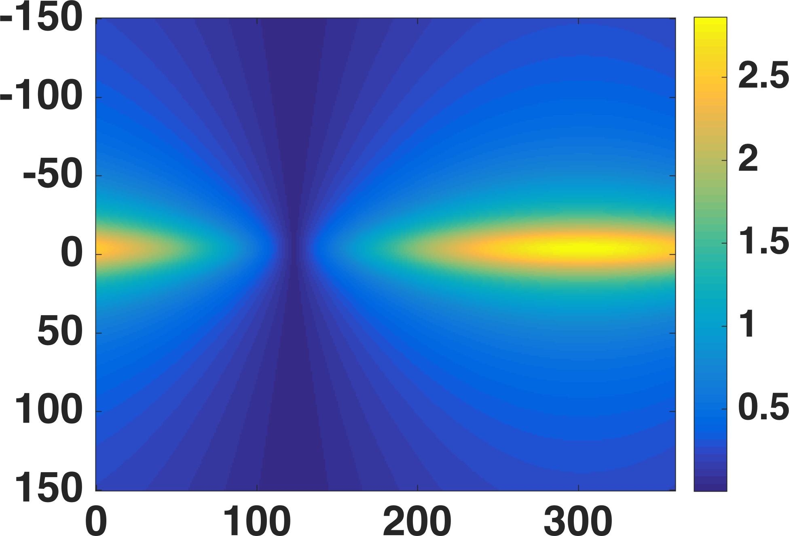
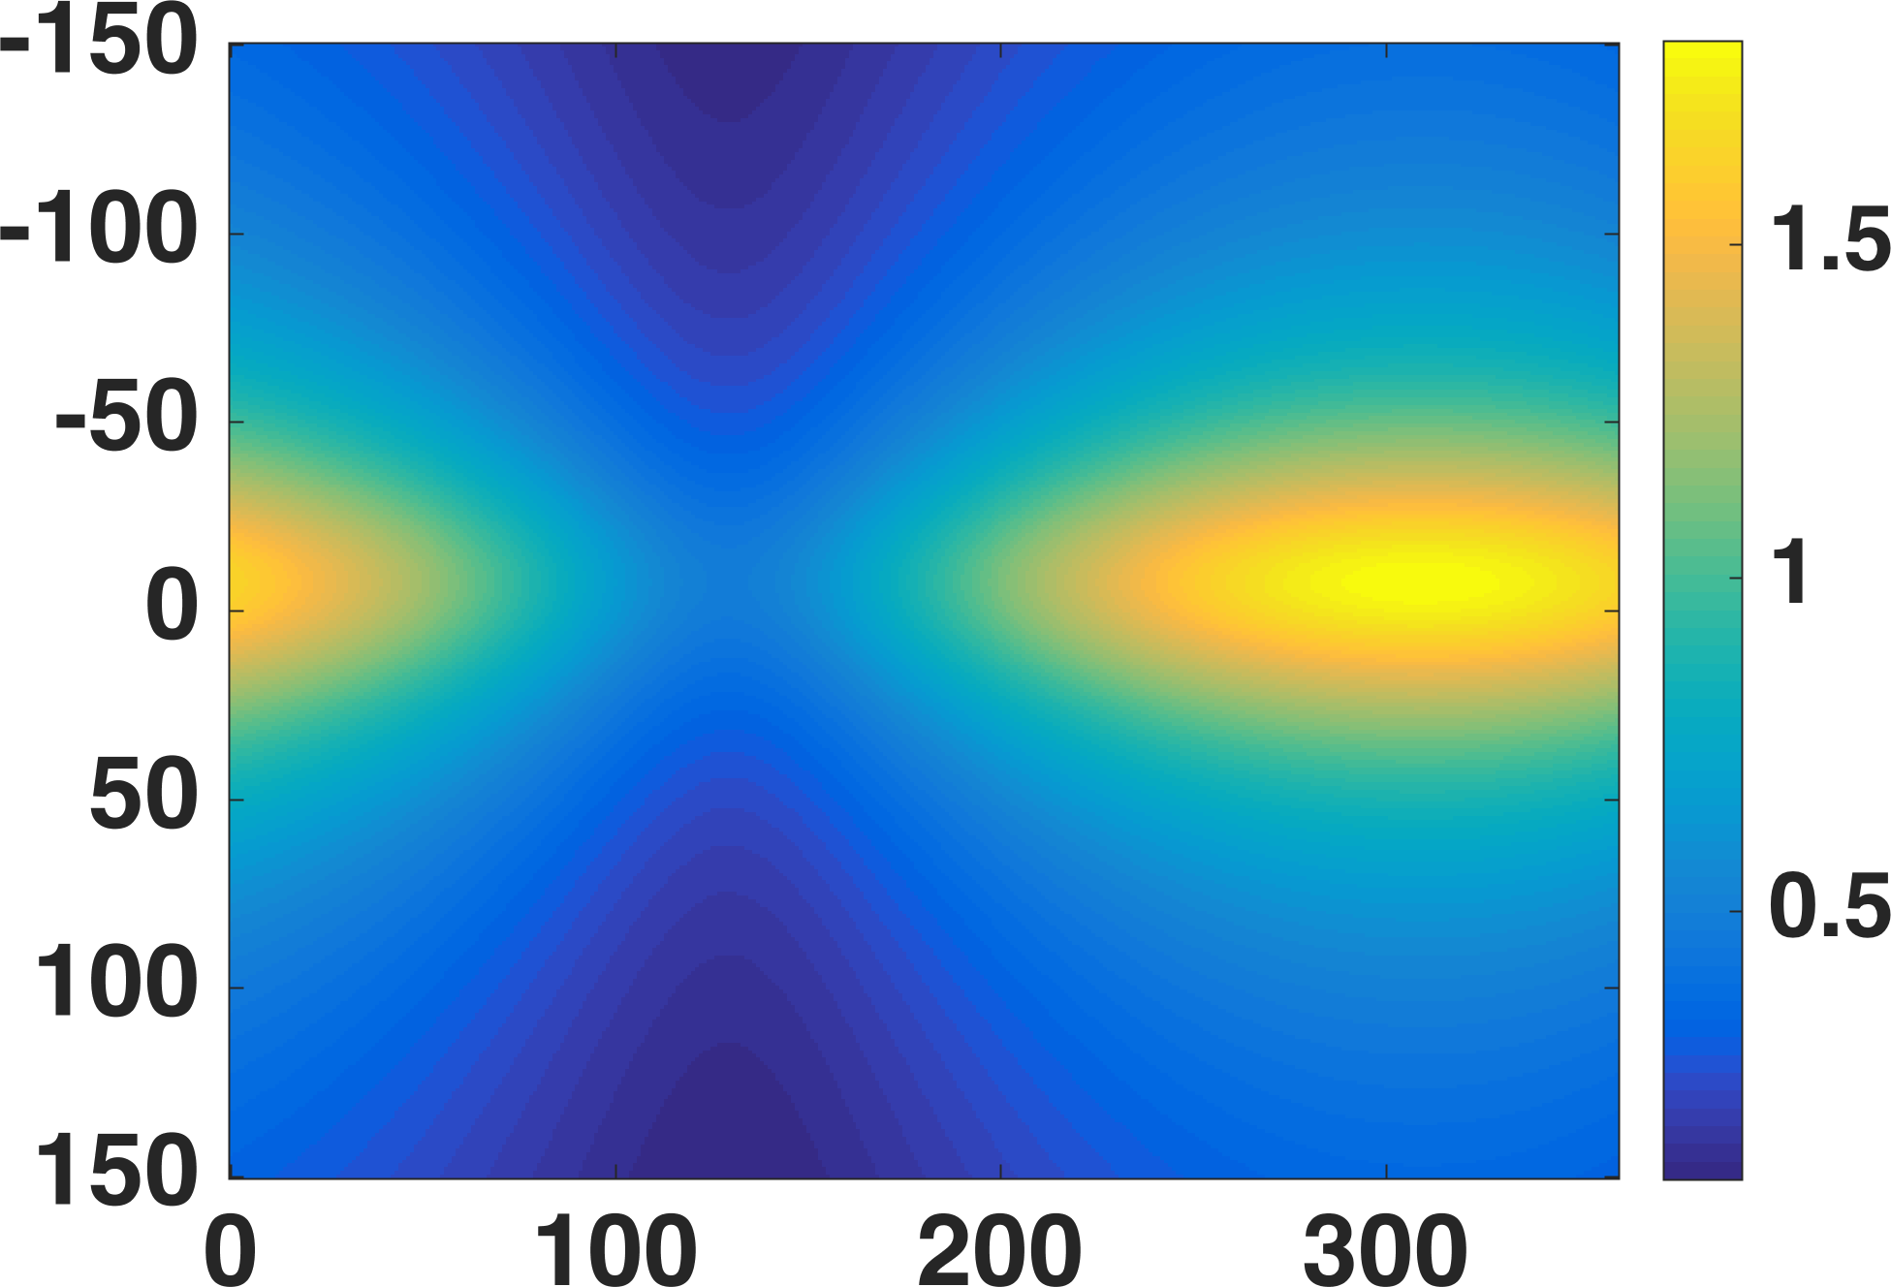
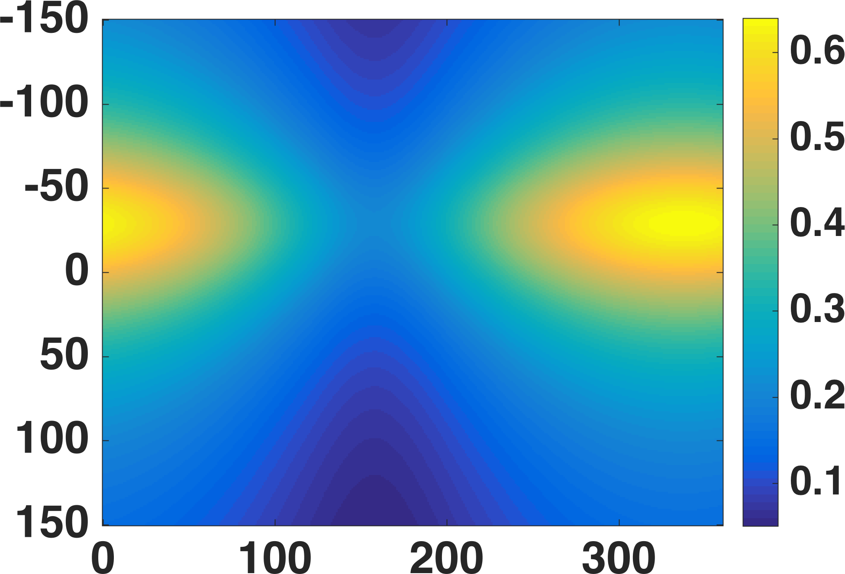






Transfer Function Reconstructed From Experimental Data Helps to Perform Selective Amplification of Mode in 2D Space of Coil Phasing and Frequency
Phasing and frequency dependence of each dominant eigenmode can be evaluated by transfer function
2D scan of coil frequency and phasing could help to amplify preferred eigenmode.
Higher coil frequency makes stronger amplification of 2nd and 3rd modes in concerned DIII-D experiment
$\left(Δφ,f\right)$ dependence of mode amplitude at HFS $δB_{r}$
1st mode
2nd mode
3rd mode
$γ_{1}$ = – 85.32 – 23.12i rad/s
G/kA
G/kA
$γ_{2}$ = $−199.93−46.62i$ rad/s
G/kA
$γ_{3}$ = $−277.72−181.33i$ rad/s
Frequency (Hz)
X
$$Δφ$$
$$Δφ$$
$$Δφ$$

Slide 20
Transfer Function Reconstructed From Experimental Data Helps to Perform Selective Amplification of Mode in 2D Space of Coil Phasing and Frequency
Phasing and frequency dependence of each dominant eigenmode can be evaluated by transfer function
2D scan of coil frequency and phasing could help to amplify preferred eigenmode.
Higher coil frequency makes stronger amplification of 2nd and 3rd modes in concerned DIII-D experiment
$\left(Δφ,f\right)$ dependence of mode amplitude at HFS $δB_{r}$
1st mode
2nd mode
3rd mode
$γ_{1}$ = – 85.32 – 23.12i rad/s
G/kA
G/kA
$γ_{2}$ = $−199.93−46.62i$ rad/s
G/kA
$γ_{3}$ = $−277.72−181.33i$ rad/s
Amplify 3rd mode
Frequency (Hz)
X
$$Δφ$$
$$Δφ$$
$$Δφ$$

Slide 21
Outline
Theory of multi-mode plasma response model
Detection of n=1 modes in stable DIII-D plasma
Multi-mode plasma response model helps to understand n=2 mode locking in L-mode DIII-D plasma

Slide 22
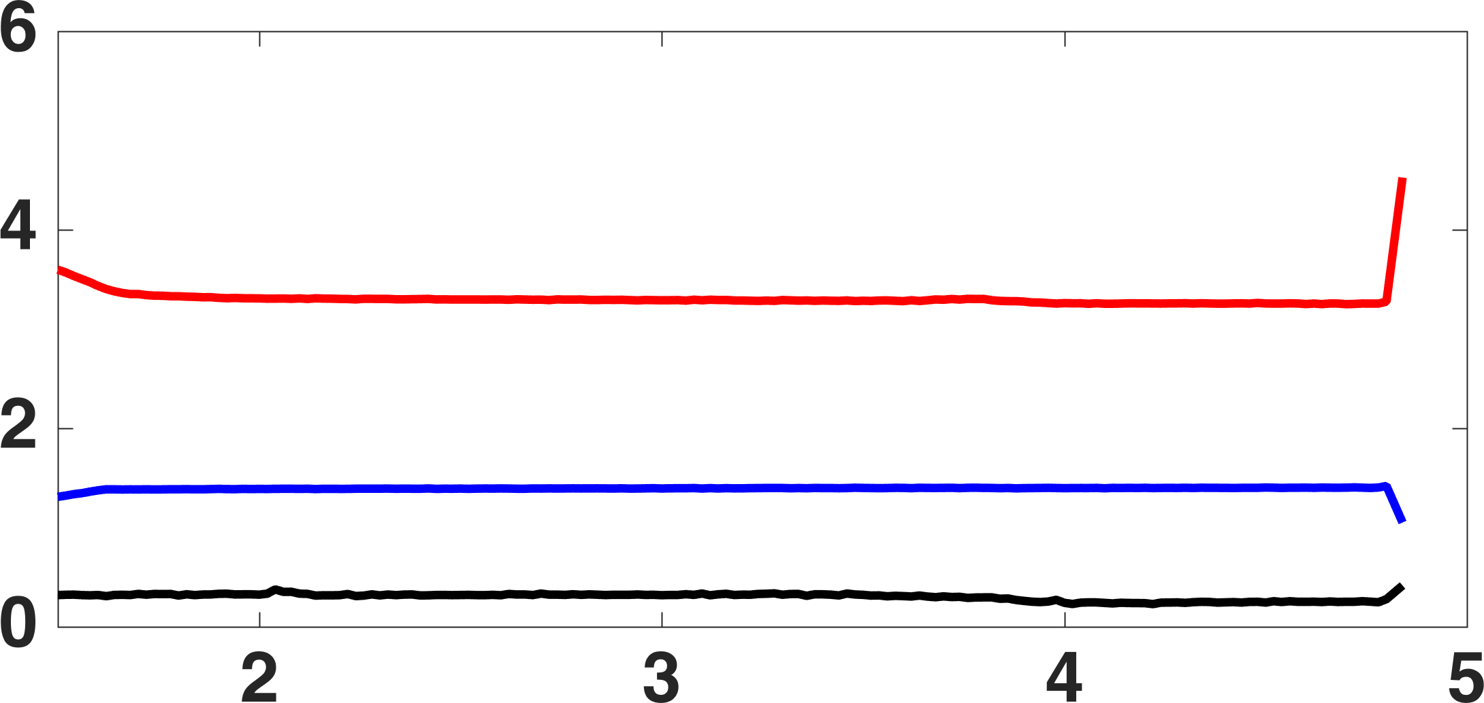
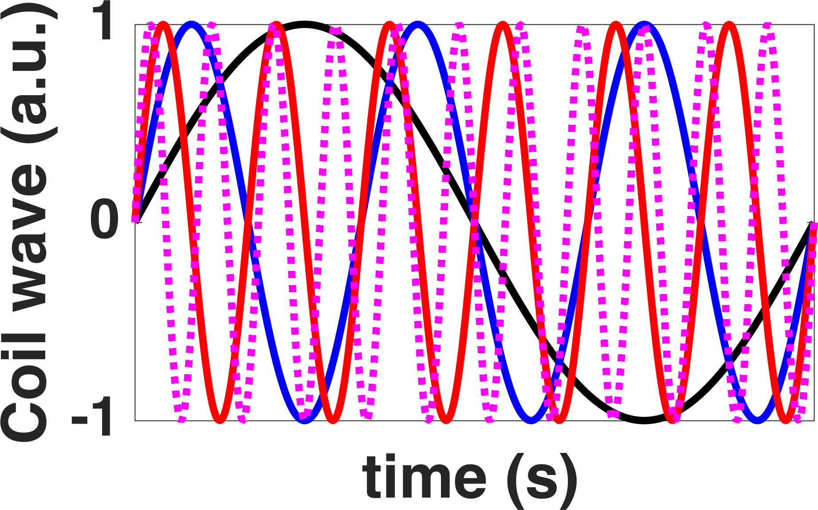
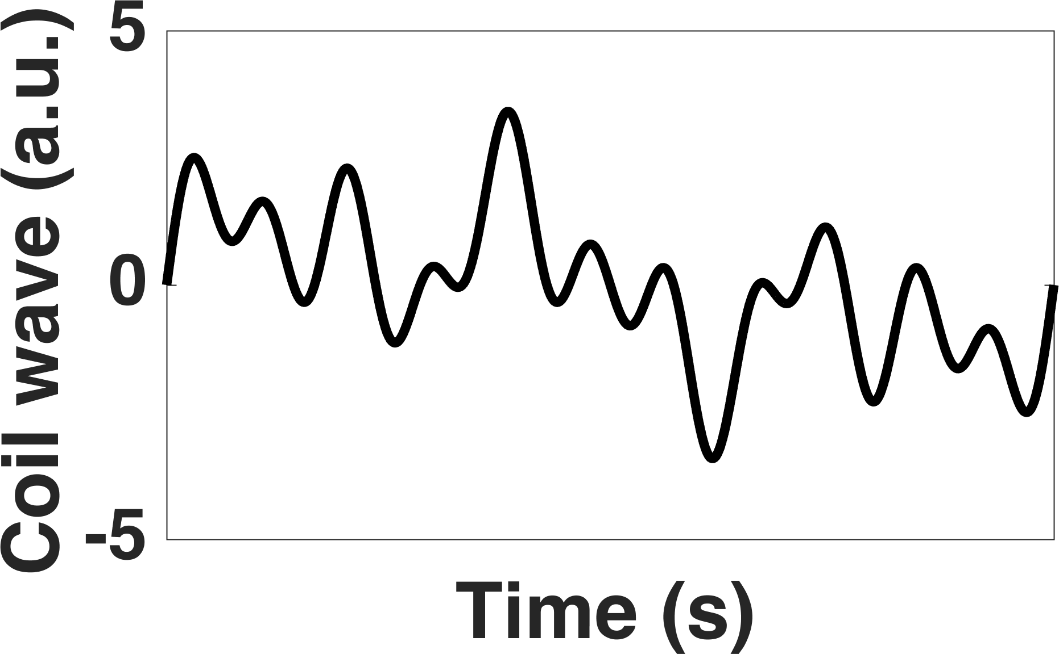
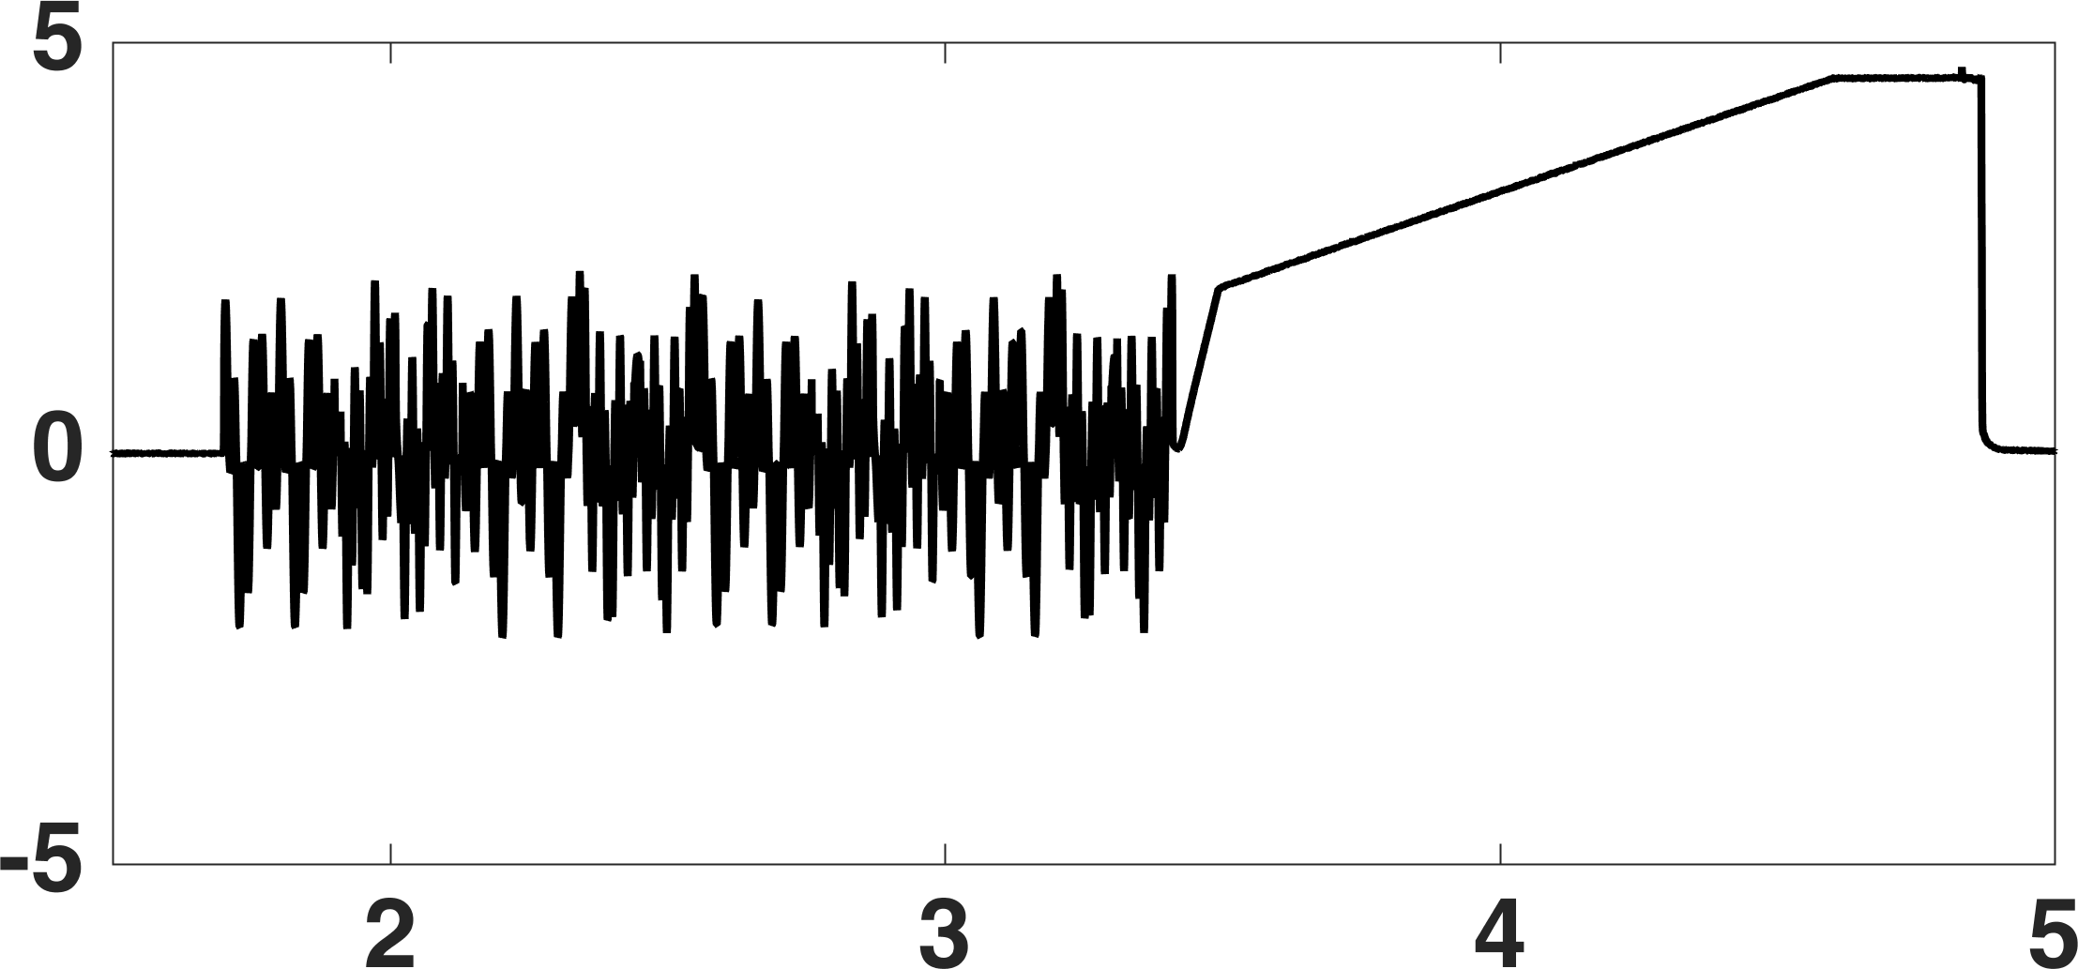
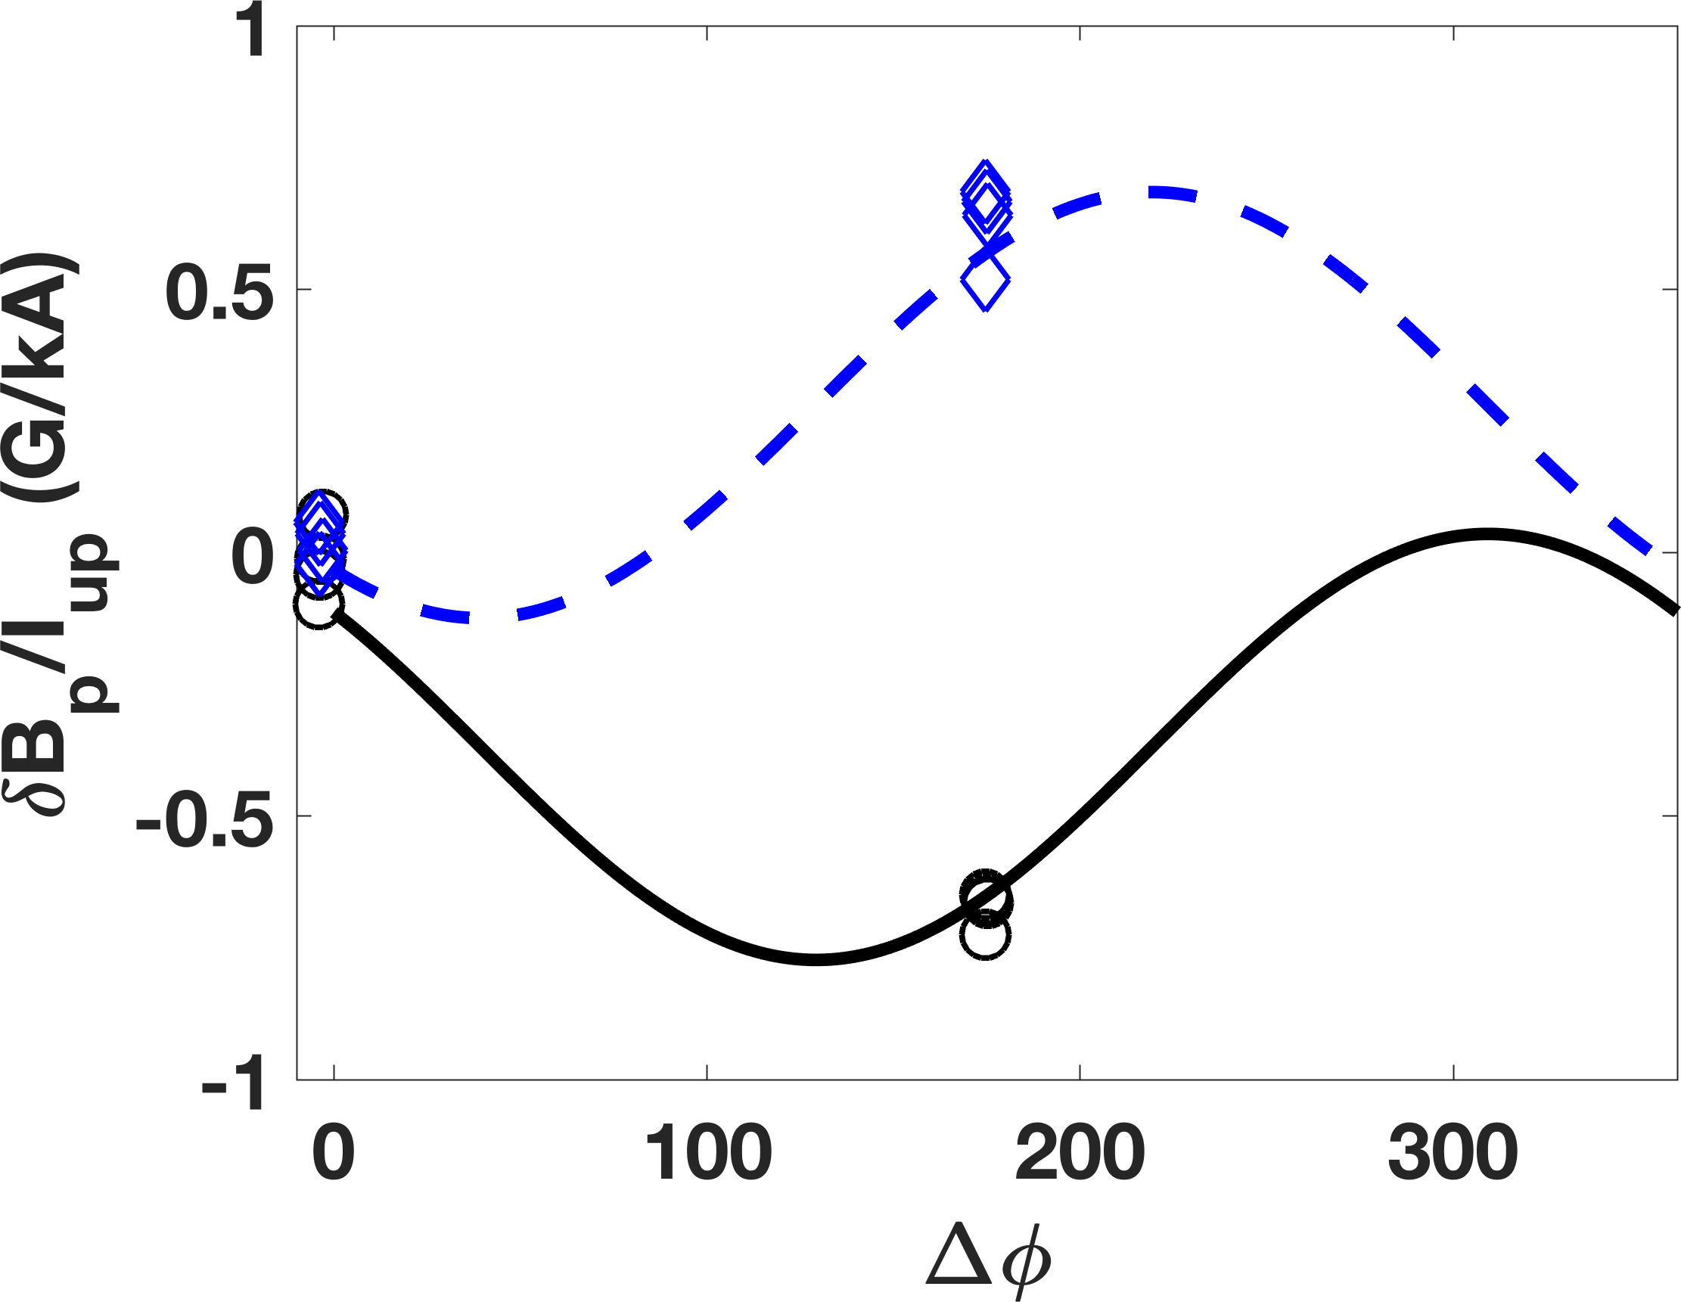
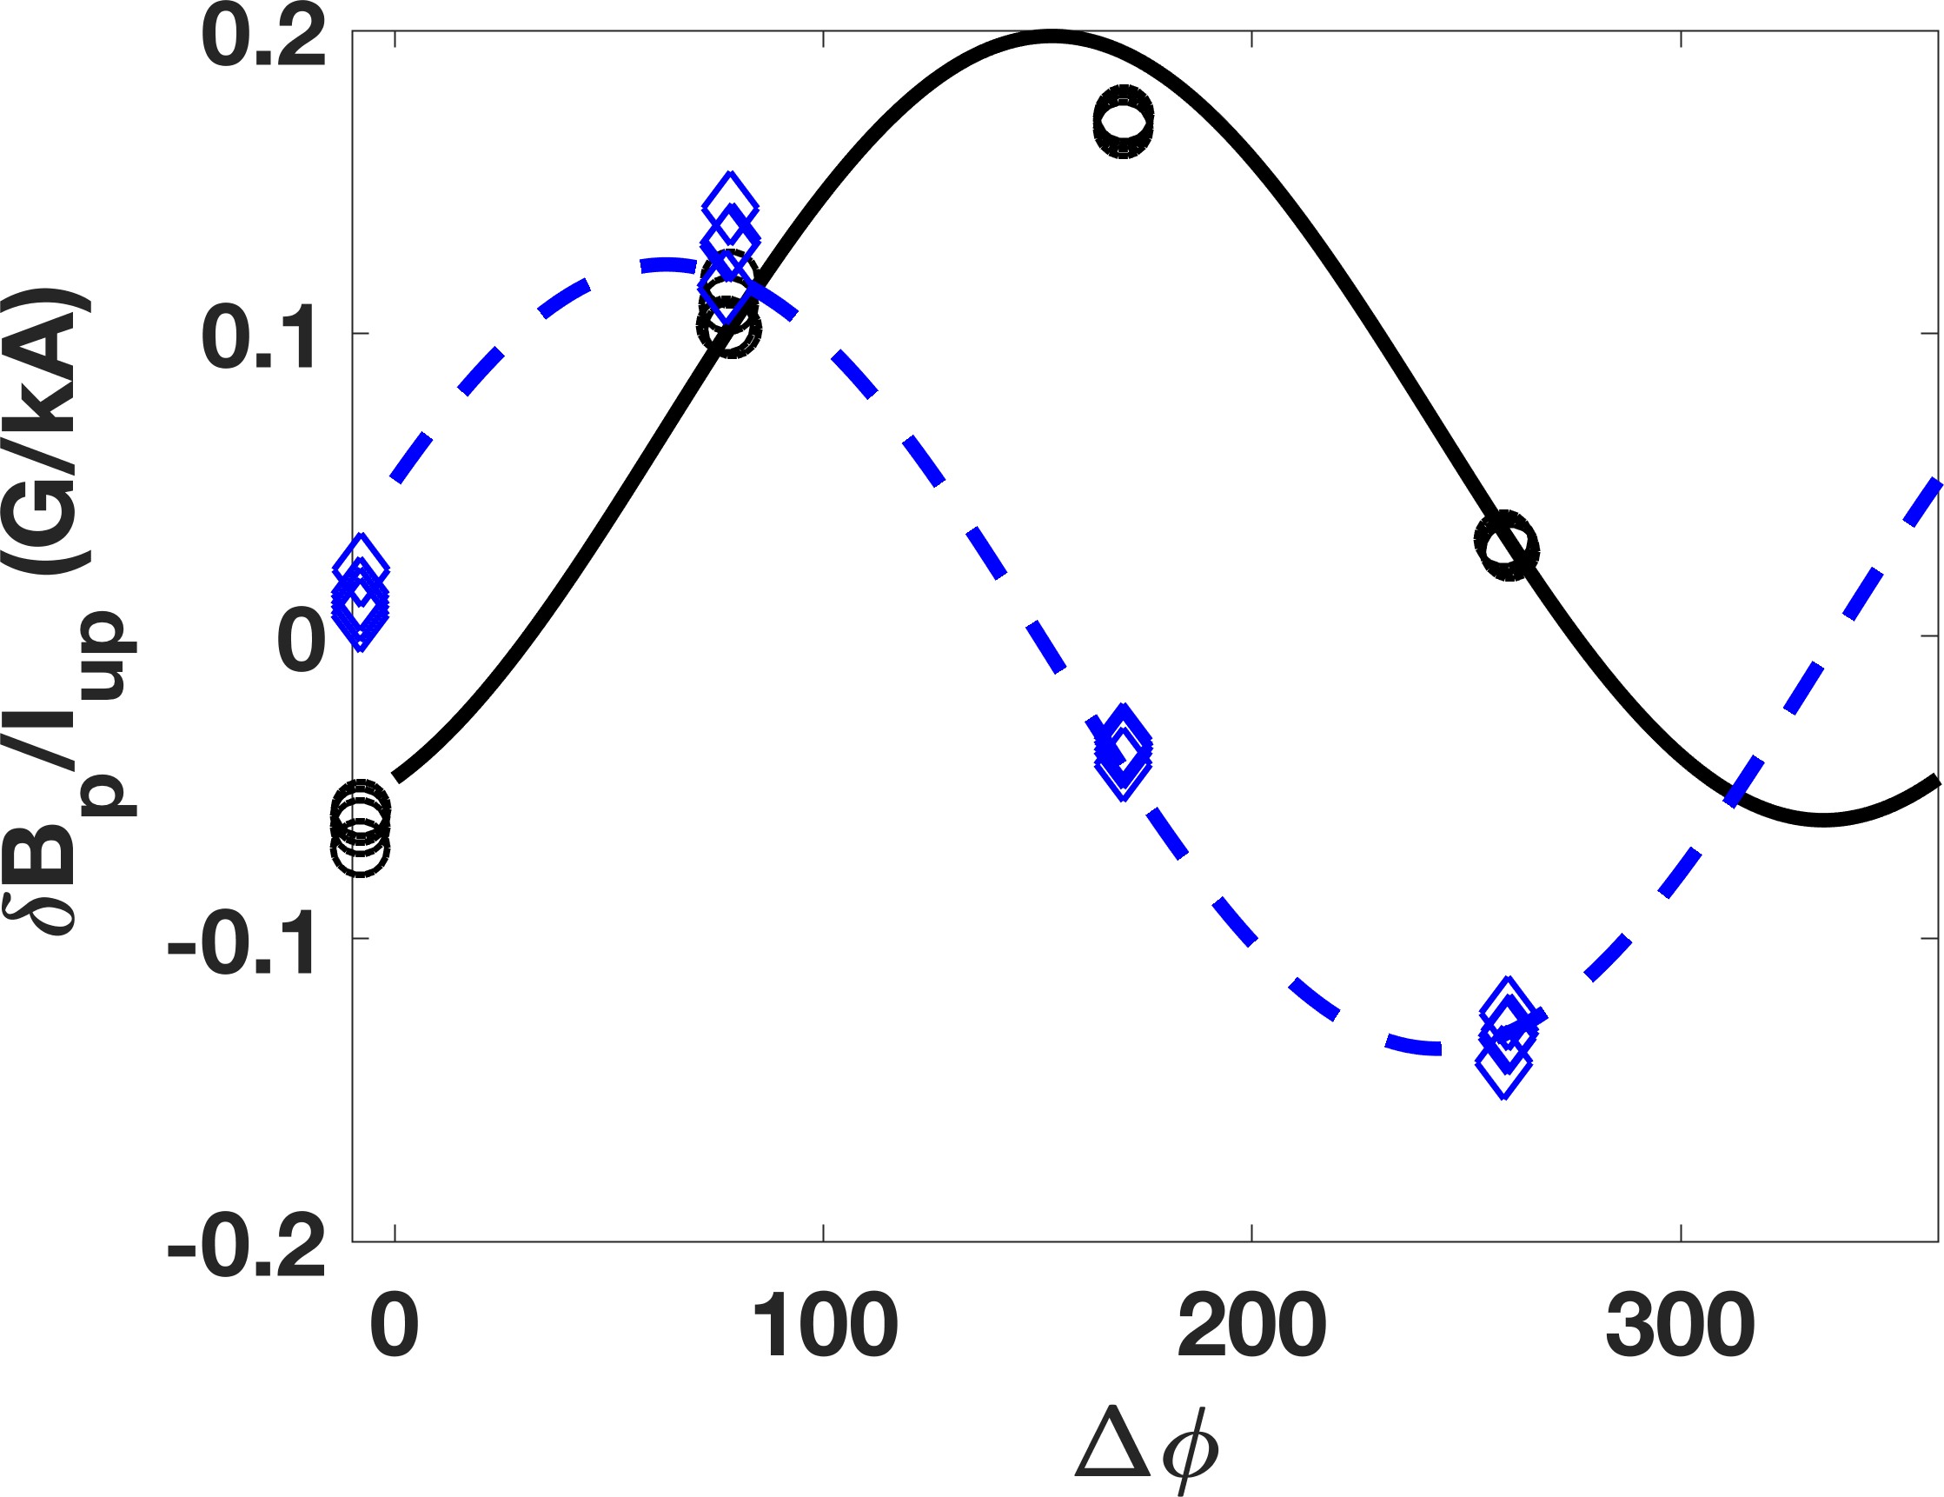












More Efficient MHD Spectroscopy with Multi-Frequency Wave Package Applied in DIII-D L-Mode for n=2 Mode Identification
Efficiency of coil phasing and frequency scan is improved by applying multiple frequencies simultaneously .
173359
$q_{95}$~3.1
$$β_{N}, I_{p},q_{95}$$
$I_{p}$~1.4 MA
$β_{N}$~0.32
$90$deg
270 deg
Upper Coil
Current
Current ramp up
$$Δφ=0 deg$$
Wave packet for given phasing (0$°$, 90$°$, 180$°$, 270$°$) is carefully designed by combining multiple waves ($±10Hz$, $±30Hz$, $±60Hz$, $±110Hz$).
$Δφ=$0 deg
18$0$deg
Mode locking
0.4s
Time (s)
Experiment
real (o)
imag(◊)
Two dominant modes are extracted from experiments
Im($P_{j}$)
Re($P_{j}$)
$γ_{1}$ = $−212.81+23.81i$ rad/s
$γ_{2}$ = $−327.23−142.63i$ rad/s
LFS Bp 10Hz
HFS Bp 110Hz

Slide 23








n=2 Combined MHD Spectroscopy Identifies Least Stable Mode as Stable Tearing Mode and Confirmed by MARS-F Eigenvalue Computation
1st mode computed by MARS-F similar to that extracted from experiment
MARS-F eigenvalue runs scanning plasma resistivity ➔ 1st mode corresponds to an unstable TM at high resistivity
Mode comparison between Expt. and Simulation
Experiment | MARS-F
$γ_{1}$ = $−212.81+23.81i$ rad/s | $−205.46−7.29i$rad/s
$γ_{2}$ = $−327.23−142.63i$ rad/s | $−1.66×10^{3}−15.02i$ rad/s
f=0 Hz
1st mode
$$π×{10}^{2}$$
MARS-F
$S\sim 10^{8}$
Unstable
$S\sim 10^{6}$
$$0$$
Expt.
Mode frequency (rad/s)
$$−π×{10}^{2}$$
Expt.
MARS-F
LFS Br
$$−2π×{10}^{2}$$
$$−4π×{10}^{2}$$
$$−2π×{10}^{2}$$
0
2$π×{10}^{2}$
$$4π×{10}^{2}$$
Growth rates (rad/s)
$S$: Lundquist number
Liu et al, PoP 2012

Slide 24


















Amplification of Stable Tearing Component at $Δφ$=0º ➔ Strong Resonant Perturbations ➔ Lower Mode Locking Threshold
MARS-F solves eigenvalue problem to find eigenmode structure of two dominant modes
  Least stable mode is resistive eigenmode
  Secondary mode has global kink structure
n=2 Least Stable Mode is Amplified at $Δφ$=0 Degree Coil Phasing (Even Parity) with Clear Tearing Structure
1st mode
2nd mode
HFS Bp
$$m=−1$$
1st mode
$$m=3$$
Tearing
Odd parity
$$real\left(ξ_{m}^{r}\right)(a.u.)$$
$$real\left(ξ_{m}^{r}\right)(a.u.)$$
$$1$$
$$4$$
$$3$$
$$5$$
$$−3$$
$$7$$
$$6$$
2nd mode
2
0
-2
$$ψ^{1/2}$$
$$ψ^{1/2}$$

Slide 25









Thesis: Multi-Mode Plasma Response Model and Combined 3D MHD Spectroscopy Provide Pertinent Tools to Study Stable MHD Modes
  Multi-mode plasma response model/plasma transfer function developed from linear MHD and control theory can identify:
    Spatial structure of each dominant stable mode in multi-mode plasma response
    Damping rates of dominant modes as quantitative index of plasma stability
  Extraction of stable eigenmodes, using multi-mode plasma response model, is validated in tokamak experiments
  Comparison between experimentally extracted multi-mode response and MARS-F simulations:
    Identify n=2 resistive eigenmode as least stable and amplified at $Δφ$=0 deg, lead to lower mode locking threshold
  Multi-mode plasma response model is a powerful tool for
    Optimizing RMP spectrum to amplify preferred eigenmode for ELM suppression
    Real-time quantitative monitoring plasma stability
H-mode
n=1 $|δB⋅n|$
L-mode
n=2$|δB⋅n|$
1st mode
2nd mode
3rd mode

Slide 26
Backup slides

Slide 27


Experimental Extracted Plasma Response Model is Verified with Independent Experiment
Experiment (shot No. 170196) only uses upper I-coil to scan frequency
Transfer function, extracted from phasing and frequency scan of I-coils, shows good agreement with sensor measurements in independent experiment
Experiment confirms linear approach of plasma response in theory
1st mode
$$P(f)$$
2nd mode
LFS Br
HFS Br
3rd mode

Slide 28








Multi-Mode Response Transfer Function Reveals Contribution of Each Eigenmode While Applying Different Coil Frequency and Phasing
This slides maybe not shown in talk
Eigenvalue of three dominant modes:
  $γ_{1}$ = $−10.96+1.23i$ Hz
  $γ_{2}$ = $−112×{10}^{2}−14.93i$ Hz
  $γ_{3}$ = $−1.45×{10}^{2}−2.32×{10}^{2}i$ Hz
Contribution of each dominant
mode can be separated at any
frequency and phasing
$Δφ$=100 deg has least stable mode dominant. $Δφ$=240deg makes 2nd and 3rd modes more important
HFS Bp
HFS Bp
f=0Hz
$$P(Δφ=100deg,f)$$
$$P(Δφ=240deg,f)$$
LFS Bp
LFS Bp
$$P(Δφ=240deg,f)$$

Slide 29





Resistive Wall Effect is Important to Determine Plasma Response While Rotating 3D Fields are Applied.
In coil frequency scan, simulated LFS $δB_{r}$ with different wall time decays faster than experimental transfer function.
An sophisticated wall modelling is important to AC plasma response simulation.
Exp. Transfer function
~ 5.63ms
No wall
~ 6.75ms
LFS $δB_{r}$
HFS Br
Wall time ~ 9ms
LFS Br
LFS $δB_{p}$
2D wall with uniform resistivity is not sufficient to resolve spatial details of wall eddy current patterns to simulate local magnetic measurements.
J.M. Hanson et al, Nucl. Fusion 2016

Slide 30


Well Restore Magnetic Response in Time Domain
HFS Br, $Δφ=240 deg$
Time(s)
Raw data
Band pass filter
Transfer function
Time(s)

Slide 31








Single Mode Response Also Leads to Different $Δφ$ of Minimum Amplitude at LFS and HFS （Toy model）
Consider two driving terms $I^{up}e^{{iφ}_{up}} and I^{low}e^{{iφ}_{low}}$, response measured by sensor at $θ_{s}$:
$$R^{s}=\frac{ [a_{1}^{up}\left(θ_{s}\right) +a_{1}^{low}\left(\left(θ_{s}\right)\right)e^{{i(φ}_{low}−φ_{up})}]{v_{1}(θ)e}^{{iφ}_{up}}}{λ_{1}}$$
$$a_{1}^{up}\left(θ_{s}\right)=\left|a_{1}^{up}\left(θ_{s}\right)\right|e^{iφ_{1}^{up }(θ_{s})}$$
$$a_{1}^{low}\left(θ_{s}\right)=\left|a_{1}^{low}\left(θ_{s}\right)\right|e^{iφ_{1}^{low }(θ_{s})}$$
$${|R}^{s}|=\frac{ |v_{1}(θ)|}{{|λ}_{1}|}\left||a_{1}^{up}\left(θ_{s}\right)| +{|a}_{1}^{low}\left(\left(θ_{s}\right)\right)|e^{−i\left[\left(φ_{up}−φ_{low}\right)−(φ_{1}^{low }\left(θ_{s}\right)−φ_{1}^{up }(θ_{s}))\right]}\right|$$
$$Δφ$$
$$Δφ_{sen}(θ_{s})$$
$$Δφ=Δφ_{sen}\left(θ_{s}\right)±π$$
$${\left|R^{s}\right|}_{min}$$
$θ_{s}$ dependence of ${\left|R^{s}\right|}_{min}$even for single mode

Slide 32









Single Mode Response Also Leads to Different $Δφ$ of Minimum Amplitude at LFS and HFS （Toy model）
Consider a complex linear system:
Eigen functions (span solution space): $v_{1}(θ)$, $v_{2}(θ)$, …, $v_{n}(θ)$
$$A(θ)x=0$$
$$v\left(θ\right)Λv^{−1}(θ)x=0$$
Eigen values: $λ_{1}$, $λ_{2}$, …, $λ_{n}$
Response to a driving term:
$$A\left(θ\right)x=I$$
Multi-mode solution: $x\left(θ\right)=\frac{i_{1}(θ)}{λ_{1}}v_{1}\left(θ\right)+$ $\frac{i_{2}(θ)}{λ_{2}}v_{2}\left(θ\right)+…+\frac{i_{n}(θ)}{λ_{n}}v_{n}\left(θ\right)$
$$v\left(θ\right)Λv^{−1}(θ)x=I$$
If only one mode, single-mode solution: $x\left(θ\right)=\frac{i_{1}(θ)}{λ_{1}}v_{1}\left(θ\right)$
Here, $i_{1}(θ)$, $i_{2}(θ)$,…, $i_{n}(θ)$ are complex coupling coefficients of coil current to each mode.
Response measured by sensor S : $R=Sx\left(θ\right)=\frac{Si_{1}(θ)}{λ_{1}}v_{1}\left(θ\right)$
Consider two driving terms $I^{up}e^{φ_{up}} and I^{low}e^{φ_{low}}$, response measured by sensor $S^{LFS}$ and $S^{HFS}$ at mid-plane of LFS $(θ=0)$ and HFS $(θ=π)$respectively
$$R^{LFS}=\frac{S^{LFS}[i_{1}^{up}\left(0\right) +i_{1}^{low}\left(0\right)e^{{i(φ}_{low}−φ_{up})}]{v_{1}(θ)e}^{{iφ}_{up}}}{λ_{1}}$$
$$R^{HFS}=\frac{S^{HFS}e^{imπ}[i_{1}^{up}\left(π\right) +i_{1}^{low}\left(π\right)e^{{i(φ}_{low}−φ_{up})}]{v_{1}(π)e}^{{iφ}_{up}}}{λ_{1}}$$
The minimum point is determined by ${φ_{min}\left(0\right)=ang(i}_{1}^{up}\left(0\right))−{ang(i}_{1}^{low}\left(0\right))±π$ and${ φ}_{min}\left(π\right)={ang(i}_{1}^{up}\left(π\right))−{ang(i}_{1}^{low}\left(π\right))±π.$
Here, single mode is amplified by upper and lower coils respectively. It can have $i_{1}^{up}\left(0\right)≠i_{1}^{low}\left(0\right)$ and $i_{1}^{up}\left(π\right)$ $≠i_{1}^{low}\left(π\right)$.
At LFS and HFS, the coupling between mode and coil can be different, $i_{1}^{up}\left(0\right)≠i_{1}^{up}\left(π\right)$ and $i_{1}^{low}\left(0\right)≠i_{1}^{low}\left(π\right)$. Therefore, $i_{1}^{up}\left(0\right)≠i_{1}^{up}\left(π\right){≠i}_{1}^{low}\left(0\right)≠i_{1}^{low}\left(π\right)$.
It is possible to have $φ_{min}\left(0\right)≠φ_{min}\left(π\right)$.
Physical understanding: single mode is amplified twice by upper and lower coils respectively. The coupling of single mode to upper and lower coils can be different at LFS and HFS. While changing $e^{φ_{low}−φ_{up}}$, the combination of two amplifications can be different at LFS ($i_{1}^{up}\left(0\right) +i_{1}^{low}\left(0\right)e^{{i(φ}_{low}−φ_{up})}$) and HFS($i_{1}^{up}\left(π\right) +i_{1}^{low}\left(π\right)e^{{i(φ}_{low}−φ_{up})}$).

