Slide 1

Prediction of the likelihood of Alfvénic mode chirping in ITER baseline scenarios
Vinícius Duarte and Nikolai Gorelenkov
Princeton Plasma Physics Laboratory, Princeton, NJ, USA
In collaboration with M. Podestà, E. Fredrickson, M. Van Zeeland,
W. Heidbrink, M. Schneller and H. Berk
APS DPP Meeting, Portland, OR, November 8th 2018

Slide 2
ITER burning plasma design specification tolerates 5% of fast ion losses¹
In ITER, two negative-ion-based neutral beam injection sources, which will account for 33MW of injected power (up to 50MW after upgrade installation of third beam).
In ITER, both the 3.5MeV fusion-born alpha particles and the tangentially injected 1MeV NBI ions will have supra-Alfvénic velocities: fast ions will interact with TAEs via their main resonance.
In this presentation: a study of the likely nonlinear evolution scenario of Alfvénic instabilities upon their interaction with fast ions in ITER is addressed
The prediction of the conditions that lead to each type of nonlinear scenario helps to understand the applicability of reduced models
¹ITER Physics Expert Group on Energetic Particles, Heating, Current Drive and ITER Physics Basis Editors 1999 Nucl. Fusion 39 2471
The confinement of fast ions is a crucial issue for the success of ITER
Neutral beam injection geometry in ITER
Singh et al, New J. Phys., 2017
Notes:
diagnostic neutral beam line (DNB) [5], which shares the port with the HNB-1 and delivers 100 keV H beams to the machine.
In the past a large number of injectors around the world used positive ion sources to produce accelerated ion beams which were subsequently neutralised using gas neutralisers in the range of energies, ENBI < 120 keV, where such neutralisation is sufficiently efficient. However with an increasing demand on the beam energy due to the increase in the plasma size and density, injectors based on positive ion sources are less efficient because of the steep reduction in neutralisation cross sections resulting in reduced power deposited by the beams in the plasma. Note that the NBI penetration depth drops with the increase in plasma size and density, λNB ∼ (ENBI/ANBI)1/2 (n a)−1. ‘ANBI’ corresponds to the mass of the neutral beam species used, ‘n’ corresponds to the plasma density and ‘a’ corresponds to the minor radius. Thus, for the reactor size ITER-like machines penetration of the NBI to the plasma centre requires NBI energies of ENBI ∼ 1 MeV (0.5–1 MeV/amu). This limitation requires injectors based on negative ion sources, for which the neutralisation efficiencies are as large as 60% at the energies of interest.
In other words, higher energies are required by bigger tokamaks so that penetration is satisfactory. The neutralization cross section at those higher energies is more effective if negative ions are employed. If a charged beam is injected, it does not penetrate to the core.

Slide 3
Alfvén waves can exhibit a range of bifurcations upon their interaction with fast ions in present day devices (≤40% of fast ion loss)
Chirping is a gateway to avalanches
Each chirp induces fast ion losses
DIII-D, Heidbrink, NF 1995
NSTX, Podestà, NF 2011
Major question in the field: why chirping is common in STs and rare in conventional tokamaks?
We develop and validate a criterion that indicates the likelihood of chirping in terms of plasma parameters

Slide 4
Chirping is supported by phase-space structures: holes and clumps
Lilley and Nyqvist, PRL 2014
hole
Stochasticity prevents the formation of holes and clumps. Multiple sources for it: RF fields, collisions, NTMs, 3D fields, resonance overlap,…
clump
Two typical scenarios for fast ion losses:
  Diffusive transport (typical for fixed-frequency modes): can be modeled using reduced theories, such as quasilinear
  Convective transport (typical for chirping frequency modes): needs to retain full nonlinear features of the wave, is sustained by nonlinear phase-space structures (numerically costly)
Chirping criterion (nonlinear prediction from linear physics elements) :
>0: fixed-frequency solution likely
<0: chirping likely to occur
Turbulence is predicted to be a major chirping prevention mechanism

Slide 5
Marked reductions of the turbulent activity causes chirping onset in DIII-D
The thermal ion heat conductivity is used as a proxy for the fast ion anomalous transport
These observations are consistent with the proposed criterion for chirping onset
Duarte et al, NF 2017.

Slide 6
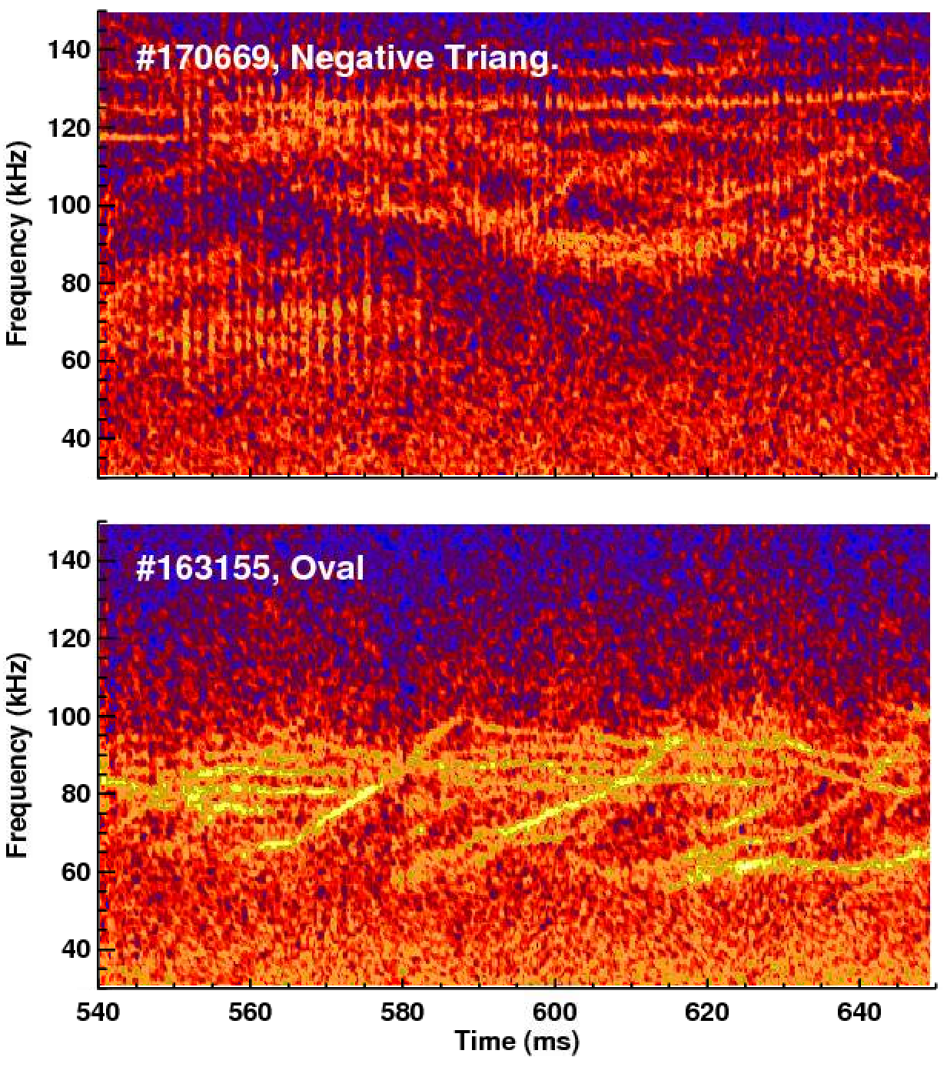
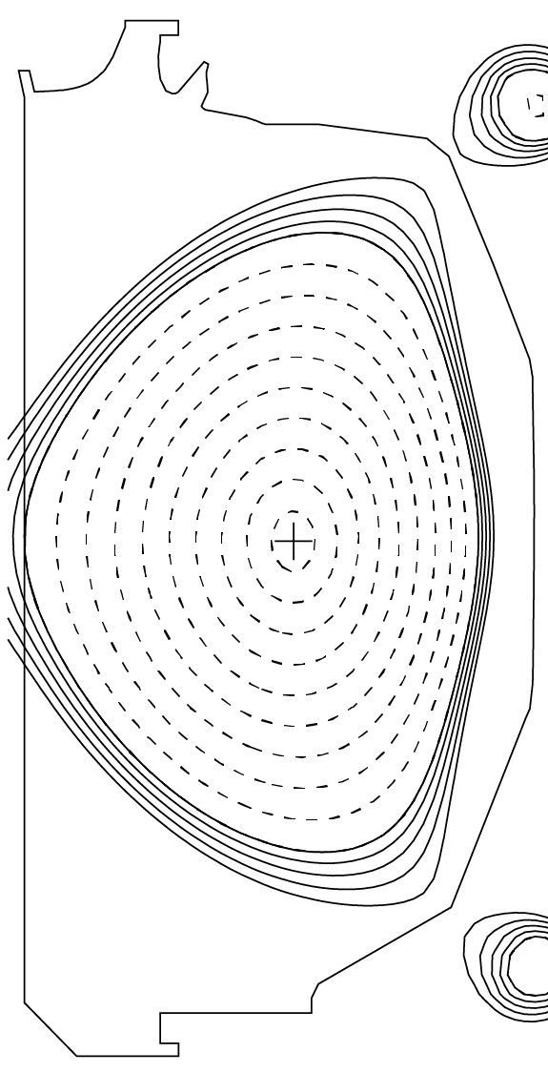
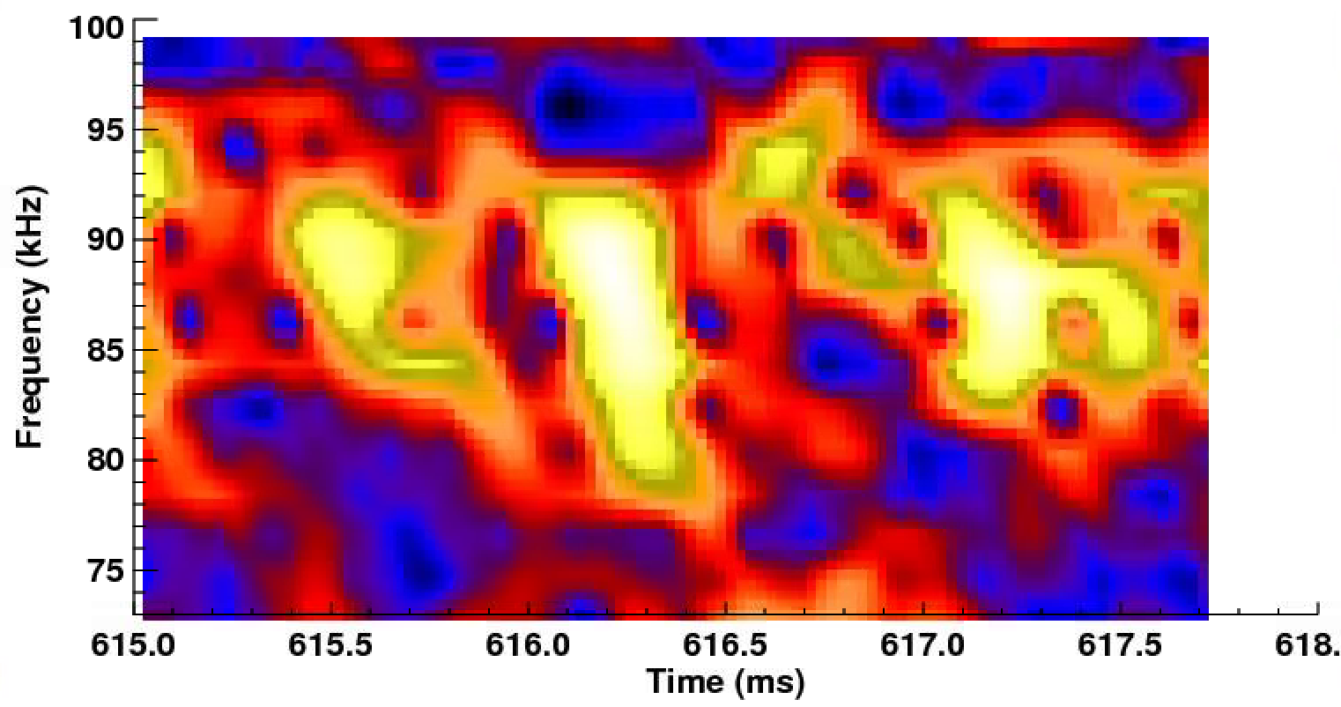
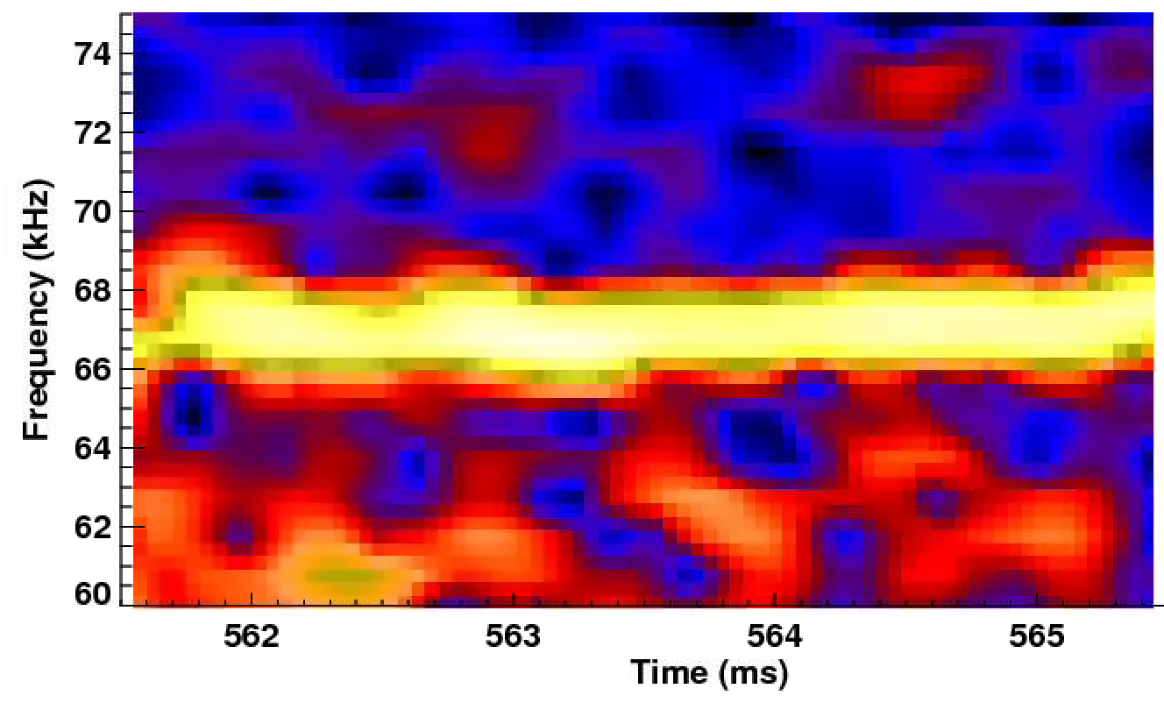
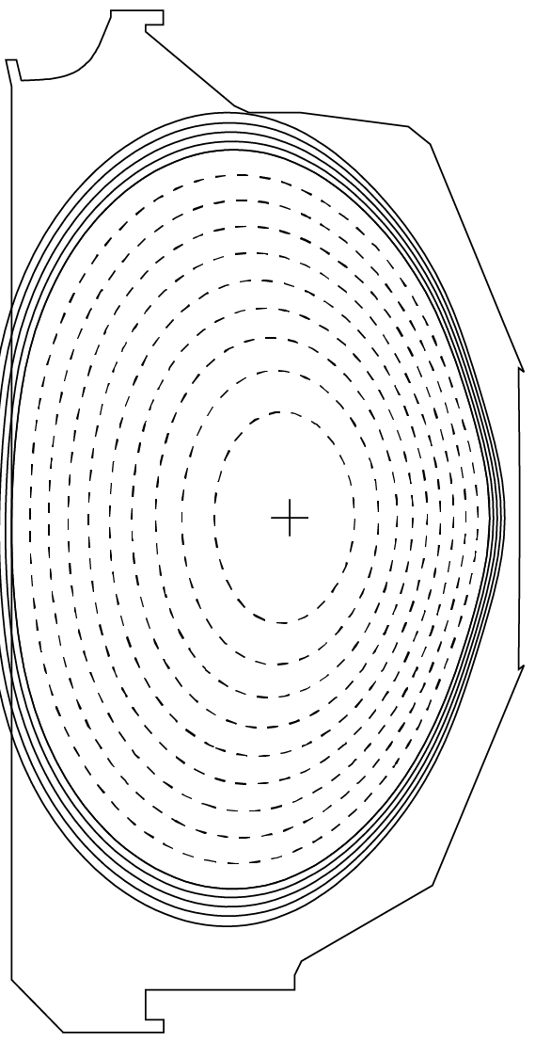
Experimental scenario developed based on the theory: dedicated experiments showed that chirping is more prevalent in negative triangularity DIII-D shots
Transport coefficients calculated in TRANSP are 2-3 times lower in negative triangularity, as compared to the the usual positive/oval triangularity
>0: fixed-frequency
<0: chirping
M. Van Zeeland, IAEA Energetic Particles, 2017.
Notes:
The TCV results showed that the eigenmodes are more sheared and that contributes to reduce turbulence
zoom the chirping and the fixed-freq

Slide 7
GTS global gyrokinetics analyses show turbulence reduction for rare NSTX TAE transitions from fixed-frequency to chirping
Electrostatic turbulence fluctuation
Before chirping, 265ms
Peak of the most intense mode
During chirping, 300ms
V. N. Duarte et al, NF 2018

Slide 8
Predictions for the most unstable n=7-11 TAEs and RSAEs¹ in ITER are near boundary between fixed frequency and chirping
Analysis based on TRANSP modeling, requiring Q>10
Arrows show how radial turbulence diffusion^{2,3} changes the prediction with respect to the purely collisional dynamics
Chirping can occur in ITER. New theoretical and numerical tools need to be developed for modeling.
¹ DOE OFES Theory Joule Milestone FY2007, Gorelenkov et al, PPPL Preprint number 4287 (2008), ²Lang & Fu, PoP 2011, ³Duarte et al, NF 2018.
Notes:
Ratio

Slide 9
Summary
The proposed chirping criterion has been validated against NSTX and DIII-D data
Chirping cannot be ruled out in ITER!
Q<10 and other decorrelation mechanisms, such as RF heating and resonance overlap, will however enforce constant Alfvénic frequency.
Theoretical and numerical tools should be developed for fully nonlinear energetic particle transport in ITER

