Slide 1
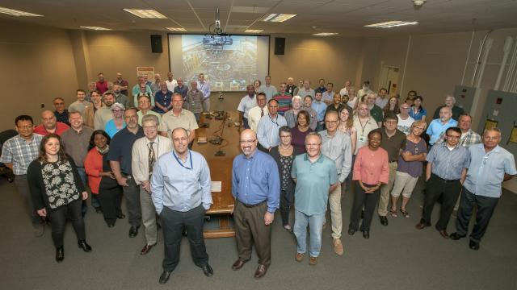
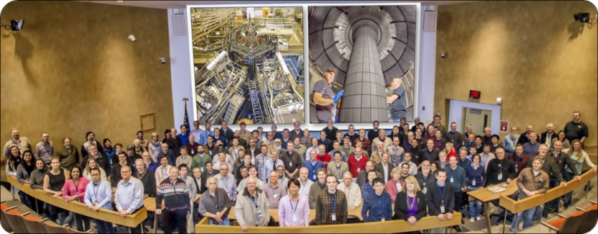
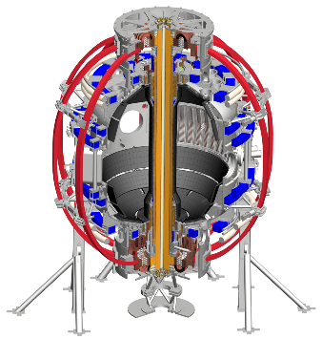
Contributed Oral Presentation YO5.00002: Status and Plans for the NSTX-U Recovery Project
J. Menard, S. Gerhardt, and R. Feder,
for the NSTX-U Recovery and Research Teams

Slide 2
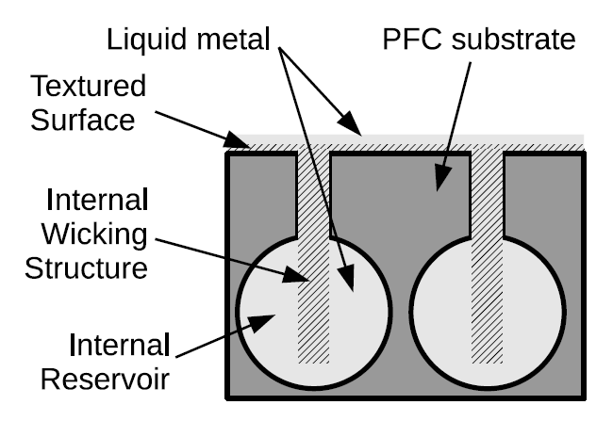
NSTX-U Mission Elements
ITER
Exploit unique Spherical Tokamak (ST) parameter regimes to advance predictive capability - for ITER and beyond
Develop solutions for plasma- material interface (PMI) challenge
Advanced divertors
Liquid metals
Explore ST physics towards reactor relevant regimes (Fusion Nuclear Science Facility, low-A Pilot Plant)
ST-FNSF / Pilot-Plant

Slide 3
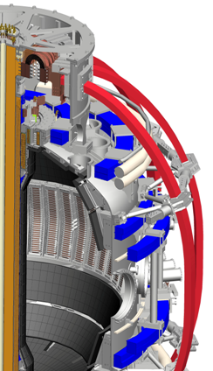
NSTX-U vital for addressing key ST / fusion questions
Maximum Parameters
New Central Magnet
New tangential NBI for j(r) control
NSTX
NSTX-U
I_{p} | ≤ | 1.4 | 2 MA
RB_{T} | ≤ | 0.47 | 0.94 m-T
P_{NBI} | ≤ | 6 | 15 MW
P_{RF} | ≤ | 6 | 6 MW
τ_{pulse} | ≤ | 1-2 | 5-10s
Conducting plates can suppress global kink instabilities
Higher B_{T} (1 T at R₀) ➔ projected largest range in β and (lower) ν* in an ST
Higher stability β_{N} / l_{i} ≤ 14 + flexible NBI ➔ high / full non-inductive current

Slide 4
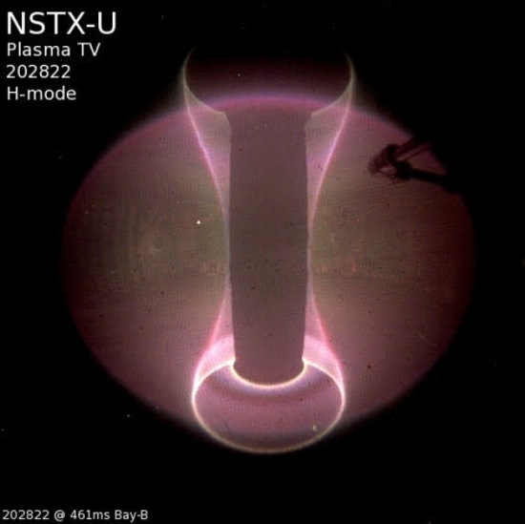
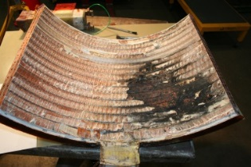
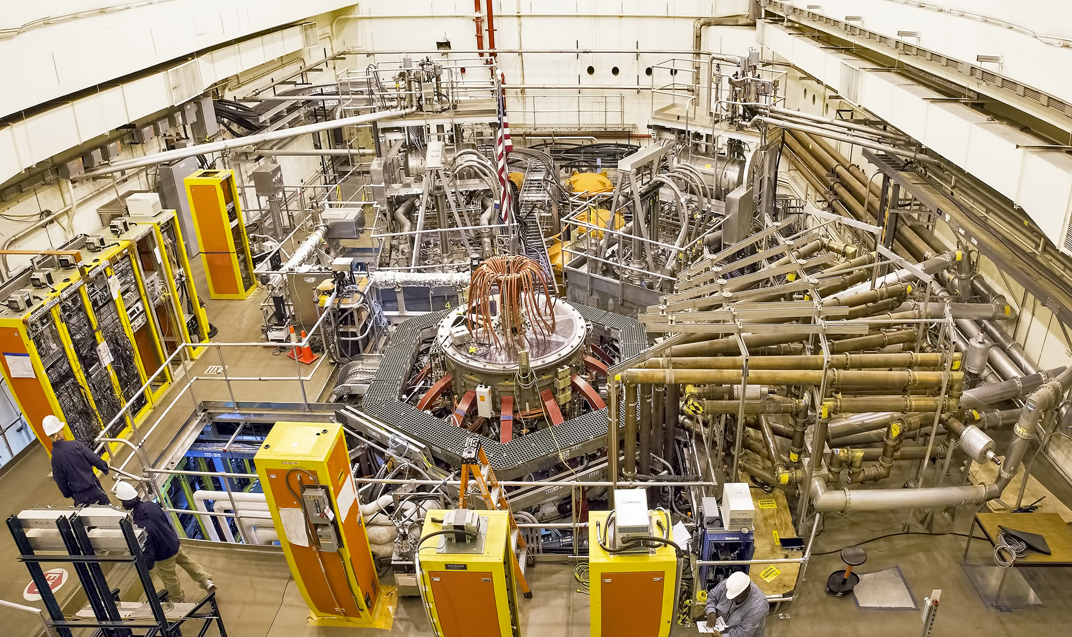
Need Recovery to reliably achieve NSTX-U full performance
NSTX-U had scientifically productive FY16 run
H-mode on 8th day of 10 weeks of operation
Surpassed magnetic field and pulse-duration of NSTX
Discovered new 2nd NBI suppresses Alfvénic instabilities
…ceased operations due to failed divertor PF coil
FY2017: “Extent of Condition” review identified additional deficiencies needing “Recovery”
FY2018 primary Recovery activities:
PPPL-DOE agreement on Recovery Project scope
(Re-)design critical and/or long-lead components
Develop initial cost and schedule estimate for Project
Section of failed PF1AU

Slide 5
Recovery scope critical for robust research facility
Rebuild all 6 inner-PF coils
Improve the “polar regions”
Strengthen passively conducting plates
Replace plasma facing components that cannot be qualified
Reassemble with improved alignment of magnets & structures
Design and install improved Bakeout System
Implement mechanical instrumentation
Improve neutron shielding of test cell, safety order & systems
Commissioning, achieve key performance parameters, 1st plasma

Slide 6
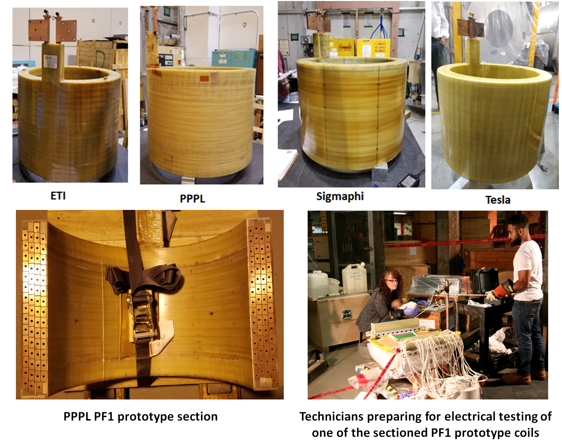
1. Nominal prototype PF1 coil testing completed
Built 4 prototype PF1A coils
All prototypes passed electrical tests
VPI inspections indicate 2 vendors qualified, other 2 vendors may qualify with remediation
Request for Proposal prep underway including all 3 external vendors
Performing lifetime/corona tests on section of coil with largest VPI voids

Slide 7
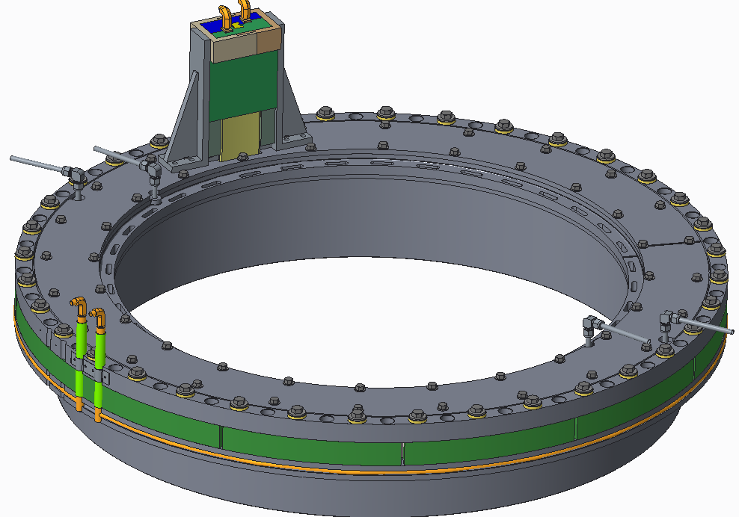
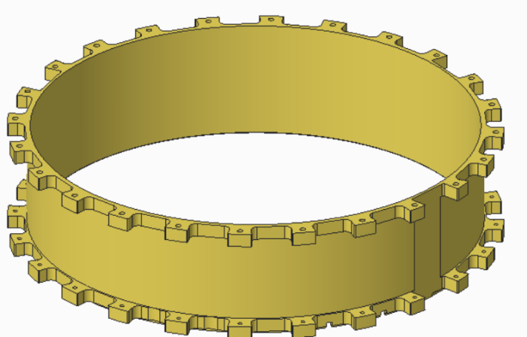
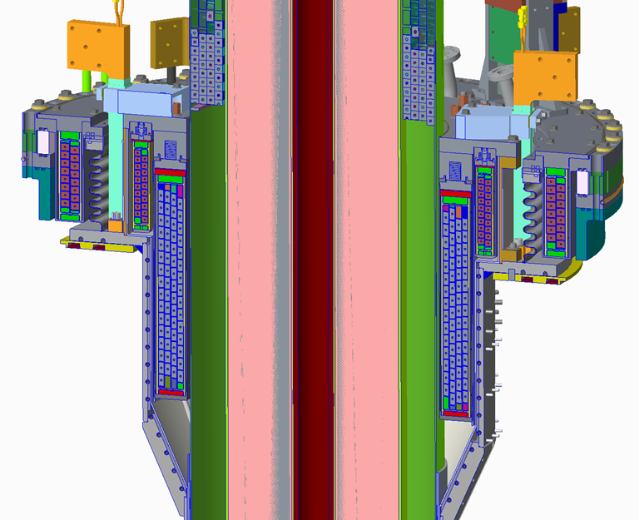
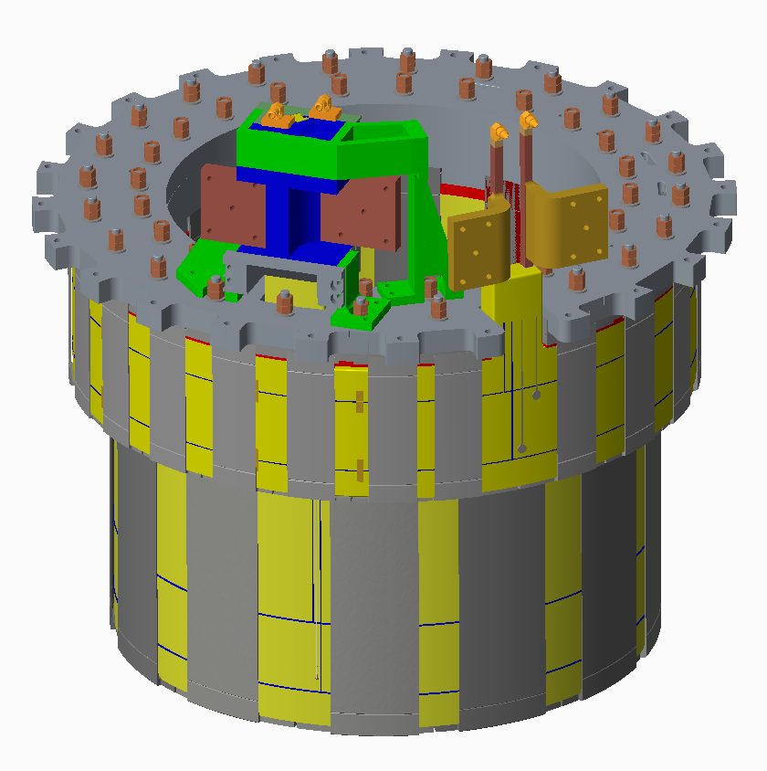
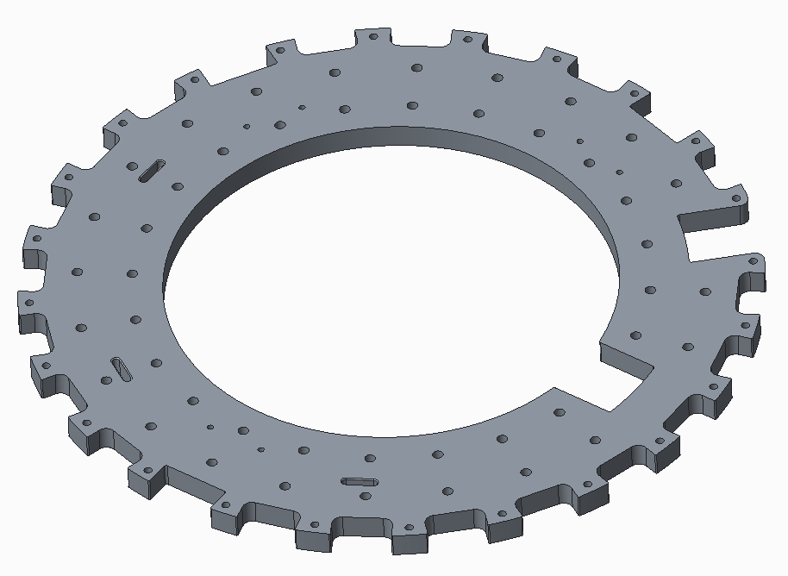
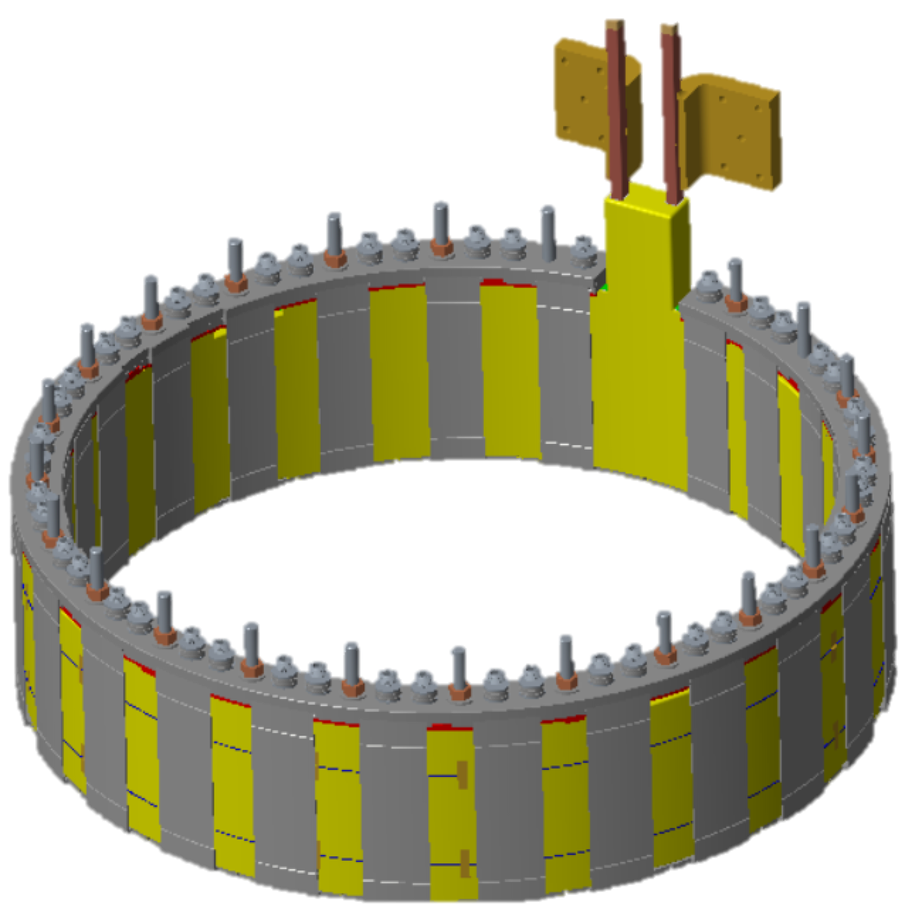
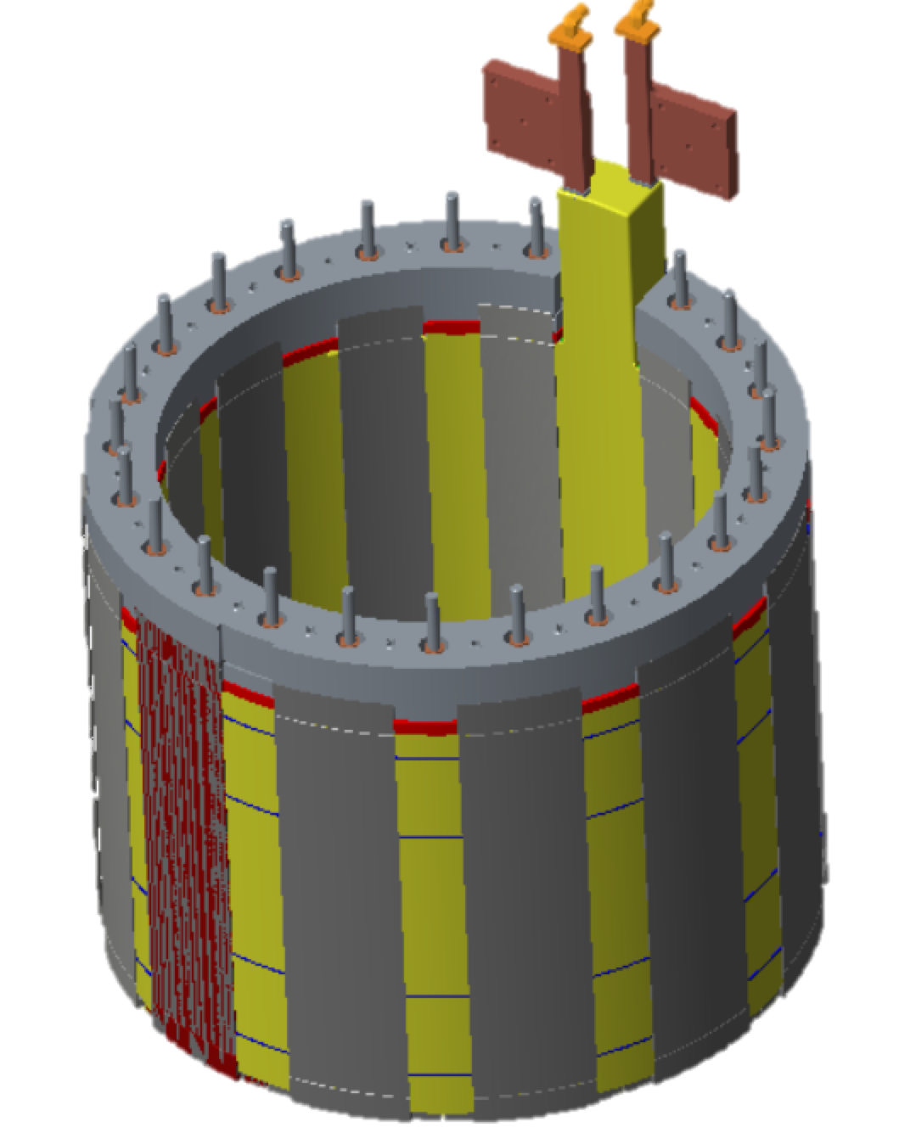
2. Robust polar region design developed
PF-1c and Ceramic Break
Design Features
Supports mandrel-free coils against all static and transient EM loads, provides preload, improves bakeout
Provides mounting structures and heating / cooling for Plasma Facing Component (PFC) Tiles
Provides robust elements of vacuum boundary, with double O-ring seals
Polar Region = Top / bottom poles of NSTX-U
Collar
PF-1a/1b Assembly
Common Flange
Full Upper Polar Region
PF-1b Assembly
PF-1a Assembly

Slide 8
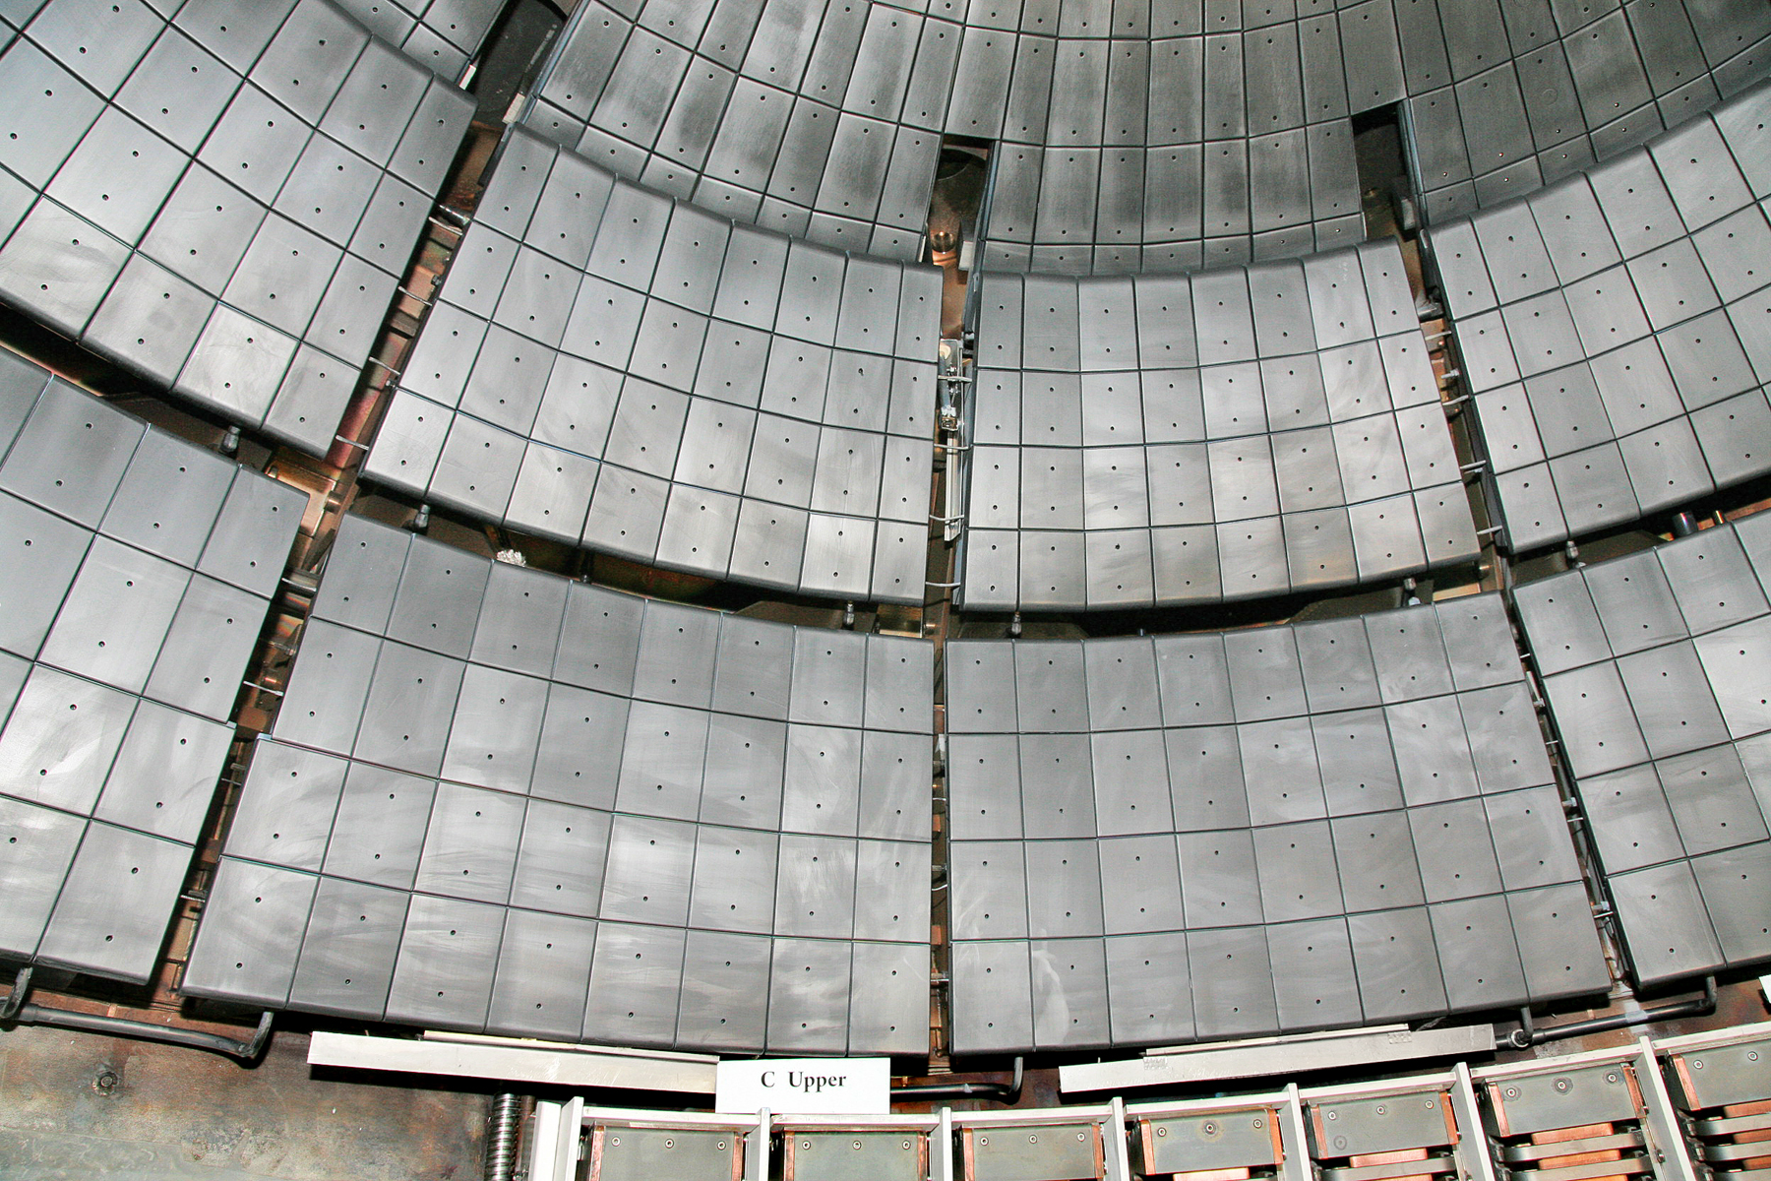
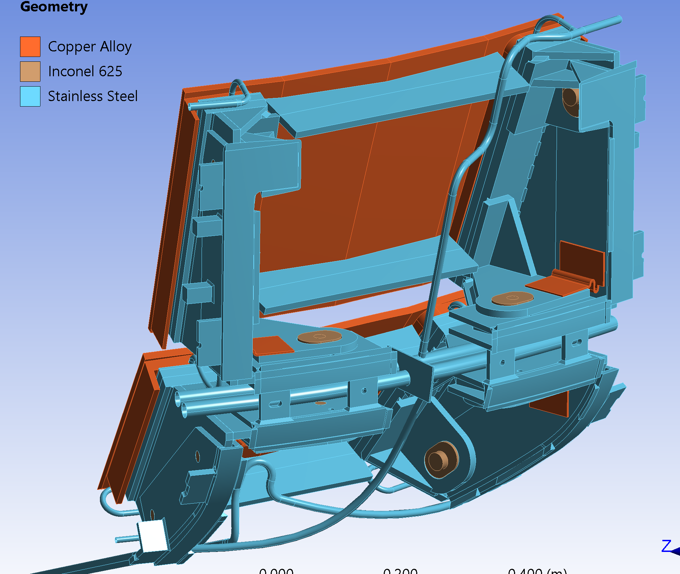
3. Passive plate issues remedied with additional hardware
Passive plates are Cu conductive plates covered by graphite tiles
Plates suppress plasma instabilities
Issues, and → resolution:
Plates flexing under disruption EM load →Plate back stiffeners
Unacceptable motion in plate bracketry →Stronger bolts, augment in-situ fasteners
Non-uniform electrical resistivity →Dedicated electrical connections (straps)
Excessive EM loads on He bakeout tubes →Dedicated tube supports
Solutions can be implemented without significant disassembly
Tube Support
19”
Plate Stiffeners
External Biscuit & Supports
Electric Strap

Slide 9
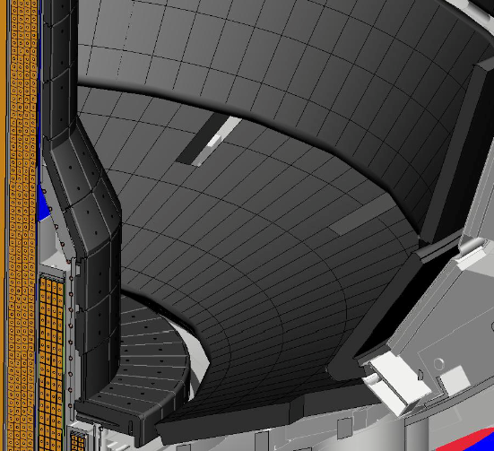
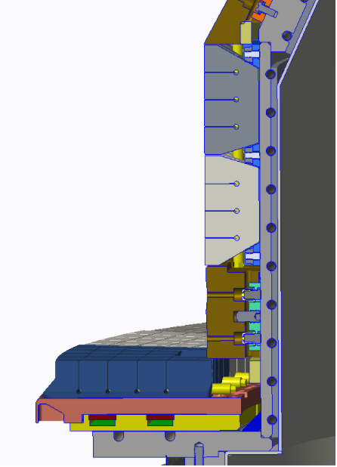
4. New tile designs meet thermal and EM load requirements
Note: original NSTX-U PFC design shown here
Retained
Passive Plate PFCs
Re-designed high-heat-flux tiles improve thermal performance, reliability:
→ Castellations minimize the material stresses for a given surface temperature
→ Fish-scaling protects all leading edges
Redesigned
Low Heat Flux PFCs
Vertical Divertor Target Tiles
Horizontal Divertor Target Tiles
Redesigned High Heat Flux PFCs
Tile Tray
Heat Transfer Plate

Slide 10
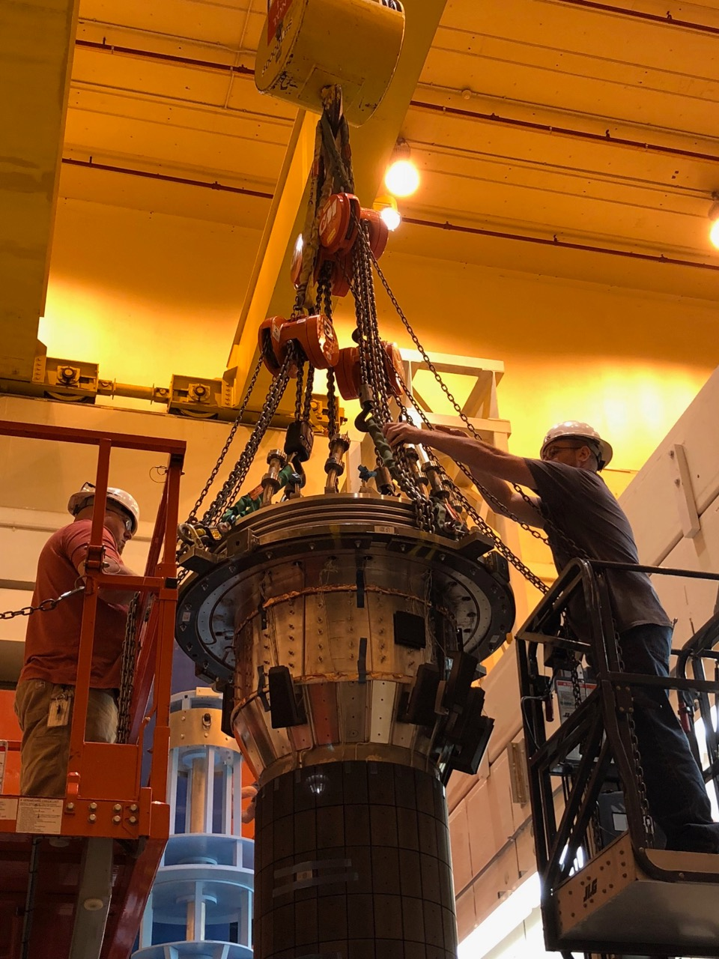
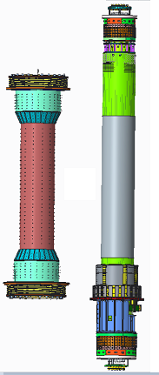
5. Alignment / tolerances managed via systems engineering
Issues from NSTX-U / 2016 run:
Casing significantly tilted relative to TF, TF tilted relative to VF → locked modes, NTV rotation damping degraded global stability
Casing-OH micro-therm insulation showed signs of damage when casing was removed
Recovery: comprehensive alignment requirements and tolerance allocations
TF and divertor PF coils / divertor targets → non-axisymmetric heat fluxes on divertor PFCs
Inner TF / vertical field coils → global stability
FY18: Successful casing/TF-bundle trial-fit
 | Requirement | Achieved
tilt [mrad] | 0.4 | 0.14
shift [in] | 0.078 | 0.015

Slide 11
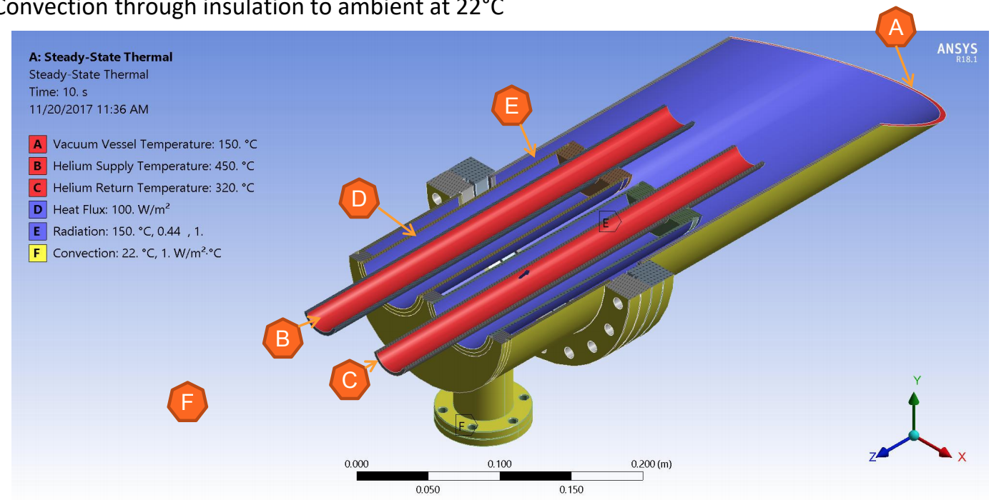
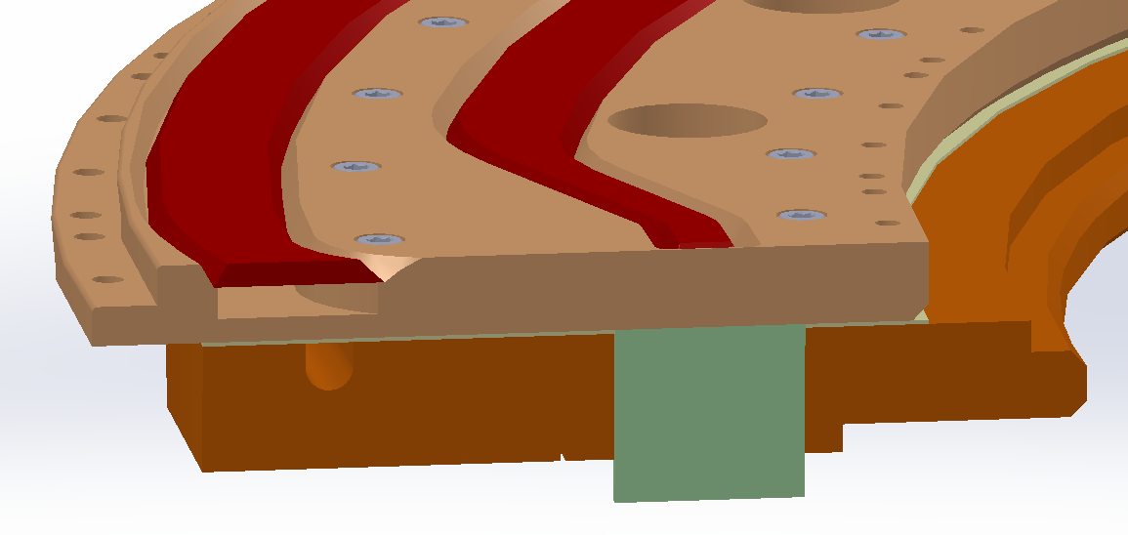
6. Bakeout scope will improve safety and performance
Additional interlocks/safety devices to mitigate risk of vaporization of 150C water for vessel bake
Implement 6 new hot-He feed-thrus to replace existing designs that exceed thermal stress allowable
Improve measurements and control of hot He distribution
Heat transfer plate to improve He bake
Grafoil
Casing Flange
Feedthru Puck

Slide 12
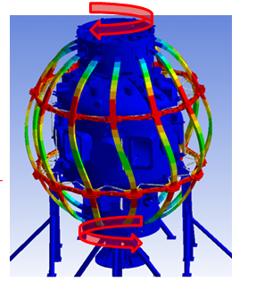
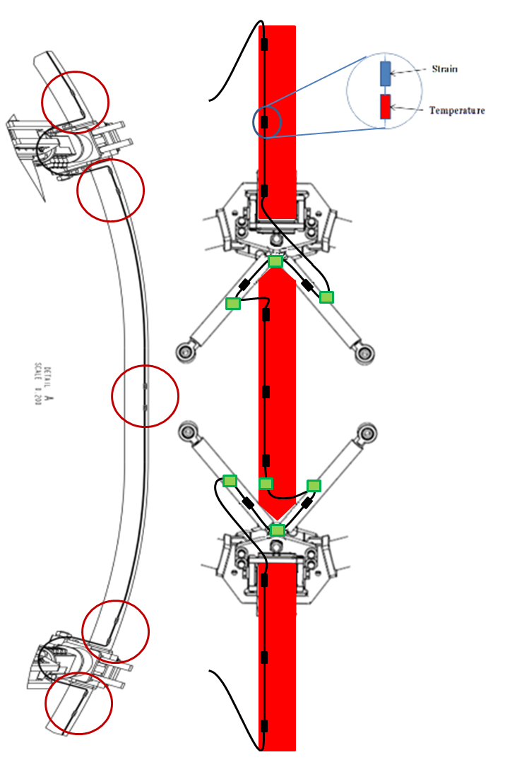
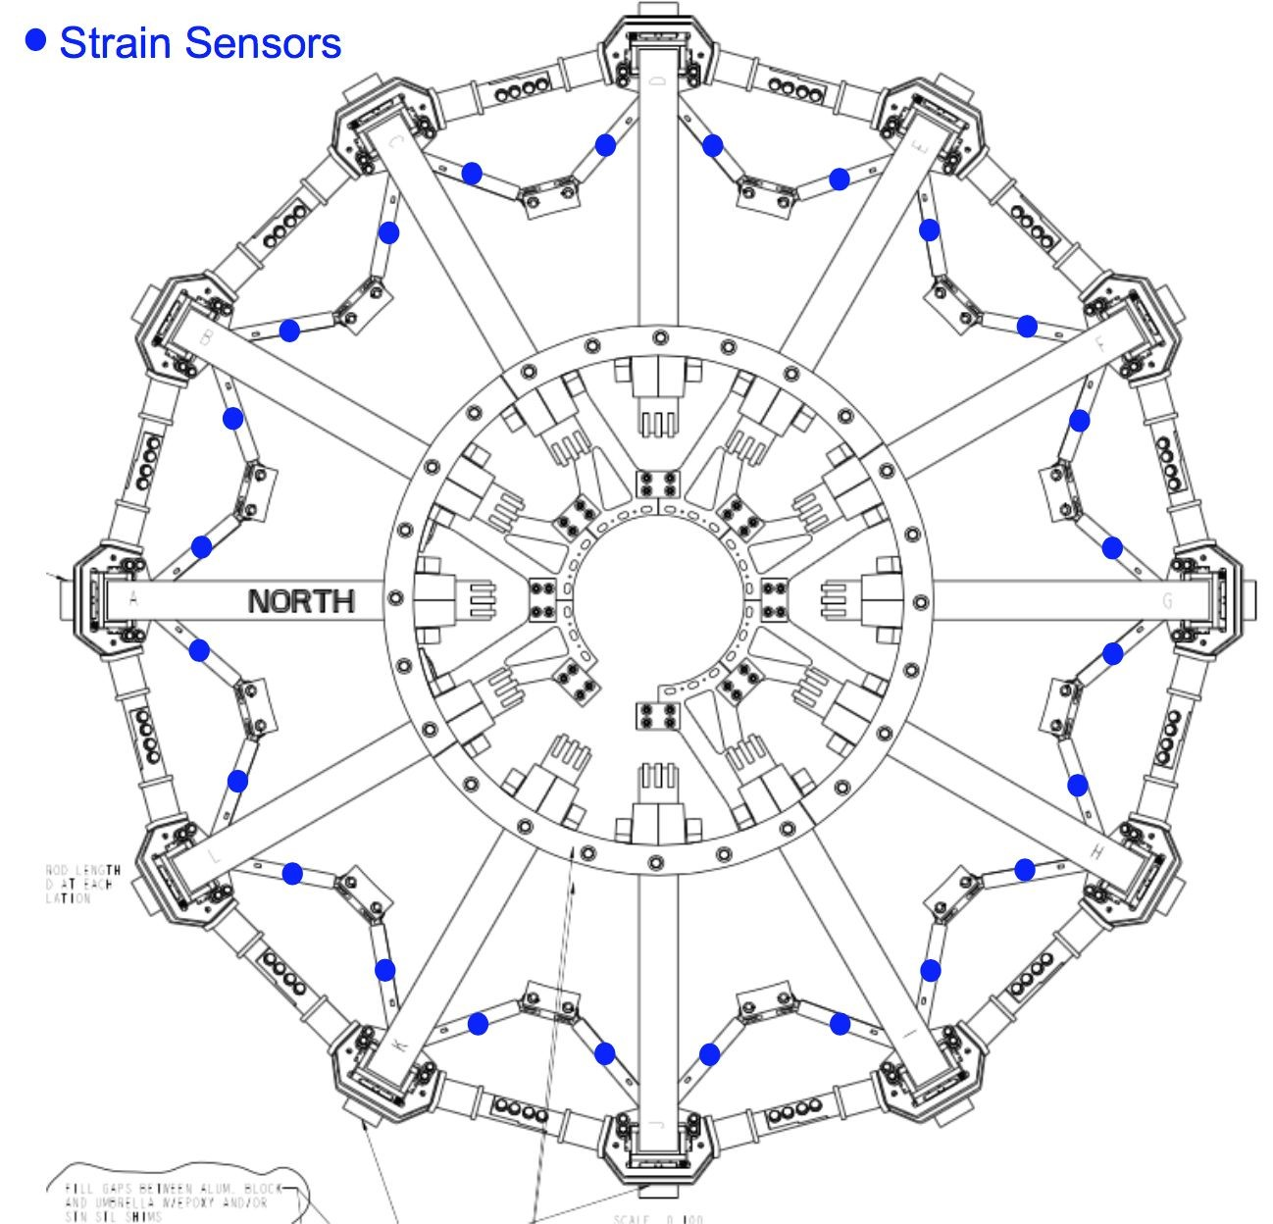
7. Machine instrumentation will diagnose and trend machine behavior
1: Global EM Torque on Coils, Transferred to Vessel
2: Requirement for Strain Sensors on Coils & Trusses
3: Design utilizing high sensor count fiber Bragg technology
High Stress Region of Outer-TF Coil
Validate structural models that are basis for designs and coil protection systems
Trend behavior / degradation of any critical components of the machine

Slide 13
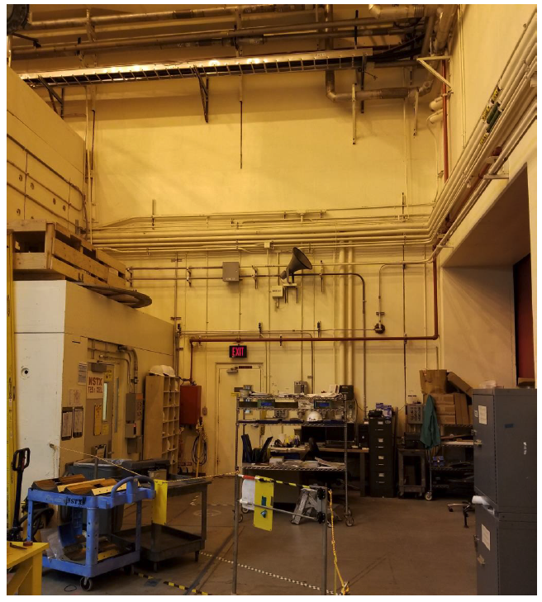
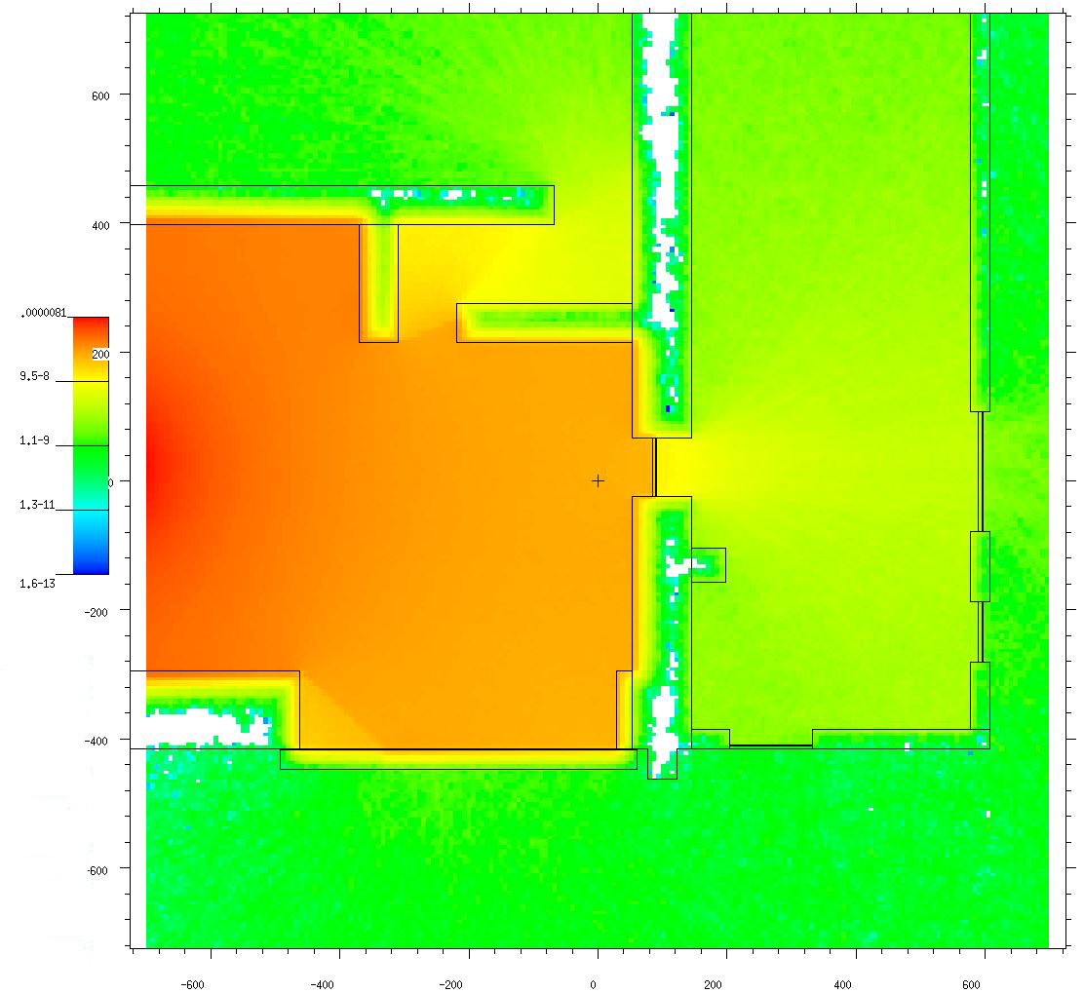
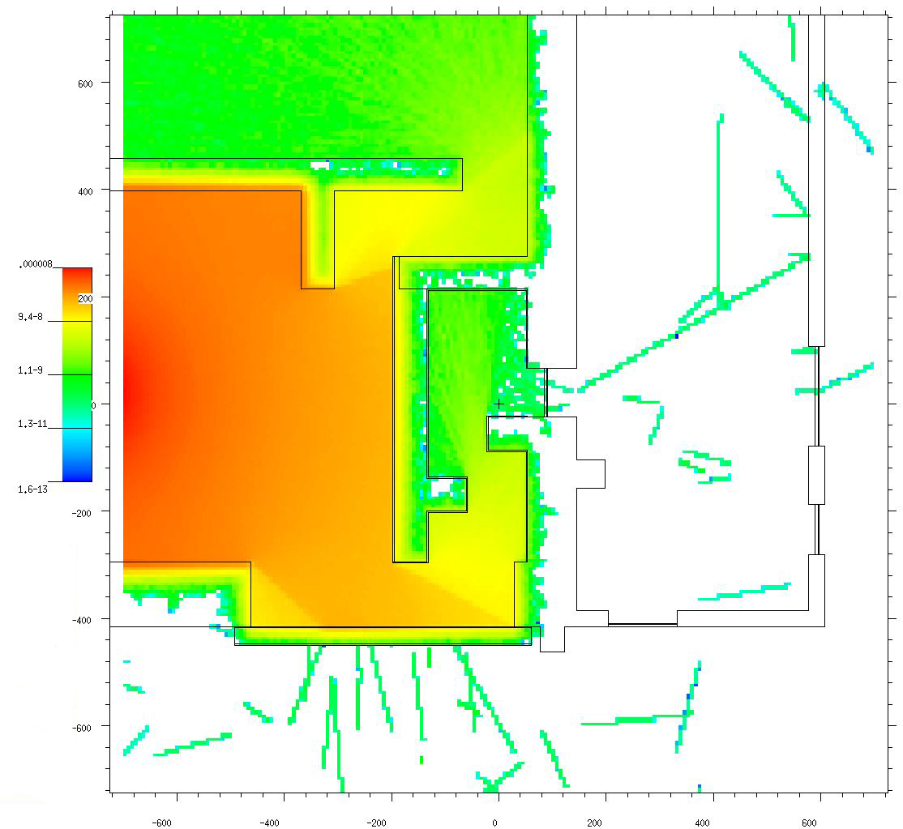
8. Neutron shielding designs support NSTX-U full performance operation (2MA, 1T, 10MW, 5s)
In south high bay, looking toward gallery door
Present Status
After additional Labyrinth
East Gallery
Potentially Unacceptable Dose During Future Ops
East Gallery
Accessible During Ops
NBPC Building Unacceptable Dose During Future Ops
NBPC Building Accessible During Ops
Test Cell Proper
South High Bay
No Access During Ops
South High Bay
No Access During Ops
Neutrons come over shield wall, can exit through door.
MCNP: Attenuate 99.9% neutrons through doors/windows
13

Slide 14
Summary
NSTX-U Recovery critical for U.S. to retain world-leading improved-reliability user facility for ST science
Recovery technical scope has progressed significantly
Project execution plan, integrated project team in place
Timeline:
FY19: Baseline project, complete design, initiate fabrication
FY20: Fabrication, installation
FY21: Final installs, commission, 1st plasma, resume research

Slide 15
Backup

Slide 16
Recovery scope is critical to Research program
Rebuild all 6 inner-PF coils
Ensure overall core device reliability and availability for users
Strong shaping / high β, divertor heat flux mitigation, advanced divertors
Improve the “polar regions” = top and bottom-most regions of vacuum chamber
Ensure high vacuum / reduce impurities for high confinement, lithium
Repair passively conducting plates
Access strongest shaping and highest β at full field and current (1T, 2MA) to stay world-leading
Replace plasma facing components that cannot be qualified
Support device full performance: 1T, 2MA, 10MW, 5s to stay world-leading, ensure reliability
Reassemble NSTX-U with improved alignment of magnets and structures
Maximize plasma performance: high rotation, β, confinement, exhaust power handling
Design and install improved Bakeout System
Eliminate safety issues, potential reliability issues
Implement mechanical instrumentation
Verify machine performance consistent with engineering models, ensure reliability
Improve test-cell neutron shielding, implement ASO and Personnel Safety System (PSS)
Facility operational excellence, support higher performance and increased DD neutron yield

