Slide 1

Validation of Ion and Electron Scale Gyrokinetic Simulations in NSTX and Comparisons with a High-k Scattering Synthetic Diagnostic
J. Ruiz Ruiz¹
W. Guttenfelder², A. E. White¹, N. Howard¹, N. F. Loureiro¹, J. Candy³, Y. Ren², D. R. Smith⁴, C. Holland⁵
1. MIT 2. PPPL 3. General Atomics 4. U Wisconsin 5. UCSD
60th Annual Meeting of the APS Division of Plasma Physics
Portland, Oregon, Nov 5-9, 2018
Work supported by DOE contracts DE-AC02-09CH11466 and DE-AC02-05CH11231

Slide 2
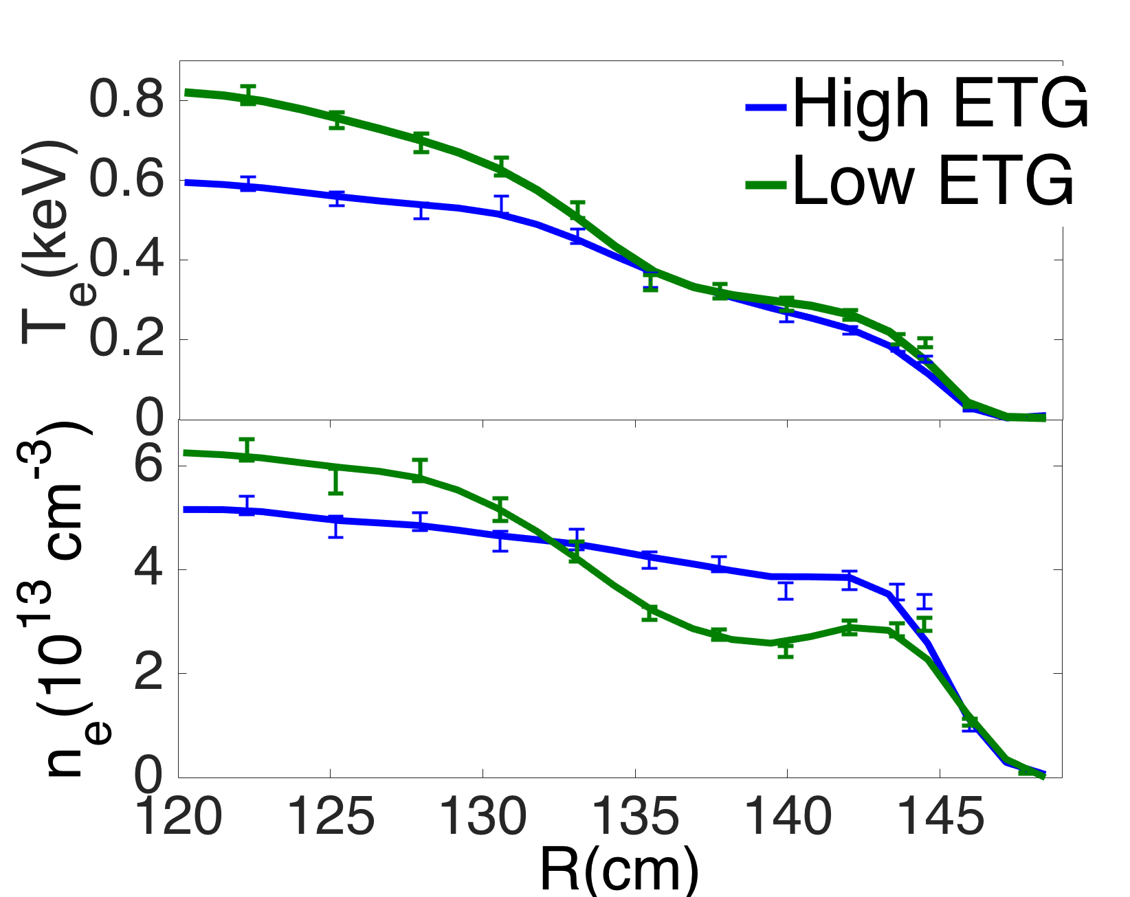
Extensive validation effort underway to study electron thermal transport in NSTX H-mode plasma
I_{p} [MA]
NBI heated H-mode with controlled current ramp-down; two steady discharge phases, little MHD activity
Local increase in equilibrium density gradient |∇n| modifies ETG drive from strong to weak, consistent with changes in measured high-k turbulence [Ruiz Ruiz PoP 2015]
In this work:
Compare experimental heat fluxes and measured high-k turbulence are to validate extensive set of nonlinear ion-scale and electron-scale gyrokinetic simulations
  Strong ETG Drive Time
  Weak ETG Drive Time
0.1
0.2
0.3
0.4
0.5
0.6
t [s]
  Strong ETG Drive
  Weak ETG Drive
Scatt. Region
r/a~0.7
Notes:
Slide with shear and q in r!

Slide 3
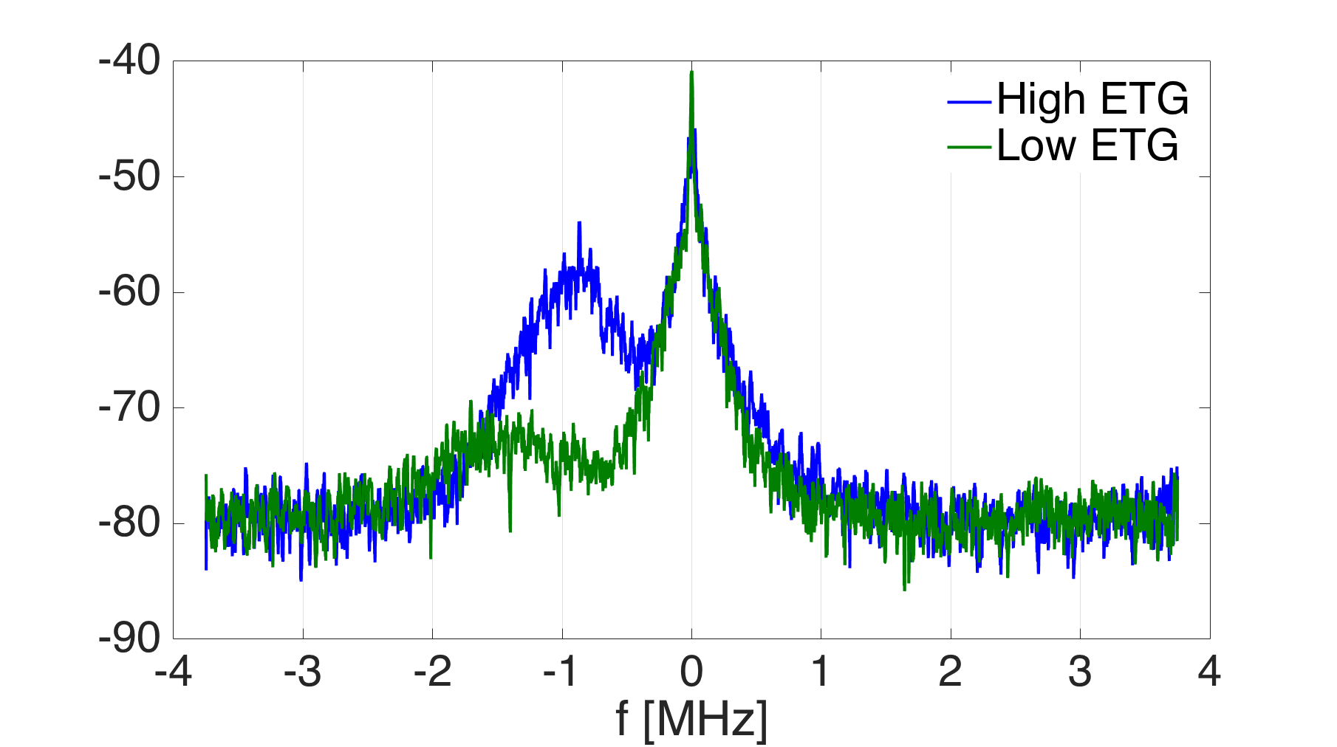
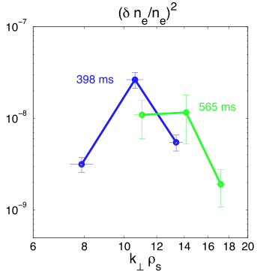
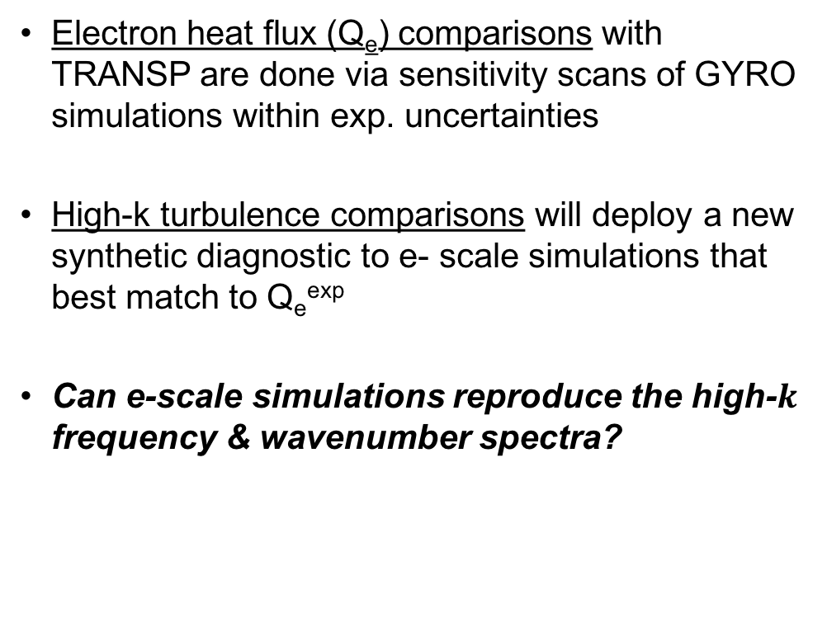


Compare experimental Q_{e} to all simulations; measured high-k turbulence only to e- scale simulations
$$P\left(f\right)∝{\left|δn\right|}^{2}$$
Electron heat flux (Q_{e}) comparisons with TRANSP are done via sensitivity scans of GYRO simulations within exp. uncertainties
High-k turbulence comparisons will deploy a new synthetic diagnostic to e- scale simulations that best match to Q_{e}^{exp}
Can e-scale simulations reproduce the high-$k$ frequency & wavenumber spectra?
EXP
  Strong ETG drive
  Weak ETG drive
$$P\left(k\right)∝{\left|δn\right|}^{2}$$
EXP
  Strong ETG
  Weak ETG
Notes:
Cannot apply synthetic diagnostic to ion scale simulations (would need multiscale sim)
Slide with shear and q in r!

Slide 4
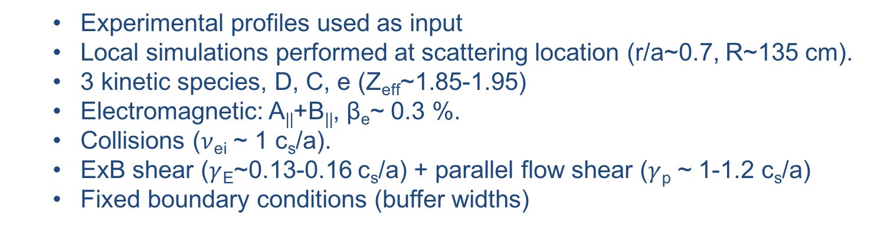
GYRO code is used to perform ion-scale and electron-scale nonlinear gyrokinetic simulations
  Ion scale simulation resolves low-k turbulence k_{θ}ρ_{s} ⪝ 1
  Electron scale simulation resolves ETG-scale turbulence 1 < k_{θ}ρ_{s} ⪝ 60
Ion scale
Electron Scale
k_{θ}𝝆_{s}
0.1
1
10
high-k diagnostic
  Experimental profiles used as input
  Local simulations performed at scattering location (r/a~0.7, R~135 cm).
  3 kinetic species, D, C, e (Z_{eff}~1.85-1.95)
  Electromagnetic: A||+B||, β_{e}~ 0.3 %.
  Collisions ($ν$_{ei} ~ 1 c_{s}/a).
  ExB shear ($γ$_{E}~0.13-0.16 c_{s}/a) + parallel flow shear ($γ$_{p} ~ 1-1.2 c_{s}/a)
  Fixed boundary conditions (buffer widths)
Notes:
Mention necessity of hybrid scale for accurate deployment of syn diagnostic

Slide 5
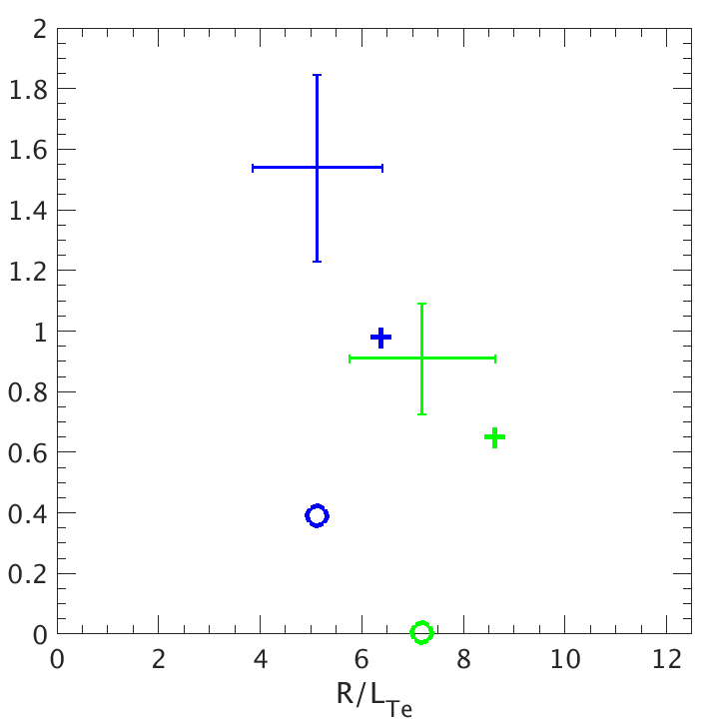
Local ion and electron-scale simulations under-predict experimental Q_{e} with experimental gradients as input
P_{e} [MW]
  Strong ETG drive time
  Weak ETG drive time
EXP
scan
EXP
e- scale sim
e- scale sim
ion scale sim
ion scale sim
P_{e} [MW] = Q_{e} [MW/m²] * Area
Notes:
Qi close to neoclassical levels
Will name Pe & Qe interchangeably, in this presentation always use Pe [MW]
Power-heat flux interchangeably

Slide 6
Sensitivity Scans for Heat Flux Comparisons
Notes:
Both ion and electron scale simulations

Slide 7
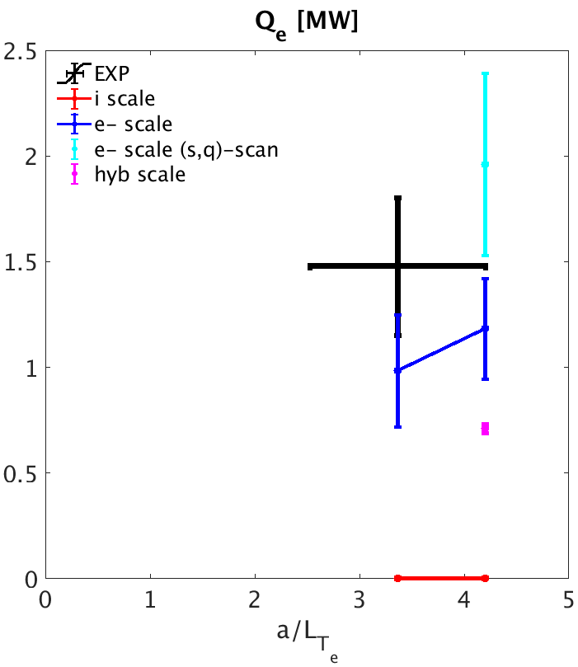
Strong ETG drive condition: electron scale simulations can match Q_{e}^{exp} within experimental uncertainty
Sensitivity scans carried out to maximize turbulent drive within error bars
a/L_{n} scaled 1-𝜎
a/L_{n} scaled 1-𝜎
Notes:
ETG highly unstable
Sensitivity scans for highest drives
Simulations are converged in box size, dr-resolution and $k_{θ}$-resolution
Only show alne_scaled

Slide 8
Strong ETG drive condition: electron scale simulations can match Q_{e}^{exp} within experimental uncertainty
Sensitivity scans carried out to maximize turbulent drive within error bars
Ion scale simulation
Scans (a/L_{T}, a/L_{n})
Suppressed by ExB shear (Q_{e}^{sim} ~ 0)
a/L_{n} scaled 1-𝜎
a/L_{n} scaled 1-𝜎
Notes:
ETG highly unstable
Sensitivity scans for highest drives
Simulations are converged in box size, dr-resolution and $k_{θ}$-resolution
Only show alne_scaled

Slide 9
Strong ETG drive condition: electron scale simulations can match Q_{e}^{exp} within experimental uncertainty
Sensitivity scans carried out to maximize turbulent drive within error bars
Ion scale simulation
Scans (a/L_{T}, a/L_{n})
Suppressed by ExB shear (Q_{e}^{sim} ~ 0)
Electron scale simulation
Scans (a/L_{T}, a/L_{n})
Can match Q_{e}^{exp}
a/L_{n} scaled 1-𝜎
a/L_{n} scaled 1-𝜎
Notes:
ETG highly unstable
Sensitivity scans for highest drives
Simulations are converged in box size, dr-resolution and $k_{θ}$-resolution
Only show alne_scaled

Slide 10
Strong ETG drive condition: electron scale simulations can match Q_{e}^{exp} within experimental uncertainty
Sensitivity scans carried out to maximize turbulent drive within error bars
Ion scale simulation
Scans (a/L_{T}, a/L_{n})
Suppressed by ExB shear (Q_{e}^{sim} ~ 0)
Electron scale simulation
Scans (a/L_{T}, a/L_{n})
Can match Q_{e}^{exp}
Electron scale simulation
Scan (a/L_{T}, a/L_{n}, q, s)
Can match Q_{e}^{exp}
a/L_{n} scaled 1-𝜎
a/L_{n} scaled 1-𝜎
Notes:
ETG highly unstable
Sensitivity scans for highest drives
Uncertainties in eq reconstruction --> scans in q, s can further enhance Qe --> build on confidence that ETG is responsible for Qe
Simulations are converged in box size, dr-resolution and $k_{θ}$-resolution

Slide 11
Strong ETG drive condition: electron scale simulations can match Q_{e}^{exp} within experimental uncertainty
Sensitivity scans carried out to maximize turbulent drive within error bars
Ion scale simulation
Scans (a/L_{T}, a/L_{n})
Suppressed by ExB shear (Q_{e}^{sim} ~ 0)
Electron scale simulation
Scans (a/L_{T}, a/L_{n})
Can match Q_{e}^{exp}
Electron scale simulation
Scan (a/L_{T}, a/L_{n}, q, s)
Can match Q_{e}^{exp}
a/L_{n} scaled 1-𝜎
a/L_{n} scaled 1-𝜎
Ion heat flux Qi close to neoclassical levels
Notes:
Simulations are converged in box size, dr-resolution and $k_{θ}$-resolution
Qi close to neoclassical levels within exp uncertainty

Slide 12
Strong ETG drive condition: electron scale simulations can match Q_{e}^{exp} within experimental uncertainty
Sensitivity scans carried out to maximize turbulent drive within error bars
Ion scale simulation
Scans (a/L_{T}, a/L_{n})
Suppressed by ExB shear (Q_{e}^{sim} ~ 0)
Electron scale simulation
Scans (a/L_{T}, a/L_{n})
Can match Q_{e}^{exp}
Electron scale simulation
Scan (a/L_{T}, a/L_{n}, q, s)
Can match Q_{e}^{exp}
a/L_{n} scaled 1-𝜎
a/L_{n} scaled 1-𝜎
Conclusions from strong ETG drive:
ETG alone can explain Q_{e}^{exp}
Ion scale turbulence suppressed
Ion heat flux Qi close to neoclassical levels
Notes:
Simulations are converged in box size, dr-resolution and $k_{θ}$-resolution
Qi close to neoclassical levels within exp uncertainty

Slide 13
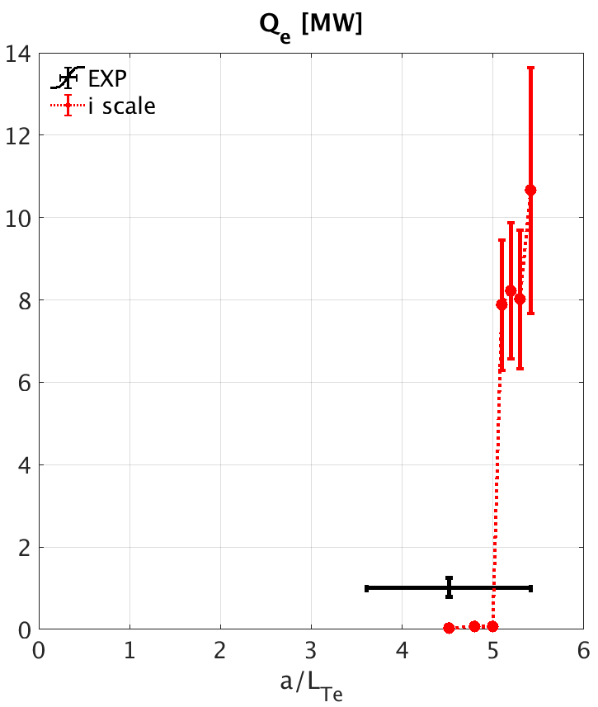
Weak ETG drive condition: sensitivity scans for ion scale simulations bracket Q_{e}^{exp} within error bars
a/L_{n} scaled 1-𝜎
Ion scale sim (TEM)
Scans in a/L_{T}, (a/L_{n} scaled 1-𝜎)
Extremely stiff: Q_{e}^{sim} → 10 X Q_{e}^{exp} !!
EXP
Notes:
Ion scale in- ‘Dimits shift
Both ion and e- scale turbulence near NL threshold

Slide 14
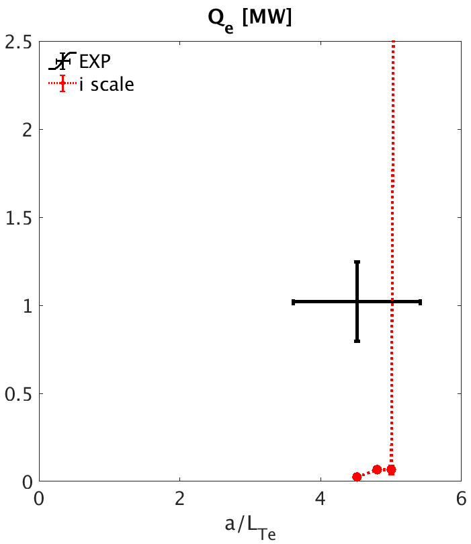
Weak ETG drive condition: sensitivity scans for ion scale simulations bracket Q_{e}^{exp} within error bars
a/L_{n} scaled 1-𝜎
ZOOM
Ion scale sim (TEM)
Scans in a/L_{T}, (a/L_{n} scaled 1-𝜎)
Extremely stiff: Q_{e}^{sim} → 10 X Q_{e}^{exp} !!
Notes:
Ion scale in- ‘Dimits shift
Both ion and e- scale turbulence near NL threshold

Slide 15
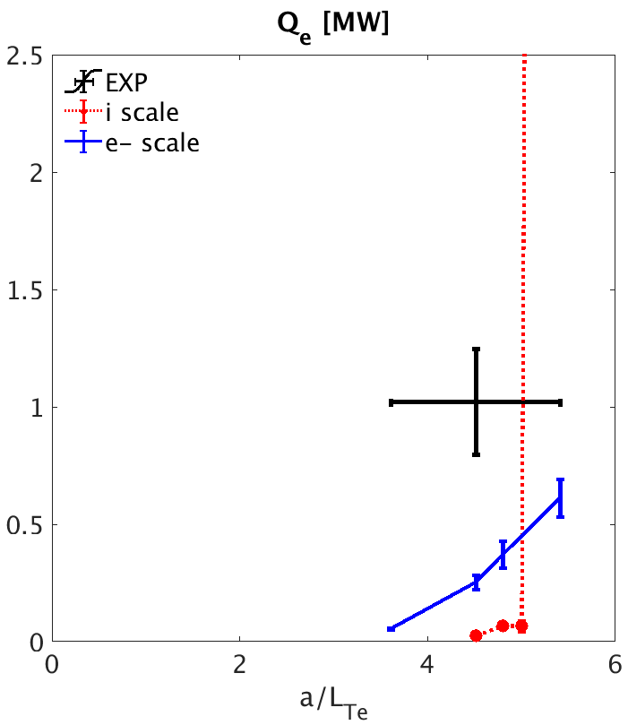
Weak ETG drive condition: sensitivity scans for ion scale simulations bracket Q_{e}^{exp} within error bars
a/L_{n} scaled 1-𝜎
ZOOM
Ion scale sim (TEM)
Scans in a/L_{T}, (a/L_{n} scaled 1-𝜎)
Extremely stiff: Q_{e}^{sim} → 10 X Q_{e}^{exp} !!
Electron scale sim (ETG)
Scans in a/L_{T}, (a/L_{n} scaled 1-𝜎)
Less stiff, under-predicts Q_{e}^{exp}
Ion heat flux Qi close to neoclassical levels
Notes:
Ion scale in- ‘Dimits shift
Both ion and e- scale turbulence near NL threshold

Slide 16
Weak ETG drive condition: sensitivity scans for ion scale simulations bracket Q_{e}^{exp} within error bars
a/L_{n} scaled 1-𝜎
ZOOM
Ion scale sim (TEM)
Scans in a/L_{T}, (a/L_{n} scaled 1-𝜎)
Extremely stiff: Q_{e}^{sim} → 10 X Q_{e}^{exp} !!
Electron scale sim (ETG)
Scans in a/L_{T}, (a/L_{n} scaled 1-𝜎)
Less stiff, under-predicts Q_{e}^{exp}
Conclusion at weak ETG Drive:
Ion-scale simulation can bracket Q_{e}^{exp}
Electron scale turb. active, cannot match Q_{e}^{exp}
Ion heat flux Qi close to neoclassical levels
Notes:
Ion scale in- ‘Dimits shift
Both ion and e- scale turbulence near NL threshold

Slide 17
High-k Turbulence Comparisons

Slide 18
Deploy synthetic diagnostic to highest Q_{e}
e- scale simulations
Strong ETG Drive
Weak ETG Drive
a/L_{n} scaled 1-𝜎
Notes:
Pink simulation dot at Strong ETG
Blue simulation dot at Weak ETG Drive

Slide 19
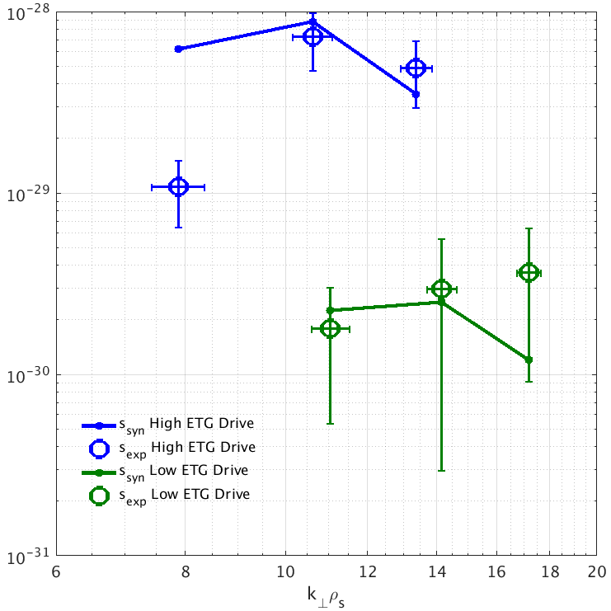

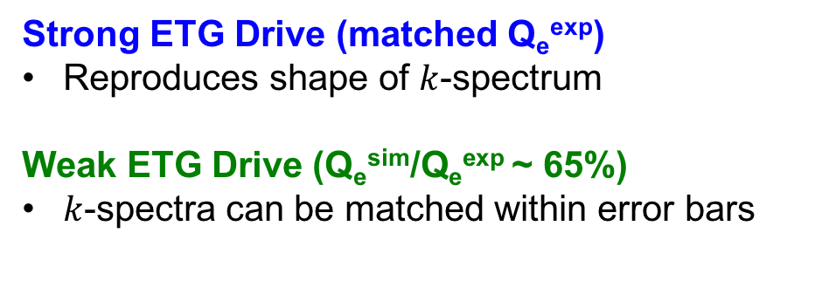
Highest Q_{e} e- scale simulations match k-spectrum shape and fluctuation level ratio
$$S\left({\vec{k}}_{exp}\right)$$
Strong ETG Drive (matched Q_{e}^{exp})
Reproduces shape of $k$-spectrum
Weak ETG Drive (Q_{e}^{sim}/Q_{e}^{exp} ~ 65%)
$k$-spectra can be matched within error bars
GYRO
exp
GYRO
exp
e- scale sims
Notes:
– e- scale sim does not correctly resolve enough modes in synthetic signal, need to resolve more k’s to quantitatively reproduce turbulent f-spectrum
Hybrid scale sim at high ETG Drive has lower fluctuation power – cannot match k-spectrum
k-resolution in e- scale simulation is too coarse for quantitative comparisons of $f$-spectra

Slide 20
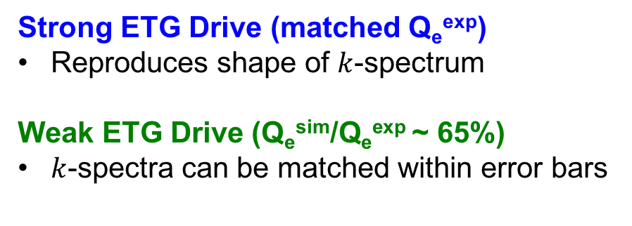
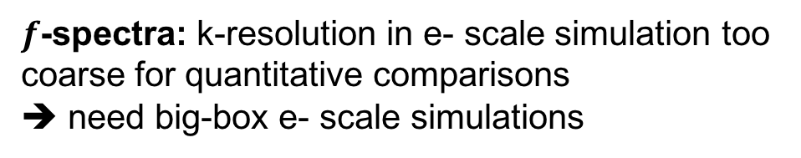
Highest Q_{e} e- scale simulations match k-spectrum shape and fluctuation level ratio
$$S\left({\vec{k}}_{exp}\right)$$
Strong ETG Drive (matched Q_{e}^{exp})
Reproduces shape of $k$-spectrum
Weak ETG Drive (Q_{e}^{sim}/Q_{e}^{exp} ~ 65%)
$k$-spectra can be matched within error bars
GYRO
exp
Can match fluctuation level ratio
S(Strong ETG Drive)/S(weak ETG Drive)
GYRO
exp
$f$-spectra: k-resolution in e- scale simulation too coarse for quantitative comparisons
➔ need big-box e- scale simulations
e- scale sims
Notes:
– e- scale sim does not correctly resolve enough modes in synthetic signal, need to resolve more k’s to quantitatively reproduce turbulent f-spectrum
Big-box e- scale sim at high ETG Drive has lower fluctuation power – cannot match k-spectrum
Big-box e- scale simulations recover much better prediction of frequency spectra than e- scale simulations, not so much k-spectra
k-resolution in e- scale simulation is too coarse for quantitative comparisons of $f$-spectra

Slide 21

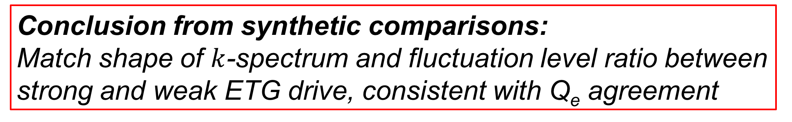
Highest Q_{e} e- scale simulations match k-spectrum shape and fluctuation level ratio
$$S\left({\vec{k}}_{exp}\right)$$
Strong ETG Drive (matched Q_{e}^{exp})
Reproduces shape of $k$-spectrum
Weak ETG Drive (Q_{e}^{sim}/Q_{e}^{exp} ~ 65%)
$k$-spectra can be matched within error bars
GYRO
exp
Can match fluctuation level ratio
S(Strong ETG Drive)/S(weak ETG Drive)
GYRO
exp
$f$-spectra: k-resolution in e- scale simulation too coarse for quantitative comparisons
➔ need big-box e- scale simulations
Conclusion from synthetic comparisons:
Match shape of $k$-spectrum and fluctuation level ratio between strong and weak ETG drive, consistent with Q_{e} agreement
e- scale sims
Notes:
– e- scale sim does not correctly resolve enough modes in synthetic signal, need to resolve more k’s to quantitatively reproduce turbulent f-spectrum
Hybrid scale sim at high ETG Drive has lower fluctuation power – cannot match k-spectrum
k-resolution in e- scale simulation is too coarse for quantitative comparisons of $f$-spectra

Slide 22
Conclusions and Next Steps
Strong ETG Drive
Ion-scale turbulence is suppressed
e- scale can match Q_{e}^{exp}, consistent with agreement in high-k wavenumber spectrum
e- scale turbulence (ETG) is likely responsible for Q_{e}^{exp}
Weak ETG Drive
Ion scale sim can bracket Q_{e}^{exp} , extremely stiff transport
Electron scale is active, under-predicts Q_{e}^{exp}
Ion scale turbulence (TEM) might be responsible for most Q_{e}^{exp}, cross-scale interactions likely important (ETG active)
Next Steps
Multi-scale simulation of NSTX H-mode + quant. comparisons with syn. diagnostic
Deploy synthetic diagnostic for additional NSTX discharges
Projections of new high-k diagnostic for NSTX-U
Notes:
Carried extensive validation effort for ion and electron scale GK sims in NSTX H mode plasma

Slide 23
Additional Material

Slide 24
Input Parameters into Nonlinear Gyrokinetic Simulations Presented
 | t=398 | t = 565
r/a | 0.71 | 0.68
a [m] | 0.6012 | 0.596
n_{e} [10^19 m-3] | 4.27 | 3.43
T_{e}[keV] | 0.39 | 0.401
a/L_{ne} | 1.005 | 4.06
a/L_{Te} | 3.36 | 4.51
β_{e}^{unit} | 0.0027 | 0.003
a/L_{nD} | 1.497 | 4.08
a/L_{Ti} | 2.96 | 3.09
T_{i}/T_{e} | 1.13 | 1.39
n_{D}/n_{e} | 0.785030 | 0.80371
n_{c}/n_{e} | 0.035828 | 0.032715
a/L_{nC} | -0.87 | 4.08
a/L_{TC} | 2.96 | 3.09
Z_{eff} | 1.95 | 1.84
nu_{ei} (a/c_{s}) | 1.38 | 1.03
q | 3.79 | 3.07
s | 1.8 | 2.346
R₀/a | 1.52 | 1.59
SHIFT =dR₀/dr | -0.3 | -0.355
KAPPA = κ | 2.11 | 1.979
s_{k}=rdln(κ)/dr | 0.15 | 0.19
DELTA = δ | 0.25 | 0.168
s_{δ}=rd(δ)/dr | 0.32 | 0.32
M | 0.2965 | 0.407
γ_{E} | 0.126 | 0.1646
γ_{p} | 1.036 | 1.1558
ρ* | 0.003 | 0.0035
λ_{D}/a | 0.000037 | 0.0000426
c_{s}/a (10⁵ s-1) | 4.4 | 2.35
Qe (gB) | 3.82 | 0.0436
Qi (gB) | 0.018 | 0.0003
Bt_loc [T] | -0.35 | -0.35
c_{s} [m/s] | 2.10⁵ | 2.10⁵
𝛀_{i} [1/s] | 3.5*10⁷ | 3.5*10⁷

Slide 25
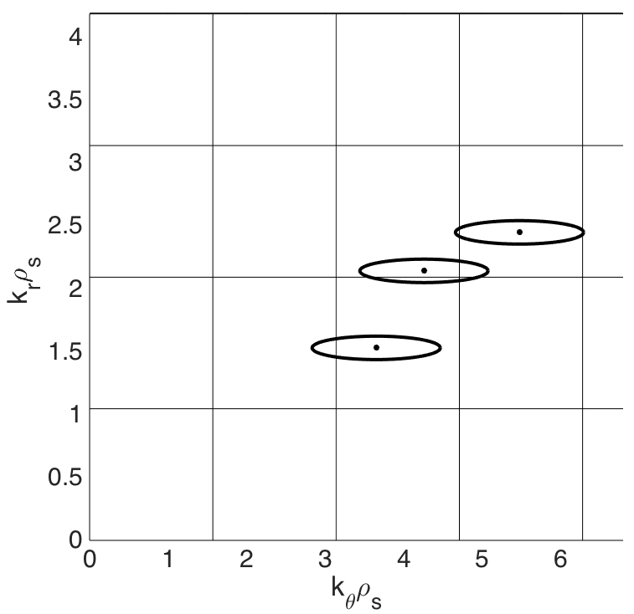
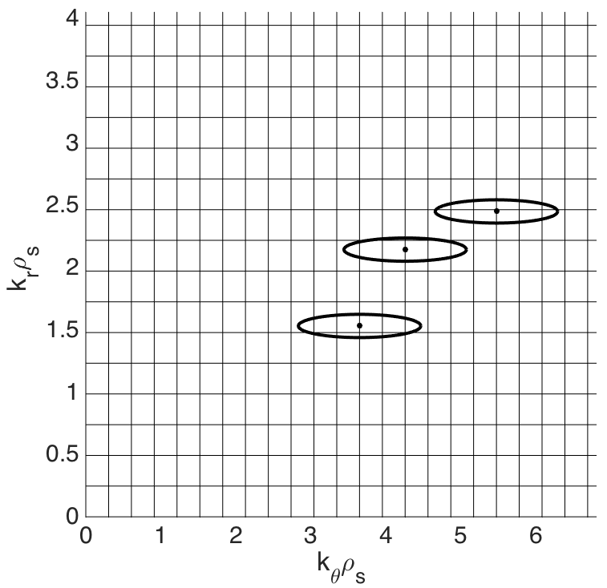
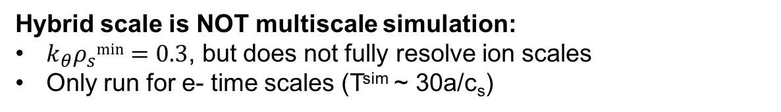
Hybrid Scale Simulation Necessary to Correctly Resolve High-k Scattering Wavenumber
Measurement-k from channels 1-3 of high-k scattering system in NSTX mapped to GYRO wavenumber grid
e- scale
hybrid scale
ch 1
ch 1
ch 2
ch 2
ch 3
ch 3
Hybrid scale is NOT multiscale simulation:
$k_{θ}ρ_{s}min=0.3$, but does not fully resolve ion scales
Only run for e- time scales (T^{sim} ~ 30a/c_{s})

Slide 26
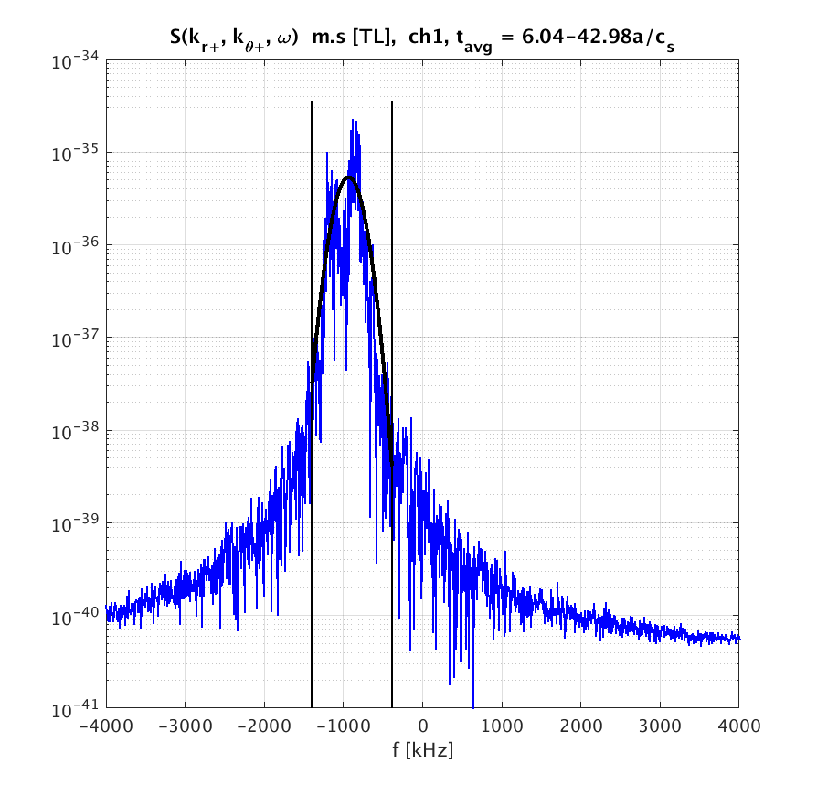
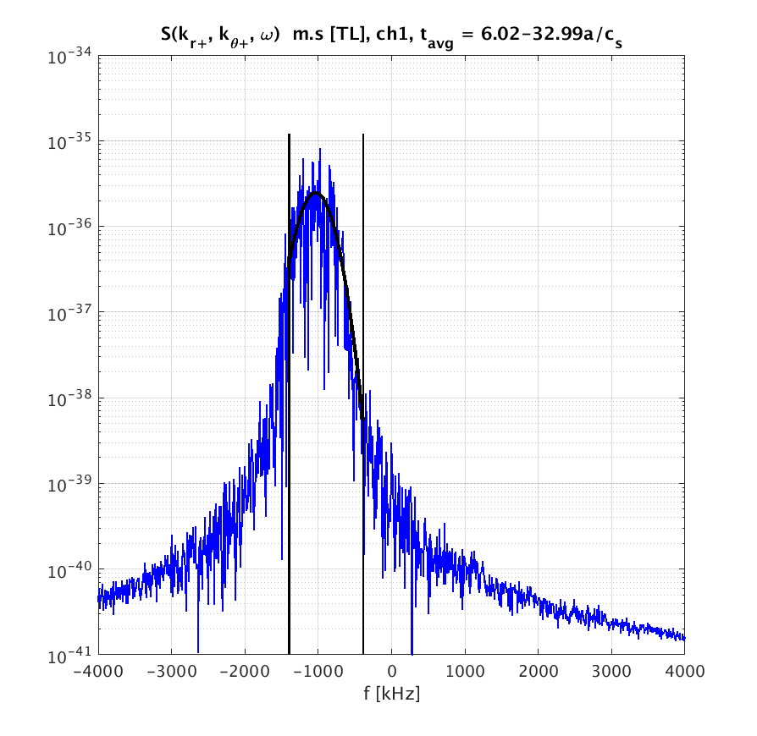
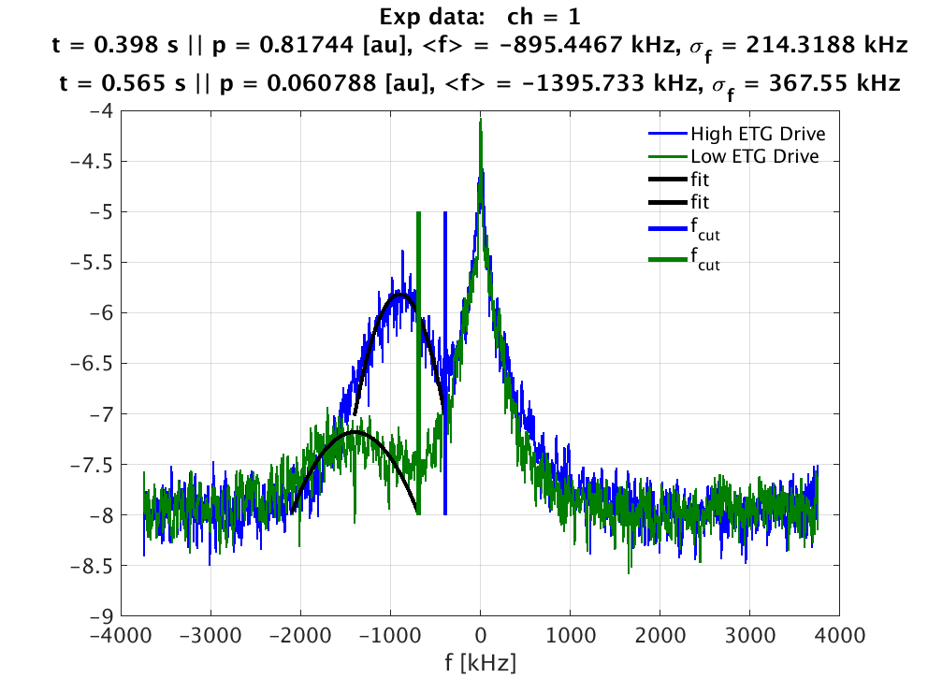
Synthetic f-spectrum at High ETG Drive, Ch1
e- scale
hyb scale

Slide 27
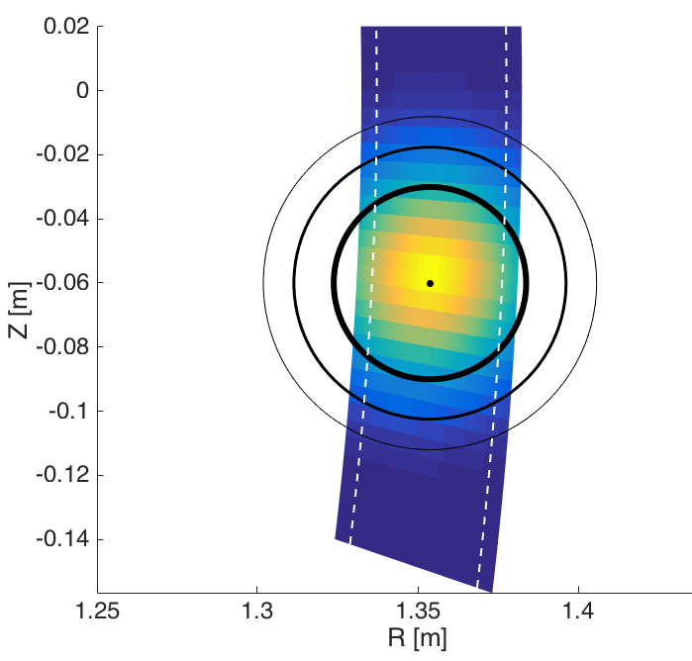
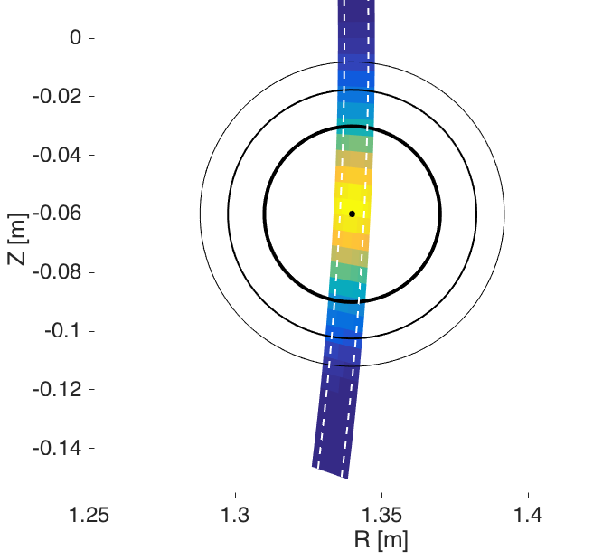
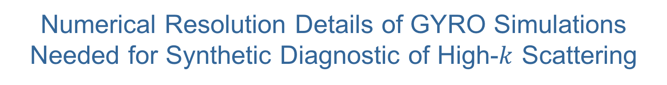
Numerical Resolution Details of GYRO Simulations Needed for Synthetic Diagnostic of High-$k$ Scattering
Extensive Box size scans show Hybrid Scale Simulation is trade off:
  Computational cost ~ 0.5 M CPU h
  Correctly resolving experimental k
Electron Scale Simulation:
  Only e- scale turbulence
Hybrid Scale
  L_{r} x L_{y} = 20-14 x 21-16 ρ_{s} (L/a~0.08)
  n_{r} x n = 512-450 x 140-220
Electron Scale
  L_{r} x L_{y} = 4 x 6 ρ_{s} (L/a ~0.02)
  n_{r} x n = 192 x 42
Notes:
Do not talk about full box

Slide 28
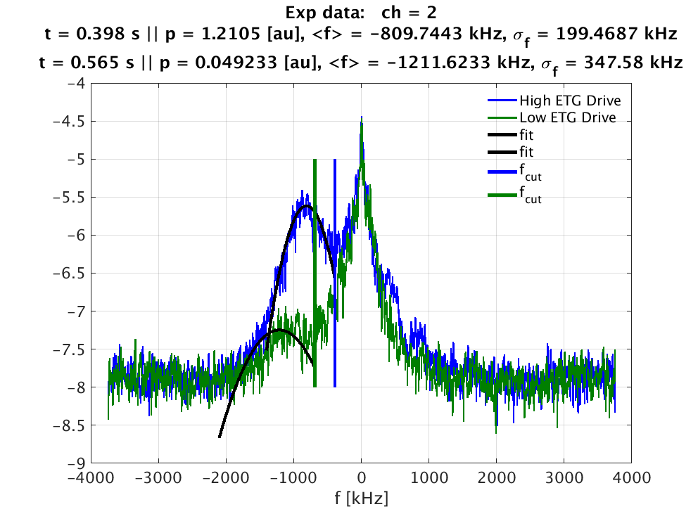
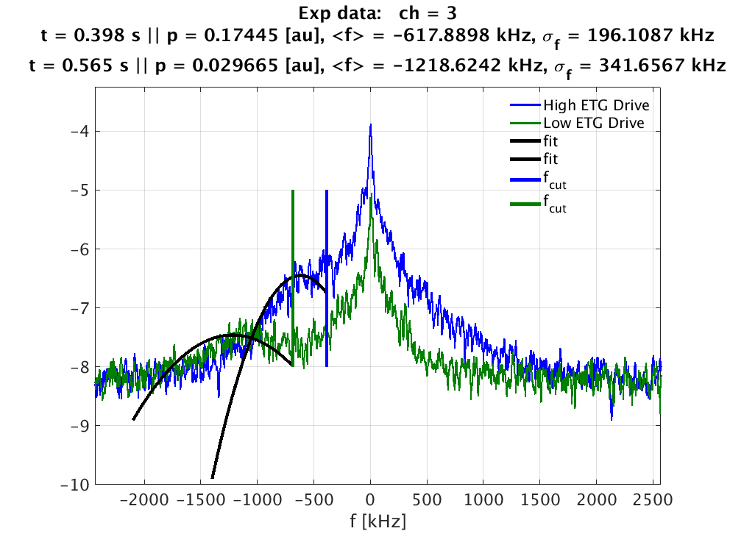
Experimental f-spectrum for ch1, 2, 3
High ETG Drive condition for ch3 has little doppler shift from f=0 (lowest k → low k.v)
→contamination of signal by f=0 noise peak

Slide 29
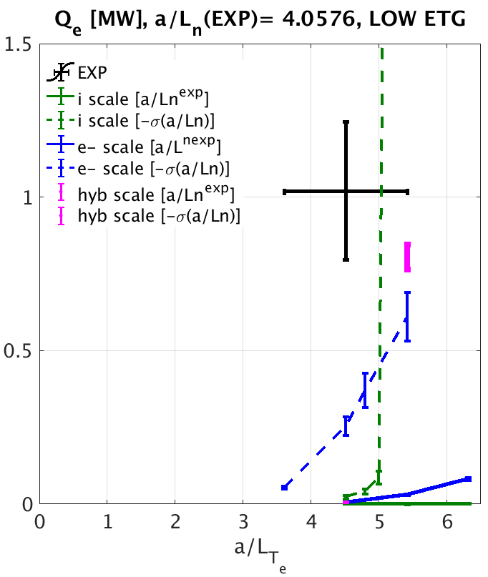
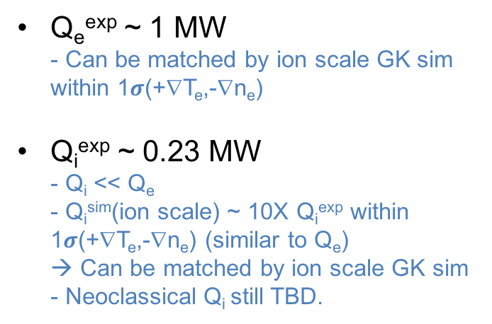
Total Thermal Transport Budget at Low ETG
Q_{e}^{exp} ~ 1 MW
- Can be matched by ion scale GK sim within 1$σ$(+∇T_{e},-∇n_{e})
Q_{i}^{exp} ~ 0.23 MW
- Q_{i} << Q_{e}
- Q_{i}^{sim}(ion scale) ~ 10X Q_{i}^{exp} within 1$σ$(+∇T_{e},-∇n_{e}) (similar to Q_{e})
→ Can be matched by ion scale GK sim
- Neoclassical Q_{i} still TBD.
Experiment sits near nonlinear threshold of both ion and electron scale turbulence.
Ionscale turbulence displays much higher stiffness than e- scale

Slide 30
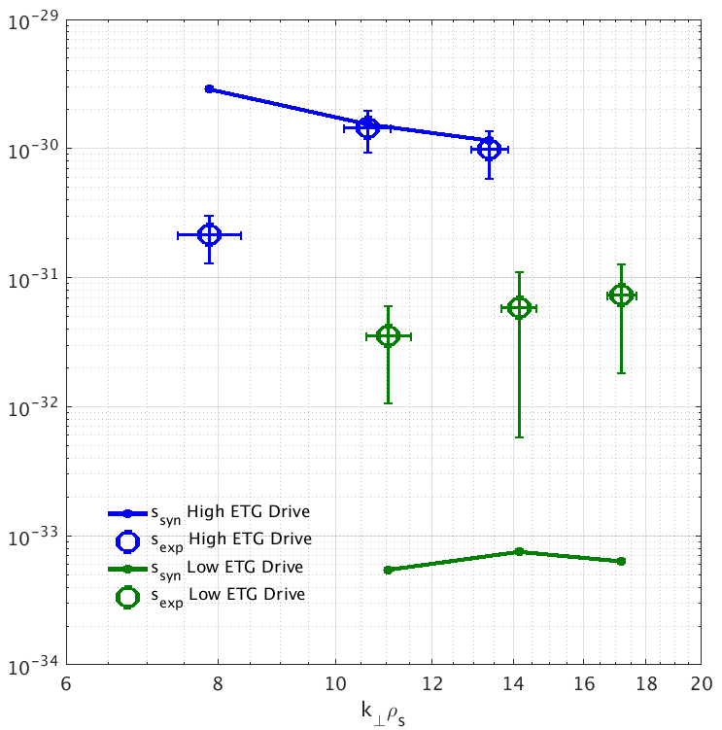
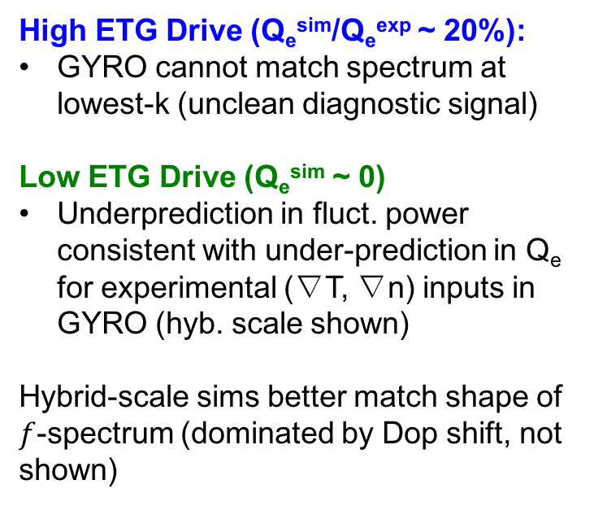

GYRO simulations using exp. inputs (∇T, ∇n)
under-predict fluctuation power at low ETG drive
$$S\left({\vec{k}}_{exp}\right)$$
High ETG Drive (Q_{e}^{sim}/Q_{e}^{exp} ~ 20%):
GYRO cannot match spectrum at lowest-k (unclean diagnostic signal)
Low ETG Drive (Q_{e}^{sim} ~ 0)
Underprediction in fluct. power consistent with under-prediction in Q_{e} for experimental (∇T, ∇n) inputs in GYRO (hyb. scale shown)
Hybrid-scale sims better match shape of $f$-spectrum (dominated by Dop shift, not shown)
GYRO
exp
exp
GYRO
Hybrid scale sims
Detected fluctuation power is scaled by constant (diagnostic not absolutely calibrated)
Notes:
Bpth for e- and hybrid scale simulations underpredict fluct power
– e- scale sim does not correctly resolve enough modes in synthetic signal
High ETG Drive lowest k signal contaminated by f=0 peak

Slide 31
Mapping (k_{r}ρ_{s},k_{θ}ρ_{s})_{GYRO} ➔ (k_{R}, k_{Z})^{exp}
Preamble 3 Wavenumber mapping under simplifying assumptions
Assumptions
  ζ=0, dζ/dr=0 (squareness + radial derivative)
  Z₀=0, dZ₀/dr=0 (elevation + radial derivative)
  UD symmetric (up-down asymmetry of flux surface)
  theta=0 (outboard mid-plane)
In the following slides, develop mapping when assumptions are not satisfied, invert
(R(r,θ),Z(r,θ))=(R_{exp}, Z_{exp}) ➔(r_{exp},θ_{exp}) .

