Slide 1


Assessment of Equilibrium Field Coil Misalignments on the Divertor Footprints in NSTX-U
S. Munaretto¹, T.E. Evans¹, N.M. Ferraro², D.M. Orlov³, G.L. Trevisan⁴, W. Wu¹
¹General Atomics
²Princeton Plasma Physics Laboratory
³University of California San Diego
⁴Oak Ridge Associated Universities
60th APS-DPP, Portland OR, 11/09/2018

Slide 2
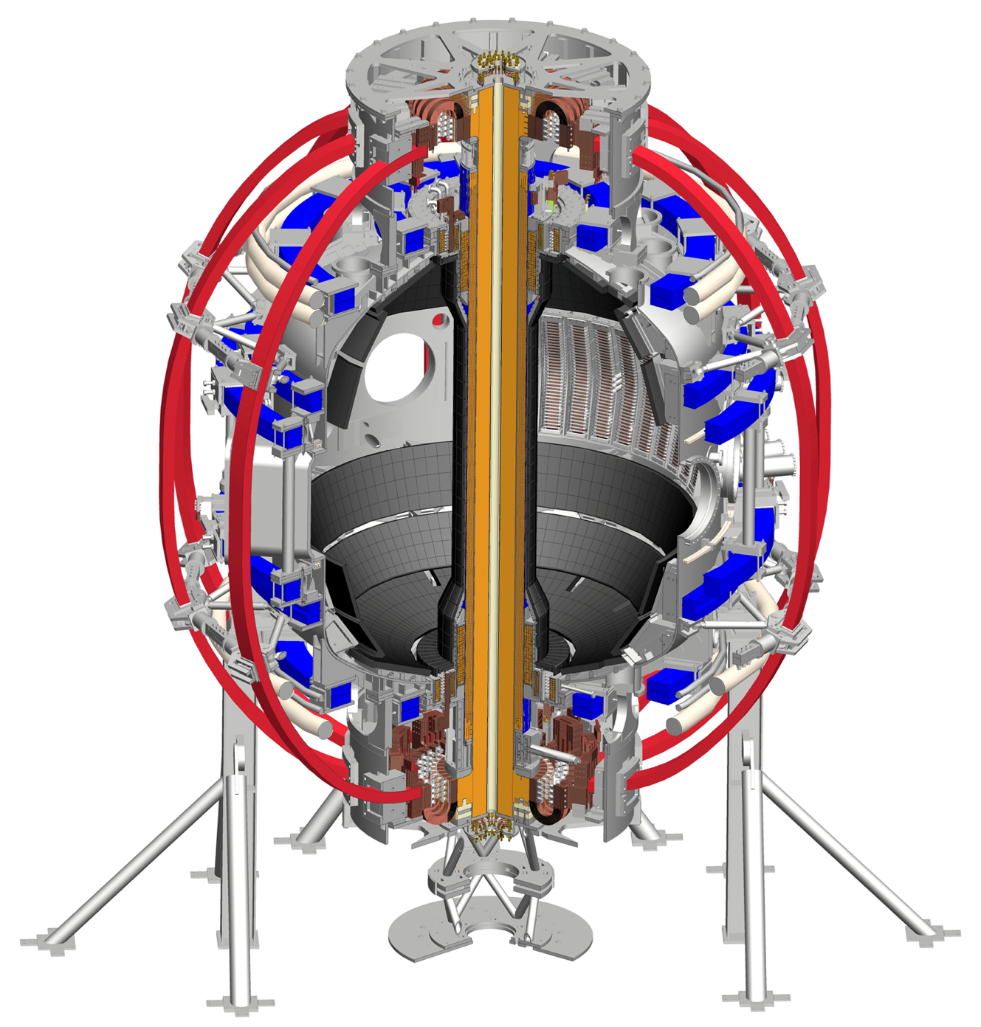
Magnetic field perturbations due to error fields produce complex 3D edge magnetic topologies
Error fields significantly alter the properties of the heat and particle flux distributions on the divertor target plates.
Error fields can lead to heat loads on undesired regions of the machine.
Physics of footprints still not fully understood.
Source of intrinsic error fields is for example a misalignment of the equilibrium coils.
This work is focused on possible NSTX-U equilibrium coils misalignments.
Toroidal Field coils
Poloidal Field coils

Slide 3
The perturbed equilibrium due to a coil misalignment is computed with the MHD code M3D-C1
For each simulation one coil is shifted (tilted) by 1 mm (1mrad).
The field line tracing code TRIP3D uses the M3D-C1 perturbed equilibrium to estimate the magnetic footprints.
The simulations are linear so shift/tilt magnitude can be varied in TRIP3D.
Lines launched from the plasma to study the fraction of lines going to the divertor.
Lines followed from a divertor plate to the other to study plasma penetration.

Slide 4
Footprints are estimated using the last step inside and first step outside the limiter and the limiter itself
Poincaré plot of the region with lines that exit the plasma
s
Hit parameter “s” is defined as the distance from inner midplane along the wall clockwise.
Top ~ 1.8 m
Bottom ~ 5.9 m
Plasma
Out

Slide 5
Including the plasma contribution in the simulations, the outer footprints size is reduced by more than a factor of 2
Neglecting the plasma contribution results in a field line loss of 50% at 𝜓_{N}≃0.95, the inner field line loss boundary when the plasma response is included
Inner loss boundary for the plasma case
Poincaré plot of the region with lines that exit the plasma.
In the rest of the talk plasma response always included.

Slide 6
5 mrad tilt of the PF5 coil produces 8 cm wide footprints on the outer divertor plates
Footprints area
Outer:
Upper -> 0.0854 m²
Lower -> 0.0876 m²
Inner:
Upper -> 0.0034 m²
Lower -> 0.0042 m²

Slide 7
The footprint area scales linearly with the tilt magnitude
For 1 mrad tilt the footprint is about 1.8 cm wide, for 5 mrad 8 cm wide
The larger the tilt, the deeper the lines go in the plasma

Slide 8
Shift at 30º from tilt direction produces the minimum area, at 210º the maximum
Combining 5 mm shift and 5 mrad tilt.
The largest footprint is also that with the deepest field lines.
The area for a 5 mrad tilt only is ~0.09 m²

Slide 9
TF coils misalignment produces the largest perturbation
Misalignment of the innermost PF (PF1A) is negligible compared to the PF5 and TF.
TF shift produces larger footprints than TF tilt. Vice versa for the PF coils.
Shift and tilt combinations at 180º produce bigger footprints than at 0º.
Combinations of shifts and tilts of PF5 and TF are not expected to exceed 6mm/6mrad

Slide 10
Conclusions
TRIP3D coupled with M3D-C1 predicts that:
  The area of the footprints changes linearly with the misalignment magnitude.
  The relative phase of the misalignments can bring to larger or smaller footprints.
  At larger footprints generally correspond field lines that go deeper in the plasma.
Next step: Is a large footprint more or less desirable than a small footprint?
  Does a larger footprint spread the heat flux on a larger surface, being therefore desirable?
  Do deeper field lines in the footprints correspond to a larger radiative layer at the edge, that also decrease the heat density on the divertor?
Comparisons with experimental data are needed to validate the predictions.
This work was done using the OMFIT framework.

Slide 11
Disclaimer
This report was prepared as an account of work sponsored by an agency of the United States Government. Neither the United States Government nor any agency thereof, nor any of their employees, makes any warranty, express or implied, or assumes any legal liability or responsibility for the accuracy, completeness, or usefulness of any information, apparatus, product, or process disclosed, or represents that its use would not infringe privately owned rights. Reference herein to any specific commercial product, process, or service by trade name, trademark, manufacturer, or otherwise does not necessarily constitute or imply its endorsement, recommendation, or favoring by the United States Government or any agency thereof. The views and opinions of authors expressed herein do not necessarily state or reflect those of the United States Government or any agency thereof.
This material is based upon work supported by the U.S. Department of Energy, Office of Science, under Award Number DE-SC0012706.

