Slide 1


High harmonic fast wave propagation in the scrape-off layer (SOL) of NSTX/NSTX-U
Effect of Wall Boundary on Power Losses in the SOL
Eun-Hwa Kim
N. Bertelli, M. Ono, E. Valeo, J. Hosea, and R. Perkins
PPPL
S. Shiraiwa and J. Wright
PSFC, MIT
2018 APS-DPP / TP11.00095

Slide 2
NSTX studies showed significant amounts of HHFW power missing from core
The Interaction between the RF antennas and the scrape of layer (SOL) plasma is of crucial importance in determining the overall performance of RF in a tokamak
  All frequencies: LH, IC, HHFW, etc …
In NSTX
  Strong interactions between HHFW and SOL plasm
  [Hosea et. al POP 2008, Phillips et al., 2009, Perkins et. al. PRL 2012]
  Core Heating Effieicny (𝜂) enhanced in stronger magnetic field
    B_{𝜙} = 0.45T (n_{𝜙} = -12) : 𝜂 ~ 44% → Power loss (P_{loss}) ~ 56%
    B_{𝜙} = 0.55T (n_{𝜙} = -12) : 𝜂 ~ 65% → Power loss (P_{loss}) ~ 35%
  Larger power losses occur for high density in front of the antenna

Slide 3
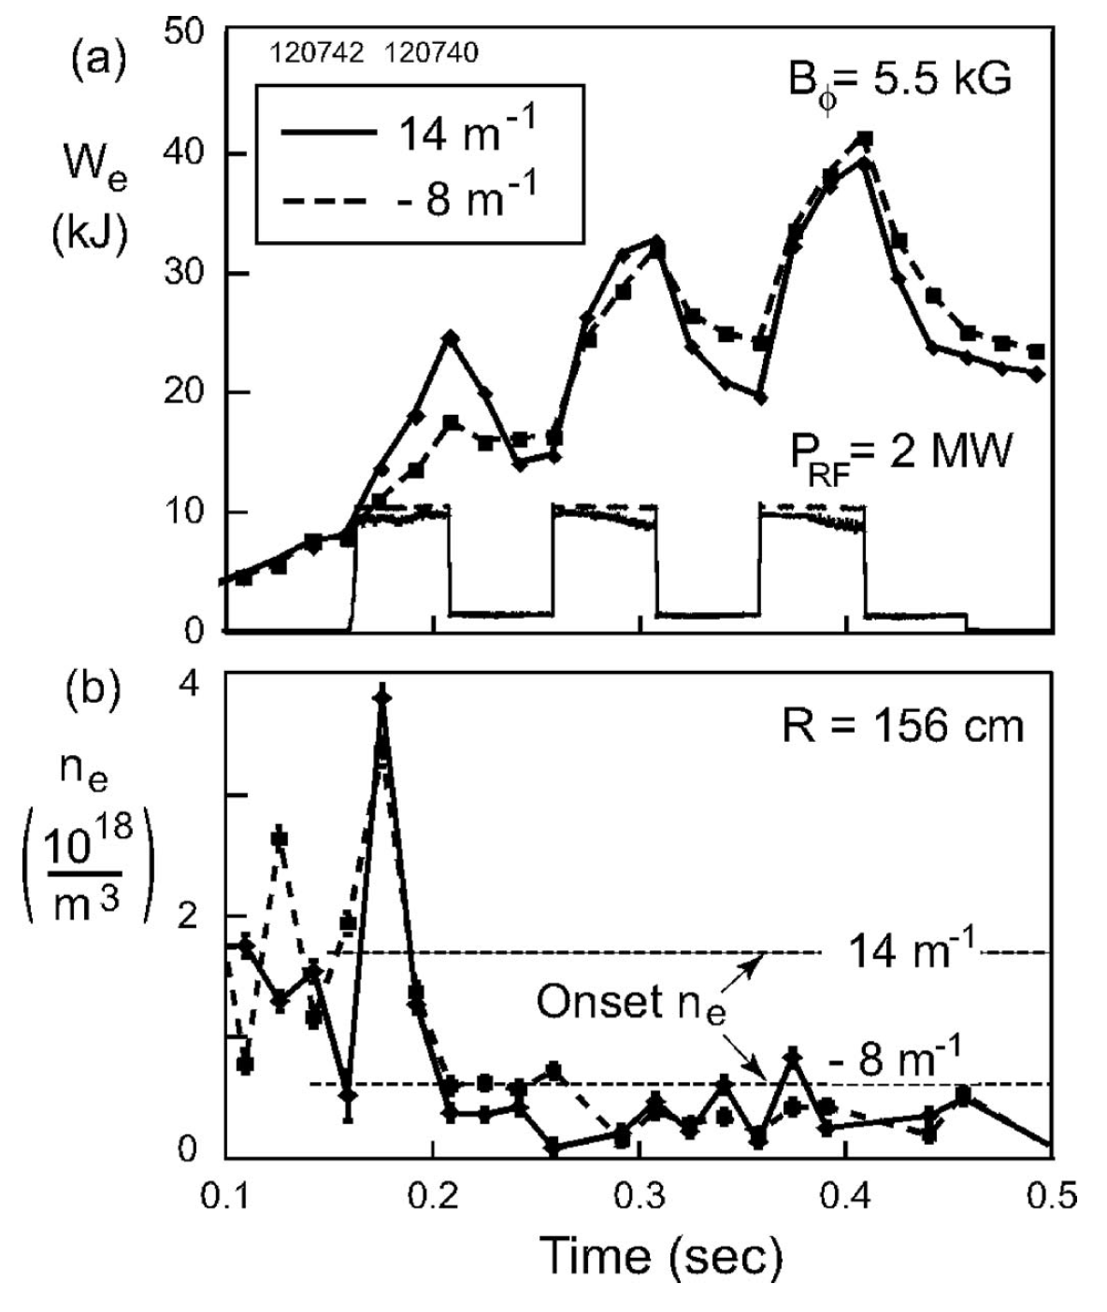
Density where FW cutoff is open is critical
NSTX HHFW
Critical Density (N_{ec}) (or Onset Density)
: where FW cutoff in front of the antenna is open
B_{𝜙} = 0.55T
n_{𝜙} = -21
n_{𝜙} = -12
N_{ant} ≤ N_{ec} (N_{ant} : density in front of antenna)
FW cannot propagate in the SOL
Higher heating
less power losses
N_{ant} >> N_{ec}
FW propagate in the SOL
Lower heating
higher power losses
N_{ant}
(X 10¹⁸ m⁻³)
Density
In front of
Antenna
n_{𝜙} = -21
n_{𝜙} = -12
[Hosea et al, POP 2008]

Slide 4
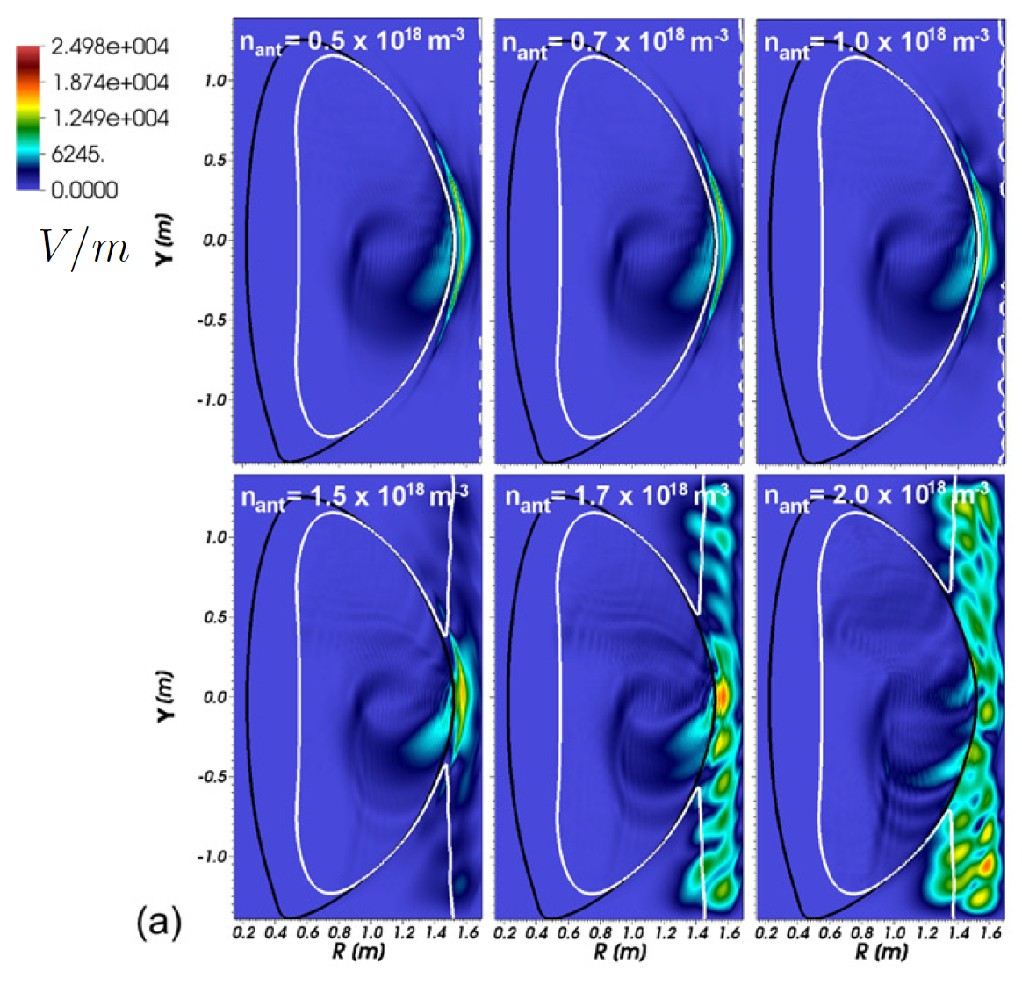
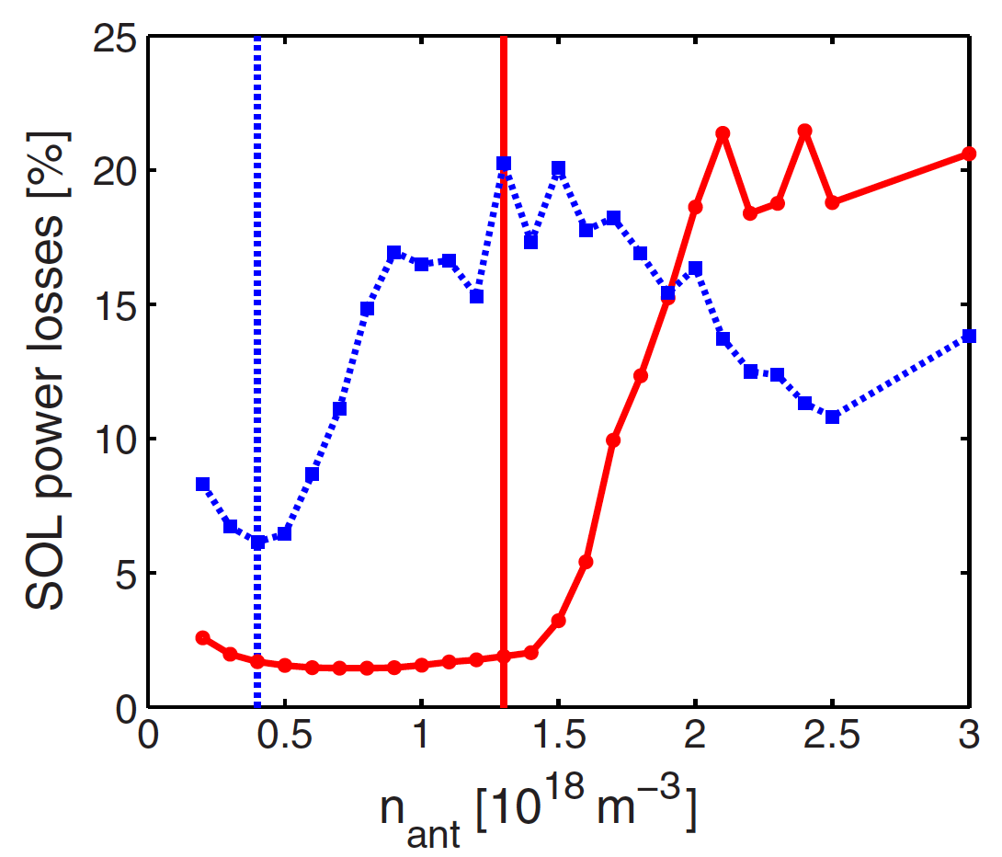
Previous simulations suggest SOL wave excitation can lead to significant SOL power losses
Wave evanescent
Weaker P_{abs}
[Bertelli et al., NF 2014]
n_{φ} = -21
Fraction of SOL power losses (P_{abs})
FW cutoff
W_{SOL (core)} : Power loss in the SOL (core)
N_{ant} ≤ N_{ec} : closed FW cutoff
n_{φ} = -12
N_{ant} > N_{ec} : open FW cutoff
n_{φ} = -12
Strong |E|
Strong P_{abs}
Density in front of antenna
N_{ant} [10¹⁸ m⁻³]

Slide 5
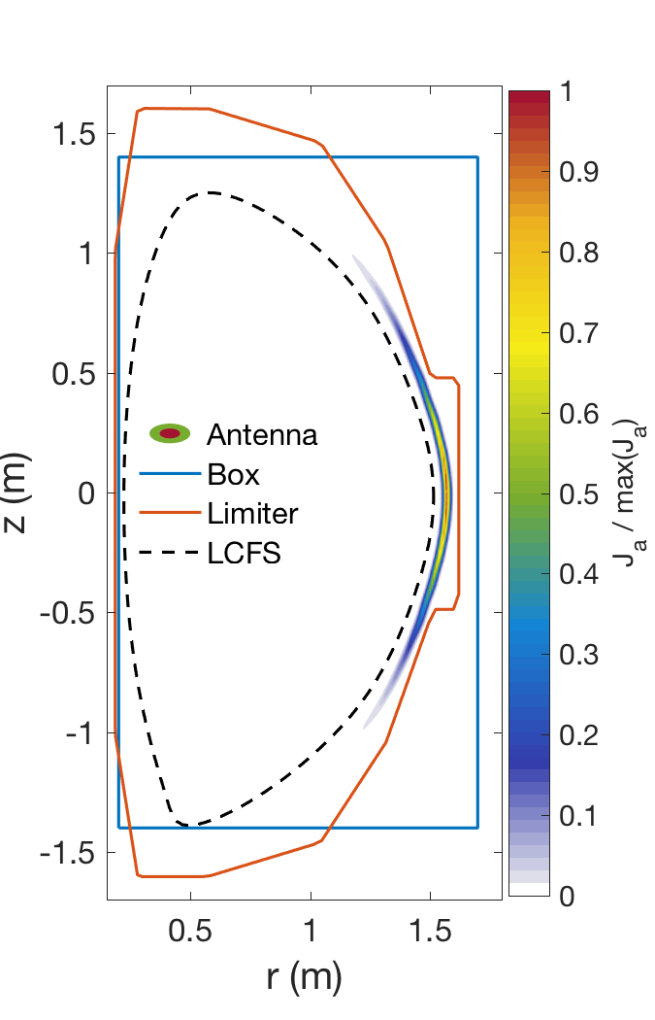
Previous simulations adopted idealized boundary for simplicity
Rectangle
Vacuum vessel
Scrape-off Layer
Wide SOL !
[Bertelli et al 2014]

Slide 6

FW2D Model Description

Slide 7
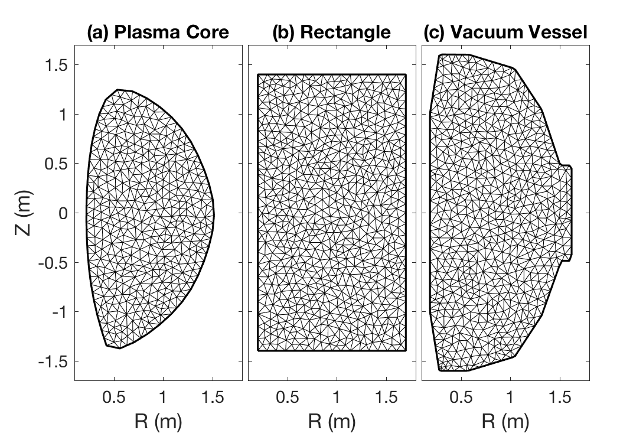
2D Full-wave model (FW2D) has been developed to investigate SOL physics in realistic boundaries
Wave equations : frequency domain
External source
output
dielectric tensor in cold plasma
m : Azimuthal (toroidal) wave number
Wave solution using finite element method and unstructured triangle mesh
Easily adopted to various geometries
(e.g., dipole, tokamak…)
Easily adopt various boundaries
(e.g., rectangle, vacuum vessel…)
Fast!
Successfully examined waves at planetary magnetospheres
Kim et al., GRL 2015; Kim and Johnson, GRL 2016; Kim et al., EPJ 2017

Slide 8
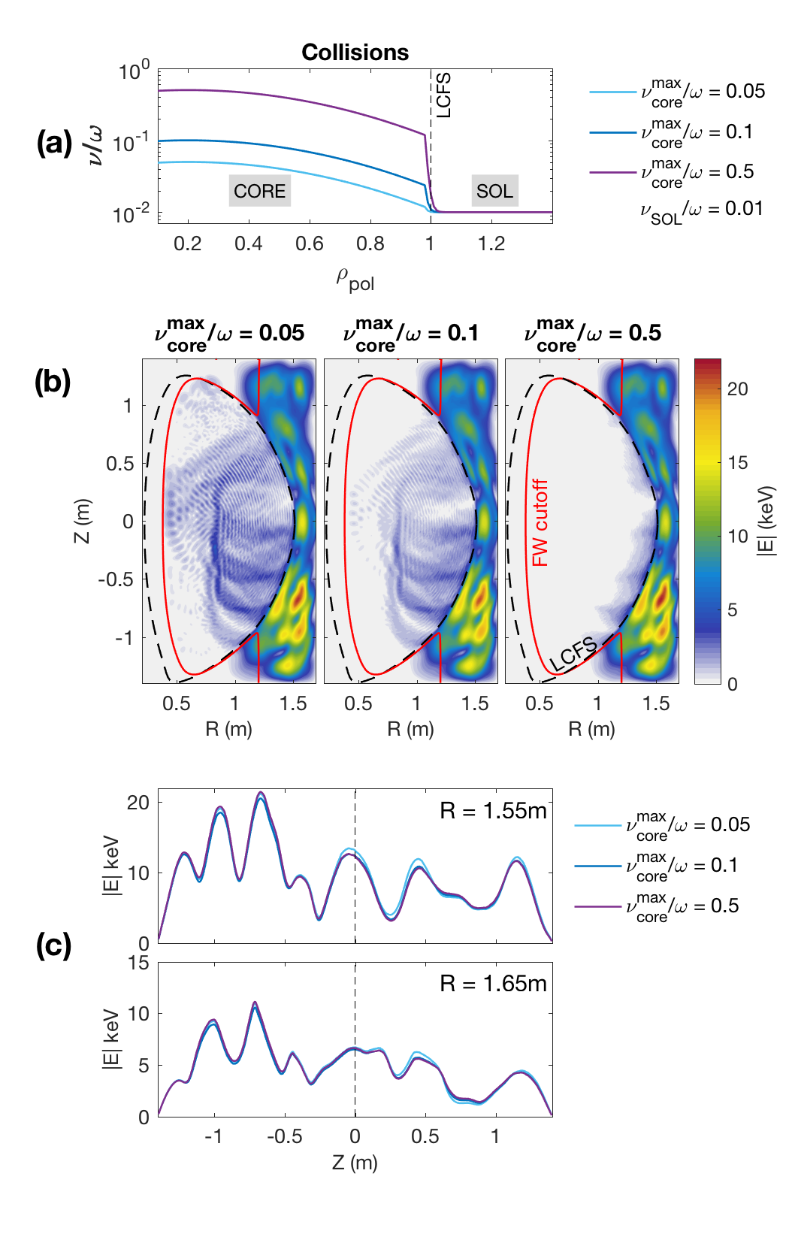
FW2D code provide rapid cold plasma wave field computation
To simulate wave absorption, collisional frequency (𝜈 ) can be implemented in the momentum equation, then
Wave in the plasma core : change with
Wave in the SOL : not affected by
Possible to estimate the SOL power losses by adopting an arbitrary collisions in the plasma core
→ 15.35 0.5 % (almost identical)
for

Slide 9
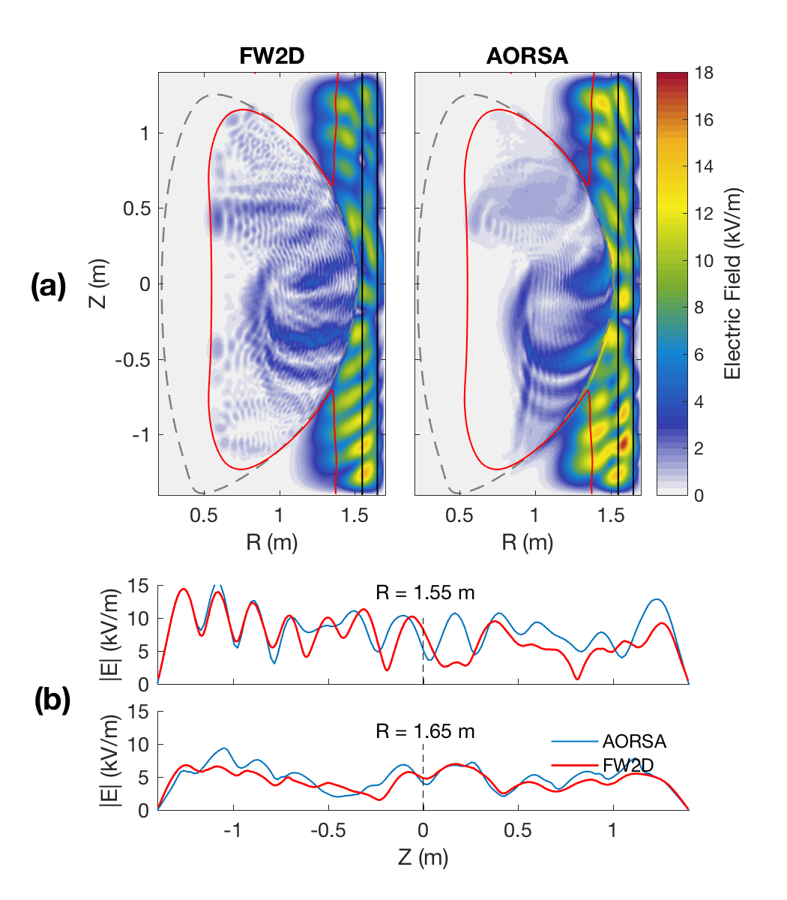
FW2D and AORSA simulations show excellent agreement in SOL field structure
FW2D → COLD approximation
→ FAST computation
AORSA → Plasma kinetic effect
→ slow computation
Wave transmission and reflection coefficients at the LCFS are not the same → Two wave solutions cannot be exactly same
The wave structure shows very good agreement between FW2D and AORSA
→ FW2D code can be used to
(efficiently) examine waves in the
cold SOL

Slide 10
HHFW in various boundaries
: Effects of SOL size variation

Slide 11
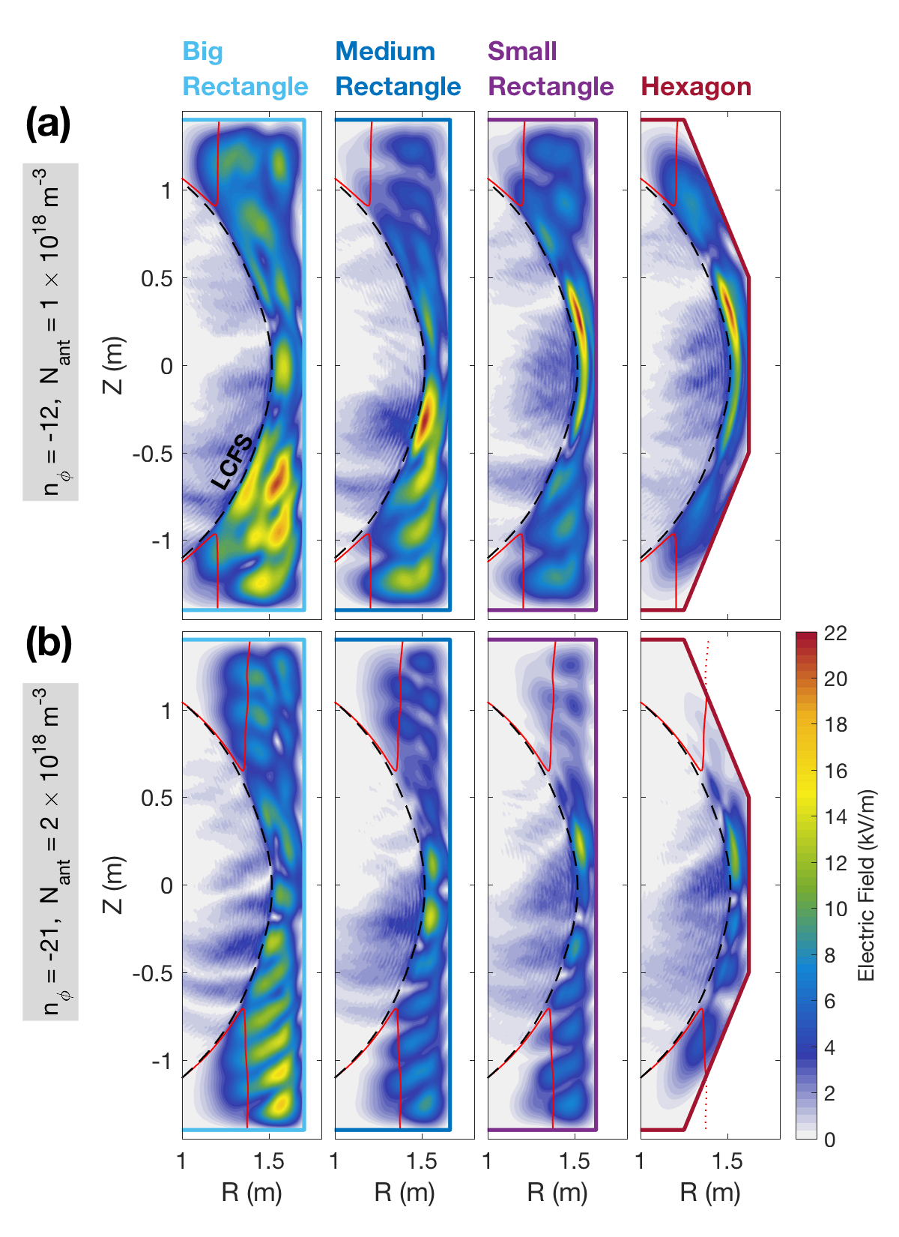
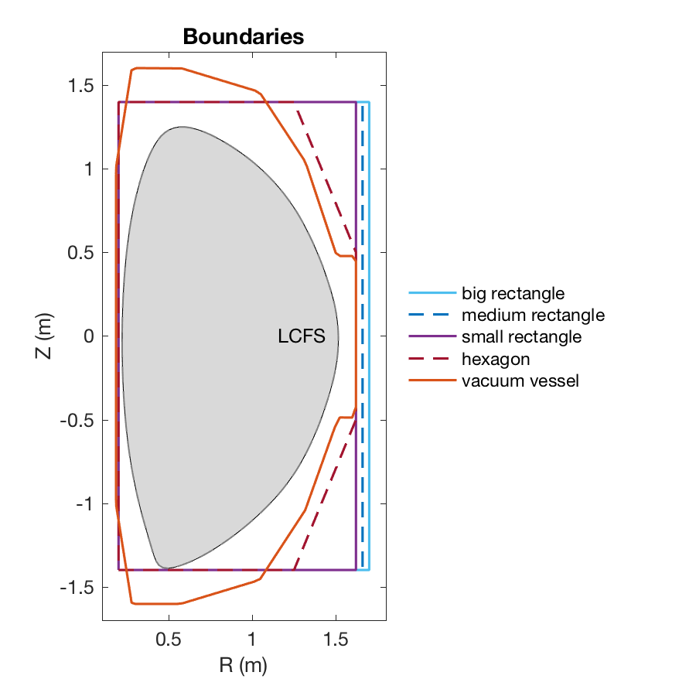
HHFW standing mode in the SOL becomes weaker as SOL size is reduced
Adopted vessel boundaries
Artificial – rectangle, hexagon
Realistic – vacuum vessel
Weaker standing mode

Slide 12
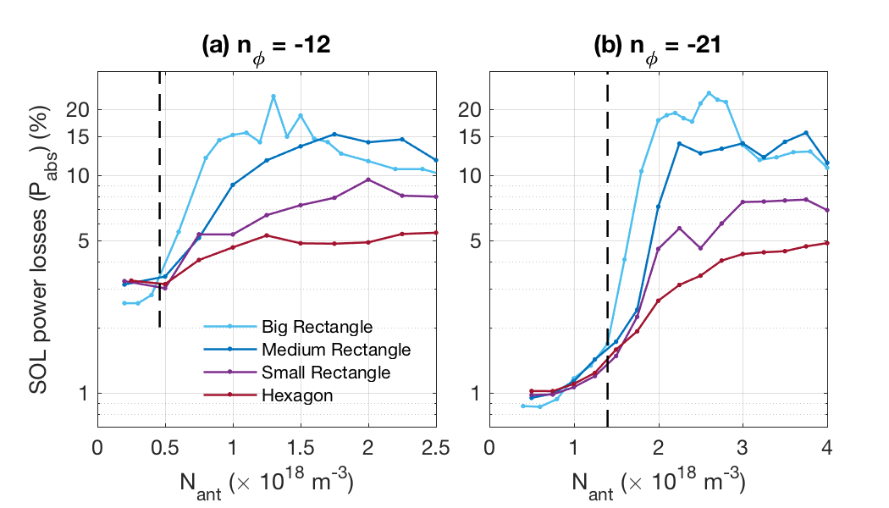
SOL Power losses in the SOL size decreases as SOL size is reduced
SIZE
DENSITY
Big Rect.
Consistent with Bertelli et al. 2014
P_{abs} tends to be steepened near the critical density where the FW cutoff is open
Hexagon
P_{abs} gradually increases
Density with maximum P_{abs} increases as SOL size increases

Slide 13
HHFW in vacuum vessel boundary

Slide 14
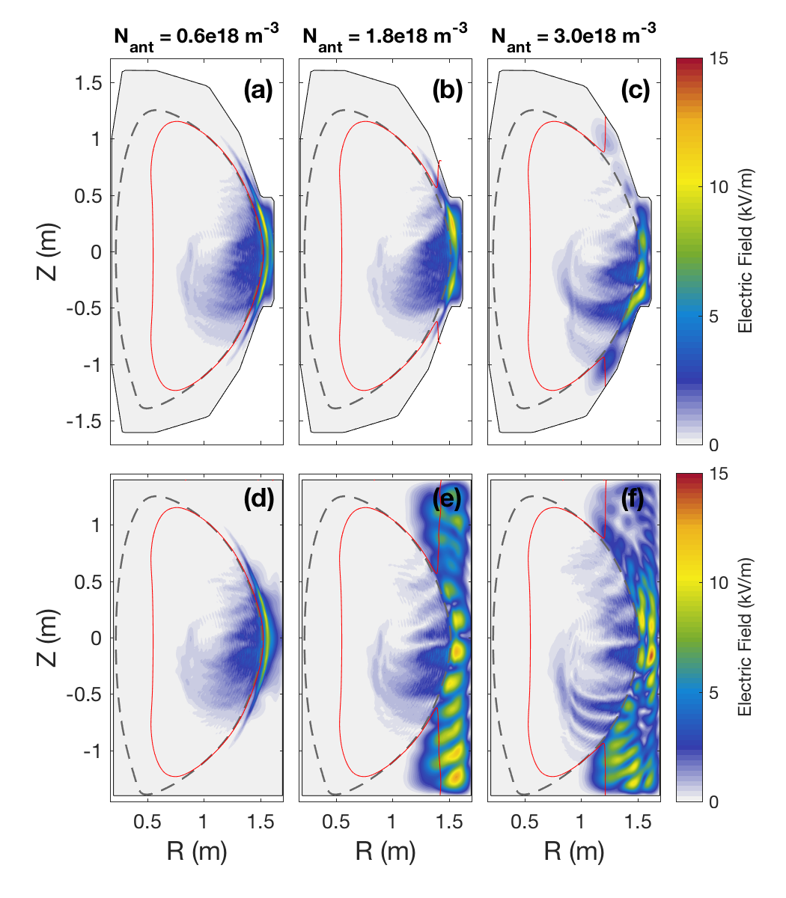
HHFW are examined by adopting a realistic vacuum vessel boundary
n_{φ} = -21
  Narrow FW SOL cavity (among LCFS, FW cutoff layer and outer boundary)
  Weaker wave power
Vacuum vessel
N_{ant} ≤ N_{ec}
N_{ant} > N_{ec}
  Large FW SOL cavity
  FW standing mode
  Large P_{abs}
Rectangle
Last Closed
Flux Surface
Fast wave cutoff layer
Kim et al. (2018b) in preparation

Slide 15
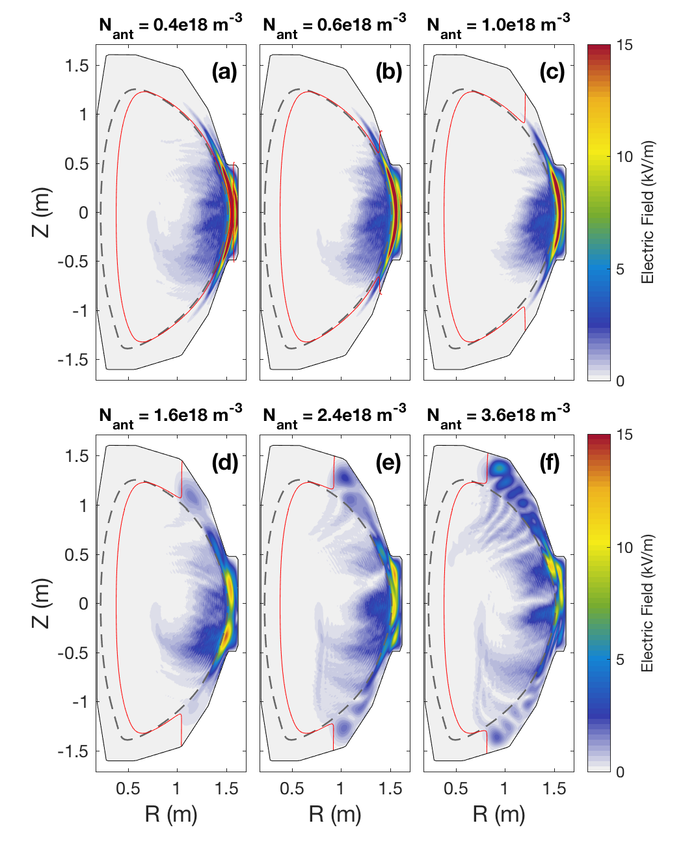
HHFW gradually propagate into the SOL as N_{ant} increases
n_{φ} = -12
  N_{ant} ~ N_{ec}
  Waves are localized near the antenna even though the FW cutoff layer is open
  N_{ant} > N_{ec}
  Standing mode structure appears
Last Closed
Flux Surface
Fast wave cutoff layer

Slide 16
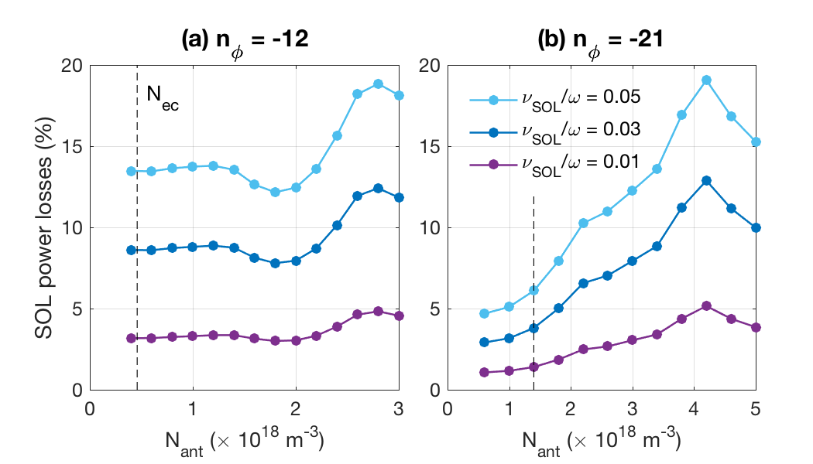
Power losses increases linearly with collision in SOL
Collision
Lower than one in a hexagonal boundary (SOL in this boundary is smaller)
SOL could be collisional losses but also represent other loss mechanisms such as convective losses to walls

Slide 17
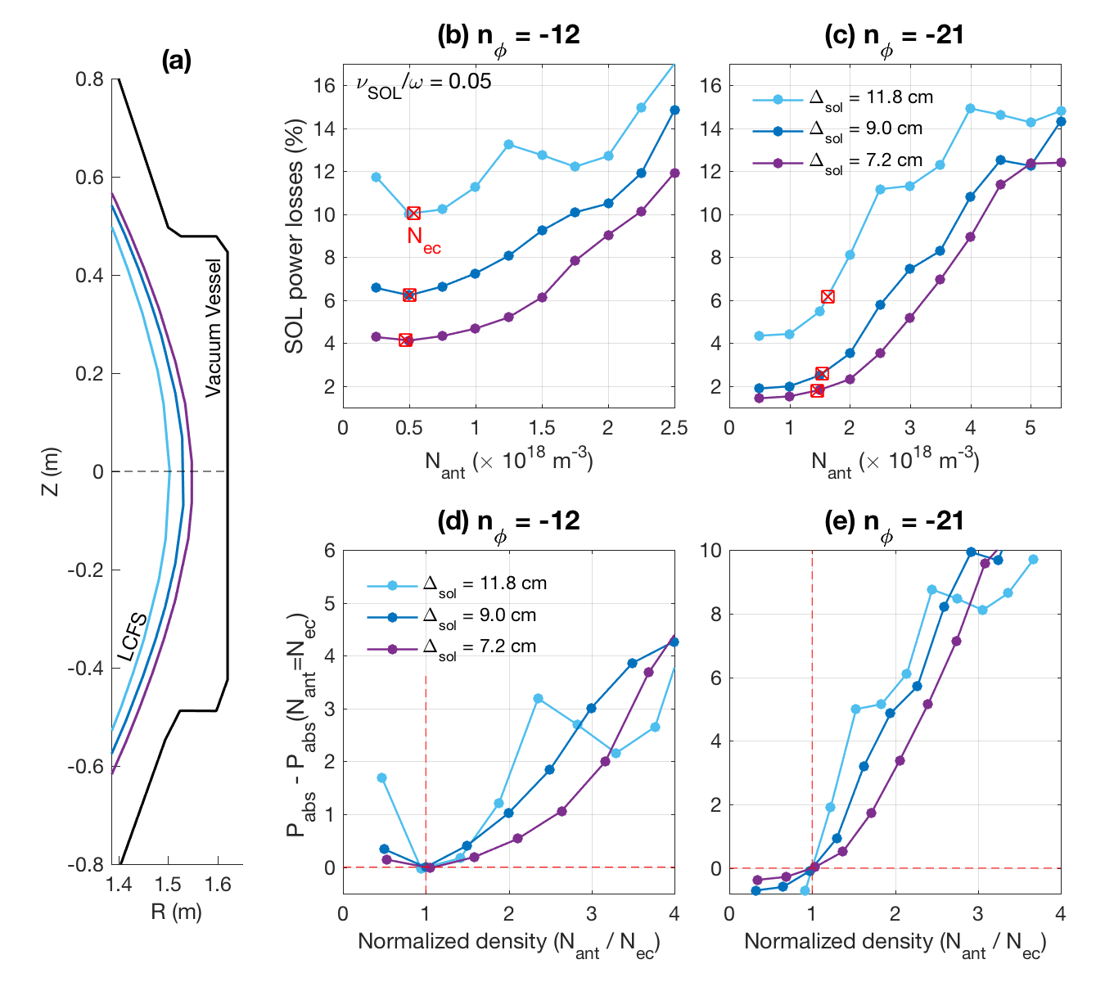
Power losses decreases as the SOL size is reduced
Adopt three magnetic equilibria of NSTX
: different location of the plasma core
SIZE
P_{abs} gradient
decreases
as SOL size
decreases

Slide 18
HHFW in various magnetic field strength plasma

Slide 19
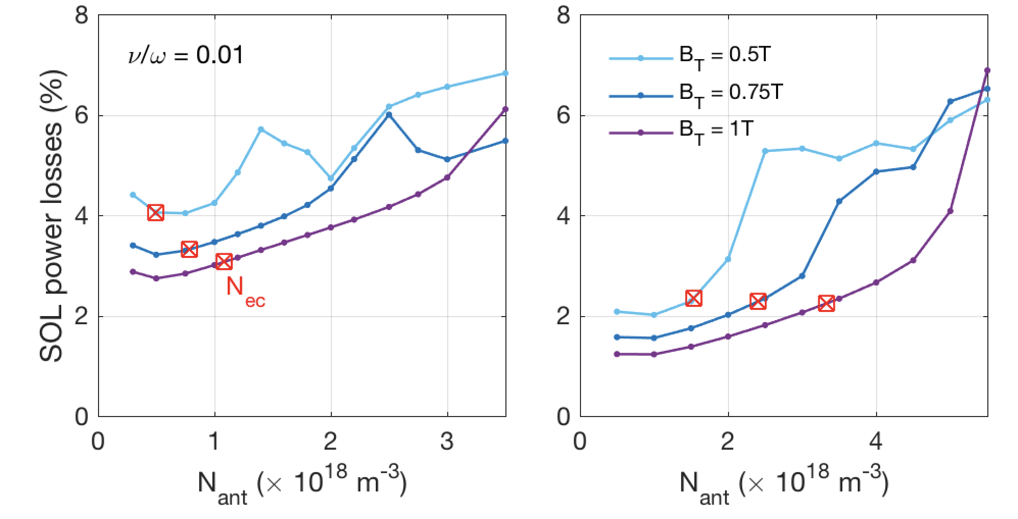
Power losses decreases as B_{T} increases
n_{φ} = -12
n_{φ} = -21
B₀
NSTX-U
Power losses increases as B₀ increases → Consistent with experiments [e.g., Hosea et al 2008]
(for lower P_{abs}) increases as B_{T} increases
→ HHFW can propagate to the plasma core in wide range of density in front of antenna for strong magnetic field case

Slide 20
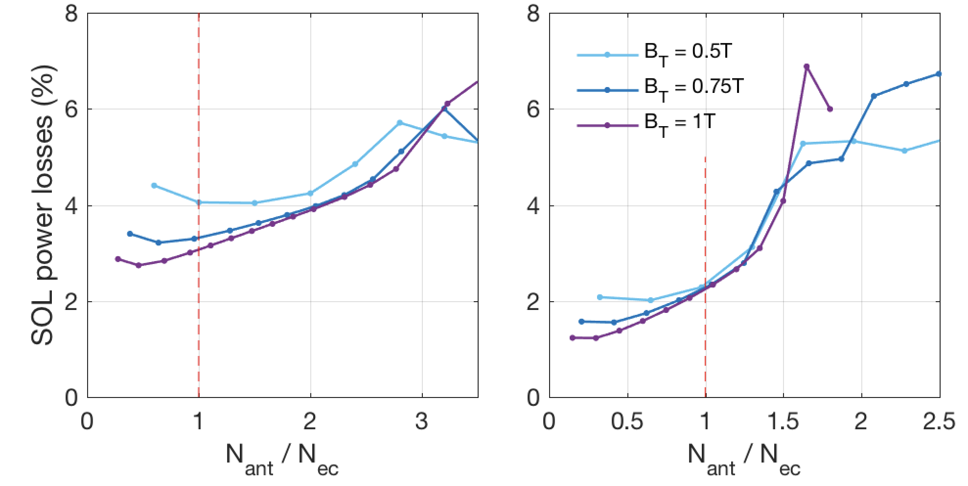
Power losses decreases as B_{T} increases
n_{φ} = -12
n_{φ} = -21
Lower P_{abs}
Lower P_{abs}
Normalized Density (N_{ant}/N_{ec})
Normalized Density (N_{ant}/N_{ec})
Lower P_{abs} occurs
N_{ant}/N_{ec} < 1.25
N_{ant}/N_{ec} < 2

Slide 21
Summary
Lower
Density in front Antenna
Narrower
Distance between
LCFS and antenna
Stronger
Magnetic field strength
Reduce
SOL collisional power losses in the vacuum vessel
Consistent with Experiments
[e.g., Hosea et al., 2008; Phillips et al., 2009]
Minimum SOL collisional losses occur (all magnetic field strength) → near the critical density where FW cutoff is open
Minimum SOL collisional losses occur (strongly magnetized plamsa) → with wide range of the density in front of antenna

Slide 22
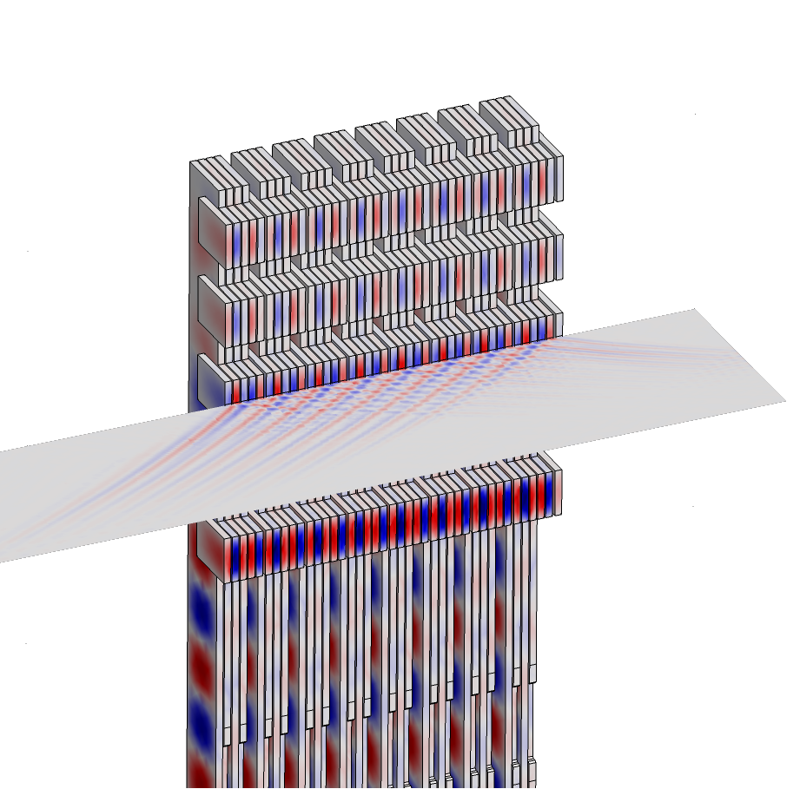
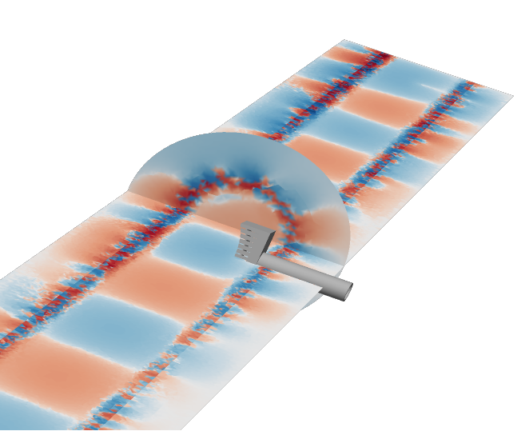
Future Work
We will examine the HHFW in the NSTX/NSTX-U using recently developed Petra-M code and compare the results from FW2D
(e.g., BP11.00082 : Shiraiwa et al., Development of Petra-M Framework: toward OS integrated FEM analysis)
LH wave
launcher
Fast wave in
Alcartor C-Mod
Fast wave in LADP

