Slide 1

FIDASIM is a synthetic diagnostic code that simulates fast ion D-alpha (FIDA) and neutral particle analyzer (NPA) signals. The code accepts a theoretical fast-ion distribution function as input and predicts the FIDA and NPA spectra. Originally, FIDASIM assumed axisymmetry and included active signals produced only by charge exchange (CX) with injected neutrals. However, passive signals produced by CX with cold neutrals can also be important. For example, passive-FIDA signals of comparable magnitude with active signals were experimentally measured on NSTX-U¹. Therefore, FIDASIM is improved to predict passive signals for a given edge-cold neutral population. The time series passive spectra output by FIDASIM is successfully cross checked with 2D passive-FIDA modeling done on NSTX-U. The effect of 3D fields on fast ion confinement is an ongoing field of study, e.g. toroidal field ripple, stellerators, etc. Thus, the functionality of FIDASIM is enhanced to simulate signals produced in 3D geometry.
Alvin Garcia¹
L. Stagner²
W. Heidbrink¹
¹University of California, Irvine
²ORISE/ORAU
¹Hao, PPCF 60 (2018) 025026
This work was supported by the U.S. Department of Energy under DE-FG02-06ER54867.

Slide 2
Outline
Motivation and introduction to FIDASIM
New cold neutral and passive signal capabilities
Successful NSTX-U passive FIDA modelling benchmark
New 3D geometry capabilities and preliminary benchmark

Slide 3
Introduction to this work
FIDASIM is widely used to model FIDA and NPA signals
Many recent experiments have shown that signals from cold neutrals can be as important as signals from injected neutrals¹²³⁴⁵⁶
3D capability is needed to properly treat tokamaks with applied 3D fields, e.g. toroidal field ripple, and stellarators
Purpose of this work: Upgrade FIDASIM to treat cold neutral and 3D effects
¹Hao, PPCF 60 (2018) 025026
²Heidbrink, PPCF 63 (2011) 085007
³Geiger, PPCF 59 (2017) 115002
⁴Heidbrink, PPCF 53 (2011) 085028
⁵Bolte, NF 56 (2016) 112023
⁶Michael C A, PPCF 55 (2013) 095007

Slide 4
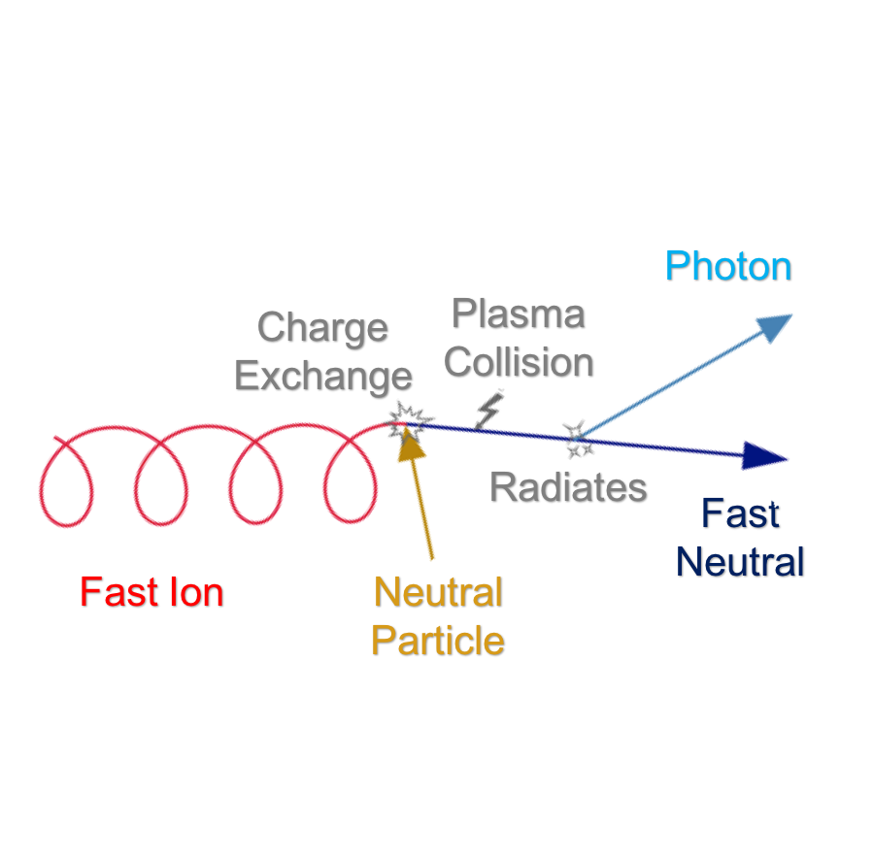
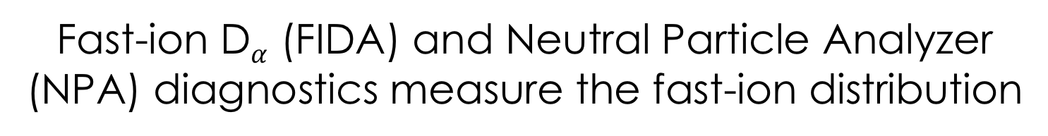
Fast-ion D$α$ (FIDA) and Neutral Particle Analyzer (NPA) diagnostics measure the fast-ion distribution
FIDA
Diagnostic
NPA
Diagnostic
https://d3denergetic.github.io/FIDASIM/

Slide 5
FIDASIM is a synthetic diagnostic code that simulates FIDA and NPA signals
Fast-ion
Distribution
Function
Forward modelling can be used to predict the FIDA and NPA spectra for comparison with experimental data¹
FIDASIM accepts a theoretical fast-ion distribution function
Charge exchange is modelled, and the FIDA radiance and NPA flux are calculated
Experimental
Measurements
¹Heidbrink, CCP 717 (2011)

Slide 6
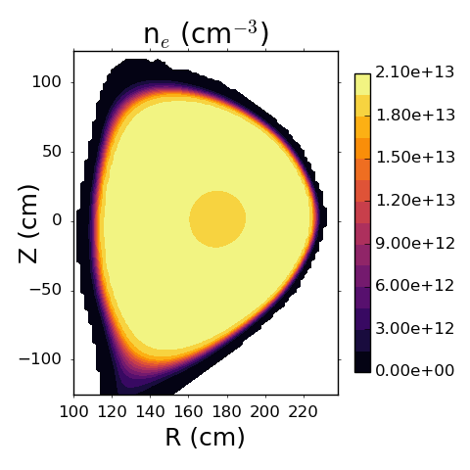
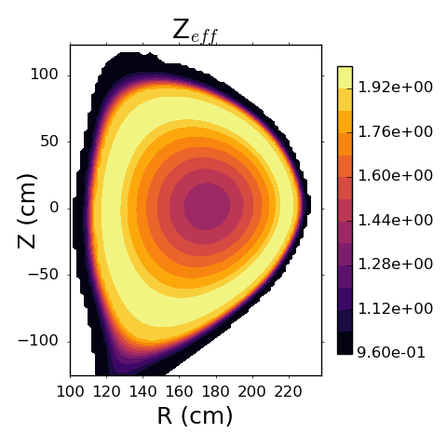
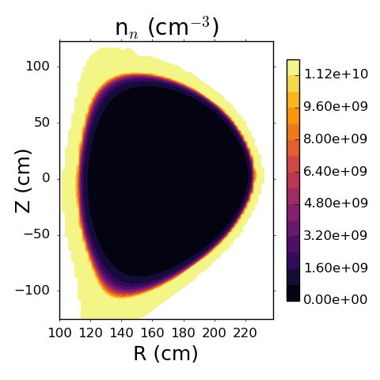
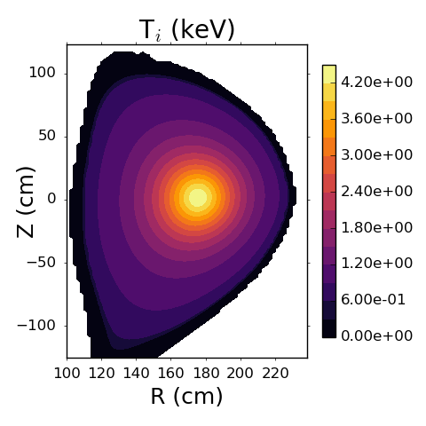
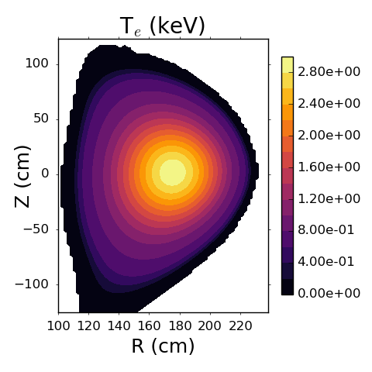
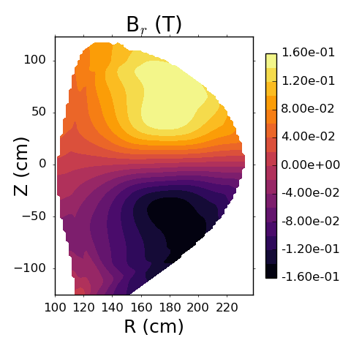
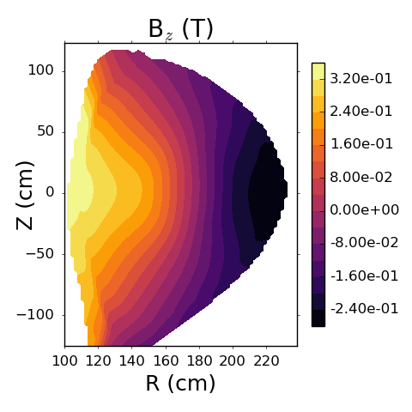
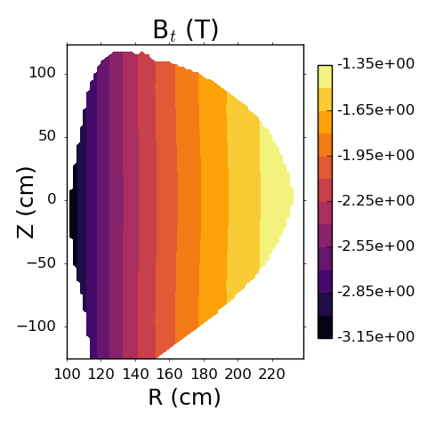
FIDASIM requires plasma profiles and electro-magnetic fields as input
plasma = {Ti, Te, Ne, Nn*, Zeff*, Vr, Vt, Vz}
fields = {Br*, Bt*, Bz*, Er*, Et*, Ez*}
*Inferred

Slide 7
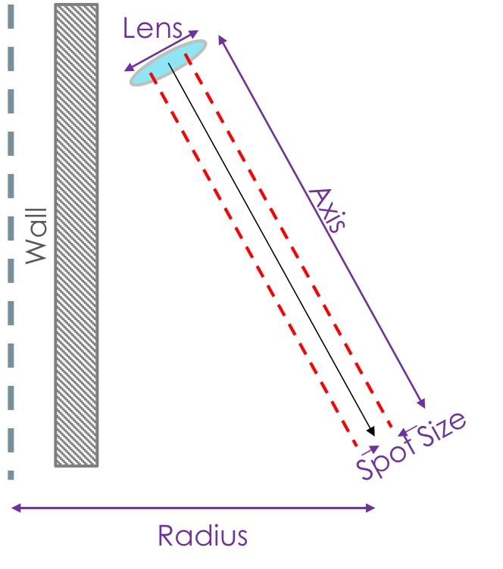
Spectroscopic and NPA geometry are inserted into FIDASIM
FIDA Diagnostic:
  Defined by the line of sight
NPA Diagnostic:
  Defined by two planes (aperture and detector)
  Circular or rectangular shapes are acceptable
Top Edge
Right Edge
Center
Top Edge
Right Edge
Center
Views are from inside the vessel

Slide 8
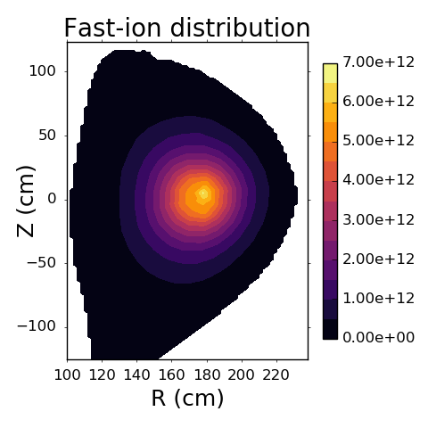
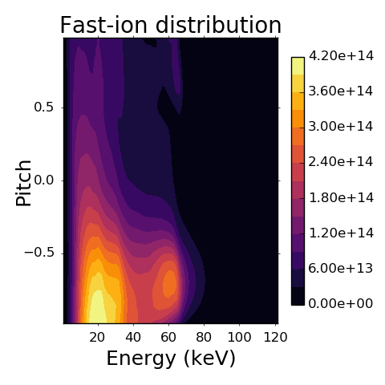
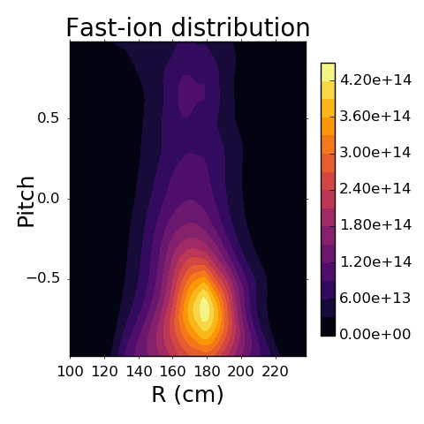
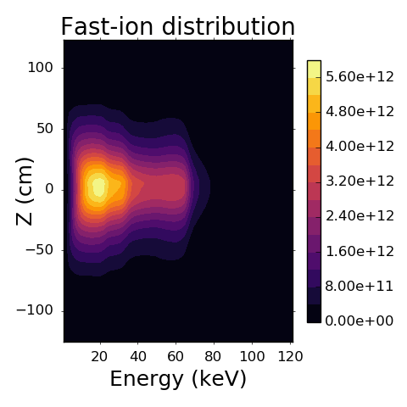
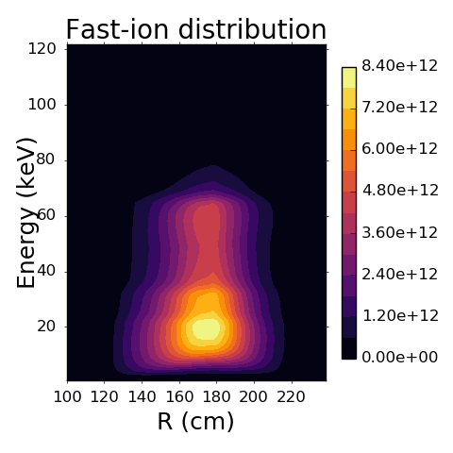
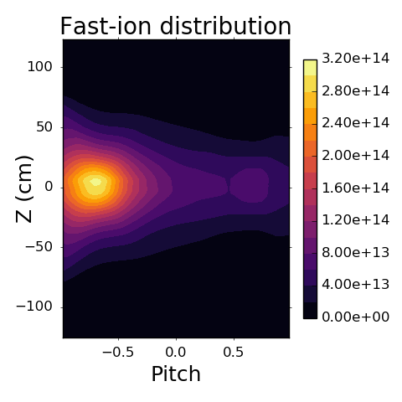
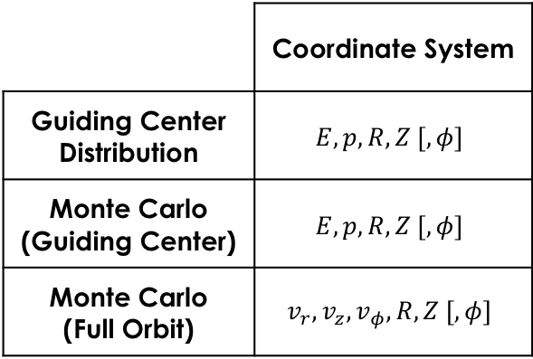
The code accepts several types of theoretical fast-ion distribution functions as input
 | Coordinate System
Guiding Center Distribution | $$E, p, R, Z [,φ]$$
Monte Carlo (Guiding Center) | $$E, p, R, Z [,φ]$$
Monte Carlo (Full Orbit) | $$v_{r},v_{z},v_{φ},R, Z [,φ]$$

Slide 9
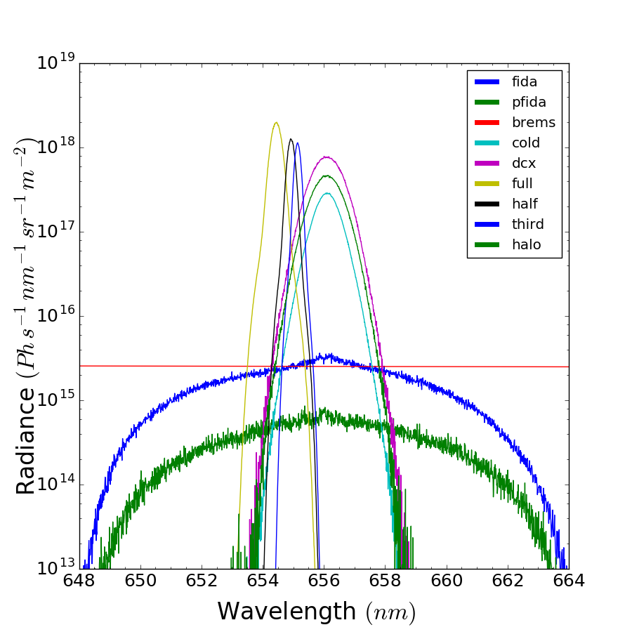
FIDASIM can model the signal produced from multiple light sources
Beam emission
(Full, Half, Third)
Bremsstrahlung
DCX and Halo
Cold neutral emission
Active Fast-ion D-α (FIDA)
Passive Fast-ion D-α (p-FIDA)

Slide 10
Passive signals improve understanding on the fast-ion distribution and neutral density profile
Active diagnostic signals are produced from charge exchange with injected neutrals, and passive signals are produced from charge exchange with cold neutrals
Passive signals must be treated to get valid active FIDA data
Simulating passive signals provides quantitative information on fast-ion losses that may be a challenge for ITER¹
P-FIDA signals are enhanced when fast ions are expelled to the edge by instabilities²
Neutral density profile may be found from a known fast-ion source with passive measurements¹
¹Bolte, NF 56 (2016) 112023
²Hao, PPCF 60 (2018) 025026

Slide 11
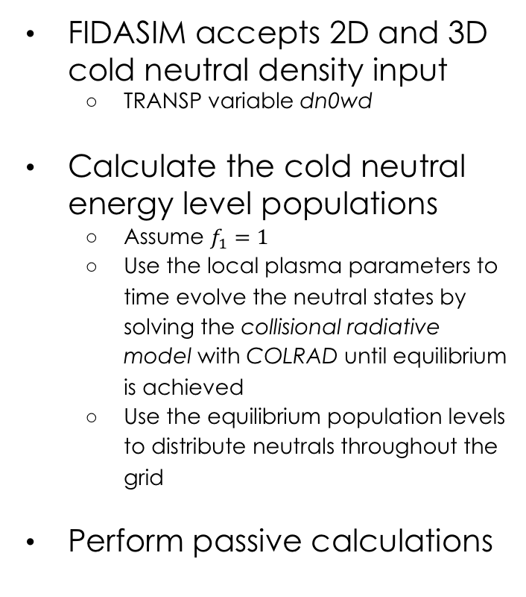
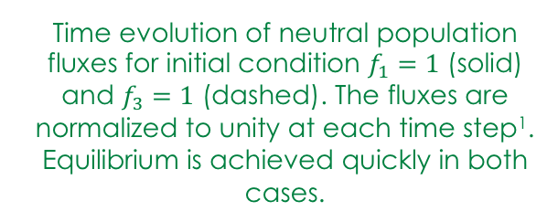
FIDASIM reads in neutral densities, then time-evolves them to simulate passive FIDA signals
FIDASIM accepts 2D and 3D
cold neutral density input
  TRANSP variable dn0wd
Calculate the cold neutral
energy level populations
  Assume $f_{1}=1$
  Use the local plasma parameters to time evolve the neutral states by solving the collisional radiative model with COLRAD until equilibrium is achieved
  Use the equilibrium population levels to distribute neutrals throughout the grid
Perform passive calculations
Time evolution of neutral population fluxes for initial condition $f_{1}=1$ (solid) and $f_{3}=1$ (dashed). The fluxes are normalized to unity at each time step¹. Equilibrium is achieved quickly in both cases.
¹Stagner, (Thesis) UCI (2018)

Slide 12
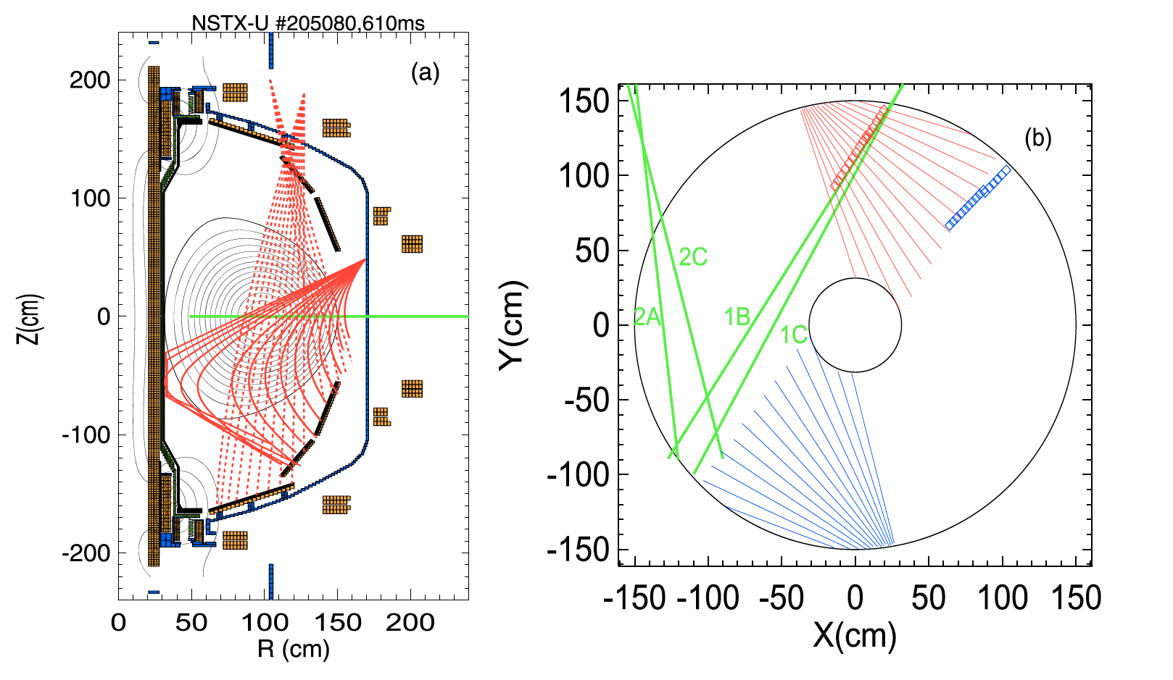
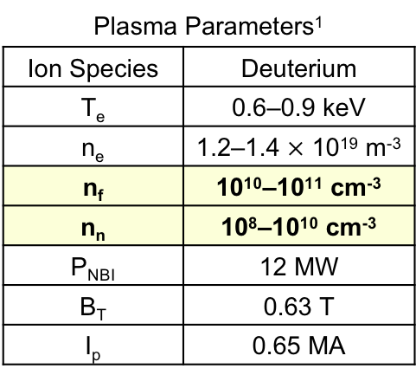
Passive-FIDA signals are comparable to active-FIDA signals at NSTX-U
Discharges are MHD quiescent, thus, the fast-ion distribution function is calculated by NUBEAM¹
3 fast-ion populations can contribute to passive
FIDA signals¹
  Axisymmetric population that passes through the edge region
  (calculated by TRANSP)
  Toroidally asymmetric cluster that traverses edge on first orbit
  Centrally confined ions that are expelled towards the edge
Plasma Parameters¹
Ion Species | Deuterium
T_{e} | 0.6–0.9 keV
n_{e} | 1.2–1.4 $×$ 10¹⁹ m⁻³
n_{f} | 10¹⁰–10¹¹ cm⁻³
n_{n} | 10⁸–10¹⁰ cm⁻³
P_{NBI} | 12 MW
B_{T} | 0.63 T
I_{p} | 0.65 MA
FIDA line of sights & beam sources
Elevation:
Dashed (vertical)
solid (tangential)
Midplane:
Squares (vertical)
Solid (tangential)
Red (active)
blue (reference)
Green (beam sources):
1B, 1C, 2A and 2C
¹Hao, PPCF 60 (2018) 025026

Slide 13
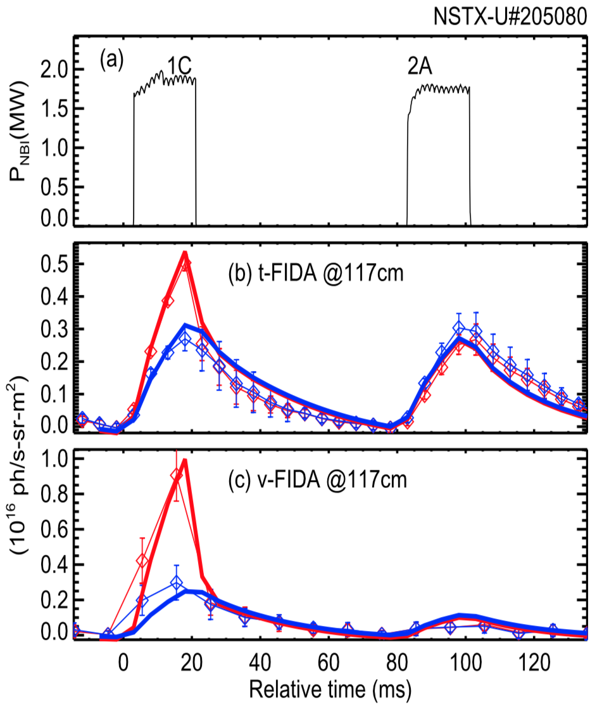
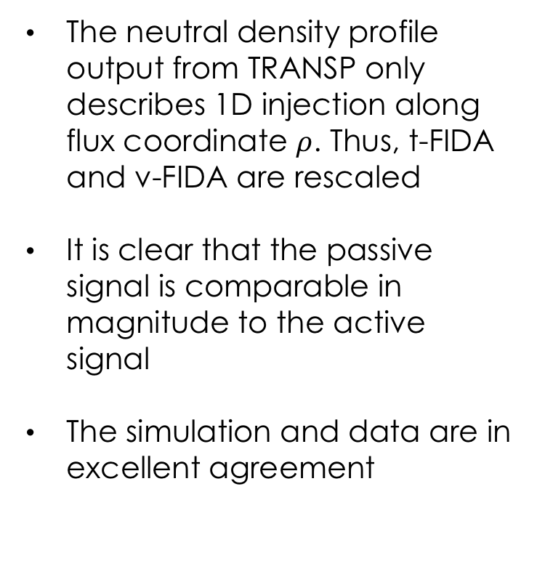
Passive-FIDA signals comparable to active-FIDA signals at NSTX-U (cont’d)
The neutral density profile output from TRANSP only describes 1D injection along flux coordinate $ρ$. Thus, t-FIDA and v-FIDA are rescaled
It is clear that the passive signal is comparable in magnitude to the active signal
The simulation and data are in excellent agreement
Thin and thick curves are experimental and FIDASIM data, respectively. Red curves denote the total signal and blue curves describe only the passive signal.
Hao, PPCF 60 (2018) 025026

Slide 14
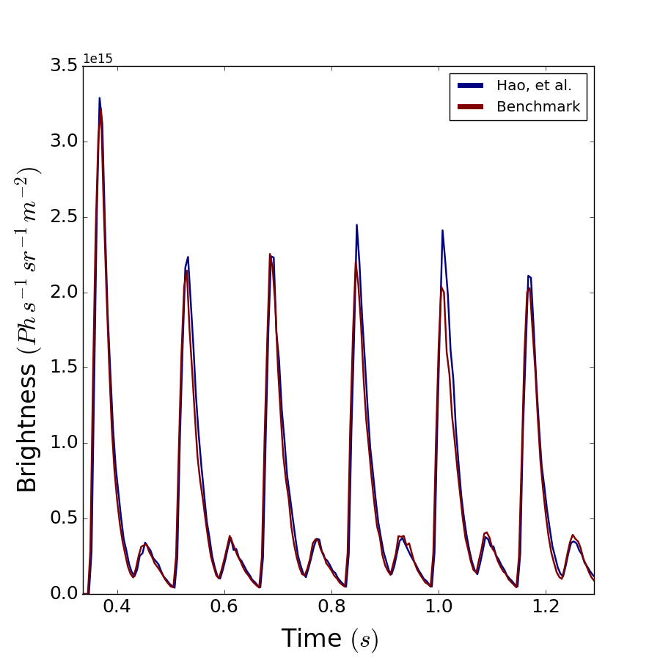
Successful FIDASIM benchmark with 2D passive-FIDA modeling
Plasma, fields, geometry and the fast-ion distribution function from the NSTX-U passive modelling are all reused in this FIDASIM benchmark
P-FIDA spectra are wavelength integrated from 650.8–654.0 nm
Both FIDASIM passive signals agree with each other

Slide 15
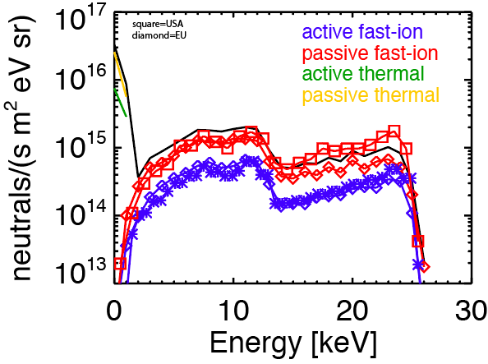
In TCV, passive signals can exceed active signals
TCV is a fairly small tokamak with relatively large orbits and deep neutral penetration
The calculated passive flux exceeds
the active flux for the tangentially viewing compact NPA
Passive FIDA signals are also large²
Calculated NPA flux at the compact NPA¹ during beam injection in TCV
¹Karpushov, RSI 77 (2006) 033504
²Geiger, PPCF 59 (2017) 115002

Slide 16

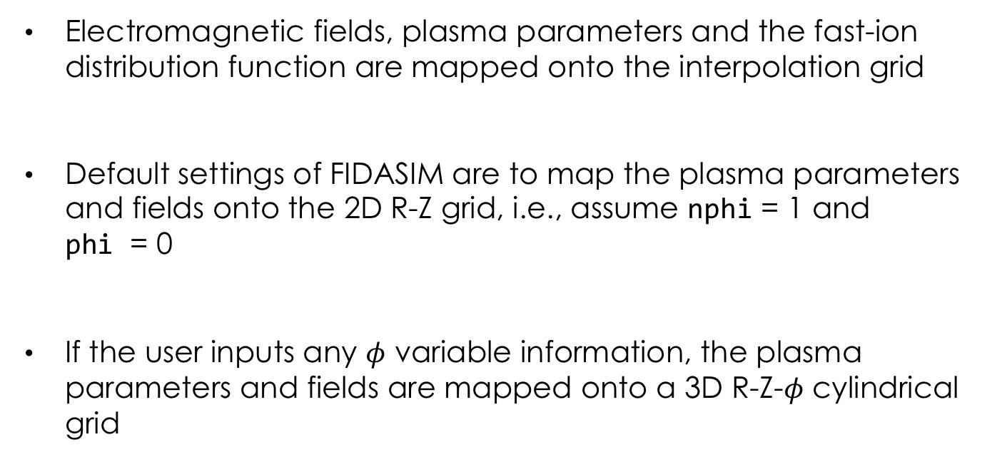
Interpolation grid extended to 3D by taking into account toroidal variable $φ$
Electromagnetic fields, plasma parameters and the fast-ion distribution function are mapped onto the interpolation grid
Default settings of FIDASIM are to map the plasma parameters and fields onto the 2D R-Z grid, i.e., assume nphi = 1 and
phi = 0
If the user inputs any $φ$ variable information, the plasma parameters and fields are mapped onto a 3D R-Z-$φ$ cylindrical grid
grid = {nr, nz, nphi, r, z, phi, r2d, z2d}

Slide 17
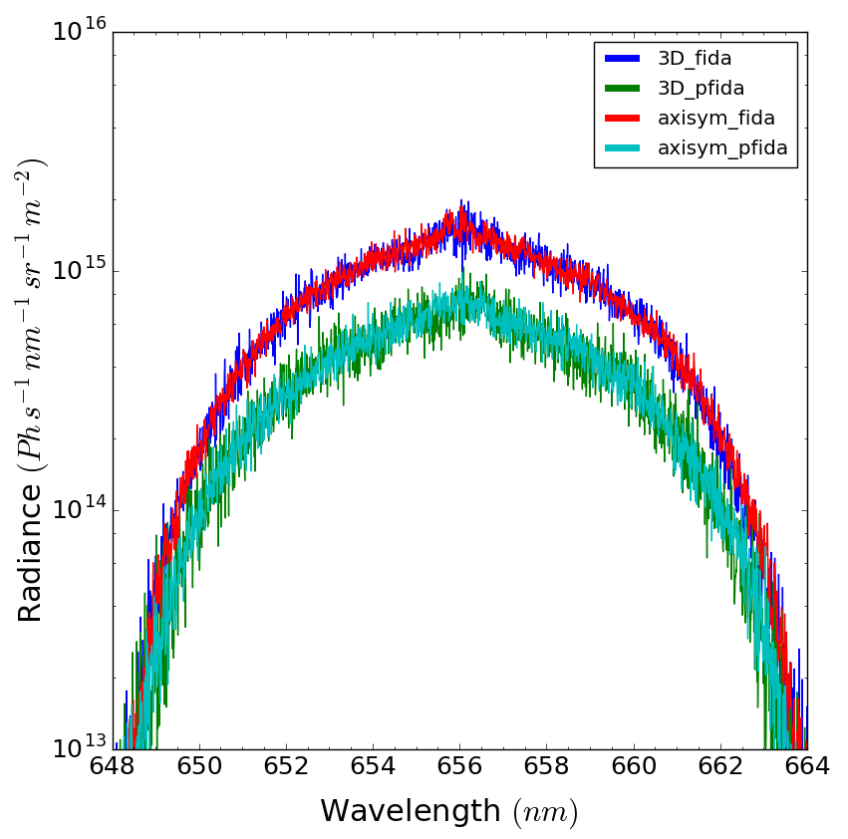
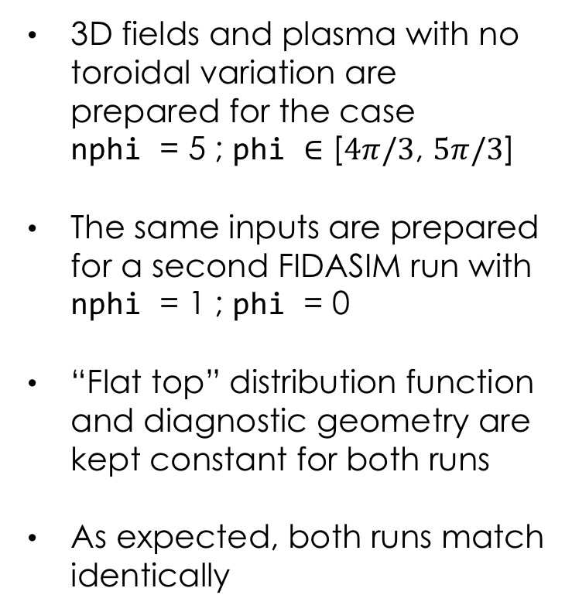
Successful preliminary 3D FIDASIM benchmark with 3D fields and profiles
3D fields and plasma with no toroidal variation are prepared for the case
nphi = 5 ; phi $∈$ [$4π/3$, $5π/3$]
The same inputs are prepared for a second FIDASIM run with nphi = 1 ; phi = 0
“Flat top” distribution function and diagnostic geometry are kept constant for both runs
As expected, both runs match identically

Slide 18
Conclusion
Passive FIDA & NPA signals are now incorporated into FIDASIM
Passive signals produced by FIDASIM agree very well with passive modelling done on NSTX-U¹
FIDASIM can accept fusion configurations with 3D geometry
¹Hao, PPCF 60 (2018) 025026

Slide 19
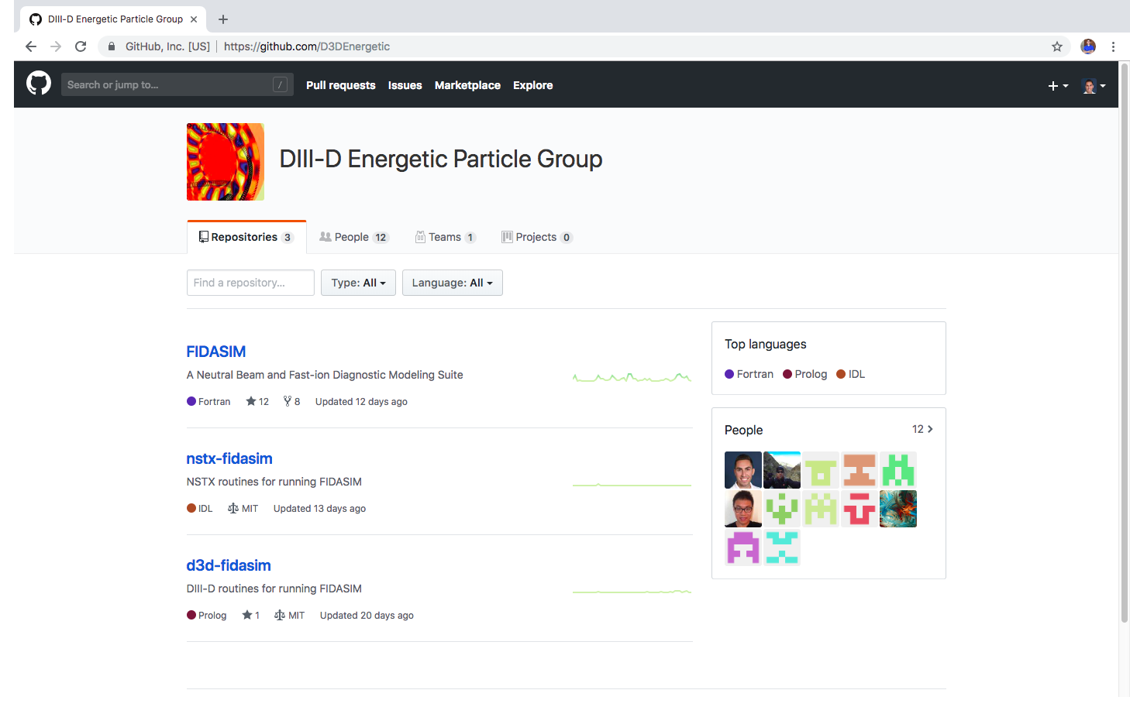
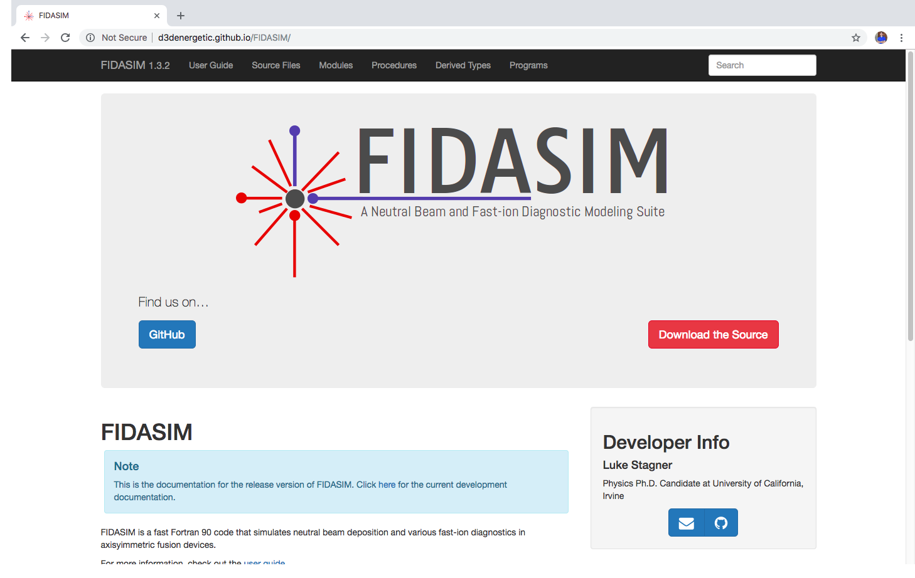
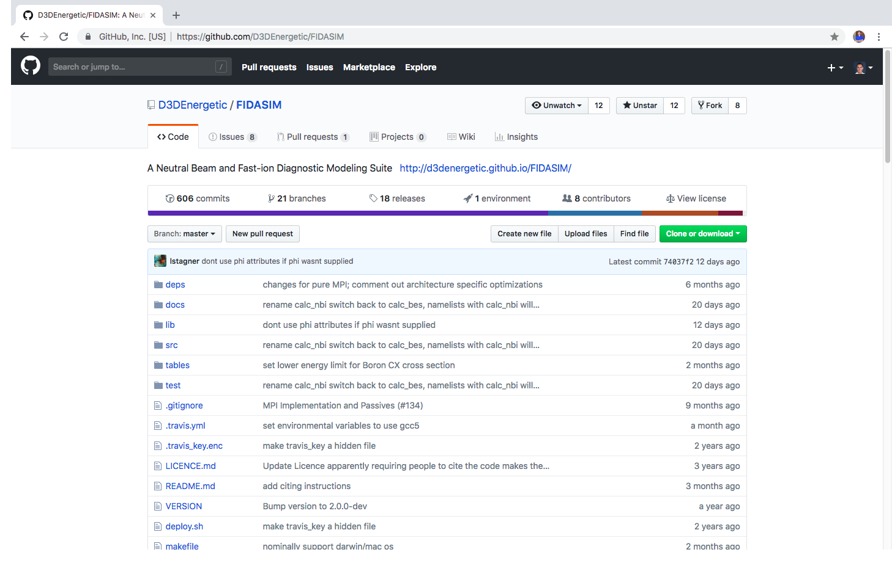
Updated source code and documentation
FIDASIM is version controlled with git
The source code and issue tracker can be found on GitHub
https://github.com/D3DEnergetic/FIDASIM
Documentation can be found at
https://d3denergetic.github.io/FIDASIM/

Slide 20
Our group is interested in expanding the network of FIDASIM users
A benchmark between the USA and EU versions of FIDASIM are underway
Creating a new remote repository for the diagnostic geometry at the Joint European Torus (JET)
Add a charged fusion product forward model to FIDASIM in relation to our Mega Ampere Spherical Tokamak Upgrade (MAST-U) collaboration
Stellarator scientists are welcome to clone our FIDASIM repository and use the new 3D capabilities
FIDASIM 2.0 entering final phases of development

