Slide 1
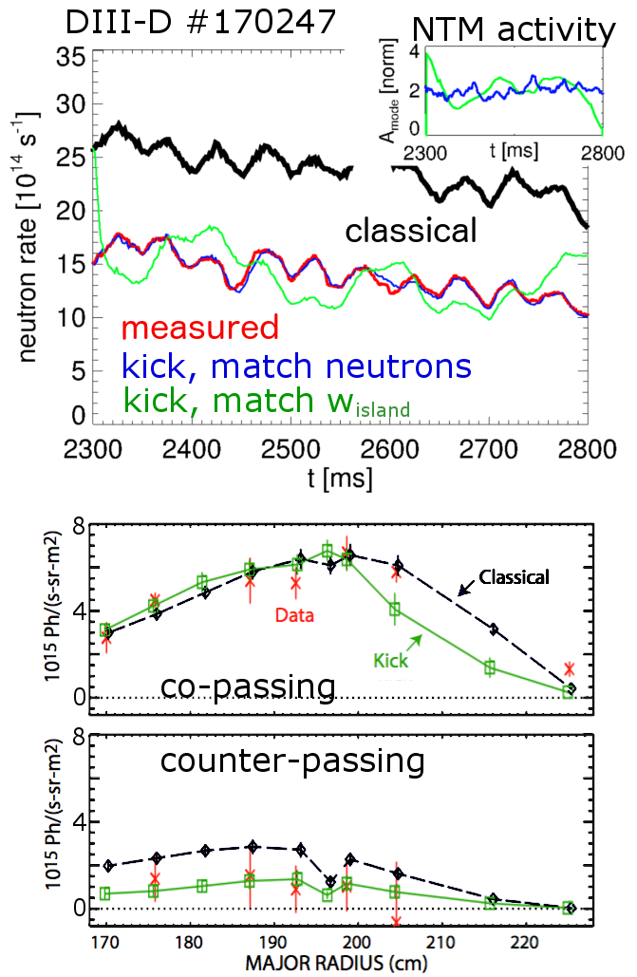
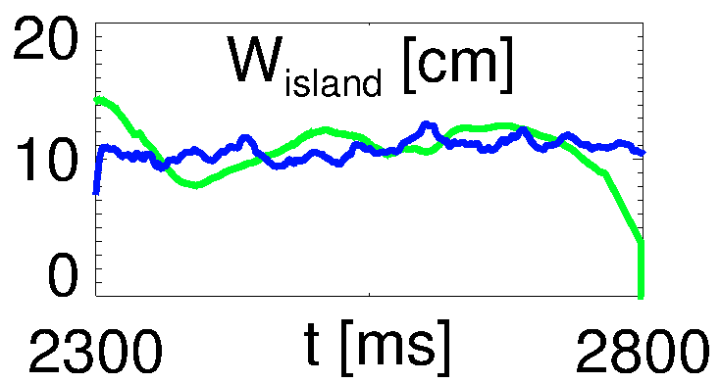
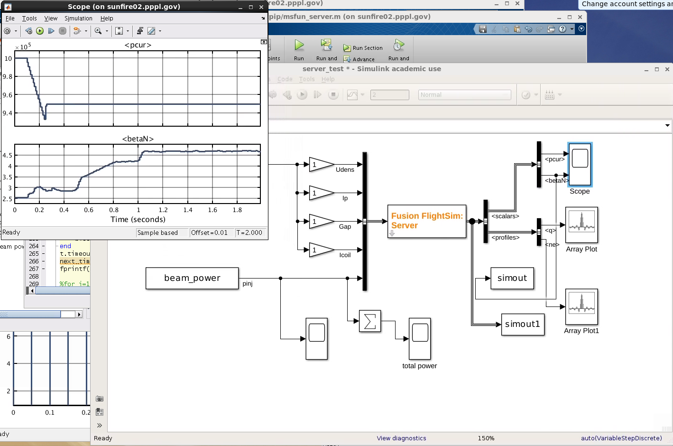
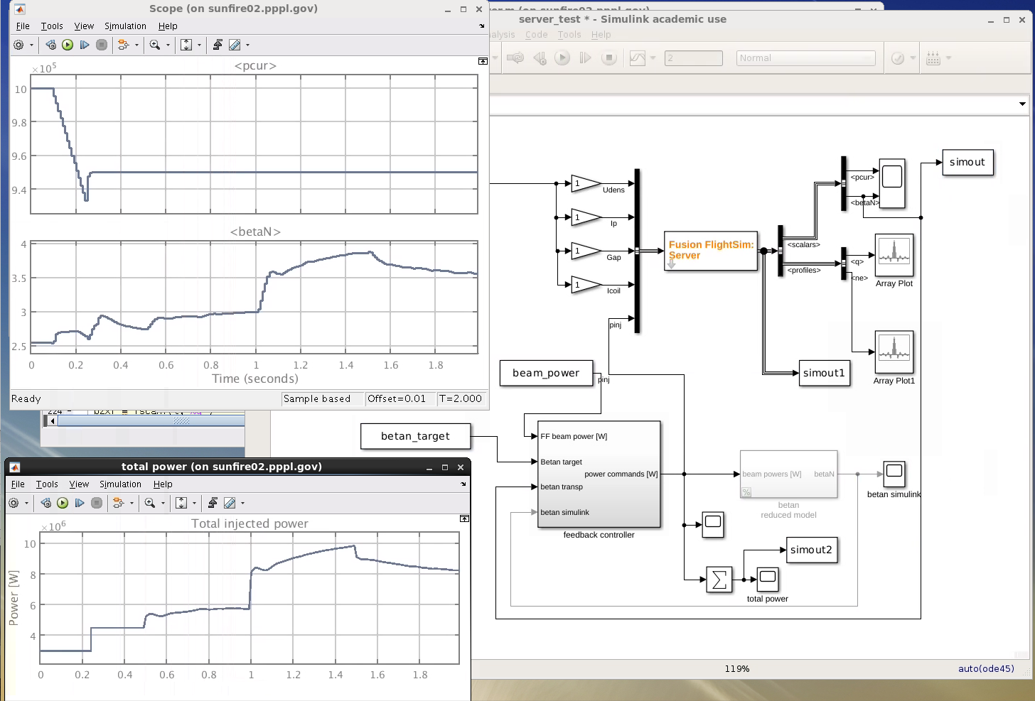
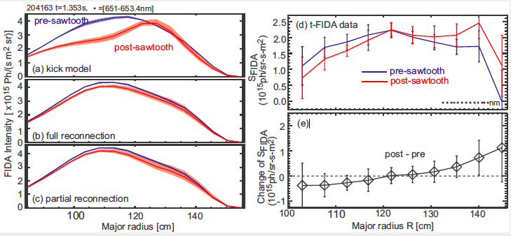
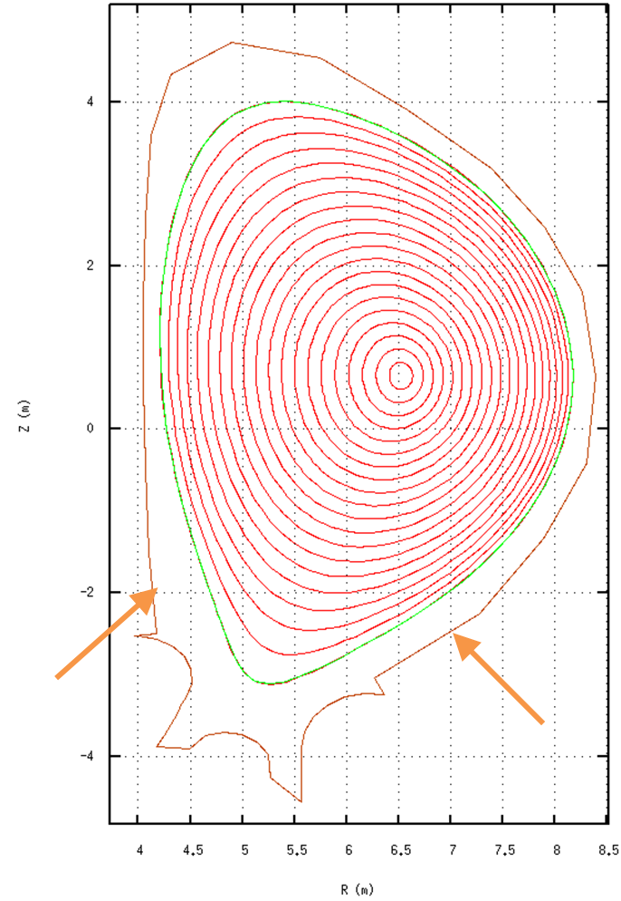
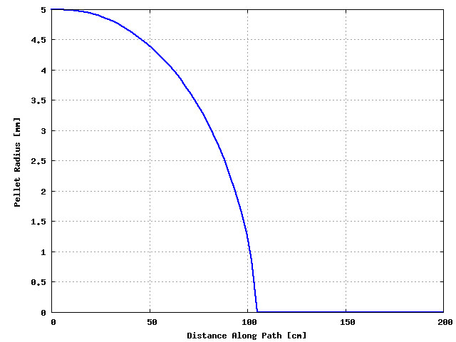
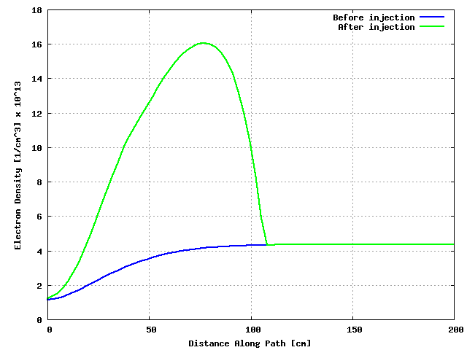
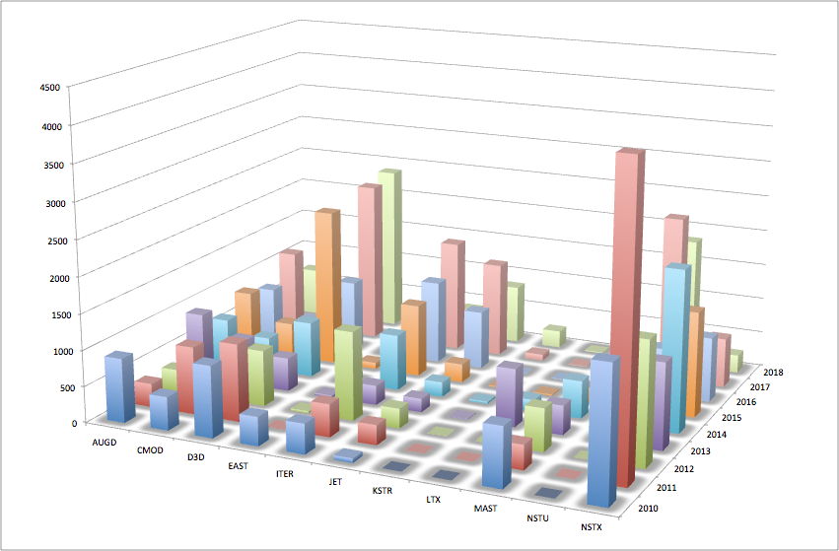
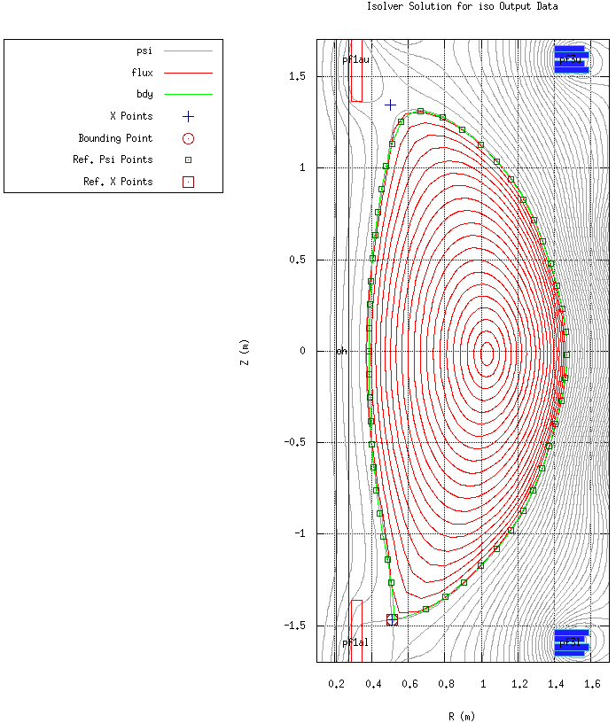
Status and Plans for the TRANSP Interpretive and Predictive Simulation Code
F. M. Poli, J. Breslau, M. Gorelenkova, J. Sachdev, X. Yuan, S. Kaye
Princeton Plasma Physics Laboratory, Princeton University Princeton, NJ, 08543
TRANSP is a time-dependent, 1.5 D solver for interpretive and predictive analysis of tokamak and RFP plasmas
Plans for improving calculations of anomalous fast ion transport
Plans for the development of a fusion flight simulator
The kick model is becoming a workhorse for the analysis of discharges with Neutral Beam Injection.
Kick “interpretive” run:
Scale kicks to match measured neutrons
Mode amplitude related to w_{island}
Inferred NTM island width agrees with measured w_{NTM} (ECE)
a posteriori check, validation
Favorable comparison with phase-space resolved data (FIDA)
Acceptable for co-passing, good for counter-passing
Key exercise for model validation
Ad-hoc diffusion would give same drop for co/cntr
[with M. Podesta’ and N. Gorelenkov (PPPL)]
INPUT: Experimental data and model/calculation assumptions
GOAL: develop user-friendly interface that allows steering TRANSP simulations from Simulink.
TRANSP provides the plasma response and Simulink provides the actuator input
Capability of monitoring the run and allow human intervention to control the discharge
NB source
(NUBEAM)
Equilibrium solver
RF source
(TORIC [ICH], LSC (LH), TORAY/TORBEAM (EC), GENRAY+CQL3D [ECH,HHFW, LHCD])
Initial ‘open loop’ test case successful
Initial ‘closed loop’ test case successful
Neutral transport
Plasma current and β_{N} measured from TRANSP run (plot updates in ‘real-time’ as the TRANSP run progresses)
Plasma current and β_{N} measured from TRANSP run (plot updates in ‘real-time’ as the TRANSP run progresses)
To/from TRANSP running on remote computer
Plasma transport solver
Heidbrink NF 2018 Bardóczi PPCF 2018 (submitted)
To/from TRANSP running on remote computer
MHD, *AE stability codes,
ELITE, IPS, SciDACs, etc.
OUTPUT
Gyrokinetic codes
(GTC-NEO, GYRO, GS2, GTS…)
FIDA brightness
Target
“Plasma State”
Beam power commands modified by Simulink control algorithm to track target β_{N}, sent to TRANSP
Feedback on
Output of TRANSP (Plasma State File) is standardized for simplifying input to other computationally intensive codes
1
Beam power waveforms programmed in Simulink, sent to TRANSP run at each timestep
Kernel of the code is the solution of particle, energy and momentum transport equations
Analysis being extended to sawtooth instabilities [D. Kim, Nucl. Fusion 2017]
Feedback on
Feedback algorithm in Simulink
The kick model reproduces the observed
asymmetry in the FIDA diagnostics, with a drop inside the inversion radius.
energy dependent model needed
to describe energy-dependent reconnection fraction in Porcelli model
For more realistic description of effects on fast ion redistribution
1
Particle:
Demonstrated communication and time stepping control
Demonstrated Simulink control of β_{N} using total beam power
Energy (e⁻):
[with M. Boyer (PPPL)]
Momentum:
Plans for self-consistent pellet injection and ablation for predictive modeling
Interpretive: INPUT: T_{e}, T_{i}, n_{e}, v_{φ},….. OUTPUT: D_{e,i}, χ_{e,i,φ},…..
Predictive: INPUT (model): χ_{e,i}, D_{e,i}, …. OUTPUT: T_{e,i,} n_{e},…..
Following recent success, we are working on the development of:
general model for anomalous fast ion transport driven by low-n instabilities
self-consistent MHD calculations
synergy between RF and fast ions
extension of fast ion losses to the SOL (with reduced model for the SOL)
GOAL: focus over next 2 years on self-consistent calculations in TRANSP for anomalous fast ion transport
Goal over the next FY is to finalize implementation of a pellet injection and ablation model for self-consistent predictive models
Time-dependent source terms for the density and energy equations as the pellet penetrates the plasma
Initial focus on hydrogenic pellets for fueling studies
Extension for impurity pellets pursued in coordination with upgrades to the impurity transport model
Current implementation only effective for penetration depth studies for interpretive simulations
TRANSP simulation stopped and pellet injected
Contribution from ablation to the density and energy equations not included back into the plasma
Upgrades and improvements to the experience of users
Standalone version of ISOLVER
Inputs for a hydrogenic pellet injection into an ITER-like discharge
Pellet injection time | 50 s
Pellet starting r-position | 4.15 m
Pellett starting y-position | -2 m
Toroidal aiming angle | 132◦
Poloidal aiming angle | 0◦
Initial pellet radius | 5 mm
Magnitude of pellet velocity | 30 m/s
International pool of users:
350 active users in 2018
about 6000 jobs/year run at PPPL
Two approaches to runs:
Standard – submit to PPPL cluster
NEW – local install of disk image
TRANSP free boundary tokamak equilibrium component, calculating coil currents or feedback for select devices to match plasma LCFS to a prescribed boundary, based on known q, pressure profiles.
Now available on the PPPL cluster as a standalone equilibrium solver.
Executable version: A minimal subset of TRANSP scripts, libraries, and executables, with Jython scripts available to read supplied profiles from text files and generate equilibrium files and plots.
Source version: A minimal subset of ISOLVER source code with makefiles linking to the NTCC library, available for customization and incorporation into alternate workflows, e.g. OMFIT.
Advantages:
expand use of TRANSP to Universities and small institutions
does not need a trusted connection with PPPL
* Work supported by US DOE Contract No. DE-AC02-09CH11466
TRANSP has DOI and version number => check @ https://transp.pppl.gov

