Slide 1
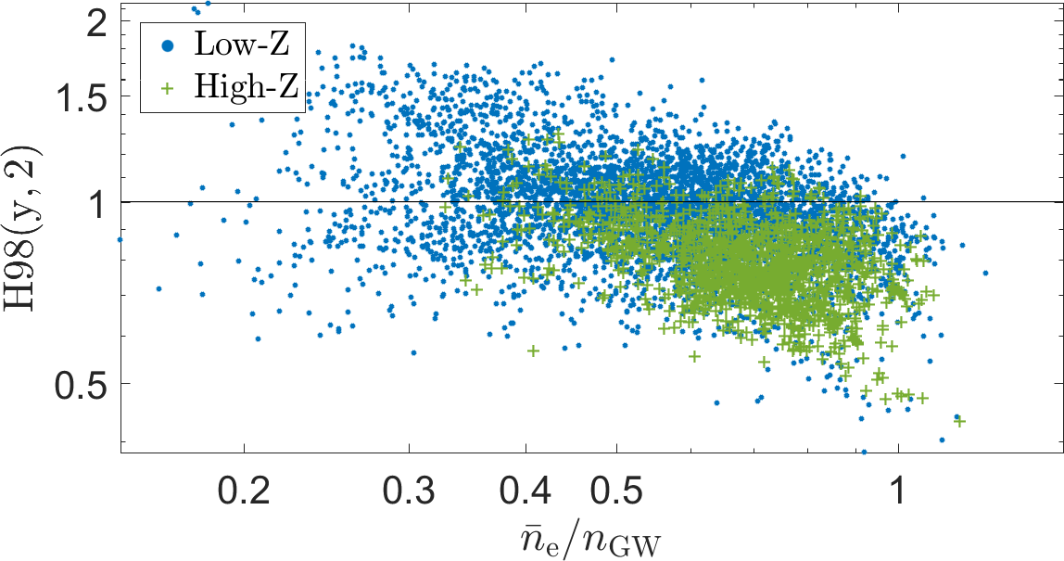
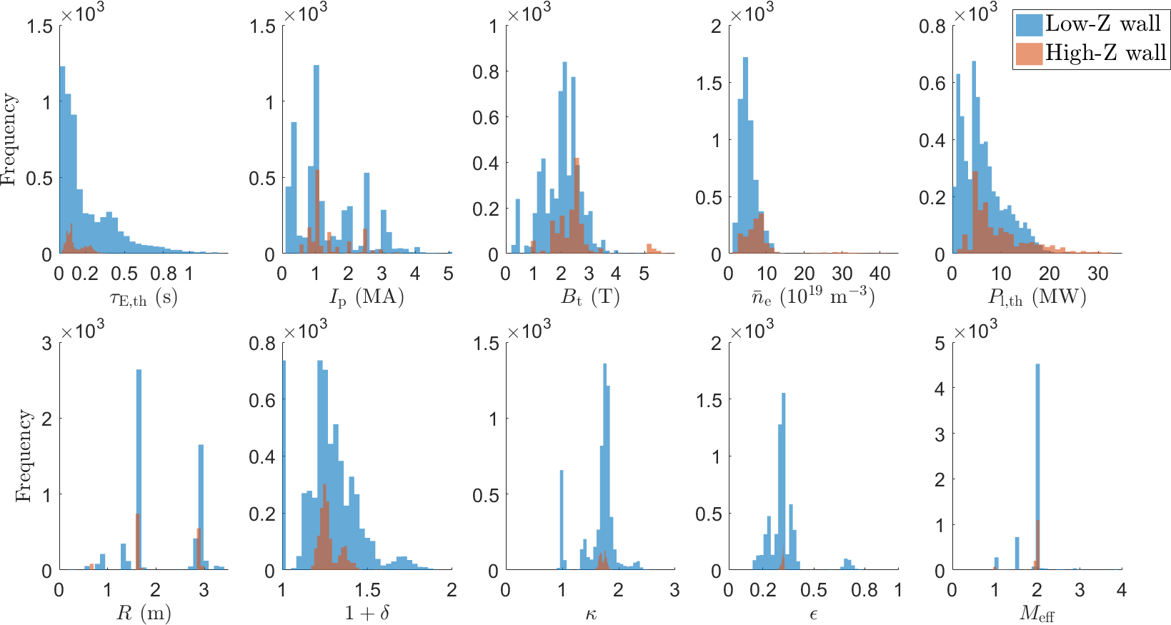




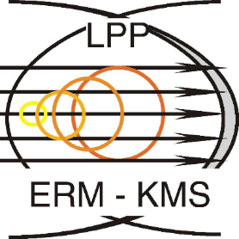





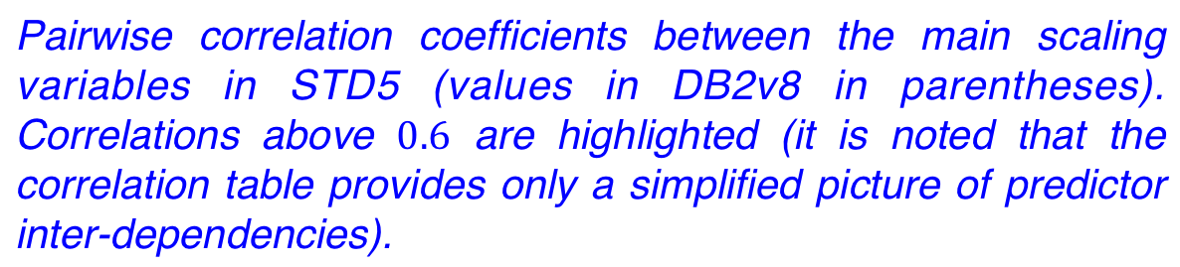
First analysis of the updated ITPA global H-mode confinement database
S.M. Kaye¹, G. Verdoolaege^{2,3}, C. Angioni⁴, O.J.W.F. Kardaun⁴, M. Maslov⁵, M. Romanelli⁵, F. Ryter⁴, K. Thomsen⁴,
the ASDEX Upgrade Team*, the EUROfusion MST1 Team† and JET Contributors‡
ITER parameters used: I_{p}=15 MA, B_{T}=5.3 T, n_{e}=10.3e19 m⁻³, R=6.2 m, ε=a/R=0.32, κ=1.7, δ=0.33, M_{eff}=2.5, P_{heat}=87 MW
¹Princeton Plasma Physics Laboratory, Princeton, NJ, USA
²Departmen^{t} of Applied Physics, Ghent University, Ghent, Belgium
³Laboratory for Plasma Physics, Royal Military Academy, Brussels, Belgium
* See the author list of “A. Kallenbach et al. Nuclear Fusion 57 (2017) 102015”
† See the author list of “H. Meyer et al., Nucl. Fusion 57 (2017), 102014”
‡ See the author list of “X. Litaudon et al., Nucl. Fusion 57 (2017), 102001”
⁴Max Planck Institute for Plasma Physics, Garching, Germany
⁵UKAEA, Culham Science Centre, Abingdon, UK
Global energy confinement scaling
  Extrapolate plasma performance to new machines (e.g. ITER)
  Reference for confinement in present experiments
  Boundary condition for numerical models
  Guidance for development of theoretical models
  Global H-Mode Confinement Database (°1989):
  Presently under ITPA umbrella
  DB4v5: data from 19 tokamaks [1, 2]
  Version 3 (DB3, subset DB2v8) for IPB98(y,2) (1998) [3]
Statistic | τ_{E,th} (s) | I_{P} (MA) | B_{T} (T) | n_{e} (10¹⁹ m⁻³) | P_{L,th} (MW) | (m) |  |  |  | M_{eff}
Min. | () | () | () | () | () | () | () | () | () | ()
Max. | () | () | () | () | () | () | () | () | () | ()
Mean | () | () | () | () | () | () | () | () | () | ()
Median | () | () | () | () | () | () | () | () | () | ()
Stand. dev. | () | () | () | () | () | () | () | () | () | ()
Variables |  | ln B_{T} | ln n_{e} |  |  |  |  |  | ln
ln I_{p} |  | − | − | − | − | − | − | − | −
 | () |  | − | − | − | − | − | − | −
 | () | ( |  | − | − | − | − | − | −
 | () | () | () |  | − | − | − | − | −
 | () | () | () | () |  | − | − | − | −
 | ( | () | () | () | () |  | − | − | −
 | ( | () | () | () | () | () |  | − | −
 | () | () | () | () | () | () | () |  | −
M_{eff} | () | () | () | () | () | () | () | ()
Motivation and goals
  Add data closer to ITER conditions and expand parameter range
  Add data from devices with fully metallic walls
  Improve reactor-relevant database coverage w.r.t. IPB98(y,2) (high ${\overline{n}}_{\text{e}}$, low $q_{95}$, high $β$)
Summary statistics for the main scaling variables in STD5 (values in DB2v8 in parentheses).
Pairwise correlation coefficients between the main scaling variables in STD5 (values in DB2v8 in parentheses). Correlations above are highlighted (it is noted that the correlation table provides only a simplified picture of predictor inter-dependencies).
‘H18’
(high n_{e}, low q₉₅, high β)
Database update: DB5
  Addition of data from fully metallic devices (2017):
    627 time slices from JET-ILW (ITER-like wall) H-modes [6, 7]
    825 from ASDEX Upgrade (AUG) full W wall [8]
  Improved fast-particle loss estimates (AUG)
  DB5v7: 13913 points from 19 devices
    STD5 (H-mode selection criteria [9]): 7294 points
    STD5-SEL1 ($q_{95}>2.8$, $1.3<κ<2.2$, $ε<0.5$, $Z_{\text{eff}}<5$): 5956 points
    STD5-SEL2 ($2.8<q_{95}<3.5$, $1.6<κ<2.0$, $0.28<ε<0.385$,
    $Z_{\text{eff}}<3$): 1674 points
  200+ variables, added $n_{\text{e},\text{sep}}$, $n_{\text{e},\text{SOL}}$, torque (JET, AUG)
}
+ C-Mod = ‘High-Z’ subset
(metal WALMAT, LIMMAT, DIVMAT)
Device | DB5 | STD3 | STD5 | STD5-SEL1 | STD5-SEL2
ASDEX
AUG-C
AUG-W |  |  |  |  | 69
C-Mod
COMPASS
DIII-D
JET-C
JET-ILW
JFT-2M
JT60-U
MAST
NSTX
PBXM
PDX
START
T10
TCV
TdeV
TEXTOR
TFTR
TUMAN3M
Total
(q₉₅>2.8, 1.3<κ<2.2, ε<0.5, Z_{eff}<5: 5956 points)
Z_{eff}<3): 1674 points)
(2.8<q₉₅<3.5, 1.6<κ<2.0, 0.28<ε<0.385
Regression methods
  Complications arising in the analysis:
  Heterogeneous data from multiple devices and diagnostics
  Heterogeneous measurement uncertainties,
  log-transformation [13, 14]
  Within-device vs. between-device variability
  Model uncertainty
  Uncertainty in predictor and response variables
  ($τ_{\text{E},\text{th}}$, $P_{\text{l},\text{th}}$, $ρ^{∗}$, $ν^{∗}$, $β$, …) [13 – 16]
  Predictor variable interdependencies (medium to strong collinearity)
Deterministic model component: regression function
$y=f\left(\left\{x_{j}\right\},\left\{α_{k}\right\}\right)$
Stochastic model component
Parameter estimation techniques
n_{e,sep}, n_{e,SOL}, torque (JET, AUG)
(τ_{E,th}, P_{l,th}, ρ*, ν*, β, …) [13-16]
Histograms for the main scaling variables in STD5, with low-Z (carbon wall components) vs. high-Z (fully metal-wall devices).
Number of data points per tokamak in DB5, the standard set before the latest update (STD3), the current standard set (STD5) and two ITER-relevant subsets (ST5-SEL1 and STD-SEL2).
* Work supported by US DOE Contract No. DE-AC02-09CH11466

