Slide 1



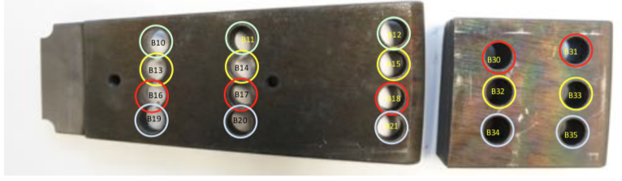
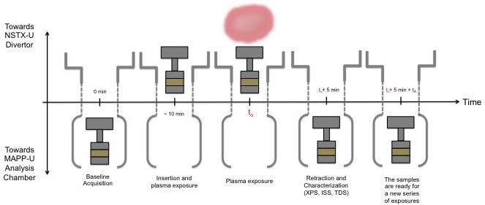
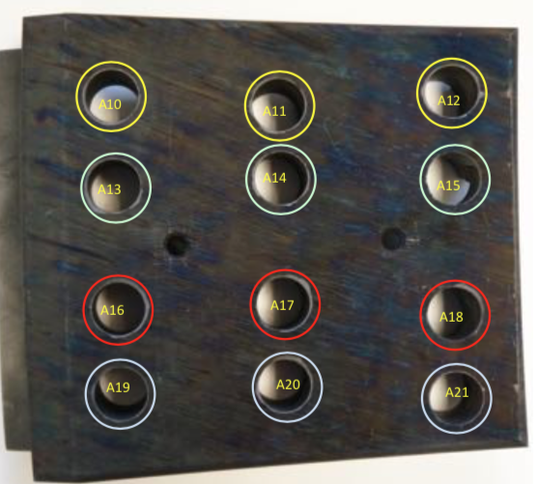
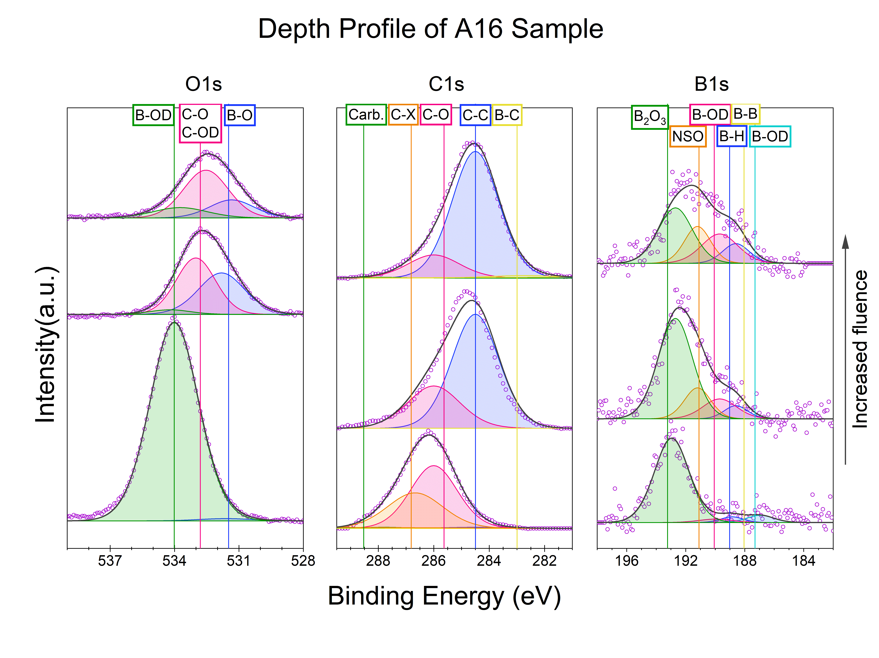
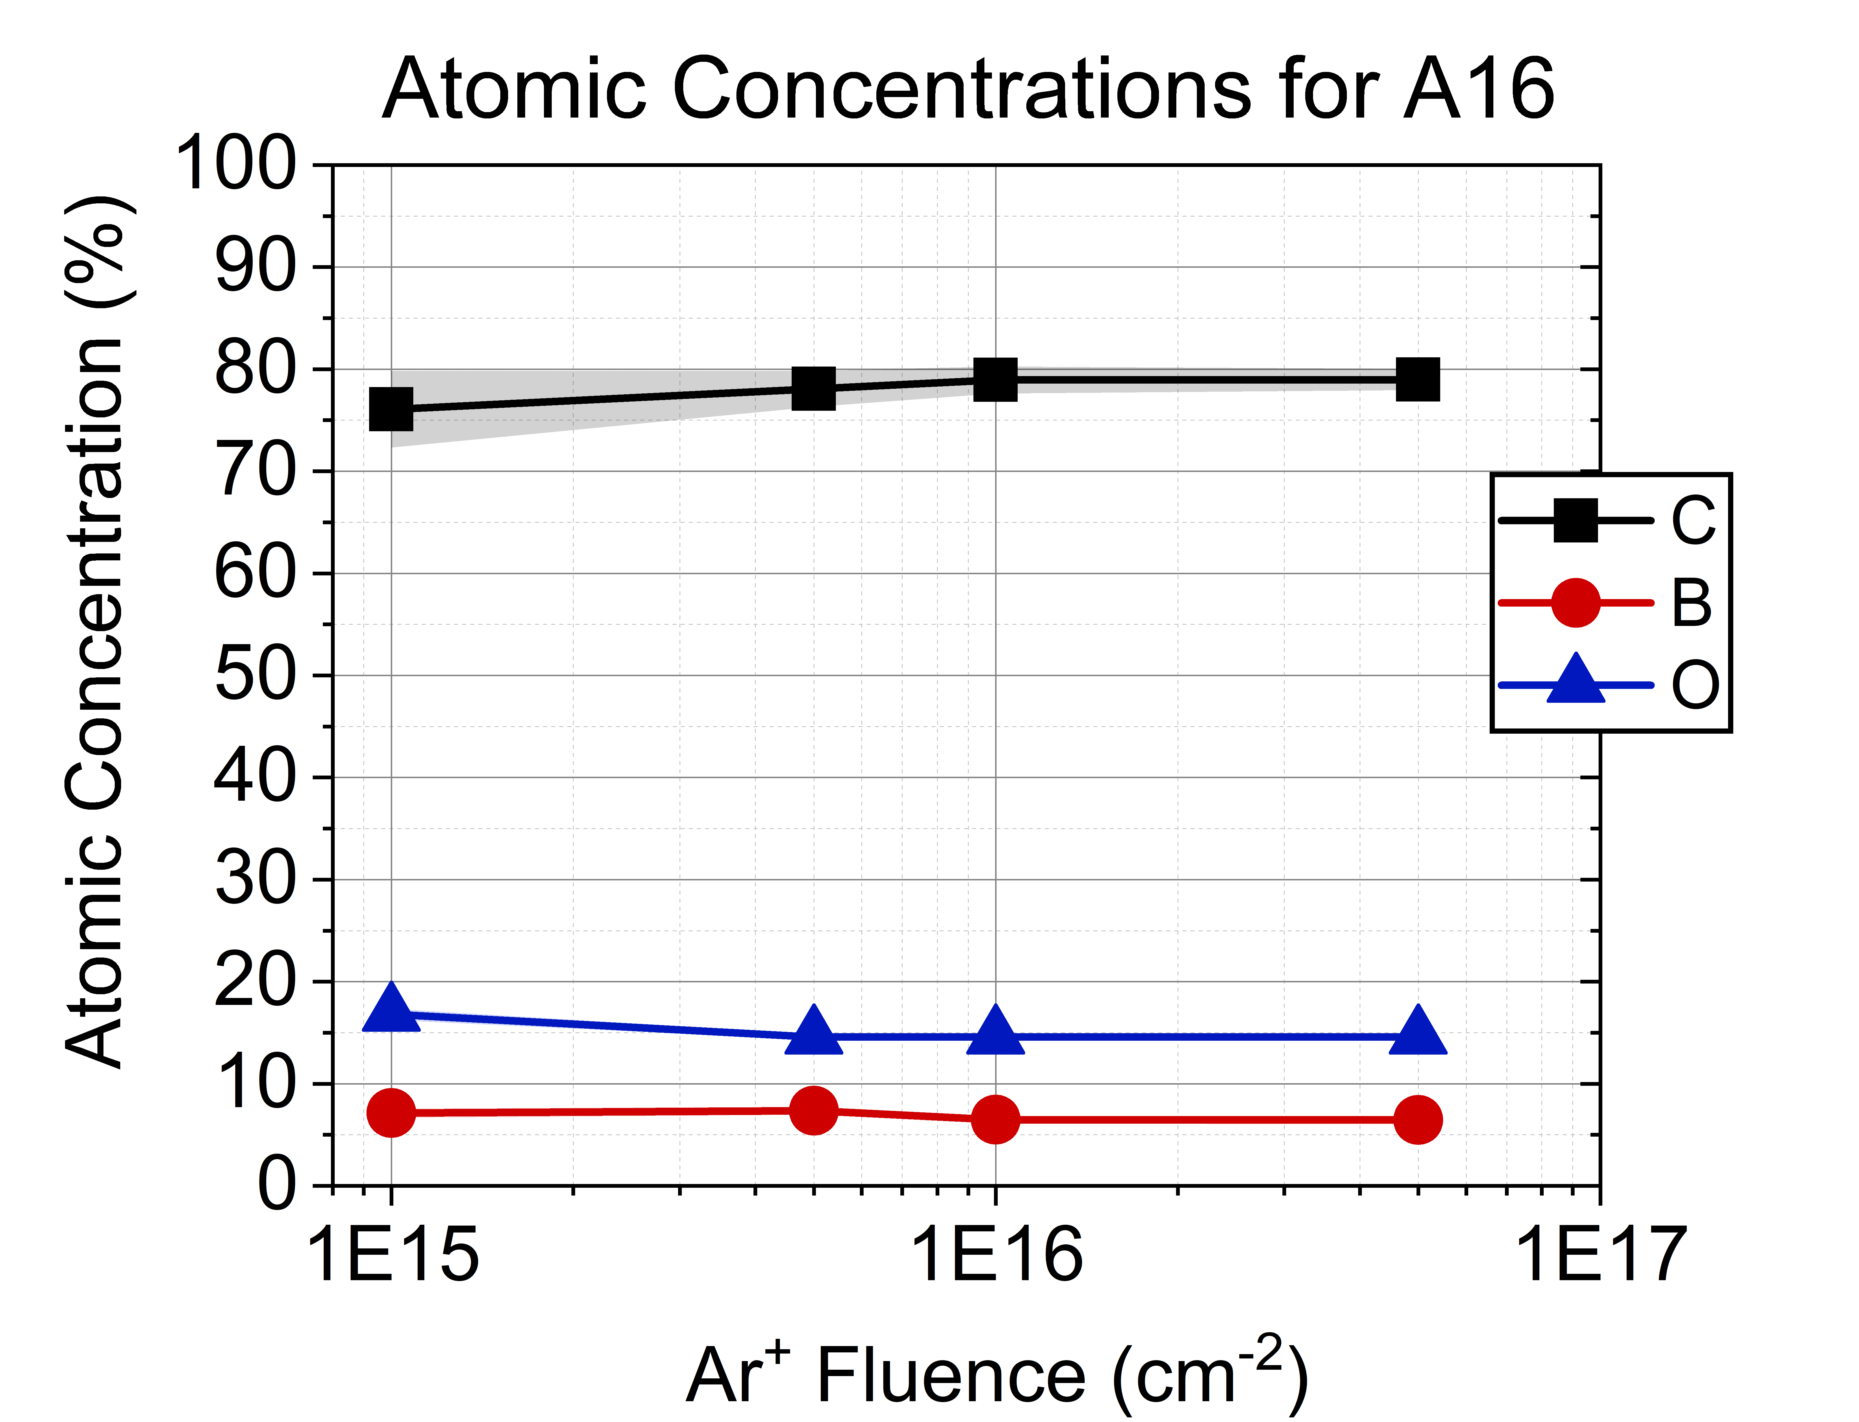
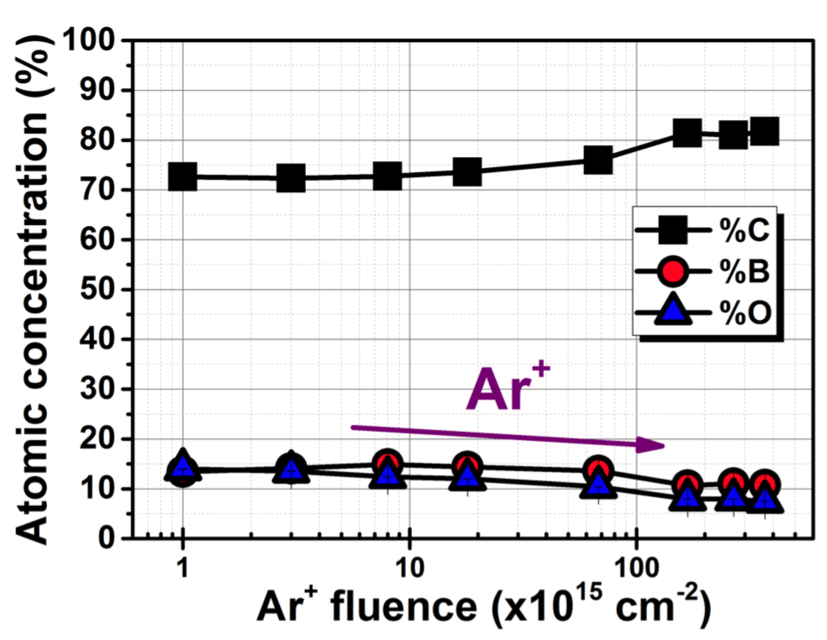
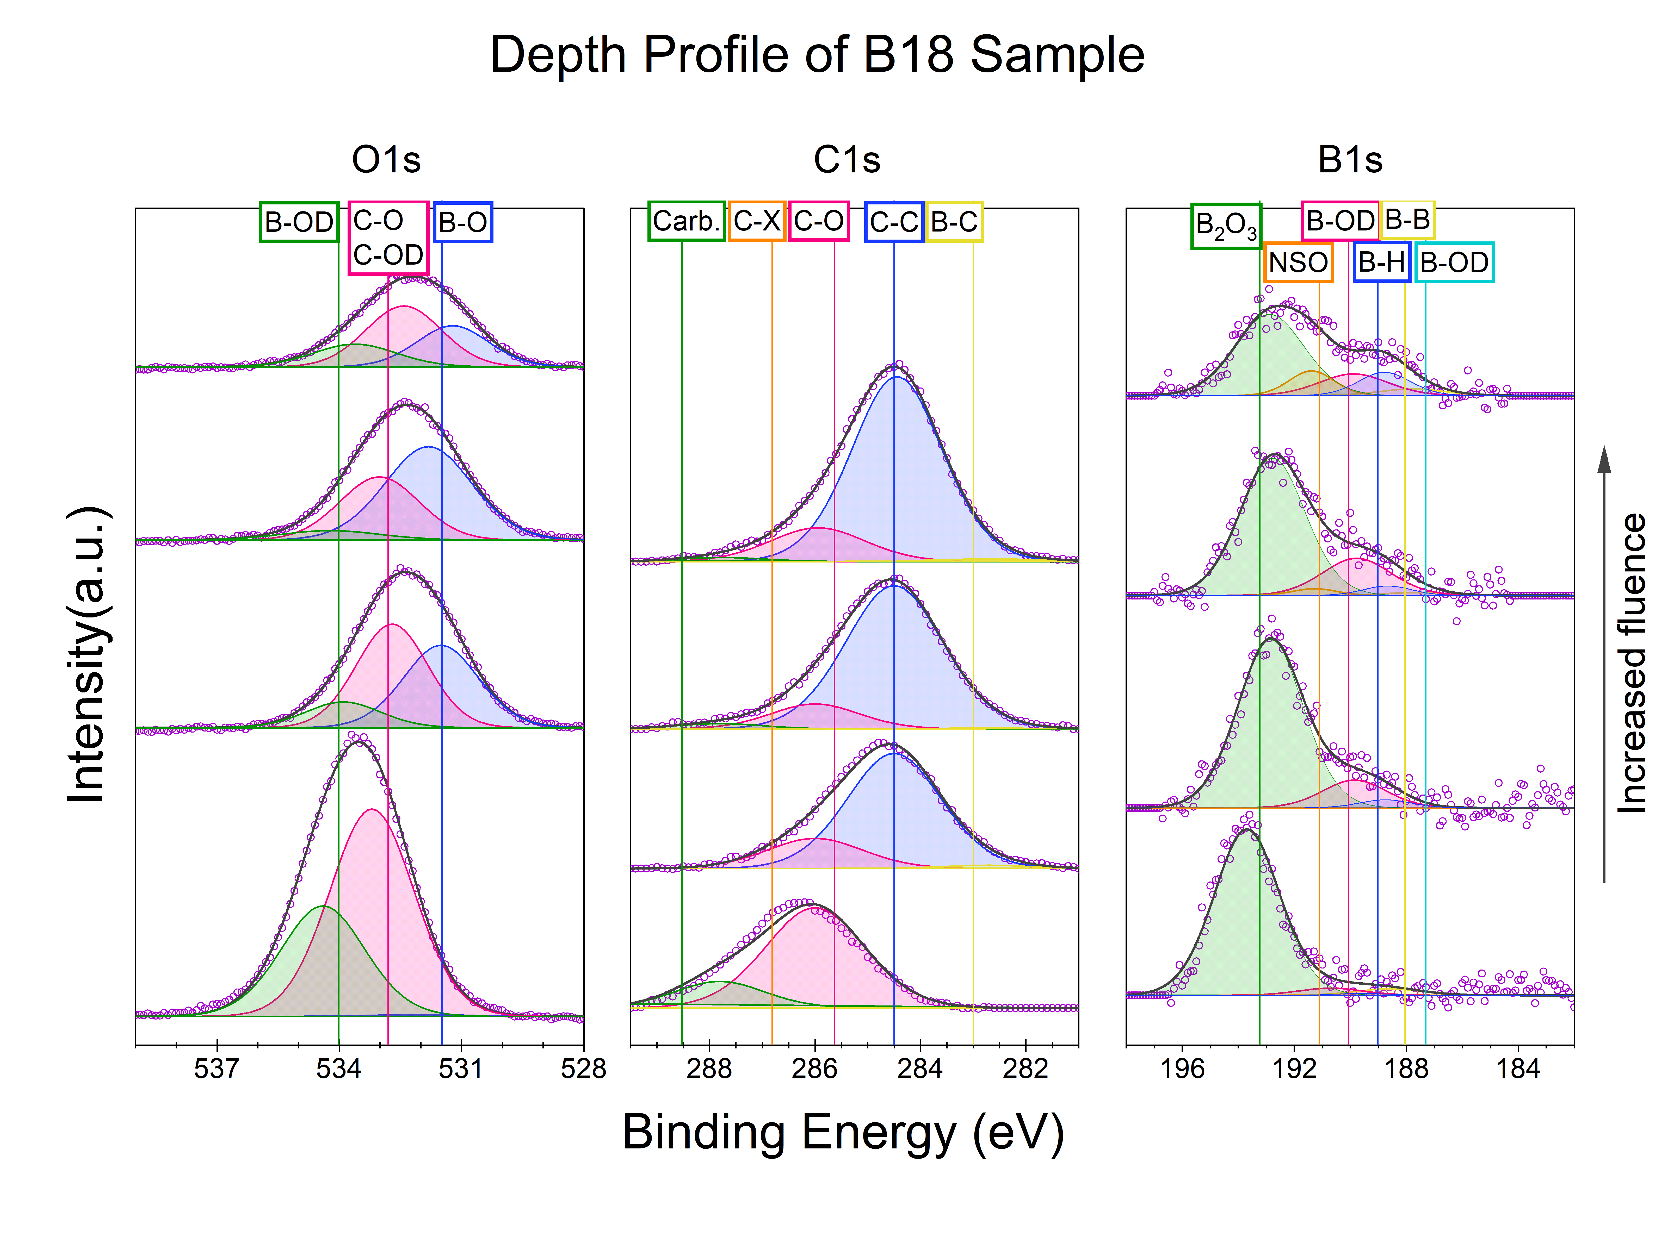
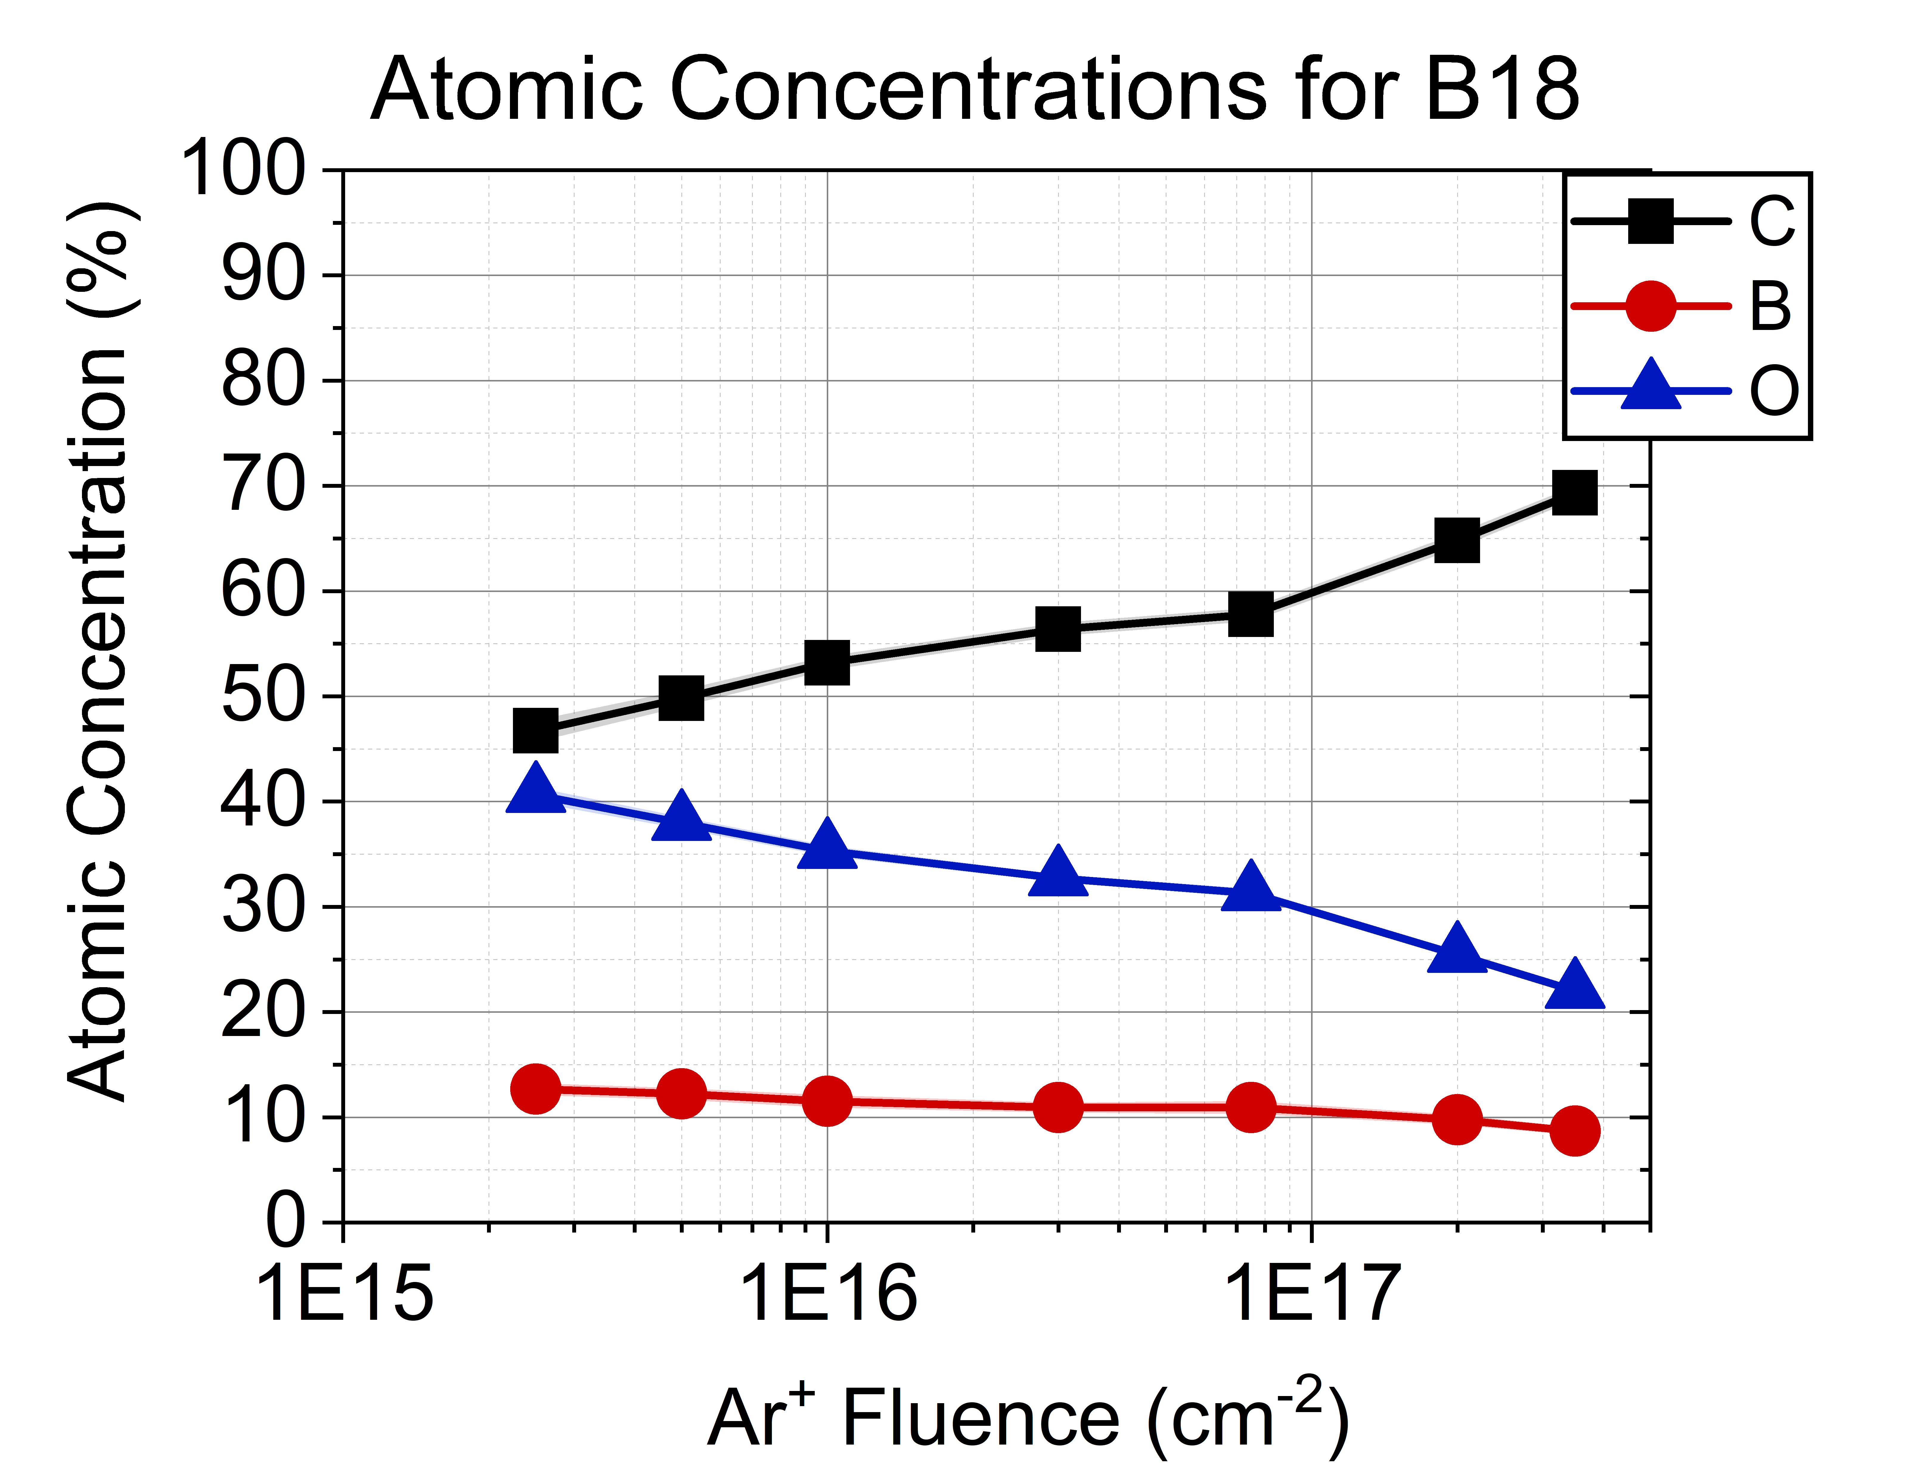
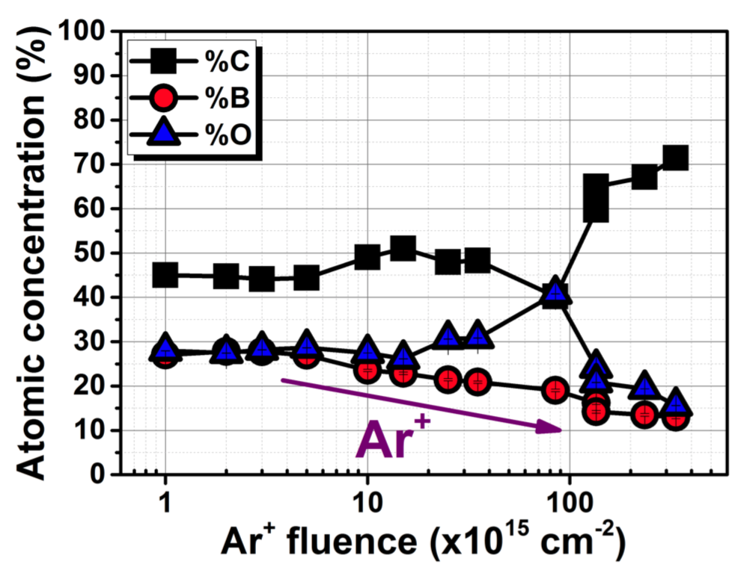
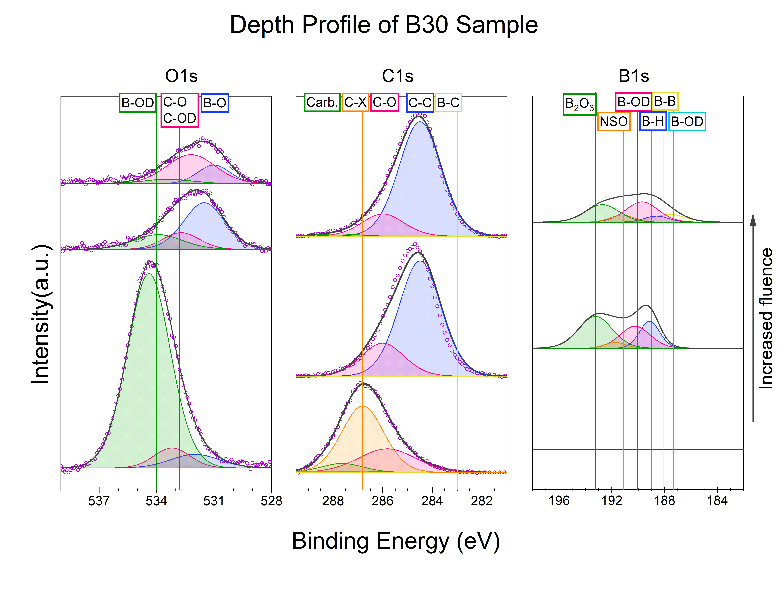
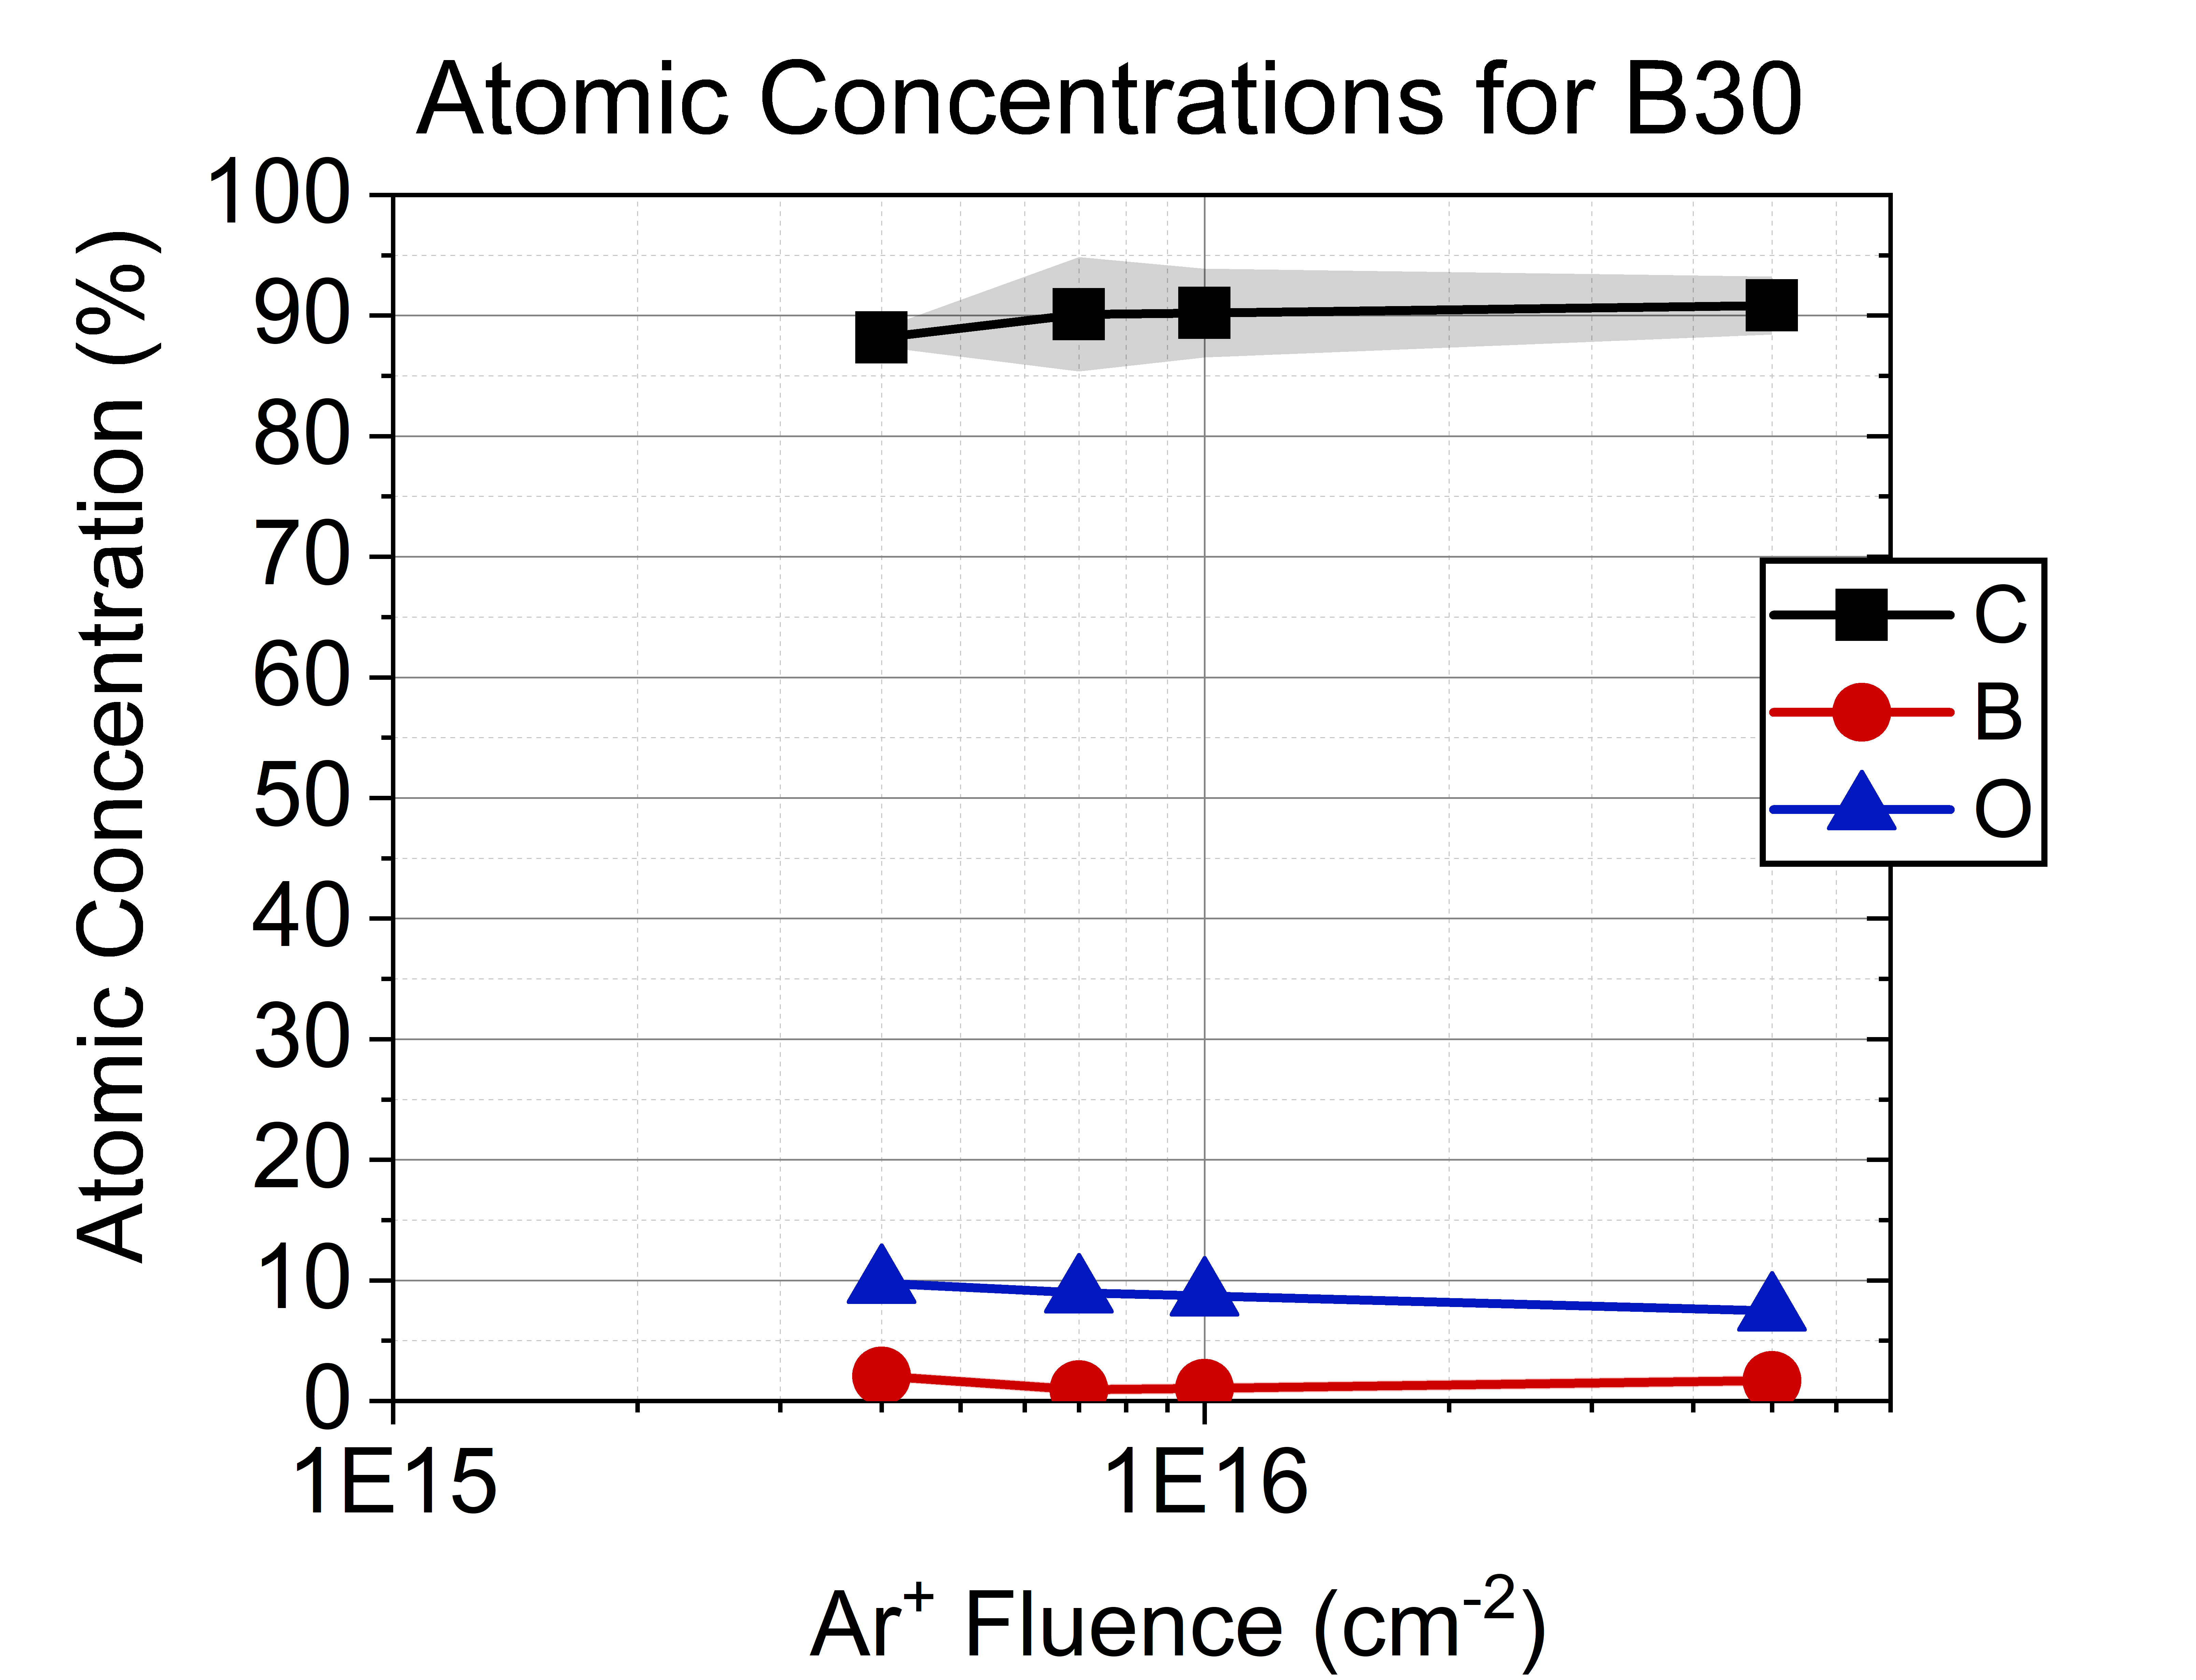
Irradiation studies of boron coatings on graphite samples from NSTX-U
H. Schamis^{1＊}, H. Sandefur¹, J. P. Allain¹, F. Bedoya², R. Kaita³
1 University of Illinois, Urbana, IL 61801; 2 MIT Plasma Science and Fusion Center, Cambridge, MA 02139; 3 University of Tennessee, Knoxville, TN 37996
Introduction
MAPP is a materials characterization technique used in NSTX-U to study the evolution of the surface chemistry of the plasma-facing components.
It has the capability of conducting X-ray Photoelectron Spectroscopy (XPS) in vacuo.
The probe is not exposed to atmospheric conditions, and can take measurements on a day-to-day basis.
Plasma-facing component conditioning is used to minimize the emission of impurities, fuel recycling, erosion, and redeposition.
During the 2015-2016 NSTX-U experimental campaign, deuterated-trimethlyborane (d-TMB; B(CD₃)₃) was used to condition the PFCs.
The next NSTX-U run will continue to feature a full graphite wall, and both boron and lithium will be used as PFC conditioning techniques. This will require new baseline XPS data for LI-B-C systems.
Previous work by Taylor et al. [1] shows that oxygen plays a key role in deuterium retention in lithiated graphite surfaces.
MAPP: The Materials Analysis and Particle Probe
Depth Profile
Depth profile XPS was conducted in IGNIS of samples taken from various points in NSTX-U.
The IGNIS facility at UIUC consists of a high vacuum chamber constructed for in-situ, in-operando surface modification and analysis using ion irradiation.
Depth profile was conducted in-situ in IGNIS. 1 keV Ar ions at normal incident angle were used to sputter off layers of material, and XPS was used to characterize the layers.
Sample A16 (Center Stack)
Sample B18 (Inner Divertor)
Sample B30 (Inner Divertor)
Comparison between samples
Previous depth profiles were done on different samples from the same tiles: B17 (Lower Divertor) and A17 (Center Stack). [2].
Samples A17 and A16 show similar atomic concentrations.
B17 has much higher B concentration (~25%) than B18 (~12%), indicating a radial dependence.
XPS data fitting
The XPS data obtained using MAPP gives information on the chemical composition of up to 10 nm of the surface of the samples.
The samples were scanned in three regions (B1s, C1s and O1s).
The data peaks were deconvoluted and fit according to the following constraints:
▷ Position/Binding energy: obtained from previous
controlled experiments [3].
▷ FWHM of the spectral fits
▷ Area relation between doublets
Atomic concentrations are calculated taking into account the photoionization cross section of each element.
Future Work
Further experiments will be carried out on the boronized graphite samples.
Samples of varying boron concentration will be dosed with Li and then irradiated with D.
In addition to providing insight into the surface processes of deuterium retention, these experiments will provide a baseline for MAPP measurements during the next NSTX-U campaign.
Hardware upgrades to MAPP will allow for enhanced energy resolution, as well as additional techniques.
Summary
With MAPP, PFC material evolution can be studied in ways not previously possible.
Post-mortem analysis provides data for various radial points.
The data shows differences in boron concentration, indicating shadowing during conditioning, sputtering, migration, or re-deposition during plasma operations.
A16
B18
B30
Above: location in NSTX-U where samples were removed from.
Above: Lower Inboard Divertor tile, with samples extracted
Right: Center Stack shoulder tile.
Schematic of the exposure sequence of MAPP
Atomic Concentrations for A17 [2]
Atomic Concentrations for B17 [2]
Acknowledgments
Work supported by US DOE Contract No. DE-AC02-09CH11466, and US DOE Contract No. DE-SC0010717.
Left: Cross section of NSTX-U Bay K. The probe is highlighted with the circle.
Upper right: MAPP probe and analysis chamber location with respect to the divertor.
Lower right: Detailed schematic of the MAPP analysis chamber and diagnostic tools.
References
[1] Taylor, et al., J. Appl. Phys. 114, 223301 (2013)
[2] Bedoya, PhD Dissertation (2017).
[3] Ghezzi, et al., Applied Surface Science 354 (2015) 408–419
＊ schamis2@illinois.edu
60th Annual Meeting of the APS Division of Plasma Physics
Portland, OR, November 2018
Notes:
- Highlight day to day data. Vision: shot-to-shot data

