Slide 1





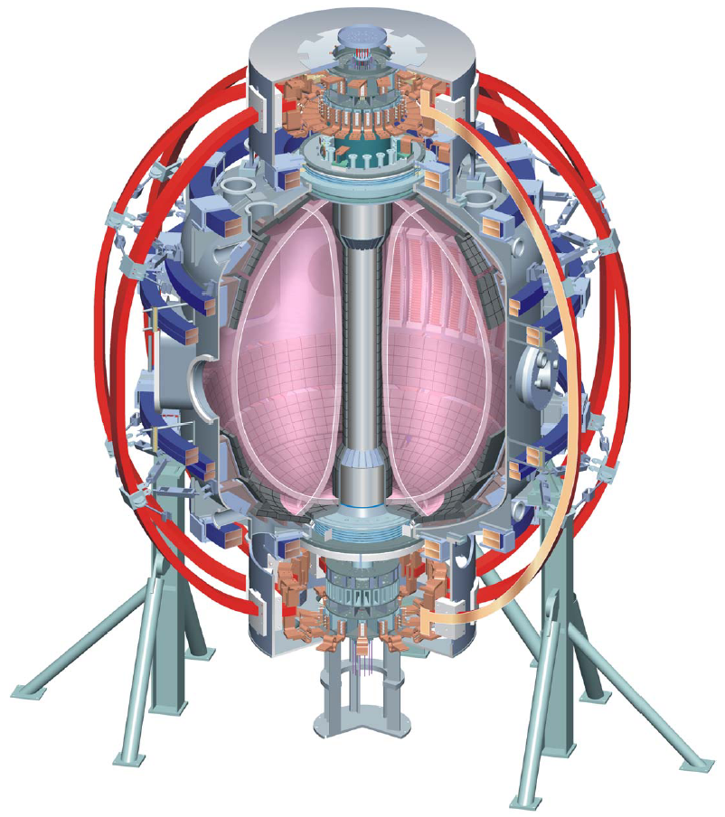
NSTX
Supported by
Office of
Science
NSTX Capabilities
- Turbulence and Profile Diagnostics at the Plasma Edge -
College W&M
Colorado Sch Mines
Columbia U
Comp-X
General Atomics
INEL
Johns Hopkins U
LANL
LLNL
Lodestar
MIT
Nova Photonics
New York U
Old Dominion U
ORNL
PPPL
PSI
Princeton U
SNL
Think Tank, Inc.
UC Davis
UC Irvine
UCLA
UCSD
U Colorado
U Maryland
U Rochester
U Washington
U Wisconsin
Culham Sci Ctr
U St. Andrews
York U
Chubu U
Fukui U
Hiroshima U
Hyogo U
Kyoto U
Kyushu U
Kyushu Tokai U
NIFS
Niigata U
U Tokyo
JAEA
Hebrew U
Ioffe Inst
RRC Kurchatov Inst
TRINITI
KBSI
KAIST
POSTECH
ASIPP
ENEA, Frascati
CEA, Cadarache
IPP, Jülich
IPP, Garching
ASCR, Czech Rep
U Quebec
S.M. Kaye
for PPPL, U. Wisc., JHU, UCLA, UC Davis Groups
NSTX-C-Mod Pedestal Workshop
PPPL
7 Sept. 2010

Slide 2
Multiple Diagnostics are Available to Explore Turbulence At or Near the Plasma Edge
Microwave Scattering (high-k_{r} turbulence: ETG, TEM, μtearing): PPPL, UC Davis
Beam Emission Spectroscopy (low-k turbulence, ZFs/GAMs, AEs): U. Wisconsin
Edge Reflectometry and Backscattering (low-k, high-k, radial correlation lengths): UCLA
Interferometery (n_{e} fluctuations <100 kHz): UC Davis
Multi-energy Soft X-ray Arrays (MHD scales,..): JHU

Slide 3
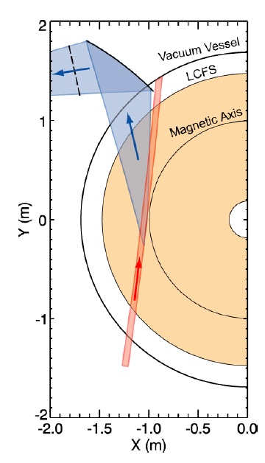
High-k Scattering is Capable of Measuring Localized
Electron Gyro-Scale Turbulence
280 GHz microwave is launched as the probe beam.
Coherent scattering by plasma density fluctuations occurs when the three-wave coupling condition is satisfied:
Since , k_{s} >> , Bragg condition determines k_{p}:
k_{p}=2k_{i}sin(θ_{s}/2)
The scattered light has a frequency of:
ω_{s}=ω_{p}+ω_{i}
with ω_{s} and ω_{i} >> ω_{p}
The scattering system characteristics are:
  Frequency bandwith: 5 MHz
  Heterodyne receiver: Wave propagation direction resolved
  Measurement: k_{r} spectrum
  Wavenumber resolution: 0.7 cm⁻¹ (2/a with a ≈ 3 cm)
  Wavenumber range (k_{r}): 5-20 cm⁻¹ (~5-20 )
  Radial resolution: 2.5 cm
  Tangential resolution: 5-15 cm
  Radial range: R=106 – 144 cm
  Minimal detectable density fluctuation:
Spherical mirror
Scattered light
k_{p}
k_{s}
k_{p}
=
+
k_{i}
k_{i}
k_{p}
θ_{s}
k_{s}
k_{i}
2a
Probe beam
Probe beam
Y. Ren, E. Mazzucato, D. Smith,
N. Luhmann, C. Domier

Slide 4
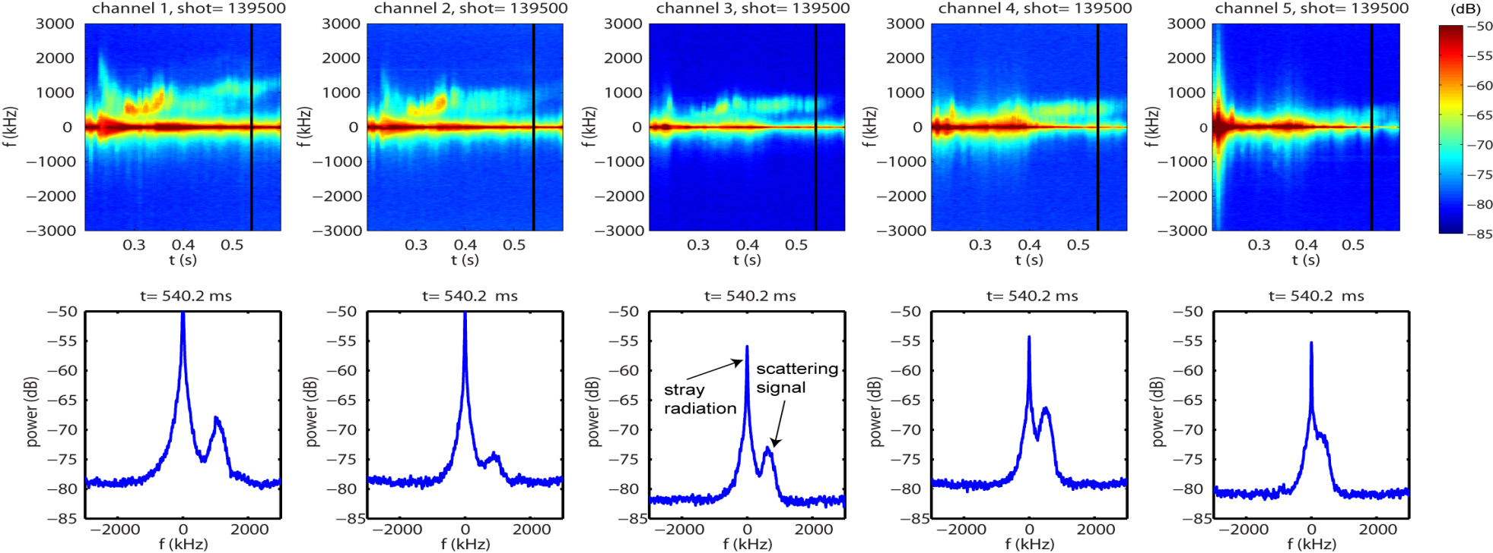
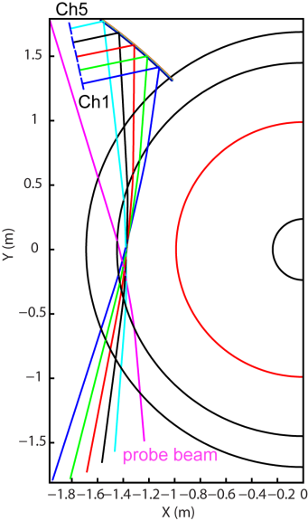
Electron Gyro-Scale Fluctuations are Measured in the Pedestal Region
k_{r} ρ_{s}≈ -16.2
k_{θ} ρ_{s} ≈ 2.84
k_{φ} ≈ 2.53 cm⁻¹
k_{r} ρ_{s} ≈ -14.1
k_{θ} ρ_{s} ≈ 2.4
k_{φ} ≈ 2.0 cm⁻¹
k_{r} ρ_{s} ≈ -11.9
k_{θ} ρ_{s} ≈ 2.0
k_{φ} ≈ 1.6 cm⁻¹
k_{r} ρ_{s} ≈ -9.5
k_{θ} ρ_{s} ≈ 1.7
k_{φ} ≈ 1.2 cm⁻¹
k_{r} ρ_{s} ≈ -7.3
k_{θ} ρ_{s} ≈ 1.0
k_{φ} ≈ 1.0 cm⁻¹
The frequency spectra shown were measured at the pedestal region of a NB-heated H-mode plasma.
The radial resolution of 2.5 cm allows localized measurements, ideal for comparisons with turbulence theory and numerical codes.
r/a ≈ 0.87 , R ≈ 140 cm

Slide 5
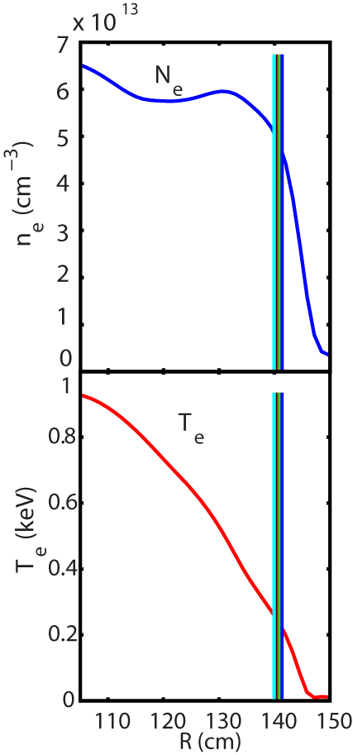
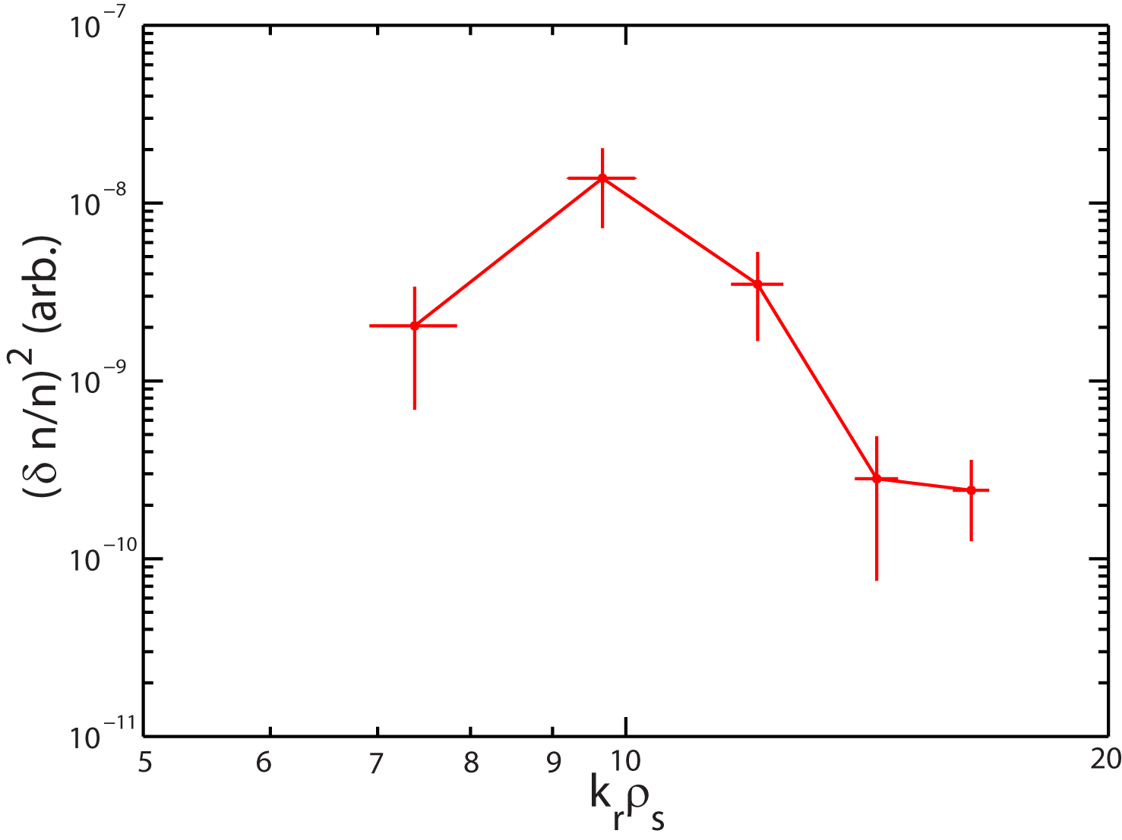
Diagnostic Can Yield k-Spectrum of Turbulence
The k_{r} spectrum does not show monotonically
increasing fluctuation power towards lower k;
measurements will be compared with results
from non-linear gyro-kinetic simulations.
Scattering location

Slide 6
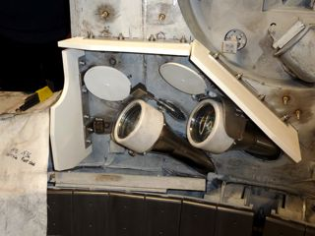
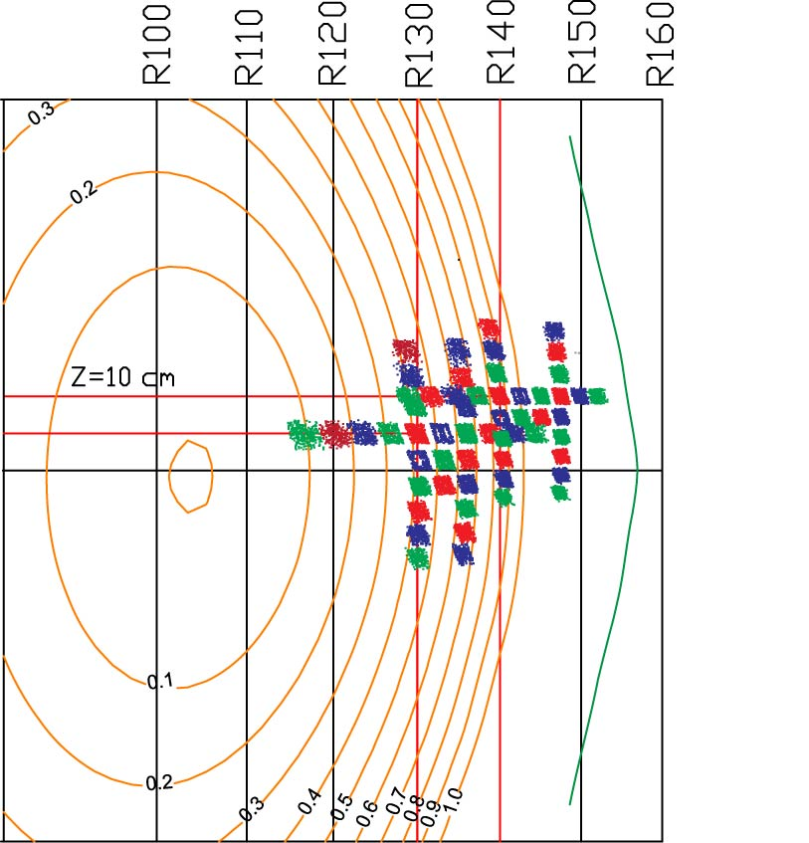
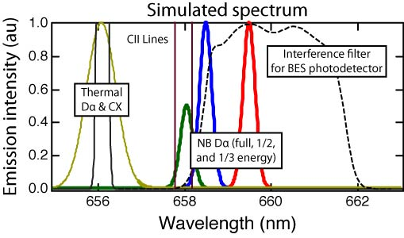
BES Measures Neutral Beam D_{a} to Study
Long Wavelength (k_{r}ρ_{i}) Density Fluctuations
Doppler shift isolates NB D_{α} emission from thermal D_{α}
Optical views are field-aligned with
spatial resolution Δx ≈ 2-3 cm
RSI paper in press (Oct 2010)
Collection optics
R140
R130
D. Smith, G. McKee, R. Fonck, B. Stratton

Slide 7
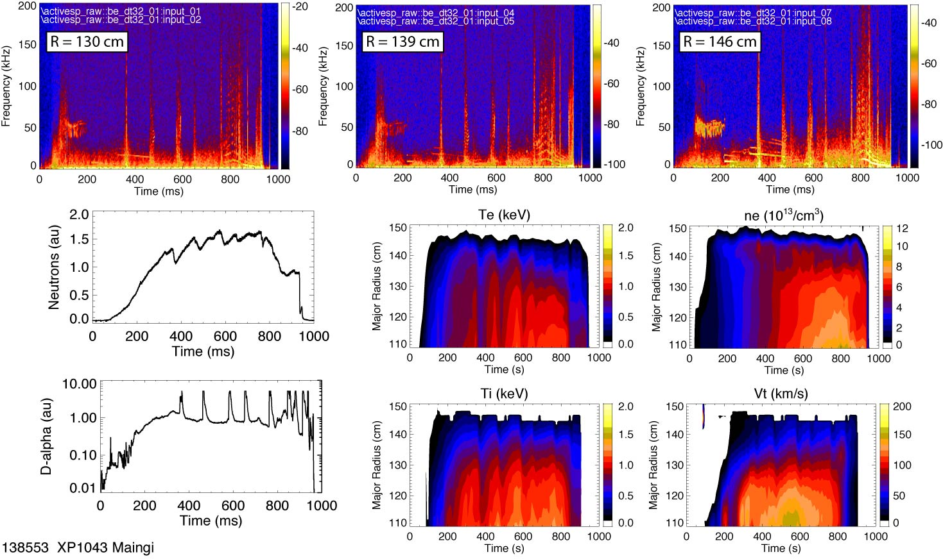
Fluctuation Amplitudes Increase During ELM Activity

Slide 8
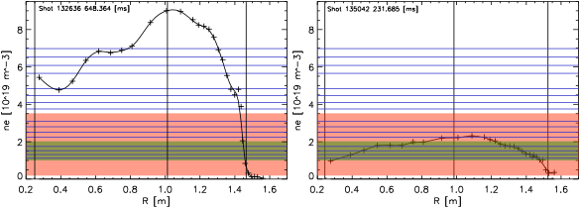
UCLA Reflectometers on NSTX
Millimeter-wave reflectometers available for 2010 (mid-plane)
  Ultra-fast swept FMCW reflectometers coupled with new analysis techniques
    Electron density profiles with ≥4 ms time resolution, 13-53 GHz
    Sub-millisecond turbulence radial correlations
    k_{r} back-scattering with radial resolution
  Poloidal correlation reflectometer (2 channel, 28.5-40 GHz)
    Turbulence flow
    Poloidal correlations
    k_{r} back-scattering with radial resolution
  16 channel fixed-frequency reflectometers (30 to 75 GHz)
    Detailed profile of coherent and turbulent fluctuation levels (2.5 MHz bandwidth)
Fixed
Frequency
Swept FMCW
Poloidal
Correlation
S. Kubota, T. Peebles

Slide 9
Change of Turbulence at Edge Can Be
Measured Through L-H Transition
k_{r} vs R spectrogram of backscattered signal across L-H transition
  Dip in the backscattered power around the ETB location (R=146 cm) first appears near the L-H transition (~0.245 s)
  Continues to deepen during H-mode
  Consistent with picture of turbulence suppression over a wide range of k_{r} at the ETB location

Slide 10
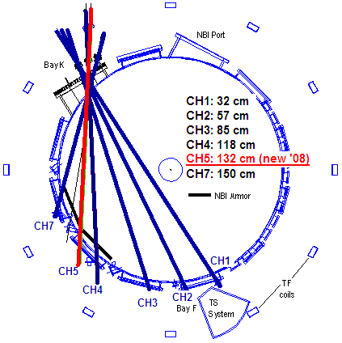
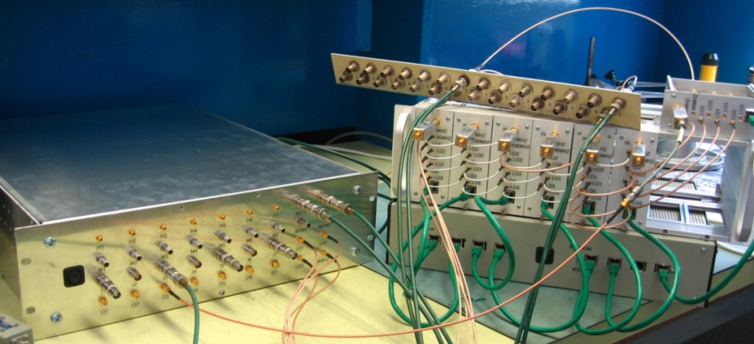
Far-Infra Red Tangential Interferometer Polarimeter
FIReTIP measures line integrated
electron density including
density fluctuations ( )
2009: upgrade electronics
to yield bandwidth of 4 MHz
K.C. Lee, N. Luhmann, C. Domier

Slide 11
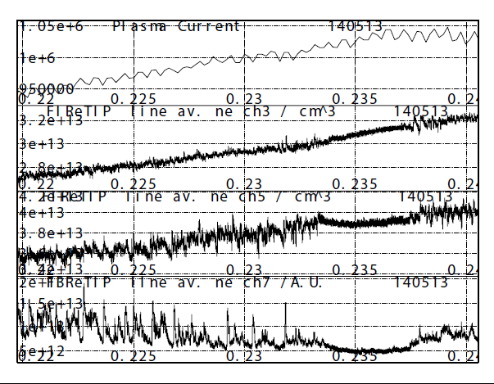
Measured Growth Rates of High-k Modes Agrees with Linear GYRO Results for Fastest Growing Mode
f(kHz)
80-
60-
40-
20-
0.22
0.23
0.24
0.22
0.23
0.24
0.22
0.23
0.24
L
H
Example of turbulence suppression
Edge channels (Ch5: R_{T}=132 cm,
Ch7: R_{T}=150 cm) showed clear decrease
Fluctuations decrease in frequency range
of < 100 kHz
Ch3
Ch5
Ch7

Slide 12
Profile Diagnostics
Thomson Scattering
  30 channels presently, 40 after upgrade
    6-9 mm spatial resolution in outer region
    2 lasers with flexible timing (generally one profile measurement every 16 ms)
CHERS
  51 spatial channels
    Down to 1-2 cm spatial resolution (~1 ρ_{i} in outer region)
    10 ms temporal resolution

Slide 13
Multi-Energy SXT Designed for High Spatial
Resolution (< 1 cm) of Outer Plasma (r/a>0.5)
K. Tritz, D. Stutman, M. Finkenthal, D. Kumar, D. Slayton

