Slide 1
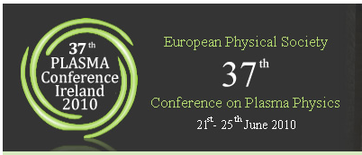
NSTX
Supported by
“Snowflake” divertor configuration in NSTX*
College W&M
Colorado Sch Mines
Columbia U
CompX
General Atomics
INEL
Johns Hopkins U
LANL
LLNL
Lodestar
MIT
Nova Photonics
New York U
Old Dominion U
ORNL
PPPL
PSI
Princeton U
Purdue U
SNL
Think Tank, Inc.
UC Davis
UC Irvine
UCLA
UCSD
U Colorado
U Illinois
U Maryland
U Rochester
U Washington
U Wisconsin
V. A. Soukhanovskii (LLNL)
D. D. Ryutov, H. A. Scott (LLNL), R. Maqueda (Nova Photonics),
J.-W. Ahn, R. Maingi, A. McLean (ORNL),
R. Bell, D. A. Gates, S. Gerhardt, R. Kaita, E. Kolemen, B. P. LeBlanc, J. E. Menard, D. Mueller, S. F. Paul, A. L. Roquemore (PPPL),
R. Raman (U Washington)
Culham Sci Ctr
U St. Andrews
York U
Chubu U
Fukui U
Hiroshima U
Hyogo U
Kyoto U
Kyushu U
Kyushu Tokai U
NIFS
Niigata U
U Tokyo
JAEA
Hebrew U
Ioffe Inst
RRC Kurchatov Inst
TRINITI
KBSI
KAIST
POSTECH
ASIPP
ENEA, Frascati
CEA, Cadarache
IPP, Jülich
IPP, Garching
ASCR, Czech Rep
U Quebec
Poster P 2.161
22 June 2010
* Supported by the U.S. DOE under Contracts DE-AC52-07NA27344, DE AC02-09CH11466, DE-AC05-00OR22725, DE-FG02-08ER54989.

Slide 2
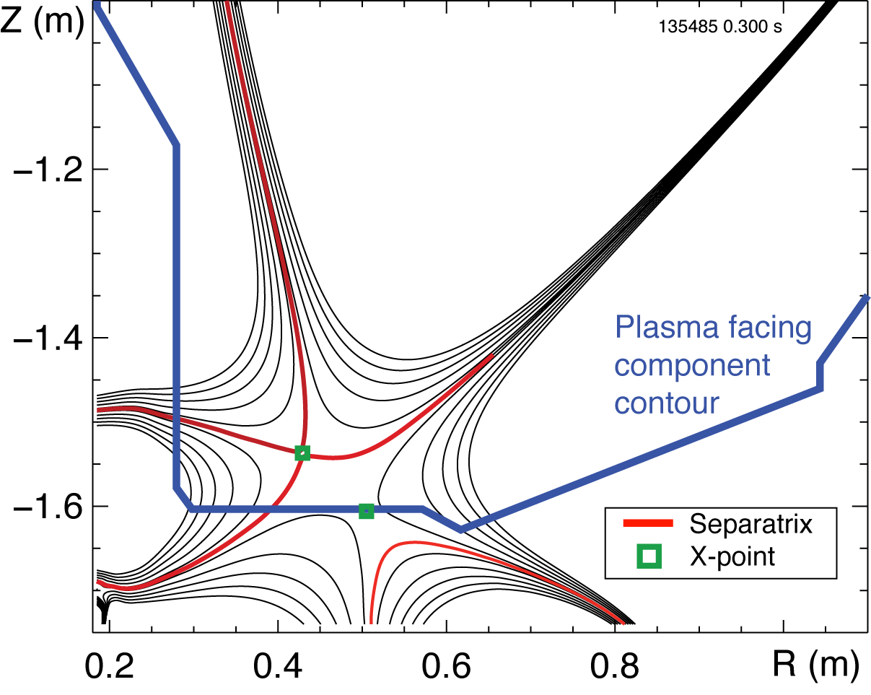
Abstract
The studies of an innovative "snowflake" divertor (SFD) configuration in the National Spherical Torus Experiment (NSTX) provide support to this plasma-material interface concept as a promising candidate for future tokamaks and spherical tokamak based devices with high heat flux divertors. A number of theoretically predicted geometric and radiative properties of the SFD configuration [1-4] have been confirmed in experiments at NSTX. The obtained SFD showed evidence of impurity control and divertor heat flux reduction. The SFD configuration was obtained in 1 MA 4-6 MW NBI-heated H-mode discharges with P_{SOL} ~ 3 MW. Two divertor coils with 4 and 12 kA current waveforms controlled by the plasma control system were used to generate the SFD. A very high poloidal flux (area) expansion of the separatrix region in the SFD, a longer connection length and a larger divertor scrape-off layer (SOL) volume (as compared to standard NSTX divertor configurations) led to a partial detachment of the first several mm of the SOL width (as mapped to the midplane). Divertor heat flux profiles showed a significant reduction of the peak values, accompanied by an increase in divertor radiated power. A volume recombination zone with T_{e} ~ 1.5 eV, n_{e} ~ 2-6 x 10²⁰ m⁻³ developed in the X-point and strike point regions, suggesting an increase in volumetric momentum losses in the divertor. The core carbon density was reduced by up to 50 % in the SFD discharges with no degradation of H-mode stored energy and confinement.
[1] D. D. Ryutov, Phys. Plasmas 14, 64502 (2007)
[2] D. D. Ryutov et. al., Phys. Plasmas 15, 092501 (2008)
[3] D. D. Ryutov et al., Paper IC/P4-8, 22st IAEA FEC, Geneva, Switzerland, 10/2008
[4] M. V. Umansky et al., Nucl. Fusion 49, 075005 (2009)

Slide 3
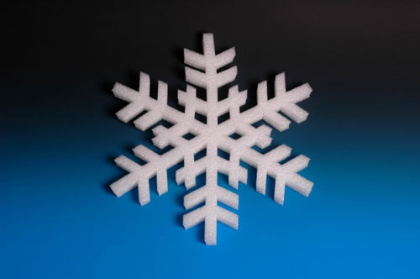
Overview and Summary
“Snowflake” divertor configuration – a promising solution for divertor heat flux mitigation in future fusion plasma devices
“Snowflake” divertor configuration (cf. standard divertor)
  Higher flux expansion (increased divertor A_{wet} )
  Higher divertor volume (increased P_{rad}, R_{rec}, R_{cx})
  Existing divertor magnetic coils for control
In recent NSTX experiments
  “snowflake” divertor was generated with 2 divertor coils
  H-mode confinement maintained
  “snowflake” divertor led to outer strike point partial detachment
    significant reduction in peak heat flux
    reduction of core impurities
  predicted “snowflake” divertor geometry properties confirmed

Slide 4



Various techniques considered for SOL / divertor q|| and q_{pk} control
Divertor heat flux mitigation solutions:
  Divertor geometry (poloidal flux expansion)
  Strike point sweeping
  Radiative divertor (or radiative mantle)
  Divertor plate tilt and divertor magnetic balance
Candidate solutions
  be compatible with good core plasma performance (H-mode confinement, MHD, ELM regime, density) and particle control
  scale to very high q_{peak} (15 - 80 MW/m²) for future devices

Slide 5
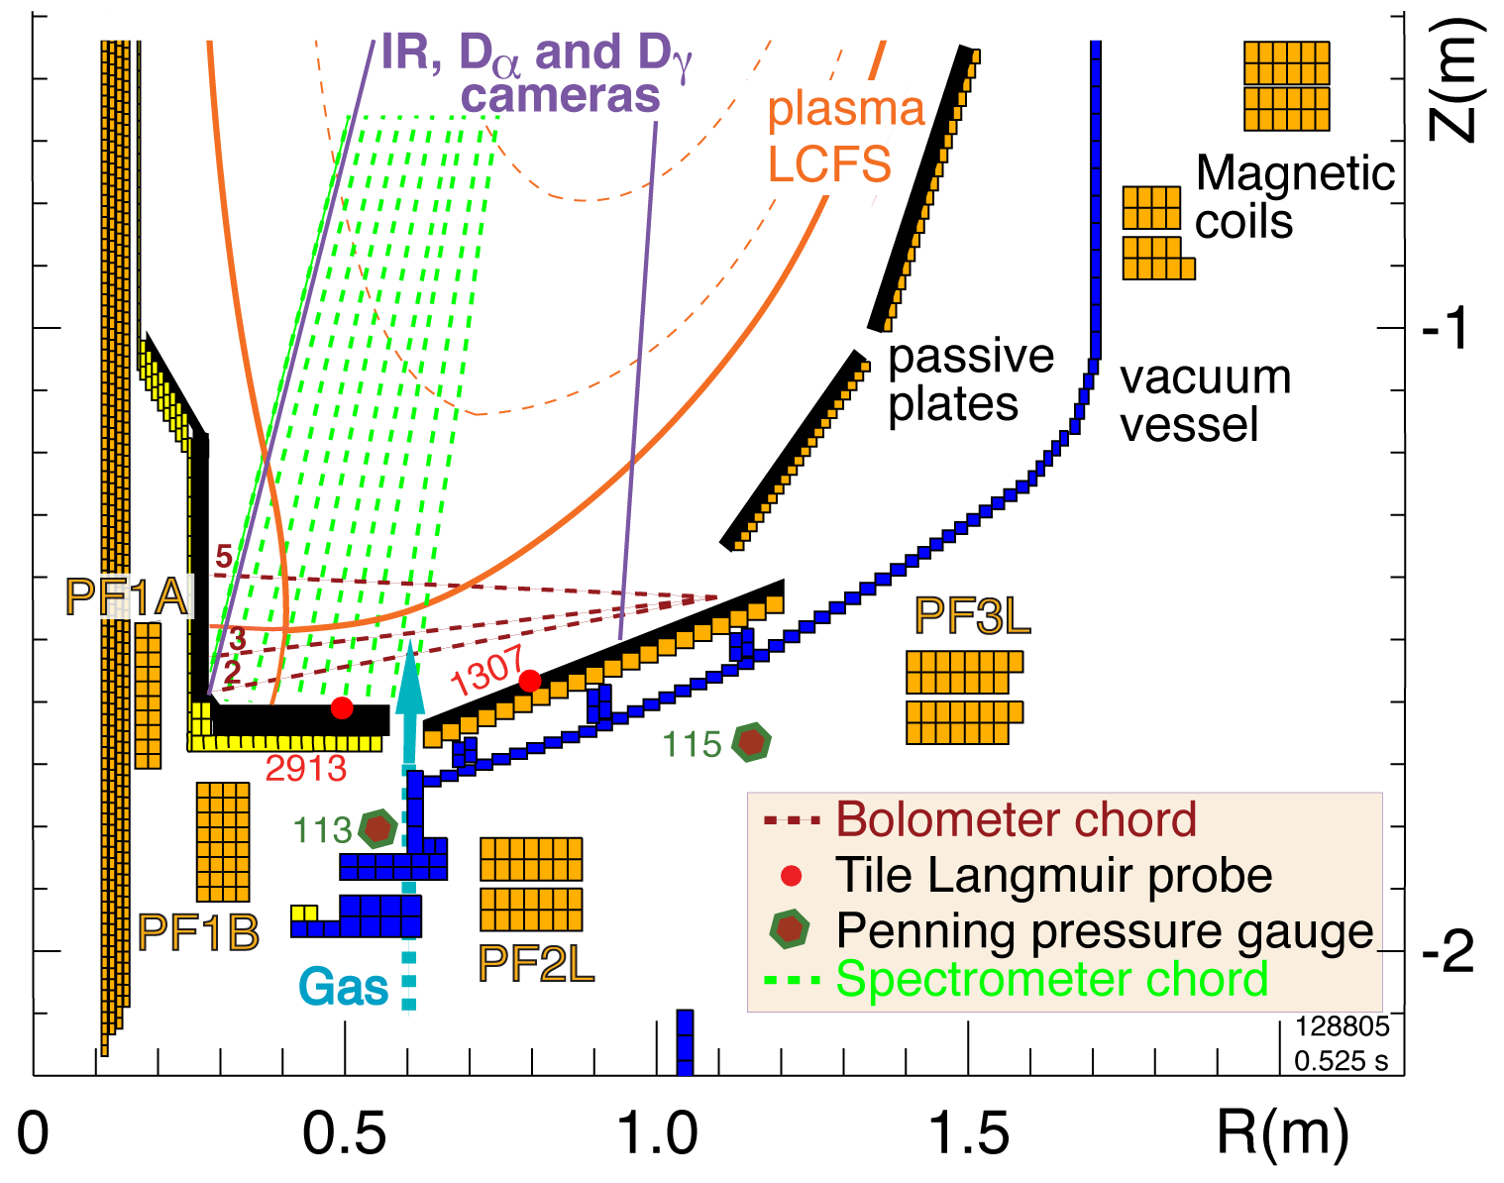
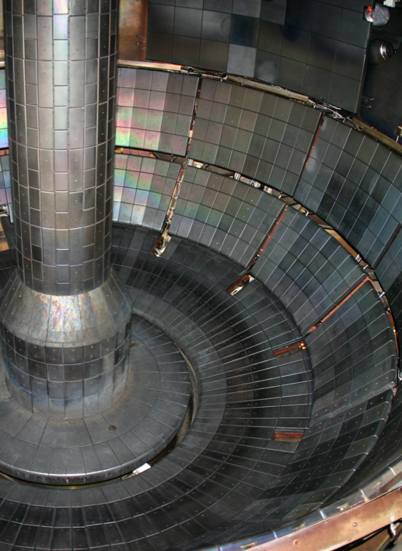
Open divertor geometry and extensive divertor diagnostics enable divertor configuration studies in NSTX
Plasma facing components
  ATJ and CFC graphite tiles
  Lithium coatings from overhead lithium evaporators

Slide 6
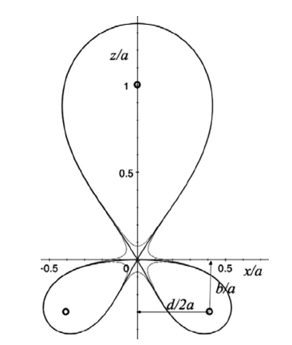
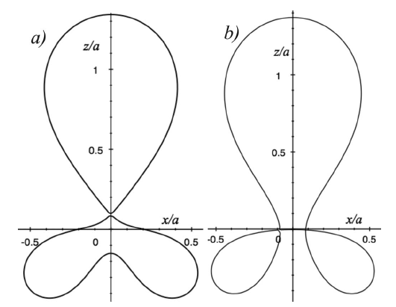
Theory predicts attractive divertor geometry properties in “snowflake” divertor configuration
Proposed by D. D. Ryutov (LLNL)
  Phys. Plasmas 14, 064502 (2007)
  34th EPS Conference on Plasma Phys. Warsaw, 2 - 6 July 2007 ECA Vol.31F, D-1.002 (2007)
  Phys. Plasmas, 15, 092501 (2008)
  Paper IC/P4-8 at IAEA FEC 2008
SFD is obtained by creating a second-order poloidal null in the (lower) divertor with existing divertor coils
Predicted properties (cf. standard divertor)
  Lower B_{p} in X-point region
  Larger A_{wet} , f_{exp}
  Larger X-point connection length L_{x}
  Larger effective divertor volume V_{div}
  X-point flux tube squeezing – barrier for turbulence?
  ELM control (increased edge magn. shear) ?
Ideal
“snowflake”
divertor
“snowflake”-plus “snowflake”-minus
divertor configurations

Slide 7
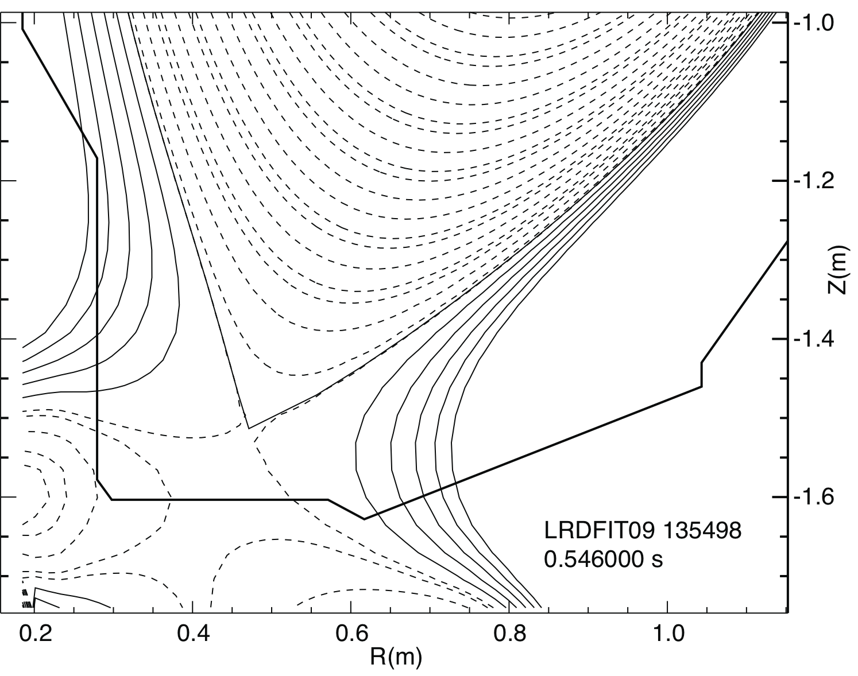
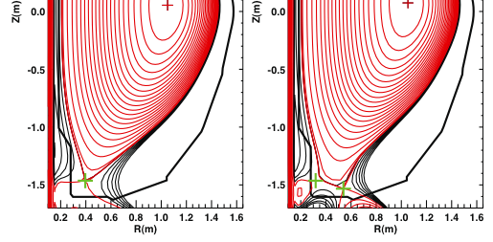
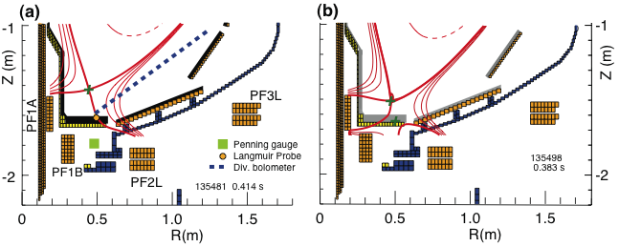
ISOLVER code was used to obtain strike point positions and divertor coil currents of “snowflake” configuration
Modeled “snowflake” divertor configurations
ISOLVER - predictive free-boundary axisymmetric equilibrium solver was used to model divertor coil currents for NSTX “snowflake” configurations
Standard divertor configuration “Snowflake” divertor configurations obtained in NSTX
+
+
Null-point separation d

Slide 8
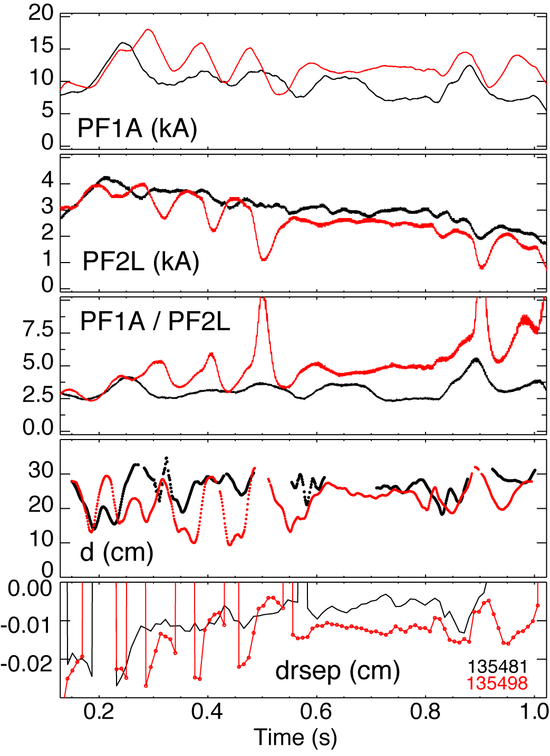
In experiment, “snowflake” divertor configuration was obtained via controlled outer strike point scan
Scanned OSP between 0.44 to 0.73 m on a shot-to-shot basis
Best “snowflake” configurations were obtained with requested R_{OSP} ~ 0.55 m (not necessarily actual R_{OSP})
“Snowflake” configuration was obtained when null-point separation d decreased to below 20 cm

Slide 9
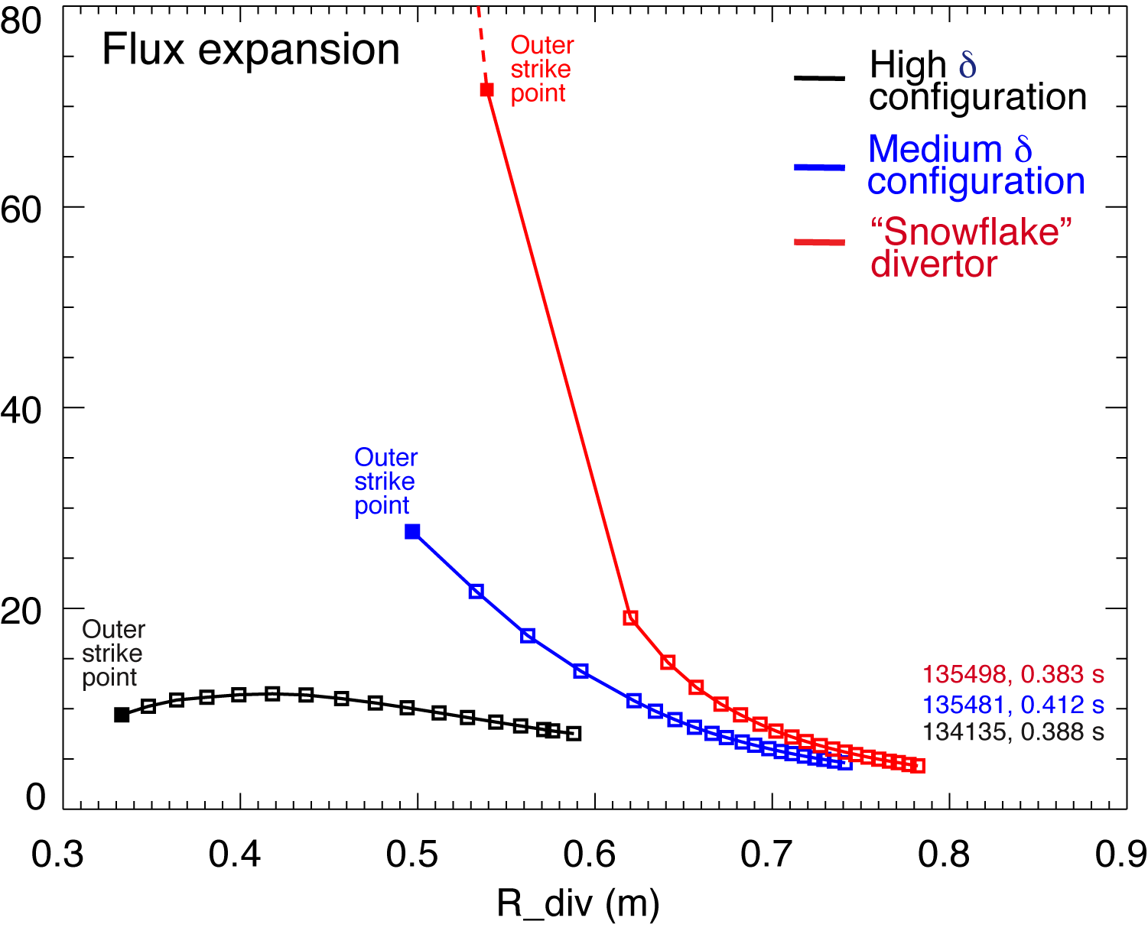
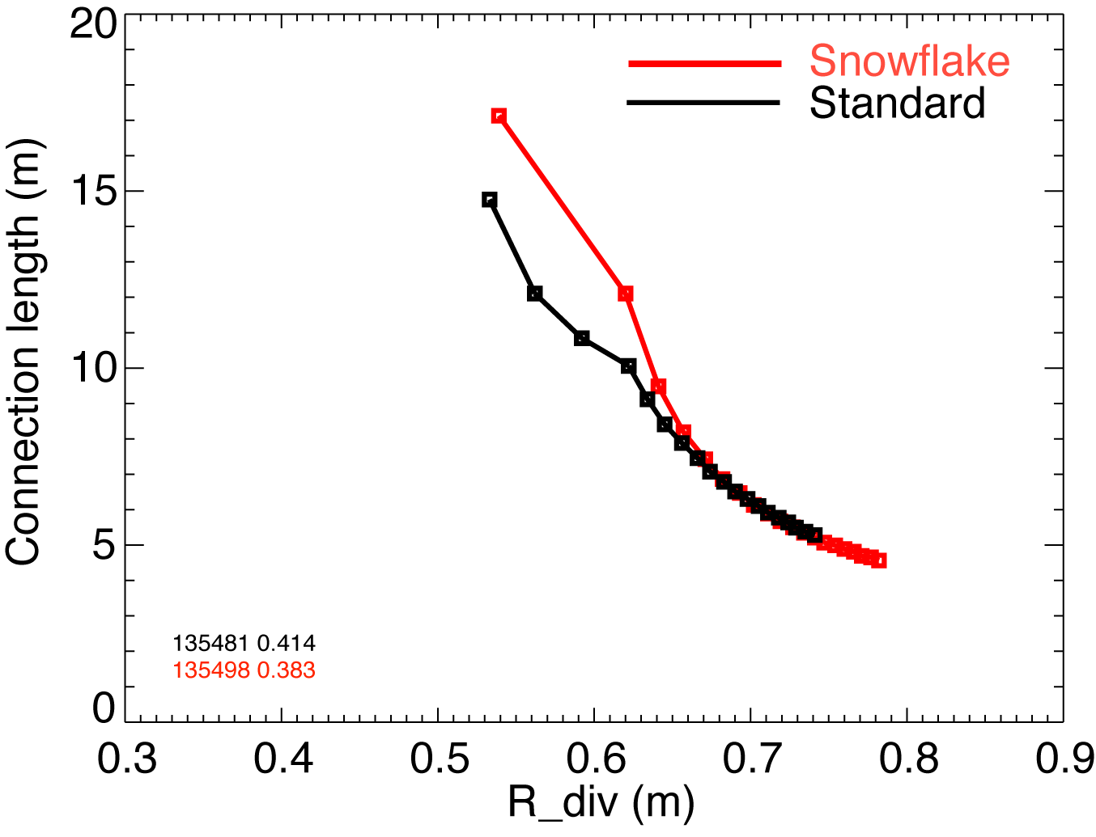
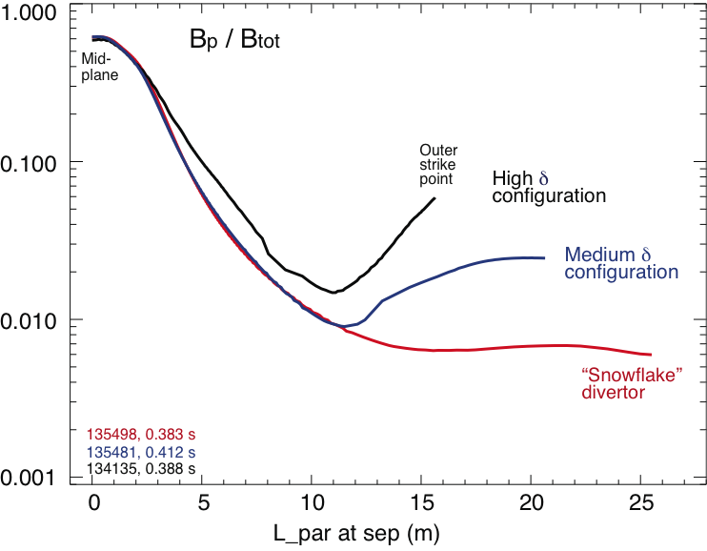
Theoretically predicted geometrical properties of the snowflake divertor configuration are confirmed in NSTX
In “snowflake” divertor
  Plasma-wetted area (flux expansion) higher by up to 50 %
  L_{x} longer (thus f_{PFR} and V_{div} higher)
These properties observed in first 2-3 mm of SOL λ_{q}

Slide 10
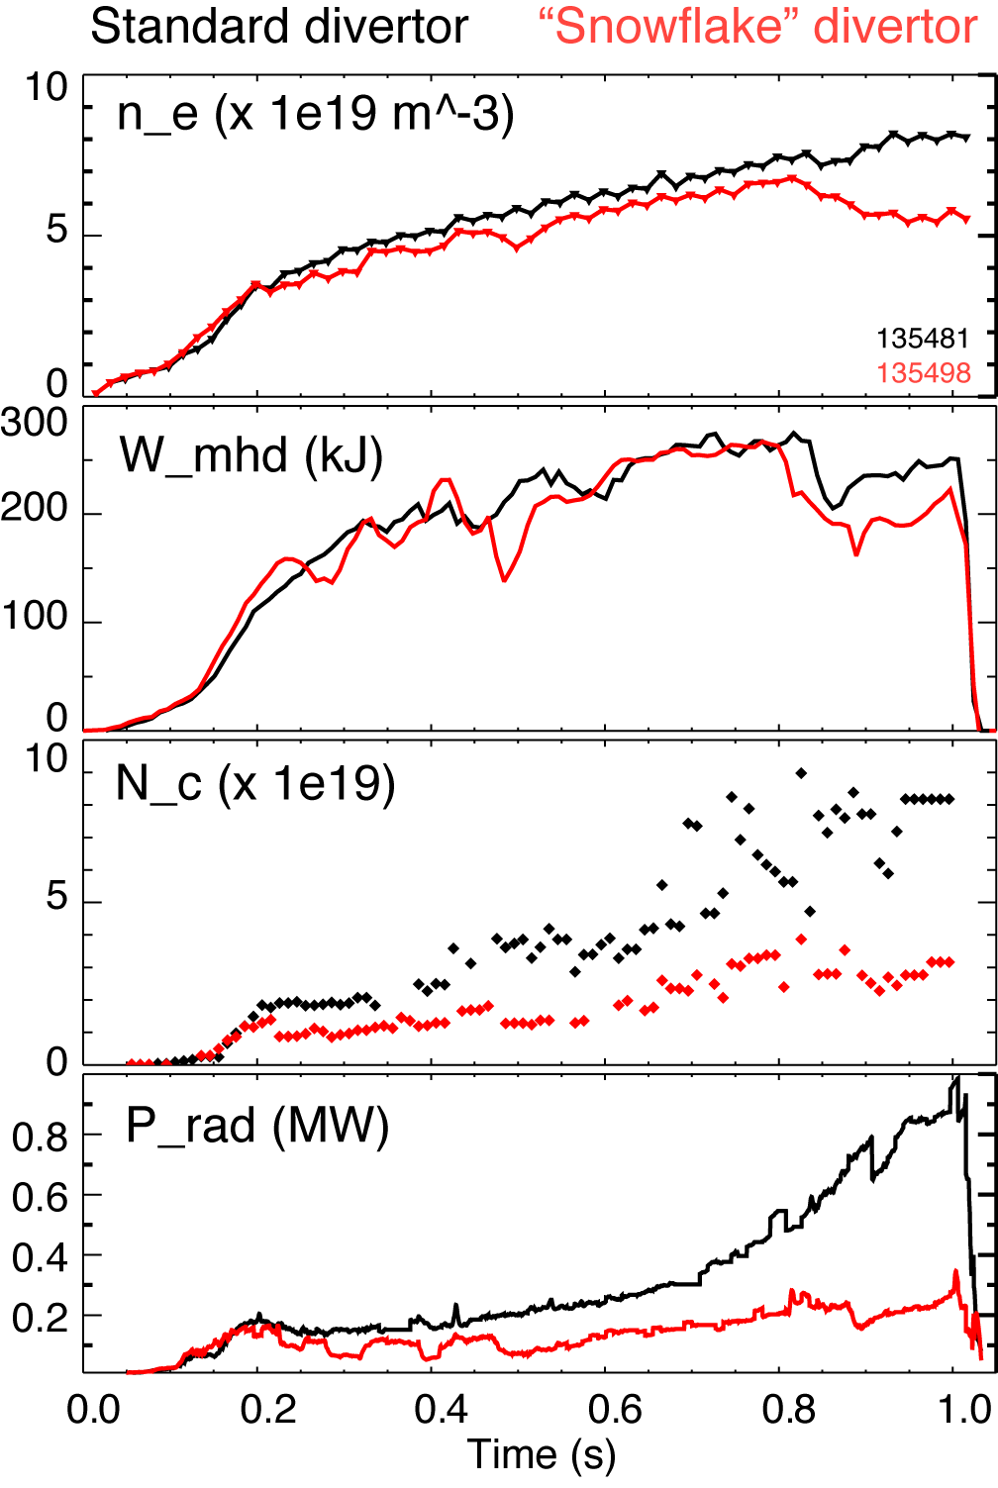
H-mode confinement retained with “snowflake” divertor, core P_{rad} and n_{C} reduced by up to 75 %
Used 80-100 g evaporated lithium per discharge for wall conditioning
ELM-free H-mode discharges had impurity accumulation
In “snowflake” divertor discharges
  Divertor sputtering source reduction (?)
  Edge confinement degradation (?)

Slide 11
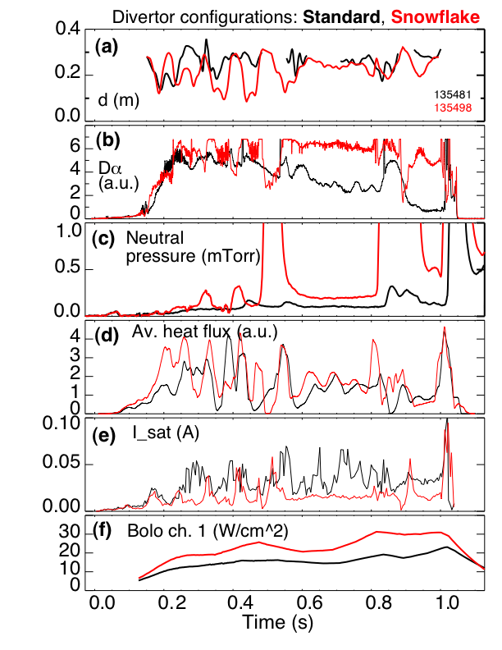
Partial detachment of outer strike point region observed in “snowflake” divertor discharges
Signs of partial detachment observed in “snowflake” divertor
  Loss of parallel pressure
  Heat and particle flux reduction at the plate
  T_{e} ≤ 1.6 eV, n_{e} ≥ 2e14 m⁻³
  Increase in divertor P_{rad}
  Increase in 3-body recombination rate
  Increase in neutral pressure

Slide 12
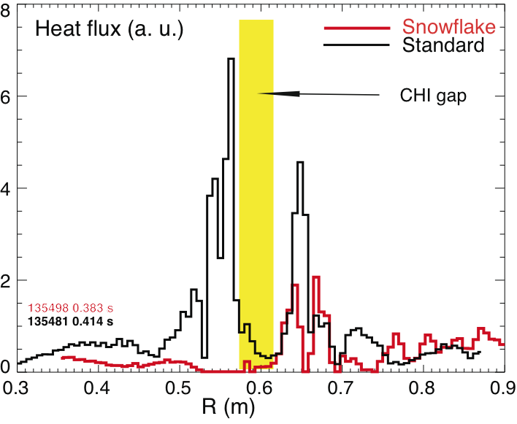
Significant reduction of heat flux observed in “snowflake” divertor
Divertor peak heat flux well correlated with null-point separation d
Reduction observed in 2-3 mm region (mapped to midplane) adjacent to separatrix
Shown heat fluxes are in uncalibrated relative units (IR camera data not calibrated due to lithium coatings)

Slide 13
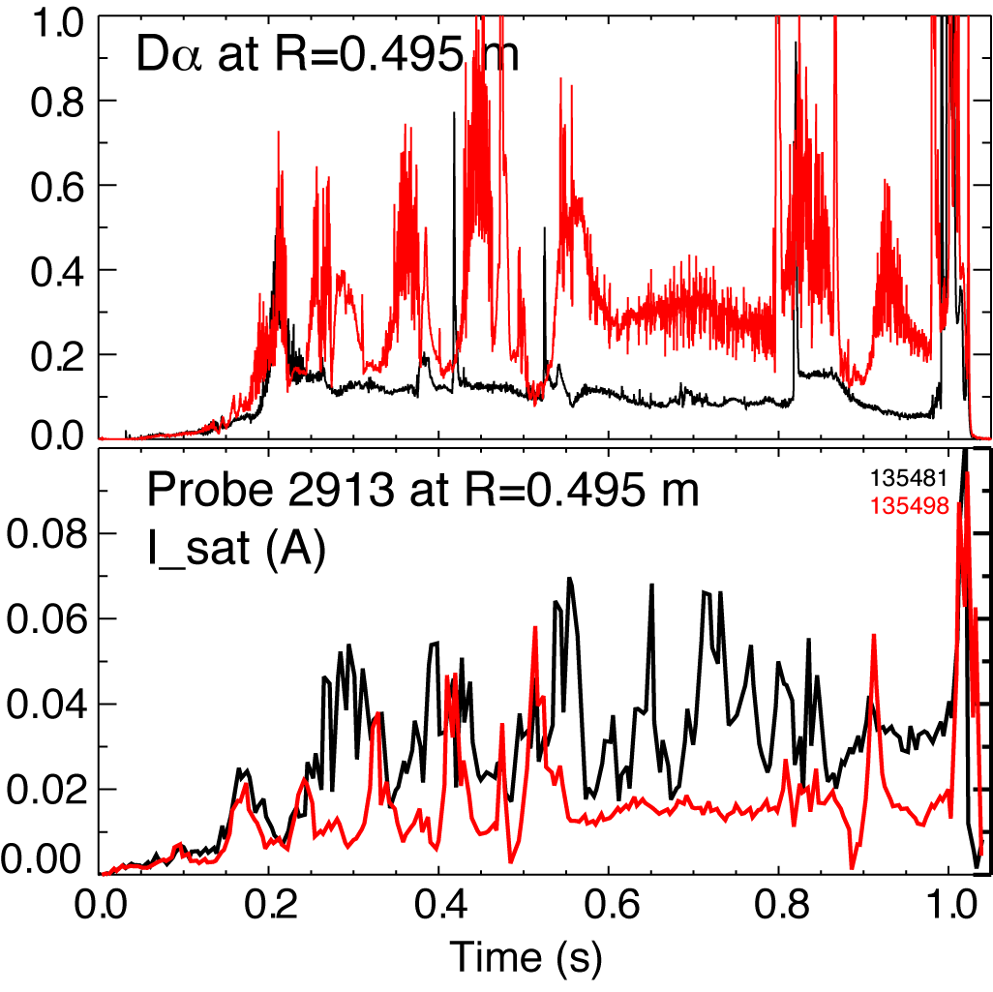
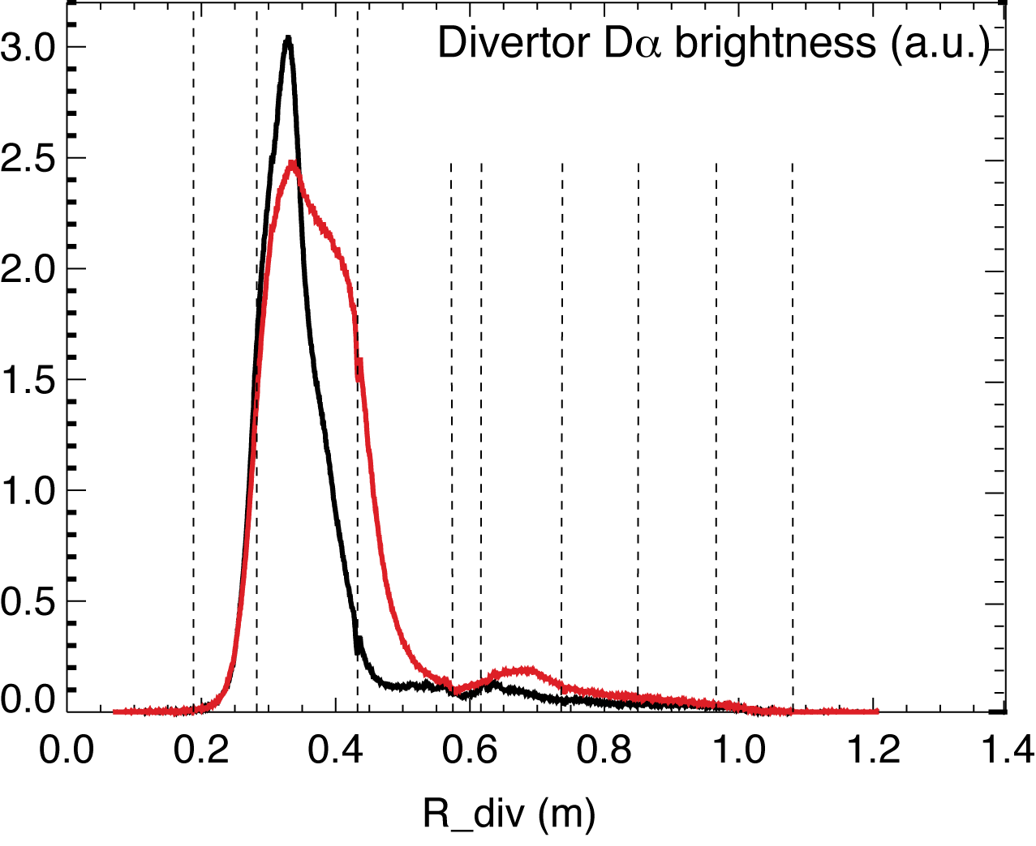
Divertor particle flux decreased, Balmer-a intensity increased (due to recombination) in “snowflake” divertor
Divertor D_{α} emission
  Increase in radiating zone width
  Brightness increase (due to recombination) correlated with Langmuir probe I_{sat} decrease (due to particle flux reduction)

Slide 14
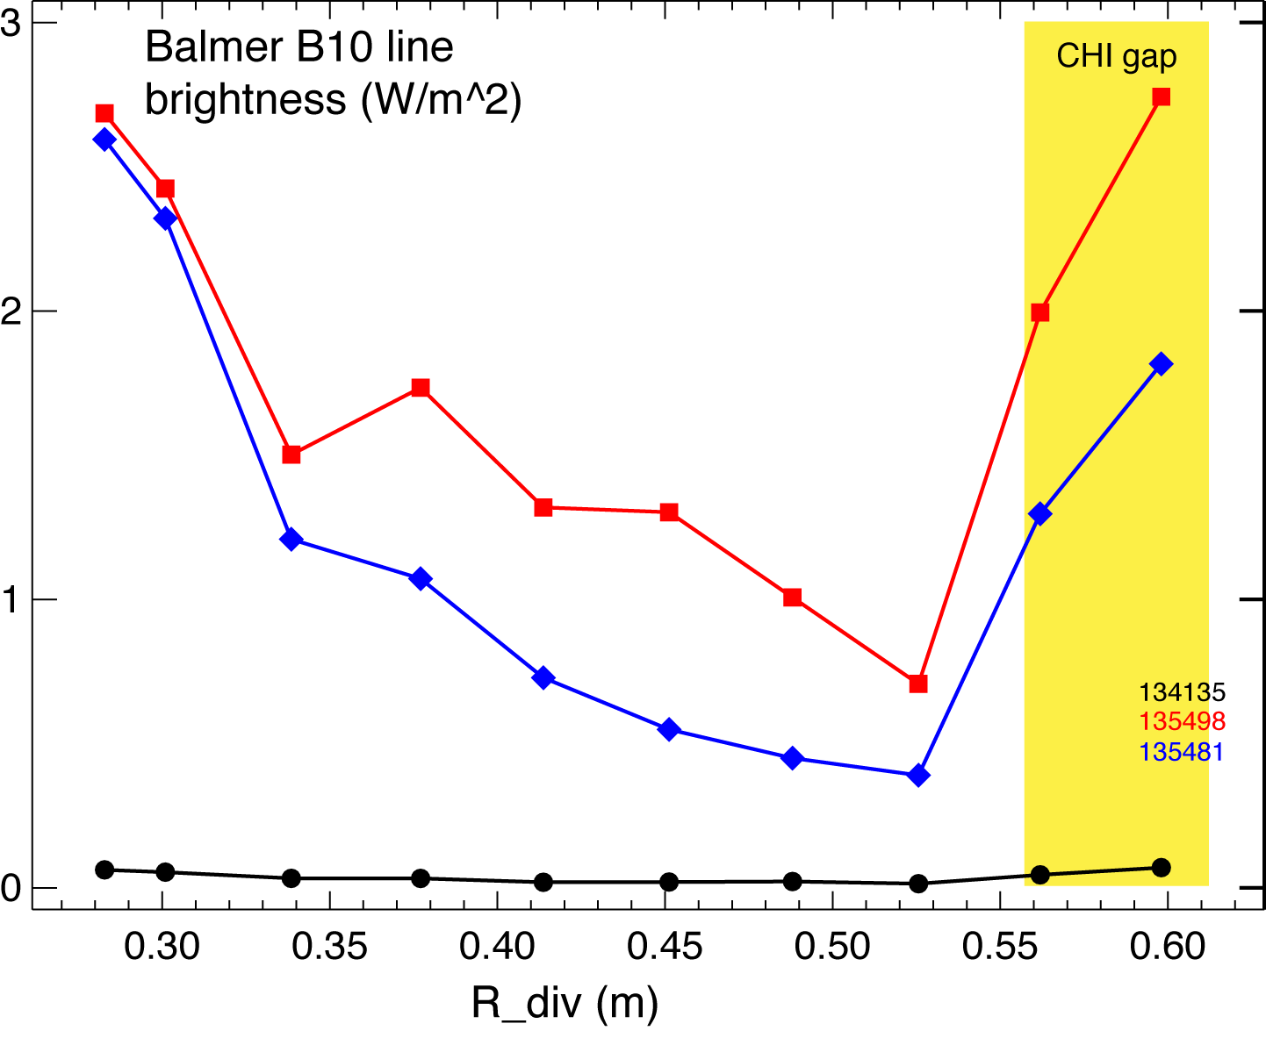
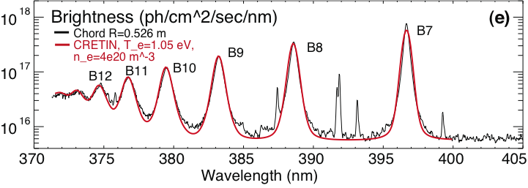
High-n Balmer line emission measurements suggest high divertor recombination rate, low T_{e}, high n_{e}
Balmer series spectra modeled with CRETIN; Spectra sensitive to
  Line intensity <-> Recombination rate
  T_{e} <-> Boltzman population distribution
  n_{e} <-> Line broadening due to linear Stark effect from ion and electron microfield
“snowflake”
standard
T_{e}=0.8-1.2 eV, n_{e}=2-7 x 10²⁰ m⁻³ inferred from modeling

Slide 15
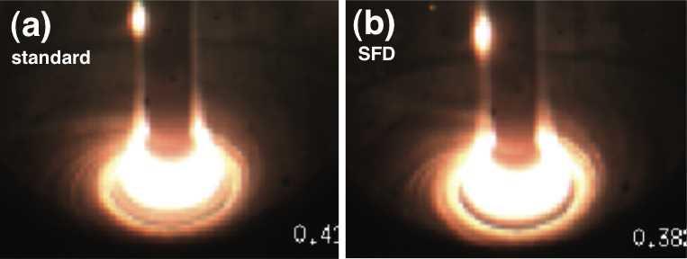
Divertor camera images show formation of extended radiation zone in “snowflake” divertor
Center stack
gas puff
Visible camera images (~ 400 – 750 nm bandpass)
Larger radiative zone in “snowflake” divertor (cf. standard divertor)

Slide 16
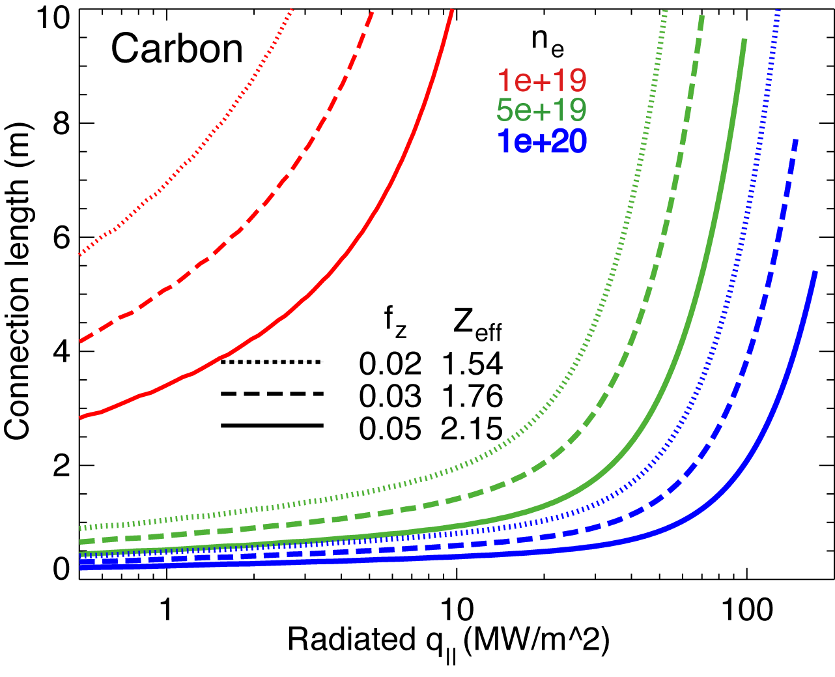
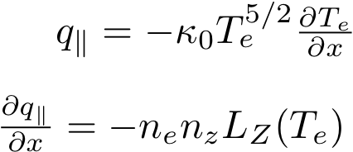
Volumetric power and momentum losses are increased due to geometry in “snowflake” divertor
Hulse-Post non-coronal radiative cooling curves for low Z impurities for n₀/n_{e}, n_{e}-τ_{recy}
Calculate max q|| that can be radiated
Express max q|| as function of distance from heat source for range of f_{z} (Post JNM 220-222, 1014 (1995) )
Power losses due to deuterium P_{rad} and ionization not considered
For NSTX, use n₀ = 0.1 % and n_{e}-τ_{recy} = n_{e} x 1e-3 s
Electron-ion recombination rate depends on divertor ion residence time
  Ion recombination time: τ_{ion}~ 1−10 ms at T_{e} =1.3 eV
  Ion residence time: τ_{ion} ≤ 3-6 ms

Slide 17
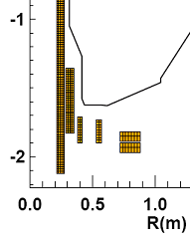
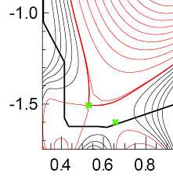
Future plans
Magnetic control of “snowflake” divertor
  RT-control of 2nd null-point with PCS
  Use of PF1B for control
Transport and turbulence characterization
Edge stability characterization
Scaling with power
High-performance plasma scenario with lithium
conditioning and reduced core impurities
NSTX-Upgrade (Poster P2.106 by J. E. Menard)
  Additional divertor coil PF1C
    flux expansion variation with fixed X-point height
    and strike-point location
  Development of PMI solutions to address
    2-3x higher input power
    up to 30 % reduction in Greenwald fraction
    3-5 x longer pulse duration

