Slide 1
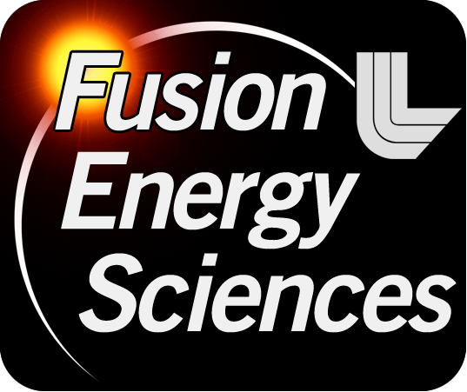


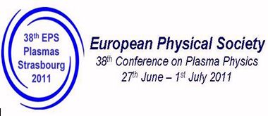
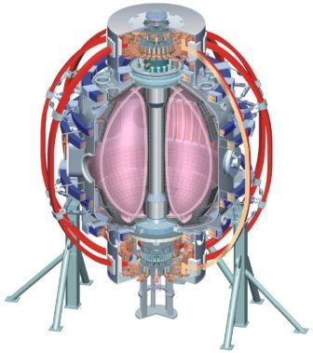

NSTX
Supported by
The snowflake divertor: a game-changer for magnetic fusion devices ?
Columbia U
CompX
General Atomics
FIU
INL
Johns Hopkins U
LANL
LLNL
Lodestar
MIT
Nova Photonics
New York U
ORNL
PPPL
Princeton U
Purdue U
SNL
Think Tank, Inc.
UC Davis
UC Irvine
UCLA
UCSD
U Colorado
U Illinois
U Maryland
U Rochester
U Washington
U Wisconsin
V. A. Soukhanovskii
Lawrence Livermore National Laboratory
Culham Sci Ctr
U St. Andrews
York U
Chubu U
Fukui U
Hiroshima U
Hyogo U
Kyoto U
Kyushu U
Kyushu Tokai U
NIFS
Niigata U
U Tokyo
JAEA
Hebrew U
Ioffe Inst
RRC Kurchatov Inst
TRINITI
NFRI
KAIST
POSTECH
ASIPP
ENEA, Frascati
CEA, Cadarache
IPP, Jülich
IPP, Garching
ASCR, Czech Rep
Talk O3.109

Slide 2
Acknowledgements
D. D. Ryutov, T. D. Rognlien, M. V. Umansky (LLNL),
R. E. Bell, D. A. Gates, A. Diallo, S. P. Gerhardt, R. Kaita,
S. M. Kaye, E. Kolemen, B. P. LeBlanc, J. E. Menard, D. Mueller, S. F. Paul, M. Podesta, A. L. Roquemore, F. Scotti (PPPL),
J.-W. Ahn, R. Maingi, A. McLean (ORNL),
D. Battaglia, T. K. Gray (ORISE),
R. Raman (U Washington),
S. A. Sabbagh (Columbia U)
Supported by the U.S. DOE under Contracts
DE-AC52-07NA27344, DE AC02-09CH11466,
DE-AC05-00OR22725, DE-FG02-08ER54989.

Slide 3
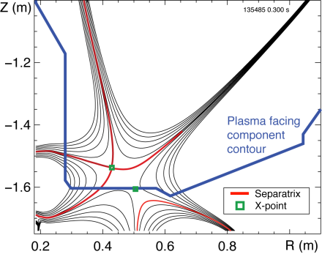
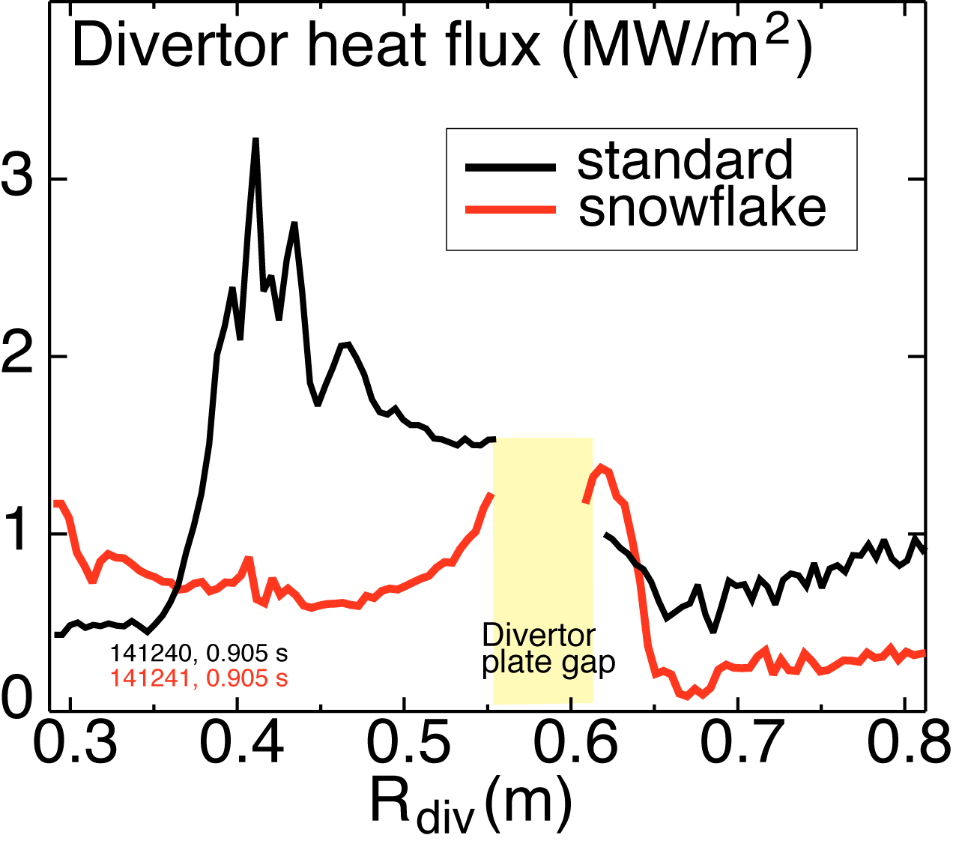
Outline: Experimental results from snowflake divertor in NSTX very encouraging
Snowflake divertor geometry attractive for heat flux management
Snowflake divertor in NSTX
  Magnetic properties realized in steady-state
  Core H-mode confinement unchanged
  Core impurities reduced
  Divertor heat flux significantly reduced
  Consistent w/ 2D edge transport model
Conclusions

Slide 4
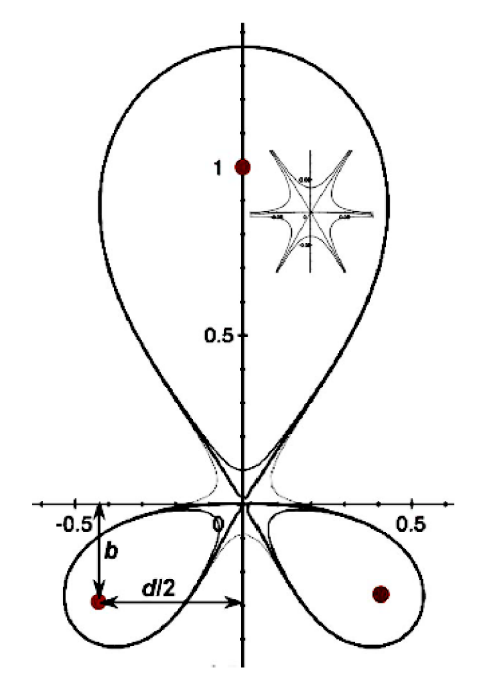
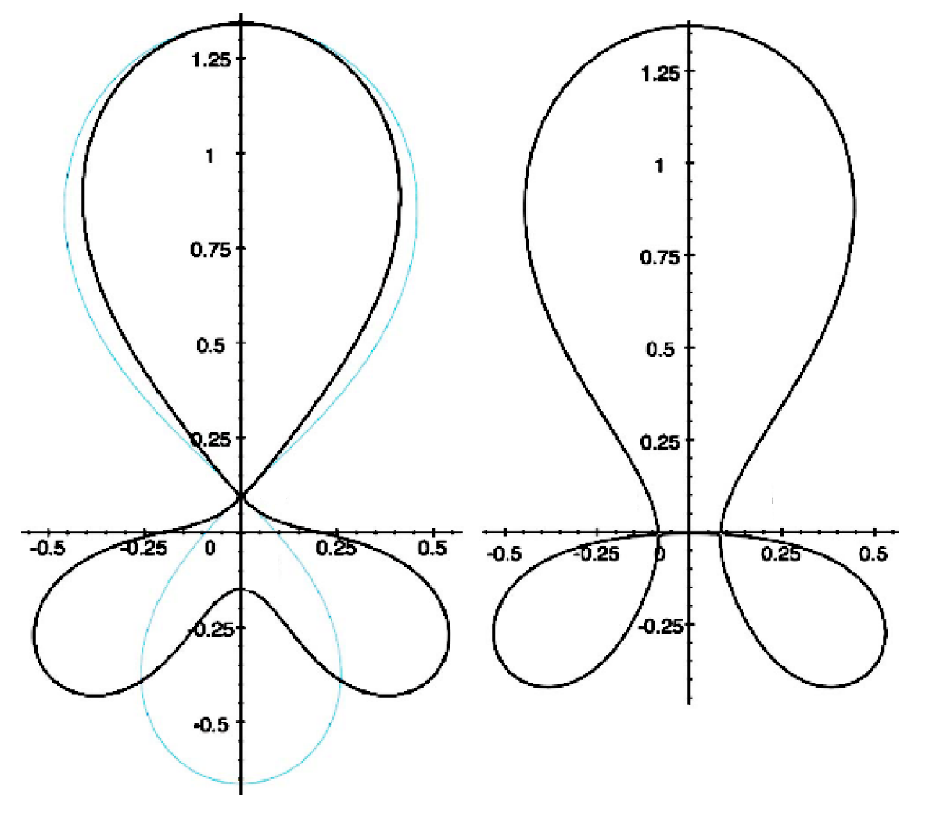
Snowflake divertor geometry attractive for heat flux mitigation
Snowflake divertor
  Second-order null
      B_{p} ~ 0 and grad B_{p} ~ 0 (Cf. first-order null: B_{p} ~ 0)
  Obtained with existing divertor coils (min. 2)
  Exact snowflake topologically unstable
Predicted geometry properties (cf. standard divertor)
  Larger region with low B_{p} around X-point: ped. stability
  Larger plasma wetted-area A_{wet} : reduce q_{div}
  Larger X-point connection length L_{x} : reduce q_{II}
  Larger effective divertor volume V_{div} : incr. P_{rad} , P_{CX}
Experiments
  TCV (F. Piras et. al, PRL 105, 155003 (2010))
  NSTX
Exact
snowflake
divertor
snowflake-minus
snowflake-plus
D. D. Ryutov, PoP 14, 064502 2007

Slide 5
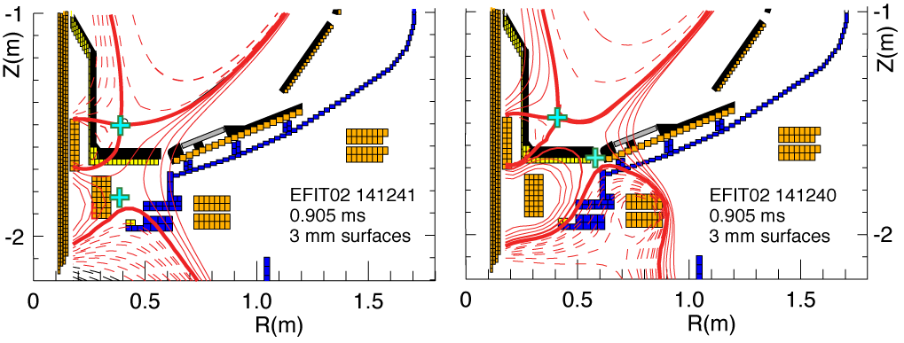
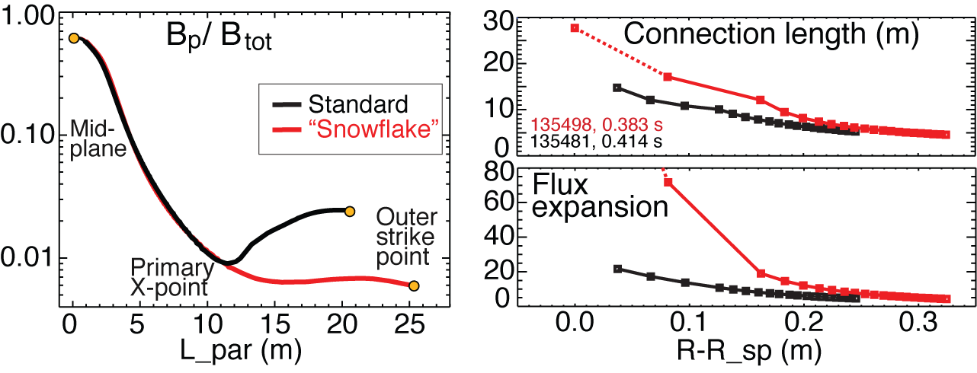
Plasma-wetted area and connection length are increased by 50-90 % in snowflake divertor
These properties observed in first 30-50 % of SOL width
B_{tot} angles in the strike point region: 1-2º, sometimes < 1º

Slide 6
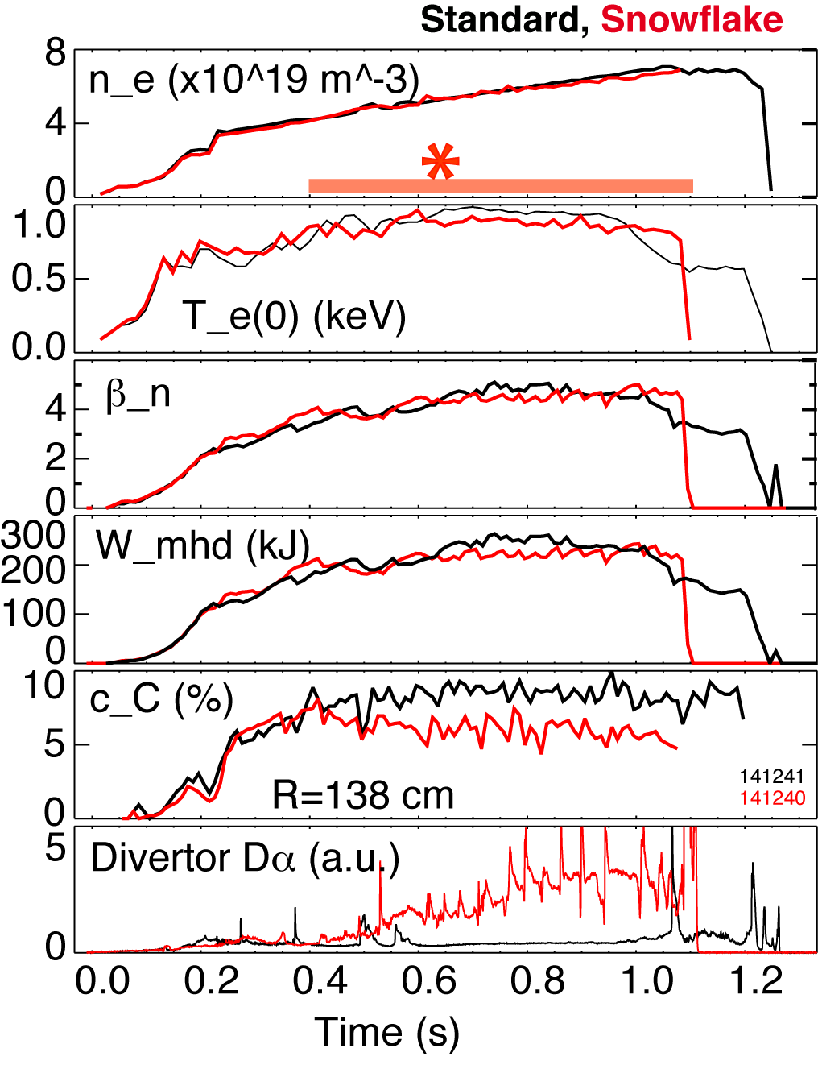
  Good H-mode confinement properties and core impurity reduction obtained with snowflake divertor
0.8 MA, 4 MW H-mode
κ=2.1, δ=0.8
Core T_{e} ~ 0.8-1 keV, T_{i} ~ 1 keV
β_{N} ~ 4-5
Plasma stored energy ~ 250 kJ
H98(y,2) ~ 1 (from TRANSP)
Core carbon reduction due to
  Type I ELMs
  Edge source reduction
    Divertor sputtering rates reduced due to partial detachment

Slide 7
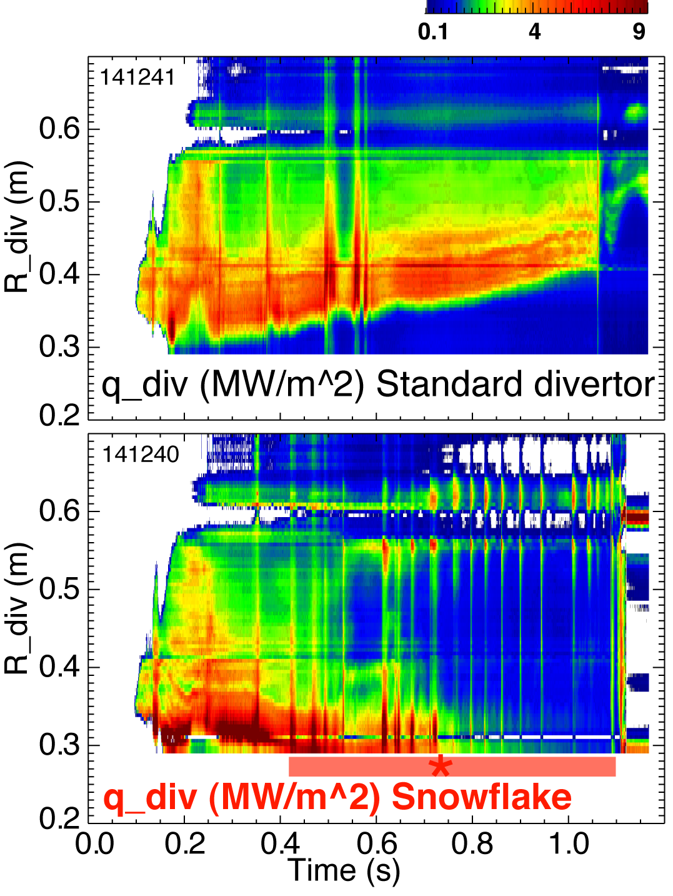
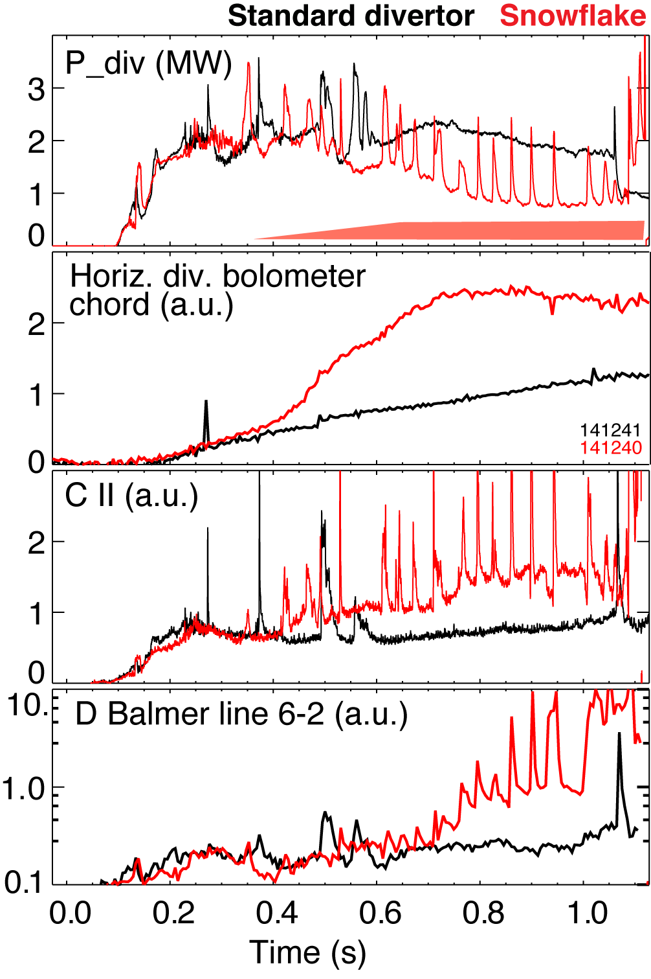
Significant reduction of steady-state divertor heat flux observed in snowflake divertor (at P_{SOL}~ 3 MW)
Partial detachment at or after snowflake formation time
  Heat and ion fluxes in the outer strike point region decreased
  Divertor recombination rate and radiated power are increased

Slide 8
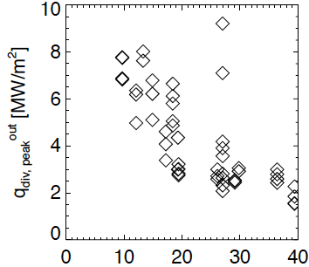
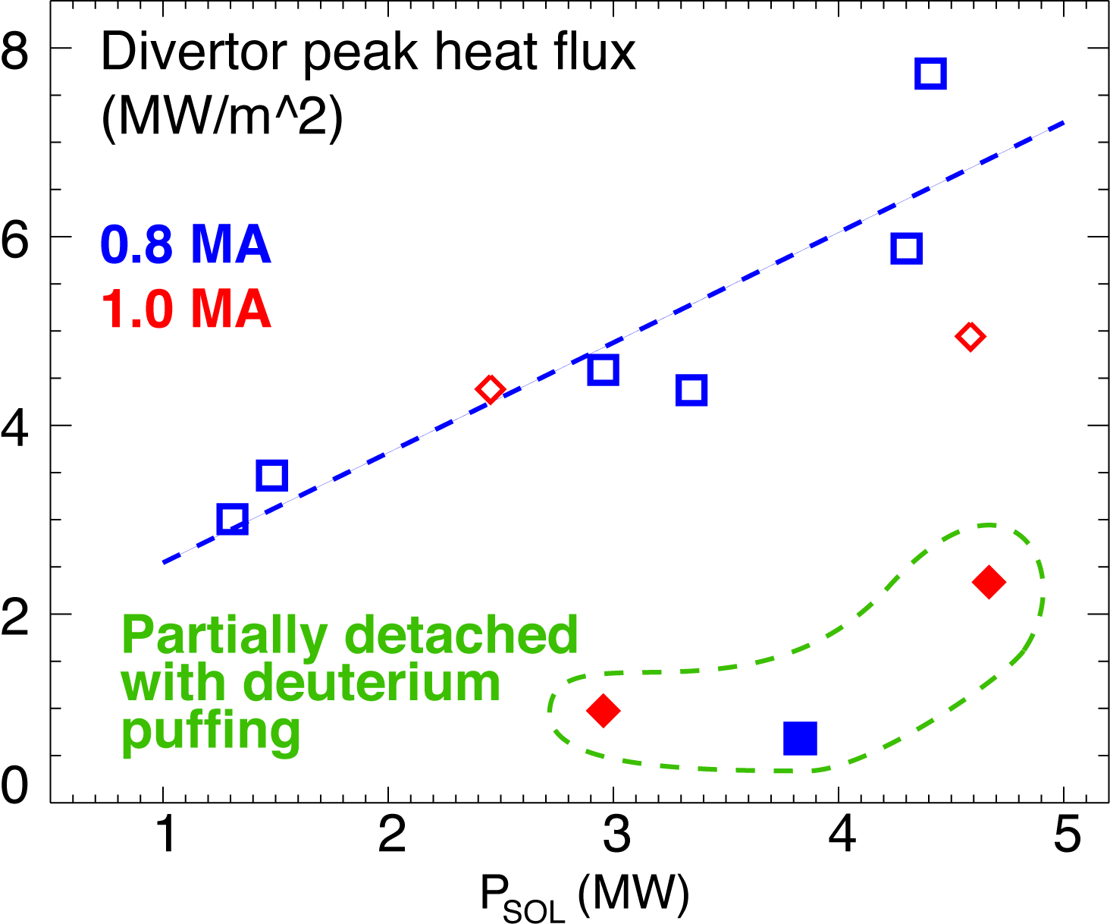
Snowflake divertor heat flux consistent with NSTX divertor heat flux scalings
0.8 MA
*
*
*
50
flux expansion
Snowflake divertor (*): P_{SOL}~3-4 MW, f_{exp}~40-60, q_{peak}~0.5-1.5 MW/m²
T. K. Gray et. al, EX/D P3-13, IAEA FEC 2010
V. A. Soukhanovskii et. al, PoP 16, 022501 (2009)

Slide 9
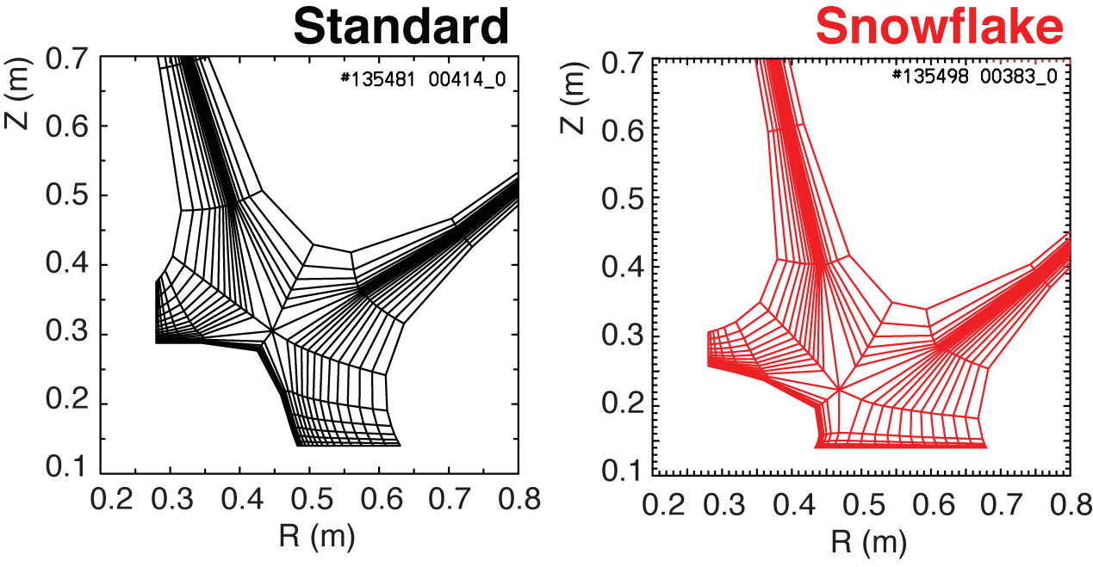
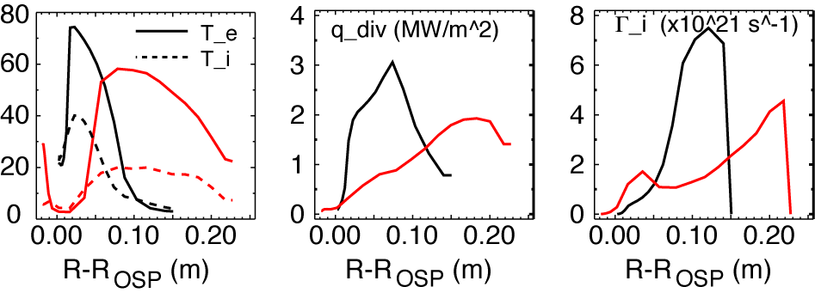
Modeling shows a trend toward reduced temperature, heat and particle fluxes in the snowflake divertor
2D multi-fluid code UEDGE
  Fluid (Braginskii) model for ions and electrons
  Fluid for neutrals
  Classical parallel transport, anomalous radial transport
    D = 0.25 m²/s
    χ_{e,i} = 0.5 m²/s
  Core interface:
    T_{e,i} = 120 eV
    n_{e} = 4.5 x 10¹⁹
  R_{recy} = 0.95
  Carbon 3 %

Slide 10
NSTX studies suggest the snowflake divertor configuration may be a viable divertor solution for present and future tokamaks
Steady-state snowflake (up to 600 ms, many τ_{E}’s)
Good H-mode confinement (τ_{E}, T_{e,i}(0), β_{N}, H98(y,2) )
Reduced core carbon concentration
Significant reduction in divertor heat flux
Potential to combine with radiative divertor for increased divertor radiation
This talk focused on divertor results. Planned research on NSTX:
  Improved magnetic control
  Pedestal peeling-balooning stability
  Snowflake at low SOL collisionality with lithium
  Divertor and upstream turbulence (blobs)
The snowflake divertor: a game-changer for magnetic fusion devices ?
✗

Slide 11
NSTX presentations at 38th EPS Conference
D. Kumar: Modeling of space resolved impurity emission in the EUV range using a transmission grating based imaging spectrometer at NSTX
D. Stutman: Multi-energy SXR imaging diagnostics for fusion experiments
D.J. Clayton: Edge transport measurements with the new multi-energy soft-x-ray diagnostic on NSTX
J.C. Hosea: Properties of HHFW electron heating generated H-modes in NSTX
R.J. La Haye: Aspect ratio effects on neoclassical tearing modes from comparison between DIII-D and NSTX
J.W. Berkery: Resistive wall mode kinetic stability advancements for refined comparison with experiments
S.A. Sabbagh: Advances in resistive wall mode stabilization to maintain high beta, low internal inductance plasmas in NSTX
G. Taylor: High-harmonic fast wave heating and current drive results for deuterium H-mode plasmas in the National Spherical Torus Experiment
W. Guttenfelder: Nonlinear gyrokinetic simulations of microtearing mode turbulence
E. Fredrickson: Internal amplitude measurements of CAE and GAE
Ya.I. Kolesnichenko: Formation of a non-monotonic energy distribution of energetic ions in NSTX
J.W. Ahn: Effect of 3-D fields on divertor detachment and associated pedestal profiles in NSTX H-mode plasmas
R. Maingi: Density Profile and Particle Transport Control as the Critical Ingredients for ELM Suppression in Tokamaks

Slide 12
Backup slides

Slide 13
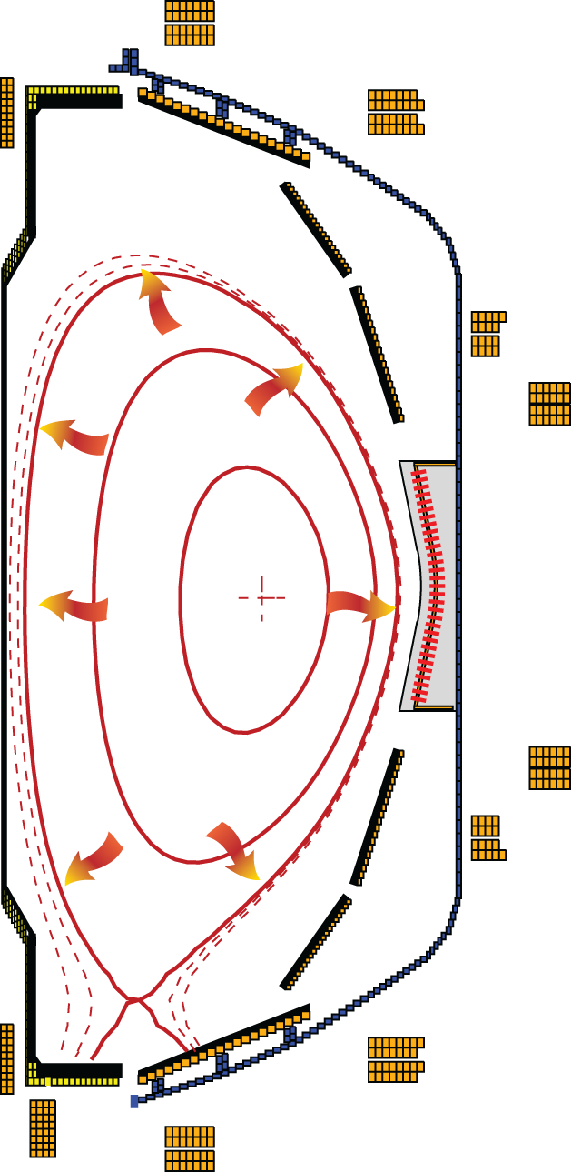
Poloidal divertor concept enabled progress in magnetic confinement fusion in the last 30 years
Divertor challenge
  Steady-state heat flux
      present limit q_{peak} ≤ 10 MW/m²
      projected to q_{peak} ≤ 80 MW/m² for future devices
  Density and impurity control
  Impulsive heat and particle loads
  Compatibility with good core plasma performance
Spherical tokamak: additional challenge - compact divertor
NSTX (Aspect ratio A=1.4-1.5)
  I_{p} ≤ 1.4 MA, P_{in} ≤ 7.4 MW (NBI), P / R ~ 10
  q_{peak} ≤ 15 MW/m², q|| ≤ 200 MW/m²
  Graphite PFCs with lithium coatings
National Spherical
Torus Experiment

Slide 14
Various techniques developed for reduction of heat fluxes q|| (divertor SOL) and q_{peak} (divertor target)
Promising divertor peak heat flux mitigation solutions:
  Divertor geometry
    poloidal flux expansion
    divertor plate tilt
    magnetic balance
  Radiative divertor
Recent ideas to improve standard divertor geometry
  X-divertor (M. Kotschenreuther et. al, IC/P6-43, IAEA FEC 2004)
  Snowflake divertor (D. D. Ryutov, PoP 14, 064502 2007)
  Super-X divertor (M. Kotschenreuther et. al, IC/P4-7, IAEA FEC 2008)

Slide 15
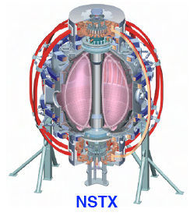
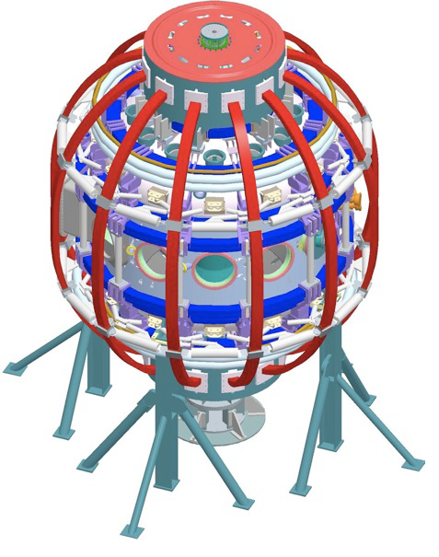
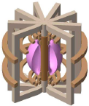
Divertor heat flux mitigation is key for present and future fusion plasma devices
ST / NSTX goals:
  Study high beta plasmas at reduced collisionality
  Access full non-inductive start-up, ramp-up, sustainment
  Prototype solutions for mitigating high heat & particle flux
In an ST, modest q|| can yield high divertor q_{pk}
  in NSTX, q||= 50-100 MW/m² and q_{pk}=6-15 MW/m²
  Large radiated power and momentum losses are needed to reduce q||
In NSTX, partially detached divertor regime is accessible only
  in highly-shaped plasma configuration with high flux expansion divertor (high plasma plugging efficiency, reduced q||)
  modest divertor D₂ injection still needed
NSTX
NSTX-U
ST-based Plasma Material Interface (PMI) Science Facility
ST-based Fusion Nuclear Science (FNS) Facility

Slide 16
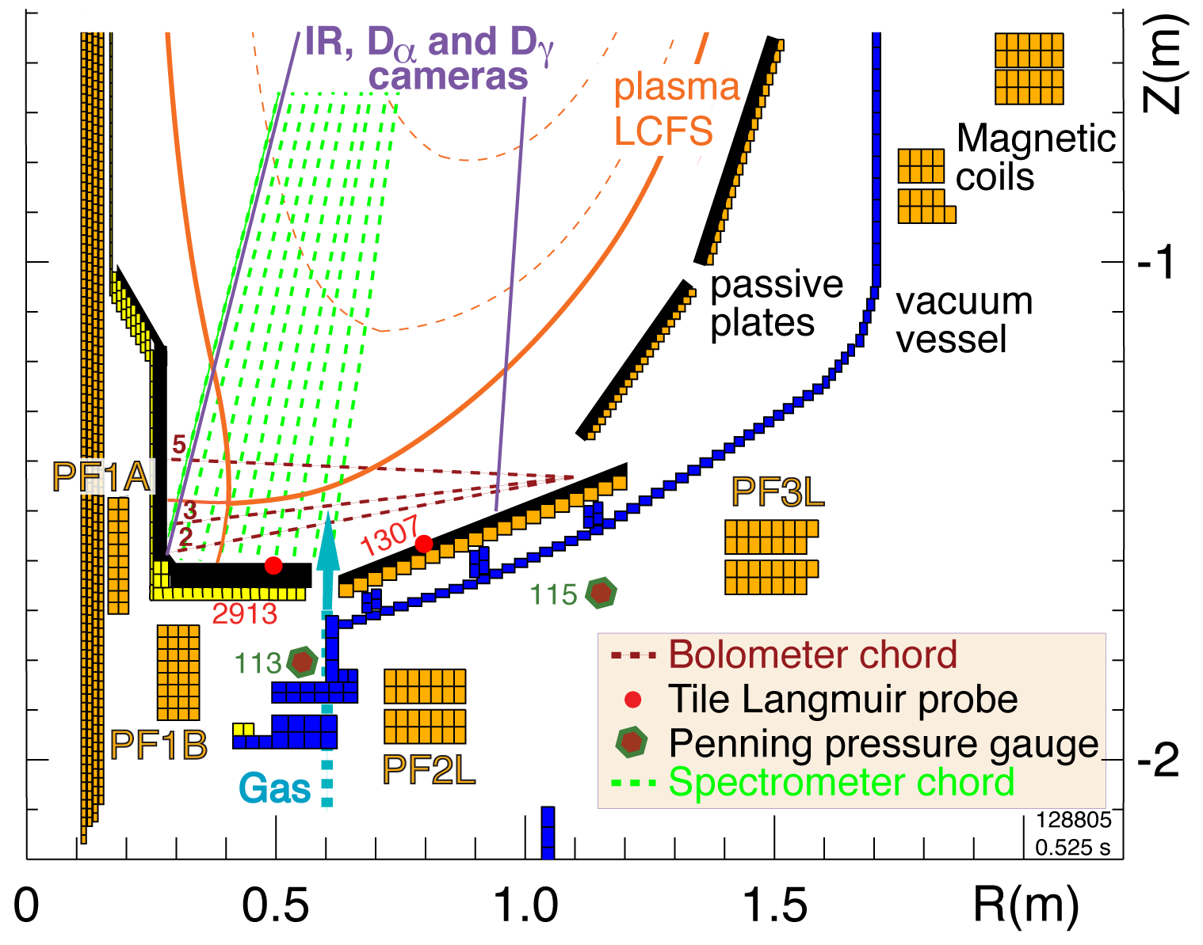
Open divertor geometry, three existing divertor coils and a good set of diagnostics enable divertor geometry studies in NSTX
I_{p} = 0.7-1.4 MA
P_{in} ≤ 7.4 MW (NBI)
ATJ and CFC graphite PFCs
Lithium coatings from lithium evaporators
Three lower divertor coils with currents 1-5, 1-25 kA-turns
Divertor gas injectors (D₂, CD₄)
Extensive diagnostic set

Slide 17
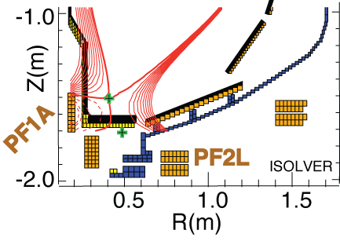
Possible snowflake divertor configurations were modeled with ISOLVER code
ISOLVER - predictive free-boundary axisymmetric Grad-Shafranov equilibrium solver
  Input: normalized profiles (P, I_{p}), boundary shape
  Match a specified I_{p} and β
  Output: magnetic coil currents
Standard divertor discharge below:
B_{t}=0.4 T, I_{p}=0.8 MA, δ_{bot}~0.6, κ∼2.1
Quantity | Standard divertor | Simulated snowflake
X-point to target parallel length L_{x} (m) | 5-10 | 10
Poloidal magnetic flux expansion f_{exp} at outer SP | 10-24 | 60
Magnetic field angle at outer SP (deg.) | 1.5-3 | ~1
Plasma-wetted area A_{wet} (m²) | ≤ 0.4 | 0.95

Slide 18
Heat flux mitigation is more challenging in compact divertor of spherical torus
NSTX
  I_{p} = 0.7-1.4 MA, t_{pulse} < 1.5 s, P_{in} ≤ 7.4 MW (NBI)
  ATJ and CFC graphite PFCs
  P / R ~ 10
  q_{pk} ≤ 15 MW/m²
  q|| ≤ 200 MW/m²
Quantity | NSTX | DIII-D
Aspect ratio | 1.4-1.5 | 2.7
In-out plasma boundary area ratio | 1:3 | 2:3
X-point to target parallel length L_{x} (m) | 5-10 | 10-20
Poloidal magnetic flux expansion f_{exp} at outer SP | 5-30 | 3-15
Magnetic field angle at outer SP (deg.) | 1-10 | 1-2

Slide 19
Snowflake divertor configurations obtained in NSTX confirm analytic theory and modeling
Standard
Snowflake
f_{exp}
B_{p}

Slide 20
Divertor profiles show low heat flux, broadened C III and
C IV radiation zones in the snowflake divertor phase
Heat flux profiles reduced to nearly flat low levels, characteristic of radiative heating
Divertor C III and C IV brightness profiles broaden
High-n Balmer line spectroscopy and CRETIN code modeling confirm outer SP detachment with T_{e} ≤ 1.5 eV, n_{e} ≤ 5 x 10²⁰ m⁻³
  Also suggests a reduction of carbon physical and chemical sputtering rates

Slide 21
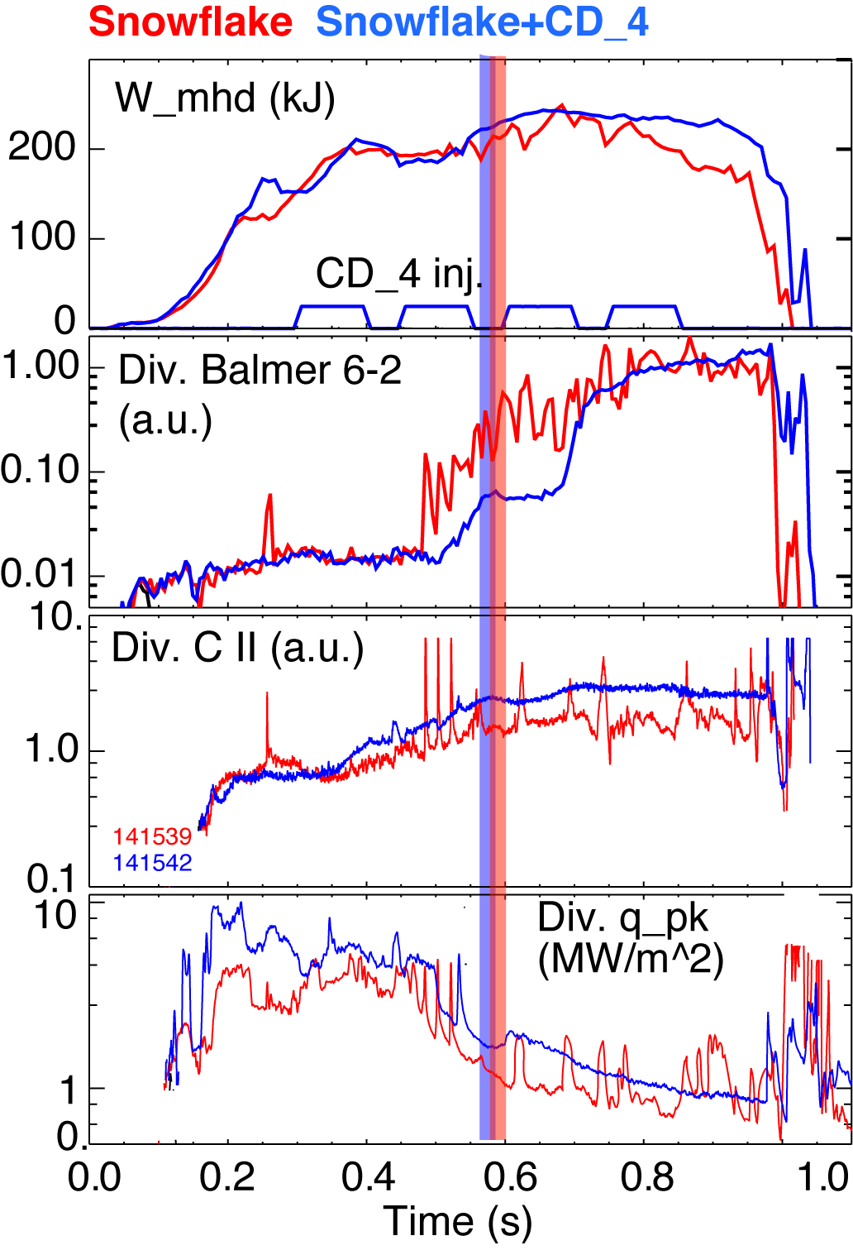
Snowflake divertor with CD₄ seeding leads to increased divertor carbon radiation
I_{p}=0.9 MA, P_{NBI}=4 MW, P_{SOL}=3 MW
Snowflake divertor (from 0.6 ms)
  Peak divertor heat flux reduced from 4-6 MW/m² to 1 MW/m²
Snowflake divertor (from 0.6 ms)
+ CD₄
  Peak divertor heat flux reduced from 4-6 MW/m² to 1-2 MW/m²
  Divertor radiation increased further
  Divertor heat flux not as low due to additional radiative heating

Slide 22
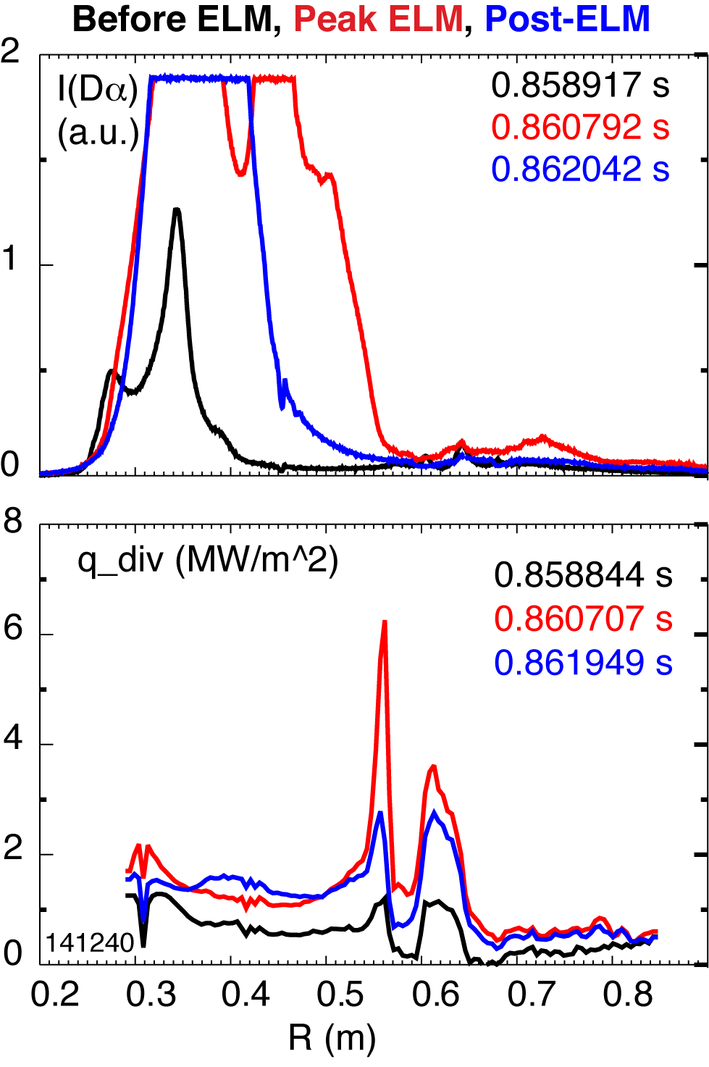
Preliminary indications that ELM heat flux is effectively dissipated in snowflake divertor
Type I ELMs is a concern for divertor lifetime
  Erosion
  Evaporation, melting
Radiative buffering of ELMs ineffective
In NSTX snowflake divertor
  Type I ELMs 5-12 % ΔW/W
  Significant dissipation of ELM energy in strike point region
  Reduction in low flux expansion region (at larger R_{div})
  Need more data to analyze mechanisms and trends
    Energy diffusion over longer conn. Length
    Field line mixing in null-point region
    Radiative / collisional dissipation
    Plasma-wetted area effect

Slide 23
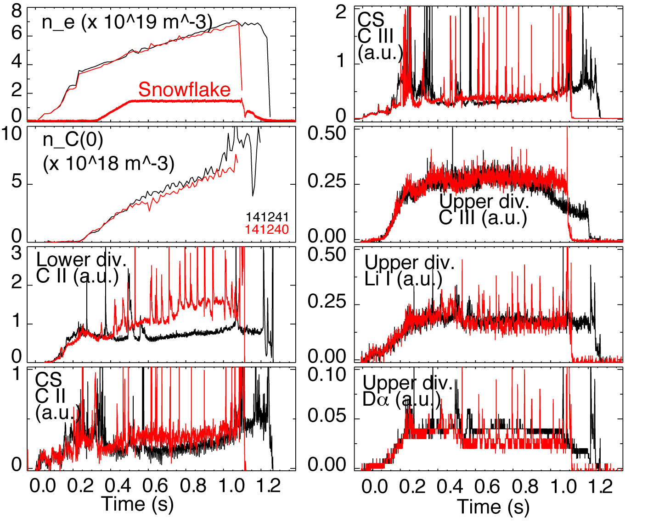
Upper divertor is unaffected by lower divertor snowflake configuration

Slide 24
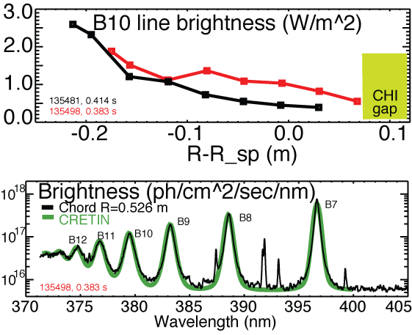
High-n Balmer line emission measurements suggest high divertor recombination rate, low T_{e} and high n_{e}
Balmer series spectra modeled with CRETIN; Spectra sensitive to
  Line intensity <-> Recombination rate
  T_{e} <-> Boltzman population distribution
  n_{e} <-> Line broadening due to linear Stark effect from ion and electron microfield
T_{e}=0.8-1.2 eV, n_{e}=2-7 x 10²⁰ m⁻³ inferred from modeling

Slide 25
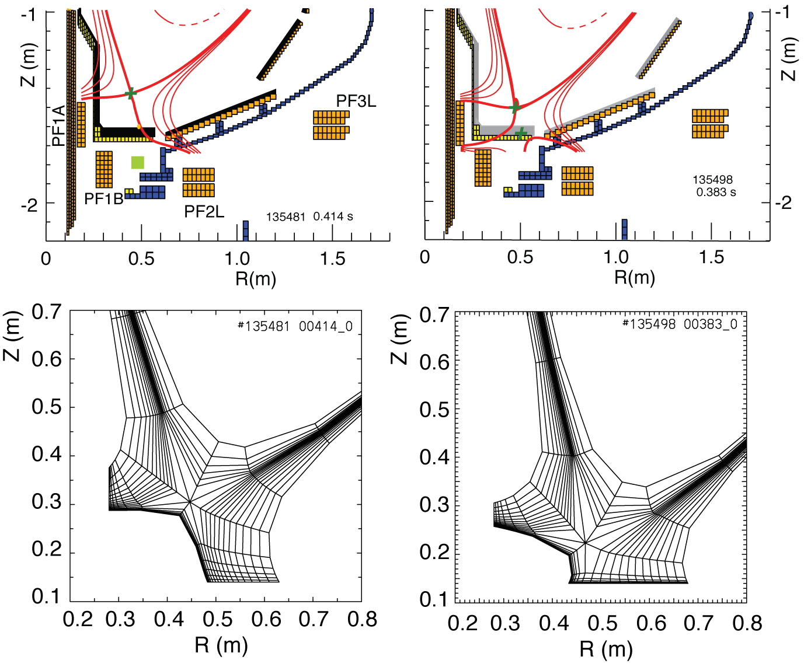
2D multi-fluid edge transport code UEDGE is used to study snowflake divertor properties
Fluid (Braginskii) model for ions and electrons
Fluid for neutrals
Classical parallel transport, anomalous radial transport
Core interface:
  T_{e} = 120 eV
  T_{i} = 120 eV
  n_{e} = 4.5 x 10¹⁹
D = 0.25 m²/s
χ_{e,i} = 0.5 m²/s
R_{recy} = 0.95
Carbon 3 %
Standard Snowflake

Slide 26
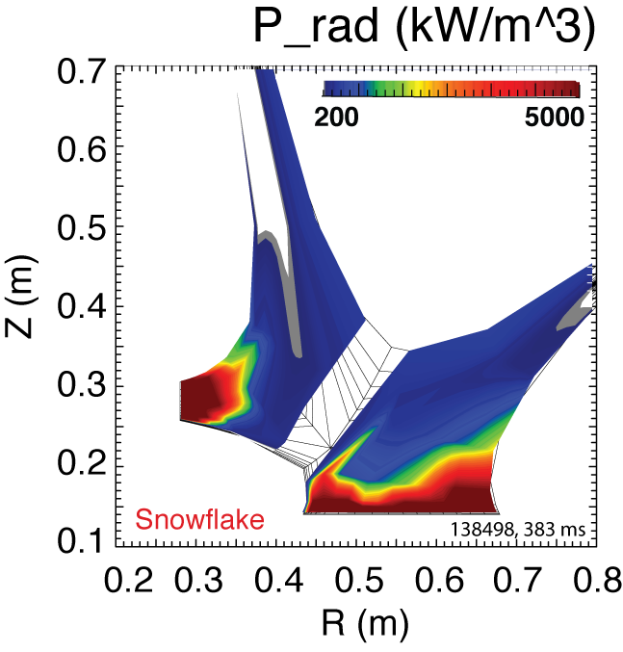
Radiated power is broadly distributed in the outer leg of snowflake divertor
UEDGE model

Slide 27
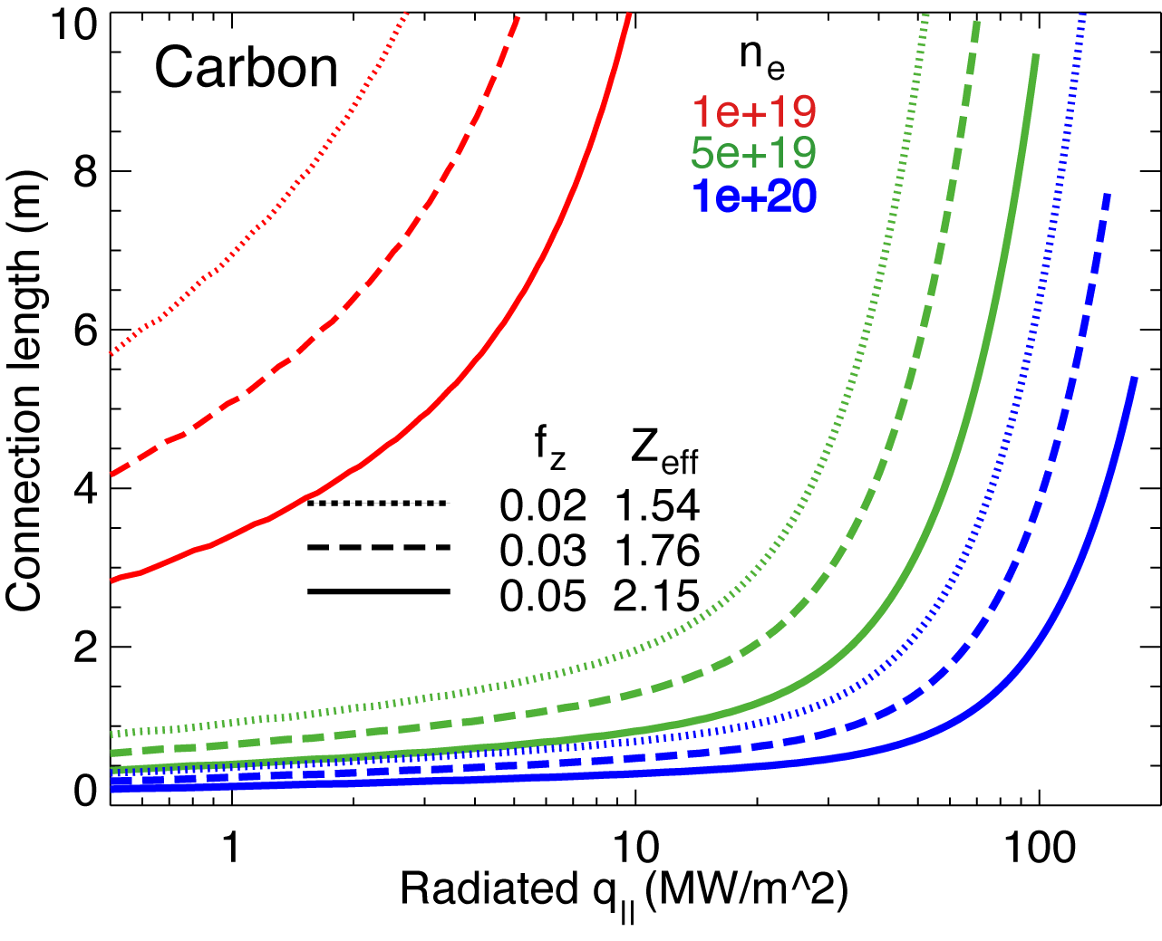
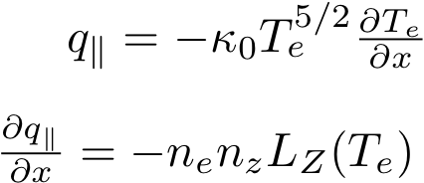
1D estimates indicate power and momentum losses are increased in snowflake divertor
1D divertor detachment model by Post
  Electron conduction with non-coronal carbon radiation
  Max q|| that can be radiated as function of connection length for range of f_{z} and n_{e}
Three-body electron-ion recombination rate depends on divertor ion residence time
  Ion recombination time: τ_{ion}~ 1−10 ms at T_{e} =1.3 eV
  Ion residence time: τ_{ion} ≤ 3-6 ms in standard divertor, x 2 in snowflake

