Slide 1



Disruption event characterization and forecasting of global and tearing mode stability for tokamaks
J.W. Berkery, S.A. Sabbagh, and J.D. Riquezes
Columbia University
S.P. Gerhardt and C.E. Myers
Princeton Plasma Physics Laboratory
2nd IAEA Technical Meeting on Fusion Data Processing, Validation and Analysis
Boston, MA
May 30- June 2, 2017
*This work is supported by the US DOE contracts DE-AC02-09CH11466 and DE-FG02-99ER54524

Slide 2
Outline
The Disruption Event Characterization And Forecasting (DECAF) code
  Contains various physical event modules with warning algorithms
A reduced kinetic model for resistive wall mode stability
  Complex calculation reduced for speed, performs well
Identification of rotating MHD
  Tracks characteristics that lead to disruption: rotation bifurcation, mode lock

Slide 3
Disruption event chain characterization capability started as next step in disruption avoidance plan
Approach to disruption prevention
  Identify disruption event chains and elements
  Predict events in disruption chains
  Cues disruption avoidance systems to break event chains
    Attack events at several places with active control
  Builds upon both physics and control successes of NSTX
t
[DOE report on Transient events (2015)]

Slide 4
Disruption Event Characterization And Forecasting (DECAF) code is structured to ease parallel development
Physical event modules
Physical event modules
  Present grouping follows work of deVries [P.C. de Vries et al., Nucl. Fusion 51, 053018 (2011)]
  – BUT, easily appended or altered
Warning algorithms
  Present approach follows [S.P. Gerhardt et al., Nucl. Fusion 53, 063021 (2013)]
  More flexible: arbitrary number of tests, thresholds, and user-defined levels and warning points
Code control workbooks
Density Limits
Confinement
Main data structure
Technical issues
Tokamak dynamics
Output processing
Power/current handling
Mode stability
RWM and tearing mode stability

Slide 5
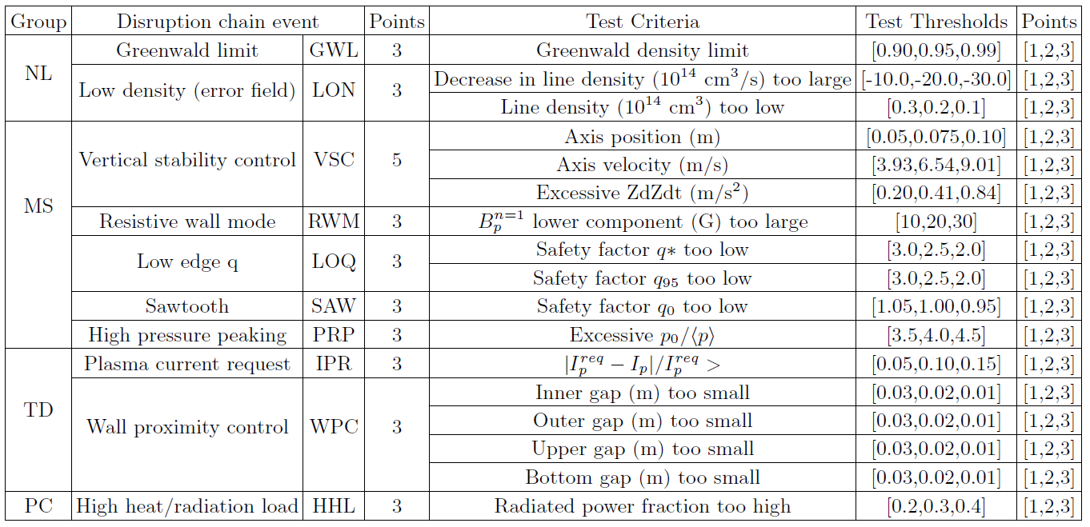
Several threshold tests are currently included in DECAF

Slide 6
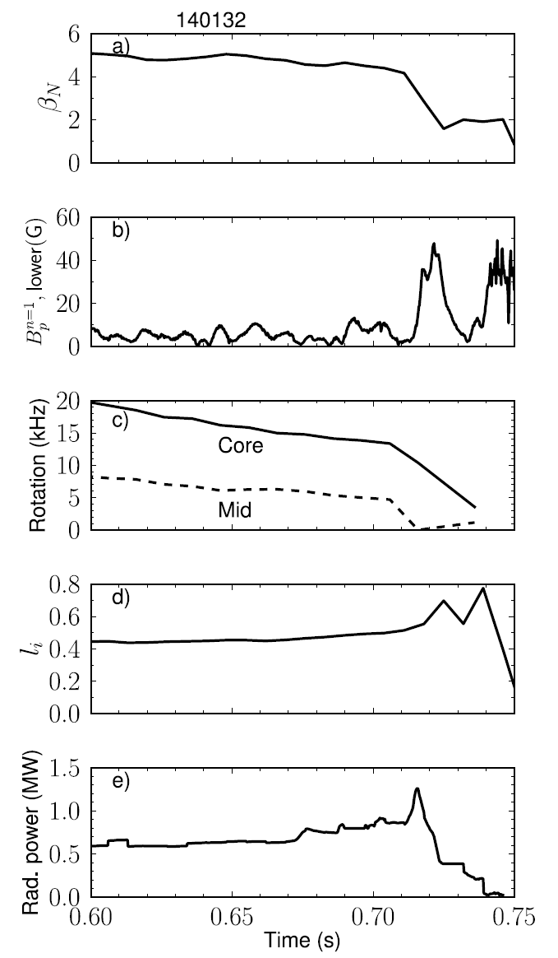
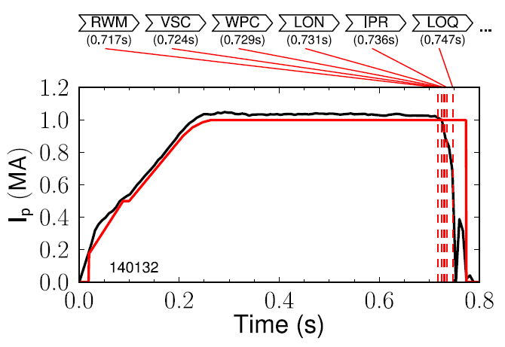
Example DECAF analysis on single NSTX discharge
DECAF uses simple threshold tests and more sophisticated models to declare events
  Ex: RWM B_{P}^{n=1} threshold 30G (δB/B0 ~ 0.67%)
NSTX
NSTX 140132

Slide 7
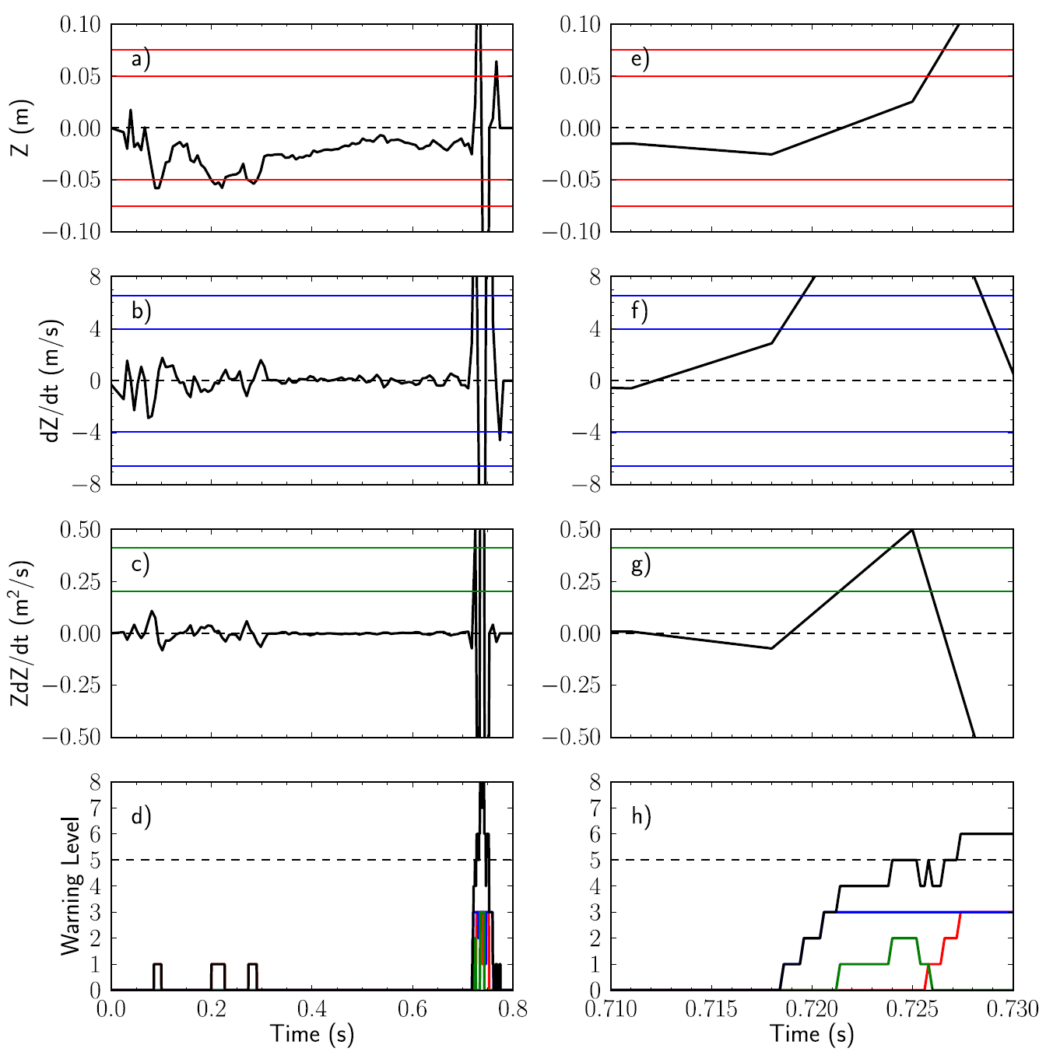
Example DECAF analysis on single NSTX discharge
DECAF uses simple threshold tests and more sophisticated models to declare events
  Ex: RWM B_{P}^{n=1} threshold 30G (δB/B0 ~ 0.67%)
Tests can be combined with “warning points”
  Ex: VSC uses Z, dZ/dt, and ZdZ/dt

Slide 8
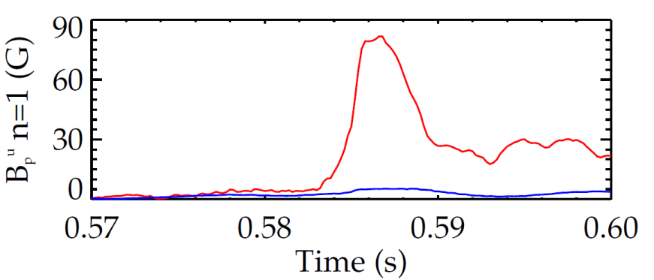
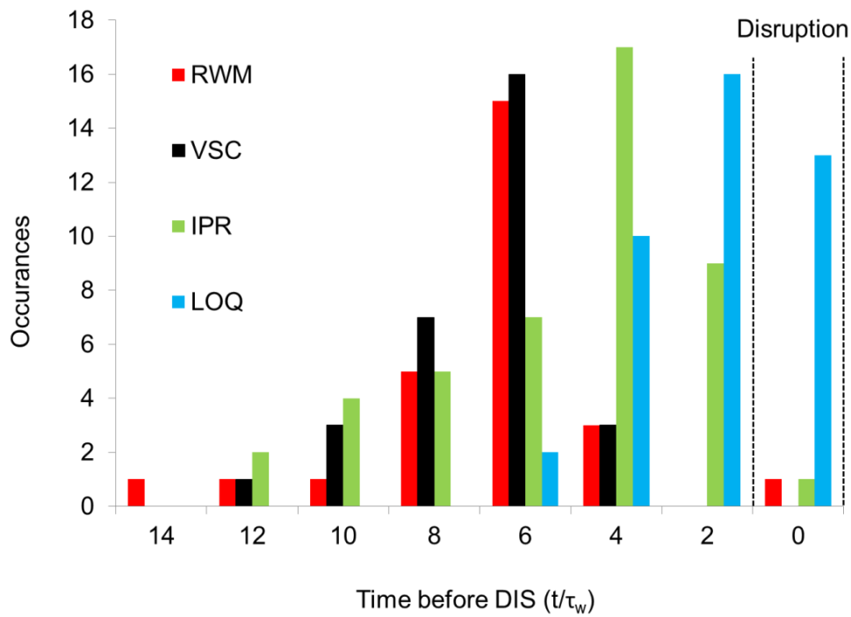
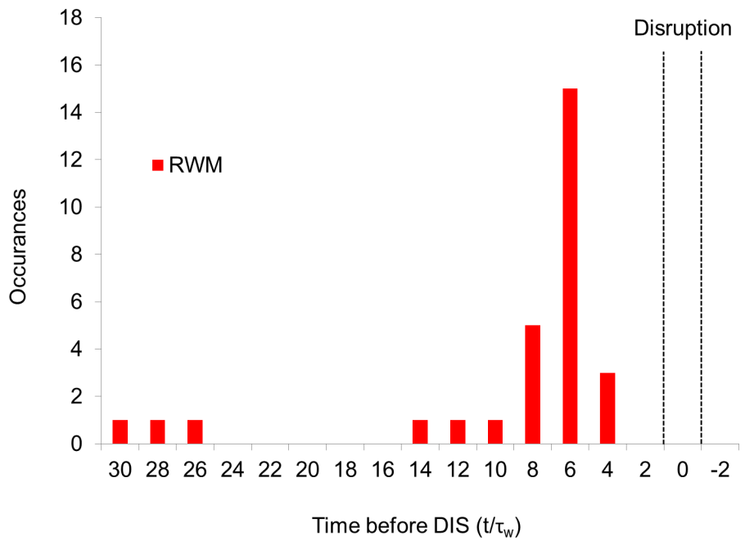
Initial DECAF results detects disruption chain events when applied to dedicated 45 shot NSTX RWM disruption database
RWM B_{P}^{n=1} threshold 30G (δB/B₀ ~ 0.67%)
60% within 14 τ_{w} of disruption time (τ_{w} = 5 ms)
unstable RWM
NSTX
137722
140102
  IPR: Plasma current request not met
  RWM: RWM event warning
  VSC: Vertical stability control
  LOQ: Low edge q warning
RWM events in DECAF
Disruption

Slide 9
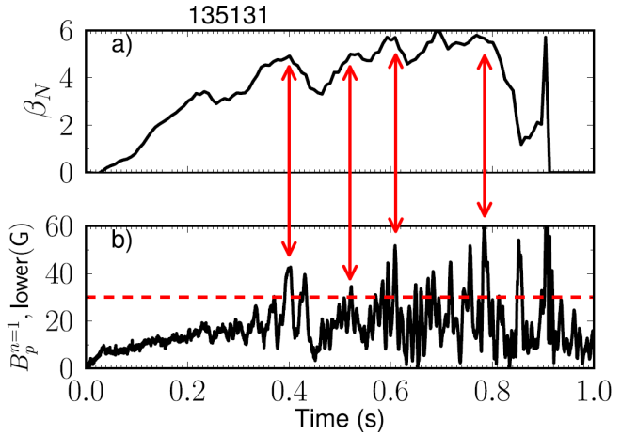
Initial DECAF analysis already finding common disruption event chains, giving new insight
Earlier RWM events not false positives
  cause large decreases in β_{N} and stored energy with subsequent recovery (minor disruptions)
Identifying common chains of events can provide insight to cue avoidance systems
  5 (out of theoretically 56) two-event combinations followed 77% of RWM cases (those that occurred within 14τ_{w} of DIS)
VSC
PRP
30.8%
VSC
WPC
19.2%
RWM
PRP
VSC
11.5%
WPC
VSC
7.7%
IPR
WPC
7.7%
Other
23.1%

Slide 10
Outline
The Disruption Event Characterization And Forecasting (DECAF) code
  Contains various physical event modules with warning algorithms
A reduced kinetic model for resistive wall mode stability
  Complex calculation reduced for speed, performs well
Identification of rotating MHD
  Tracks characteristics that lead to disruption: rotation bifurcation, mode lock

Slide 11
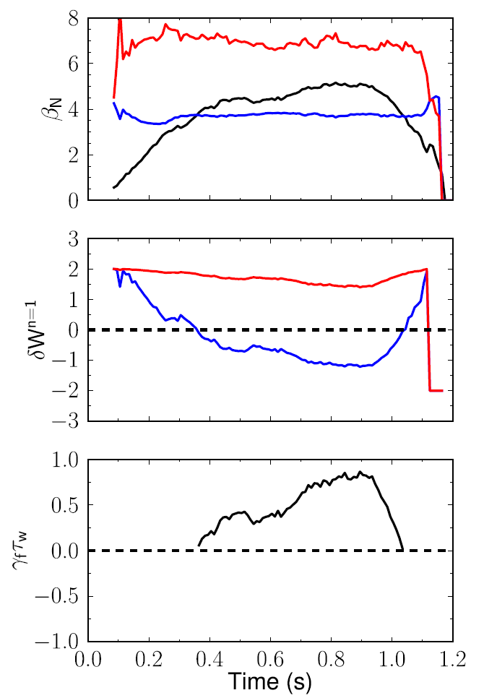
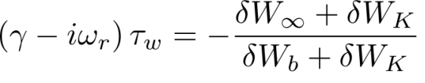
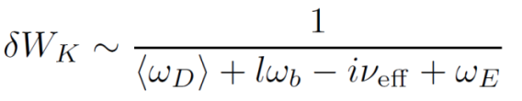
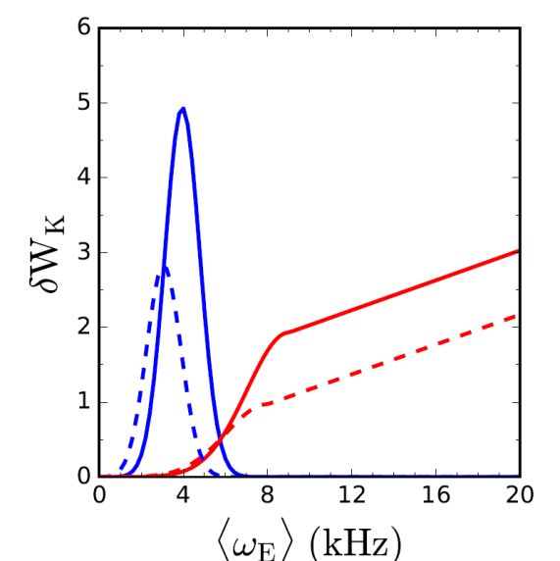
Goal is to forecast mode growth rate in real-time using parameterized reduced models for δW terms
RWM dispersion relation
with-wall limit
β limits
no-wall limit
with-wall limit
Fluid terms
Kinetic effects:
Collisionality
Rotation
δW
Precession resonance
Gaussian functions used for resonances
no-wall limit
Bounce resonances
fluid RWM growth rate
  Coefficients selected to reflect NSTX experience
growth
rate
(γτ_{w})
stabilized by kinetic effects
<ν> = 1 kHz

Slide 12
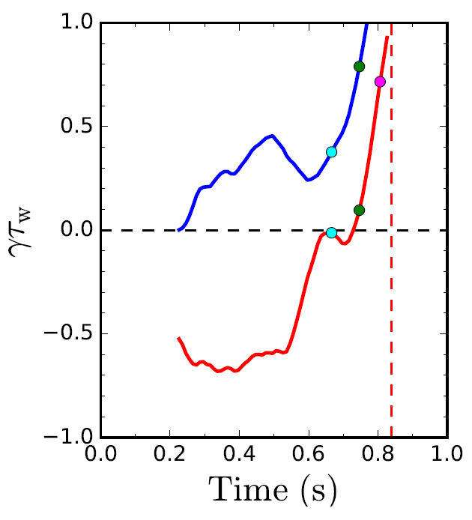
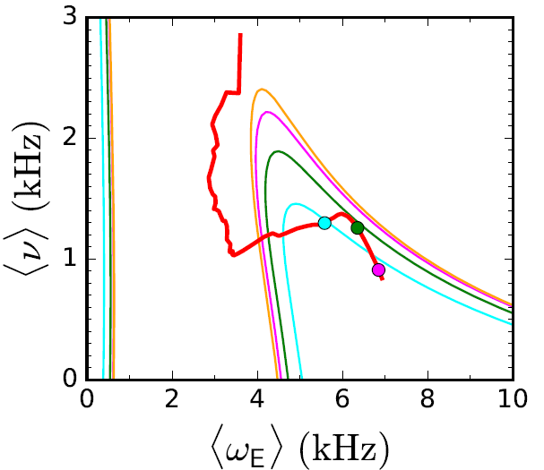

DECAF contains modeled kinetic quantities for generation of stability maps
Normalized growth rate vs. time
Stability diagram shows trajectory of a discharge towards unstable regions
C_{β}
C_{β} =
(β_{N} – β_{N}^{no-wall})/
(β_{N}^{with-wall} – β_{N}^{no-wall})
Fluid
unstable
stable
Fluid + Kinetic
unstable
region

Slide 13
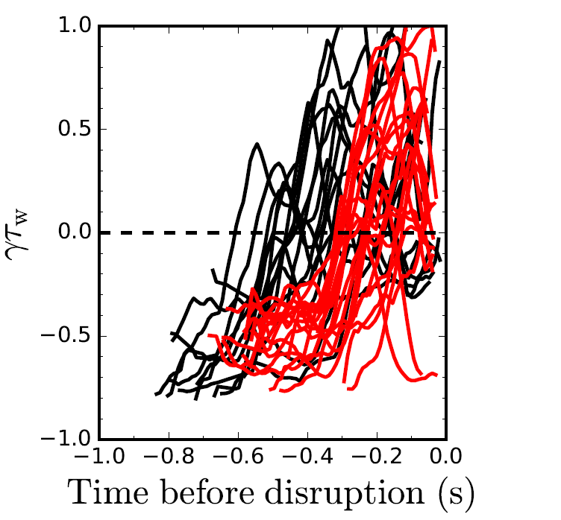
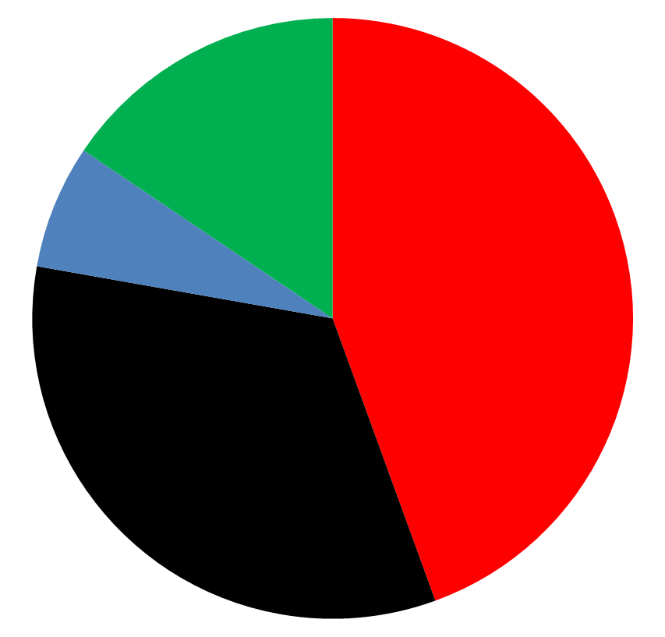
DECAF reduced kinetic model results initially tested on a database of NSTX discharges with unstable RWMs
Normalized growth rate vs. time
Predicted instability statistics (45 shots)
44% predicted unstable < 320 ms (approx. 60τ_{w}) before current quench
33% predicted unstable within 100 ms of a minor disruption
Stable
(16%)
(7%) False
positives
Instability < 320 ms
before disruption
(44%)
(7%) False
positives
unstable
unstable
stable
Instability within 100 ms of minor
disruption
(33%)
stable

Slide 14
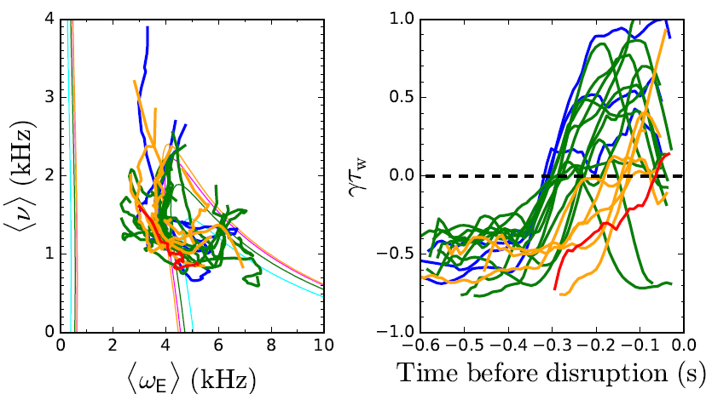
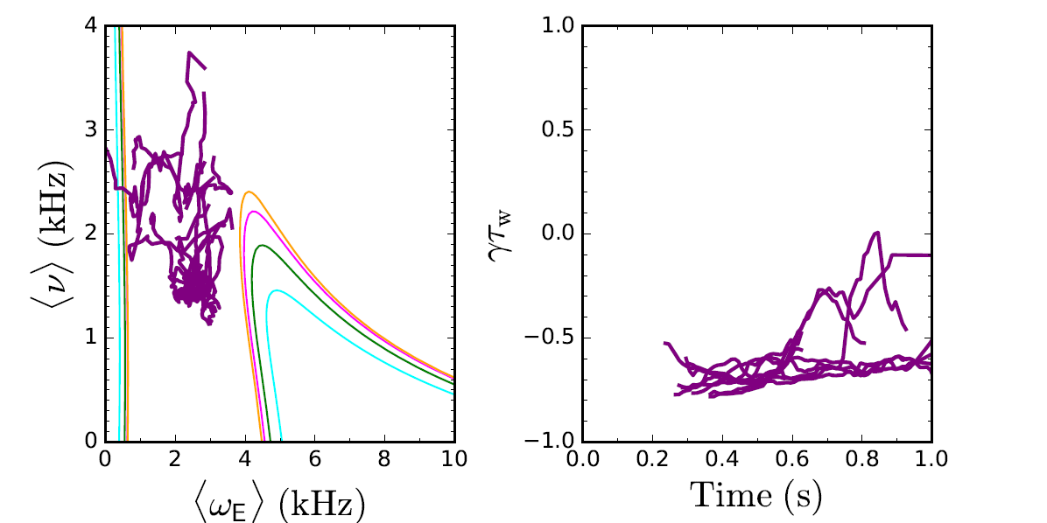
Reduced kinetic model distinguishes between stable and unstable NSTX discharges
Unstable cases
If <ω_{E}> ~ 0 warnings are eliminated, 10/13, or 77%, of stable cases are stable in the model
Model is successful in first incarnation - development continues to improve forecasting performance
Stable cases
Tradeoff: missed vs. early warnings

Slide 15
Outline
The Disruption Event Characterization And Forecasting (DECAF) code
  Contains various physical event modules with warning algorithms
A reduced kinetic model for resistive wall mode stability
  Complex calculation reduced for speed, performs well
Identification of rotating MHD
  Tracks characteristics that lead to disruption: rotation bifurcation, mode lock

Slide 16
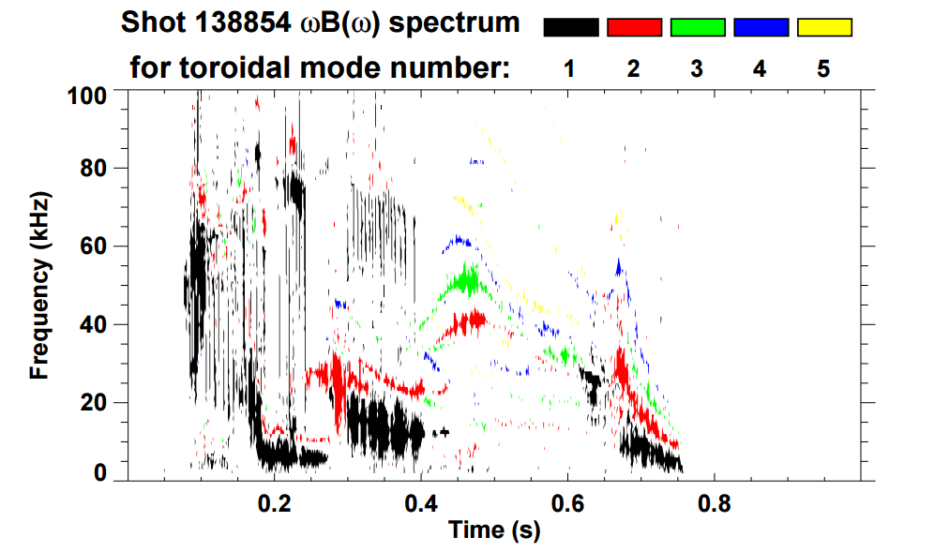
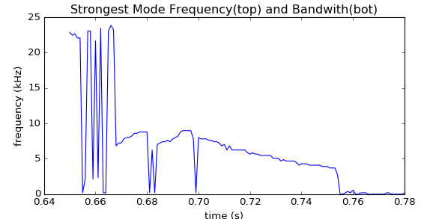
      Essential new step for DECAF analysis of general tokamak data: Identification of rotating MHD (e.g. NTMs)
Initial goals
  Create portable code to identify existence of rotating MHD modes
  Track characteristics that lead to disruption
    e.g. rotation bifurcation, mode lock
Approach
  Apply FFT analysis to determine mode frequency, bandwidth evolution
  Determine bifurcation and mode locking
Magnetic spectrogram of rotating MHD in NSTX
NSTX “stable periods” – enhanced by high elongation (κ ~ 2.7), lithium wall conditioning
NSTX-U: rotating MHD more common (lower κ ~ 2.3, no lithium)
n = 1 mode frequency vs. time
ω₀ ~ 9 kHz
bifurcation ~ 4 kHz

Slide 17
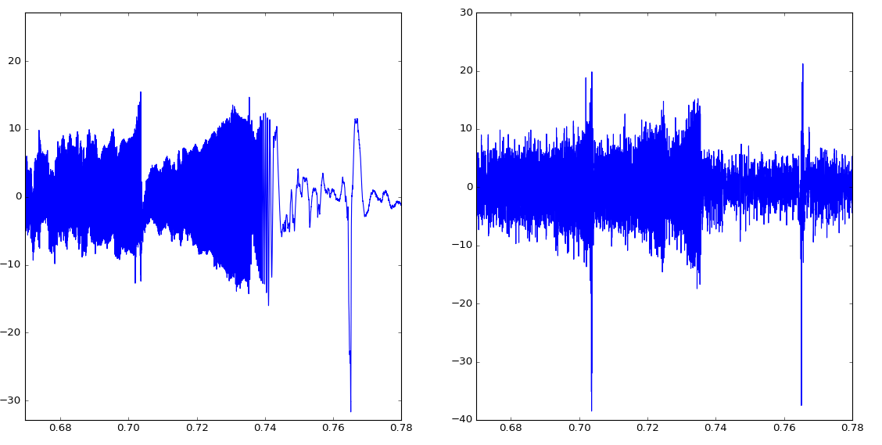
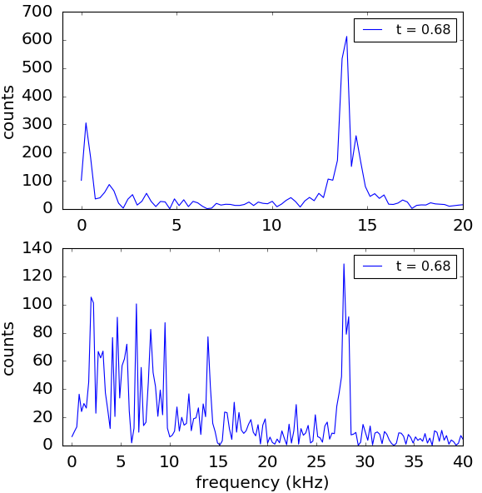
      DECAF rotating MHD analysis identifies the state of the modes found
Signals
FFTs
20
Odd-n
Odd-n
Fast Fourier transforms used to find mode peak frequency within a time interval
10
B (G)
0
-10
-20
mode lock
-30
30
Even-n
Even-n
20
10
B (G)
0
-10
-20
-30
0.68
0.70
0.72
0.74
0.76
0.78
time (s)

Slide 18
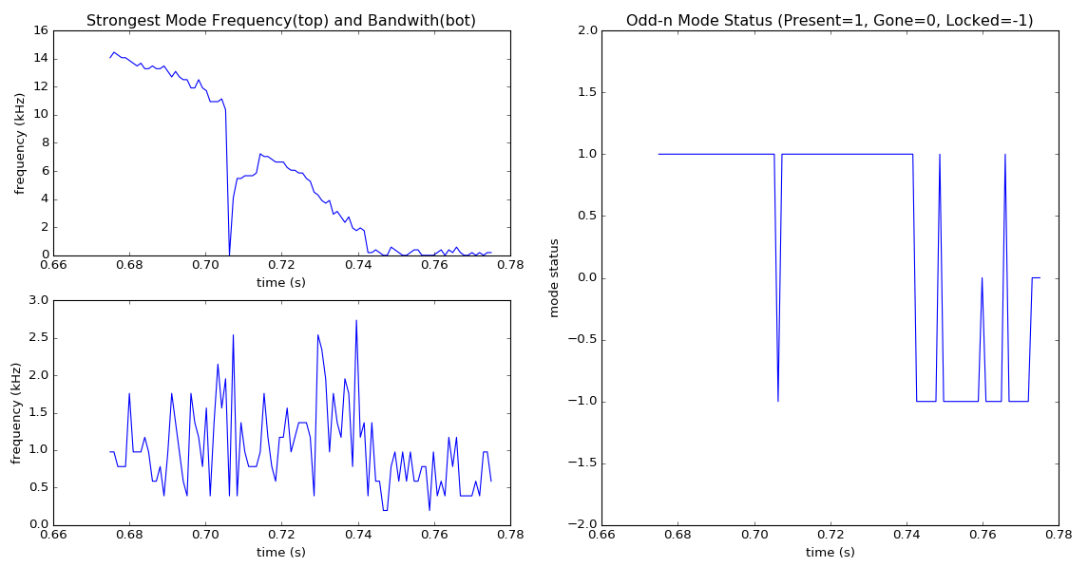
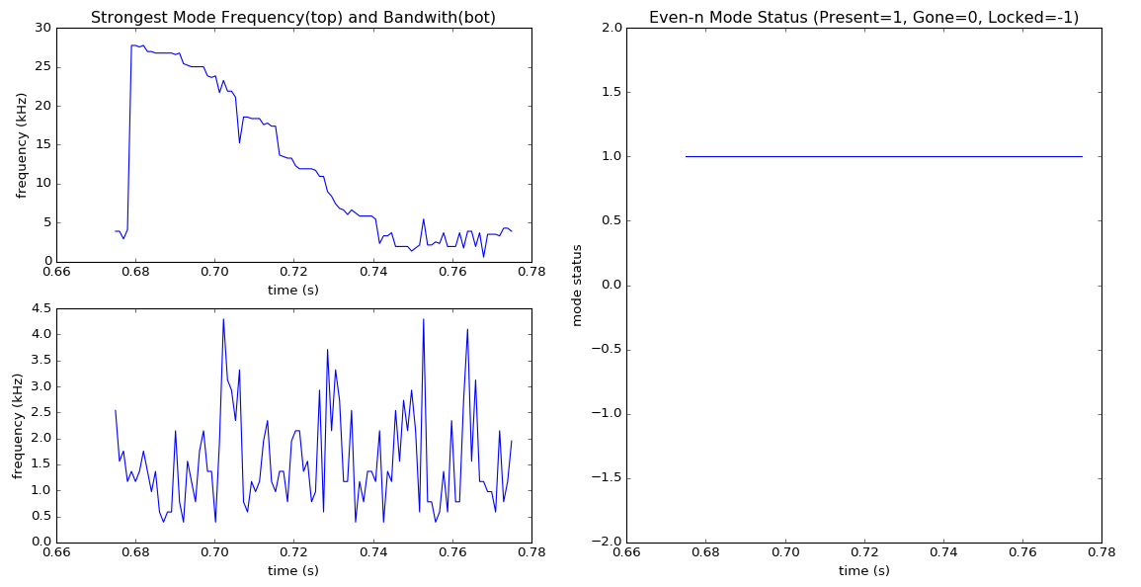
      DECAF rotating MHD analysis identifies the state of the modes found
Frequency vs. time
DECAF mode status
Odd-n
1 = mode rotating
1
0
0 = No mode
-1
-1 = mode locked
Even-n
1 = mode rotating
1
0
0 = No mode
-1
-1 = mode locked
0.66
0.70
0.74
0.78
t (s)

Slide 19
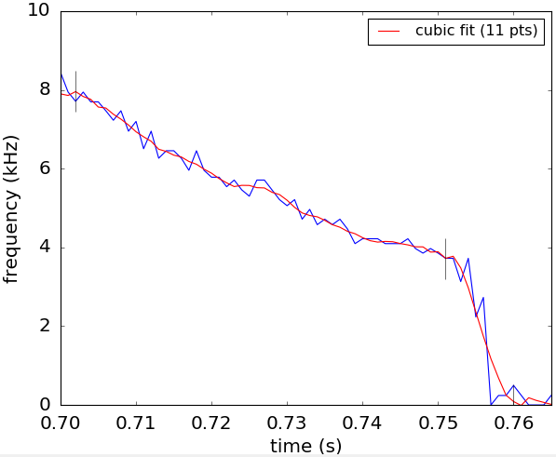
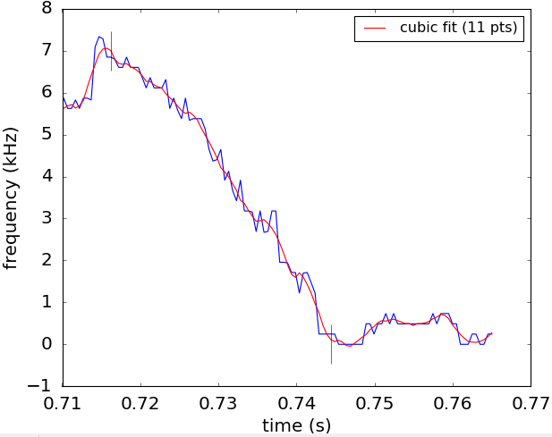
The characterization algorithm shows that the expected bifurcation and locking events can be found
Algorithm written looks for a “quasi-steady state” period, a potential bifurcation, and possible mode locking
odd-n peak frequencies
odd-n peak frequencies
Mode frequency
NSTX shot 138854
NSTX-U shot 204202
bifurcates
lock
lock

Slide 20
Conclusions
The DECAF code can characterize chains of events leading to disruption
  Expanding set of modules and warnings used to analyze data sets
A reduced kinetic model for resistive wall mode stability
  Complex calculation reduced for speed, performs well
Algorithm for identifying rotating MHD can find frequency, bifurcation points, locking times

Slide 21
Backup

Slide 22
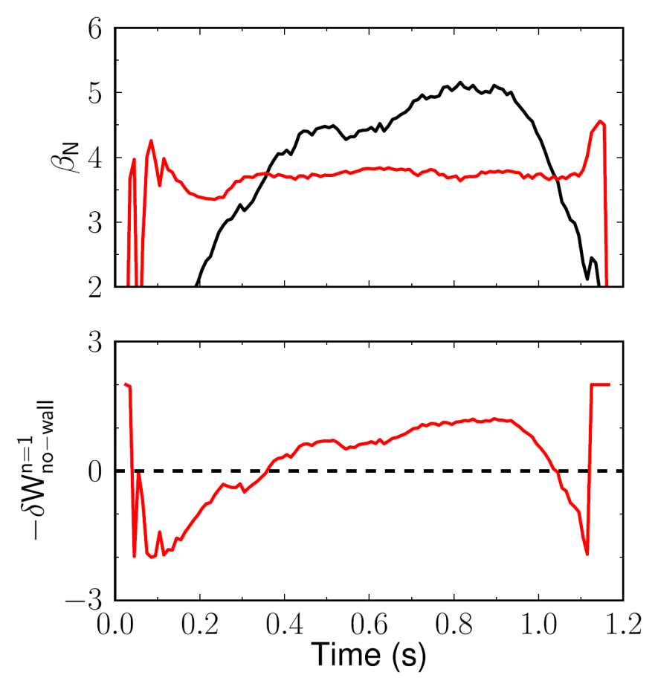
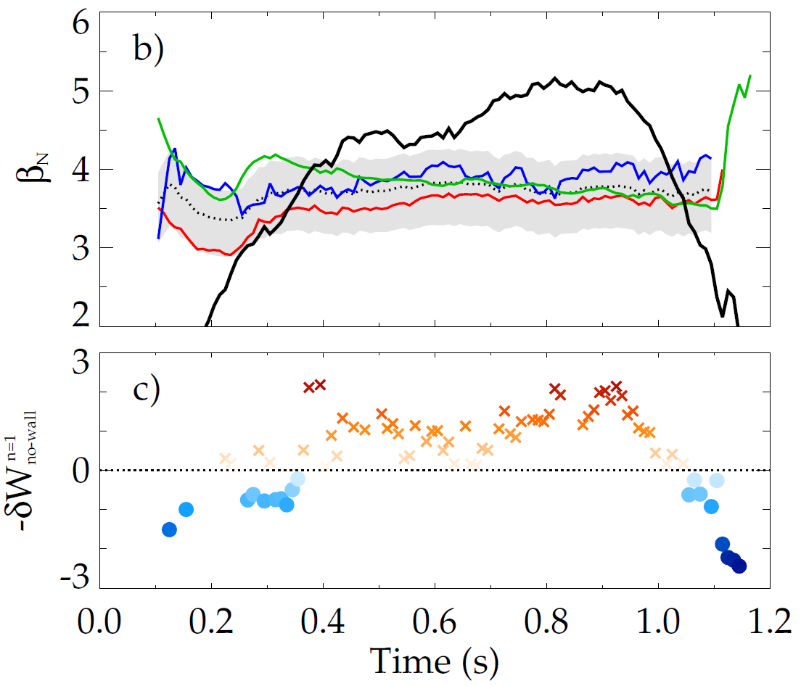
DECAF contains modeled quantities for stability estimation
Modeled estimates for NSTX no-wall limit
DECAF
Internal inductance
Pressure peaking
Aspect ratio
Composite no-wall limit model
DECAF replicates published NSTX β_{N} no-wall model
NSTX 138556
Above no-wall
limit
DECAF δW no-wall model similar to DCON results
Below
DCON
[J.W. Berkery et al., Nucl. Fusion 55, 123007 (2015)]

Slide 23
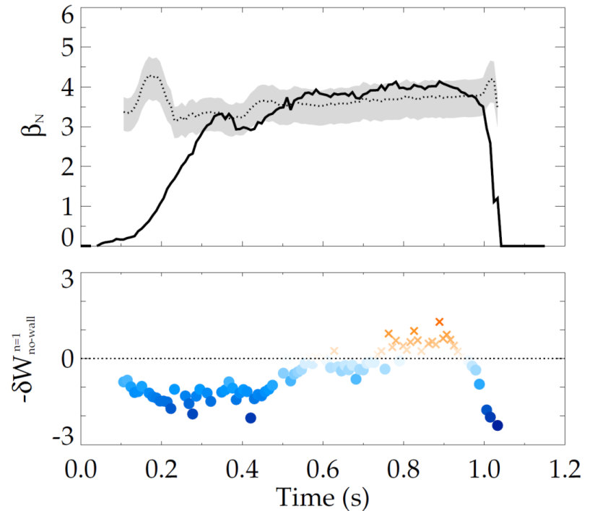
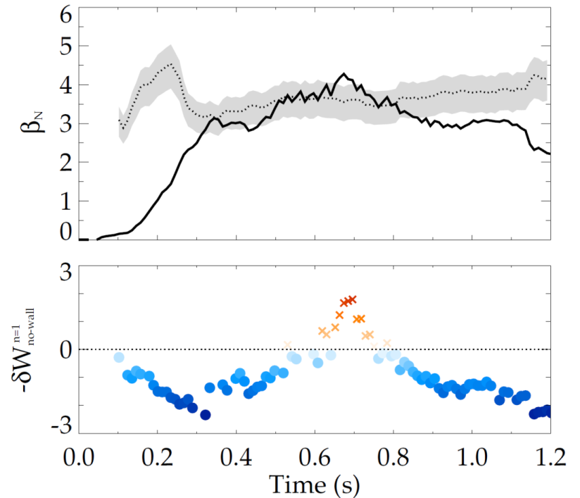
DCON confirms NSTX-U above the no-wall limit;
NSTX-based model gives good estimate
NSTX-U H-mode discharges: 204112
204118 (April 2016)
Composite no-wall limit model
Composite no-wall limit model
DCON
DCON
Above no-wall limit
Above no-wall limit
Below
Below
NSTX no-wall limit model ([J.W. Berkery et al., Nucl. Fusion 55, 123007 (2015)]) includes internal inductance, pressure peaking, and aspect ratio, predicts NSTX-U DCON no-wall limit

