Slide 1



The PPPL Perspective on Ten Year Planning
S. Prager
Princeton Plasma Physics Laboratory

Slide 2
Questions from panel to PPPL
Describe initiatives over the next 5, 10, 15 years that would
enhance PPPL's leadership in ensuring ITER-experiment success.
(2) Describe initiatives over the next 5, 10, 15 years that would inform the FNSF configuration decision (AT, ST, stellarator).
(3) If/when NSTX-U were to close, say in 5 years, 10 years, and 15 years, what would PPPL like to be involved in?
Focus this talk on magnetic fusion,
discover science discussed elsewhere

Slide 3
Our process for selecting initiatives
(in magnetic fusion)
10 year mission
Prepare for a breakout to an energy development program
Strategic objectives
ITER preparation
Steady-state at high performance
Plasma-material interface
Fusion nuclear materials
Selection criteria
Importance to success of fusion
Opportunity for world leadership (realistically)
Innovation
Select initiatives that satisfy the above

Slide 4
The same process can work for the panel
10 year mission
Prepare for a breakout to energy development program
Strategic objectives
ITER preparation
Steady-state at high performance
Plasma-material interface
Fusion nuclear materials
Selection criteria
Importance to success of fusion
Opportunity for world leadership
Innovation
Select initiatives that satisfy the above
Identify activities to start up, activities to ramp down or, where needed, additional review/advisory steps to decide
No need for panel to define
Will discuss assessment of PPPL,
in inverse order

Slide 5
Fusion Nuclear Science Facility
The spherical tokamak offers a size advantage
NSTX-U is essential to determine the physics feasibility of the ST FNSF (second to none in the world)
(see NSTX-U/ST white papers)
QUASAR would provide key information for stellarator consideration as FNSF
PPPL strives to play a lead role in FNSF design and research, independent of configuration

Slide 6
The plasma-material interface
Two approaches : solids (tungsten) and liquid metals
Neither is yet known to work in a reactor
The world program
Strong in tungsten
Only emerging work in liquid metals
Liquid metals could be a breakthrough solution
LM should be studied co-equally with solids, worldwide
Thus LM are a huge opportunity for US world leadership
PPPL plans to have a comprehensive, collaborative program
“atoms to tokamaks,” attack all the issues definitively
A possible game changer for a potential show stopper

Slide 7
Steady-state, high performance plasmas
Stellarators are a mandatory research element to provide steady-state, disruption-absence, high gain
Quasi-axisymmetric stellarators are a mandatory research element for size reduction (and physics understanding)
Large gap in the world stellarator progam:
only two large stellarators, and only one is “optimized”
Therefore, PPPL envisions a future that includes forefront stellarator research

Slide 8
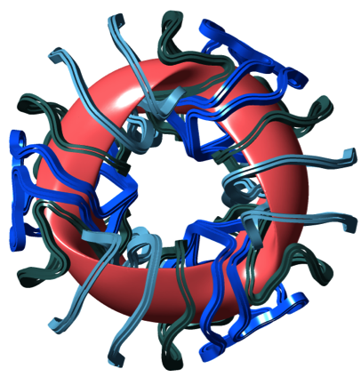
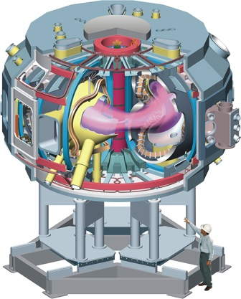
If we build a facility starting in ~ 5 years
QUASAR is ideal – an affordable experiment that would be unambiguously at the world forefront, within a national program
Complex coils completed, toroidal sectors assembled

Slide 9
If we build a facility starting in ~ 5 years
QUASAR is ideal – an affordable experiment that would be unambiguously at the world forefront
Huge international support
J. Li, ASIPP, China: “we would contribute components and staff… to reduce the U.S. costs for NCSX. Staff can include researchers, engineers, on-site assembly labor, etc.” [might reduce construction costs by ~ 30%]
Board of Scientific Directors, IPP, Germany: Quasar would, in our opinion, be the most innovative fusion experiment in the US since many years”
A possible route to reduced-costs:
partnerships on construction ($105M → ~ $80M, excl htng, diag)
can operate NSTX-U and QUASAR for 1.5 x the cost of either op alone
(shared infrastructure and staff; cost-effective opportunity)
(Operating cost increment ~ $30M/yr)

Slide 10
If a new US stellarator can only be built in 10 – 15 years
Design a new stellarator
(e.g., further turbulent transport, simplified coils, optimized divertor……)
Partner internationally to build QUASAR outside the US
(to make use of the NCSX hardware)

Slide 11
ITER preparation
The non-US tokamak facility base is impressive
(JET, ASDEX-U, EAST, KSTAR, WEST, JT60-SA, FT-U…….)
(ITER-like wall, DT, ITER shape, long pulse, high performance….)
PPPL collaborates worldwide, and on DIII-D, C-MOD
NSTX-U contributes substantially to ITER
Through unique ST features
(e.g., robust energetic particle instabilities, EM turbulence)
Through areas where aspect ratio is not important
(e.g., disruption mitigation, PMI studies)
Integrated simulation
  The US can lead (if we move rapidly)

Slide 12
What if the PPPL budget were flat for 10 years?
2015 2020 2025
QUASAR (3 yr const)
or
NSTX-U
NSTX-U (PMI)
Major LM program
Liquid metal research
Prep studies for stellarator and LM programs
Prep studies major next steps in PMI, stellarator, FNSF

Slide 13
A More Sensible Plan
2015 2020 2025
QUASAR (3 yr const)
and
NSTX-U
NSTX-U (PMI)
Major LM program
Liquid metal research
Prep studies for stellarator and LM programs
Prep studies major next steps in PMI, stellarator, FNSF

Slide 14
Summary
The US can contribute at the world forefront if we evolve the program over the next decade
Can be done in an orderly way, maintaining our core capabilities and human resources as facilities change
PPPL’s program is poised to perform at the world forefront for various US fusion futures

