Slide 1
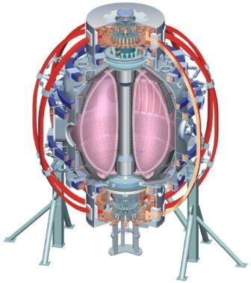
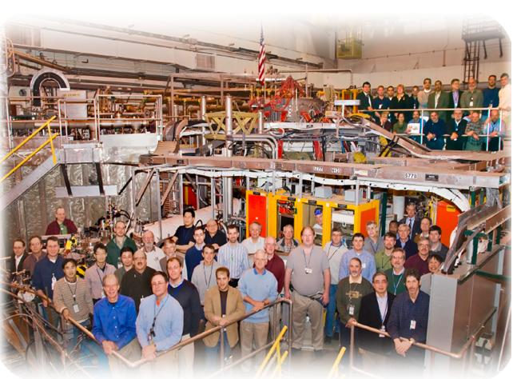

NSTX
Supported by
Spectroscopic Diagnostics for Liquid
Lithium Divertor Studies on NSTX
College W&M
Colorado Sch Mines
Columbia U
CompX
General Atomics
INEL
Johns Hopkins U
LANL
LLNL
Lodestar
MIT
Nova Photonics
New York U
Old Dominion U
ORNL
PPPL
PSI
Princeton U
Purdue U
SNL
Think Tank, Inc.
UC Davis
UC Irvine
UCLA
UCSD
U Colorado
U Illinois
U Maryland
U Rochester
U Washington
U Wisconsin
V. A. Soukhanovskii, LLNL
A. L. Roquemore, R. E. Bell, R. Kaita, H. W. Kugel, PPPL
Culham Sci Ctr
U St. Andrews
York U
Chubu U
Fukui U
Hiroshima U
Hyogo U
Kyoto U
Kyushu U
Kyushu Tokai U
NIFS
Niigata U
U Tokyo
JAEA
Hebrew U
Ioffe Inst
RRC Kurchatov Inst
TRINITI
KBSI
KAIST
POSTECH
ASIPP
ENEA, Frascati
CEA, Cadarache
IPP, Jülich
IPP, Garching
ASCR, Czech Rep
U Quebec
Poster F48

Slide 2
Abstract and Acknowledgements
The NSTX device has been investigating the impact of lithium coatings on graphite plasma facing components for plasma density control. A recently installed liquid lithium divertor (LLD) module has a porous molybdenum surface, separated by a stainless steel liner from a heated copper substrate. Lithium will be deposited on the LLD from two evaporators. Two new spectroscopic diagnostics are installed to study the plasma surface interactions on the LLD: 1) a AXUV diode array for divertor recycling rate measurements in the highly-reflective LLD environment, and 2) an UV-VIS-NIR imaging spectrometer for D I, Li I-III, C I-V, Mo I, D₂, LiD, CD₄ emission and temperature profile measurements on and around the LLD module. The 20-channel diode array is equipped with a 6-nm bandpass filter centered at 121.6 nm (the Lyman-α transition). The spectrometer system includes a divertor viewing achromatic lens, a 50-fiber relay bundle, a R=0.67 m commercial Czerny-Turner spectrograph with 1800, 2400, and 3600 line/mm gratings, and a 512x512 pixel electron-multiplying CCD detector. The use of photometrically calibrated measurements together with atomic physics factors enables studies of recycling and impurity particle fluxes as functions of LLD temperature, ion flux, and divertor geometry.
Supported by the U.S. DOE under Contracts DE-AC52-07NA27344 and
DE-AC02-09CH11466.

Slide 3
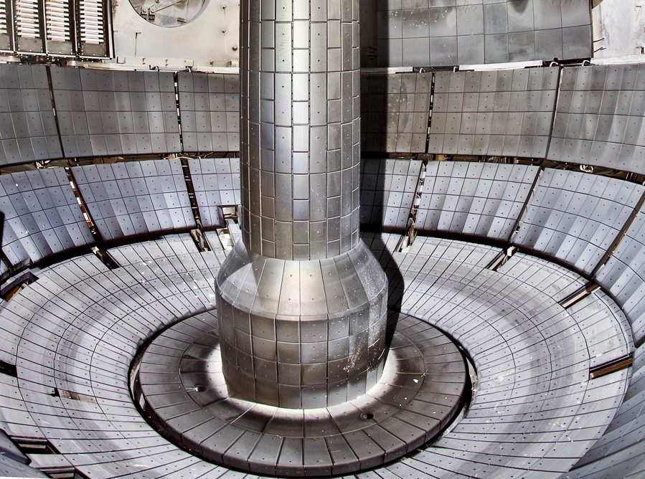
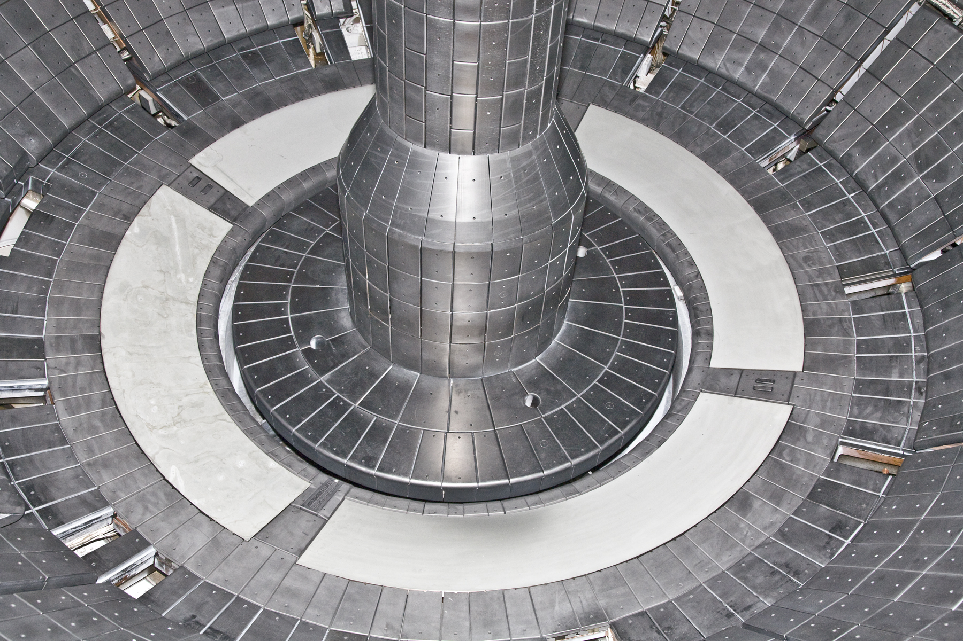
Lithium research program on NSTX focuses on solid and liquid lithium plasma facing components
NSTX plasma facing components
  ATJ and CFC graphite tiles
  Typical divertor tile
  temperature in 1 s pulses
  T < 500 C (q_{peak} ≤ 10 MW/m²)
Liquid Lithium Divertor
  0.165 mm Mo plasma sprayed with 45% porosity, 0.25 mm 316-SS liner, brazed to 2.22 cm Cu substrate
  LLD filling method – lithium evaporators
Lithium pumping
  Through formation of LiD
  Coating can bind D with a full 200-400 nm thickness
LLD

Slide 4
Lithium coatings can affect diagnostic measurements and their interpretation
Degradation of window transmission and mirror reflectivity
  Examples: VIS and NIR measurements
Exposed diagnostic parts
  Examples: Langmuir probes, foil filters, windowless detectors
Change in dynamic range of measured quantities
  Examples: neutral pressure, density, recycling
Effect due to measurement interpretation
  Impact of reflectivity of LLD or Li-coated surfaces on IR thermography, visible spectroscopy

Slide 5
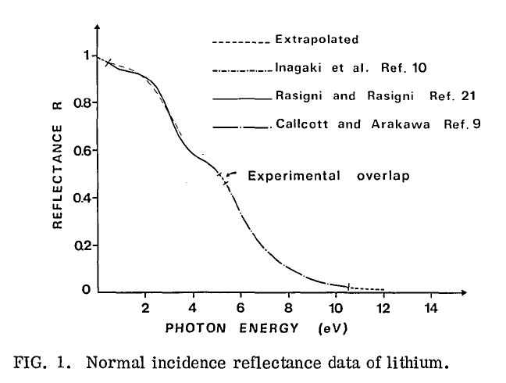

Deuterium Balmer line measurements may be difficult to interpret due to reflections from LLD
D_{α}
D_{β}
D_{γ}
Ly_{α}
Figure from M. Rosigni et al., JOSA 67, 54 (1977)
Shows that reflections for the Balmer lines (α, β, γ) in the visible range are much higher than for the Lyman line λ=121.6 nm (Ly_{α}) in the far UV range

Slide 6
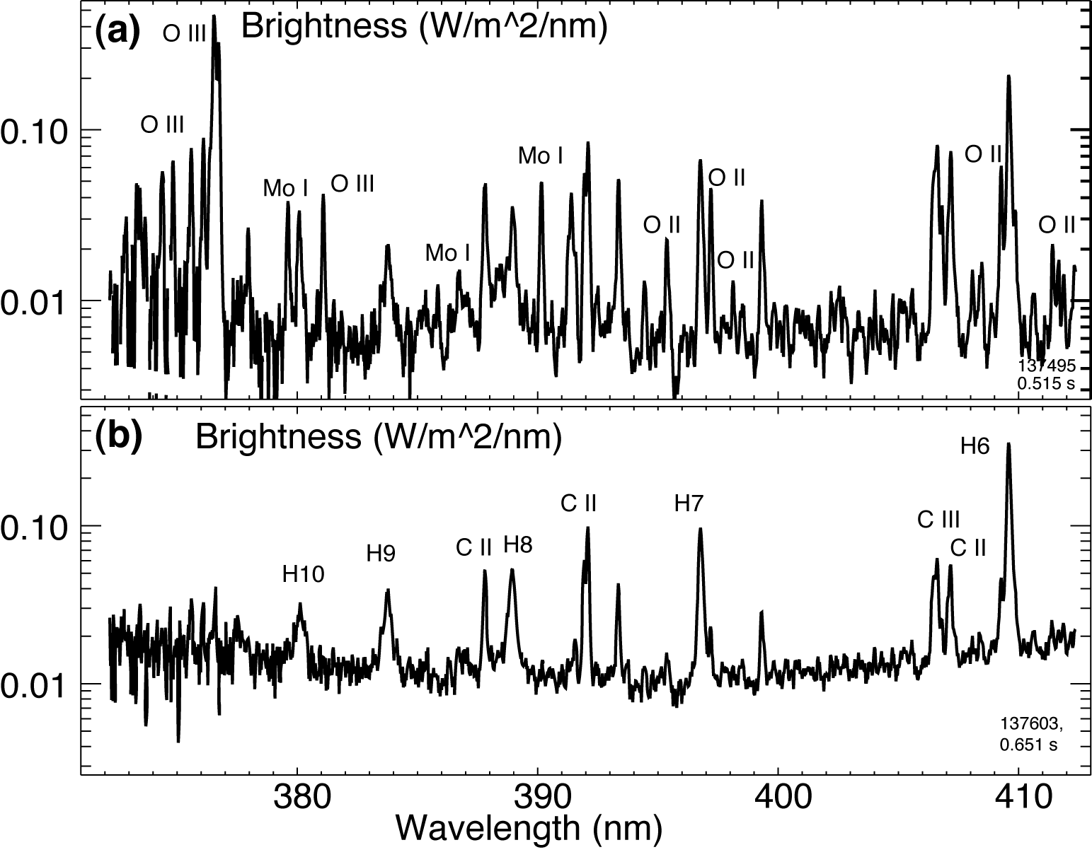
UV spectroscopy to monitor plasma-LLD surface interactions
LLD at room temperature,
3 MW NBI discharge,
Mo I lines observed due to large plasma event hitting LLD
LLD at 320 C,
3 MW NBI discharge,
LiD, O II, O III line intensity reduced, no moly influx
Data from existing UV spectrometer

Slide 7
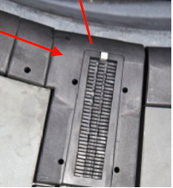
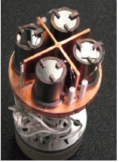
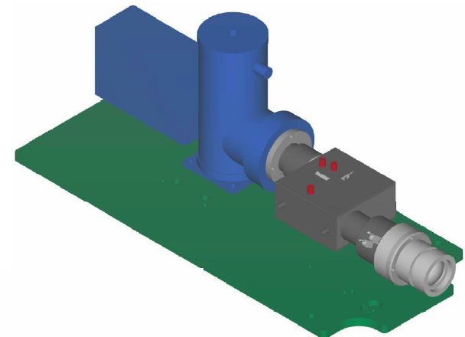
Experiments with lithium require special diagnostics
New LLD diagnostics:
  Two-color IR thermography
  (A. G. McLean, Poster N32)
  Divertor Langmuir probe array
  (M. A. Jaworski, Poster J39;
  J. Kallman, Poster J40)
  Material Analysis and Particle Probe
  Lyman-α diode array (this poster)
  Divertor UV-VIS-NIR imaging spectrometer (this poster)

Slide 8
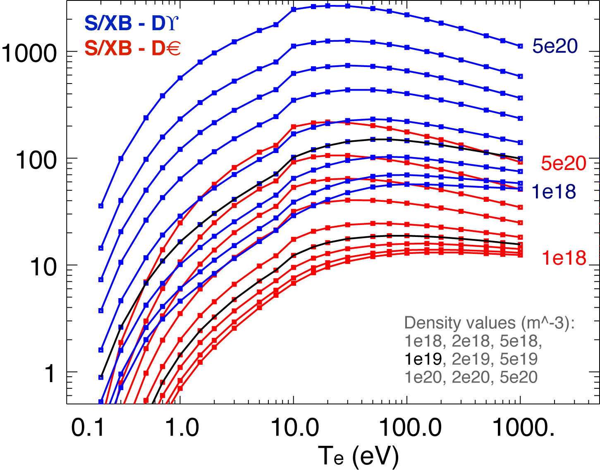
The relationship between lithiated surface conditions and edge and core plasma is studied in NSTX
Study D retention as a function of LLD surface conditions (Li coverage, temperature), divertor T_{e} and n_{e}, strike-point location, and flux expansion
Relate the LLD surface temperature to the measured influx of lithium and hydrogenic species
  Using deuterium recycling measurements
  Assessing D, Li, and C sources from the divertor and Li transport from the plasma edge to the core
D_{β}
D_{α}
Define recycling as R_{local}=Γ_{i}^{out} / Γ_{i}^{in}
  Ion flux into LLD Γ_{i}^{in} measured by Langmuir Probes
  Ion outflux Γ_{i}^{out} estimated from measured D line intensity and S/XB (ionizations/photon) coefficient

Slide 9




S/XB technique is used to estimate particle influx from spectroscopic measurements
Technique originally developed by L. C. Johnson & E. Hinnov, K. Behringer, A. Kallenbach
Used for deuterium and impurities
1D viewing geometry
x1- recycling / erosion boundary, x2 - detector location
Recombination neglected
Excitation and ionization occur in the same volume
Steady-state condition

Slide 10
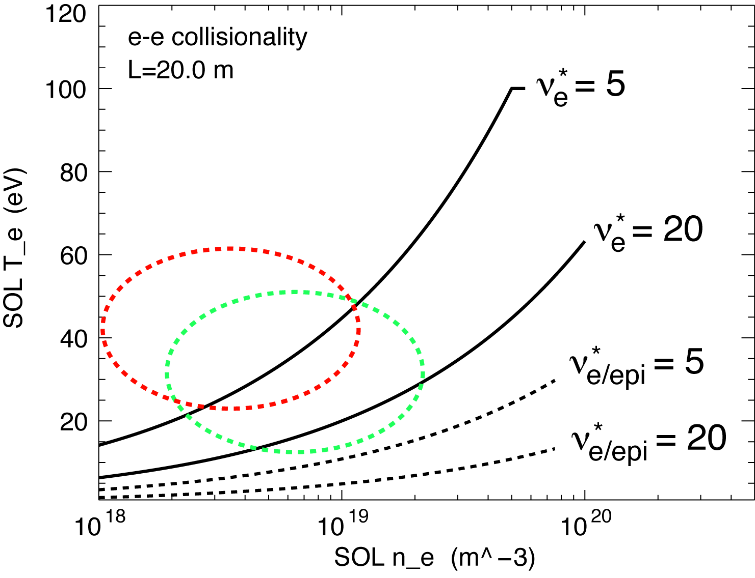
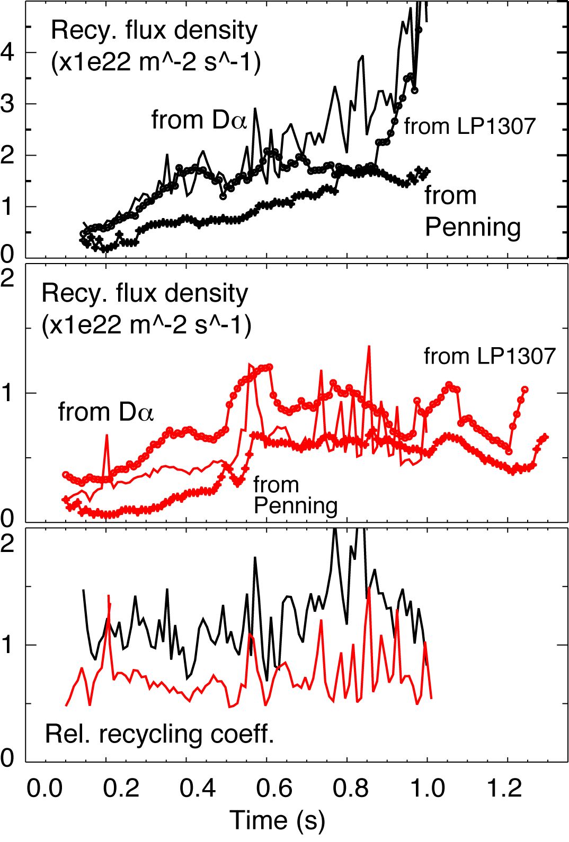
Divertor recycling and SOL collisionality decreased in discharges with lithium coatings
with Lithium
no Li
Transition from conduction-limited (high recycling) regime to low-recycling (sheath-limited)

Slide 11
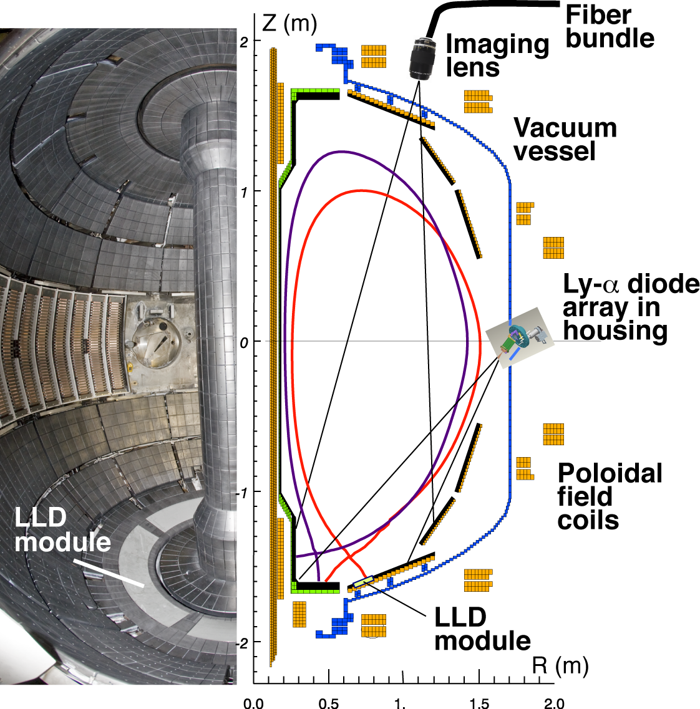
New diagnostics LADA and DIMS are installed on NSTX to enhance spectroscopic studies of LLD
LADA –
Lyman Alpha (Ly_{α}) Diode Array
DIMS –
Divertor Imaging Spectrometer

Slide 12
LADA diagnostic summary
LADA – Lyman Alpha (Ly_{α}) Diode Array
  20-channel AXUV-20EL diode array from IRD Inc.
  Narrow bandpass filter with central wavelength at λ=121.6 nm from Acton Research Corp.
  20-channel trans-impedance amplifier from Clear-Pulse, Inc.
  D-tacq data acquisition module transfers data directly to MDS Plus data server after every shot
  cm-scale resolution in lower divertor, 3-5 channels on LLD
  10-20 kHz time response
  In-vessel installation is required to avoid absorption of vacuum ultraviolet (VUV) emission by air
  Active water cooling of in-vessel filter holder to avoid permanent filter transmission loss occurring at T > 60-70^{O} C

Slide 13
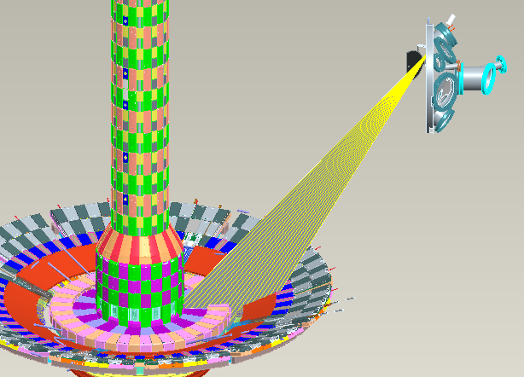
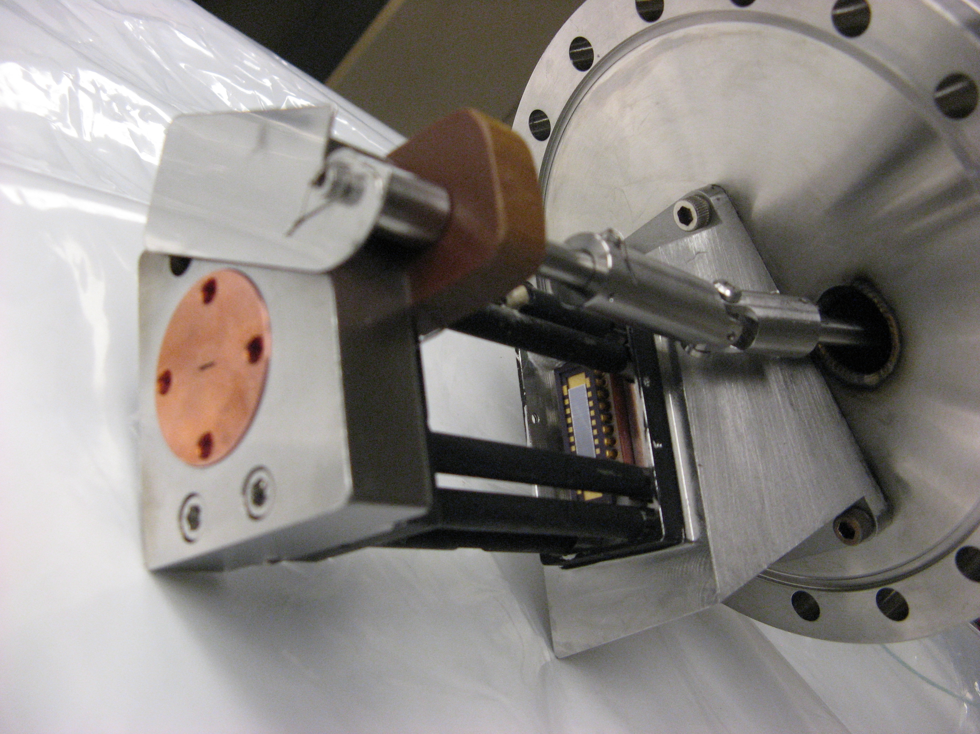
LADA provides 20-chord imaging of lower divertor with 5-6 chords on LLD for recy measurements

Slide 14
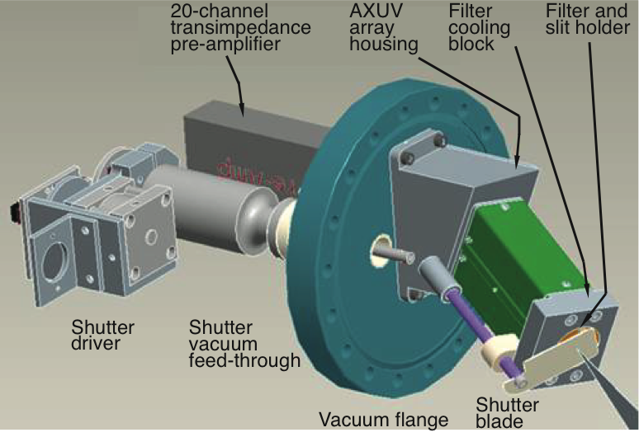
LADA is a filtered pin-hole camera and comprises of mostly in-vessel hardware

Slide 15
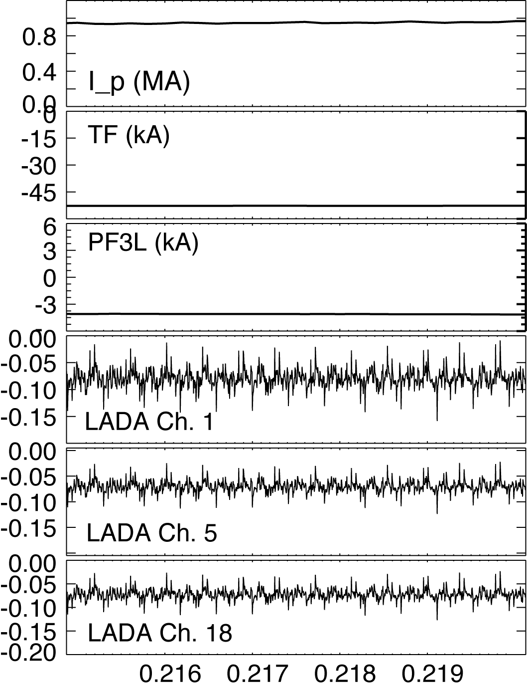
Encouraging background noise data has been collected during initial NSTX operation in 2010
Input parameters
  AXUV diode efficiency at Ly_{α} wavelength - 0.11 A W⁻¹
  Ly_{α} filter transmission - 0.055
  Pre-amp gain - 10⁶ V A⁻¹
  Diode area - 3x10⁻⁶ m⁻² (AXUV-20EL)
  Aperture (slit) area – 2x10⁻⁶ m⁻²
  Etendue - 6x10⁻¹⁰ sr m²
  Ly_{α} brightness - 10³-10⁵ W m⁻² sr
Signal estimates
  From Ly-α − lower bound ~ 0.01 V, upper bound 1-2 V
  Johnson (thermal) noise ~ uV level

Slide 16
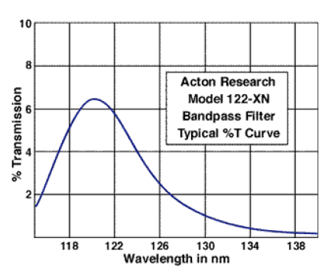
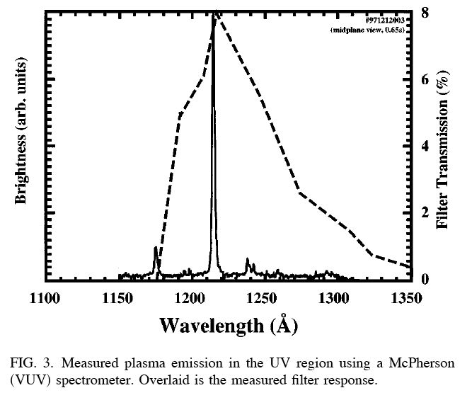
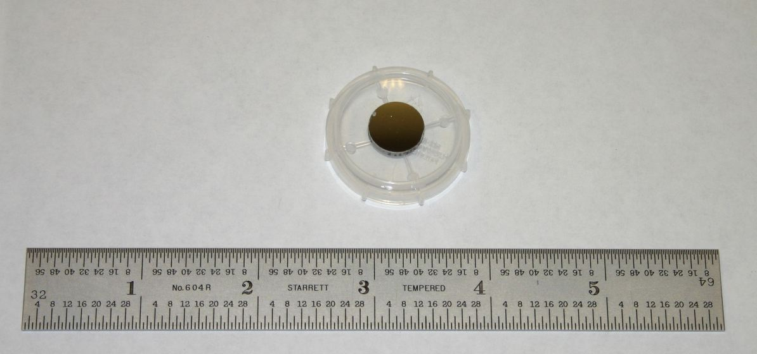
Narrow-bandpass multilayer FUV filter from ARC
Open-faced multilayer transmission filter mounted on MgF₂ substrate
Bandpass is narrow enough to transmit only Ly_{α} light
Practically no impurity (C, O) emission lines within bandpass (e.g. Boivin et. al. RSI 72 (2001) 961

Slide 17
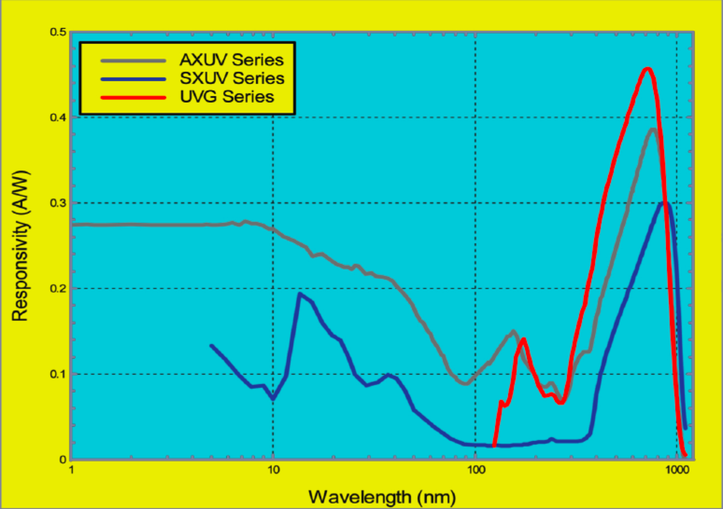
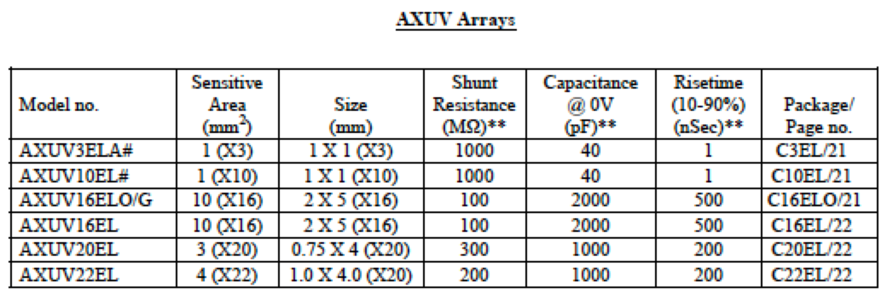
AXUV20EL array

Slide 18
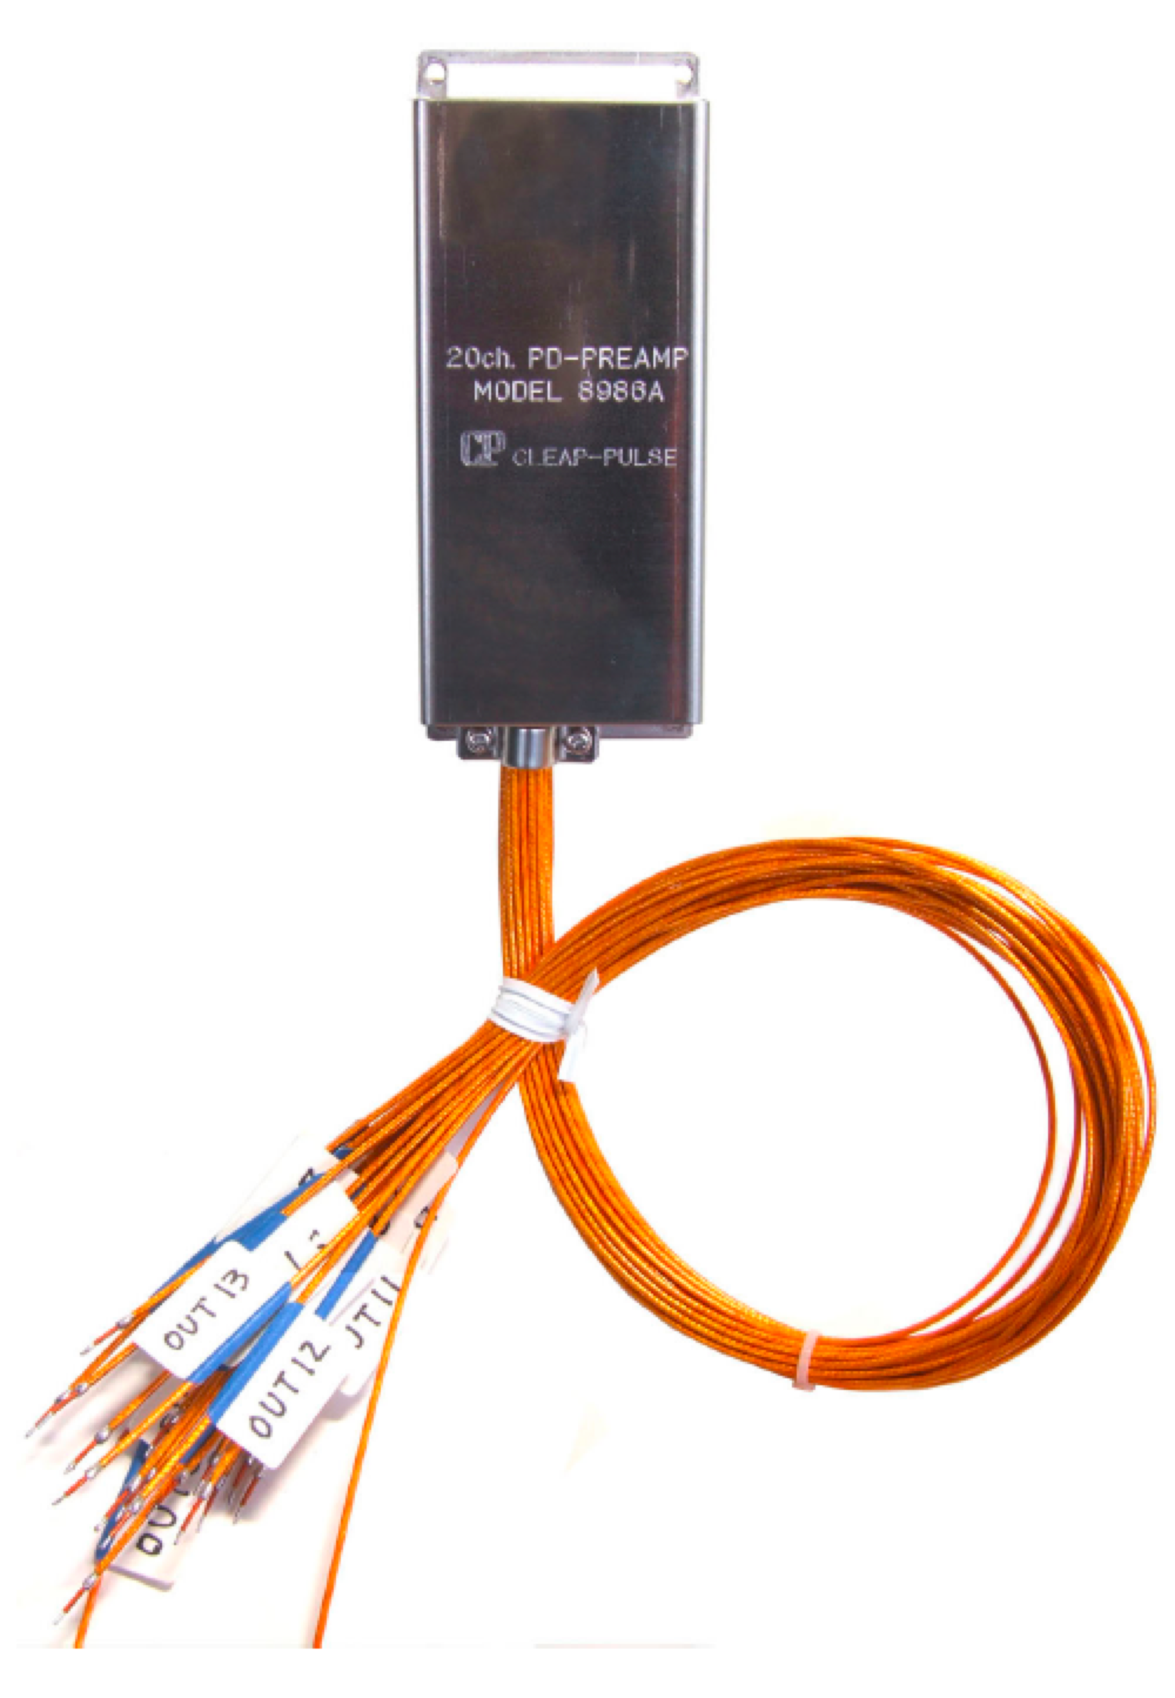
DC-coupled 20-channel pre-amplifier
Clear-Pulse Inc. (Japan)
Model 8986A Pre-amplifier
  20 ch
  Teflon or ceramic sockets
  40 cm Kapton cable
  Gain: 10^6
  10 kHz time response

Slide 19
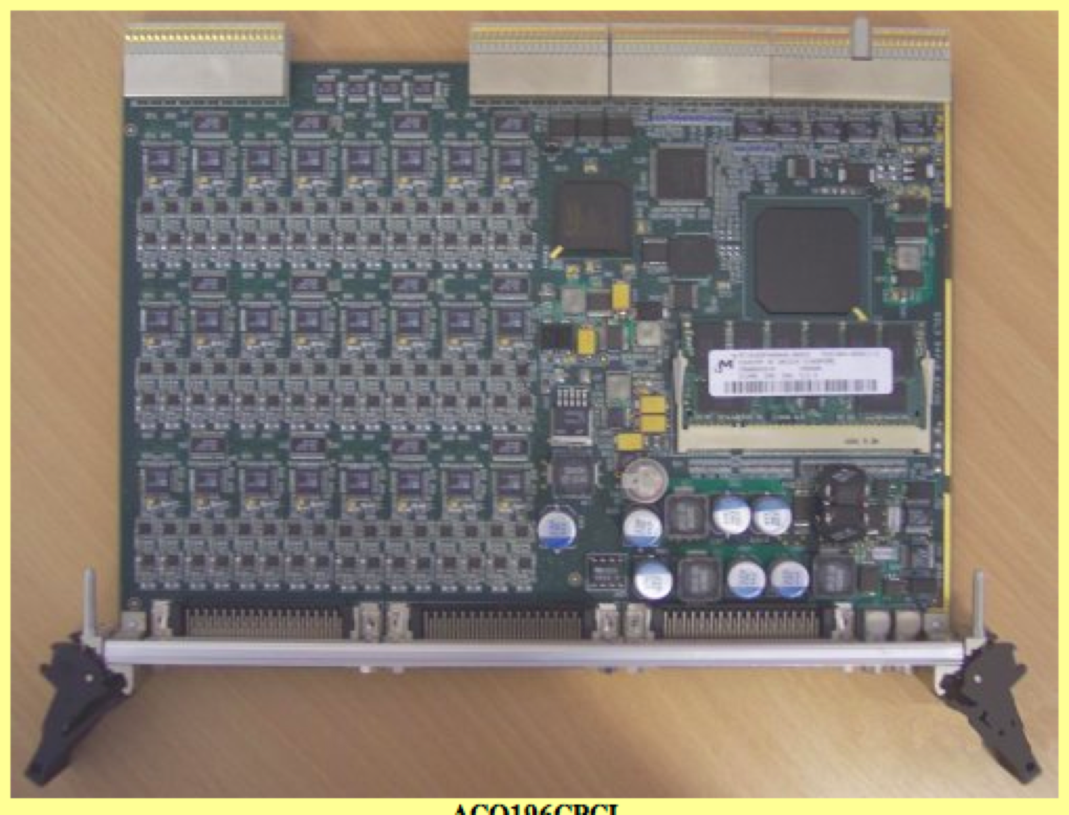
Data acquisition: MDS Plus ready D-TACQ module
Module ACQ196CPCI-96-250
  96 channels
  250 kSPS Simultaneous Digitizer
  16 bit ADC per channel for true simultaneous analog input
  True differential input to each channel
  Plant cable interface to front panel - 3 x SCSI 68 connectors on front panel
  Standalone networked mode
  External clock, trigger, internal clock
  Direct TCP/IP connection to network / to MDS server

Slide 20
DIMS diagnostic summary
DIMS – Divertor Imaging Spectrometer
  Optimized for ultraviolet, visible, and near-infrared high-resolution imaging spectroscopy from 250 nm to 1100 nm
  Tochigi Nikon UV 105mm f/4.5 imaging lens
  50-fiber optical relay bundle, 400-um FBP400 broadband fibers from Polymicro, Inc.
  Two achromatic triplet lenses as input optics
  McPherson Model 207 R=0.67 m f/4.7 spectrograph with aberration-corrected imaging optics
  Three gratings (3600, 2400, 1800 lines/mm) for ultraviolet, visible, and near-infrared line spectra
  Princeton Instruments Pro EM 512 CCD camera
  Expect 18-point divertor profiles with 1 cm spatial resolution, 1-10 ms time resolution

Slide 21
New spectrometer will address high-priority goals in NSTX Boundary Physics research
Divertor source characterization
  Atomic D, Li, C influx profile measurements in divertor
  Molecular sources (D₂, LiD, BD, CD₄, …)
  Atomic Mo, Fe sources for LLD protection
Divertor ion sink characterization
  Electron-ion recombination patterns in divertor (D, He, Li)
  High-n Balmer (and Paschen) series lines for n_{e}, T_{e} estimates
Ion temperature measurements in divertor (based on Doppler broadening) for ion heat transport analysis

Slide 22
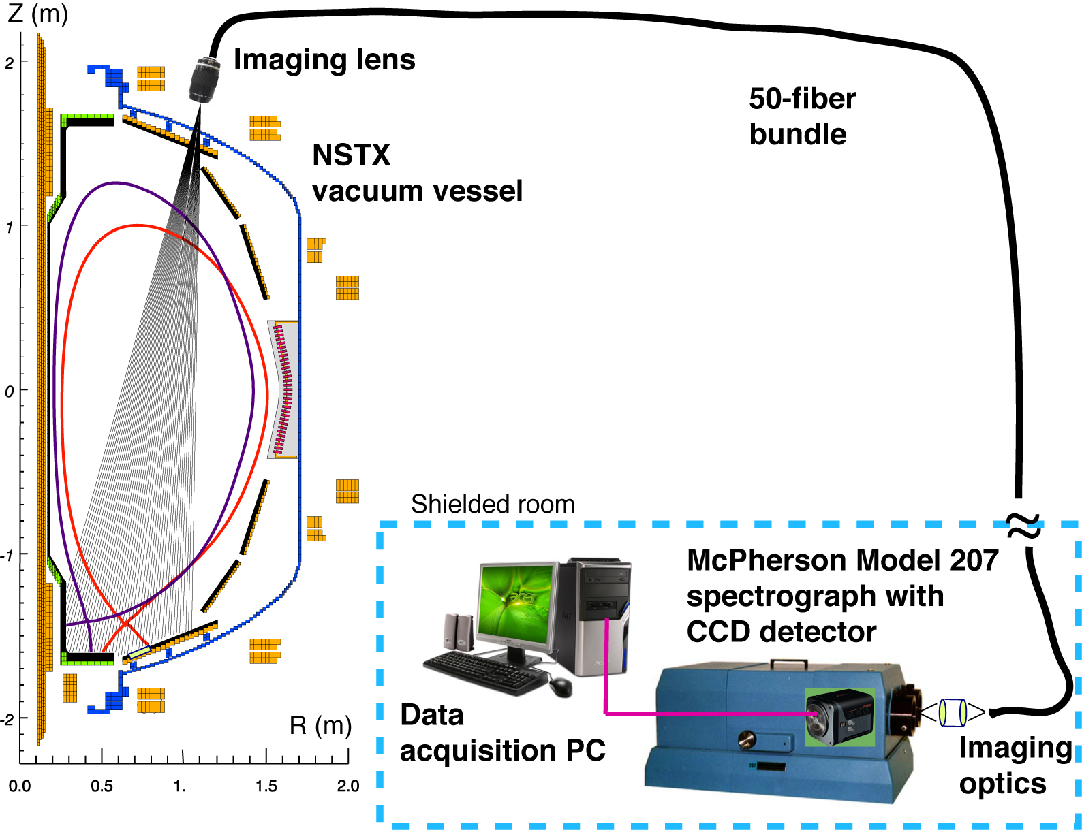
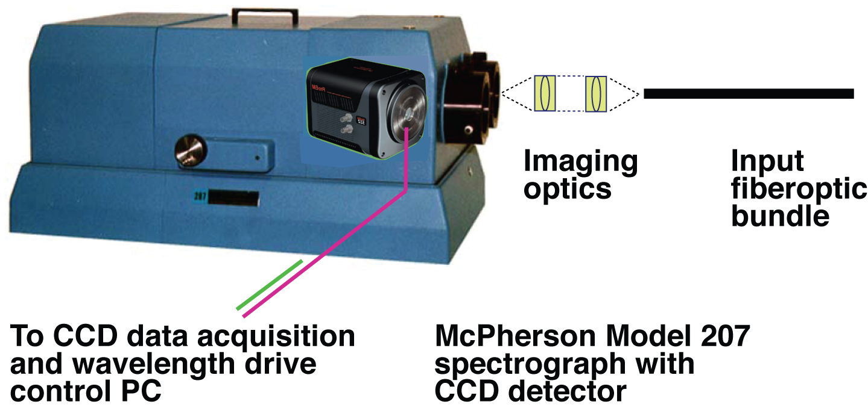
DIMS is places in a remote room shielded from radiation

Slide 23
Conceptual requirements to new spectrometer
Diagnostic requirement | Input optics, including fibers | Spectrograph | CCD camera detector
Full divertor coverage with 1 cm resolution | Long FL imaging lens; Small diameter fibers | Stigmatic, aberration-free imaging of input slit of < 1 cm height | CCD chip height
Broadband spectral coverage 350-1200 (1900) nm | Low attenuation in range | Several gratings | Broadband sensitivity
Temporal resolution 1- 50 ms | Optimized throughput | Largest f/# for given size | Fast readout
High spectral resolution > 0.01 nm | Optimized throughput, imaging of divertor on entrance slit | Large size; 2400-3600 gr/mm gratings | Small pixel size (10-15 um)
High imaging quality | Stigmatic, aberration-free imaging | Stigmatic, aberration-free imaging | Square chip

Slide 24
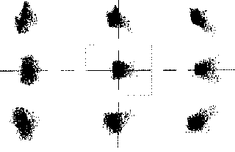
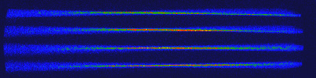
Imaging with McPherson spectrographs
Imaging aberrations: spherical aberration, astigmatism, coma, line curvature
Correcting spherical aberration and astigmatism is self-exclusive
McPherson: introduce a master cylinder correction mirror at one of the side port mirror positions
Ray-tracing: 9 spots at ± 10 mm spatially, ± 13 mm on the dispersion axis, 100 um diameter
Since high quality imaging region is limited, CCD detector can be square, not extended along dispersion axis

Slide 25
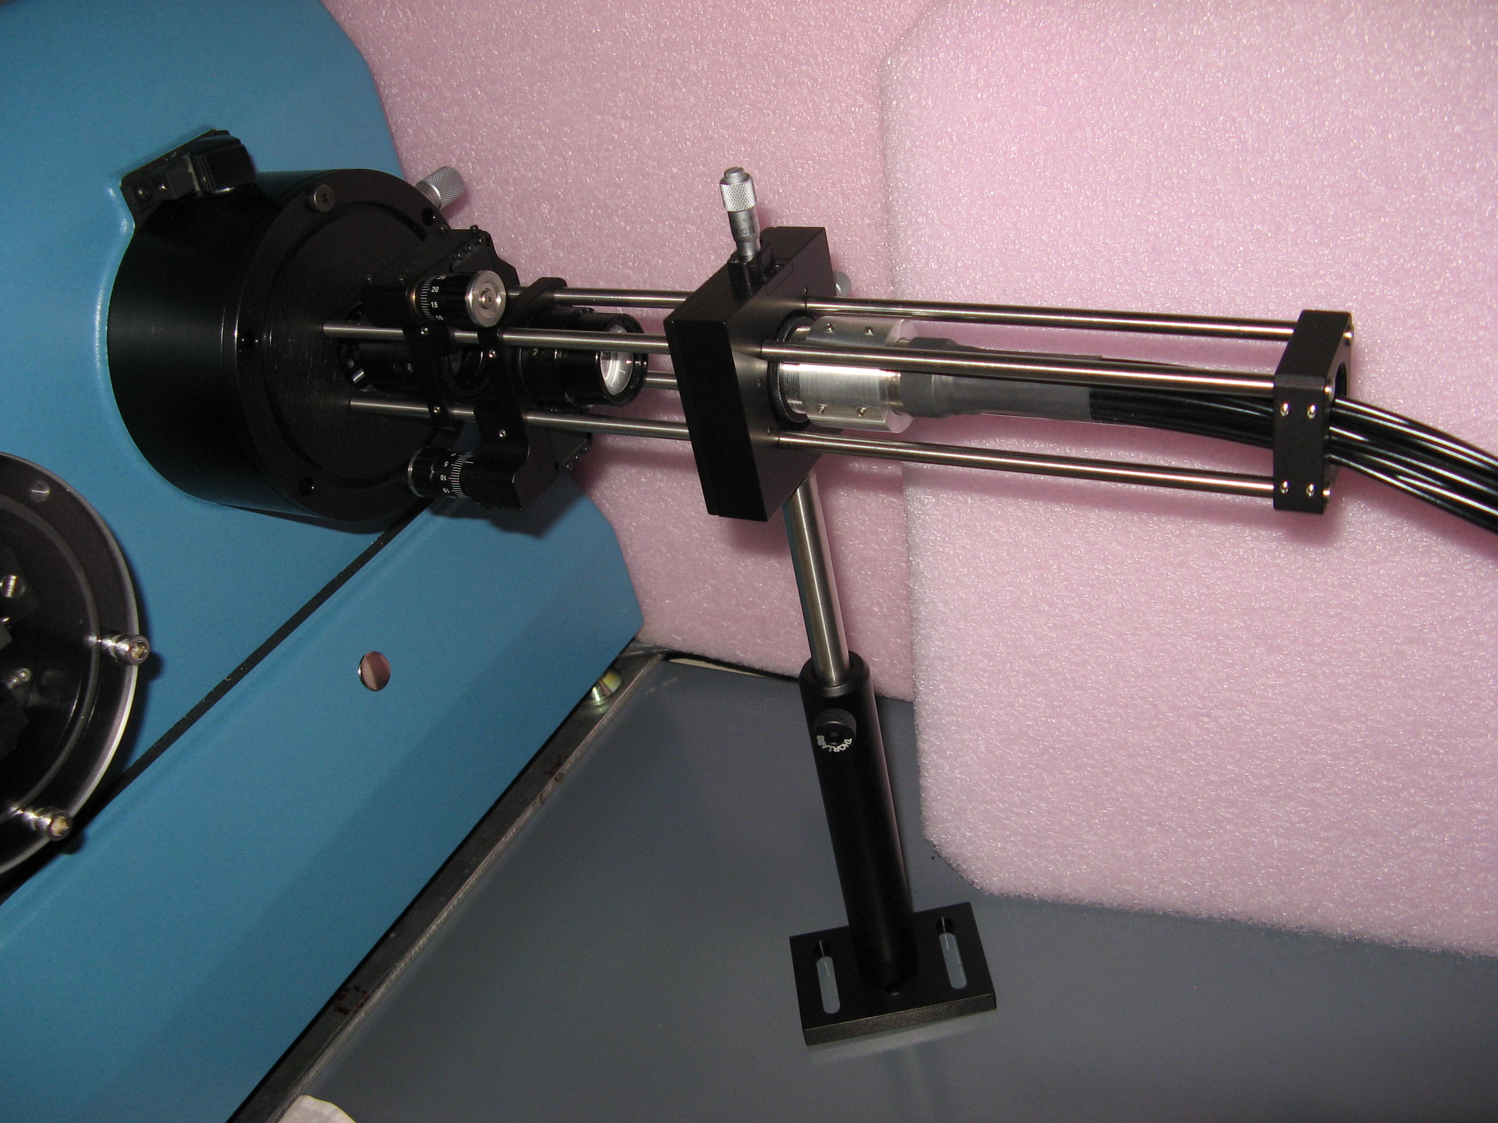
DIMS etendue is optimized by matching F/#’s of all optical components
Lens: F/#2.8 - Fiber: F/#2.3 - Matching optics: F/#2.0 - Spectrograph: F/#4.7

Slide 26
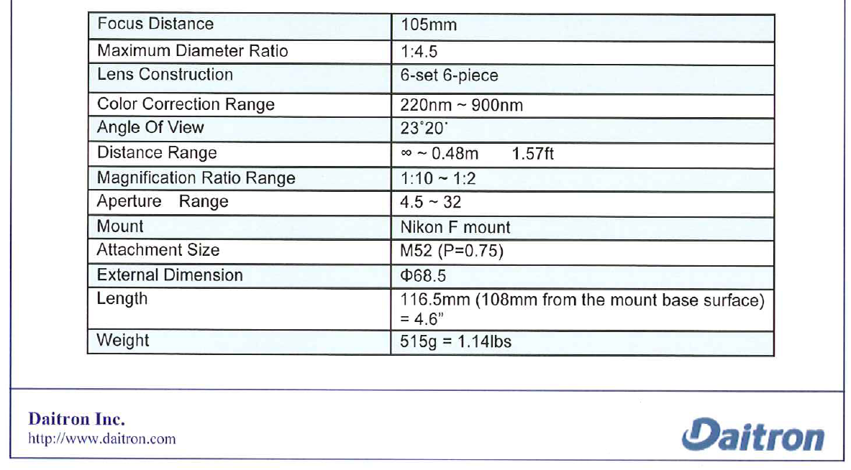
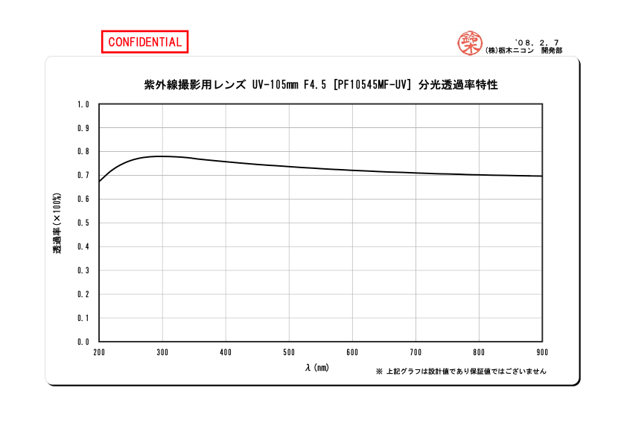
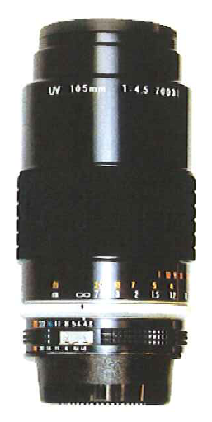
Divertor imaging lens provides achromatic imaging in a broad UV-VI-NIR range
Tochigi Nikon 105mm, f/# 4.5

Slide 27
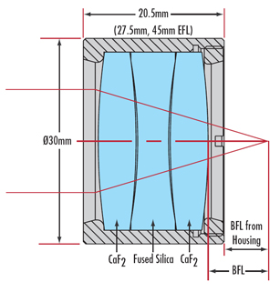
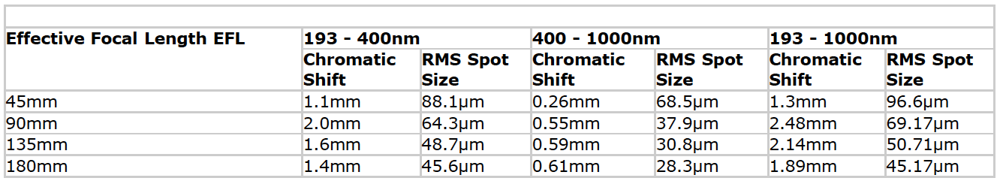
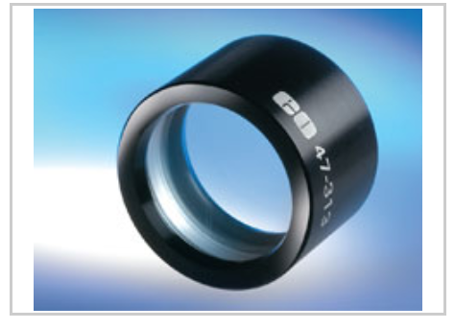
Spectrometer front-end focusing optics comprises two infinity-conjugated achromatic lenses
f=90mm EFL UV-to-NIR Corrected Triplet, Uncoated, Edmunds Optics, Model NT47-311

Slide 28
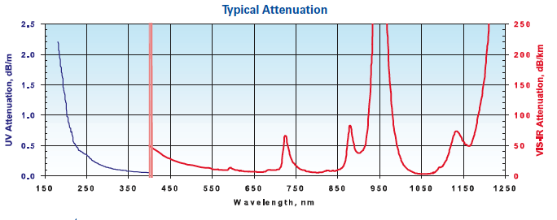
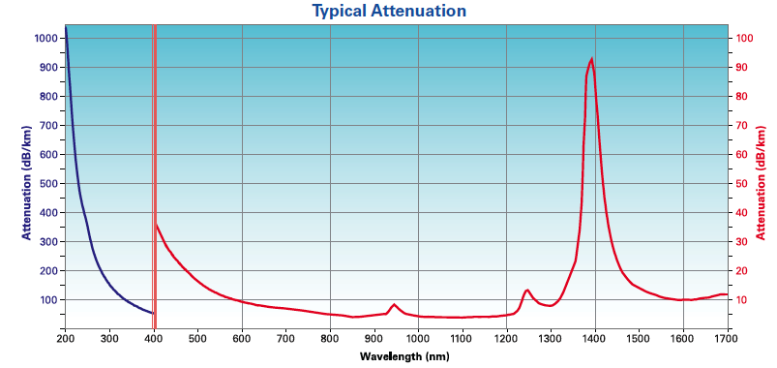
Light relay optical fibers have low attenuation over a broad UV-VIS-NIR range
Polymicro FBP broadband fiber Type FBP400440480
NA=0.22
(f/#=2.27)
Diameter : 400 um core
With Nikon imaging lens, estimated spots on divertor - 1 cm diameter
Silica-silica with high OH
FBP fiber

Slide 29
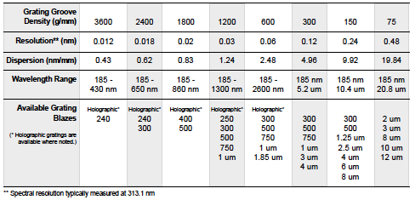
McPherson Model 207 Spectrograph
Highest f/# 4.7 at R=0.67 m in industry
Grating Size 120 x 140 mm
Imaging Optics
Automated wavelength scan
Accuracy 0.05 nm (with 1200-g/mm grating)
Reproducibility ±0.005 nm (with 1200-g/mm grating)
Entrance slit height 2-20 mm, entrance slit width 5-4000 um

Slide 30
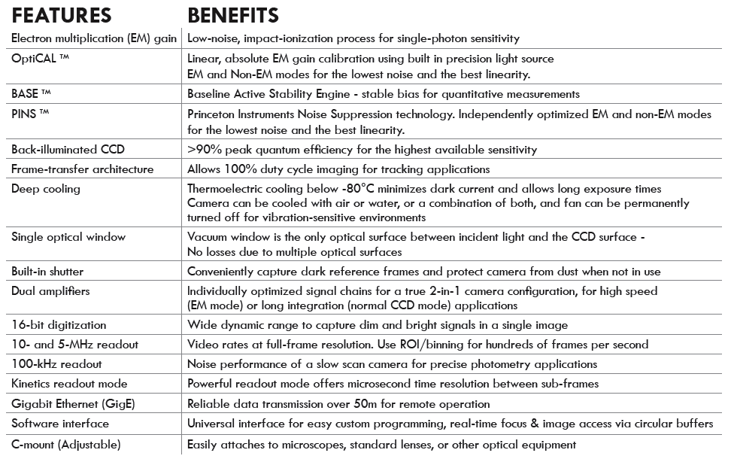
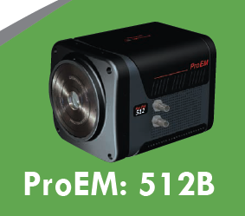
Princeton Instruments Pro EM 512 CCD camera

Slide 31
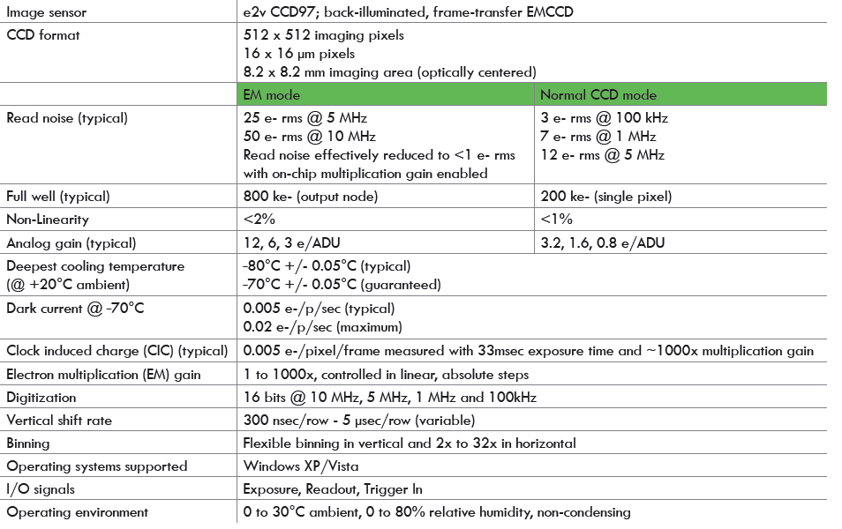
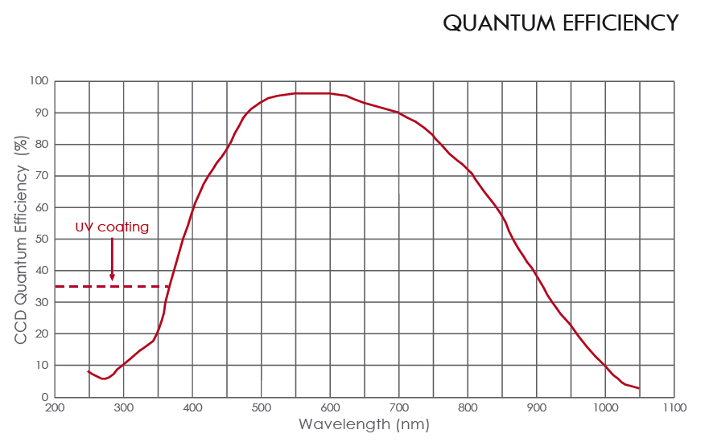
Princeton Instruments Pro EM 512 CCD camera

Slide 32
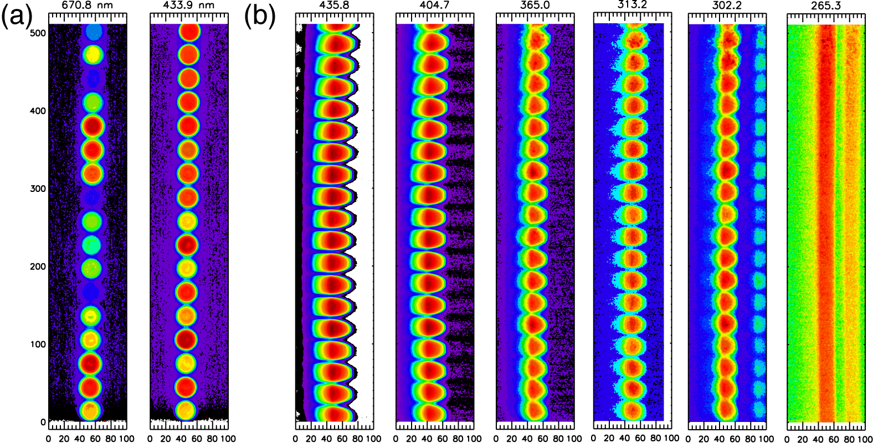
Initial laboratory tests show excellent imaging properties over broad spectral range
(a) Test of front optics at two λ, (b) Tests of Hg-lamp imaging with at six λ

Slide 33

Doppler spectroscopy
Maxwellian distribution of atom (ion) velocities lead to a Gaussian shape of projection on line of sight
FWHM is related to temperature
When ions charge-exchange with neutrals (e.g. D), neutral temperature is close to ion temperature
Large variety of D, He, Li neutral and ion lines in UV, VIS, and NIR
Based on PI ProEM CCD, 4 pixels 16 um each, FWHM of one instrumental line takes 64 um, or 0.064 mm
With given McPherson 207 spectrograph imaging quality and dispersion, FWHM of Doppler broadened line must exceed 0.064 mm on the detector

Slide 34
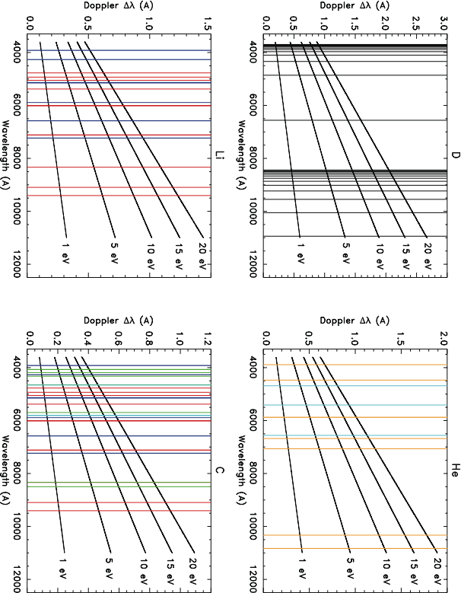
McPherson 207 with 3600 g/mm grating and
Pro EM 512 CCD will have 0.027 nm instr. line
35 A on CCD chip

Slide 35
McPherson 207 with 1200 g/mm grating and
Pro EM 512 CCD will have 0.08 nm instr. line
100 A on CCD chip

