Slide 1






Supported by
Diagnostic options for radiative divertor feedback control on NSTX-Upgrade
V. A. Soukhanovskii
S. P. Gerhardt, R. Kaita, A. G. McLean, R. Raman
and the NSTX Research Team
Coll of Wm & Mary
Columbia U
CompX
General Atomics
FIU
INL
Johns Hopkins U
LANL
LLNL
Lodestar
MIT
Lehigh U
Nova Photonics
ORNL
PPPL
Princeton U
Purdue U
SNL
Think Tank, Inc.
UC Davis
UC Irvine
UCLA
UCSD
U Colorado
U Illinois
U Maryland
U Rochester
U Tennessee
U Tulsa
U Washington
U Wisconsin
X Science LLC
Culham Sci Ctr
York U
Chubu U
Fukui U
Hiroshima U
Hyogo U
Kyoto U
Kyushu U
Kyushu Tokai U
NIFS
Niigata U
U Tokyo
JAEA
Inst for Nucl Res, Kiev
Ioffe Inst
TRINITI
Chonbuk Natl U
NFRI
KAIST
POSTECH
Seoul Natl U
ASIPP
CIEMAT
FOM Inst DIFFER
ENEA, Frascati
CEA, Cadarache
IPP, Jülich
IPP, Garching
ASCR, Czech Rep
Poster P.6.18
19th Topical Conference High-Temperature Plasma Diagnostics Monterey, CA, May 6-10, 2012

Slide 2
Outline - Developing real-time radiative divertor feedback control for NSTX-U
Impurity-seeded radiative divertor technique is one of the leading candidates to mitigate divertor heat flux in NSTX-U discharges
  Unmitigated 20-30 MW/m² peak heat fluxes predicted
Radiative divertor feedback control being developed for NSTX-U
  Proportional, integral, derivative process controller to be used in digital plasma control system
  Fast piezoelectric valve is the actuator
    Gas flow rate is proportional to control voltage
  Control signal diagnostics for divertor detachment identification and control (System ID) are discussed in this poster
    Divertor ID diagnostics
      IR thermography
      Thermoelectric current
      Impurity VUV spectroscopy and bolometry
      Neutral gas pressure
      Electron-ion recombination rate via UV/NIR spectroscopy
    Pedestal ID diagnostics

Slide 3
Abstract
A radiative divertor technique is used by present day tokamak experiments and planned for ITER to mitigate high heat loads on divertor plasma-facing components to prevent their excessive erosion and thermal damage. The radiative divertor uses induced plasma volumetric power and momentum losses to reduce heat and particle flux density on divertor target plates. Extrinsically seeded deuterium or impurity gases have been employed to control divertor parameters in several tokamak experiments via a real-time feedback control of the gas seeding rate, providing design guidelines for the radiative divertor control system in ITER [1].
In the National Spherical Torus Experiment (NSTX), a medium-size spherical tokamak with lithium-coated graphite plasma-facing components (PFC) and high divertor heat flux (q_{peak} ≤ 15 MW/m², q|| ≤ 200 MW/m² [2]), radiative divertor experiments employed deuterium, methane, and neon preprogrammed gas injections. A significant reduction of divertor peak heat flux simultaneously with good core H-mode confinement has been demonstrated [3]. In the NSTX-U device, steady-state peak divertor heat fluxes are projected to 20-30 MW/m² [2]. In this work we use NSTX radiative divertor results to analyze diagnostic options applicable to NSTX-U for real-time feedback control of divertor heat flux.
The divertor detachment process is device-specific w.r.t. seeding gas species, radiating impurity, and onset parameters, albeit universally measured signatures such as reduction of divertor q_{peak}, increase in divertor n_{e} and decrease in T_{e} to below 2-3 eV, increase in P_{rad}, reduction of particle flux density and increase in recombination rate. Characteristic detachment onset time and spatial extent define diagnostic requirements to the control signal: the time resolution 5-10 ms and the spatial resolution of 1 cm. Two-dimensional coverage might be desirable. Based on the NSTX divertor detachment signatures [3], we identify three categories of diagnostics that can be used for control signals: 1) PFC diagnostics (e.g., surface temperature, impurity influx measurements); 2) divertor plasma diagnostics (e.g., radiated power, impurity spectroscopy, neutral or impurity gas pressure, ion flux, divertor T_{e} and n_{e}, ion recombination measurements); 3) scrape-off layer and pedestal diagnostics (e.g., monitoring MARFEs or pedestal degradation signs). These radiative divertor signatures are analyzed for uniqueness and ranked in utility. Once the control signal is unambiguously linked to the radiative divertor state identification, it can be fed into a real-time plasma control system that uses an algorithm (e.g., the proportional-integral-derivative controller) to compare the control signal to the set value, quantify the difference, and feedback on the control signal using impurity seeding as an actuator.
[1] ITER Physics Expert Group on Divertor, Nucl. Fusion 39 (1999 ) 2391; Nucl. Fusion 47 (2007) 8203
[2] T. K. Gray et al., J. Nucl. Mater. 415 (2011) S360
[3] V. A. Soukhanovskii et al., Phys. Plasmas 16 (2009) 022501; Nucl. Fusion 49 (2009) 095025

Slide 4
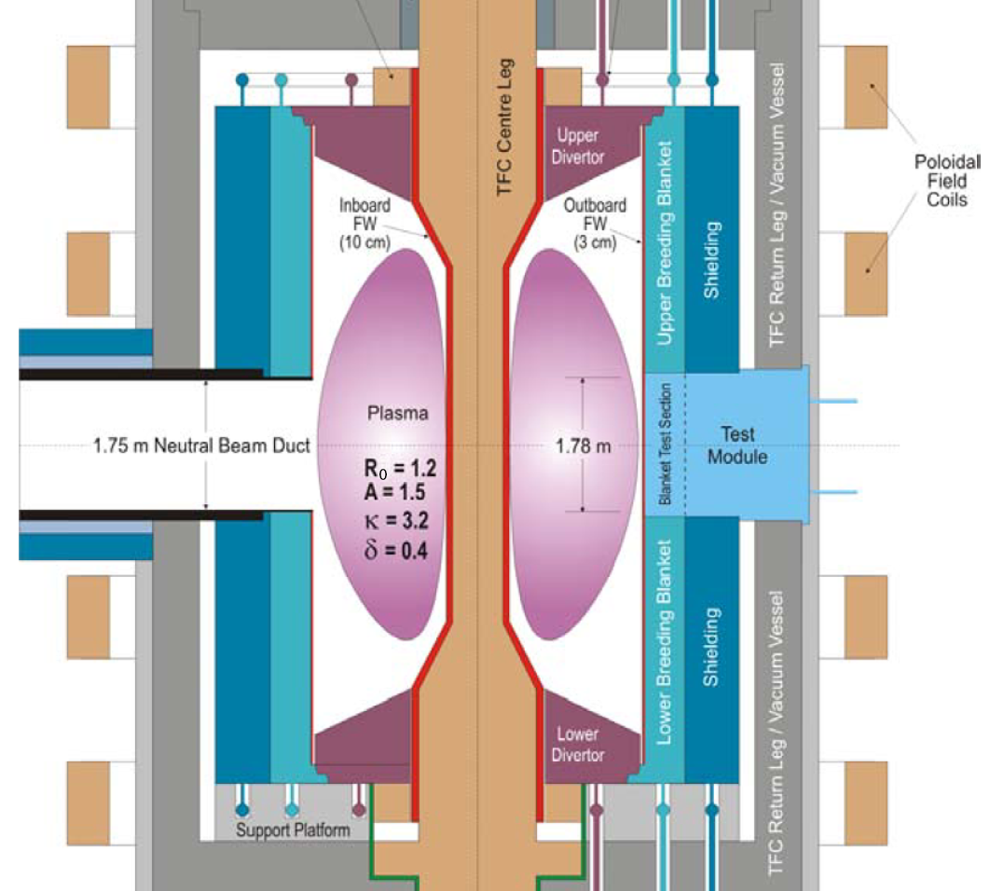

Divertor heat flux mitigation is key for present and future fusion plasma devices
Radiative divertor is envisioned for
present and future devices (e.g. ITER, ST-FNSF) as the steady-state heat flux mitigation solution
  Divertor q_{peak} < 10 MW/m²
  Large divertor radiated power fractions
  (f_{rad} = 0.50 - 0.80)
  Integration with pedestal and core
  Partial divertor strike point detachment is the
  most promising regime
Peng et al, PPCF 47, B263 (2005)

Slide 5
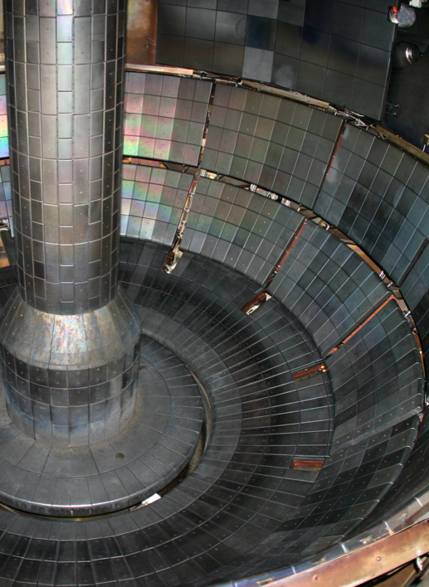
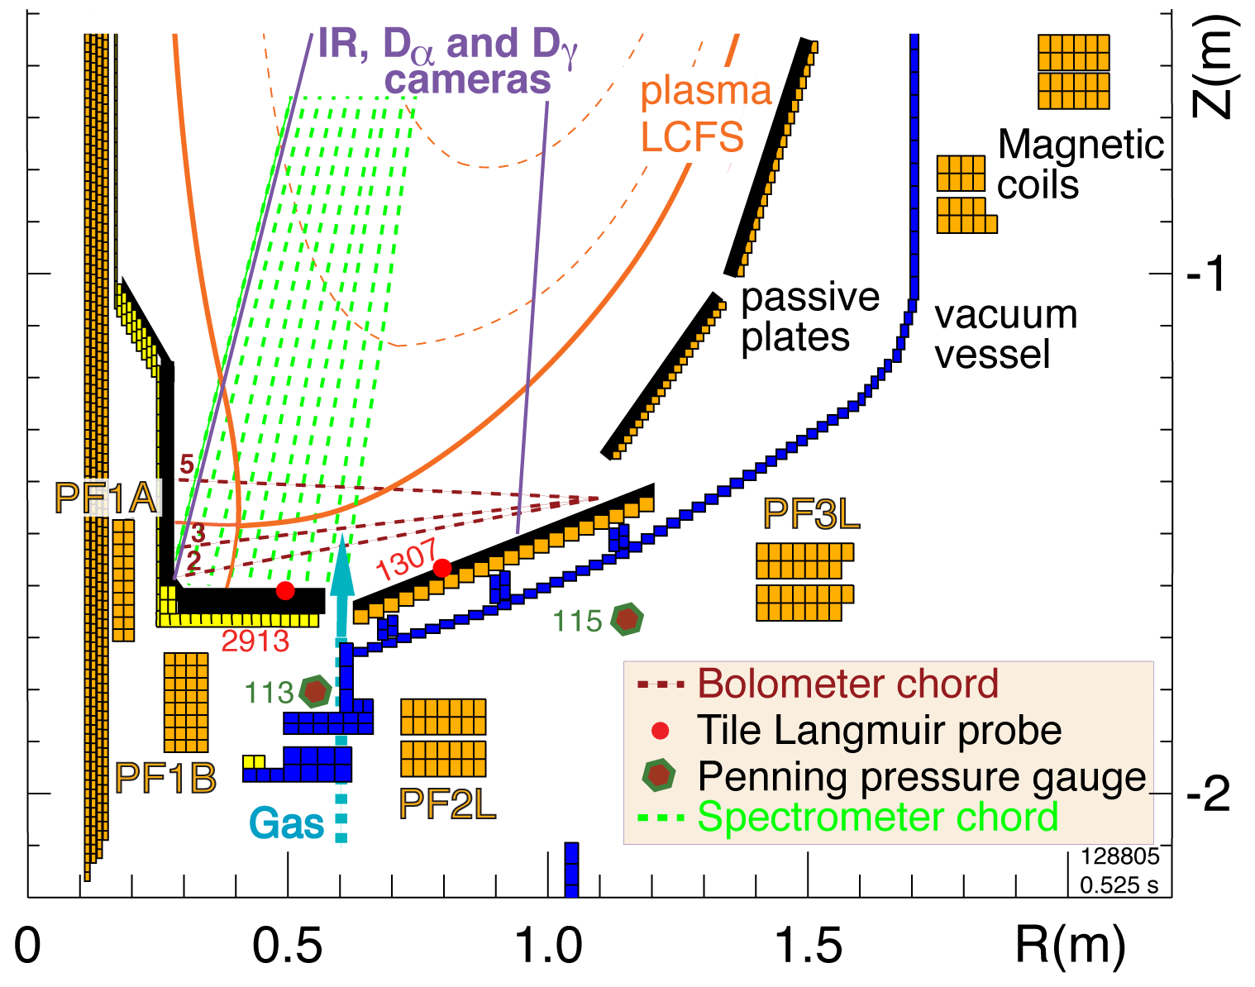
Multiple diagnostic measurements were needed to elucidate on radiative divertor physics in NSTX
Plasma facing components
  ATJ and CFC tiles, lithium coatings
  Max P_{rad} fraction limited by impurity radiation efficiency (Li, C)
  Typical divertor tile temperature in 1 s pulses T < 500 C (q_{peak} ≤ 10 MW/m²)

Slide 6
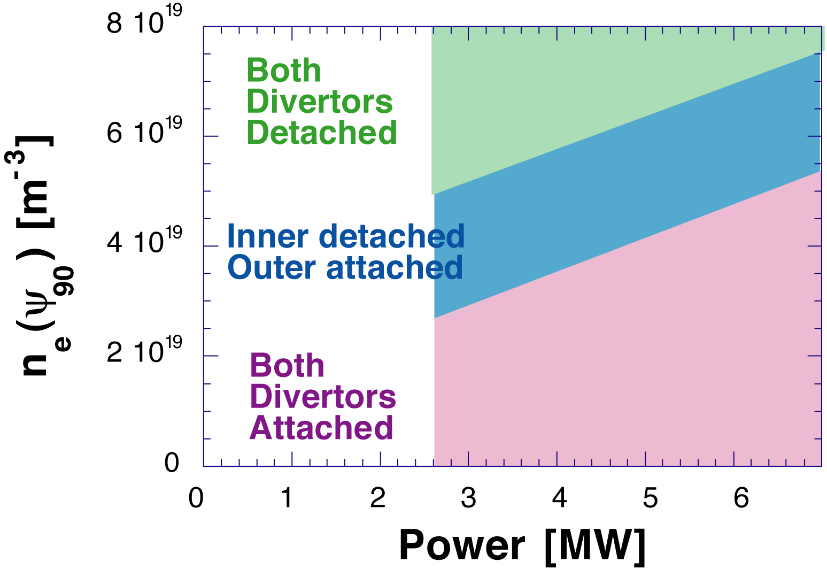
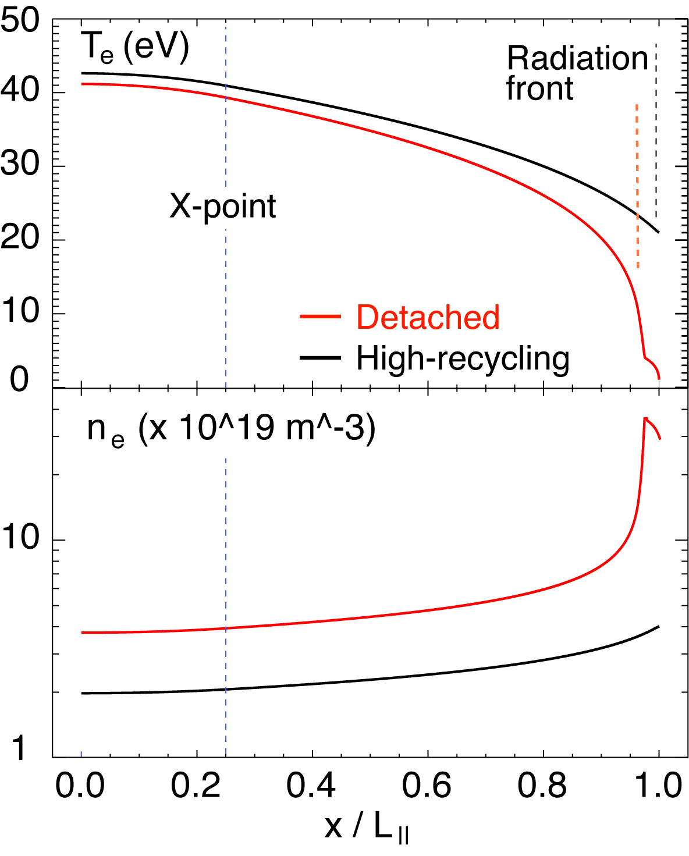

Models used to simulate detachment operation space and divertor plasma parameters during detachment
G. Porter
N. Wolf
Operating space P_{in}, n_{e}
UEDGE calculations predicted limited “window” of outer divertor strike point detachment
Radiation from intrinsic carbon at 3-5 %
5-zone 1D SOL model predicts typical T_{e} and n_{e} in NSTX during detachment
High f_{rad} ~0.8-0.9 used for detachment simulation
SOUKHANOVSKII, V. et al., Phys. Plasmas 16 (2009) 022501,
SOUKHANOVSKII, V. et al., J. Nucl. Mater. 363-365 (2007) 432.

Slide 7
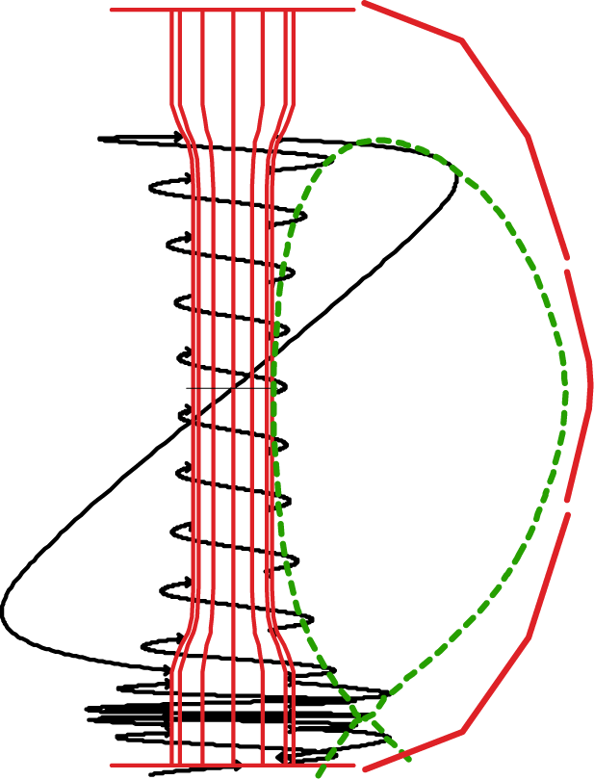
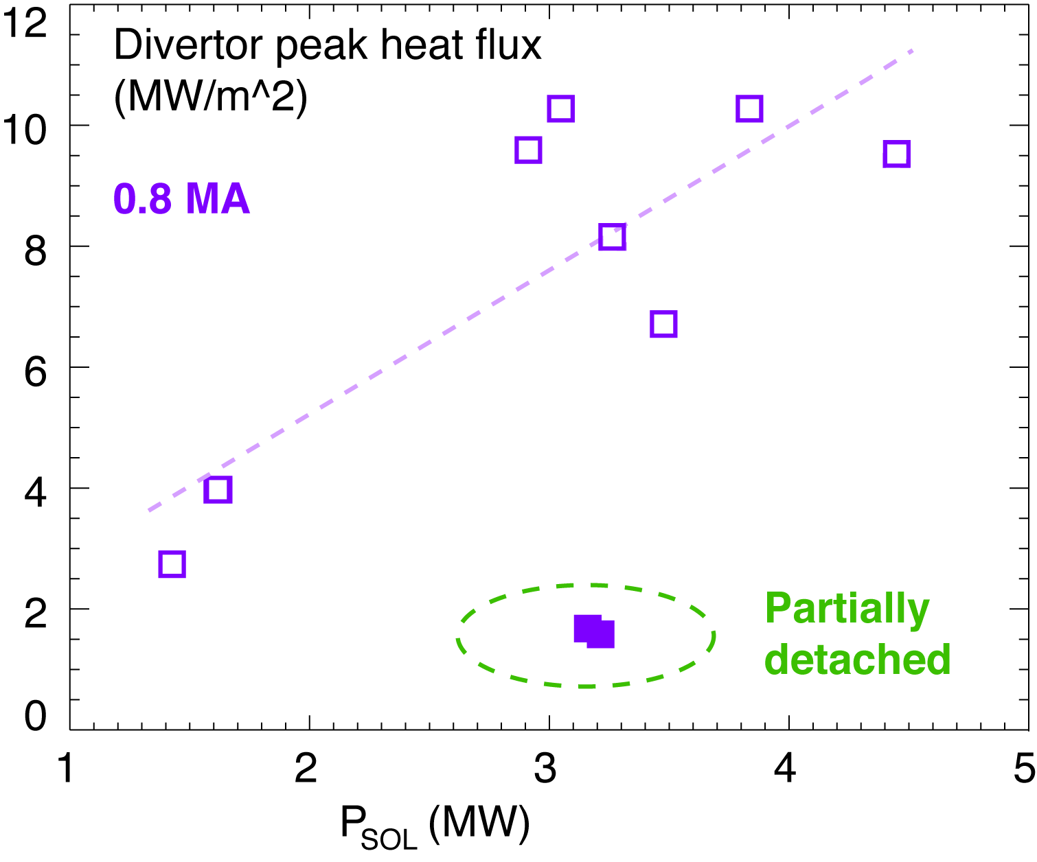
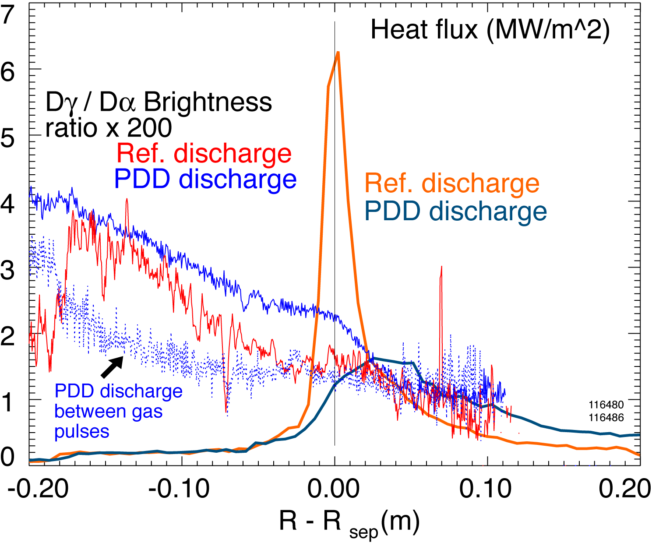
Radiative divertor experiments using low κ, δ configuration showed q_{peak} reduced albeit with confinement degradation
Peak heat flux in outer divertor:
  ITER-level q_{out}< 10-15 MW/m²
  Scaling of q_{peak}: linear with P_{sol} (P_{NBI}), linear-monotonic with I_{p}
  Large q_{peak} asymmetry - 2-10; inner divertor always detached
Experiments using D₂ injection:
  q_{peak} reduced by up to 60 % in transient detachment regime
  X-point MARFE degraded confinement within 2-3 x τ_{E}
GRAY, T. et al., J. Nucl. Mater. 415 (2011) S360,
SOUKHANOVSKII, V. et al., IAEA FEC 2006

Slide 8
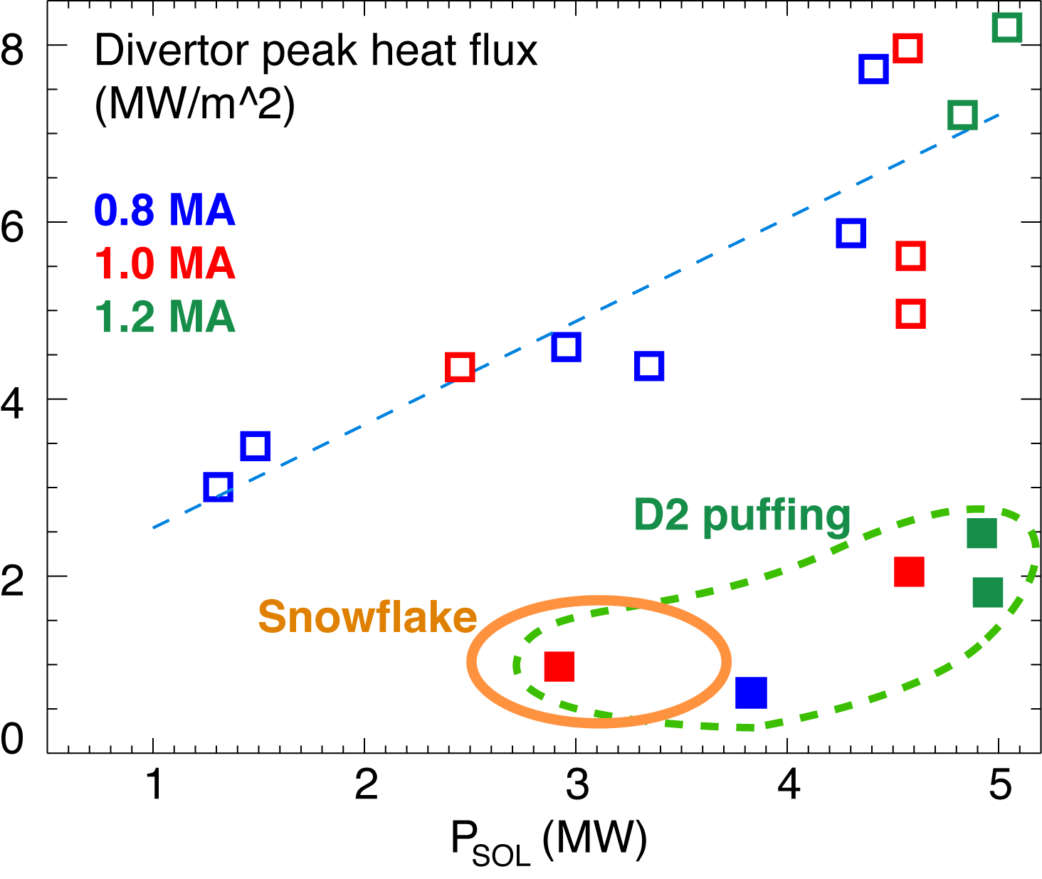
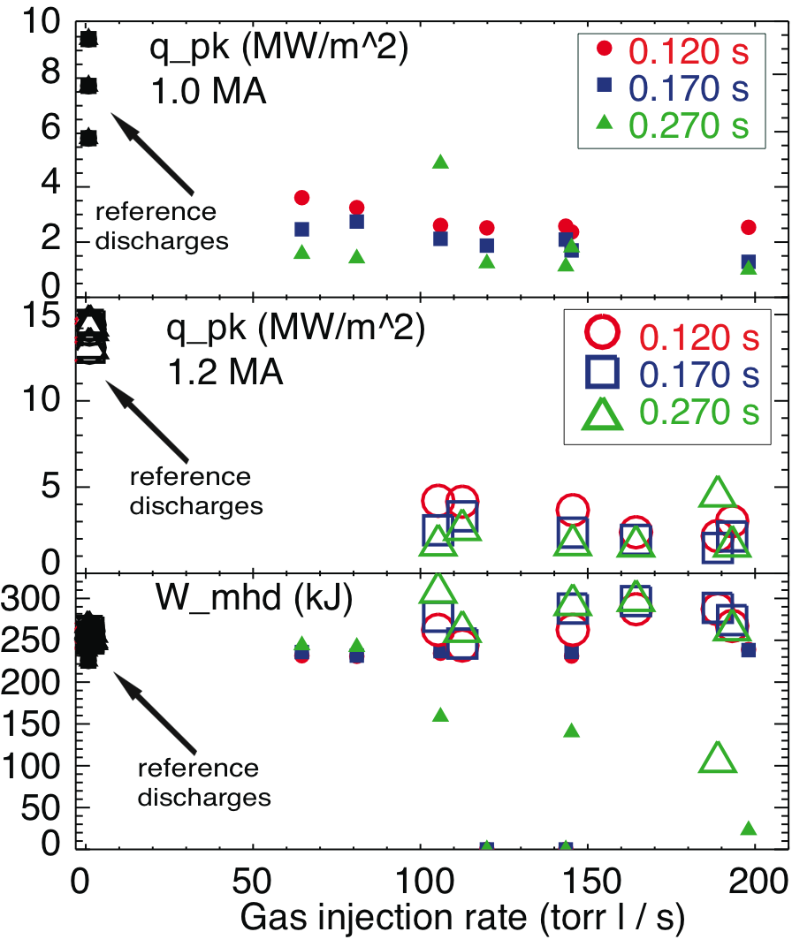
Good core plasma performance and significant q_{peak} reduction obtained in high κ, δ detached divertor
Experiments conducted in 0.8-1.2 MA 4-6 MW NBI-heated H-mode discharges with κ=2.2-2.3, δ=0.6-0.75
Obtained partially detached divertor outer strike point using divertor D₂ injection; P_{rad} due to intrinsic carbon
q_{peak} reduced by 60 - 80 % with min. confinement degradation
SOUKHANOVSKII, V. et al., Phys. Plasmas 16 (2009) 022501,
SOUKHANOVSKII, V. et al., Nucl. Fusion 49 (2009) 095025

Slide 9
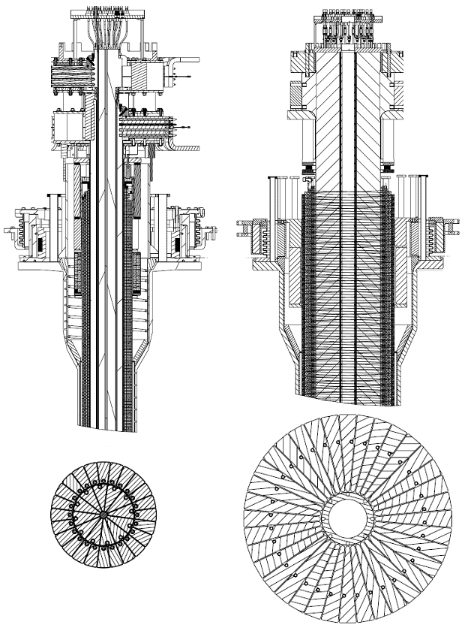
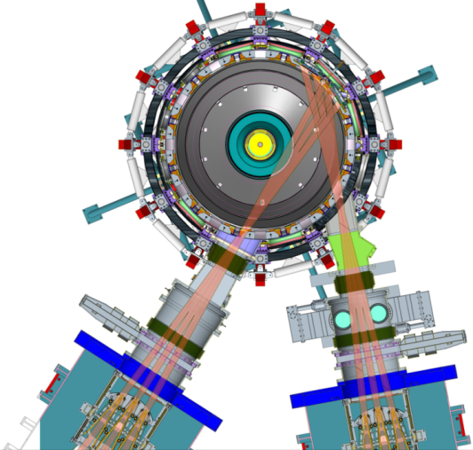
NSTX Upgrade will address critical plasma confinement and sustainment questions by exploiting 2 new capabilities
New center-stack
Reduces ν* → ST-FNSF values to understand ST confinement
  Expect 2x higher T by doubling B_{T}, I_{P}, and NBI heating power
  Provides 5x longer pulse-length
  q(r,t) profile equilibration
  Tests of NBI + BS non-inductive ramp-up and sustainment
TF OD = 20cm
TF OD = 40cm
Previous
center-stack
New
center-stack
New 2nd NBI
  2x higher CD efficiency from larger tangency radius R_{TAN}
100% non-inductive CD with q(r) profile controllable by:
  NBI tangency radius
  Plasma density
  Plasma position
Present NBI
New 2nd NBI
MENARD, J. et al., Proceedings of the 24th IEEE Symposium on Fusion Engineering (2011).

Slide 10
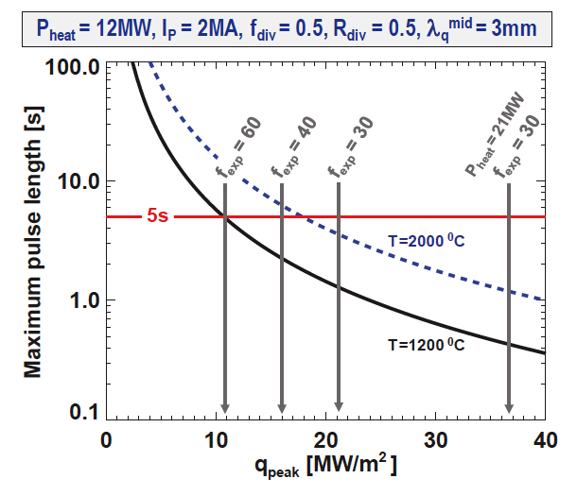
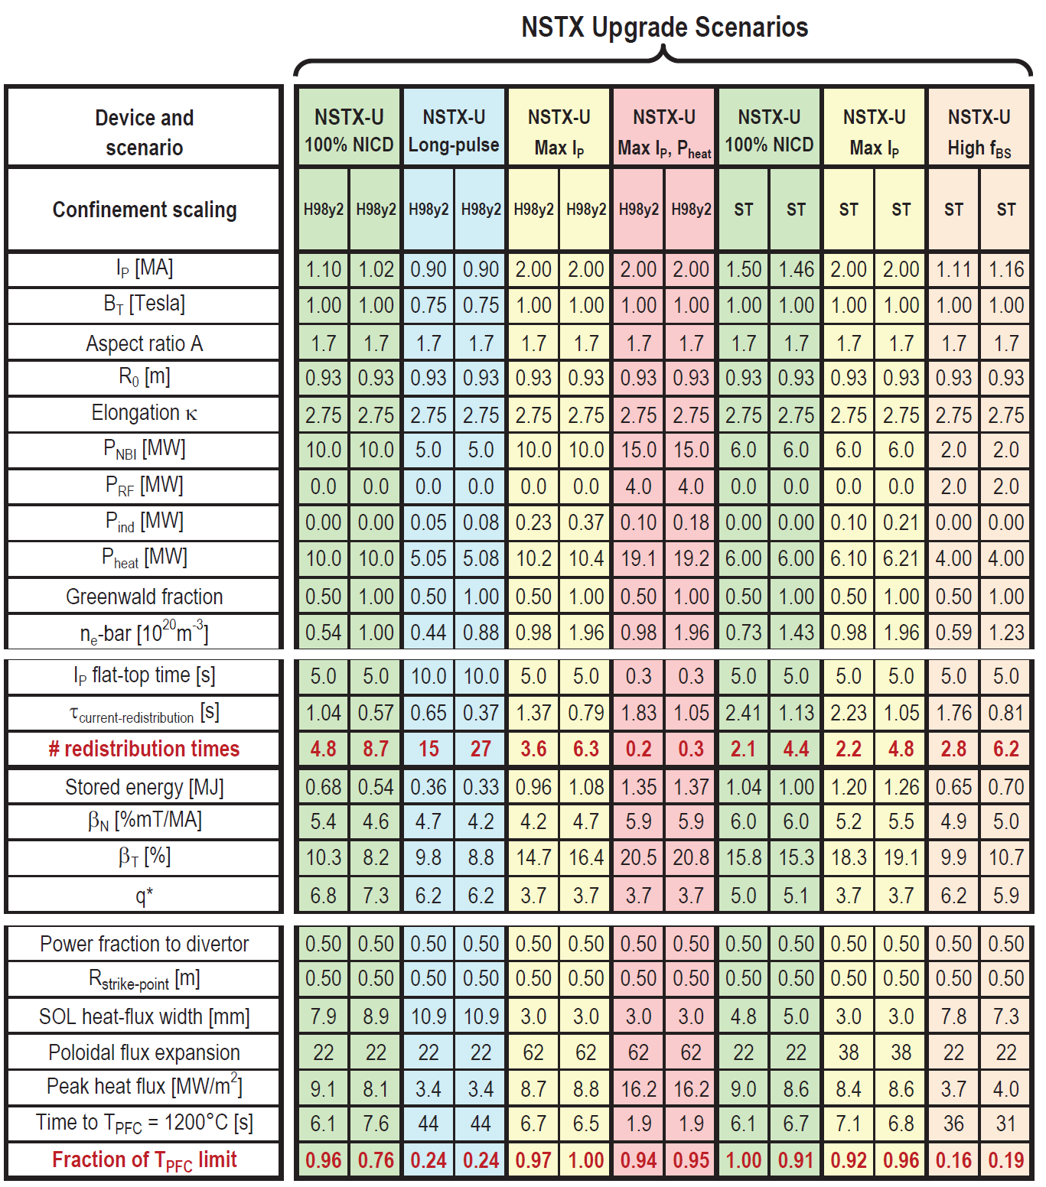
NSTX-U scenarios with high I_{p} and P_{NBI} are projected to challenge passive cooling limits of graphite divertor PFCs
MENARD, J. et al., Proceedings of the 24th IEEE Symposium on Fusion Engineering (2011).
R. Maingi (ORNL)
High I_{P} scenarios projected to have narrow λ_{q}^{mid} → ~3mm
  At high power, peak heat flux ≥ 9MW/m² even with high flux expansion ~60 with U/L snowflake
  Numbers shown ignore radiation, plate tilt, strike-point sweeping
Passive cooling ok for low-I_{P} scenarios
Long-pulse + high I_{P} and power may ultimately require active divertor cooling

Slide 11
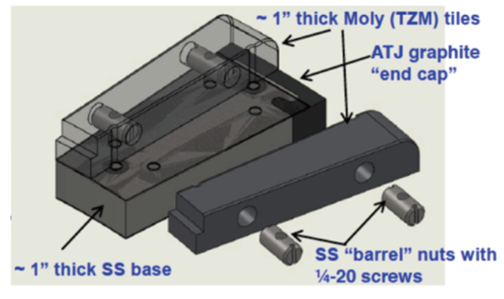
Radiative divertor control options are affected by NSTX-U plasma-facing component development plan
Possible progressions
Developing PFC plan to transition to full metal coverage for FNSF-relevant PMI development
Wall conditioning: GDC, lithium and / or boron coatings
PFC bake-out at 300-350ºC
C
BN
C
BN
C
BN
BN
Mo
Mo
Mo
Mo
Mo
W
Baseline
Upper
Mo divertor
All
Mo divertor
All Mo tiles
All Mo PFCs
Mo wall
+ W divertor
5 yr plan
Radiative divertor elements affected by PFC choice:
  Divertor impurity gas handling and injection system
    D₂, CD₄, Ar with graphite PFCs and lithium coatings
    D₂, N₂, CD₄, Ar with refractory metal PFCs
  Diagnostic sensors for control
  Plasma Control System development
Mo tiles

Slide 12
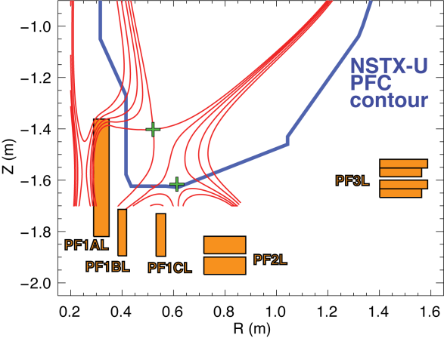
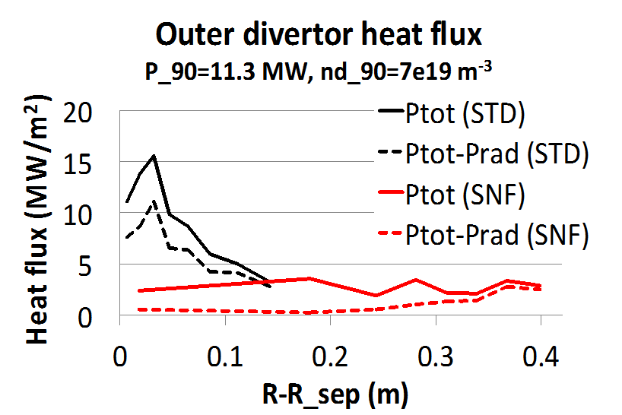
Impurity-seeded radiative divertor with feedback and snowflake geometry are the leading NSTX-U heat flux mitigation candidates
NSTX-U scenarios with high I_{p} and P_{in} projected to challenge thermal limits of graphite divertor PFCs
Single and double-null radiative divertors and upper-lower snowflake configurations considered
  Supported by NSTX-U divertor coils and compatible with coil current limits
Snowflake divertor projections to NSTX-U optimistic
  UEDGE modeling shows radiative detachment of all snowflake cases with 3% carbon and up to P_{SOL}~11 MW
    q_{peak} reduced from ~15 MW/m² (standard) to 0.5-3 MW/m² (snowflake)
  Snowflake divertor with impurity seeding for P_{SOL} ~ 20 MW under study
NSTX-U
snowflake
simulation
E. Meier (LLNL)

Slide 13
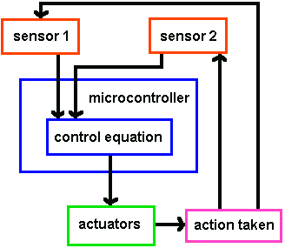
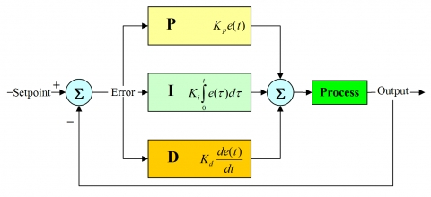
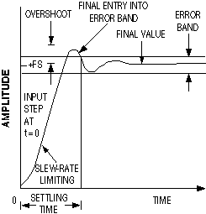
Conceptual design of radiative divertor feedback control system is based on PID control
Proportional, integral, derivative controller

Slide 14
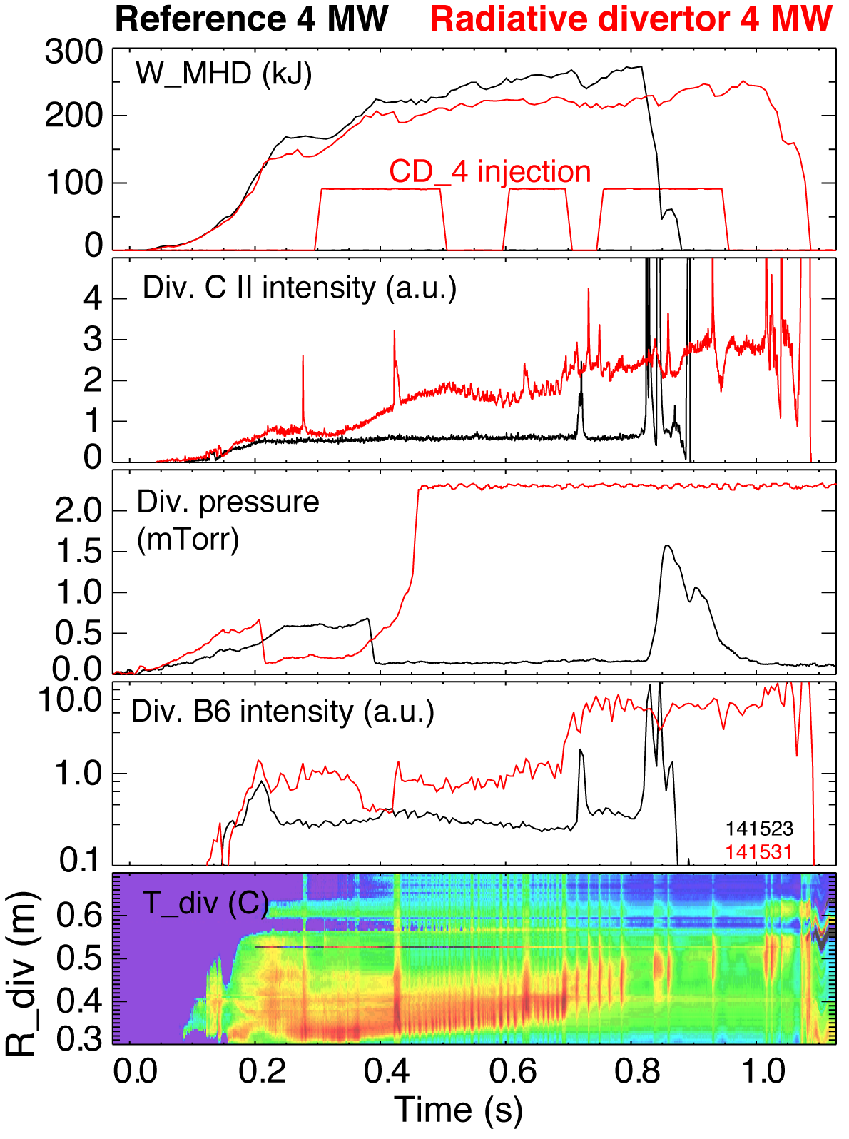
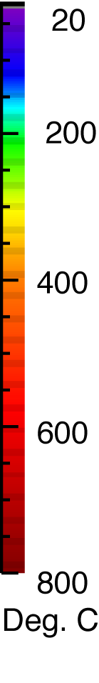
Control signal options demonstrated using divertor outer strike point partial detachment with D₂ or CD₄ puffing
4MW NBI-heated H-mode
  CD₄ injection preprogrammed wave form
Outer strike point detachment occurred at about 0.7 s (red traces)
  Characteristic onset time 50 ms
Divertor detachment affected divertor power balance
  Carbon radiation and P_{rad} increased
  Divertor heat flux decreased
Divertor detachment affected SOL momentum balance
  Neutral pressure increased (also due to gas puffing)
  Divertor volumetric recombination rate increased (Balmer line intensities increased)

Slide 15
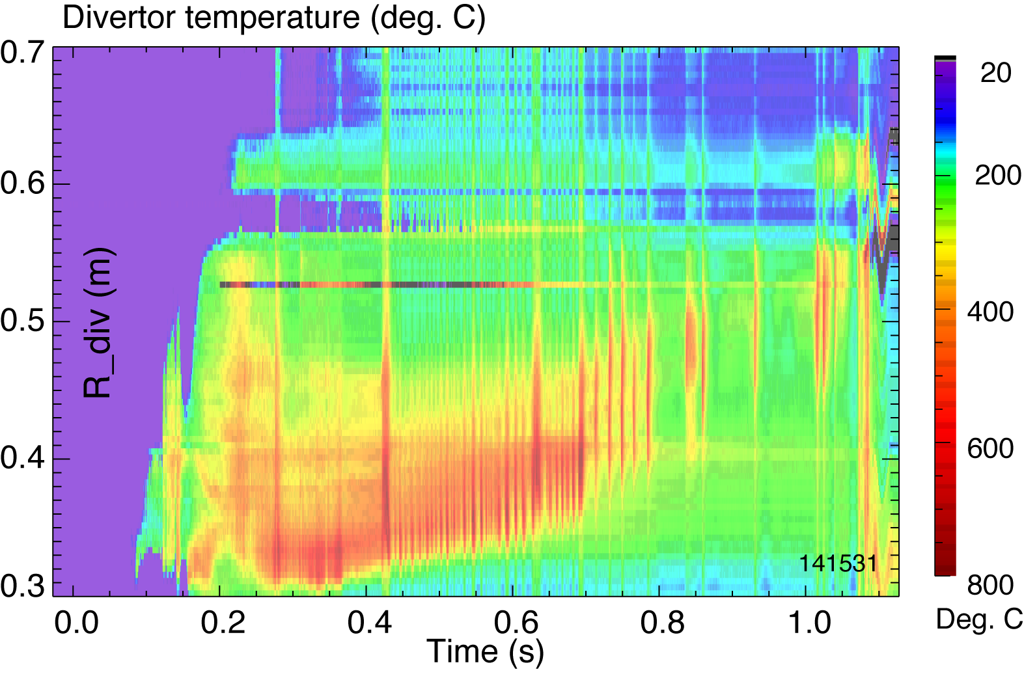
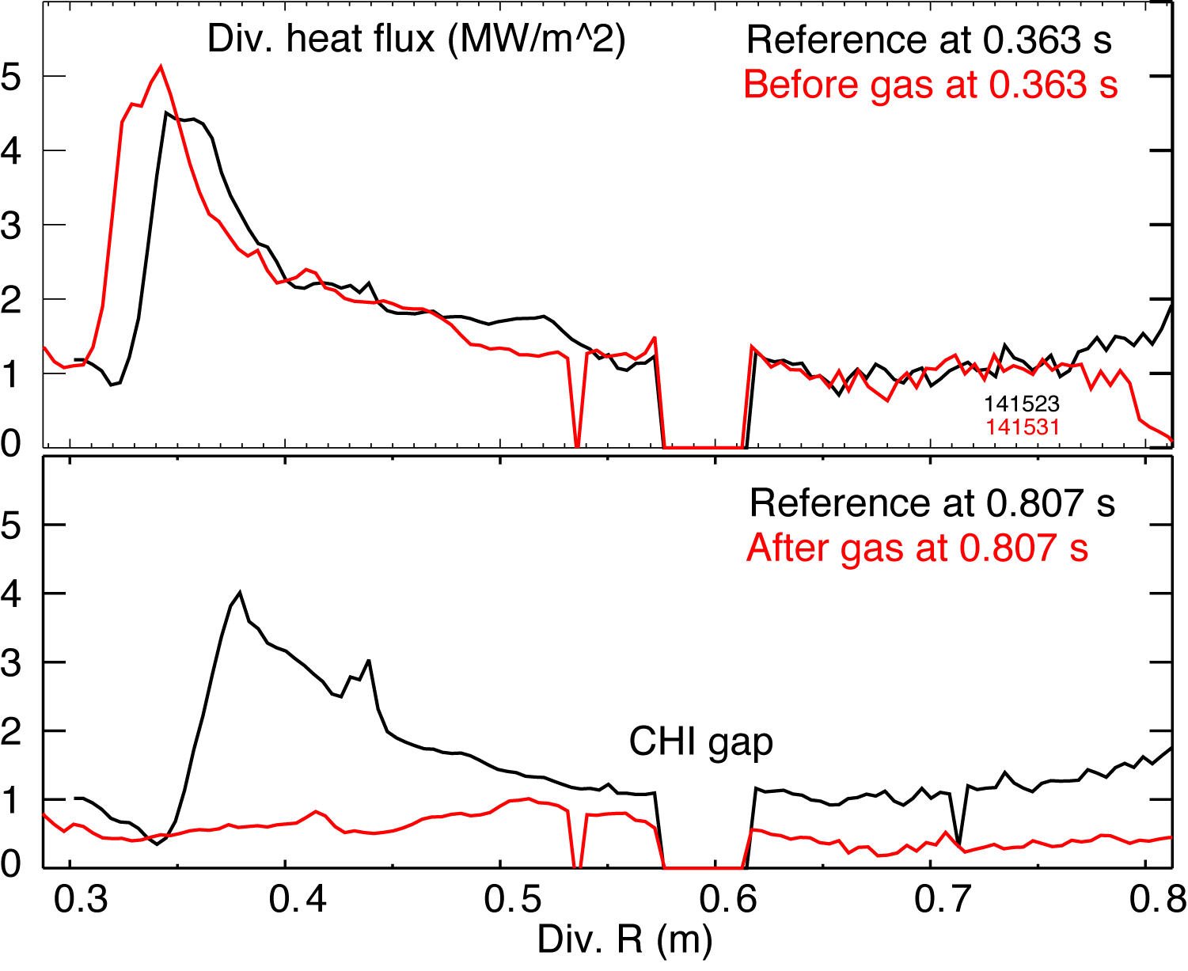
Option 1: IR thermography for divertor surface temperature monitoring
detachment
Diagnostic principle and description
  Measure PFC surface IR emission, calibrate for temperature
  IR arrays (1D or 2D) or single-channel IR diode with strike-point region view
Signal details from NSTX experiments
  Detached region localization: 5-12 cm
  Characteristic time: 1 ms
  X 4 reduction during detachment
Advantages:
  Direct PFC temperature monitoring
Issues:
  Toroidal and poloidal localization
  Interpretation and calibration issues due to PFC coatings (e.g., lithium)
Implementation
  Needs special IR and relay optics
  IR optics
AHN, J.-W. et al., Rev. Sci. Instrum. 81 (2010) 023501.

Slide 16
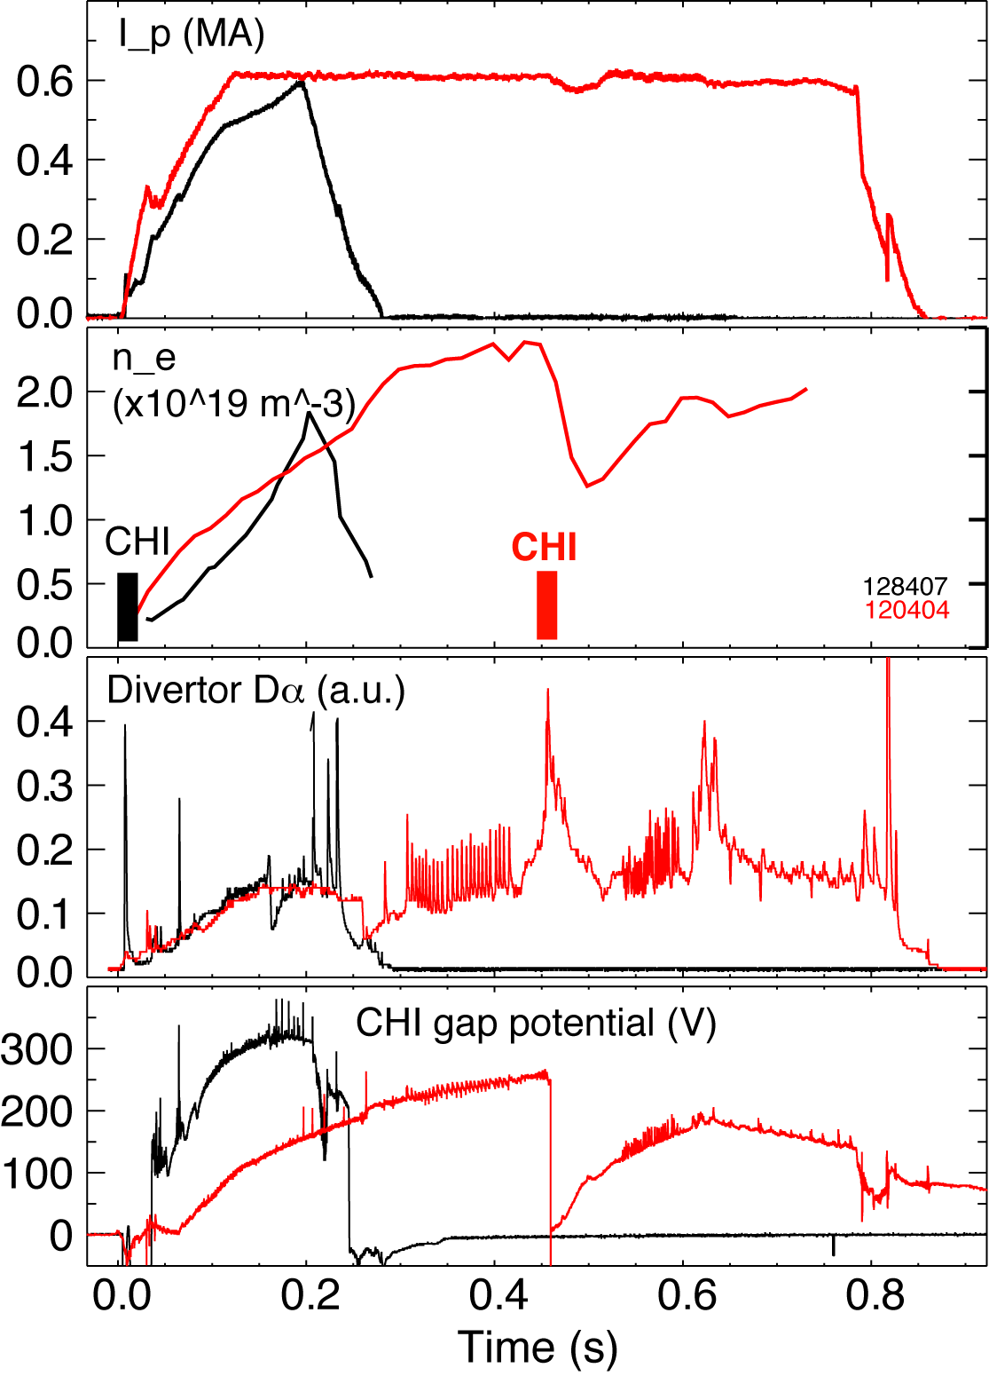
Option 2: monitor SOL thermo-electric current representative of divertor electron temperature
Diagnostic principle and description
  SOL thermoelectric current due to divertor T_{e} difference
  Electric current and potential
Signal details from NSTX experiments
  In NSTX inner and outer vessels electrically isolated
  Potential V measured in CHI exp’s
Advantage:
  Toroidally-averaged current and potential, linked to divertor T_{e}
Issues:
  More experiments needed to improve interpretation
RAMAN, R. et al., Nucl. Fusion 49 (2009) 065006
STAEBLER, G. et al., Nucl. Fusion 29 (1989) 1820
KALLENBACH, A. et al., J. Nucl. Mater. 290-293 (2001) 639
Measure V, I

Slide 17
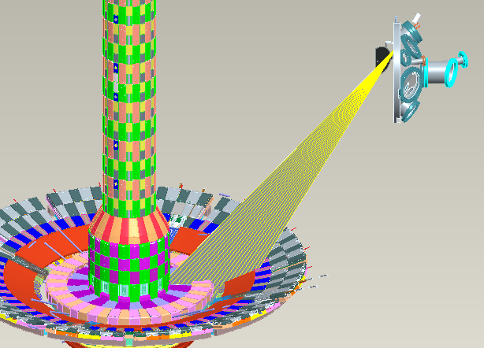
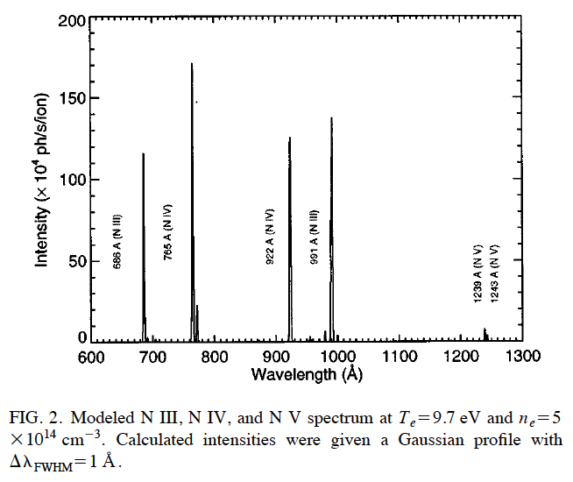
Option 3: Monitor divertor radiated power or spectroscopic representation of radiated power
Diagnostic principle and description
  Fast bolometer or AXUV diode (or array) to monitor divertor rad. power
  VUV spectroscopy
Advantage:
  Toroidally-averaged quantity linked to seeded impurity radiation
Issues:
  Need to know radiation distribution and spectral composition
Implementation
  Existing AXUV diode array (s)
  Divertor SPRED
  Dedicated divertor VUV monitor
SOUKHANOVSKII, V. et al., Rev. Sci. Instrum. 70 (1999) 340
SOUKHANOVSKII, V. et al., Rev. Sci. Instrum. 72 (2001) 3270

Slide 18
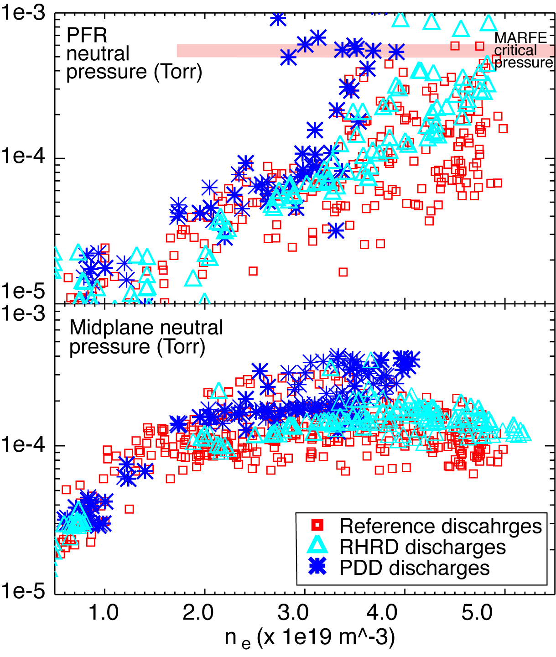
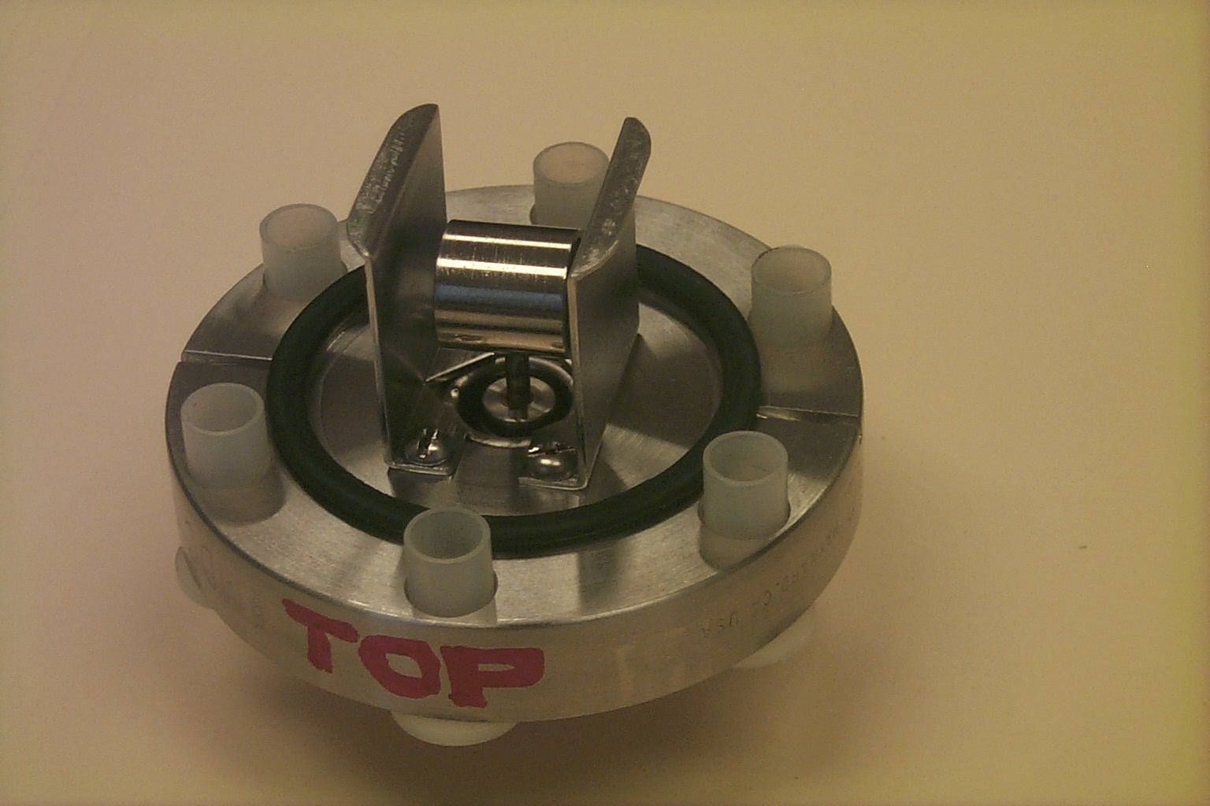
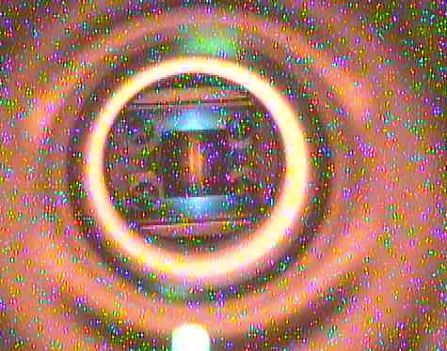
Option 4: Monitor neutral pressure
Diagnostic description
  Penning gauge for gas pressure monitoring in range 0.1-5 mTorr
Signal details from NSTX experiments
  Divertor pressure measured in private flux region, outer strike point region
Advantages:
  Direct seeding gas pressure measurement
Issues:
  Need to understand links to detachment characteristics
Implementation
  Straightforward, existing gauges can be used
  Developing calibrated spectroscopic monitoring of Penning gauge
FINKEN, K. et al., Rev. Sci. Instrum. 63 (1992)

Slide 19
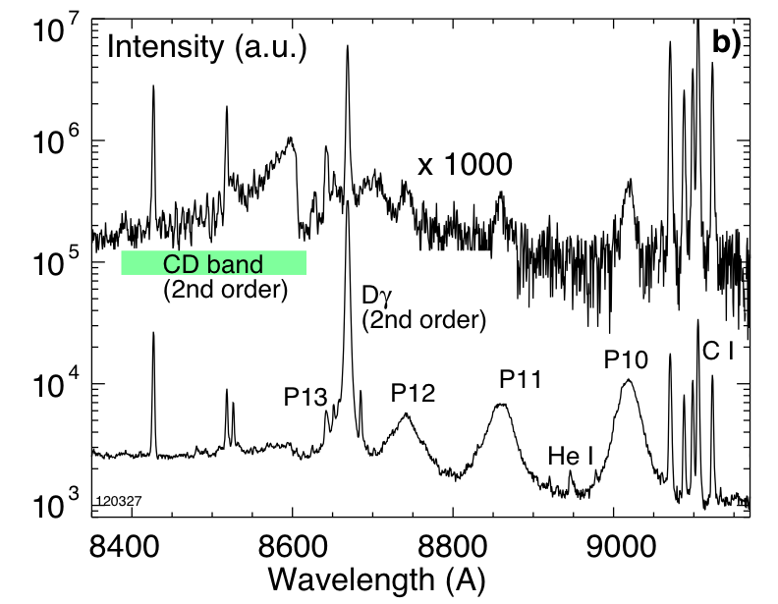
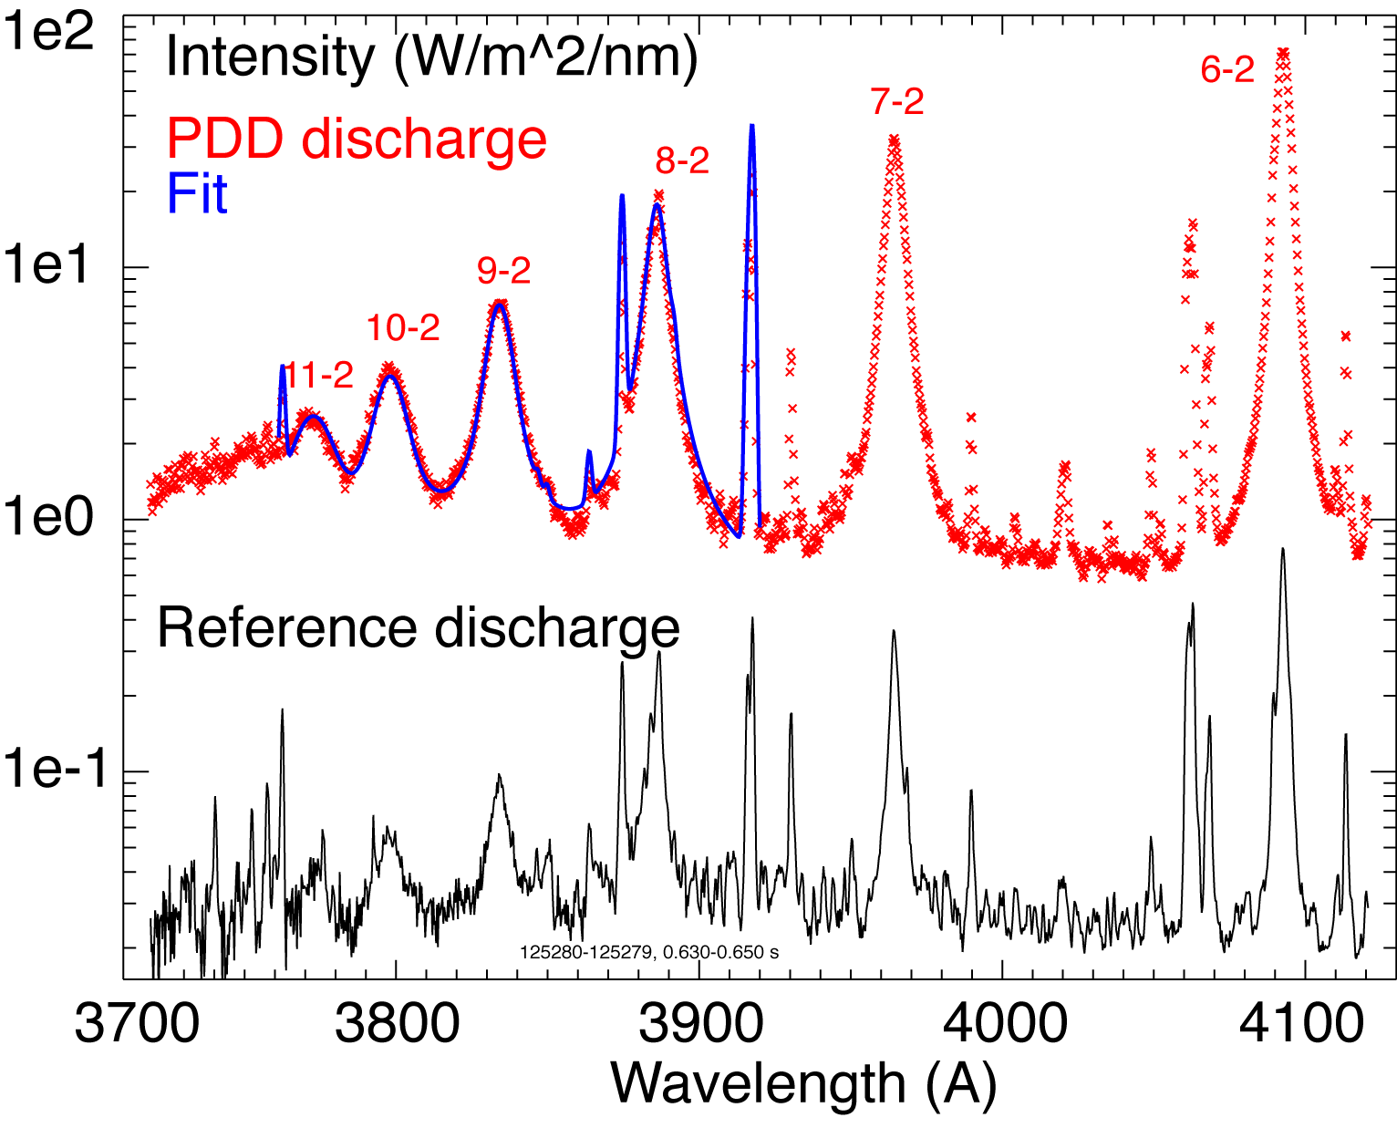
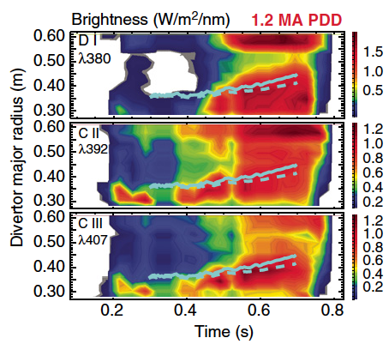
Option 5: Monitor recombination rate via Balmer or Paschen line spectroscopy
Diagnostic description
  UV or NIR spectroscopy to monitor emission line intensity from high-n Balmer or Paschen series lines
Signal details from NSTX expt’s
  Strong indication of detachment, signal increases by up to 10²
  Observed n=2-m, m=3-12 (Balmer)
  Observed n=3-m, m=5-10 (Paschen)
Advantages:
  Toroidally-averaged quantity
  Direct measure of recombination rate
Implementation
  Can use existing UV and NIR fibers and instruments
SOUKHANOVSKII, V. et al., Rev. Sci. Instrum. 77 (2006) 10127
SOUKHANOVSKII, V., Rev. Sci. Instrum. 79 (2008) 10539
SOUKHANOVSKII, V. et al., Rev. Sci. Instrum. 81 (2010) 10723.

Slide 20
Option 6: need “security” monitoring for signs of confinement degradation (pedestal temperature or MARFEs)
Diagnostic principle and description
  Monitor pedestal T_{e} (100-600 eV)
    Soft X-ray arrays, real-time Thomson
  Monitor MARFE formation
    Edge neutral pressure
    Divertor recombination rate
Optimal D₂ injection rate found (used 300 ms pulses)
50-100 Torr l /s for 1.0 MA discharges
110-160 Torr l /s for 1.2 MA discharges
X-point MARFE formation during high-rate supersonic gas injection. Balmer B10 line intensity is plotted.

