Slide 1
Beam emission spectroscopy measurements on NSTX: diagnostic performance and low-k turbulence characterization
David R. Smith¹, R. Fonck¹, G. McKee¹, D. Thompson¹, B. Stratton², and I. U. Uzun-Kaymak¹
¹University of Wisconsin-Madison ²Princeton Plasma Physics Lab
19th High Temperature Plasma Diagnostics Conference
Monterey, CA
May 6-10, 2012

Slide 2
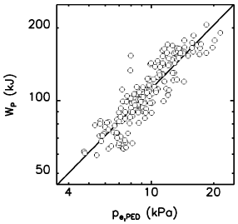
What are the characteristics and parametric dependencies of pedestal turbulence in NSTX?
ITER and next-step devices need accurate models of pedestal dynamics
Global confinement predictions
Diverter heat flux and first-wall lifetime predictions
ST edge parameters are among the most challenging regimes for turbulence simulations (steep gradients, high β, large ρ_{ι}/a, strong shaping)
Here, we measure pedestal turbulence parameters in NSTX H-mode plasmas during ELM-free, MHD quiescent periods
Poloidal correlation length, wavenumber, and decorrelation time
Identify parametric dependencies (∇n_{e}, ∇T_{i}, etc)
C-Mod: stored energy increases with pedestal height
NSTX: BES
measurements
from multiple discharges in steep gradient region
Hughes, PoP, 2002

Slide 3
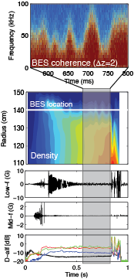
Outline
Beam emission spectroscopy (BES) diagnostic on NSTX
Pedestal turbulence measurements
LH transition
ELM-free, MHD quiescent periods
Parametric scalings
Correlation length during the ELM cycle
Initial theory/experiment comparison
Other BES observations
Post-ELM harmonic features
TAE and GAE mode structures
Future work and summary

Slide 4
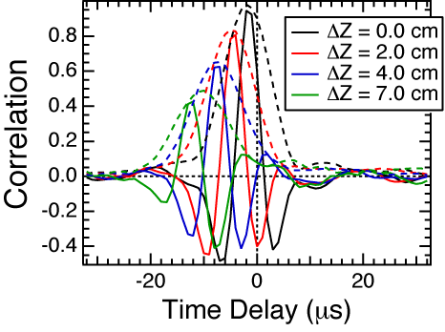
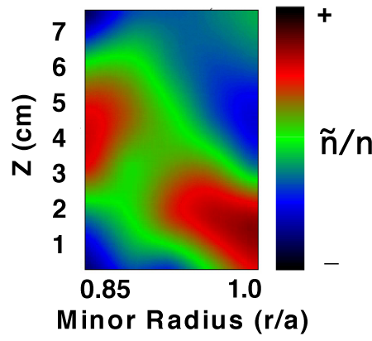
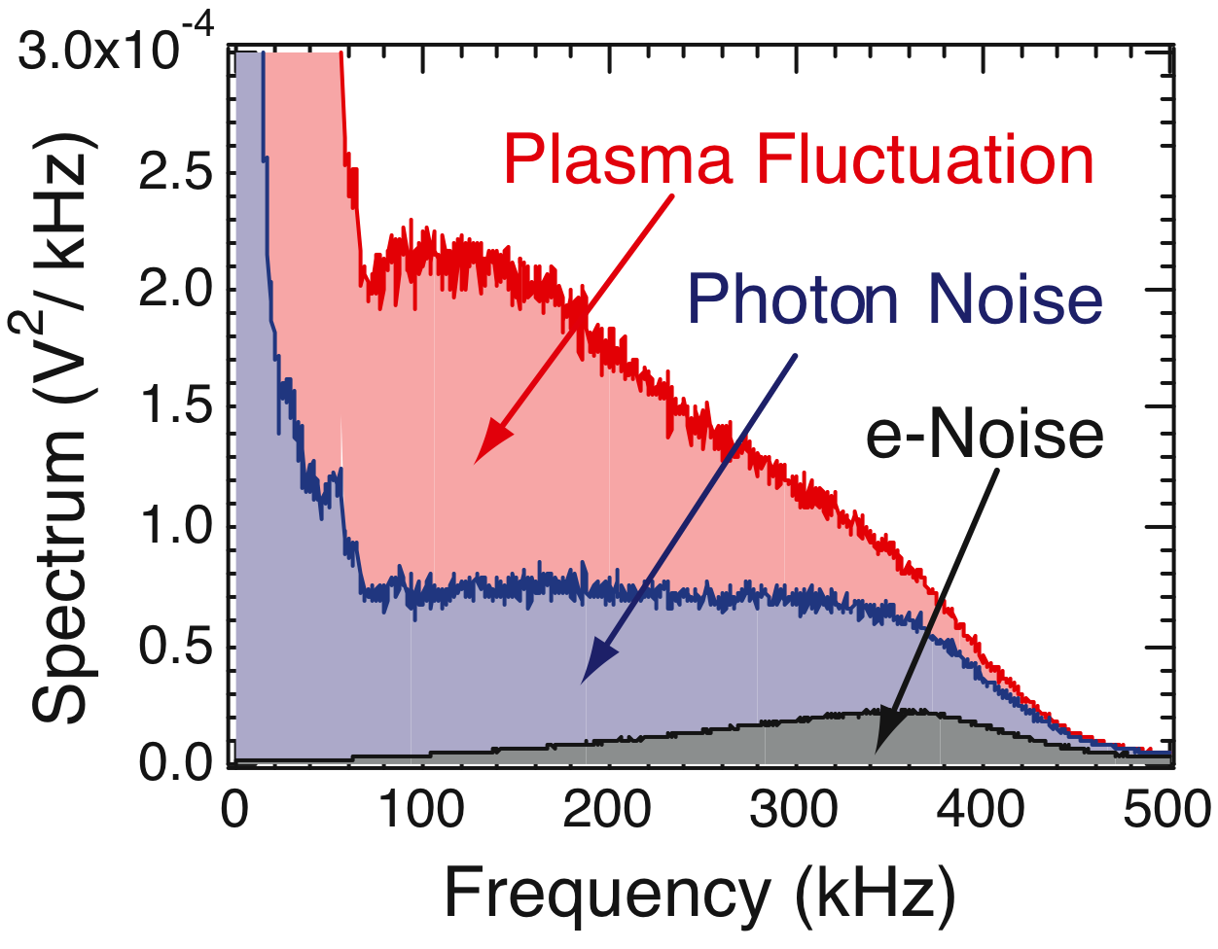
Beam emission spectroscopy (BES) is a diagnostic technique for measuring ion gyroscale (kρ_{i} < 1) density fluctuations
Measured & derived quantities
Fluctuation amplitudes
Frequency spectra
Radial and poloidal correlation lengths
Decorrelation times
Poloidal flow, flow fluctuations, flow shear, and 2D flow fields
2D fluctuation imaging
3-wave bispectral analysis
Particle flux
Figures courtesy of
DIII-D BES group

Slide 5
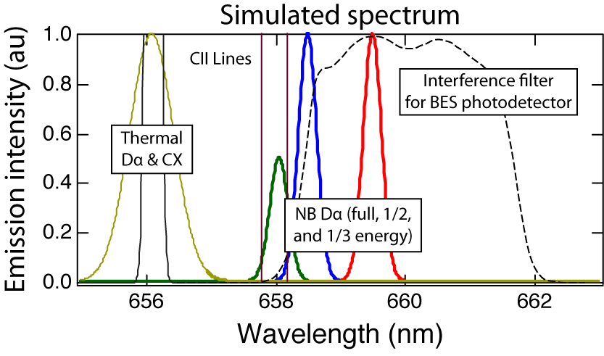
BES measures Doppler-shifted D_{α} emission (λ₀=656 nm) from neutral beam particles
C ≈ 1/2
neutral beam D_{α} emission
density
fluctuation

Slide 6
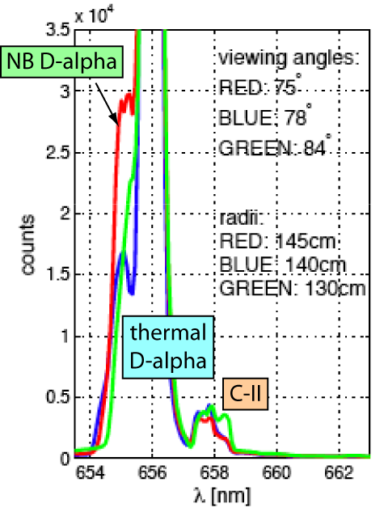
MSE & FIDA measurements on NSTX indicate NB D_{α} emission is comparable to or greater than C-II emission
MSE spectrum
tangential view with
large red-shift in NB D_{α}
and long-time integration
Courtesy of H. Yuh & F. Levinton
MSE & FIDA spectra
indicate:
Also, C-II fluctuations should average out due to large C-II sampling volume.
FIDA spectrum
vertical view with
small blue-shift in NB D_{α}
and short-time integration
Courtesy of M. Podesta & W. Heidbrink

Slide 7
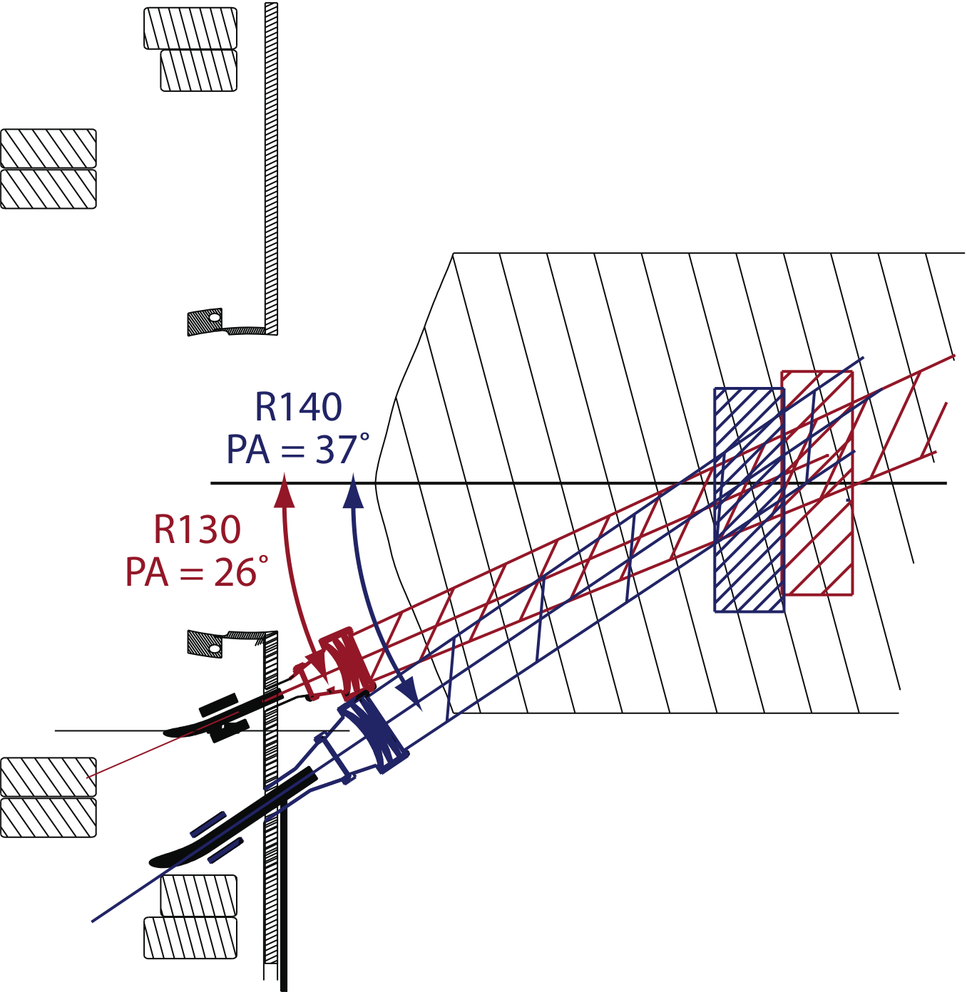
Optical views are aligned to the magnetic field pitch angle within the NB volume to optimize cross-field spatial resolution
Reentrant optics increase light collection

Slide 8
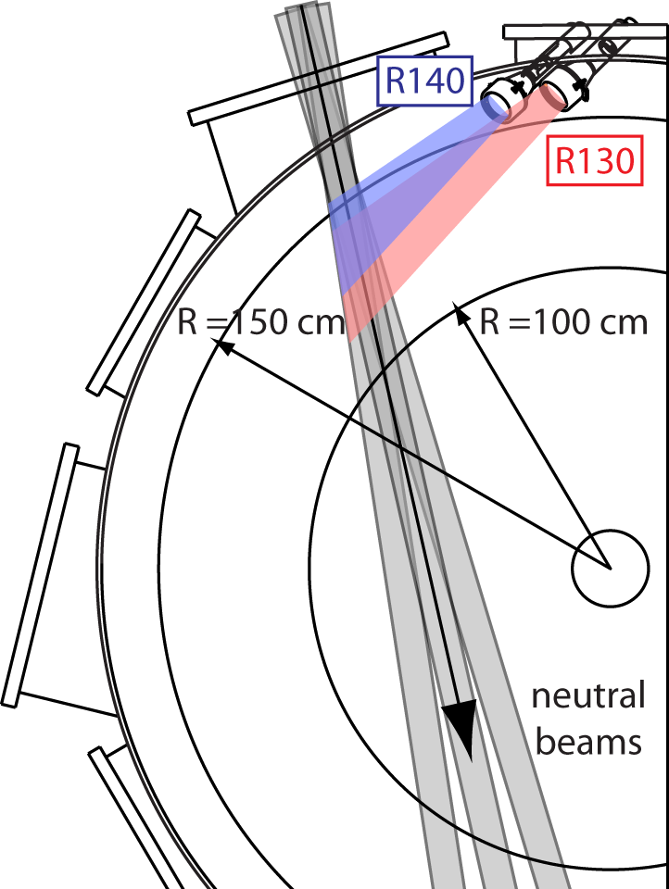
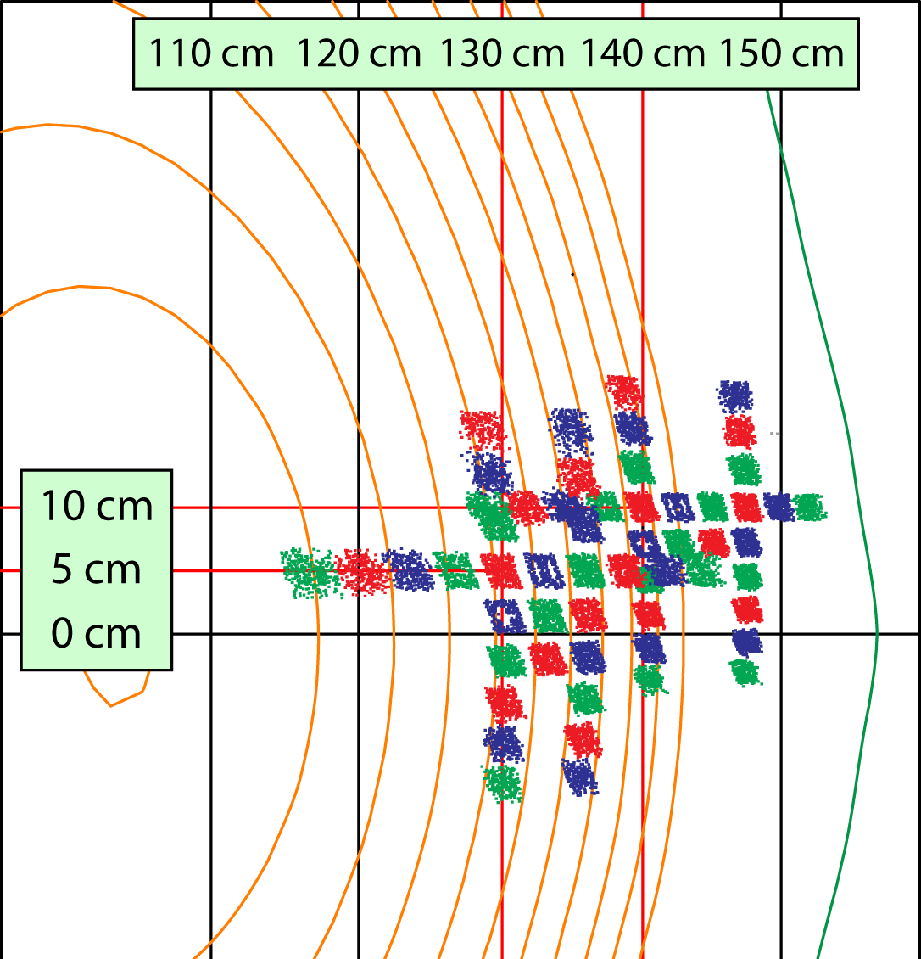
The NSTX BES system has 56 sightlines in radial and poloidal arrays spanning core to SOL
32 detection channels presently and expansion planned for NSTX-U
2 MHz sampling with digital anti-alias filter
2-3 cm image size and sensitive to ñ with k┴ρ_{i} ≤ 1.5
Field-aligned optics with high throughput (etendue = 2.3 mm²-ster)

Slide 9
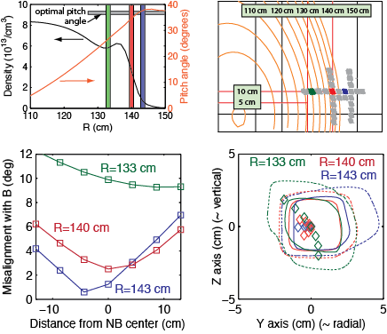
Point spread function calculations indicate image distortion from atomic state lifetimes and field line geometry are negligible
field line misalignment
nearly optimized
low density region
distortion from misalignment (dashed=10% of peak int.)
distortion from
atomic state lifetimes
FWHM distortions (solid line) are ~10%

Slide 10
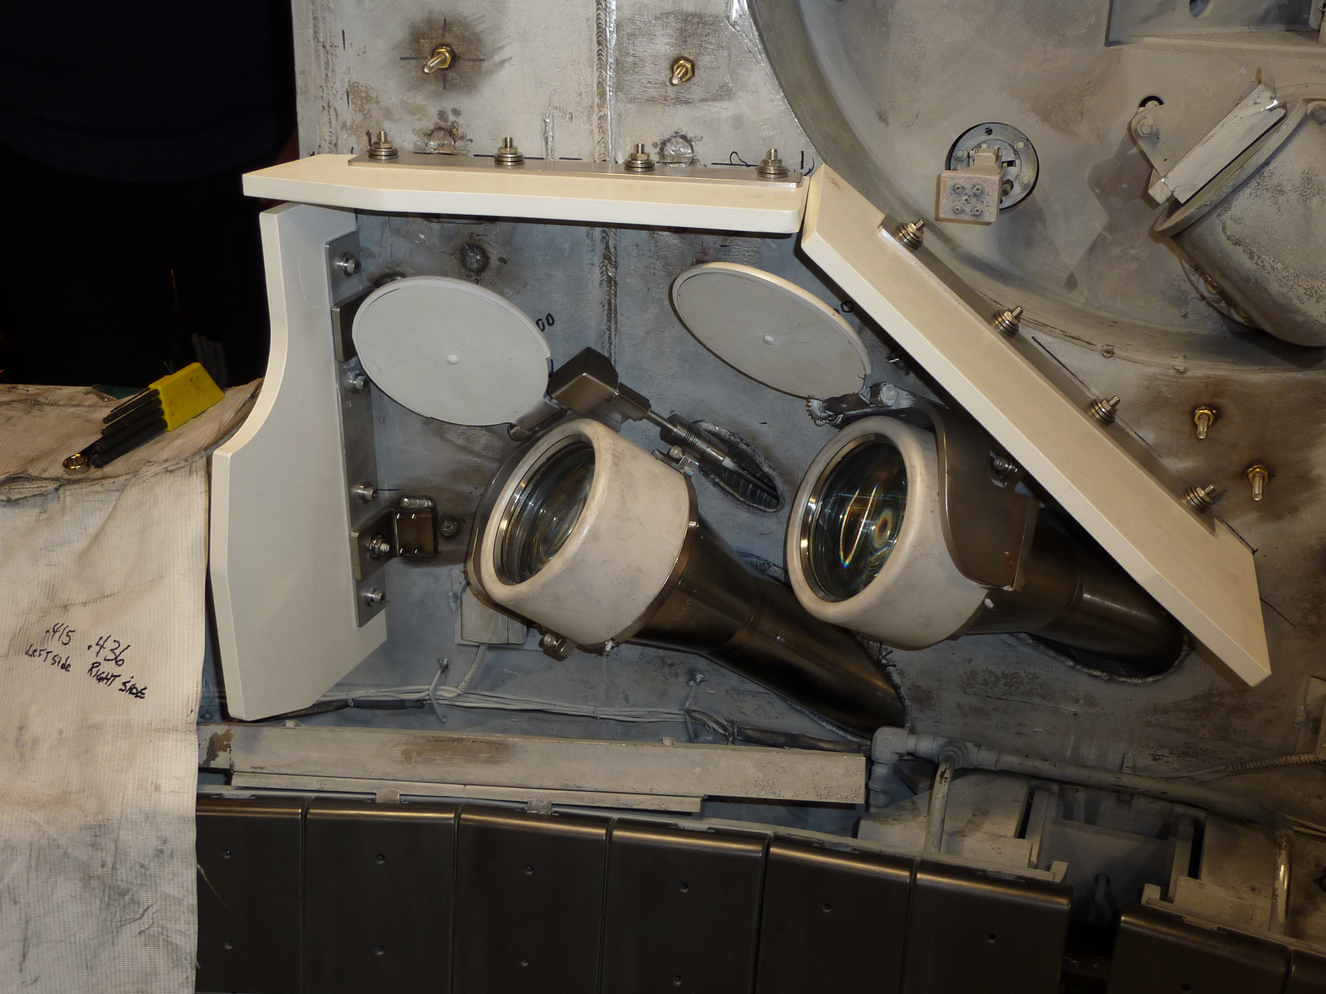
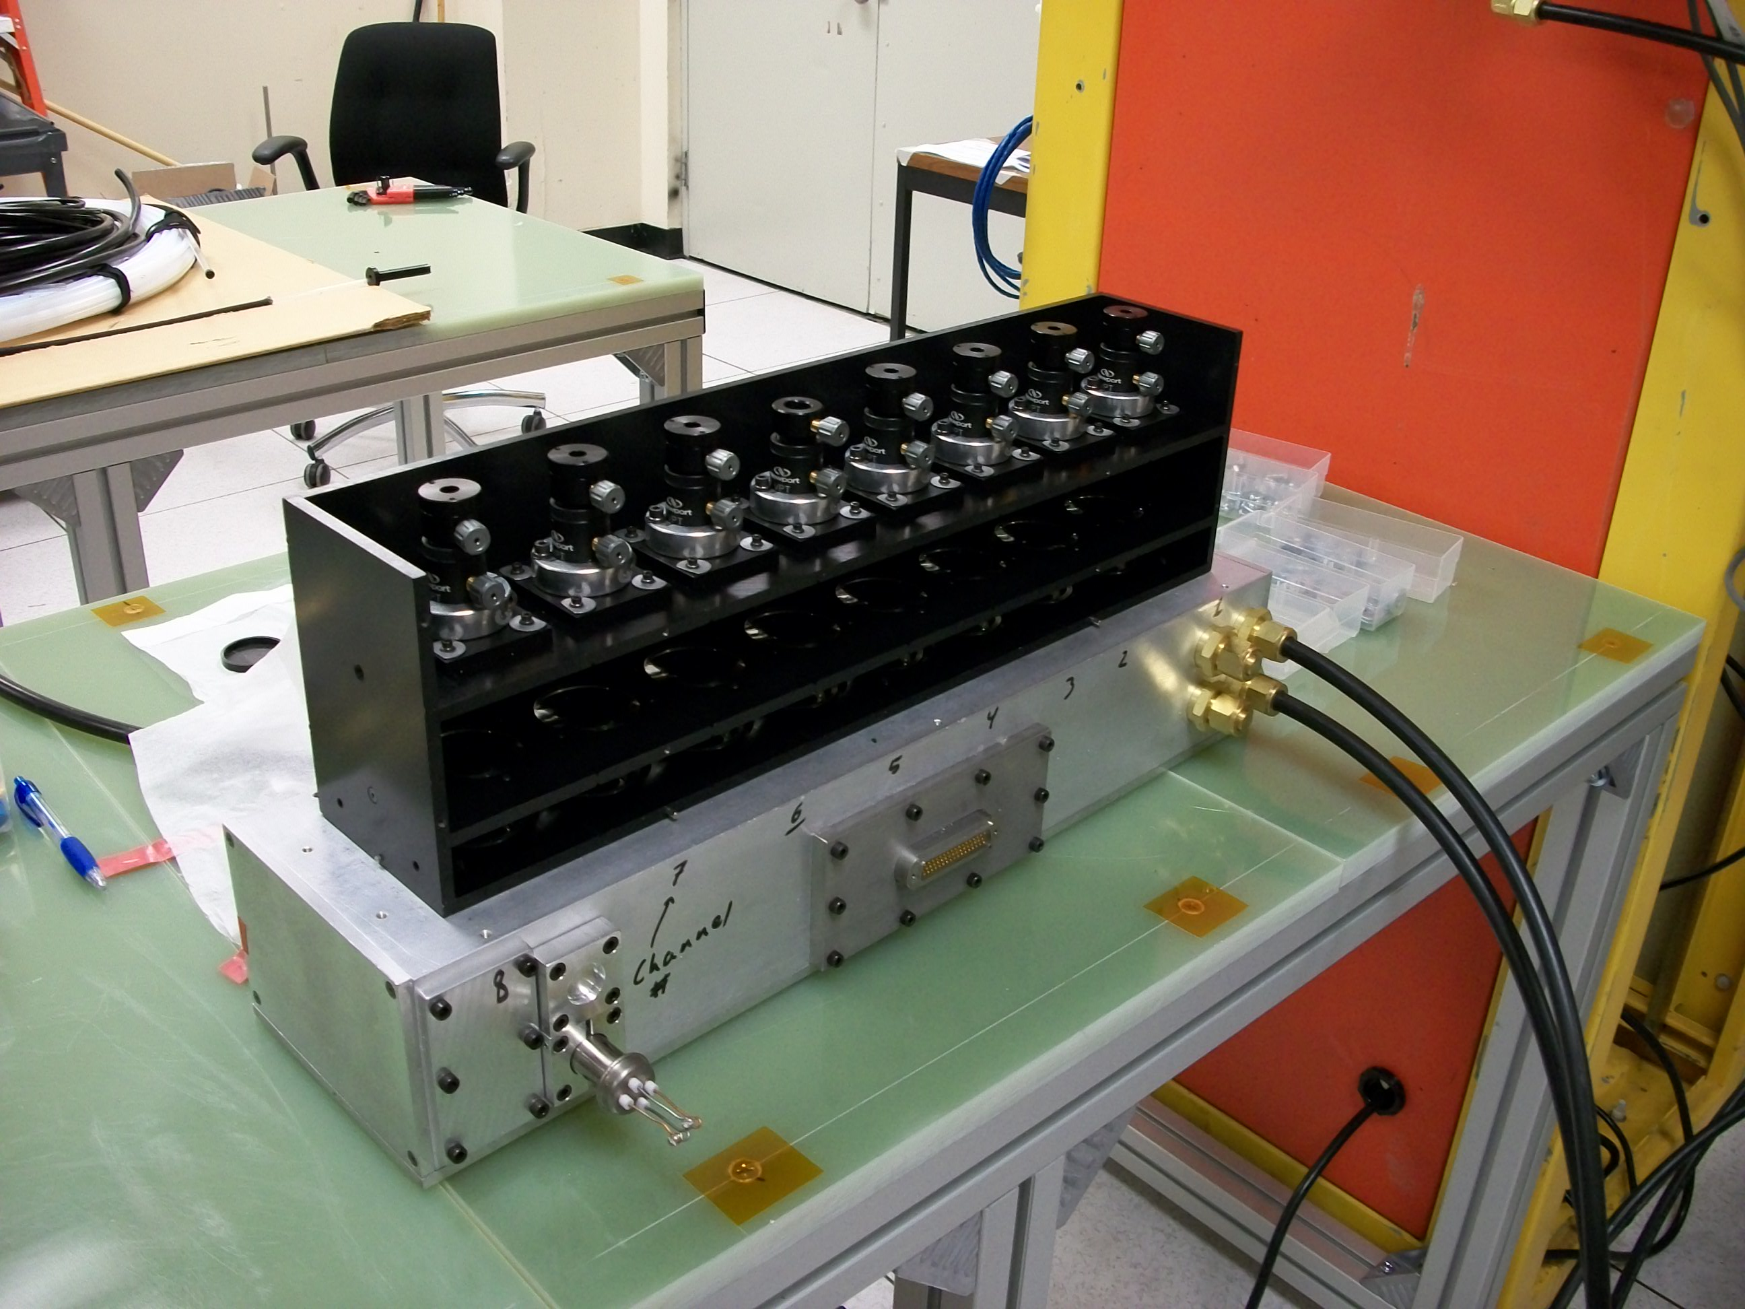
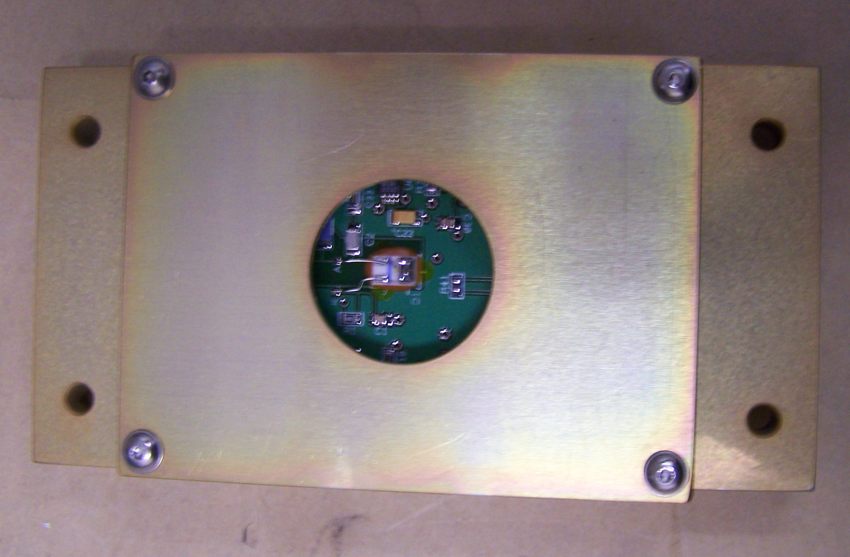
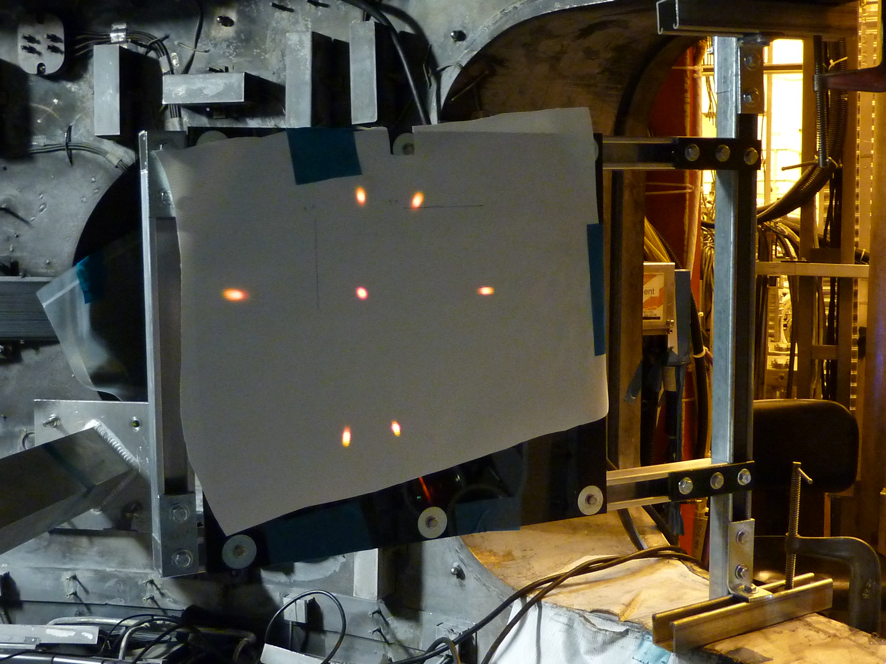
NSTX BES system was commissioned in 2010
Collection optics
Detector module
Photodetector
Fiber images

Slide 11
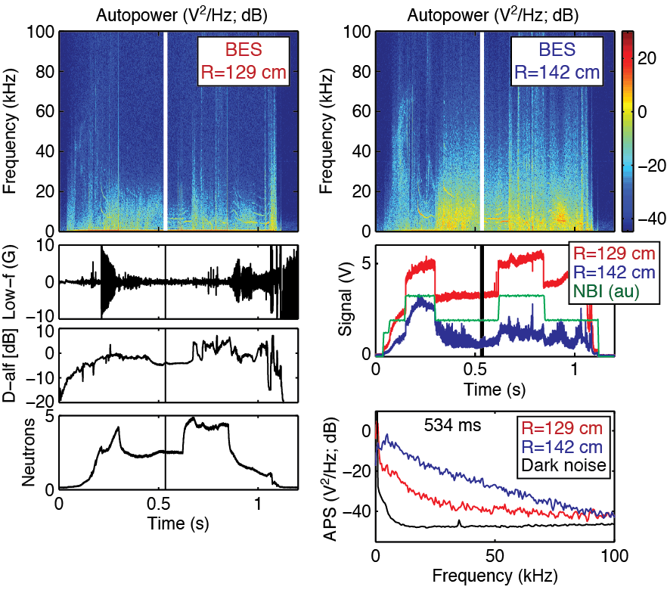
BES measurements show radially-localized response to neutral beam emission and high signal-to-noise ratio

Slide 12
BES measurements provide poloidal correlation lengths (L_{c}), poloidal wavenumbers (k_{θ}), and decorrelation times (τ_{d}) in the pedestal
Filtered data shows eddy propagation
Turbulence quantities calculated from time-lag cross-correlations

Slide 13
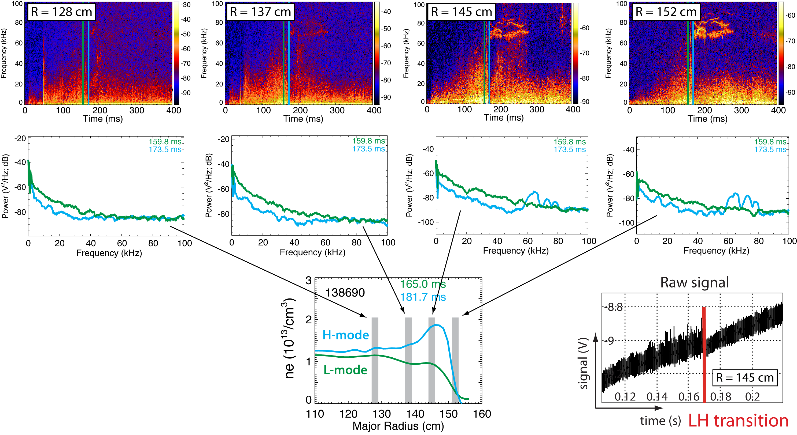
Edge and core regions show reduced fluctuations at LH transition
Similar increase in fluctuations observed at HL back-transitions

Slide 14
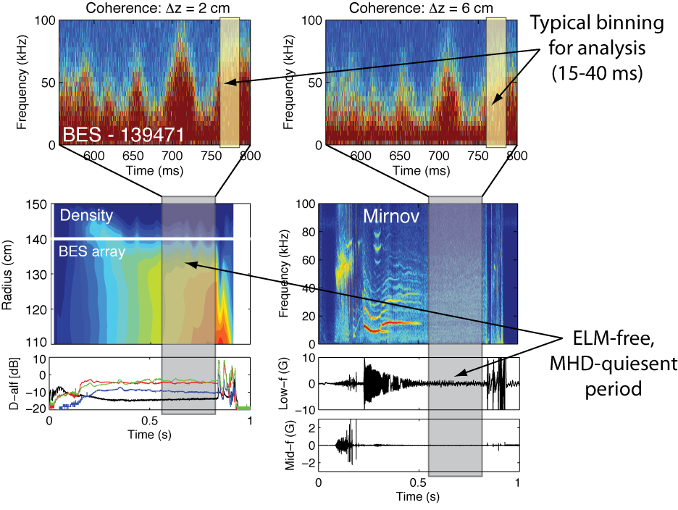
Pedestal measurements show complex turbulence activity during quiescent H-mode periods

Slide 15
Questions about pedestal turbulence to ask and answer with BES measurements
What are typical L_{c}, k_{θ}, and τ_{d} values in the H-mode pedestal during ELM-free, MHD quiescent periods?
How do L_{c}, k_{θ}, and τ_{d} change with plasma parameters?
∇n_{e}, ∇T_{i}, q/ŝ, ν_{e}, β_{e}, n_{ped}, etc.
Can we connect observations to edge turbulence simulations?
XGC1 or BOUT++?

Slide 16
Pedestal turbulence measurements and plasma parameters from ELM-free, MHD quiescent H-modes were gathered in a database
Database details
129 entries from 29 discharges
B_{T0} = 4.5 kG
I_{p} = 700-900 kA
15-45 ms averaging
Turbulence parameters
L_{c}/ρ_{i} ~ 12
k_{θ}ρ_{i} ~ 0.2
τ_{d}/(a/c_{s}) ~ 5
τ_{d}ω*_{pi} ~ 0.15
Plasma parameters
generally 50%-300% variation
n_{e}, ∇n_{e}, T_{e}, ∇T_{e}, Ti, ∇T_{i}, v_{t}, ∇v_{t}, q, ŝ, ν_{e}, ν_{i}, β, β_{e}, n_{ped}, ΔR_{ped}, δ_{r}^{sep}

Slide 17
A search algorithm identifies linear regression models that show similar scalings despite different parameter compositions
plasma
parameters
turbulence
parameters
scaling
coefficient
Algorithm adds or removes x_{k} in model to find local minimum in model error
Many local minima exist in high dimensional x_{k} space
Screen models for statistical quality to identify “good” models
Statistical significance (α_{k} t-statistics)
Multicollinearity (variance inflation factor)
Error normality (Studentized residuals)
Linear regression models exhibit similar scalings despite different parameter compositions

Slide 18
L_{c} increases at higher ∇n_{e}, 1/L_{Te}, ν, and n_{ped}; decreases at higher T_{i}, ∇T_{i}, and ∇v_{t}
Consistent scalings
emerge from different regression models

Slide 19
k_{θ} scalings consistent with L_{c} scalings; τ_{d} scalings provide additional insight

Slide 20
Scalings point to a variety of turbulence mechanisms
Parametric scalings point to enhanced turbulence structures (larger L_{c} and τ_{d}) at higher ∇n_{e} and 1/L_{Te}
Possibly TEM turbulence
∇v_{t} scalings for L_{c} and k_{θ} point to turbulence suppression
Equilibrium E×B flow shear
ν_{e} and ν_{i} scalings for L_{c} and k_{θ} are consistent with zonal flows
τ_{d} decreases with ν_{e}
Pedestal height (n_{ped}) increases at larger L_{c} and τ_{d}
Consistent with larger structures and wider pedestals

Slide 21
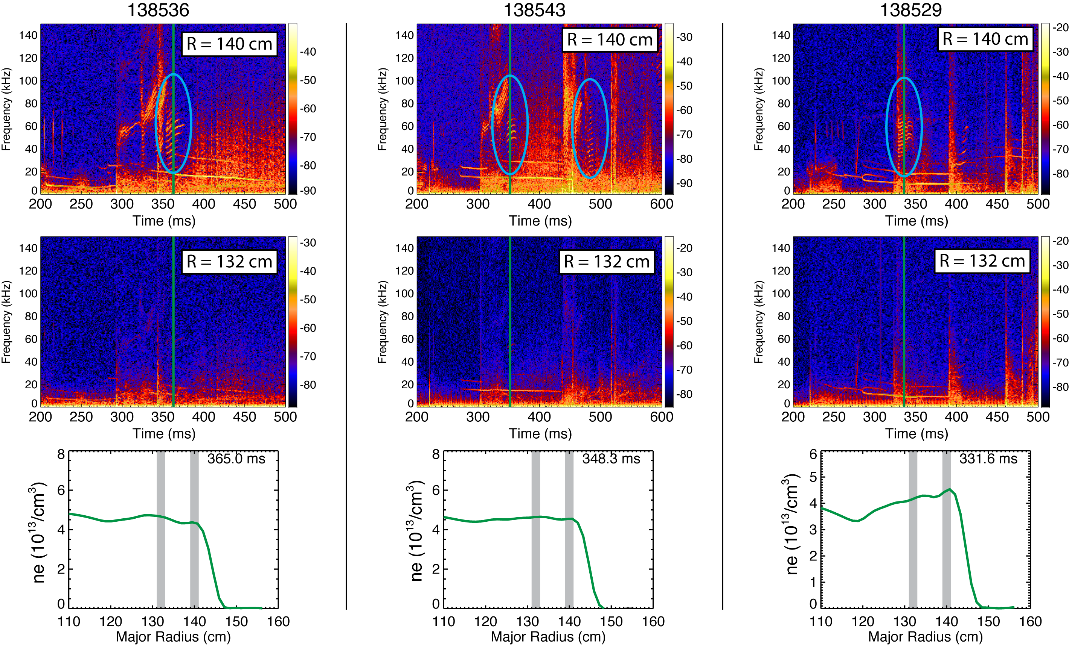
Post-ELM harmonic features at 50-100 kHz are localized at the top of the pedestal
Harmonic features are either absent from or weakly present in magnetic spectra

Slide 22
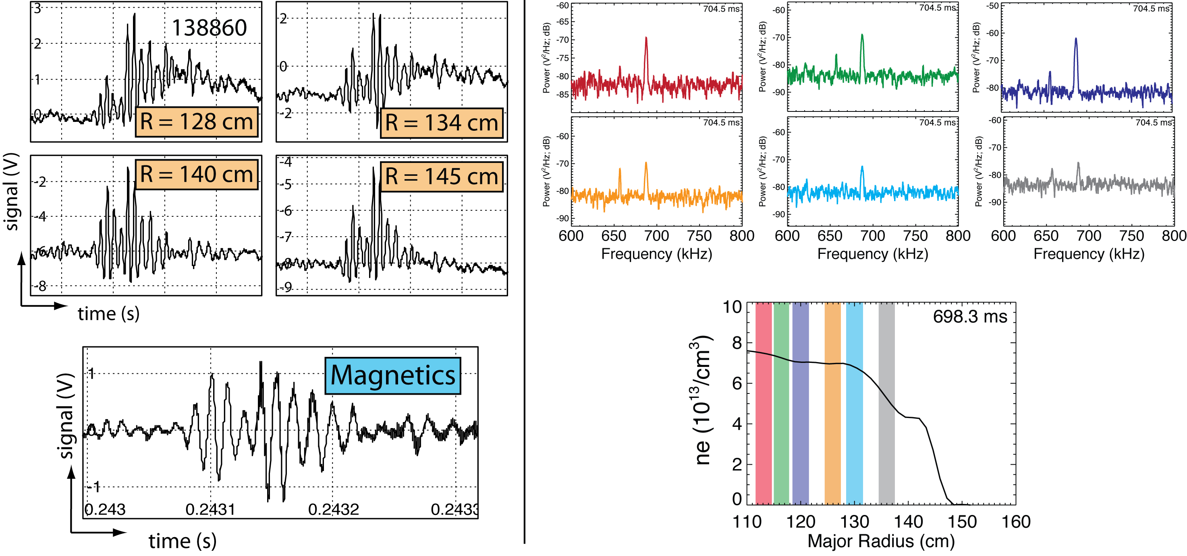
TAE and GAE mode structures have been observed in extended radial regions
TAE burst
GAE mode
with A. Bortolon and W. Heidbrink
with K. Tritz

Slide 23
Directions for future work
Big picture goal: validate plasma turbulence and transport models in core and edge regions
Quantify fluctuation amplitudes and radial correlation lengths
Study pre- and post-LH transition
Turbulence spreading from edge to core
Measure flow fluctuations and flow shear
Study flow fluctuations and shear across LH transition
Identify role of zonal flows and mean flow
Identify post-ELM harmonic oscillations
Captured by peeling-ballooning model?
Connect to DIII-D observations and edge harmonic oscillations

Slide 24
Summary: We measured pedestal turbulence quantities and identified parametric dependencies in ELM-free, MHD quiescent H-mode plasmas
The BES system on NSTX provides localized density fluctuation measurements with core-to-edge radial coverage
The BES system has measured poloidal correlation length, wavenumber, and decorrelation time of pedestal turbulence
Regression models identify parametric scalings and point to a variety of turbulence mechanisms
Enhanced turbulence structures at higher ∇n_{e} and 1/L_{Te}
∇v_{t} scalings point to E×B turbulence suppression
Collisionality scalings for L_{c} and k_{θ} are consistent with zonal flows
Pedestal height increases at longer L_{c} and τ_{d}
Other observations
Reduced turbulence at LH transition
Post-ELM harmonic oscillations
TAE and GAE mode structure

