Slide 1
Investigation of ELM evolution patterns on NSTX-U with beam emission spectroscopy measurements
David R. Smith¹, G. McKee¹, R. Fonck¹, A. Diallo², S. Kaye², B. LeBlanc², S. Sabbagh³, and B. Stratton²
¹U. Wisconsin-Madison, ²PPPL, ³Columbia U.
21st Topical Conf. on
High-Temperature Plasma Diagnostics
Madison, WI
June 5-9, 2016
Notes:
Thank you for this opportunity to tell you about ELM evolution patterns on NSTX and NSTX-U. I’d like to acknowledge contributions from several colleagues from Wisconsin, PPPL, and Columbia.

Slide 2
Nonlinear ELM dynamics and measurement capabilities
Edge localized modes (ELMs) are peeling-ballooning instabilities in the edge/pedestal region driven by pressure and current gradients
Unmitigated ELMs pose risk for ITER
Nonlinear mechanisms impact ELM dynamics
Broadly: NL mode coupling, saturation mechanisms, filament dynamics
Hyper-resistivity is key for realistic ELM radial penetration (X. Xu et al, PRL, 2010)
Growth of sub-dominant linear modes in the NL phase (M. Holzl et al, PoP, 2012)
Reverse shear stabilization of low-n modes (P. Zhu et al, PoP, 2012)
EHOs attributed to saturated PB modes (K. Burrell et al, PRL, 2009)
Common ELM analysis tools/methods do not capture the nonlinear, Alfven-scale evolution dynamics
Heuristic classification schemes (Type I, III, etc.)
Sub-Alfvenic measurements with Thomson scattering and filterscopes
Peeling-ballooning/KBM linear stability threshold
2D BES measurements on NSTX-U and DIII-D can capture the Alfven-scale evolution of ELM events
Notes:
ELM evolution patterns inherently capture and reflect the nonlinear dynamics of ELM events. Examples of nonlinear dynamics include EHO stabilization by rotational damping, hyper-resistivity for realistic simulations of radial penetration, and the enhanced growth of sub-dominant modes in the nonlinear growth phase. However, common ELM analysis tools and methods… 2D BES measurements on NSTX-U and DIII-D can

Slide 3
ELM evolution patterns on NSTX/NSTX-U
Beam emission spectroscopy (BES) system on NSTX/NSTX-U
Identification of ELM evolution patterns with machine learning analysis on NSTX
Time-series similarity metrics
Hierarchical and k-means cluster analysis
Parameter regimes for identified evolution patterns and plans for nonlinear ELM simulations
2D measurements of ELM events from NSTX-U
Notes:
Outline

Slide 4
ELM evolution patterns on NSTX/NSTX-U
Beam emission spectroscopy (BES) system on NSTX/NSTX-U
Identification of ELM evolution patterns with machine learning analysis on NSTX
Time-series similarity metrics
Hierarchical and k-means cluster analysis
Parameter regimes for identified evolution patterns and plans for nonlinear ELM simulations
2D measurements of ELM events from NSTX-U

Slide 5
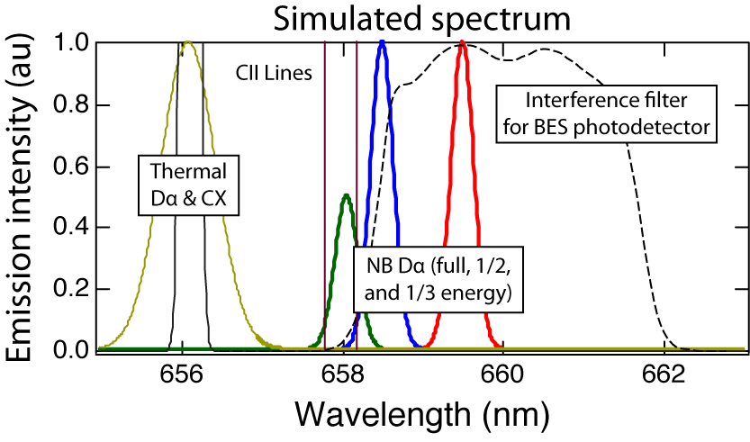
Beam emission spectroscopy (BES) measures Doppler-shifted D_{α} emission from a deuterium heating beam
C ≈ 1/2
neutral beam D_{α} emission
density
fluctuation
R. Fonck et al, RSI 61, 3487 (1990)
R. Fonck et al, PRL 70, 3736 (1993)
Notes:
BES measures Doppler-shifted D-alpha emission from a deuterium heating beam. In the top left, you can see NB D-alpha red-shifted relative to thermal D-alpha emission. An optical filter in the BES detection system passes the NB D-alpha and blocks other emission. In the top right, you see that the emission intensity is primary sensitive to plasma density and weakly sensitive to beam energy and temperature. In the bottom, you see a cartoon layout of the NSTX BES system. The beam emission is imaged onto optical fibers. At the fiber termination, the emission is collimated, passed through the interference filter, and reimaged onto a photodiode.

Slide 6
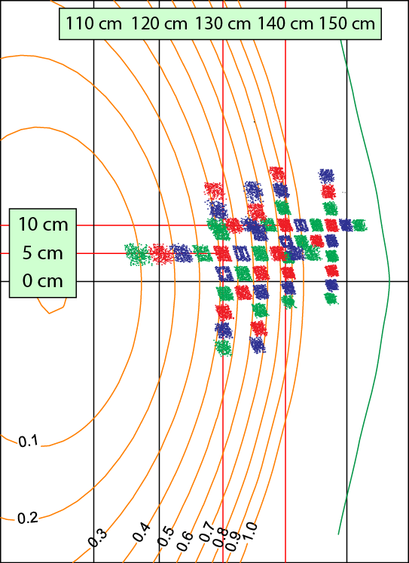
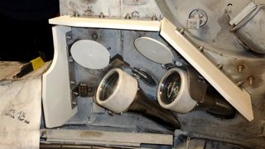
Radial and poloidal coverage on NSTX
High-throughput, field-aligned collection optics
NSTX
Edge ”R140”
Core “R130”
2.5-3 cm spot sizes
Measurements are sensitive to density fluctuations on the ion gyroscale with k⊥ρ_{i} ≤ 1.5
D. Smith et al, RSI 81, 10D717 (2010)
N. Schoenbeck et al, RSI 81, 10D718 (2010)
D. Smith et al, RSI 83, 10D502 (2012)
Notes:
The left figure shows the radial and poloidal coverage of the original BES system on NSTX. The sightlines were split among two sets of collection optics: the edge “R140” view and the core “R130” view. The measurements are sensitive to fluctuations down to the ion gyroscale.

Slide 7
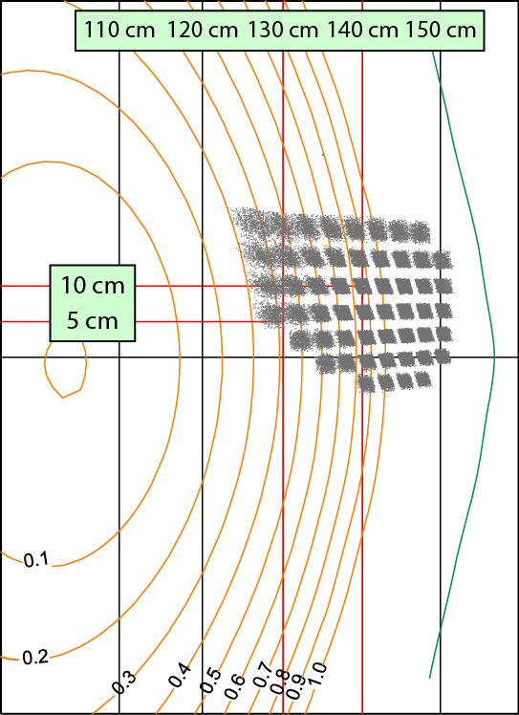
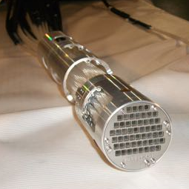
Upgraded 2D coverage on NSTX-U
2D fiber assembly w/ 54 bundles of 3x3 fibers
NSTX-U
Designed & fab’ed
by UW Phys. Sci. Lab
Notes:
For NSTX-U, BES sightlines were reconfigured for 2D measurements. The 2D fiber assembly was designed and fabricated by the UW Physical Sciences Lab.

Slide 8
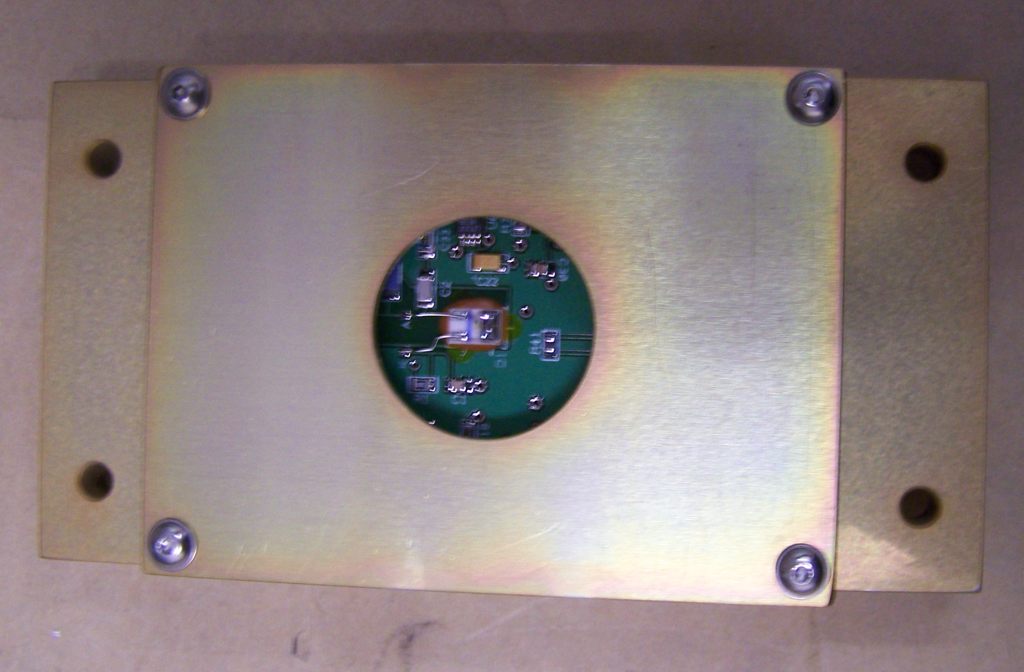
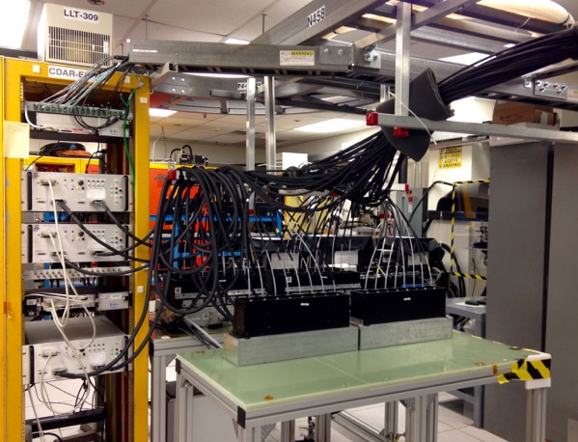
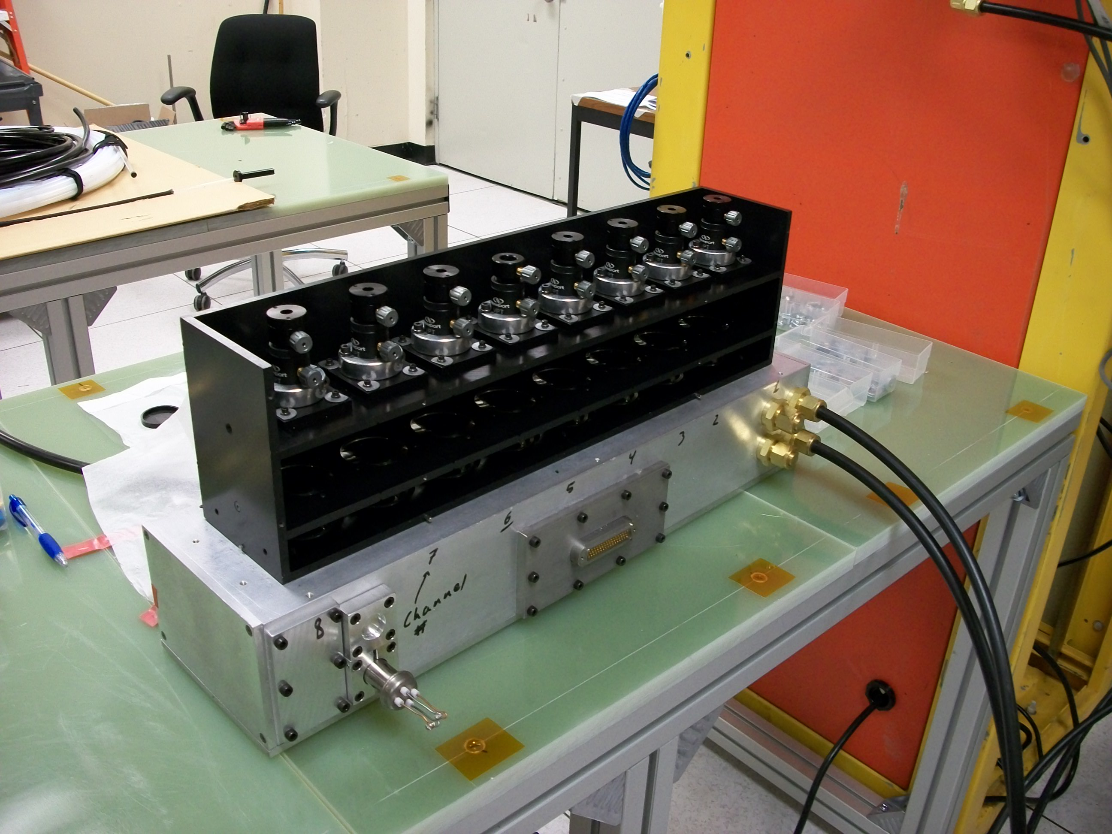
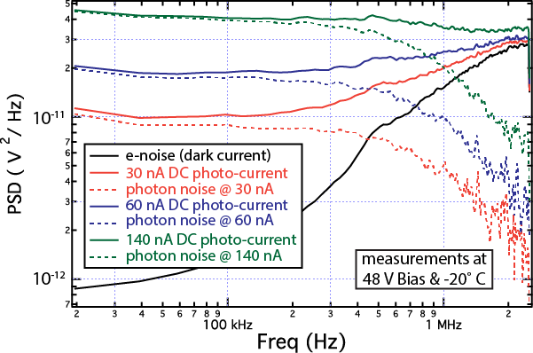
Low-noise, high quantum efficiency detection system
PIN photodiode (0.45 A/W) and pre-amp
48-channel (6 modules)
detection system
Designed & fab’ed by UW Space Astro. Lab
Digitizers: 2 MHz sampling with FPGA-based anti-alias filter
Fiber mount,
collimating lens, and filter
8-channel module
Photon noise limited up to 700 kHz at 60 nA photo-current
Vacuum & refrig. lines
Notes:
The top left shows a PIN photodiode and preamp circuit in an enclosure, and the circuit was designed by the UW Space Astronomy Lab. The bottom left shows an 8-channel detector module. The top black region contains fiber mounts, collimating lenses, and interference filters. The bottom is the vacuum box that houses the detectors. Here you see vacuum and vacuum-jacketed refrigerant lines connected to the vacuum box. On the right you see 54 fiber bundles winding down from the ceiling into 6 detector boxes; that’s 48 channels. In the rack you see three 16-channel signal conditioning units and two 32-channel digitizers.

Slide 9
ELM evolution patterns on NSTX/NSTX-U
Beam emission spectroscopy (BES) system on NSTX/NSTX-U
Identification of ELM evolution patterns with machine learning analysis on NSTX
Time-series similarity metrics
Hierarchical and k-means cluster analysis
Parameter regimes for identified evolution patterns and plans for nonlinear ELM simulations
2D measurements of ELM events from NSTX-U

Slide 10
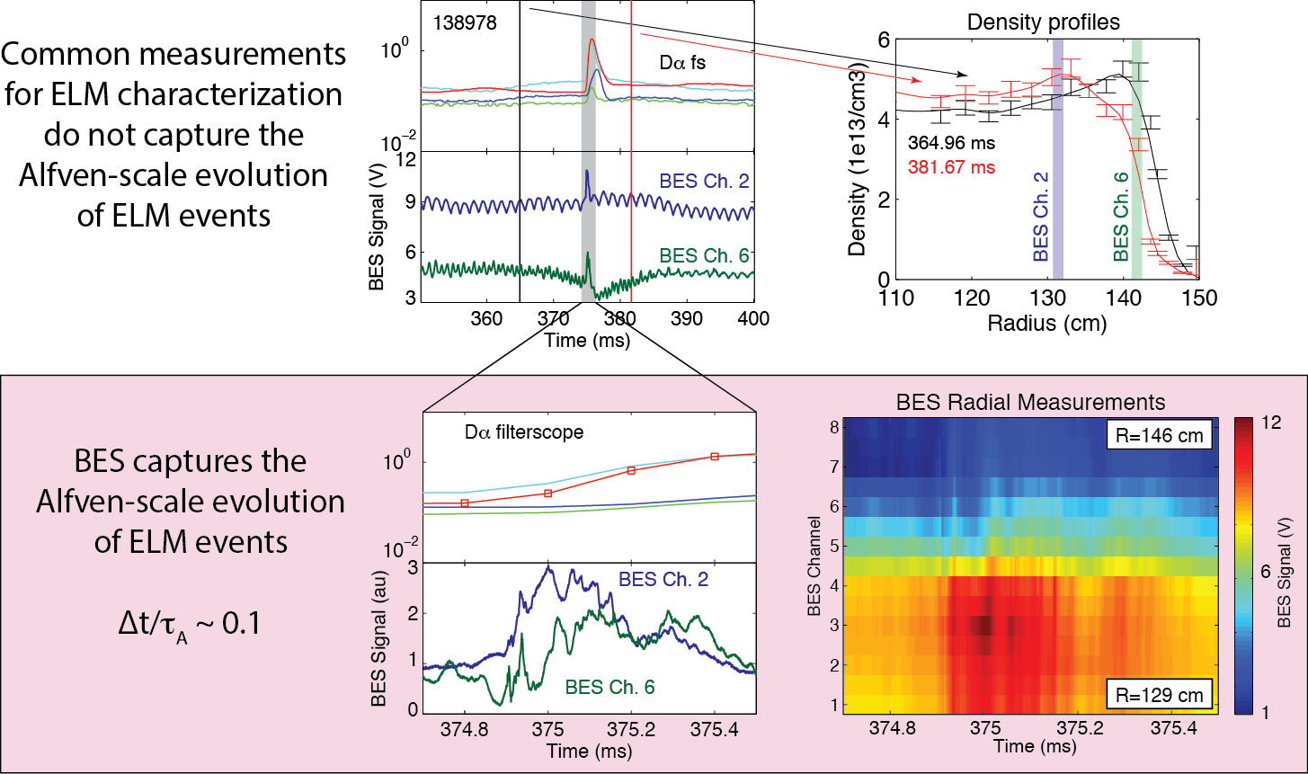
BES measurements with sub-𝛍s time resolution capture the Alfven-scale evolution and radial profile of ELM events
Notes:
This slide illustrates how BES measurements can capture ELM events with Alfven-scale time resolution and multi-point radial measurements. ELMs are often characterized with Thomson scattering and filterscope measurements. MPTS provides profile data at time intervals long compared to the ELM event, and similarly filterscopes do not capture the Alfven-scale evolution of ELM. In the bottom panels, you can see that BES captures ELM evolution details not available in other measurements.

Slide 11
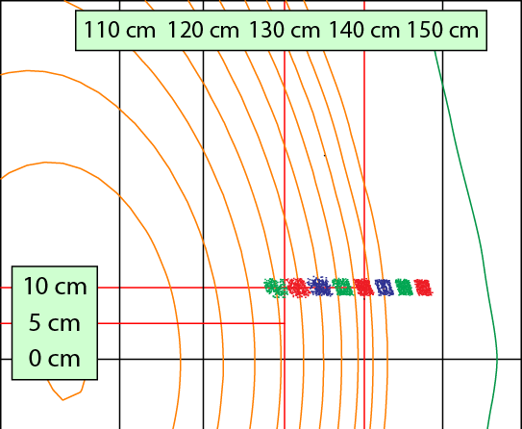
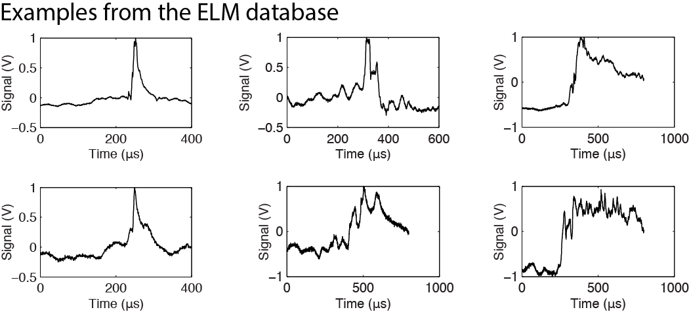
Goal – Identify common evolution patterns (if any) in ELM time-series data
Database of 51 ELM events measured with BES
8 radial BES channels spanning pedestal region
34 NSTX discharges from 8 run days spanning 4 months
1%-16% stored energy loss and observable pedestal collapse
Most likely type I ELMs
Notes:
We assembled a database of 51 ELM events with measurements from a radial array of BES sightlines spanning the outer plasma and SOL, shown in the top left. The ELMs exhibited a stored energy loss of 1-16% and an observable pedestal collapse from MPTS measurements. In the bottom, you see that BES measurements reveal significant variation in ELM evolution. The goal of this research activity is use machine learning tools to identify evolution patterns in ELM time-series data.

Slide 12
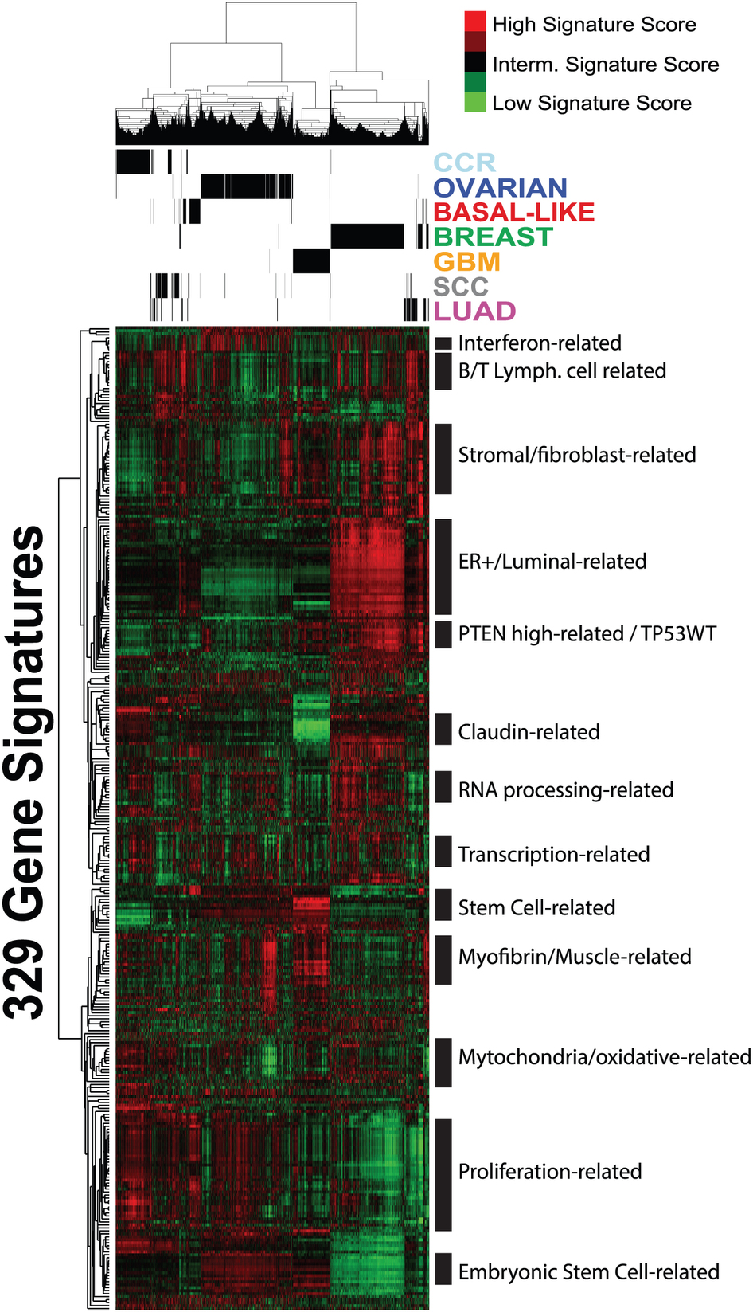
Method – Apply unsupervised machine learning techniques and time-series similarity metrics to identify common evolution patterns
Hierarchical clustering
Popularized in genomics
Produces a multi-level hierarchy of similar objects
Requires an intrinsic similarity metric to quantify similarity among time-series
Time-series similarity metrics
Time-lag cross-correlation
Euclidean distance
Dynamic time warping (DTW)
Wavelet decomposition
K-means clustering
Groups similar objects into k mutually exclusive clusters
Requires an extrinsic similar metric to quantify similarity among time-series
Optimum cluster number found by trial-and-error
Prat et al, Scientific Reports 3, 3544 (2013)

Slide 13
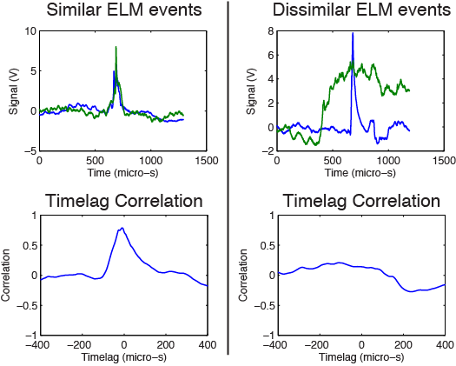
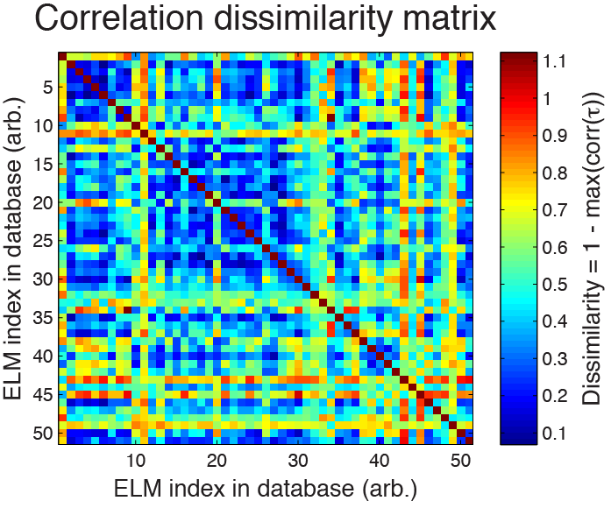
Hierarchical clustering (I) – Assemble pair-wise similarity metrics into a dissimilarity matrix
Time-lag cross-correlation can quantify the similarity of ELM events
Assemble pair-wise metrics into a dissimilarity matrix
Low
similarity
High similarity
Larger max correlation ➞ more similar
Notes:
We start with hierarchical clustering and we consider time-lag cross-correlation as a similarity metric. On the left you see that ELM events with similar evolution traces exhibit a larger maximum cross-correlation. We collect maximum cross-correlations for all ELM pairs and we assembly a dissimilarity matrix where dissimilarity is defined to be 1- max(corr). In the matrix, blue represents high similarity pairs and red is low similarity pairs.

Slide 14
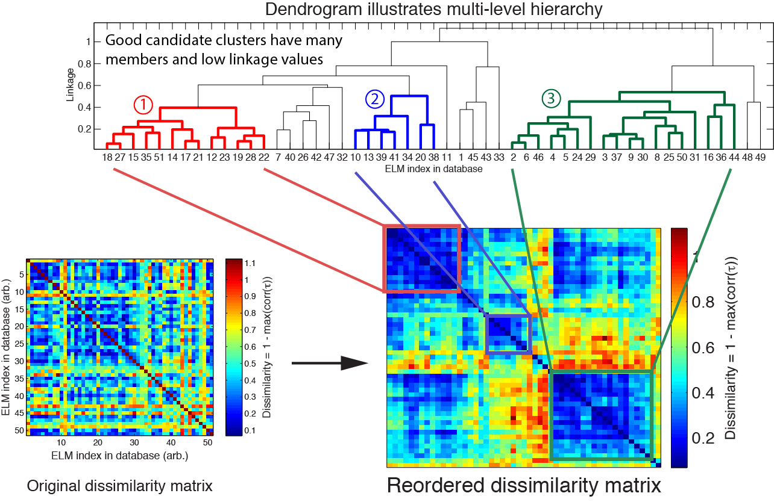
Hierarchical clustering (II) – Apply clustering algorithm to dissimilarity matrix to identify groups of similar ELMs
D. Smith et al, PPCF 58, 045003 (2016)
Notes:
The designation of red, blue, and green groups will be preserved in upcoming slides.

Slide 15
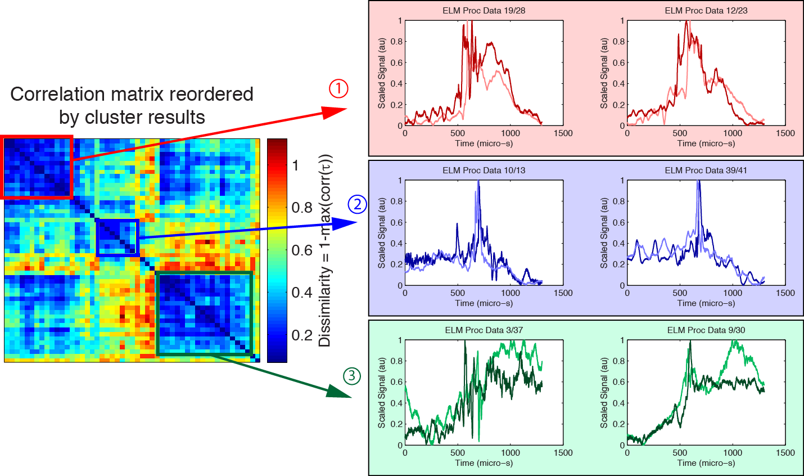
The identified ELM groups show similar evolution characteristics

Slide 16
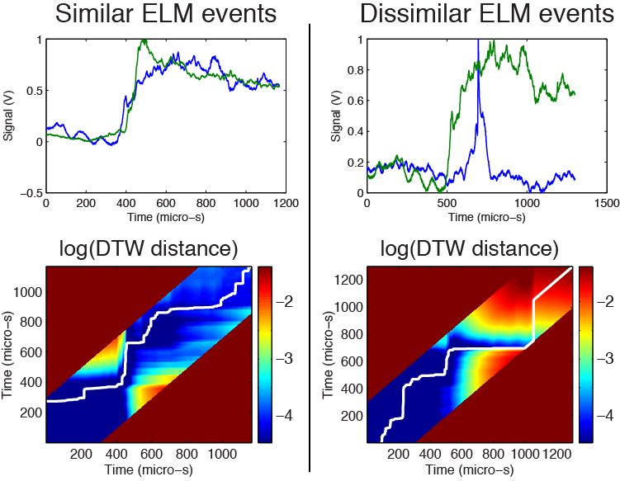
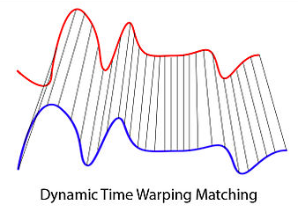
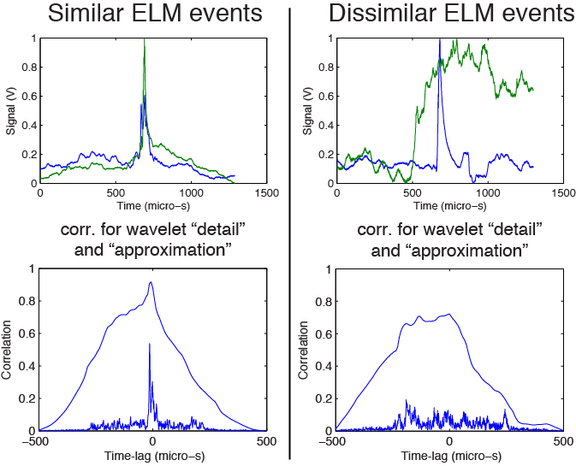
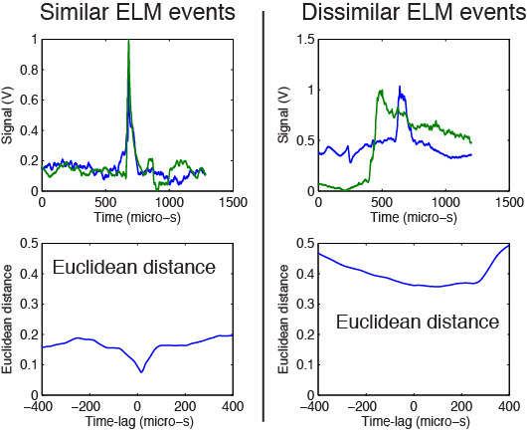
Now try other similarity metrics
Dynamic time warping
Wikipedia
Cross-corr. of wavelet- transformed signals
Euclidean
distance
D. Smith et al, PPCF 58, 045003 (2016)

Slide 17
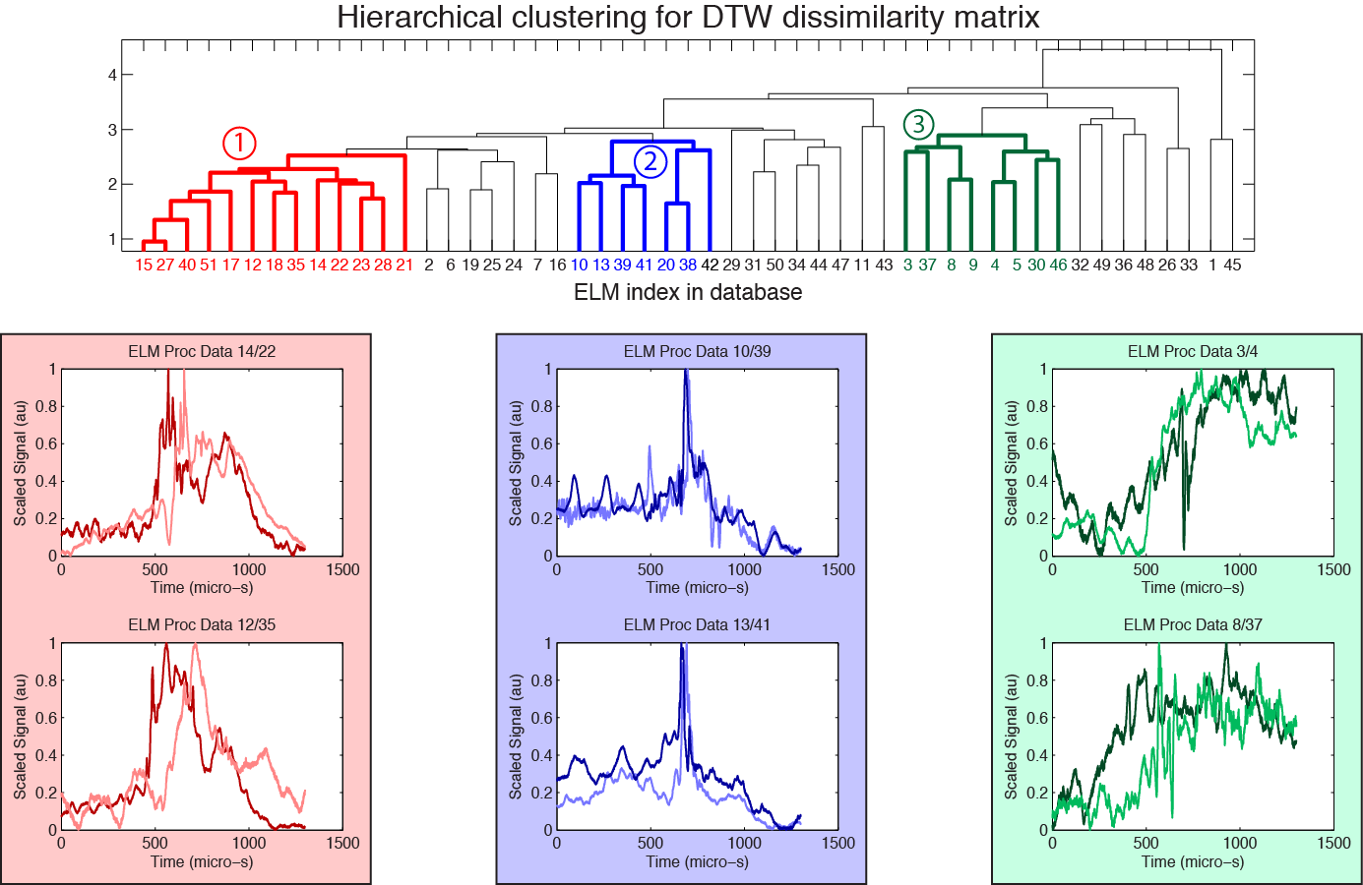
For instance, dynamic time warping (DTW) yields cluster results similar to time-lag correlation

Slide 18
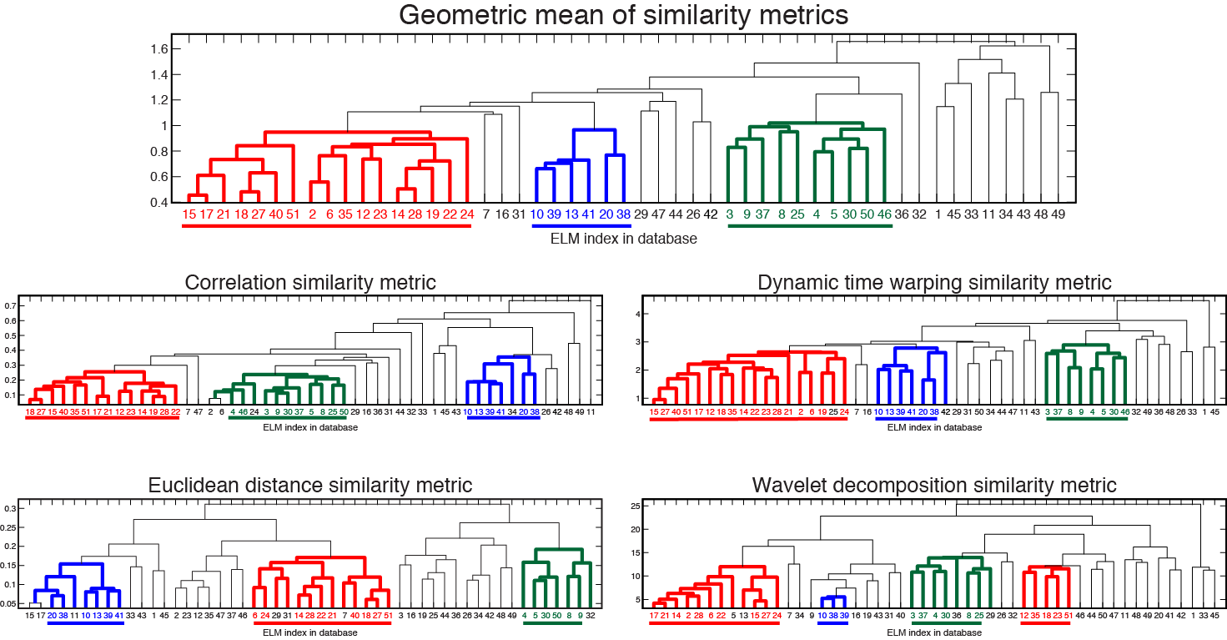
Similar ELM groups from different metrics suggests that the ELM groups are robust results
D. Smith et al, PPCF 58, 045003 (2016)

Slide 19
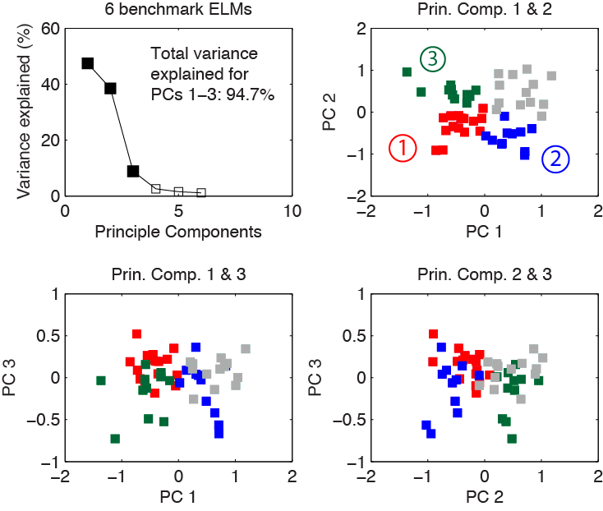
K-means clustering (I) – Group objects into mutually exclusive groups
Requires extrinsic similarity metrics
Designate benchmark ELMs to serve as extrinsic metrics
Visualize results in low-dimensional space from PCA
K-means clustering with 6 benchmark ELMs
# of clusters | Mean ratio*
2 | 0.49
3 | 0.51
4 | 0.52
5 | 0.48
6 | 0.46
7 | 0.45
Optimal
*Out-of-cluster/in-cluster distance ratio
D. Smith et al, PPCF 58, 045003 (2016)

Slide 20
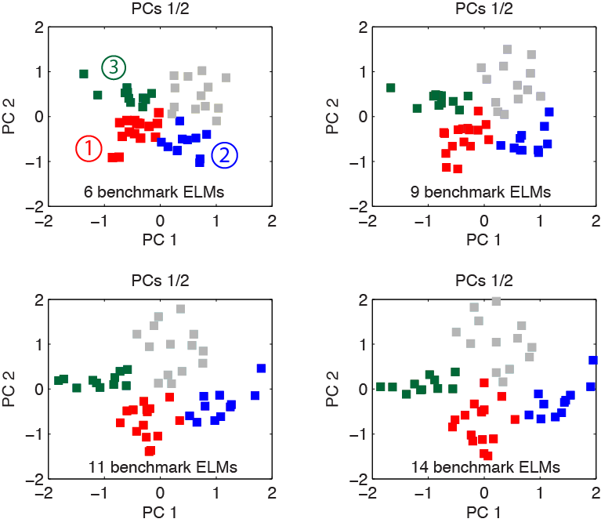
K-means clustering (II) – Different sets of benchmark ELMs yield similar results
# of benchmark ELMs | Optimal cluster # | Mean ratio
6 | 4 | 0.52
9 | 4 | 0.52
11 | 4 | 0.53
14 | 4 | 0.52
Clusters are highly consistent for calculations with different benchmark ELMs
Red cluster ELMs: 2, 35, 23, 19, 22, 12, 28, 14, 51, 24
Blue cluster ELMs: 13, 15, 10, 39, 41, 40, 38, 17, 27, 18
Green cluster ELMs: 30, 4, 50, 3, 5, 36, 29, 9, 8, 46

Slide 21
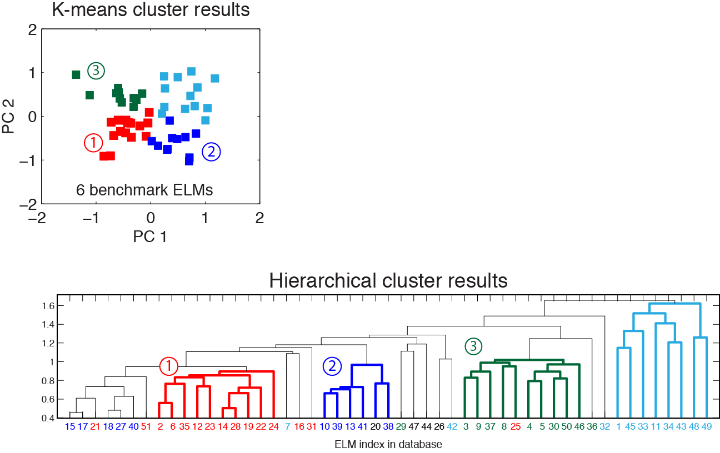
k-means clustering and hierarchical clustering yield consistent results
Red, Blue, and Green groups in k-means results are largely consistent with previous hierarchical cluster results
The Cyan group in k-means corresponds to poorly linked ELMs in the hierarchical cluster
Colors correspond to k-means clusters
D. Smith et al, PPCF 58, 045003 (2016)

Slide 22
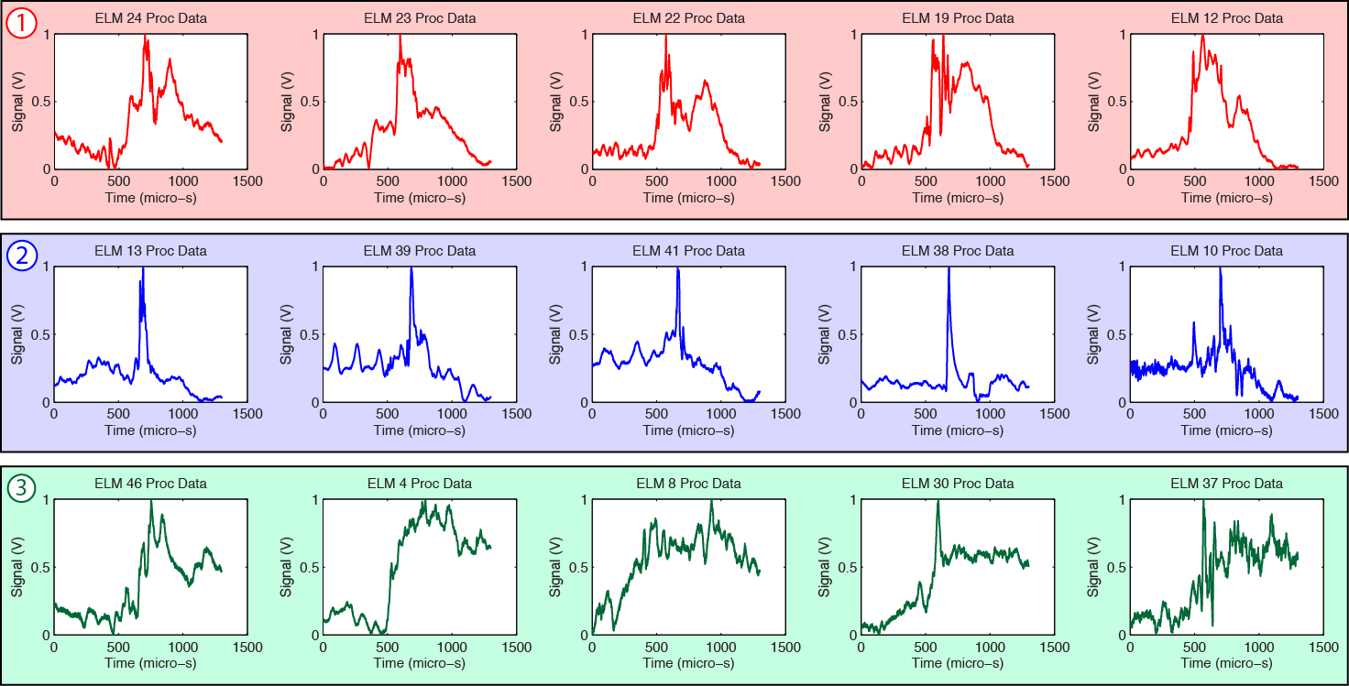
ELMs with similar evolution characteristics
This analysis demonstrates that machine learning techniques can identify patterns and similarities in time-series data

Slide 23
ELM evolution patterns on NSTX/NSTX-U
Beam emission spectroscopy (BES) system on NSTX/NSTX-U
Identification of ELM evolution patterns with machine learning analysis on NSTX
Time-series similarity metrics
Hierarchical and k-means cluster analysis
Parameter regimes for identified evolution patterns and plans for nonlinear ELM simulations
2D measurements of ELM events from NSTX-U

Slide 24
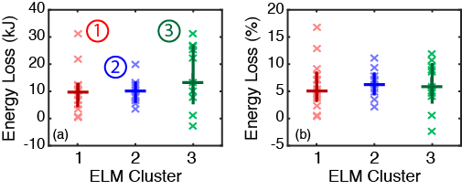
Identified ELM groups exhibit similar stored energy losses
Values for individual ELMs
20th, 50th, & 80th percentile values
Stored energy loss can’t differentiate the identified ELM groups
D. Smith et al, PPCF 58, 045003 (2016)

Slide 25
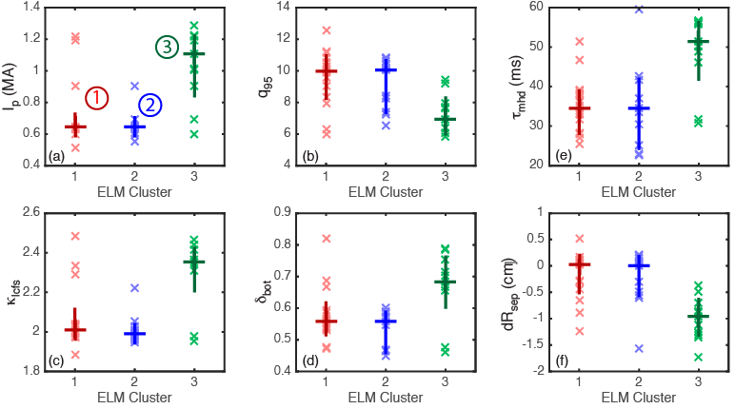
Identified ELM groups correlate with distinct parameter regimes (I)
Red and Blue ELM groups exhibit similar parameter regimes
Observed evolution patterns and associated parameter regimes suggest genuine variations in underlying nonlinear dynamics
Higher triangularity is stabilizing for PB modes (Snyder, PPCF, 2004)
At higher Ip, most unstable mode shifts to lower n (Liu, PoP, 2014) Higher Ip is stabilizing for PB (Snyder, PPCF, 2004)

Slide 26
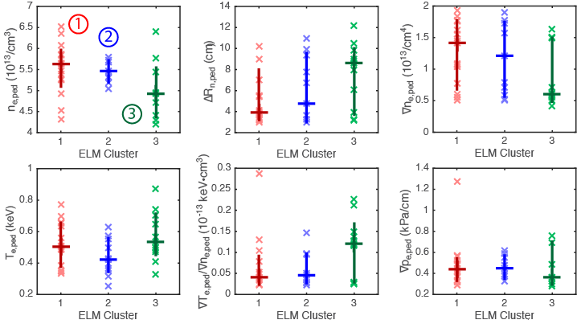
Identified ELM groups correlate with distinct parameter regimes (II)
Pedestal density parameters appear to
differentiate the ELM groups
The pressure gradient does not appear
to differentiate the ELM groups

Slide 27
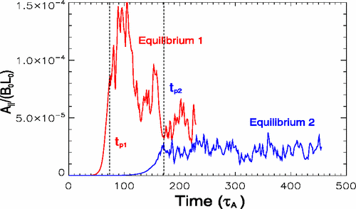
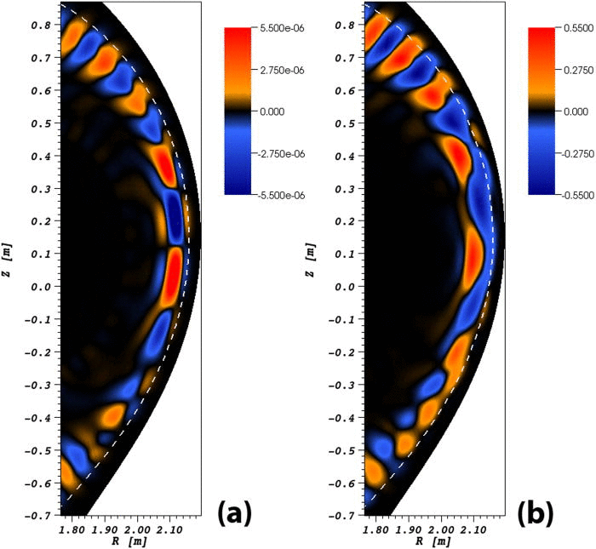
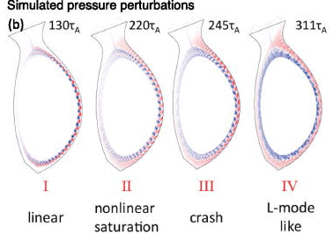
Nonlinear ELM simulations provide time evolution and 3D perturbations
X. Xu et al, PRL, 2010
M. Holzl et al, PoP, 2012
Z. Liu et al, PoP, 2014
Work-in-progress: Nonlinear BOUT++ simulations for the identified ELM evolution patterns and parameter regimes

Slide 28
ELM evolution patterns on NSTX/NSTX-U
Beam emission spectroscopy (BES) system on NSTX/NSTX-U
Identification of ELM evolution patterns with machine learning analysis on NSTX
Time-series similarity metrics
Hierarchical and k-means cluster analysis
Parameter regimes for identified evolution patterns and plans for nonlinear ELM simulations
2D measurements of ELM events from NSTX-U

Slide 29
2D BES measurement of ELM event on NSTX-U

Slide 30
Summary
BES measurements with Alfvenic time resolution capture the nonlinear evolution of ELM events on NSTX
Unsupervised machine learning algorithms identified groups of ELMs with similar evolution characteristics
The identified ELM groups correlate with parameter regimes relevant to ELM physics
Ip, q-95, δ, dR_{sep}, n_{e,ped}, ∆R_{n,ped}
Working towards NL simulations to clarify the mechanisms at play in the identified ELM groups
2D BES measurements are now available on NSTX-U
Machine learning techniques can leverage large data archives for pattern recognition, relationship discovery, and automated classification

Slide 31
Backup

Slide 32
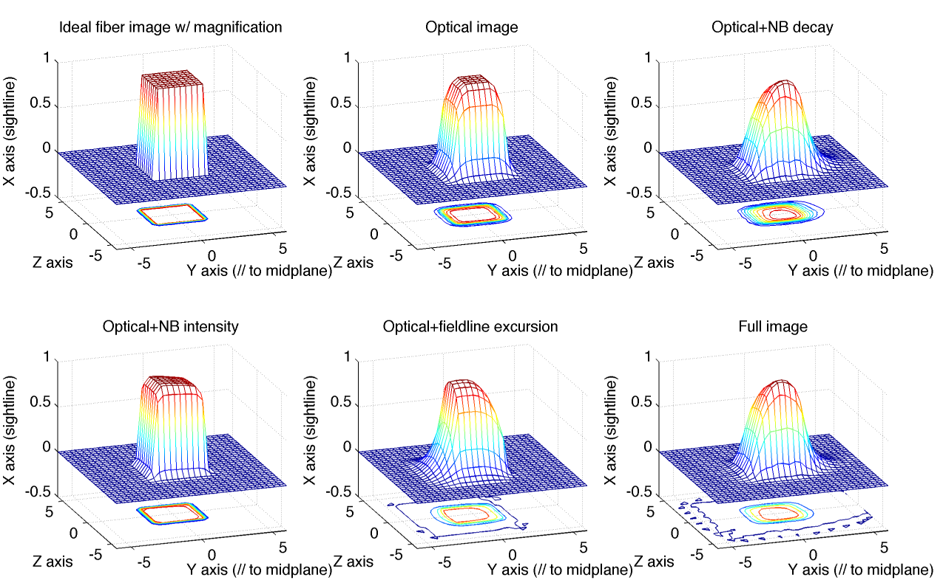
Point spread function calculations indicate NB excited state lifetimes and fieldline trajectory blur the 1/e² spot size by 10%
 | Fiber bundle | Optical Image | Opt + D* Lifetime | Opt + NB int. | Opt + B Misalign. | All Effects
Rad. 1/e² width (cm) | 3.2 | 4.0 | 4.4 | 3.2 | 4.4 | 4.4
Rad. displ. (cm) | 0 | 0 | 0.5 | 0 | -0.5 | 0.3
X (au) image int.
Y (cm) ~ radial
Z (cm) ~ binormal
Simulated fiber image
Notes:
Three effects can distort the spatial distribution of BES measurements: the finite lifetime of deuterium excited states, the deuterium beam spatial distribution, and misalignment with the local magnetic field. The calculations summarized here show that the effects blur the 1/e2 spot size by about 10%. The 1/e2 width of the optical image is 4 cm, but finite lifetime of deuterium excited states blurs the 1/e2 width to 4.4 cm. Similarly, the angular misalignment between the sightline and the curving fieldline blurs the 1/e2 width to 4.4 cm.

Slide 33
Machine learning techniques can boost the scientific impact of large data archives
Many data-rich scientific fields successfully leverage machine learning techniques
Unsupervised pattern recognition, relationship discovery in complex datasets, automated data classification
Cancer genomics, exo-planet detection, seismic wave classification, seizure onset prediction
ML techniques excel when the quantity of data exceeds the capacity for human inspection
NSTX/NSTX-U data archive
About 40 TB of data obtained with R&D investment approaching $1B
ML tools can leverage large data archive with automated, whole-archive analysis

