Slide 1



Vacuum ultraviolet and Ultraviolet Spectrometers for Real-time Radiative Divertor Feedback Control in the NSTX-U Tokamak
V. A. Soukhanovskii, R. Kaita, B. Stratton, and NSTX-U Team
Madison, WI, 5-9 June 2016, 2016

Slide 2
Abstract
To prevent excessive erosion and thermal damage of divertor plasma-facing components, a radiative divertor technique is planned for the NSTX-U tokamak. In the radiative (partially detached) divertor, plasma volumetric power and momentum losses are significantly increased by means of extrinsically seeded deuterium or impurity gases. A real-time feedback control of the gas seeding rate (the actuator) is planned. The control sensors can include a variety of diagnostics; however, to make the radiative divertor control independent of main plasma discharge parameters (e.g., input power, plasma current, density, seeding gas, etc), we consider divertor plasma electron temperature as a control parameter. During divertor detachment, a radiation front is formed at 10-15 eV if low-Z impurities (e.g., carbon, nitrogen) are used for radiation. In the strike point region, strong deuterium high-n Balmer and Paschen series line emissions are observed. A vacuum ultraviolet spectrometer SPRED with a fast camera detector is developed for temperature monitoring at T_{e} < 15 eV, based on the Dn=0,1,2 line intensity ratios of low-Z lines in the spectral range 300-1600 A. A separate multichannel ultraviolet spectrometer is used for temperature measurements based on the Balmer line intensities at T_{e} < 5 eV. Both spectrometers use collisional-radiative model based line intensity ratio interpretation and output a real-time T_{e}-dependent signal within a characteristic divertor detachment equilibration time of ≤ 15 ms.
Prepared under Contracts DE-AC52-07NA27344 and DE-AC02-09CH11466.

Slide 3
Outline
Radiative divertor technique in standard and snowflake configurations are leading heat flux mitigation candidates in NSTX-U
Real-time T_{e} from two spectrometers is proposed as control signal for radiative divertor control
  VUV spectrometer SPRED – carbon and nitrogen ion emission lines for 5 eV ≤ T_{e} ≤ 25 eV
  UV spectrometer DIBS – deuterium Balmer lines and recombination continuum for T_{e} ≤ 0.5-3 eV

Slide 4
Various techniques developed for reduction of heat fluxes q|| (divertor SOL) and q_{peak} (divertor target)
Radiated power loss
Increase via V_{div}, L_{II}
Poloidal target
inclination, up-down,
in-out fractions,
N divertors
Increase plasma-wetted area
Increase divertor area at large R_{SP}
Increase plasma-wetted area via increasing f_{exp}
Increase λ_{q} via
increased
radial transport, L_{II}
Divertor peak heat flux mitigation techniques:
Divertor geometry (poloidal flux expansion, divertor plate tilt, magnetic balance, snowflake divertor)
Radiative divertor with extrinsic impurity seeding

Slide 5
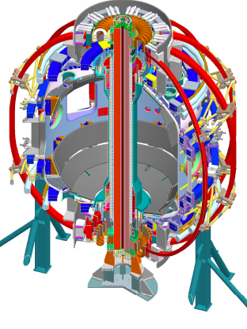
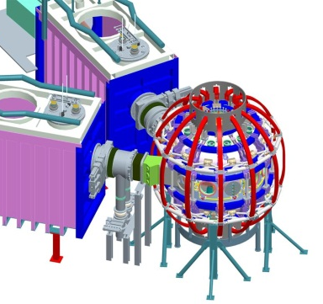

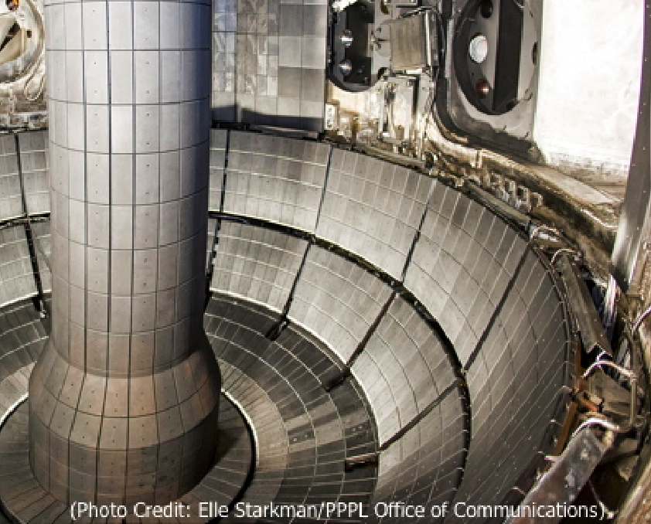
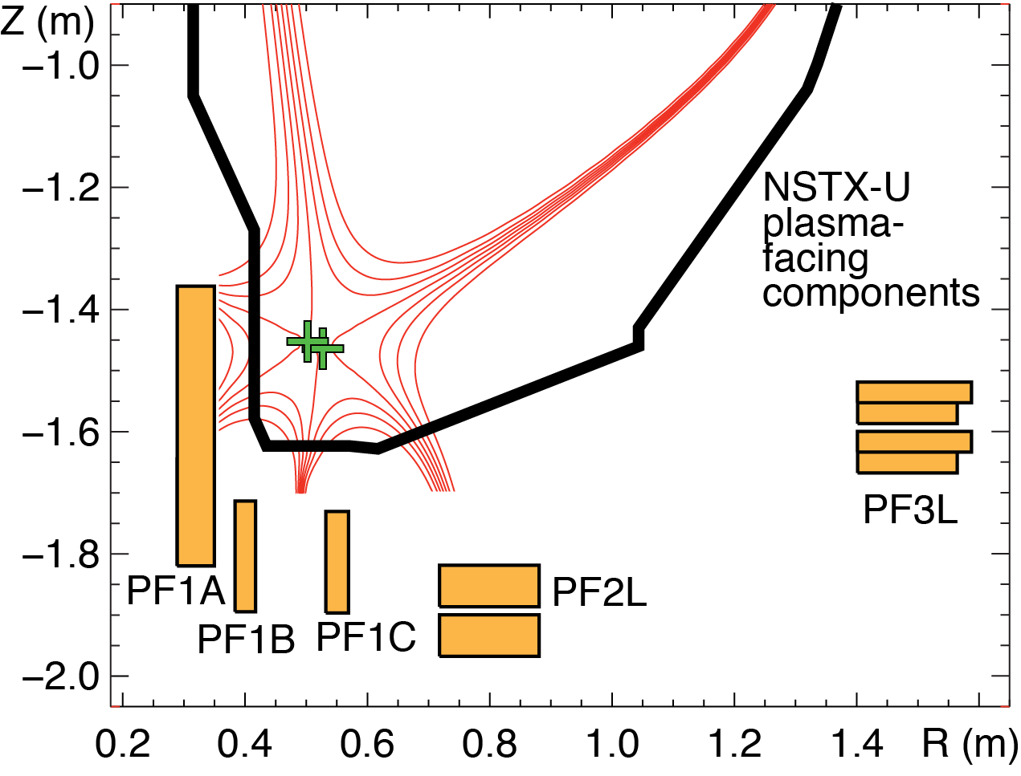
Open geometry divertor with graphite PFCs will be used in initial years in NSTX Upgrade
Gas
New center-stack
2nd neutral beam
B_{T}
I_{p}
1 T
P_{NBI}
pulse
12 MW
2 MA
5 s
J. E. Menard et. al, Nucl. Fusion 52 (2012) 083015
Open divertor geometry
No active divertor pumping
Graphite plasma facing components
Four up-down symmetric divertor coils
Diagnostics: IR cameras, MPTS, Langmuir probes, filtered visible cameras, VUV-UV-VIS-NIR spectroscopy

Slide 6
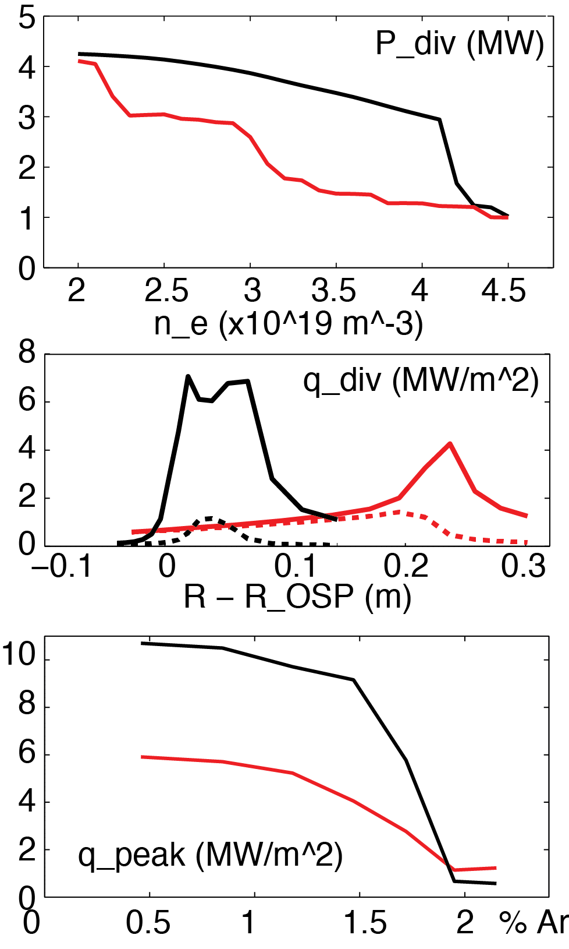
Edge modeling predicts significant heat flux reduction with radiative snowflake divertor
Standard Snowflake
Snowflake with 3% carbon
Wide density operational window as low as n_{e}/n_{G}≤0.4
  Peak heat flux reduced up to 50% stronger (cf. standard radiative divertor) at lower n_{e}
  Less impurity seeding (argon or neon) needed for lower peak heat flux
Multi-fluid code UEDGE
  B_{t} = 1.0 T, I_{p} = 2 MA, P_{SOL} = 9 MW
  NSTX-like transport χ_{i,e}=2-4 m²/s, D=0.5 m²/s
Total
Rad.
heating
E. T. Meier et. al, Nucl. Fusion (2015)

Slide 7
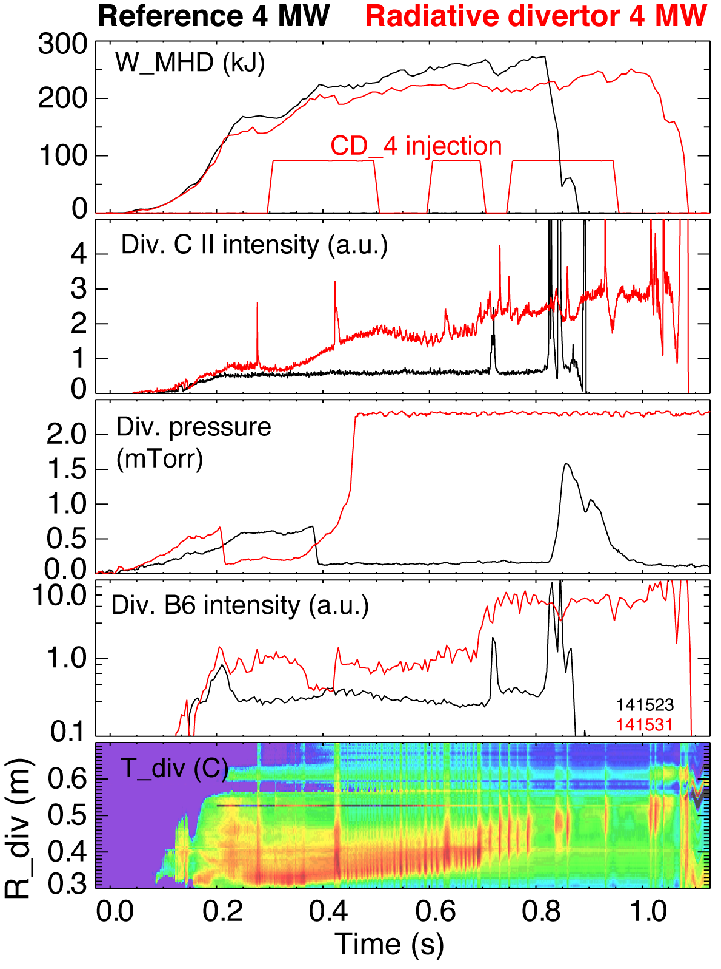
Impurity-seeded radiative divertor with feedback control is planned for long discharges
In NSTX, heat flux reduction in radiative divertor compatible with H-mode confinement was demonstrated with D₂ or CD₄ puffing
Feedback control of divertor radiation via impurity particle balance control
  Cryopump for particle removal
  Divertor gas injectors
  Real-time control signal diagnostics could include
    PFC temperature via IR thermography or thermocouple
    Thermoelectric current between inner and outer divertor
    Impurity VUV spectroscopy or bolometry
    Neutral gas pressure or electron-ion recombination rate
    Spectroscopic T_{e} estimation
Soukhanovskii, HTPD 2012, RSI 2012

Slide 8
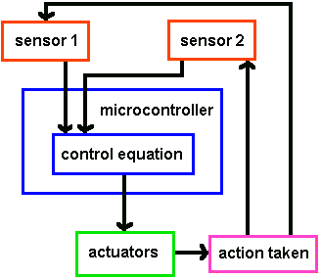
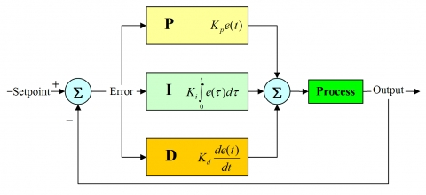
Conceptual design of radiative divertor feedback control system is based on PID control
Proportional, integral, derivative controller

Slide 9
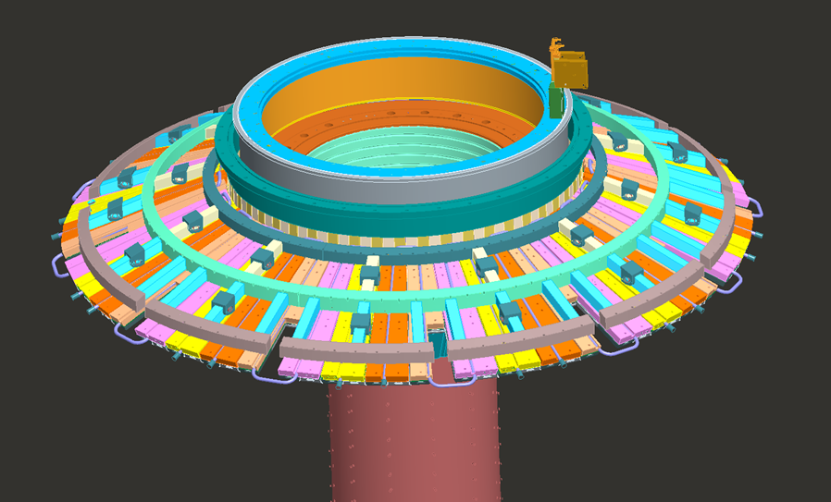
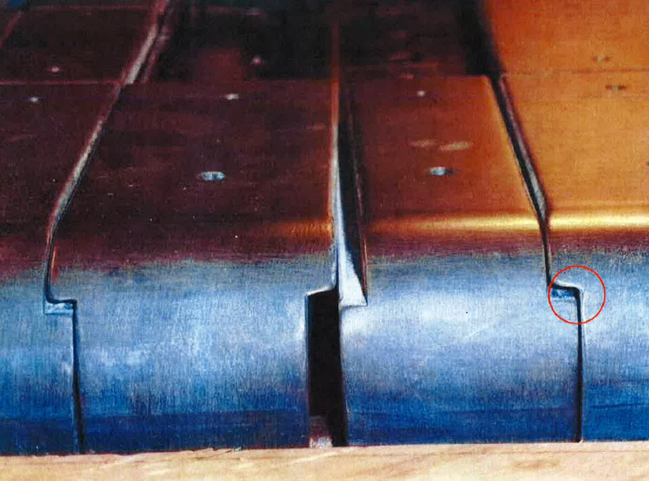
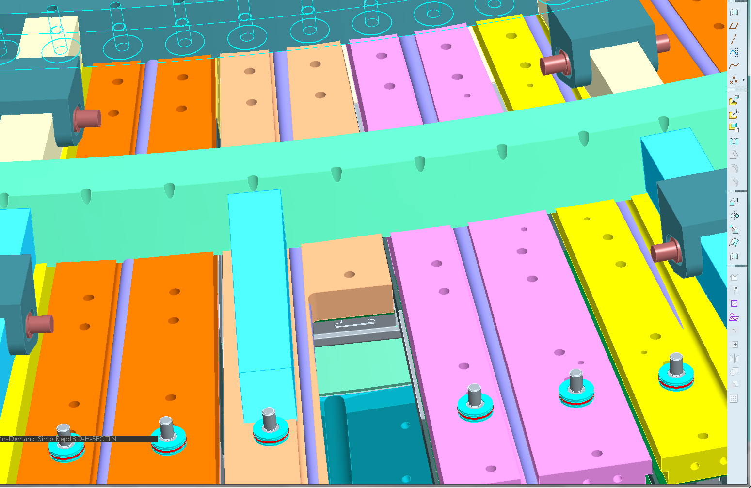
Control actuator – the new divertor gas injection system is being commissioned
Four ½” OD SS divertor gas injection lines
2 upper and 2 lower
  Copper backing plates modified to run tubing
  Piezoelectric valves located at L=50 ms x v_{c} from orifice
  Γ ≤ 1e22 particles/s

Slide 10
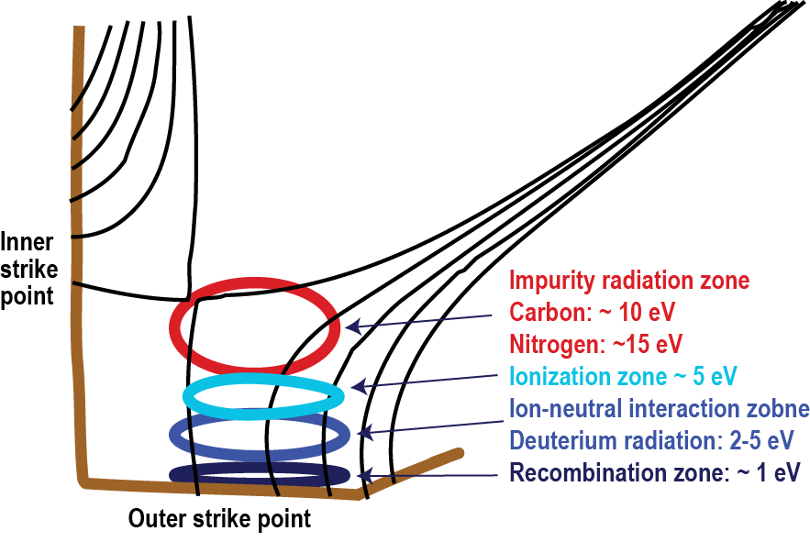
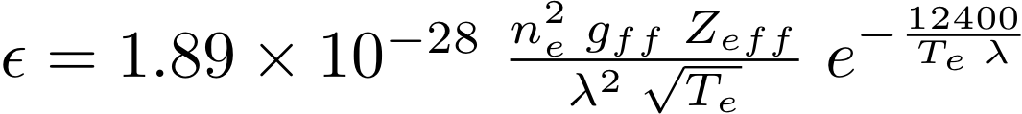


T_{e}-sensitive line intensity ratios are considered for divertor detachment control signal
Balmer n=6-12 series lines in ion-neutral interaction zone T_{e} ≤ 5 eV
  Population kinetics is dominated by 3-body recombination at lower temperature
  3-body recombination rate
  R ~ n_{e}³ T_{e}^{-4.5}
  Plasma is optically thin for Balmer lines
  Dominated by Stark broadening due to linear Stark effect in electron and ion microfield. Other mechanisms neglected: Zeeman spitting, Van der Waals and natural broadening
  Background due to bremsstrahlung and radiative recombination
Figure concept after M. E. Fenstermacher, PPCF 1999
Carbon or nitrogen Δn=0; 1; 2 lines in impurity radiation zone T_{e} ≤ 10-15 eV
  Intensity ratios highly T_{e} sensitive due to T_{e} sensitivity of excitation rates
  Emission also proportional to impurity density

Slide 11
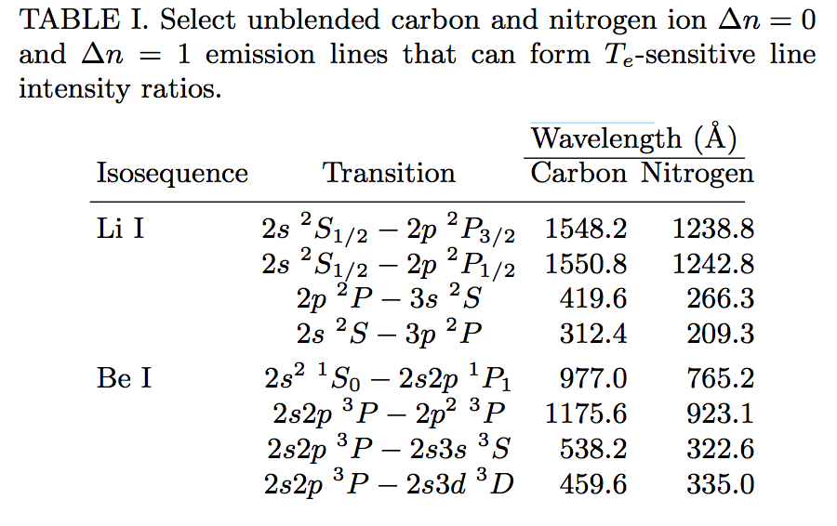
Carbon or nitrogen Li-like and Be-like ion Δn=0; 1; 2 line intensity ratios are T_{e} sensitive
Δn=0 and Δn=1 are baseline approach
Δn=2 transitions can also be considered if reliably measured
ADAS PECs used (PEC93)
← Lines correspond to three densities 2, 5, 20 x 10¹⁹ m⁻³

Slide 12
Divertor SPRED spectrometer has broad applications for NSTX-U program
Support plasma-facing component program
  Steady-state and transient divertor impurity measurements
    edge / divertor Mo III-XIV line emission
    SOL / divertor Li II, Li III, C II, C III, C IV line emission
Support divertor program
  Divertor carbon ionization balance (steady-state and during ELMs)
  Divertor T_{e} estimates from C II, C III, C IV line ratio (LR) measurements
    Deviation from Maxwellian EEDF might be detected from these LR’s
  Improved divertor P_{rad} analysis
    Most P_{rad} is due to several strong C III - C IV emission lines in the VUV
  Radiative divertor impurity radiation (CD₄, N₂, Ne, Ar)
  Detached divertor Lyman series for recombination rate, T_{e}, opacity

Slide 13
Divertor SPRED VUV spectrometer enables impurity emission measurement in outer divertor leg

Slide 14
VUV spectrometer SPRED
McPherson Model 251 flat-field 0.3 m spectrograph (Weight: 250 lb)
Two-grating turret with Au-coated gratings 290 and 2105 l/mm
MCP-based detector with CsI-coated photocathode and P46 phosphor
  Time response 50 um
Ion pump with controller
Schott 12 ft imaging bundle 25x4 mm
Princeton Instruments Pro-EM 1600x200 camera
  Electron multiplication gain 1-1000
  16 um pixels
  Readout time if fully vertically binned 0.70 ms
  Readout time if single row 0.22 ms

Slide 15
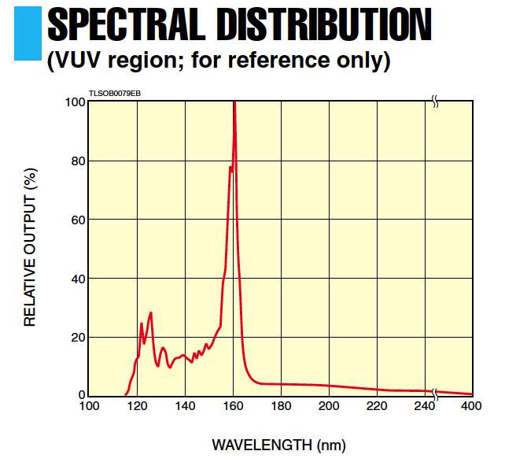
Laboratory spectral measurements with divertor SPRED
Hamamatsu VUV D₂ lamp
Laboratory SPRED measurements performed through a MgF₂ window – hence the cut-off at about 1150 A
Laboratory measurements show high dynamic range of the detector system
Spectral range 200-1600 A is adjusted and confirmed

Slide 16
Micro-channel plate gain and phosphor acceleration ranges are verified in the laboratory
MCP + CCD tested with Hamamatsu VUV D₂ lamp
Spectral feature at 1260 A is used
MCP gain varies over 2.5 orders of magnitude
Phosphor acceleration can also be varied by factor 10

Slide 17
NBS 1963A Optical resolution target test shows 30 um spatial resolution of optical relay and detector system
High-frequency NBS 1963A resolution test targets
Target attached to fiberoptic bundle, lens and CCD
Resolution about 30 um

Slide 18
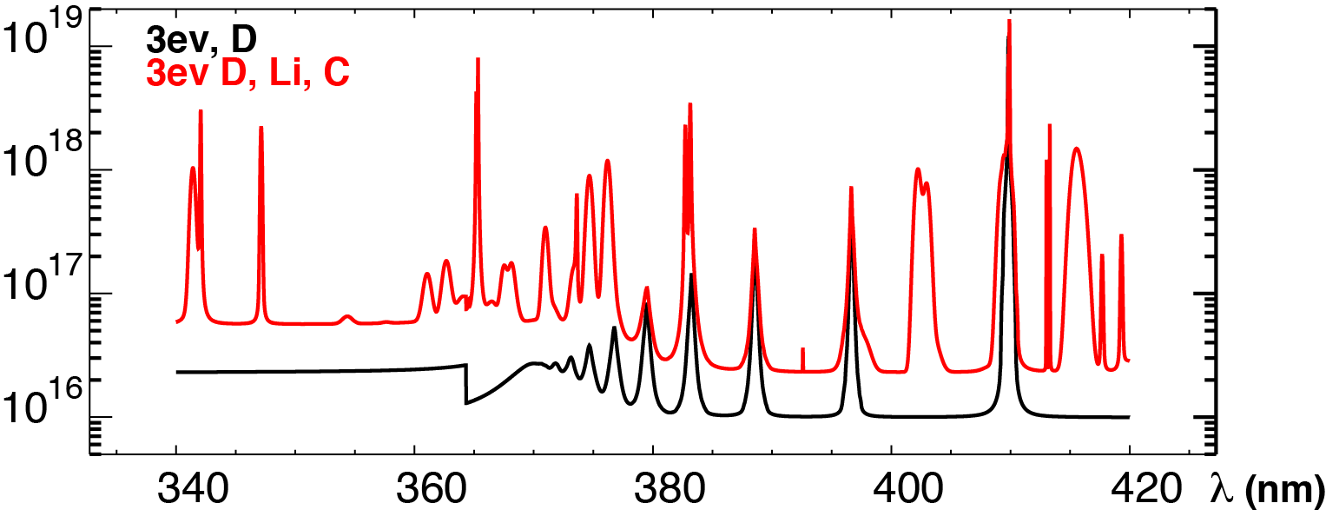
CRETIN code modeling used for T_{e} sensitivity of D, Li, C spectra
CRETIN code is a collisional-radiative and radiation transport solver
  H. Scott, J. Quant. Spectrosc. Radiat. Transf. 71 (2001) 689
  Calculates whole spectrum including bremsstrahlung, line emission,line profiles, self-absorption, ionization and recombination
  Includes NLTA population kinetics, radiation transport, neutral diffusion, diagnostic simulators
  Line profiles code: TOTAL
    Quasi-static approximation for ions, impact approximation for electrons
    Electric dipole momentum reduced matrix elements must be calculated elsewhere
Atomic data either from FAC or from hydrogenic model

Slide 19
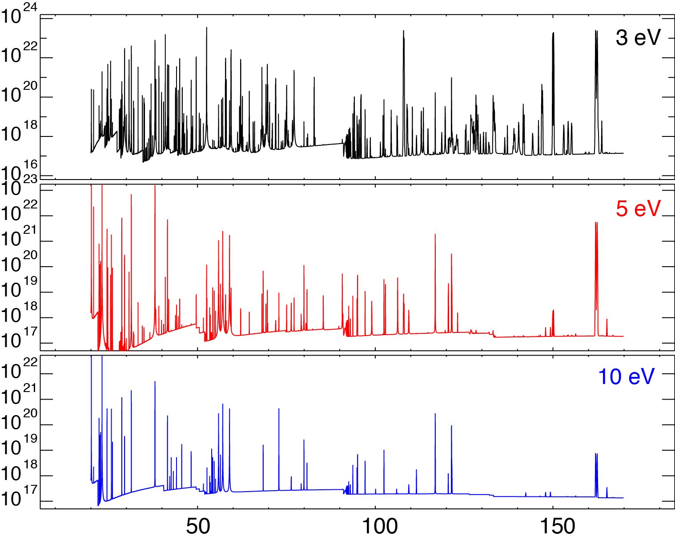
Li, C, O spectra simulations with CRETIN demonstrate feasibility of spectroscopic T_{e} measurements
λ (nm)

Slide 20
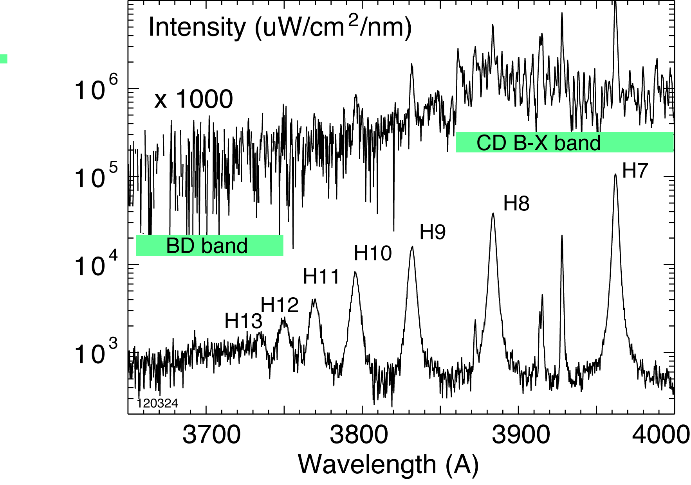
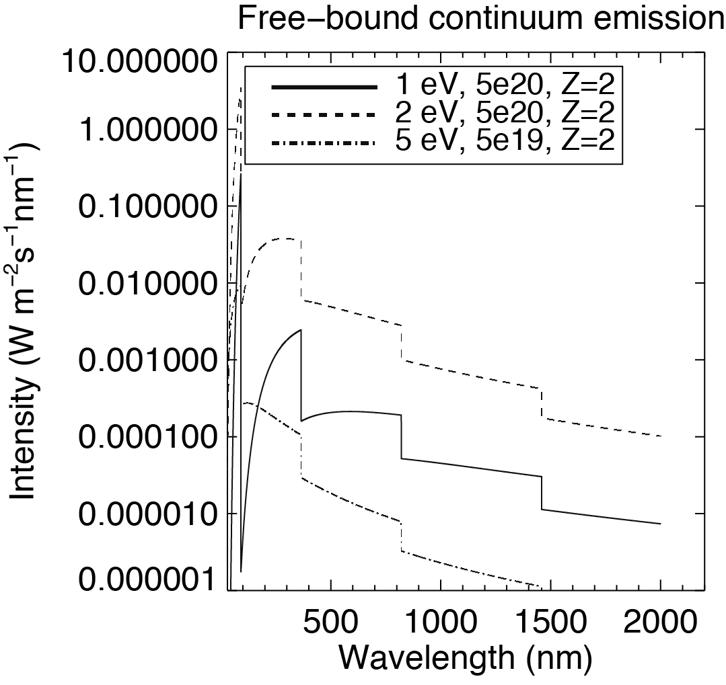
High-n Balmer line spectra used in NSTX for divertor recombination rate, T_{e} and n_{e} studies
Balmer series spectra modeled with CRETIN
T_{e}=0.8-1.2 eV, n_{e}=2-7 x 10²⁰ m⁻³ inferred from modeling
Free-bound continuum modeled with CHIANTI
V. A. Soukhanovskii et al., Nucl. Fusion 2011
V. A. Soukhanovskii et al., RSI 2006

Slide 21
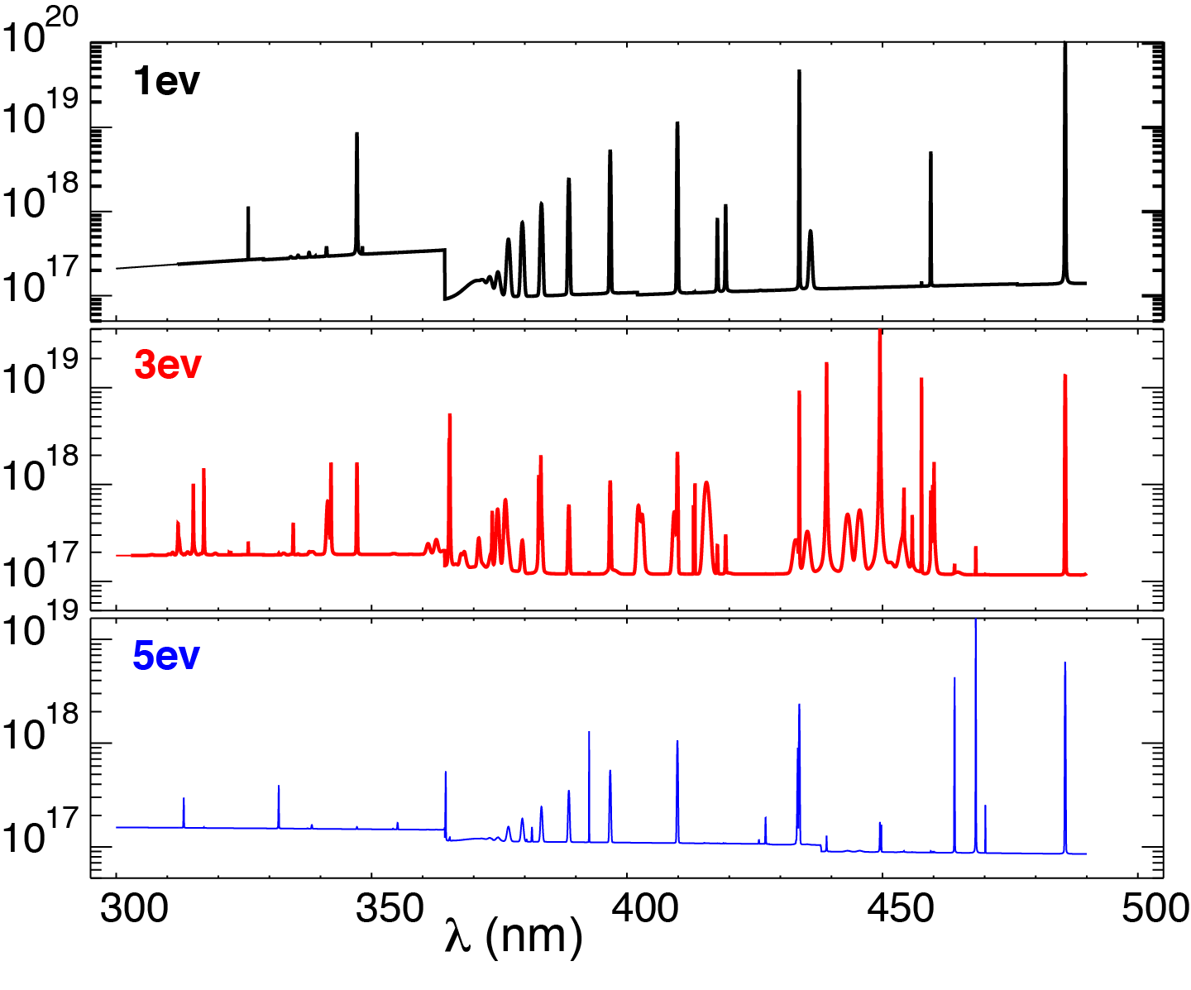
Cretin UV spectra simulations demonstrate feasibility of spectroscopic T_{e} measurements
S

Slide 22
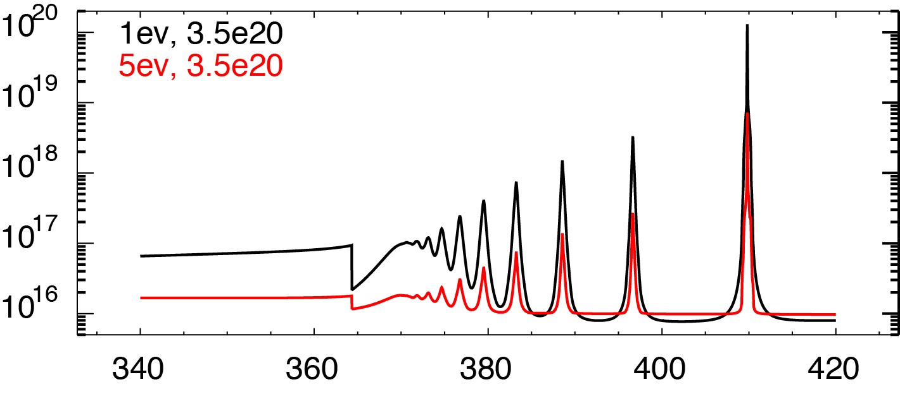
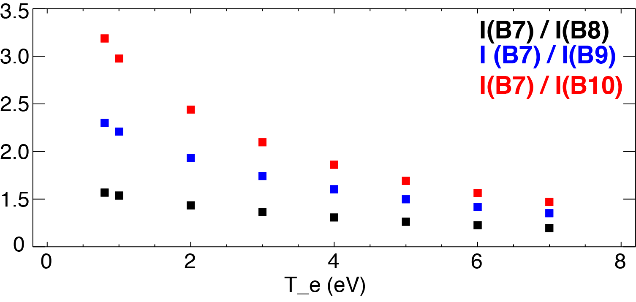
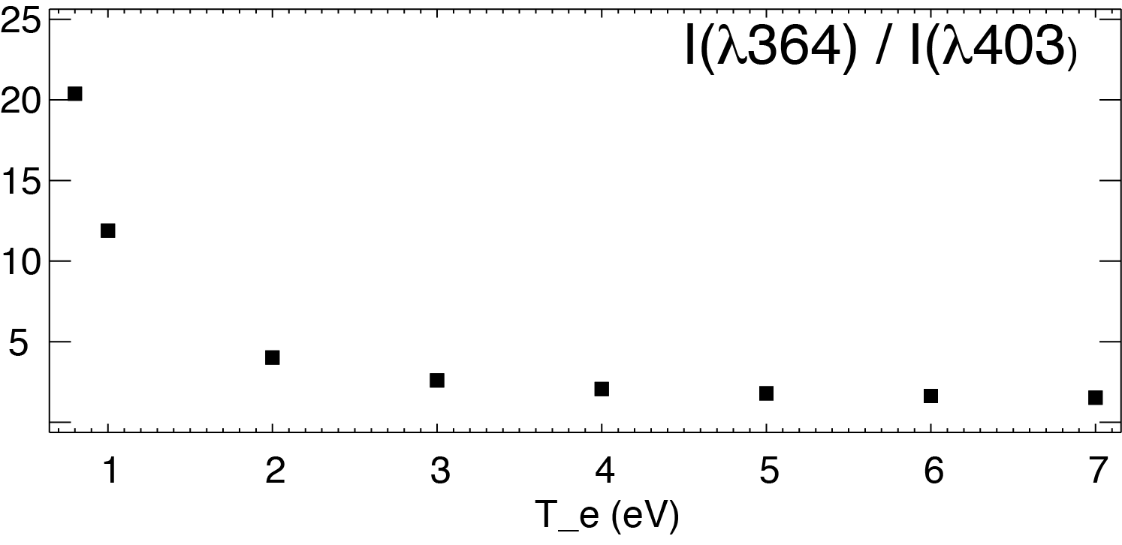
T_{e} is estimated from Balmer line intensity ratio and from continua intensity ratio at Paschen jump
λ (nm)

Slide 23
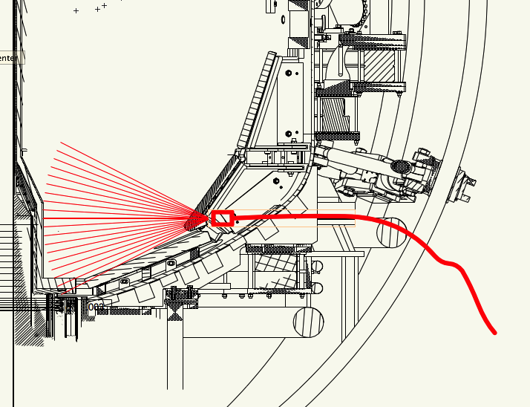
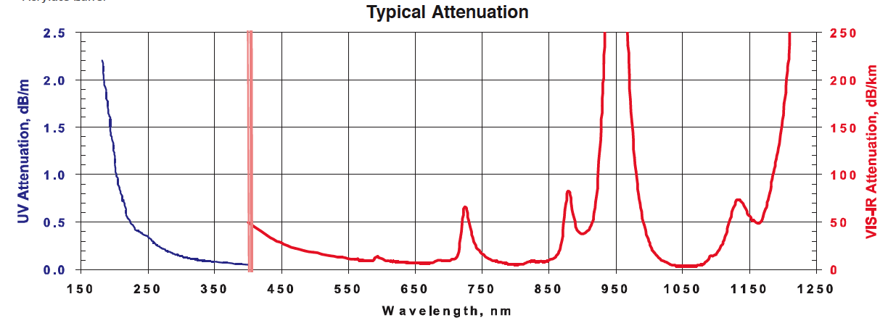
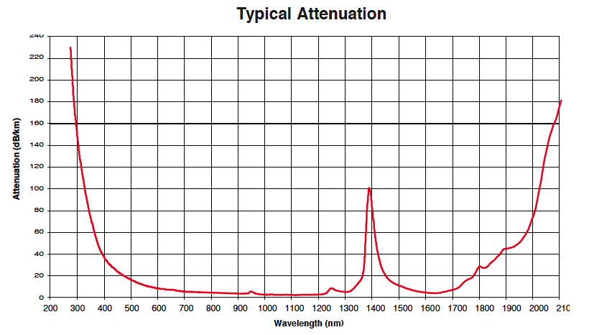
Divertor imaging optics enables quasi-2D divertor emission measurements in UV-VIS-NIR
FVP
FBP
26-fiber bundle (Radiation resistant Molex FVP 200 um)
10-fiber bundle (Molex FBP 200 um)
30 m length
Kogaku 8 or 12 mm imaging UV lens
Fiber projection spot size 2-6 mm

Slide 24
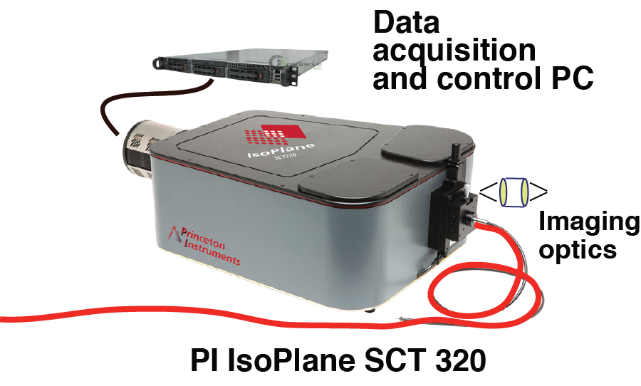
Divertor Imaging Balmer Spectrometer (DIBS) enables fast line and continua measurements
SCT 320 Czerny-Turner-Schmitt spectrograph
  600, 1200, 1800 gr/mm UV-VIS 68 mm gratings
CCD camera PI ProEM 1600x400
Real-time DAQ via WinSpec32 (pvcam)
Grating l/mm | CWL | Range (nm) | Short wl | Long wl | Dispersion nm/mm | CCD resolution (FWHM) | Bandwidth per pixel
600 | 399 | 124 | 336 | 461 | 4.849 | 0.14 | 0.078
1200 | 380 399 | 59 59 | 350 369 | 409 428 | 2.333 2.321 | 0.067 0.067 | 0.037 0.037
1800 | 399 | 37 | 380 | 417 | 1.452 | 0.044 | 0.023

