Slide 1



Developing snowflake divertor physics basis in the DIII-D and NSTX tokamaks.
1st IAEA Technical Meeting on Divertor Concepts
Vlad Soukhanovskii
1 October 2015

Slide 2
Acknowledgements
S.L. Allen¹, M.E. Fenstermacher¹, C.J. Lasnier¹,M.A. Makowski¹, A.G. McLean¹, E.T. Meier¹, W.H. Meyer¹, T.D. Rognlien¹, D.D. Ryutov¹, F. Scotti¹, E. Kolemen², R.E. Bell², A. Diallo², S. Gerhardt², R. Kaita², S. Kaye², B.P. LeBlanc², R. Maingi², J.E. Menard², M. Podesta², A.L. Roquemore², R.J. Groebner³, A.W. Hyatt³, A.W. Leonard³, T.H. Osborne³, T.W. Petrie³, J.-W. Ahn⁴, R. Raman⁵, and J.G. Watkins⁶
¹ Lawrence Livermore National Laboratory, 7000 East Ave, Livermore, CA 94550, USA
² Princeton Plasma Physics Laboratory, PO Box 451, Princeton, NJ 08543-0451, USA
³ General Atomics, PO Box 85608, San Diego, CA 92186-5608, USA
⁴ Oak Ridge National Laboratory, Oak Ridge, TN 37831, USA
⁵ University of Washington, Seattle, WA 98195, USA
⁶ Sandia National Laboratories, PO Box 969 Livermore, California 94551-0969, USA

Slide 3
Divertor strike point heat flux mitigation using radiated power loss and magnetic geometry
Radiated power loss
Increase via V_{div}, L_{II}
Poloidal target inclination, up-down, in-out fractions,
N divertors
Increase plasma-wetted area
Increase divertor area at large R_{SP}
Increase λ_{q} via
increased
radial transport, L_{II}
Divertor physics is inherently 2D or even 3D
  Parallel / cross-field transport and turbulence
  Radiation front (detachment) stability
  Neutral pressure / density distribution
Important engineering aspect – divertor coil layout
Increase plasma-wetted area via increasing f_{exp}

Slide 4
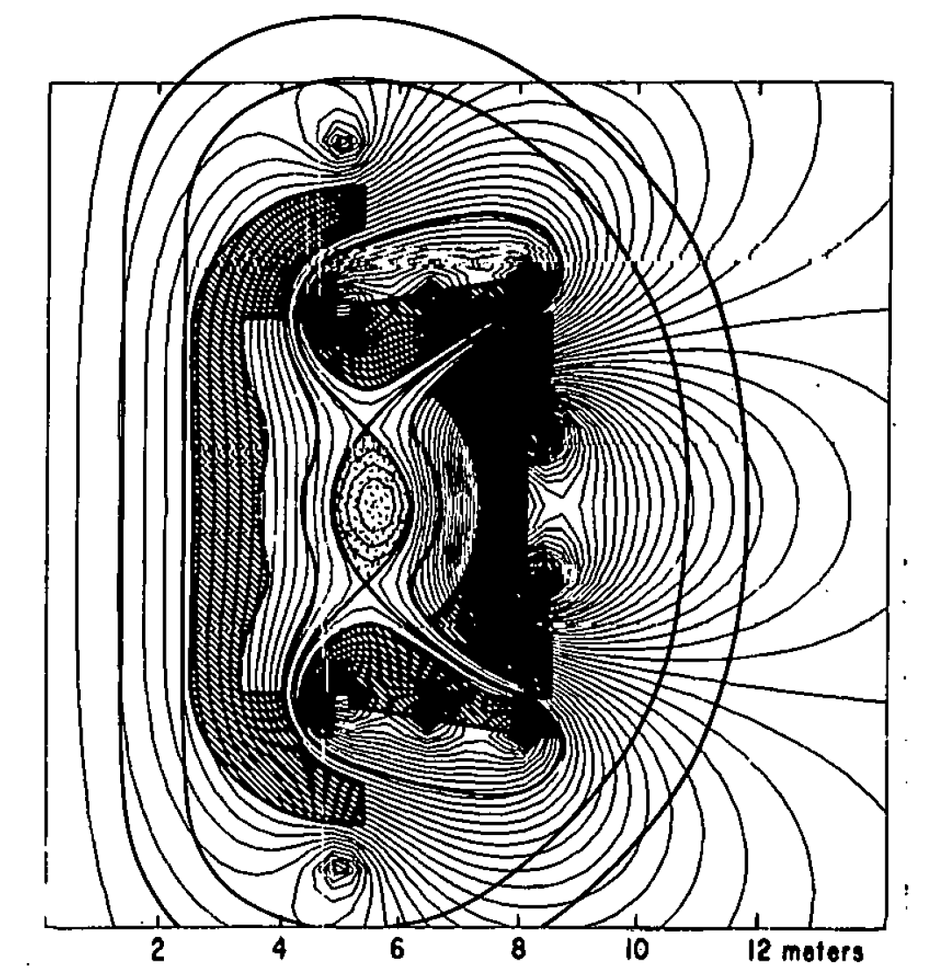
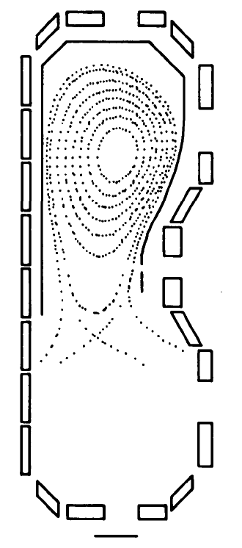
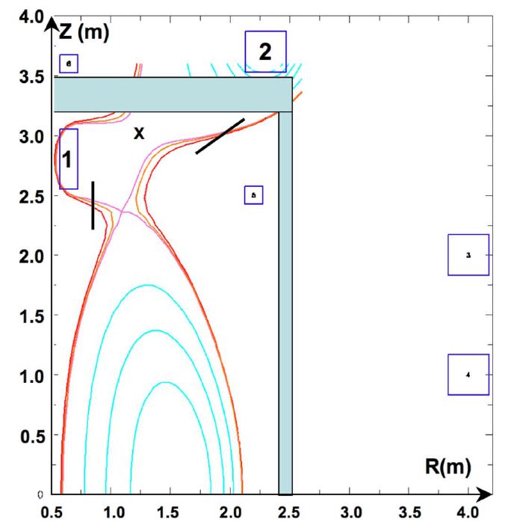
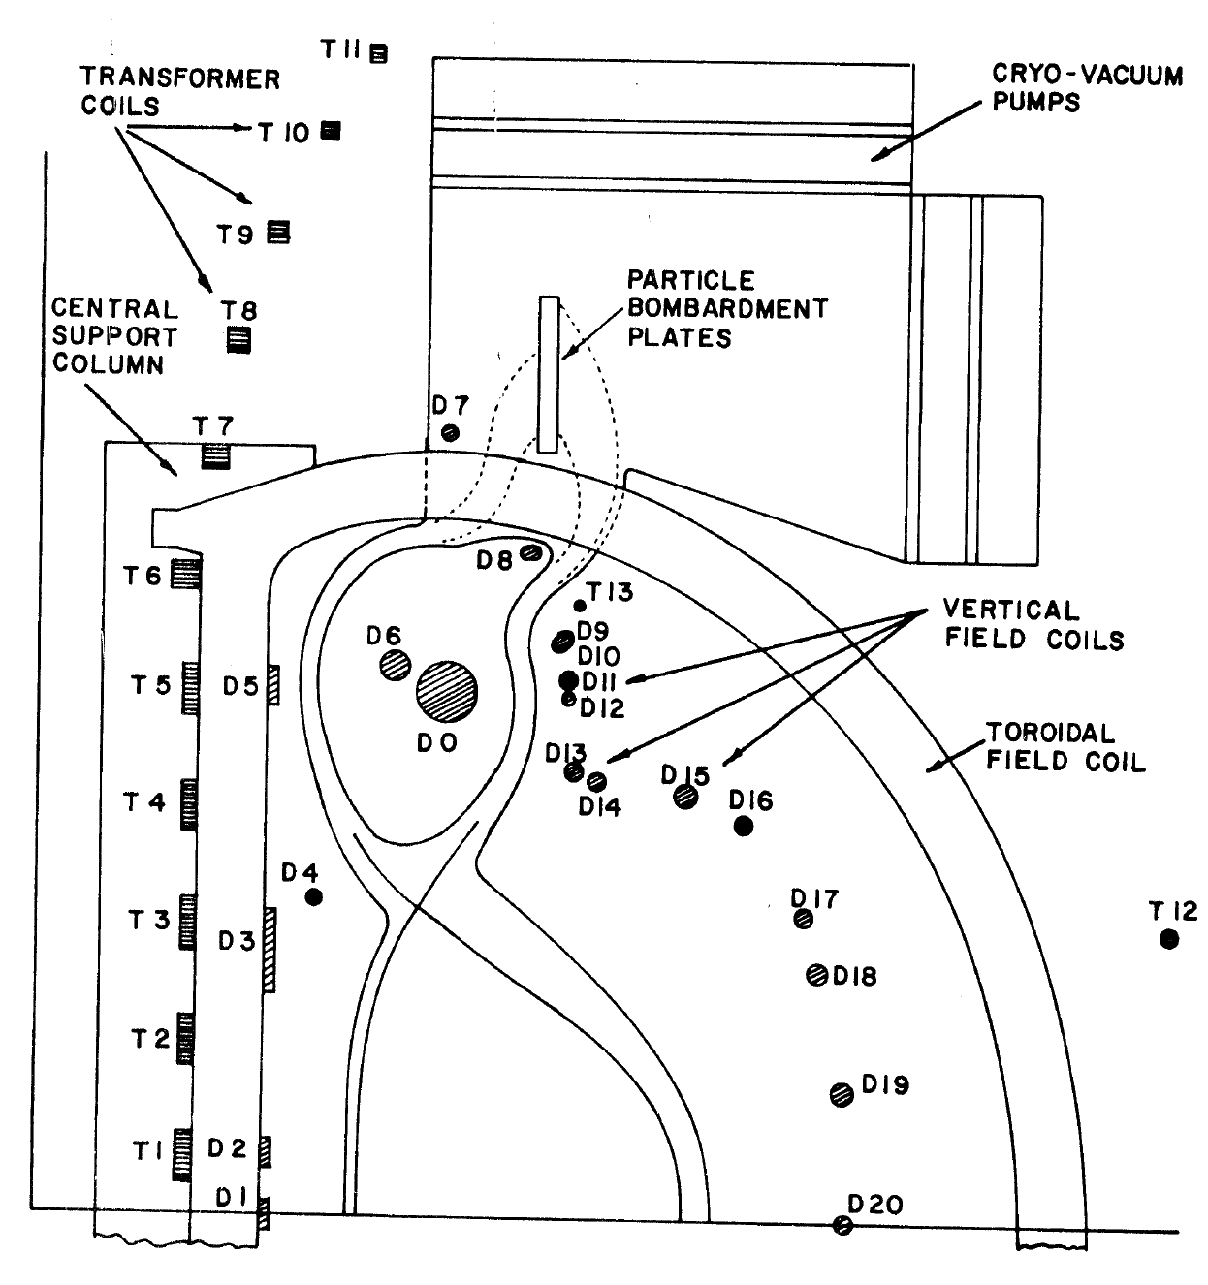
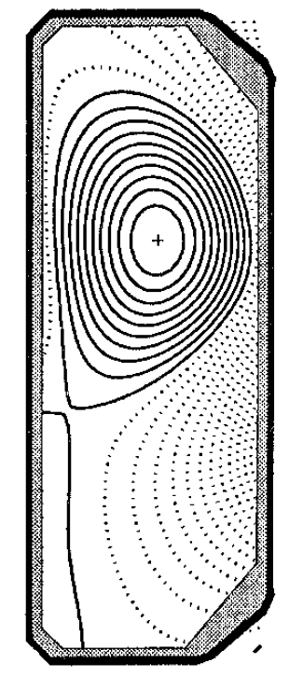
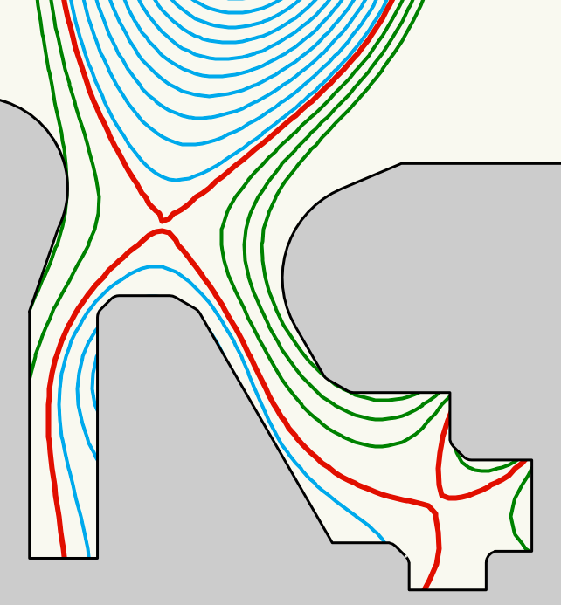
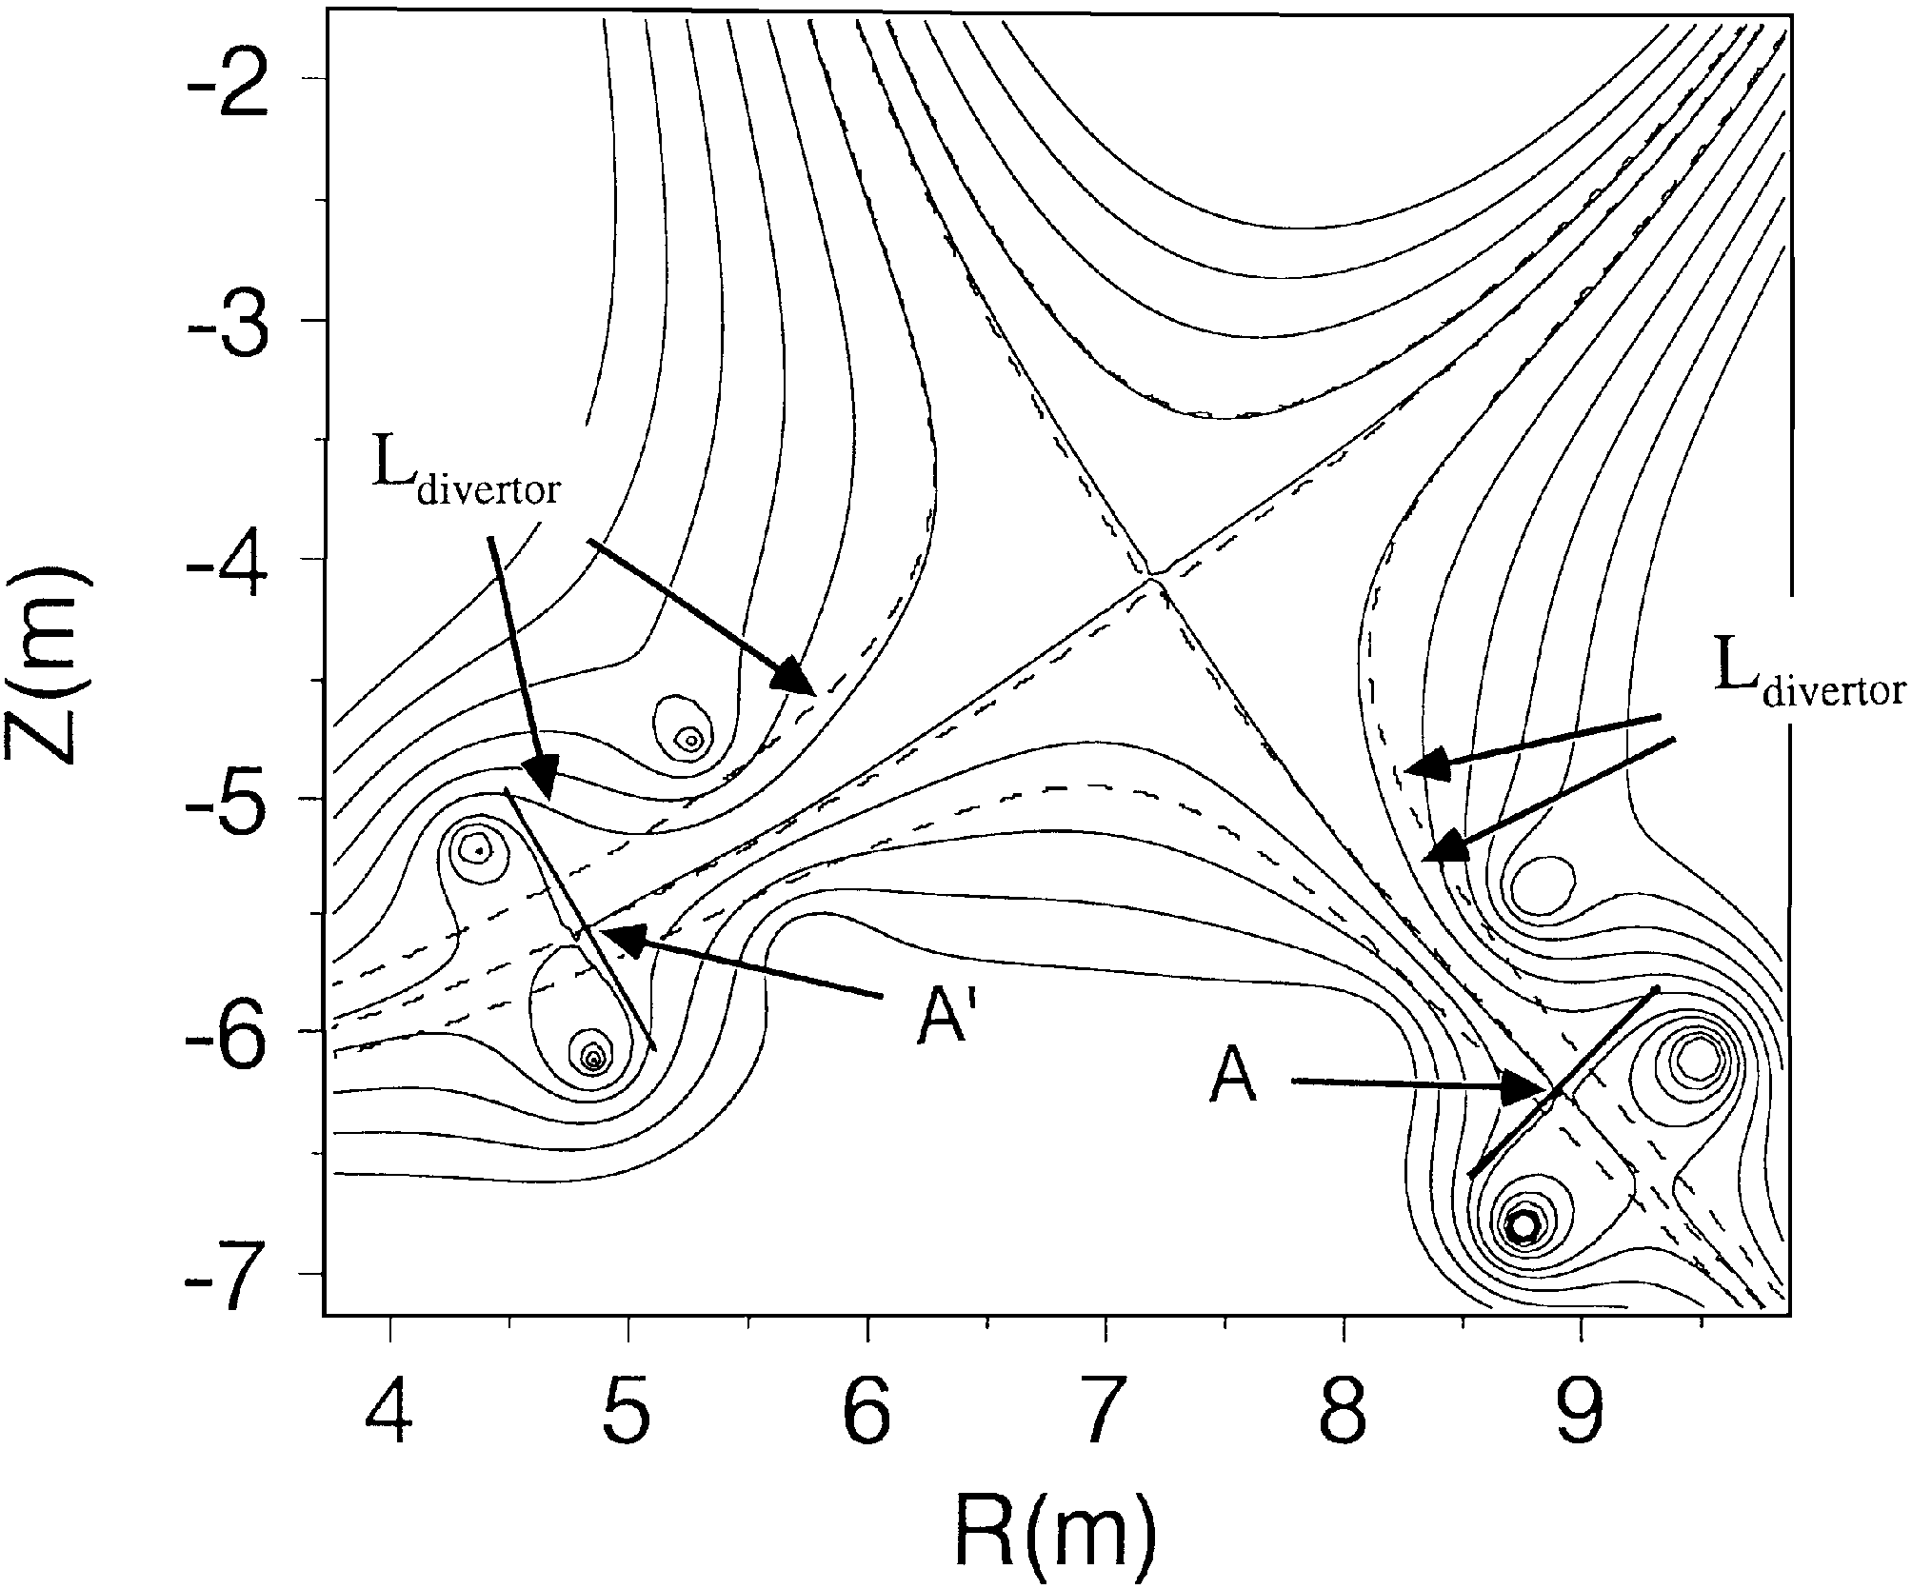
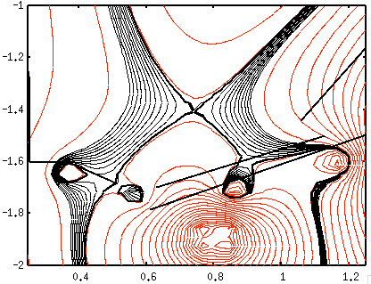
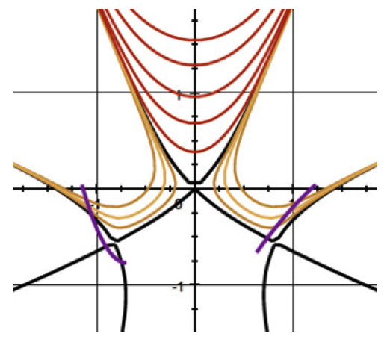
Focus on divertor power exhaust via geometry since early days of tokamak studies. Some examples…
UWMAK-III
Double-null with long legs
Super-X
Expanded
Boundary,
Doublet III
N. Ohyabu et. al, Nucl. Fusion 5 519 (1981)
P. M. Valanju et.al, Phys.
Plasmas 16, 056110 (2009)
B. Badger et.al, U. Wisc. Report UWFDM-150, 1975
TCV
F. H. Tenney,
PPPL Report 1284, 1976
Super-cusp with
Remote coils
X-divertor
Cusp-like
X-point
divertor
R. A. Pitts et. al, JNM 290-293, 2001, 940
M. Kotschenreuther et. al, IAEA FEC 2004; Phys. Plasmas 14, 072502 (2007)
B. LaBombard et.al, NF 55 (2015) 053020
D. D. Ryutov, J. Plasma Phys. 2015, 81, 495810516
H. Takase, J. Phys. Soc. J. 70, 609, 2001

Slide 5
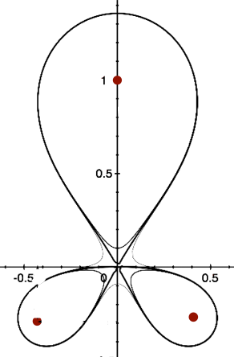
Snowflake Divertor Configuration as a Tokamak Divertor Power Exhaust Concept
Snowflake, 2nd order null
  B_{p} ~ 0, grad B_{p} ~ 0
    (Cf. first-order null: B_{p} ~ 0)
  B_{p}(r)~r² (Cf. first-order null: B_{p} ~ r )
  Four divertor legs
Geometry benefits
  Higher edge magnetic shear
  Larger plasma wetted-area A_{wet} (f_{exp})
  Larger parallel connection length L||
  Larger effective divertor volume V_{div}
To maximize geometry benefits: d_{XX} ≤ a (λ_{q} /a)^{1/3}
Transport benefits
  High convection zone with radius D*
  Power sharing over four strike points
  Enhanced radial transport (larger λ_{q})
To maximize sharing: d_{XX} ≤ D*~a (a β_{pm} / R)^{1/3}
D. D. Ryutov, PoP 14, 064502 2007;
PPCF 54, 124050 (2012)

Slide 6
Snowflake configurations obtained in NSTX and DIII-D using existing PF coils for many energy confinement times
NSTX
  I_{p}=0.8-1.0 MA
  B_{t}≤0.45 T
  3 divertor coils, pre-programmed currents
  SF for 0.5 s
DIII-D
  I_{p}=0.8-1.0 MA
  B_{t}=2 T
  3 divertor coils w/control
  SF for 2-3 s
Next slides: Attempt to generalize snowflake divertor effects observed in NSTX and DIII-D

Slide 7
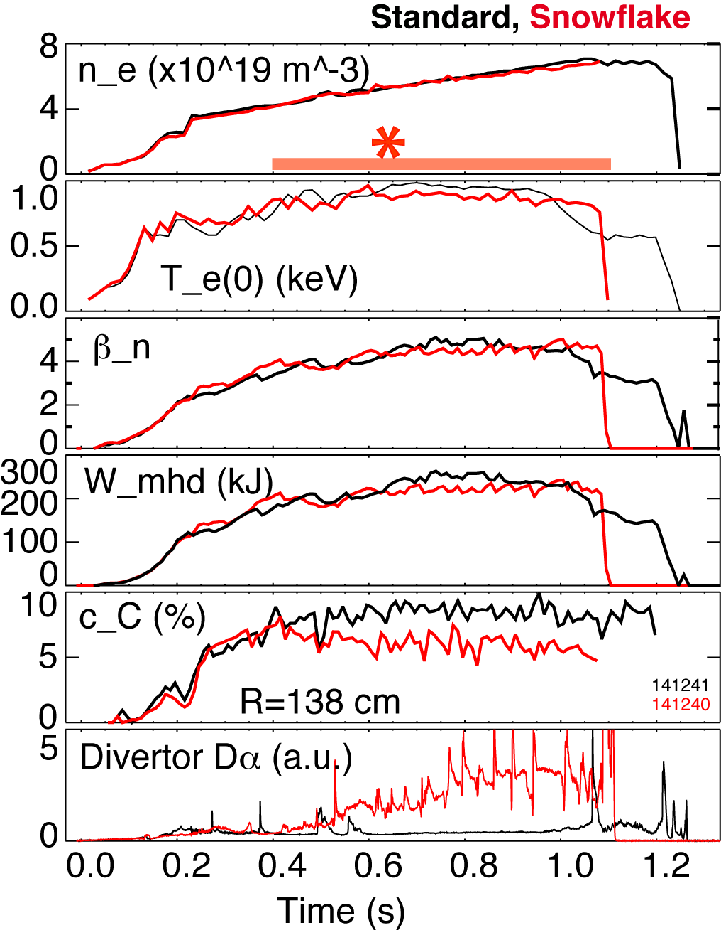
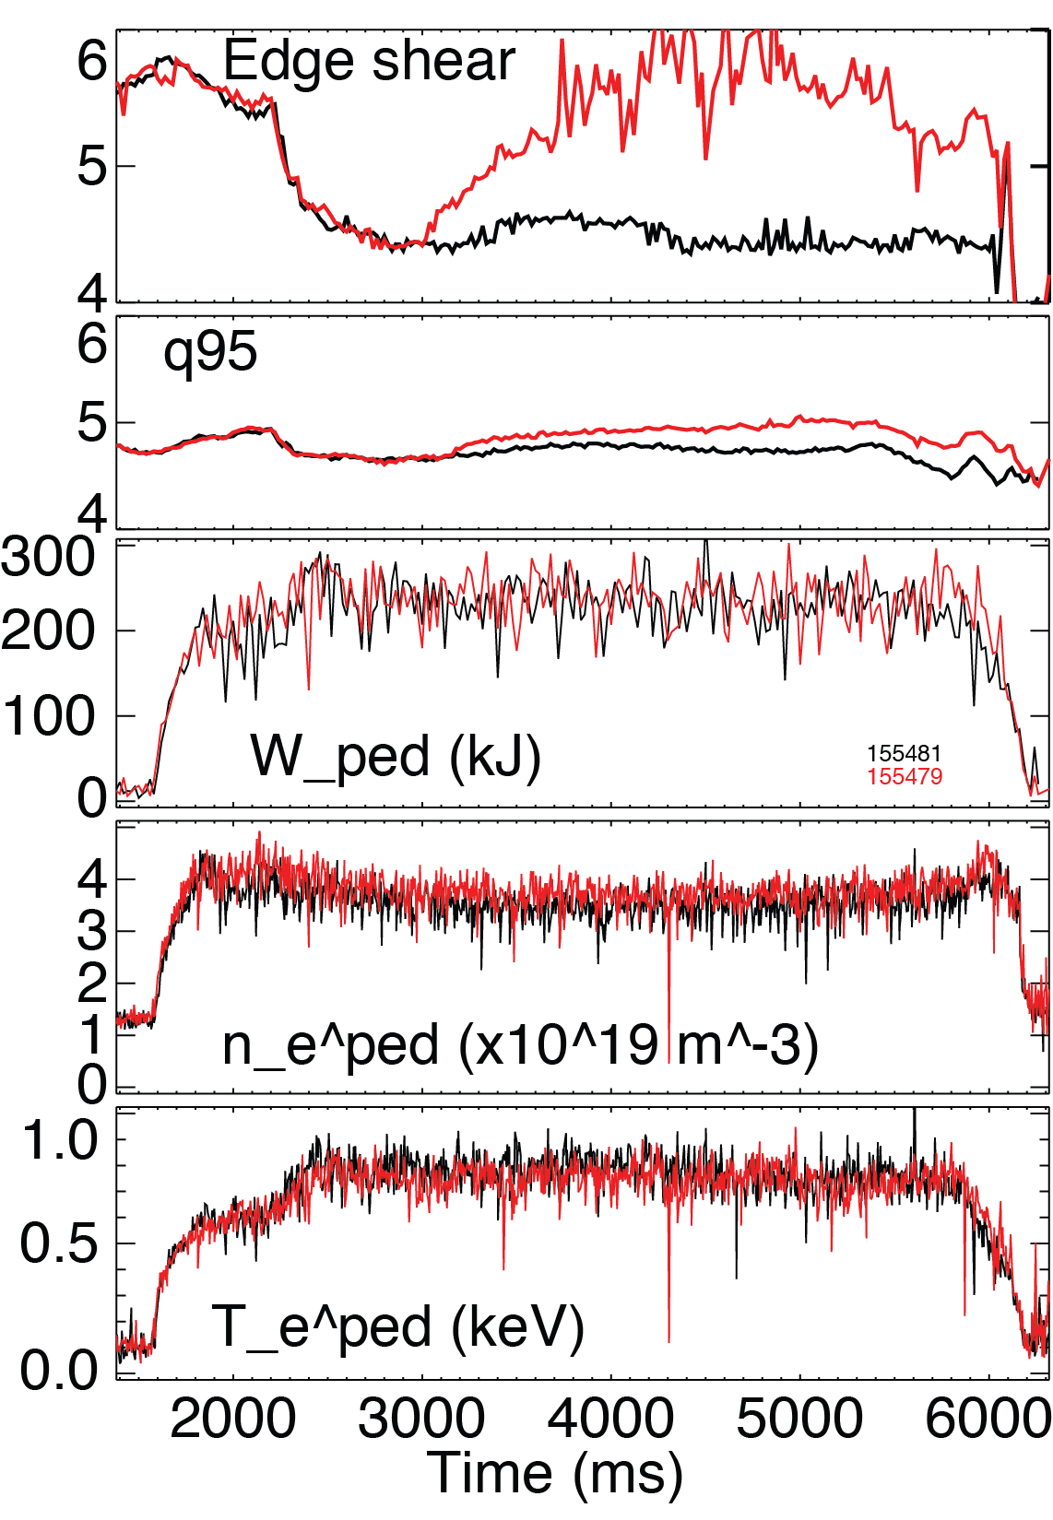
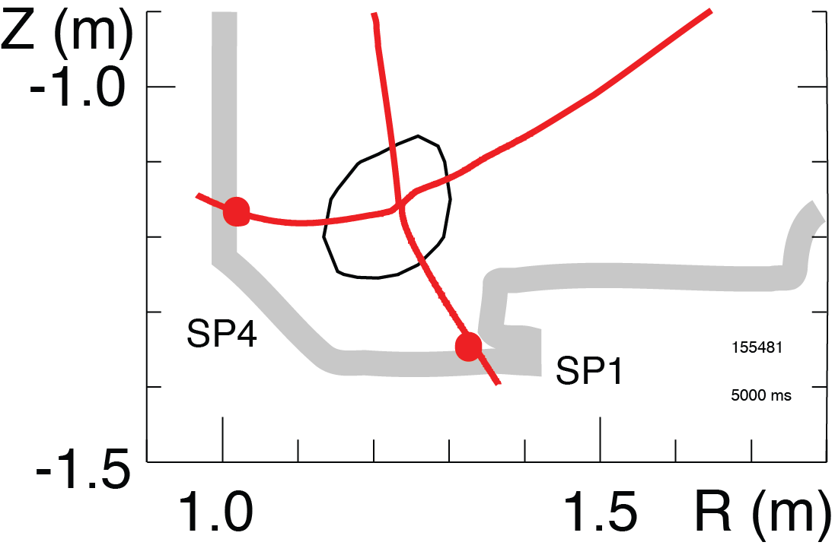
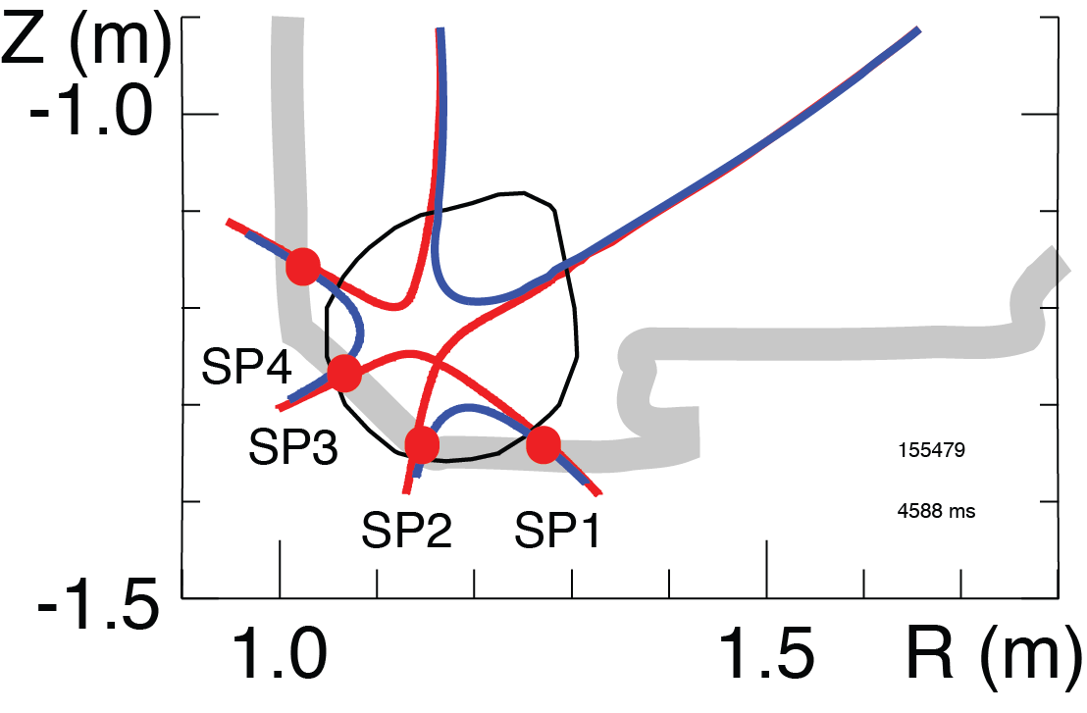
Snowflake divertor compatible with H-mode core and pedestal confinement, effect on ELMs vary
Standard
Snowflake
SF Divertor Weakly Affects Pedestal Magnetic and Kinetic Characteristics, Peeling-ballooning Stability in DIII-D
SF divertor strongly affects pedestal peeling-ballooning stability in NSTX, destabilizes ELMs

Slide 8
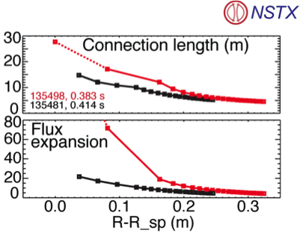
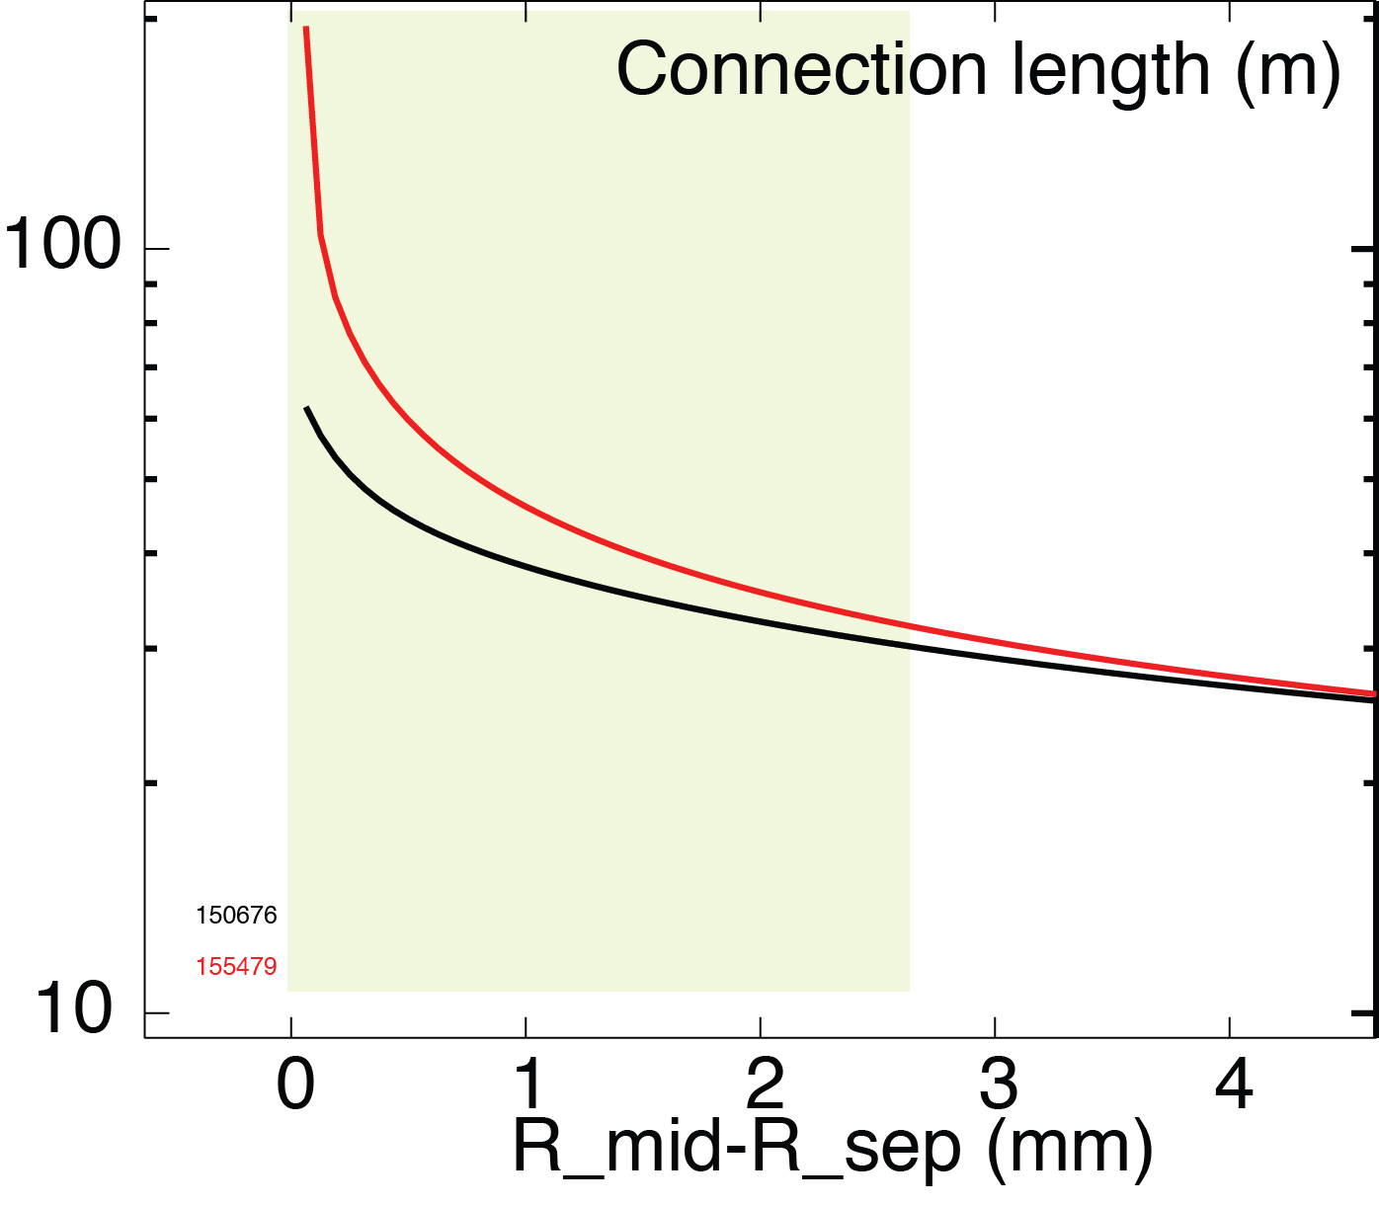
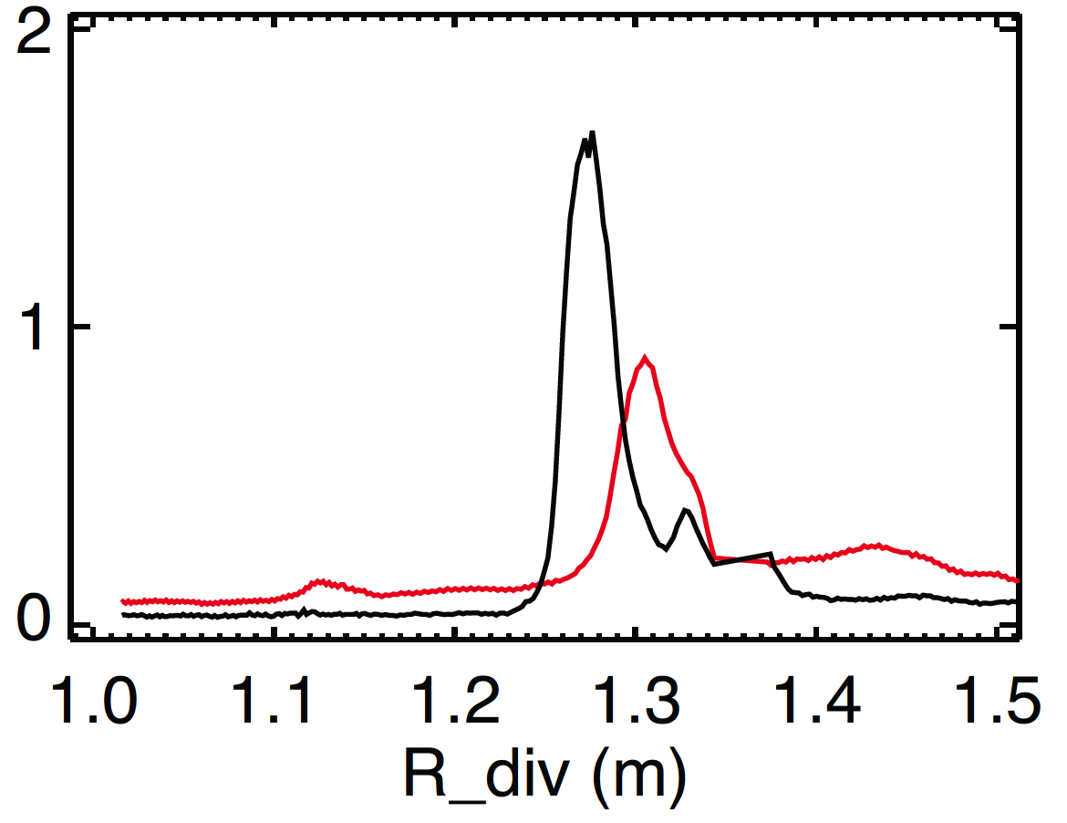
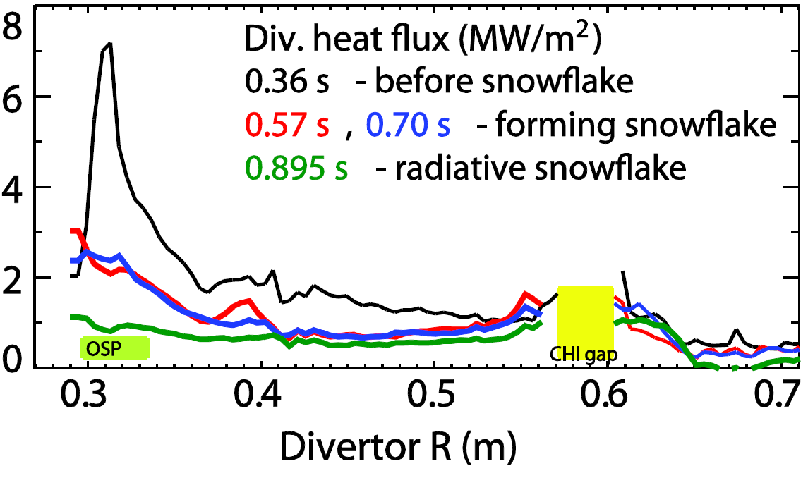
Peak divertor heat flux significantly reduced due to snowflake divertor geometry effects
Standard Snowflake
Snowflake
SOL width
q_div (MW/m^2)
Standard
Flux expansion increased ~20%
L|| increased by 20-60% over SOL width
Divertor heat flux reduced ~40%
Due to geometry and radiation

Slide 9
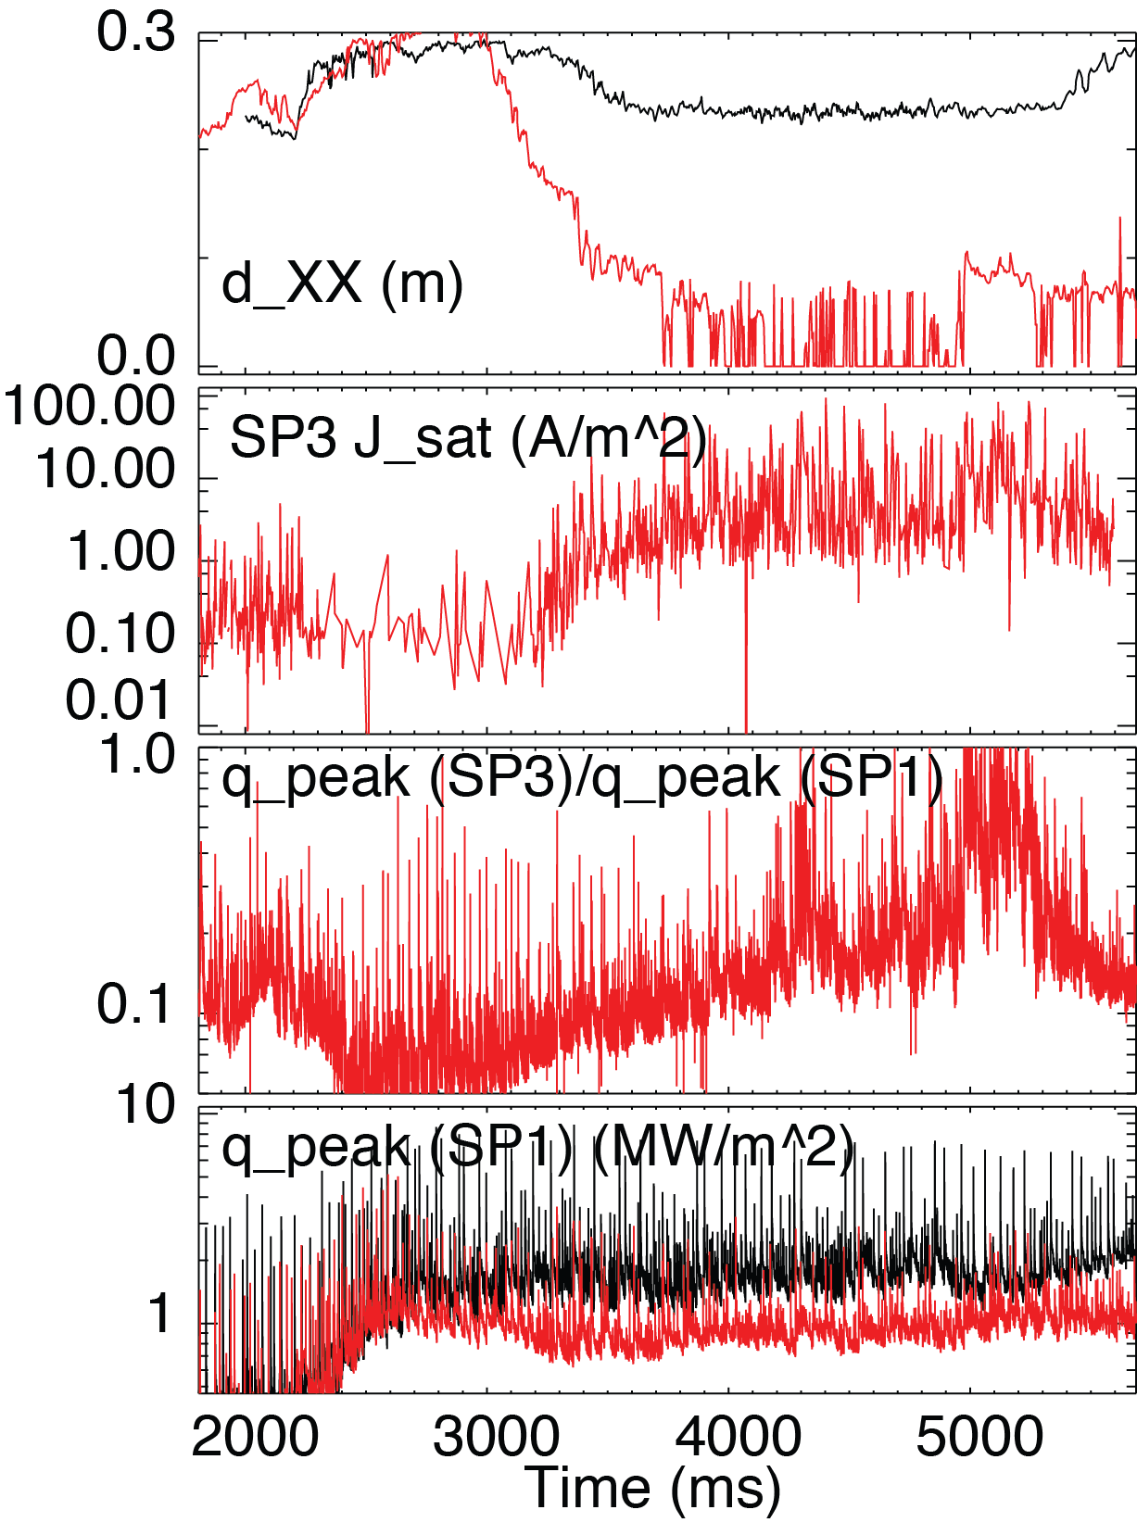
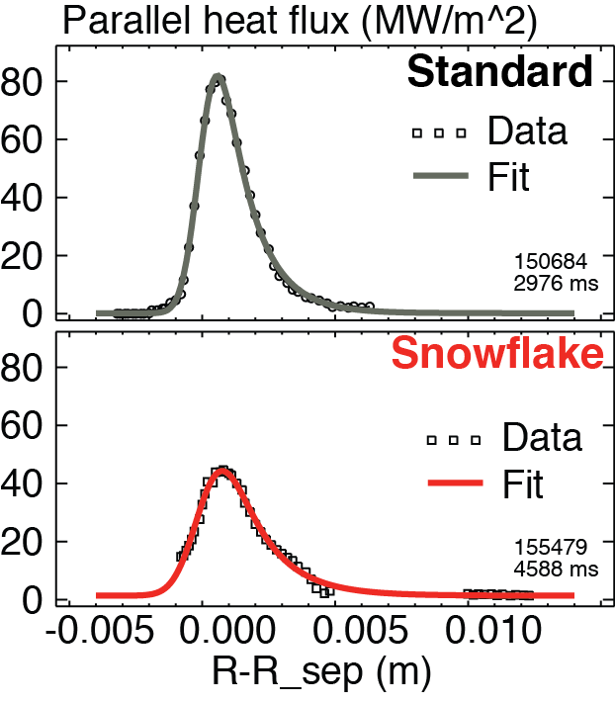
Snowflake divertor enables power and particle sharing over multiple strike points
Standard Snowflake
SP1 Parallel heat flux (MW/m²)
Γ_{SP3}
λ_{q} = 2.40 mm
q_{SP3}
λ_{q} = 3.20 mm
q_{SP1}
Increased λ_{q} may imply increased transport

Slide 10
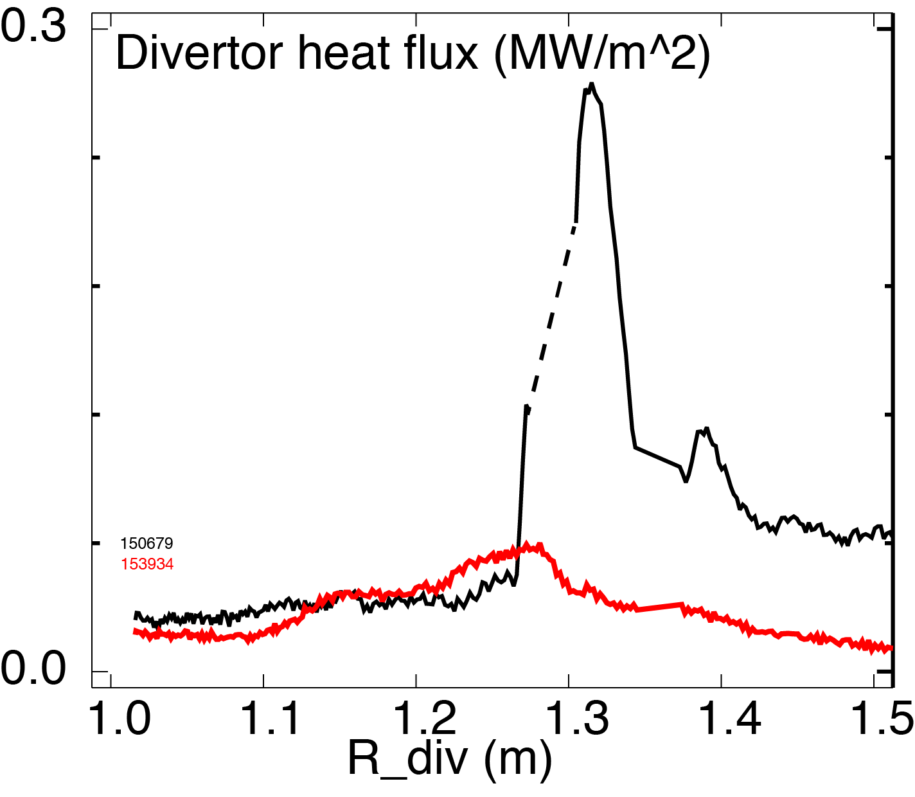
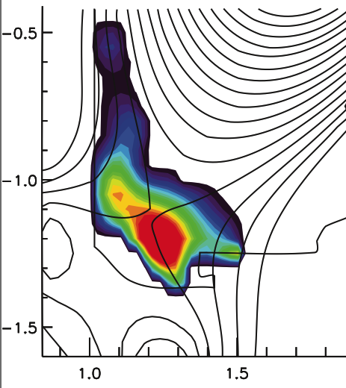
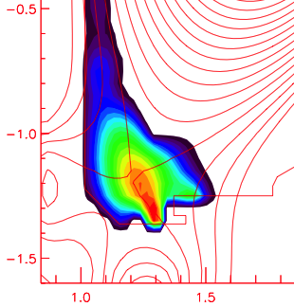
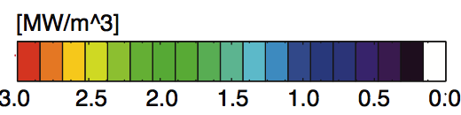
Snowflake configuration favorably affects radiative divertor and detachment
Radiative Radiative
Standard Snowflake
P_{SOL} = 2-3 MW
P_{SOL} = 3-4 MW
Nearly complete power detachment
Radiative Radiative
Standard Snowflake
Natural partial detachment in NSTX snowflake otherwise inaccessible with standard divertor
Significant radiated power re-distribution
Decreased near null, increased through leg

Slide 11
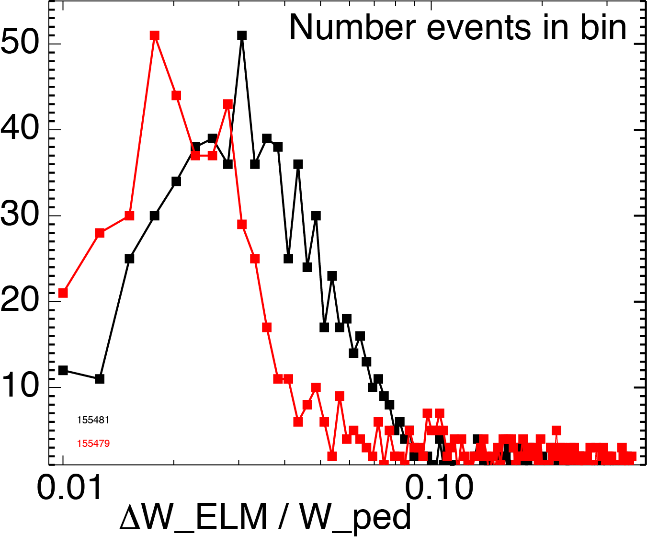
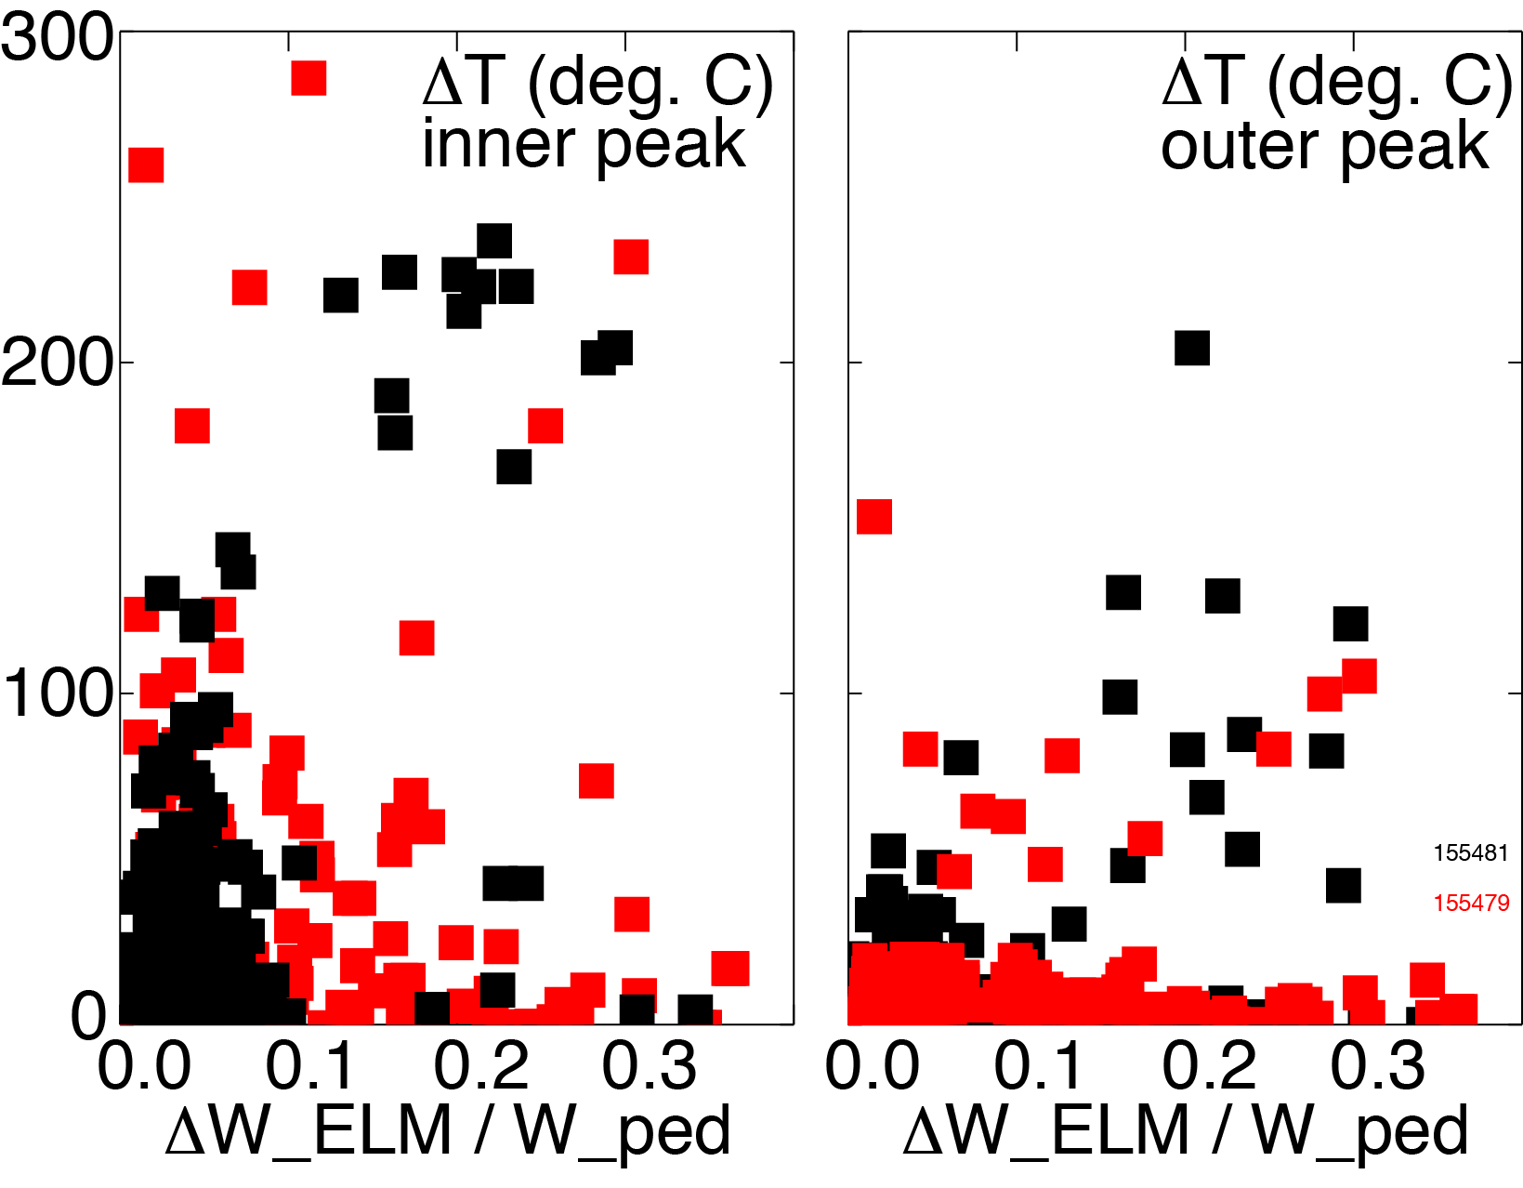
Snowflake divertor reduces ELM energy and divertor surface heating (peak heat flux)
Standard Snowflake
Standard Snowflake
Both ΔW_{ELM} and ΔW_{ELM}/W_{ped} weakly reduced
Mostly for ΔW_{ELM}/W_{ped} < 0.10
ΔT_{surf}~E_{ELM}/(A_{wet} τ_{ELM} )^{1/2}
Increased τ_{ELM}=L_{II}/c_{s,ped}
  Weakly reduced E_{ELM}
  A_{wet}^{ELM} similar
Divertor heat flux significantly reduced during Type-I ELMs (ΔW/W ~ 5-15 %)
T. D. Rognlien et. al,
JNM 438, 2013, S418

Slide 12
Developing the Snowflake Divertor Physics Basis For High-power Density Tokamaks
SF divertor configurations compatible with high
H-mode confinement and high pressure pedestal
Snowflake geometry may offer multiple benefits for inter-ELM and ELM heat flux mitigation
  Geometry enables divertor inter-ELM heat flux spreading over larger plasma-wetted area, multiple strike points
  Broader parallel heat fluxes may imply increased radial transport
  ELM divertor peak target temperature and heat flux reduction, especially in radiative snowflake configurations

Slide 13
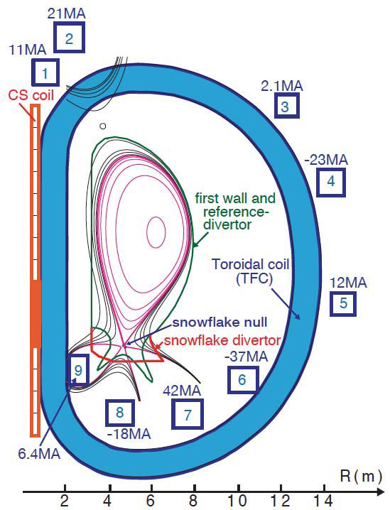
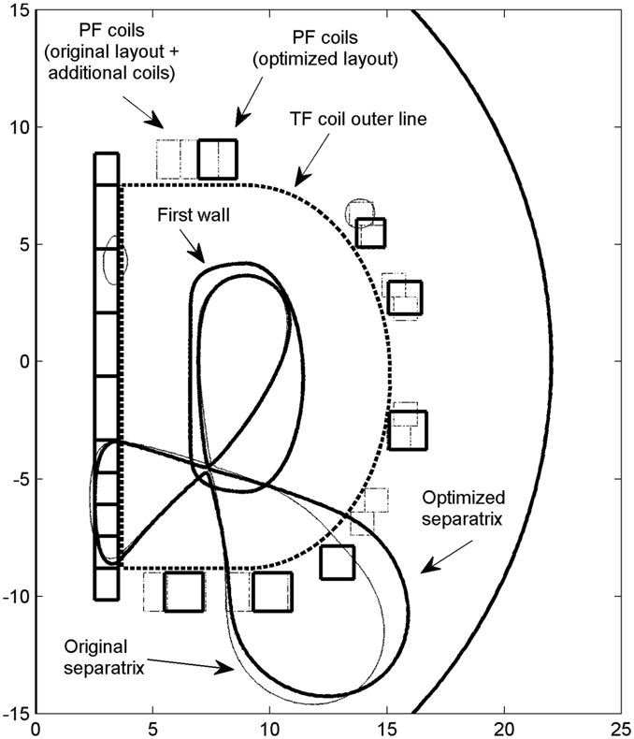
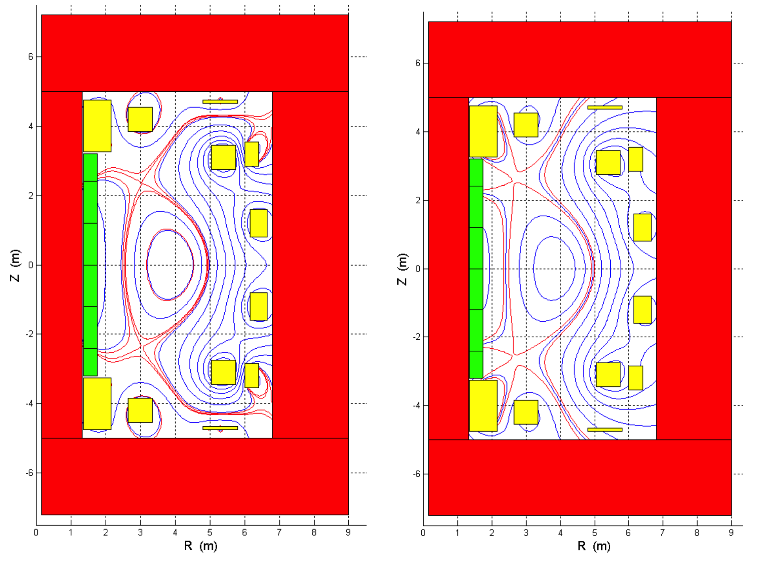
First pre-DEMO and DEMO device designs with snowflake divertor configurations
Snowflake for DEMO
Snowflake for DEMO
Snowflake for DEMO
CFETR
N. Asakura et.al,
Trans. Fus. Sci. Tech. 63, 2013, 70.
R Albanese et. al,
PPCF, 56 (2014) 035008
Y. Wan, SOFE 2013
Z. Luo et.al, IEEE TRANSACTIONS ON PLASMA SCIENCE, V42, 2014, 1021

Slide 14
Backup

Slide 15

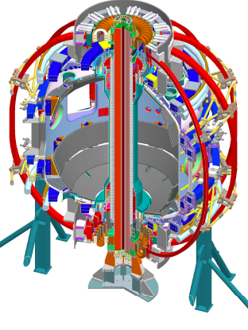
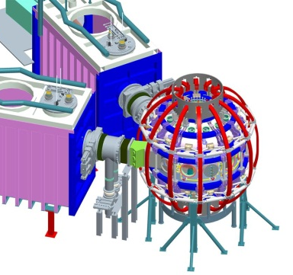
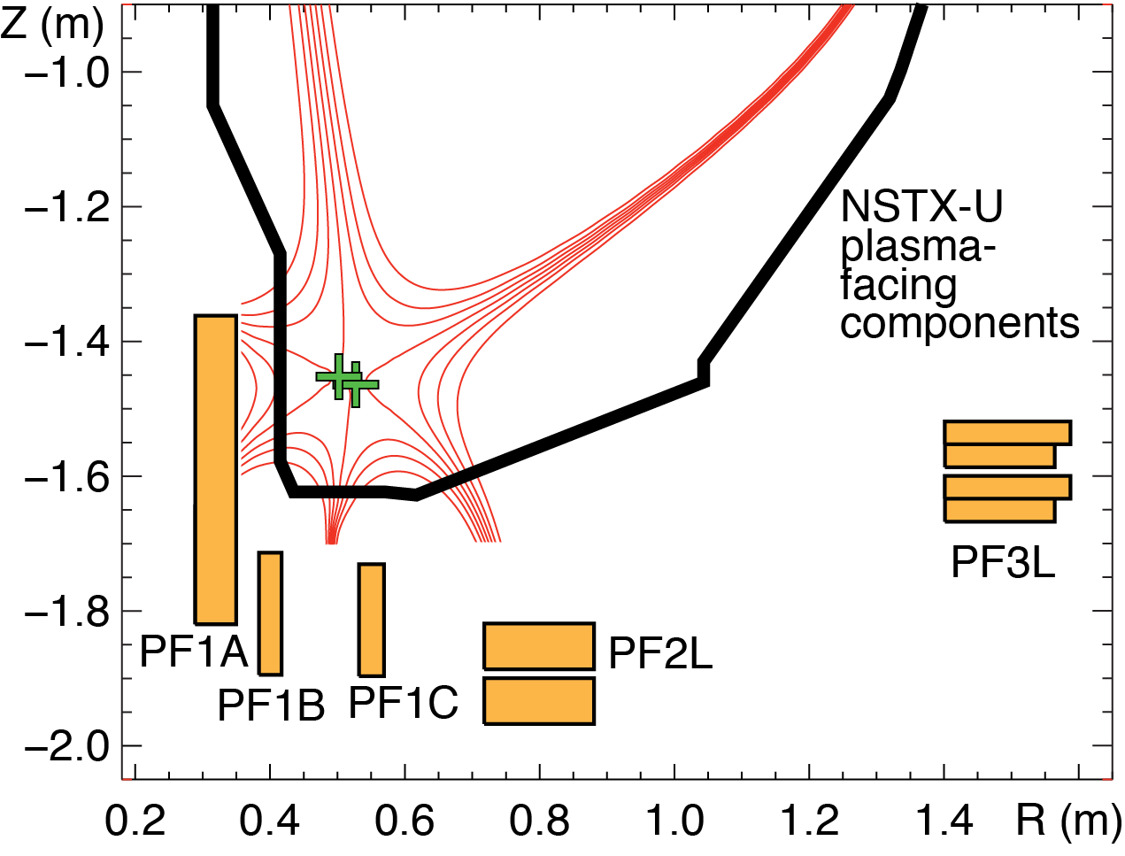
Snowflake divertor is a leading heat flux mitigation candidate for NSTX Upgrade
New center-stack
2nd neutral beam
B_{T}
I_{p}
1 T
P_{NBI}
pulse
12 MW
2 MA
5 s
J. E. Menard et. al, Nucl. Fusion 52 (2012) 083015
  New divertor coil
  Upper-lower snowflake divertors
  Supported by NSTX-U divertor coils and compatible with coil current limits
NSTX-U Mission elements:
  Advance ST as candidate for Fusion Nuclear Science Facility
  Develop solutions for the plasma-material interface challenge
  Explore unique ST parameter regimes to advance predictive capability for ITER
  Develop ST as fusion energy system

Slide 16
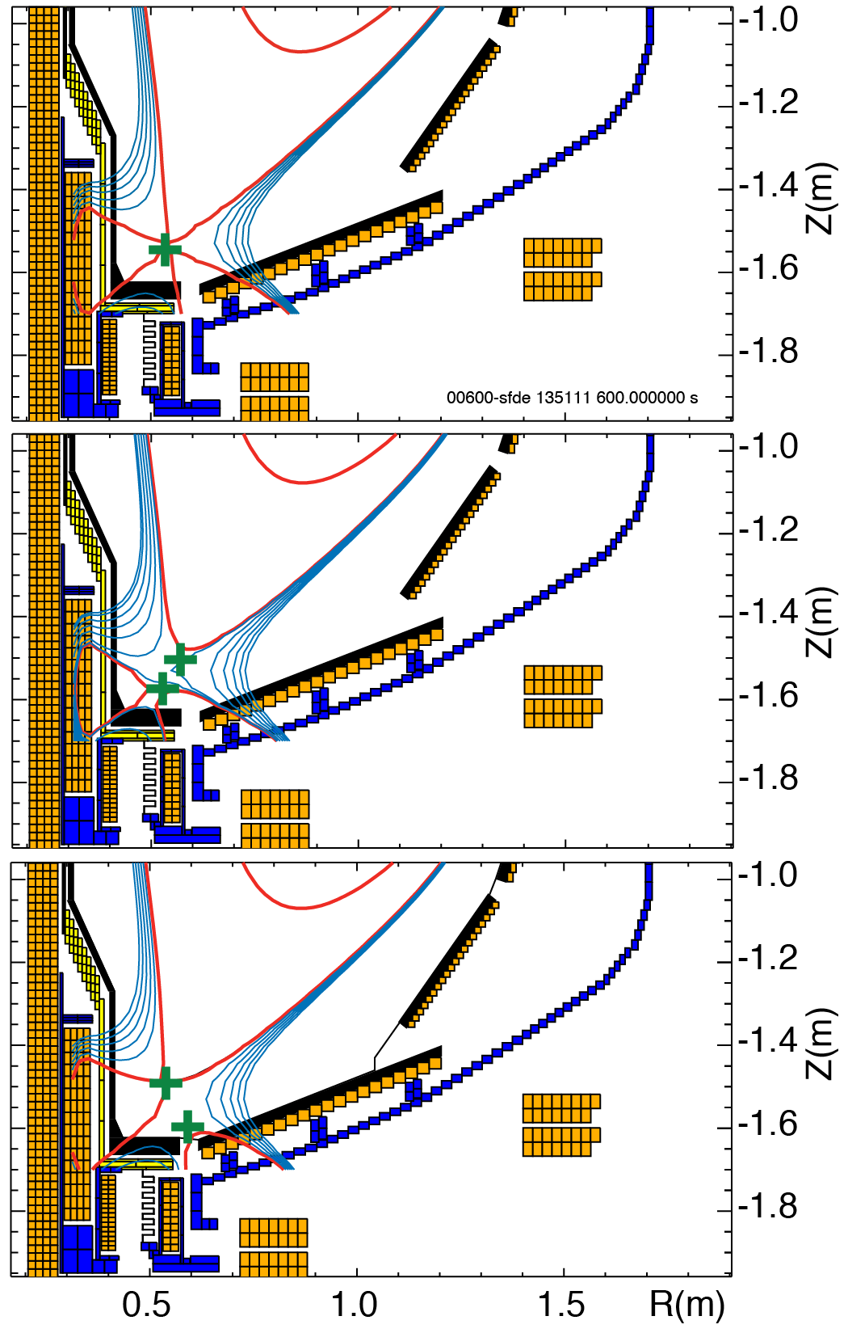
Snowflake divertor is a leading heat flux mitigation candidate for NSTX Upgrade
New center-stack
2nd neutral beam
B_{T}
I_{p}
1 T
P_{NBI}
pulse
12 MW
2 MA
5 s
J. E. Menard et. al, Nucl. Fusion 52 (2012) 083015
NSTX-U Mission elements:
  Advance ST as candidate for Fusion Nuclear Science Facility
  Develop solutions for the plasma-material interface challenge
  Explore unique ST parameter regimes to advance predictive capability for ITER
  Develop ST as fusion energy system

Slide 17
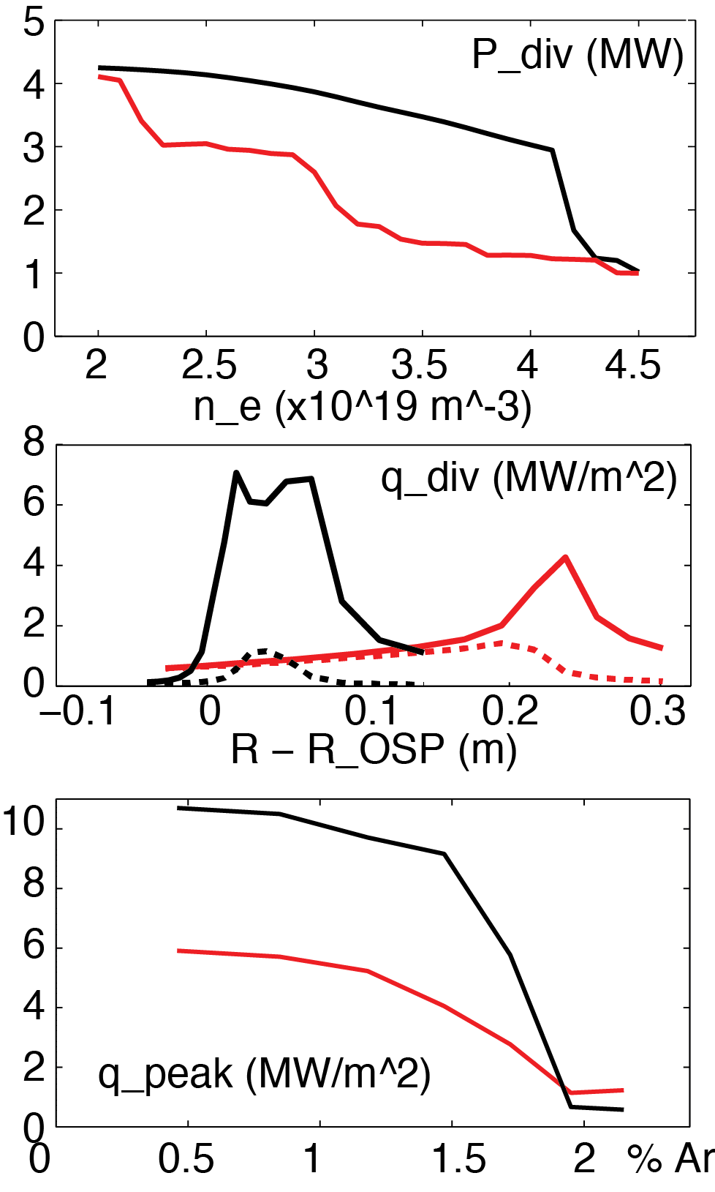
Edge modeling predicts significant heat flux reduction with radiative snowflake divertor
  Snowflake with 3% carbon
    Wide density operational window as low as n_{e}/n_{G}≤0.4
    Peak heat flux reduced up to 50% stronger (cf. standard radiative divertor) at lower n_{e}
  Less impurity seeding (argon or neon) needed for lower peak heat flux
  Multi-fluid code UEDGE
  B_{t} = 1.0 T, I_{p} = 2 MA, P_{SOL} = 9 MW
  NSTX-like transport χ_{i,e}=2-4 m²/s, D=0.5 m²/s
Standard Snowflake
Total
Rad.
heating
E. T. Meier et. al, Nucl. Fusion (2015)

Slide 18
Advanced divertor magnetic configurations (classified by appearance)
Multiple divertors, each with one X-point
Higher order (2nd, 3rd) null divertors
Divertor with multiple X-points
Long-legged divertors with multiple X-points
Note on early concepts
  Envisioned before H-mode discovery (1982)
  Some concepts envisioned divertor for particle and impurity control only

Slide 19
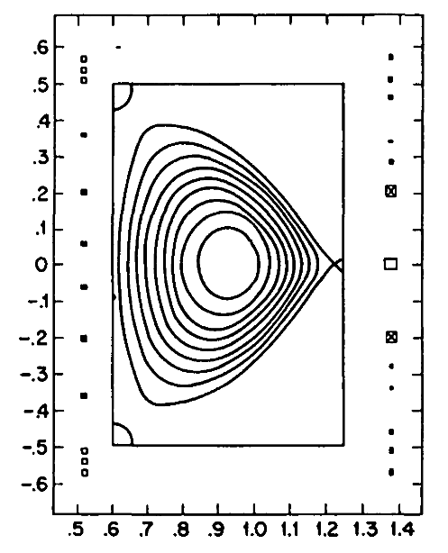
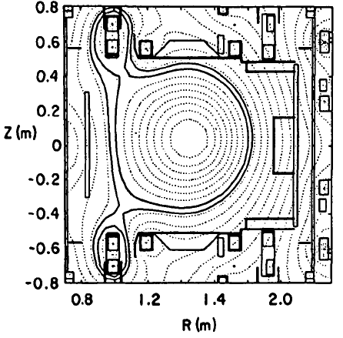
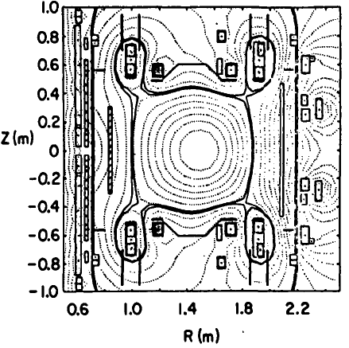
1. Multiple divertors: triple-null, quadruple-null to share heat and particle fluxes
Poloidal Divertor Experiment tokamak at PPPL (1979 – 1983)
Significant contribution to divertor physics with double-null configuration
D-shaped plasma, high triangularity
Increased local shear
Enhanced kink stbility
K. Bol et.al, Nucl. Fusion 25, 1149 (1985)
J. Kesner, Nucl. Fusion 30, 548 (1990)

Slide 20
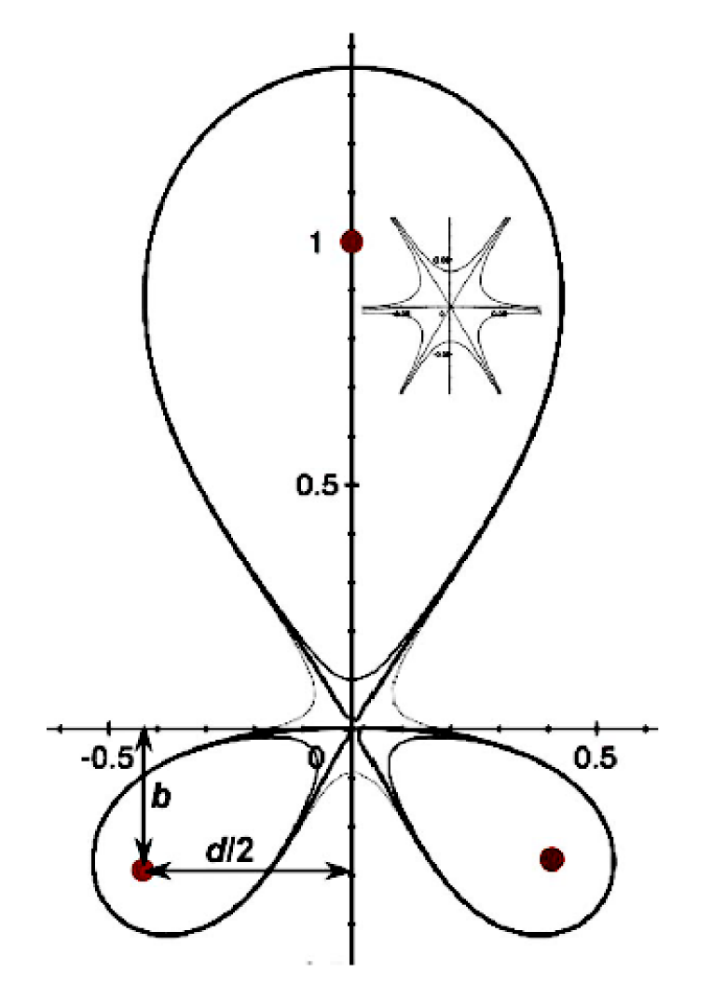
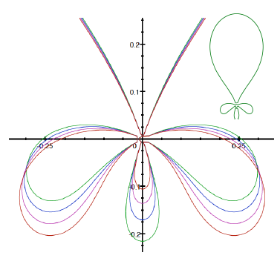
2. Higher order null divertors : larger region of very low B_{p} to affect geometry and transport
Snowflake, 2nd order null
  B_{p} ~ 0, grad B_{p} ~ 0 (Cf. first-order null: B_{p} ~ 0)
  B_{p}(r)~r² (Cf. first-order null: B_{p} ~ r )
  Four divertor legs
Cloverleaf, 3rd order null
  B_{p}(r)~r³
  Six divertor legs
Strong plasma convection
D. D. Ryutov, Phys. Plasmas 14 (2007), 064502
D. D. Ryutov et. al, Phys. Plasmas 20 (2013), 092509

Slide 21
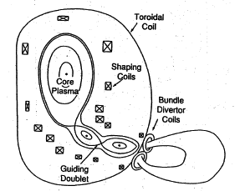
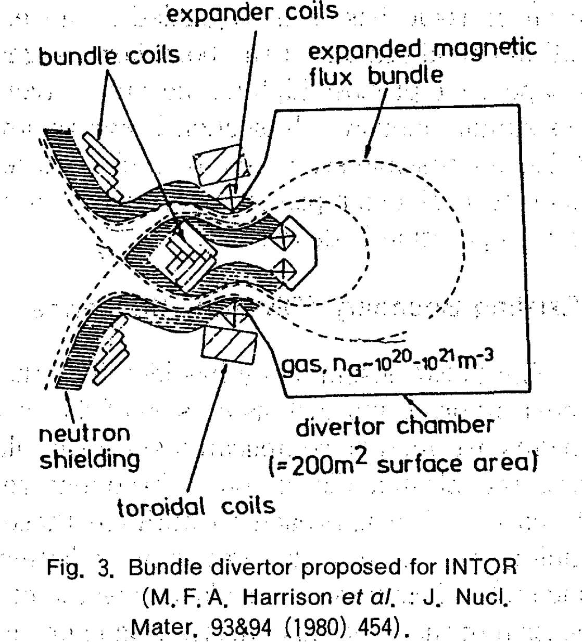
3. Divertor with multiple X-points: expand SOL in the divertor region
N. Ohyabu et. al, Nucl. Fusion 5 519 (1981)
N. Ohyabu, J. Plasma Fus. Res. 5 525 (1991)
Doublet III Expanded Boundary
Poloidal Bundle + Expanded Boundary
Analysis of radiation, H-mode compatibility, neutron shielding, coil currents

Slide 22
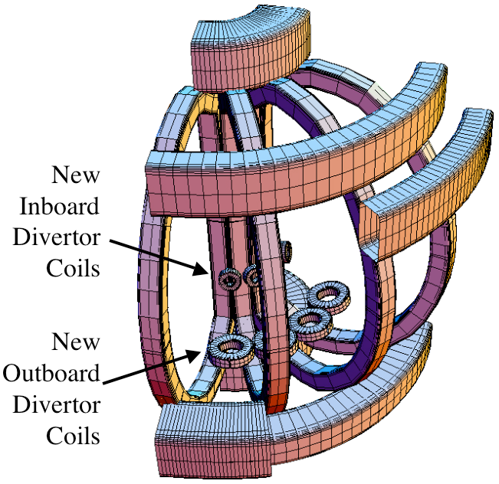
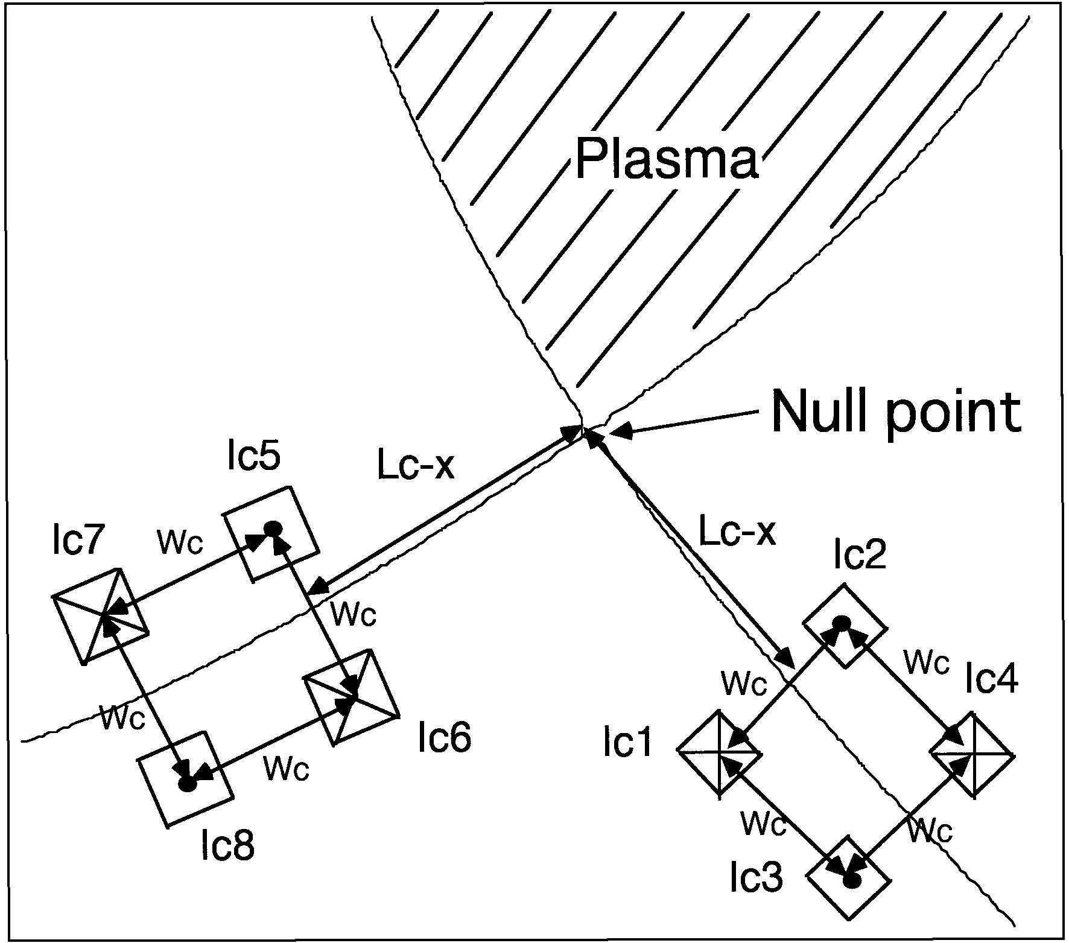
3. Divertor with multiple X-points: expand SOL in the divertor region
H. Takase, J. Phys. Soc. J. 70, 609, 2001
M. Kotschenreuther et. al, IAEA FEC 2004;
Phys. Plasmas 14, 072502 (2007)
Cusp-like divertor configuration
  Coil currents acceptable for ITER-like parameters
X-Divertor
  Small dipole coils under each divertor leg, inside the TF
  Potential to stabilize rad. front

Slide 23
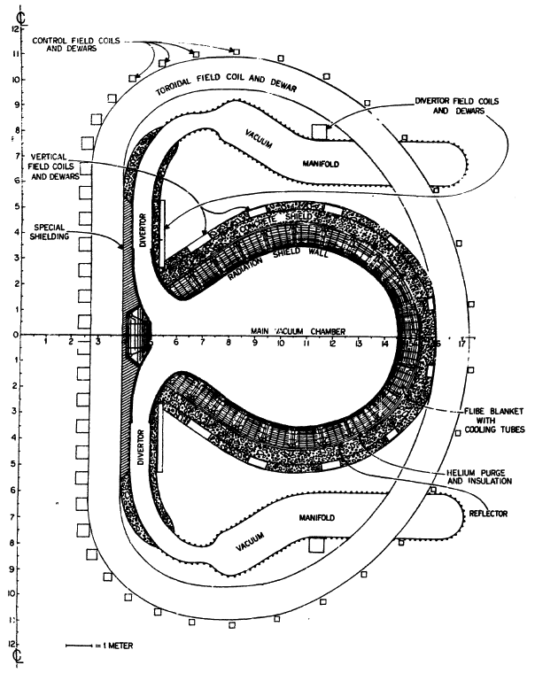
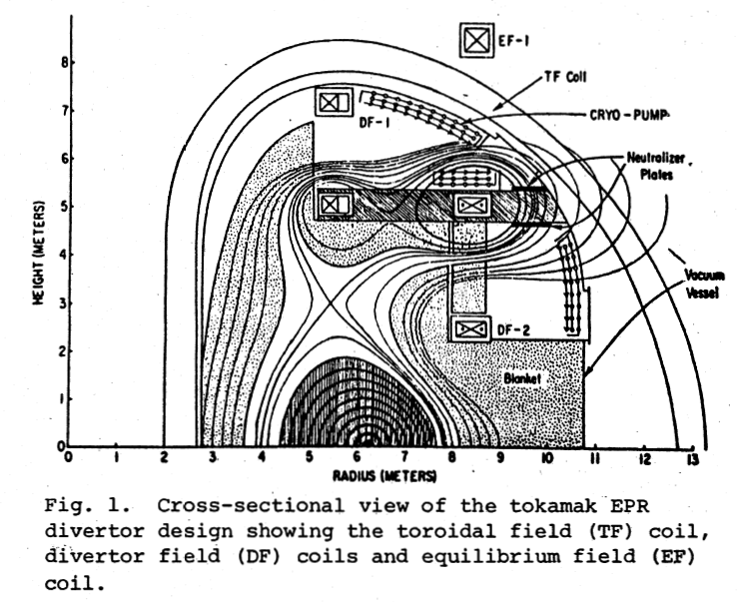
4. Long-legged divertors with multiple X-points: increase connection length, expand SOL
F. H. Tenney et.al,
J. Nucl. Mater. 53 43 (1974)
A.V. Georgievsky et.al, 6th Symp Eng Prob of Fus Energy, p 583, 1975, IEEE 75CH1097-5-NPS, Copyright 1976
F. H. Tenney,
PPPL Report 1284, 1976
Conceptual divertor design for Princeton Reference Design Reactor.
Long-legged high flux expansion poloidal divertor
Long-legged double null poloidal divertor

Slide 24
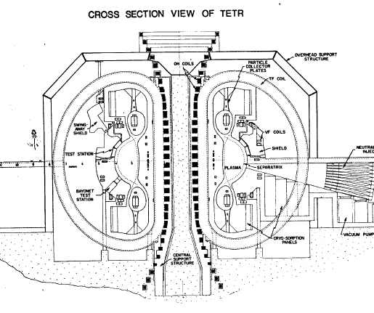
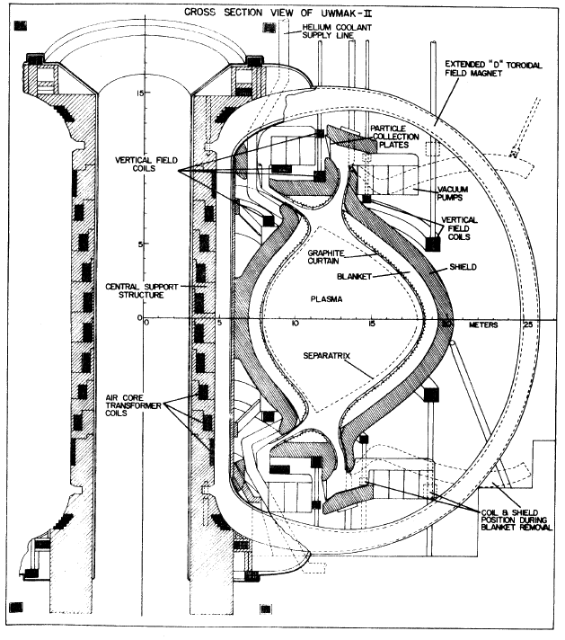
Long-legged divertors with multiple X-points
R. W. Conn et.al, U. Wisc. Report UWFDM-114, 1974
B. Badger et.al, U. Wisc. Report UWFDM-150, 1975
G. L. Kulcinski et.al, U. Wisc. Report UWFDM-173, 1976
UWMAK-II
UWMAK-III
Tokamak Enginering Test Reactor
UW Fusion Technology Institute conceptual reactor systems studies

Slide 25
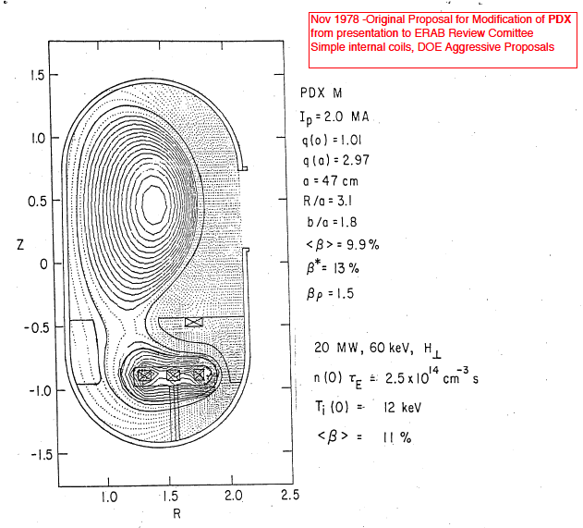
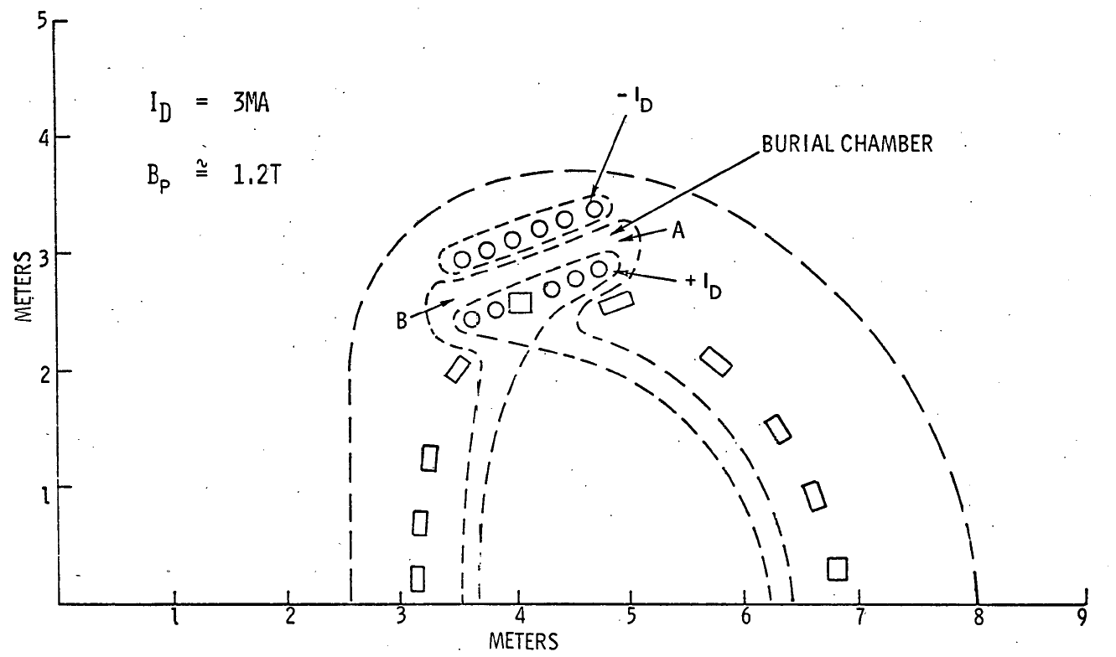
4. Long-legged divertors with multiple X-points
T. F. Yang et.al, Westinghouse Corp. WFPS-TME-055 1977
TNS reactor (w/ ORNL)
Divertor heat flux 1-3 MW/m²
Flowing liquid lithium targets for heat and particle removal
D. Meade, Private Communication
PDX Modification proposal

Slide 26
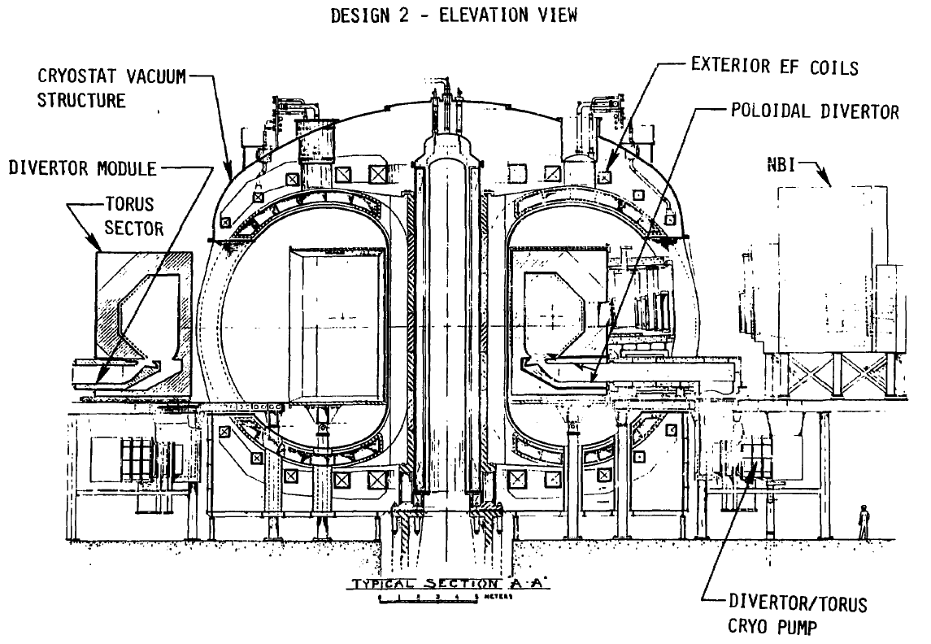
4. Long-legged divertors remove interaction zone away from plasma
Conceptual design Engineering Test Facility
R=5.6 m
a=1.3 m
B_{t}=5.5 T
I_{p}=6.1 MA
P_{NBI}=60 MW
Poloidal divertor
  W target plates
  Cryo-panels for particle control
P. H. Sager et. al, J. Vac. Sci. Tech. 18, 1081 (1981)

Slide 27

4. Long-legged divertors with multiple X-points
P. M. Valanju et.al, Phys.
Plasmas 16, 056110 (2009)
B. LaBombard et.al, APS 2013,
IAEA 2014
M. Peng, Steady-state Spherical tokamak TST,
Workshop on Edge Plasma for BPX and ITER, 1991
X-point target divertor
ADX tokamak proposal
Super-X divertor

Slide 28
Advanced magnetic divertor configurations: status of experiments
Dedicated experimental devices (1979-1986)
    PDX
    Doublet III Expanded boundary
Snowflake divertor configuration (existing devices with existing coils, 2008-present)
    TCV, 2008
    NSTX, 2009
    DIII-D, 2012
    EAST, 2014
Long leg divertor physics (2010-present)

Slide 29

1. Doublet III Expanded Boundary was the first advanced magnetic divertor configuration experiment
Stability of divertor configuration with outside PF coils
Integrated power and particle exhaust
  Reduction of intrinsic impurities in the core
  Radiative divertor plasma cooling with seeded argon
  Argon screening from main plasma
Compatibility with core confinement
N. Ohyabu et. al, Nucl. Fusion 5 519 (1981)
A. Mahdavi et. al, J. Nuc. Mater. 111 (1982) 355

Slide 30
Snowflake divertor configurations obtained with existing divertor coils, maintained for up to 10 τ_{E}

Slide 31


Snowflake divertor configurations obtained with existing divertor coils in NSTX

Slide 32




Impulsive heat loads due to Type I ELMs are mitigated in snowflake divertor
Steady-state At ELM peak
H-mode discharge, W_{MHD} ~ 220-250 kJ
  Type I ELM (W/ΔW ~ 5-8 %)

Slide 33

NSTX: Access to radiative detachment with intrinsic carbon in snowflake divertor facilitated
Snowflake divertor (*): P_{SOL}~3-4 MW, f_{exp}~40-60, q_{peak}~0.5-1.5 MW/m²
  Low detachment threshold
  Detachment characteristics comparable to PDD with D₂ or CD₄ puffing

Slide 34

Increased Plasma-wetted Area Leads to q_{peak} Reduction In Snowflake Divertor
Standard Snowflake
Snowflake with d_{XX} < 10 cm
Core plasma unaffected
  5 MW NBI H-mode
  Stored energy and density constant
Divertor power balance unaffected
In outer divertor, q_{peak} reduced by 30%

Slide 35

Detailed ELM Analysis: ΔW(ELM) decreased,
W pedestal constant in SF
Detailed ELM analysis before/during SF shows:
Pedestal Energy (W_{PEDESTAL}) Constant
Confinement Constant
Change in stored energy lost per ELM (ΔW_{ELM}) is reduced
Consistent with Loarte connection length scaling
S. L. Allen et al., Paper PD/1-2, IAEA FEC 2012.

Slide 36


q_{peak} Reduction in Snowflake Divertor Partly Due to Increased A_{wet} and L||
Standard Snowflake
Strike
point
Flux expansion increased ~20%
  Depends on configuration, can be up to X3
L|| increased by 20-60% over SOL width
Divertor heat flux reduced ~30%
Parallel heat flux reduced ~20%
SOL width

Slide 37


Convective Plasma Mixing Driven by Null-region Instabilities May Modify Particle and Heat Transport
  Flute-like, ballooning and electrostatic modes are predicted in the low B_{p} region
  β_{p}=P_{k}/P_{m} = 8π P_{k}/B_{p}² >> 1
  Loss of poloidal equilibrium
  Fast convective plasma redistribution
  Especially efficient during ELMs when P_{k} is large
Estimated size of convective zone
  Standard: 1 cm
  Snowflake: 6-8 cm
Divertor null-region β_{p} measured by divertor Thomson Scattering
  In snowflake, broad region of higher β_{p}>>1
  Higher X10 during ELMs
D. D. Ryutov, IAEA 2012; Phys. Scripta 89 (2014) 088002.

Slide 38

Broader q|| Profiles in Snowflake Divertor May Imply Increased Radial Transport
Parallel heat flux (MW/m²)
Standard Snowflake
λ_{q} = 2.40 mm
λ_{q} = 3.20 mm
Fit q|| profile with Gaussian (S) and Exp. (λ_{SOL}) functions (Eich PRL 107 (2011) 215001)
Increased λ_{q} may imply increased transport
  Increased radial spreading due to L||
  SOL transport affected by null-region mixing
  Enhanced dissipation may also play role

Slide 39

Peak divertor heat flux significantly reduced due to snowflake divertor geometry effects
Standard
Snowflake
Standard Snowflake
SOL width
Inner SP
Outer SP
Flux expansion increased ~20%
L|| increased by 20-60% over SOL width
Divertor heat flux reduced ~40%
Geometry and radiation

