Slide 1
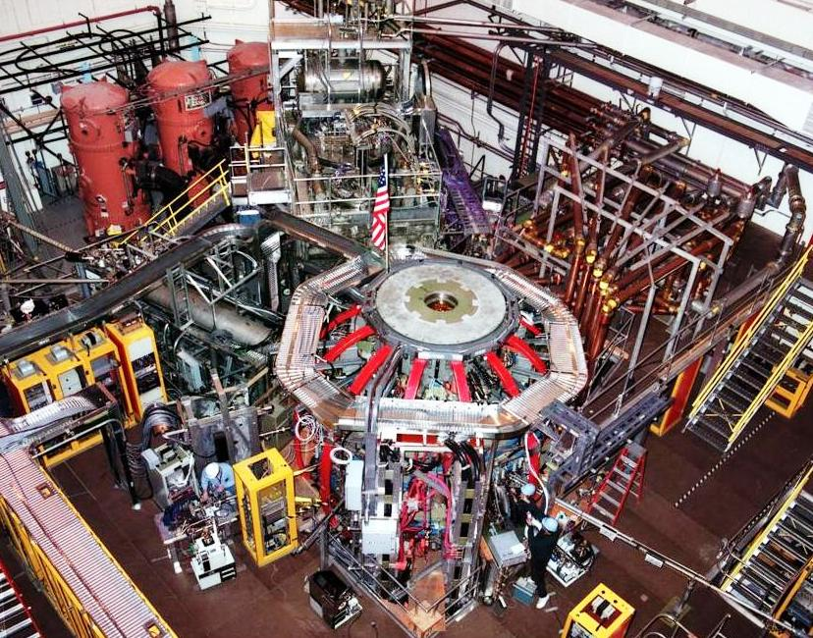
NSTX
Supported by
Overview of Physics Results from the
National Spherical Torus Experiment (NSTX)
Roger Raman
University of Washington
For the NSTX Research Team
College W&M
Colorado Sch Mines
Columbia U
CompX
General Atomics
INL
Johns Hopkins U
LANL
LLNL
Lodestar
MIT
Nova Photonics
New York U
Old Dominion U
ORNL
PPPL
PSI
Princeton U
Purdue U
SNL
Think Tank, Inc.
UC Davis
UC Irvine
UCLA
UCSD
U Colorado
U Maryland
U Rochester
U Washington
U Wisconsin
Culham Sci Ctr
U St. Andrews
York U
Chubu U
Fukui U
Hiroshima U
Hyogo U
Kyoto U
Kyushu U
Kyushu Tokai U
NIFS
Niigata U
U Tokyo
JAEA
Hebrew U
Ioffe Inst
RRC Kurchatov Inst
TRINITI
KBSI
KAIST
POSTECH
ASIPP
ENEA, Frascati
CEA, Cadarache
IPP, Jülich
IPP, Garching
ASCR, Czech Rep
U Quebec
23rd IAEA Fusion Energy Conference
October 11-16, 2010
Daejeon, Korea

Slide 2
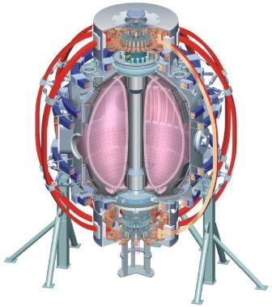
NSTX Studies Toroidal Confinement Physics at
Low Aspect-Ratio & Supports ITER Research
Outline:
1) Lithium Research
Confinement improvement
ELM stability
Liquid lithium divertor
2) ITER Support
L-H thresholds
Error field amplification
Resistive Wall Mode
Fast ion instabilities & effects
ELM pacing & divertor heat loads
Aspect ratio A 1.3 – 1.6
Elongation κ 1.8 – 3.0
Major radius R₀ 0.85m
Plasma Current I_{p} 1.5MA
Toroidal Field 0.55 T
Auxiliary heating:
NBI (100kV) 7 MW
RF (30MHz) 6 MW
3) Advanced Scenarios
Snowflake divertor
CHI start-up
Partial non-inductive sustainment
Feedback control

Slide 3
Lithium Research
Confinement improvement
ELM stability
Liquid lithium divertor

Slide 4
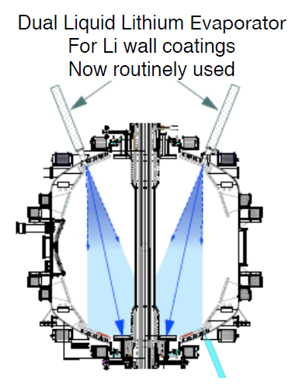
NSTX Experiments are Exploring the
Benefits of Lithium to Magnetic Fusion Research
Typically 50 to 300mg lithium now deposited between shots
H.W. Kugel FTP/3-6Ra

Slide 5
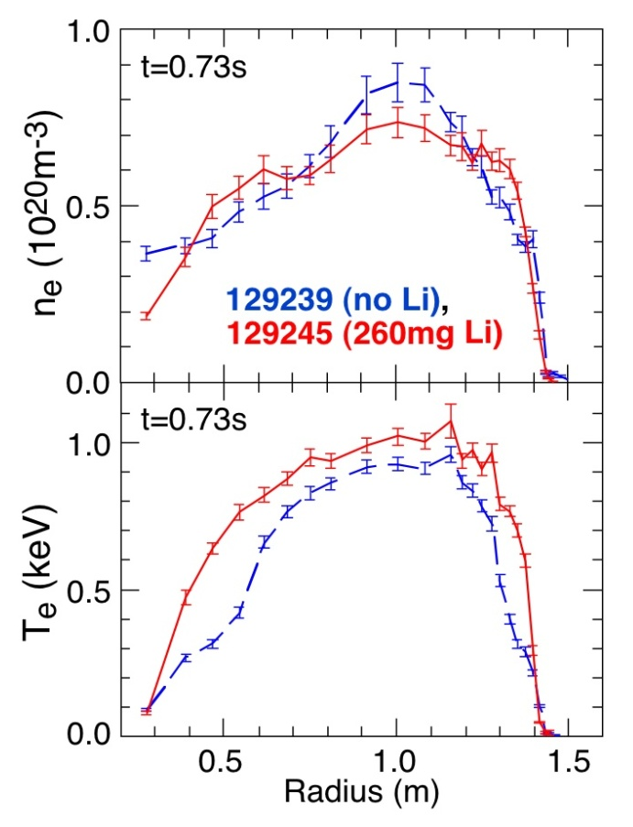
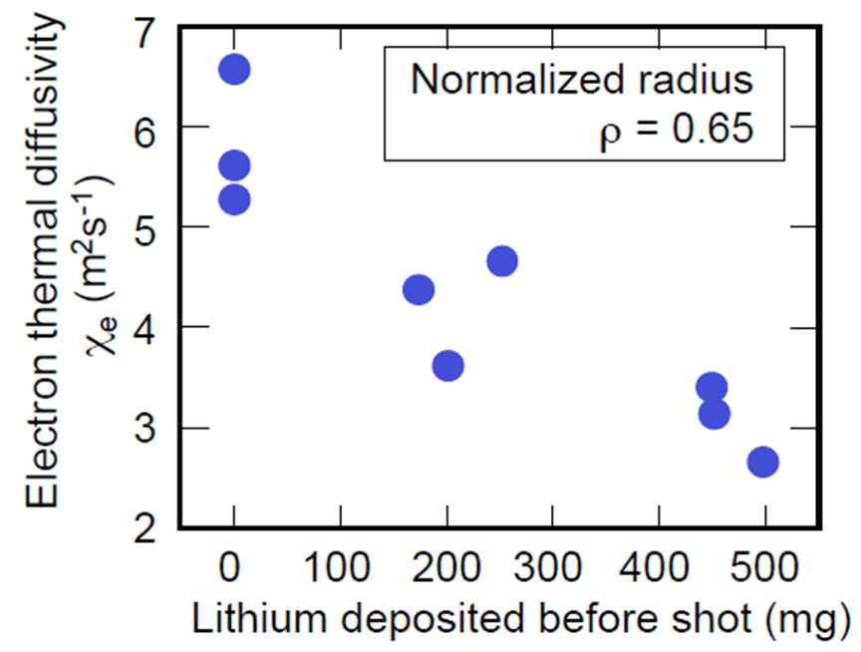
Improved Electron Confinement With Lithium Coating Arises from Broadening of T_{e} Profile
TRANSP analysis confirms electron thermal transport in outer region progressively reduced by lithium coating. Measure reductions in high-k turbulence near edge.
Thermal ion confinement remains close to neoclassical both with and without lithium
New confinement mode, Enhanced Pedestal H-mode, found with H_{98y2}=1.8
[R. Maingi, et al., PRL 135004 (2010)]
S. Ding et al., Plasma Phys. Control. Fusion 52 (1), 015001 (2010)

Slide 6
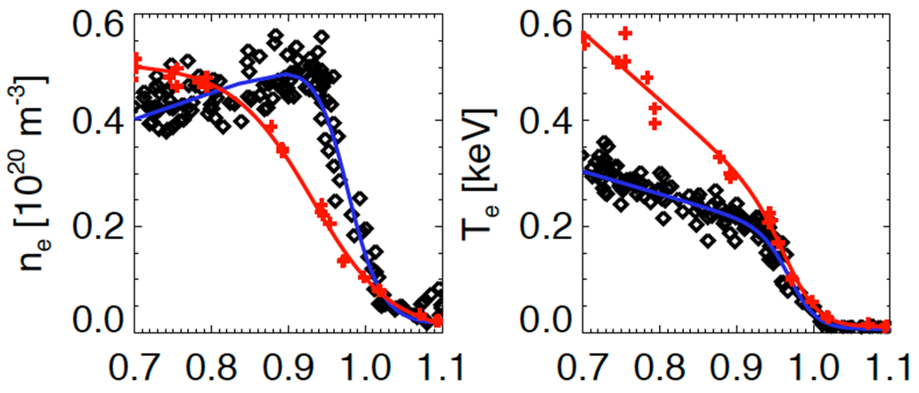

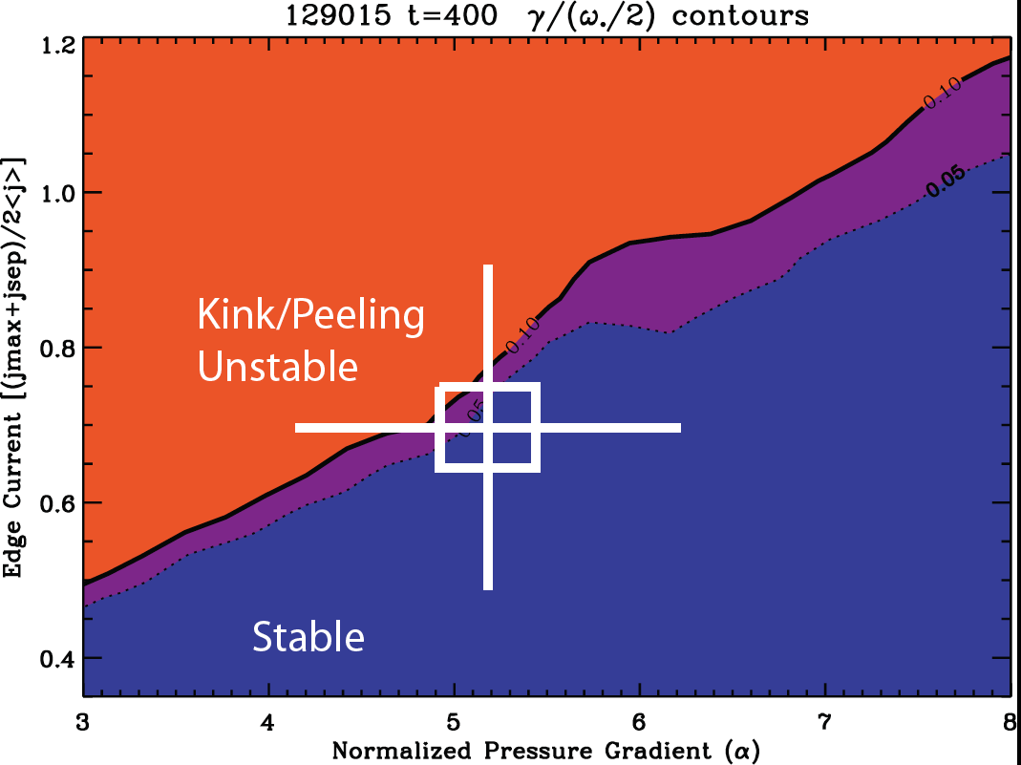
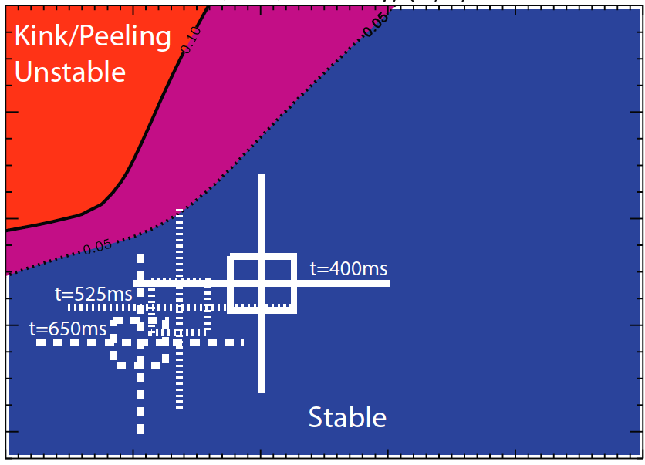
Pedestal Profiles Broadened and
ELMs Suppressed by Lithium Wall Coatings
  Edge stability calculations (ELITE)
  Colors represent contours of ratio of linear mode growth rate to diamagnetic drift frequency
  Pre-Li discharges close to kink/peeling stability boundary
H-Mode
pedestal
Post Li
Pre- Li
γ_{lin}/(ω*/2)
1.2
0.8
0.4
0.1 0.05
0.1 0.05
With Lithium
Edge current
[(jmax+jsep)/2<j>]
No Lithium
3 4 5 6 7 8
Normalized Pressure Gradient (α)
3 4 5 6 7 8
Normalized Pressure Gradient (α)
R. Maingi EXD/2-2

Slide 7
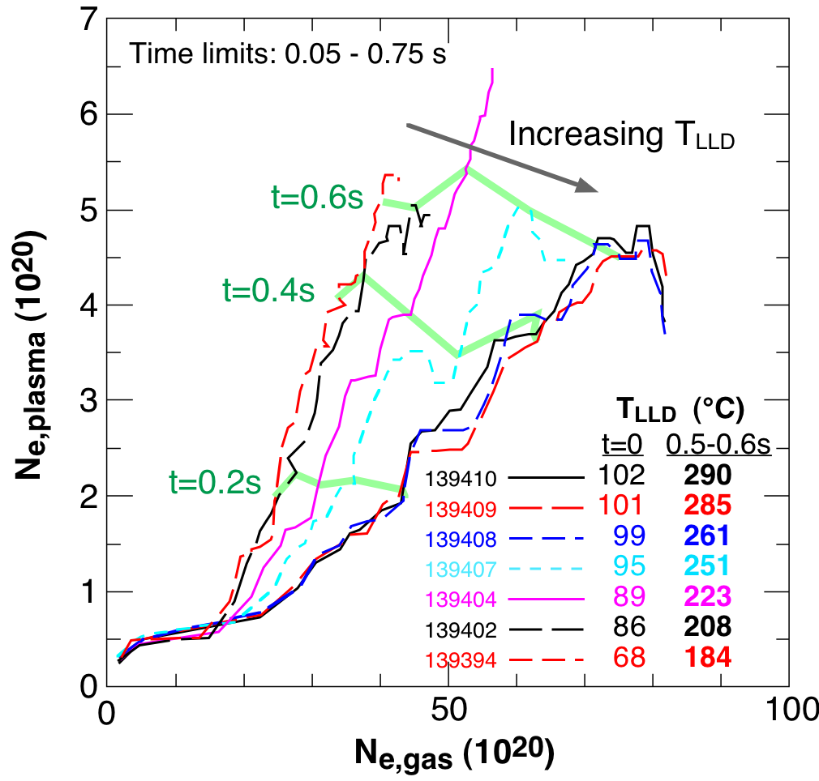
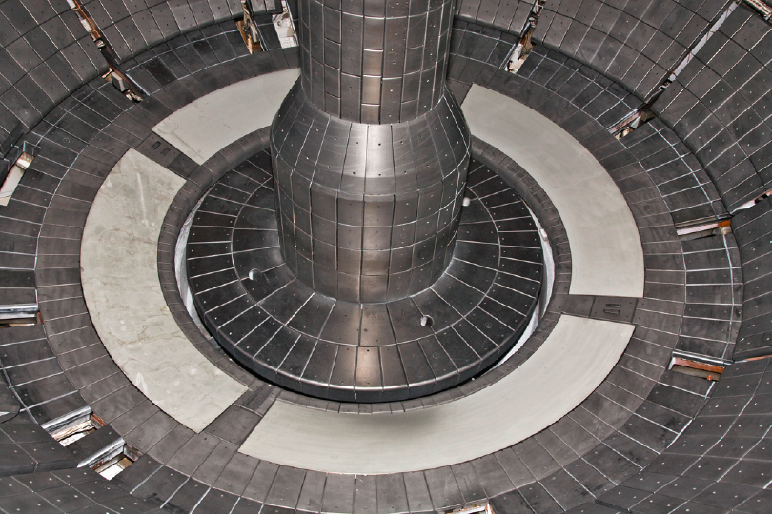
Now Investigating Pumping Capability and
Plasma Effects of a Liquid Lithium Divertor (LLD)
4 LLD plates form ~20cm wide annulus in lower outboard divertor
  Heatable surface of porous molybdenum
  Loaded with lithium by LITER deposition
Observed preliminary indications of D pumping when surface heating by plasma liquefies lithium coating on LLD
  Lower single null divertor plasmas with outer strike point on LLD raise peak surface temperature to ~300°C
H.W. Kugel FTP/3-6Ra

Slide 8
Toroidal Confinement Physics and ITER Support
  L-H thresholds
  Error field amplification
  Resistive Wall Mode
  Fast-ion instabilities and effects
  ELM pacing & divertor heat loads

Slide 9
NSTX Strongly Supports ITPA Joint Experiments
Transport and Confinement
TC-1 Beta degradation of energy confinement
TC-2 Hysteresis and access to H~1
TC-4 Species dependence of L-H threshold
TC-9 Scaling of intrinsic rotation
TC-10 Exptl. identification of turbulence and comparison with codes
TC-12 Confinement at low aspect ratio
TC-14 RF rotation drive
TC-15 Dependence of momentum and particle pinch on collisionality
Macroscopic Stability
MDC-2 RWM physics
MDC-14 Rotation effect on NTMs
MDC-15 Disruption database development
MDC-17 Active disruption avoidance
Energetic Particles
EP-1 Measurement of damping rate of TAEs
EP-2 Fast ion loss/redistribution from localized Aes
EP-4 Effect of dynamic friction at resonance on non-linear AE evolution
Pedestal
PEP-6 Pedestal structure and ELM stability in DN
PEP-19 Edge transport with RMP
PEP-23 ELM suppressions by magnetic perturbations
PEP-26 Critical edge parameters for achieving L-H
PEP-27 Pedestal profile evolution following L-H transition
Divertor and Scrape-Off Layer
DSOL21 Dust transport
Integrated Operating Scenarios
IOS-5.2 Maintaining ICRF coupling in expected ITER regimes

Slide 10
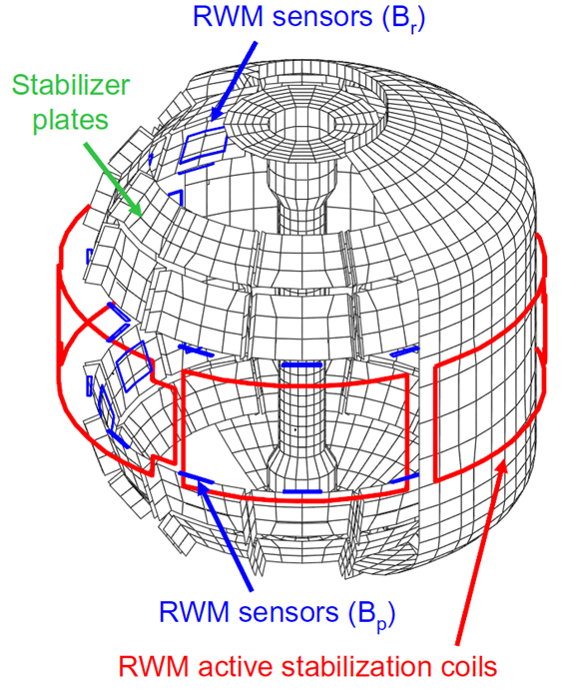
NSTX Equipped with Midplane Non-Axisymmetric Coils for MHD, Confinement and Pedestal Studies
Produce n = 1, 3 or 2 (4) radial field perturbations
Used for studies of:
H-mode threshold
Error field correction (EFC)
Resistive Wall Mode (RWM)
ELM pacing
Momentum transport

Slide 11
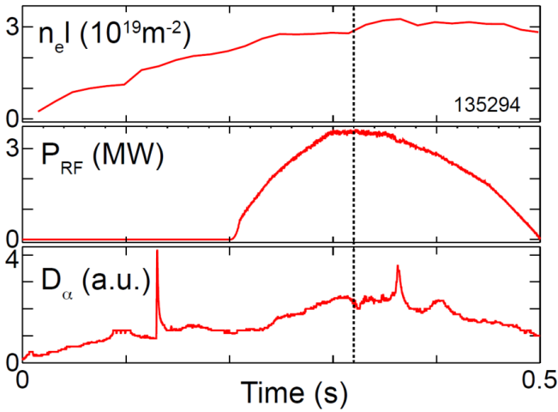
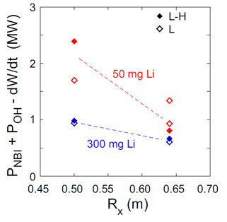
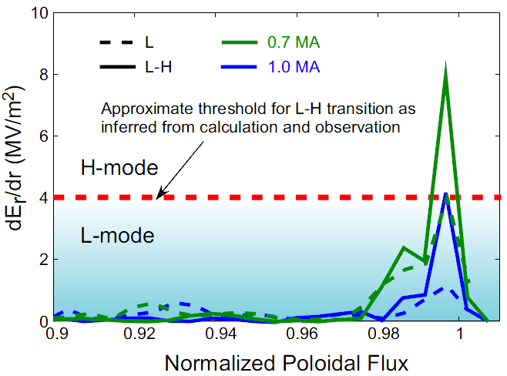
L-H Threshold Experiments in NSTX Have
Explored Many ITER and ST-Relevant Issues
Species dependence
  P_{LH} (He) ~ 1.2-1.4 P_{LH} (D): RF-heated
  H_{98y,2} ~1 with no ELMs after L-H transition
Non-axisymmetric field application
  P_{LH} /n_{e} increased ~65% with several Gauss n=3 fields
Plasma configuration
  Lower P_{LH} at increased major radius of X-point
Lithium coatings
  P_{LH} /n_{e} decreased by ~35% with lithium coating
  Additive influence for R_{X} , USN vs. LSN
Strong I_{p} dependence (ST effect)
  lower P_{LH} with lower I_{p}
  XGC0 calculations show larger E_{r} shear at lower I_{p}
Role of ion-scale turbulence
  Beam Emission Spectroscopy now operational
S.M. Kaye EXC/2-3Rb

Slide 12
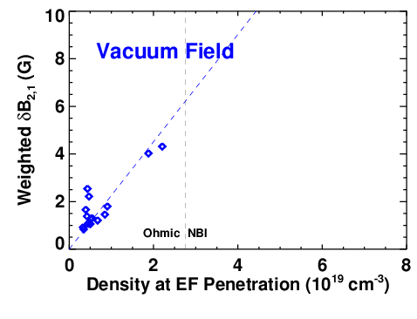
Inclusion of Plasma Response Important to
Understanding Effects of Error Fields
Measure dependence on the line-average density of resonant 2/1 amplitude at q = 2 surface at which mode locks
Ohmic L-mode plasmas at low density show familiar proportional dependence

Slide 13
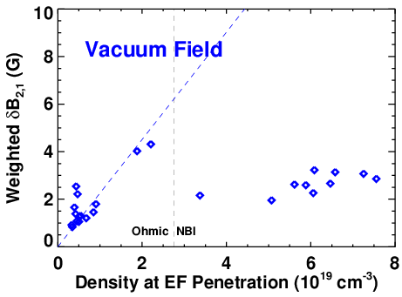
Inclusion of Plasma Response Important to
Understanding Effects of Error Fields
Measure dependence on the line-average density of resonant 2/1 amplitude at q = 2 surface at which mode locks
Ohmic L-mode plasmas at low density show familiar proportional dependence
Linear scaling with density breaks down in high-density, high-β NBI-heated plasmas
  mode locks at anomalously low error field

Slide 14
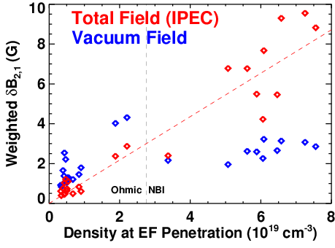
Inclusion of Plasma Response Important to
Understanding Effects of Error Fields
Measure dependence on the line-average density of resonant 2/1 amplitude at q = 2 surface at which mode locks
Ohmic L-mode plasmas at low density show familiar proportional dependence
Linear scaling with density breaks down in high-density, high-β NBI-heated plasmas
  mode locks at anomalously low error field
Linear scaling is restored when plasma amplification of applied field included
  Plasma response is calculated by IPEC
IPEC:
Ideal Perturbed Equilibrium Code
Calculates
Ideal plasma response
Shielding currents
Total resonant field at q=m/n
Ideal Plasma Amplification
J-K. Park EXS/P5-12

Slide 15
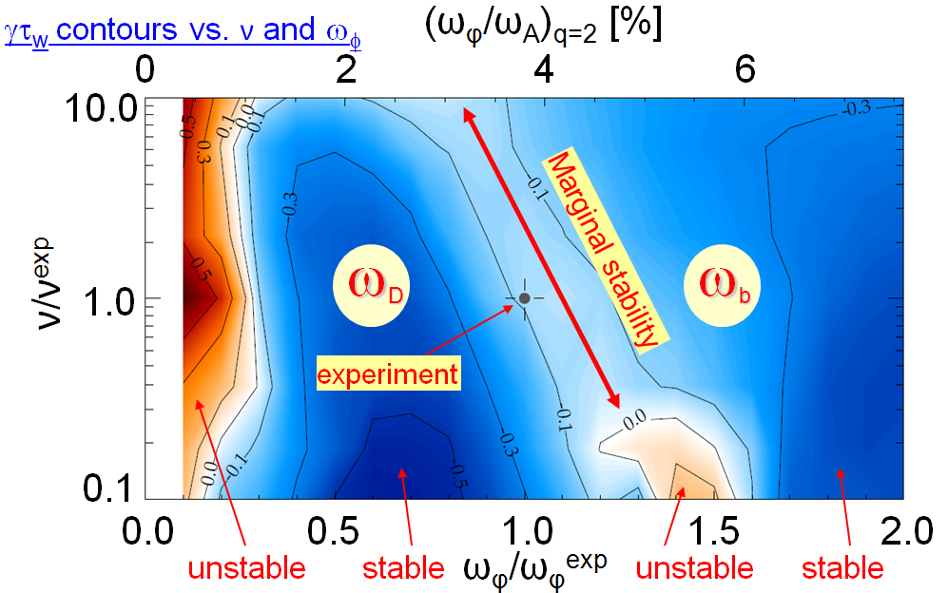
Resistive Wall Mode (RWM) Stability Depends on Thermal Kinetic Resonances and Fast-ion Content
Calculated growth rate γτ_{w} contours vs
collisionality ν and rotation frequency ω_{φ}
Observe that RWM can be unstable despite significant plasma rotation
MISK code predicts stabilization of RWM from:
  precession drift resonance
  ω_{D} at low rotation
  bounce resonance ω_{b} at high rotation
Plasma marginally unstable at intermediate rotation
(ω_{φ}/ω_{A})_{q=2} [%]
Stability to RWM predicted to improve with fast ion content
  Lower rotation speed required to stabilize RWM for higher fast-ion density
  Important for high-beta ST-FNSF and ITER advanced scenarios
S. Sabbagh EXS/5-5

Slide 16
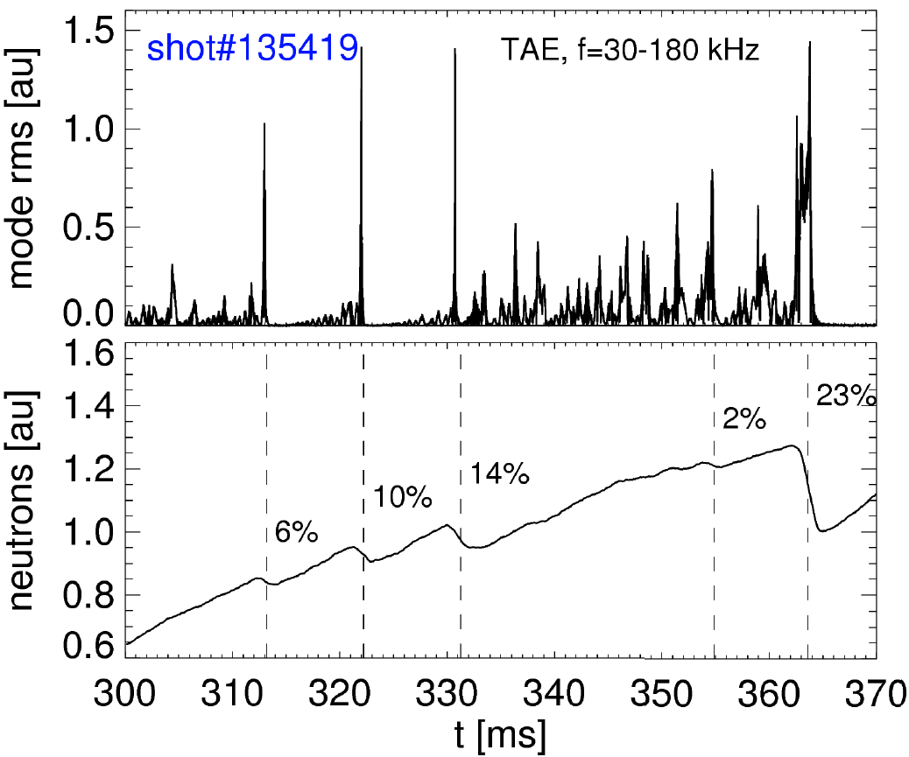
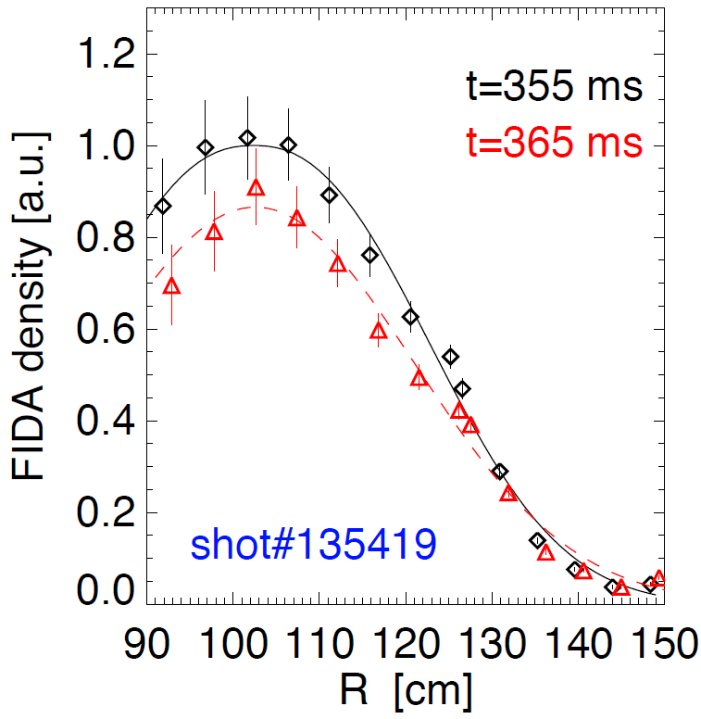
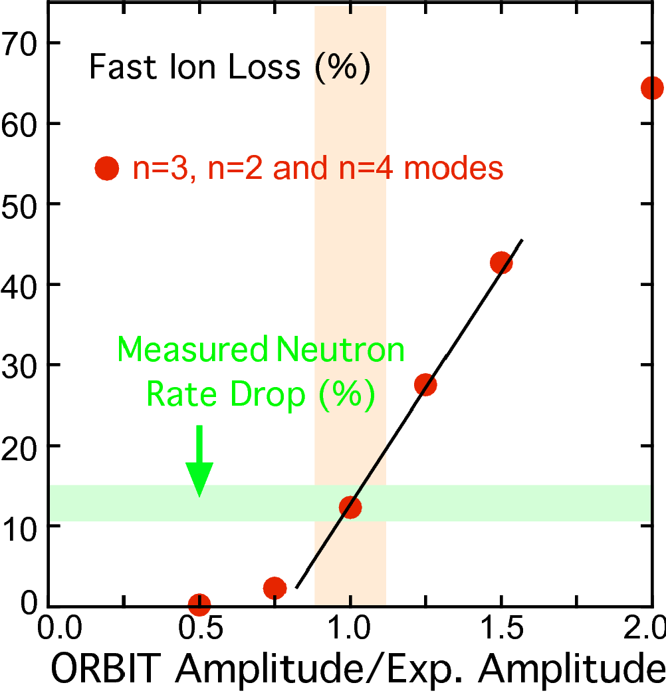
TAE-Avalanche Induced Neutron Rate Drop Modeled
Successfully Using NOVA and ORBIT Codes
Fast Ion Profile
(E_{λ} = 30-60keV)
Toroidal Alfvén Eigenmode (TAE) avalanches in NBI-heated plasmas associated with transient reductions in D-D (beam-target) neutron rate
Change in beam-ion profile measured with Fast-ion D-alpha (FIDA)
Modeled using NOVA and ORBIT codes
  Mode structure obtained by comparing NOVA calculations with reflectometer data
  Fast ion dynamics in the presence of TAEs calculated by guiding-center code ORBIT
E. Fredrickson EXW/P7-06
M. Podestà EXW/P7-23
G-Y. Fu THW/2-2Rb

Slide 17
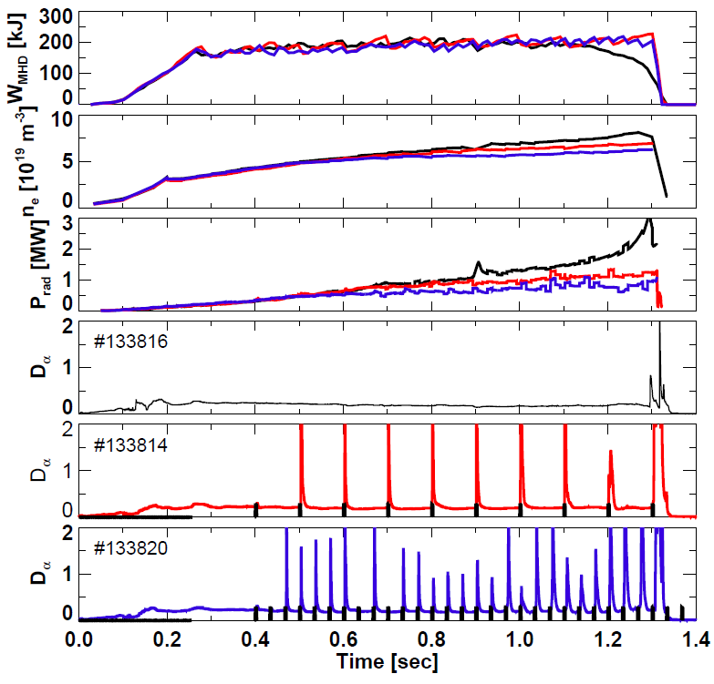
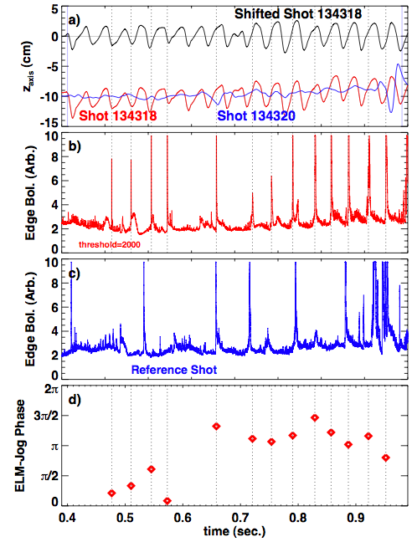
ELM Pacing Developed With Pulsed
Non-Resonant Fields and Vertical Jogs
Rapid, Reliable Triggering with Pulsed 3-D Fields
ELM Pacing Via Vertical Jogs
Stored Energy
Electron Density
Radiated Power
D-Alpha
Phase Locked
D-Alpha
D-Alpha
Vertical jogging successful despite thick continuous vacuum vessel.
ELMs become phase locked to upward motion
- Reduction in radiated power
- Rapid ELMs lead to smaller per-ELM energy loss
J. Canik EXC/8-1
S. Gerhardt EXS/P2-8

Slide 18
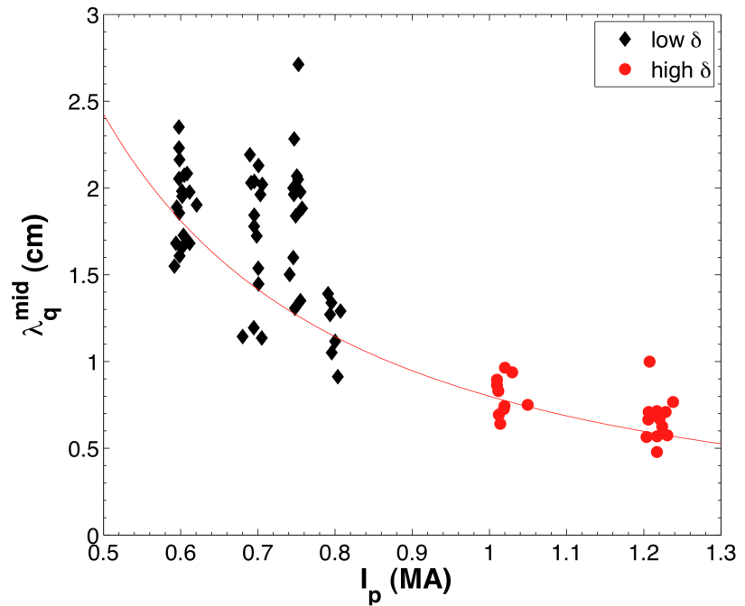
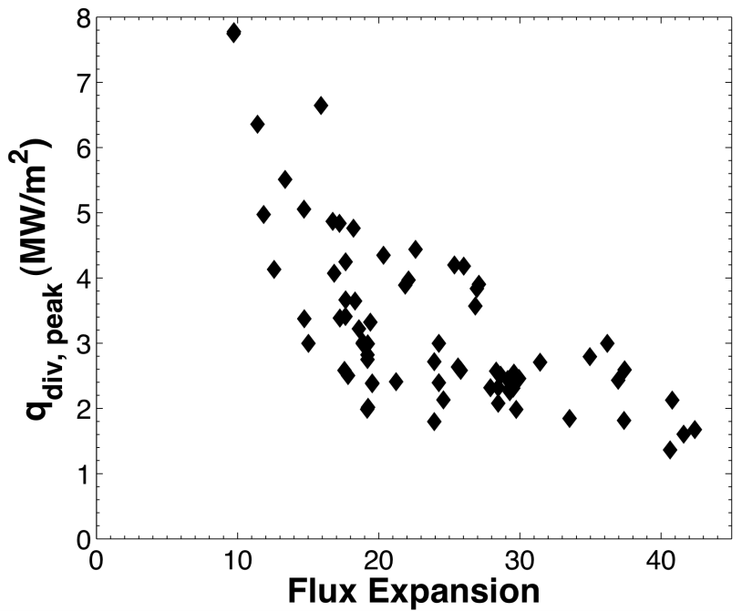
Heat Flux Profile Width Decreases Strongly with I_{p} in NSTX, Largely Independent of P_{loss}, Flux Expansion, and B_{T}
Divertor heat flux width, magnetically mapped to the midplane, shows a strong decrease as I_{p} is increased
  λ_{q}^{mid} further decreases in ELM-free Li conditioned discharges
  Research continuing to determine if adverse Ip scaling is offset by favorable size scaling to future devices.
Divertor heat flux inversely proportional to flux expansion over a factor of five
λ_{q}^{mid} ~ I_{p}^{-1.6}
T.K. Gray, EXD/P3-13

Slide 19
Advanced Scenarios
  Snowflake divertor
  CHI start-up
  Partial non-inductive sustainment
  Feedback control

Slide 20
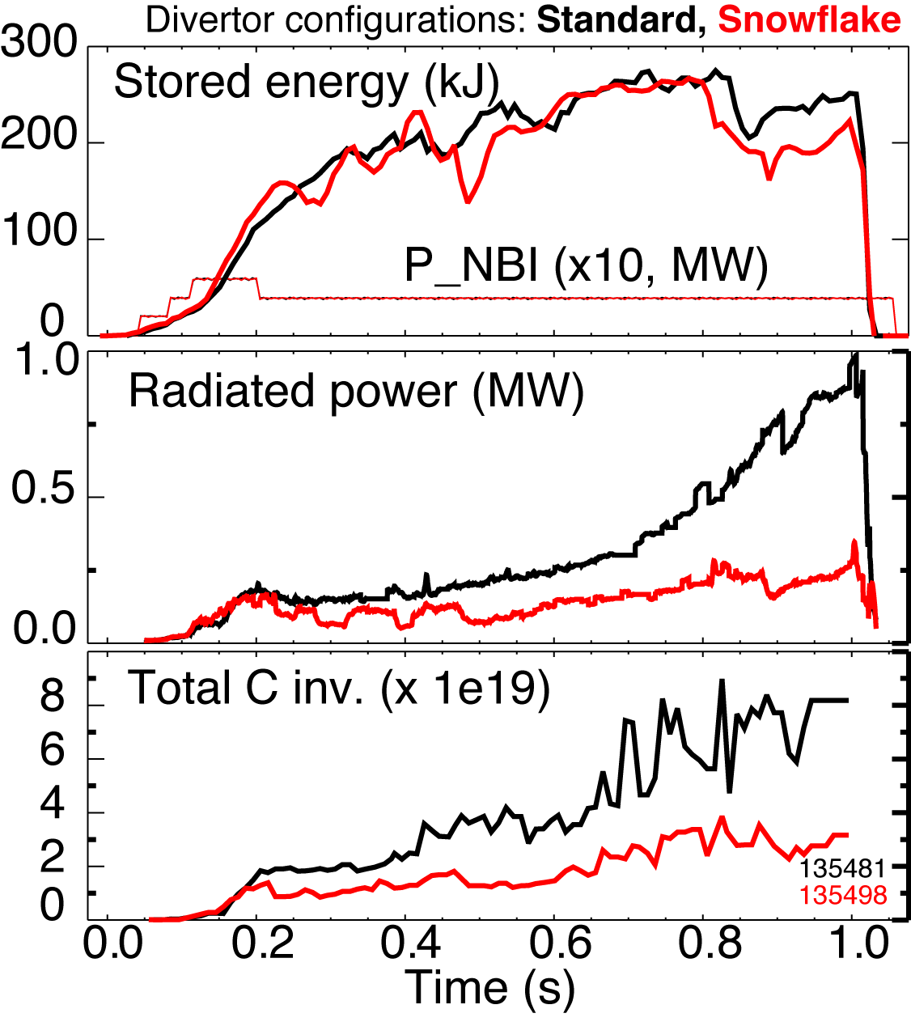
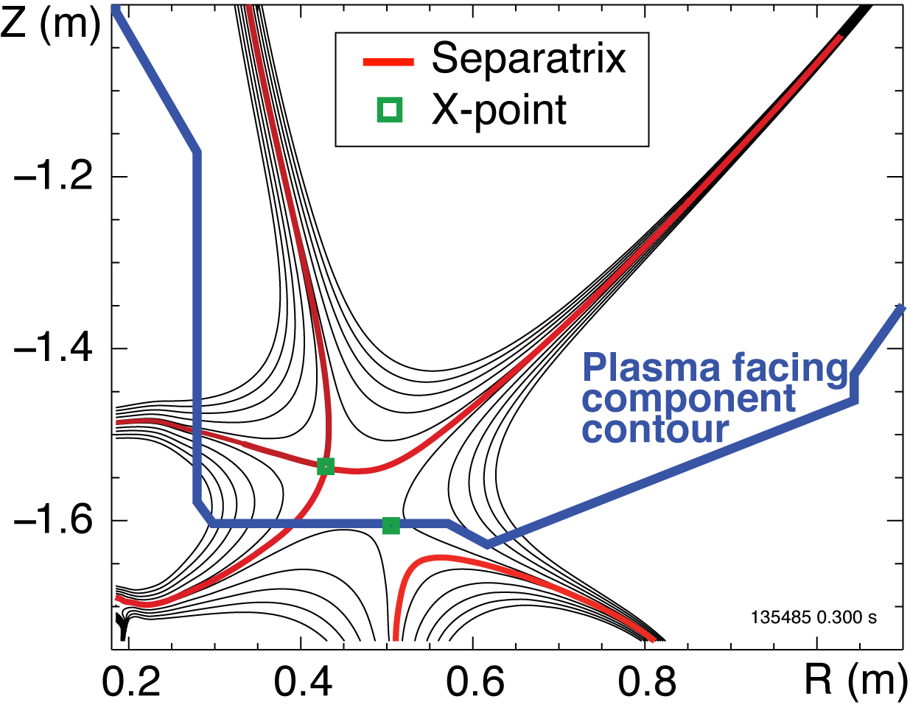
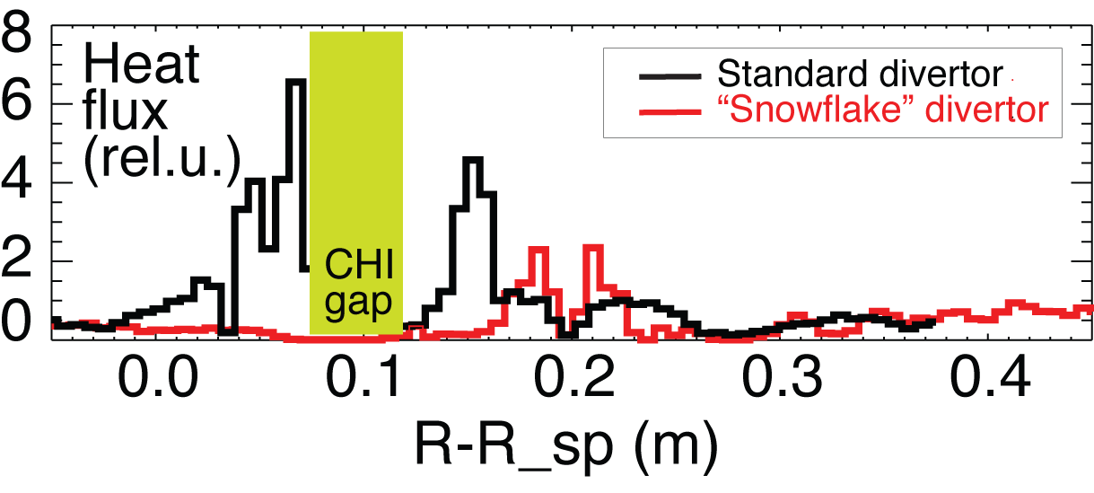
“Snowflake” Divertor Configuration Resulted in Significant Divertor Heat Flux Reduction and Impurity Screening
Higher flux expansion (increased div wetted area)
Higher divertor volume (increased div. losses)
Maintained “snowflake”-like configuration for 100-600 ms
Maintained H-mode confinement with core carbon reduction by 50%
V. Soukhanovskii EXD/P3-32

Slide 21
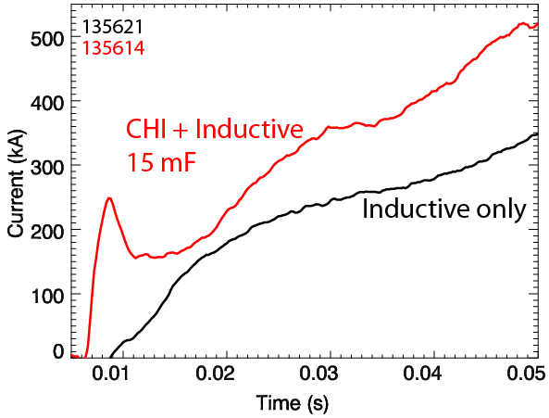
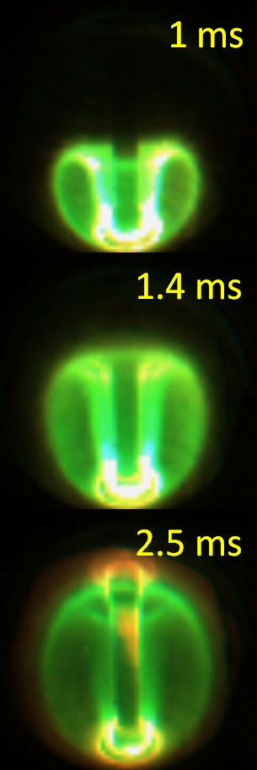
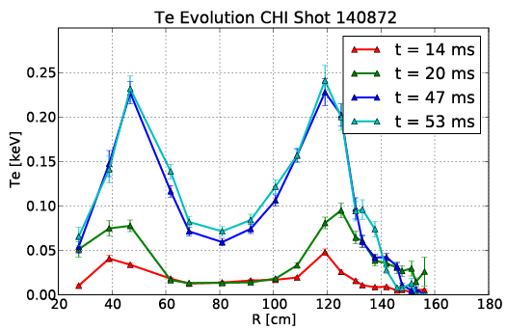
Coaxial Helicity Injection (CHI) has Produced Substantial
Flux Savings and Scales Favorably with Size and B_{T}
  Enabling capabilities
  Elimination of arcs in absorber region
  Conditioning of lower divertor
Time after CHI starts
200 kA more current with CHI start-up
  Generated 1MA using 40% less flux than induction- only case
  Hollow T_{e} maintained during ramp
  Low internal inductance (l_{i} ≈ 0.35)
  High elongation
  Suitable startup for advanced scenarios
B.A. Nelson EXW/P2-8

Slide 22
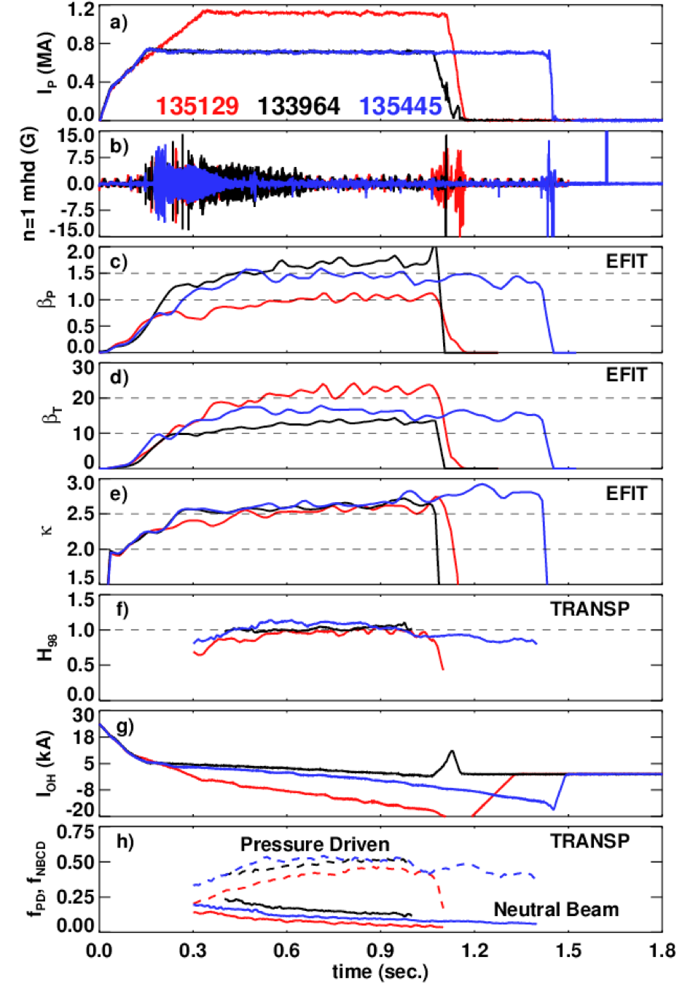
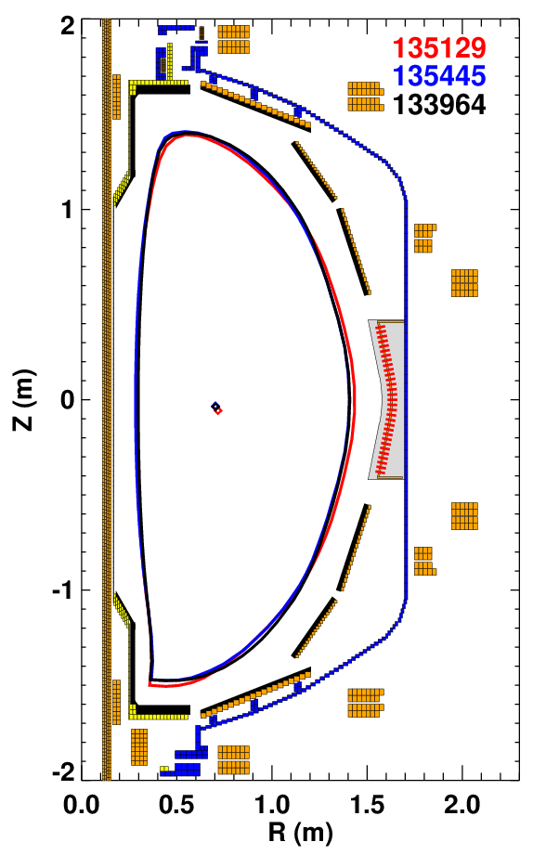
Developed Sustained High-Elongation Configurations
Over a Range of Currents and Fields
High-β_{T} Long Pulse High-β_{P}
q*=2.8 q*=3.9 q*=4.7
Plasma current
B_{T}=0.44 T
I_{P}=1100 kA
B_{T}=0.38 T
I_{P}=700 kA
B_{T}=0.48 T
I_{P}=700 kA
Poloidal beta
Toroidal beta
κ~2.6-2.7
δ~0.8
Double Null
H₉₈>=1
Current in central solenoid
S. Gerhardt EXS/P2-8

Slide 23
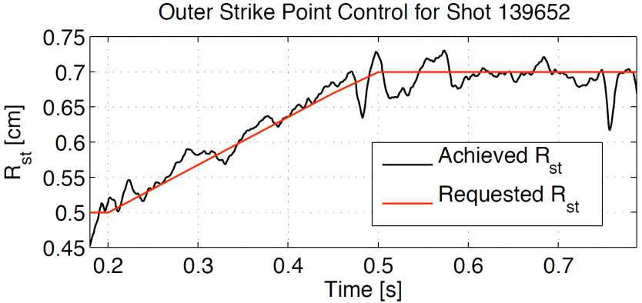
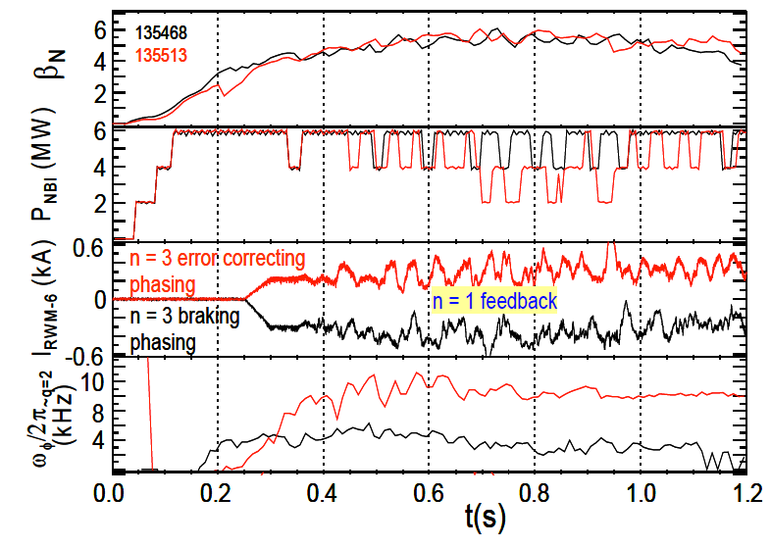
NSTX is Developing Shape and Stability Control Techniques Relevant to ITER and Next-Step STs
New inner & outer strike-point control
  In-line system ID for single-shot optimal gain identification
  Used for LLD experiments and snowflake divertor control
Feedback-based n=1 error field correction and RWM control.
  Routine with PID controller + first
  state-space RWM controller in high-β tokamak.
Control β_{N} using NBI power modulation
Combined controllers result in improved performance.
  Example: simultaneous RWM + β_{N} control w/ different levels of rotation.
Controlled Strike-Point Motion
Simultaneous Control of β_{N} and n=1 RWMs
E. Kolemen EXD/P3-18
S. Gerhardt EXS/P2-8
S.A. Sabbagh EXS/5-5

Slide 24
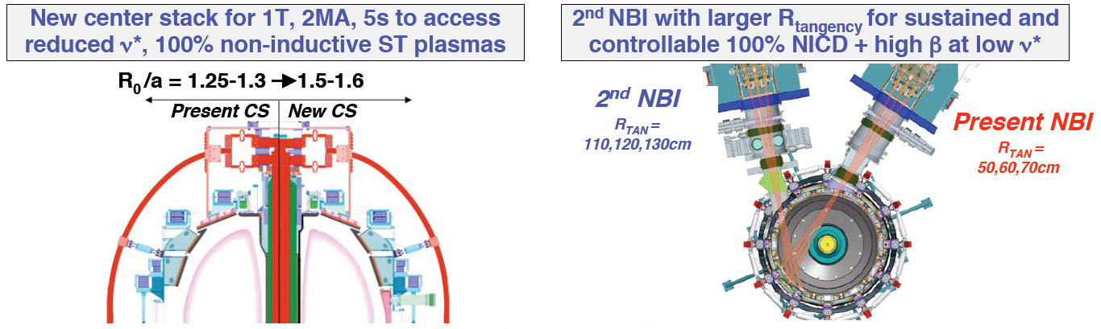
Summary: Considerable Progress Made in NSTX
Towards Sustained Operation in Support of STs and ITER
Developing understanding of transport and stability changes from Li
Strongly supporting ITER (LH threshold, ELM triggering, SOL width scaling)
Using CHI to initiate ST plasmas, advanced control to sustain ST plasmas
FUTURE: Major upgrade of NSTX to occur 2012-2014 with 2 elements:

Slide 25
NSTX related papers at this conference
Tuesday POSTERS
Advanced scenarios S.P. Gerhardt EXS/P2-8
Solenoid-free startup B.A. Nelson EXWP2-8
Internal Modes J.A. Breslau THS/P2-3
Wednesday
L-H Threshold S. Kaye EXC/2-3Rb
Particle Transport L. Delgado-Aparicio EXC/P4-4
Divertor profile mod. J-W. Ahn EXD/P3-1
Divertor heat flux T.K. Gray EXD/P3-13
Plasma Control E. Kolemen EXD/P3-18
ELM pedestal A. Sontag EXD/P3-31
Snowflake divertor V. Soukhanovskii EXD/P3-32
H-Mode formation K.C. Lee THC/P3-4
Gyro kinetic simul. S. Ethier THC/P4-08
Transport W.X. Wang THC/P4-30
Thursday
NTMs R. Buttery EXS/P5-3
3D Error Fields J-K. Park EXS/P5-12
Lithium Technology H.W. Kugel FTP/3-6Ra
Friday
GAE E. Fredrickson EXW/P7-06
HHFW physics B.P. LeBlanc EXW/P7-12
TAE avalanches M. Podesta EXW/P7-23
Talks
Tuesday
“Modification of edge profiles, edge transport and ELM stability with lithium in NSTX ” R. Maingi EXD/2-2
“L-H Threshold Studies on NSTX” H. Meyer / S. Kaye EXC/2-3R
Wednesday
“Simulation of Energetic Particle-driven Alfven Instabilities with Source and Sink” G. Fu THW/2-2Rb
Thursday
“Resistive wall mode stabilization and plasma rotation damping considerations for maintaining high beta plasmas in NSTX” S. Sabbagh EXS/5-5
Friday
“Optimization of Density and Radiated Power Evolution Control using Magnetic ELM Pace-making in NSTX ” J.M. Canik EXC/8-1
“Prospects for pilot plants based on the tokamak, ST and stellarator” J. Menard FTP/2-2
“Lithium Technologies and Their Impact on Boundary Control, Core Plasma Performance, and Operations” H.W. Kugel FTP/3-6R

Slide 26
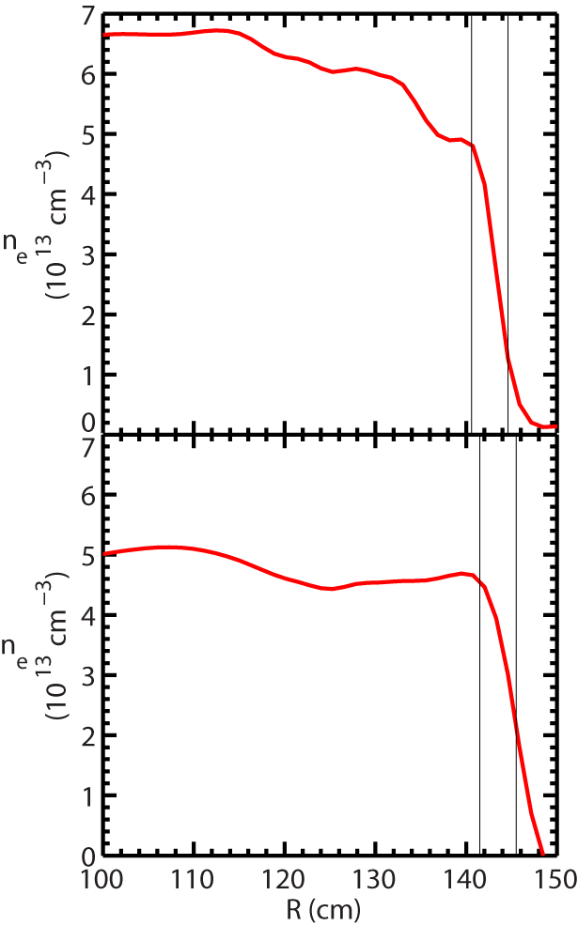
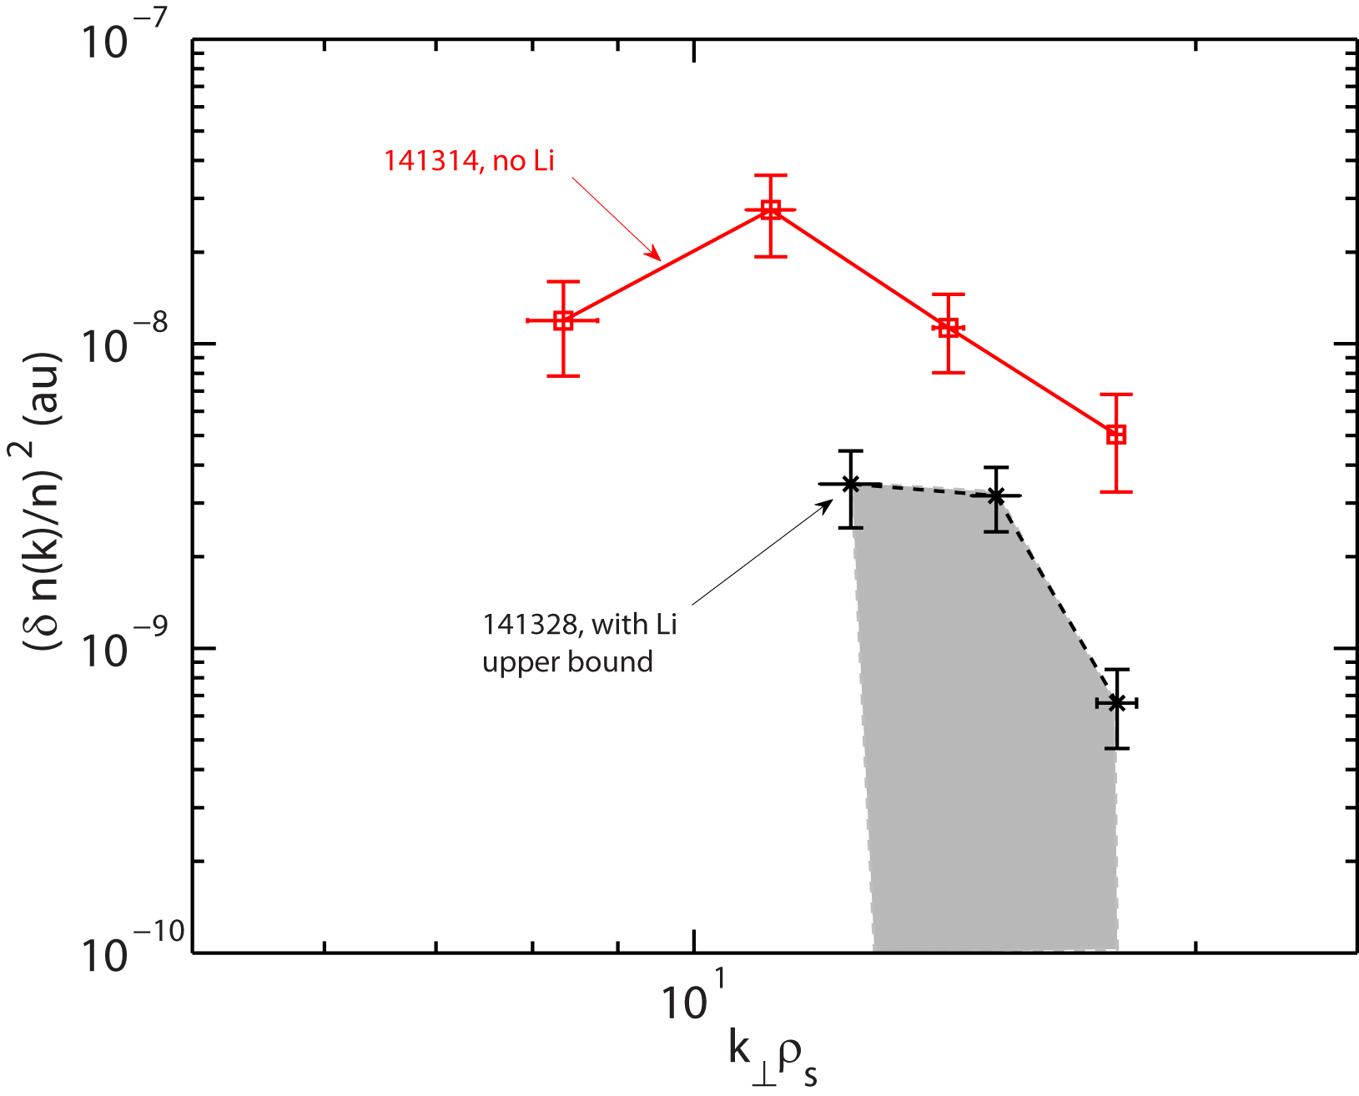
Electron Gyro-scale Turbulence in Edge Reduced with Lithium
k spectra of normalized density fluctuations
Reduction of high-k turbulence power is observed in the pedestal region as Lithium is added.
No Li
High-k location
No Li
With Li
Upper bound
With Li
High-k location
Y. Ren, E. Mazzucato et al.

Slide 27
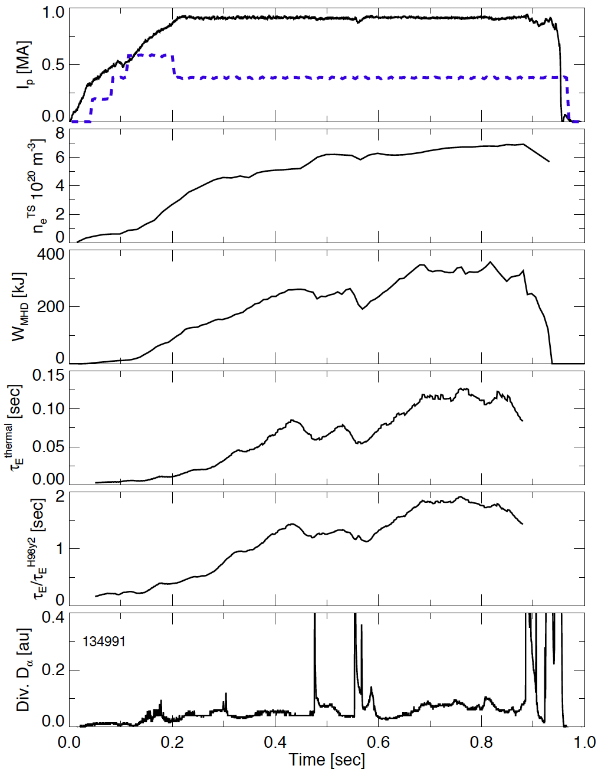
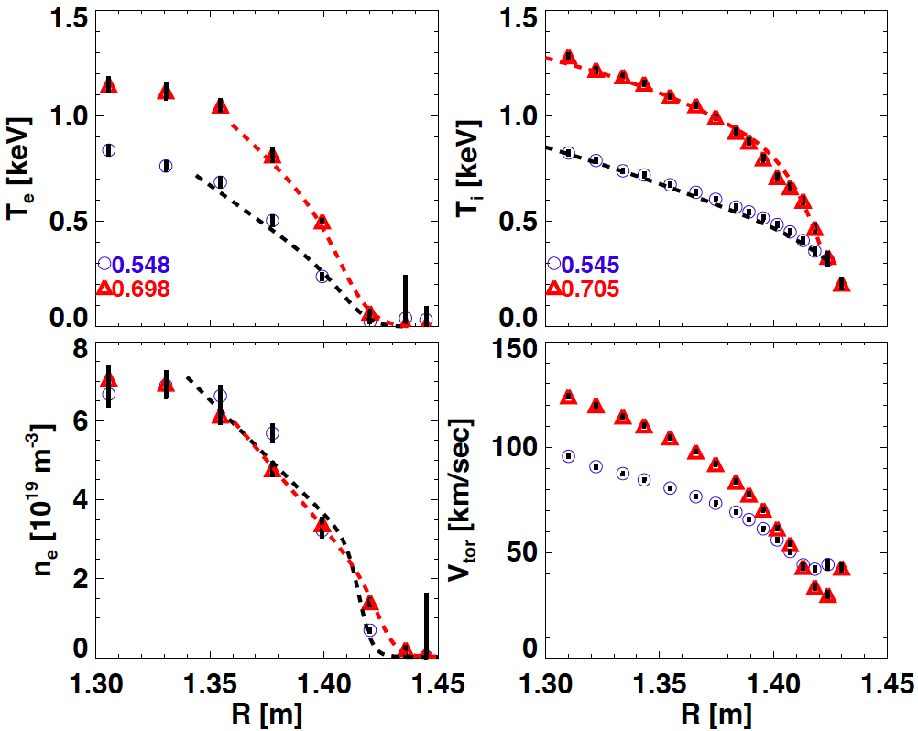
New high confinement regime with HH98y2 < 1.8 observed in NSTX
“Enhanced Pedestal” H-mode
Standard H-mode
P_{NBI}/10 [MW]
separatrix
EPH
t₁ t₂
R. Maingi, PRL 2010
27
Notes:
27

