Slide 1


NSTX
Supported by
Synergy Between Lithium Plasma-Facing Component Coatings and the Snowflake Divertor Configuration in NSTX*
College W&M
Colorado Sch Mines
Columbia U
CompX
General Atomics
INEL
Johns Hopkins U
LANL
LLNL
Lodestar
MIT
Nova Photonics
New York U
Old Dominion U
ORNL
PPPL
PSI
Princeton U
Purdue U
SNL
Think Tank, Inc.
UC Davis
UC Irvine
UCLA
UCSD
U Colorado
U Illinois
U Maryland
U Rochester
U Washington
U Wisconsin
V. A. Soukhanovskii (LLNL)
M. G. Bell, R. E. Bell, D. A. Gates, S. P. Gerhardt, R. Kaita,
E. Kolemen, H. W. Kugel, B. P. LeBlanc, R. Maqueda,
J. E. Menard, D. Mueller, S. F. Paul, A. L. Roquemore (PPPL), T. Rognlien, D. D. Ryutov (LLNL),
J.-W. Ahn, A. McLean (ORNL),
S. A. Sabbagh (Columbia U.), R. Raman (U Washington),
A. Yu. Pigarov, R. Smirnov (UCSD)
Culham Sci Ctr
U St. Andrews
York U
Chubu U
Fukui U
Hiroshima U
Hyogo U
Kyoto U
Kyushu U
Kyushu Tokai U
NIFS
Niigata U
U Tokyo
JAEA
Hebrew U
Ioffe Inst
RRC Kurchatov Inst
TRINITI
KBSI
KAIST
POSTECH
ASIPP
ENEA, Frascati
CEA, Cadarache
IPP, Jülich
IPP, Garching
ASCR, Czech Rep
U Quebec
Poster EXD / P 3-32
13 October 2010
* Supported by the U.S. DOE under Contracts DE-AC52-07NA27344, DE AC02-09CH11466, DE-AC05-00OR22725, DE-FG02-08ER54989.

Slide 2
Abstract
The studies of an innovative “snowflake” divertor configuration and evaporated lithium wall and divertor coatings in NSTX provide support to these PMI concepts as viable candidates for future high divertor heat flux tokamaks and spherical tokamak based devices for fusion development applications. Lithium coatings have enabled ion density reduction up to 50 % in NSTX through the reduction of wall and divertor recycling rates. The outer SOL parallel heat transport regime changed from the high-recycling, heat flux conduction-limited to the sheath-limited regime. An enhancement in edge transport and a recycling coefficient of R~0.85 were inferred from interpretive two dimensional multi-fluid edge transport modeling. However, a concomitant elimination of ELMs and an improvement in particle confinement caused impurity accumulations. The “snowflake” divertor (SFD) configuration obtained in NSTX in 0.8 MA 4-6 MW NBI-heated H-mode lithium-assisted discharges demonstrated encouraging impurity control and divertor heat flux handling results. A number of theoretically predicted geometric and radiative properties of the SFD configuration has been confirmed. A very high poloidal flux expansion of the separatrix region in the SFD, as well as a longer connection length, as compared to a standard divertor configuration, led to a partial strike point detachment and the associated peak heat flux reduction. The core carbon density and radiated power were also significantly reduced.

Slide 3
Overview and Summary: High flux expansion area-pumping divertor is studied in NSTX
Evaporative lithium coatings on carbon PFCs modify divertor and SOL
  Surface pumping reduced ion inventory (density) by up to 50 %
  Recycling was reduced by up to 50 % in both divertors and wall
  Local recycling coefficients reduced on inner wall and far SOL, remained similar in the outer strike point region
  Parallel heat transport regime in the SOL changes from conduction-limited (high-recycling) to sheath-limited (low-recycling)
  Edge transport enhancement and recycling coefficient R~0.85 concluded from interpretive UEDGE modeling that matched experimental data
“Snowflake” divertor configuration (cf. standard divertor)
  Obtained with 2 divertor coils and w/ 3 divertor coils for 100-600 ms
  H-mode confinement maintained with significant reduction in core impurities
  Significant reduction in peak heat flux (and outer strike point partial detachment)
  Higher divertor plasma-wetted area A_{wet} and volume (increased P_{rad}, R_{rec}, R_{cx})
  Excellent candidate divertor solution for future high divertor heat flux devices

Slide 4



Various techniques considered for SOL / divertor q|| and q_{pk} control
Divertor heat flux mitigation solutions:
  Divertor geometry (poloidal flux expansion)
  Strike point sweeping
  Radiative divertor (or radiative mantle)
  Divertor plate tilt and divertor magnetic balance
Candidate solutions must
  be compatible with good core plasma performance (H-mode confinement, MHD, ELM regime, density)
  be compatible with particle control (e.g., cryopump, lithium)
  scale to very high q_{peak} (15 - 80 MW/m²) for future devices

Slide 5
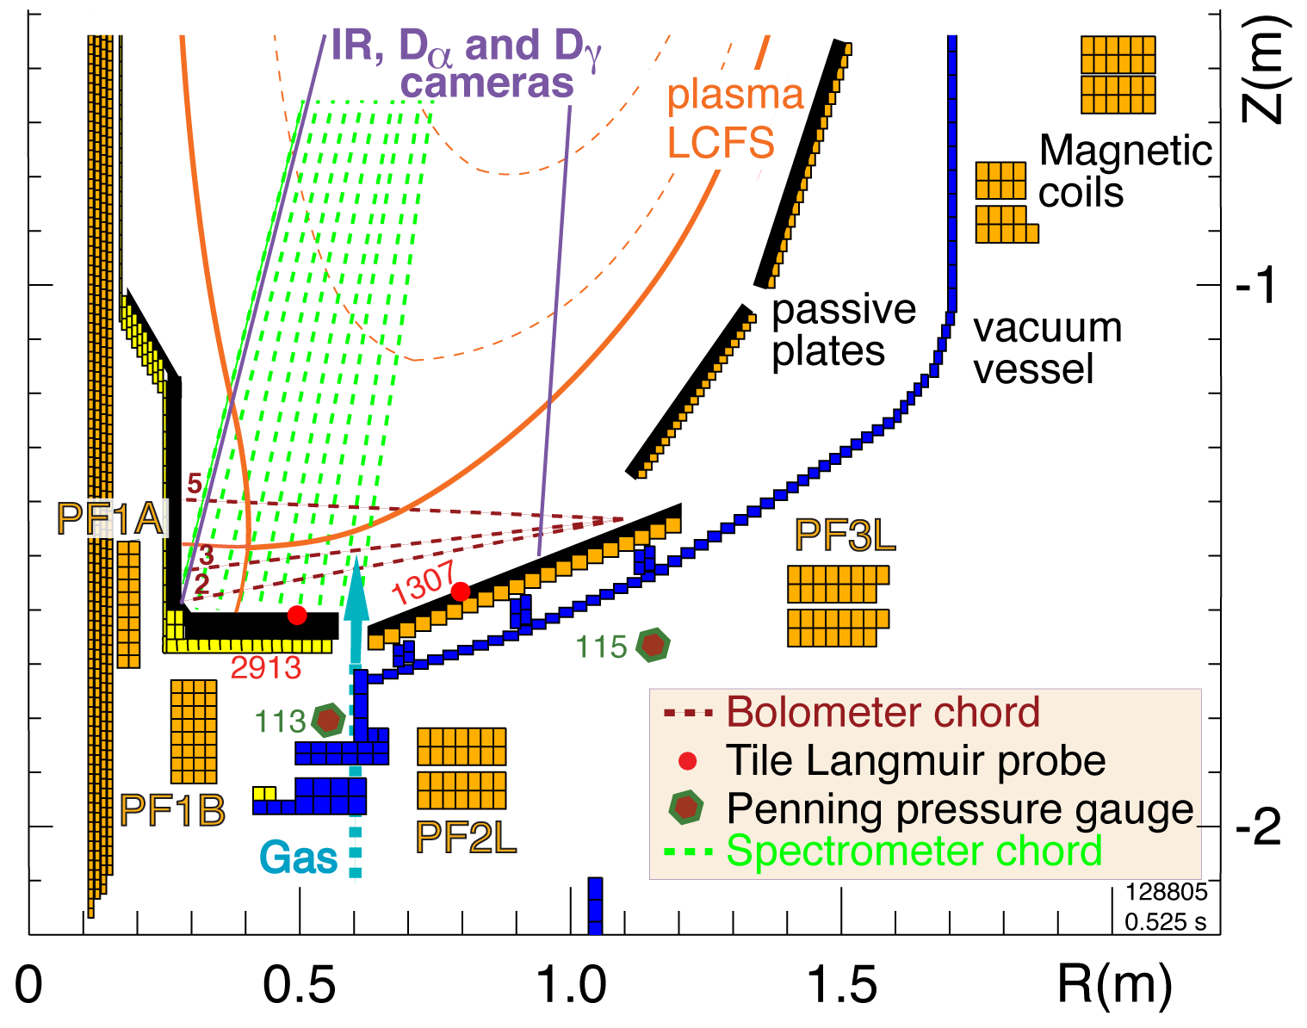
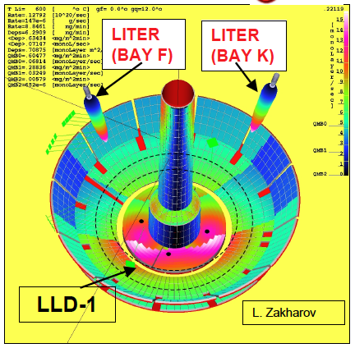
Open divertor geometry enables well-diagnosed divertor configuration studies and area pumping by lithium coatings
NSTX plasma facing components
  ATJ and CFC graphite tiles
Lithium pumping
  Through LiD formation
  Solid coating bind D up to a full 200-400 nm thickness
Impurity (Li, C) generation
  Sputtering by D ions, Self-sputtering, Evaporation
Two lithium evaporators (LITERs)
Typical Operating Conditions
  Capacity: 90 g Li
  Oven Temp: 600-680°C
  Rate: 1mg/min - 80mg/min

Slide 6
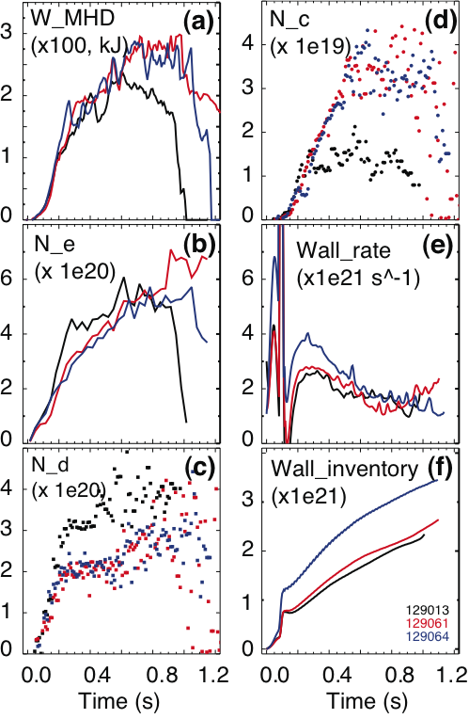
Ion density is reduced by up to 50 % in 4-6 MW H-mode discharges by lithium conditioning
Particle balance model
  Continuous pumping throughout a discharge
  cumulative coatings provide higher pumping rate
  Wall in pumping state far from saturation
Particle inventory balance: N_{e}=6 N_{C}+N_{i}
0.9 MA, 4.5 kG, 4-6 MW NBI
High κ~2.3, δ~0.6 shape
Biased DN with δr_{sep} ~-6mm
Change in
ion
inventory
Gas feed rate
NBI
fueling
rate
NBI
cryopump
rate
Wall
loading
rate
Turbo.
pump
rate
Neutrals
build-up
rate
No lithium (129013)
190 mg Lithium (129061)
600 mg lithium (129064)

Slide 7
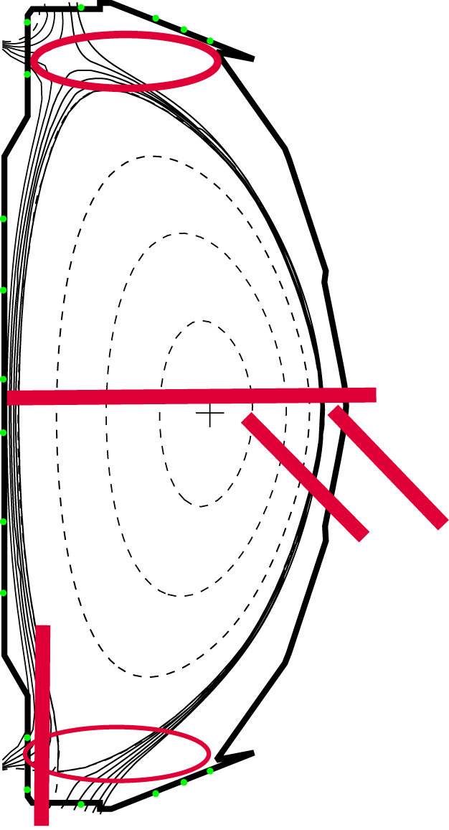
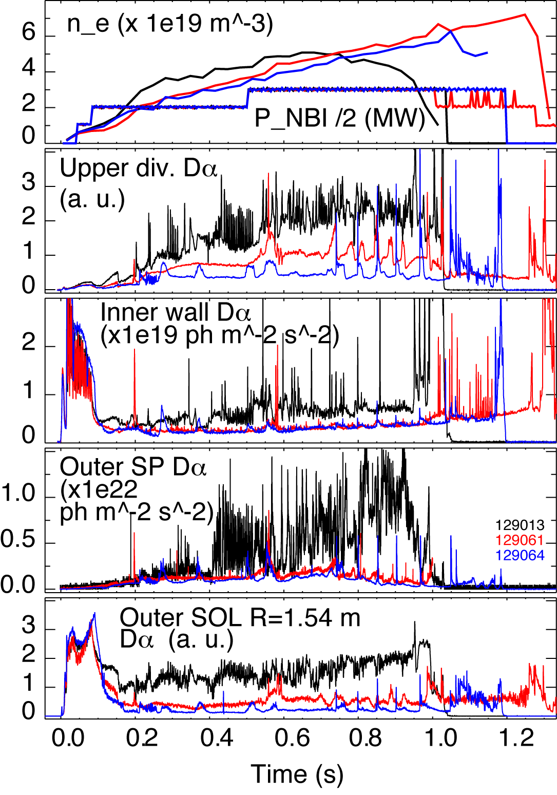
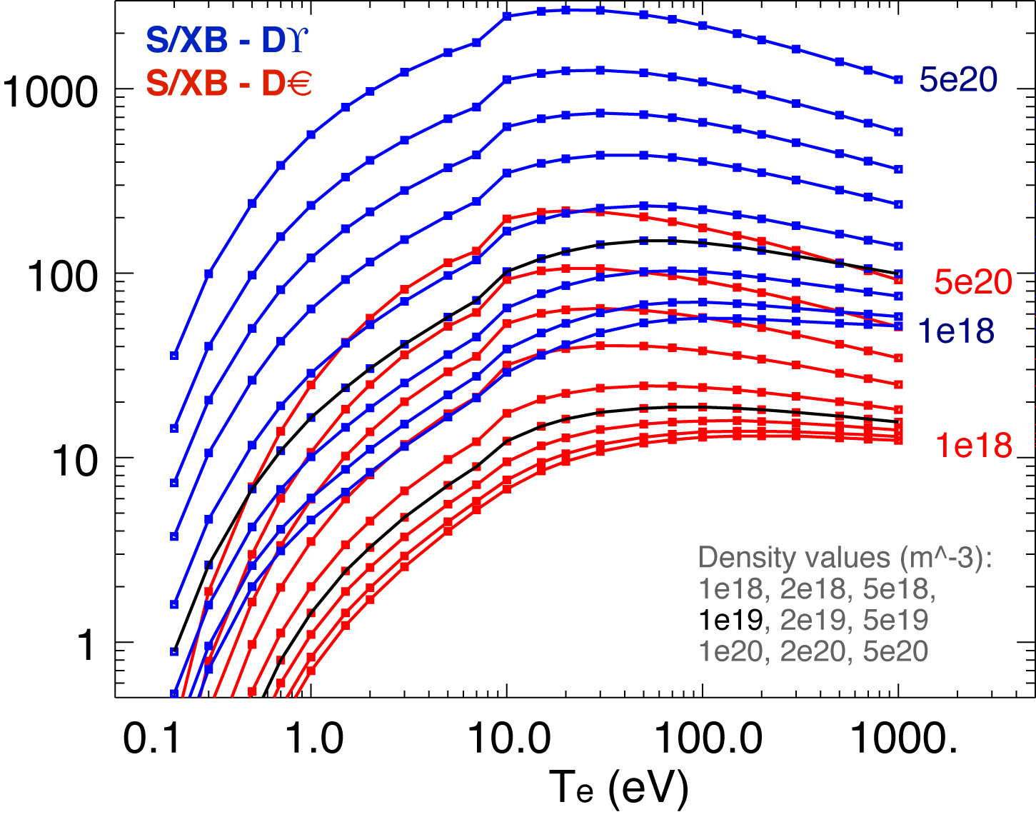
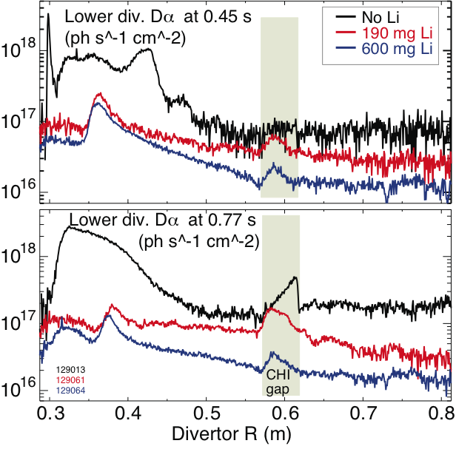
Lithium conditioning had a profound and cumulative effect on poloidal recycling flux profile
No lithium
(129013)
190 mg lithium
(129061)
600 mg lithium
(129064)
Γ_{recy}~ SX/B I_{Dα}

Slide 8
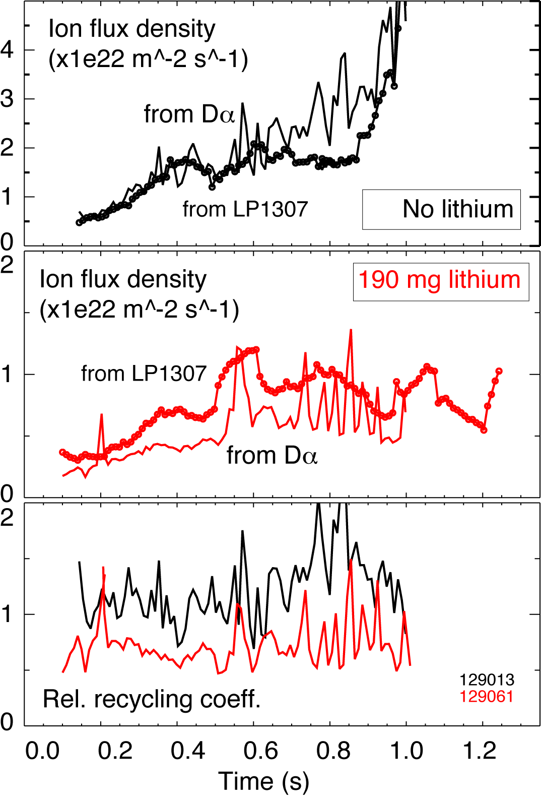
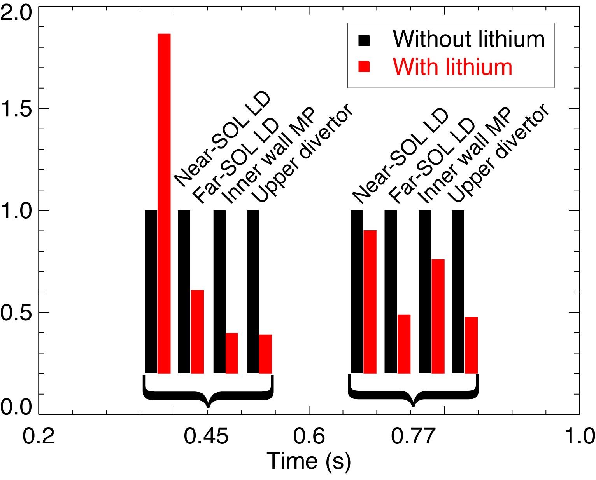
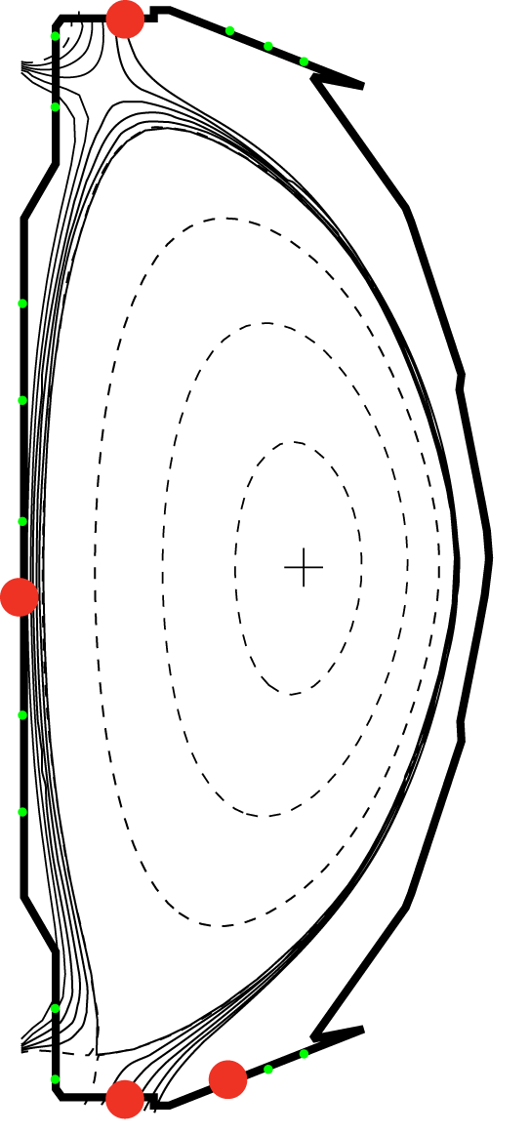
Lithium conditioning reduced local ion recycling coefficients on PFCs except in the near-SOL region
Local recycling R_{local}=Γ_{i}^{out} / Γ_{i}^{in}
  Ion flux into LLD Γ_{i}^{in} is measured by Langmuir Probes (LPs)
  Ion outflux Γ_{i}^{out} estimated from measured Dα fintensity and S/XB (ionizations/photon) coefficient from ADAS
No lithium (129013)
190 mg Lithium (129061)

Slide 9
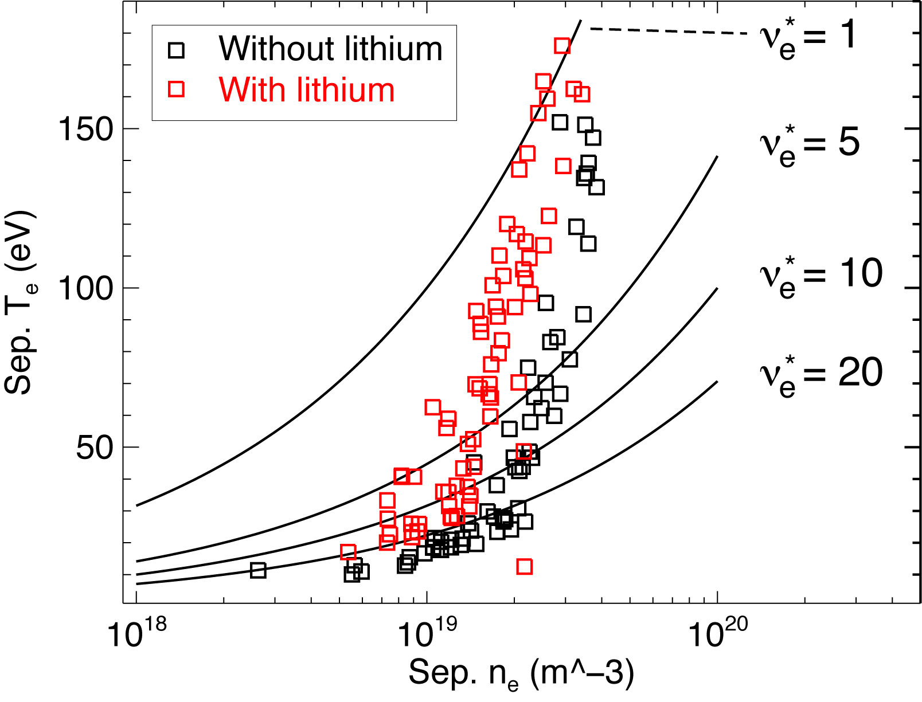

A transition from conduction-limited to sheath-limited parallel SOL heat transport regime is observed with lithium
l_{c}=10 m – typical connection length
λ_{e} – electron mean free path
ν_{e}*=10⁻¹⁶ n_{e} l_{c} / T_{e}
Borderline between sheath-limited and conduction-limited at ν_{e}*=10

Slide 10
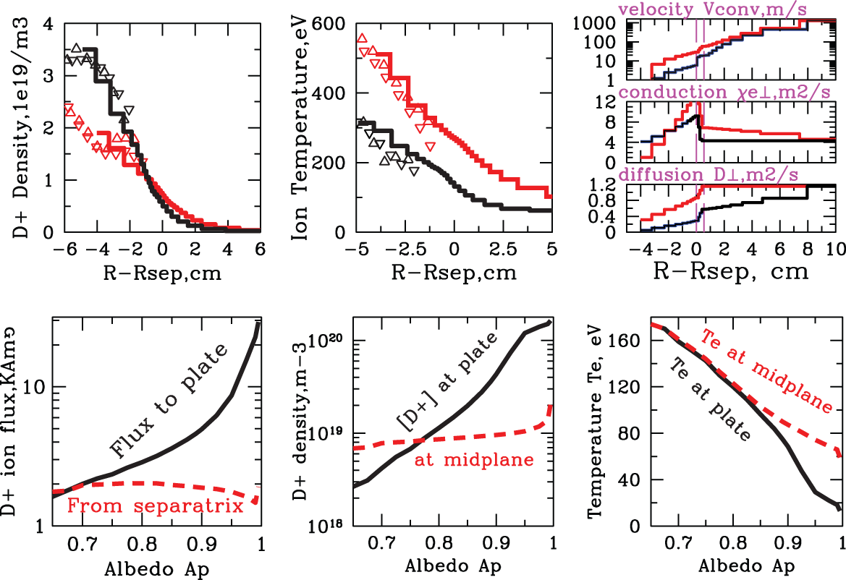
2D edge transport code UEDGE suggests enhanced edge transport and R~0.85 with lithium

Slide 11
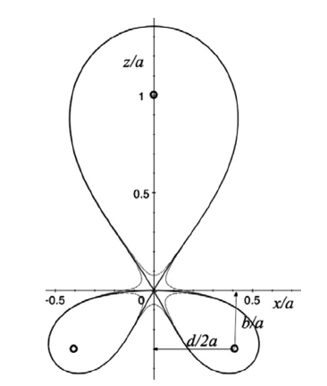
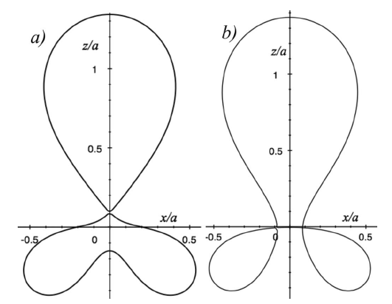
Theory predicts attractive divertor geometry properties in “snowflake” divertor configuration
Proposed by D. D. Ryutov (LLNL)
  Phys. Plasmas 14, 064502 (2007)
  34th EPS Conference on Plasma Phys. Warsaw, 2 - 6 July 2007 ECA Vol.31F, D-1.002 (2007)
  Phys. Plasmas, 15, 092501 (2008)
  Paper IC/P4-8 at IAEA FEC 2008
SFD is obtained by creating a second-order poloidal null in the (lower) divertor with existing divertor coils
Predicted properties (cf. standard divertor)
  Larger low B_{p} region around X-point
  Larger plasma wetted-area A_{wet} , flux expansion f_{exp}
  Larger X-point connection length L_{x}
  Larger effective divertor volume V_{div}
  X-point flux tube squeezing – barrier for turbulence?
  ELM control (increased edge magn. shear) ?
Ideal
“snowflake”
divertor
“snowflake”-plus “snowflake”-minus
divertor configurations

Slide 12
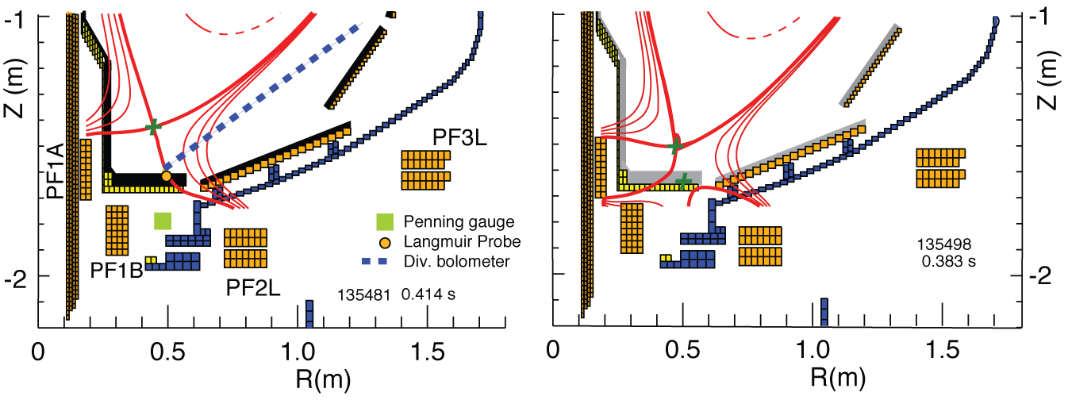
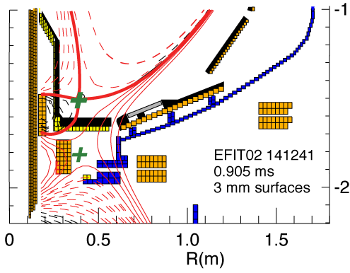
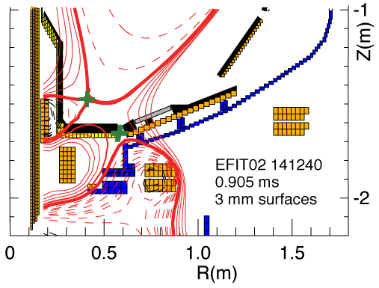
“Snowflake” divertor configurations are obtained in NSTX with two and with three divertor coils
Standard divertor configuration
(δ ~0.55-0.60) is transformed into “Snowflake” divertor with
two coils
Standard high-δ divertor configuration is transformed into “Snowflake” divertor with
three coils

Slide 13
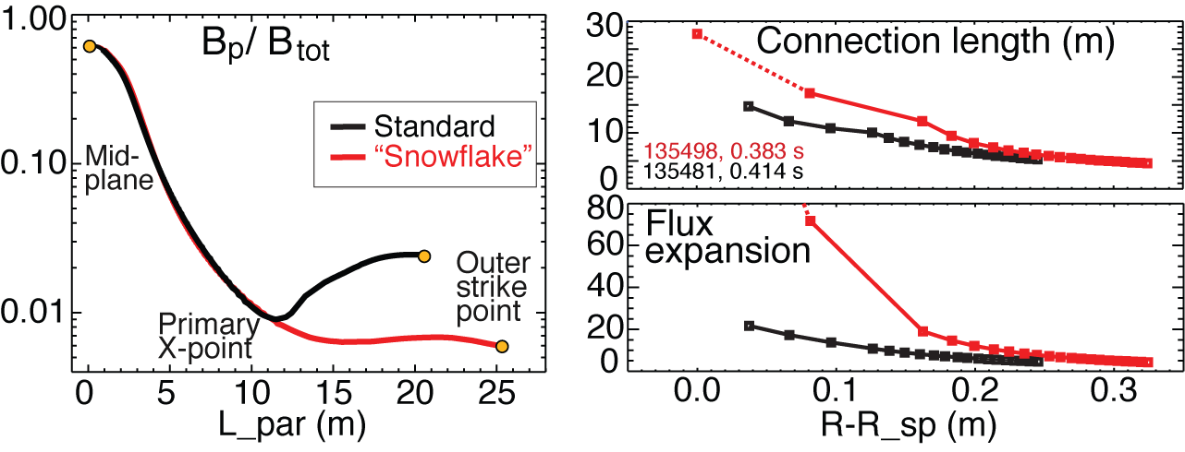
Poloidal flux expansion and connection length are increased by up to 90 % in “snowflake” divertor
In “snowflake” divertor
  Plasma-wetted area (flux expansion) higher by up to 90 %
  L_{x} longer (thus f_{PFR} and V_{div} higher)
These properties observed in first 2-3 mm of SOL λ_{q} when mapped to midplane

Slide 14
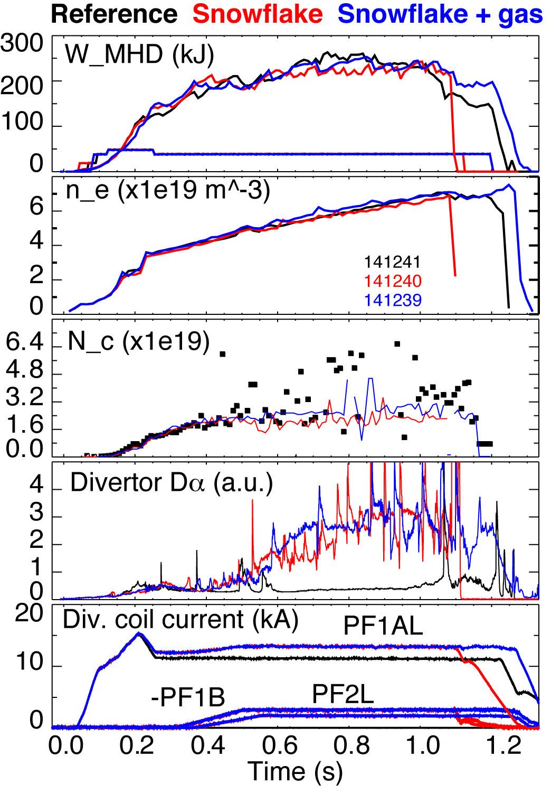
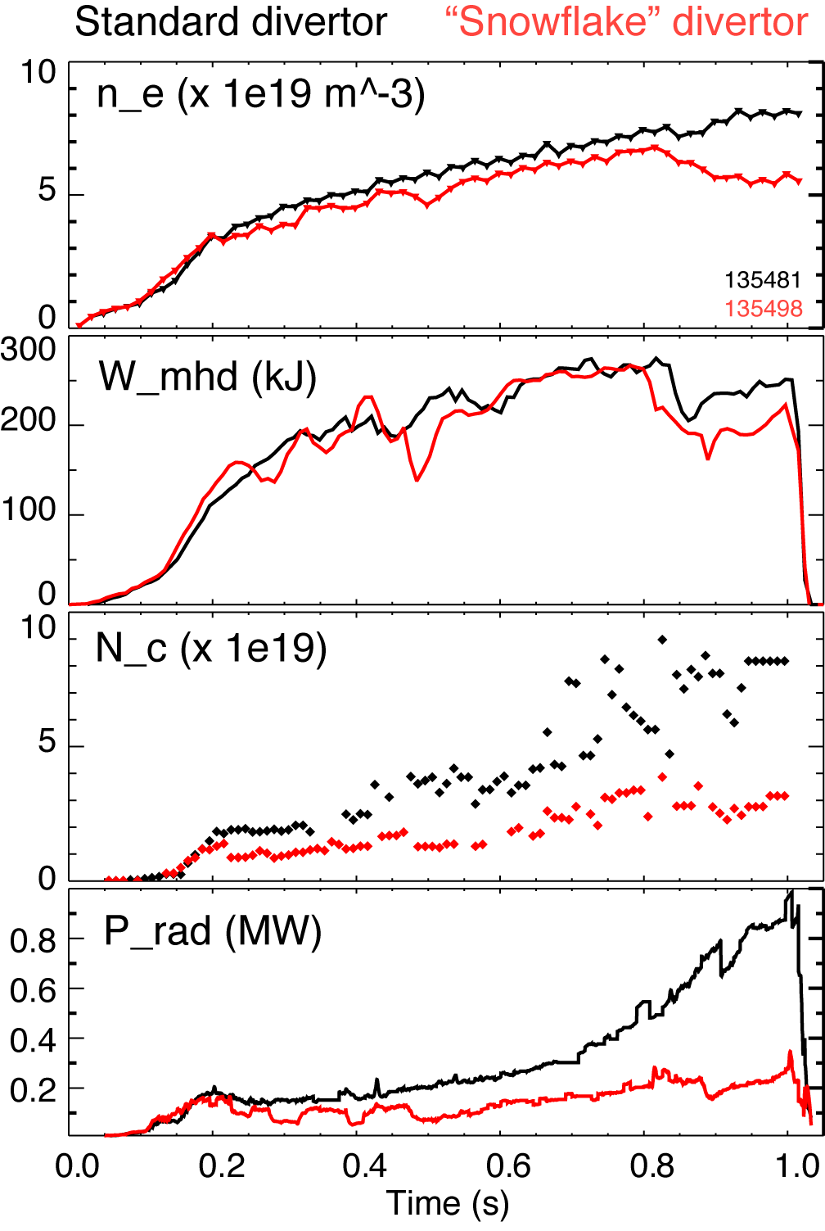
H-mode confinement retained with “snowflake” divertor, core P_{rad} and N_{C} reduced by up to 75 %
Used 80-100 mg evaporated lithium
0.8 MA, 4 MW ELM-free H-mode discharges had impurity accumulation
Core impurity reduction in “snowflake” divertor discharges may be due to
  Divertor sputtering source reduction
  Better impurity entrainment in SOL flow
  Edge inward convection reduction
3-coil “snowflake” 2-coil “snowflake”

Slide 15
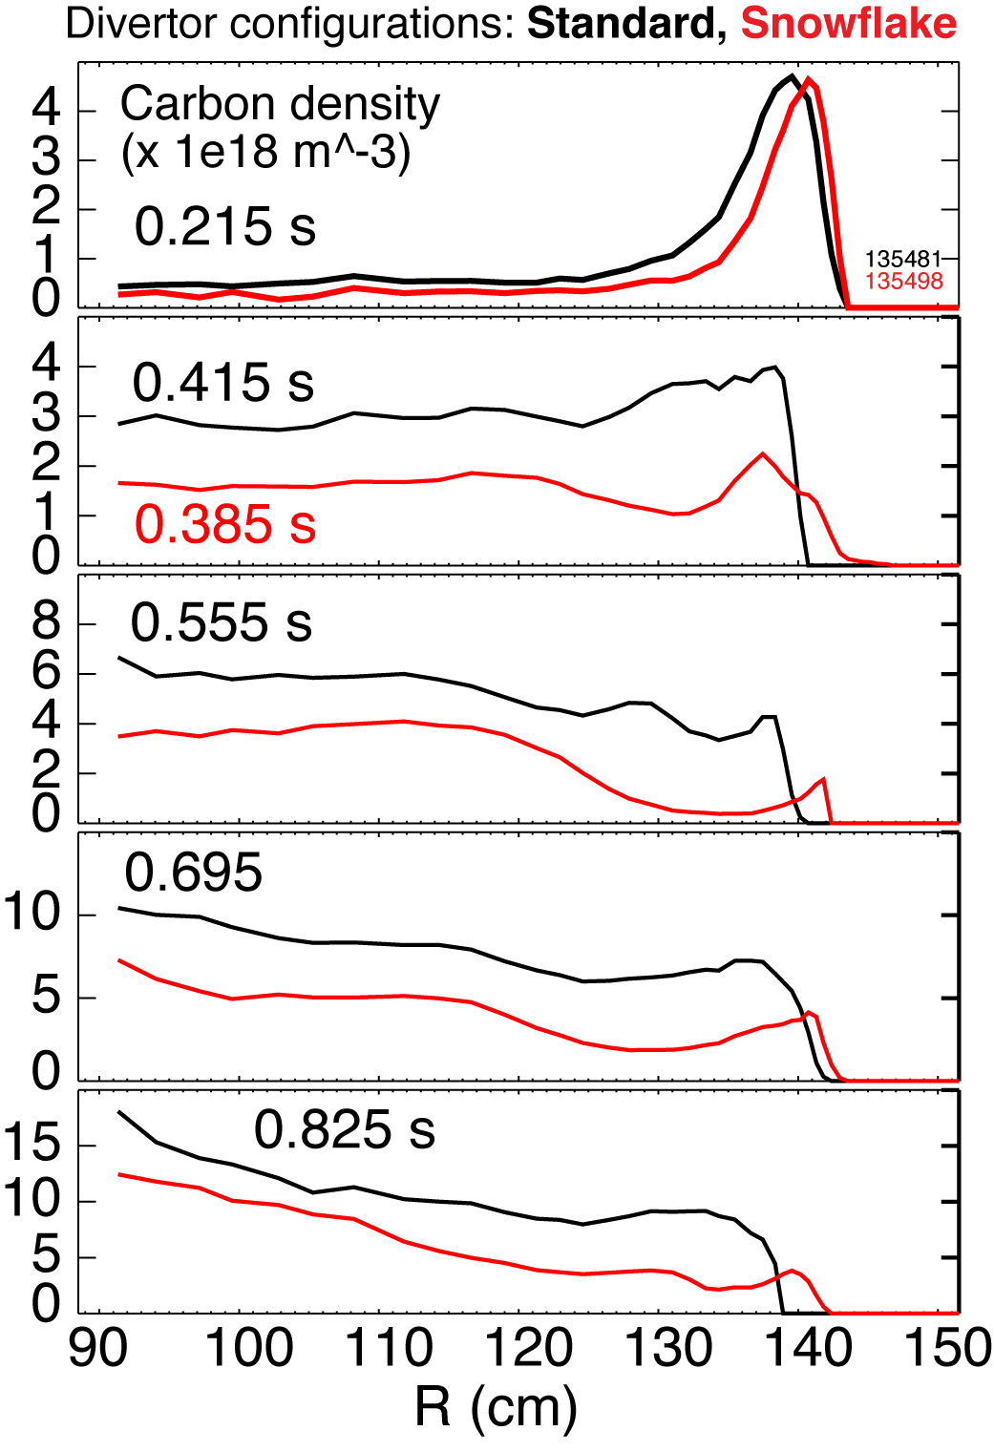
Core carbon density profiles show drastic reduction of carbon in ELM-free “snowflake” discharges
Core impurity reduction in “snowflake” divertor discharges may be due to
  Divertor sputtering source reduction
  Better impurity entrainment in SOL flow
  Edge inward convection reduction
Impurity transport modeling in progress to understand the dominant cause of n_{C} reduction
Carbon density from Charge Exchange Recombination Spectroscopy system
s

Slide 16
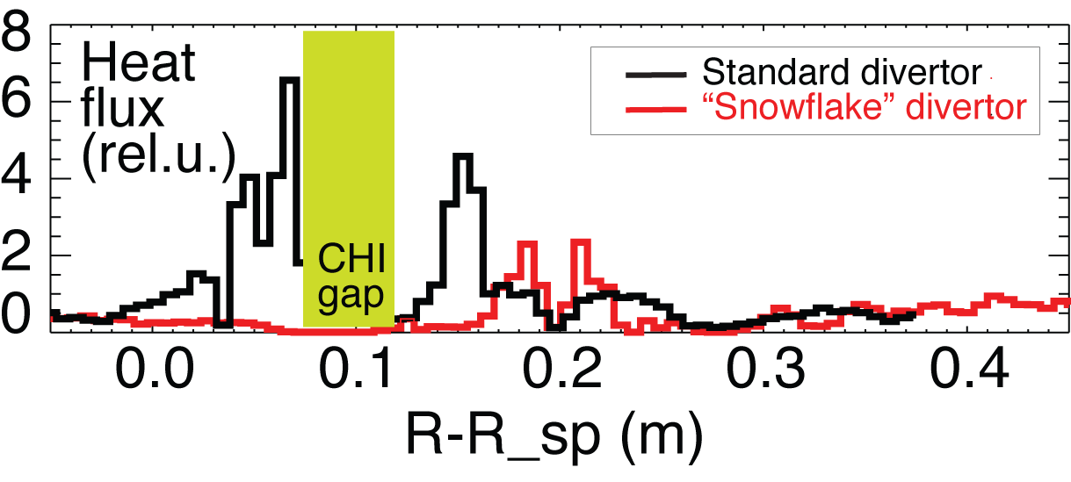
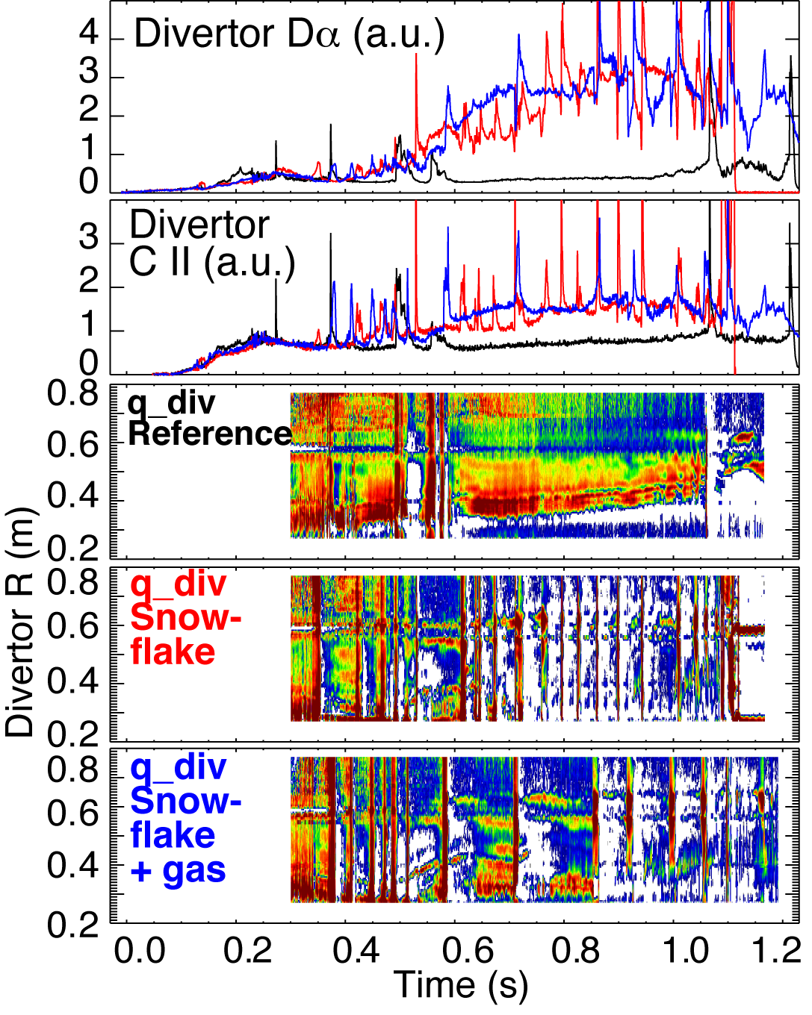
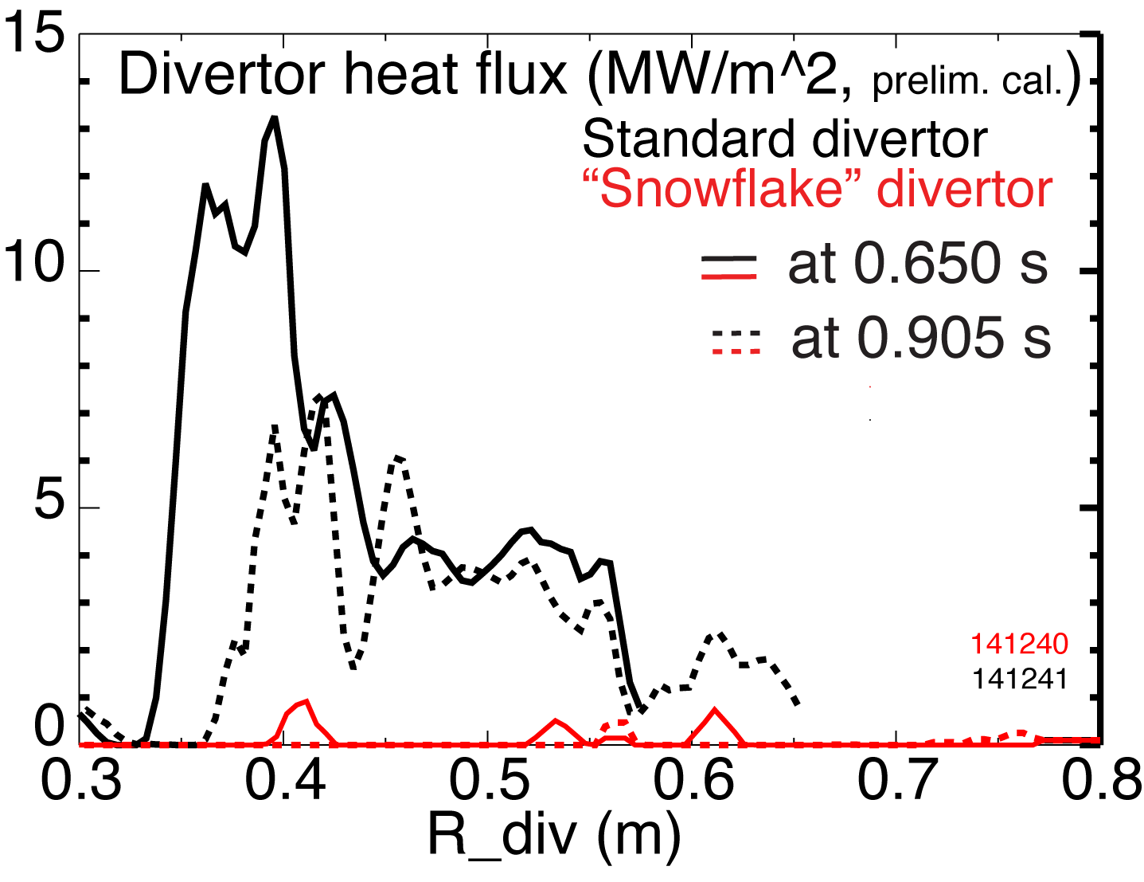
Significant reduction of peak heat flux observed in “snowflake” divertor

Slide 17
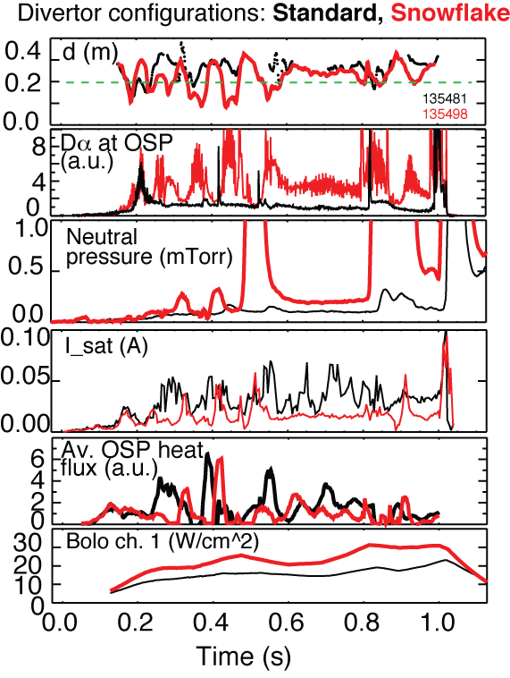
Partial detachment of outer strike point region observed in “snowflake” divertor discharges
Signs of partial detachment observed in “snowflake” divertor
  Loss of parallel pressure
  Heat and particle flux reduction at the plate
  T_{e} ≤ 1.6 eV, n_{e} ≤ 4x10²⁰ m⁻³
  Increase in divertor P_{rad}
  Increase in 3-body recombination rate
  Increase in neutral pressure

Slide 18
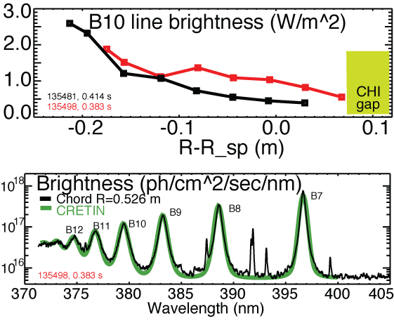
High-n Balmer line emission measurements suggest high divertor recombination rate, low T_{e}, high n_{e}
Balmer series spectra modeled with CRETIN; Spectra sensitive to
  Line intensity <-> Recombination rate
  T_{e} <-> Boltzman population distribution
  n_{e} <-> Line broadening due to linear Stark effect from ion and electron microfield
T_{e}=0.8-1.2 eV, n_{e}=2-7 x 10²⁰ m⁻³ inferred from modeling

Slide 19
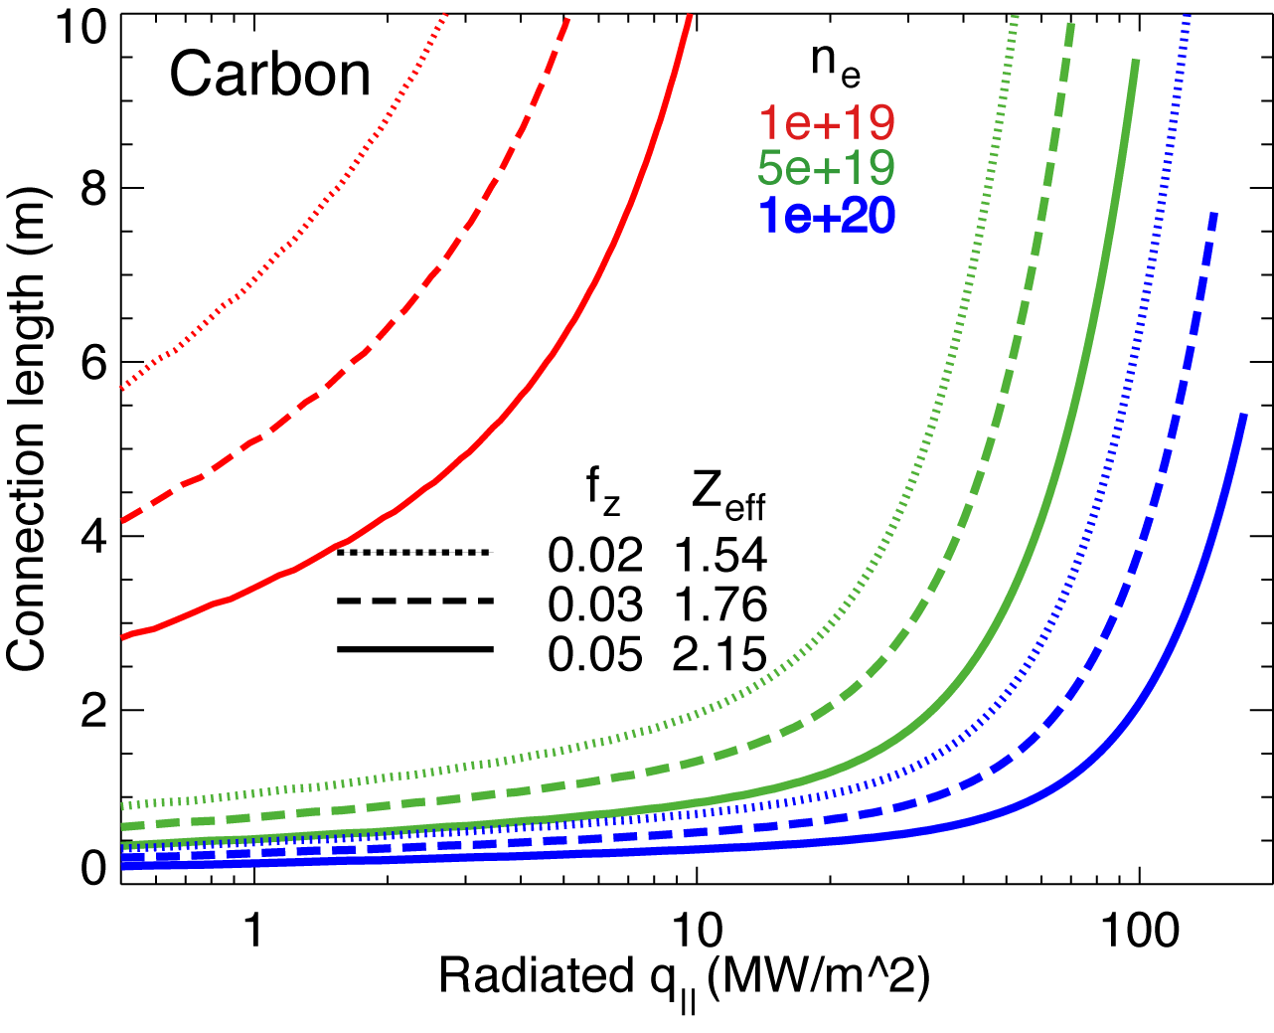
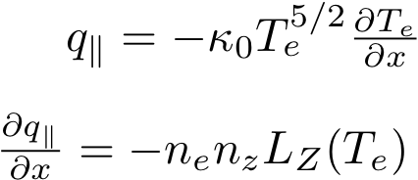
Volumetric power and momentum losses are increased due to geometry in “snowflake” divertor
Hulse-Post non-coronal radiative cooling curves for low Z impurities for n₀/n_{e}, n_{e}-τ_{recy}
Calculate max q|| that can be radiated
Express max q|| as function of distance from heat source for range of f_{z} (Post JNM 220-222, 1014 (1995) )
Power losses due to deuterium P_{rad} and ionization not considered
For NSTX, use n₀ = 0.1 % and
  n_{e}-τ_{recy} = n_{e} x 1 ms
Electron-ion recombination rate depends on divertor ion residence time
  Ion recombination time: τ_{ion}~ 1−10 ms at T_{e} =1.3 eV
  Ion residence time: τ_{ion} ≤ 3-6 ms

Slide 20
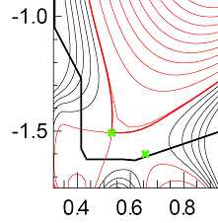
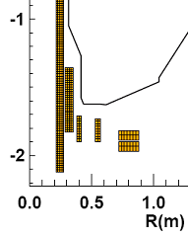
Outlook and future plans
Good synergy between ion pumping by lithium and divertor heat flux reduction and impurity screening by the “snowflake” divertor is demonstrated
    Sheath-limited divertor regime with lithium simulates high heat flux divertors in future devices
    High flux expansion divertor pumping
    Studying compatibility of ”snowflake” divertor with liquid lithium divertor module (H. W. Kugel et. al, FTP/3-6R)
NSTX-Upgrade
  Development of divertor solutions to address
    2-3x higher input power
    Projected peak divertor heat fluxes up to 24 MW/m²
    (T. K. Gray EXD/P3-13)
    Up to 30 % reduction in Greenwald fraction
    3-5 x longer pulse duration
  Additional divertor coil PF1C
    Flux expansion variation with fixed X-point height

