Slide 1










Progress on developing the spherical tokamak for fusion applications
Jonathan Menard¹
T. Brown¹, J. Canik², J. Chrzanowski¹, L. Dudek¹, L. El Guebaly³, S. Gerhardt¹, S. Kaye¹,
C. Kessel¹, E. Kolemen¹, M. Kotschenreuther⁴, R. Maingi², C. Neumeyer¹,
M. Ono¹, R. Raman⁵, S. Sabbagh⁶, V. Soukhanovskii⁷, T. Stevenson¹,
R. Strykowsky¹, P. Titus¹, P. Valanju⁴, G. Voss⁸, A. Zolfaghari¹,
and the NSTX Upgrade Team
¹Princeton Plasma Physics Laboratory, Princeton, NJ 08543
²Oak Ridge National Laboratory, Oak Ridge, TN, USA
³University of Wisconsin, Madison, WI, USA
⁴University of Texas, Austin, TX, USA
⁵University of Washington, Seattle, WA, USA
⁶Columbia University, New York, NY, USA
⁷Lawrence Livermore National Laboratory, Livermore, CA, USA
⁸Culham Centre for Fusion Energy, Abingdon, Oxfordshire, UK
24th IAEA Fusion Energy Conference
San Diego, USA
8-13 October 2012
Paper FTP/3-4
This work supported by the US DOE Contract No. DE-AC02-09CH11466

Slide 2
Fusion applications of low-A spherical tokamak (ST)
Develop plasma-material-interface (PMI) solutions for next-steps
  Exploit high divertor heat flux from lower-A/smaller major radius
Fusion Nuclear Science/Component Test Facility (FNSF/CTF)
  Exploit high neutron wall loading for material and component development
  Utilize modular configuration of ST for improved accessibility, maintenance
Extend toroidal confinement physics predictive capability
  Access strong shaping, high β, v_{fast} / v_{Alfvén}, and rotation, to test physics models for ITER and next-steps (see NSTX, MAST, other ST presentations)
Long-term: reduced-mass/waste low-A superconducting Demo
This talk:
  Planned capabilities and construction progress of NSTX Upgrade
  Mission and configuration studies for ST-based FNSF/CTF

Slide 3
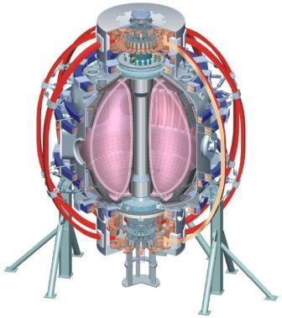

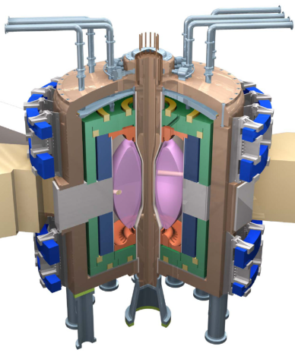
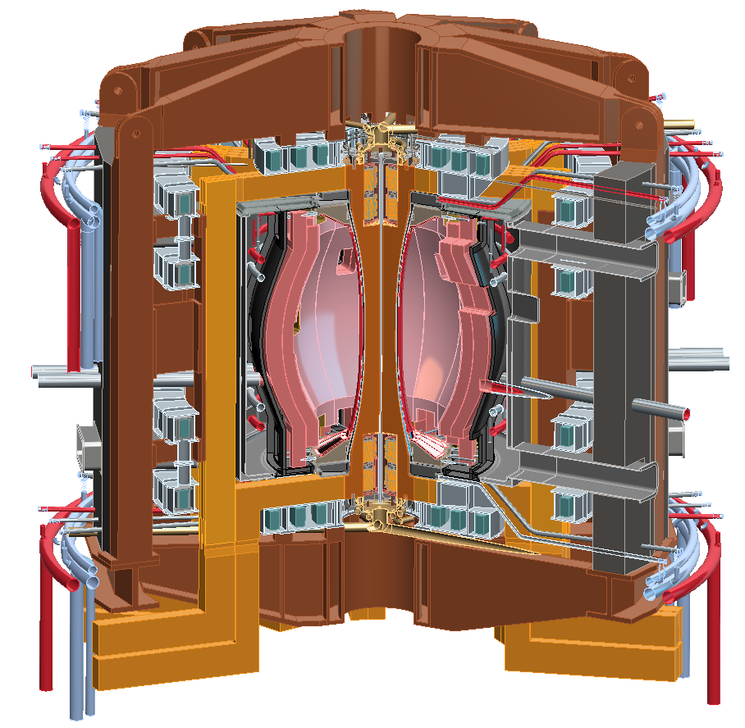
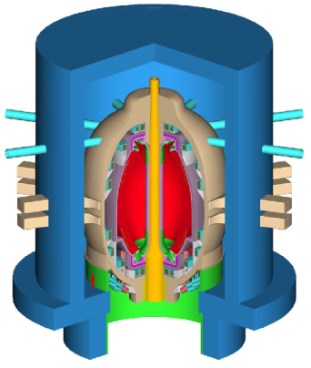
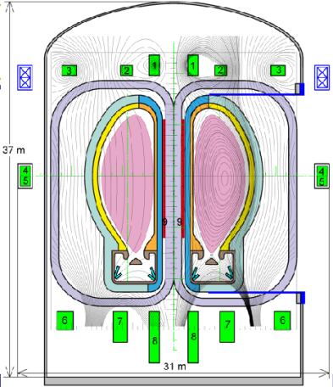
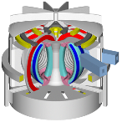
NSTX Upgrade will access next factor of two increase in performance to bridge gaps to next-step STs
Low-A
Power Plants
Parameter | NSTX | NSTX Upgrade | Fusion Nuclear Science Facility | Pilot Plant
Major Radius R₀ [m] | 0.86 | 0.94 | 1.3 | 1.6 – 2.2
Aspect Ratio R₀ / a | ≥ 1.3 | ≥ 1.5 | ≥ 1.5 | ≥ 1.7
Plasma Current [MA] | 1 | 2 | 4 – 10 | 11 – 18
Toroidal Field [T] | 0.5 | 1 | 2 – 3 | 2.4 – 3
Auxiliary Power [MW] | ≤ 8 | ≤ 19* | 22 – 45 | 50 – 85
P/R [MW/m] | 10 | 20 | 30 – 60 | 70 – 90
P/S [MW/m²] | 0.2 | 0.4 | 0.6 – 1.2 | 0.7 – 0.9
Fusion Gain Q |  |  | 1 – 2 | 2 – 10
ARIES-ST (A=1.6)
JUST (A=1.8)
* Includes 4MW of high-harmonic fast-wave (HHFW) heating power
VECTOR (A=2.3)
Confinement scaling (electron transport)
Non-inductive ramp-up and sustainment
Divertor solutions for mitigating high heat flux
Radiation-tolerant magnets (for Cu TF STs)
Key issues to resolve for next-step STs

Slide 4
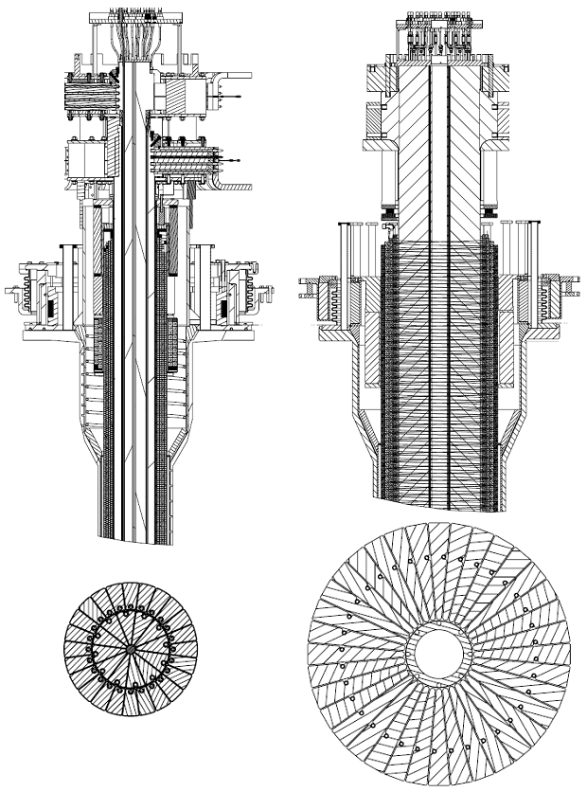
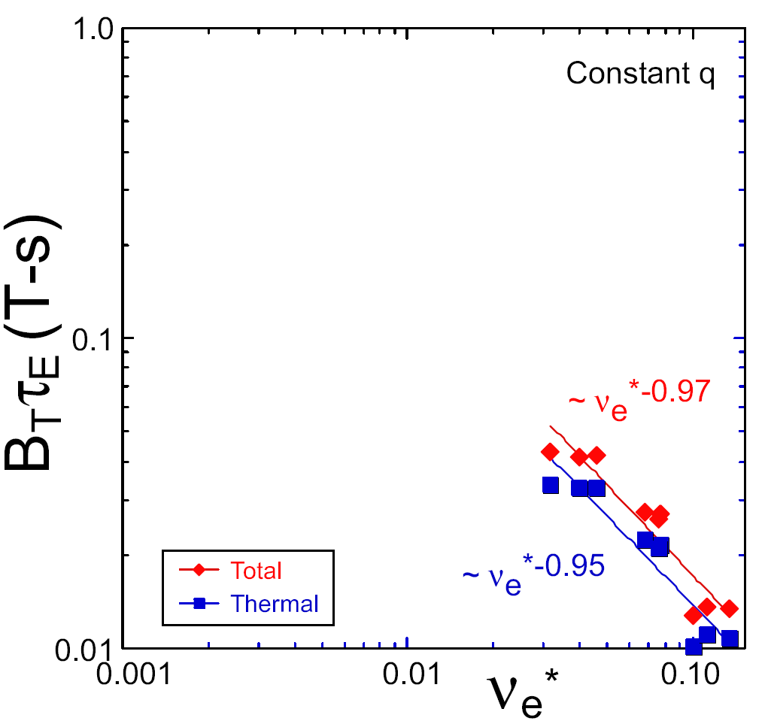
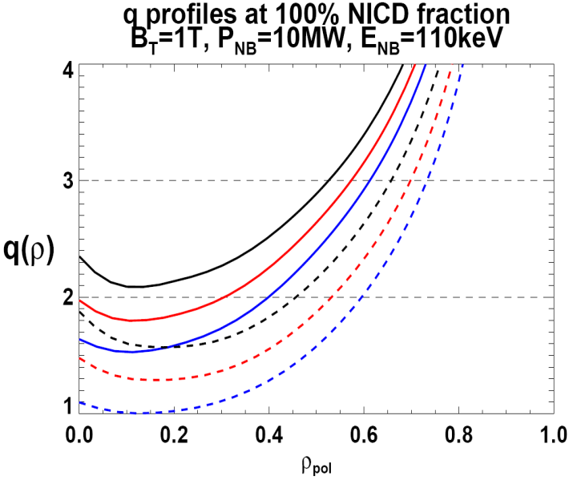
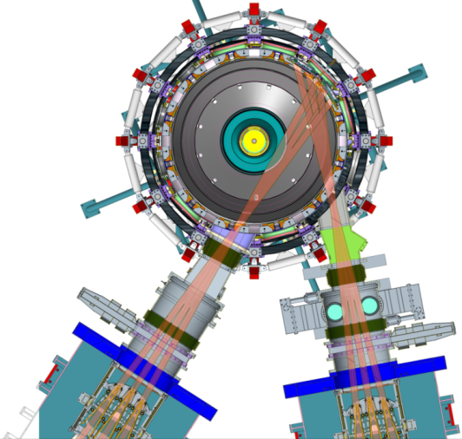
NSTX Upgrade will address critical plasma confinement and sustainment questions by exploiting 2 new capabilities
Previous
center-stack
New
center-stack
ST-FNSF
constant q, β, ρ∗
2x higher B_{T} and I_{P} increases T, reduces ν* toward ST-FNSF to better understand confinement
  Provides 5x longer pulses for profile equilibration, NBI ramp-up
NSTX Upgrade
?
ITER-like scaling
TF OD = 20cm
TF OD = 40cm
Normalized e-collisionality ν_{e}* ∝ n_{e} / T_{e}²
I_{P}=0.95MA, H_{98y2}=1.2, β_{N}=5, β_{T} = 10%
B_{T} = 1T, P_{NBI} = 10MW, P_{RF} = 4MW
  2x higher CD efficiency from larger tangency radius R_{TAN}
100% non-inductive CD with q(r) profile controllable by:
  tangency radius, density, position
n
e
/
n
Greenwald
0.95
0.72
R_{TAN} [cm]
__________________
50, 60, 70, 130
60, 70,120,130
70,110,120,130
Present NBI
New 2nd NBI
J. Menard, et al., Nucl. Fusion 52 (2012) 083015

Slide 5
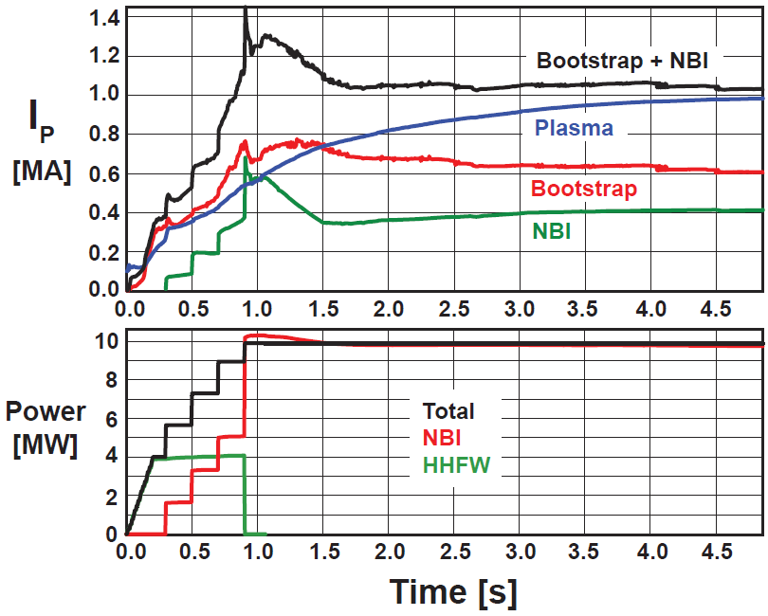
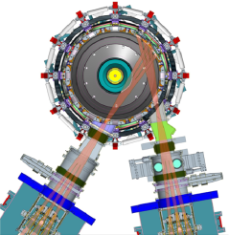
Non-inductive ramp-up from ~0.4MA to ~1MA projected to be possible with new centerstack (CS) + more tangential 2nd NBI
New CS provides higher TF (improves stability), 3-5s needed for J(r) equilibration
More tangential injection provides 3-4x higher CD at low I_{P}:
  2x higher absorption (40→80%) at low I_{P} = 0.4MA
  1.5-2x higher current drive efficiency
TSC simulation of non-inductive ramp-up from I_{P} = 0.1MA, T_{e}=0.5keV target at B_{T}=1T
Present NBI
More tangential 2nd NBI

Slide 6
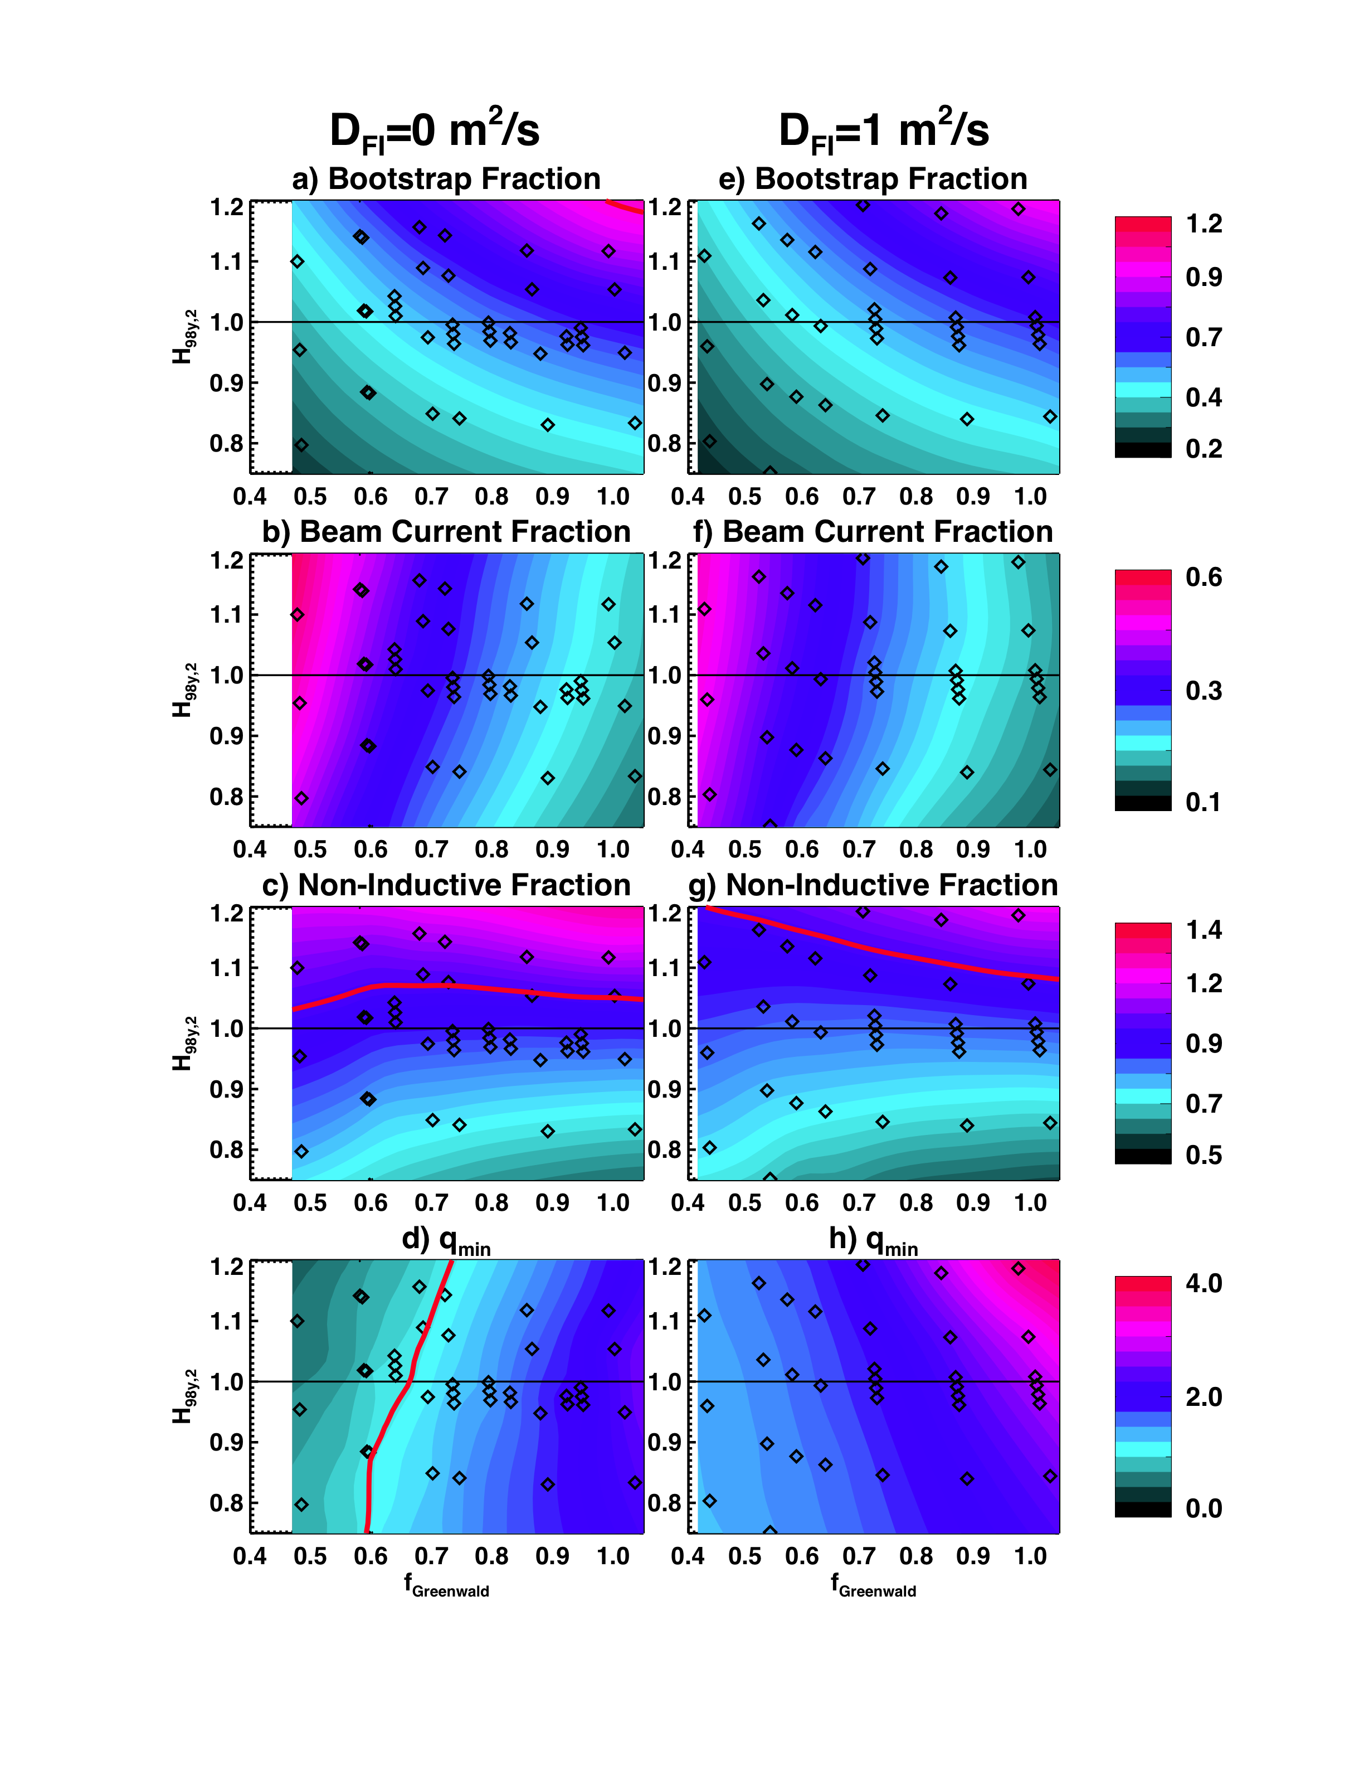
100% non-inductive operating points projected for a range of toroidal fields, densities, and confinement levels
B_{T} = 1.0 T, I_{P} = 1MA, P_{inj} = 12.6MW
Projected Non-Inductive Current Levels for κ~2.85, A~1.75, f_{GW}=0.7
Contours of Non-Inductive Fraction
B_{T} [T] | P_{inj} [MW] | I_{P} [MA]
0.75 | 6.8 | 0.6-0.8
0.75 | 8.4 | 0.7-0.85
1.0 | 10.2 | 0.8-1.2
1.0 | 12.6 | 0.9-1.3
1.0 | 15.6 | 1.0-1.5
Contours of q_{min}
From GTS (ITG) and GTC-Neo (neoclassical):
  χ_{i,ITG}/χ_{i,Neo} ~ 10⁻²
  Assumption of neoclassical ion thermal transport should be valid
S. Gerhardt, et al., Nucl. Fusion 52 (2012) 083020

Slide 7
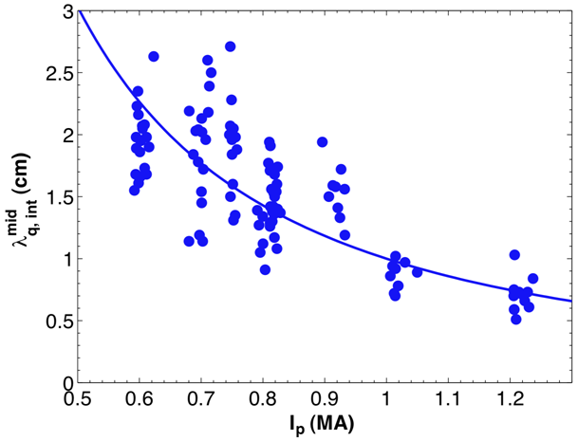
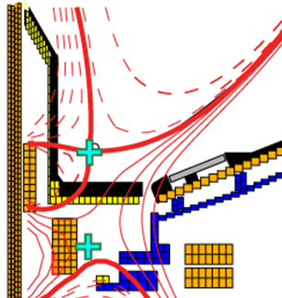
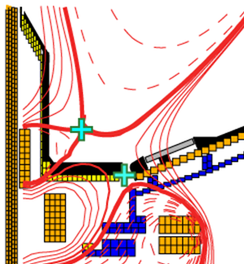
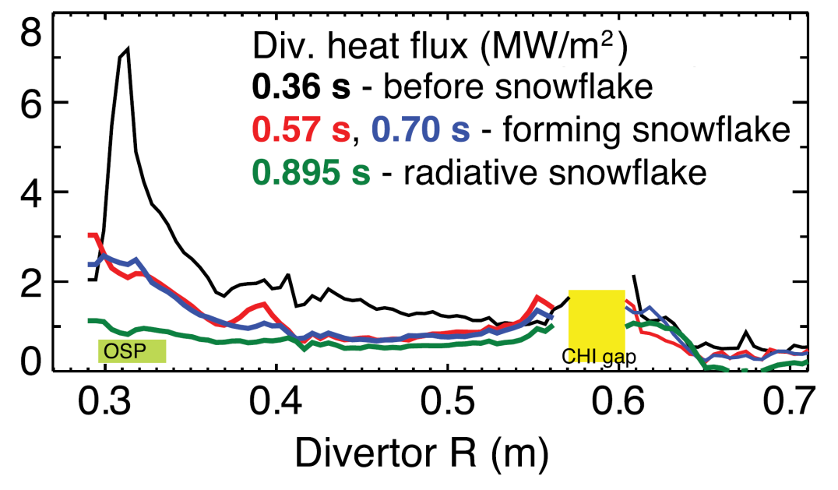
NSTX-U will investigate detachment and high-flux-expansion “snowflake” divertor for heat flux mitigation
λ_{q}^{mid} ~ I_{p}^{-1 to -1.6}
Divertor heat flux width decreases with increased plasma current I_{P}
Can reduce heat flux by 2-4× in NSTX via partial detachment at sufficiently high f_{rad}
30-45MW/m² in NSTX-U with conventional LSN divertor at full current and power
Soukhanovskii EX/P5-21
NSTX data
Standard Divertor
Snowflake Divertor
Snowflake→ high flux expansion = 40-60 lowers incident q⊥, promotes detachment
NSTX-U: U/D balanced snowflake has < 10MW/m² at I_{P} = 2MA, P_{AUX}=10-15MW

Slide 8
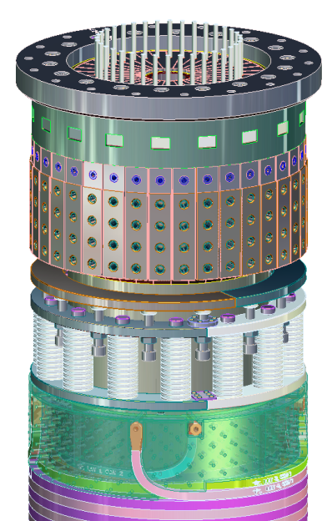
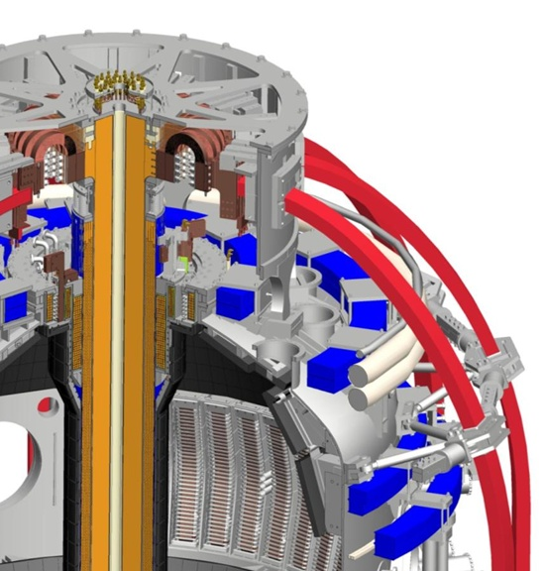
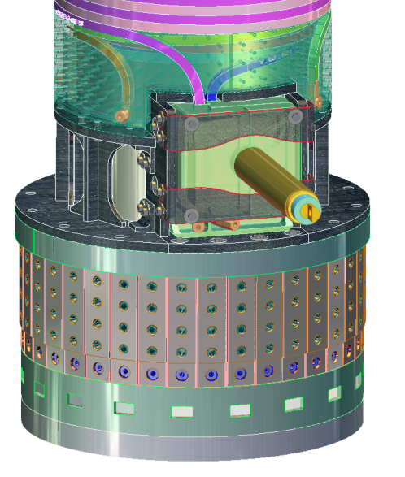
Major engineering challenge of NSTX Upgrade:
Field and current each increase 2× → E-M forces increase 4×
Design solutions for increased loads:
1. Simplified inner TF design
Single layer of TF conductors
Upper TF/ OH Ends
2. Improved TF joint design
Joint radius increased → lower B
Flex-jumper improved
3. Reinforcements:
Umbrella structure
PF, TF coil supports
4. OH leads placed at bottom, made coaxial to minimize forces, error-fields

Slide 9
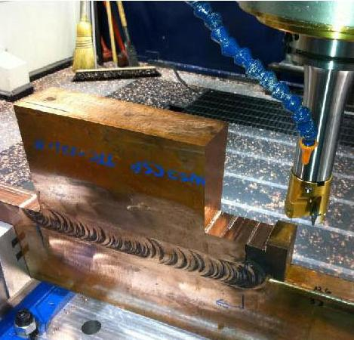
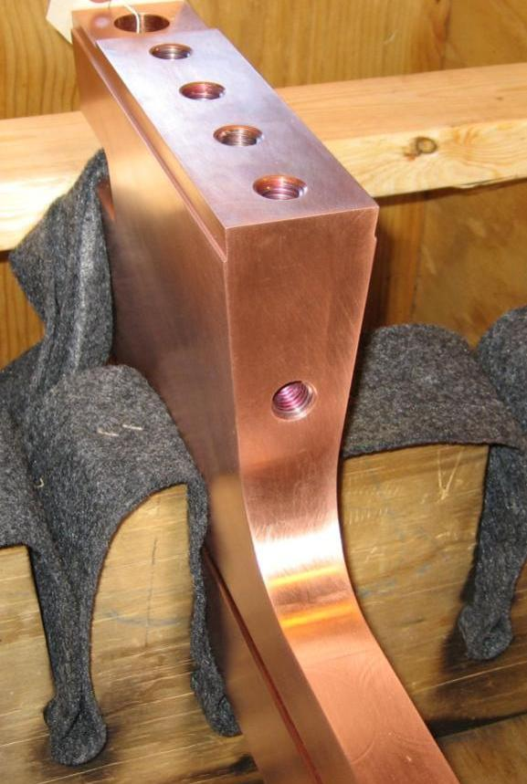
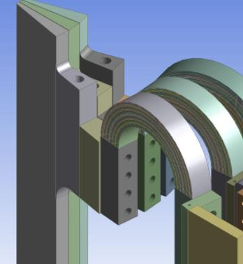
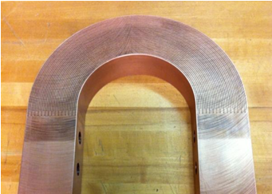
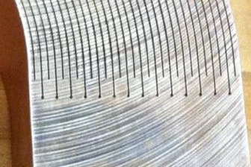
Substantial R&D completed to achieve higher toroidal field with new center-stack
Friction-stir welded joint
Cu
CuCrZr
Flexible TF strap
Wire EDM used instead of laminated build

Slide 10
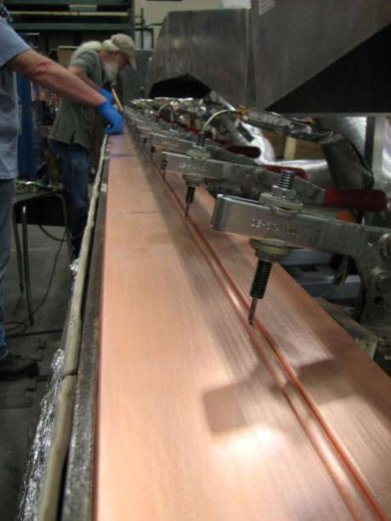
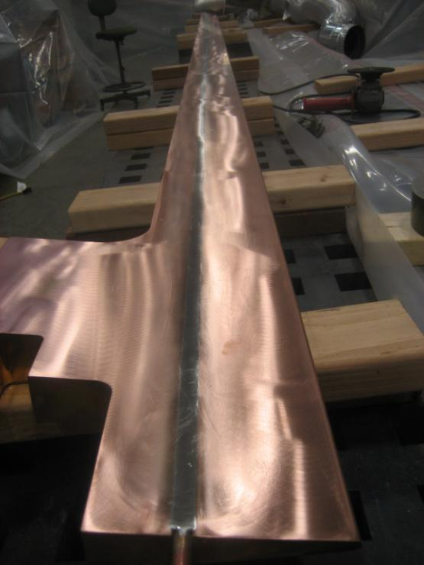
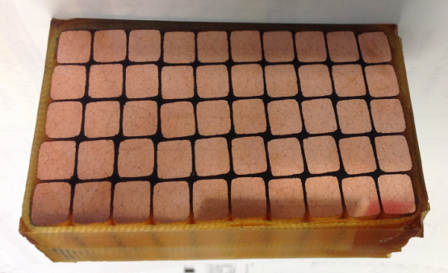
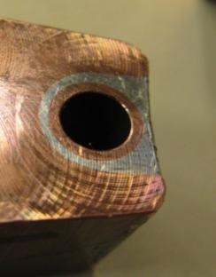
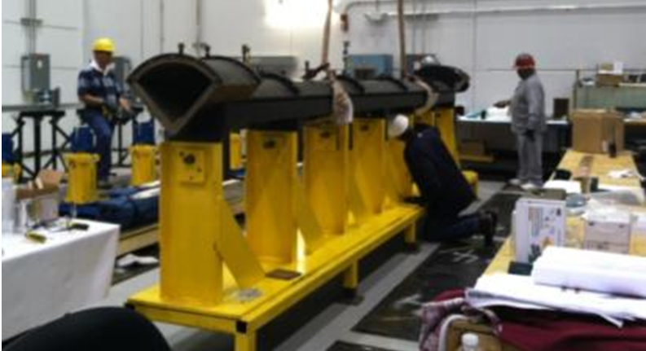
TF cooling tube soldering & flux removal process improved,
1st quadrant of TF bundle to be completed November 2012
Vacuum-pressure impregnation (VPI) using special cyanate-ester epoxy blend (CTD-425) required for shear strength will be used for the inner TF assembly
Recent successful VPI trials
Bar placed on heat plate, cooling tube inserted into grove
Bar post-soldering and ground smooth
Close up view of solder joint on test conductor
Quadrant mold for VPI nearly ready

Slide 11
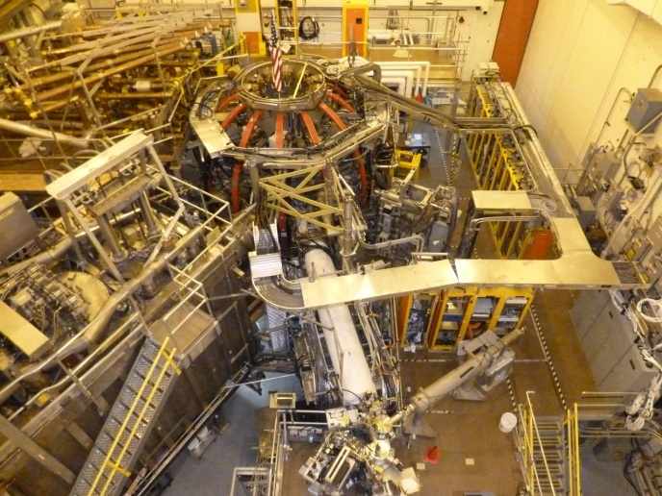
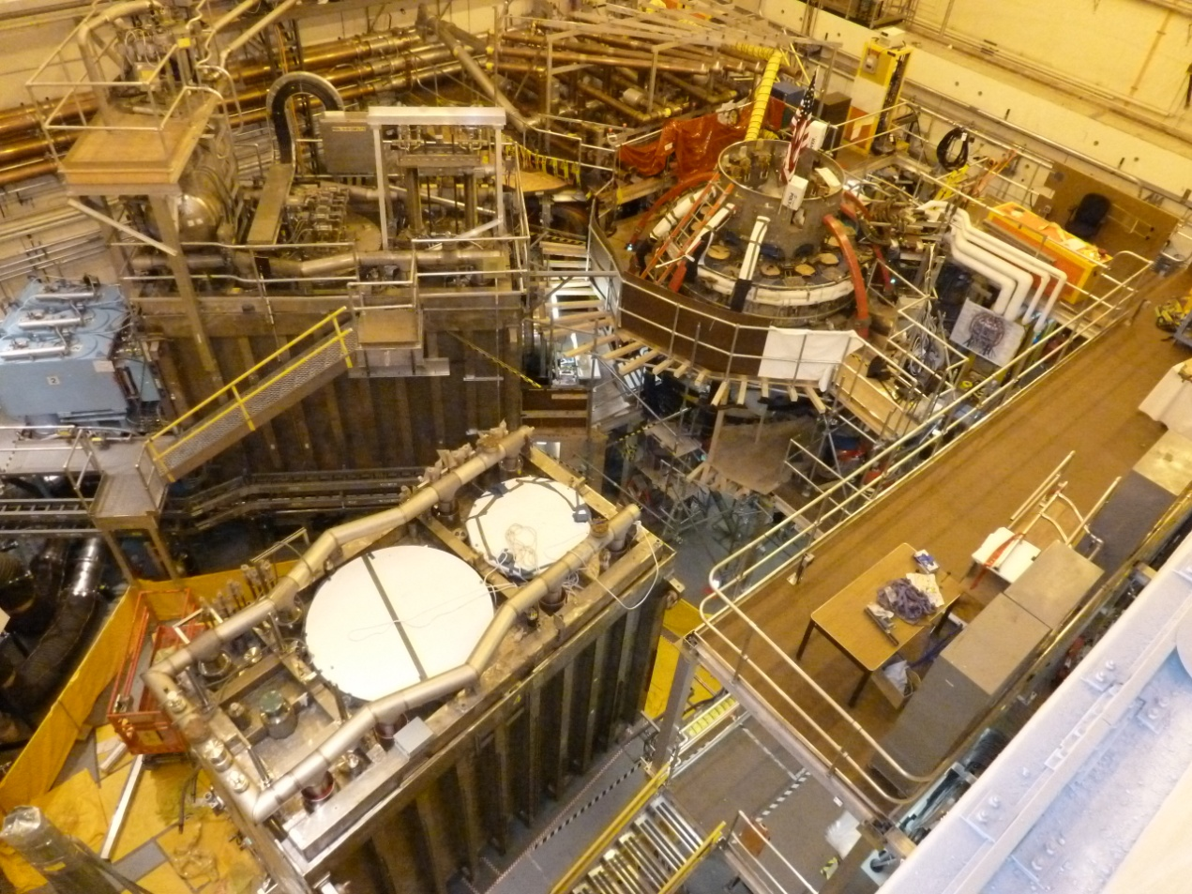
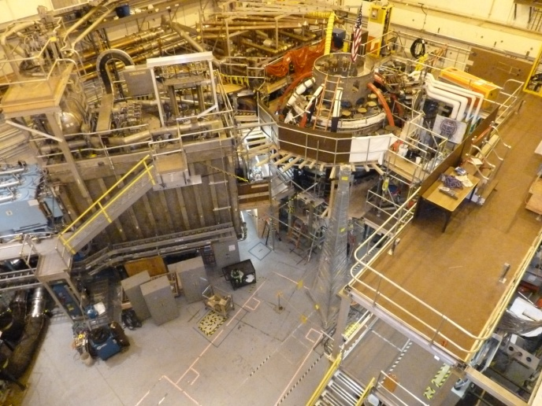
Significant progress made during past year to prepare NSTX-U test-cell and 2nd NBI
Oct. 2011: Start of construction
Oct. 2012: 2nd NBI box moved to test cell
Sept. 2011: NBI space cleared
Upper diagnostic platform installed

Slide 12
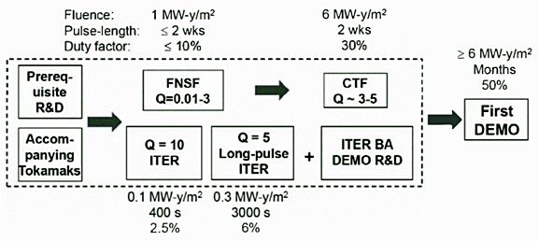
Successful operation of NSTX-U (and MAST-U) would provide basis for design and operation of next-step ST
Present next-step focus is on Fusion Nuclear Science Facility
  Mission: provide continuous fusion neutron source to develop knowledge-base for materials and components, tritium fuel cycle, power extraction
FNSF → CTF would complement ITER path to DEMO
M. Peng et al., IEEE/NPSS Paper S04A-2 - 24th SOFE Conf. (2011)
Studying wide range of ST-FNSF configurations to identify advantageous features, incorporate into improved ST design
Investigating performance vs. device size since fusion power, gain, tritium consumption and breeding, … depend on size

Slide 13
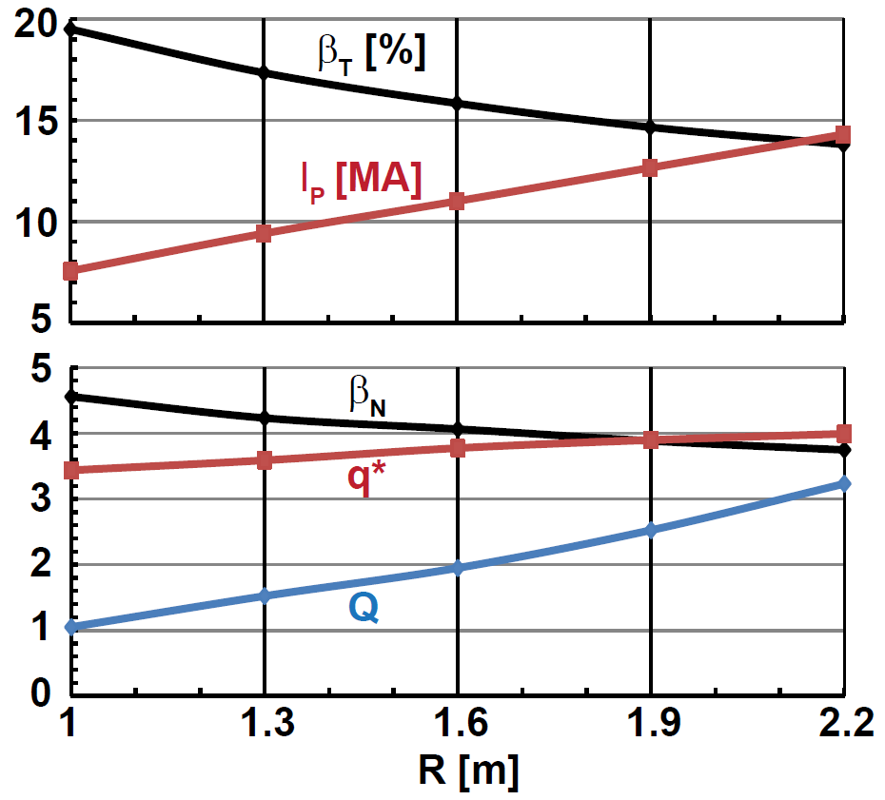
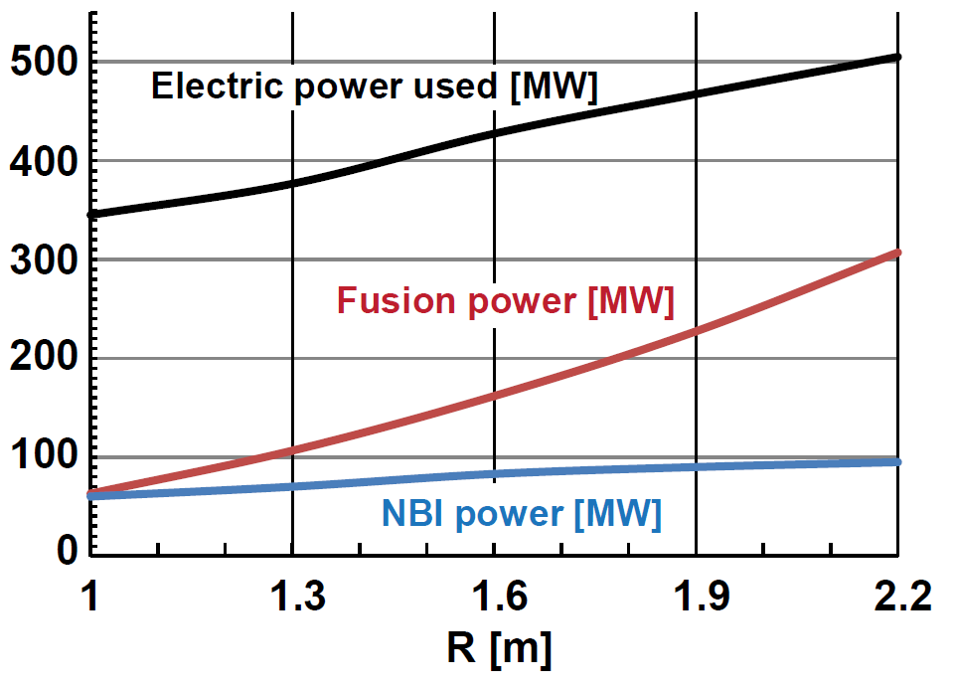
Increased device size provides modest increase in stability, but significantly increases tritium consumption
Scan R = 1m → 2.2m (smallest FNSF → pilot plant with Q_{eng} ~ 1)
Fixed average neutron wall loading = 1MW/m²
B_{T} = 3T, A=1.7, κ=3, H₉₈ = 1.2, f_{Greenwald} = 0.8
100% non-inductive: f_{BS} = 75-85% + NNBI-CD (E_{NBI}=0.5MeV JT60-SA design)
Q = 1 → 3, P_{fusion} = 60MW → 300MW → 5× increase in T consumption
2-3× higher wall loading for CTF/Pilot Plant if β_{N} → 6, H₉₈ → 1.5 (not shown)
Larger R lowers β_{T} & β_{N}, increases q*
Comparable/higher β_{T} and β_{N} values already sustained in NSTX

Slide 14
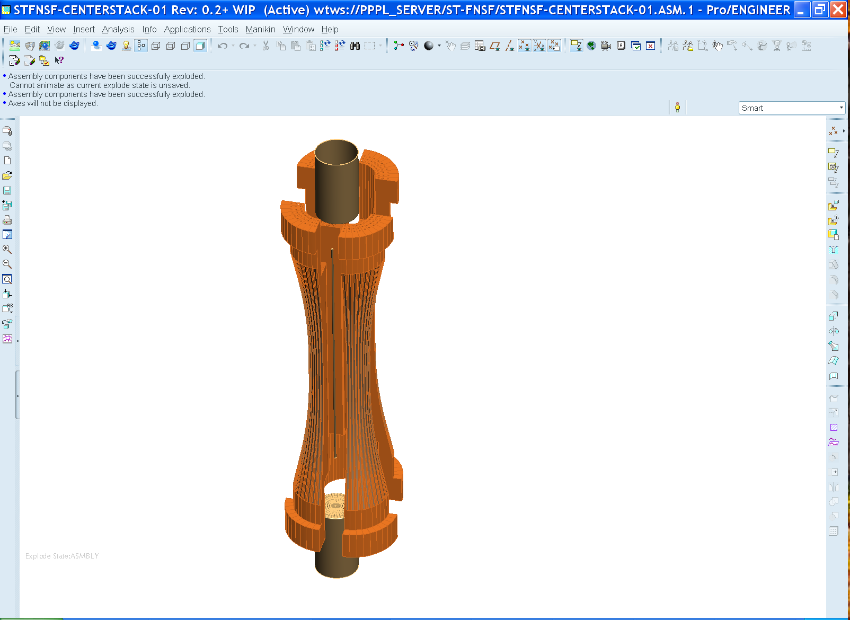
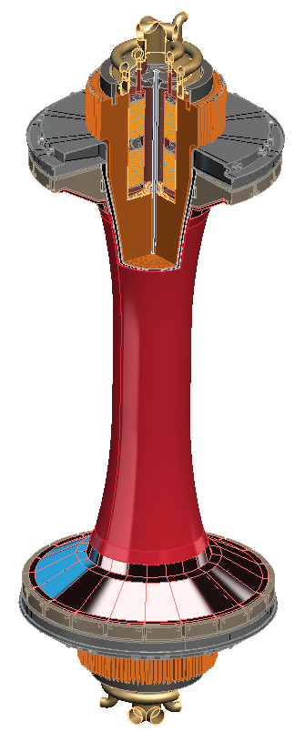
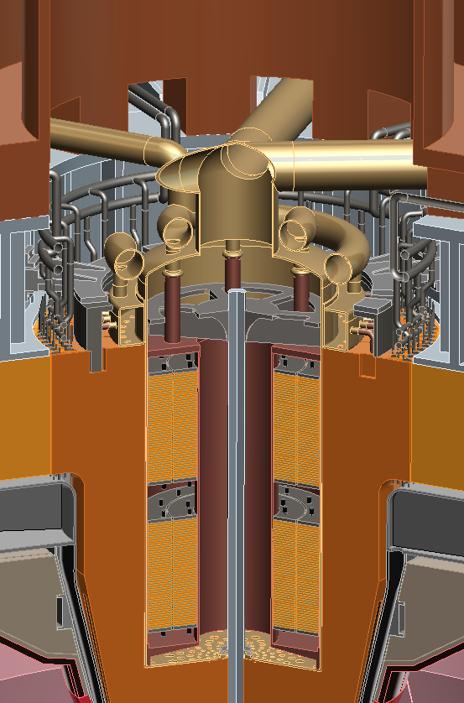
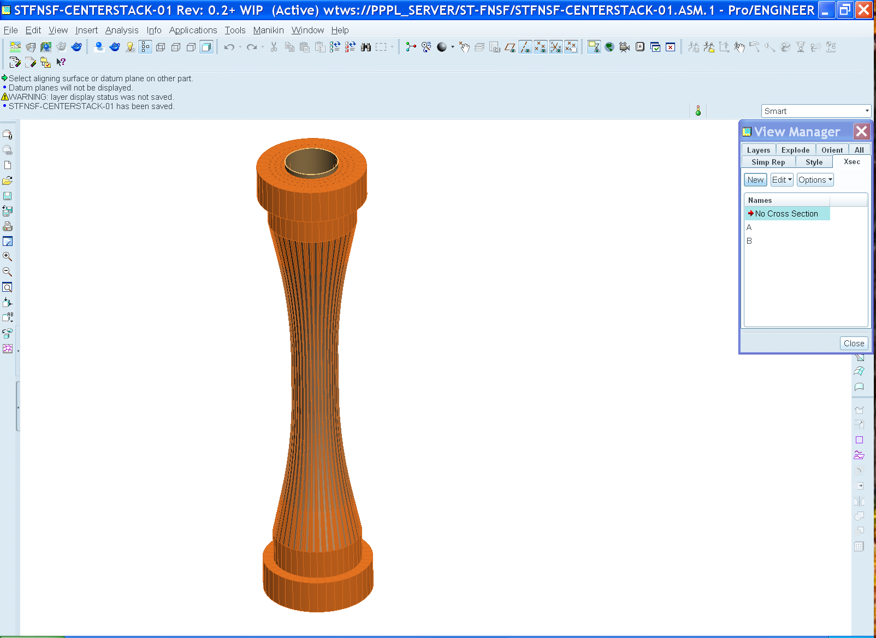
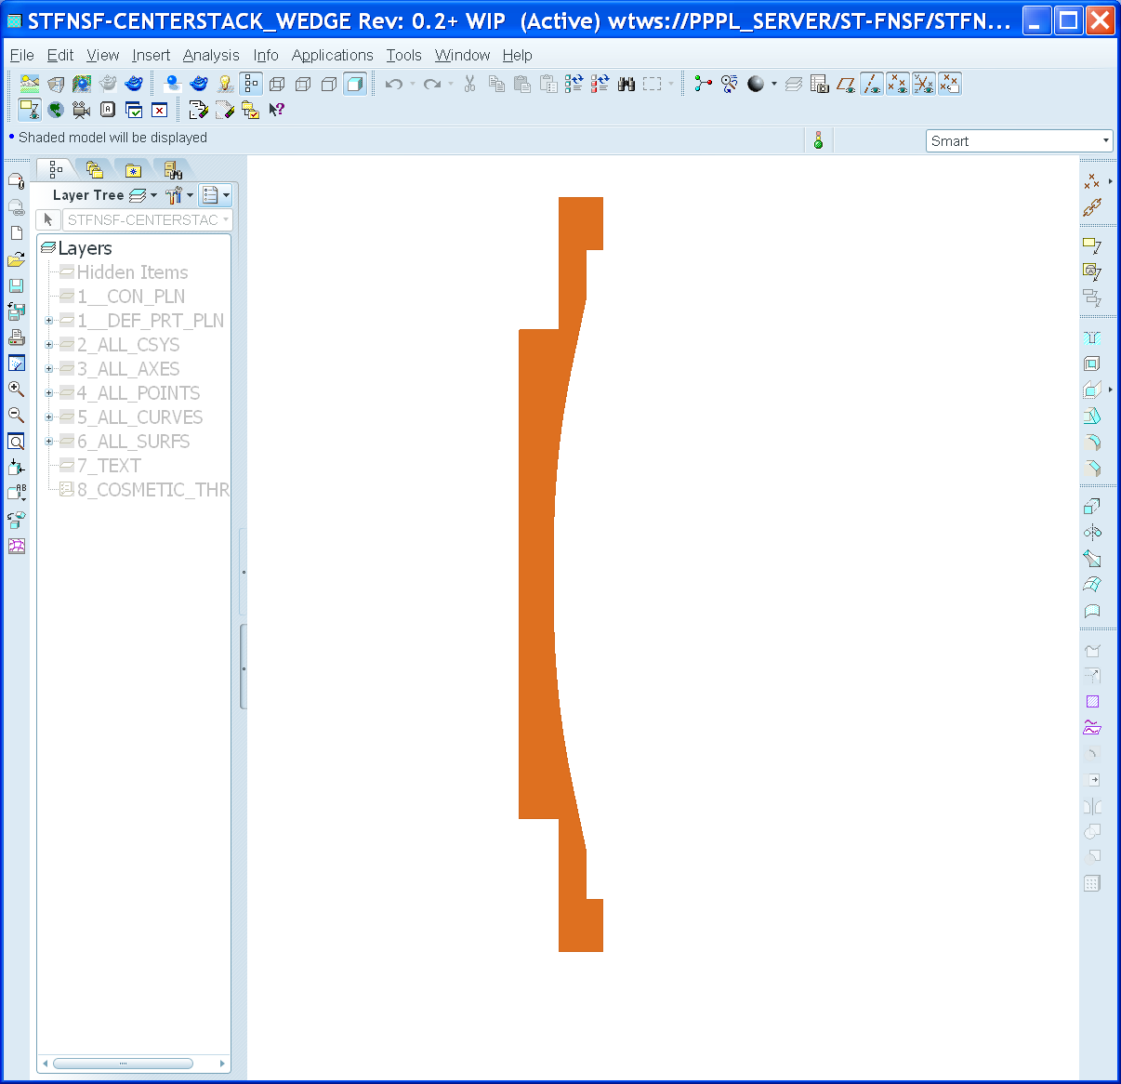
FNSF center-stack can build upon NSTX-U design and incorporate NSTX stability results
Like NSTX-U, use TF wedge segments (but brazed/pressed-fit together)
  Coolant paths: gun-drilled holes or NSTX-U-like grooves in wedge + welded tube
Bitter-plate divertor PF magnets in ends of TF enable high triangularity
  NSTX data: High δ > 0.55 and shaping S ≡ q₉₅I_{P}/aB_{T} > 25 minimizes disruptivity
  Neutronics: MgO insulation can withstand lifetime (6 FPY) radiation dose

Slide 15
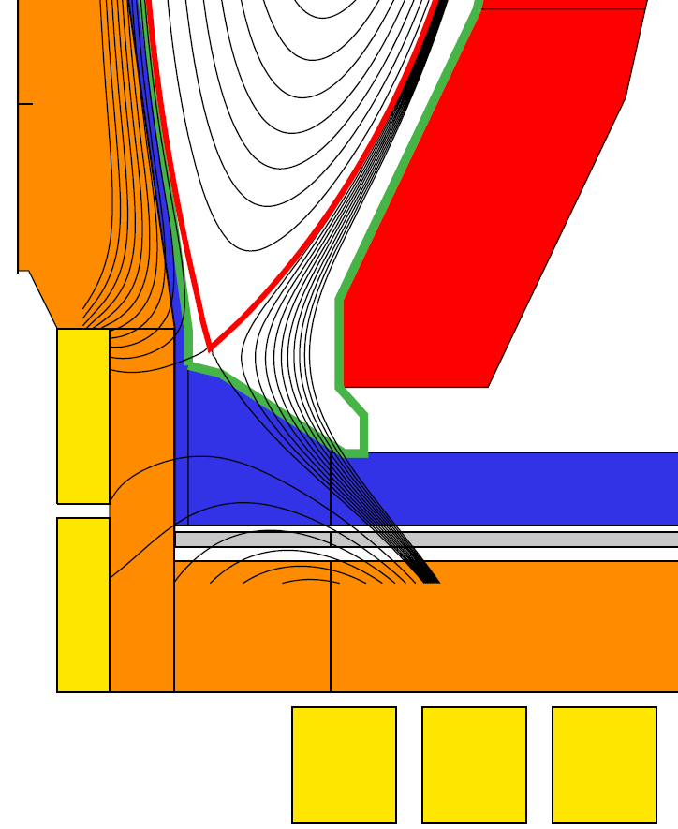
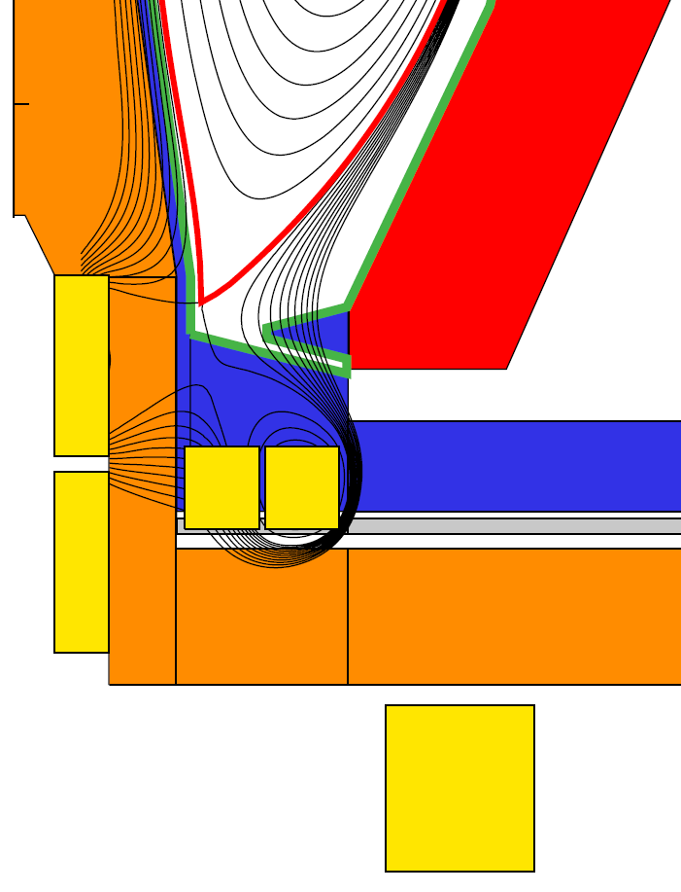
Divertor PF coil configurations identified to achieve high δ while maintaining peak divertor heat flux < 10MW/m²
Field-line angle
of incidence at
strike-point = 1˚
Conventional
Snowflake
Flux expansion = 15-25, δ_{x} ~ 0.55
1/sin(θ_{plate}) = 2-3
Detachment, pumping questionable
  Future: assess long-leg, V-shape divertor (JA)
Flux expansion = 40-60, δ_{x} ~ 0.62
1/sin(θ_{plate}) = 1-1.5
Good detachment (NSTX data) and cryo-pumping (NSTX-U modeling)
Will also test liquid metal PFCs in NSTX-U for power-handling, surface replenishment
Jaworski EX/P5-31

Slide 16
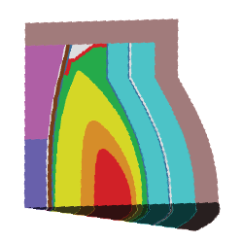
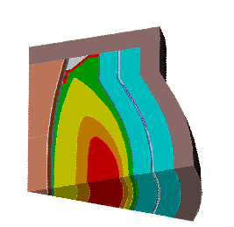
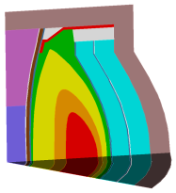
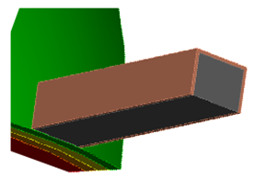
Cost of tritium and need to demonstrate T self-sufficiency motivate analysis of tritium breeding ratio (TBR)
Example costs of T w/o breeding at $0.1B/kg for R=1 → 1.6m
  FNS mission: 1MWy/m² $0.33B → $0.9B
  Component testing: 6MWy/m² $2B → $5.4B
Implications:
  TBR << 1 likely affordable for FNS mission with R ~ 1m
  Component testing arguably requires TBR approaching 1 for all R
Initial analysis: R=1.6m ST-FNSF can achieve TBR ~ 1
Extended
conformal blanket
+ 3cm thick stabilizing shell
Shorter blanket for
radial divertor access
Stabilizing
shell
NBI penetration at midplane
TBR = 1.1
TBR = 1.07
TBR = 1.016
TBR = 0.97
10 NBI penetrations
Future work: assess smaller R, 3D effects (inter-blanket gaps, test-blankets)

Slide 17
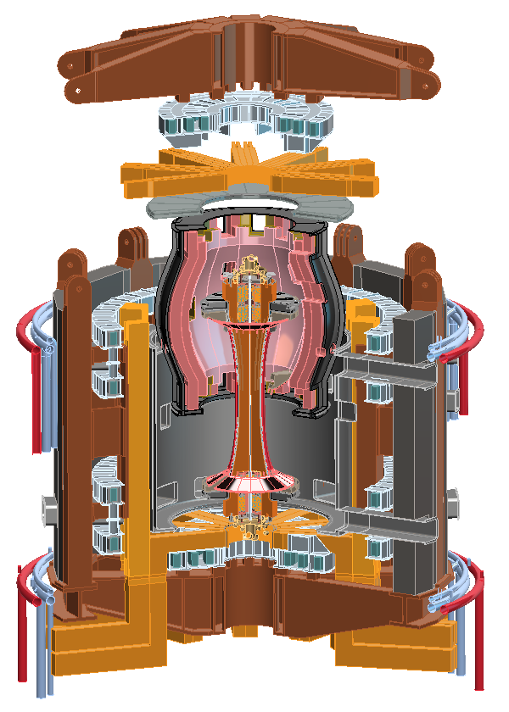
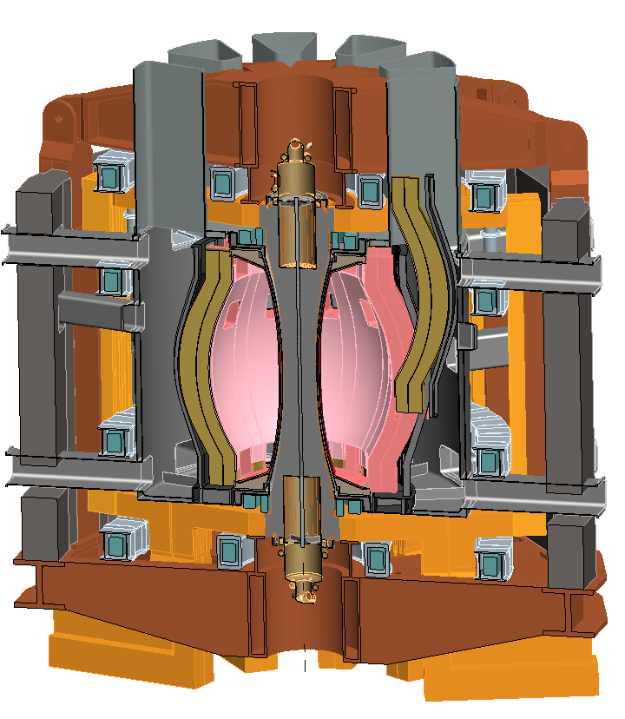
Flexible and efficient in-vessel access important for testing, replacing, improving components, maximizing availability
Several maintenance approaches under consideration:
Vertically remove entire blanket and/or center-stack
  Better for full blanket replacement?
Translate blanket segments radially then vertically
  Better for more frequent blanket module replacement and/or repair?
Radial ports
for divertor
maintenance
or pumping
May be possible to combine features of both approaches

Slide 18
Summary
NSTX Upgrade device and research aim to narrow performance and understanding gaps to next-steps
Upgrade Project has made good progress in overcoming key design challenges
  Project on schedule and budget, ~45-50% complete
  Aiming for project completion in summer 2014
ST-FNSF development studies are quantifying performance dependence on size
  Building on achieved/projected NSTX/NSTX-U performance and design
  Incorporating high δ, advanced divertors, TBR ~ 1, good maintainability

Slide 19
Backup slides

Slide 20
Backup slides
NSTX Upgrade Project

Slide 21
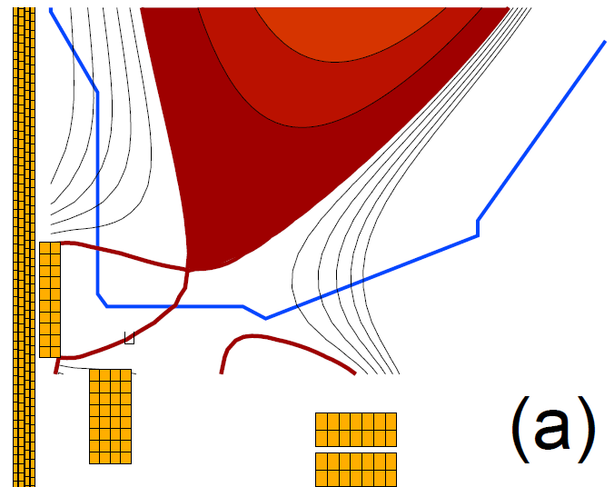


Upgrade CS design provides additional coils for flexible and controllable divertor including snowflake, and supports CHI
NSTX Snowflake
NSTX-U Snowflake
21

Slide 22



Optimized plenum geometry capable of pumping to low density for a range of R_{OSP}, I_{P} in NSTX Upgrade
SD = Standard Divertor (shown)
SFD = Snowflake Divertor
Greenwald density fraction f_{G} to < 0.5
  Moving R_{OSP} closer to pump allows lower n_{e}, but limited by power handling
High flux expansion in SFD gives better pumping with SOL-side configuration
  More plasma in far SOL near pump
  More room to increase R_{OSP} at high I_{p}
q_{pk} > 10 MW/m²
-1.8 -1.6 -1.4 -1.2 -1.0 -0.8
Z (m)
0.4 0.6 0.8 1.0 1.2
R (m)
SOLPS geometry to be used in future calculations

Slide 23

Upgrade substantially increases B_{T}, I_{p}, P_{NBI}, τ_{pulse}
Field and current will be within factor of 2 of initial operation of ST-FNSF
I_{P} = 1 → 2MA, B_{T} = 0.5 → 1T (at same major radius)
Available OH flux increased 3x, 3-5x longer flat-top
NBI power increased 2x (5→10MW for 5s, 15MW 1.5s)
Plasma stored energy increased up to 4x (0.25→ 1MJ)
Relative performance of Upgraded NSTX vs. Base:
Ip (Amp/10)
Itf (Amp)
Ioh (Amp)
Previous NSTX

Slide 24


Upgrade structural enhancements designed to support high β at full I_{P} = 2MA, B_{T}=1T: β_{N} = 5, l_{i} ≤ 1 and β_{N} = 8, l_{i} ≤ 0.6
NSTX Upgrade
High l_{i}, high-β_{N} scenarios determine the maximum vertical field (PF5) current required

Slide 25


Friction Stir Welding
Lead Extension to Inner TF Conductor
Development trials required to prove dissimilar material welding

Slide 26


Features of TF inner/outer flex strap connector
Flex strap
Supernuts® to be used to facilitate assembly
Inner TF
Testing (60,000 cycles)
Wire EDM instead of laminated build

Slide 27


NSTX operations was abruptly terminated in
July 2011 due to a failure of the inner TF bundle
An autopsy/sectioning of the failed bundle was performed
Failure of conductors was noted to be located in 1 of 3 pairs that were sub-optimal during acceptance tests
  100-3000 M-ohm versus 30,000-50,000 M-ohm during 3 kV quadrant tests
Forensics yielded convincing evidence with regard to both remaining sub-optimal pairs
  Found 1-10 M-ohm conductive path in a distinct location measured with an ohmmeter
  Discoloration of epoxy/glass insulation system
  Localized resin-poor area
Increased conductivity traced to zinc chloride in residual solder flux
→ Decided to start 2½ year Upgrade outage 6 months early

Slide 28

The NSTX-U center-stack design incorporates improvements that address factors contributing to NSTX center-stack failure
New
Single-layer vs. double layer design
  Reduced voltage stress between conductors (30 volts)
  Terminal voltage (1 kV) is across quadrant segments where there is increased insulation
VPI vs B-Stage glass resin system
  More homogenous insulation system without voids
Bundle manufacturing improved to address residual solder flux
  Less corrosive flux
  Post-soldering bakeout
Old

Slide 29



Improved soldering and flux removal process for TF cooling tubes has also been developed
Bar placed on heat plate, cooling tube inserted into grove
Solder flowing. Supplemental heat applied by torch
Bar heated, solder paste added
Good wetting of both the tube and copper bar, indicating effectiveness of flux
Bar ground smooth
Close up views of solder joint

Slide 30


TF cooling tube soldering technique
Solder Trials:
  Trials have been performed with the assistance of Solder Consultant to verify materials and heating processes
  Successful heat runs w/actual TF bar
Materials:
  Solder paste- 96.5 Sn /3.5 Ag w/ GMS based “R” flux [Glyceryl Mono-stearate, Terigitol (a detergent) and Cyclohexlamine Hydro-bromide]
Solder Temperatures:
  Liquidus ~221º C (430º F)
  Soludus~ 246º C (475ºF)
  TF solder temperature~ 270 degrees C to ensure wetting
Heating Method:
  Power supply w/heating plate
  Torch heat to complete process
30

Slide 31



Center-stack fabrication is now underway
Conductor bar being removed from oven after post-solder bake out
Bar being wrapped with insulation
Now entering riskiest stage of project → inner TF and OH fabrication and VPI – will VPI 1st quadrant by end of 2012

Slide 32

Fabrication techniques for the TF and OH coils
Epoxy VPI (CTD-425: special cyanate-ester blend) required for shear strength will be used for the inner TF assembly
Aquapour™ will be used as a temporary winding mandrel material to maintain gap between inner TF and OH of 0.1”
Recent successful VPI trials
Inner TF
OH conductor will be wound on inner TF
Inner TF
OH Conductor

Slide 33


New NBI port-cap being readied for installation
Preparing to plasma-cut hole in vessel for cap installation

Slide 34

Tentative plans for initial operations
NSTX-U will be brought up methodically
to full performance capabilities

Slide 35


Plasma initiation with small or no transformer is unique challenge for ST-based Fusion Nuclear Science Facility
ST-FNSF has no/small central solenoid
CHI / guns, ECH
NSTX-U goals:
  Generate ~0.3-0.4MA full non-inductive start-up with helicity injection + ECH and/or fast wave heating, then ramp to ~0.8-1MA with NBI
  Develop predictive capability for non-inductive ramp-up to high performance 100% non-inductive ST plasma → prototype FNSF

Slide 36




Transient CHI: Axisymmetric Reconnection Leads to Formation of Closed Flux Surfaces
Absorber region
Current multiplication increases with toroidal field
    - Favorable scaling with machine size
    - High efficiency (10 Amps/Joule in NSTX)

Slide 37

Simulations of CHI project to increased start-up current in NSTX Upgrade, highlight need for additional electron heating
TSC simulations of transient CHI consistent with NSTX trends
Favorable projections for NSTX-U:
  TF increased to 1T and injector flux increased to about 80% of max allowed → can generate up to ~400kA closed-flux current
  Figs (a-c): T_{e} = 40 eV, Z_{eff} = 2.5
  Fig (d): T_{e} = 150 eV for t > 12 ms
T_{e} ~150-200eV needed to extend current decay time to several 10’s of ms
Low density and β of CHI plasma + transient position (i.e. outer gap) evolution → HHFW coupling and heating very challenging
NSTX CHI plasmas not over-dense → 28GHz ECH heating of 1T CHI plasma likely best option for generating non-inductive ramp-up target

Slide 38


Scenario modeling using TRANSP projects to 100% non-inductive current at I_{P} = 0.9-1.3MA at B_{T}=1.0 T
Dashed: ITER-98 confinement scaling
Solid: ST confinement scaling
Narrow, H_{ST}=1
Broad, H_{ST}=1
Narrow, H_{ST}=1
Broad, H_{ST}=1
Broad, H₉₈=1
Broad, H₉₈=1
Narrow, H₉₈=1
Narrow, H₉₈=1
Fix: 1.0T, P_{inj}=12.6 MW, f_{GW}=0.72
Fix: A=1.75, κ=2.8
Find the non-inductive current level for 2 confinement and 2 profile assumptions…yields 4 different projections.
Broad, H_{ST}=1
Confinement | Profiles | I_{P} [kA] | β_{N}
H₉₈=1 | Broad | 975 | 4.34
H_{ST}=1 | Broad | 1325 | 5.32
H₉₈=1 | Narrow | 875 | 4.87
H_{ST}=1 | Narrow | 1300 | 5.97
Narrow, H_{ST}=1
Broad, H₉₈=1
Narrow, H₉₈=1

Slide 39
Backup slides
ST Development

Slide 40

NSTX disruptivity data informs FNSF operating parameters
Increased disruptivity for q* < 2.7
  Significantly increased for q* < 2.5
Lower disruptivity for β_{N} = 4-6 compared to lower β_{N}
  Higher β_{N} increases f_{BS}, broadens J profile, elevates q_{min}
  Operation above no-wall limit aided by:
    NBI co-rotation
    Close-fitting conducting wall
    Active error-field and RWM control
Strong shaping also important
  S ≡ q₉₅ I_{P}/aB_{T}
  S > 30 provides strongest stabilization
  S > 22-25 good stability
  S < 22 unfavorable
Gerhardt EX/9-3

Slide 41

Investigating high performance scenarios for accessing increased neutron wall loading and engineering gain
Decrease B_{T} = 3T → 2.6T, increase H₉₈ = 1.2 → 1.5
Fix β_{N} = 6, β_{T} = 35%, q* = 2.5, f_{Greenwald} varies: 0.66 to 0.47
P_{electric} produced
P_{electric} consumed
Q_{eng} ≡
See J. Menard, et al.,
Nucl. Fusion 51 (2011) 103014 for detail on definitions/parameters
Note: Outboard PF coils are superconducting
Size scan: Q increases from 3 (R=1m) to 14 (R=2.2m)
Smallest ST for Q_{eng} ~ 1 is R=1.6m → requires very efficient blankets
Average neutron wall loading increases from 1.8 to 3 MW/m² (not shown)

Slide 42

Neutronics analysis indicates organic insulator for divertor PF coils unacceptable

Slide 43


MgO insulation appears to have good radiation resistance for divertor PF coils
UW analysis of divertor PFs
  1.8x10¹² rad = 1.8x10¹⁰ Gy at 6FPY for P_{fus} = 160MW
Pilot mission for R=1.6m:
  P_{fus} = 420MW vs. 160MW → 2.6x higher → 4.7x10¹⁰ Gy
  Even for Pilot mission, dose is < limit of 10¹¹ Gy
Limiting factor may be Cu
Need to analyze CS lifetime
Revisit option for multi-turn TF and small OH solenoid

Slide 44



Parameters for R=1.6m ST-FNSF conventional divertor
Strike point radius
P_{heat} (1-f_{rad}) f_{obd} sin(θ_{pol})
2πR_{strike} f_{exp} λ_{q-mid} N_{div}
Peak q_{⊥-div} ≈
P_{heat} = 115MW, f_{rad}=0.8, f_{obd}=0.8, sin(θ_{p}) = 0.39
R_{strike} = 1.16m, f_{exp} = 22, λ_{q-mid} =2.7mm, N_{div} = 2

Slide 45



Parameters for R=1.6m ST-FNSF snowflake divertor
Strike point radius
P_{heat} (1-f_{rad}) f_{obd} sin(θ_{pol})
2πR_{strike} f_{exp} λ_{q-mid} N_{div}
Peak q_{⊥-div} ≈
P_{heat} = 115MW, f_{rad}=0.8, f_{obd}=0.8, sin(θ_{p}) = 0.87
R_{strike} = 1.05m, f_{exp} = 50, λ_{q-mid} =2.7mm, N_{div} = 2

Slide 46



R=1.6m ST-FNSF TBR calculations
Extended
conformal blanket
+ 3cm thick stabilizing shell
NBI penetration at midplane
Stabilizing
shell
TBR = 1.02
10 NBI penetrations
TBR = 1.1
TBR = 1.07
Extended
straight blanket
Straight blanket
with flat top
Conformal blanket
Straight blanket
TBR = 1.046
TBR = 0.8
TBR = 1.0
TBR = 1.047

Slide 47


Assembly and maintenance schemes with snowflake divertor and vertical ports
Full Blanket Assembly Removed
Centerstack Assembly Removed

Slide 48


Possible divertor module maintenance scheme using radial installation and vertical translation through vertical ports

Slide 49

R=1.6m ST-FNSF cutaway view
showing blanket module maintenance

Slide 50

Large cylindrical vessel of R=1.6m FNSF could be used for PMI R&D (hot walls, Super-X?), other blanket configurations
NOTE: TBR values do not include stabilizing shells or penetrations
Straight blanket
TBR = 0.8
Straight blanket
with flat top
TBR = 1.047

Slide 51
Backup slides
Liquid metal and PFC research

Slide 52




Operation with outer strike-point on liquid lithium divertor (LLD)
(porous Mo coated w/ Li) compatible w/ high plasma performance
LLD FY2010 results:
LLD
LLD did not increase D pumping beyond that achieved with LiTER
No evidence of Mo from LLD in plasma during normal operation
Operation with strike-point on LLD can yield reduced core impurities
Row of inboard Mo tiles installed for FY11-12 run, can re-use in NSTX-U
Strike-point on inner C divertor (no ELMs)
Strike-point on LLD, T_{LLD} < T_{Li-melt}
Strike-point on LLD, T_{LLD} > T_{Li-melt} (+ fueling differences)
  No ELMs, no → small, small → larger
  Li + plasma-facing component research will be continued, extended in NSTX-U

Slide 53



LLD with optimized pore size and layer thickness can provide stable lithium surface
LLD
LLD surface cross section: plasma sprayed porous Mo
LLD filled with 67 g-Li by evaporation,
(twice that needed to fill the porosity).
No major Mo or macroscopic Li influx observed even with strike point on LLD.
No lithium ejection events from LLD observed during NSTX transients > 100 kA/m²
  Thin layers and small pore diameters increase critical current (J_{crit}) for ejection.
  Modelling consistent with DIII-D Li-DIMES ejection at 10kA/m² and NSTX experience.
M.A. Jaworski, et al., J. Nucl. Mater. 415 (2011) S985.
D. Whyte, et al., Fusion Eng. Des. 72 (2004) 133.

Slide 54
Flowing LLD will be studied as alternative means of particle and power exhaust, access to low recycling
LLD, LTX → liquid Li required to achieve pumping persistence
  Flowing Li required to remove by-products of reactions with background gases
Substantial R&D needed for flowing Li
Need to identify optimal choice of concept for pumping, power handling:
  Slow-flowing thin film (FLiLi)
  Capillary porous system (CPS)
  Lithium infused trenches (LiMIT)
  All systems above require active cooling to mitigate highest heat fluxes of NSTX-U
Elimination of C from divertor needed for “clean” test of LLD D pumping
  May need to remove all C PFCs?
Possible approach:
Dedicate 1-2 toroidal sectors (30-60˚ each) to LLD testing
(and/or integrate with RDM?)
Test several concepts simultaneously
Full toroidal coverage after best concept is identified
C
Mo
Flowing LLD

Slide 55
Direct comparison of cryo-pumping and flowing LLD by end of next 5 yr plan would inform FNSF divertor decisions
Partially-detached snowflake + cryo-pump may provide sufficient heat-flux mitigation and particle control for NSTX-U, FNSF
However, erosion of solid PFCs could pollute plasma, damage FNSF divertor/FW
  FNSF at 30% duty factor → ~10² - 10³ kg net erosion / year for typical FNSF size & power
  Further motivates research in flowing liquid metals
5 year plan for divertors (present thinking):
  Dedicate upper divertor to cryo-pump
  Dedicate lower divertor to flowing liquid Li tests, materials analysis particle probe (MAPP)
Cryo-pump
C
BN
Mo
(or W)
Flowing LLD, MAPP probe, possible replaceable divertor module (RDM)

Slide 56
NSTX-U 5 year plan goal: transition to (nearly) complete wall coverage w/ metallic PFCs to support FNSF PMI studies
Assess compatibility of high τ_{E} and β + 100% NICD with metallic PFCs
Baseline
W is leading candidate material for FNSF/Demo divertor
C
BN
Mo PFCs
plus W divertor
Upper
Mo divertor
All
Mo divertor
All Mo tiles
All Mo PFCs
Mo
W
Possible implementation paths for high-Z PFCs
Beginning of 5 yr plan
End of 5 yr plan

Slide 57


Lab-based R&D on liquid metal technology will inform long term PFC decisions:
Thin flowing Li film in FLiLi (Zakharov)
Pre-NSTX-U R&D initiated by PPPL:
Laboratory studies of D uptake as a function of Li dose, C/Mo substrate, surface oxidation, wetting…
Tests of prototype of scalable flowing liquid
lithium system (FliLi) at PPPL and on HT7
Basic liquid lithium flow loop on textured surfaces
Analysis and design of actively-cooled PFCs with Li flows due to capillary action and thermoelectric MHD
Magnum-PSI tests begun June 2012
Soaker hose capillary porous system concept (Goldston/Jaworski)
mesh
Li
Coolant
(He, supercritical CO₂, Na heatpipe…)

Slide 58


PPPL Lithium Granule Injector Tested on EAST
Dennis Mansfield (PPPL, retired)
Lane Roquemore (PPPL)
Jiansheng Hu and D. Mansfield
6 inch
Independent Control:
Granule Size
(change between shots)
Injection Speed
(ramp during shots)
Pacing Frequency
(ramp during shots)
Dropper
5.5 inch
10 mm
Li Granules
8 inch
V = 0 - 100 m/s
Freq = 0 - 100 Hz

Slide 59

Triggered ELMs (~ 25 Hz) with 0.7 mm Li Granules @ ~ 45 m/s → could be very useful for triggering ELMs in Li-ELM free H-modes in NSTX-U

Slide 60

NSTX Upgrade will extend normalized divertor and first-wall heat-loads much closer to FNS and Demo regimes
NSTX

