Slide 1






NSTX-U
Supported by
Snowflake Divertor as Plasma-Material Interface for Future High Power Density Fusion Devices
V. A. Soukhanovskii, R. E. Bell, S. P. Gerhardt,
S. Kaye, E. Kolemen, B. P. LeBlanc, E. T. Meier,
J. E. Menard, A. G. McLean, T. D. Rognlien,
D. D. Ryutov, F. Scotti, A. Diallo, R. Kaita, R. Maingi, M. Podesta, R. Raman, A. L. Roquemore
Coll of Wm & Mary
Columbia U
CompX
General Atomics
FIU
INL
Johns Hopkins U
LANL
LLNL
Lodestar
MIT
Lehigh U
Nova Photonics
ORNL
PPPL
Princeton U
Purdue U
SNL
Think Tank, Inc.
UC Davis
UC Irvine
UCLA
UCSD
U Colorado
U Illinois
U Maryland
U Rochester
U Tennessee
U Tulsa
U Washington
U Wisconsin
X Science LLC
Culham Sci Ctr
York U
Chubu U
Fukui U
Hiroshima U
Hyogo U
Kyoto U
Kyushu U
Kyushu Tokai U
NIFS
Niigata U
U Tokyo
JAEA
Inst for Nucl Res, Kiev
Ioffe Inst
TRINITI
Chonbuk Natl U
NFRI
KAIST
POSTECH
Seoul Natl U
ASIPP
CIEMAT
FOM Inst DIFFER
ENEA, Frascati
CEA, Cadarache
IPP, Jülich
IPP, Garching
ASCR, Czech Rep
Poster EX/D P5.021

Slide 2
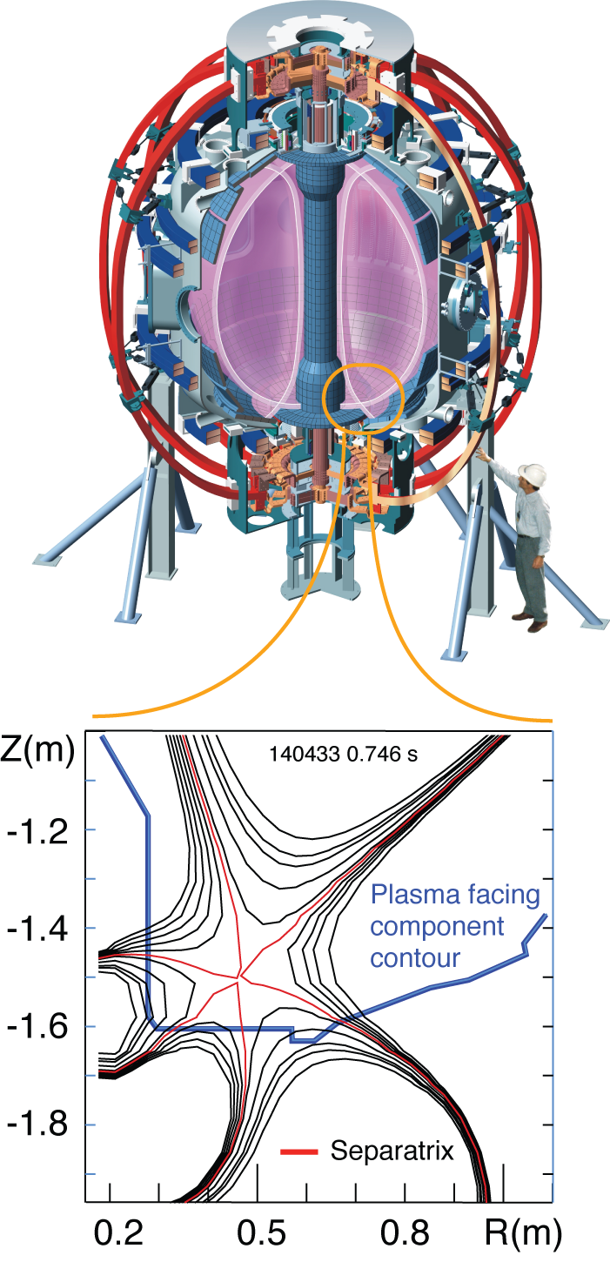
Snowflake divertor is a promising solution for mitigating divertor heat loads, and projects favorably to future fusion devices
Recent NSTX results demonstrate that the snowflake divertor (SFD) configuration may provide a promising solution for mitigating steady-state and transient divertor heat loads and target plate erosion, and project favorably to future fusion devices. In NSTX, a large spherical tokamak with high divertor heat flux q_{peak} ≤ 15 MW/m², q||≤200 MW/m², steady-state SFD configurations lasting up to 0.6 s (10 t_{E}) were obtained using the existing divertor poloidal field coils. The SFD geometry significantly increased the plasma-wetted area, the parallel connection length, and the divertor volumetric losses compared to the standard divertor configuration. The SFD formation led to a stable partial detachment of the outer strike point otherwise inaccessible in the standard divertor geometry at P_{SOL}=3 MW and n_{e}/n_{G} ~0.6-0.8 in NSTX. Peak divertor heat fluxes were reduced from 3-7 MW/m² to 0.5-1 MW/m² between ELMs, and from 5-20 MW/m² to 1-5 MW/m² at peak times of Type I ELMs (D W_{MHD} /W_{MHD}=7-15 %). H-mode core confinement was maintained albeit the radiative detachment, while core carbon concentration was reduced by up to 50 %. Additional divertor CD₄ seeding increased divertor radiation further. Based on the NSTX experiments, the SFD configuration is being developed as a leading heat flux mitigation technique for the NSTX Upgrade device. An edge transport model based on the two-dimensional multi-fluid code UEDGE favorably projects SFD properties to NSTX-U, showing a significant reduction of the steady-state peak divertor heat flux from 15 to about 3 MW/m² expected in 2 MA discharges with 12 MW NBI heating.

Slide 3
Snowflake divertor is a promising solution for mitigating divertor heat loads, and projects favorably to future fusion devices
Snowflake divertor configuration in NSTX
  Core H-mode confinement unaffected, core carbon concentration reduced
  Pedestal stability modified: suppressed Type I ELMs re-appeared
  Divertor heat flux significantly reduced
      Between-ELM reduction due to geometry and radiative detachment
      ELM heat flux reduction due to power sharing between strike points, radiation and geometry
Snowflake divertor is a leading candidate for NSTX-U
  Divertor coils enable a variety of snowflakes
  In 2 MA, 12 MW NBI-heated discharges
    SOL power width λ_{SOL} = 3 mm projected
    q_{div} ≤ 15 - 25 MW/m² projected in standard divertor
    q_{div} ≤ 3 MW/m² projected in snowflake divertor

Slide 4
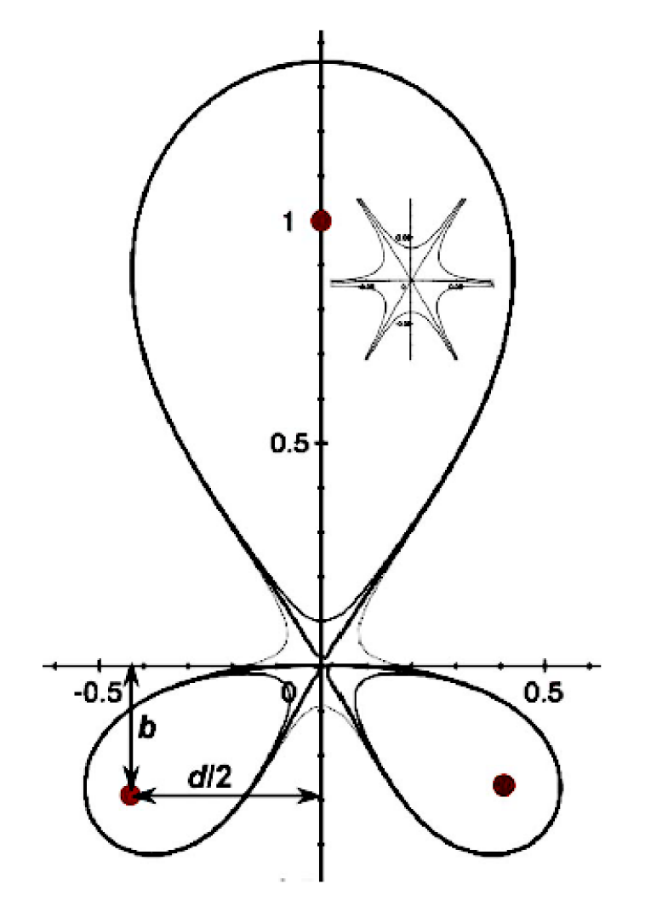
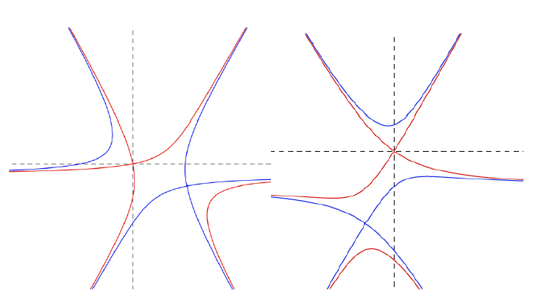
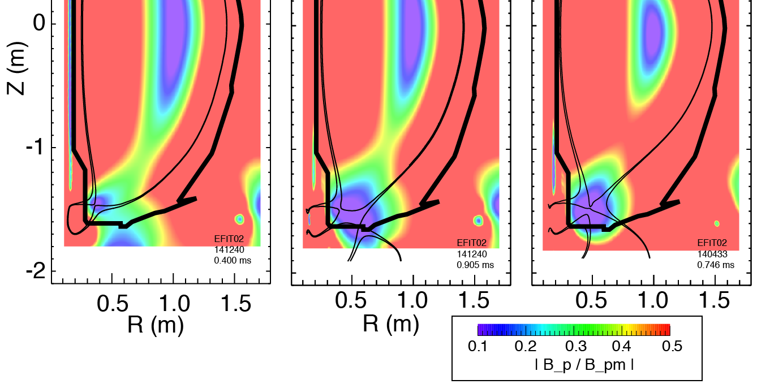
Snowflake divertor geometry takes advantage of second-order poloidal field null properties
Snowflake divertor configuration
  Second-order null
      B_{p} ~ 0 and grad B_{p} ~ 0 (Cf. first-order null: B_{p} ~ 0)
  Obtained with existing divertor coils (min. 2)
  Exact snowflake topologically unstable
  Deviation from ideal snowflake: σ = d / a
    d – distance between nulls, a – plasma minor radius
Exact (ideal)
snowflake
*
Standard divertor Snowflake-minus Exact snowflake
+
+
+
+
snowflake-minus
snowflake-plus
D. D. Ryutov, PoP 14, 064502 2007
EPS 2012 Invited, subm. to PPCF

Slide 5
Snowflake divertor geometry has benefits over standard X-point divertor geometry
Predicted geometry properties in snowflake divertor (cf. standard divertor)
  Increased edge shear :ped. stability
  Add’l null: H-mode power threshold, ion loss
  Larger plasma wetted-area A_{wet} : reduce q_{div}
  Four strike points : share q_{II}
  Larger X-point connection length L_{x} : reduce q_{II}
  Larger effective divertor volume V_{div} : incr. P_{rad} , P_{CX}
  D. D. Ryutov, PoP 14, 064502 2007

Slide 6
Snowflake divertor configurations obtained with existing divertor coils, maintained for up to 10 τ_{E}

Slide 7
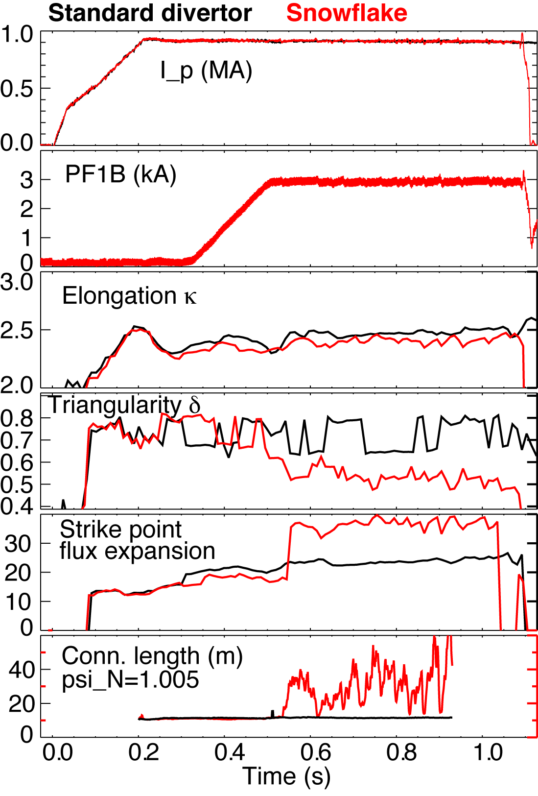
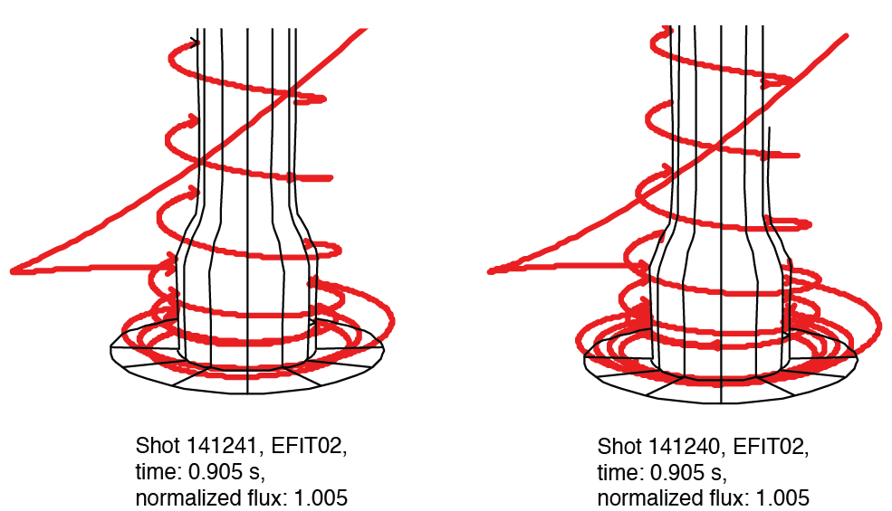
Plasma-wetted area and connection length are increased by 50-90 % in snowflake divertor
Standard divertor Snowflake-minus
These properties observed in first 30-50 % of SOL width
B_{tot} angles in the strike point region: 1-2º, sometimes < 1º

Slide 8
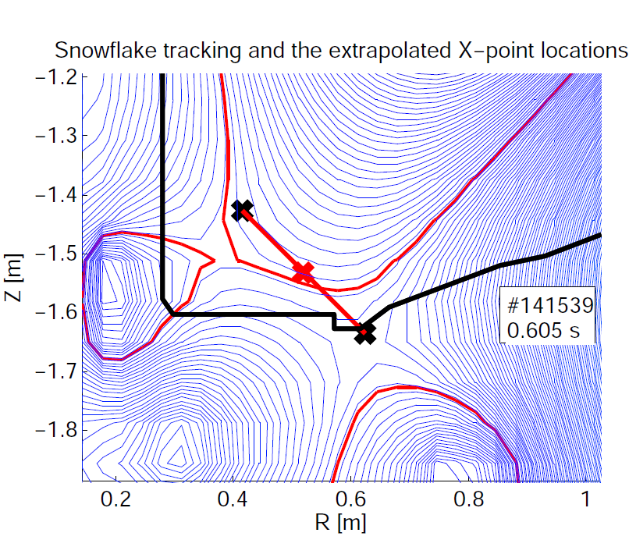
Close-loop feedback control of divertor coil currents is desirable for steady-state snowflake
  All configurations are obtained reproducibly under feed-forward control in NSTX
  In NSTX
  Developed X-point tracking algorithm that locates nulls and centroid
  Algorithm tested on NSTX snowflakes successfully
  Implementing snowflake control in digital plasma control system
M.A. Makowski & D. Ryutov, “X-Point Tracking Algorithm for the Snowflake Divertor”

Slide 9
  Good H-mode confinement properties and core impurity reduction obtained with snowflake divertor
0.8 MA, 4 MW H-mode
κ=2.1, δ=0.8
Core T_{e} ~ 0.8-1 keV, T_{i} ~ 1 keV
β_{N} ~ 4-5
Plasma stored energy ~ 250 kJ
H98(y,2) ~ 1 (from TRANSP)
ELMs
  Suppressed in standard divertor H-mode via lithium conditioning
  Re-appeared in snowflake H-mode
Core carbon reduction due to
  Type I ELMs
  Edge source reduction
    Divertor sputtering rates reduced due to partial detachment

Slide 10
Core carbon density significantly reduced with snowflake divertor
Standard divertor Snowflake

Slide 11
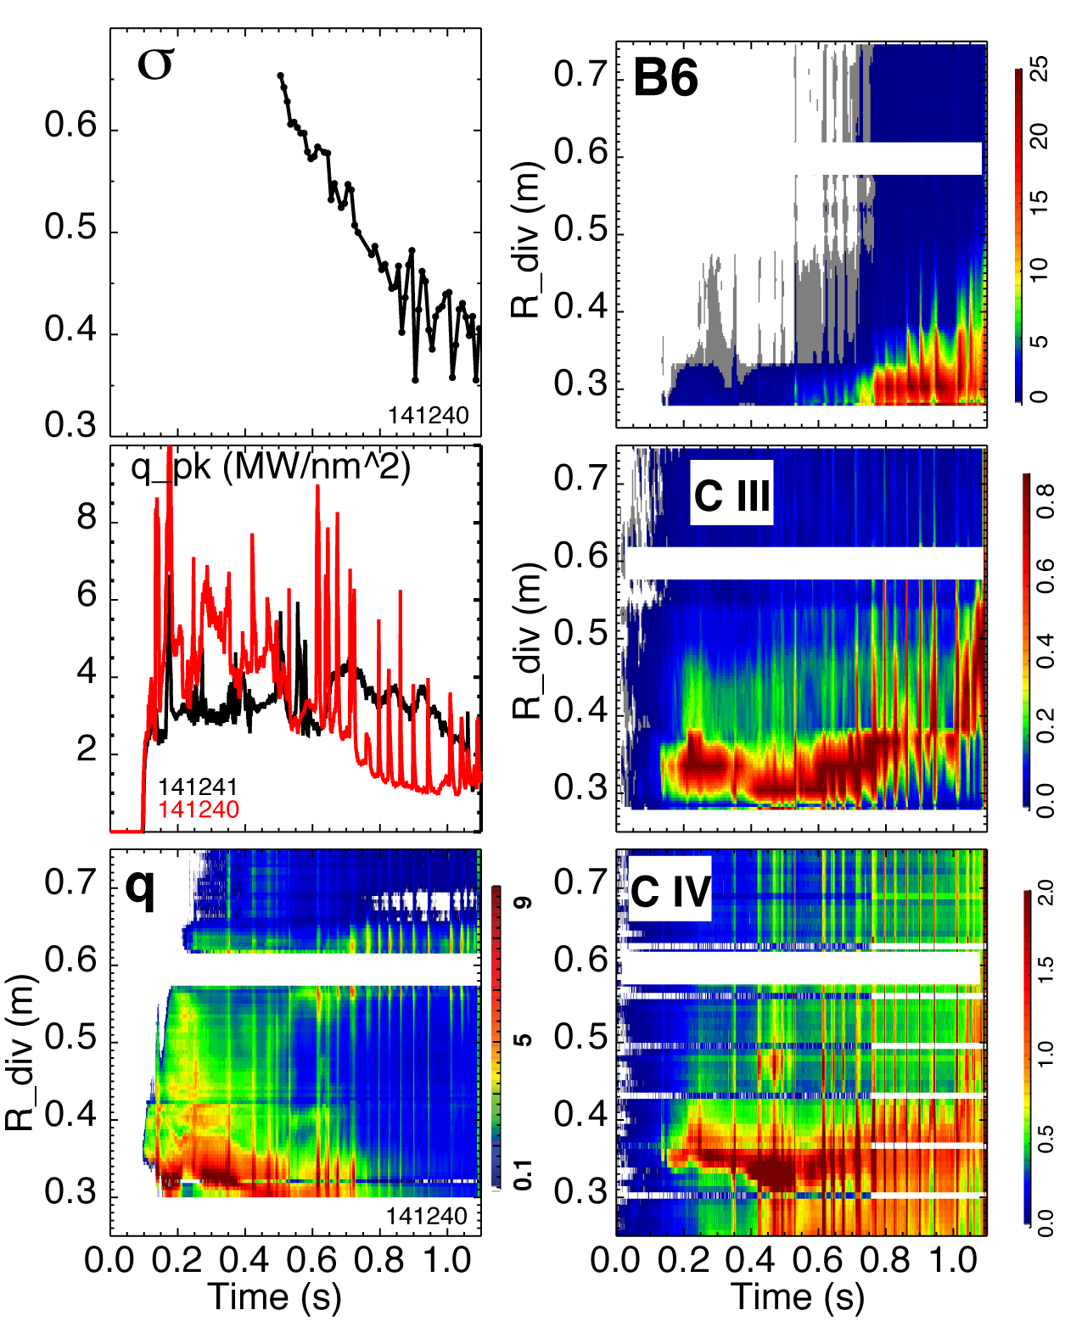
Radiative detachment with strong recombination and high radiated power observed in snowflake divertor
Attached standard divertor - snowflake transition - snowflake + detachment
P_{SOL} ~ 3 MW (P_{NBI} = 4 MW)
Q_{div} ~ 2 MW -> Q_{div} ~ 1.2 MW -> Q_{div} ~ 0.5-0.7 MW

Slide 12
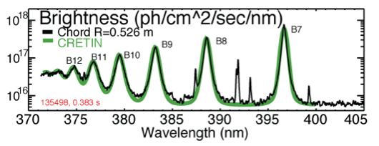
Divertor profiles show low heat flux, broadened C III and
C IV radiation zones in the snowflake divertor phase
Heat flux profiles reduced to nearly flat low levels, characteristic of radiative heating
Divertor C III and C IV brightness profiles broaden
High-n Balmer line spectroscopy and CRETIN code modeling confirm outer SP detachment with T_{e} ≤ 1.5 eV,
n_{e} ≤ 5 x 10²⁰ m⁻³
  Also suggests a reduction of carbon physical and chemical sputtering rates

Slide 13
No leading edge PFC tile heating observed at shallow magnetic field incidence angles
Reduction of q|| due to radiative detachment is considered

Slide 14
Peak divertor heat flux decreases with stronger snowflake effects (lower σ)
Deviation from ideal snowflake: σ = d / a
  d – distance between nulls, a – plasma minor radius
Clear trends of flux expansion, connection length, and peak heat flux with σ observed

Slide 15
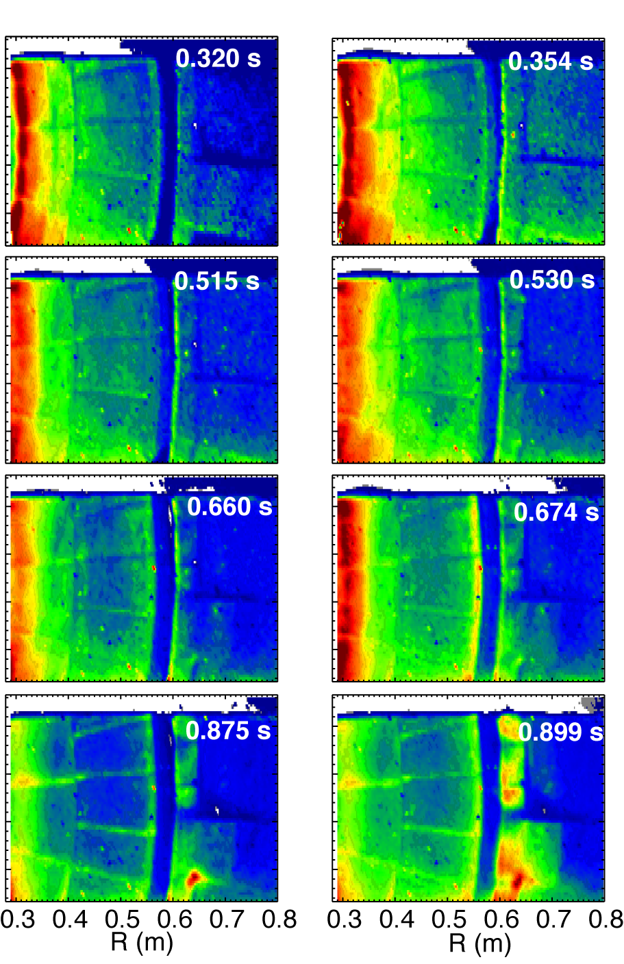
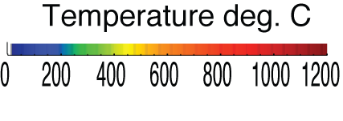
Impulsive heat loads due to Type I ELMs are mitigated in snowflake divertor
Steady-state At ELM peak

Slide 16
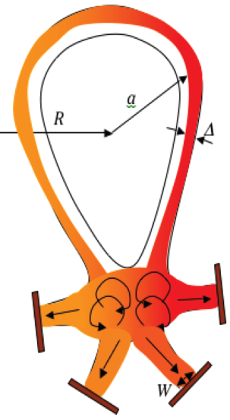
ELM peak heat flux strongly decreases with stronger snowflake effects (lower σ)
H-mode standard divertor discharge
  W_{MHD} ~ 220-250 kJ
  Type I ELMs suppressed by lithium conditioning
  Occasional ELMs occur
In the snowflake phase
  Type I ELM (ΔW/W ~ 5-15 %) re-appeared
  ELM peak heat flux lower
Theory (D. Ryutov, TH/ P4-18)
  Reduced surface heating due to increased ELM energy deposition time
  Convective mixing of ELM heat flux in null-point region -> heat flux partitioning between separatrix branches

Slide 17
  Good H-mode confinement properties retained or slightly reduced with CD₄-seeded snowflake divertor
Standard
Snowflake
Radiative divertor w/ CD₄
Snowflake+CD₄

Slide 18
Divertor profiles show enhanced radiation and recombination zone in snowflake divertor w/ and w/o CD₄
Standard
Snowflake
Radiative divertor w/ CD₄
Snowflake+CD₄

Slide 19
Divertor heat flux reduced by radiation and/or geometry in radiative and snowflake divertors
Stnadard
Snowflake
Radiative divertor w/ CD₄
Snowflake+CD₄

Slide 20
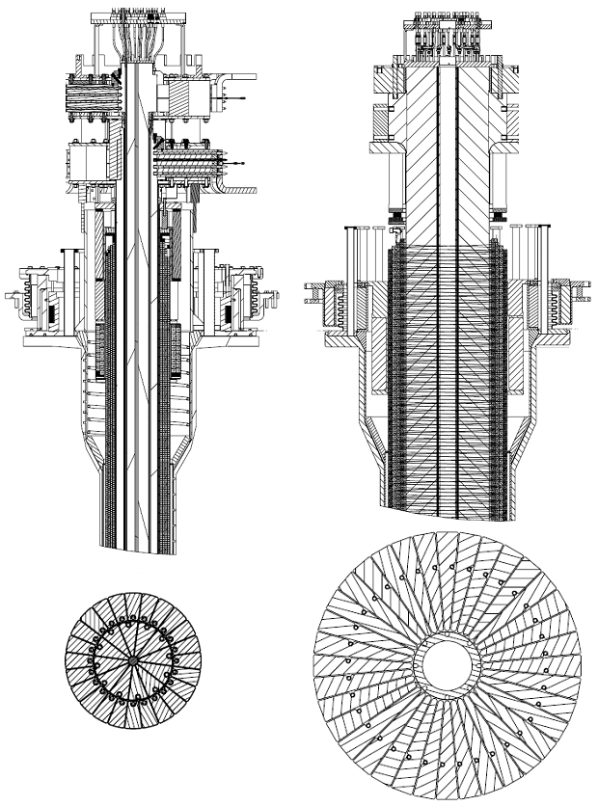
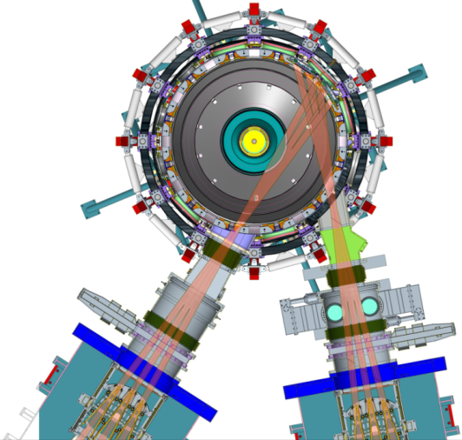
NSTX Upgrade will address critical plasma confinement and sustainment questions by exploiting 2 new capabilities
New center-stack
Reduces ν* → ST-FNSF values to understand ST confinement
  Expect 2x higher T by doubling B_{T}, I_{P}, and NBI heating power
  Provides 5x longer pulse-length
  q(r,t) profile equilibration
  Tests of NBI + BS non-inductive ramp-up and sustainment
TF OD = 20cm
TF OD = 40cm
Previous
center-stack
New
center-stack
New 2nd NBI
  2x higher CD efficiency from larger tangency radius R_{TAN}
100% non-inductive CD with q(r) profile controllable by:
  NBI tangency radius
  Plasma density
  Plasma position
Present NBI
New 2nd NBI

Slide 21
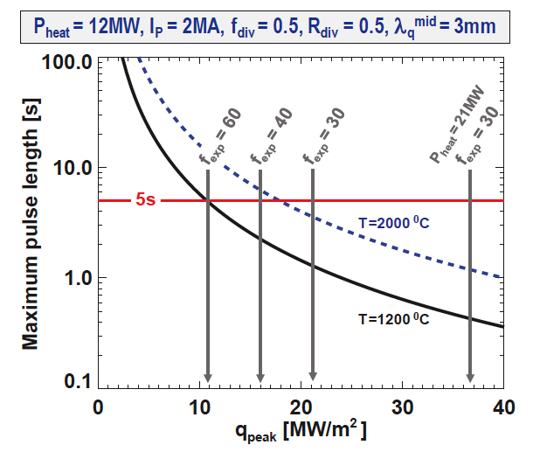
Divertor heat flux mitigation options are affected by NSTX-U plasma-facing component development plan
Developing PFC plan to transition to full metal coverage for FNSF-relevant PMI development
Wall conditioning: GDC, lithium and / or boron
PFC bake-out at 300-350ºC
Divertor impurity seeding:
  D₂, CD₄, Ne, Ar with graphite PFCs
  N₂ with molybdenum PFCs
C
BN
C
BN
C
BN
BN
Mo
Mo
Mo
Mo
Mo
W
Baseline
Upper
Mo divertor
All
Mo divertor
All Mo tiles
All Mo PFCs
Mo wall
+ W divertor
High I_{P} = 2 MA scenarios projected to have narrow λ_{q}^{mid} ~ 3mm
Scenarios with high I_{p} and P_{NBI} are projected to challenge passive cooling limits of graphite divertor PFCs
R. Maingi (ORNL)

Slide 22
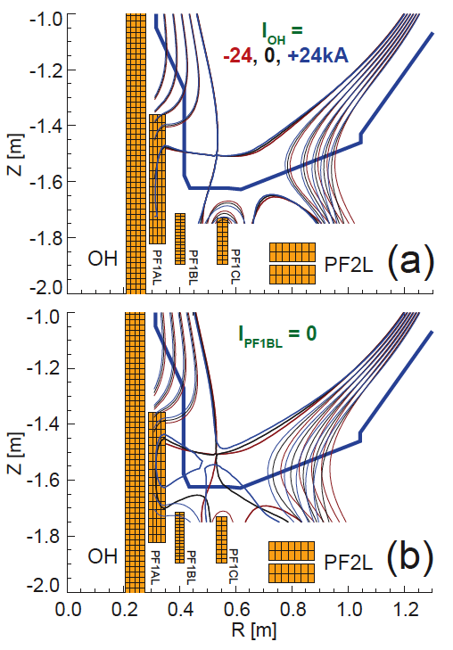
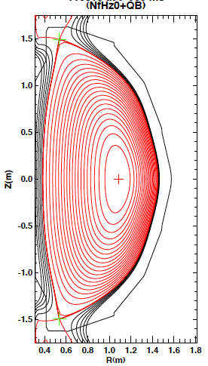
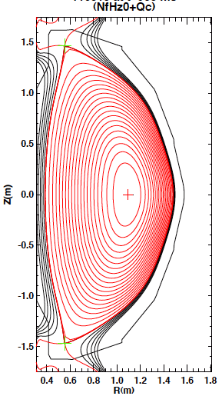
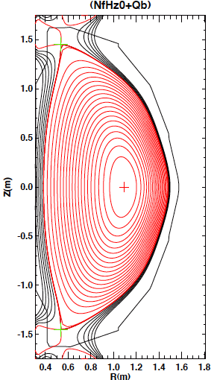
Snowflake divertor is a leading heat flux mitigation candidate for NSTX-U
Single and double-null radiative divertors and upper-lower snowflake configurations considered
  Supported by NSTX-U divertor coils and compatible with coil current limits
  ISOLVER modeling shows many possible equilibria
    Impact of changing I_{OH} on snowflake minimal
    Reduced divertor coil set can be used for snowflakes
NSTX-U simulation
NSTX-U double-null
NSTX-U double-snowflake-plus
NSTX-U double-snowflake-minus

Slide 23
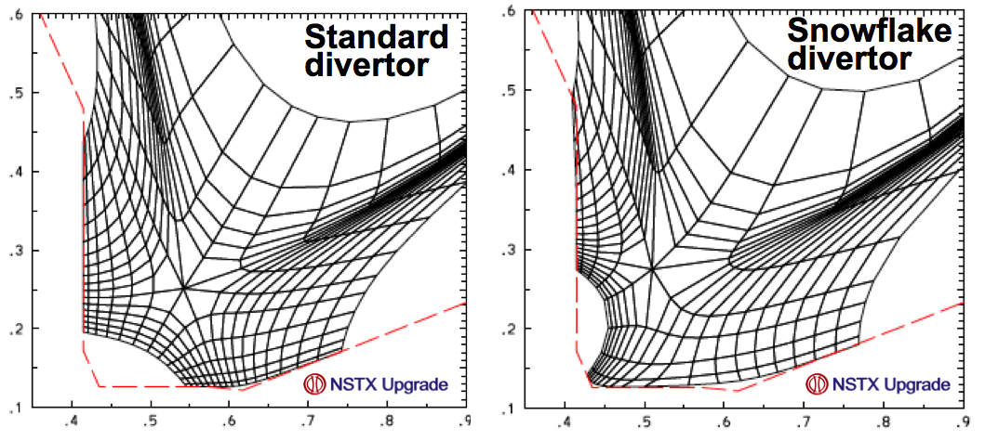
Projections with UEDGE edge multi-fluid model for NSTX-U are optimistic
Fluid (Braginskii) model for ions and electrons
Fluid for neutrals
Classical parallel transport, anomalous radial transport
Core interface:
  P_{SOL90} = 5; 7; 9 MW
D = 0.1-0.5 m²/s
χ_{e,i} = 1-2 m²/s
R_{recy} = 0.99
Carbon 5 %
Grids extend from psi=0.9 to psi=1.2
STD grid covers 3.1 cm outside the separatrix at the outer MP
SNF grid covers 3.4 cm outside the separatrix at the outer MP.

Slide 24
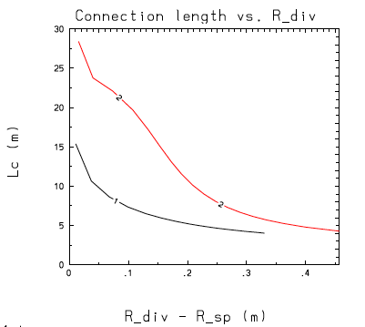
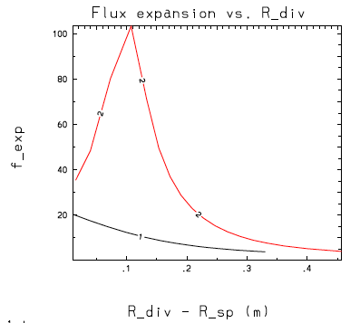
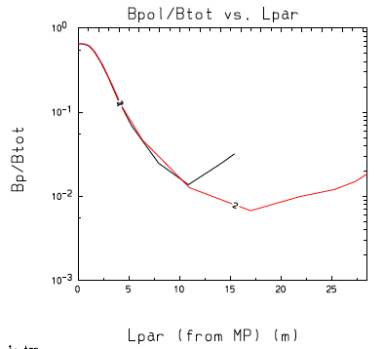
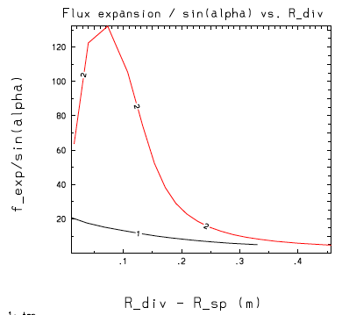
In modeled NSTX-U snowflake configuration magnetic geometry shows clear benefits (cf. standard divertor)

Slide 25
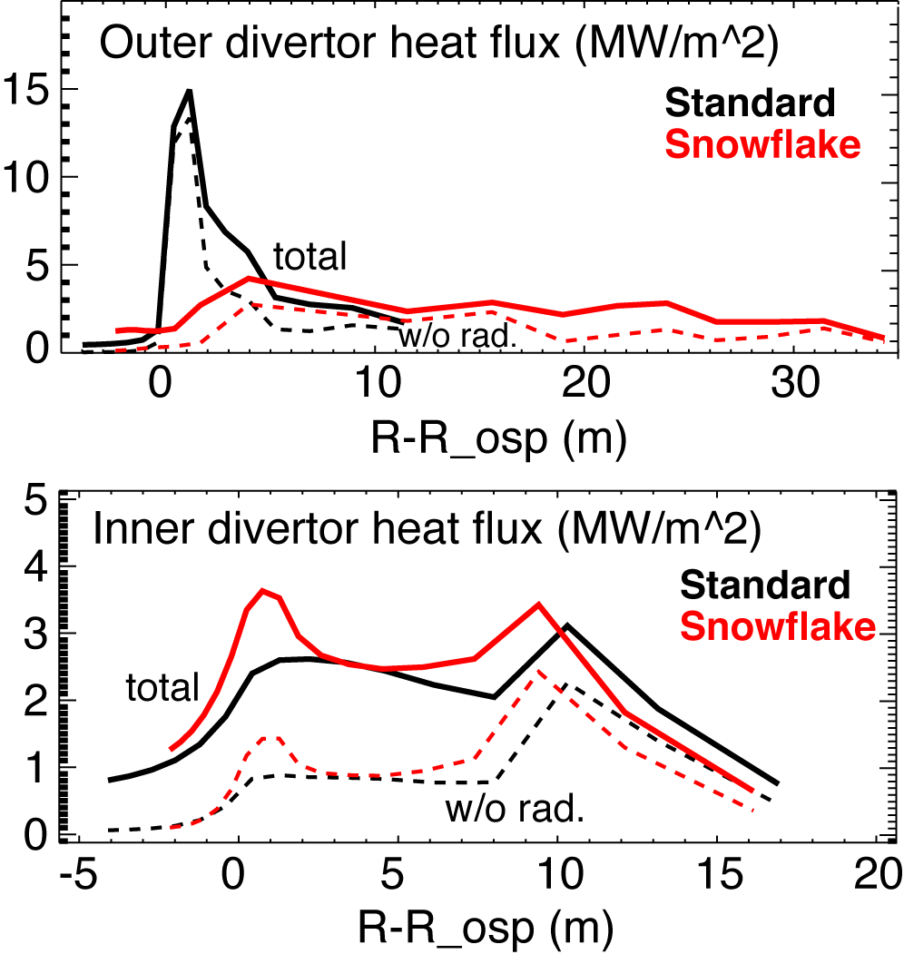
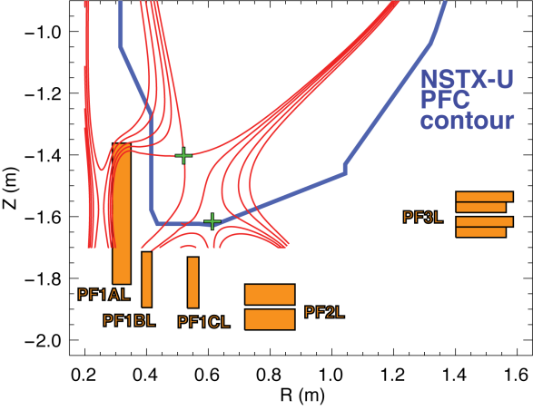
UEDGE predicts significant divertor heat flux reduction and attached conditions in NSTX-U at 12 MW NBI heating
Predictions for 12 MW NBI case
  P_{SOL}=9 MW
  Outer divertor attached
    T_{e}, T_{i} ≤ 80 eV
  Inner divertor detached
NSTX-U
snowflake
simulation

