Slide 1




NSTX-U
Supported by
Overview of Physics Results from the National Spherical Torus Experiment
S. A. Sabbagh
Columbia University
for the NSTX Research Team
Coll of Wm & Mary
Columbia U
CompX
General Atomics
FIU
INL
Johns Hopkins U
LANL
LLNL
Lodestar
MIT
Lehigh U
Nova Photonics
ORNL
PPPL
Princeton U
Purdue U
SNL
Think Tank, Inc.
UC Davis
UC Irvine
UCLA
UCSD
U Colorado
U Illinois
U Maryland
U Rochester
U Tennessee
U Tulsa
U Washington
U Wisconsin
X Science LLC
Culham Sci Ctr
York U
Chubu U
Fukui U
Hiroshima U
Hyogo U
Kyoto U
Kyushu U
Kyushu Tokai U
NIFS
Niigata U
U Tokyo
JAEA
Inst for Nucl Res, Kiev
Ioffe Inst
TRINITI
Chonbuk Natl U
NFRI
KAIST
POSTECH
Seoul Natl U
ASIPP
CIEMAT
FOM Inst DIFFER
ENEA, Frascati
CEA, Cadarache
IPP, Jülich
IPP, Garching
ASCR, Czech Rep
24th IAEA Energy Fusion Conference
October 9th, 2012
San Diego, California
V2.0

Slide 2
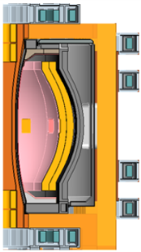
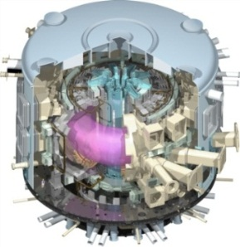
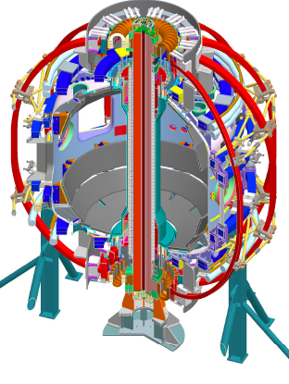
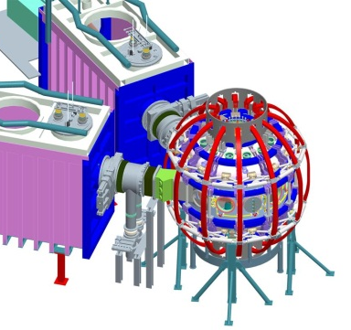
NSTX research targets predictive physics understanding needed for fusion energy development facilities
Enable devices: ST-FNSF, ST-Pilot/DEMO, ITER
  Leveraging unique ST plasmas provides new understanding for tokamaks, challenges theory
Fusion Nuclear Science Facility (FNSF)
ST Pilot Plant
Outline
Develop key physics understanding to be tested in unexplored, hotter ST plasmas
  Study high beta plasma transport and stability at reduced collisionality, for extended pulse
  Prototype methods to mitigate very high heat/particle flux
  Move toward fully non-inductive operation
ITER
NSTX-U
New center-stack
2nd neutral beam
3D effects are pervasive in this research
B_{T}
I_{p}
1 T
P_{NBI}
pulse
12 MW
2 MA
5 s

Slide 3
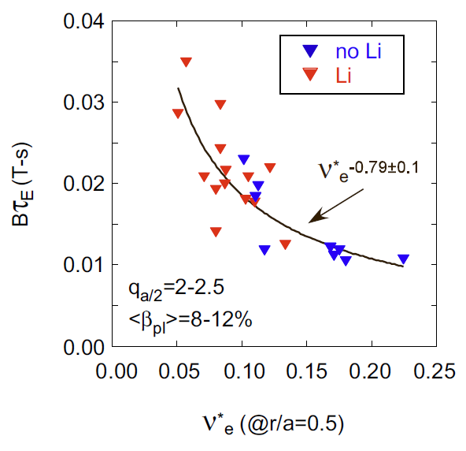
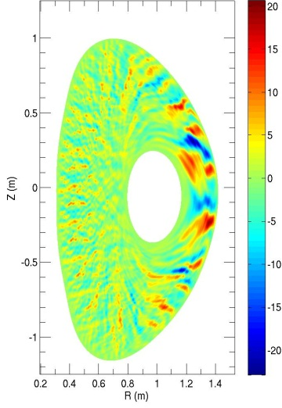
First successful nonlinear microtearing simulations for NSTX predict reduced electron heat transport at lower collisionality
Experiment
Theory
δB_{r} (Gauss)
experiment
B_{t}τ_{E} (T-s)
χ_{e}^{sim} ~ ν_{e}^{1.1}
120968
W. Guttenfelder, et al., PRL 106, 155004 (2011)
ν∗_{e} (at r/a = 0.5)
Predicted χ_{e} and scaling ~ ν_{e}^{1.1} consistent with experiment (Ωτ_{E} ~ B_{t}τ_{E} ~ ν*_{e}^{-0.8})
Transport dominated by magnetic “flutter”
  Significant δB_{r}/B ~ 0.1%
Increase in τ_{E} as ν∗_{e} decreases
Trend continues when lithium is used
Kaye EX/7-1
Guttenfelder TH/6-1
NSTX-U computed to extend studies down to < 1/4 of present ν∗

Slide 4
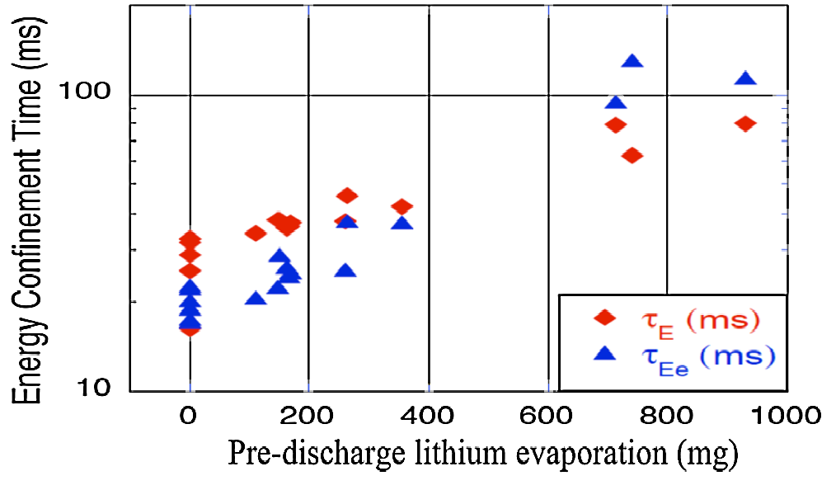
Plasma characteristics change nearly continuously with increasing lithium evaporation; reach kink/peeling limit
1.0
Bootstrap current profile
0.8
0.6
XGC0 model
0.4
Norm. surface avg. current
0.2
Sauter model
Energy Confinement Time (ms)
0.0
0.5
0.6
0.7
0.8
0.9
1.0
ψ_{N}
Pre-discharge lithium evaporation (mg)
R. Maingi, et al., PRL 107 (2011) 145004
Global parameters generally improve
ELM frequency declines - to zero
  ELMs stabilize
Edge transport declines
  As lithium evaporation increases, transport barrier widens, pedestal-top χ_{e} reduced
New bootstrap current calculation (XGC0 code) improves agreement with profile reaching kink/peeling limit
Maingi EX/11-2
Canik EX/P7-16
Chang TH/P4-12

Slide 5
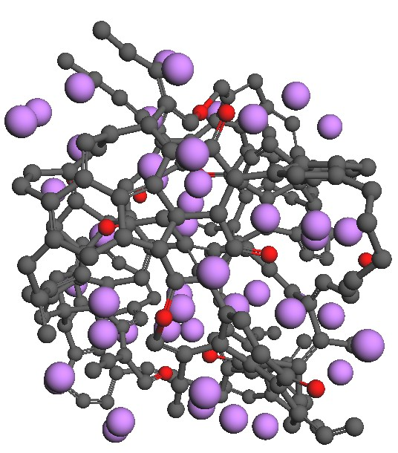
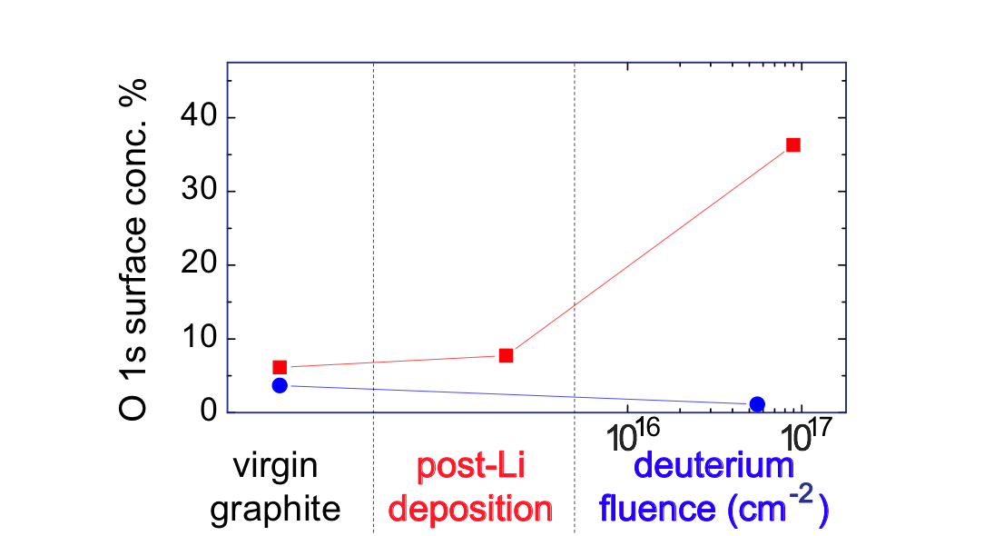
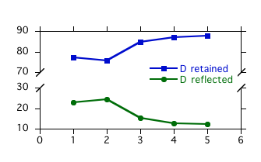
Simulations and lab results show importance of oxygen in lithium-graphite PMI for pumping deuterium
Quantum-classical atomistic simulations show surface oxygen plays key role in the retention of deuterium in graphite
D
%
O
Li
C
P. Krstic, sub. to Nature Comm.
Accordingly, lab results support that Li on graphite can pump D effectively due to O
  XPS measurements show 2 µm of Li increases surface oxygen content of lithiated graphite to ~10%
  deuterium ion irradiation of lithiated graphite greatly enhances oxygen content to 20%-40%
    In stark contrast, D irradiation of graphite without Li decreases amount of surface O
  Li acts as an O getter, and the O retains D
1 2 3 4 5
atomic composition
D⁺ bombarded Li-graphite
D⁺ bombarded graphite
Jaworski EX/P5-31
J.P. Allain, Taylor (Purdue U.)

Slide 6
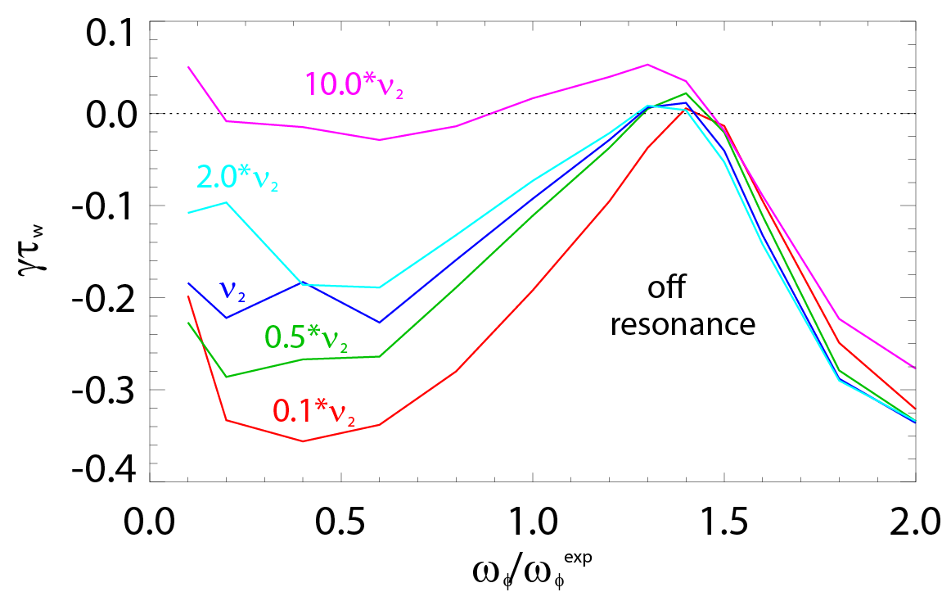
Experiments measuring global stability vs. ν further support kinetic RWM stability theory, provide guidance for NSTX-U
Theory: RWM growth rate vs. ν and ω_{φ}
Exp: Resonant Field Amplification (RFA) vs ν
unstable
off resonance
Marginal
stability
Collisionality
RWM growth rate (γτ_{w})
off-resonance
on resonance
on resonance
Plasma Rotation
MISK code
(trajectories of 20 experimental plasmas)
Two competing effects at lower ν
  Collisional dissipation reduced
  Stabilizing resonant kinetic effects enhanced (contrasts early theory)
Expectations at lower ν
  More stabilization near ω_{φ} resonances; almost no effect off-resonance
Mode stability directly measured in experiment using MHD spectroscopy
  Decreases with ν at lower RFA (“on resonance”)
  Independent of ν at higher RFA (“off resonance”)
B_{plasma}
RFA =
J. Berkery et al., PRL 106 (2011) 075004
B_{applied}
Berkery EX/P8-07

Slide 7
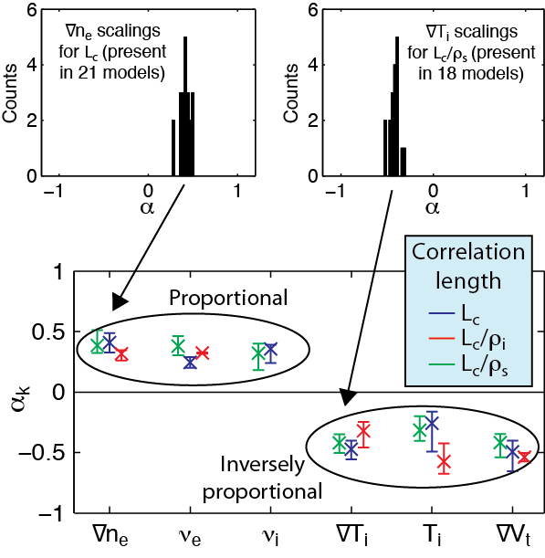
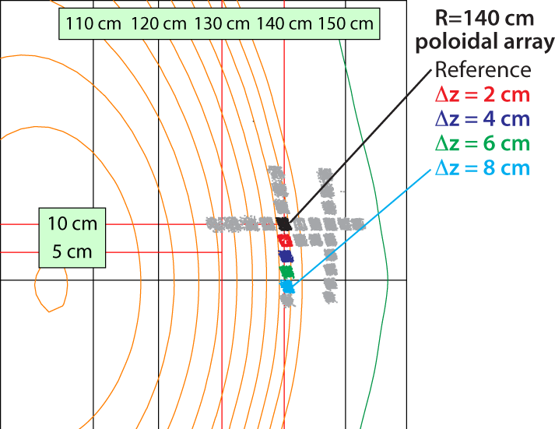
BES measured low-k turbulence in ELM-free H-mode pedestal steep gradient region is most consistent with TEMs
Beam emission spectroscopy (BES) array
Poloidal Correlation Length vs. Parameters
Z
R
Multivariate linear scaling coefficients α_{k}
Turbulence measurements in the steep gradient of the pedestal
  Most consistent with Trapped Electron Modes
  Partially consistent with KBM and μ-Tearing Modes
  Least consistent with ITG Modes
Measurements during MHD quiet periods, in steep gradient region
Large poloidal correlation lengths
  k_{θ} ≈ 0.2-0.4 cm⁻¹ and k_{θ}ρ_{i} ≈ 0.2
Smith EX/P7-18

Slide 8
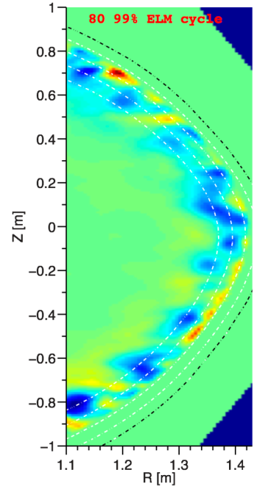

Pedestal width scaling differs from tokamaks; turbulence correlation measurements consistent with theory
Pedestal width scaling
Turbulence correlation lengths
0.16
  (During inter-ELM period, at pedestal top)
NSTX
Theory
(non-linear XGC1 code)
0.4 (β_{θ}^{ped})
^{1.05}
3 cm | 2 – 4 cm (reflecto-metery)
11 cm | 10 – 14 cm (BES)
0.12
Experiment
Pedestal width (ψ_{N})
C-Mod
0.08
radial
DIII-D
0.04
poloidal
~ 0.08 (β_{θ}^{ped})
^{0.5}
0.00
R = 1.38m
80% - 99% ELM cycle
0.1
0.3
0.5
0.7
0.9
139047
Pedestal width scaling β_{θ}^{α} applies to multiple machines
In NSTX, observed ped. width is larger
  e.g., 2.4 x DIII-D
  Data indicates stronger scaling: β_{θ} vs. β_{θ}^{0.5}
Measured correlation lengths at pedestal top are consistent with theory
  BES and reflectometry
    spatial structure exhibits ion-scale microturbulence (k⊥ρ_{i} ~ 0.2 - 0.7)
    Compatible with ITG modes and/or KBM
Diallo EX/P4-04
A. Diallo, C.S. Chang, S. Ku (PPPL), D. Smith (UW), S. Kubota (UCLA)
8
8
Notes:
8
8

Slide 9
Stability control improvements significantly reduce unstable RWMs at low l_{i} and high β_{N}; improved stability at high β_{N}/l_{i}
Resonant Field Amplification (RFA) vs. β_{N}/l_{i}
unstable
mode
Unstable RWM
Stable / controlled RWM
Mode stability directly measured in experiments using MHD spectroscopy
  Stability decreases up to β_{N}/l_{i} = 10
  Stability increases at higher β_{N}/l_{i}
  Presently analysis indicates consistency with kinetic resonance stabilization
Disruption probability reduced by a factor of 3 on controlled experiments
  Reached 2 times computed n = 1 no-wall limit of β_{N}/l_{i} = 6.7
Lower probability of unstable RWMs at high β_{N}/l_{i}
S.A. Sabbagh
Berkery EX/P8-07

Slide 10
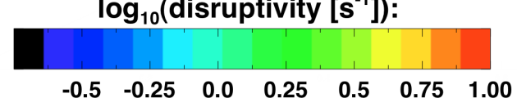

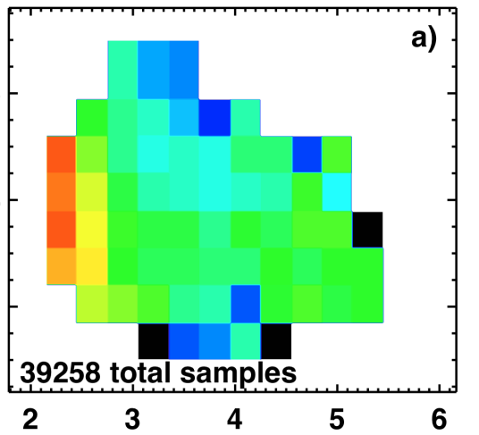
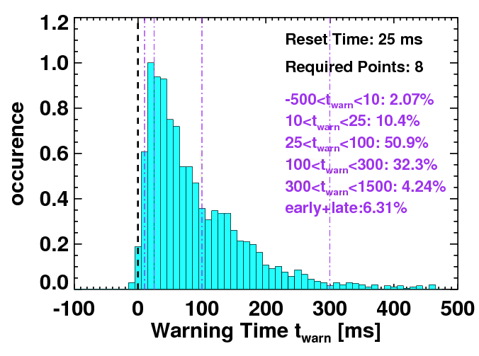
Disruptivity Studies and Warning Analysis of NSTX database are Being Conducted for Disruption Avoidance in NSTX-U
Disruptivity
Warning Algorithms
Disruption warning algorithm shows high probability of success
  Based on combinations of single threshold based tests
β_{N}
l_{i}
q*
All discharges since 2006
Physics results
  Low disruptivity at relatively high β_{N} ~ 6; β_{N} / β_{N}^{no-wall(n=1)} ~ 1.3-1.5
    Consistent with specific disruption control experiments, RFA analysis
  Strong disruptivity increase for q* < 2.5
  Strong disruptivity increase for very low rotation
Results
  ~ 98% disruptions flagged with at least 10ms warning, ~ 6% false positives
  False positive count dominated by near-disruptive events
Gerhardt EX/9-3

Slide 11
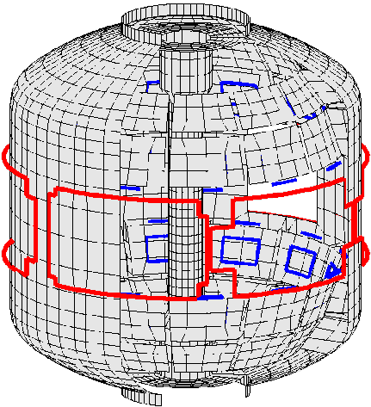
Improved stability control includes dual field component feedback and state space feedback, improved by 3D effects
1
Active n = 1 B_{p} + B_{R} feedback (FB) control
Calculation of B_{r} + B_{p} control (VALEN)
6
Feedback on
140124
140125
140126
140127
2.8
β_{N}
0 deg FB phase
4
2.7
2
B_{r} FB phase = 225º
0
2.6
B_{r}^{n = 1} (G)
Radial field n = 1 (G)
90 deg FB phase
6
B_{r} FB phase = 180º
2.5
4
Vacuum error field
2
2.4
180 deg FB phase
+ RFA
0
Vacuum error field
0.0
0.2
0.4
0.6
0.8
1.0
1.2
1.4
2.3
B_{r} FB phase = 0º
B_{r} FB phase = 90º
t (s)
0.0
0.04
0.08
0.12
Δt (s) (model)
2
RWM State Space Controller
No NBI port
With 3D NBI port
3D wall,
ports,
mode currents
Measurement
Measurement
Sensor Differences (G)
Controller
Controller
Inclusion of 3D mode and wall detail improves control
S.A. Sabbagh, O. Katsuro-Hopkins, J.M. Bialek, S.P. Gerhardt

Slide 12
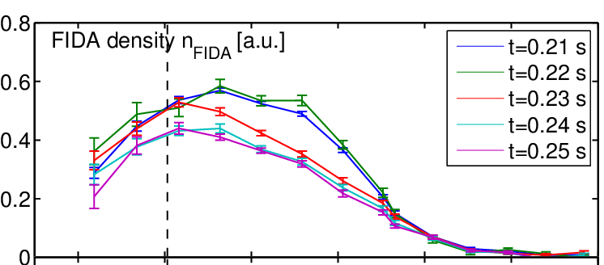
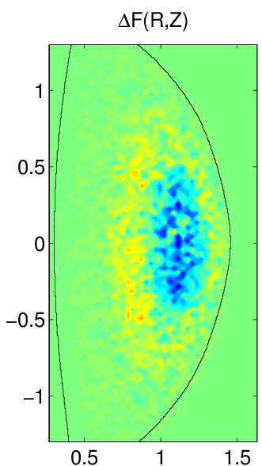
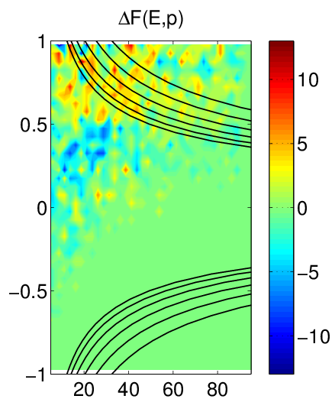
Fast ion redistribution associated with low frequency MHD measured by fast ion D_{α} (FIDA) diagnostic
Caused by n = 1 global kink instabilities
Redistribution can affect stability of *AE, RWMs, other MHD
Full-orbit code (SPIRAL) shows redistribution in real and velocity space
  Radial redistribution from core plasma
  Particles shift towards V||/V = 1
Applied 3D fields alter GAE stability
  By altered fast ion distribution (SPIRAL)
Fast ion density reduction
0.9
1.0
1.1
1.2
1.3
1.4
1.5
R(m)
Change in distribution due to kink mode
SPIRAL code
Fast ion energy redistribution accounts for neutron rate decrease in H-mode TAE avalanches
Core localized CAE/GAEs measured in H-mode plasmas (reflectometer)
Z [m]
V||\V
CAE resonances
Fredrickson EX/P6-05
R [m]
Energy [keV]
Crocker EX/P6-02
A. Bortolon

Slide 13
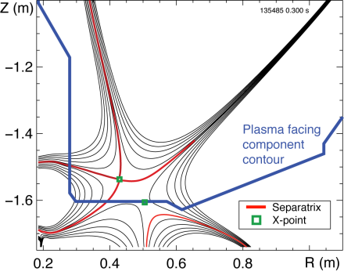
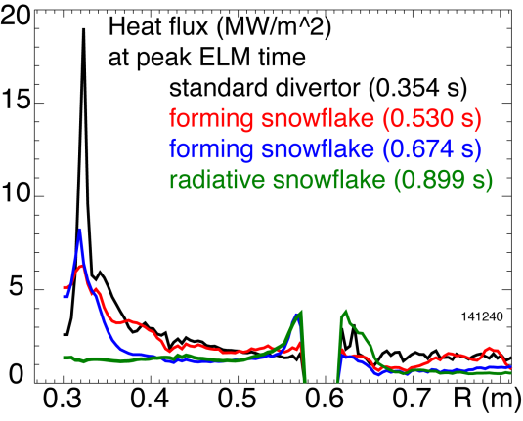
Snowflake divertor experiments provide basis for required divertor heat flux mitigation in NSTX-U
Snowflake divertor in NSTX
Needed, as divertor heat flux width strongly decreases as I_{p} increases
Snowflake divertor experiments (P_{NBI} = 4 MW, P_{SOL} = 3 MW)
  Good H-mode τ_{E}, β_{N}, sustained during snowflake operation
  Divertor heat flux significantly reduced both during and between ELMs
    during ELMs: 19 to ~ 1.5 MW/m²
    steady-state: 5-7 to ~ 1 MW/m²
  Achieved by a synergistic combination of detachment + radiative snowflake divertor
Z (m)
R (m)
Heat flux at peak ELM time
Divertor heat flux (MW/m²)
CHI gap
Soukhanovskii EX/P5-21
R (m)

Slide 14
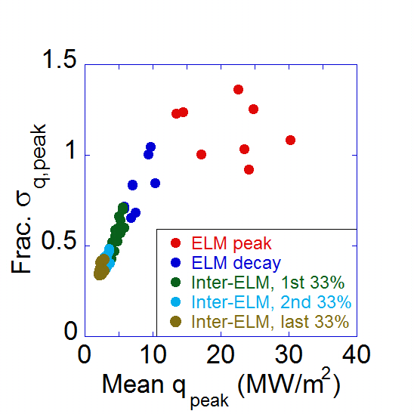
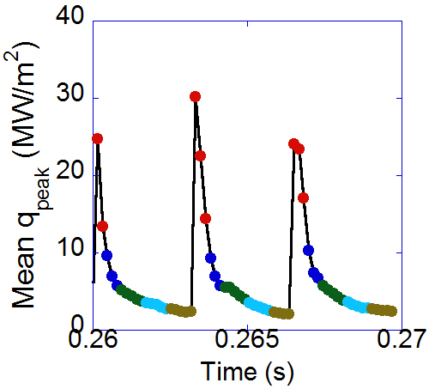
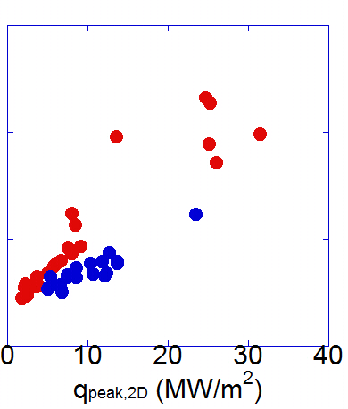
Toroidal asymmetry of heat deposition measured during standard ELMs, but decreases for 3D field-triggered ELMs
Toroidal Degree of Asymmetry vs. q_{peak}
Mean Peak 2D Heat Flux
During ELMs vs. t
No 3D fields
Reduction with 3D fields
132438
Type-I ELMs
Standard ELMs
q_{peak,2D} (MW/m²)
DoA(q_{peak})
n=3 triggered
at ELM peak times
,2D
2D fast IR camera measurement (1.6kHz), heat flux from TACO code
Toroidal asymmetry
  Becomes largest at the peak heat flux for usual Type-I ELMs
  Reduced by up to 50% in ELMs triggered by n = 3 applied fields
Ahn EX/P5-33

Slide 15

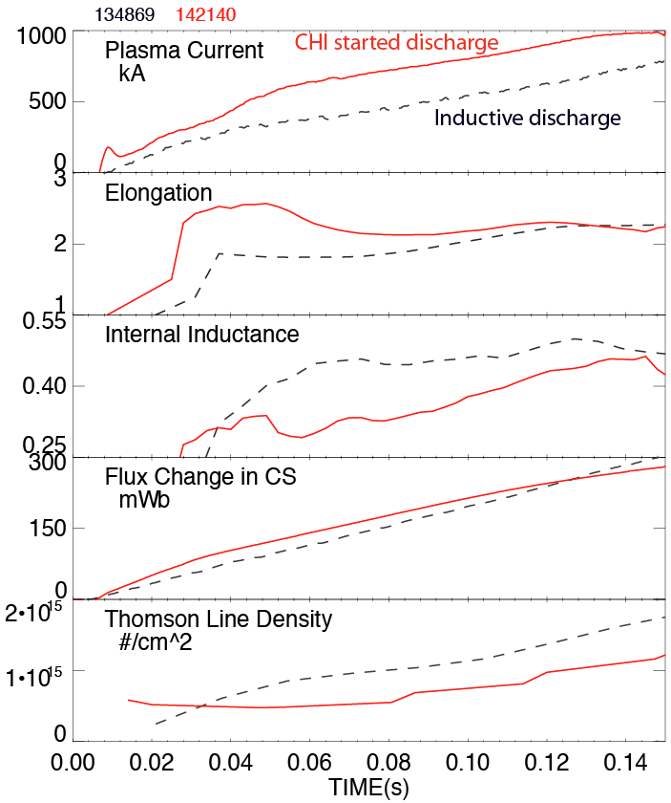
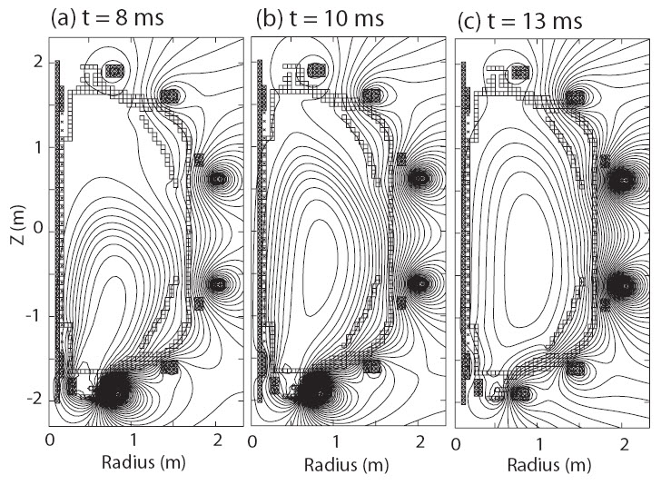
L-mode discharge ramping to 1MA requires 35% less inductive flux when coaxial helicity injection (CHI) is used
CHI assisted startup in NSTX
TSC simulation of CHI startup
High elongation
Low inductance
CHI generates plasmas with high elongation, low l_{i} and n_{e}
TSC now used for full discharge modeling to 1MA
  CHI start-up + NBI current ramp-up
Results imply a doubling of closed flux current > 400kA in NSTX-U
Low density
Raman EX/P2-10

Slide 16
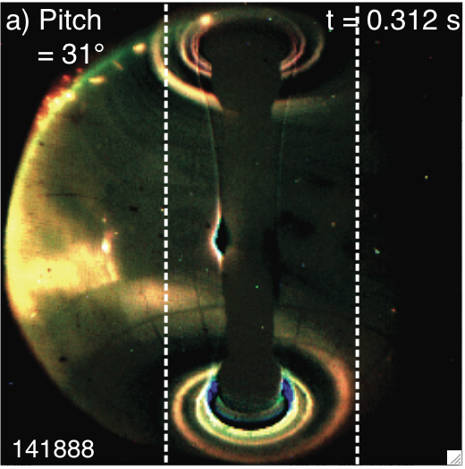
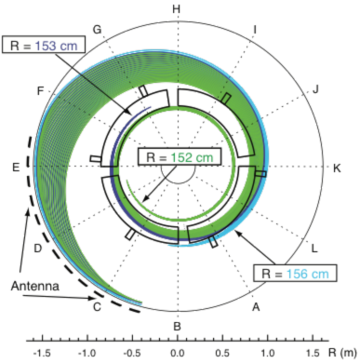
Significant fraction of the HHFW power lost in the SOL in front of antenna, flows to the divertor region
Visible camera image of edge RF power flow to divertor
SPIRAL modeling of field lines from antenna to divertor
Top View
Divertor
HHFW
Antenna
Divertor
HHFW
Antenna
-1.0
0.0
1.0
R(m)
RF power couples to field lines across entire SOL width, not just to field lines connected to antenna components
Shows importance of quantitatively understanding RF power coupling to the SOL for prediction to future devices
R. Perkins, et al., PRL 109 (2012) 045001
Perkins EX/P5-40

Slide 17
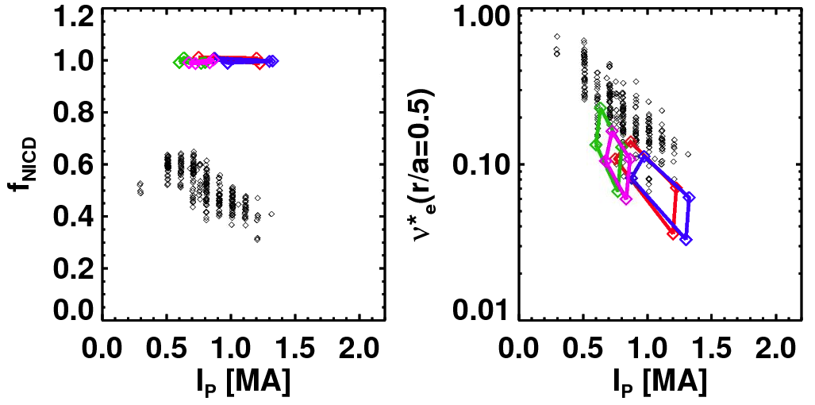
Non-inductive current fractions of up to 65% sustained in NSTX, >70% transiently; Upgrade projected to achieve 100%
NSTX-U projections
NSTX Results
NSTX Results
Total Non-inductive Fraction
B_{T}=0.75 T
B_{T}=1 T
via high harmonic FW
B_{T}=0.75 T
NSTX-U
(100% NI)
B_{T}=1 T
(ranges created by profile peakedness, τ_{E} scalings, etc.)
I_{p} (MA)
Maximum sustained non-inductive fractions of 65% w/NBI at I_{P} = 0.7 MA
100% non-inductive scenarios found over wide operation range
  Scenarios at 74% Greenwald density
70- 100% non-inductive reached transiently using HHFW CD
G. Taylor (Phys. Plasmas 19 (2012) 042501)
Menard FTP/3-4
S. Gerhardt, et al., Nucl. Fusion 51 (2011) 073031

Slide 18
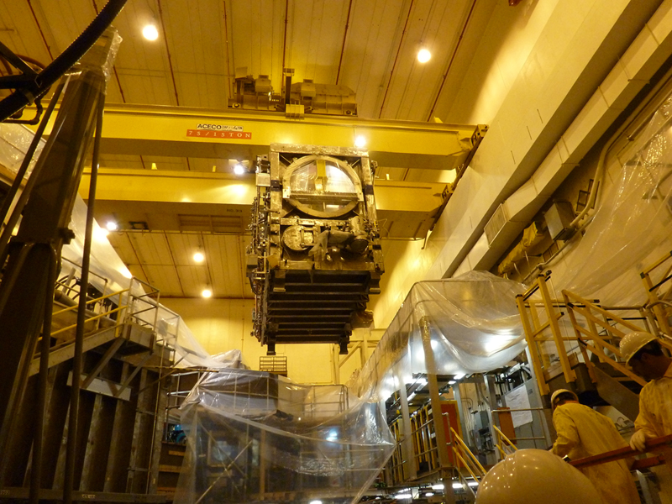
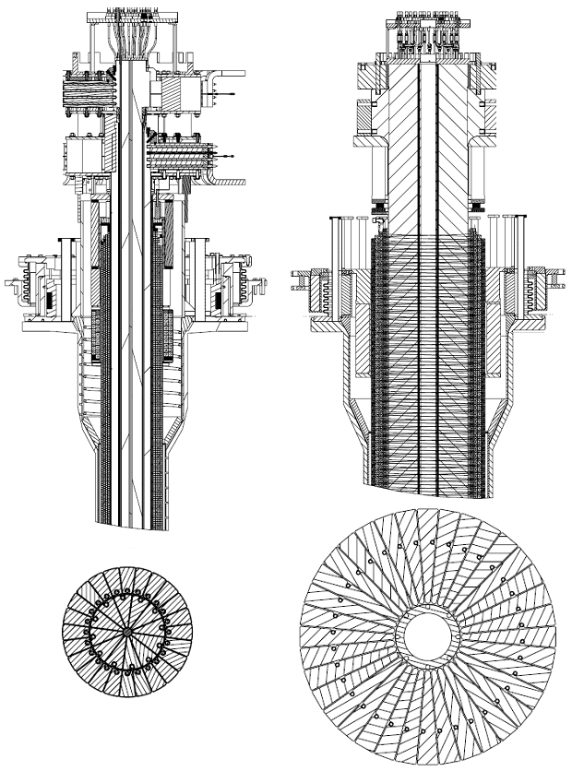
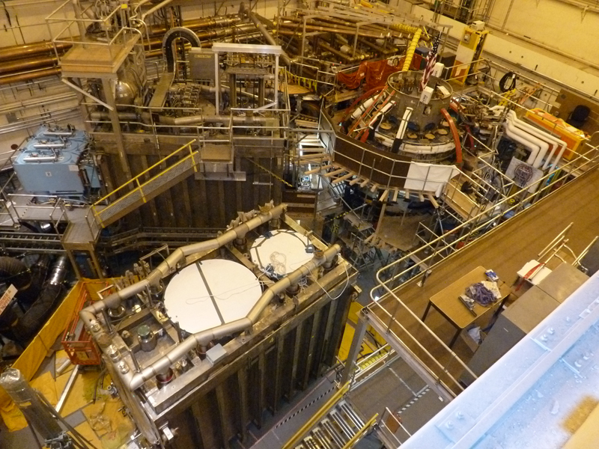
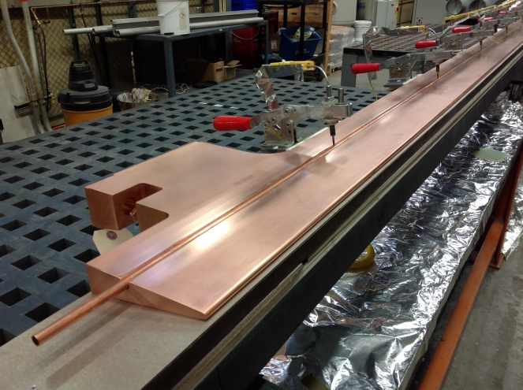
Rapid Progress is Being Made on NSTX Upgrade
Old center stack
NEW Center Stack
TF OD = 20cm
TF OD = 40cm
2nd neutral beam moved into place
TF conductors being made
(first plasma anticipated June 2014)
Menard FTP/3-4

Slide 19
Continuing analysis of NSTX data targets a predictive physics understanding required for future fusion devices
Transport and stability at reduced collisionality
  τ_{E} scalings unified by collisionality; non-linear microtearing simulations match experimental χ_{e}, predict lower χ_{e} at lower ν_{e}* shown in experiment
  Nearly continuous increase of favorable confinement with increased lithium
  Stabilizing kinetic RWM effects enhanced at lower ν when near resonances
Pedestal
  Width scaling stronger than usual (β_{p}^{ped})^{0.5}; measured δn_{e} correlation lengths consistent w/non-linear gyrokinetics at pedestal top
Pulse sustainment / disruption avoidance
  Global stability increased + low disruptivity at high β_{N}/l_{i}, advanced mode control
  Disruption detection algorithm shows high (98%) success rate
Power/particle handling and first wall
  Large heat flux reduction from synergistic combination of radiative snowflake divertor + detachment, both during, and between ELMs
Significant upgrade underway (NSTX-U)
  Doubled B_{T}, I_{p}, NBI power; 5x pulse length, projected 100% non-inductive sustainment over broad operating range

Slide 20
NSTX Presentations at the 2012 IAEA FEC
Talks
Posters
Tuesday
Lithium program | Ono | FTP/P1-14
Co-axial helicity injection | Raman | EX/P2-10
Wednesday
Bootstrap current XGC | Chang | TH/P4-12
Pedestal transport | Diallo | EX/P4-04
Power scrape-off width | Goldston | TH/P4-19
Vertical stability at low A | Kolemen | EX/P4-28
Blob dynamics / edge V shear | Myra | TH/P4-23
EHOs | Park | EX/P4-33
Core lithium levels | Podesta | EX/P3-02
C, Li impurity transport | Scotti | EX/P3-34
Snowflake divertor theory | Ryutov | TH/P4-18
Thursday
Divertor heat asymmetry | Ahn | EX/P5-33
L-H power threshold vs. X pt. | Battaglia | EX/P5-28
NBI-driven GAE simulations | Belova | TH/P6-16
CAE/GAE structure | Crocker | EX/P6-02
TAE avalanches in H-mode | Fredrickson | EX/P6-05
Li deposition / power exhaust | Gray | EX/P5-27
Liquid lithium divertor results | Jaworski | EX/P5-31
RF power flow in SOL | Perkins | EX/P5-40
Snowflake divertor | Soukhanovksii | EX/P5-21
Friday
Global mode control / physics | Berkery | EX/P8-07
Edge transport with Li PFCs | Canik | EX/P7-16
Particle code NTV simulation | Kim | TH/P2-27
Turbulence near OH L-H trans. | Kubota | EX/P7-21
ELM triggering by Li in EAST | Mansfield | PD
Electron-scale turbulence | Ren | EX/P7-02
Low-k turbulence vs. params. | Smith | EX/P7-18
Thursday
Progress in Simulating Turbulent Electron Thermal Transport in NSTX | Guttenfelder | TH/6-1
The Dependence of H-mode Energy Confinement and Transport on Collisionality in NSTX | Kaye | EX/7-1
Friday
Disruptions in the High Beta Spherical Torus NSTX | Gerhardt | EX/9-3
Progress on Developing the Spherical Tokamak for Fusion Applications | Menard | FTP/3-4
The Nearly Continuous Improvement of Discharge Characteristics and Edge Stability with Increasing Lithium Coatings in NSTX | Maingi | EX/11-2

Slide 21
Tasks to Complete for this Presentation
Additions
  Add bullet on L-H power threshold – REF Battaglia talk EX/P5-28
Tasks
  Shorten talk to 18 slides
  Poster up to 24 slides

Slide 22
Extra slides for poster follow

Slide 23
Supporting slides follow

Slide 24
Plasma characteristics change nearly continuously with increasing lithium evaporation inside vessel
Measured density fluctuation vs. k⊥ρ_{s}
Outer plasma
R = 1.4 - 1.46 m
(r/a = 0.74 – 0.95)
Without Li
Energy Confinement Time (ms)
(δn/n)² (arb)
With Li
Pre-discharge lithium evaporation (mg)
141314
141328
Global parameters generally improve
ELM frequency declines - to zero
  ELMs stabilize
Edge transport declines
  As lithium evaporation increases, transport barrier widens, pedestal-top χ_{e} reduced
k⊥ρ_{s}
Measured reduction in high-k turbulence consistent with reduced χ_{e}
Impact of collisionality and ∇n on turbulence is under investigation
  B_{t}τ_{E} ~ ν_{e}*^{-0.8} observed
Maingi EX/11-2
Canik EX/11-2
Ren EX/P7-02

Slide 25
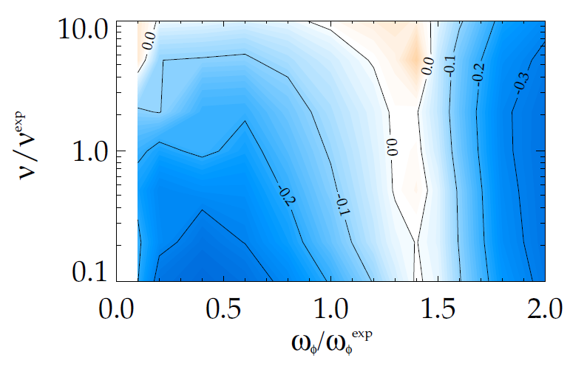
Kinetic RWM stability theory further tested against NSTX experiments, provides guidance for NSTX-U
RWM stability vs. ω_{φ}
MISK code
RWM growth rate contours (γτ_{w})
Marginal
Stability
unstable
NSTX
NSTX-U
Collisionality
Plasma Rotation
Two competing effects at lower ν
  Collisional dissipation reduced
  Stabilizing resonant kinetic effects enhanced (contrasts early theory)
Expectations at lower ν
  More stabilization near ω_{φ} resonances; almost no effect off-resonance
    Active RWM control important
Improvements to physics model
  Anisotropy effects
  Testing terms thought small
    Already good agreement between theory and experiment of marginal stability point improved
J. Berkery et al., PRL 106, 075004 (2011)
Berkery EX/P8-07

Slide 26
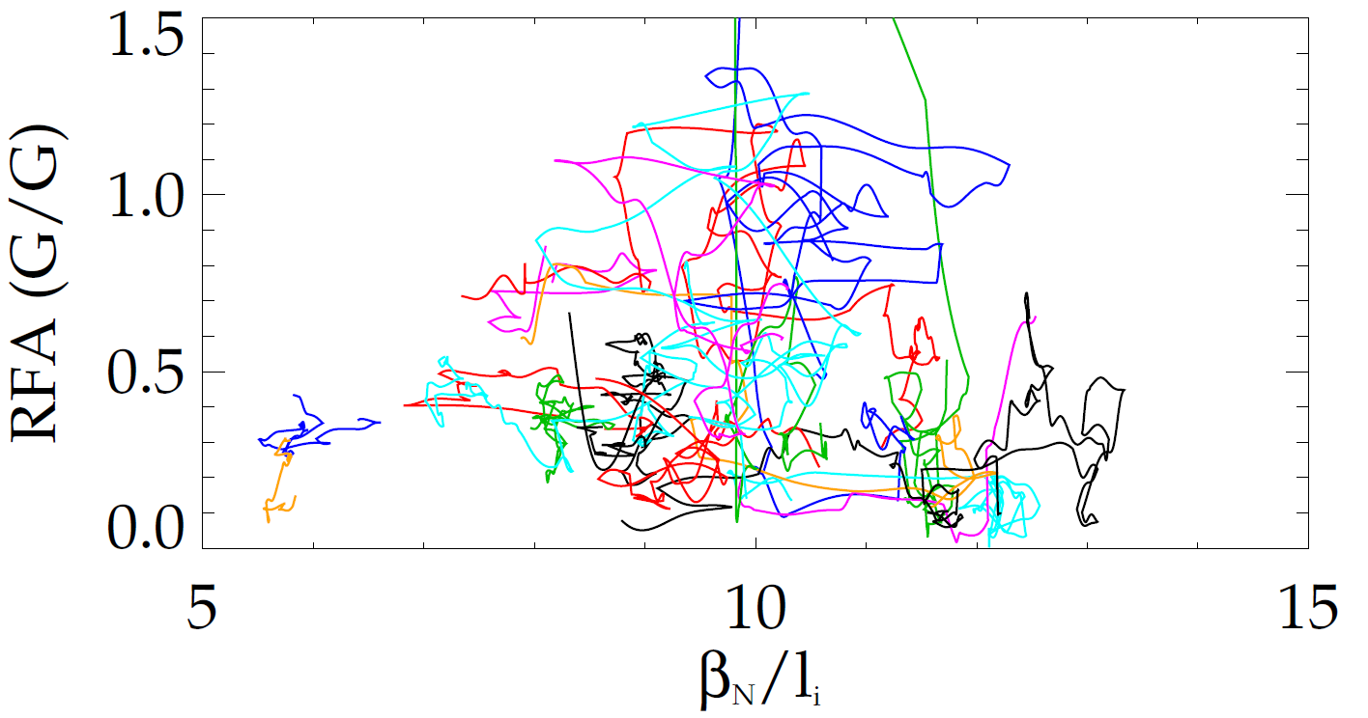
Experiments using MHD spectroscopy show that highest β_{N}/l_{i} plasmas are not the least stable
unstable RWMs
B_{plasma}
RFA =
1.5
B_{applied}
NSTX
Low frequency (40Hz) rotating n = 1 applied field used as seed field
n = 1 resonant field amplification (RFA) of seed field used to measure global mode growth rate in stable plasmas
  Higher amplitude = less stability
1.0
n = 1 RFA (G/G)
0.5
0.0
5
10
β_{N}/l_{i}
15
J.W. Berkery, S.A. Sabbagh
Discharges with β_{N}/l_{i} > 10 have greater stability
  Presently thought to be due to differing plasma rotation profile
Berkery EX/P8-07

Slide 27
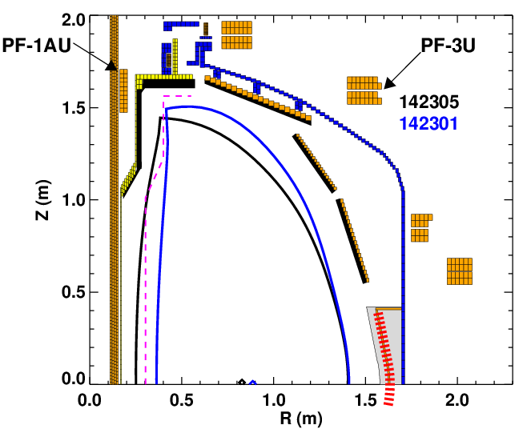
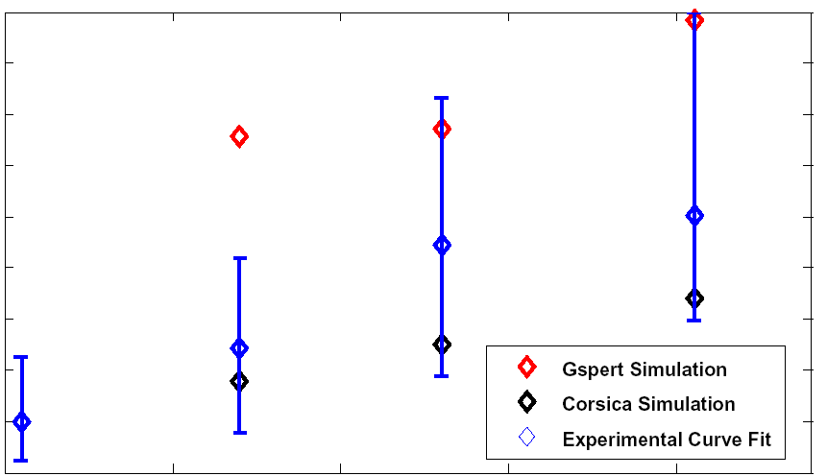
Higher aspect ratio of NSTX-U tested in NSTX, vertical stability growth rate data obtained, compared to simulation
Vertical Stability Growth Rates vs. A
5
4
3
2
1
GSPERT
Corsica
Experiment
γ/γ₀
1.5 1.55 1.6 1.65
Aspect Ratio
NSTX-U
PFC Boundary
Improvements to vertical control capability and understanding
  Begun to compare measured growth rates to theoretical predictions (Corsica, GSPERT)
  Improved plasma position observer
  Modeled use of RWM coils for n=0 control
NSTX Discharges have matched aspect ratio and elongation of NSTX-U without performance degradation
Kolemen EX/P4-28

Slide 28
Single summary slides follows
NOTE: The single summary slide is not an adequate summary

Slide 29

OV/3-1: NSTX research targets needed predictive physics understanding crucial for fusion energy development
Enable devices: ST-FNSF, ST-Pilot/DEMO, ITER
  Leveraging unique ST plasmas provides new understanding for tokamaks, challenges theory
Highlights
Fusion Nuclear Science Facility (FNSF)
ITER
Transport, stability at reduced collisionality
  τ_{E} scalings unified by collisionality; microtearing code matches XP χ_{e}, predicts lower χ_{e} at lower ν_{e}*
  Stabilizing kinetic RWM effects enhanced
Pedestal
  Width scaling stronger than usual (β_{p}^{ped})^{0.5}; measured δn_{e} correl. lengths agree w/non-linear gyrokinetics
Pulse sustainment / disruption avoidance
  Global stability increased + low disruptivity at high β_{N}
Power/particle handling and first wall
  Radiative snowflake divertor mitigates high heat flux both between & during ELMs, Li wall cond. effects
Significant upgrade underway (NSTX-U)
  Doubled B_{T}, I_{p}, NBI power, non-inductive sustainment
τ_{e} vs. collisionality
kink-induced fast ion redistribution
disruption
warning analysis
non-inductive
scenarios

Slide 30
Breakdown of Topics in Talk
Should have 18 slides total (17 plus 1 reference to other talks)
Advanced Scenarios and Control 2 slides
Boundary Physics / Pedestal 1 slides
Lithium Research 2 slides
Macroscopic Stability 4 slides
Solenoid-free Start-up / Ramp-up 1 slides
Transport and Turbulence 3 slides
Waves and Energetic Particles 1 slides
Title, intro, summary, reference 4 slides
Total 18 slides

Slide 31
NSTX Overview presentation and papers – preparation IAEA FEC 2012 (discussion on 8/13/12)
Presentation length
  Past talks: average of 13.5 slides in 17 minutes (0.8/min), suggests:
  Overview: 17 slides in 21 minutes (+ 4 minutes for questions)
Presentation status / needs (thanks for material sent so far!)
  Working from NSTX PAC talk (approximately same length)
  Will update with most recent analysis from NSTX Team
Papers
  12 page proceedings paper
  Longer Nuclear Fusion paper
Paper Preparation
  Most contributors sent slides, not text – please send text/references !
  Some text available from EPS 2012 presentations, but not all topics are covered
  Will send further requests for input / seek out new results
V1.0

Slide 32
Alternate slides follow

Slide 33
NSTX research targets predictive physics understanding needed for fusion energy development facilities
Enable key ST applications
  Move toward steady-state ST FNSF, pilot plant
  Close key gaps to DEMO
Extend understanding to tokamak / ITER
  Leverage ST to test theory, develop predictive capability
Fusion Nuclear Science Facility (FNSF)
ST Pilot Plant
Outline
ITER
Develop key physics understanding to be tested in unexplored, hotter ST plasmas
  Study high beta plasma transport and stability at reduced collisionality, extended pulse
  Prototype methods to mitigate very high heat/particle flux
  Move toward fully non-inductive operation
NSTX-U
New center-stack
2nd Neutral Beam
B_{T}
I_{p}
1 T
P_{NBI}
pulse
12 MW
3D effects are pervasive in this research
2 MA
5 s

Slide 34
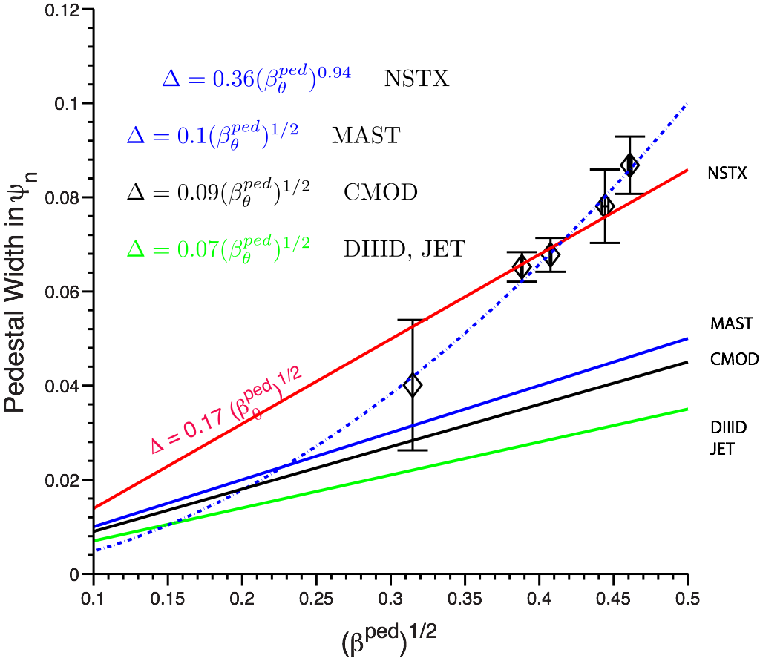
Pedestal scaling, structure, and dynamics studied theoretically and experimentally
Pedestal width scaling
Turbulence correlation lengths
  (During inter-ELM period, at pedestal top)
Theory
(non-linear XGC1 code)
3 cm | 2 – 4 cm (reflecto-metery)
11 cm | 10 – 14 cm (BES)
Experiment
MAST
radial
C-Mod
DIII-D
JET
poloidal
R = 1.38m
80% - 99% ELM cycle
139047
Pedestal width scaling β_{θ}^{α} applies to multiple machines
In NSTX, observed ped. width is larger
  1.7 x MAST, 2.4 x DIII-D
  Data indicates stronger for NSTX: β_{θ}^{0.94} vs. β_{θ}^{0.5}
Measured correlation lengths at pedestal top are consistent with theory
  BES and reflectometry
    spatial structure exhibits ion-scale microturbulence (k⊥ρ_{i} ~ 0.2 - 0.7)
    Compatible with ITG and/or KBM
Diallo EX/P4-04
A. Diallo, C.S. Chang, S. Ku (PPPL), D. Smith (UW), S. Kubota (UCLA)
34
34
Notes:
34
34

Slide 35
Experiments measuring global stability vs. ν further support kinetic RWM stability theory, provide guidance for NSTX-U
Theory: RWM growth rate contours (γτ_{w})
Exp: Resonant Field Amplification (RFA) vs ν
“off resonance”
Marginal
Stability
unstable
NSTX
NSTX-U
“on resonance”
Collisionality
Plasma Rotation
MISK code
(trajectories of 20 experimental plasmas)
Two competing effects at lower ν
  Collisional dissipation reduced
  Stabilizing resonant kinetic effects enhanced (contrasts early theory)
Expectations at lower ν
  More stabilization near ω_{φ} resonances; almost no effect off-resonance
Mode stability directly measured in experiment using MHD spectroscopy
  Decreases with ν at lower RFA (“on resonance”)
  Independent of ν at higher RFA (“off resonance”)
B_{plasma}
RFA =
J. Berkery et al., PRL 106, 075004 (2011)
B_{applied}
Berkery EX/P8-07

Slide 36
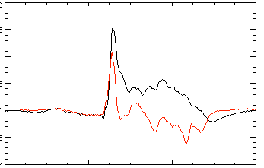
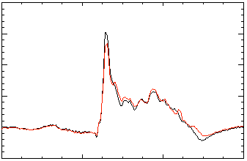
Improved stability control includes dual field component feedback and state space feedback with 3D structure
Active n = 1 B_{p} + B_{R} feedback (FB) control
Calculation of B_{r} + B_{p} control (VALEN)
6
Feedback on
140124
140125
140126
140127
2.8
β_{N}
0 deg FB phase
4
2.7
2
B_{r} FB phase = 225º
0
2.6
B_{r}^{n = 1} (G)
Radial field n = 1 (G)
90 deg FB phase
6
B_{r} FB phase = 180º
2.5
4
Vacuum error field
2
2.4
180 deg FB phase
+ RFA
0
Vacuum error field
0.0
0.2
0.4
0.6
0.8
1.0
1.2
1.4
2.3
B_{r} FB phase = 0º
B_{r} FB phase = 90º
t (s)
0.0
0.04
0.08
0.12
Δt (s) (model)
RWM State Space Controller
2 states
7 states
200
δB_{p}¹⁸⁰
Measurement
δB_{p}¹⁸⁰
Measurement
3D wall,
ports,
mode currents
100
Sensor Differences (G)
0
-100
Controller (observer)
Controller (observer)
0.56
0.58
0.60
0.62
0.58
0.60
0.62
Significantly reduced disruptions at high β_{N} in controlled experiments
t (s)
t (s)
S.A. Sabbagh, O. Katsuro-Hopkins, J.M. Bialek

Slide 37
Fast ion redistribution associated with low frequency MHD measured by fast ion D_{α} (FIDA) diagnostic
Caused by n = 1 global instabilities
  Primarily n = 1, weaker n = 2 present
Redistribution can affect stability of *AE, RWMs, other MHD
  CAE activity observed after onset of low frequency MHD
Full-orbit code (SPIRAL) shows redistribution in real and velocity space
  Radial redistribution from core plasma
  Particles shift towards V||/V = 1
Fast ion density reduction
0.9
1.0
1.1
1.2
1.3
1.4
1.5
R(m)
Change in distribution due to kink mode
SPIRAL code
Z [m]
V||\V
CAE resonances
Measured CAE and GAEs (reflectometer) in H-mode core plasmas
  mode #, frequency measured: modes peak in core, resonant with electron orbit frequencies
R [m]
Energy [keV]
Crocker EX/P6-02
A. Bortolon

Slide 38
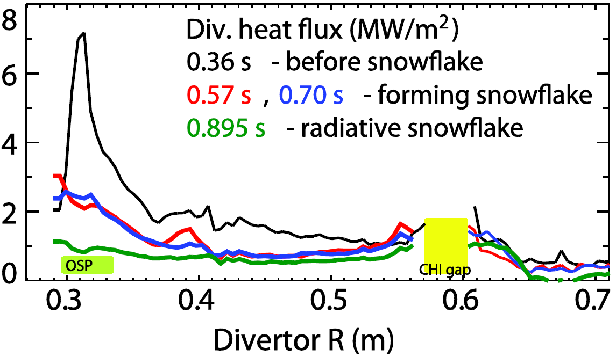
Snowflake divertor experiments provide basis for required divertor heat flux mitigation in NSTX-U
Snowflake divertor in NSTX
Needed for NSTX-U, as divertor heat flux width strongly decreases as I_{p} increases
Snowflake divertor experiments (P_{NBI} = 4 MW, P_{SOL} = 3 MW)
  Good H-mode τ_{E}, β_{N}, sustained during snowflake operation
  Divertor heat flux significantly reduced both during and between ELMs
    during ELMs: 19 to < 1 MW/m²
    steady-state: 7 to < 1 MW/m²
  Achieved by a synergistic combination of detachment + radiative snowflake divertor
OSP
Divertor heat flux (MW/m²)
Soukhanovskii EX/P5-21

Slide 39
Significant fraction of the HHFW power may be lost in the SOL in front of antenna and flow to the divertor region
View from Top
Divertor
HHFW
Antenna
Divertor
HHFW
Antenna
Visible camera image shows edge RF power flow follows magnetic field from antenna to divertor
SPIRAL results show field lines (green) spiraling from SOL in front of HHFW antenna to divertor
Field line mapping predicts RF power deposited in SOL, not at antenna face
  3D AORSA will assess surface wave excitation in NSTX-U
Proposed DIII-D experiment to look for RF edge losses during 2012 run
NSTX-U experiments and modeling to emphasize HHFW heating of high NBI power, long-pulse H-modes → assess effect of varying outer gap
R. J. Perkins, et al., PRL (2012)
Perkins EX/P5-40

Slide 40
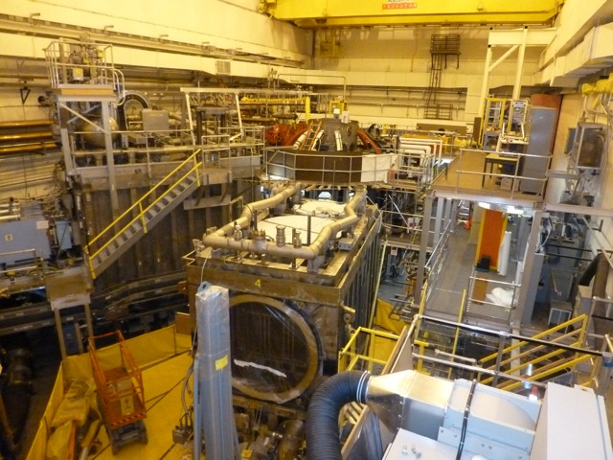
Rapid Progress is Being Made on NSTX Upgrade
Old center stack
NEW Center Stack
TF OD = 20cm
TF OD = 40cm
2nd NBI box moved into place
TF conductors being made
(first plasma anticipated June 2014)
Menard FTP/3-4

