Slide 1
Shielding and amplification of non-axisymmetric divertor heat flux by plasma response to applied 3-D fields in NSTX and KSTAR
J-W. Ahn¹, K. Kim², A.R. Briesemeister¹, G. Canal³, J.M. Canik¹, T.K. Gray¹, Y. In⁴, Y.M.
Jeon⁴, J.W. Yoo⁴, J. Kim⁴, W.H. Ko⁴, H.H. Lee⁴, A. Loarte⁵, J.D. Lore¹, R. Maingi⁶, A.G.
McLean⁷, J.-K. Park⁶, O. Schmitz⁸, F. Scotti⁷, and S.W. Yoon⁴
¹ORNL, ²KAIST, ³GA, ⁴NFRI, ⁵ITER, ⁶PPPL, ⁷LLNL, ⁸UW-Madison
IAEA FEC
Kyoto, Japan
17 – 22 Oct, 2016

Slide 2
Motivation and outline
Non-axisymmetric divertor footprints with 3-D fields are concern for future machines due to 3-D erosion and re-deposition
3-D footprints are strongly affected by plasma response → measurement is compared to field line tracing
Vacuum field line tracing
Ideal plasma response model (IPEC)
Different response for n=3 and n=1
Understanding of common underlying physics over multiple machines is important
Compact size of NSTX offers a chance of wide view of divertor
KSTAR has 3 rows of coils → fine tuning of field spectra is possible
Same analysis tools (plasma response, footprint measurements, etc)

Slide 3
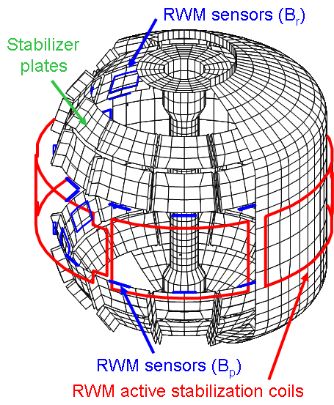
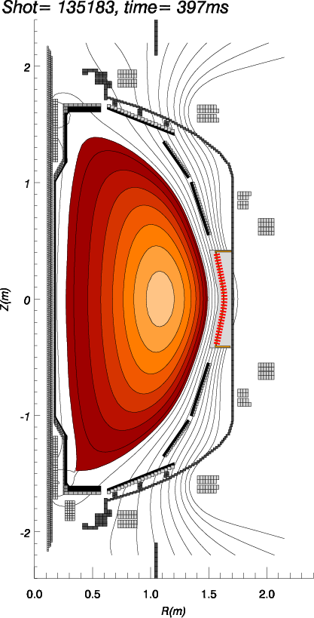
NSTX 3-D field coils and diagnostics
2-D wide angle visible camera, nearly full Φ
B_{r} sensors
1-D D_{α} camera Φ=255º
2-D dual band
IR camera, Φ=135º
USXR array
Ch 16
TS and CHERS
3-D field coil
Ch 1
B_{p} sensors
3-D field coils
3-D fields (n=1, 2, 3) applied by mid-plane EFC coils

Slide 4
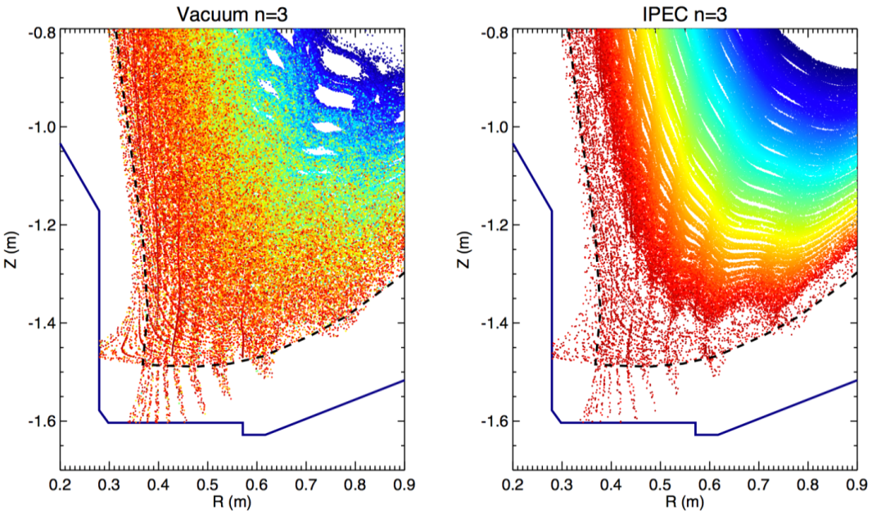
Field line tracing identifies lobes in the X-point region generated by 3-D fields, w/ and w/o plasma response
Vacuum n=3
IPEC n=3
K. Kim, PPCF 57 (2015), 104002
Homoclinic tangles
3-D fields induce 3-D topology of perturbed field lines → lobe of homoclinic tangles
Field line tracing simulation provides magnetic structure of 3-D lobes
Provide Poincare plot, divertor footprint, field line connection length profile, etc.
Compare results from vacuum approximation to that with ideal plasma response (IPEC)

Slide 5
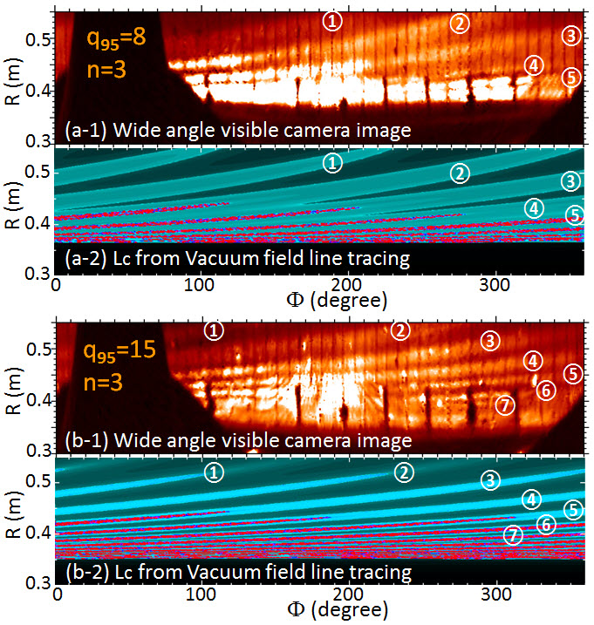
Vacuum approximation in agreement with footprints measurement for n=3 perturbation
Wide angle camera images enable comprehensive comparison to connection length (L_{c}) contour plot from vacuum field line tracing
Both camera images and vacuum field line tracing produce more and narrower striations for higher q₉₅
Good agreement between camera and vacuum field line tracing
J-W. Ahn, PPCF 56 (2014), 015005

Slide 6
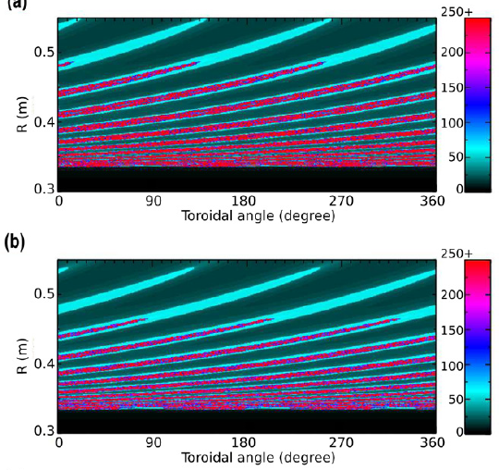
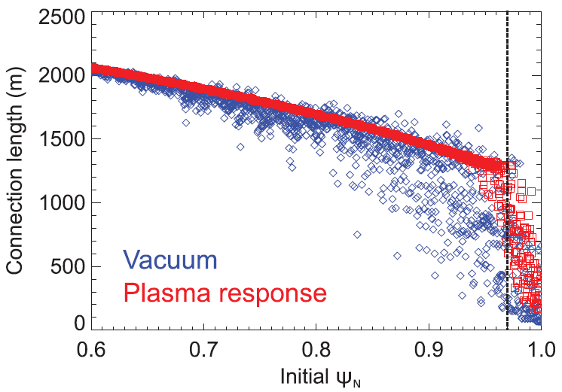
Ideal plasma response shields applied 3D fields but overall structure is similar to vacuum result for n=3
Boundary of ideal plasma modeling
Vacuum
IPEC, Ψ_{N}=0.97
Vacuum
Vacuum
Weakening effect from IPEC is affected by location of ideal plasma boundary
Envelope of lobes not changed by response
L_{c} profile inside separatrix shows modification of stochasticity and clear shielding effect by ideal plasma response
IPEC, Ψ_{N}=0.97
IPEC, Ψ_{N}=0.97
K. Kim, PPCF 57 (2015), 104002
IPEC, Ψ_{N}=0.99

Slide 7
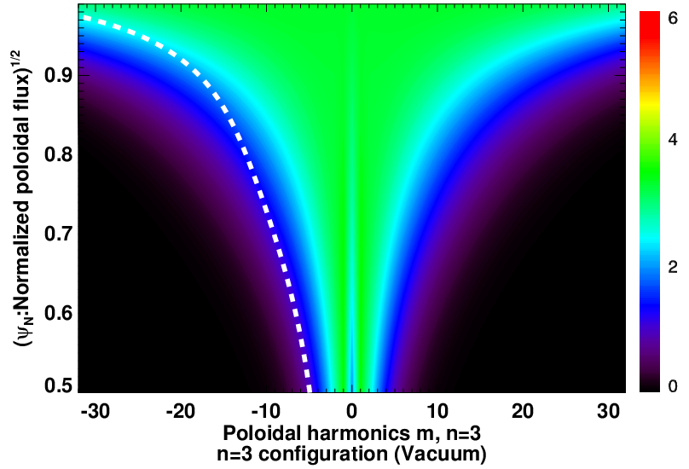
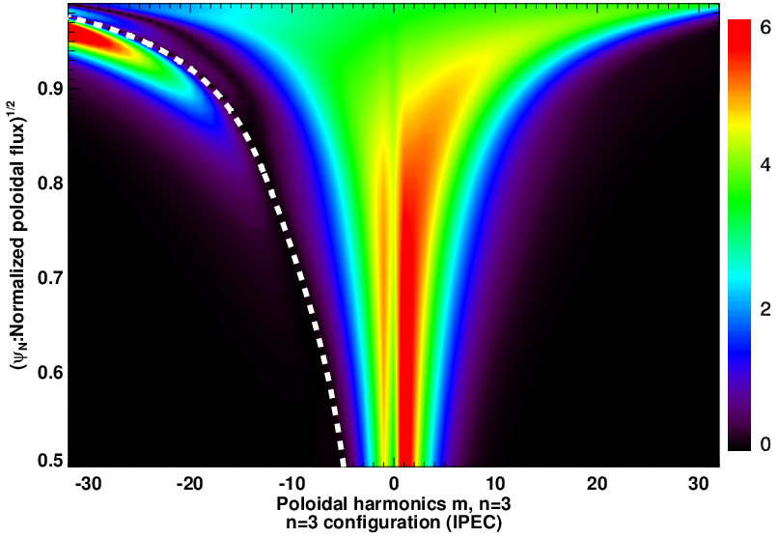
Shielding of resonant fields and amplification of kink response lead to weaker footprint splitting for n=3
q = m/3 rational surfaces
Poloidal spectrum of 3D fields (G)
Vacuum
IPEC, Ψ_{N}=0.97
Kink excitation
Shielding of resonant fields
Resonant components are strongly shielded by ideal plasma response
Non-resonant kink excitation is also observed
Combined net effect is to shield the applied n=3 fields and weaken magnetic separatrix splitting

Slide 8
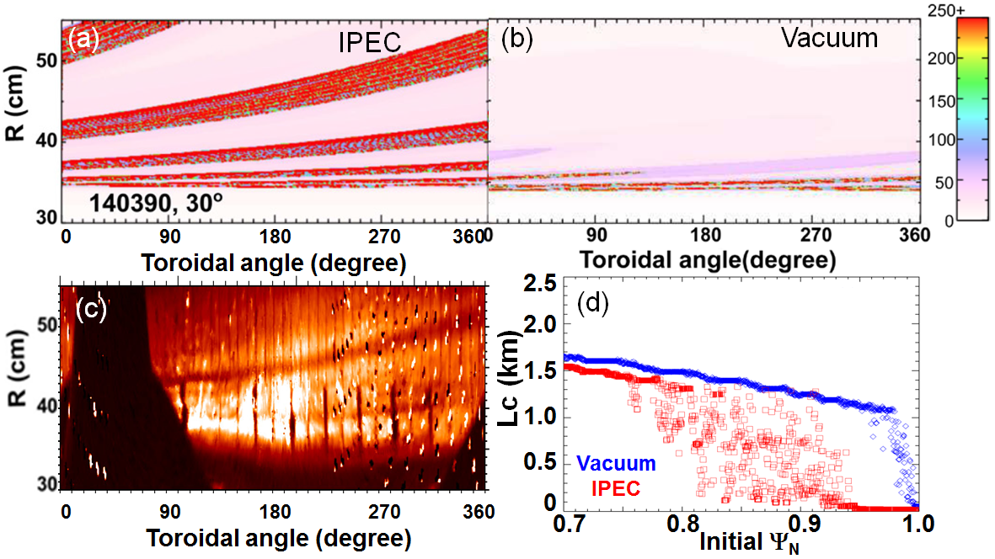
n=1 perturbation is very sensitive to plasma response – amplification of footprint splitting is observed
Ideal plasma response dramatically amplifies n=1 separatrix splitting
→ better agrees with camera image
Plasma response not only modifies amplitude, but also changes envelope of striations, unlike n=3

Slide 9
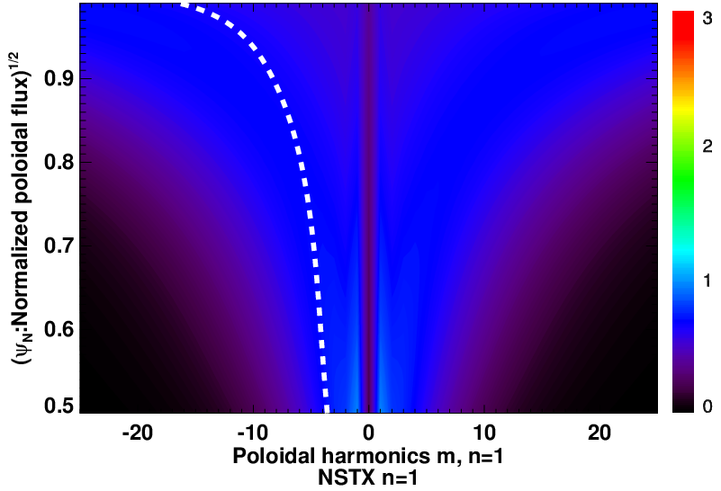
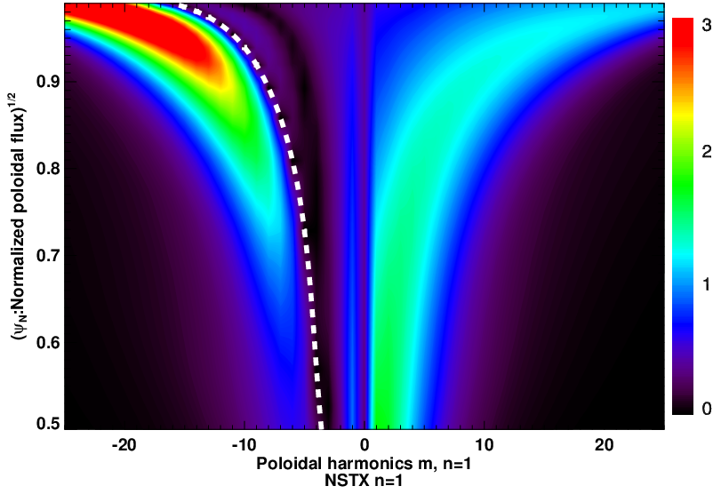
Strong kink excitation appears to be responsible for amplification of footprint splitting for n=1
q = m/3 rational surfaces
Poloidal spectrum of 3D fields (G)
Vacuum
Kink excitation
IPEC, Ψ_{N}=0.97
Shielding of resonant fields
Resonant components are very weak in vacuum modeling and the ideal response only slightly shields them
Non-resonant kink excitation is very strong
Combined net effect is to significantly amplify the applied n=1 fields and splitting

Slide 10
KSTAR can produce various 3-D field configurations
with 3x4 array of internal coils
O. Schmitz, PPCF 50 (2008) 124029
This allows complete toroidal rotation of phase shift between upper and lower row of coils for n=1 (Δφ = 0 – 360º)
2 phase configurations for n=2 (0º and 90º)

Slide 11
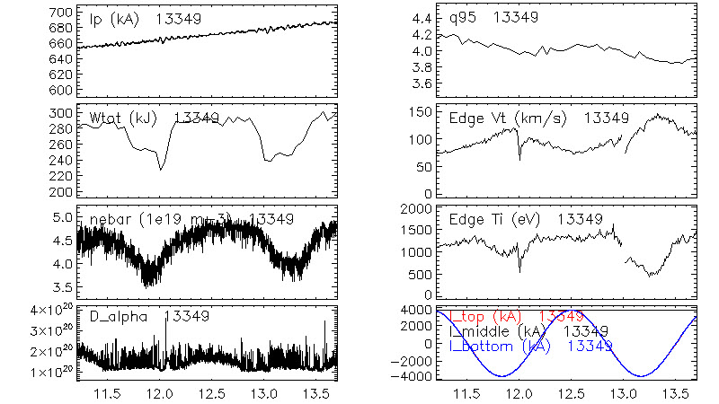
Continuous phase swing in n=2 produced obvious change in plasma parameters
n=2, Δφ_{UL}=0º
n=2, mid-plane only
n=2, Δφ_{UL}=90º
Effect of relative phase between upper and lower row of coils (Δφ_{UL}) on W_{tot}, density pump-out, V_{t}, T_{i}, → Change in ELM behavior

Slide 12
Ideal plasma response weakens divertor footprint splitting pattern and provides better agreement with measurement
Vacuum
Plasma response (IPEC)
Mesured
heat flux
Δφ_{UL}= 0º
(non-resonant)
IR camera
IR camera
+
-
+
-
+
-
+
-
+
-
+
-
??
Δφ_{UL}= 90º
(resonant)
+
-
+
-
-
+
-
+
+
-
+
-
IPEC weakens splitting for both 0º and 90º phases
Agreement of radial location of lobes between measurement and field line tracing becomes better when ideal plasma response is included
Some lobes are not caught in measurement → transport effect?

Slide 13
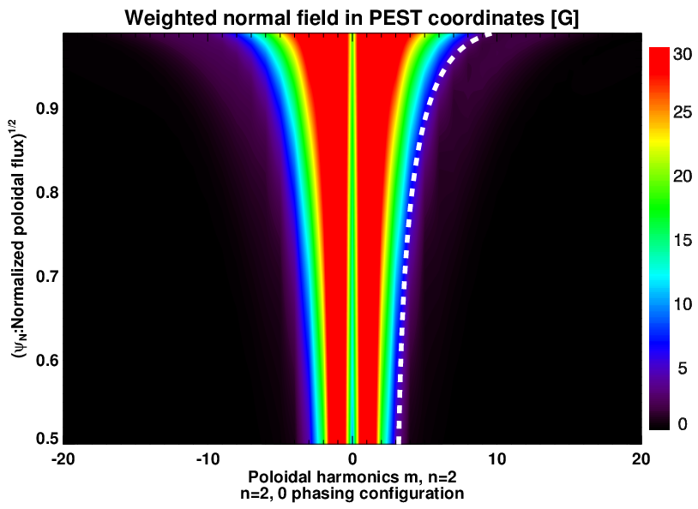
Net effect of plasma response leads to shielding of applied 3-D fields and footprint splitting for n=2
Profile of ave. normal field
Shielding
Shielding
How to quantify the net effect of resonant shielding and non-resonant excitation of 3-D fields? → calculate surface average of normal fields for whole flux surface at each radial point
Plasma response reduces surface averaged normal fields for whole radial cross section for n=2, ie shielding of applied 3-D fields → consistent with the weakening of splitting from field line tracing

Slide 14
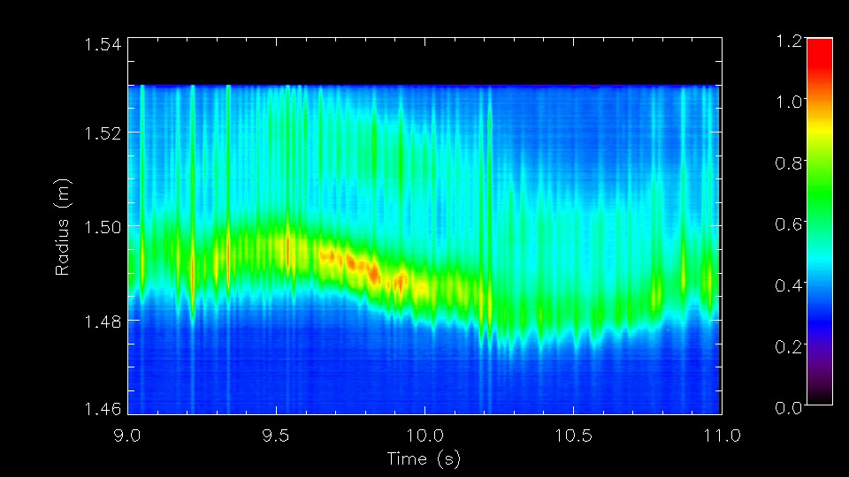
Peak heat flux and splitting becomes stronger for resonant phases of n=1
Δφ_{UM}= 0º
90º
180º
270º
360º
+
+
-
-
+
+
-
-
Δφ_{UM}= 0º
(non-resonant)
+
+
-
-
-
+
+
-
Δφ_{UM}= 90º
(resonant)
+
+
-
-
-
-
+
+
Δφ_{UM}= 180º
(resonant)
Phase scan of n=1 fields using only upper and middle coils (Δφ_{UM}= 0 – 360º)
No ELM suppression (I_{upper}~3 – 4 kA, I_{mid}~2.5 kA)
Peak heat flux increases during resonant phases (Δφ_{UM}= 90 – 180º)
→ similar trend as for n=2
Splitting is strongest for resonant phases (Δφ_{UM} ~ 90 – 180º), → Contrary to n=2 (stronger splitting for non-resonant phase, Δφ_{UL} ~ 0º)

Slide 15
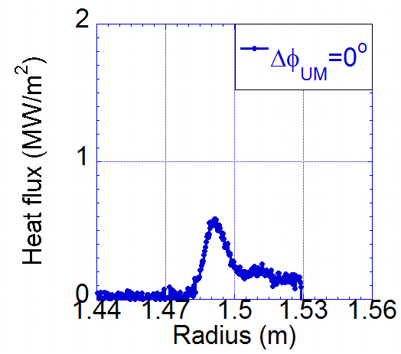
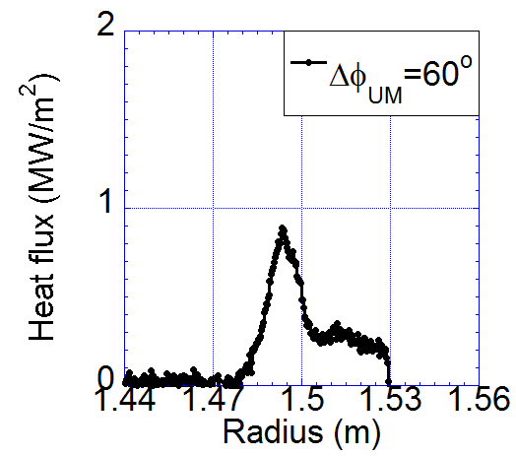
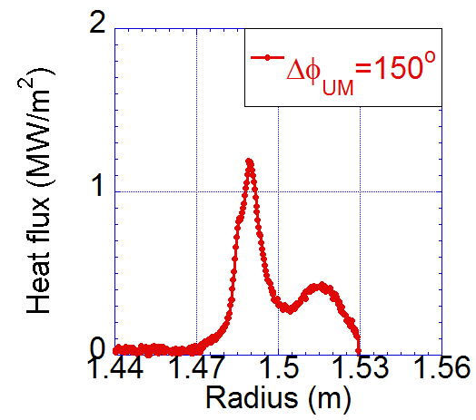
Plasma response shields or amplifies applied n=1 fields, depending on phase
Ave. normal field at boundary
Comparison of 3-D fields at plasma boundary:
0º: shielding
50 – 60º: ~constant
150º: amplification
Plasma response also shifts phase
q_{peak} and heat flux splitting better agree with plasma response case than vacuum, and become stronger with higher normal fields
0º
60º
150º
Amplification
Shielding

Slide 16
Poloidal spectrum analysis again shows similar trend for resonant and non-resonant fields as in n=2
Vacuum
IPEC
Kink excitation
Δφ_{UM}= 0º
(non-resonant)
+
+
-
-
+
+
-
-
q=m/1
rational
surfaces
Shielding of
resonant
components
Δφ_{UM}= 150º
(resonant)
+
+
-
-
-
-
+
+
-
0º phase is non-resonant and kink excitation is only weak
150º phase is very resonant → kink excitation is very strong
Net effect is to be shown by profile of averaged normal field

Slide 17
Phase variation determines plasma response to applied 3-D fields
Profile of ave. normal field
Ave. normal field at boundary
0º
150º
Amplification
Amplification
Shielding
Shielding
Shielding
Normal field profile is decreased by plasma response for 0º phase
For 150º, it is mostly strong amplification but shielding occurs in the core region near magnetic axis
Phase variation strongly affects reaction of plasma to applied fields → leads to shielding or amplification of magnetic lobes and 3-D heat and particle flux pattern

Slide 18
Intentionally misaligned 90º n=1 fields effectively spread heat flux to lower peak value with increasing misalignment
Δφ_{M}=10º
Δφ_{M}=15º
Δφ_{M}=20º
t=3-4s, No RMP
t=6-7s, Δφ_{M}=10º
t=8-9s, Δφ_{M}=15º
t=10-11s, Δφ_{M}=20º
n=1 90º
+
+
-
-
16822
-
+
+
-
Δφ_{M}
-
+
+
t=3.7s, No RMP
t=6.5s, Δφ_{M}=10º
t=8.5s, Δφ_{M}=15º
t=10.5s, Δφ_{M}=20º
RMP increases peak heat flux compared to no RMP case
With increasing misalignment, wetted area increases (i.e., profile broadens) and peak heat flux decreases
16822
Y. In, FEC 2016

Slide 19
However, it’s not yet clear how small misalignment led to significant change in divertor footprints
Flux surface displacement from ideal plasma response (IPEC)
With different EFIT
With same EFIT
Δφ_{M}=10º
Δφ_{M}=15º
Δφ_{M}=20º
Δφ_{M}=10º
Δφ_{M}=15º
Δφ_{M}=20º
Δφ_{M}=10º
Δφ_{M}=15º
Δφ_{M}=20º
Only very small (<5%) difference of external fields due to misalignment
Plasma response (IPEC) does not produce significant difference in field structure by misalignment
How can the difference in IR heat flux be explained? Bifurcation?

Slide 20
Summary and conclusions
Applied 3-D fields can be either shielded or amplified depending on field configurations and phase, leading to modification of divertor footprints
NSTX: wide view of divertor area allows for easier comparison to modeling
Ideal plasma response weakens n=3 footprint splitting, primarily due to shielding effect of resonant components. Sensitive to location of simulation boundary
Envelope of lobes for n=3 is not changed by plasma response
Ideal plasma response significantly amplifies vacuum n=1 footprints, due to strong non-resonant kink excitation
KSTAR: three rows of coils enable to fine tune structure of applied 3-D fields
n=2 fields are shielded by plasma response for both 0º and 90º phase, therefore footprints are weakened compared to vacuum result
n=1 fields are either shielded or amplified depending on phase shift between upper and lower coils.
Slight misalignment effectively broadened heat flux profile and reduced peak heat flux, but the underlying physics is still not clear yet

