Slide 1

Exploring the Regime of Validity of Global Gyrokinetic Simulations with Spherical Tokamak Plasmas (EX/P4-35)
Y. Ren¹
W.X. Wang¹, W. Guttenfelder¹, S.M. Kaye¹, S. Ethier¹, R.E. Bell¹, B.P. LeBlanc¹, E. Mazzucato¹, D.R. Smith², C.W. Domier³, H. Yuh⁴ and the NSTX-U Team
1. PPPL 2. UW-Madison 3. UC-Davis 4. Nova Photonics
26th IAEA Fusion Energy Conference
Kyoto, Japan, October 17-22, 2016

Slide 2
Why are Global Effects Important?
Local assumption of flux tube simulations based on
ρ*->0
  Large ρ* of STs due to weaker toroidal field compared to conventional tokamaks (ρ* ~ 0.01 for NSTX)
  Global effects can be important for STs
  Requiring global GK codes
Study of global effects are important for achieving predictive capability for future STs
  Need to validate first principle model for developing reduced transport model with global effects
Serious validation efforts applying global GK codes to ST plasmas are still lacking
  Important to map the regime of validity of global GK codes

Slide 3
Outline
Brief introduction to GYROKINETIC TOKAMAK SIMULATION (GTS) code
Exploring the Regime of Validity of Global GTS simulations with NSTX L and H-mode plasmas
  NSTX RF-heated L-mode plasmas
    Fast response of electron-scale turbulence to RF cessation
    Gradient-driven ion-scale GTS simulations fail to explain experimental observation
  NSTX H-mode plasmas
    Density gradient stabilization of electron-scale turbulence
    Good agreement between ion-scale GTS simulations and experiment in ion thermal transport but not in electron thermal transport
Summary

Slide 4
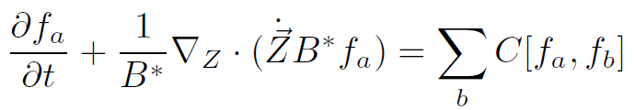
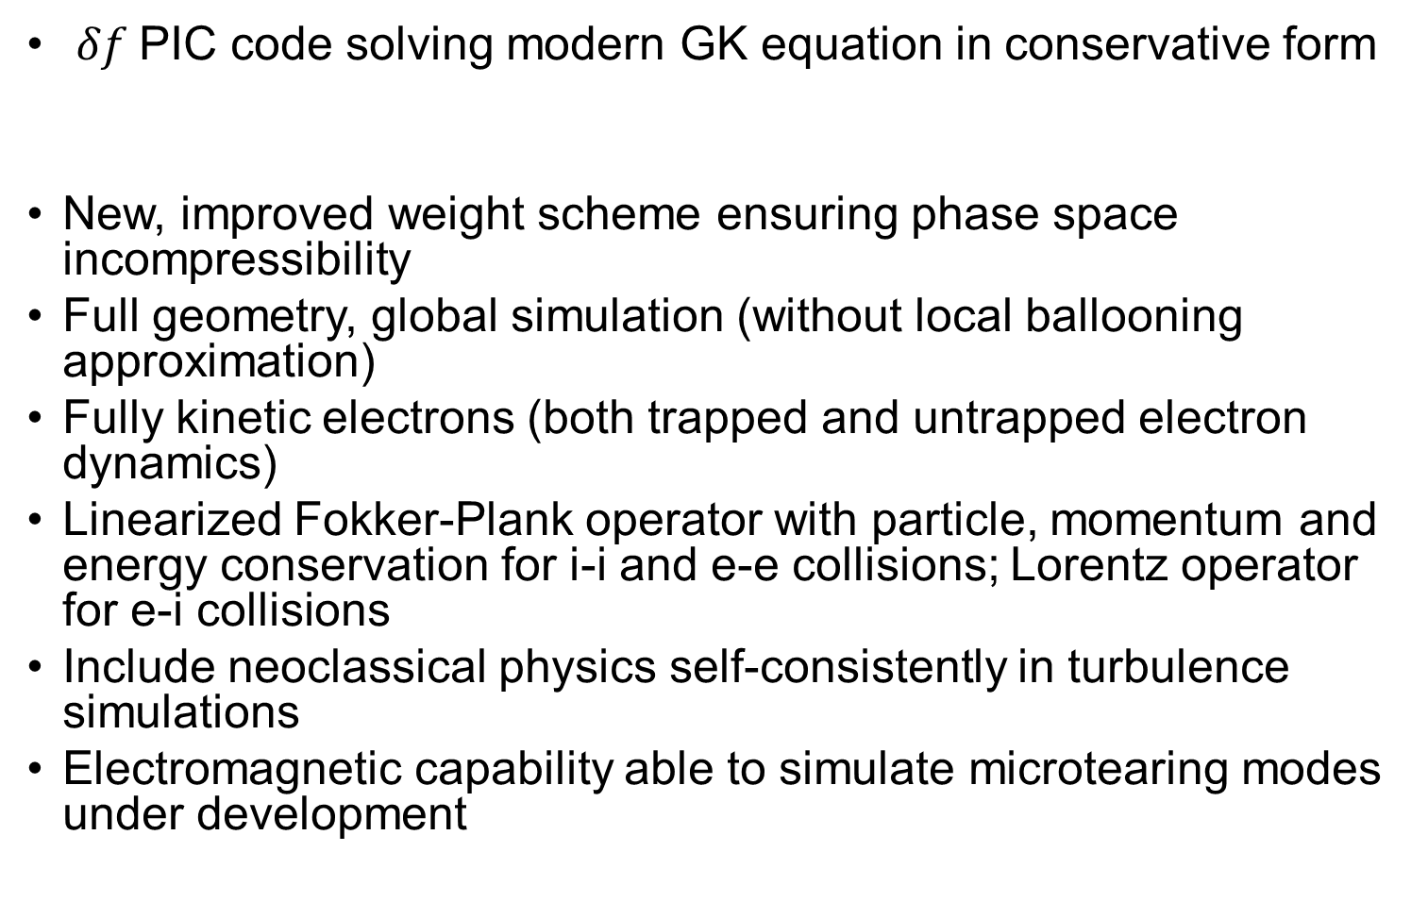
GTS - a Global Gyrokinetic Code with Robust Capability to Simulate Turbulence & Transport for Tokamak Experiments
$δf$PIC code solving modern GK equation in conservative form
New, improved weight scheme ensuring phase space incompressibility
Full geometry, global simulation (without local ballooning approximation)
Fully kinetic electrons (both trapped and untrapped electron dynamics)
Linearized Fokker-Plank operator with particle, momentum and energy conservation for i-i and e-e collisions; Lorentz operator for e-i collisions
Include neoclassical physics self-consistently in turbulence simulations
Electromagnetic capability able to simulate microtearing modes under development

Slide 5
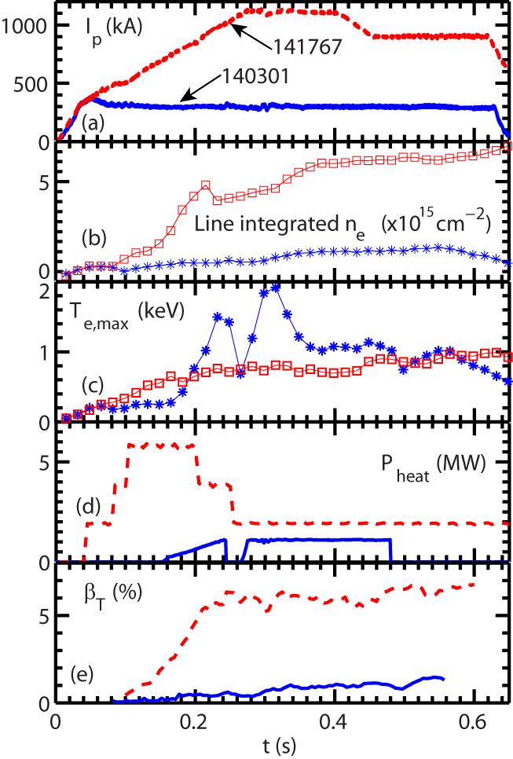
Targeted NSTX Plasmas Are in Distinct Parametric Regimes
NSTX RF-heated L-mode plasma, shot 140301
  B_{T} =5.5 kG
  Low plasma current I_{p}=300 kA
  Low density and low plasma beta
  RF heating power ~ 1 MW
  Ren et al., PoP 2015
NSTX NBI-heated H-mode, shot 141767
  B_{T} =5.5 kG
  High plasma current I_{p}~1 MA
  High density density and high plasma beta
  NBI-heating power ~ 2 MW at current flattop
  Ruiz-Ruiz et al., PoP 2015
H-mode
L-mode

Slide 6
NSTX RF-heated L-mode plasmas with fast response of electron-scale turbulence to RF cessation

Slide 7
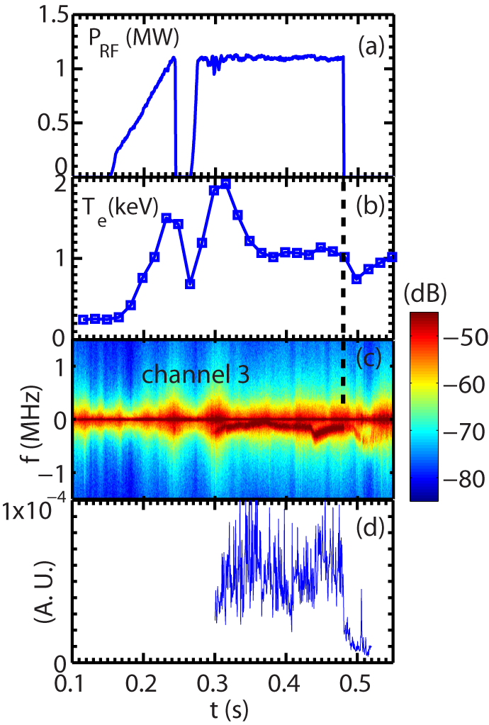
Measured Turbulence Frequency Spectral Power Shows a Significant Drop Following the RF Cessation
Shot=140301
Drop in turbulence frequency spectral power at the time of RF cessation
  The drop happens in 0.5 to 1 ms
Electron heat flux decreases by about a factor of 2 after the RF cessation
RF-heated L-mode plasma with
B_{T} =5.5 kG and I_{p}=300 kA
A sudden drop in spectral power
Ren et al., PoP 2015

Slide 8
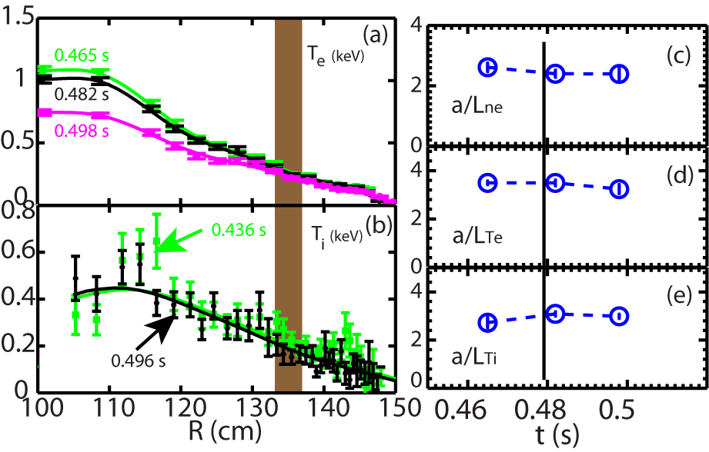
What Causes the Sudden Drop of Electron-scale Turbulence?
Short turbulence variation time scale, 0.5-1 ms
  Much smaller than Energy confinement time ~ 10 ms
  Equilibrium quantities not expected to change significantly
<15% variation in equilibrium quantities in the high-k measurement region
High-k measurement region
Time of the RF cessation

Slide 9
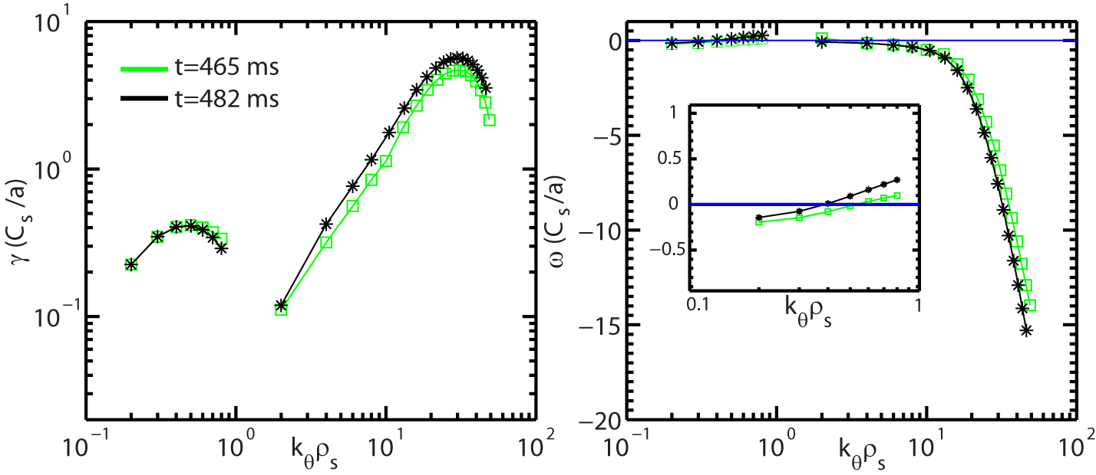
Changes in Linear Growth Rate Cannot Explain the Observed Significant Drop in High-k Turbulence
Ion scale modes are ITG/TEM hybrid
  Growth rate similar before and after the RF cessation
ETG mode maximum growth rates show small increase from t=465 to 482 ms
  Inconsistent with the drop in the measure high-k spectral power
After the RF cessation
Ion direction
Electron direction
ExB shearing rate
Stability Analysis was performed with the GS2 code (Kotschenreuther et al., 1995)

Slide 10
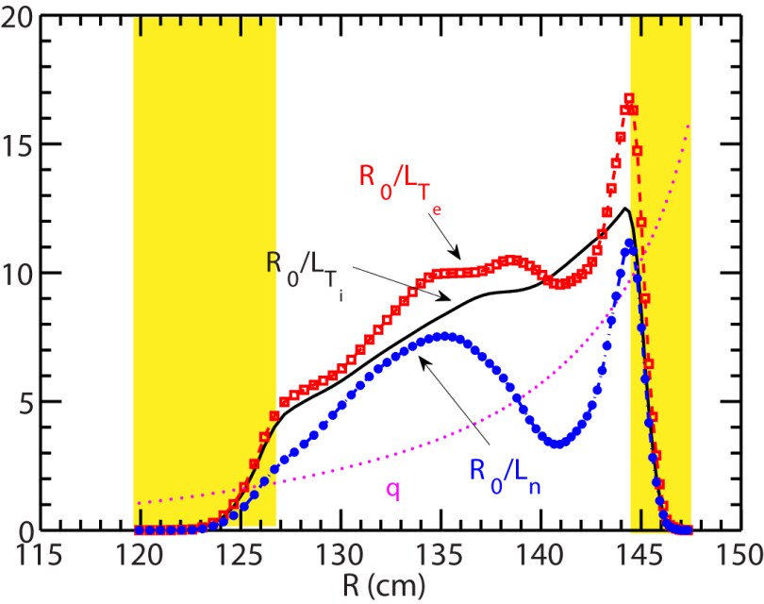
Are Global Effects Able to Explain the Observation?
Global effects, e.g. profile variation, may be important
  Turbulence could spread from one region to another
Electrostatic GTS simulations are carried out with experimental equilibria
  Local linear GS2 simulations help determine the radial domain for GTS simulations
  Focus on ion-scale turbulence due to weak ExB shear
High-k measurement region R=133~137 cm
0.25 ρ 0.8

Slide 11
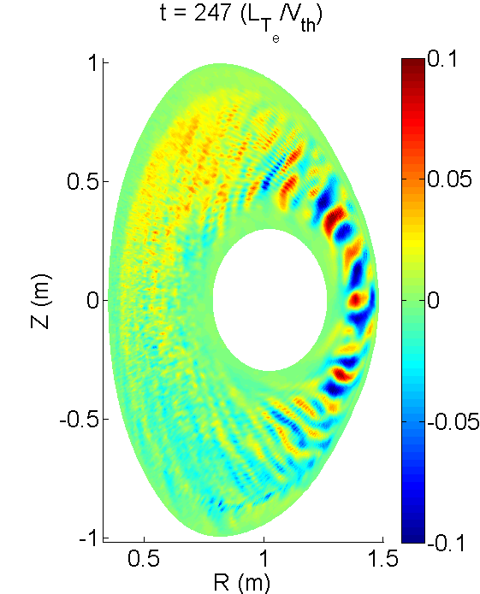

Robust Ion-scale Turbulence is Seen
t=465 ms
$$δΦ$$
Strong ion-scale turbulence develops
  ExB shear is weak without strong NBI
Turbulence propagates in the electron diamagnetic direction

Slide 12
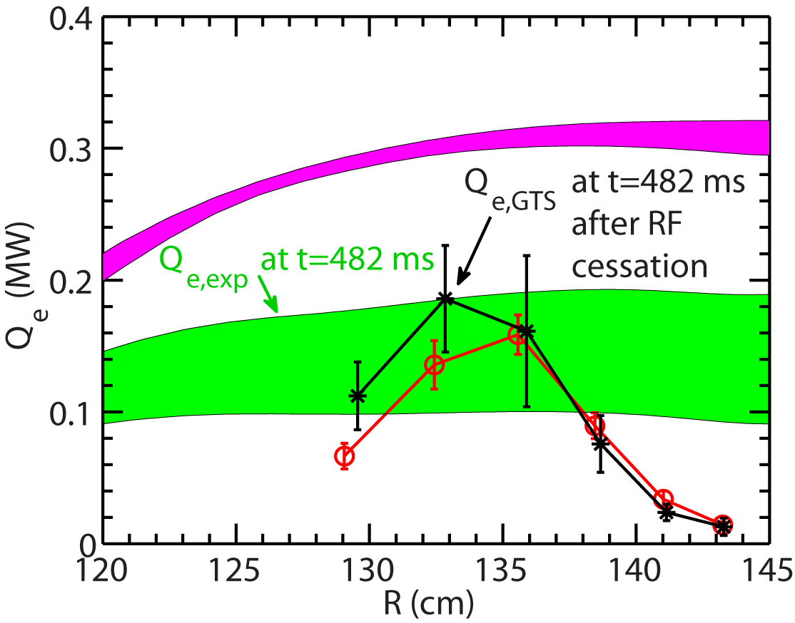
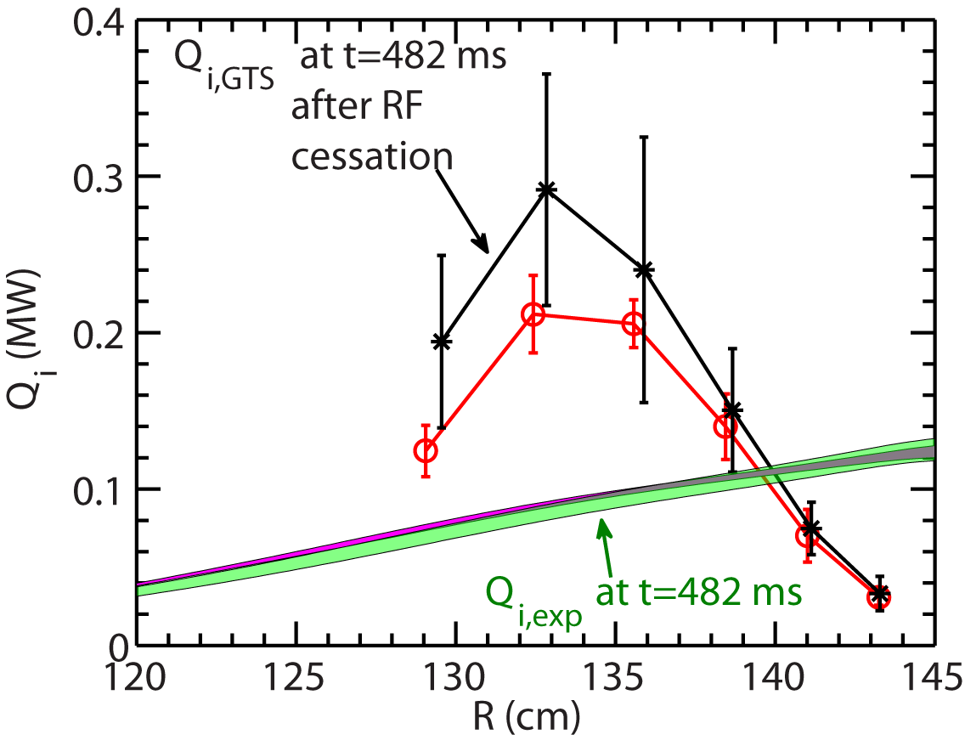
Similar Energy Fluxes from GTS are Seen before and after the RF cessation
Consistent with observed small change in equilibrium profiles
Electron energy flux matches experimental value after the RF cessation but not before
Ion energy flux is over-predicted for both cases
Electron energy flux
Ion energy flux

Slide 13
Gradient-driven Gyrokinetic Models have Difficulty Explaining Experimental Observations
Turbulence decreases on 0.5 -1 ms time scale; About a factor of 2 decrease in Q_{e} after the RF cessation
  Equilibrium profiles not expected to vary significantly on 0.5 – 1 ms time scale (much smaller than confinement time ~ 10 ms)
  <15% variation in equilibrium quantities in the high-k measurement region are found before and right after the RF cessation (over 17 ms)
Local and global gyrokinetic simulations using experimental profiles are unable to explain observed change in turbulence and electron thermal transport
Nonlocal flux-driven mechanism may be important (S.-I Itoh and K. Itoh, Sci. Rep. 2012)

Slide 14
NSTX H-mode plasmas with
density gradient stabilization of electron-scale turbulence

Slide 15
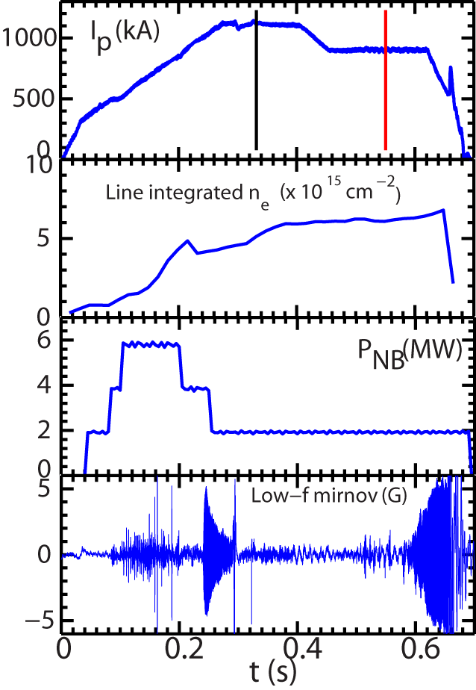
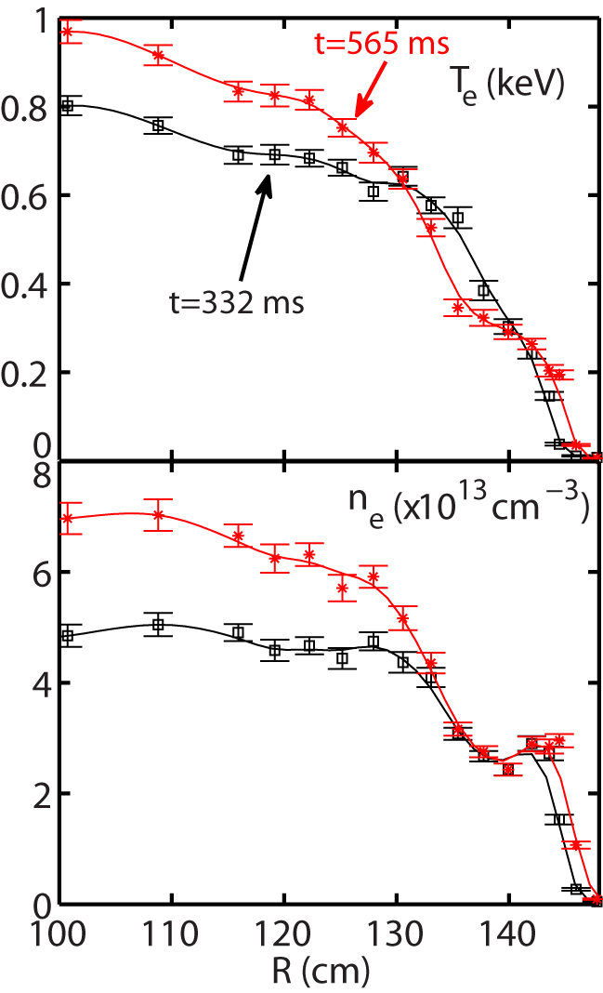
Current Ramp-down in NSTX H-mode Plasma Leads to Core Density Gradient Increase
Shot=141767
NBI-heated H-mode plasma with
B_{T} =5.5 kG
Ruiz-Ruiz et al., PoP 2015

Slide 16
Current Ramp-down in NSTX H-mode Plasma Leads to Core Density Gradient Increase
Shot=141767
ETG turbulence suppressed by large density gradient
  See Ruiz-Ruiz’s Talk in Friday morning
Is ion-scale turbulence driving thermal transport?
  Here, we focus on ion-scale GTS simulations and thermal transport
NBI-heated H-mode plasma with
B_{T} =5.5 kG
Ruiz-Ruiz et al., PoP 2015

Slide 17
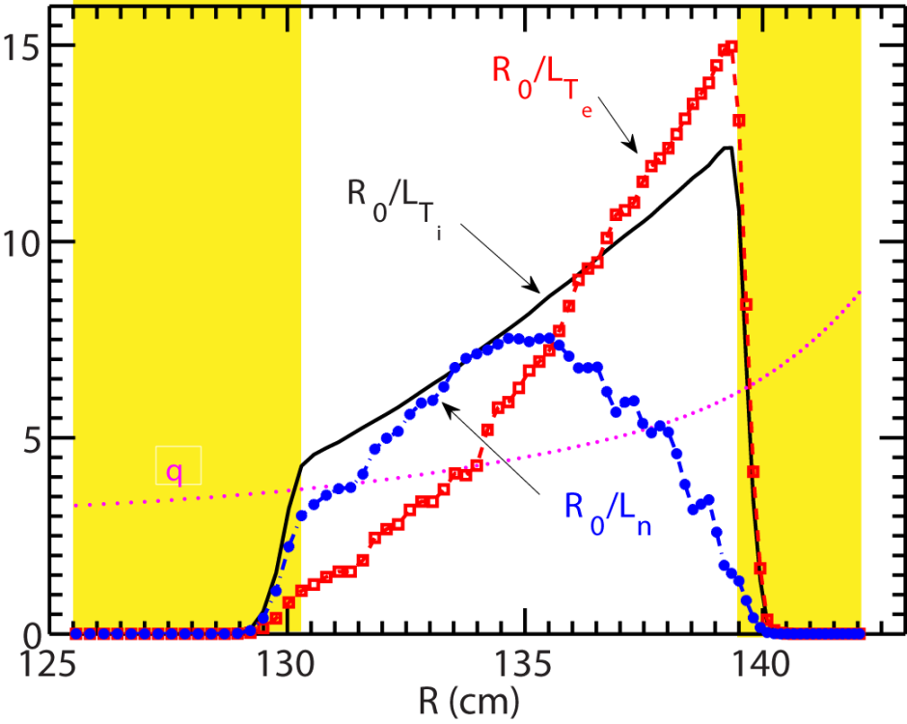
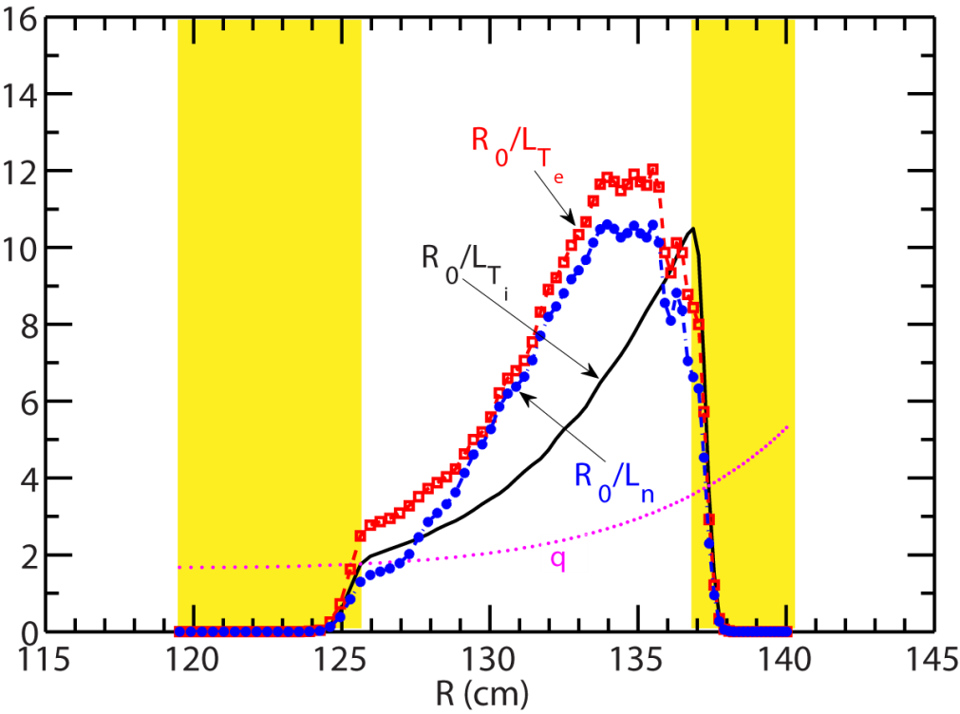
GTS Simulation Domains are Chosen to Have Significant Gradients
Density gradient is significantly larger at t=565 ms than at t=332 ms
t= 332 ms
t= 565 ms
0.45 ρ 0.9
0.25 ρ 0.7

Slide 18
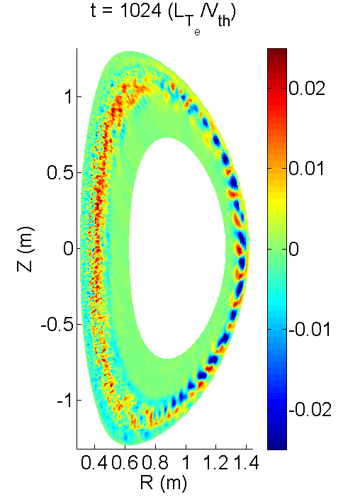
Robust Ion-scale Turbulence is Seen at t=332 ms
t=332 ms
$$δΦ$$
ExB shear is turned on from the beginning of the simulation
Turbulence propagates in the ion diamagnetic direction, due to toroidal rotation

Slide 19
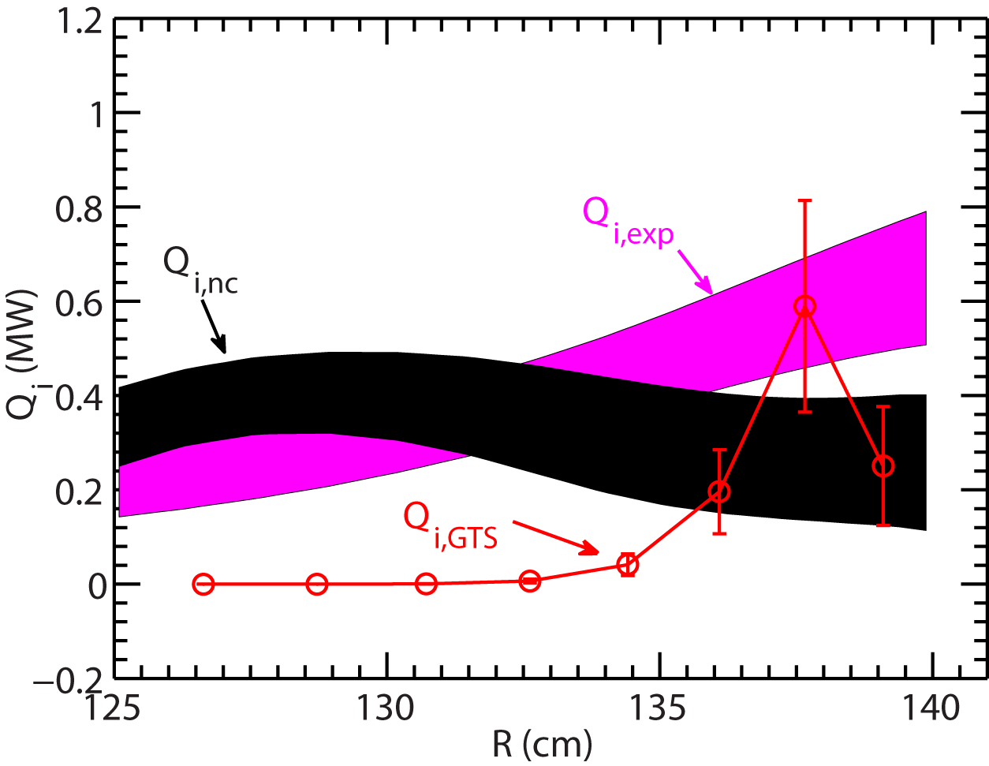
Ion Energy Flux from GTS is in Agreement with Experiment at t=332 ms
t=332 ms
Ion energy flux from ion-scale turbulence contributes significantly at R>135 cm
Neoclassical ion thermal transport is important further in the core of the plasma
  Neoclassical ion thermal transport from NCLASS

Slide 20
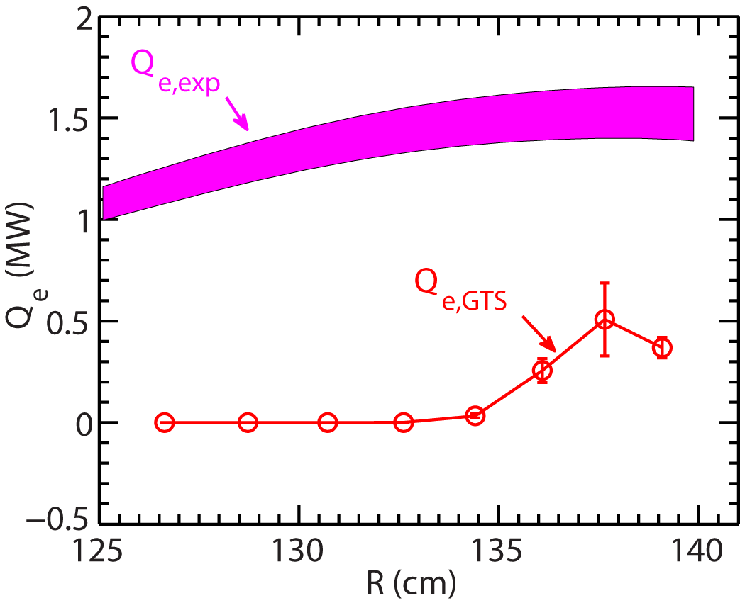
Electron Thermal Transport is Significantly Under-predicted by GTS at t=332 ms
t=332 ms
Electron energy flux from GTS is only significant at R>135 cm
  Much smaller than experimental electron thermal transport
Contribution from residual ETG and/or electromagnetic effects

Slide 21
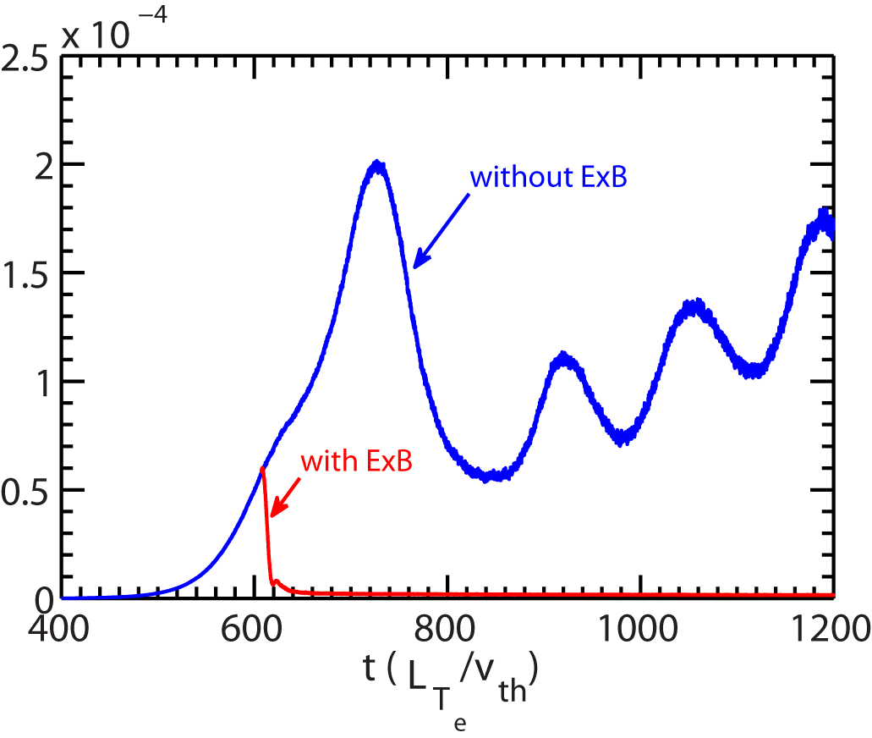
Ion-scale Turbulence is Robustly Suppressed in GTS Simulation for t=565 ms
t=565 ms, R=134.5 cm
Turbulence is suppressed after ExB shear is turned on at t~600
No turbulence growth if ExB shear is turned on at the beginning of the simulation

Slide 22
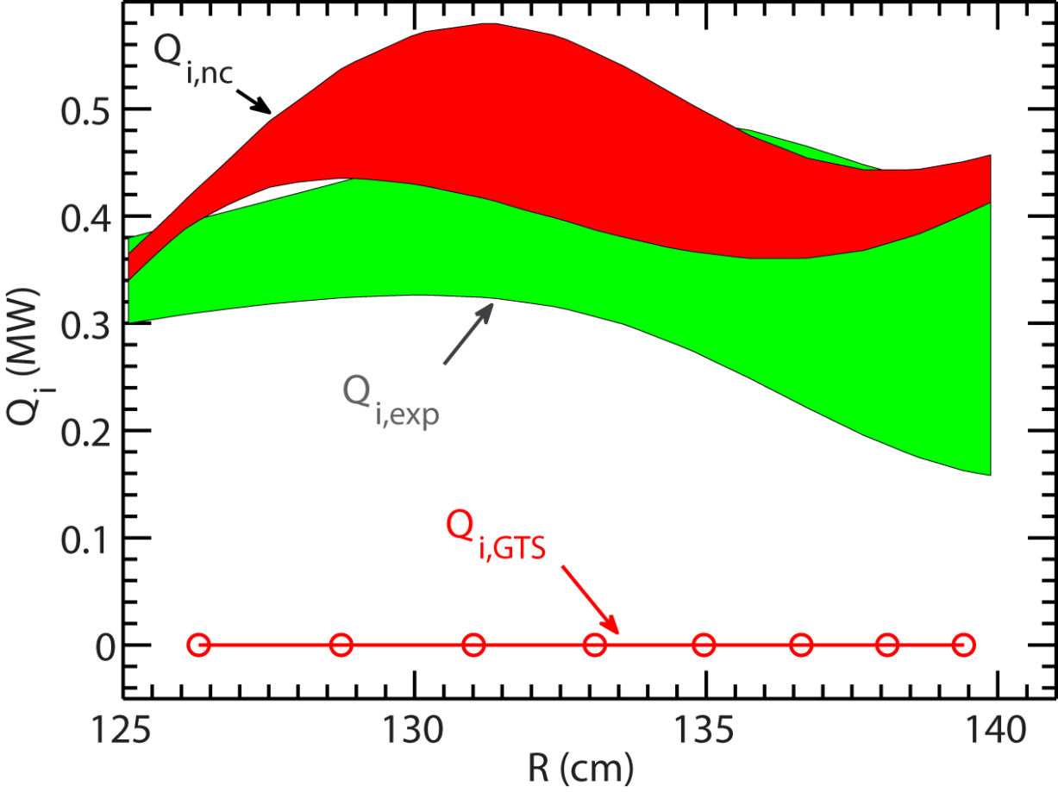
Ion Energy Flux from GTS is Still in Agreement with Experiment at t=565 ms
Neoclassical ion thermal transport is comparable to experimental ion thermal transport level
  Neoclassical ion thermal transport from NCLASS
ETG is significantly suppressed by density gradient
  Electromagnetic effects may be important
t=565 ms

Slide 23
Summary
We have started to make serious efforts to validate global GTS code with NSTX L- and H-mode plasmas and to quantify its regime of validity
Gradient-driven GTS simulation predictions for electron thermal transport before and after the RF cessation are not consistent with a set of RF-heated L-mode plasmas
  Consistent with observed small equilibrium changes before and after the RF cessation
  Showing the possible importance of nonlocal flux-driven mechanism in electron thermal transport in NSTX RF-heated L-mode plasmas
Global ion-scale GTS simulations for a NSTX NBI-heated H-mode plasma show nice agreements with experimental ion thermal transport but not with electron thermal transport
Further simulations and experiments needed for explaining the difference between the L- and H-mode plasmas and to map/quantify the regime of validity

