Slide 1

Feedback control design for non-inductively sustained scenarios in NSTX-U using TRANSP
M.D. Boyer, R. Andre, D.A. Gates, S. Gerhardt,
J. Menard, F. Poli
26th IAEA Fusion Energy Conference
17-22 October 2016, Kyoto, Japan

Slide 2
Overview
A major goal of NSTX-U is to demonstrate fully non-inductive operation
Early experiments are planned to focus on non-inductive sustainment and will begin with inductive start-up and ramp-up
In this work, TRANSP is used to predict and study the dynamic response of the plasma during such experiments
  The effect of various parameter perturbations on the dynamic response is explored
The potential for using feedback control of the available actuators to improve the system response and reject perturbations is explored
A framework for feedback control simulations in TRANSP is used as a platform for assessing controller performance
This research was supported by the U.S. Department of Energy
under contract number DE-AC02-09CH11466.

Slide 3
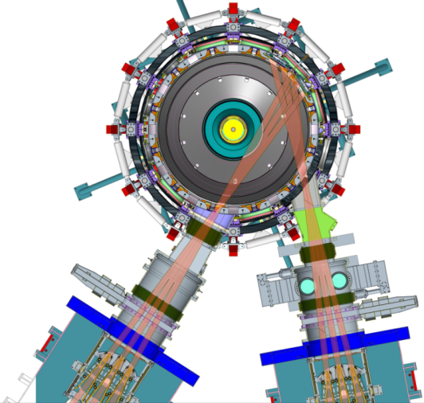
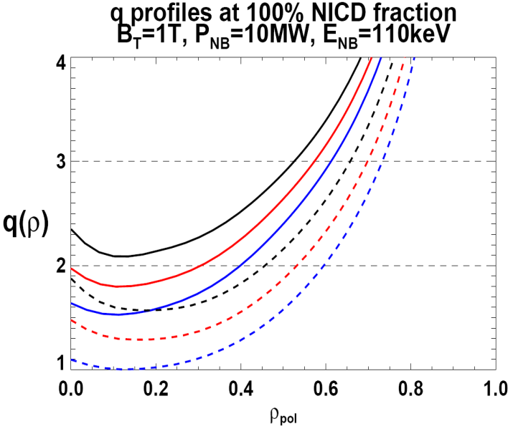
NSTX-U improves controllability and brings about new control requirements
New opportunities to use feedback control to optimize performance as a result of:
  Longer pulse length, increased toroidal field, increased heating and current drive
Advanced control will be necessary for achieving many operational goals, e.g.,
  Non-inductive scenarios, snowflake divertor, rotation control, current profile control
  2x higher CD efficiency from larger tangency radius R_{TAN}
100% non-inductive CD with core q(r) profile controllable by:
  NBI tangency radius
  Plasma density, position
f_{GW}
0.95
0.72
R_{TAN} [cm]
__________________
50, 60, 70, 130
60, 70,120,130
70,110,120,130
Present NBI
New 2nd NBI

Slide 4
A major goal of NSTX-U is to study non-inductive operation
A spherical torus based design may be an economical option for a fusion nuclear science facility (FNSF)
However, designs have little to no room for a central solenoid
  Plasma current would need to be generated non-inductively
The upgrades to the device in the NSTX-U project will enable the study of non-inductive scenarios
  Start-up, ramp-up, and flattop current sustainment
Early experiments will look at non-inductive current sustainment after inductive start-up/ramp-up
  Solenoid current will be `frozen’ to mimic solenoid-free operation
  Plasma current evolution determined by coupling between kinetic and magnetic profiles
  Resulting dynamics may be intolerably slow (maybe unstable) and highly sensitive to perturbations in profiles, confinement, etc.
Can feedback control with the available actuators be used to improve response and achieve desired conditions?

Slide 5
TRANSP predictive simulation approach
Desired boundary
MHD equilibrium
Injected power
n_{e}, T_{e} profiles, Z_{eff}
Heating/current drive
Transport
ISOLVER
T_{i}: Chang-Hinton
NUBEAM
T_{e}: constrained by H-factor
Sauter
n_{e}: constrained by total
Ohmic coil current fixed after initial inductive phase of simulation, other currents determined to best match prescribed boundary
Electron temperature evolved using ITER98 scaling
Prescribed: H-factor, total particle inventory, Z_{eff}, electron density/temperature profile shapes, beam power, plasma boundary
n_{i}: based on Z_{eff}
Z_{eff}: prescribed

Slide 6
Reference simulation evolves slowly toward steady-state, is sensitive to profile shapes
NB sources: 1B, 1C, 2A, and 2B
Outer gap: 14cm
Broad n_{e}, T_{e} profiles from NSTX 142301
Particle inventory held fixed during simulation
Slow evolution to 100% non-inductive in both reference (broad) and peaked profile case
  Using peaked profiles results in similar β_{N}, lower current and higher q0

Slide 7
Scenario is also sensitive to disturbances in density and confinement
Density disturbances (+15%, -10%)
Current inversely proportional to density
q₀ proportional to density
Small effect on β_{N}
Confinement disturbances (+10%, -10%)
Current varies significantly with confinement
Final q₀ unchanged but evolution is faster with higher confinement
β_{N} proportional to confinement

Slide 8
Design goal: Improve response, reject disturbances, + enable tracking w/ feedback
Control q_{0,} β_{N,} and I_{p} by varying beam sources, outer gap
  Outer gap affects outputs through beam deposition profile and bootstrap current
Initially tried simple PI (proportional-integral) controllers
  Difficult to tune due to actuator constraints and coupling
Developed a model-based multi-input-multi-output control approach to explicitly handle:
  Coupling
  Actuator constraints
  Disturbances, tracking
  Noisy measurements
Resulting control law tested in feedback TRANSP simulations
Reference plasma boundaries:
Small outer gap
Large outer gap

Slide 9
Dynamic system ID based on modulation of beams and outer gap in TRANSP
Open loop signals applied to each actuator
Prediction-error method used to determine optimal model parameters for a chosen model order using part of data set (estimation set)
Remainder of data (validation set) used to determine best model order (number of states)
Notes:
Legend model+TRANSP

Slide 10
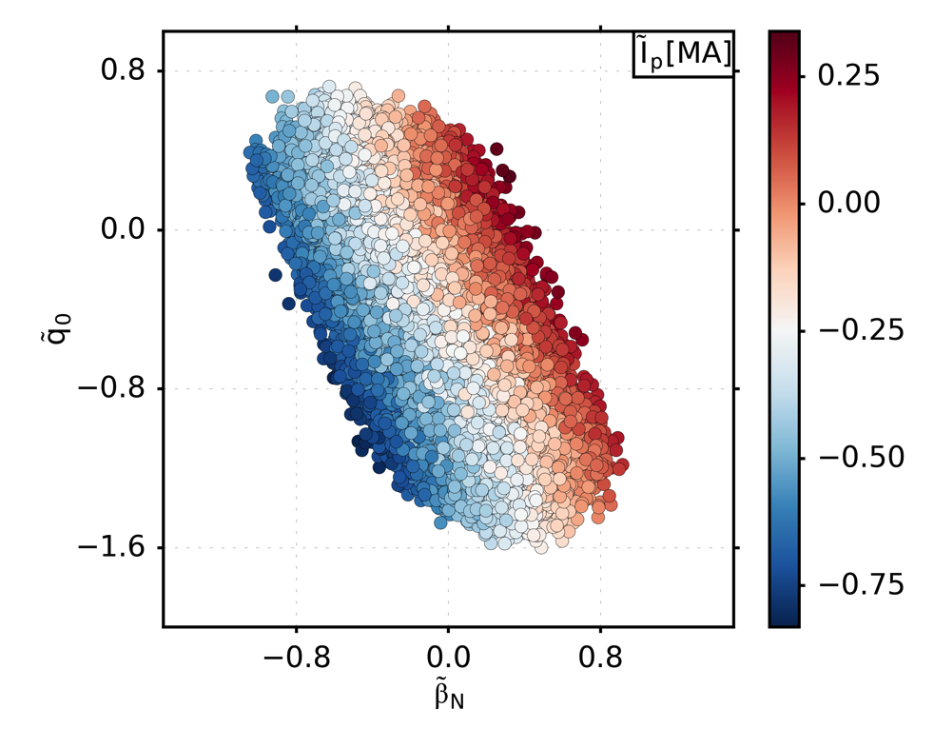
Actuator constraints and strong coupling limit the controllability of the scenario
Maximum q_{0,} β_{N} cannot be achieved simultaneously
For a particular I_{p}, the values of q_{0,} β_{N} are roughly constrained around a line
Many more actuators than controlled outputs
  However, only two outputs independently controllable
Several actuators have similar effects on the outputs
Beams are only uni-directional since they are either at there minimum or maximum in the reference scenario
Effect of maximum positive change in actuator shown with solid bar, maximum negative change shown with empty bar.
1A considered fixed on to enable MSE measurements.

Slide 11
Multi-component model-based controller proposed to handle complexity of problem
Each component uses an optimal control approach to minimize a cost function weighting outputs and actuator effort
  More complex design than PID, but makes tuning more intuitive for operators
  Each block has some ‘expert’ settings that would be set up during commissioning
  Operators can then change reference, targets, and weighting of actuators and outputs

Slide 12
Observer estimates states and disturbances, feedforward compensator tracks targets.
Observer mitigates the effect of noisy measurements and input disturbances, ensuring smooth estimates with no steady-state error
  Provides estimate of disturbances to feedforward compensator
  Provides state estimates for feedback control
Online estimate of
disturbance provides integral action
Feedforward compensator determines actuator values to optimize a cost function weighting steady-state error and actuator effort
  Uses model, estimates of disturbances, and actuator constraints
β_{N} weighted less heavily, actuator constraints prevent perfect tracking
System responds to feedforward command on a slow time scale

Slide 13
Feedback improves system response, anti-windup mitigates actuator limit effects.
Feedback controller acts on difference between feedforward target states and observer estimated states
  Allows response time of system to be improved
Faster response
compared to feedforward only
Actuator saturation changes the ‘direction’ of applied feedback
  Can cause degraded tracking of constrained targets
  Anti-windup redistributes actuator request to reduce effect of saturation, hides effect of saturation from feedback law
Target tracked more closely with anti-windup active

Slide 14
The need for high-fidelity control simulations
Control design relies on reduced modeling to make the design problem tractable
  Simplified analytical or empirical expression used to capture dominant phenomena
  Linearization, time-scale separation, or other means are often used to further simplify the model used for design
When tested experimentally, the nonlinearities and coupling of the actual system may degrade performance
  Dedicated experimental time needed for commissioning
Testing controllers using the integrated modeling code TRANSP prior to implementation may:
  Improve controller performance and reduce time for commissioning and fine tuning
  Enable demonstration of new control techniques to justify implementation and experimental time
Design
Actual system
First-principles model
Simplified model
(empirical/analytical scalings)
Model for control design
Control design
Testing

Slide 15
Closed-loop TRANSP simulations used to test effect of disturbances on performance
Reference evolution can be recovered with +10% confinement
β_{N} weighted less than other outputs in this example
Beam power reduced to reduce plasma current to target
Gap transiently reduced
Similar result for -10% density perturbation

Slide 16
Discussion and future work
Dynamics of non-inductively sustained NSTX-U plasmas (with inductive start-up/ramp-up) may be slow and sensitive to perturbations
  Changes in density may cause q₀<1 or slower response
  Profile peaking and confinement degradation may significantly reduce achieved plasma current
Matlab and TRANSP simulations indicate feedback control using beams and outer gap can be used to reject perturbations, and speed up response
Strong coupling and actuator constraints make multi-variable optimal control important
  Specific attention to avoiding stability limits may also be necessary
Beam modulation may cause significant oscillations in β_{N,} smaller modulations in current
  Methods to minimize modulations will be studied

