Slide 1

Liquid lithium loop system to solve challenging technology issues for fusion power plant
FIP/2-5
M. Ono¹, R. Majeski¹, M.A. Jaworski¹, Y. Hirooka², R. Kaita¹, T.K. Gray³, R. Maingi¹, C. H. Skinner¹, M. Christenson⁴, D. N. Ruzic⁴ and the NSTX Research Team
¹ Princeton Plasma Physics Laboratory, PO Box 451, Princeton, NJ 08543, USA.
² National Institute for Fusion Science, 322-6 Oroshi, Toki, Gifu 509-5292, Japan.
³ Oak Ridge National Laboratory, PO Box 2008, Oak Ridge, TN 37831, USA.
⁴ University of Illinois at Urbana-Champaign, IL 61801, USA
Notes:
On behalf of the multi-institutional team.

Slide 2
Talk Outline
Motivation of lithium (Li) in fusion reactor
Divertor heat and particle handling using radiative liquid lithium divertor (RLLD, Active RLLD)
• Liquid Lithium(LL) -loop system
  General description
  Dust removal
  Tritium recovery methods
  Tritium Inventory
  LL and tritium clean-up
• Summary
T ~ 0.5 g/s
Fusion Power Plant Plasma Core
Return to divertor
RLLD
Lithium-Loop
Dust filter
T Extractor
LL flow ~ 1 l /s
Notes:
I would like to briefly describe motivation of lithium in fusion reactor including increased plasma performance enhancements and possible solution for divertor heat and particle handling.
I then describe the LL-loop system including dust removal, tritium recovery methods, tritium inventory, and cleanup method.

Slide 3
Why lithium (Li) for fusion energy development?
Some Li related facts and information
Li is the lowest Z = 3 metal – compatible with hot fusion plasmas
Liquid lithium (LL) has a wide operating temperature range of 180 -1344°C – expected LL operating temperature of 200 – 400°C (low lithium vapor pressure) – compatible with fusion reactor environment
Lithium reacts and captures D, T, O – Can provide strong divertor particle pumping – e.g., low-recycling radiative divertor possible!
• Lithium as PFC were investigated by many fusion devices with mostly beneficial results on plasmas: TFTR, NSTX and LTX (PPPL, USA), FTU (ENEA, Italy), T-11M (Trinity, RF), T-10 (Kurchatov Institute, RF), TJ-II (CIEMAT, Spain), EAST (ASIPP, China), HT-7 (ASIPP, China), DIII-D (GA, USA), ISTTOK (IPFN, Portugal) and KTM (NNC RK, Kazakhstan).
• The fourth International Symposium on Liquid Metal Application for Fusion Device (ISLA-2015) : held in September 2015 at Granada, Spain. http://www-fusion.ciemat.es/quixplorer/
Notes:
Lithium has three important properties: Li is the lowest Z metal and compatible with hot fusion plasmas with low coronal radiation
LL exists in a wide operating temperature range above 180°C quite compatible with fusion reactor environment
And Li chemically reacts with working gas and some of the impurities such as oxygen providing strong divertor particle pumping
I should also note that many fusion research devices have experimented with lithium mainly to improve plasma performance and many recent Li experimental results can be founds in the liquid metal symposium proceeding.

Slide 4
Radiative LL Divertor Concept (RLLD, ARLLD)
Possibility of Radiative Divertor with Low Recycling!
• Conventional radiative divertor proved effective in reducing divertor heat flux – however often caused plasma confinement degradation.
• Li with non-coronal radiation* could significantly reduce divertor heat flux. Li injection shown effective in heat flux reduction in EAST.
• Li can provide strong particle pumping for low recycling divertor.
• LL provides renewable protective layer for high-Z substrate.
M. Ono et al., RLLD - NF 2013,
ARLLD - FE&D 2014
Divertor heat & particle flux
Active
Li Injection
(ARLLD)
LL
Li
non-coronal radiation
From
LL-loop
Li
*S. V. Mirnov et al., PPCF (2006)
T, D
Thin
~ 0.2 mm
LL coated high Z divertor wall
Impurities
Li influx
(RLLD)
To
LL-loop
Notes:
The present radiative LL divertor concept works the same way as the conventinal radiative divertor which proved to be effective in reducing the divertor heat flux. However excessive gas injection often resulted in plasma confinement degradation. With lithium, we can still get a significant divertor radiation through non-coronal radiation. The enhanced radiation and heat flux reduction was indeed observed in recent experiment on EAST. One can inject lithium actively as needed. The lithium is also evaporated from the divertor strike point region due to the temperature rise at the divertor strike point. In this configuration, we introducing lithium at the top of divertor and let it exit at the bottom and LL forms a renewable and protective layer for high-Z substrate. We heard in T-10, Li application significantly reduced influx from tungsten limiter. Lithium tends to stick to the wall so it is inherently low recycling. The LL wall can also pump tritium and deuterium through formation of Li-hydride.
16:00

Slide 5
A LL-Loop as a part of Fusion Reactor “Ecosystem”
Continuously Removing Dust, T, D, H, He, O, & Other Impurities
D₂, T₂ ~ 0.5 g/s needed for ~ 3 GW-fusion power with 1% burn
First Wall Temperature
600 – 700 °C keeps wall clean
Fusion Power Plant Plasma Core
T₂ ~ 0.5 g/s
T₂ Recycling
Flowing LL can capture and carry out dust, T, D, H, He, O, & other impurities
T₂, D₂, He, H₂, O₂
Tritium
Separater
T ~ 0.5 g/s
D₂, He, &
Other impurities
Radiative Liquid Lithium Divertor Chamber
Return to divertor
0.4% T ~ 2.0 g/s
Tritium Removal
(Surface Cold traps
Centrifugal separator)
200°C
Dust filter for solid waste
0.5% T ~ 2.5 g/s
400°C
LL flow ~ 1 l /s
Notes:
While we have shown that llithium can be a quite useful tool for fusion reactor operations, there are some technology challenges we need to solve to be used in a fusion reactor environment.
In this concept, we assume the first wall temperature to be high, 600 – 700 °C range which would keep the wall clean from lithium and tritium.
One strong advantage of flowing LL is that it can capture and carry out almost all the waste produced within vacuum vessel including dust, working gas, and other impurities.
We then must purity LL before returning to the VV. For this purpose, we envision a LL-loop system with about 1 l per sec circulation which is relatively modest. The power required for such a loop should be also relatively modest.

Slide 6


Dust Generation Identified as a Serious Issue for Fusion Reactor*
0.5 g of dust generation per second results in 17 tons per year!
*G. Federici et al., NF 2001
• With 0.1% dust fraction by weight in 1 l/sec LL flow, can carry away 17 tons of dust in a year!
• While LL may also reduce the dust generation in divertor, the philosophy is to remove the dust as much as possible whenever generated.
“Uchi-mizu” in Kyoto
Flowing LL can capture and carry out the “dust”
Return loop
Return loop
Flowing LL film along divertor wall for pumping and protection
1 l / sec over , 50 m x 1.5 m
~ 0.2 mm thick LL film
~ 10 cm/s flow speed
~ 15 sec transit time
Dust/particle filters are located below divertor and dust are carried to filter by gravity action and if needed jxB and, themoelectric actions.
Tritium/impurity removal
Surface Cold Trap /
Centrifuge
Dust / particle
filter
Notes:
Earlier, I was invited to attend the ICEF conference in Tokyo. This is an international conference started by Prime minister Abe to come up with solutions to counter the global warming. I certainly thought fusion can contribute to the solutions of this serious problem for mankind. However to make fusion power plant a reality, we must come up with a way to run the fusion reactor steady state. Perhaps the dust generation is one of the most serious technology issue we face for such operations. Half gram of dust generation per second in 3 GW fusion power plant is quite possible but such dust generation ends up producing 17 tons of dust in a year if allowed to accumulate. Such a quantify of dust would be unacceptable from safety and tritium inventory point of view as the dust will be activated with huge surface areas which could also retain tritium. So with the lithium loop of 1 l/sec, half gram of dust only represent 0.1% of LL by weight. The idea is to remove the dust promptly when generated. The idea may be similar to an old custom in Kyoto called Uchi-mizu to sprinke water in hot summer months to keep the down down and keep the street cool and clean. Once the dust is removed from the vacuum vessel, it should be relatively straight forward to remove the dust and solid particles from LL.

Slide 7
A LL-Loop as a part of Fusion Reactor “Ecosystem”
Continuously Removing Dust, T, D, H, He, O, & Other Impurities
D₂, T₂ ~ 0.5 g/s needed for ~ 3 GW-fusion power with 1% burn
First Wall Temperature
600 – 700 °C keeps wall clean
Fusion Power Plant Plasma Core
T₂ ~ 0.5 g/s
T₂ Recycling
Flowing LL can capture and carry out dust, T, D, H, He, O, & other impurities
T₂, D₂, He, H₂, O₂
Tritium
Separater
T ~ 0.5 g/s
D₂, He, &
Other impurities
Radiative Liquid Lithium Divertor Chamber
Return to divertor
0.4% T ~ 2.0 g/s
Tritium Removal
(Surface Cold traps
Centrifugal separator)
200°C
Dust filter for solid waste
0.5% T ~ 2.5 g/s
400°C
LL flow ~ 1 l /s
Notes:
While we have shown that llithium can be a quite useful tool for fusion reactor operations, there are some technology challenges we need to solve to be used in a fusion reactor environment.
In this concept, we assume the first wall temperature to be high, 600 – 700 °C range which would keep the wall clean from lithium and tritium.
One strong advantage of flowing LL is that it can capture and carry out almost all the waste produced within vacuum vessel including dust, working gas, and other impurities.
We then must purity LL before returning to the VV. For this purpose, we envision a LL-loop system with about 1 l per sec circulation which is relatively modest. The power required for such a loop should be also relatively modest.

Slide 8

“Cold” Trap at 200 °C Could Remove T, D, H, and O
Cold trap can be regenerated at higher temperatures
Surface crystallization in supersaturate solution
10⁵
Super saturation
1
~ 0.7% by wt
10⁴
T Solubility (wt %)
crystallization
T Solubility (ppm)
0.1
~ 0.08% by wt
10³
700
500
300
200
“rock candy”
Temperature (°C)
P.F. Adams JLCM 1975
• At 200 °C, hydrogen can be reduced toward 0.08% level.
• Oxygen is also effectively reduced with cold trap (e.g., IFMIF).
• Nitrogen would require separate hot nitrogen trap if needed.
Notes:
Now we are going to address how to remove the tritium from LL in real time. This is a lot technically challenging compared to solid or dust removal since tritium is chemically bound in a form of Li-hydride. The first method is based on T solubility change in LL with temperature used in the so-called “cold” trap. The tritium solubility in LL changes significantly with temperature as shown. At 500 °C, the solubility is ~ 0.7 % while the solubility goes does to ~ 0.08% at 200 °C. This solubility difference gives an opportunity to extract tritium from LL in the LL-loop. To extract 0.5 g per second of T from LL, the cold trap must reduce the T concentration by only 01%. So, the cold trap idea is to cool down the LL from ~ 400 °C to ~ 200 °C resulting in a super saturated LiT solution . One can then extract the supersaturated LiT solution by letting LiT crystalize on the surfaces. Rock candy is an example of surface crystalization on a surface of a stick in a supersaturated sugar solution.

Slide 9
Surface Cold Trap (SCT) system to provide
Large surface area to facilitate LiT crystallization
1 m³ SCT can provide 100 m² of collection surfaces
Hole or slit
Flowing LL layer ~ 0.1 mm thick
Flow speed ~ 5 cm/s
Total LL volume ~ 10 l
Or 1% of SCT volume
LL-in
LL
0.1 mm
LiT crystal layer
LL flow
LiT Diffusion
τ ~ few sec
Advantage of SCT:
• Reduce the cold trap LL volume and T inventory.
• Facilitate LL draining and regeneration of T.
• Provide robust structural design regeneration cycle.
• Minimize probability of LL clogging.
• Facilitate the CT maintenance due to its simplicity.
LiT collection plates
LL-out
Notes:
To facilitate LiT crystal collection, we envision a cold trap we termed surface cold trap. SCT consists of a series of metal plates as shown. The super saturated LL flows on the surface of the plate and grow LiT crystal on the surface. One might make the surface rough to facilitate the crystal formation. The LL film should be thin ~ 0.1 mm . With the talk surface area of 100 m2 in a 1 cubic meter of volume, the LL volum is only 10 l of 1 % of the SCT volume.

Slide 10
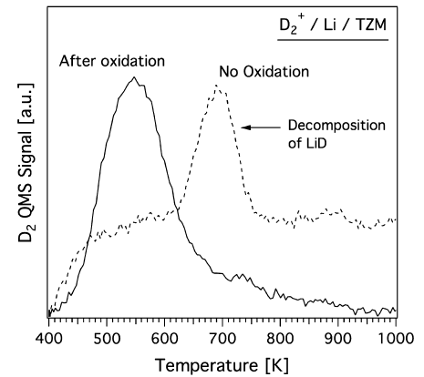
Modest heating of SCT can release T from LiT
Release of D₂ shown by heating LiD film to ~ 400 - 600 °C
D₂ release from thin LiD film occurred at relatively lowTemperature ~ 400°C
T recovery from SCT:
• The LL flow is diverted to another SCT.
• LL in the SCT is then drained
• The accumulated LiT on the surface of SCT is then heated to ~ 400 – 600°C to release T
• The released T pumped out for recovery.
D₂,
To tritium separator
T₂
400°C
T₂,
D₂
T₂
A.M. Capece, JNM (2015)
D₂
Similar observation by E. Oyarzabal et al., JNM (2015)
Quantification of Li-H crystallization and H-isotope release are being investigated in collaboration with University of Illinois – U.C.
Notes:
Once the sufficient amount of LiT crystal is collected, one can then divert the LL to another SCT. LL in the SCT is then drained. The empty SCT can be then heated to 400 – 600 °C to release T and D. In one laboratory experiment we performed, deuterium is shown to be released at 400 °C.. With collaboration with UI, we have also started to quantify the H-isotope release with temperature. Once tiritum is in gaseous form, a conventional tritium separator can be used to separate the tritium from other gases released.

Slide 11
Centrifugal separation of LiD, LiT also appears feasible
LiT, LiD ~ 1 g/cc is twice as heavy as LL ~ 0.5 g/cc
Centrifuge Separator
Operate at ~ 190°C
LiD, LiT
Processed LL
LiD, LiT
Enriched slurry of LiD, LiT
Separation via cascaded centrifuges
  Enriched slurry of LiD, LiT removed continuously at periphery
  Need to prevent LiD, LiT accumulation
Commercial units handle 60,000 liters/hour
Notes:
Another tritium separator uses the principle of centrifuge taking advantage of LiT density being twice as large as that of LL. As the heavier LiT migrates toward outside, the enriched LiT slurry is expelled at the outer radius, In this case, it is desirable for the LiT to not stick to the outerwall and to exit from the intended exit pipe so the outer wall should be smooth and slippery for LiT.
Such a system of course will be located outside the strong magnetic field region.

Slide 12
Tritium (T) Inventory Control in Fusion Power Plant
~ 2.5 kg with 1100 l LL-loop system
T ~ 0.5 g/s
T inventory in LL-loop system:
Fusion
1 % burn
• 0.5 % (by weight) T concentration LL contains ~ 2.5 g of T / l
• LL inside VV may contain up to 100 l of LL or 0.25 kg
• LL in LL-loop before and in cold traps (~ 0.5%) may contain 500 l of LL or 1.25 kg
• LL after cold traps (~ 0.4%) may contain 500 l of LL or 1.0 kg
• Total tritium inventory in RLLD/ALLD may contains 2.5 kg of T.
100 l
LL flow ~ 1 l /s
0.5% T ~ 2.5 g/s
500 l
Dust filter
T ~ 0.5 g/s
T Extractor
500 l
Return to RLLD/ARLLD
0.4% T ~ 2.0 g/s
T % in VV | T(kg)
0.7 | 3.6
0.6 | 3.05
0.5 | 2.5
0.4 | 1.95
0.3 | 1.4
T inventory is quite manageable; ~ 2.5 kg with ~ 0.5% T in 1100 l LL system. Less with lower T%.
Notes:
Now, I would like to estimate the tritium inventory level in the LL-loop system. The inside of the vacuum vessel should contain less that 100 l of LL. The lithium film of 0.2 mm over 100 m2 divertor wall surfaces only amount to be about 20 l. One can have thicker LL layer near the divertor strike point which may add another 20 l. The actual lithium within the plasma for the radiative divertor should be only a small fraction of 1l. We therefore conservatively assume 100 l of LL within the vacuum chamber. We estimate the total of 500 l for the dust filters and related pipes and the another 500 l for tritium extractor system and pipes. The total LL volume is estimated at 1100 l. With 0.5% tritium, the total tritium inventory is estimated to be 2.5 kg. With lower T%, the estimate is correspondingly lower.

Slide 13
Li – T Clean-up Before Shutdown
In preparation for refurbishment/maintenance
In preparation for shut down, drain LL into Li reservoir while keeping VV and divertor chamber at ~ 600 °C to release residual gas and Li.
Maintain VV and divertor chamber at ~ 600 °C
• Continue pump and collect residual T released.
• Collect any residual Li into Li reservoir operating at ~ 200°C. Li vapor condenses on coldest surfaces which is the L reservoir.
• Shut down once all LL and T are collected.
To
Pump
Dust Filter
T Extractor
Li reservoir at 200 °C
Notes:
For lithium and tritium clean up before opnening, we can maintain the VV temperature at 600 °C while draining LL into the Li reservor and pump out the tritium . The Li reservoir at 200 °C should capture any remaining Li.

Slide 14
Summary
• LL provides renewable surfaces and effective medium to protect high-Z divertor PFC substrates from steady-state and transient heat/particle flux in reactor.
• Lithium can provide an effective means of reducing divertor heat flux through non-coronal radiation without increasing recycling (RLLD and ARLLD)
• A modest LL-loop of ~ 1 l / sec could provide a means to remove dust/impurities from reactor divertor chamber.
• The LL-loop system could provide an efficient way to remove tritium and control tritium inventory in fusion reactor.
• Surface cold trap and centrifugal systems are proposed for real time tritium removal in the LL-loop system.
• NSTX-U will conduct basic RLLD/ARLLD experiments in H-mode plasmas.
• LL-loop and T extraction R&D cam be performed with relatively modest investment.
Notes:
19.00

Slide 15
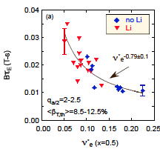
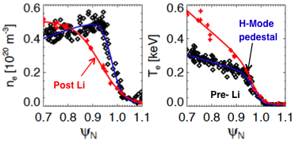
In NSTX, Li Improved H-mode Performance
Modest amount of Li ~ 0.3 g improved plasma performance
Broader pressure and current profile for improved MHD stability (H. Kugel, PoP 2008)
Electron energy confinement improvement by ~ 20 - 30 % (R. Maingi, PRL 2011 )
Reduction in H-mode power threshold by ~ 20 - 30%. (S. Kaye, NF 2011)
ELM stabilization (D. Mansfield, JNM 2009)
Very low Li core dilution observed < 0.1% (M. Podesta, 2012)
S. Kaye, NF 2014
R. Maingi, PRL 2009

Slide 16
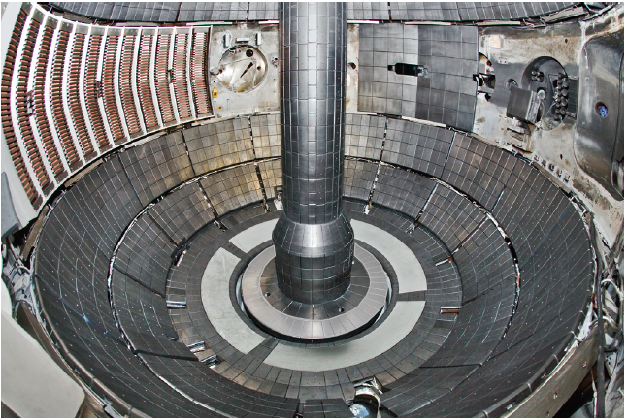
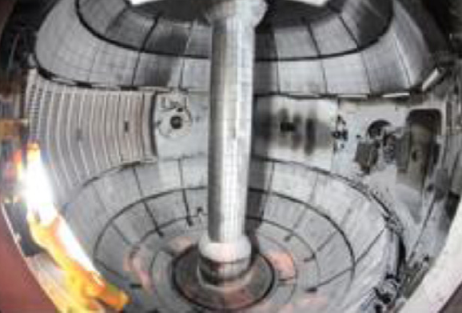
NSTX Liquid Lithium Divertor (LLD) Experiment
Modest amount of lithium protected LLD metal surfaces
Thin sub-millimeter Li coating protected the LLD surface even with the strike-point directly on it.
No sign of LLD surface material (moly) in the plasma.
NSTX LLD Experiment
Before
After
LLD
LLD
0.2 mm thick Li layer protected the LLD surface
H. Kugel FE&D 2012

Slide 17
Double walled for safety and tritium recovery
Also provide efficient thermal barrier
LL Double Walled System
Vacuum
Flowing LL
Vacuum
Double walled system for the LL loop system:
Provide extra layer of safety protection. Should be able to detect the LL leak at early stage.
Vacuum provides good thermal insulation.
Any tritium migration into vacuum can be collected by the double walled system, essentially eliminating tritium loss from the system.
Notes:
19.00

Slide 18
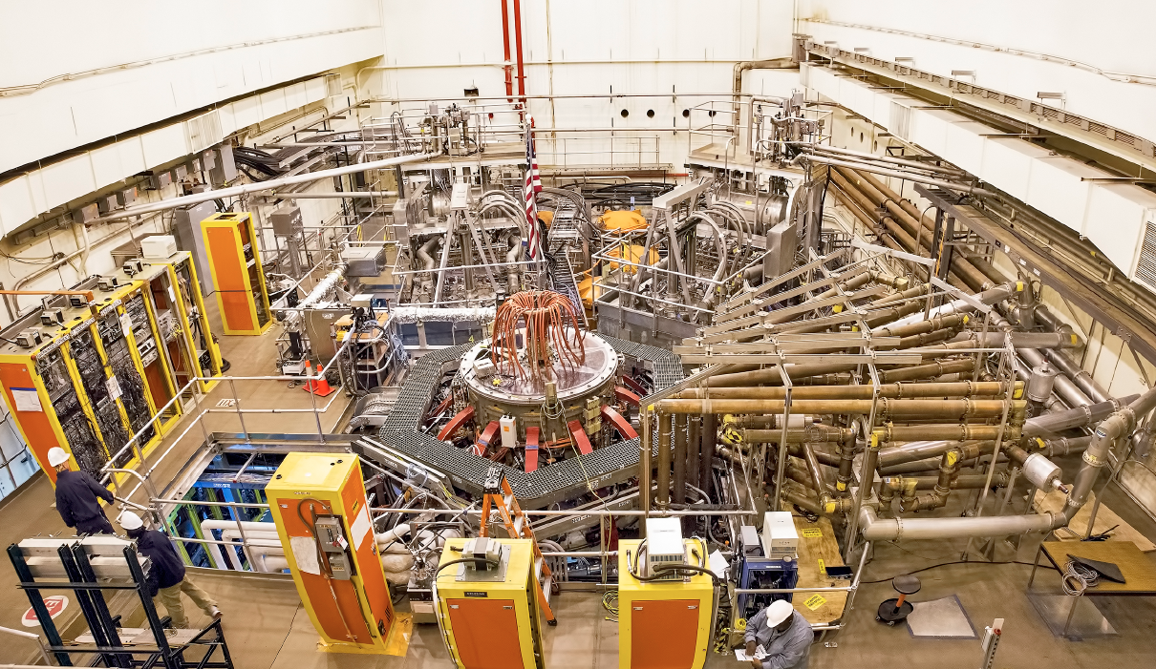
NSTX-U Facility Came On Line This year
To demonstrate fully sustained high beta plasmas
2nd NBI
1st NBI
HHFW System
NSTX-U

Slide 19
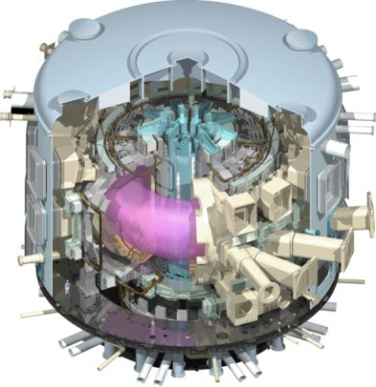
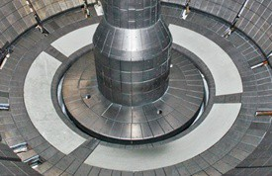
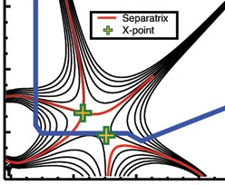
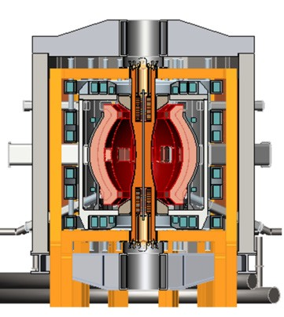
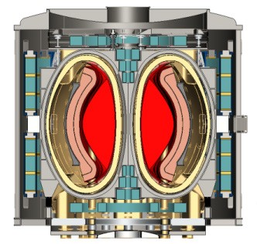
NSTX-U Mission Elements:
Explore unique ST parameter regimes to advance predictive capability - for ITER and beyond
ITER
Develop solutions for plasma- material interface (PMI)
Liquid metals / Lithium
Snowflake/X
ST-FNSF /
Pilot-Plant
Advance ST as Fusion Nuclear Science Facility and Pilot Plant

Slide 20
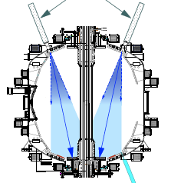
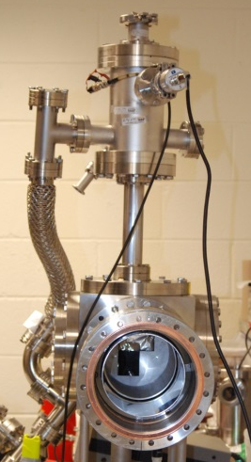
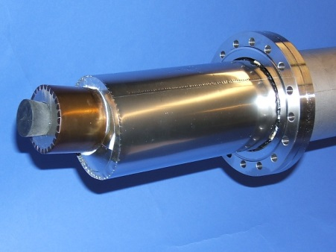
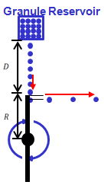
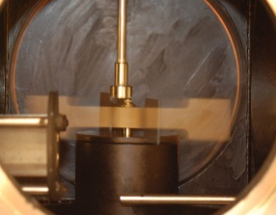
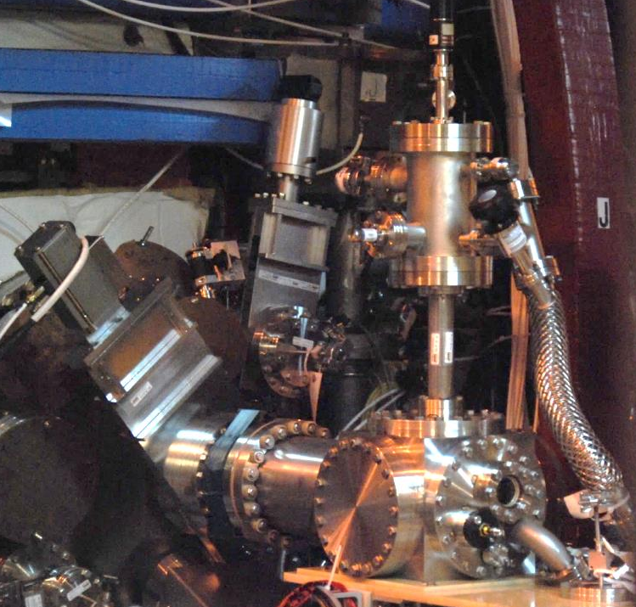
Lithium applications will be investigated on NSTX-U
Lithium Evaporators, Granule Injector
Lithium Evaporator (LITERs)
LITERs
Granule injector (GI) for ELM pacing
Successfully tested
on EAST and DIII-D
Granules: Li, B₄C, C
f ~ up to 500 Hz
Granular Reservoir
• LITERs filing set up in high bay south of NSTX-U Test Cell.
• Argon purge system implemented for Li safety, used for the quick argon vent.
• Ready to support the run.
Rotating Impeller
• GI is now operational.
GI installed on NSTX-U

Slide 21
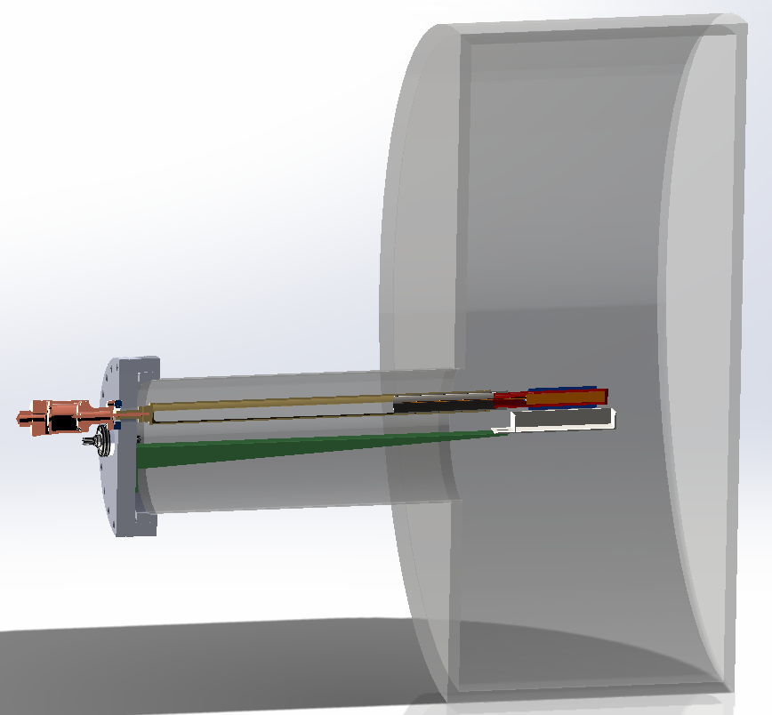
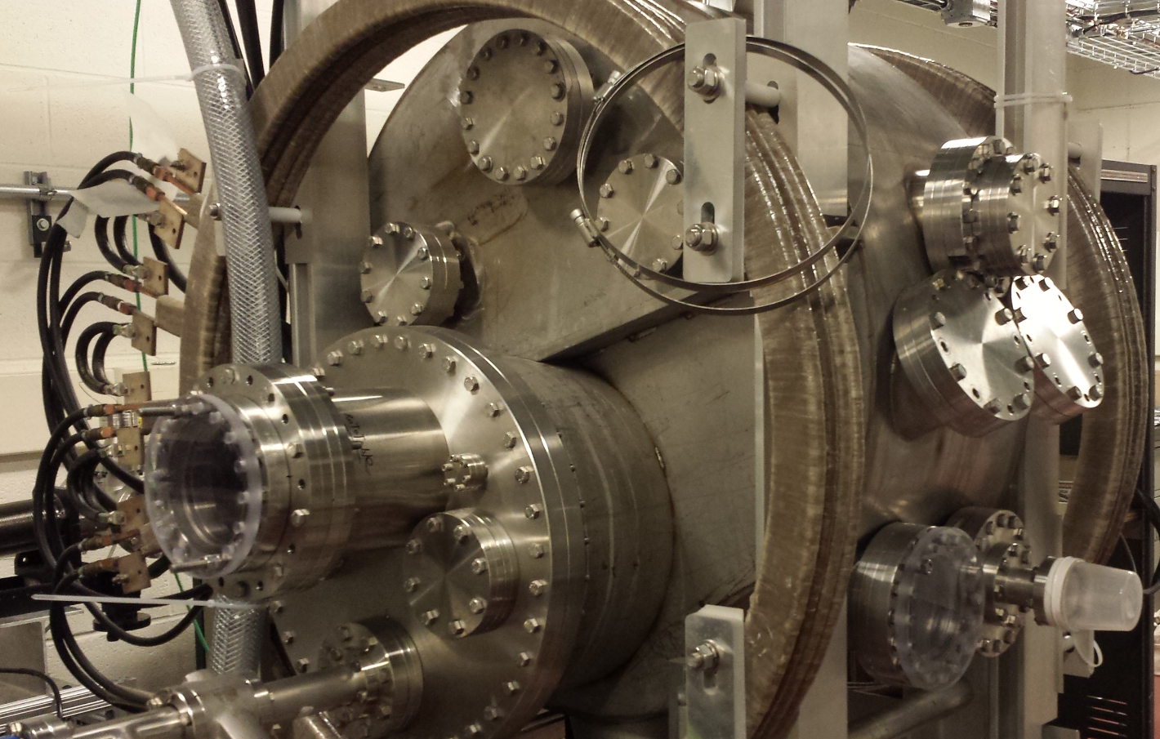
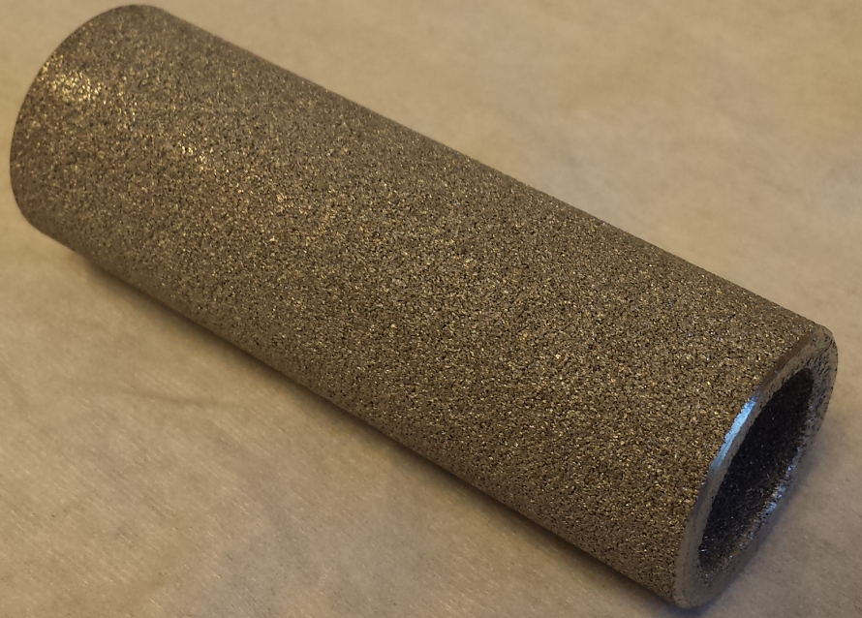
Upward Lithium Evaporator R&D Being Performed
Fast evaporation with much less lithium
• WAF completed for ULITER prototype development
• Based on resistive heating of lithium in porous stainless steel medium for fast evaporation
• Prototype can be used on NSTX-U if installed using power supply with remote control
• Evaluation of porous medium to absorb liquid lithium in progress
Li
21”

