Slide 1

Active conditioning of ASDEX-Upgrade tungsten PFCs through boron particulate injection (FIP/2-3)
R. Lunsford¹ , V. Rohde², A. Bortolon¹, A. Drenik², R. Dux², A. Herrmann²,
A. Kallenbach², R. M. McDermott², R. Maingi¹, D.K. Mansfield¹, A. Nagy¹,
R. Neu², E. Wolfrum² and the ASDEX-Upgrade team
¹Princeton Plasma Physics Laboratory, Princeton, NJ, USA
²Max Planck Institute for Plasma Physics, Garching, Germany
27th IAEA Fusion Energy Conference,
22-27 October 2018, Gandhinagar, India

Slide 2
“Real-Time” boronization through powder injection
Plasma assisted wall conditioning uses solid B compounds instead of toxic and explosive B₂D₆ gas
Deposition of B powders extends the effective lifetime of boronization coatings
  Allows density-controlled, high-purity plasmas with reduced wall fueling and mitigated High-Z impurity sources
  Maintains controlled wall conditions over a run campaign
  Could be used to provide active boronization for future long pulse discharges

Slide 3
Outline
Experimental Apparatus
Boron Injection Experiments
  Boron Nitride Injection Series
  Boron Injection Series
Conditioning Effects

Slide 4
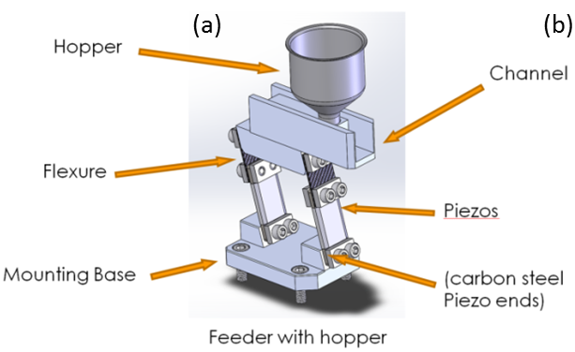
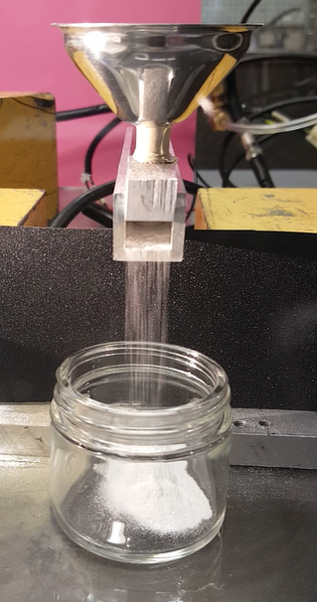
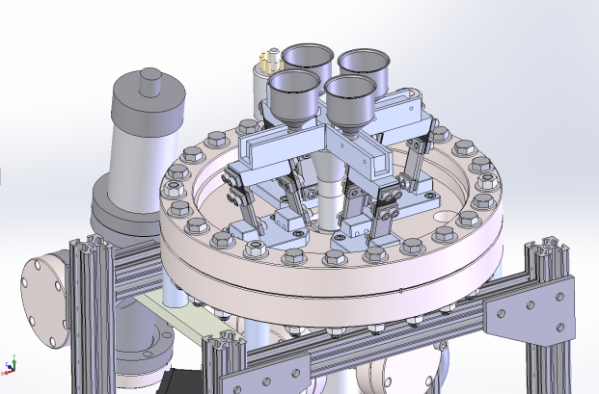
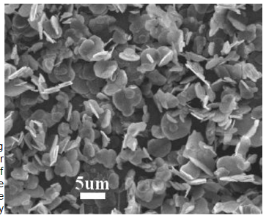
Impurity powder dropper (IPD)
Multi-impurity injection system based on linear piezoelectric powder feeder
4 feeders with separate reservoirs (30 ml) around central drop tube
Tested with multiple materials
  B, BN, Li, Si, SiC, Sn…
  particle size 5-100 μm
  calibrated rates 2-200 mg/s
Injection calibrated with accelerometer, optical flow-meter confirms mass injection rate
Boron Nitride BN
A. Nagy et al., Rev. Sci. Instr. at press 2018

Slide 5
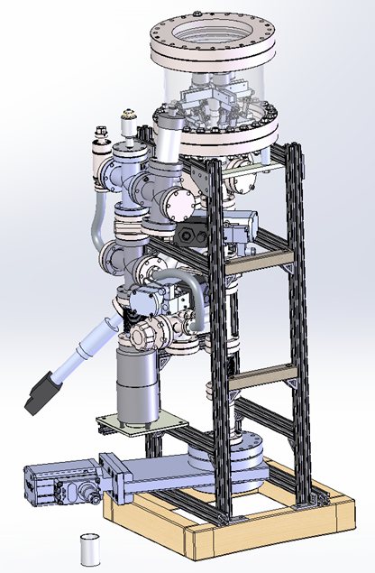
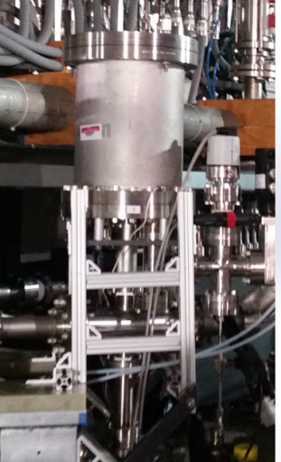
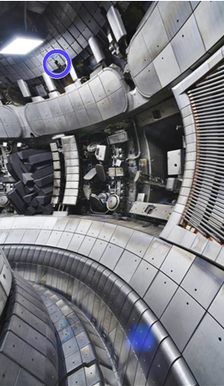
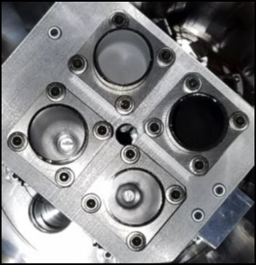
IPD installed atop AUG during Fall 2017
BN
B
2.5 m drop tube connects IPD with crown of AUG discharge
Chamber 1 loaded with 5 μm BN powder
Chamber 2 loaded with 70 μm B powder

Slide 6
Outline
Experimental Apparatus
Boron Injection Experiments
  Boron Nitride Injection Series
  Boron Injection Series
Conditioning Effects

Slide 7
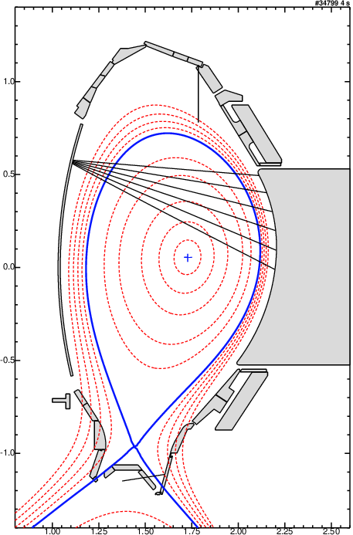
B/BN injected into conformal discharges to enhance coating
IPD
Wall-conditioning discharge with conformal shape
  SOL surfaces parallel to antenna limiter
ELM-y H-mode discharges with I_{P} = 0.8 MA, B_{T} = 2.5 T, P_{NBI} = 10 MW, P_{EC} = 0.8 MW, n_{e} = 6.5x10¹⁹ m⁻³
Conditioning effects inferred from
visible spectroscopy
  Line emission from BII, OII, WI
  assumed representative of wall source
  Views for divertor (DVL) and limiter (LVL)
W impurity influx from ICRH antenna limiter inhibits low-collisionality operation
  D₂ puff required to maintain robust ELM frequency
LVL
ICRH antenna
limiter
DVL

Slide 8
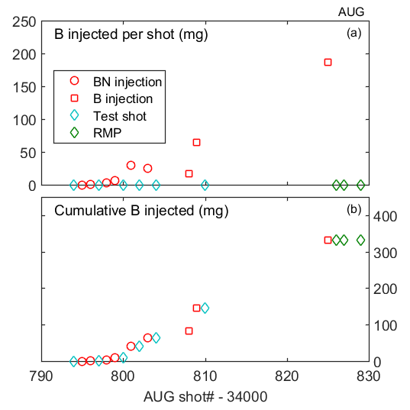
Wall conditioning by B powder injection
Experiment scheduled to provide maximum chance to observe changing wall conditions (directly before standard D₂B₆ boronization)
9 conditioning discharges with BN or B
  Constant injection rate for 1-3 s @ 2-75 mg/s
6 test discharges w/o IPD
  Interleaved to assess changing wall conditions
3 attempts at ELM-suppression with RMP after completing conditioning discharge sequence
  scenario tests access to low collisionality
Total ~330 mg of B introduced in AUG
34790
34800
34810
34820
34830
ASDEX-U Shot Number

Slide 9
Outline
Experimental Apparatus
Boron Injection Experiments
  Boron Nitride Injection Series
  Boron Injection Series
Conditioning Effects

Slide 10
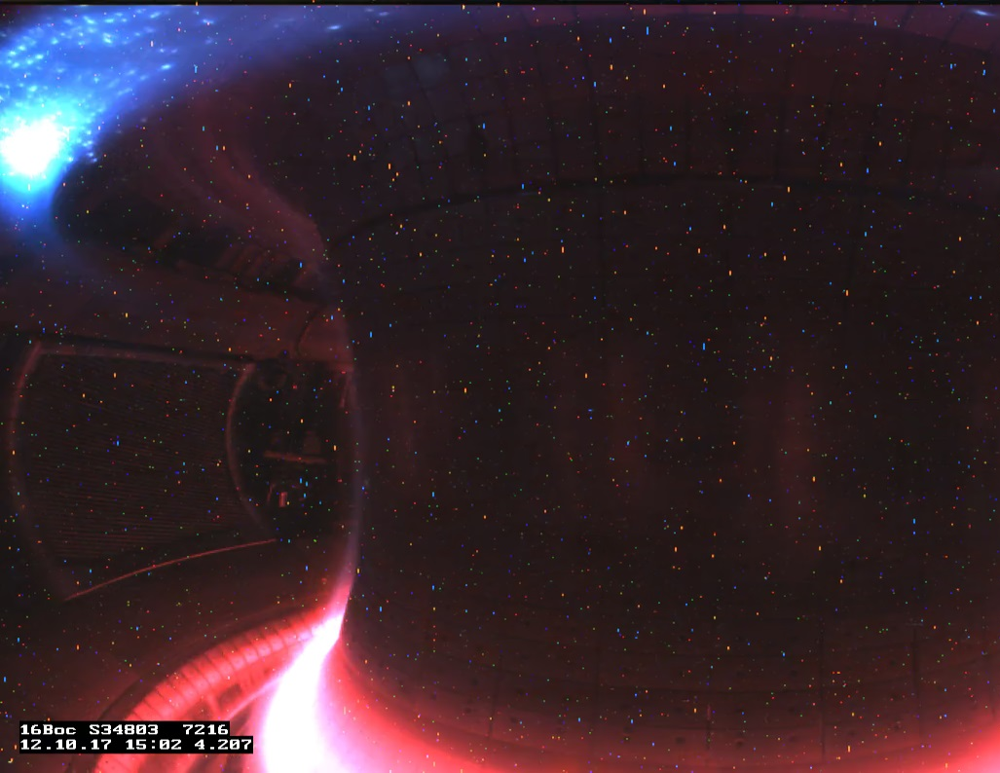
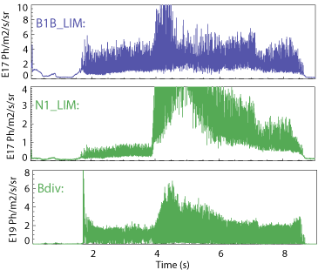
Boron nitride injection series
Nitrogen Intensity
ASDEX Discharge | Injection Species | Quantity of boron injected (atoms) | Cumulative boron injection
34796 | BN | 1.7x10¹⁹ | 1.7x10¹⁹
34798 | BN | 1.7x10²⁰ | 1.9x10²⁰
34799 | BN | 3.5x10²⁰ | 5.4x10²⁰
34801 | BN | 1.6x10²¹ | 2.2x10²¹
34803 | BN | 1.4x10²¹ | 3.6x10²¹
Intensity (a.u.)
BN input from 3.8-4.9 s
N radiation dominates, No N latency
B radiation at limiter and divertor

Slide 11
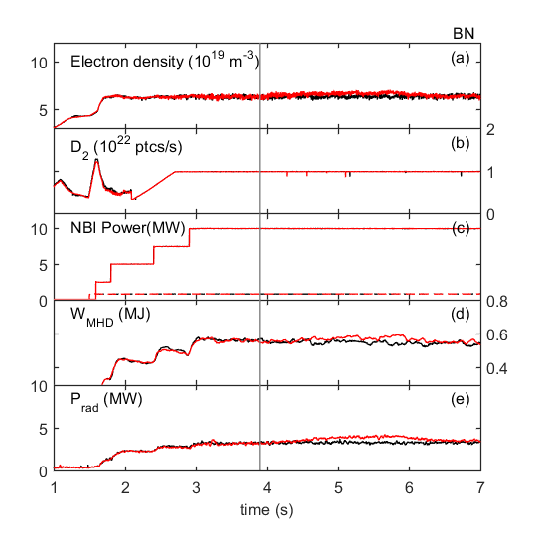
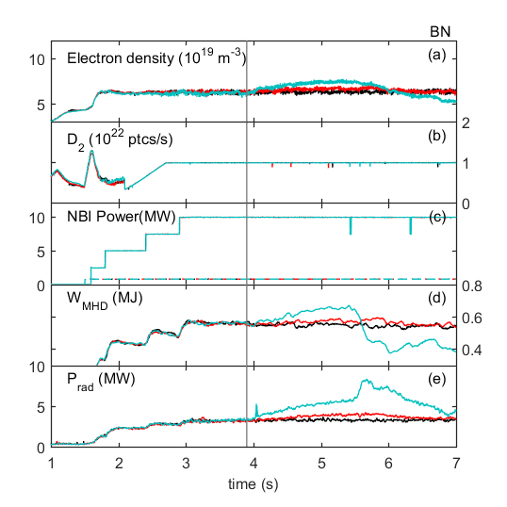
BN increases confinement similar to N₂
#34802 : Control Discharge
#34799 : 9 mg/s
  5% increase of n_{e} and P_{rad}
  Stored energy W_{MHD} unchanged
#34801 : 52 mg/s
  n_{e} +25% and P_{rad} +80%
  W_{MHD} increases until core mode destabilized (β_{N}~2.7)
  Confinement improvement
  associated with pedestal recovery
  Greater coupling to discharge than seen with N2 gas puff
34802
34799
34801
BN, 52 mg/s
BN, 9 mg/s
A. Bortolon et al., Submitted J. Nucl. Mater. Energy 2018

Slide 12
Outline
Experimental Apparatus
Boron Injection Experiments
  Boron Nitride Injection Series
  Boron Injection Series
Conditioning Effects

Slide 13
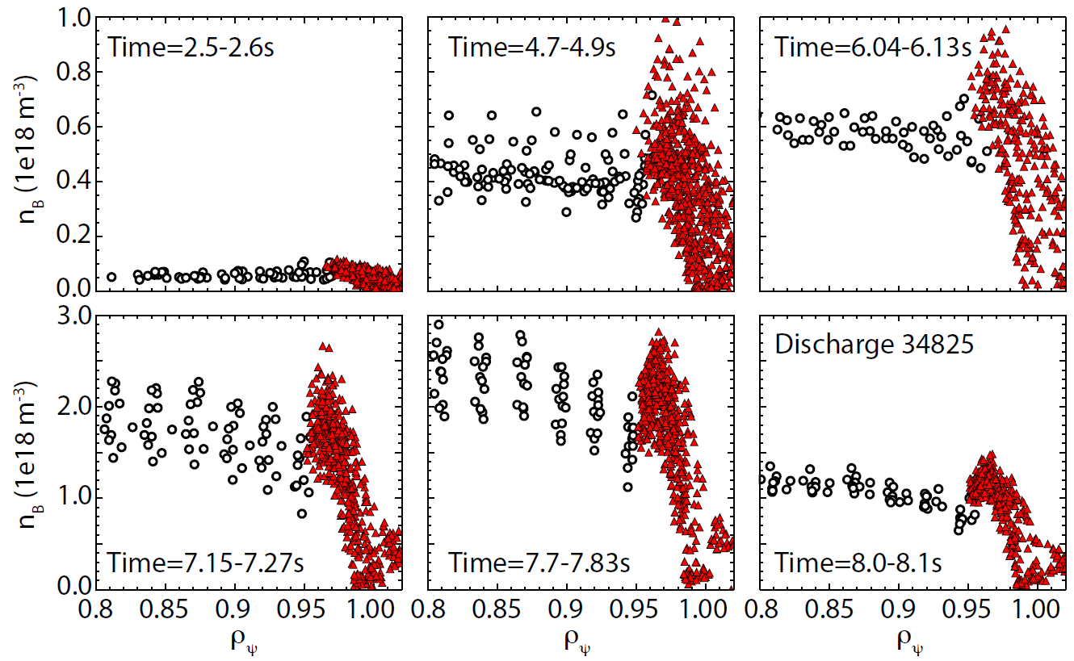
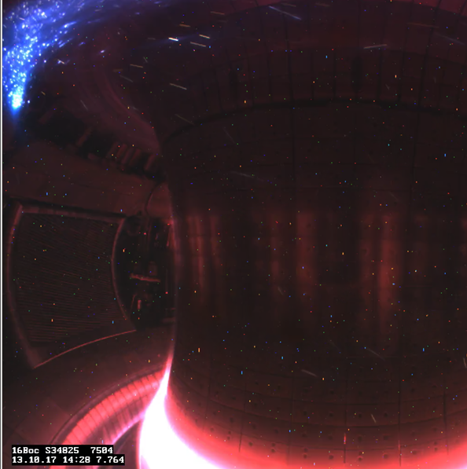
Metallic Boron Injection Series
B⁵⁺ concentration
ASDEX Discharge | Injection Species | Quantity of boron injected (atoms) | Cumulative boron injection
34808 | B | 9.6x10²⁰ | 4.5x10²¹
34809 | B | 3.6x10²¹ | 8.1x10²¹
34825 | B | 1.0x10²² | 1.9x10²²
Pure B input from 3.8-7.9 s
Less additional radiation, stable discharge
CEX shows B fully penetrates discharge

Slide 14
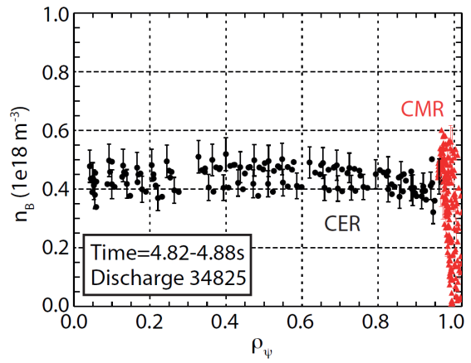
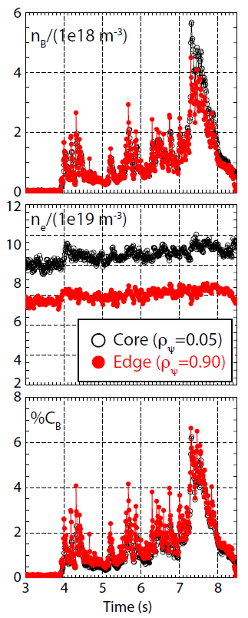
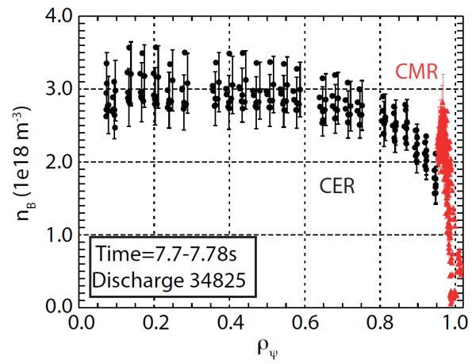
Metallic Boron Injection Series
ASDEX Discharge | Injection Species | Quantity of boron injected (atoms) | Cumulative boron injection
34808 | B | 9.6x10²⁰ | 4.5x10²¹
34809 | B | 3.6x10²¹ | 8.1x10²¹
34825 | B | 1.0x10²² | 1.9x10²²

Slide 15
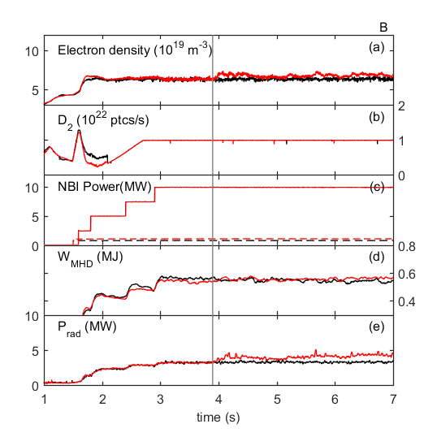
Boron injection well tolerated by plasma
34802
34825
ELMy H-modes, f_{ELM}~70-100 Hz
  10 MW NBI, 1.2 MW ECRH
  D₂ fueling throughout
#34825 : B injection, 75 mg/s
  Modest ~5% increase of n_{e}
  Oscillations due to fluctuations in drop rate (B clumping)
P_{rad} increase by 20%
No effect on stored energy W_{MHD}
B 75 mg/s
A. Bortolon et al., Submitted J. Nucl. Mater. Energy 2018

Slide 16
Outline
Experimental Apparatus
Boron Injection Experiments
  Boron Nitride Injection Series
  Boron Injection Series
Conditioning Effects

Slide 17
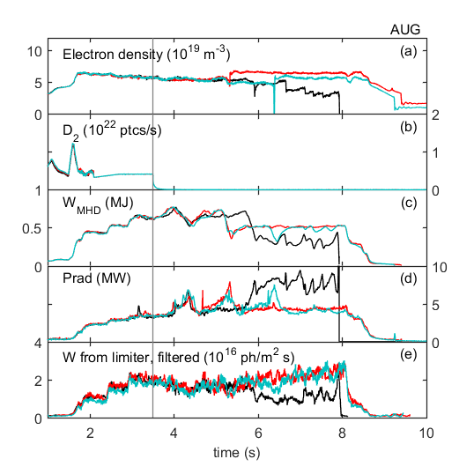
Low-density test shot shows slight improvement
34797
34800
34810
#34797 : ~3.7 x 10¹⁸ B atoms injected
#34800 : ~1.3 x 10²⁰ B atoms injected
#34810 : ~5.8 x 10²¹ B atoms injected
Due to wall conditions test discharge scenario is unstable w/o gas puff
  Core MHD
  P_{rad} runs away
  Radiative collapses → disruption
After BN/B injection MHD persists
  P_{rad} run away is avoided
  Plasma sustained to completion
A. Bortolon et al., Submitted J. Nucl. Mater. Energy 2018

Slide 18
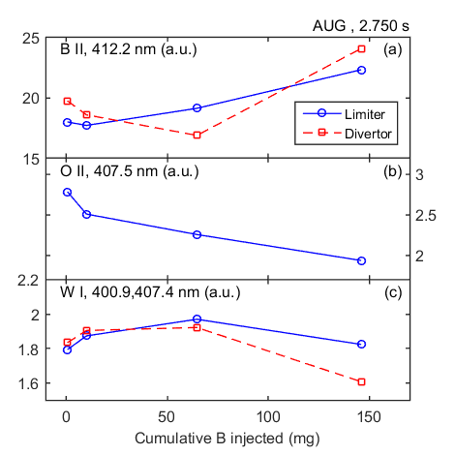
Wall condition observables improve during test-shot series
Impurity source estimated from
time-average of line emission
  BII, OII and WI
B from limiter increases → B coating
O from limiter decrease → O gettering
W source decreases for >100 mg B
Similar trends observed in divertor
A. Bortolon et al., Submitted J. Nucl. Mater. Energy 2018

Slide 19
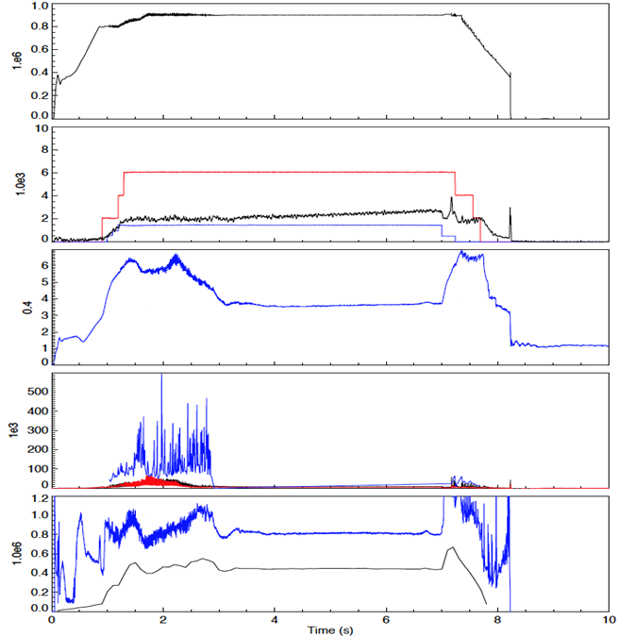
Boron injection assists successful RMP ELM suppression
34826
Total boron injected : 330 mg
#34826 : Attempted ELM-suppression
D₂ puff stopped at t=2.25s
n = 2 RMP from 2.5 – 7 s
Full-shot ELM suppression achieved
  Sufficient n_{e} pump-out maintained
  3 consecutive discharges
Slow increase in P_{rad} and W radiation
  Impurity sources recovering
  on discharge time-scales
Need to confirm B injection is responsible
Magnetic Perturbations
I_{P}(MA)
P_{AUX}(a.u.)
P_{RAD}(a.u.)
n_{e}( x10¹⁹ m⁻³)
D_{α}(a.u.)
ELMs suppressed
#34827 & #34829
suppressed also
H₉₈
W_{MHD}(MJ)

Slide 20
Summary
BN and B powder both successfully injected into auxiliary heated AUG plasmas
Boron Nitride:
  Observed increased B & N flux from limiters & divertor
  P_{rad} increased by > 100% at highest rates
  At high injection rates, confinement and stored energy increased by 20-30%, as observed with N₂ puffing
  Crashed at β_{N} > 2.7
Elemental Boron
  Observed increased B flux from limiters & divertor
  P_{rad} increased by 50% at highest rate
  Discharge stable, B injection limit not reached

Slide 21
Conclusions and Outlook
Initial AUG experiments suggest that boron powder injection can be used to augment borization coating during tokamak operation
  Successful modification of edge impurity levels
  Successful access to low density for RMP ELM suppression
  Upcoming experiments planned to corroborate results and optimize technique
Particulate wall conditioning could aid steady-state operation where initial coatings will erode rapidly
IPD has been/is being installed on other devices
  DIII-D results to be presented at APS 2018
  Successful horizontal B₄C injection into W7-X
  Experiments on EAST, KSTAR to address
  applicability to long pulse operation

Slide 22

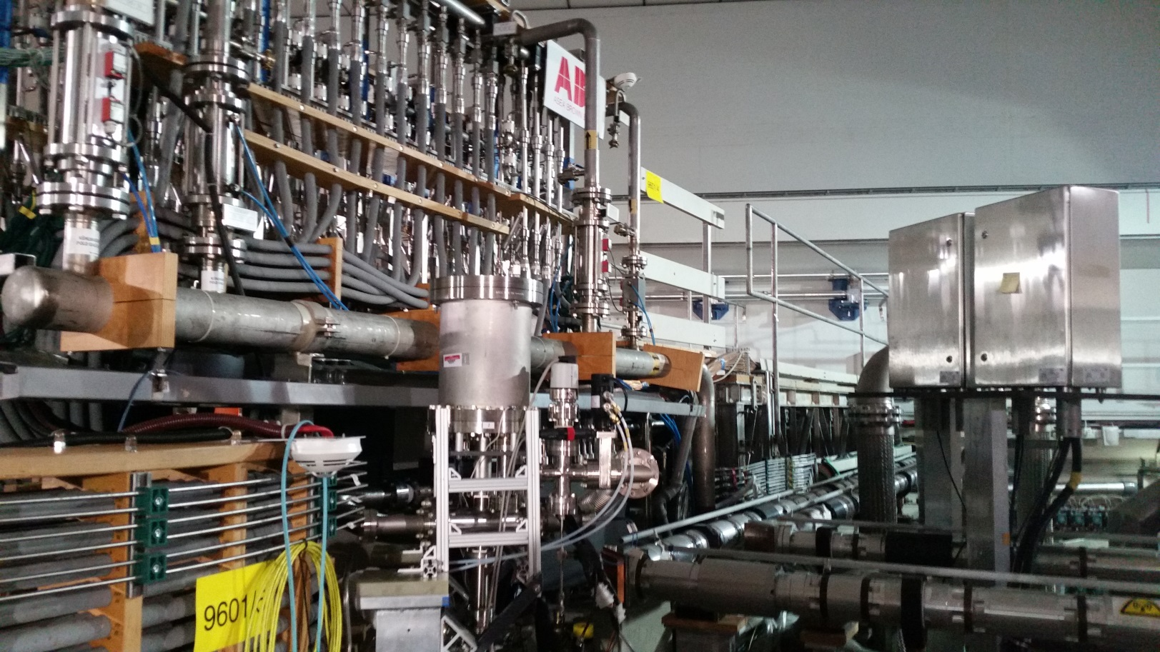
Thank you!
IPD

Slide 23
Supplemetal Information

Slide 24
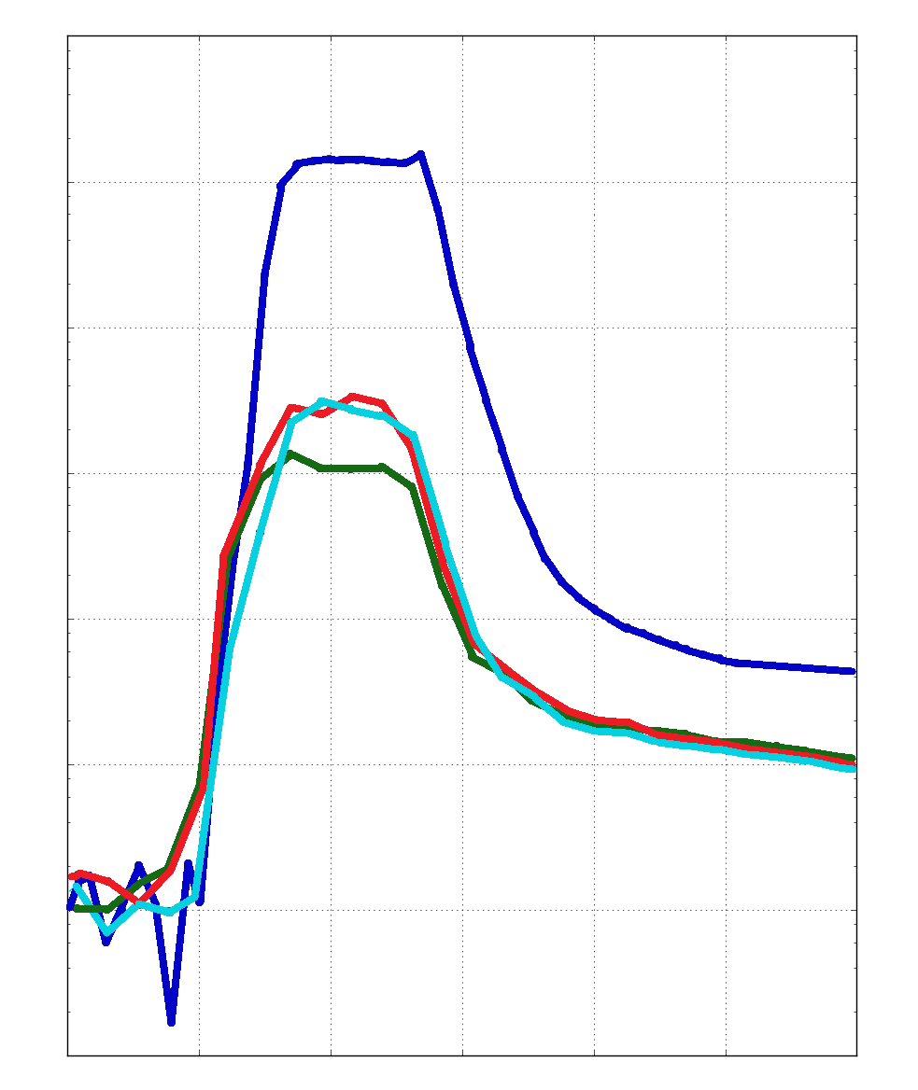
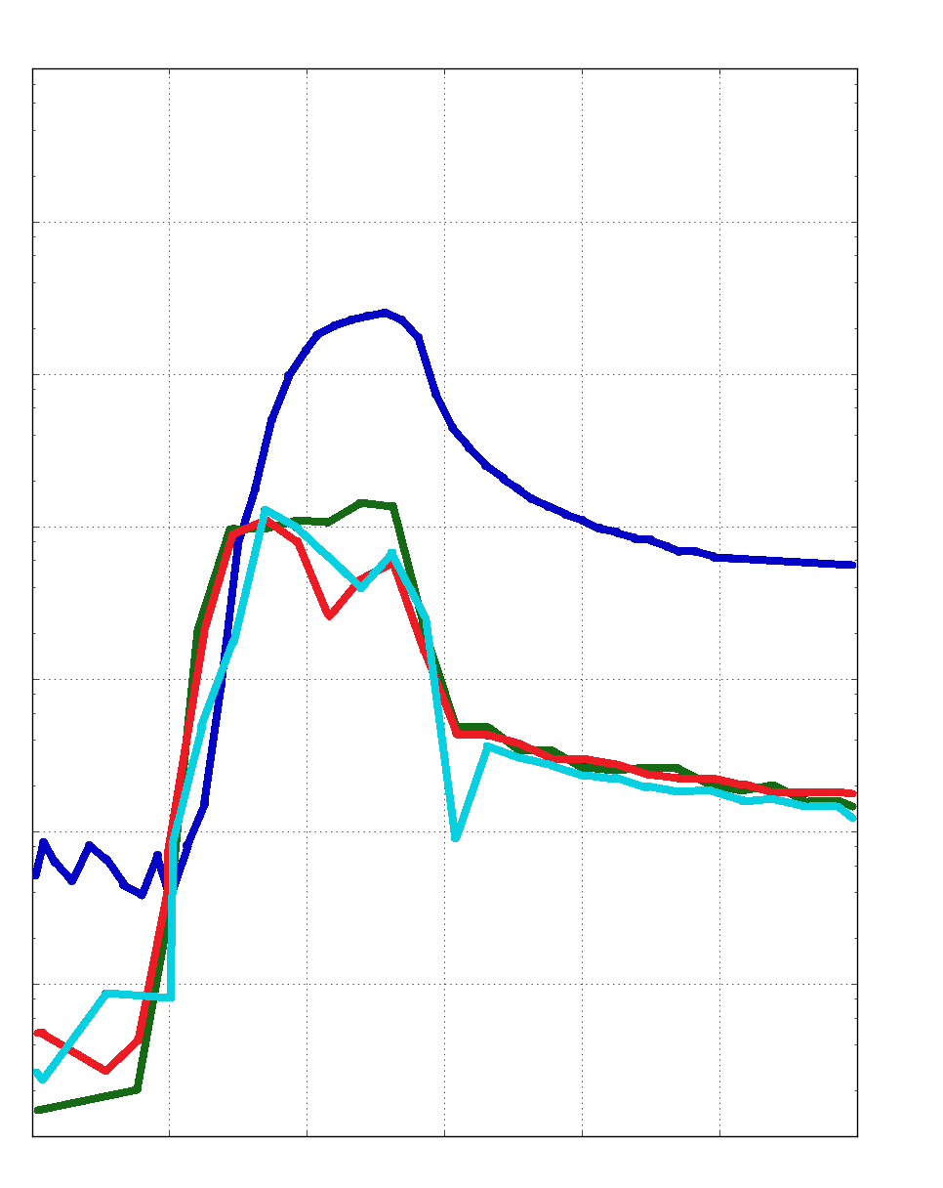
Performance enhancement observed with BN similar to N₂ gas puff
Greater coupling to discharge with smaller Nitrogen quantity
Reduction in Ammonia quantity
Suggestive of NH₃ mitigation possibilities for JET & ITER to prevent tritium sequestration
Full behavior not well understood, further study required
RGA Comparison of BN injection and N₂ gas puff
Inner Divertor – Partial Pressure of Residual Gasses
Nitrogen
Ammonia
10⁻⁴
10⁻⁴
10⁻⁶
10⁻⁶
Partial Pressure [a.u.]
Partial Pressure [a.u.]
10⁻⁸
10⁻⁸
# 34267, Gaseous N₂
# 34800, No BN
# 34803, BN
# 34809, B
10⁻¹⁰
0
5
10
15
20
25
10⁻¹⁰
0
5
10
15
20
25
Time(s)
Time(s)

