Slide 1

Development of a
Lithium Vapor Box Divertor
for Controlled Plasma Detachment
Rob Goldston, Eric Emdee, Michael Jaworski, Jacob Schwartz
Princeton Plasma Physics Laboratory
Tom Rognlien, Marv Rensink
Lawrence Livermore National Laboratory
IAEA FEC 2018

Slide 2
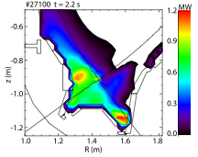
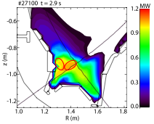
Divertor Detachment Front
Easily Runs up to the Main Plasma
Potzel, NF 2014, AUG
Prad
Prad
0.7 s
Deleterious effect on H-Mode pedestal.

Slide 3

Lithium Vapor Box Divertor Concept
Provide a localized cloud of Li vapor
away from main plasma
  Evaporation at ~ 750° C
  Condensation at ~ 3-400° C
  (determines DT pumping)
Return liquid lithium to evaporator.
Creates strong vapor gradient.
  Detachment front cannot run up to x-point.
  Detachment front location is resilient to variable heat flux.
Cannot be achieved with gaseous impurities – pumping is too weak

Slide 4
UEDGE Model with Lithium
UEDGE has a purely diffusive model for lithium vapor transport.
  Based on collisions of lithium atoms with plasma ions.
  No Li-Li collisions.
  Inaccurate in regions dominated by lithium convection/viscosity:
  Navier-Stokes regime.
Transports lithium in plasma, calculates radiation self-consistently.
  Issues with thermal force model at high impurity fraction.
Achieves detached plasma in Fusion Nuclear Science Facility (FNSF) with nearly 100% lithium radiated power. In “real” world would include other (seed) impurities.
  Upstream lithium fraction depends on upstream electron density.

Slide 5
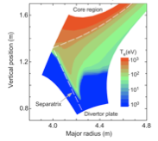
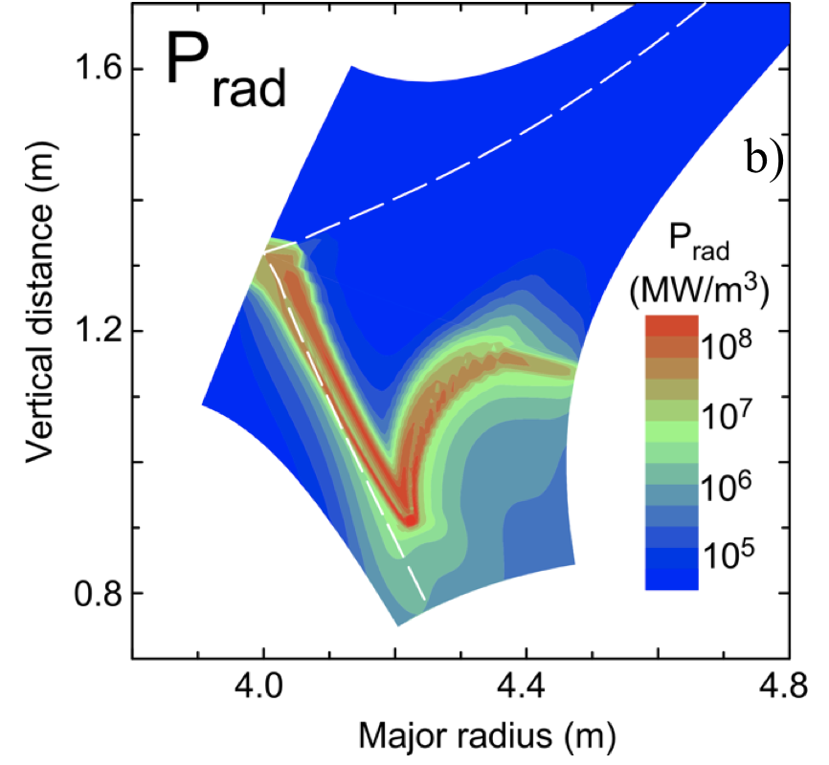
UEDGE Predicts Detachment in FNSF
with Lithium in Simplified Divertor
0.5 m
outer divertor leg,
Open geometry
Localized
evaporation,
absorbing walls.
60 eV radiation
per ionization
Divertor region
heat flux
All radiative!
~ 2 MW/m²
Te
Evaporation
Peak Prad

Slide 6
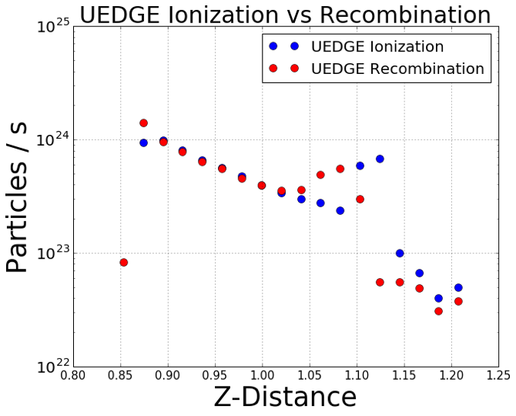
UEDGE Lithium Ionization &
Recombination in Near Local Balance
Detachment
Front
Far SOL
Vertical Position (m)
Recombination roughly equals ionization at a given Z position.
In effect, plasma acts like a mirror (with a cricket bat).

Slide 7
SPARTA Provides Alternative Model for
Lithium Vapor, including Convection & Viscosity
Using SPARTA Monte-Carlo Direct Simulation code for lithium vapor
  Li-Li collision model based on known vapor viscosity vs. T.
  Model evaporation and condensation based on known
  equilibrium Li pressure vs. T, and Langmuir fluxes from surfaces.
Lithium – Plasma interaction
  Assume absorption of lithium at Te = 0.2 eV
  Recombination at the same point.
    Lithium leaves along B with TLi = E||,Li = 0.2 eV
￼

Slide 8
A Simplified Lithium Vapor Box Divertor
Based on UEDGE Results
FW Reflector
~600 C
FW Reflector
~600 C
Plasma
Plasma
Reflector
~600 C
Condenser
~3-400 C
Reflector
~600 C
Condenser
~3-400 C
Condenser
~3-400 C
Condenser
~3-400 C
Condenser
~3-400 C
Condenser
~3-400 C
Evaporator
~700 C
Evaporator
~700 C
Evaporator
~750 C
Allows more Li efflux, but needs less total evaporation
Makes experimental implementation easier,
including starting with a toroidal segment
￼

Slide 9
Lithium Accumulation on First Wall
will be Very Low
140 g/s of lithium evaporated for Prad = 66 MW.
Assume all of this is deposited on first wall, Tw ~ 600 C.
Evaporation rate at 600 C = 2.66 g/s/m²
Area of first wall ~ 300 m²
Total evaporation rate with multi-monolayer surface coverage = 800 g/sec
Can’t even accumulate a few monolayers of Li
LiH decomposes in << 1 sec at 600 C.

Slide 10
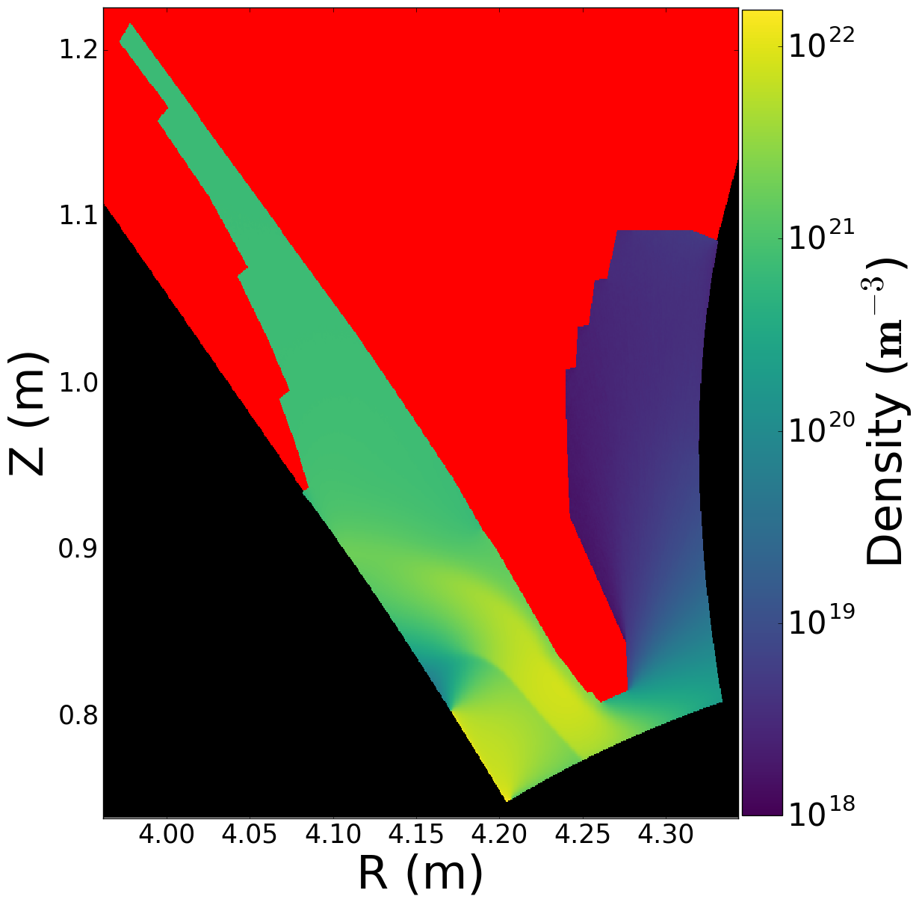
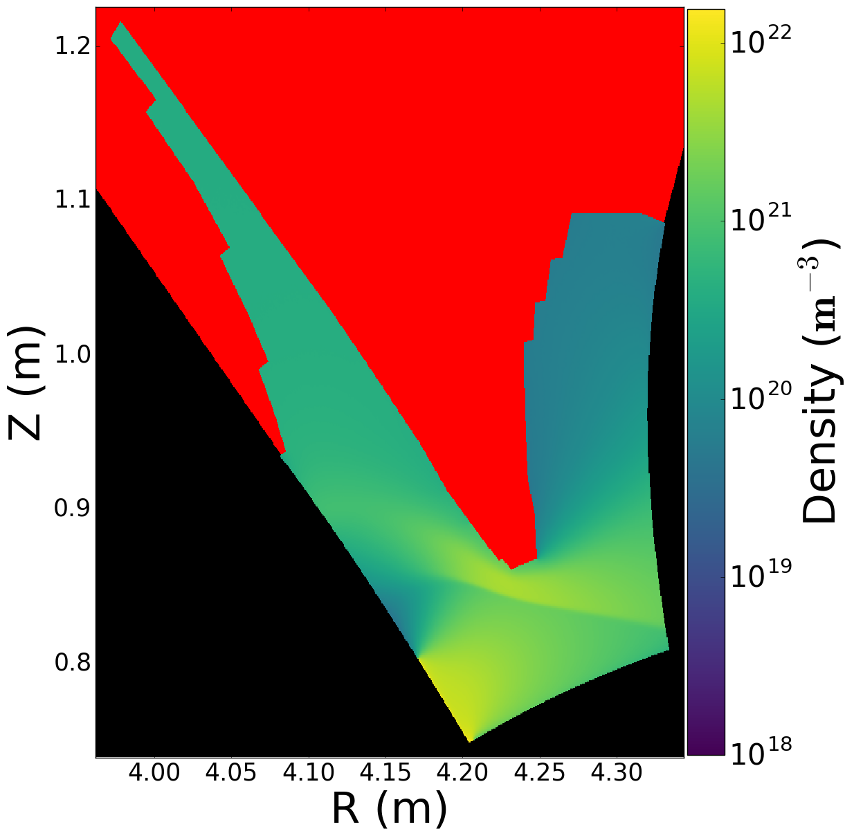
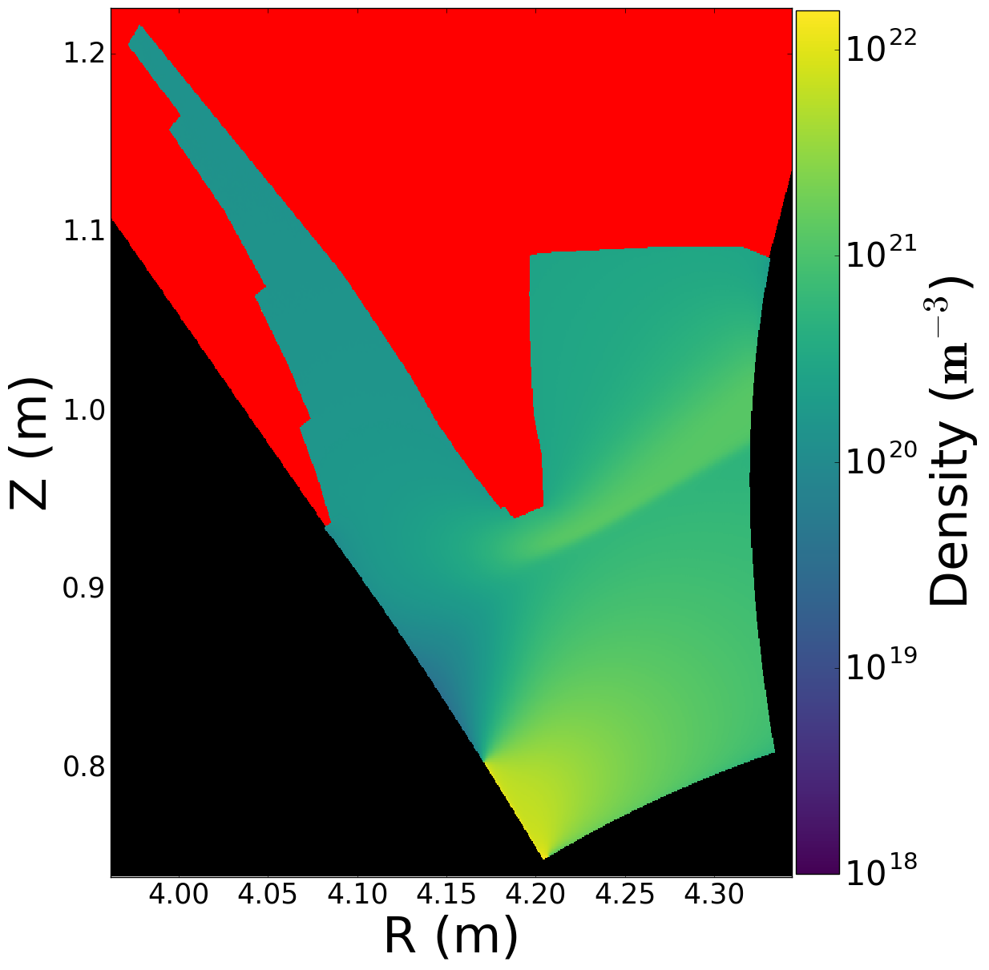
SPARTA Shows Strong Variation in
Lithium Absorption with Detachment Vertical Position
Plasma
Lithium
Vapor
Lithium evaporation from private flux side is much more efficient
when leg is closer to evaporator.
(Does not include radiative heating of evaporator.)

Slide 11
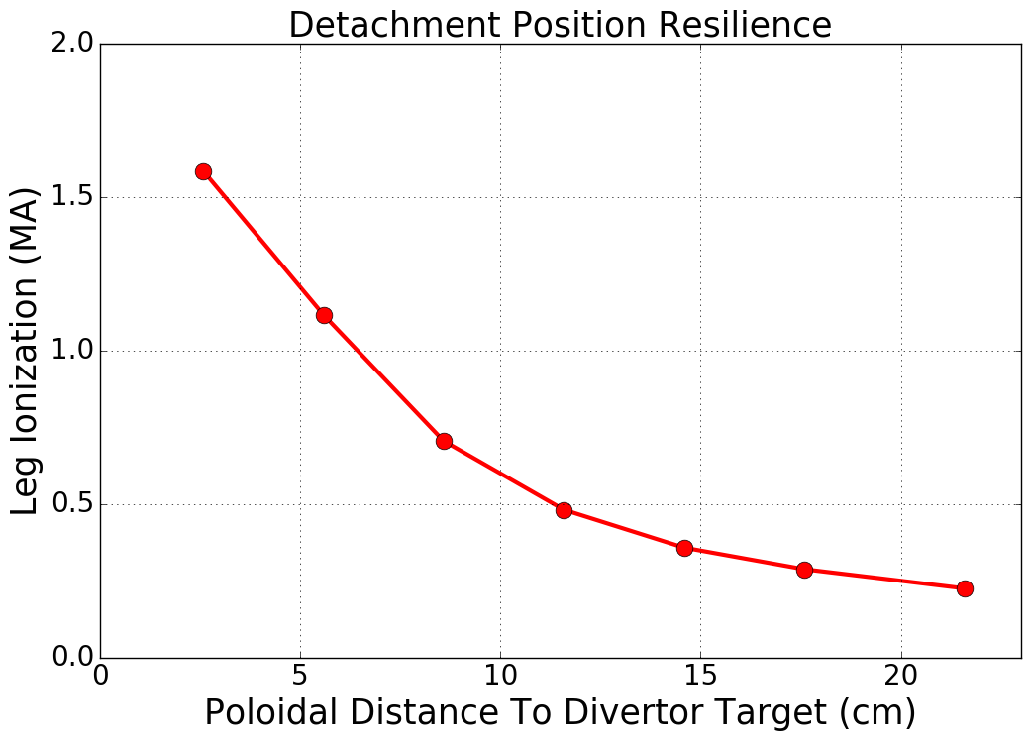
SPARTA Gives Very High Positional Resilience
x 6
Lithium injection from private flux side is much less efficient
as leg moves away from evaporator → Positional resilience.
(Does not include change in radiative heating of evaporator.)

Slide 12
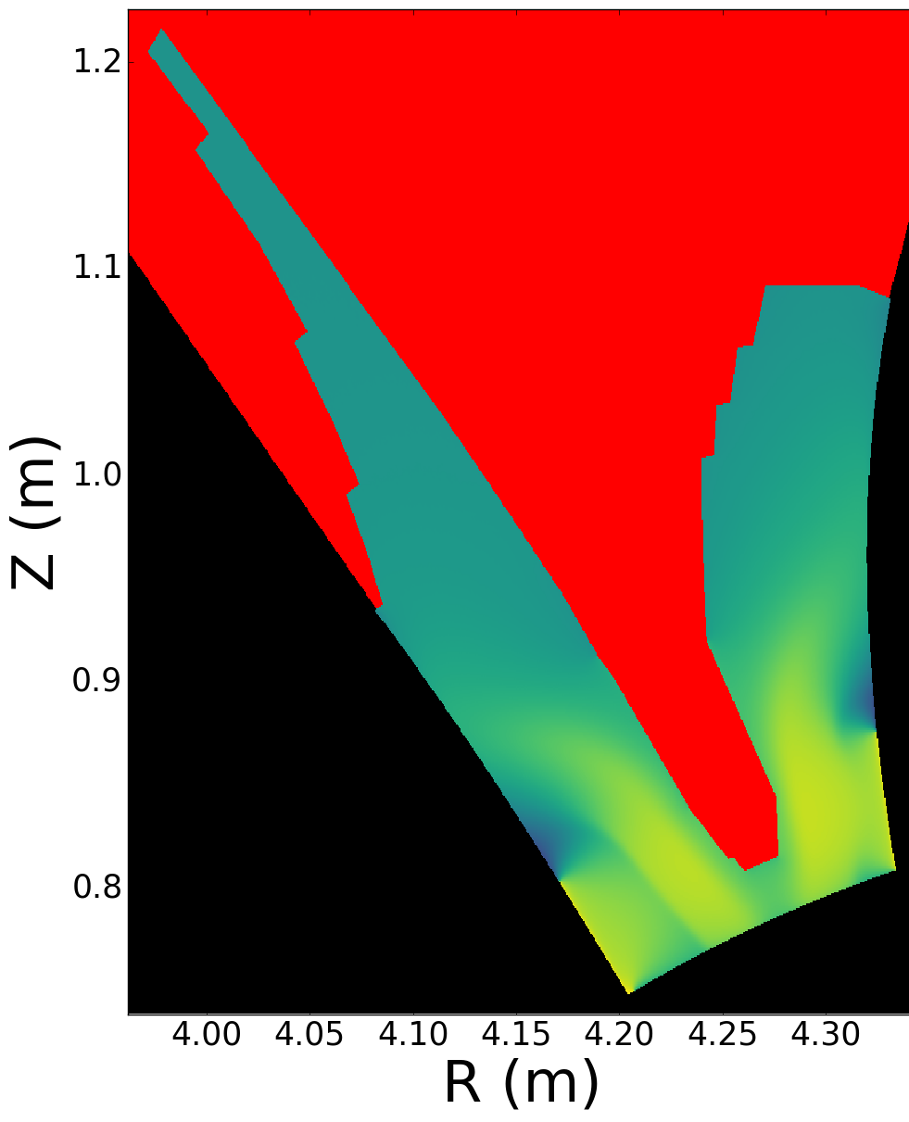
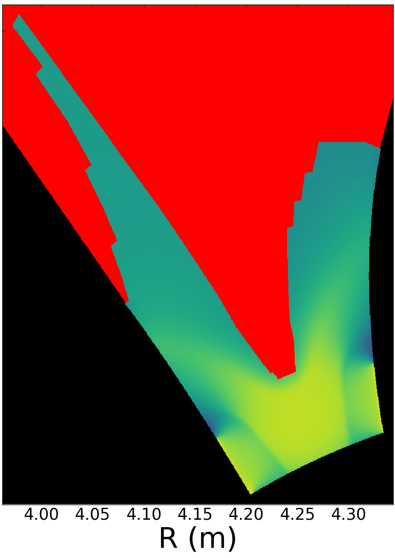
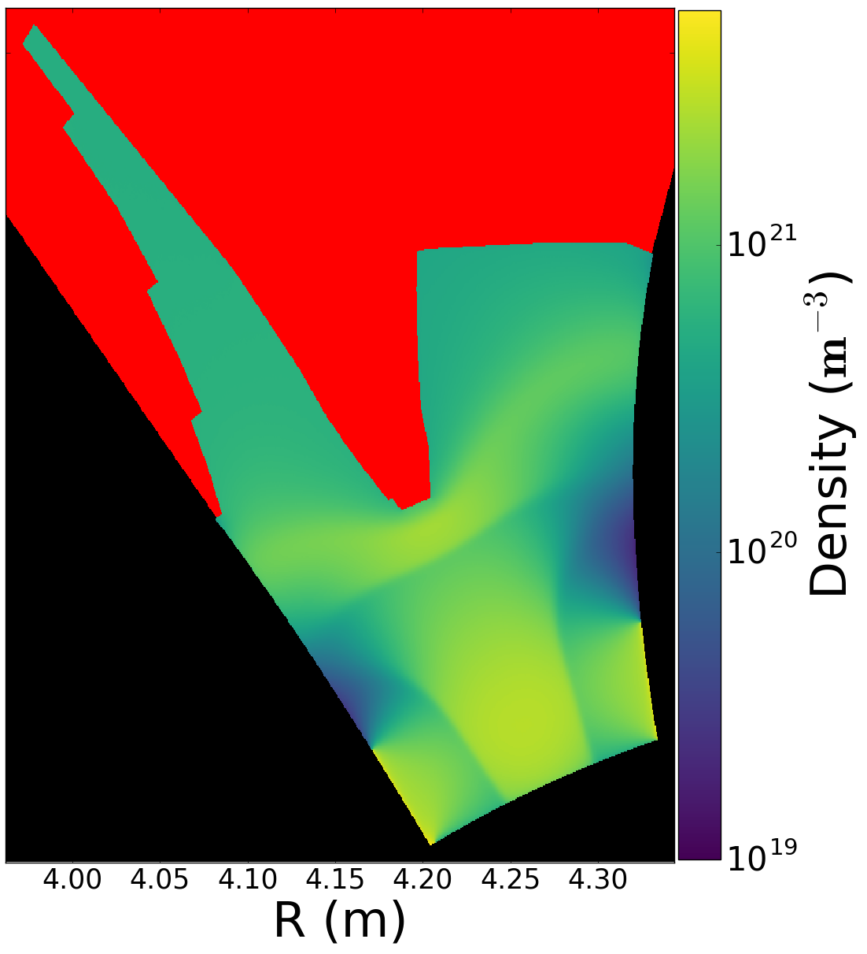
Two-Sided Injection Has Low Resilience
Plasma
Lithium
Vapor
Little variation in Li absorption as leg moves away from evaporators. Same low resilience with bottom evaporation.

Slide 13



Lithium Return Flow is Determined by Balance between Capillary Pull & MHD Drag

Slide 14
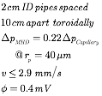
Sandwich Flow Channel Inserts Reduce ΔPMHD
Sandwich FCI:
0.5 mm steel
0.5 mm MgO insulator
1 mm steel
Gap in Flow Channel Insert orients towards divertor surface.
Works top and bottom, leaves margin for other effects.

Slide 15
Conclusions
UEDGE predicts detachment in FNSF with Li alone,
shows lithium dynamics at detachment front.
This provides a preliminary physics basis to
optimize Lithium Vapor Box Divertor using SPARTA.
A divertor with private-flux-side lithium evaporation near the bottom of the divertor leg –
  Provides adequate lithium for detachment.
  Provides strong positional resilience of the detachment front, without baffles. No issue of Li accumulation on 600 C surfaces.
  Sandwich Flow Channel Inserts facilitate capillary force to return
  140 g/s of lithium across 7T magnetic field.
Integrated modeling, design, & experiments are needed.

Slide 16
COPY?

Slide 17
Back-up Slides

Slide 18
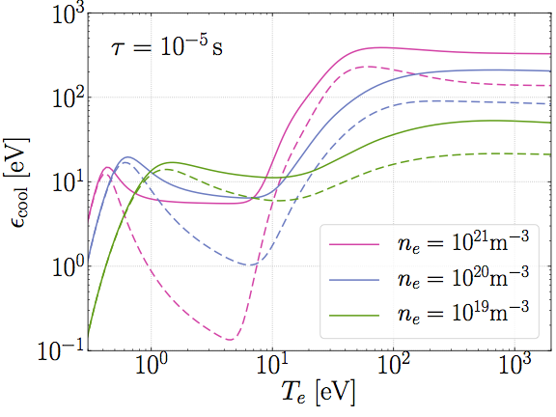
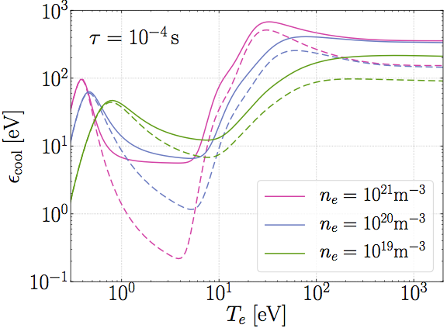
Expected Lithium Cooling per Particle
(Solid lines total cooling, dashed radiation only)
Simple model for power dissipation
based on ADAS Collisional-Radiative model

Slide 19
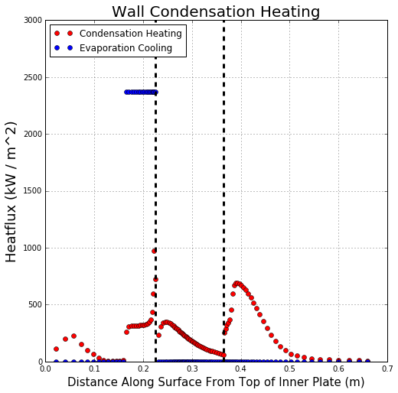
Evaporative Cooling & Heating
UEDGE heat flux
to chamber walls
is about 2 MW/m²
all Li radiation
Divertor leg moving
in front of evaporator
should enhance
evaporation,
positional resilience.

Slide 20
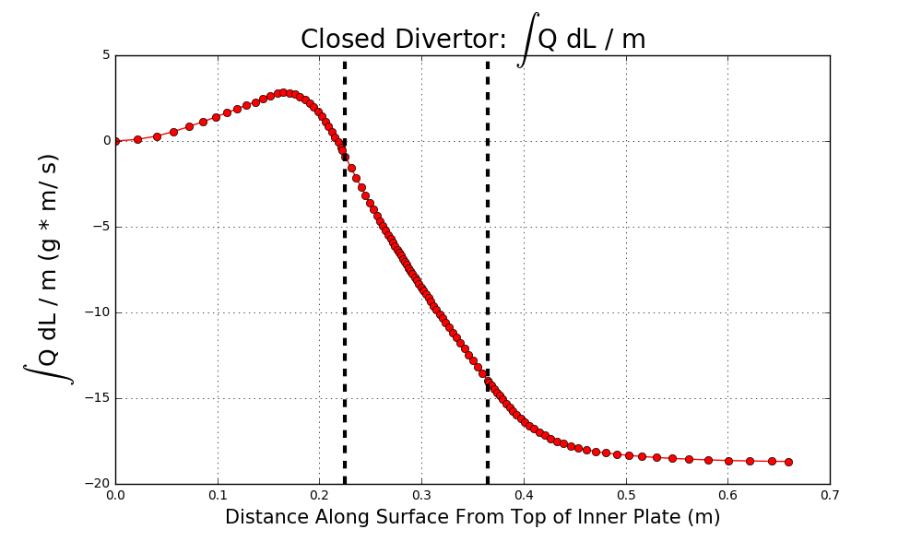
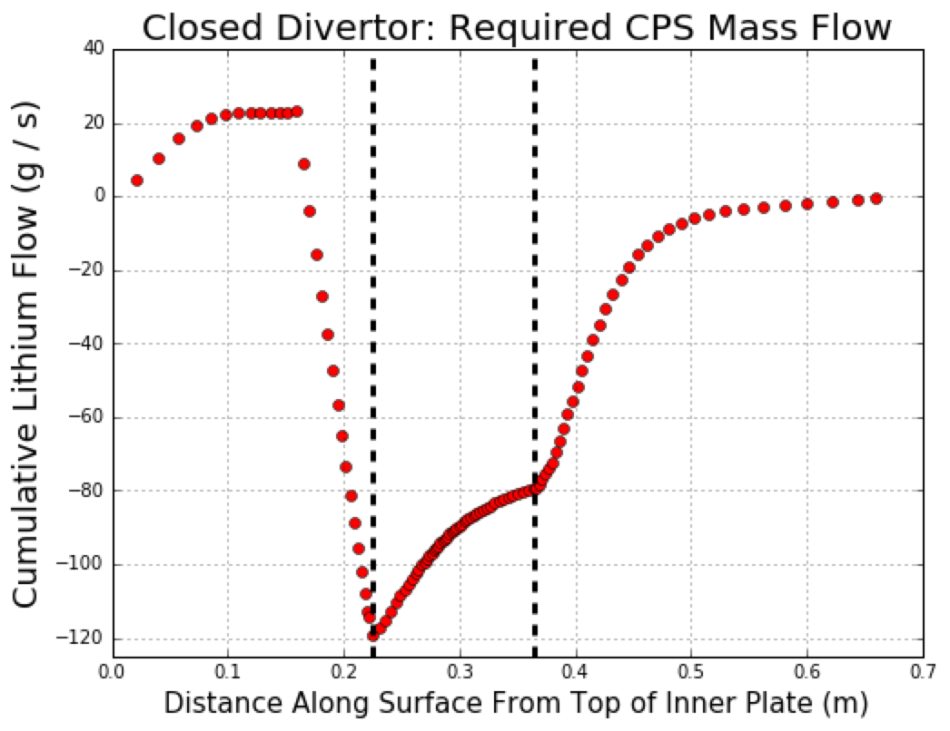
Mass Flows

Slide 21
Storing an image

