Slide 1





NSTX/NSTX-U Theory, Modeling and Analysis Results &
Overview of New MAST Physics in Anticipation of First Results from MAST Upgrade
MAST-U
IAEA FEC, Oct. 23, 2018
J.E. Menard for S.M. Kaye (PPPL), J. Harrison (CCFE) and the NSTX-U and MAST-U Teams

Slide 2
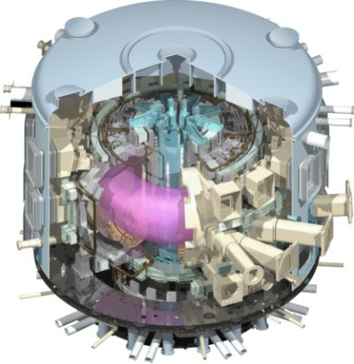
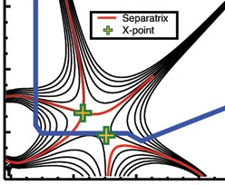
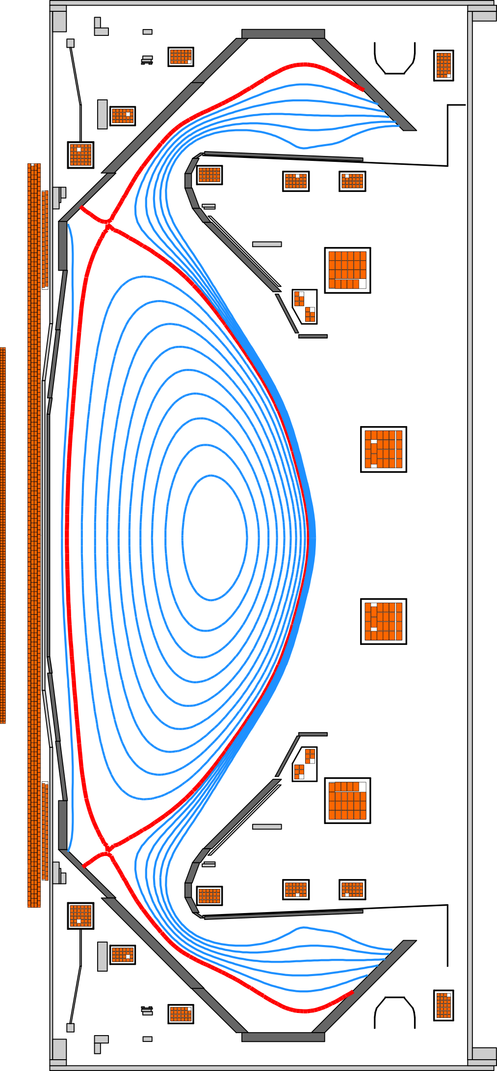
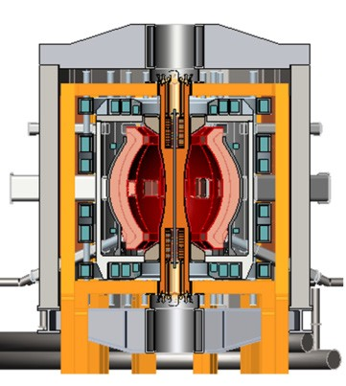
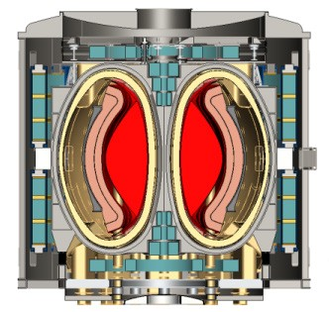
Missions of NSTX(-U) and MAST(-U)
Exploit unique Spherical Tokamak (ST) parameter regimes to advance predictive capability - for ITER and beyond
ITER
Super-X
Develop solutions for plasma- material interface (PMI)
Snowflake/X
ST-FNSF /
Pilot-Plant
Explore ST physics towards reactor relevant regimes (e.g., Fusion Nuclear Science Facility and Pilot Plant)

Slide 3
NSTX(-U) and MAST address urgent issues for fusion science, ITER and next-step devices
Spherical Tokamaks (STs) can investigate turbulence over an extended range in β (tens %)
  Electrostatic and electromagnetic effects
STs Energetic Particle (EP) physics spans phase space expected in Burning Plasmas
  v_{fast}/v_{Alfvén} vs β_{fast}/β_{tot}
  Develop predictive and control methods
Reduced aspect ratio expands range of field line connection length to study and mitigate divertor heat flux

Slide 4
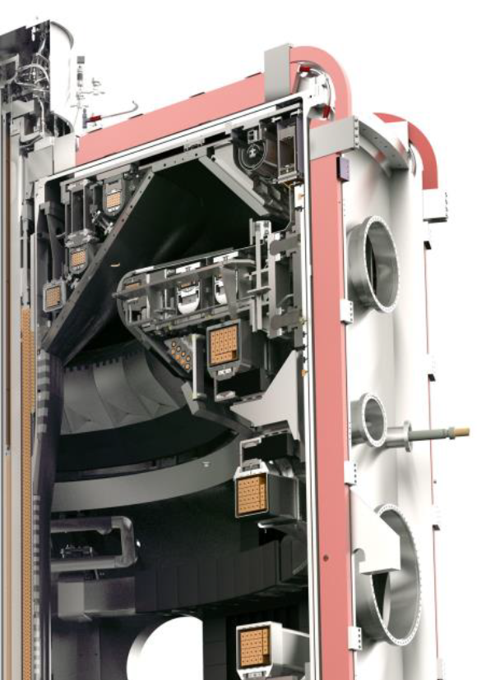
MAST-U will emphasize boundary physics
Maximum Parameters
Super-X divertor configuration
MAST
MAST-U
I_{p} | ≤ | 1.3 | 2 MA
RB_{T} | ≤ | 0.44 | 0.64 m-T
P_{NBI} | ≤ | 3.5 | 10 MW
τ_{pulse} | ≤ | 0.7 | 5 s
On and off-midplane NBI
Flexible divertor with Super-X capability for exhaust research
Off-midplane 3D magnetic coils for edge instability control

Slide 5
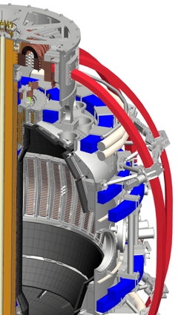
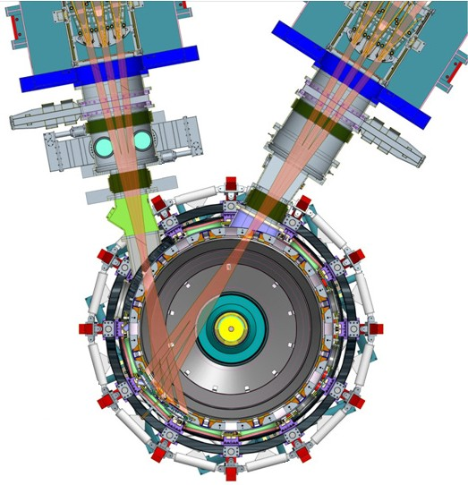
NSTX-U will emphasize core physics
Maximum Parameters
New tangential NBI for j(r) control
NSTX
NSTX-U
I_{p} | ≤ | 1.4 | 2 MA
RB_{T} | ≤ | 0.47 | 0.94 m-T
P_{NBI} | ≤ | 6 | 15 MW
P_{RF} | ≤ | 6 | 6 MW
τ_{pulse} | ≤ | 1 | 5 s
Conducting plates can suppress global kink instabilities
High B_{T} (1 T at R₀) ➔ projected largest range in β and (lower) ν* in an ST
Greater stability (β_{n}/l_{i} ≤ 14) + flexible NBI ➔ high non-inductive current

Slide 6
This talk will cover recent complementary results from NSTX(-U) and MAST
Core transport and stability physics
Energetic particle physics/mode stability
Boundary and divertor physics
Future plans

Slide 7
This talk will cover recent complementary results from NSTX(-U) and MAST
Core transport and stability physics
  ST confinement trends differ from those at higher aspect ratio
    NSTX/MAST: τ_{E} ~ I_{p}^{0.5}B_{T}¹ ~ ν*^{-0.8}
    (ITER-Basis: τ_{E} ~ I_{p}¹B_{T}⁰ ~ ν*⁰)
  Stability control methods necessary for high-β operation
e-m turbulence
NSTX-U
NSTX/MAST
MAST-U
Electron beta
e-s turbulence
Normalized collisionality (~n/T²)

Slide 8
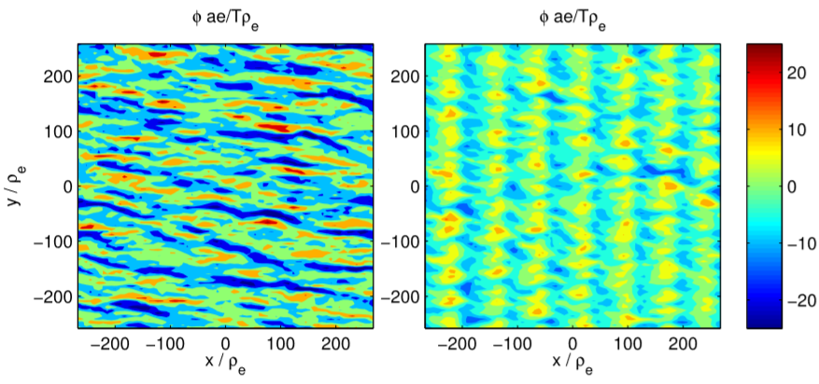
Core: Measurements and theory help in understanding the turbulence that underlies confinement trends in STs
ITG turbulence often suppressed by flow shear
  MAST BES measurements of ITG ñ show flow shear breaks symmetry of turbulence in space (tilt) and amplitude (skewed PDF)
  Collisionality dependence controlled by electron transport due to
  electrostatic dissipative TEM/electromagnetic microtearing modes on NSTX
  electrostatic ETG on MAST
High ν*
Low ν*
MAST
ETG sims initially produce streamer-like structures before forming ‘vortex streets’
  Collisionality dependence due to damping of zonal flows
[G. Colyer et al., PPCF 59 055002 (2017)]
[M. F. J. Fox et al., PPCF 59 034002 (2017)]
[F. van Wyk et al., PPCF 59 114003 (2017)]

Slide 9
Core: Multi-scale and non-local effects potentially important for understanding underlying turbulence
Ion heat flux (MW)
Ion-scale (ITG/TEM) non-linear simulations (GTS) for NSTX L-mode illustrate importance of global effects
  Transport from global (GTS) lower than from local (GYRO) simulations → profile shearing effects at large ρ* important
    1/ρ* ~ 75 (NSTX), 200 (DIII-D), 350 (JET)
Electron-scale (ETG) non-linear simulations predict significant Q_{e}; close to expt’l
  Similarity in Q_{e, high-k} and Q_{i, low-k} indicates cross-scale coupling may be important
Local GYRO
Global GTS
Q_{i}
Neoclassical
Electron heat flux (MW)
Q_{e}

Slide 10
Core: Disruption Event Characterization and Forecasting (DECAF) code used to provide a cross-machine comparison of disruptivity
MAST
DECAF analysis of disruption event
  Shots analyzed at 10 ms intervals during Ip flat-top
  MAST: 8,902 plasmas analyzed; NSTX: 10,432 plasmas
Supports published result that disruptivity doesn’t increase with β_{N}
Disruptivity plots provide important information, but can be misleading when used incorrectly
  Plasma conditions can change significantly between first problem detected and when disruption happens
  Circles mark the key region to study with DECAF: where events that lead to disruptions (X’s) start
NSTX
[Sabbagh et al., EX/P6-26 (DECAF)]

Slide 11
This talk will cover recent complementary results from NSTX(-U) and MAST
Energetic particle physics/mode stability
  Energetic particle-driven instabilities may reflect those in ITER, next-step devices
  Will show examples of fast ion distribution effects by sawteeth, high-frequency AE to develop understanding, predictive capabilities, and control methods
  Instabilities in both frequency ranges may be important for ITER

Slide 12
Energetic Particles: Sawteeth on MAST and NSTX-U have a significant effect on the fast particle population
MAST – Neutron Camera
MAST neutron camera measurements show drop in neutron rate (fast ion distribution) across profile
  Modeling indicates that sawteeth have comparable effect on both trapped and passing particles
FIDA & solid-state NPA measurements on NSTX-U indicate that passing particles strongly expelled from core by sawteeth [Liu, Nuc. Fusion (2018)]
  Little effect on trapped particles
Before s-t crash
After s-t crash
[M Cecconello et al., PPCF 60 055008 2018]
Radius (m)
Radius (m)
NSTX-U ssNPA
Passing (Edge)
Trapped (Core)

Slide 13
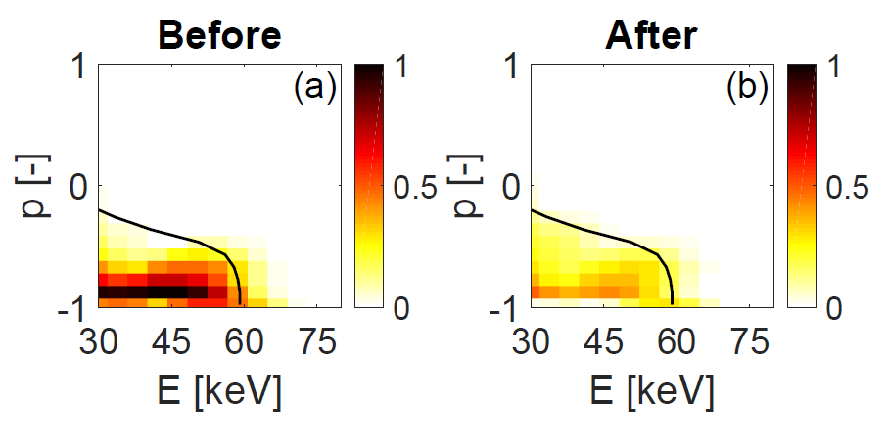
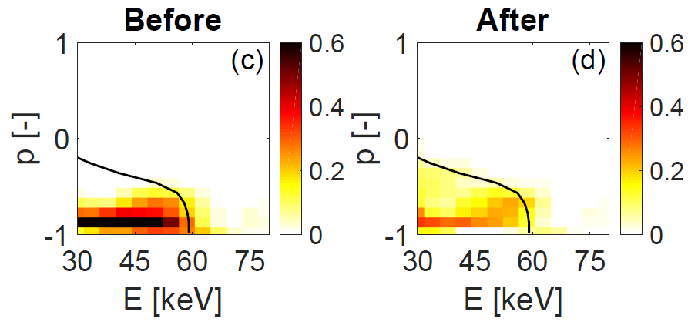
Energetic Particles: Different sawtooth models on MAST and NSTX-U show agreement with experiment
Full reconnection model (Kadomtsev) consistent with measurements in MAST
  Inversion of real and synthetic FIDA data show expulsion of trapped and passing particles from core
Simple sawtooth models cannot reproduce spatial redistribution of fast particles in NSTX-U [Kim, EX/P6-33]
  “Kick” model [Podesta, PPCF (2014)], based on orbit-following calculations of fast ions, lead to better agreement
Before S-T
After S-T
TRANSP/FIDASIM (Kadomtsev model)
Experiment
[B. Madsen et al., RSI 89 10D125 (2018)]

Slide 14
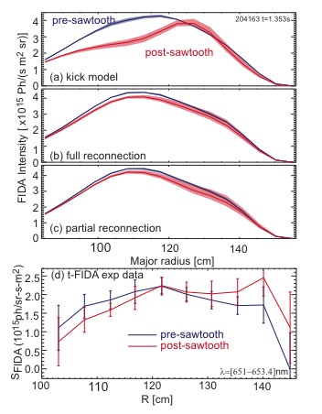
Energetic Particles: Different sawtooth models on MAST and NSTX-U show agreement with experiment
Full reconnection model (Kadomtsev) consistent with measurements in MAST
  Inversion of real and synthetic FIDA data show expulsion of trapped and passing particles from core
Simple sawtooth models cannot reproduce spatial redistribution of fast particles in NSTX-U [Kim, EX/P6-33]
  “Kick” model [Podesta, PPCF (2014)], based on orbit-following calculations of fast ions, lead to better agreement
Kadomtsev model
Porcelli model
Are differences due to differences in injection energy, phase space distribution of EP?

Slide 15
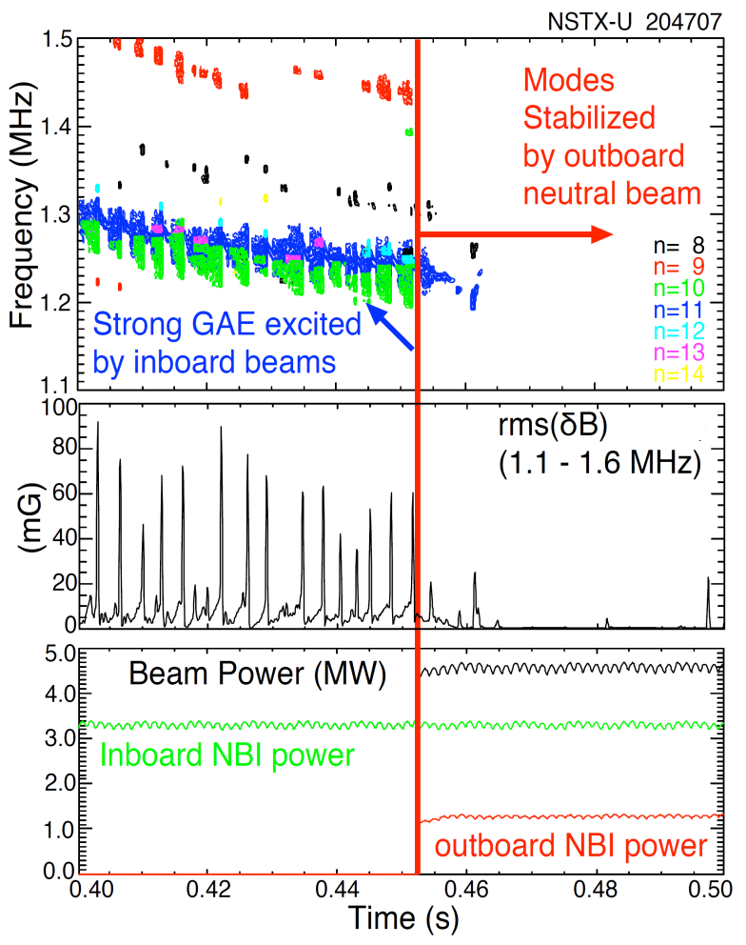
Energetic Particles: Progress in developing tool for phase-space engineering of EP-driven instabilities in NSTX-U
High frequency global Alfvén Eigenmodes (GAEs) suppressed by off-axis beam injection [Fredrickson PRL (2017), Nuc. Fus. (2018)]
Non-linear HYM simulations show unstable counter-rotating GAEs
  Maximum growth rates for toroidal mode numbers -7 to -11
  Predicted frequencies match measurements
  Peak saturation amplitudes δB/B ~ 5e-3
  Effect on electron transport under investigation

Slide 16
Energetic Particles: Progress in developing tool for phase-space engineering of EP-driven instabilities in NSTX-U
High frequency global Alfvén Eigenmodes (GAEs) suppressed by off-axis beam injection [Fredrickson PRL (2017), Nuc. Fus. (2018)]
Non-linear HYM simulations show unstable counter-rotating GAEs
  Maximum growth rates for toroidal mode numbers -7 to -11
  Predicted frequencies match measurements
  Peak saturation amplitudes δB/B ~ 5e-3
  Effect on electron transport under investigation
EP phase space engineering will be explored in MAST-U using on/off-midplane NB and off-midplane RMP coils

Slide 17
This talk will cover recent complementary results from NSTX(-U) and MAST
Boundary and divertor physics
  Turbulence studies at midplane and in divertor SOL for aid in understanding processes controlling heat flux amplitude and profile

Slide 18
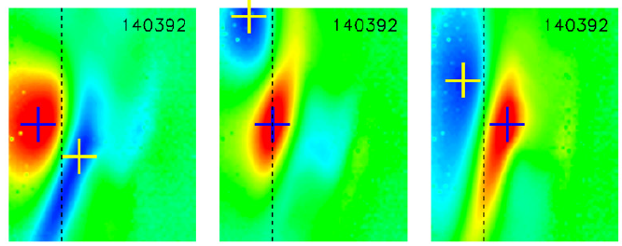
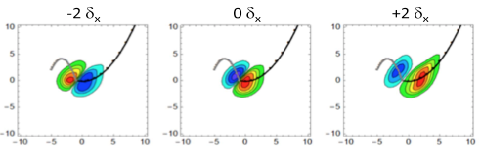
Boundary: Gas puff imaging & theory being used to study edge turbulence near the midplane in NSTX
origin inside
separatrix
origin near
separatrix
origin outside
separatrix
GPI measurements of edge turbulence show dipole-like 2-D spatial correlations with large negative regions (blue)
Semi-analytic model assuming blob-hole pairs shows similar 2D correlation patterns, dipole flip across separatrix [Myra, PPCF (2018)]
radially out
Edge turbulence is being better understood through a combination of semi-analytic models and numerical simulation (e.g. XGC1)

Slide 19
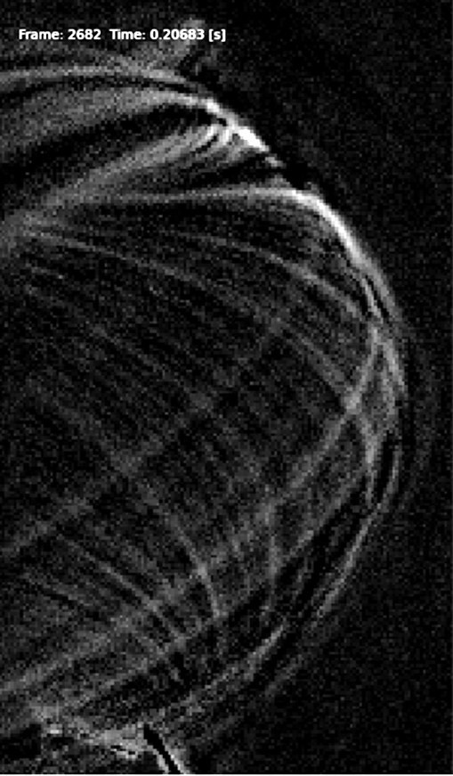
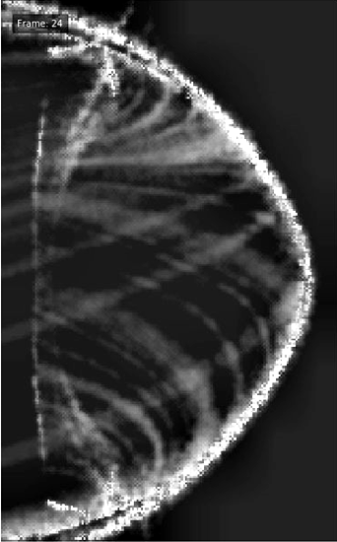
Divertor: Fast camera imaging of the divertor provides new insights into SOL turbulence
Non-linear 3D drift-fluid simulations (STORM/BOUT++) of SOL turbulence performed in realistic MAST geometry [Militello TH/7-1]
  Reproduces filaments seen in fast camera videos of main chamber and divertor
    SOL D_{α} profiles well described by superposition of independently moving filaments
  Quiescent region in SOL near X-point has been identified [Walkden et al., Nuc. Fus. 57 126028 (2017)]
  Synthetic diagnostics developed to enable direct comparison with experiments
Background subtracted fast camera data
BOUT++ simulation

Slide 20
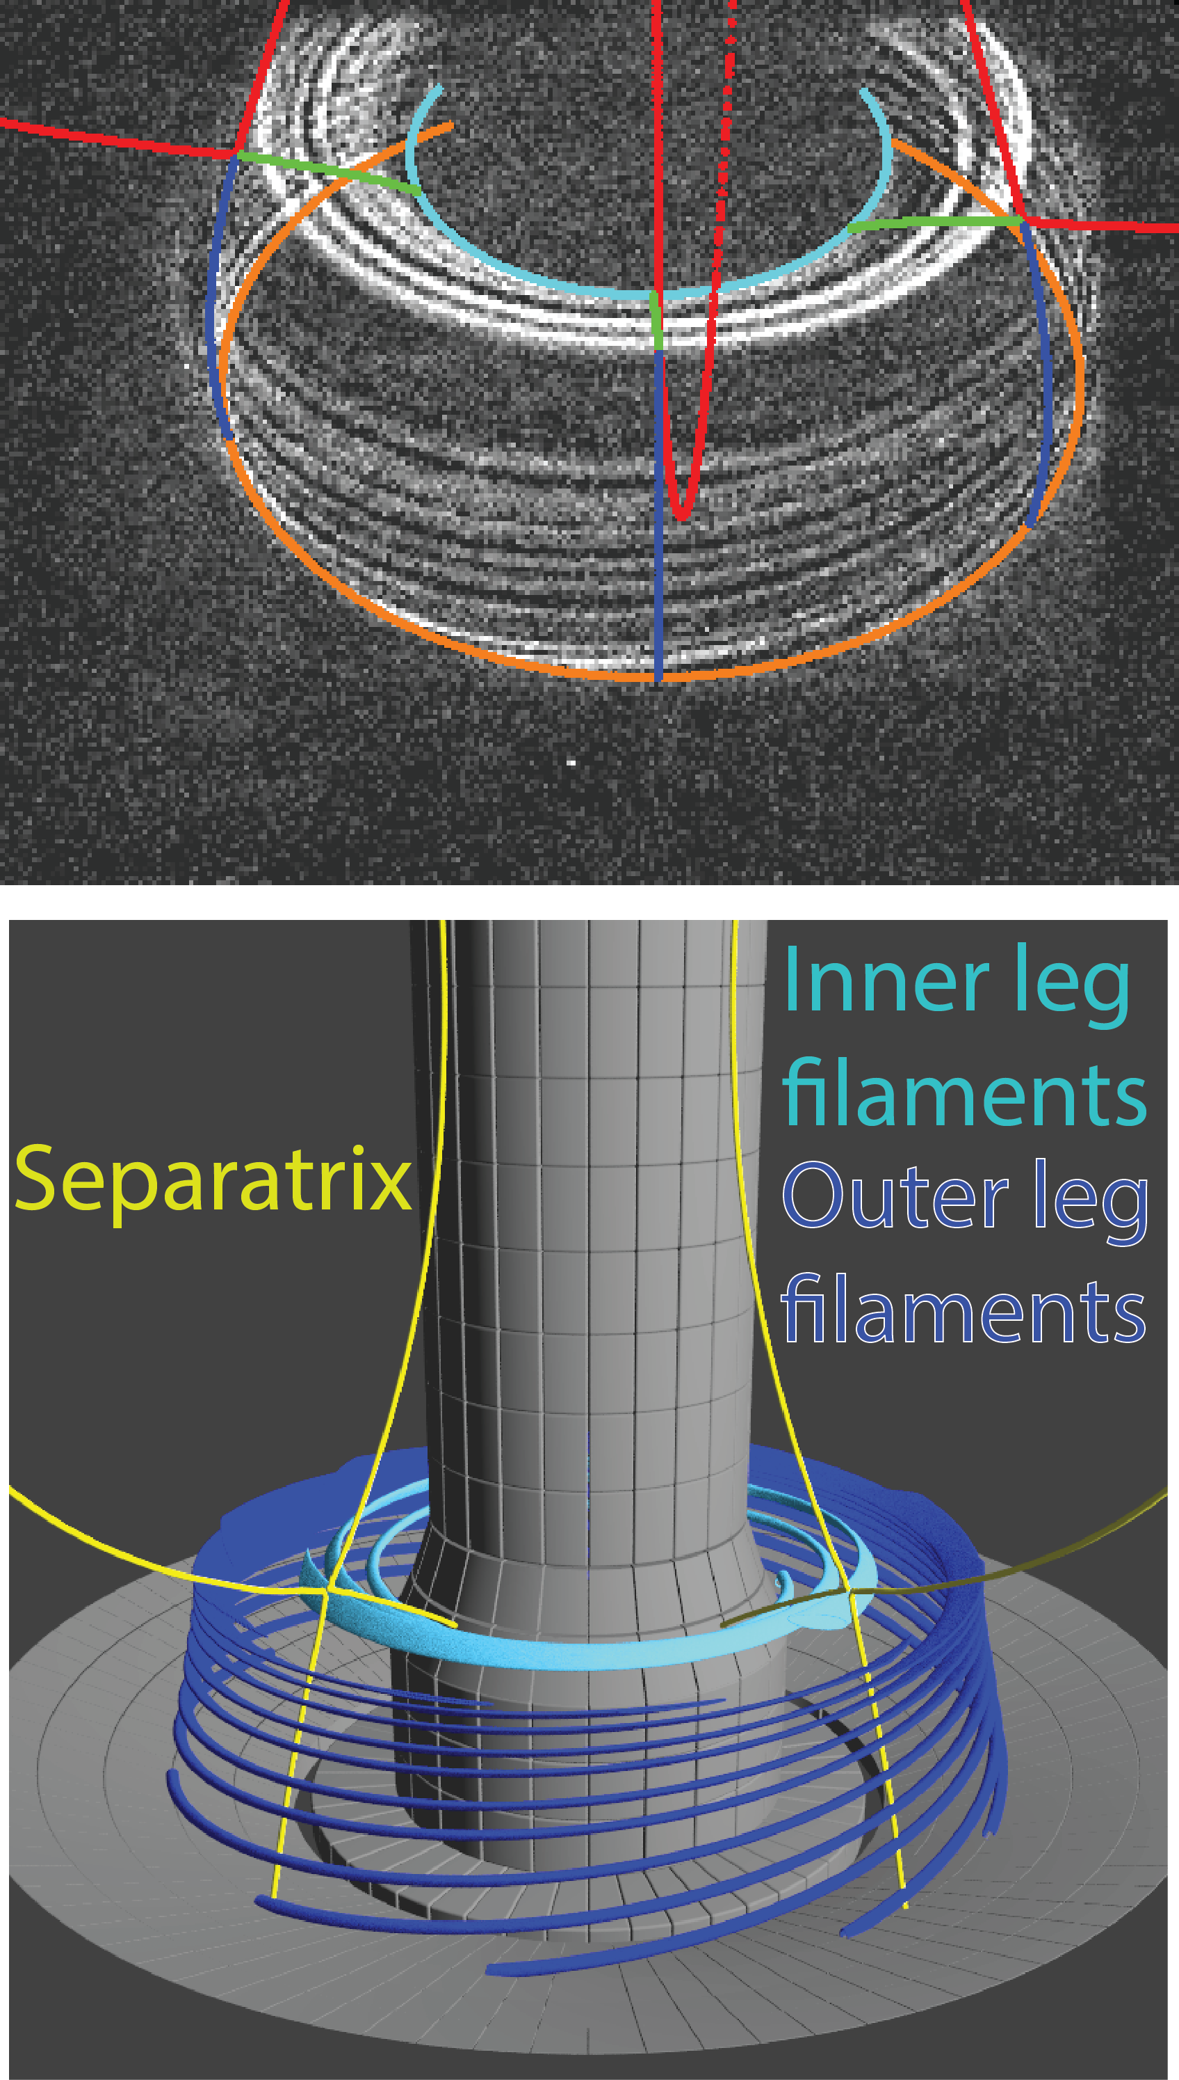
Divertor: Fast camera imaging of the divertor provides new insights into SOL turbulence
Divertor leg fluctuations observed by fast imaging in NSTX-U
  Intermittent; localized to bad curvature side
Evidence for X-point disconnection
  Inner and outer filament legs not correlated
  Divertor filaments/midplane blobs not correlated
Simulations with ArbiTER code find unstable resistive ballooning modes [Baver, CCP (2016)]
Images in CIII emission
[Scotti, Nuc. Fusion (2018)]
Rendering

Slide 21
This talk will cover recent complementary results from NSTX(-U) and MAST
Future plans

Slide 22
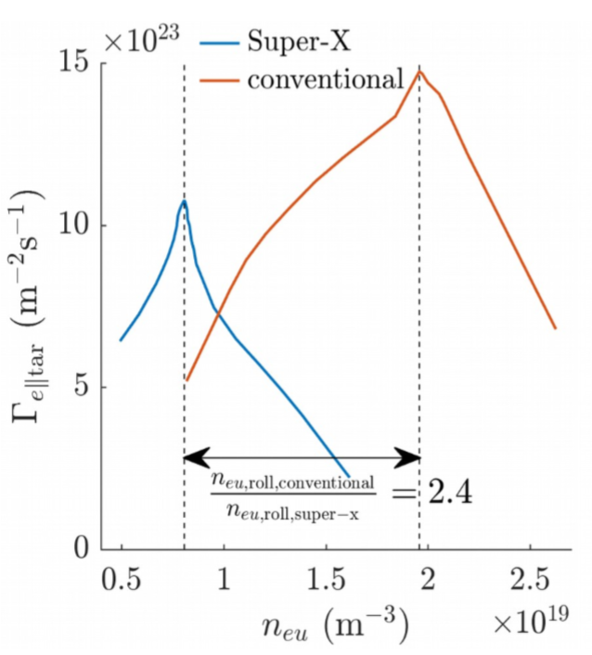
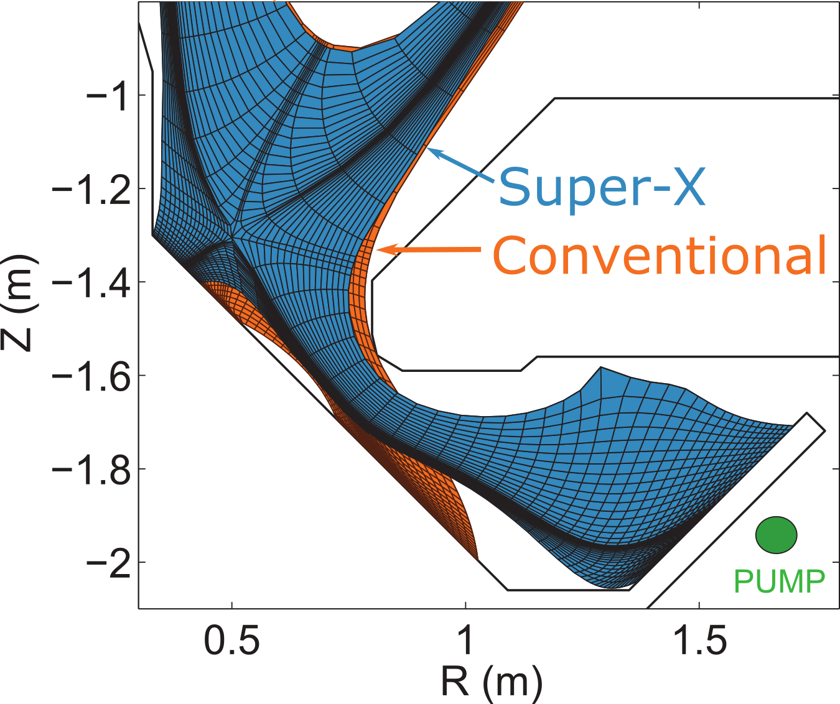
Expected benefits of Super-X divertor will be tested during first experimental campaign of MAST-U
Super-X expected to improve exhaust mitigation and control of detachment front position
Detachment in Super-X expected at lower density than in conventional
Parallel particle flux (m⁻²s⁻¹)
[D. Moulton et al., Proc 44th EPS Conf. 2017]
[B. Lipschultz, et al., NF 56 056007 2016]
Density (m⁻³)
Parallel heat flux gradients along Super-X leg should improve detachment control
  Scales with B_{x-pt}/B_{target}; can be higher is STs (~3) than at conventional aspect ratio (~1-2)

Slide 23
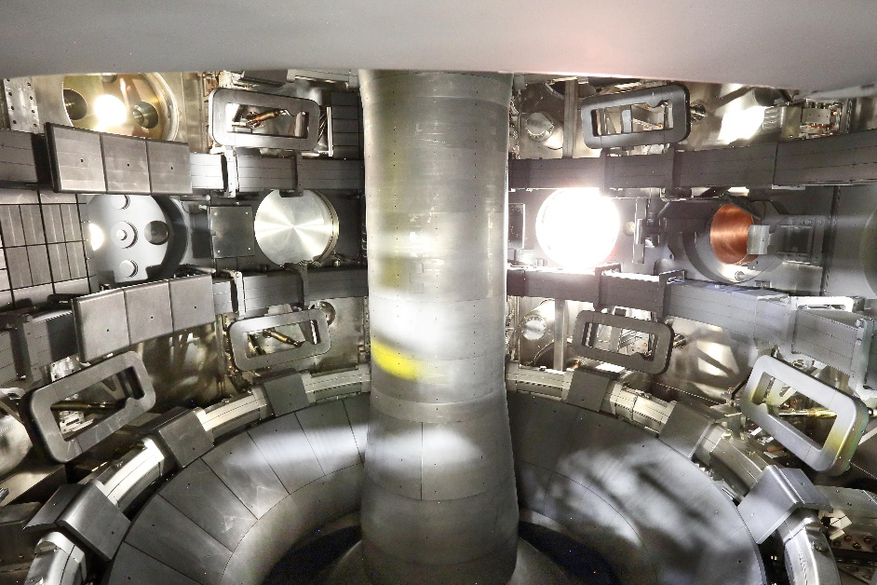
MAST-U preparing for operation
MAST-U presently baking out; modifying TF linkages
Expected physics operation Autumn 2019
Detailed characterization of intrinsic error field carried out to optimize correction and broaden operating space
New diagnostics
  Divertor: 850 Langmuir probes, divertor TS, IR & visible cameras, bolometers
  Energetic particles: ssNPA, FILD

Slide 24
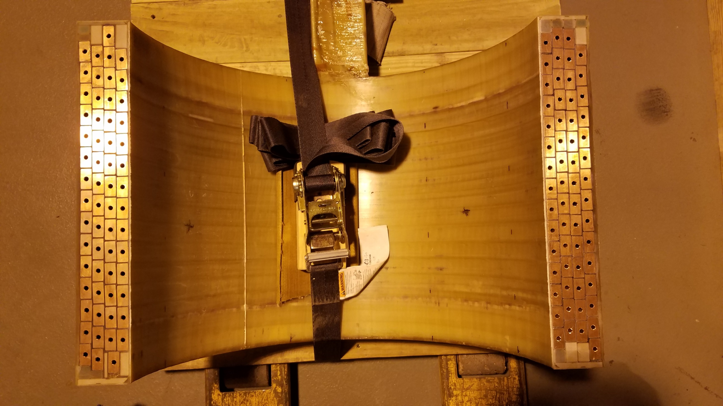
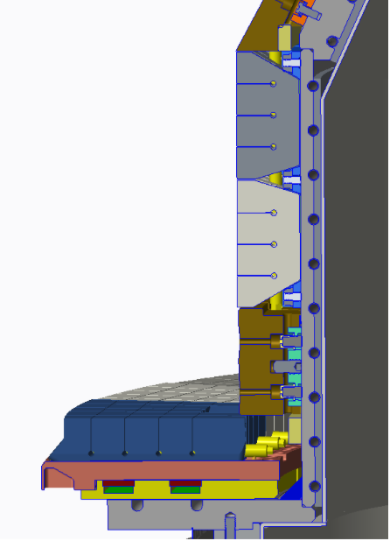
NSTX-U Recovery underway
NSTX-U operated for 10 weeks in 2016, achieving good H-mode performance, surpassing magnetic field and pulse duration of NSTX
Run ended prematurely due to divertor PF fault
Full repair will consist of installing improved PF coils, graphite PFCs to handle heat fluxes of high-power, long-pulse scenarios, minimized error fields to increase reliability [Gerhardt, FIP/P3-63]
Projected to commence operations in early 2021
  Study transport and stability physics at high-β/low ν* (Bτ ~ ν*^{-0.8})
  Demonstrate full non-inductive operation (j(r) control with NBI)

Slide 25
Close collaboration between NSTX-U and MAST-U on developing startup scenarios
Vacuum field calculations support magnetic calibrations and inductive startup scenario development
Procedure for producing MAST-U first plasma being developed using the PPPL-LRDFIT code
  Results from NSTX(-U) provide basis for first-plasma scenarios on MAST-U
  Extended on-site (CCFE) visits facilitate collaboration

Slide 26
Summary: NSTX(-U) and MAST address urgent issues for fusion science, ITER and next-step devices
Core transport & turbulence studied over an extended range of β and ν*
  Electrostatic and electromagnetic effects drive strong favorable ν* scaling
  Multi-scale effects (low- & high-k) must be considered
Energetic particle effects and instabilities studied in portions of parameter space expected for α-burning plasmas
  Low and high frequency modes can have profound effect on EP distribution
  Predictive models and phase-space engineering techniques being developed
Boundary and divertor studies address processes controlling heat flux width
  Filamentary structures/turbulence
  Heat flux mitigation through innovative divertor designs
When operation commences, NSTX-U and MAST-U will be the most capable devices in the world-wide ST program
Relevant IAEA contributions follow

Slide 27
NSTX(-U)/MAST(-U) related IAEA presentations
J. Menard: Fusion energy development utilizing the Spherical Tokamak OV/P-6 (Mon AM)
R. Lunsford: Electromagnetic particle injector FIP/P1-51 (Tues AM)
M. Podesta: Reduced EP transport models EX/1-2
E. Belova: Numerical simulations of GAE suppression TH/P2-16 (Tues PM)
S. Pamela: ELM and ELM-control simulations OV/4-4
S. Gerhardt: NSTX-U Recovery physics and engineering FIP/P3-63 (Wed AM)
V. Menon: Performance of large and small R/a fusion tokamaks FIP/P3-60
N. Bertelli: Impact of H⁺ on HHFW in NSTX-U TH/P4-13 (Wed PM)
G.Z. Hao: Centrifugal force driven low-f modes in STs TH/P5-13 (Thurs AM)
T. Rafiq: Effects of microtearing modes on Te evolution in NSTX TH/P5-10
S. Sabbagh: Disruption characterization and forecasting EX/P6-26 (Thurs PM)
N. Ferraro: EF impact on mode locking and divertor heat flux in NSTX-U EX/P6-40
E. Fredrickson/M. Podesta: GAE stability dependences on fast ion distribution EX/P6-32
D. Kim: Fast ion redistribution by sawteeth on NSTX-U EX/P6-33
L. D-Aparacio: Rotation-induced electrostatic potentials and density asymmetries in NSTX EX/P6-33
R. Goldston: Development of Li vapor box divertor for controlled plasma detachment FIP/3-6
T. Brown: A toroidal confinement facility to study liquid lithium divertor (Fri AM)
A. Hakim: Continuum g-k simulations of NSTX SOL turbulence with sheath-limited geometries TH/P7-33
I. Krebs: Nonlinear 3D simulations of VDEs in tokamaks TH/P8-10 (Fri PM)
F. Militello: Predicting Scrape-Off Layer profiles and filamentary transport for reactor relevant devices TH/7-1

Slide 28
Backup

Slide 29
NSTX(-U) and MAST research address urgent issues for fusion science, ITER and next-step devices
MOVE TO BACKUP?
STs can investigate turbulence over an extended range in β (tens %)
  Electrostatic and electromagnetic effects at large ρ*
STs EP physics spans phase space expected in Burning Plasmas
  Develop predictive and control methods
Reduced connection length and surface area can lead to increased q_{target} in conventional divertors in STs
  Developing strategies to mitigate heat fluxes in STs critical
e-m turbulence
NSTX-U
NSTX/MAST
MAST-U
Electron beta
KBM
MTM
e-s turbulence
ITG/TEM/ETG
Normalized collisionality (~n/T²)

Slide 30
NSTX(-U) and MAST research address urgent issues for fusion science, ITER and next-step devices
MOVE TO BACKUP?
STs can investigate turbulence over an extended range in β (tens %)
  Electrostatic and electromagnetic effects at large ρ*
STs EP physics spans phase space expected in Burning Plasmas
  Develop predictive and control methods
Reduced connection length and surface area can lead to increased q_{target} in conventional divertors in STs
  Developing strategies to mitigate heat fluxes in STs critical

Slide 31
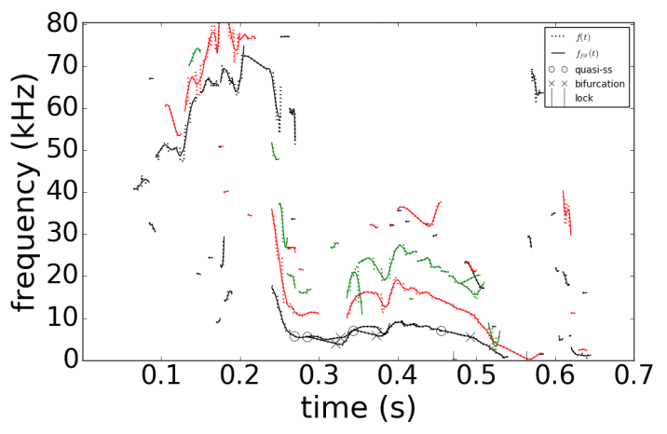
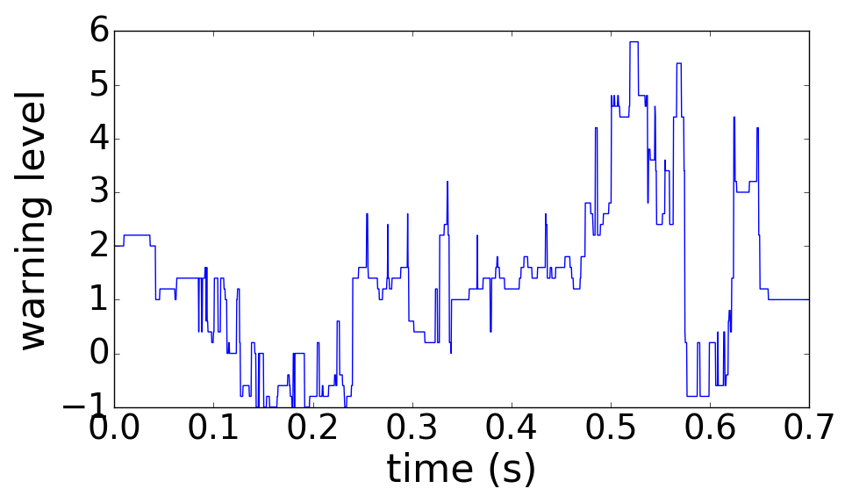
Core: Disruption Event Characterization and Forecasting (DECAF) algorithm being developed for stable operation
DECAF utilizes physics-based models as much as possible to identify event chain leading to disruptions in a time-evolving fashion [Sabbagh et al., EX/P6-26]
  Couple to real-time control system for stable operation, disruption mitigation
NSTX
DECAF automated MHD events
n =
1
2
3
DECAF MHD warning level
DECAF event chain
n=1 appears
n=1 locks
p(r) peaks
large dI_{p}/dt
hits wall
disruption
VDE
MHD-n1
LTM-n1
PRP
IPR
WPC
DIS
VDE
Multi-institutional effort [NSTX, MAST, KSTAR, DIII-D, TCV (so far)]
(0.490s)
(+.045s)
(+.068s)
(+.073s)
(+.073s)
(+.077s)
(+.080s)

Slide 32
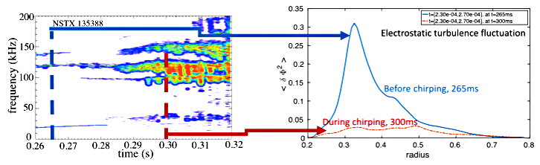
Energetic Particles: Microturbulence is a mediator of EP instabilities on NSTX-U
High β_{fast}, v_{fast}/v_{Alfvén}>1 provide significant drive for enhanced wave-particle and nonlinear mode-mode interactions (chirping, avalanches)
  Seen predominantly at lower than at higher aspect ratio
Microturbulence can increase scattering of resonant fast ions to reduce chirping and avalanching [Duarte Nuc. Fusion (2018)]
  Global GTS non-linear simulations support theoretical prediction

Slide 33
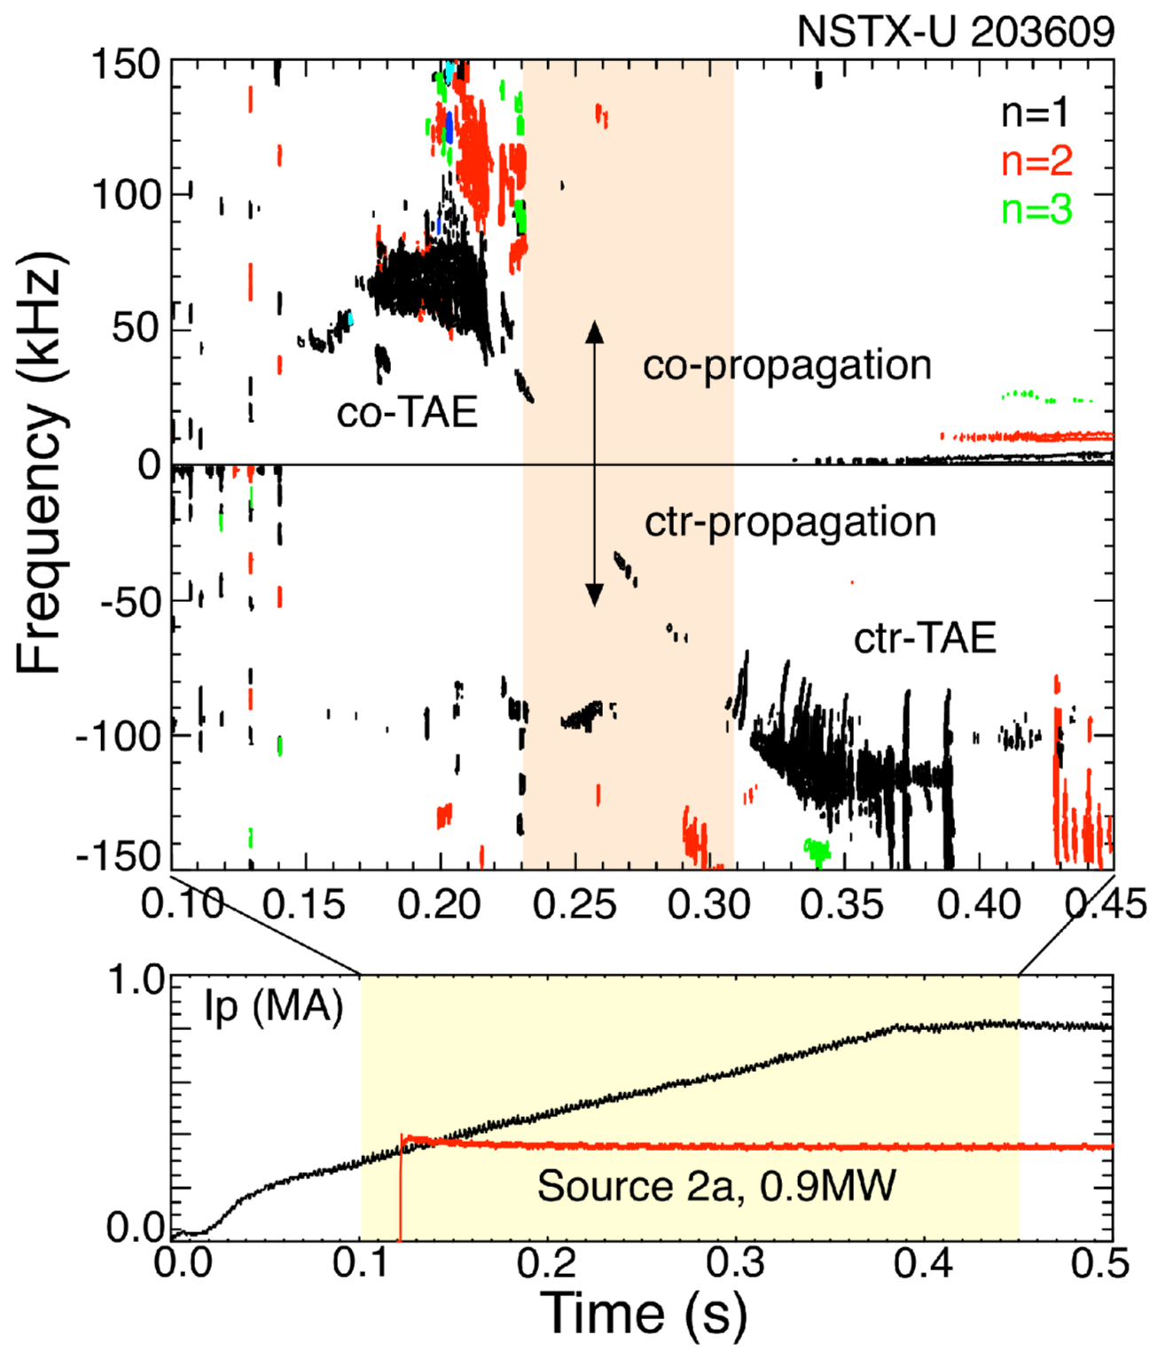
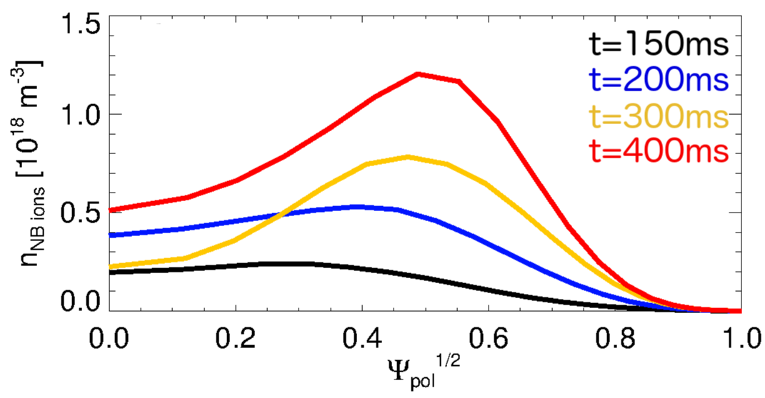
Counter-TAEs can be destabilized by off-axis
co-NB injection from 2nd NB line
Single NB source from 2nd NBI
Low power, P_{NB}~1MW
Off-axis NBI results in broad/hollow NB ion density profile
A transition is observed from co-TAEs only to cntr-TAEs

Slide 34
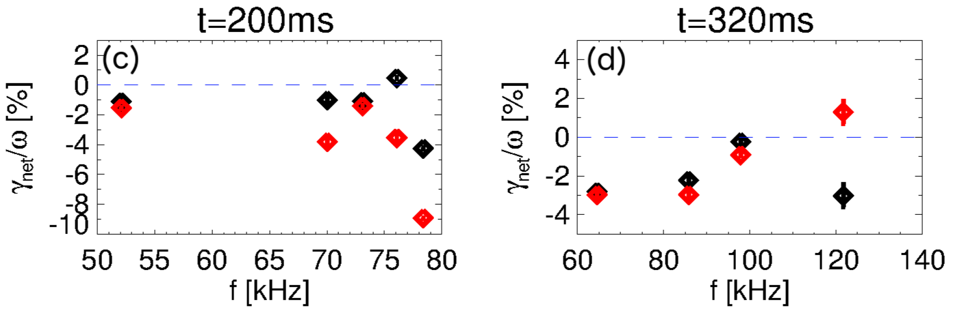
Details of fast ion distribution explain destabilization of counter-TAEs by co-NBI
Single NB source from 2nd NBI
Low power, P_{NB}~1MW
Stability analysis with TRANSP + kick model recovers observations
Drive results from competition between gradients in energy and canonical momentum
[Podestà, NF 2018]
co-TAEs
cntr-TAEs

Slide 35
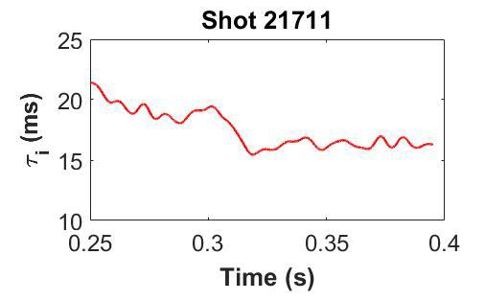
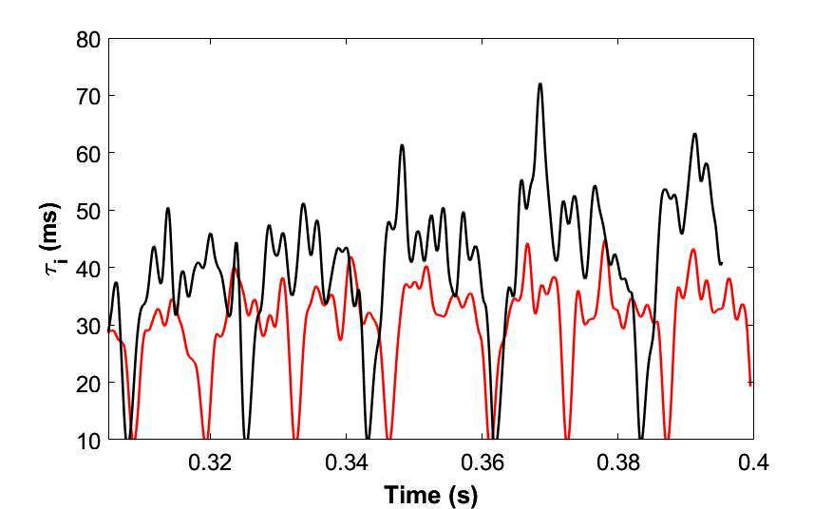
Boundary: Particle confinement control and turbulence being studied in MAST
Application of Resonant Magnetic Perturbations (RMPs) reduces particle confinement
  τ_{ion} reduced by ~20% in L-mode (with n=3 RMP) and 30% in H-mode (with n=4 RMP)
L-mode
H-mode
RMP OFF
RMP ON
RMP OFF (29092)
RMP ON (29178)
RMP OFF
RMP ON
τ_{ion} (ms)
τ_{ion} (ms)
Time (s)
Time (s)
First estimates of radial wave number of Geodesic Acoustic Mode in an ST in an ohmic L-Mode in good agreement with global 2-fluid simulations [Hnat, PPCF (2018)]
  Oscillation localized to boundary that can influence L-H transition dynamics
  10 kHz, k_{r}ρ_{p} ~ -0.15, v_{r} ~ 1 km/s, located 2 cm inside the separatrix

Slide 36
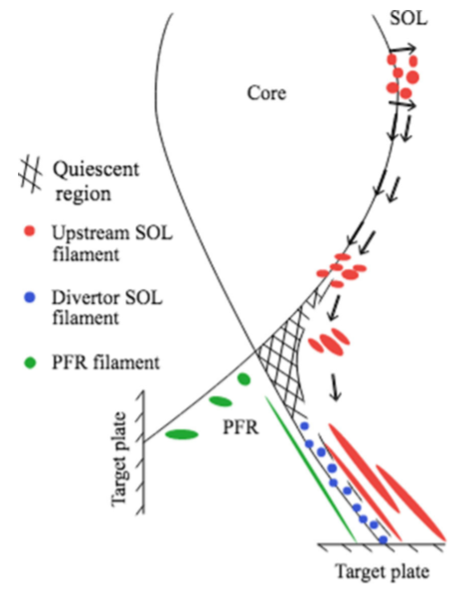
Divertor Physics: SOL turbulence can contribute of cross-field transport: being studied in both MAST and NSTX-U
MAST SOL density profiles are well described by the superposition of independently moving filaments
  Quiescent region in the SOL near X-point
Divertor leg fluctuations observed by fast imaging in NSTX-U
  Intermittent; localized to bad curvature side
  Connected to divertor target plate
Evidence for X-point disconnection
  Inner and outer filament legs not correlated
  Divertor filaments/midplane blobs not correlated
(“blobs”)
[F. Militello et al., PoP 25 056112 2018]
[N. Walkden et al., NF 57 126028 2017]

Slide 37
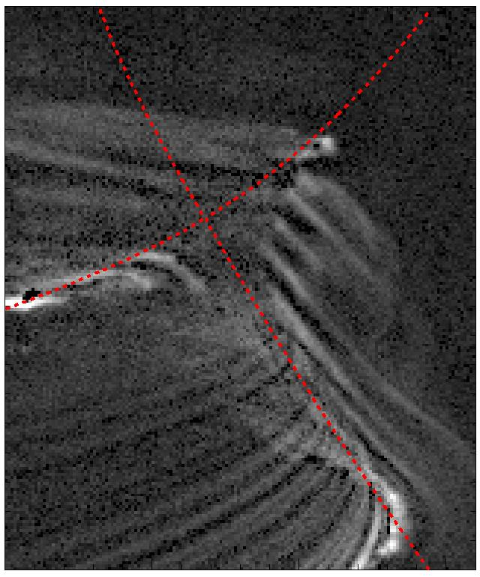
Divertor Physics: Fast camera imaging of the divertor provides new insights into SOL turbulence
SOL turbulence being studied in both MAST and NSTX
  MAST SOL density profiles are well described by the superposition of independently moving filaments
Quiescent region in the SOL near the X-point has been identified
Divertor leg fluctuations observed by fast imaging in NSTX-U
  Intermittent; localized to bad curvature side
Evidence for X-point disconnection
  Inner and outer filament legs not correlated
  Divertor filaments/midplane blobs not correlated
Moving average subtracted unfiltered frame
[F. Militello et al., PoP 25 056112 2018]
[N. Walkden et al., NF 57 126028 2017]

Slide 38
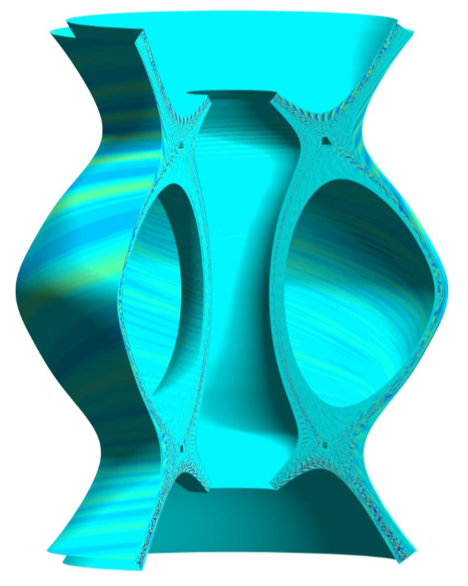
Divertor: Linear and non-linear simulations of SOL turbulence being performed in NSTX-U and MAST
Linear simulations with ArbiTER code for NSTX-U find unstable resistive ballooning modes [Baver, CCP (2016)]
  Higher mode numbers on outer than on inner legs
Non-linear 3D drift-fluid simulations (STORM/BOUT++) of SOL turbulence performed in realistic MAST geometry
  Reproduces filamentary structures seen in fast camera videos in main chamber and divertor
MAST

Slide 39
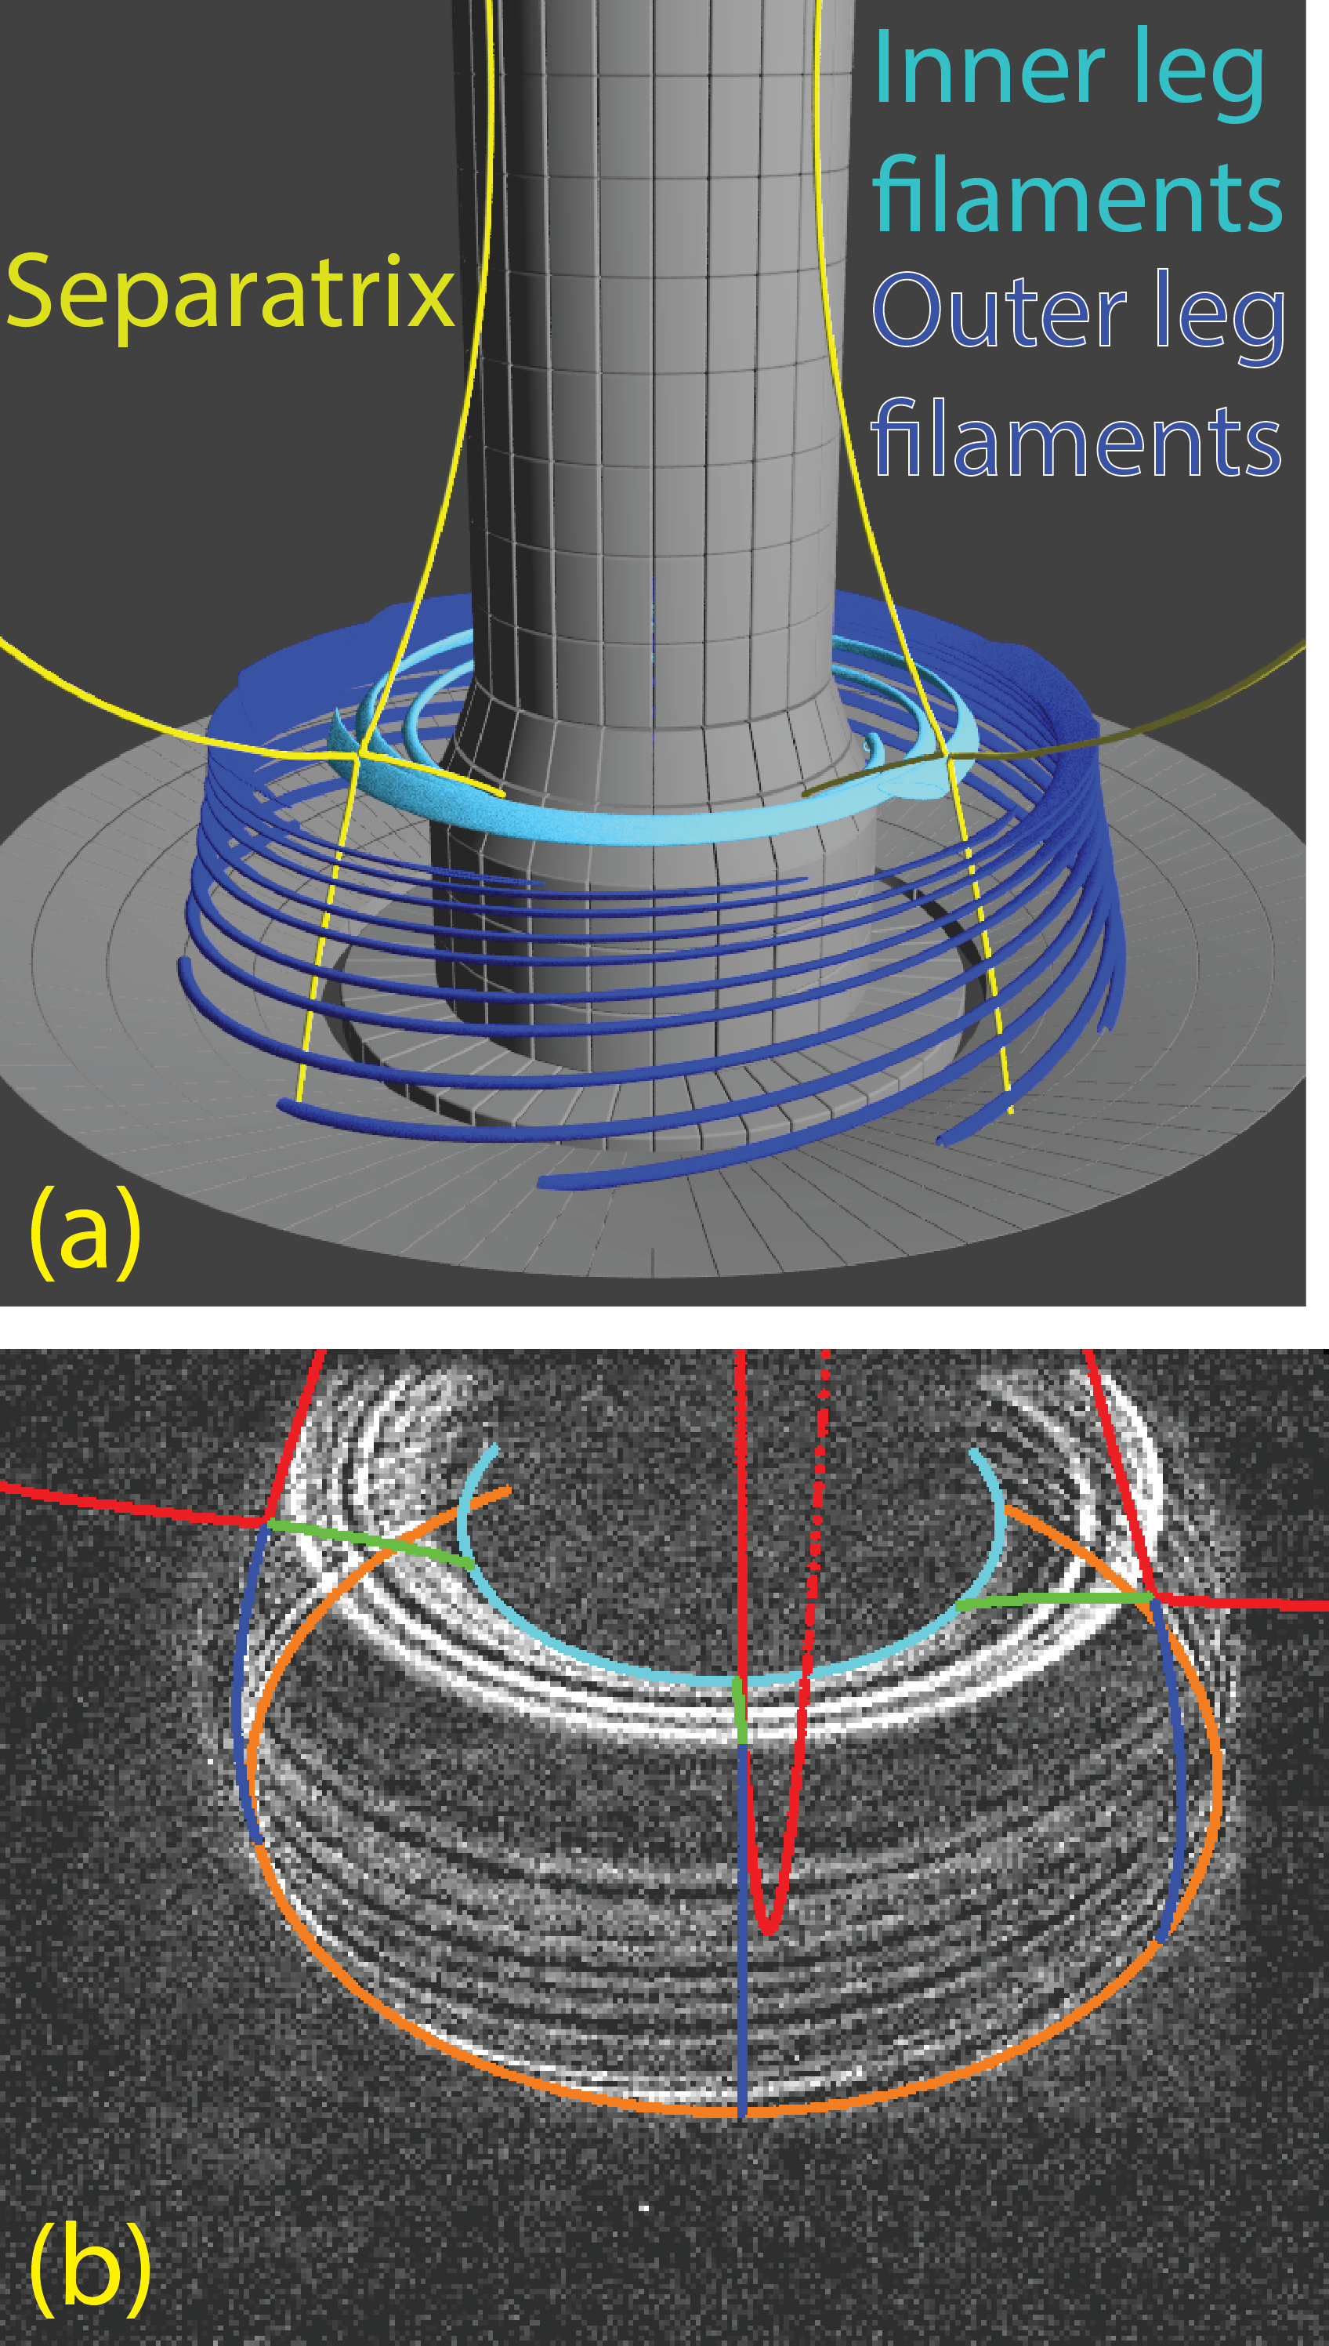
Divertor Physics: Intermittent field-aligned filaments localized to bad curvature side of divertor legs in NSTX-U
Rendering
Divertor leg fluctuations observed by fast imaging [Scotti, Nuc. Fusion (2018)]
  10-30 kHz, k_{pol}ρ_{i}~0.01-0.1, v_{pol}~1-2 km/s
Connected to divertor target plate
Evidence for X-point disconnection
  Inner and outer filament legs not correlated
  Divertor filaments/midplane blobs not correlated
Simulations with ArbiTER code find unstable resistive ballooning modes [Baver, CCP (2016)]
  Higher mode numbers on outer than on inner legs
Images in CIII emission

Slide 40


Edge: NSTX is exploring L-H transition physics
Turbulence fluctuation energies
Zonal ExB energy
Non-zonal
ExB energy
P>0
Thermal free
energy
P<0
Production term, P, related to Reynold’s stress
Find P<0 just prior to L-H in NSTX
  Energy transfer from ZF to turbulence
Inconsistent with Predator-Prey model [Diallo, Nuc. Fusion (2017)]
NSTX

