Slide 1

Error Field Impact on Mode Locking and Divertor Heat Flux in NSTX-U
Nate Ferraro¹
J-K Park,¹ CE Myers,² ML Reinke,³ SP Gerhardt,¹
JE Menard,¹ A Brooks,¹ S Munaretto⁴
¹ Princeton Plasma Physics Lab, Princeton NJ United States
² Sandia National Lab, Albuquerque NM United States
³ Oak Ridge National Lab, Oak Ridge TN United States
⁴ General Atomics, San Diego CA United States
IAEA FEC
Ahmedabad, India
Oct. 2018
Work supported by US DOE under contract DE-AC02-09CH11466

Slide 2
Error Fields Impacted NSTX-U Performance in 2016
Most NSTX-U L-modes were locked from q=2 outward
Significant tearing mode activity could be a consequence of rotation braking from EFs
Locked modes were not preventable or correctable with NSTX-U RMP coils
Experiments reveal multi-mode, time-dependent sensitivity, making EFC very challenging
Goal of this work is to identify sources of error fields and sensitivity of plasma, to help eliminate most deleterious error fields before NSTX-U resumes operation

Slide 3
Experiments Show Clear Evidence of Multi-Mode Sensitivity
In single-mode model, one RMP coil row should be able to prevent or correct locked mode without causing additional locking
However, q=2 mode could not be unlocked using RMP coils due to q=1 locking at large RMP amplitude
  Shows multi-mode sensitivity
Also, q=2 mode could not be prevented by RMP coils
  Shows that error field is large
Mode was unlocked by tangential beams, and healed by H-mode transition

Slide 4
Optimal Error Field Correction Phase Found to Change in Time
The EFC phase that optimizes rotation and density early in shot does poorly later (and vice-versa)
Change appears to occur after formation of q=1 surface (0.4 s)
Experiments rule out change in OH current as source
Would require time-dependent (or equilibrium-dependent) EFC algorithm
“Black” phase does poorly early, but well in flattop
“Purple” phase does well early, but poorly in flattop

Slide 5
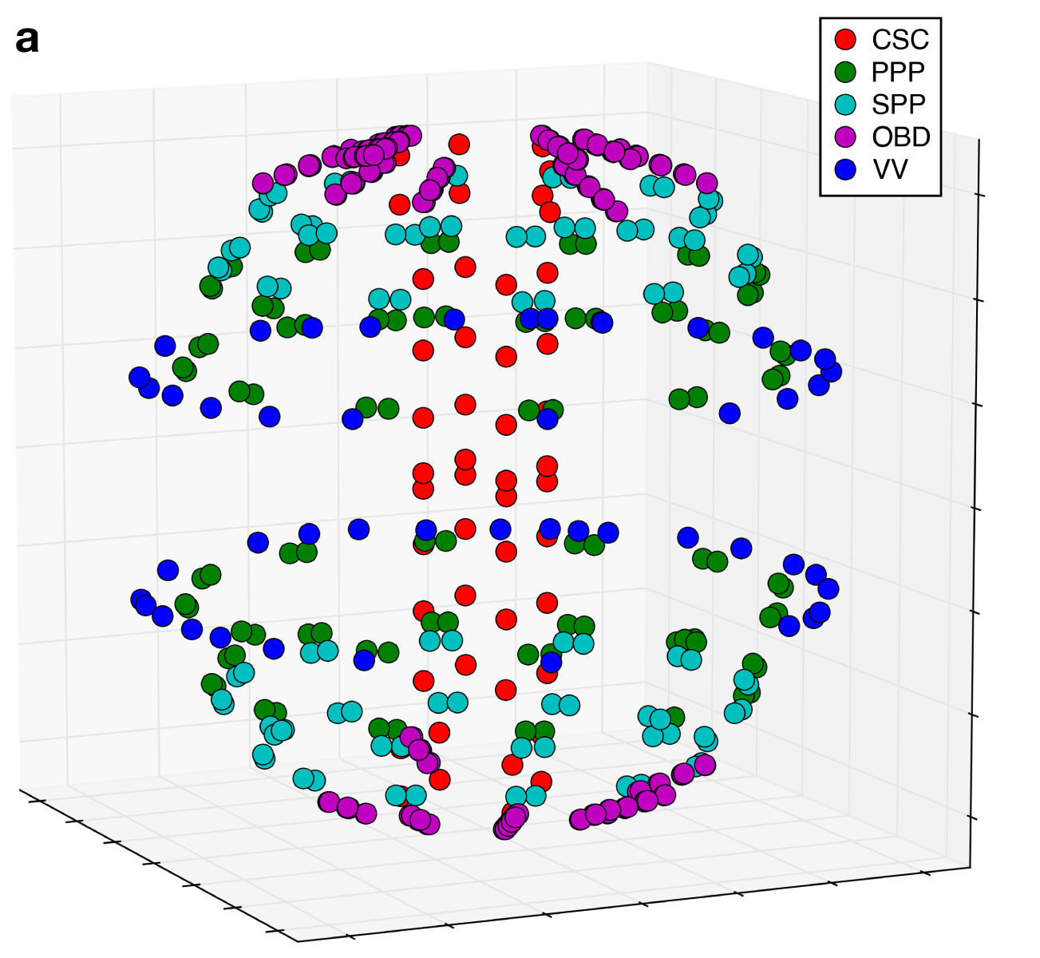
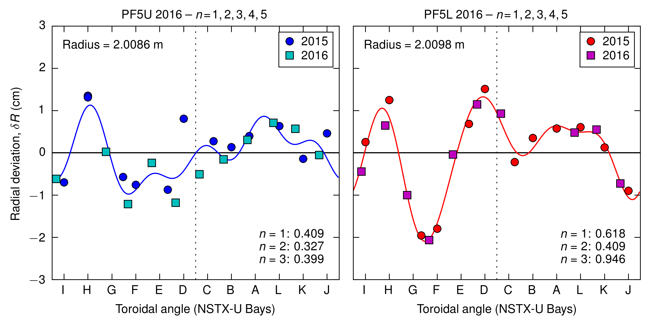
Extensive Metrology Conducted After 2016 Campaign to Identify EF Sources
Vessel measured using ROMER Arm
  Show no changes relative to 2004 measurements
PF5 measured relative to vessel
  Show significant changes relative to 2004 measurements, due to removal of mechanical constraints to allow thermal expansion of coils
TF center rod / CS casing measured using FARO laser tracker

Slide 6
Error Field Models Constructed From Metrology Data
n=1 error field calculated from measured shift / tilt of TF, PF5, and OH coils
Several model scenarios and NSTX-U equilibrium reconstructions considered
  Error fields proportional to coil currents, and therefore scenario-dependent.
Coil | δR_{n=1} | φ_{n=1} | δR_{n=2} | φ_{n=2} | δR_{n=3} | φ_{n=3}
PF5U | 4.09 mm | 121° | 3.42 mm | 113° | 4.01 mm | 323°
PF5L | 6.19 mm | 55° | 4.09 mm | 11° | 9.45 mm | 292°
 | Shift | Shift Angle | Tilt | Tilt Angle
CS Casing | 1.8 mm | 242° | 0.15 mrad | 156°
TF Center Rod | 4.9 mm | 246° | 1.15 mrad | 206°

Slide 7
Effect of Error Fields on Plasma Calculated with M3D-C1 and IPEC/GPEC
Given error field sources, perturbed equilibria calculated using M3D-C1 and IPEC/GPEC
M3D-C1 is an extended-MHD code that includes resistivity, viscosity, and anisotropic thermal conductivity
IPEC / GPEC is an ideal-MHD code that optionally includes self-consistent kinetic effects (e.g. NTV)
Linear, single-fluid models are used here for convenience

Slide 8
Total Resonant Fields
Confinement and locking are strongly correlated with the total resonant field in the perturbed equilibrium
TF misalignment is found to be dominant source of total resonant field, due to large current in TF
TF error field is dominantly m/n = 1/1, consistent with finding of sensitivity to q=1 surface
IPEC finds time-dependent plasma response and optimal EFC phase in agreement with experiment
  Calculation fails when q=1 surface is present, complicating analysis

Slide 9
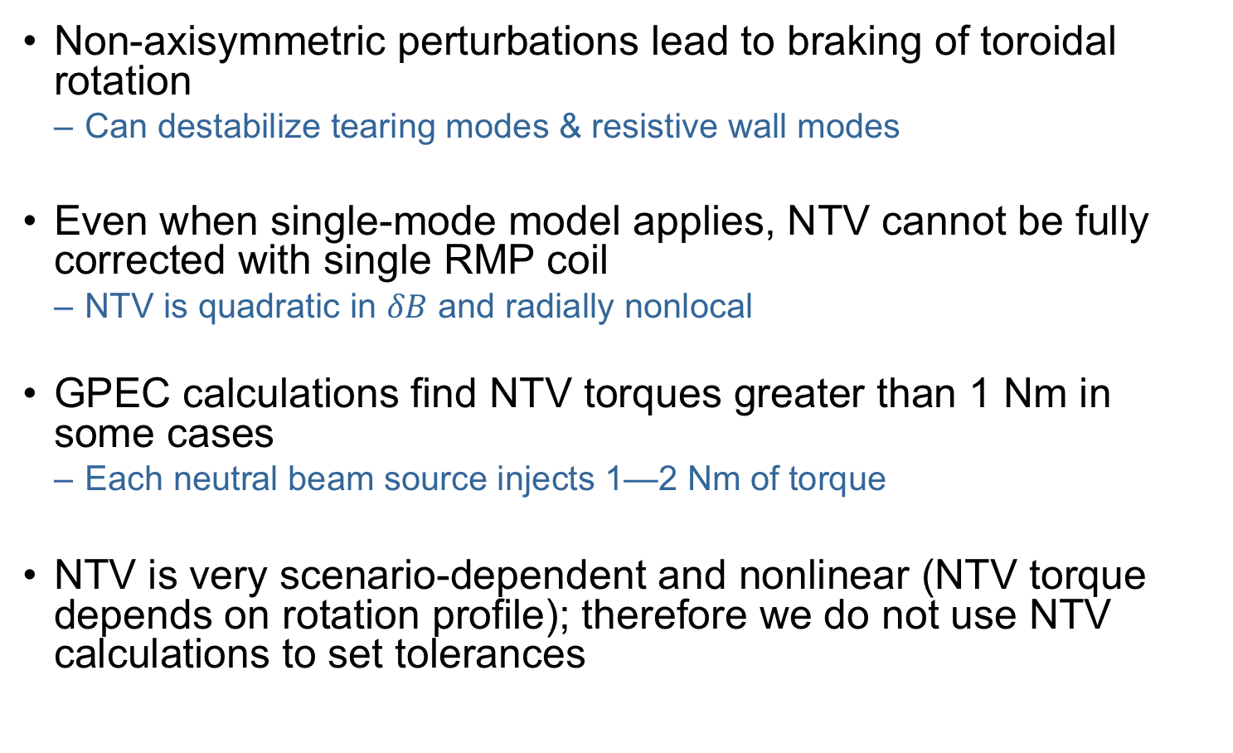
Neoclassical Toroidal Viscosity
Non-axisymmetric perturbations lead to braking of toroidal rotation
  Can destabilize tearing modes & resistive wall modes
Even when single-mode model applies, NTV cannot be fully corrected with single RMP coil
  NTV is quadratic in $δB$ and radially nonlocal
GPEC calculations find NTV torques greater than 1 Nm in some cases
  Each neutral beam source injects 1—2 Nm of torque
NTV is very scenario-dependent and nonlinear (NTV torque depends on rotation profile); therefore we do not use NTV calculations to set tolerances

Slide 10
Field Line Pitch at Divertor Plates
For high-power discharges, pitch angle must be shallow to handle heat flux
Perturbations to pitch angle at strike points could cause localized hot spots
Perturbations to pitch angle (including plasma response) calculated by M3D-C1
The biggest perturbation to pitch angle are caused by misalignment of coils near the divertor (i.e. PF1, PF2) cause
Plasma response does not strongly affect pitch angle
  ”Vacuum” field analysis is usually good enough

Slide 11
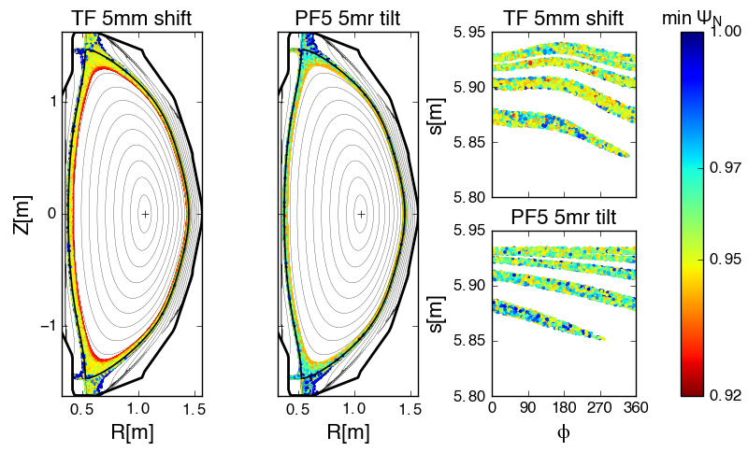
Divertor Footprints
TRIP3D calculates divertor footprint using perturbed equilibrium from M3D-C1
Footprint area scales roughly linearly with error field
Error fields that elicit strong plasma response (i.e. PF4, PF5 & TF) cause the biggest perturbation to the footprints

Slide 12
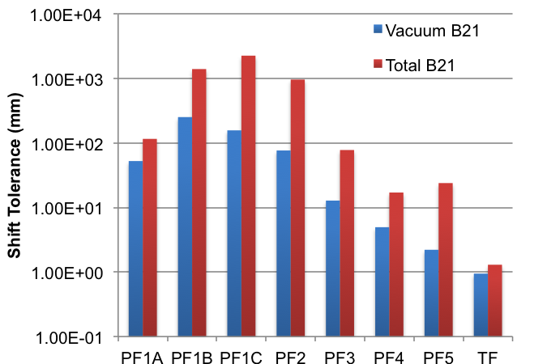
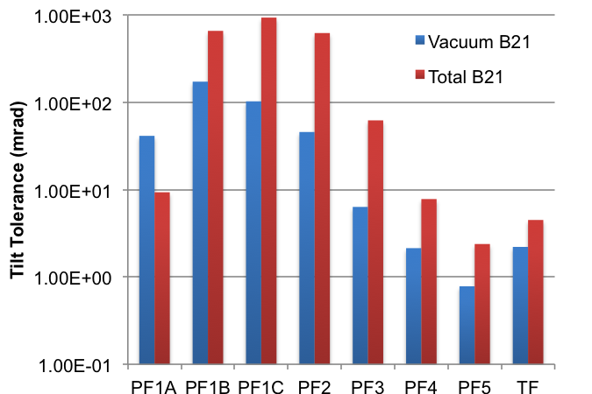
Alignment Tolerances Based on Total Resonant Field Criterion
Maximum shift or tilt of individual coil before total resonant field exceeds that produced by 1 kA-turn in RMP coil

Slide 13
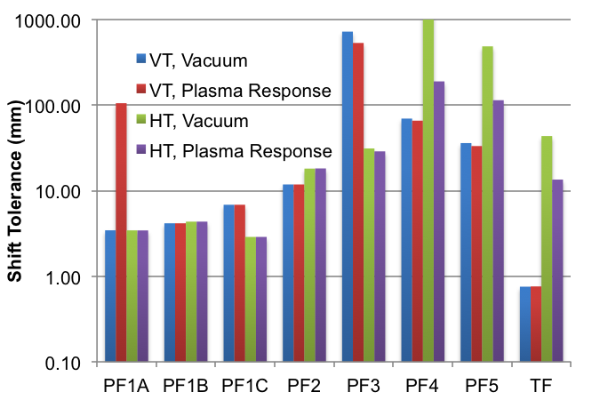
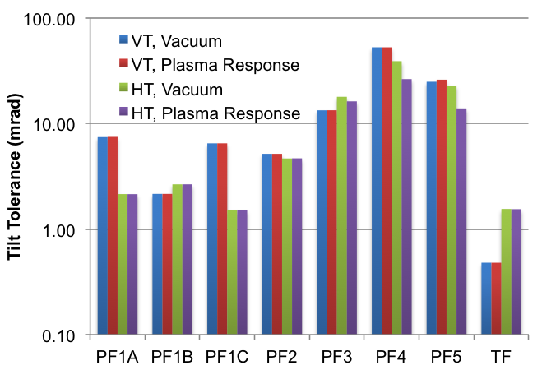
Alignment Tolerances Based on Magnetic Pitch Angle Perturbation Criterion
Maximum shift or tilt of individual coil before perturbation to magnetic pitch exceeds 10% of axisymmetric value

Slide 14
Summary
Error fields (EFs) were found to affect performance of NSTX-U in 2016
EF correction was challenging due to multi-mode, time-dependent plasma response
Extensive metrology carried out to determine EF sources
IPEC/GPEC and M3D-C1 modeling used to evaluate impact of Efs
TF, PF5, and PF4 alignments found to have largest impact on resonant fields (braking / locking) and divertor footprints
TF, PF1, and PF2 alignment found to have largest impact on magnetic pitch angle at divertors
Modeling used to set engineering tolerances for magnets and PFCs

