Slide 1
Supported by the
U.S. Department of Energy Office of Science
Fusion Energy Sciences
Stability, Transport, and Active MHD Mode Control
Analysis of KSTAR High Performance Plasmas
Supporting Disruption Avoidance*
Y.S. Park¹, S.A. Sabbagh¹, J.H. Ahn¹, J.W. Berkery¹, Y. Jiang¹,
B.H. Park², J. Kim², H.S. Han², S.H. Hahn², J.G. Bak²,
J.M. Bialek¹, Y.M. Jeon², W.H. Ko², M.J. Choi², J.S. Ko²,
H.S. Kim², H.H. Lee², J.H. Lee², L. Terzolo², S.J. Wang²,
J.G. Kwak², S.W. Yoon², J.D. Riquezes¹, S. Scott³, Y.K. In⁴,
Z. Wang³, J.-K. Park³, N.M. Ferraro³, S.C. Jardin³, F. Poli³,
M.D. Boyer³, A.H. Glasser⁵, H.K. Park⁴, G.S. Yun⁶
¹Department of Applied Physics, Columbia University, New York, NY, USA
²National Fusion Research Institute, Daejeon, Korea
³Princeton Plasma Physics Laboratory, Princeton, NJ, USA
⁴UNIST, Ulsan, Korea
⁵Fusion Theory and Computation, Inc., Kingston, WA, USA
⁶POSTECH, Pohang, Korea
presented at the
27th IAEA Fusion Energy Conference
October 22nd – 27th, 2018
Gandhinagar, India
National Fusion
Research Institute
* Work supported by the U.S. Department of Energy under contract DE-FG02-99ER54524 and DE-SC0016614
V1.1

Slide 2
Abstract of paper EX/P7-16
H-mode plasma operation in KSTAR has surpassed the n = 1 ideal MHD no-wall beta limit computed to occur at β_{N} = 2.5 with l_{i} = 0.7. High β_{N} operation produced β_{N} of 3.3 sustained for 3 s, limited by tearing instabilities rather than resistive wall modes (RWMs). High fidelity kinetic equilibrium reconstructions (EFIT) have been developed to include Thomson scattering, charge exchange spectroscopy data, and an allowance for fast particle pressure. In addition, motional Stark effect data are used to produce reliable evaluation of the safety factor, q, profile. The reconstructed equilibria can exhibit significant variation of the q-profile dependent upon the broadness of the bootstrap current profile as computed by TRANSP analysis. TRANSP analysis indicates that the non-inductive current fraction can reach up to 75% while its profile can vary significantly depending upon plasma operational scenario. The classical stability of the m/n = 2/1 tearing mode that limited high β_{N} operation is examined using the resistive DCON code and by the M3D-C¹ code using the kinetic EFIT reconstructions as input. For equilibria at high β_{N} > 3, the tearing stability index, Δ′, is more unstable compared to that of equilibria at reduced β_{N}. However calculations of instability of stable lower β_{N} equilibria indicate that the neoclassical components of tearing stability need to be invoked to produce consistency with experiment. MISK code analysis which examines global MHD stability modified by kinetic effects shows significant passive kinetic stabilization of the RWM in these plasmas. Predict-first TRANSP analysis was conducted to design KSTAR plasma operation with 100% non-inductive fraction at β_{N} above 4. Active RWM control has additionally been enabled on KSTAR. To accurately determine the dominant n-component produced by RWMs expected to onset at higher beta utilizing the new second NBI system, an algorithm has been developed that includes magnetic sensor compensation of the prompt applied field and the field from the induced current on the passive conductors. This analysis on stability, transport, and control provides the required foundation for disruption prediction and avoidance research on KSTAR.

Slide 3
US-KSTAR collaborative research on stability, transport, and active MHD mode control for disruption avoidance
Motivation
To achieve high performance plasma operation with high non-inductive current fraction without disruptions, the estimation of stability and unique equilibrium and transport properties is crucial
These analyses will provide the required foundation for disruption prediction and avoidance on KSTAR
Outline
Equilibrium reconstructions using measured kinetic profiles and MSE data for reliable stability and transport analysis
Transport analysis using TRANSP code to investigate high non-inductive current operation and to optimize the stability
Ideal and resistive stability analysis using the resistive-DCON, MISK and M3D-C¹ code
Active RWM feedback algorithm implemented in the KSTAR PCS
S.A. Sabbagh, et al., EX/P6-26 in this conference

Slide 4
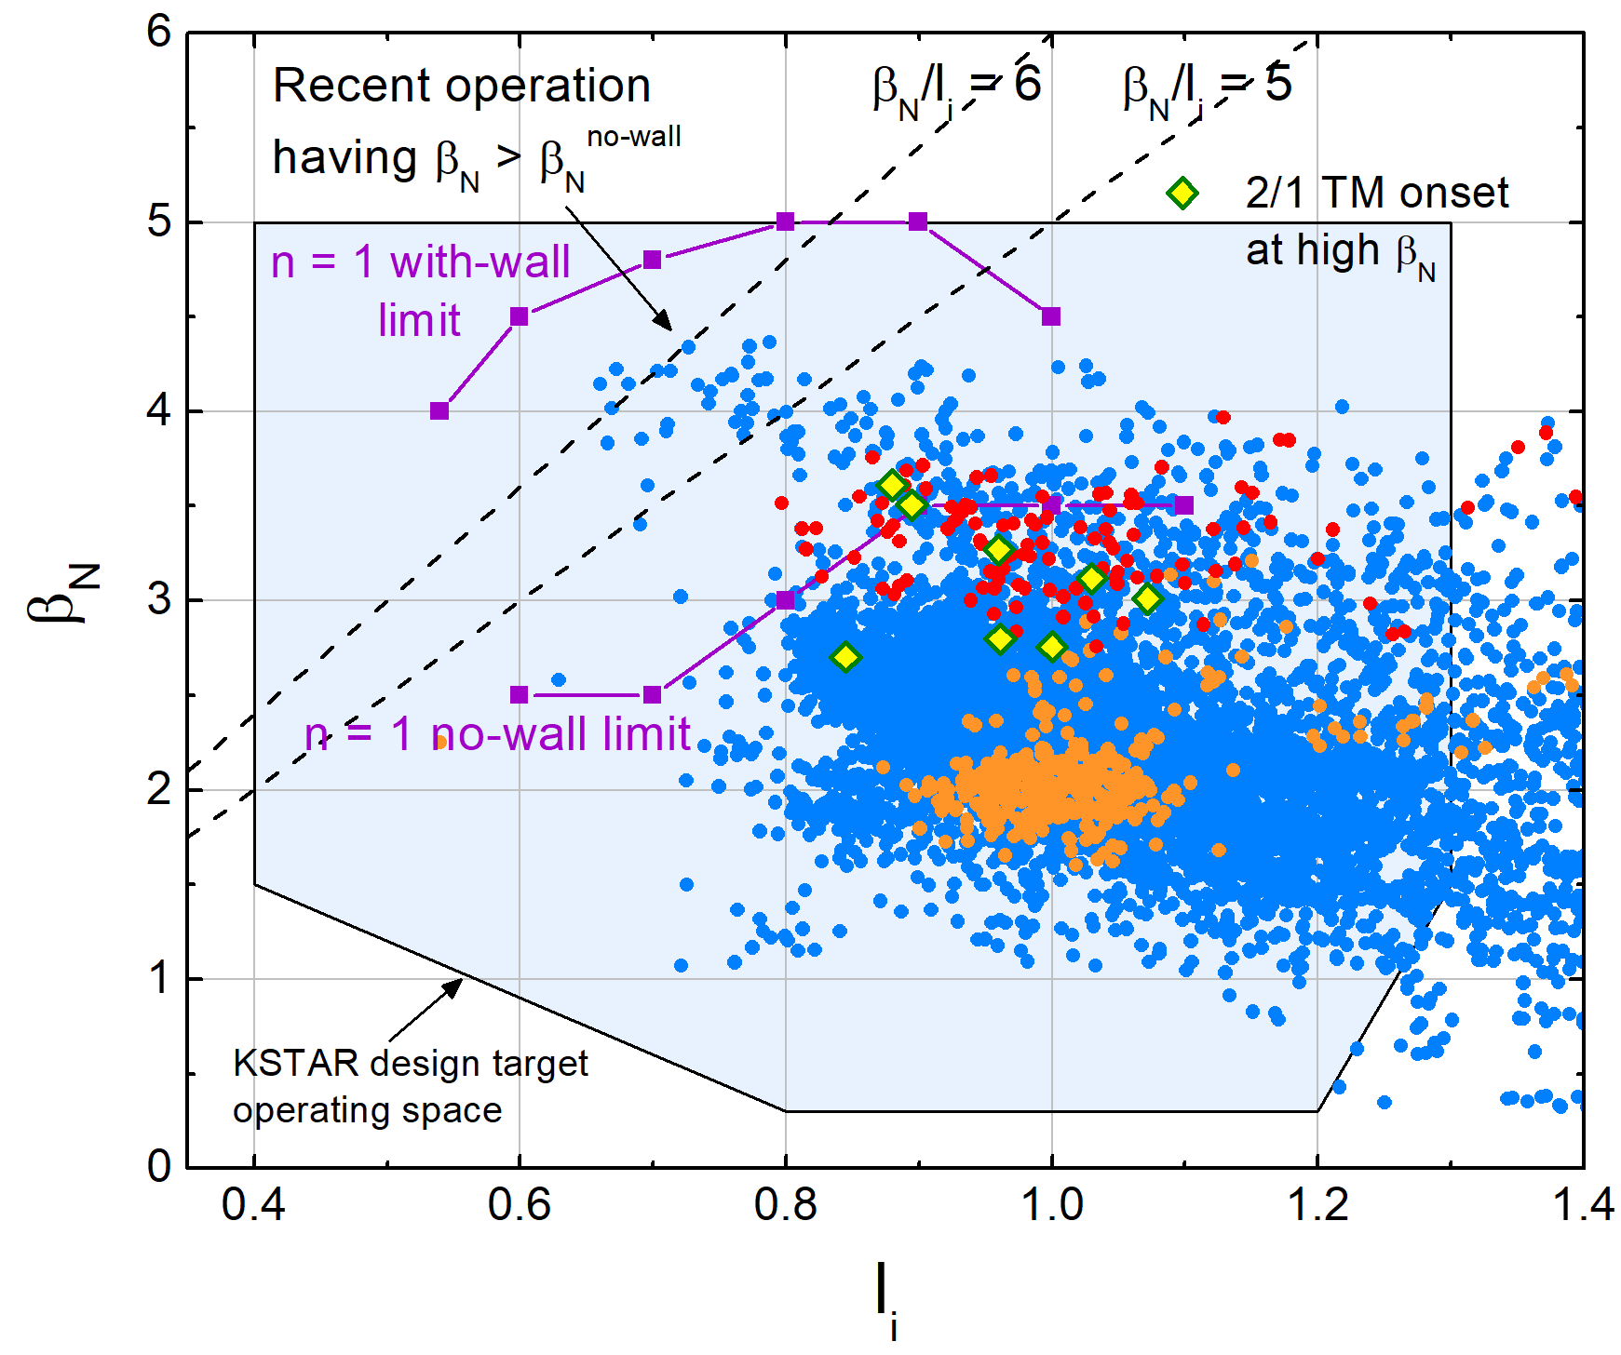
KSTAR H-mode equilibria have reached and exceeded the computed
n = 1 ideal no-wall stability limit
Parameters for high β_{N}
B_{T} in range 0.9-1.3 T
P_{NBI} = 4.5-5.5 MW
Highest β_{N} = 4.3, β_{N}/l_{i} > 6
MHD stability at high β_{N}
Many equilibria operate above the published ideal n = 1 no-wall stability limit (DCON)
Plasma is subject to RWM instability, depending on plasma rotation profile
High β_{N} > β_{N}^{no-wall} operation mostly limited by 2/1 tearing mode onset
Shot 16295
*
Shot 16325
Normalized beta vs. internal inductance from EFIT reconstruction**
containing ~9,000 equilibria produced in the 2016 device campaign
*O. Katsuro-Hopkins, et al., Nucl. Fusion 50 (2010) 025019
** Y.S. Park, et al., Nucl. Fusion 53 (2013) 083029

Slide 5
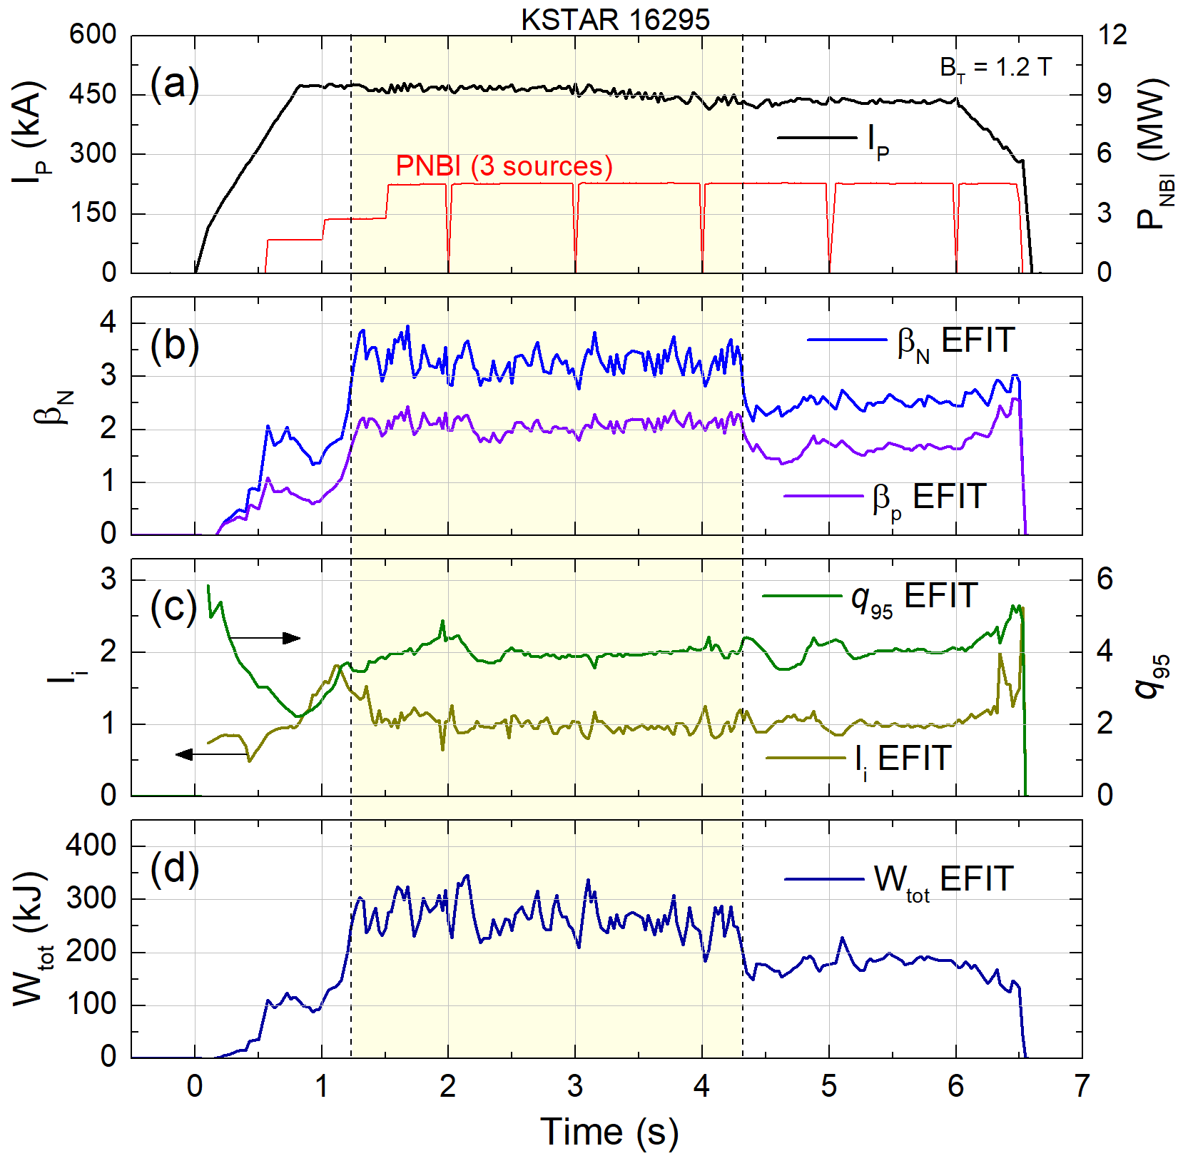
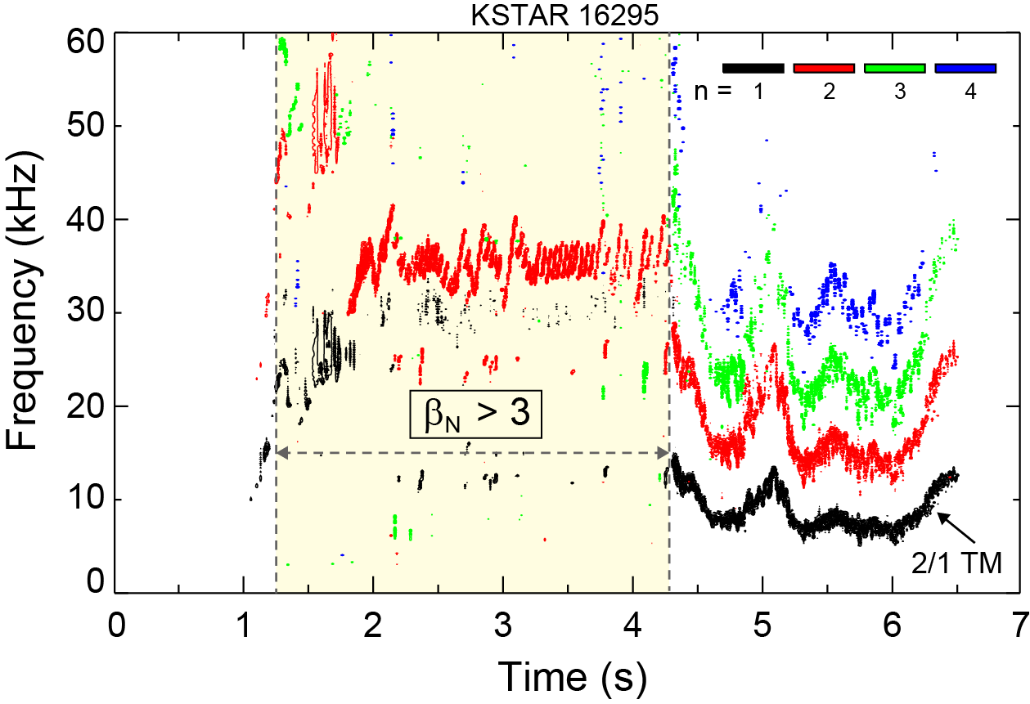
High β_{N} > 3 equilibria limited by MHD - shot 16295
2/1 mode onset
2/1 mode onset
2/1 TM
β_{N} > 3
Toroidal magnetic probe spectrum
q₉₅ ~ 4
Sustained high β_{N}^{avg} = 3.3 achieved for 3 s
High β_{N} operation was limited by strong 2/1 tearing mode onset
Measured mode amplitude > 20 G
Both W_{tot} and β_{N} were reduced by ~35% but maintained H-mode
The 2/1 mode is expected to be triggered by co-existing sawteeth
Stored energy
KSTAR high β_{N} discharge evolution showing parameters from fully converged EFIT reconstructions

Slide 6
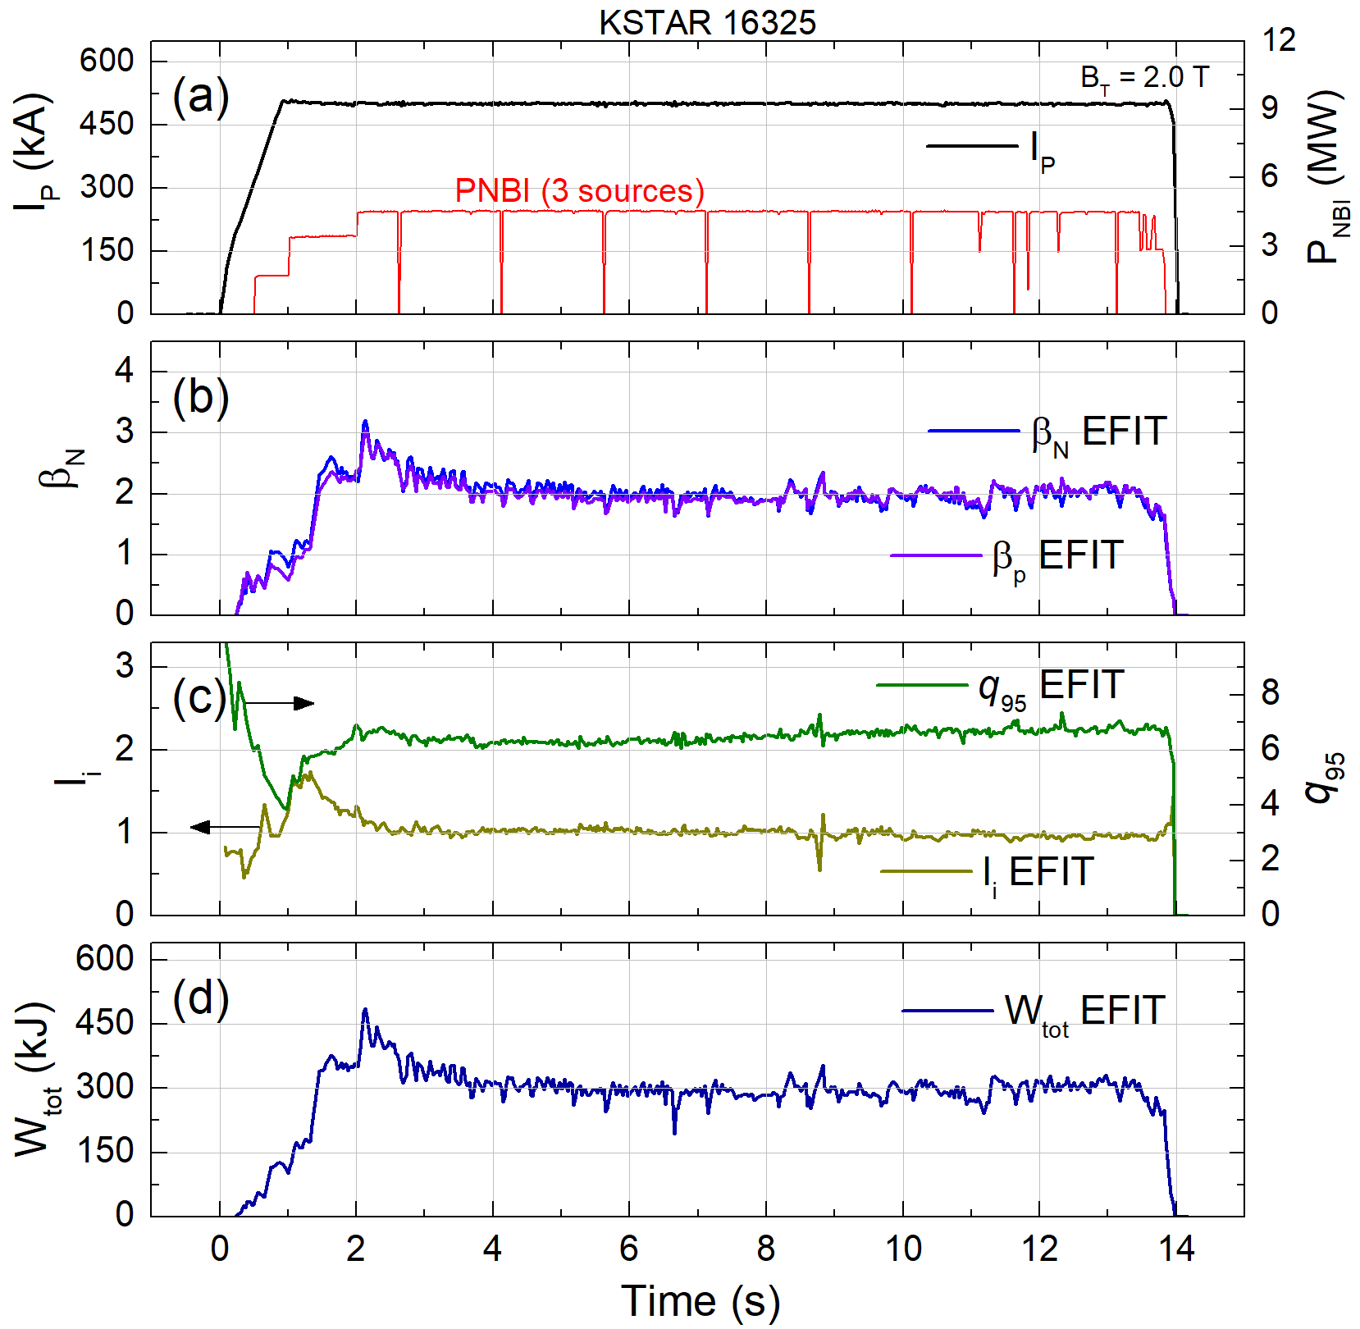
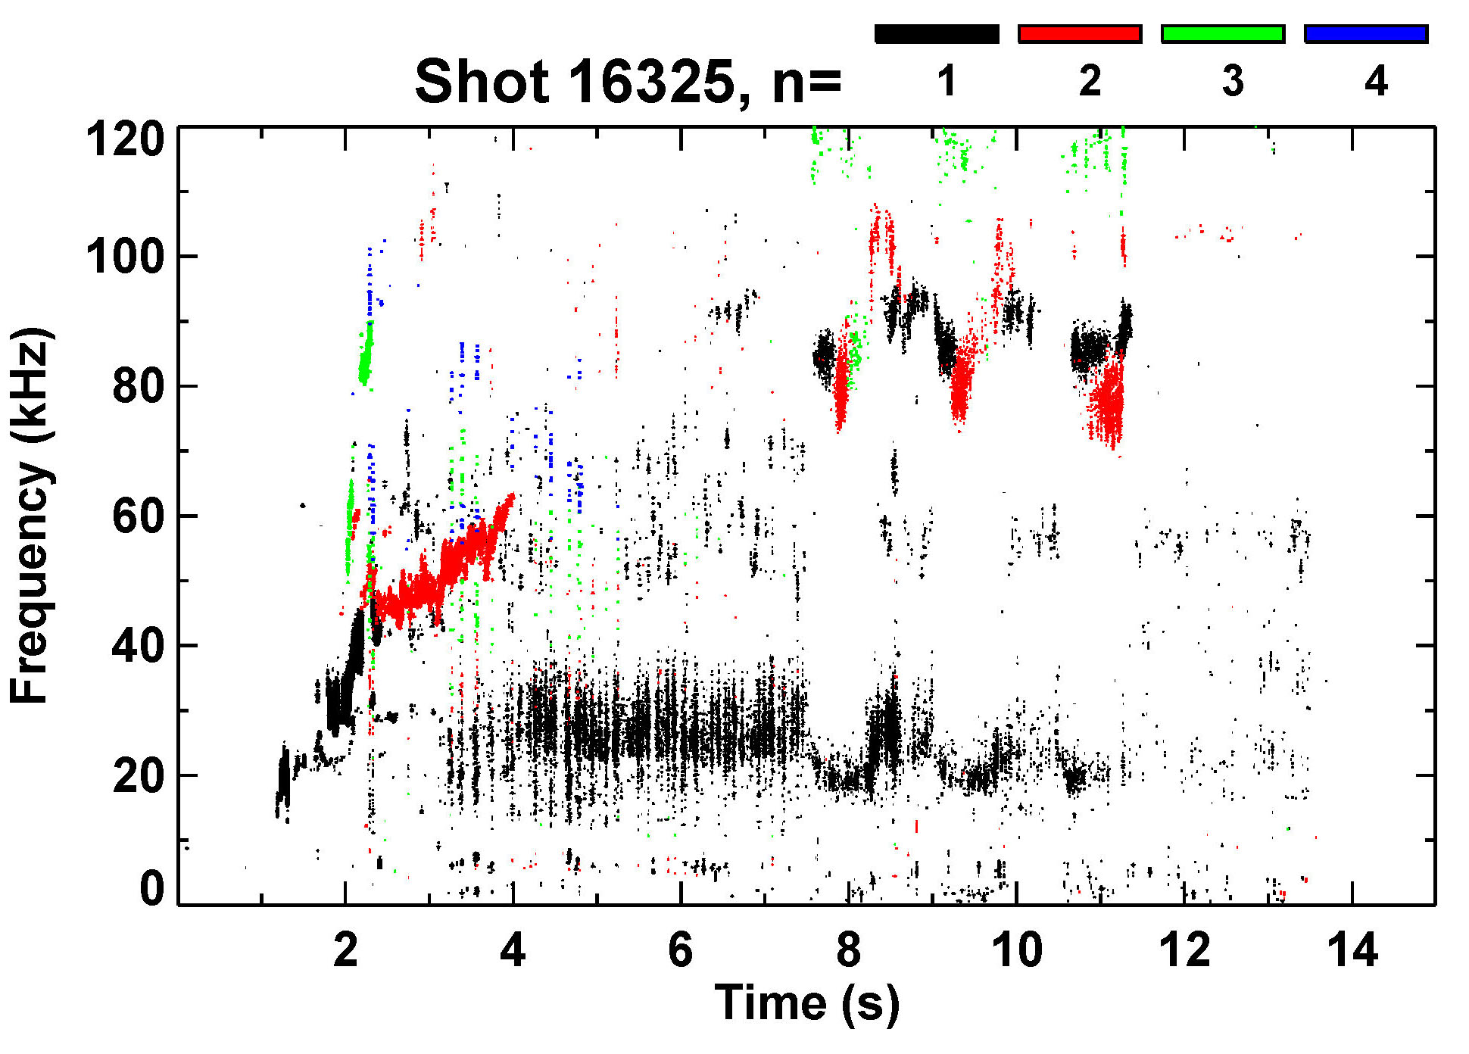
Comparative equilibria stable to disruptive MHD instabilities
- shot 16325
KSTAR 16325
β_{N} ~ β_{p} > 2
Tearing modes absent
q₉₅ > 6
Toroidal magnetic probe spectrum
Plasma operation at elevated B_{T} produced equilibria having higher q₉₅
Unlike shot 16295, discharge doesn’t experience any major beta-limiting MHD activities
Stored energy
KSTAR 16325 discharge evolution showing parameters from fully converged EFIT reconstructions

Slide 7
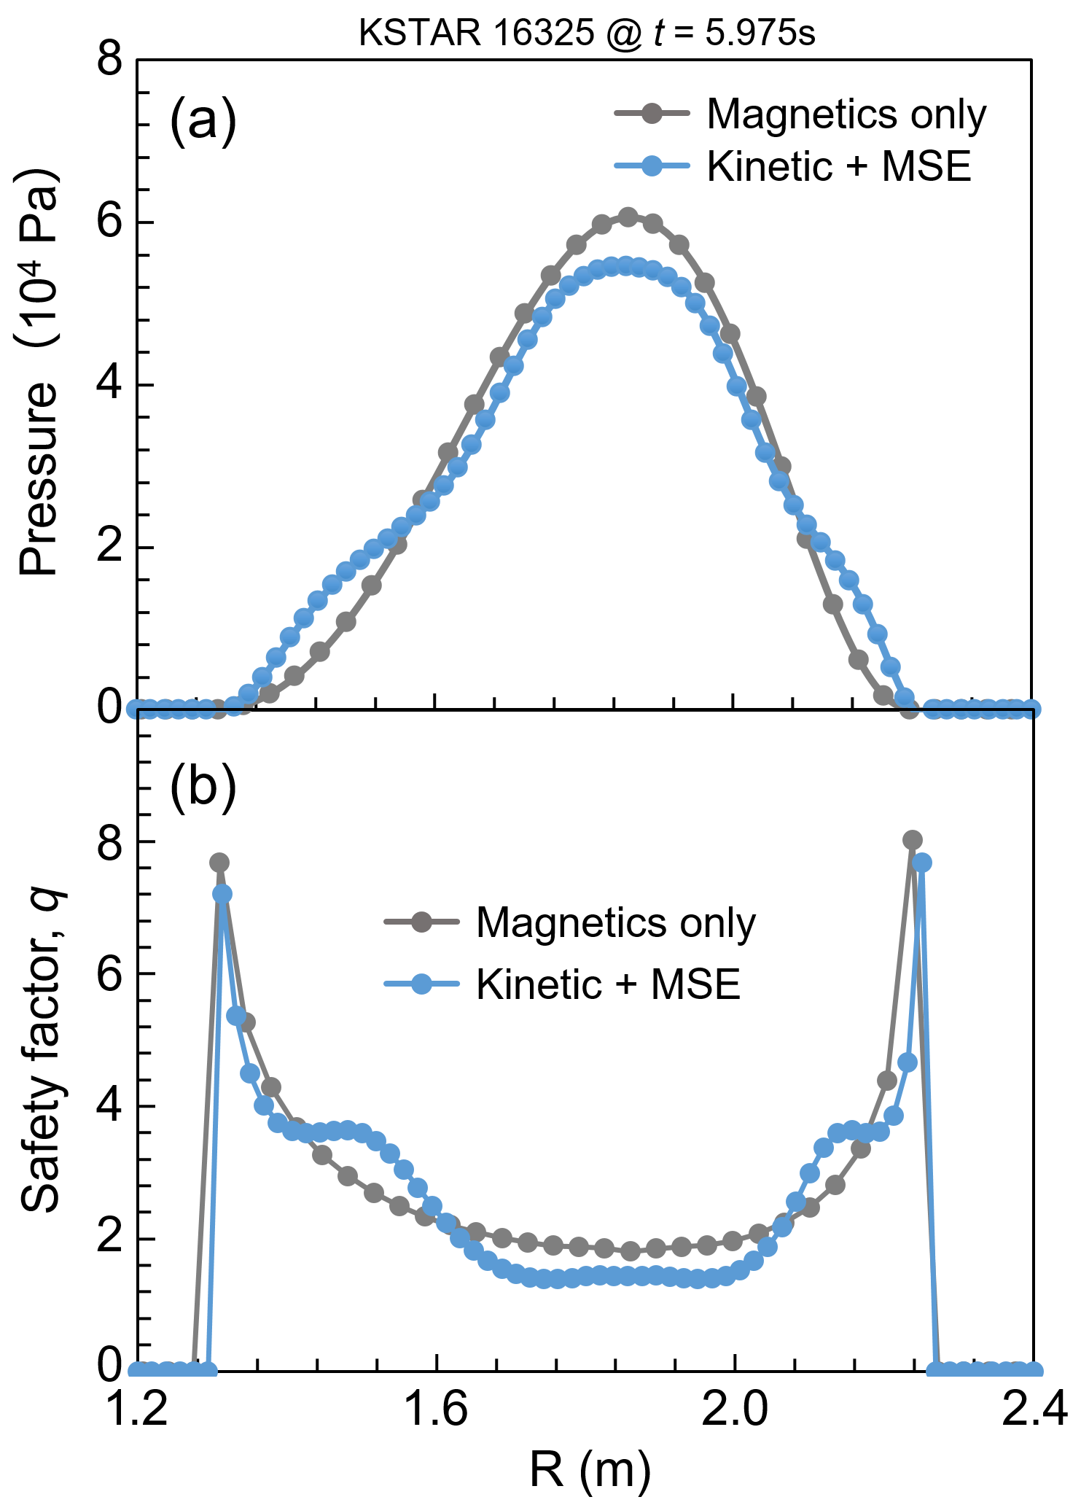
Kinetic EFIT with MSE constraints used for accurate stability and transport analysis on KSTAR
Equilibrium reconstruction using measured internal profile constraints provides reliable pressure profile and internal magnetic geometry
KSTAR is equipped with key internal profile diagnostics
Charge exchange (T_{i}, V_{φ}) : 32 CHs
Thomson scattering (T_{e}, n_{e}) : 27 CHs
Motional Stark Effect : 25 CHs
MSE background polychrometer installed in the device will improve the measurement
Reconstructed q-profile shows region of low shear appear at varied q-values in different operational regimes due to broadness of bootstrap current profile
S.A. Sabbagh, Nucl. Fusion 41 (2001) 1601
Low q-shear
(a) Reconstructed pressure and (b) safety factor profile from kinetic EFIT using internal profile constraints

Slide 8
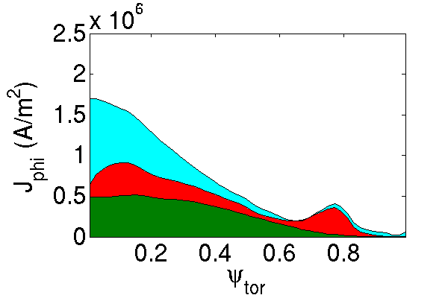
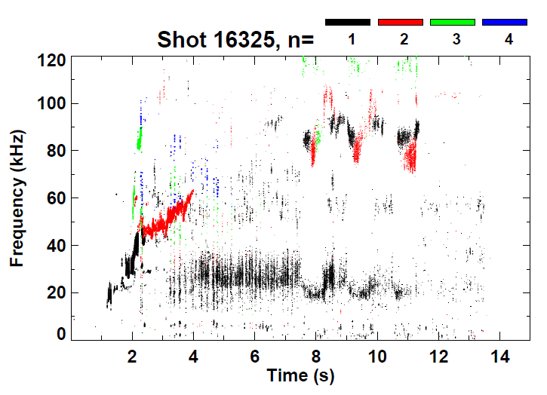
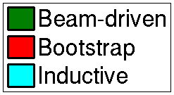
Kinetic EFIT reconstruction shows evolution of low-sheared q-profile region at varied q-values
x10⁶
KSTAR 16325 @ t = 2.05 s
t1
t2
t3
Magnetic spectrogram
TRANSP
(f_{NI} = 71%)
Kinetic + MSE reconstructed q-profile evolution
20
20
15
t1 = 1.906 s
t2 = 4.979 s
t3 = 10.491 s
15
15
10
Low shear forms again, but at high q
Safety factor, q
Safety factor, q
Safety factor, q
10
10
q_{min} < 1
5
5
5
0
0
0
0.0 0.2 0.4 0.6 0.8 1.0
Ψ_{N}
0.0 0.2 0.4 0.6 0.8 1.0
Ψ_{N}
0.0 0.2 0.4 0.6 0.8 1.0
Ψ_{N}

Slide 9
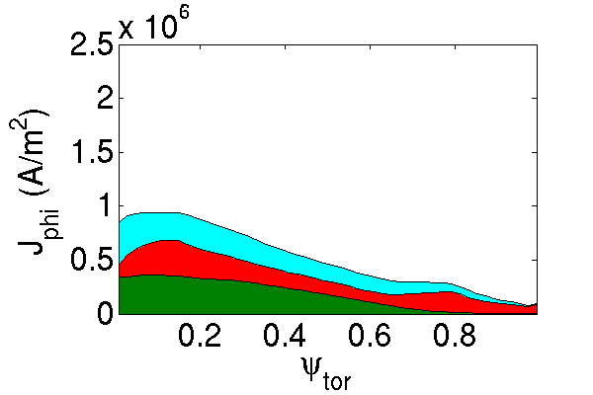
Interpretive TRANSP analysis computes high non-inductive current fraction in the experimental equilibria
Intermediate β_{N} = 2.7
High β_{N} > 4 equilibrium
KSTAR 16325 @ t = 2.05 s
KSTAR 16295 @ t = 1.75 s
TRANSP
TRANSP
P_{NBI} = 4.5 MW
P_{NBI} = 4.5 MW
β_{N} = 2.7
f_{NI} = 71%
β_{N} = 4.3
f_{NI} = 67%
Significant edge j_{BS}
Broad j_{BS}
Transport calculations using TRANSP to investigate a disruption-free path to device target high beta operation with high non-inductive current fraction, f_{NI}
Interpretive TRANSP runs indicate f_{NI} can reach up to 75% in the experiment
While f_{NI} can be high in different operating conditions, the bootstrap and total non-inductive current profile can vary significantly

Slide 10
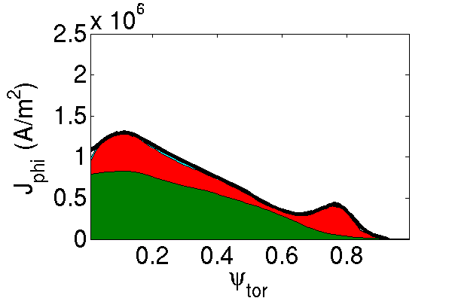
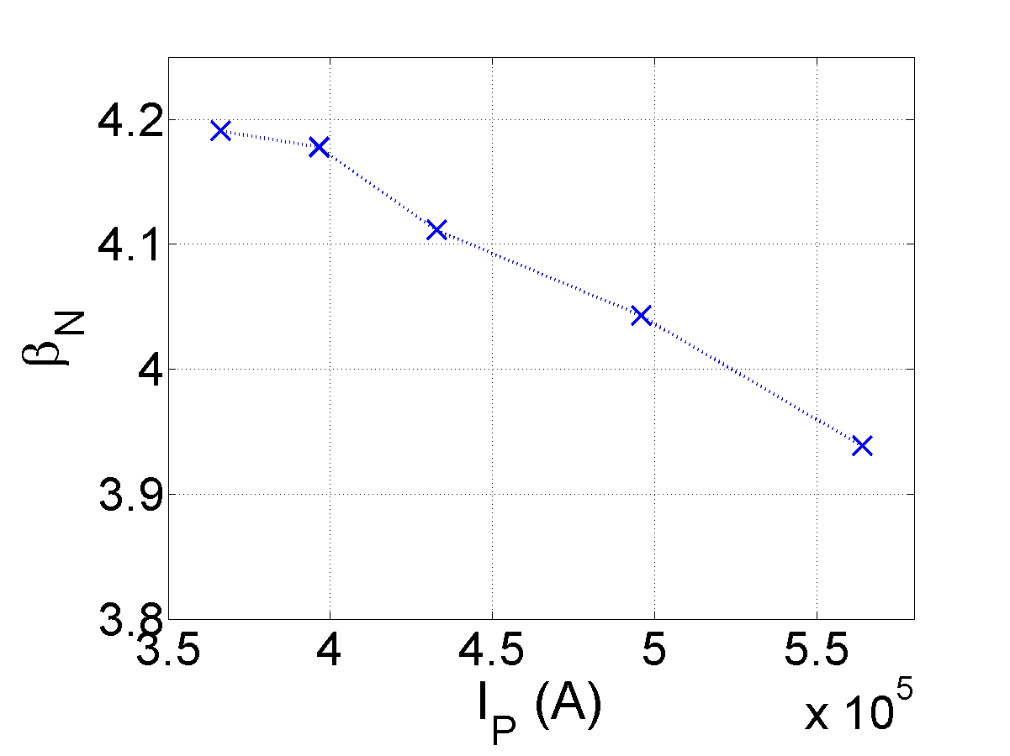
High β_{N} > 4 can be achieved with near fully non-inductive current by using the planned P_{NBI} increase in KSTAR
Projected from KSTAR 16325
TRANSP
(Predictive)
TRANSP
(Predictive)
P_{NBI} = 6.5 MW
B_{T} = 2 T
β_{N} = 3.4
f_{NI} = 96%
P_{NBI} = 6.5 MW
B_{T} = 1.7 T
A new off-axis 2nd NBI system is being installed for the 2018 device operation
Experimental f_{GW} = 0.5 and H_{98y2} = 1.25 are maintained, and total P_{NBI} = 6.5 MW (P_{NBI-1} = 5 MW, P_{NBI-2} = 1.5 MW) is used in the predictive TRANSP runs
Predictive runs indicate β_{N} > 4 can be achieved with fully non-inductive current by using a fraction of the planned P_{NBI} increase (P_{NBI} > 11 MW from 2019)

Slide 11
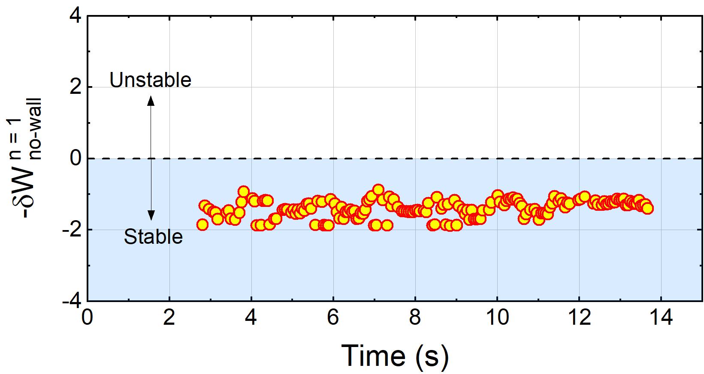
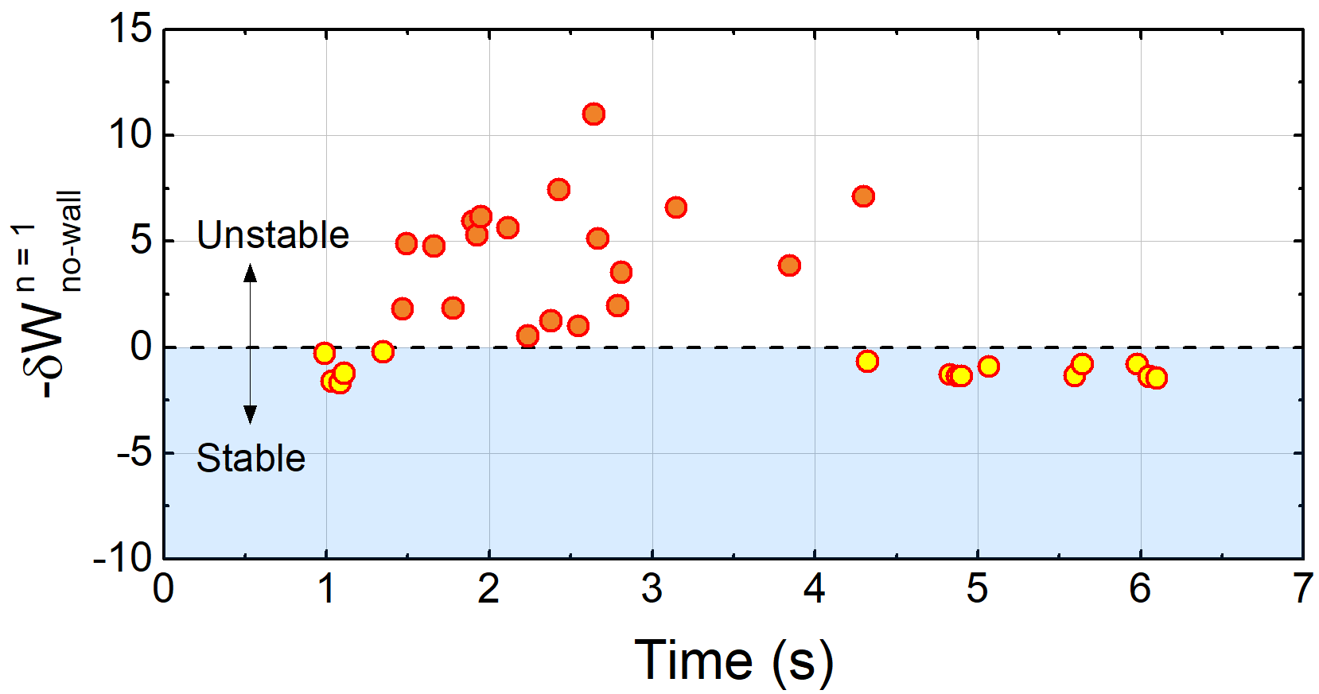
DCON stability calculation shows high β_{N} equilibria are subject to n = 1 ideal instability
KSTAR 16325
KSTAR 16295
DCON δW
DCON δW
β_{N} ~ 2
β_{N} > 3
DCON computed ideal MHD n = 1 δW with no-wall
Equilibria at lower β_{N} ~ 2 is consistently stable to n = 1 ideal modes in DCON
Unlike the lower β_{N} case, DCON calculates unstable n = 1 mode with no-wall (β_{N} > β_{N} ^{no-wall}) at the achieved high β_{N} > 3
The small deviations in the reconstructed profiles in the high β_{N} phase is responsible for reduced equilibrium convergence and the scatter in δW
A.H. Glasser, Phys. Plasmas 23 (2016) 072505

Slide 12
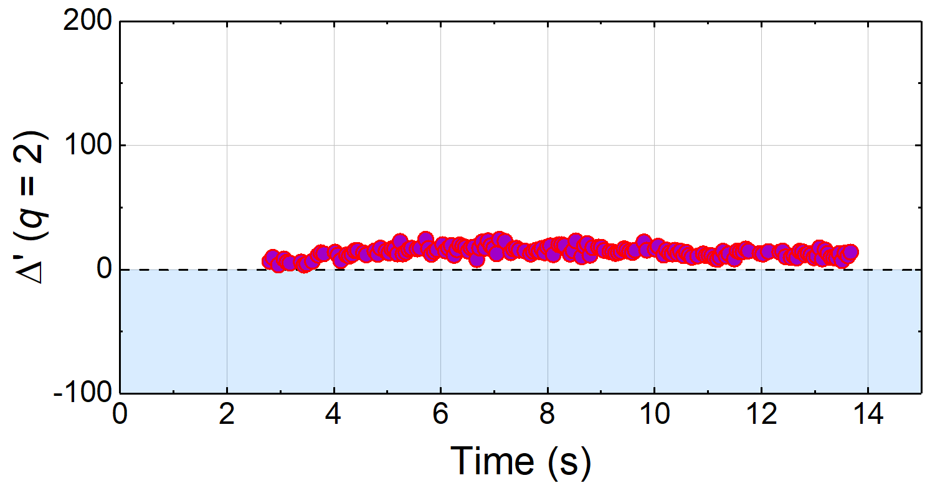
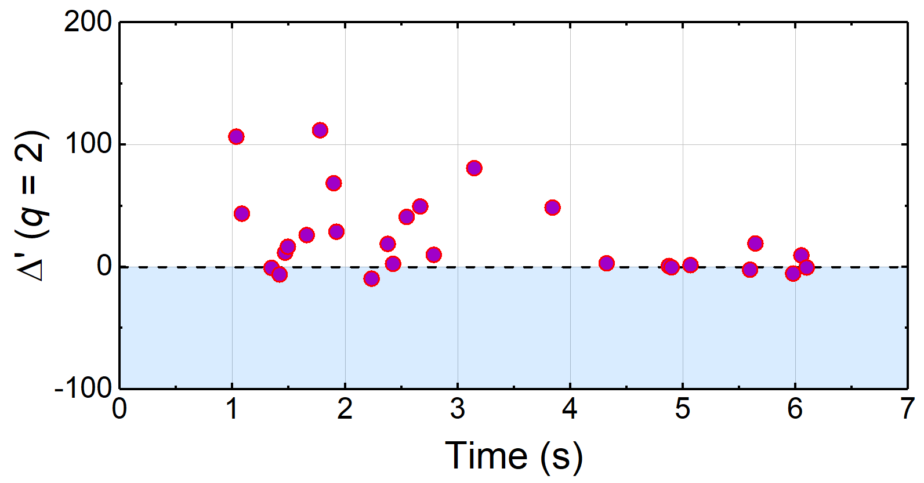
Tearing stability is examined by the resistive DCON code
KSTAR 16325
KSTAR 16295
R-DCON $Δ′$
Susceptible to tearing mode onset in the experiment
R-DCON $Δ′$
β_{N} ~ 2
β_{N} > 3
Resistive DCON computed $Δ′$ at q = 2 surface
The tearing stability index, Δ′, at high β_{N} > 3 is more unstable compared to that at reduced β_{N} later in the discharge
The intermediate β_{N} ~ 2 equilibria that are experimentally stable to tearing modes but show an unstable value of Δ′ indicate that stabilizing components of the NTM stability combined with sheared toroidal rotation need to be invoked
A.H. Glasser, et al., Phys. Plasmas 23 (2016) 112506

Slide 13
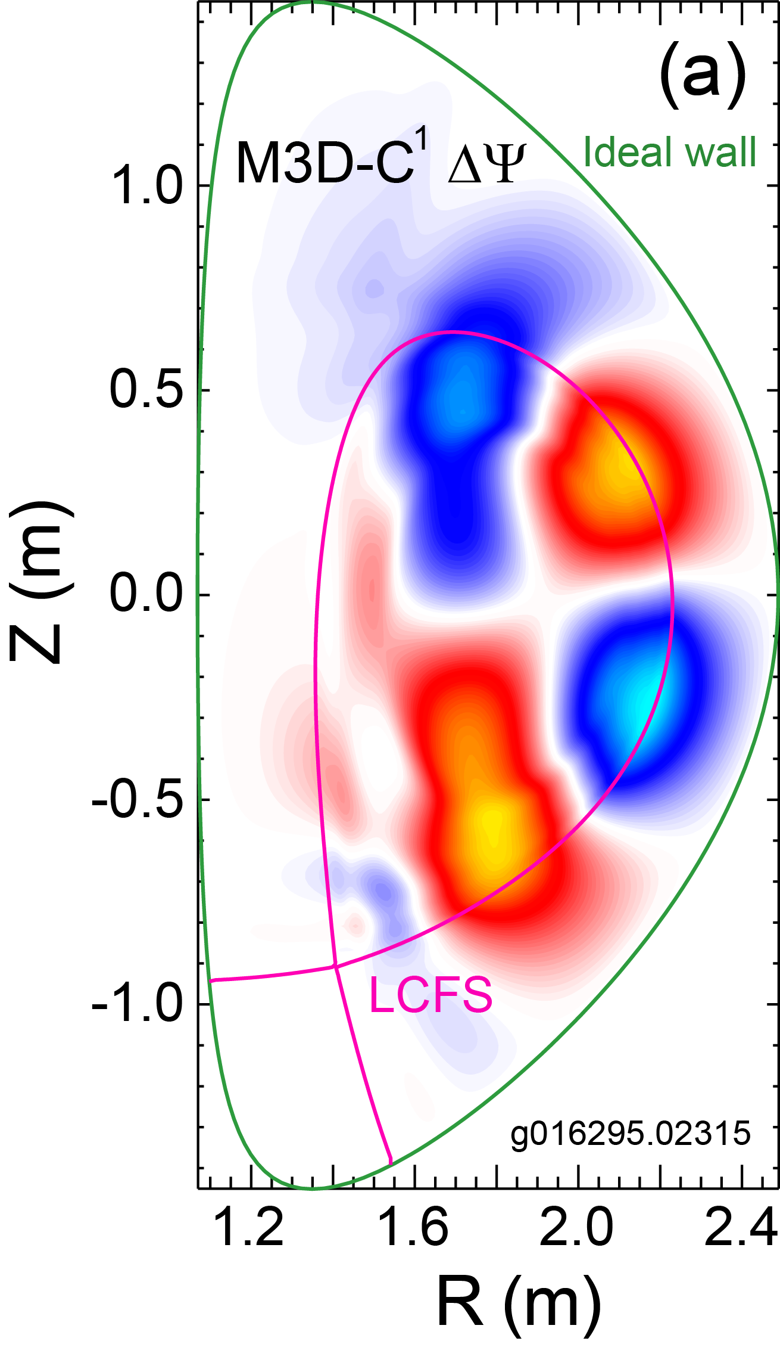
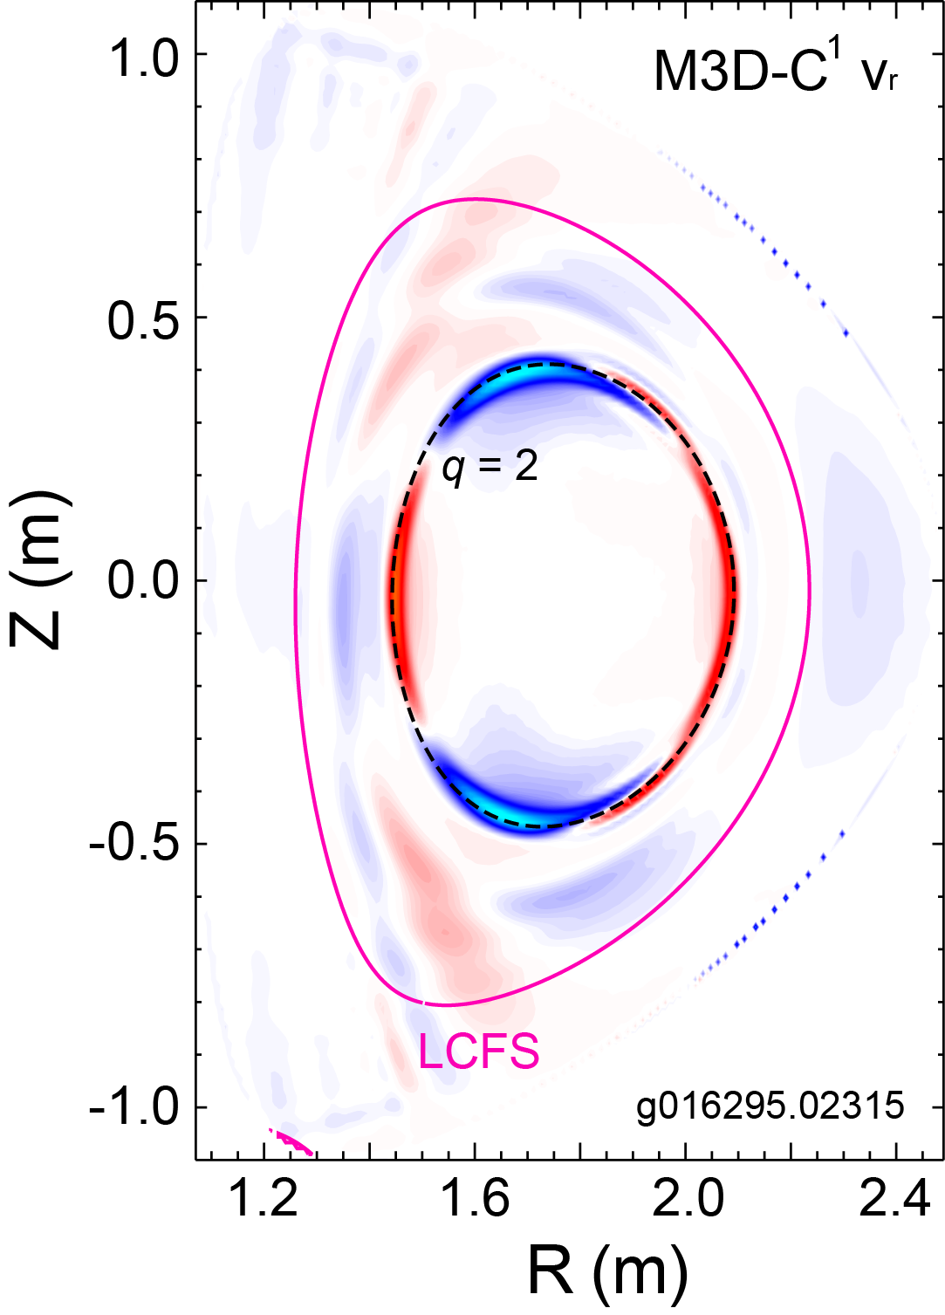
Ideal and resistive stability of high β_{N} equilibria examined
by using M3D-C¹
KSTAR 16295
KSTAR 16295
(b)
The high β_{N} equilibrium is computed to be unstable to n = 1 ideal mode by linear M3D-C¹ analysis consistent with DCON
Kinetic RWM stability can explain the observed RWM stable operation at β_{N} > β_{N}^{no-wall}
A marginally stable 2/1 tearing mode is computed in M3D-C¹ using a simplified input plasma resistivity estimated from measured T_{e} profile
(a) The perturbed poloidal flux of unstable ideal mode and (b) the radial velocity eigenfunction of a 2/1 tearing mode from M3D-C¹
S.C. Jardin, et al., J. Comput. Phys. 226 (2007) 2146

Slide 14
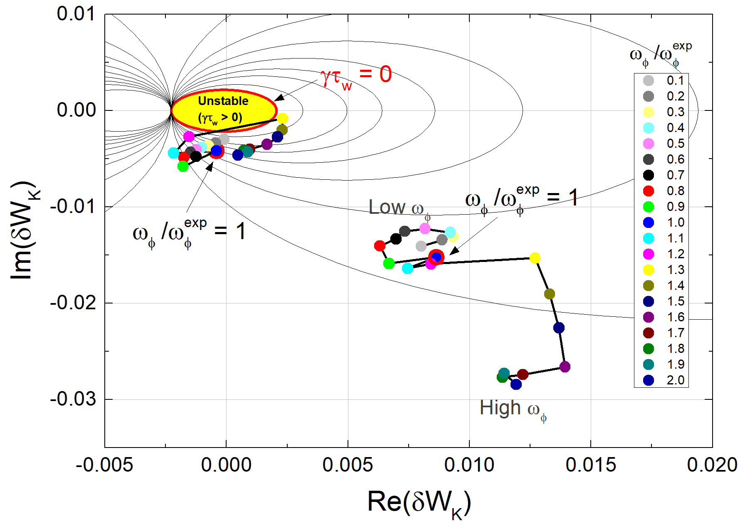
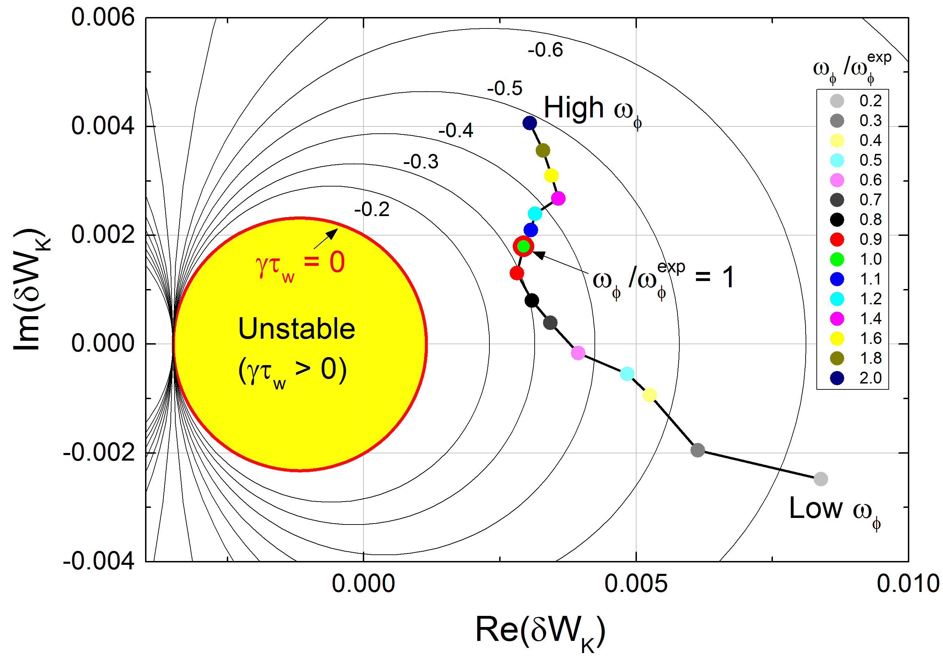
Kinetic modification of RWM stability is evaluated with including energetic particle effects
KSTAR 16325 @ 11.975 s
KSTAR 16295 @ 2.315 s
β_{N} = 2
MISK δW_{K}
β_{N} = 3
w/o Energetic
particles
Experiment (w/ EP)
Experiment (w/o EP)
Experiment (w/o EP)
w/ Energetic
particles
Stable
(γτ_{w} < 0)
MISK δW_{K}
n = 1 RWM stability diagram with scaled experimental rotation profiles
MISK calculations find the equilibrium is stable to RWM as is consistent with experiment (rotation profile is scaled from 0.1 to 2 times in the analysis)
Energetic particles are predicted to give a strong stabilizing effect to RWMs
J.W. Berkery, et al., PRL 104 (2010) 035003
Y.S. Park, et al., Nucl. Fusion 51 (2011) 053001

Slide 15
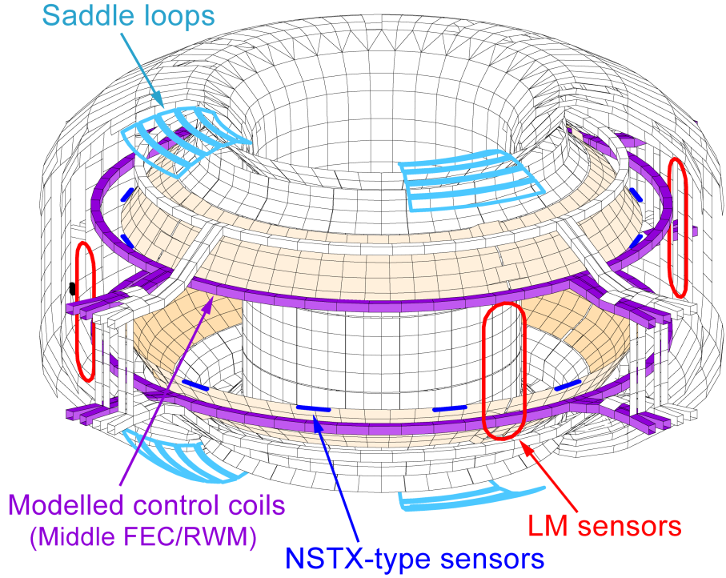
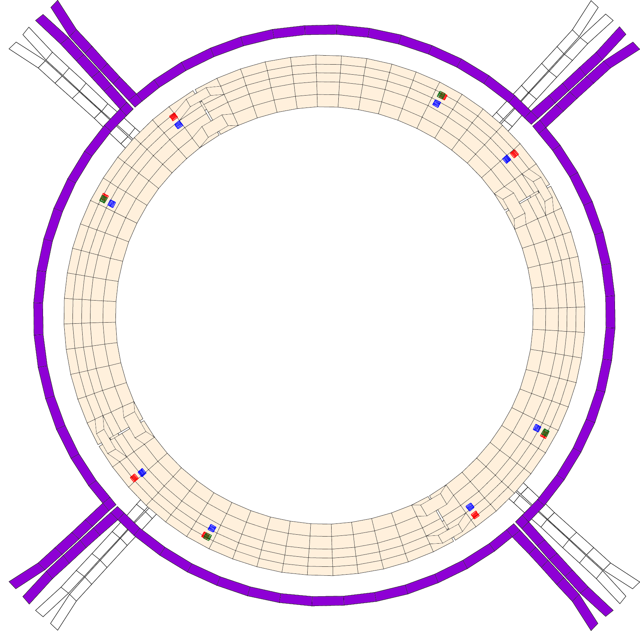
RWM active feedback control system installed in KSTAR
KSTAR RWM feedback physics model in VALEN-3D
RWM feedback sensors on passive plates
~8,000 finite elements
RWM sensors
MPZU03 (4 sensors)
(R = 2.18 m,
Z = 0.56 m)
28º
MPZU04 (8 sensors)
(R = 2.10 m,
Z = 0.68 m)
322º
49º
298º
φ
Middle-IVCC
RWM control
coils (4 coils)
MPs
118º
229º
208º
142º
MPZL20 (8 sensors)
(R = 2.18 m,
Z = -0.56 m)
Primary RWM control coils
(Middle FEC/RWM)
NSTX-type future RWM
sensors (imaginary)
Y.S. Park, et al., Phys. Plasmas 21 (2014) 012513
<lower passive plate - top view>
For plasma operation at β_{N} > β_{N}^{no-wall}, RWM control system is prepared in KSTAR
The middle in-vessel control coils (IVCCs) minimizes the inductive shielding by the copper passive stabilizing plates during RWM feedback
Three sets of RWM B_{p} sensors at 8 toroidal positions above and below the midplane have been installed at the inside of the passive plates total 20 independent B_{p} measurements for RWM identification (f_{sample} = 20 kHz)

Slide 16
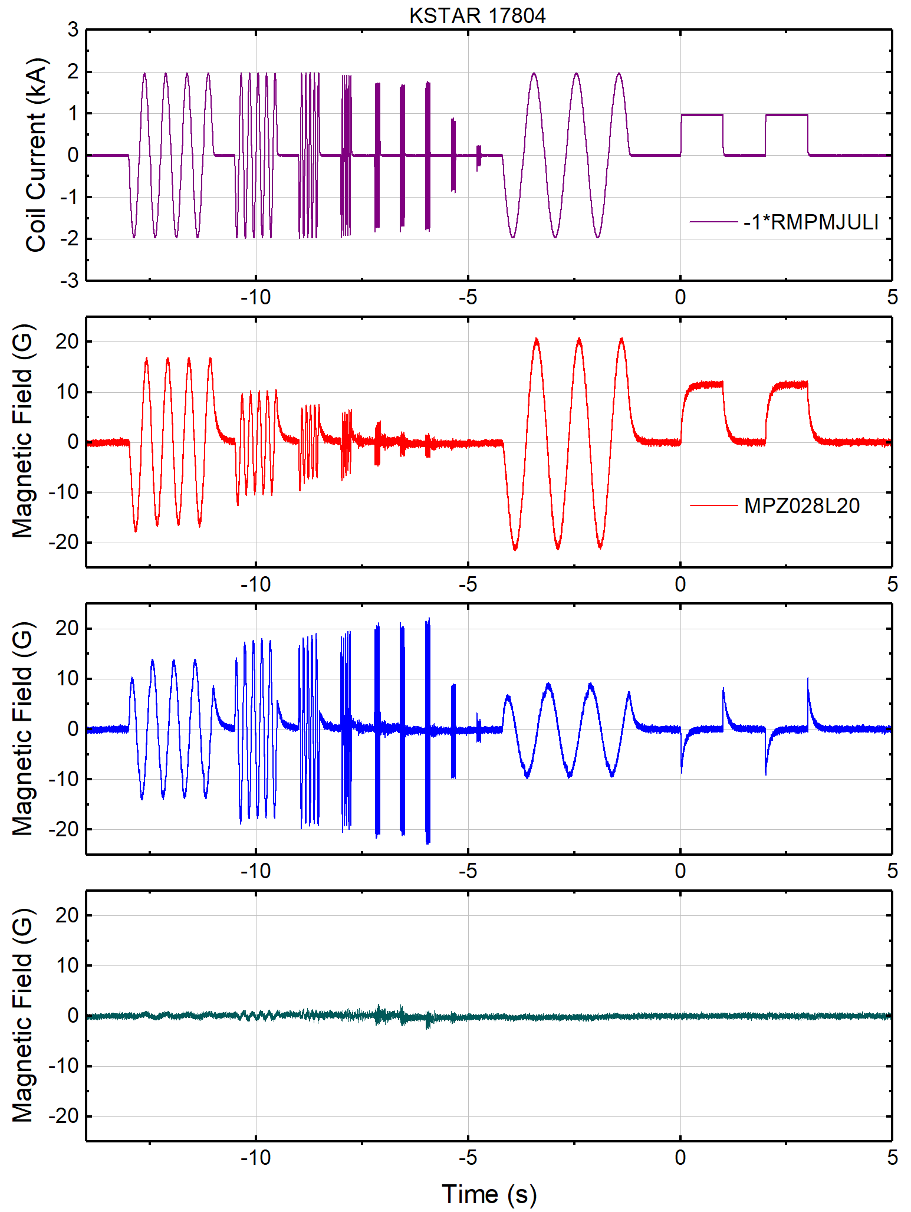
Magnetic fields from induced currents are compensated from sensor measurement for accurate RWM identification
Coil current
Define the DC-compensated δB:
Significant inductive component still remains in δB_{DC} due to high sensor mutual coupling to the passive plates
Similar to NSTX, use low-pass-filtered (LPF) RWM coil current derivative as the source of the inductive δB
Define the AC-compensated δB:
Tested three τ_{AC} values well compensates the inductive effect with remaining |δB| < 2 G after applying DC/AC compensations
$${δB}_{DC}=δB−\sum_{j}^{N_{coil}}{M_{j}I_{j}}$$
Sensor B_{p}
DC compensated B_{p}
$${δB}_{AC}={δB}_{DC}−\sum_{j}^{N_{coil}}{\sum_{k}^{N_{τ}}{p_{j,k}LPF\left(\frac{dI_{RWM,j}}{dt};τ_{AC,k}\right)}}$$
DC/AC compensated B_{p}

Slide 17
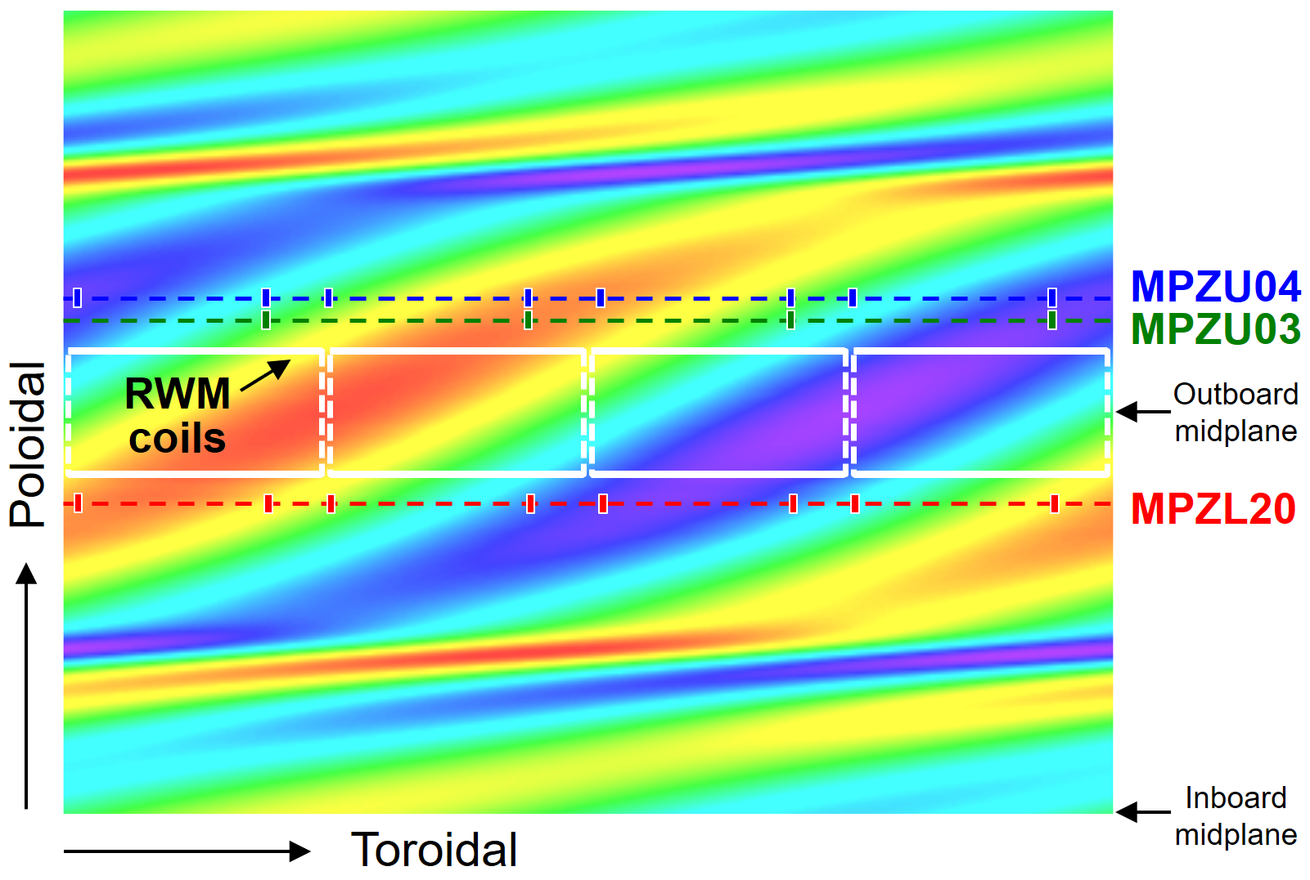
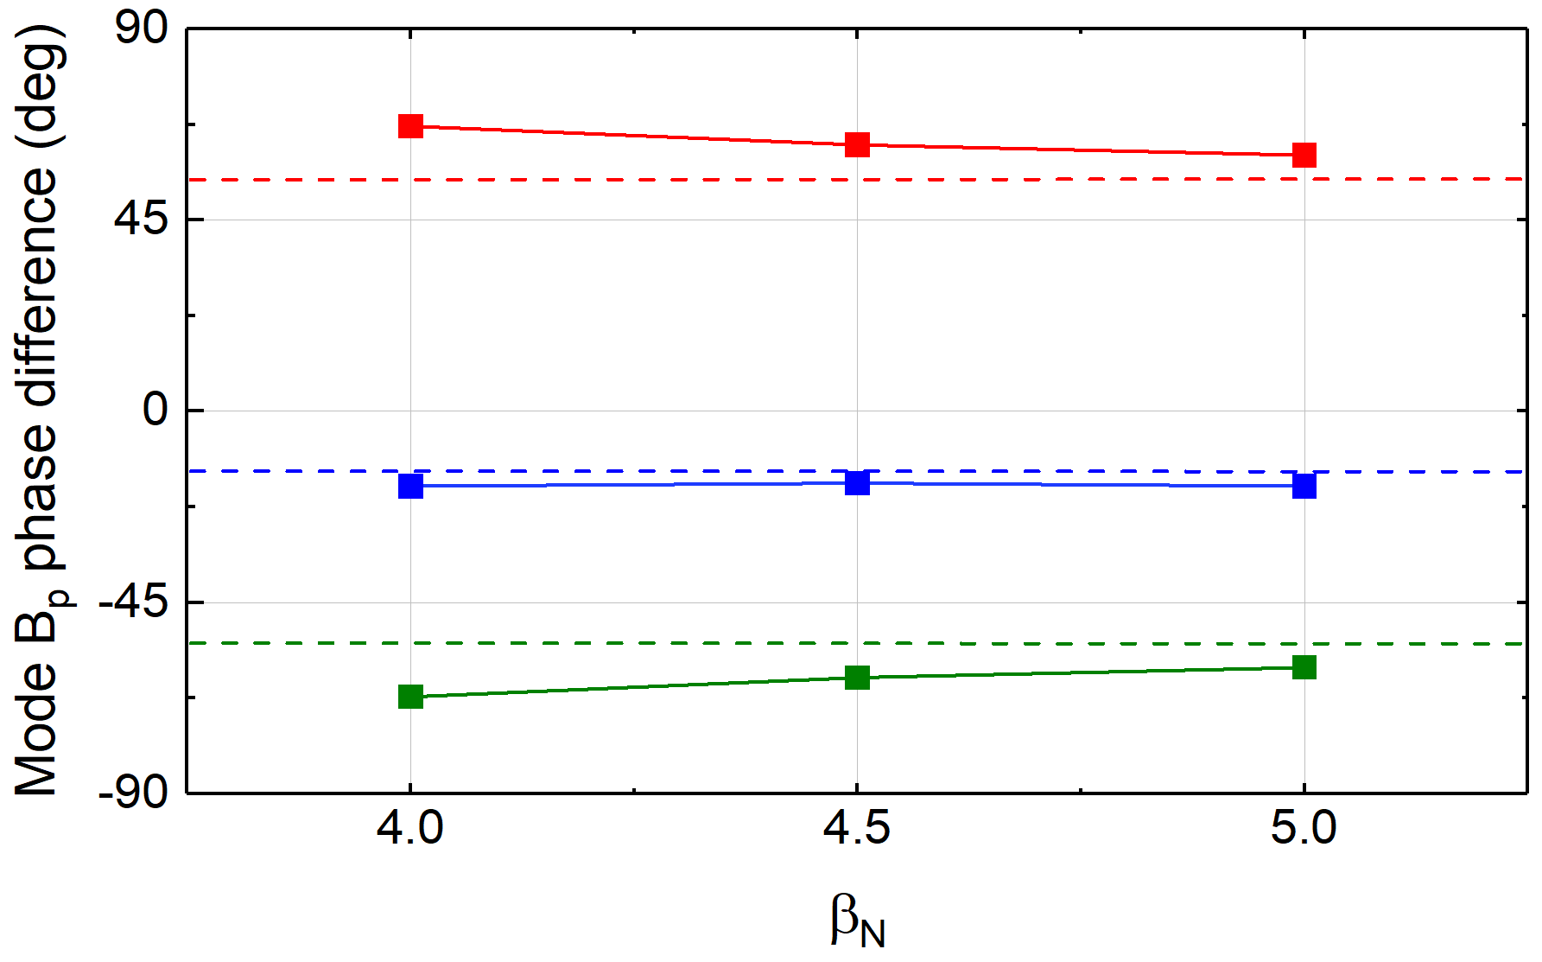
Utilization of multiple RWM sensor arrays is enabled by examining the phase of the perturbed δB of RWMs
DCON δB_{p} (no-wall)
MPZL20
without wall
_{(dashed lines)}
VALEN-3D
MPZU04
MPZU03
Relative phase of RWM measured by the sensor arrays w.r.t the phase at the midplane
The perturbed δB_{p} for an unstable n = 1 eigenfunction
Utilization of the entire available sensor arrays is beneficial for a better control since the RWM eigenfunction can have varying helicities of δB in the outboard
The phase difference between the midplane and off-midplane region changes with β_{N} as the response of the wall increases with faster mode growth
Assumed sensor toroidal angles in mode decomposition are modified accordingly

Slide 18
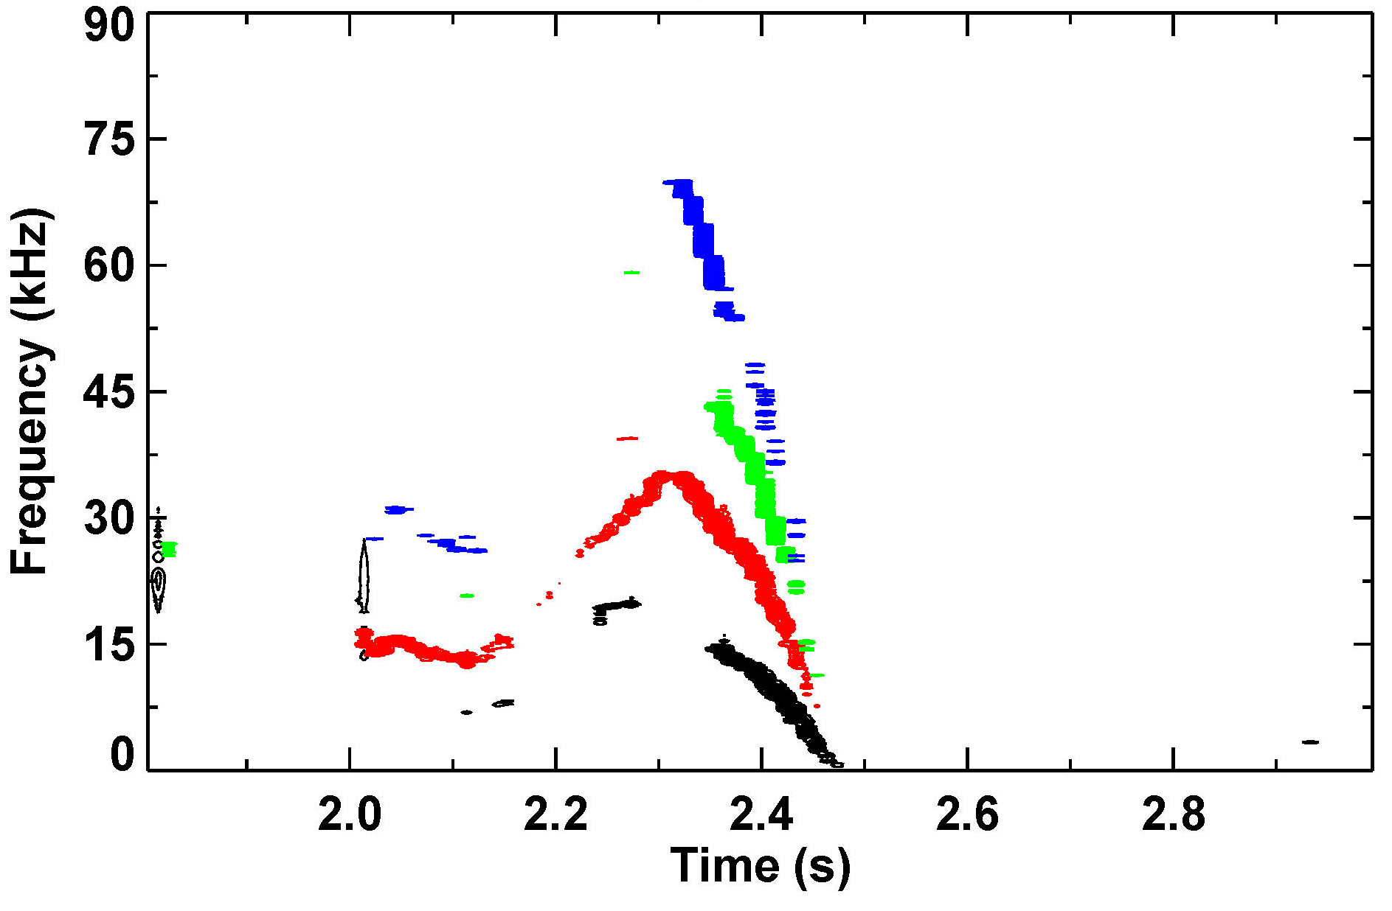
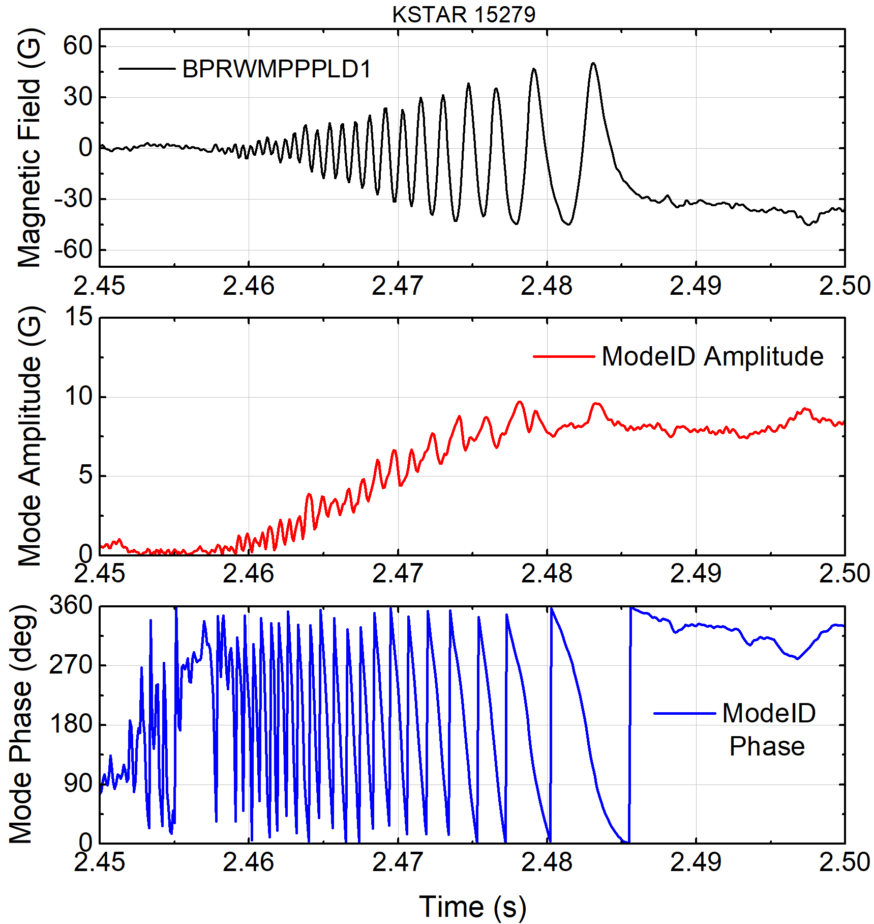
Measured amplitude and phase of slowly rotating MHD mode
KSTAR 15279
Exp. by Y.M. Jeon (NFRI)
Lower B_{p}
difference #1
Mode starts to be
measured by RWM sensors
Mode amplitude
2/1 mode
locks
Fast Mirnov probe
f_{sample} = 200 kHz
Mode
phase
Toroidal magnetic probe spectrum and mode amplitude
Measured mode amplitude and phase
Since RWMs have yet to be measured on KSTAR, mode identification has been tested for slowly rotating tearing modes (w/o applied feedback)
Used 10 B_{p} sensor differences (180º opposing sensor pairs) for n = 1 identification
Mode identification well measures the evolution of n = 1 locking tearing mode

Slide 19
Conclusions and Next Steps
Stability and transport of high performance KSTAR plasmas are analyzed
Kinetic EFIT with MSE is used for accurate stability and transport analysis
TRANSP analysis computes high β_{N} > 4 with fully non-inductive current can be achieved with newly increased P_{NBI} in KSTAR
Achieved high β_{N} equilibria are subject to ideal n = 1 instability (DCON, M3D-C¹)
Resistive DCON analysis emphasizes the role of the pressure driven effects in the observed tearing stability
MISK analysis can explain the observed RWM stable operation at high β_{N} > β_{N}^{no-wall}
Development of algorithm for RWM identification and feedback
Significant δB produced by induced currents in conducting structures is compensated from RWM sensors, and utilization of multiple sensor arrays is enabled by examining the perturbed δB structure of RWMs
Next Steps
Improve stability analysis by employing the pressure driven terms of NTM stability
Test the developed RWM feedback algorithm in high β_{N} experiment
Experiments are scheduled in 2018 to improve sustained high β_{N}, and probe stability

Slide 20
BACKUP SLIDES

Slide 21
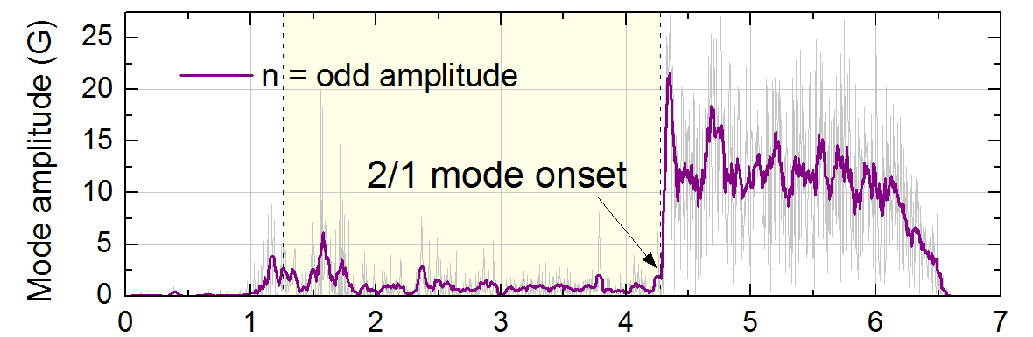
Onset of strong 2/1 tearing mode terminated high β_{N}
KSTAR 16295
At high β_{N} phase, a benign n = 2 mode (presumably 3/2 mode) exists with strong sawteeth
No indication of W_{tot} reduction due to the n = 2 mode having |B_{p}| ~ 2 G
High β_{N} operation was limited by strong 2/1 tearing mode onset
Measured mode amplitude > 20 G
Both W_{tot} and β_{N} were reduced by ~35% but maintained H-mode
Similar discharges exhibited different 2/1 tearing mode onset time (expected to be triggered by sawteeth)
Plasma rotation profile significantly reduced by > 20% due to the 2/1 mode onset
~
Weak n = 2 mode
Toroidal magnetic probe spectrum and mode amplitude in high β_{N} discharge

Slide 22
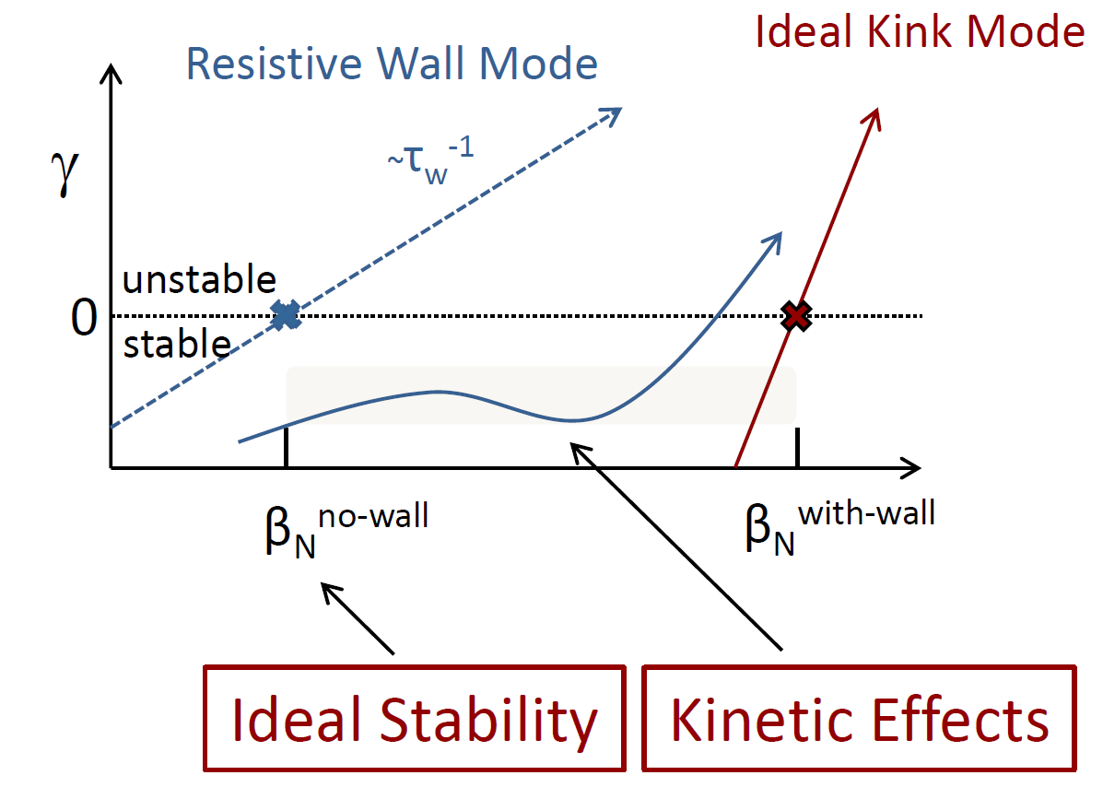
RWM stability evaluated with ideal and kinetic components allows for passive stabilization of the RWM
Kinetic effects modify ideal MHD n = 1 stability (MISK code)
Collisional dissipation
Rotational stabilization
Stability modification depends on
Integrated ω_{φ} profile: resonances in δW_{K}
Particle collisionality
Plasma is stable when rotation is in resonance
l = 0 harmonic : resonance with precession drift frequency
l = -1 harmonic : resonance with bounce frequency
kinetic
modification
B. Hu, et al., PRL 93 (2004) 105002
J.W. Berkery, et al., PRL 104 (2010) 035003
S.A. Sabbagh, et al., Nucl. Fusion 50 (2010) 025020
Trapped ion component (typically dominates Re(δW_{K}))
precession drift
bounce
collisionality
E⨉B
J.W. Berkery, et al., MHD Workshop (2015)

Slide 23
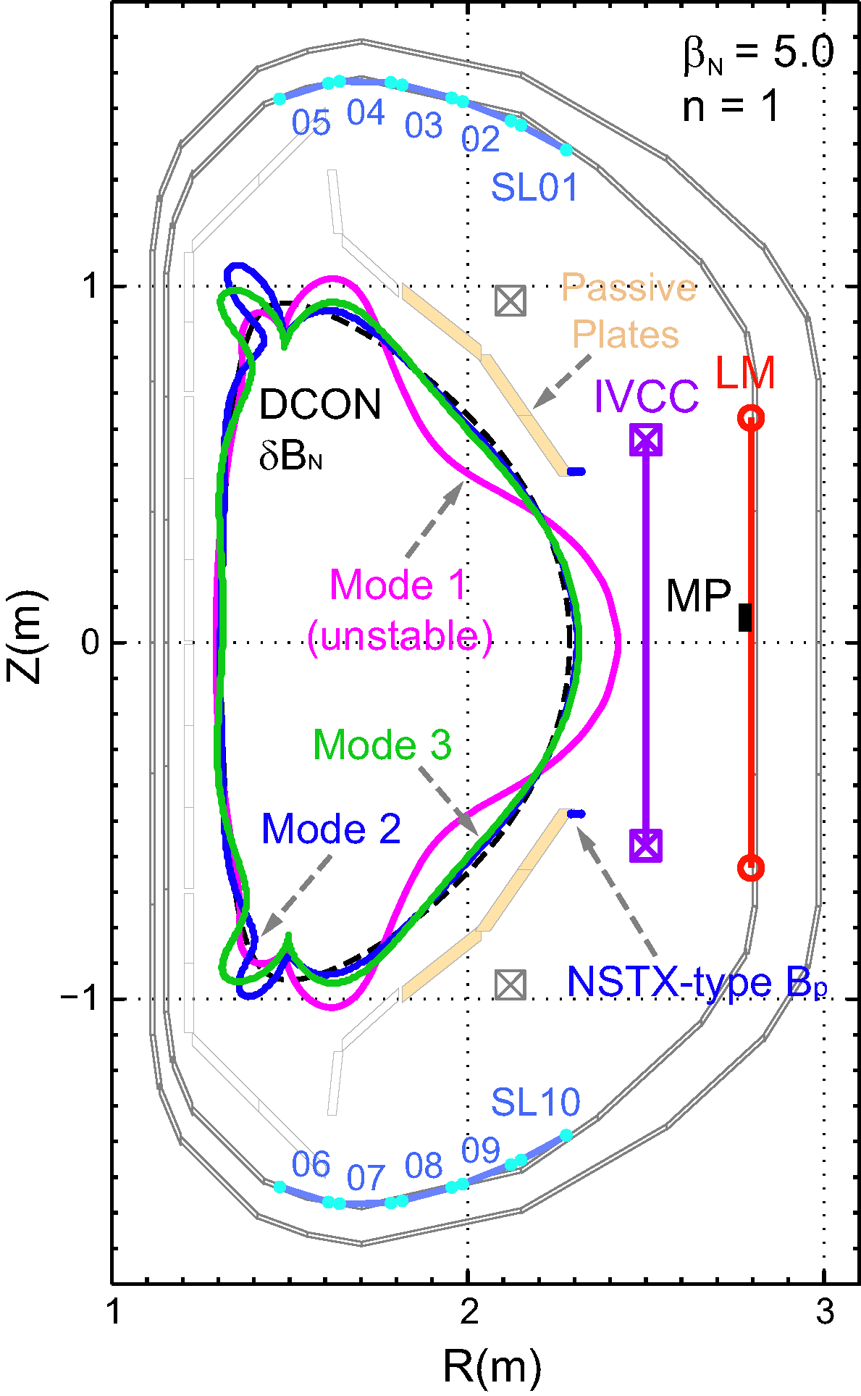
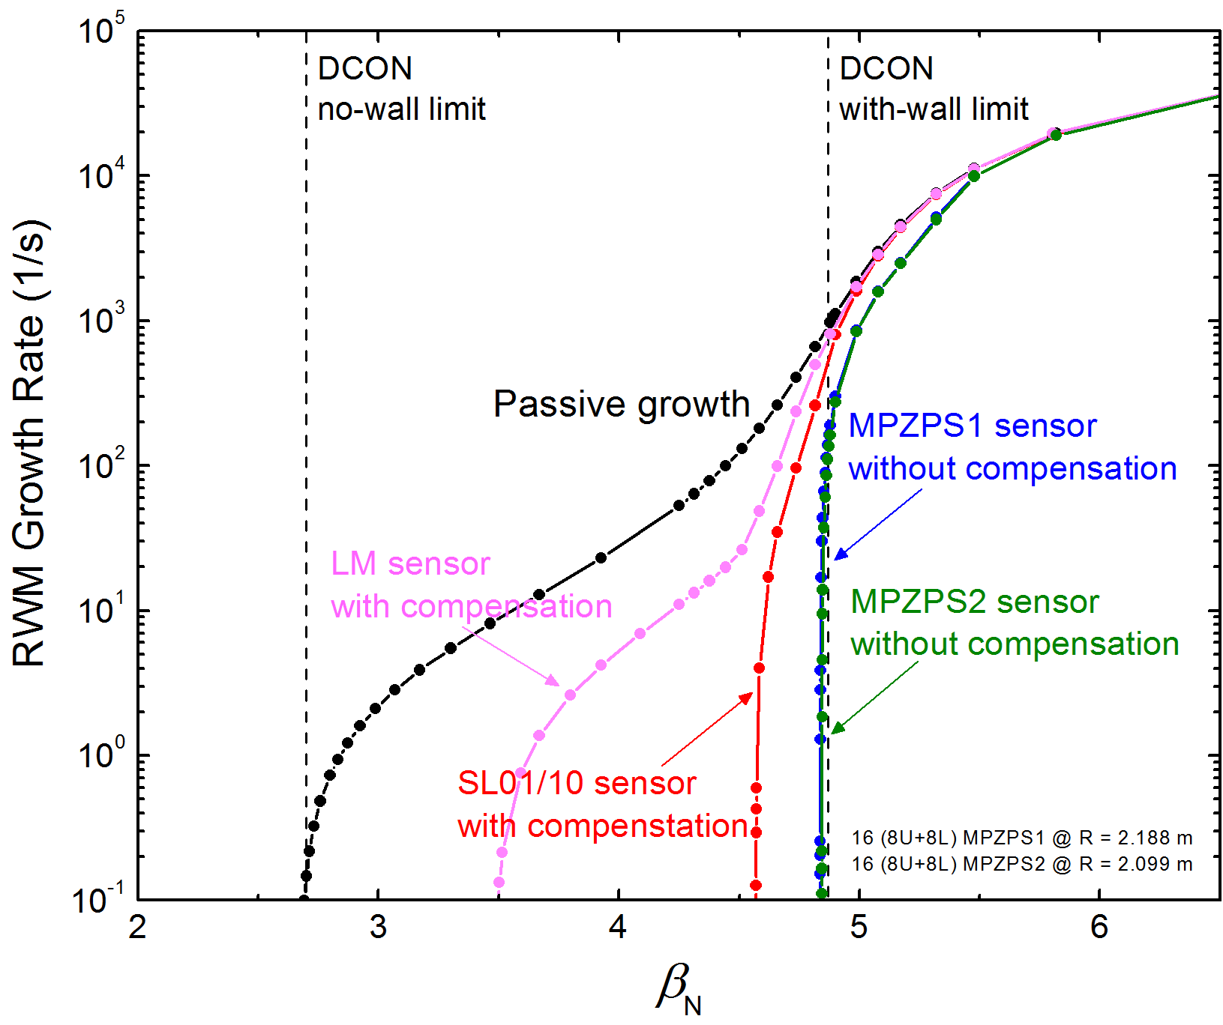
New RWM sensors will give superior control performance over the previous device sensors
SLs
New RWM sensor
performance
New RWM sensors
MPZU03-L20 sensor
w/o compensation
(C_{β} = 37 %)
MPZU04-L19 sensor
w/o compensation
SLs
(C_{β} = 86 %)
MPZU03-L20 (8+8) @ R = 2.188 m
MPZU04-L19 (8+8) @ R = 2.099 m
Y.S. Park, et al., Phys. Plasmas 21 (2014) 012513
RWM control performance of the new RWM sensors
The design advantages of the new RWM sensors result in greater mode control - almost up to the ideal with-wall limit (C_{β} = 98%, β_{N} = 4.8)

Slide 24
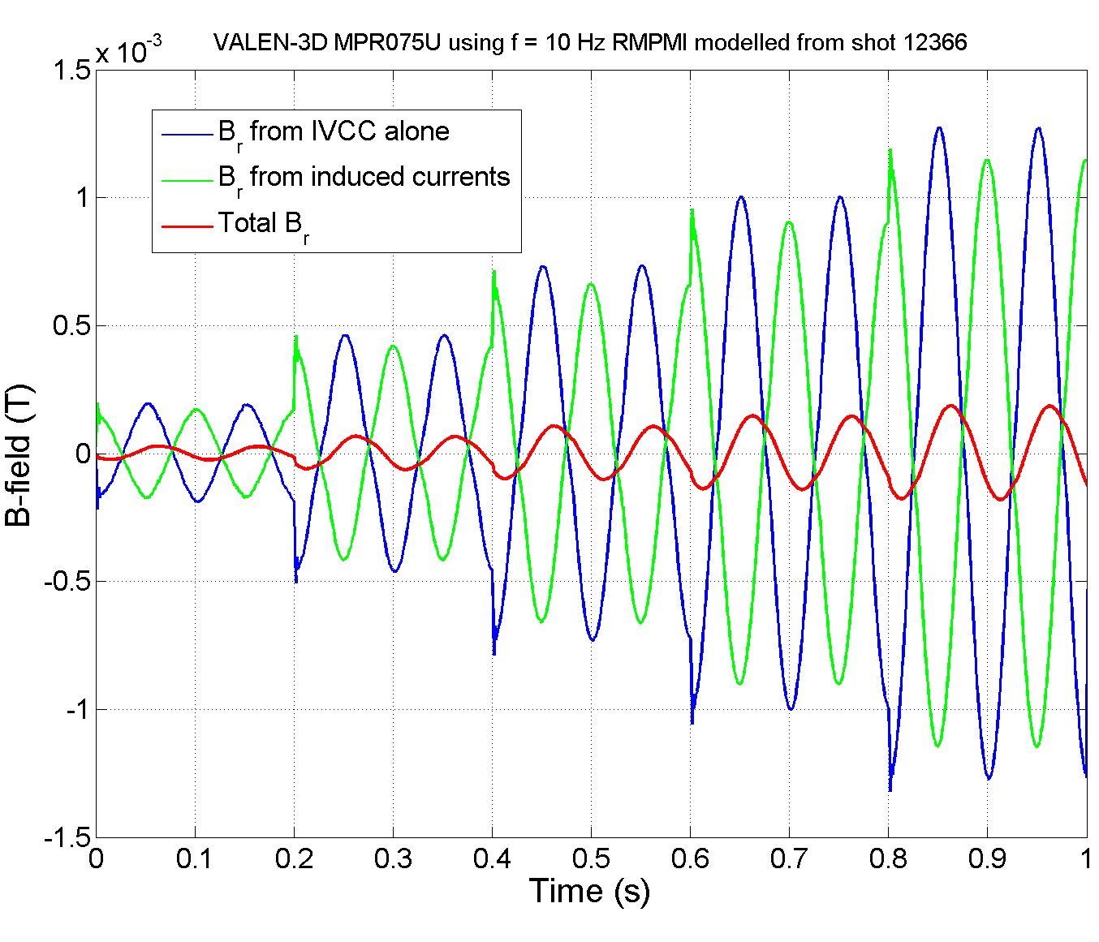
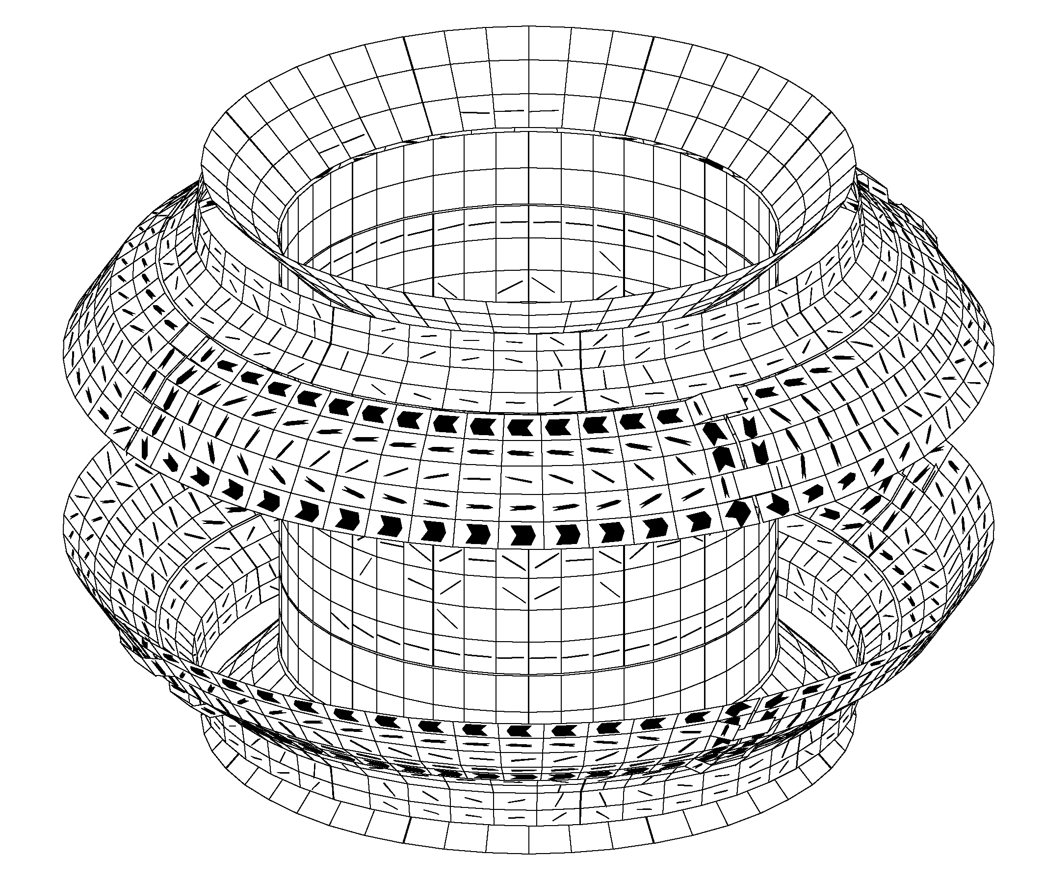
Strong coupling between RWM feedback sensors and passive plates could be detrimental to RWM feedback
15
10
5
0
-5
-10
-15
t = 0.845 s
Magnetic Field (G)
Computed induced currents on the internal passive conductors when 10 Hz n = 1 rotating field is applied from RWM control coils (m-IVCCs)
Time (s)
VALEN-3D computed sensor measurement
Transient effects of the induced currents on the passive plates have been examined by VALEN-3D code
KSTAR passive plates are found to give a significant inductive effect on RWM sensor measurement when RWM coils are activated

Slide 25
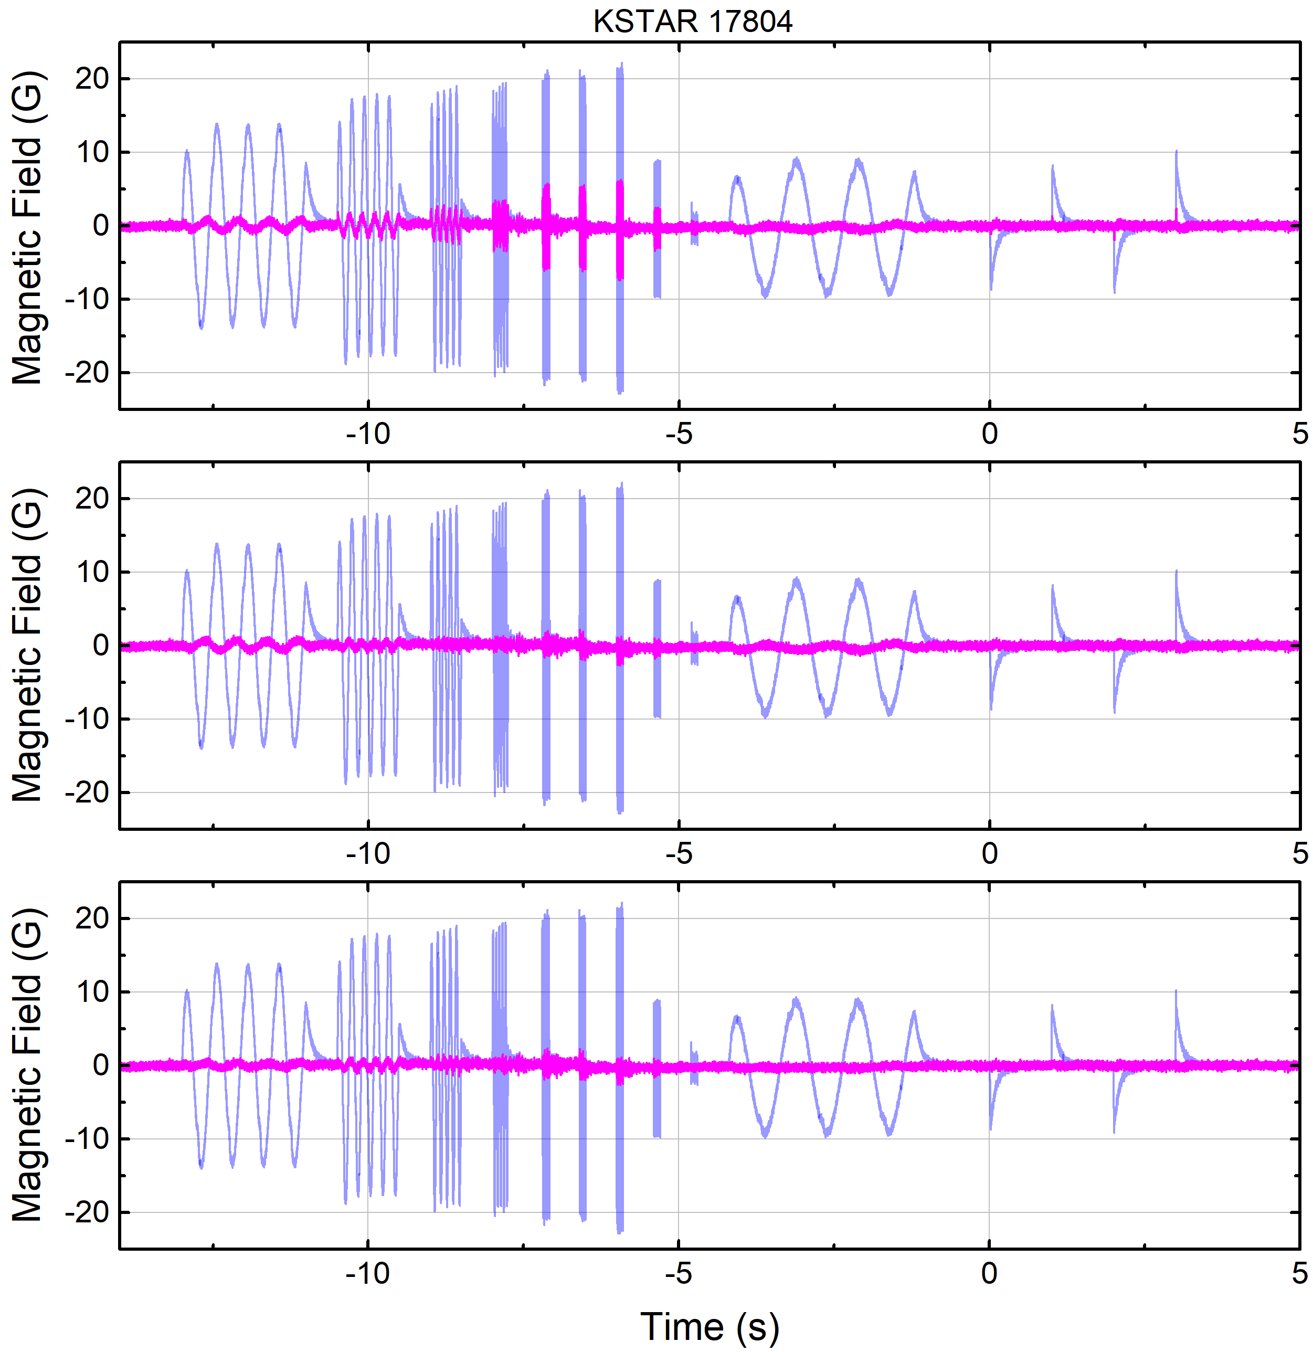
AC sensor compensation can eliminate the remaining δB components after the DC compensations
Similar to NSTX, use low-pass-filtered (LPF) RWM coil currents as the source of the inductive δB
Define the AC compensated δB:
The coefficient matrix p has max. 20 (N_{sensor}) x 12 (N_{coil}) x 3 (N_{τ}) = 720 elements
LPF with 3 different τ values has been tested
Tested τ set well compensates the inductive effect. For the entire RWM sensors, remaining |δB| < 2 G after DC+AC compensations
Remaining after τ₁
δB_{DC}
τ₁ = 92 ms
< δB_{AC} with τ₁ >
$${δB}_{AC}={δB}_{DC}−\sum_{j}^{N_{coil}}{\sum_{k}^{N_{τ}}{p_{j,k}LPF\left(\frac{dI_{RWM,j}}{dt};τ_{AC,k}\right)}}$$
δB_{DC}
τ₂ = 3 ms
Compensated by τ₂
< δB_{AC} with τ₁, τ₂ >
δB_{DC}
τ₃ = 215 ms
Compensated by τ₃
< δB_{AC} with τ₁, τ₂ , τ₃ >

Slide 26
Algorithms for mode identification
The magnetic perturbation has an amplitude (A_{RWM}) and phase (φ_{RWM})
At the i-th sensor, the measured mode amplitude is:
Combine signals to form an amplitude and phase of the plasma 3D perturbation
Convert the sensor fields at each time point to amplitude and phase
Outputs passed within PCS to RWM feedback algorithms for control current request
Algorithm is presently being implemented in KSTAR PCS for use in 2018
M : mode-ID matrix (20 x 2) for KSTAR

