Slide 1


Fusion Energy Development Applications Utilizing the Spherical Tokamak and Associated Research Needs and Tools
27th IAEA Fusion Energy Conference - IAEA CN-258
Paper Number OV/P-6
J.E. Menard, et al.

Slide 2
Collaborative and international effort including 23 co-authors
J.E. MENARD, R. MAJESKI, M. ONO Princeton Plasma Physics Laboratory Princeton, NJ USA | Y. NAGAYAMA Nihon University Tokyo, Japan
N.N. BAKHAREV, V.K. GUSEV Ioffe Institute Saint Petersburg, Russia | Y. ONO, Y. TAKASE The University of Tokyo Tokyo, Japan
M. GRYAZNEVICH, D. KINGHAM, S. MCNAMARA, P. THOMAS Tokamak Energy Ltd Oxfordshire, United Kingdom | M. REINKE Oak Ridge National Laboratory Oak Ridge, TN, USA
K. HANADA Kyushu University Fukuoka, Japan | K. TOBITA National Inst. for Quantum & Radiological Science & Technology Aomori, Japan
J. HARRISON, B. LLOYD Culham Centre for Fusion Energy (CCFE) Oxfordshire, United Kingdom | Z. GAO Tsinghua University Beijing, China
Y.S. HWANG Seoul National University Seoul, South Korea | F. ALLADIO ENEA Rome, Italy
B. LIPSCHULTZ, H. WILSON (also CCFE) University of York York, United Kingdom | R.J. FONCK University of Wisconsin-Madison Madison, WI, USA

Slide 3
Abstract / Overview
The fusion community is assessing the suitability of the ST for applications to advance fusion energy including the development of:
Solutions for the plasma-material-interface (PMI) challenge
Fusion neutron source / Fusion-fission hybrid systems
Fusion components capable of withstanding high fusion neutron flux/fluence including breeding blankets (Component Test / Fusion Nuclear Science Facility)
Demonstrating electricity break-even from a pure fusion system (Pilot Plant)
Electricity production at industrial levels in modular fusion power plants
Electricity production at industrial levels in larger-scale fusion power plants
This range of fusion energy development applications utilizing the ST is described, common application-driven research needs discussed, upcoming and recently achieved ST facility capabilities and relevant highlights described, and near-term prioritized ST research directions supporting longer-term fusion energy development applications presented.

Slide 4
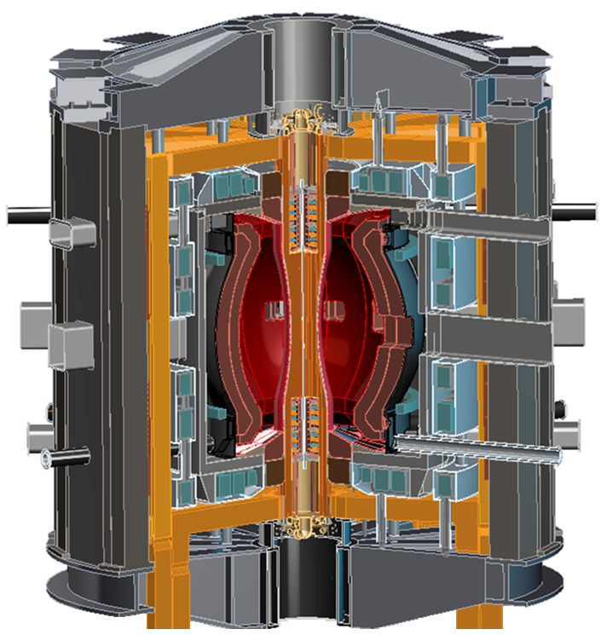
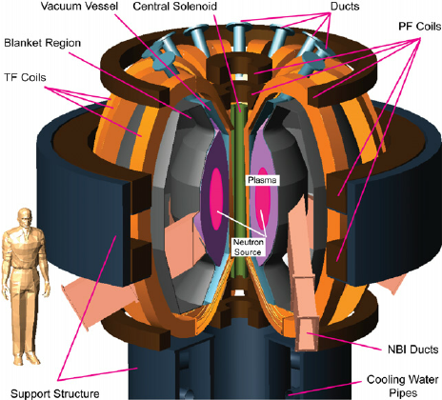
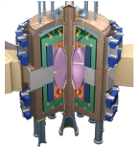
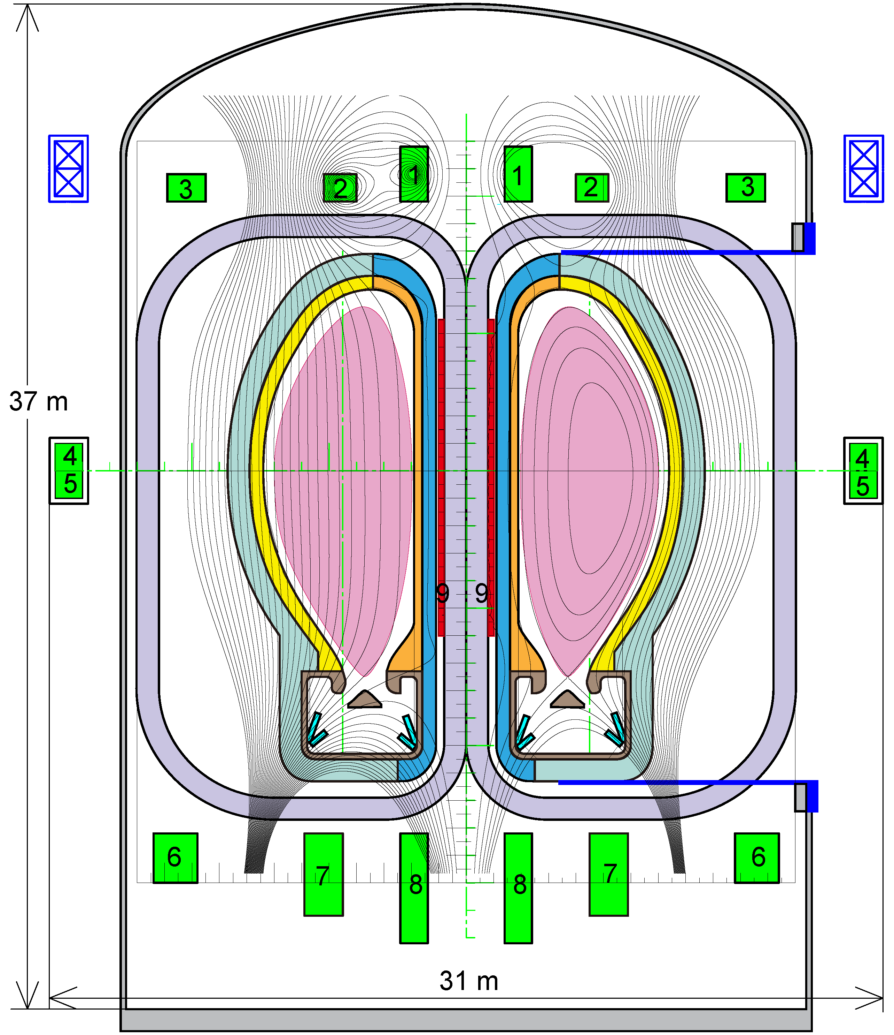
Possible next-step ST facilities
Kurchatov
CCFE
ORNL
PPPL
Fusion neutron source (FNS-ST)
Component Test Facility (ST-CTF)
Fusion Nuclear Science Facility (ST-FNSF)
PPPL
Japan
Low-A (A=2) HTS Pilot Plant
A=2.3 VECTOR
A=1.8 JUST
SC low-A reactors

Slide 5
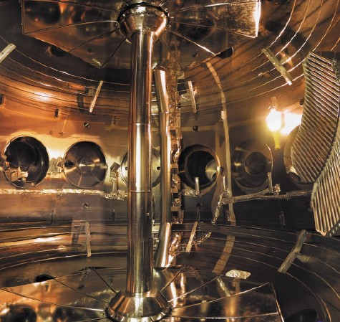
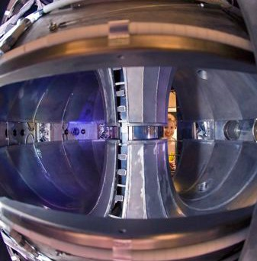
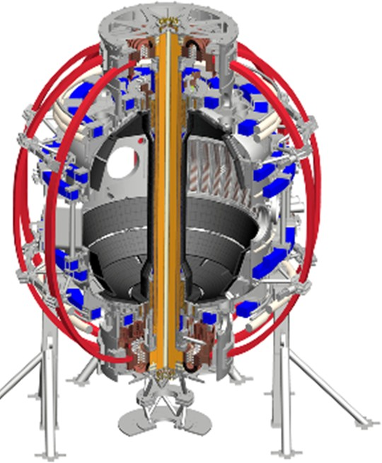
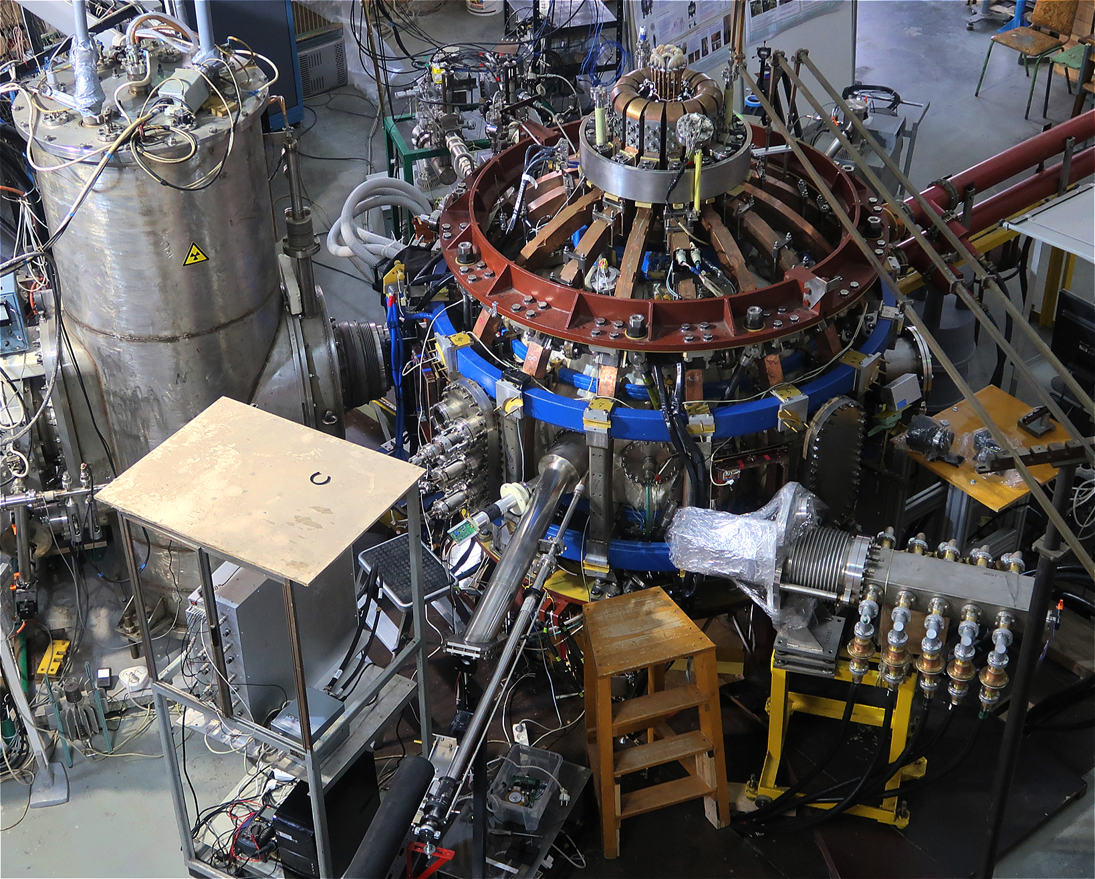
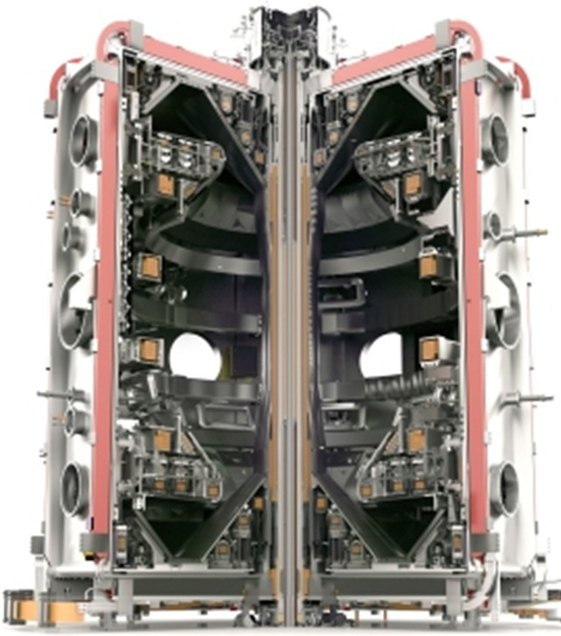
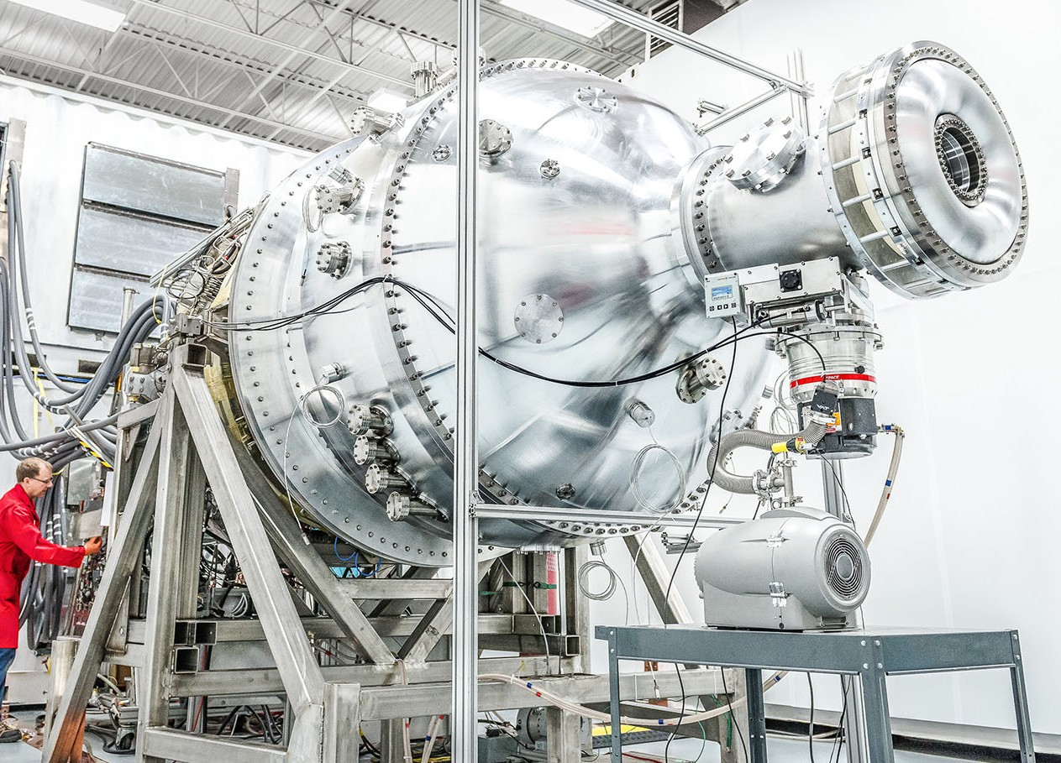
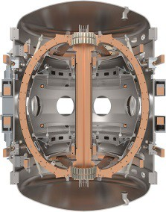
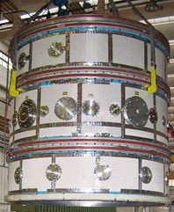
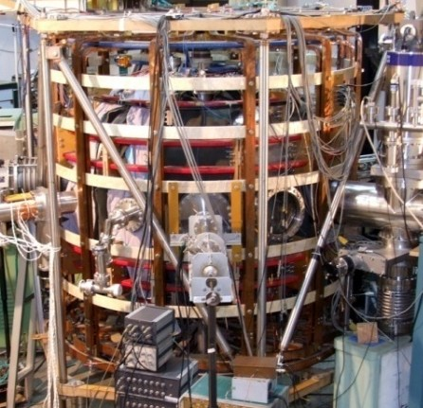
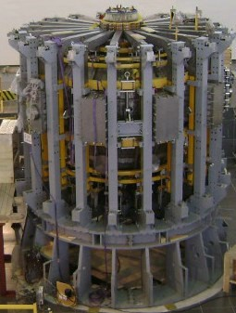
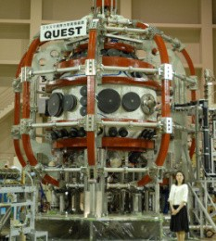
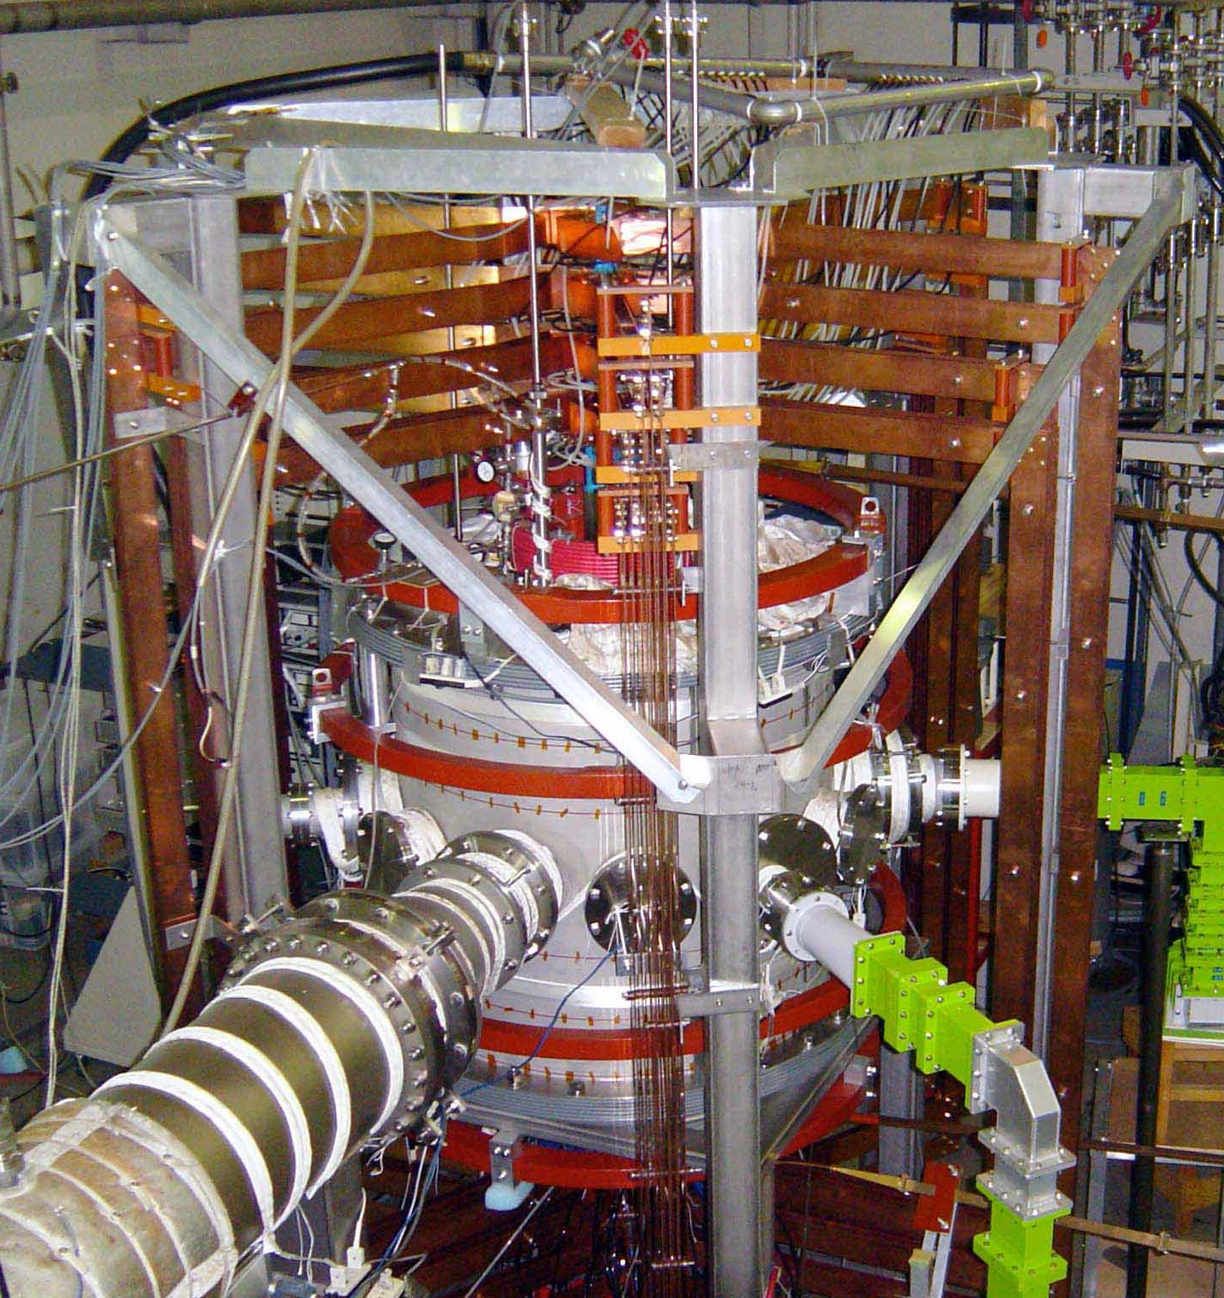
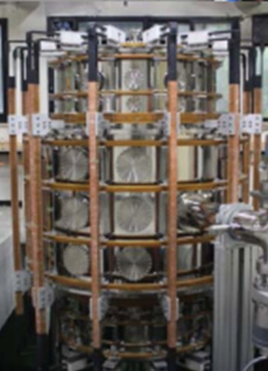
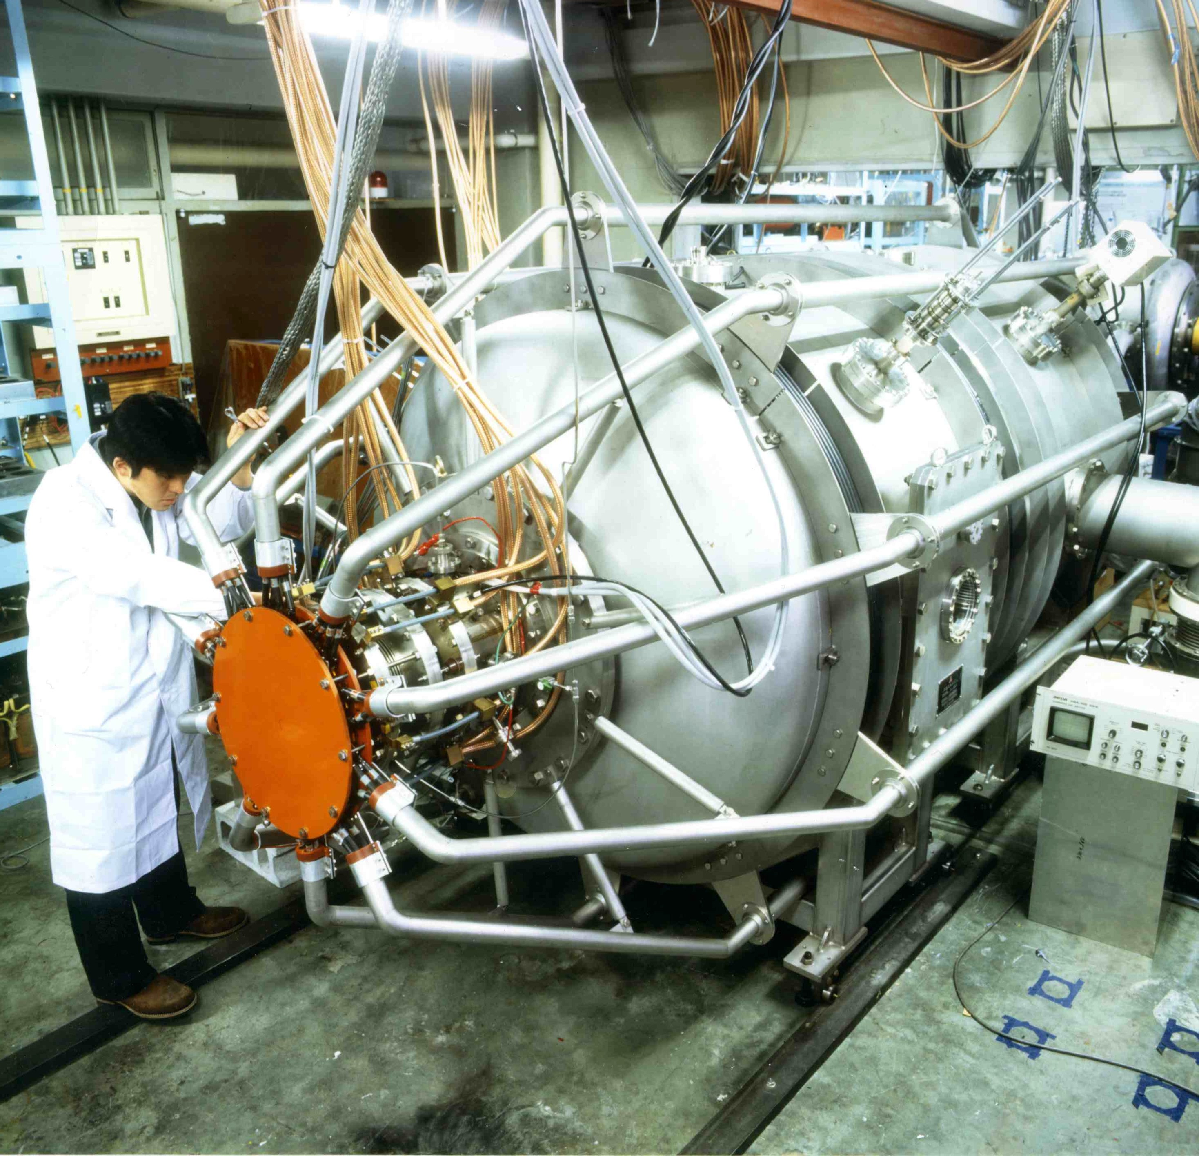
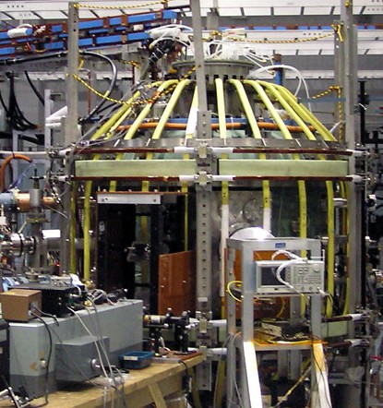
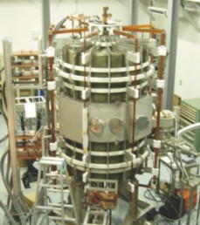

17 existing/near-term international ST facilities
NSTX-U, USA
PEGASUS, USA
LTX-β / CDX-U, USA
GLOBUS-M2, Russia
MAST-U, UK
ST40, UK
Proto Sphera, Italy
SUNIST, China
KTM,
Kazakhstan
PI3, Canada
QUEST/CPD, Japan
VEST, Korea
HIST, Japan
LATE, Japan
TST-2, Japan
UTST, Japan
TS3/4, Japan

Slide 6
Near-term STs support wide MHD stability space spanning nearly all proposed next-step ST configurations
Exception: β_{N} = 7 of JUST exceeds expected near-term capabilities
  Additional studies needed to assess MHD stability of JUST scenarios

Slide 7
Near-term STs will need to access higher f_{BS} to study scenarios anticipated for steady-state ST reactors
MAST-U / NSTX-U baseline non-inductive scenarios: f_{BS} ≈ 15-70%
PPPL FNSF/Pilot and Japanese reactors: f_{BS} = 70-95% → research gap

Slide 8
Near-term STs greatly expand access to high β at low ν*
NSTX-U at full field, power and low density (f_{GW}=0.25) accesses low ν_{e}* at high electron β_{T-e} spanning pilot plant and reactor regimes
Low f_{GW}=0.25 CTF/FNSF projected to access ~2x lower ν_{e}*

Slide 9
Near-term STs cannot access low ρ* of larger next-steps
Larger and/or higher field needed for more reactor-relevant ρ*, ν*

Slide 10
Near-term ST facilities targeting ⟨p⟩ ≈ 1 atm
NSTX-U ≤ 0.8 atm, ST-40 ≤ 1.6 atm, next-steps: 1.5 to 12 atm

Slide 11
ST-40 could provide important tests of SOL-width scaling
ST-40

Slide 12
Next-steps extrapolate to higher P/S, very high q||
Advanced/new divertor concepts needed to mitigate q|| = 1-30GW/m²

Slide 13
Most next-steps have neutron wall loading ≈ 1-3 MW/m²
Exception: (very) compact ST reactor VECTOR with ⟨W_{n}⟩ ≈ 6 MW/m²

Slide 14
Summary of research needs to support next-steps
MHD stability, access to low ν* covered by near-term STs
NSTX-U plans access to high f_{BS} and full non-inductive
  Need to extend to 70-95% bootstrap fraction for reactor-relevant scenarios
Near-term STs limited to 1/ρ_{i*} ≤ ≈ 50-120
  Need to extend to 200-300 with new facility (?) and/or leverage tokamak results
Full performance ST-40 could test ST λ_{q} scaling to high B_{P}
Very high q|| in next-steps requires divertor innovation
  MAST-U Super-X capability and/or liquid metals (LTX-β, long-term NSTX-U)
Very compact ST reactors (R=3-4m) generate high neutron wall loading and require innovations in blankets and first-wall

Slide 15
Sign-up

