Slide 1


27th IAEA FUSION ENERGY CONFERENCE Gandhinagar (Ahmedabad) INDIA, October 2018
TH/P2-16
Numerical simulations of Global Alfven Eigenmode (GAE) stabilization in NSTX-U
E. V. Belova¹, E. D. Fredrickson¹, N. A. Crocker², and the NSTX-U team
1) Princeton Plasma Physics Laboratory, Princeton NJ, USA
2) University of California, Los Angeles, California 90095, USA

Slide 2
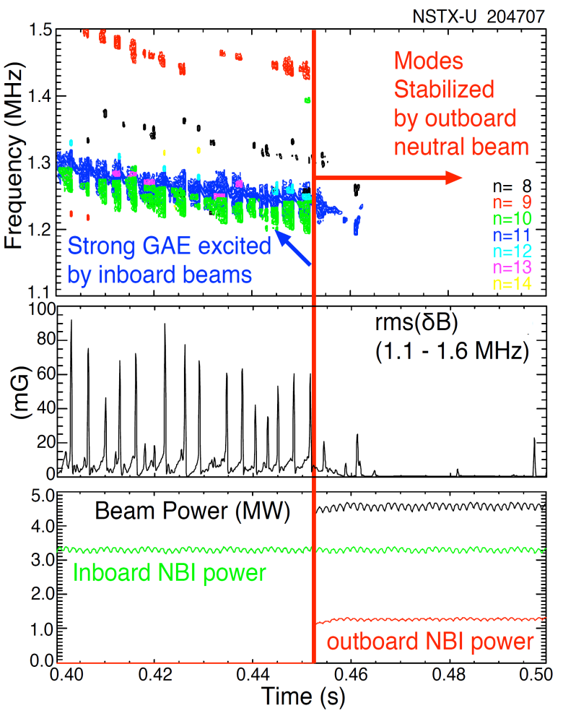
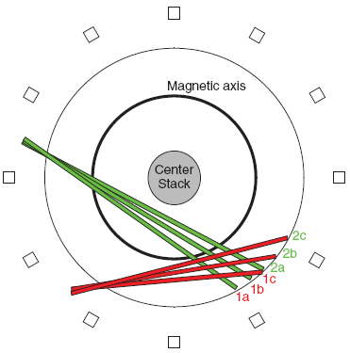
NSTX-U off-axis neutral beam suppresses Global Alfven Eigenmodes (GAEs) [E. Fredrickson, PRL 2017]
Counter-propagating GAEs are frequently observed in the sub-cyclotron frequency range of 0.1f_{ci} up to 0.5f_{ci}, in NSTX and NSTX-U.
Driven by cyclotron resonance with beam ions
New neutral beam sources ― ability to control the fast ion distribution.
2c
2b
2a
1c
1b
1a
Sketch of neutral beam geometry. Original beams in green, labeled 1a, 1b, 1c; new beams for NSTX-U shown in red labeled 2a, 2b and 2c.
Off-axis neutral beams inject fast ions onto trajectories largely parallel to the magnetic field, with pitch 0.8<V||/V<1.
Reliable suppression of the counter-propagating GAE when an additional 1.3MW is injected using the outboard beam.

Slide 3
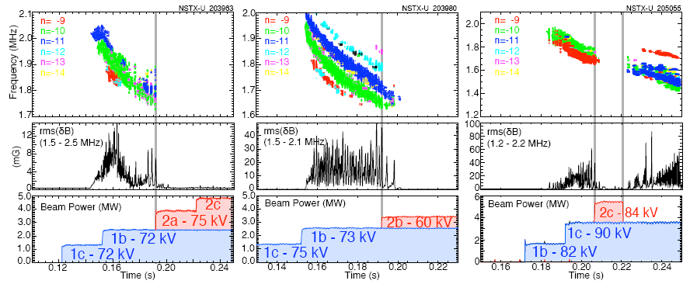
GAE stabilization has been well documented for many NSTX-U shots
Three examples of GAE being suppressed by the injection of one of the three off-axis beam sources.
Figure 1(c) also shows that the GAE can reappear when the 2c power is turned off.
The measured GAE suppression time ~ few ms is much smaller than slowing-down time (~50ms), suggesting that it takes relatively few high-pitch fast ions to suppress the GAE.

Slide 4
HYM – HYbrid and MHD code
Applications
NSTX
- Sub-cyclotron frequency Alfven eigenmodes (GAE and CAE)
ICC Theory and Modeling
- Hybrid simulations of spheromak merging
- FRC: Effects of beam ions on stability
- Rotation control
- n=2 rotational and n=1 wobble modes
Code description
3-D nonlinear.
Physical models:
- Resistive MHD & Hall-MHD
- Hybrid (fluid electrons, particle ions)
- MHD/particle (one-fluid thermal plasma, + energetic particle ions)
- Drift-kinetic particle electrons
Full-orbit kinetic ions.
For particles: delta-f / full-f numerical scheme.
Parallel (3D domain decomposition, MPI)

Slide 5
Self-consistent MHD + fast ions coupling scheme
Background plasma - fluid:
Fast ions – delta-F scheme:
- particle weight
ρ, V and p are thermal plasma density, velocity and pressure, n_{b} and j_{b} are beam ion density and current, and n_{b} << n_{e} – is assumed.

Slide 6
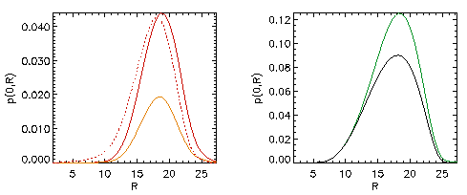
Self-consistent anisotropic equilibrium including the NBI ions
Grad-Shafranov equation for two-component plasma:
MHD plasma (thermal) and fast ions [Belova et al, Phys. Plasmas 2003].
, G – poloidal stream
function
Beam effects
Beam
Modifications of equilibrium due to beam ions:
more peaked current profile,
anisotropic pressure,
increase in Shafranov shift
might have indirect effect on stability.

Slide 7
Fast ions – delta-f scheme: F₀=F₀(ε,μ,p_{φ})
Equilibrium distribution function F₀ = F₁(v) F₂(λ) F₃(p_{φ},v)
where v₀ = 2-5v_{A}, v*= v₀ /2, λ= μB₀/ε – pitch angle parameter, λ₀= 0.5-0.7 (typical of on-axis
beam), and μ= μ₀ + μ₁ includes first-order corrections [Littlejohn’81]:
Parameters are chosen to match TRANSP beam profiles.

Slide 8
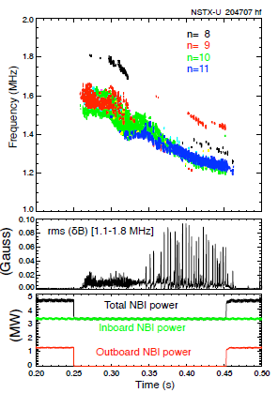
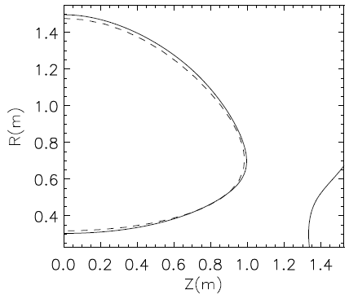
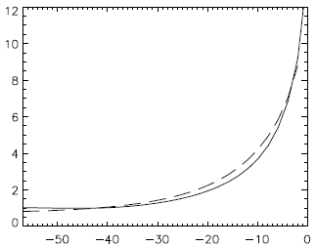
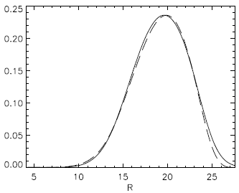
Simulations have been performed to study the excitation and stabilization of GAEs in the NSTX-U
⎯⎯ HYM
- - - - TRANSP
Simulations using the HYM code have been performed for NSTX-U shot #204707 right before (t=0.44s) and shortly after (t=0.47s) the additional off-axis beam injection.
Plasma and beam profiles have been chosen to match TRANSP profiles for t=0.44s and t=0.47s.
The beam ion distribution function matches TRANSP data, with pitch distribution in the form
F_{b}~ exp[-(λ-λ₀(ε))²/Δλ(ε)²] –
improved fit includes energy dependence of pitch distribution.
q(ψ)
ψ
n_{b}/n₀(R)
t=0.44
t=0.47
0.3 0.5 1.0 1.5 R(m)
(a) Spectrogram on magnetic fluctuations (n=8-11 counter-GAEs).
(b) Rms magnetic fluctuations;
(c) Injected beam power.
Plasma shape, q- and n_{b} profiles for NSTX-U shot 204707 t=0.44 from TRANSP and HYM GS solver + FREE_FIX.

Slide 9
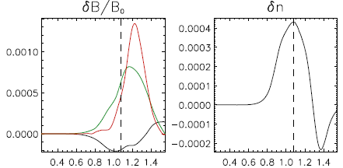
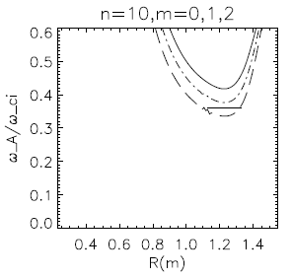
NSTX-U linear simulations: n=-10 counter-GAE (t=0.44s)
dB┴
dB||
R(m)
R(m)
Radial profile of δB and δn for n=-10 counter-GAE.
Radial profile of ω_{A}/ω_{ci} for n=-10, m=0-2; location of GAE.
Unstable modes are counter-rotating and have shear Alfven polarization
Located near min of ω_{A}

Slide 10
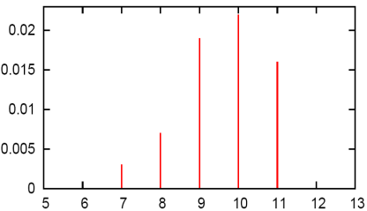
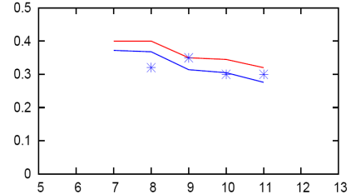
HYM reproduces experimentally observed unstable GAEs
HYM #204707 t=0.44
Simulations reproduce most unstable toroidal mode numbers and GAEs frequencies.
HYM overestimates growth rates compared experimental analysis by 2-3 times.
Experimental estimates [Fredrickson, NF 2018]:
n=-10 γ/ω_{ci}=0.84%
n=-11 γ/ω_{ci}=0.6%
Growth rates are sensitive to distribution function parameters – resonance particles are in ‘tail’ of distribution.
γ/ω_{ci}
ω/ω_{ci}
-n
(a) Growth rates and (b) frequencies of unstable counter-GAEs from HYM simulations for t=0.44s. Blue line is Doppler-shift corrected frequencies, points – experimental values.

Slide 11
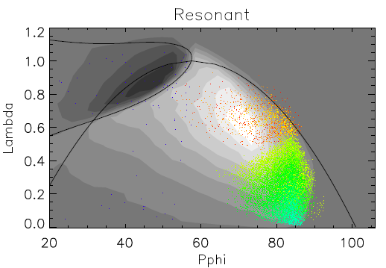
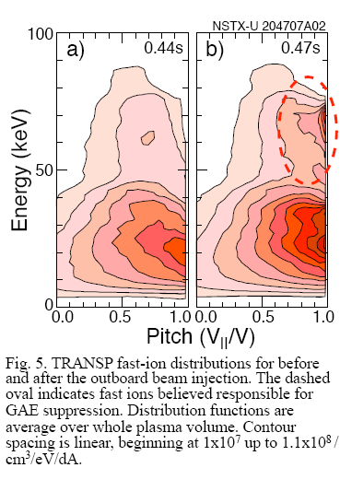
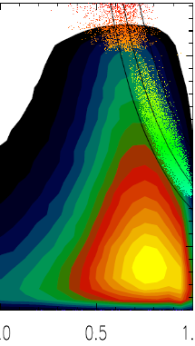
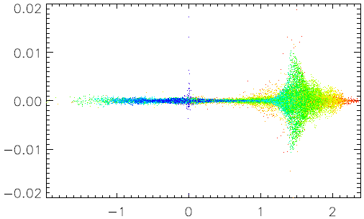
Improved F_{beam} fit allows more accurate description
b)
cyclotron
resonance
δF/F
V||/V
TRANSP fast-ion distribution before the outboard beam injection t=0.44.
HYM fast-ion distribution from n=-11 GAE simulations; dots show resonant particles.
V||/V_{A}
Location of resonant particles in phase space: λ=μB₀/ε vs p_{φ}.
Particle weight w ~ δF/F vs orbit-averaged parallel velocity. Particle color corresponds to different energies: from E=0 (purple) to E=90keV (red).

Slide 12
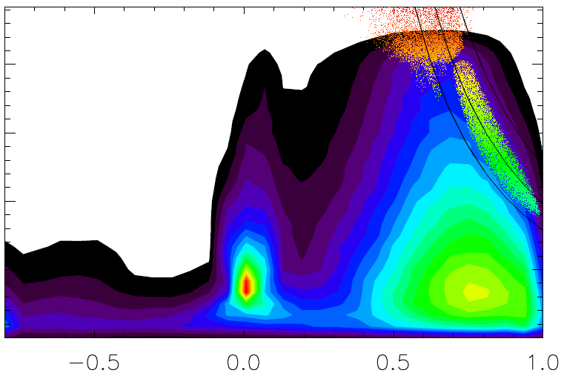
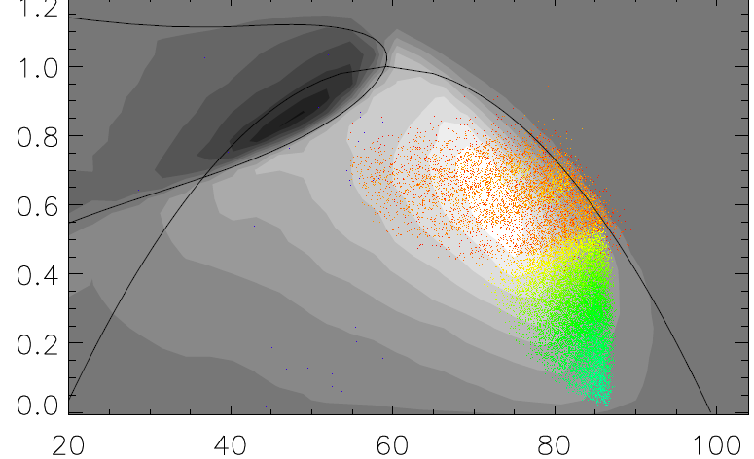
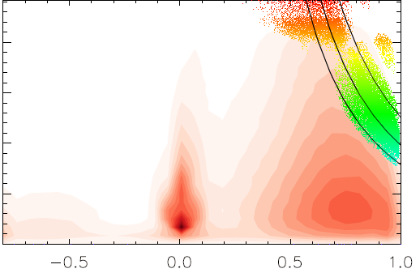
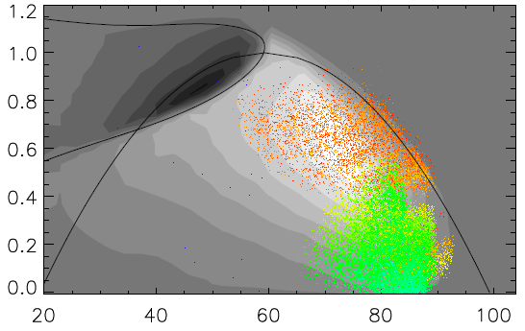
Resonant region is wider in nonlinear phase
LIN
LIN
Energy (keV)
0 50 100
λ
NL
NL
Energy (keV)
0 50 100
λ
‹V||›/V
p_{φ}
Location of resonant particles in phase space; from linearized and nonlinear simulations of n=-11 GAE. Particle color corresponds to different energies: from E=0 (purple) to E=90keV (red); ‹V||› - orbit averaged velocity.

Slide 13
Nonlinear simulations: n=-11 counter-GAE (t=0.44s)
Nonlinear simulations show peak saturation amplitudes of δB/B₀~5×10⁻³ at R~1.2m close to the minimum of the Alfvén continuum, and δB/B₀~10⁻³ near the edge at the midplane.
Unstable modes have shear Alfven polarization in the core, and mixed polarization at the edge.
Time evolution of perturbed magnetic field components from nonlinear simulations for n=-11 GAE.

Slide 14
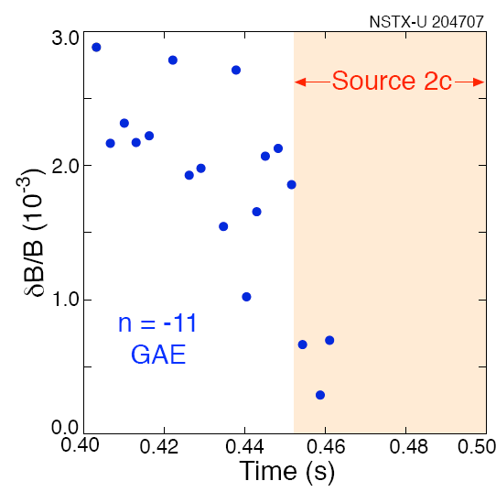
Experimental amplitudes estimates are comparable to nonlinear simulation results
Approximate peak amplitudes averaged over the time window. A correction factor (the ratio between peak and average amplitude) varied between 1.2 and 2.7.
Experimental estimates of the peak mode amplitudes are δB/B₀≈2.7•10⁻³ for the n=-10 and δB/B₀≈(1-2)•10⁻³ for the n=-11 modes at t~0.44s.
Large uncertainty is in the reflectometer reconstructions which depend on accurate density profile gradient data.
Time evolution of peak amplitude of n=-11 GAE in NSTX-U shot 204707, based on reflectometer reconstructions [E. Fredrickson].

Slide 15
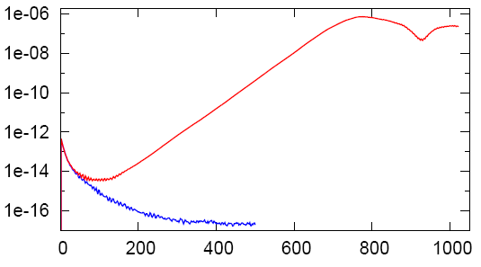
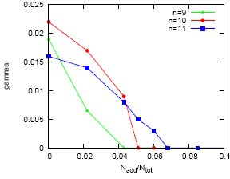
HYM simulations reproduce experimental finding: off-axis neutral beam injection reliably and strongly suppresses unstable GAEs
Off-axis beam injection has been modelled by adding beam ions with distribution F_{add} ~ exp[-λ²/Δλ (ε)²], and varying density.
For NSTX-U beam parameters, HYM shows complete linear stabilization of all unstable GAEs.
In additional simulations, fraction of off-axis beam population of the total fast ion inventory has been varied from 4% to 17%.
Unstable n=-11 GAE is stabilized when the fraction of the off-axis beam ions is larger than 7%
Stabilization threshold is lower for lower |n| modes.
HYM #204707, t=0.44, t=0.47
n= -11
t=0.44s
|dB|²
t=0.47s
tω_{ci}
Time evolution of magnetic energy of n=-11 GAE from HYM simulations for t=0.44s (red), and t=0.47s (blue).
γ/ω_{ci}
Fraction of outboard beam power vs total beam power in NSTX-U was ~24-30%, but the GAEs become suppressed at the point where the fast ion population has increased by 6% (based on the neutron rate increase by 6%) – excellent agreement with simulations.
tω_{ci}
N_{add}/N_{tot}
Growth rates of n=-11 (blue), -10 (red), -9 (green) GAEs vs fraction of outboard beam ion population.

Slide 16
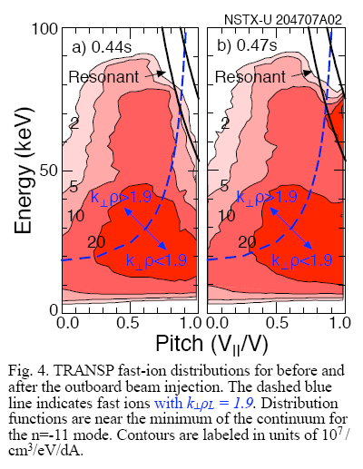
GAE stabilization is consistent with analytic predictions
Analytical instability condition: 2 < k⊥ρ_{b}< 4 [Gorelenkov,2003] – large pitch particles are stabilizing.
N_{add}/N_{tot}=0
N_{add}/N_{tot}=5%
t=0.44s
n=9
n=10
n=11
TRANSP fast-ion distribution before and after the outboard beam injection. Fast ions with pitch v||/v~1 are responsible for GAE suppression [Fredrickson,2017].
Fast-ion distribution from HYM simulations before the outboard beam injection and for case with N_{add}/N_{tot}=5% (n=9,10 are stable). Cyclotron resonance lines are shown for n=9,10,11 GAEs.

Slide 17
Summary
Simulations confirm robust stabilizing mechanism for beam-driven global Alfvén eigenmodes (GAEs) discovered experimentally in NSTX-U, where new beam sources injecting nearly parallel to magnetic field reliably and strongly suppressed unstable GAEs [E. Fredrickson, PRL 2017].
GAEs have been linked to flattening of electron temperature profiles and anomalously low central temperature at high beam power in the NSTX.
Good agreement of simulations with experimental observations:
  - range of toroidal mode numbers, frequencies, and saturation amplitudes of unstable GAEs match the experimentally observed.
A very effective mechanism for stabilizing GAEs - threshold for stabilization of all modes for extra beam is less than 7% of total beam power – demonstrated both experimentally and numerically.
Relevant to ITER, and other fusion devices where super-Alfvénic fast ions might be present.

