Slide 1
Effects of Microtearing Modes on the Evolution of Electron Temperature Profiles in High Collisionality NSTX discharges*
T. RAFIQ¹, S. KAYE², W. GUTTENFELDER², J. WEILAND³, and J. ANDERSON³
¹Lehigh University, Bethlehem, PA, USA
²Princeton Plasma Physics Laboratory, Princeton, NJ, USA ³Chalmers University of Technology, Gothenburg, Sweden
27th IAEA Fusion Energy Conference, Gujarat, India, Oct 22-27 (2018)
*This research is supported by the U.S. Department of Energy, Office of Science, under Award Numbers DE-SC0013977, DE-FG02-92ER54141 and DE-AC02-09CH11466

Slide 2
Motivation
Microtearing modes (MTMs) can provide a significant contribution to the electron thermal transport in low-aspect ratio tokamaks
In plasmas where $βe$ and collisionality are sufficiently high, MTMs can become the dominant instability [W. Guttenfelder et al., PRL. 106, 155004 (2011)]
MTMs may be unstable even when collisionality is negligible with the role of collisionality taken by particle inertia [I. Predebon et al., PoP 20(4), 040701 (2013)]
In a GS2 gyrokinetic stability analysis, MTMs are found to be the most unstable modes in the core region [K. Wong et al., PRL 99, 135003 (2007)]
Due to the somewhat low $B$, low electron temperature and high density
Apart from the plasma core region, MTMs may be relevant in the plasma edge region regulating heat transport and, possibly, pedestal evolution [D. Dickinson et al., PRL 108, 135002 (2012)]
Non-linear GYRO calculations have shown that MTMs in high β H-mode NSTX plasmas can drive electron thermal transport at levels that match those inferred from experiment [W. Guttenfelder et al., PoP 19(5), 056119 (2012)]
Important to develop a reduced transport model for MTMs in order to understand how MTMs affect electron thermal transport and consequently the evolution of temperatures in tokamak plasmas

Slide 3
Microtearing Modes (MTMs)
MTMs are short-wavelength $\left(k_{y}L_{n}≫1\right)$ ion scale (low $k$) electromagnetic instabilities driven by electron temperature gradients
Propagate in the electron diamagnetic drift frequency ($ω_{∗e}$) direction, and have electron collisionality, $ν_{e}$/$ω$ $\sim O\left(1\right)$
Frequency is generally greater than $ω_{∗e}$ and the mode structure is extended along the magnetic field lines
Nonlinear MTMs produce magnetic islands which saturate by transferring energy to stable long wavelength modes
MTMs drive electron thermal transport through ${δA}_{∥}$ (magnetic potential fluctuations, with even parity), while other transport channels and contributions from ${δB}_{∥}$ (compressional magnetic perturbations) may be significantly smaller
Ion thermal and particle transport resulting from MTMs are negligible
A unified fluid/kinetic approach is used in the development of a model for the transport driven by MTMs
Derivation includes the effects of $δϕ$ and ${δA}_{∥}$ fluctuations, collisionality, electron temperature and density gradients, $k_{∥}$ and magnetic curvature

Slide 4
Outline
Derivation of the microtearing mode model starts with the use of the gyrokinetic equation with collisions included
Finite Larmor radius effects for electrons are ignored
Parallel current is calculated using nonlinear fluid equations of electron momentum, electron density, Maxwell equations, Ampere’s law and quasi-neutrality condition
Iterative nonlinear approach is used to calculate $δf,$ which is used to calculate nonlinear parallel current and nonlinear dispersion relation
Collision dominant case of nonlinear microtearing dispersion relation is compared with the corresponding case of Drake et al., PRL 44, 994 (1980)
Dependence of the microtearing mode real frequency, growth rate, magnetic fluctuation strength as well as electron thermal diffusivity on plasma parameters and on NSTX like plasma profiles is examined
Magnetic fluctuation strength as well as electron thermal diffusivity due to microtearing modes is computed utilizing numerically determined microtearing mode eigenvalues

Slide 5
Calculation of MTM Magnetic Fluctuation and Thermal Diffusivity
The MTM derivation yields the nonlinear dispersion relation which is solved for the fastest growing mode
$ω+\frac{k_{⊥}^{2}c^{2}}{ω_{pe}^{2}}\left(ω−ω_{De}+iν_{th}\right)=ω_{∗e} \left(1+η_{e} \right)−\frac{3}{8}Γ\left(\frac{9}{2}\right)\frac{{η_{e}ω}_{∗e} \left(ω−ω_{De}\right)}{ω − ω_{De + iν_{th}}}−\frac{ω_{∗e} − ω_{De}}{ω−ω_{De}+iν_{th}}\frac{k_{∥}^{2} u_{A}^{2}}{ω}−\frac{5}{12}Γ\left(\frac{11}{2}\right)η_{e}\frac{u_{th}^{2}}{ν_{th}}\sum_{k^{′}}{\frac{ω_{∗e}−ω_{∗e}^{′}}{\left({ ω}_{k} −{ ω}_{Dek}+{ ω}_{k^{′ }}− ω_{Dek^{′}} \right)}}\frac{{\frac{1}{2}\left|\frac{δB_{k^{′}}}{B}⋅k u_{th}\right|}^{2}}{\left(ω_{k^{′}}−{ ω}_{Dek^{′}} +{ ω}_{k−k^{′}}−{ ω}_{Dek−k^{′}}+ iν_{th}\right)}$
The strength of the magnetic field fluctuations is obtained:
$\frac{∂\hat{A}}{∂t}=\frac{3}{8}Γ\left(\frac{9}{2}\right)\frac{ {η_{e}ω}_{∗e} \left(ω−ω_{De}\right)}{ν_{th}}\hat{A}−\frac{5}{12}Γ\left(\frac{11}{2}\right)η_{e}\frac{u_{th}^{2}}{ν_{th}}\sum{{\left|\frac{δB_{k^{′}}}{B}⋅k \right|}^{2}\frac{ω_{∗e} − ω_{∗e}^{′}}{\left({ ω}_{k} −{ ω}_{Dek} + { ω}_{k^{′ }}− ω_{Dek^{′}} \right)} }\hat{A}$
${\left|δB\right|}^{2}/B^{2 }$can be computed using the most unstable eigenvalue and as well as on its sidebands in the k_{y} spectrum
Electron thermal diffusivity is then given by $χ_{e}=\frac{u_{th}^{2}}{ν_{ei}}$ $\frac{{ \left|δB\right|}^{2}}{B^{2 }}$

Slide 6
Plasma Parameters of NSTX Discharge 120968
R (m) | 0.94
a (m) | 0.62
r_{min} (m) | 0.372
B_{T} (T) | 0.35
$$β_{e}$$ | 0.09
q | 1.7
s | 1.7
T_{i,e} (keV) | 0.45
$$k_{y}ρ_{s}$$ | 0.67
$$k_{y}/k_{x}$$ | 0.2
ν_{ei} (s⁻¹⁾ | 3.44 $×{10}^{5}$
C_{s} (m/s) | 1.47 $×{10}^{5}$
$n_{e}(m^{−3})$ | $$6.0×{10}^{19}$$
R/L_{Te} | 4.1
R/L_{ne} | 0
NSTX Discharge 120968:
This shot is a part of $ν_{∗}$ and $β$ dimensionless confinement scaling studies
S.M. Kaye et al. Nucl. Fusion 47, 499 (2007)

Slide 7
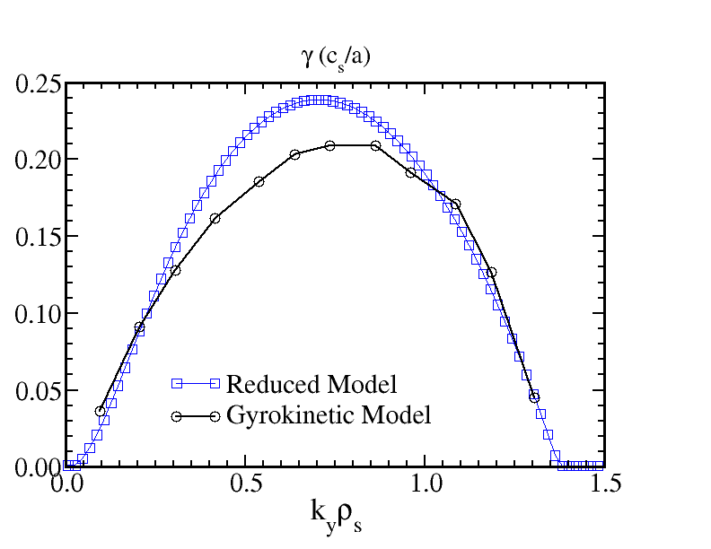
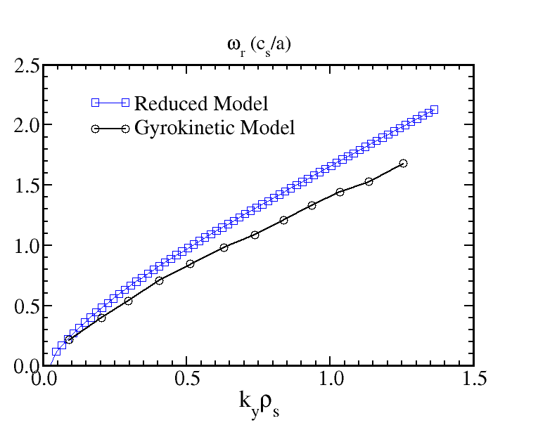
k_{y}ρ_{s} Comparison Between Reduced Model and Gyrokinetic MTM Linear Growthrate and Frequency
MTM linear growthrate and real frequency as a function of k_{y}ρ_{s} is compared with gyrokinetic code GYRO MTM linear growthrate and real frequency W. Guttenfelder et al Phys Plasmas 19, 022506 (2012)

Slide 8
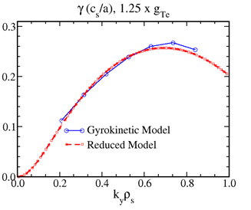
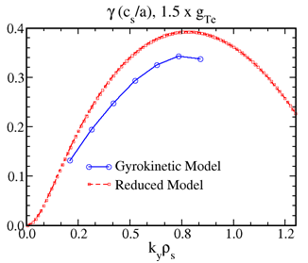
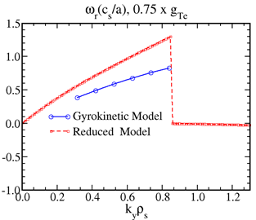
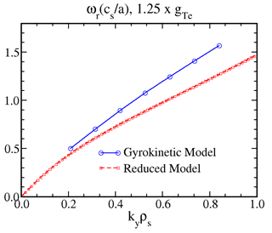
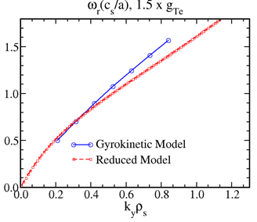
k_{y}ρ_{s} Comparison Between Reduced Model and Gyrokinetic MTM Linear Growthrate and Frequency

Slide 9
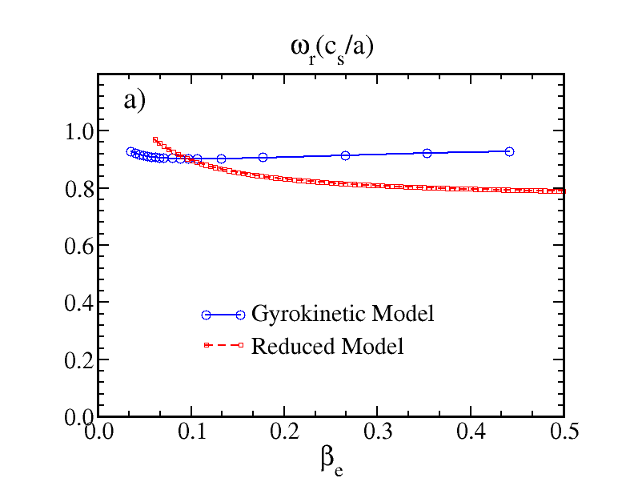
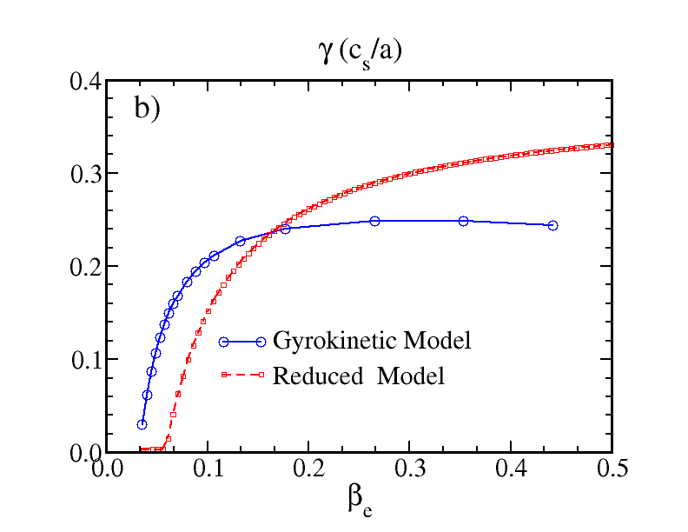
β_{e} Comparison Between Reduced Model and Gyrokinetic MTM Linear Growthrate and Frequency
The MTM instability threshold in electron beta is found to be $βe ≈5.0\%$
Local experimental value of β_{e} is 9.0%
For low values of β_{e,} $γ$ increases with increasing values of β_{e}
Real frequency is found to be almost independent of β_{e} in both the reduced and gyrokinetic model
Moderate destabilization with β_{e} in experimental range is qualitatively consistent with the weak confinement scaling Ω τ_{E} = β^{-0.1} observed in NSTX

Slide 10
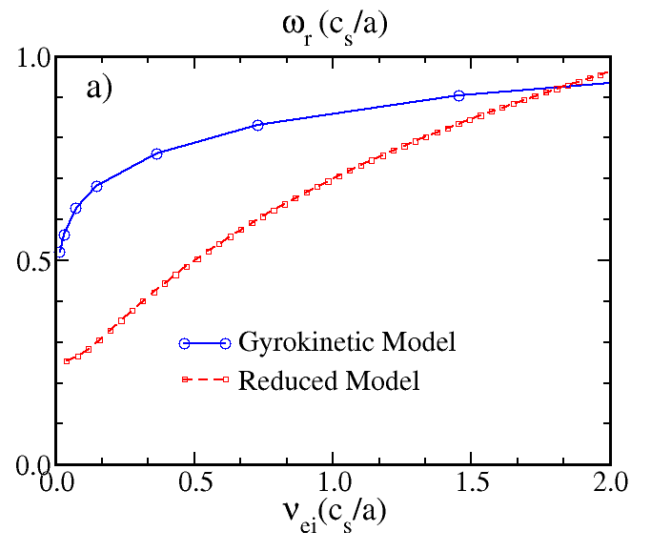
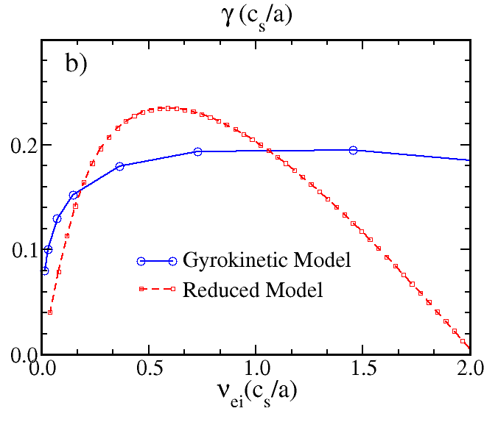
$ν_{ei}$Comparison Between Reduced Model and Gyrokinetic MTM Linear Growthrate and Frequency
Real frequency of MTM is found to be increasing with $ν_{ei}$
Maximum $γ$ is found for moderate values of $ν_{ei}$
Nonmonotonic dependence of $γ$on $ν_{ei}$ is consistent with gyrokinetic simulations
Growthrate decreases with decreasing $ν_{ei}$is consistent with the dependence on collisionality is observed in the NSTX discharges

Slide 11
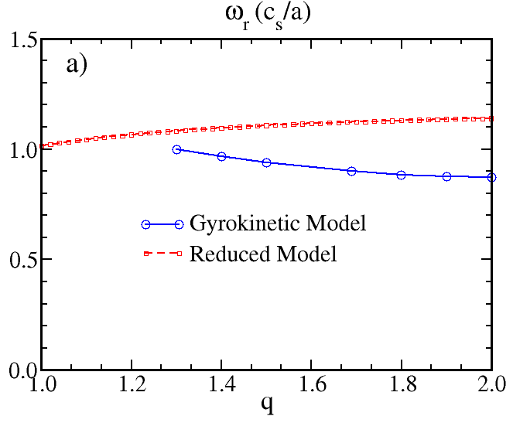
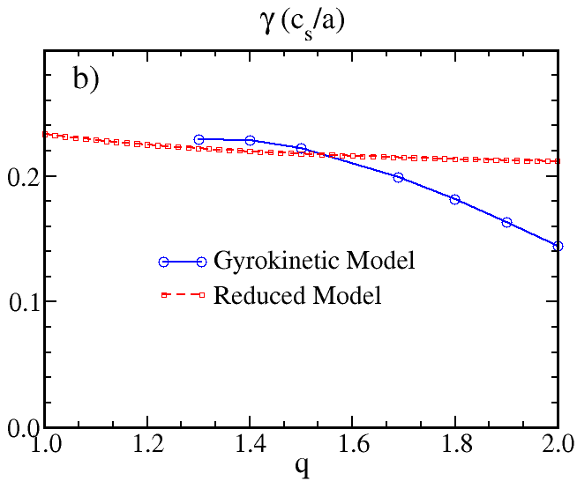
Magnetic-q Comparison Between Reduced Model and Gyrokinetic MTM Linear Growthrate and Frequency
Magnitude of real frequency and growthrate in reduced and gyrokinetic models are not very different, but the significant decreasing of growthrate for larger values of magnetic-q in the gyrokinetic model results is not captured by the reduced model
Simple estimation of $k_{∥}$, which does not depend on toroidal geometry, might be a reason of not capturing the decreasing trend of $γ$ for large values of magnetic-q

Slide 12
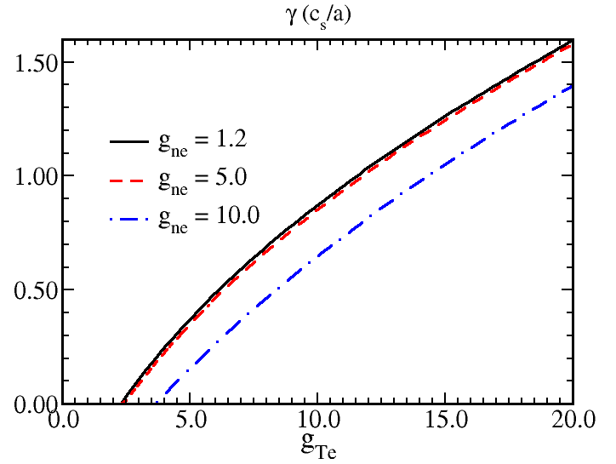
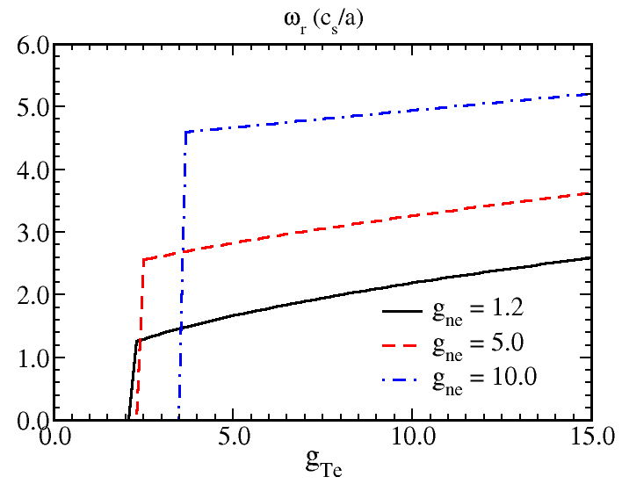
Temperature Gradient Dependence of MTM for Different Values of Density Gradients
Destabilizing effect of increasing temperature gradient, g_{Te} is illustrated
MTM instability threshold in g_{Te} is found to be dependent on density gradient
Threshold is found to be increasing and growthrate is found to be decreasing with increasing density gradient, g_{ne}
Experimental g_{Te} is larger than the inferred linear threshold in g_{Te}
MTM growth rate increases rapidly above the g_{Te} threshold for small g_{ne}
MTM real frequency increase with g_{Te} and with g_{ne}

Slide 13
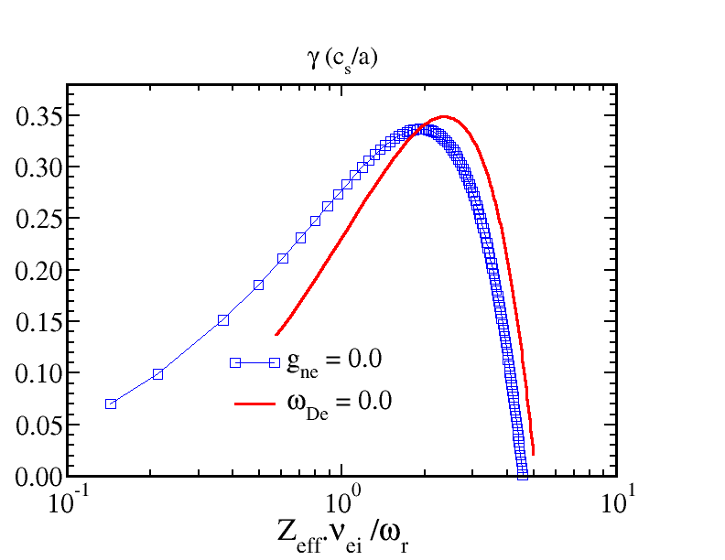
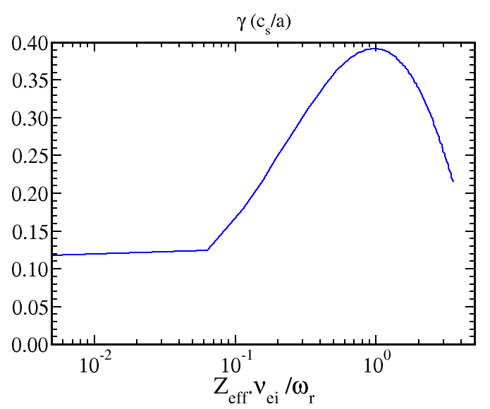
Collisionality Dependence of MTM
k_{y}ρ_{s} Fixed
k_{y}ρ_{s} Varied
As $ν_{ei}$ is reduced, MTM growth rate is reduced
This scaling trend is qualitatively consistent with the global energy confinement trend, Ωτ_{E} = $ν_{∗}$^{-0.95} observed in NSTX analysis
This behavior is opposite to the drift waves instabilities where collisionality tends to provide a stabilizing influence to TEM which otherwise enhance the ITG and ETG instability in the collisionless limit
Peak MTM growth rate occurs around $\frac{Z_{eff}{ ν}_{ei}}{ω}≈2$

Slide 14
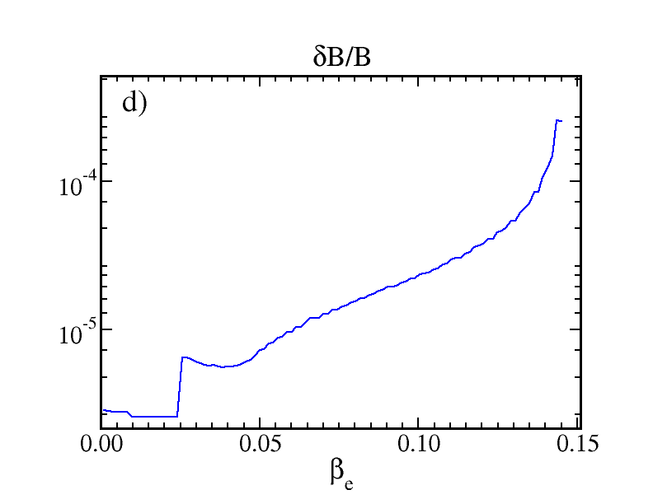
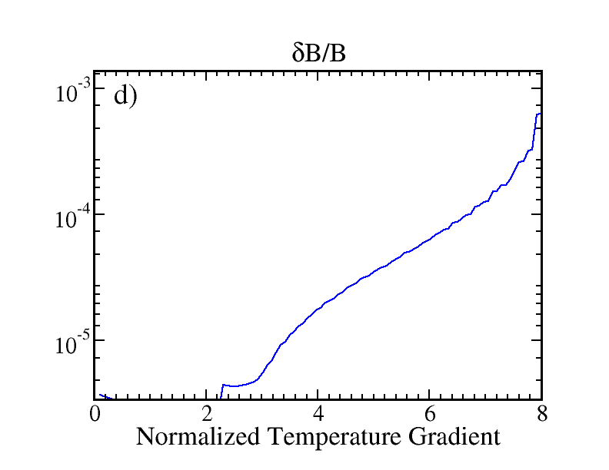
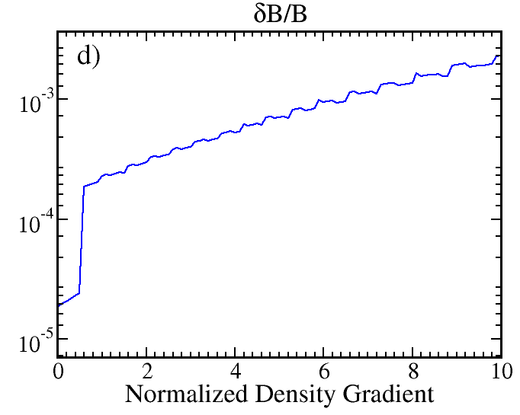
Magnetic Fluctuation Dependence on β_{e}, Temperature Gradient and Density Gradient
Saturated magnetic fluctuation, $δB/B$ clearly show dependence on $β_{e}$, temperature and density gradients
Use of mixing length estimate $\frac{δB}{B}≈ρ_{e}/L_{Te}$ in previous MTM related publications is incapable of capturing such dependencies

Slide 15
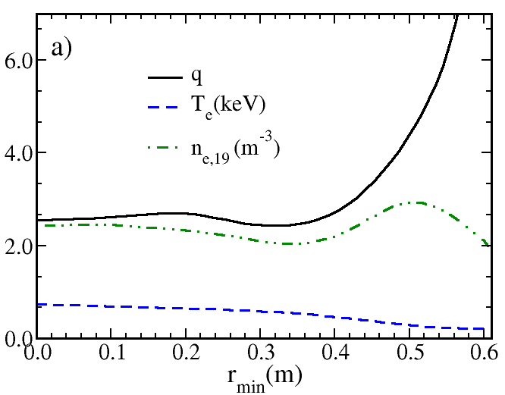
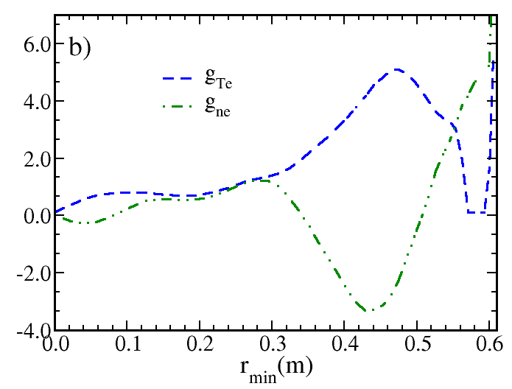
Magnetic q, Electron Temperature, Density and Gradient Profiles
Magnetic q, electron temperature, and density profiles are specified
Normalized temperature gradient, $g_{Te}$ and density gradients, $g_{ne}$ are shown

Slide 16
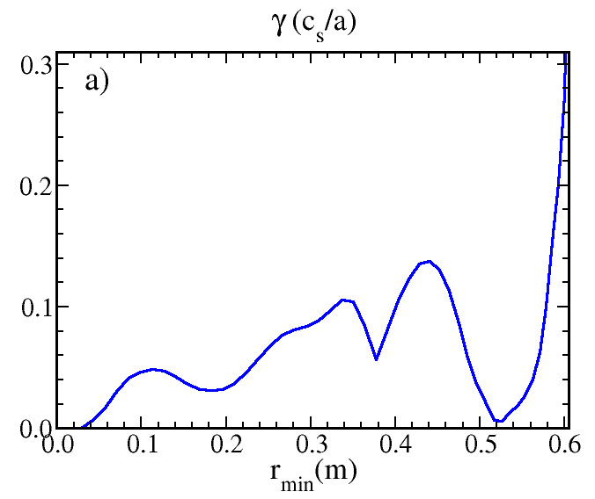
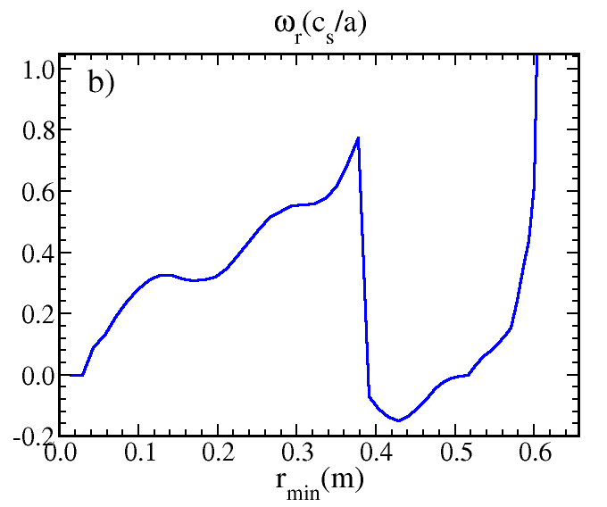
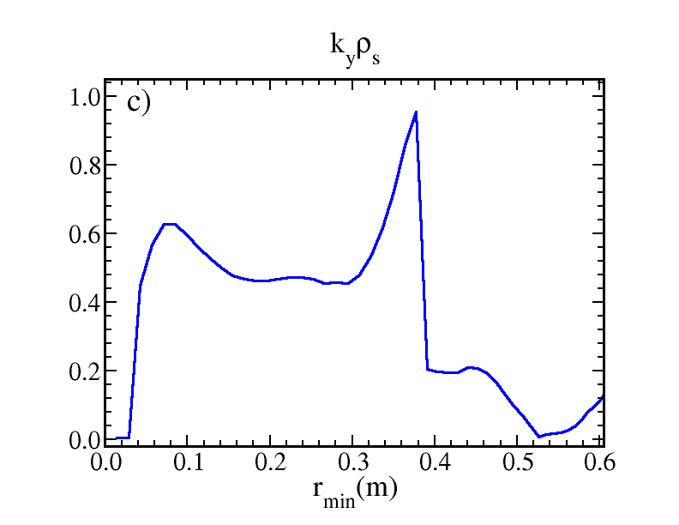
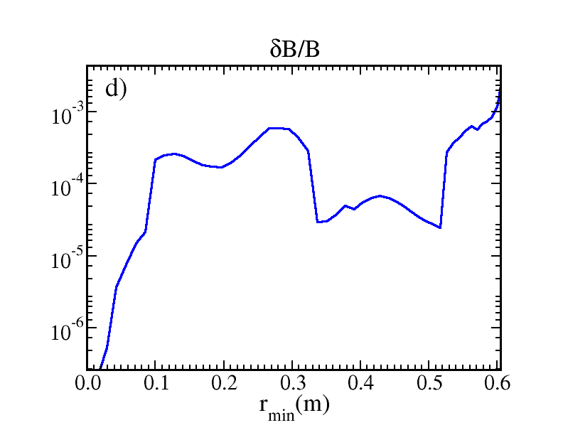
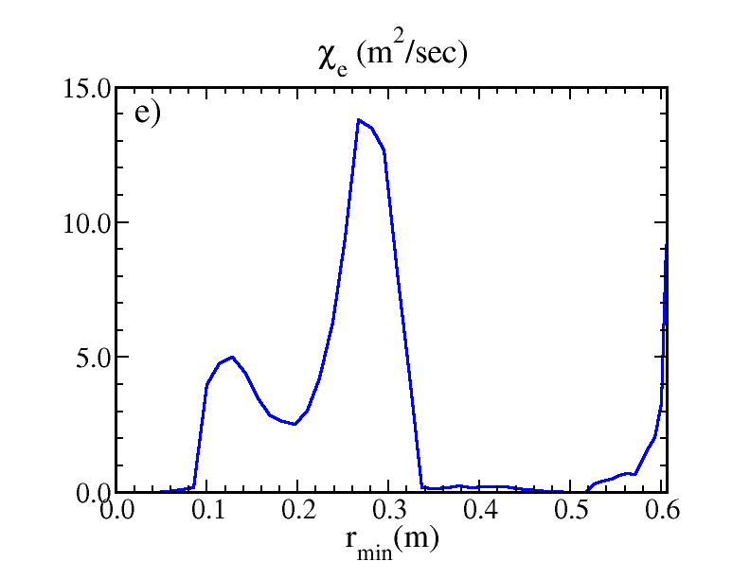
Behavior of the MTM Model for Prescribed Profiles

Slide 17
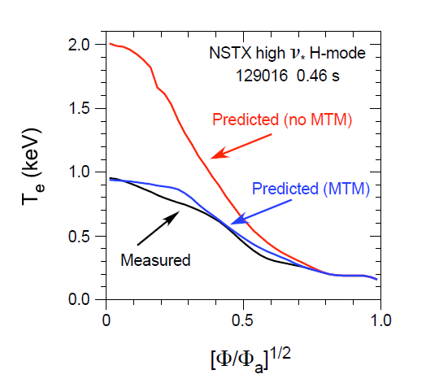
Predicted and Measured Electron Temperatures for High $ν^{∗}$ NSTX Discharge
Predicted and measured T_{e} profiles for the high $ν^{∗}$ NSTX discharge, 120916, with and without the contribution of transport associated with microtearing modes, as a function of the normalized square root of toroidal flux
When the MM model, that includes transport associated with microtearing modes, is installed in the TRANSP code and is utilized in studying electron thermal transport in NSTX discharge, it is found that agreement with the experimental electron temperature profile is significantly improved in a high collisionality discharge
When the microtearing component in MM model is not included, an over-prediction of temperature occurs

Slide 18
Summary
Microtearing modes have been identified as a source of significant electron thermal transport in tokamak discharges
Reduced model for nonlinear microtearing modes in integrated predictive modeling codes is developed
Goal is to improve the prediction of electron thermal transport and, consequently, the prediction of the evolution of the plasma in devices in which microtearing modes have a significant role
Dependence of MTM stability on plasma parameters appropriate for high collisionality NSTX discharges is investigated
Growth rate and real frequency obtained using the reduced transport model for MTM are compared and found to be consistent with MTM results obtained using the gyrokinetic code GYRO
Saturated amplitude of the magnetic fluctuation strength, which depends upon the growth rate and real frequency of the most unstable mode and as well as on their sidebands in the k_{y} spectrum, is computed
Agreement with experimental electron temperature profile is significantly improved in a high collisionality discharge when MTM model is included as a component in the MMM model

