Slide 1


Kinetic Resistive Wall Mode Stabilization Physics in Tokamaks
Jack Berkery
Columbia University
S.A. Sabbagh¹, R. Betti², H. Reimerdes³, J. Hanson¹,
A. Balbaky¹, R.E. Bell⁴, A. Diallo⁴, S.P. Gerhardt⁴, B.P. Le Blanc⁴, J.E. Menard⁴, M. Podesta⁴, Z.R. Wang⁴
¹Columbia University, ²University of Rochester, ³Ecole Polytechnique Fédérale de Lausanne, ⁴PPPL
18th International Congress on Plasma Physics
Kaohsiung, Taiwan, June 27 – July 1, 2016
*This work supported by the US DOE contracts DE-AC02-09CH11466 and DE-FG02-99ER54524

Slide 2
Outline
RWM Definition and Motivation
Kinetic Stability Theory
  Rotation
  Collisionality
  Energetic Particles
Comparison of Calculations and Experimental Results
Stability Estimation and Rotation Profile Control
Summary

Slide 3

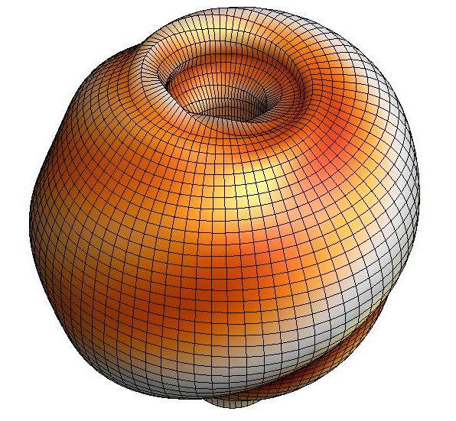

An unstable RWM is an exponential growth of magnetic field line kinking that can cause disruptions
The resistive wall mode (RWM) is a kinking of magnetic field lines slowed by penetration through vessel structures
Ideal Kink
Mode
γ
unstable
0
stable
[S. Sabbagh et al., Nucl. Fusion 46, 635 (2006)]
β_{N}^{no-wall}
RWMs can cause a collapse in β, disruption, and termination of the plasma

Slide 4
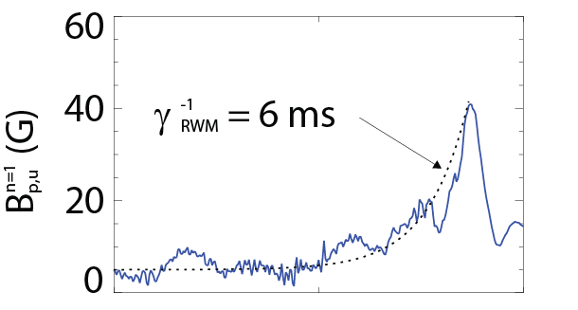

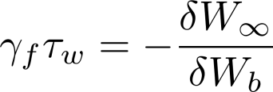
An unstable RWM is an exponential growth of magnetic field line kinking that can cause disruptions
The resistive wall mode (RWM) is a kinking of magnetic field lines slowed by penetration through vessel structures
Copper plate
where
NSTX 130235
B_{p}
Resistive Wall Mode
Ideal Kink
Mode
γ
~τ_{w}⁻¹
unstable
0
stable
[S. Sabbagh et al., Nucl. Fusion 46, 635 (2006)]
β_{N}^{no-wall}
β_{N}^{with-wall}
RWMs can cause a collapse in β, disruption, and termination of the plasma

Slide 5
An unstable RWM is an exponential growth of magnetic field line kinking that can cause disruptions
The resistive wall mode (RWM) is a kinking of magnetic field lines slowed by penetration through vessel structures
Copper plate
where
NSTX 130235
B_{p}
Resistive Wall Mode
Ideal Kink
Mode
γ
~τ_{w}⁻¹
unstable
0
stable
[S. Sabbagh et al., Nucl. Fusion 46, 635 (2006)]
β_{N}^{no-wall}
β_{N}^{with-wall}
RWMs can cause a collapse in β, disruption, and termination of the plasma

Slide 6
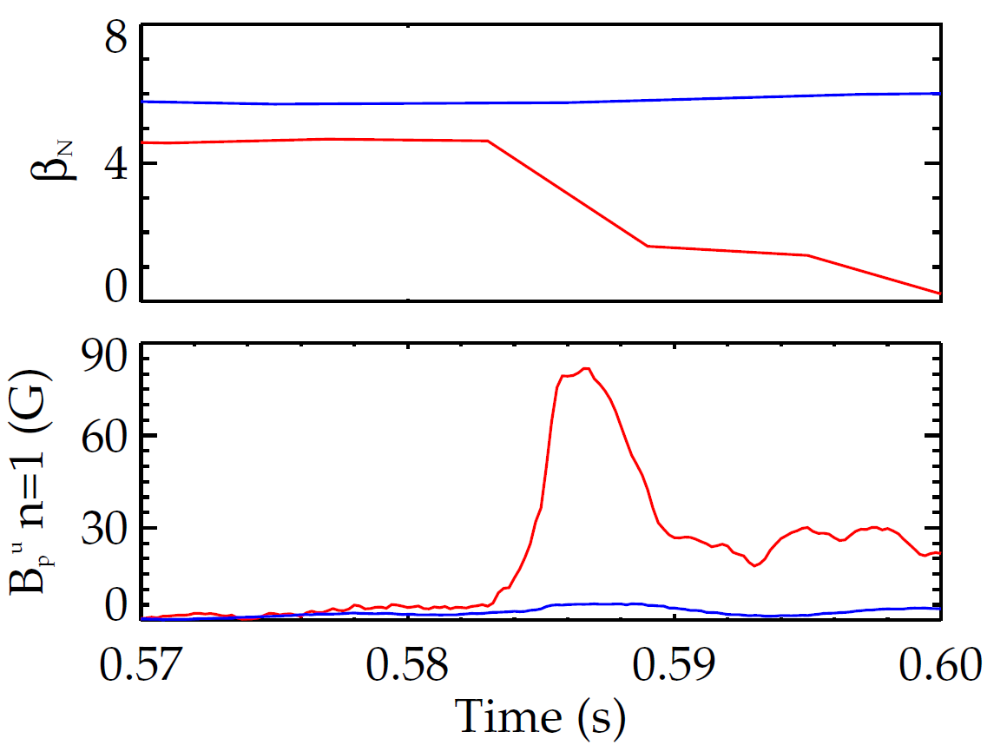
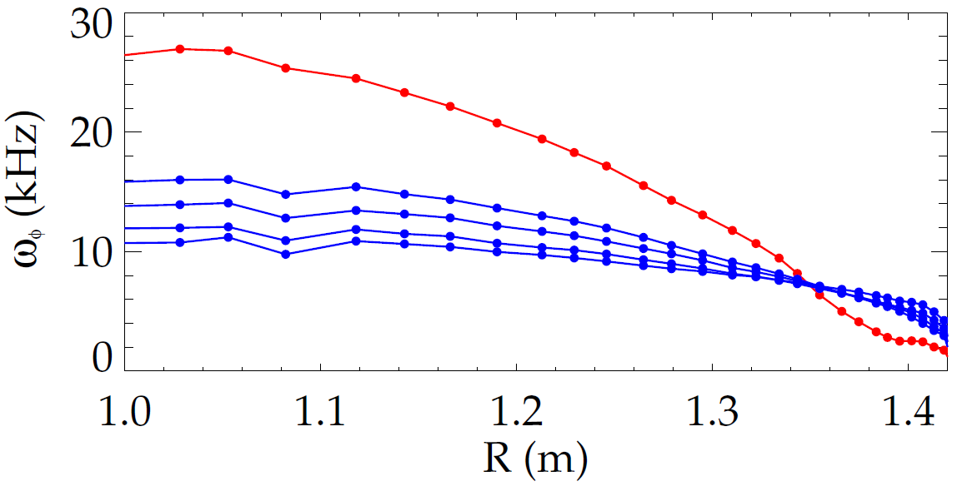
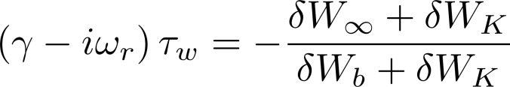
A scalar critical plasma rotation model can not explain RWM stability; it depends on the ω_{φ} profile
Early stability theories:
  Collisional dissipation of mode energy
  Rotational damping
140102
NSTX
137722
    But models with scalar “critical rotation” for stability could not explain experiments
unstable RWM
Unexplained experiments
New theory: consider kinetic effects
Ideal Stability
Kinetic Effects
Plasma rotation
unstable
slowed by n=3 braking
[B. Hu et al., Phys. Rev. Lett. 93, 105002 (2004)]

Slide 7
Outline
RWM Definition and Motivation
Kinetic Stability Theory
  Rotation
  Collisionality
  Energetic Particles
Comparison of Calculations and Experimental Results
Stability Estimation and Rotation Profile Control
Summary

Slide 8
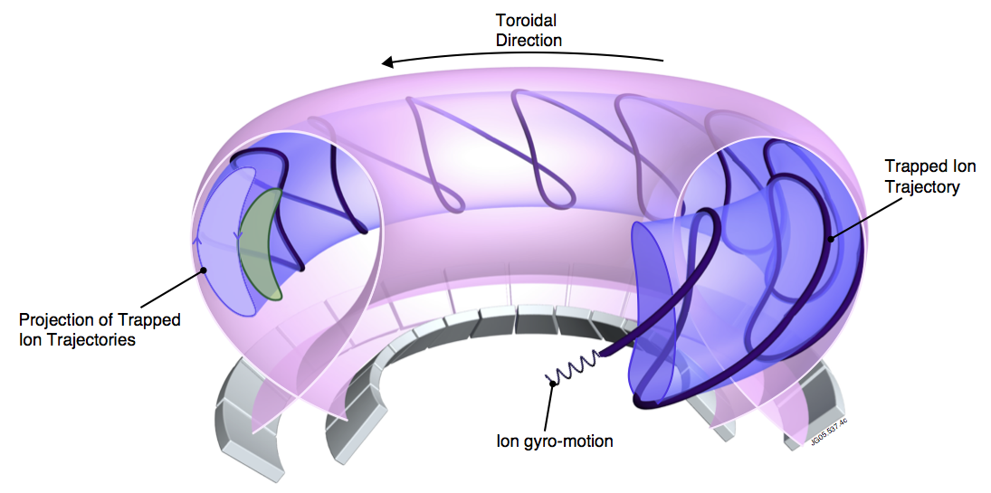

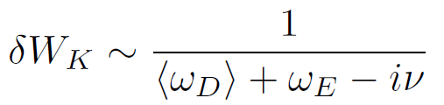
“Kinetic effects” means taking into account complicated particle motion rather than treating the plasma as a fluid
MISK code
Solves for RWM growth rate
is solved by using from the drift kinetic equation
[R. Pitts et al., Physics World, March 2006
D. Pace et al., Physics Today 68, 34 (2015)]
Precession Drift
~ Plasma Rotation
Rotational resonance effect
[J. Berkery et al., Phys. Rev. Lett. 104, 035003 (2010)]

Slide 9
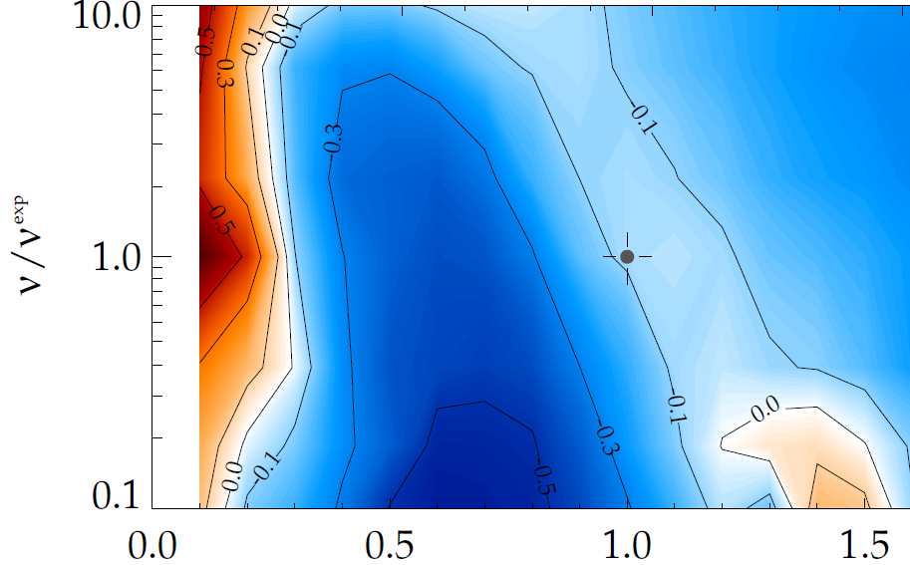
Kinetic theory consistent with RWM destabilization at intermediate plasma rotation
MISK calculations of γτ_{w} contours vs. ν and ω_{φ}
Destabilization appears between:
precession resonance at low ω_{φ}
bounce resonance at high ω_{φ}
(marginal stability)
instability
(NSTX
experiment)
ν/ν^{exp (marginal stability)}
Precession drift resonance stabilization
unstable
ω_{φ}/ω_{φ}^{exp (marginal stability)}
unstable
Precession Drift
~ Plasma Rotation
Rotational resonance effect
[J. Berkery et al., Phys. Rev. Lett. 104, 035003 (2010)]

Slide 10
Collisionality affects the strength of kinetic resonances
MISK calculations of γτ_{w} contours vs. ν and ω_{φ}
Early theory predicted RWM stability should decrease at low ν
Kinetic RWM stability theory:
  Stabilizing resonant kinetic effects enhanced at low ν
Important for ITER
(marginal stability)
instability
(NSTX
experiment)
ν/ν^{exp (marginal stability)}
unstable
ω_{φ}/ω_{φ}^{exp (marginal stability)}
Collisionality
Collisionality effect
[J. Berkery et al., Phys. Rev. Lett. 106, 075004 (2011)]

Slide 11
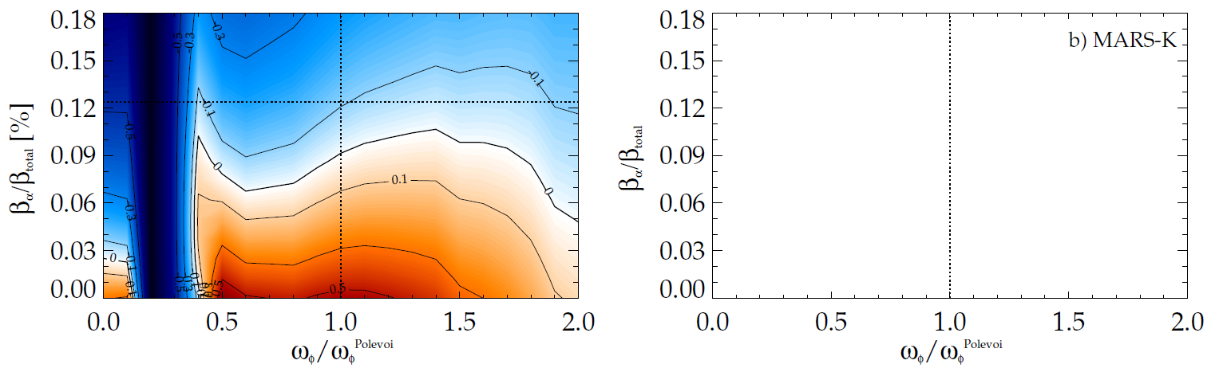
Energetic particles provide a stabilizing force that is nearly independent of rotation and collisionality
MISK calculation for ITER
Energetic partilces provide stabilizing effect
Energetic particles are not in mode resonance
  Effect is nearly independent of ω_{φ}
  Effect is not energy dissipation, but rather a restoring force
stable
expected β_{α}
expected ω_{φ}
unstable
Large for EPs
Small for EPs
Precession Drift
~ Plasma Rotation
Collisionality
Energetic particle effect
[J. Berkery et al., Phys. Plasmas 17, 082504 (2010)]

Slide 12
Outline
RWM Definition and Motivation
Kinetic Stability Theory
  Rotation
  Collisionality
  Energetic Particles
Comparison of Calculations and Experimental Results
Stability Estimation and Rotation Profile Control
Summary

Slide 13
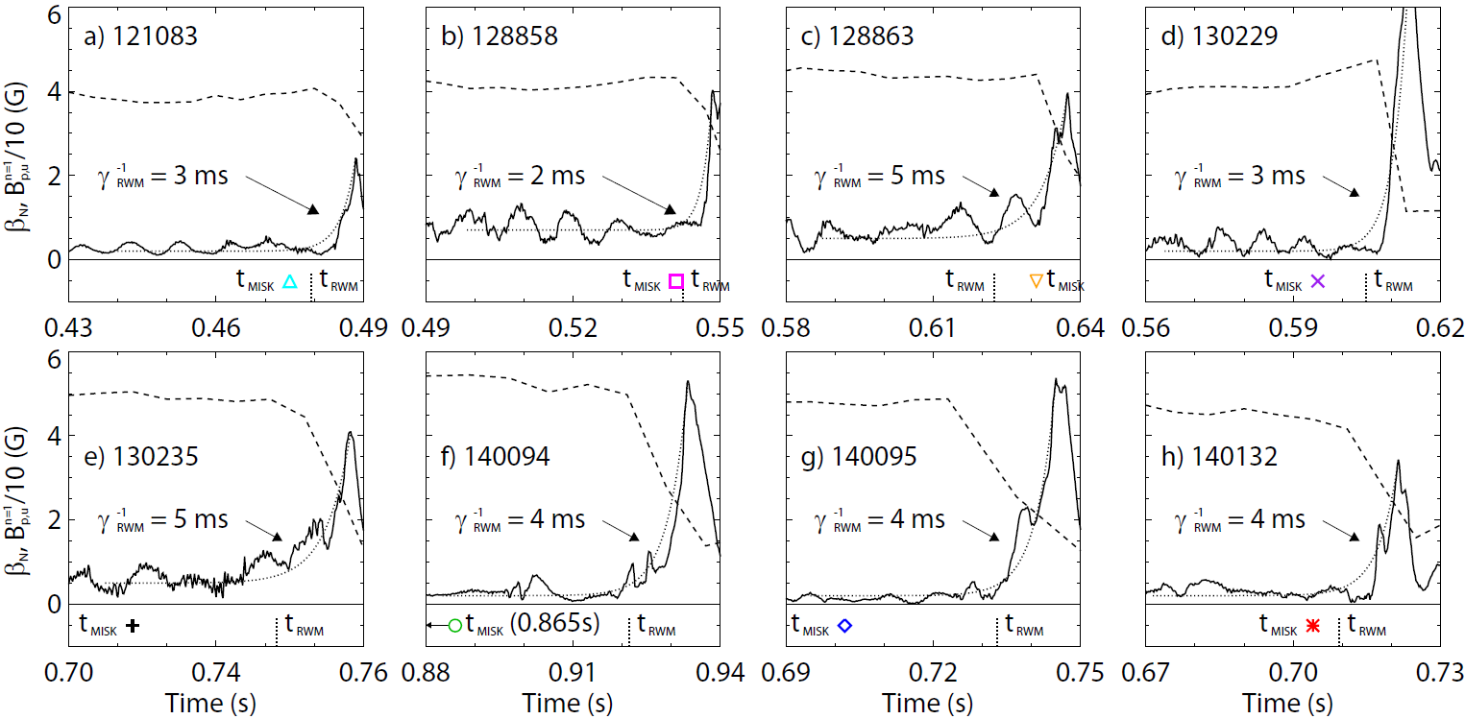
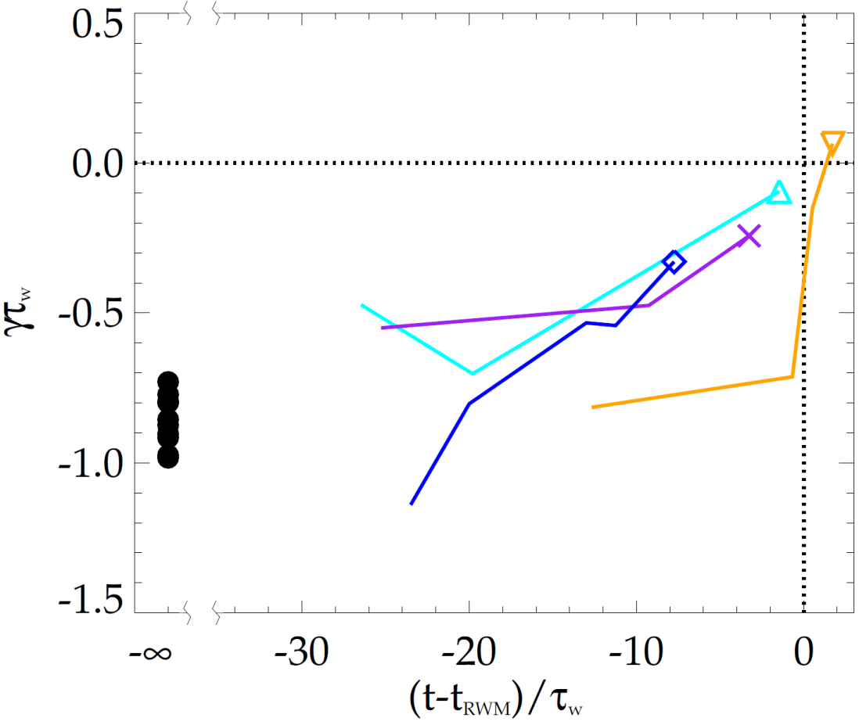
MISK calculations validated against unstable experimental plasmas; reproduce approach towards marginal stability
NSTX
NSTX
unstable
stable
[J. Berkery et al., Nucl. Fusion 55, 123007 (2015)]
MISK calculations including kinetic effects have been tested against many marginally stable NSTX experimental cases

Slide 14
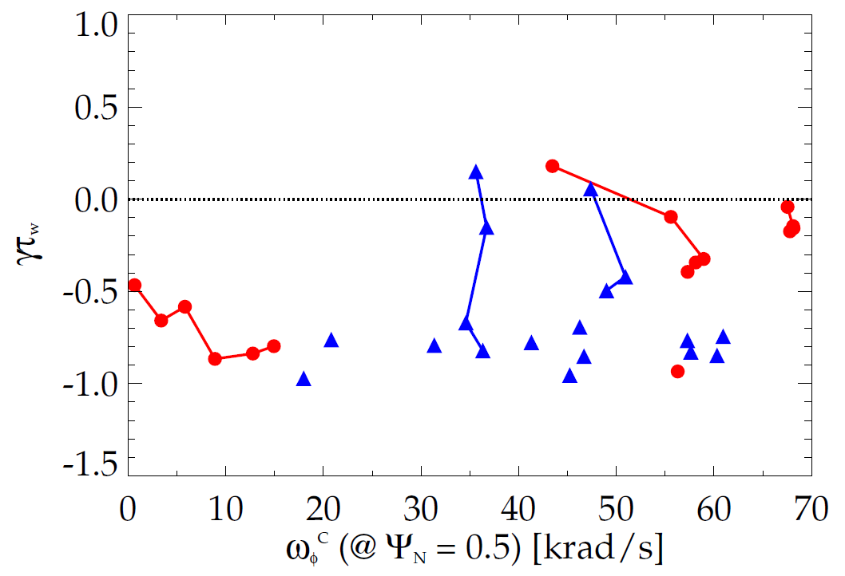

Kinetic RWM stability physics unites results from
DIII-D and NSTX plasmas
Kinetic RWM stability analysis for experiments (MISK)
Addition of kinetic effects yields agreement with marginal point in NSTX
Further testing against DIII-D experiments shows good agreement
Strong bursting MHD modes can lead to non-linear destabilization before linear stability limits are reached
DIII-D
unstable
NSTX
Normalized growth rate (γτ_{w})
“weak stability” region
major disruption
minor disruption
stable
Plasma rotation [krad/s] (Ψ_{N} = 0.5)
[S. Sabbagh, J. Berkery, J. Hanson, et al., APS invited 2014]

Slide 15
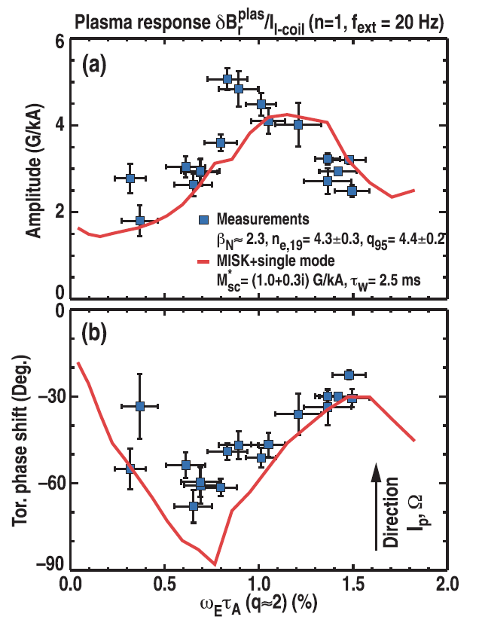
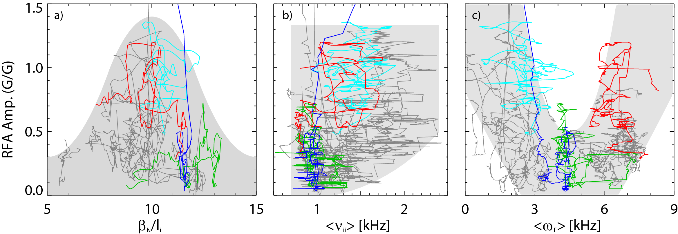
Active MHD spectroscopy experiments show the importance of kinetic effects in stable plasmas as well
Favorable rotation range
NSTX
DIII-D
[H. Reimerdes et al., Phys. Rev. Lett. 106, 215002 (2011)]
[J. Berkery et al., Phys. Plasmas 21, 056112 (2014)]
Resonant field amplification indicates weakening stability
  Plasma response is enhanced where kinetic effects and RWM stability are weak
Discharge trajectories for 20 NSTX plasmas shows favorable ω range
  Matches theoretical expectation for precession drift resonance
MISK calculations match experiments

Slide 16
Outline
RWM Definition and Motivation
Kinetic Stability Theory
  Rotation
  Collisionality
  Energetic Particles
Comparison of Calculations and Experimental Results
Stability Estimation and Rotation Profile Control
Summary

Slide 17
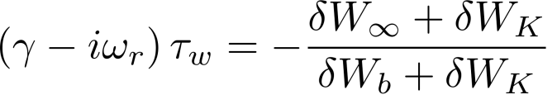
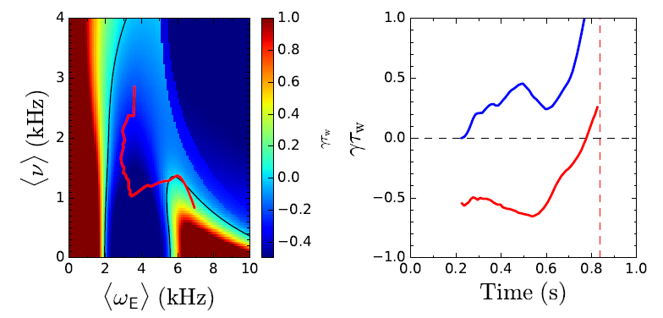
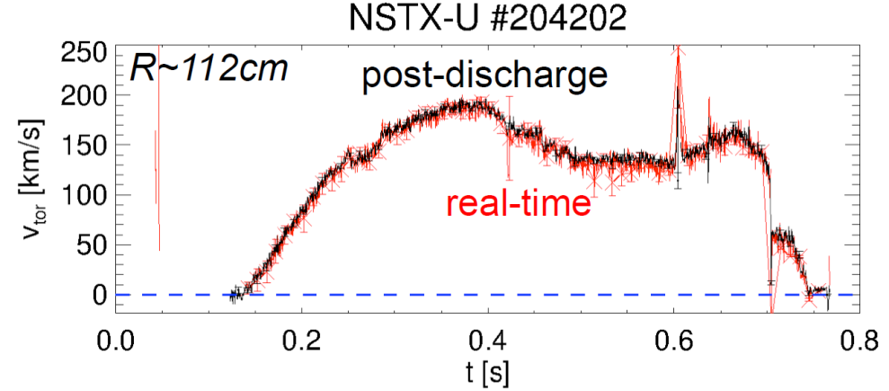
Physics understanding from previous research used to construct a reduced kinetic model
Goal is to forecast γ in real-time using parameterized reduced models for δW terms
Need δW_{K} as a function of the most important, real-time measurable quantities
MISK² Calculations
  Compared to experiments
Fluid terms
Kinetic effects:
Rotation
Collisionality
+ Energetic Particles
Reduced Kinetic Model
Real-time velocity data now available on NSTX-U
fluid
kinetic
Rotation controller designed using NBI, NTV

Slide 18
Summary
RWM stability must be understood for future devices
Kinetic theory modifies ideal stability, includes rotation, collisionality, and energetic particle effects
ITER stability projections show all kinetic effects important
MISK code calculations can explain experimental stability
Reduced models needed for real-time disruption avoidance
Fluid terms
Kinetic effects
~ Rotation
Collisionality
Rotation resonance
Collisionality
Energetic Particles

