Slide 1

Key physics issues and opportunities for next-step spherical torus devices
Jonathan Menard (PPPL)
18th International Congress on Plasma Physics
Kaohsiung Exhibition Center, Kaohsiung, Taiwan
June 27 – July 1, 2016

Slide 2
Outline
Motivations for studying “spherical” tokamak (ST)
Mission elements of NSTX-U Research Program
NSTX-U research commissioning status
Key physics issues for ST
  Energy transport
  High-beta stability
  Power exhaust
  Current sustainment and start-up

Slide 3
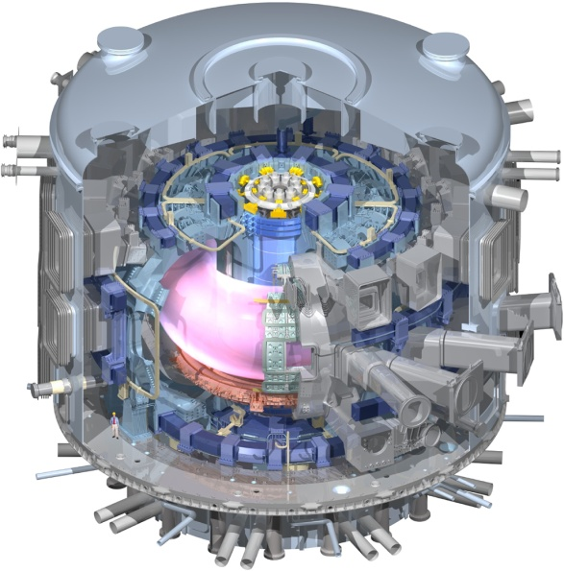
ST research extends predictive capability
for ITER and toroidal confinement science
  High β physics, rotation, shaping extend stability, transport knowledge
  NBI fast-ions in present STs mimic DT fusion product parameters in ITER → study burning plasma science
  STs can more easily study electron scale turbulence at low collisionality → important for all magnetic fusion
Burning Plasma Physics - ITER

Slide 4
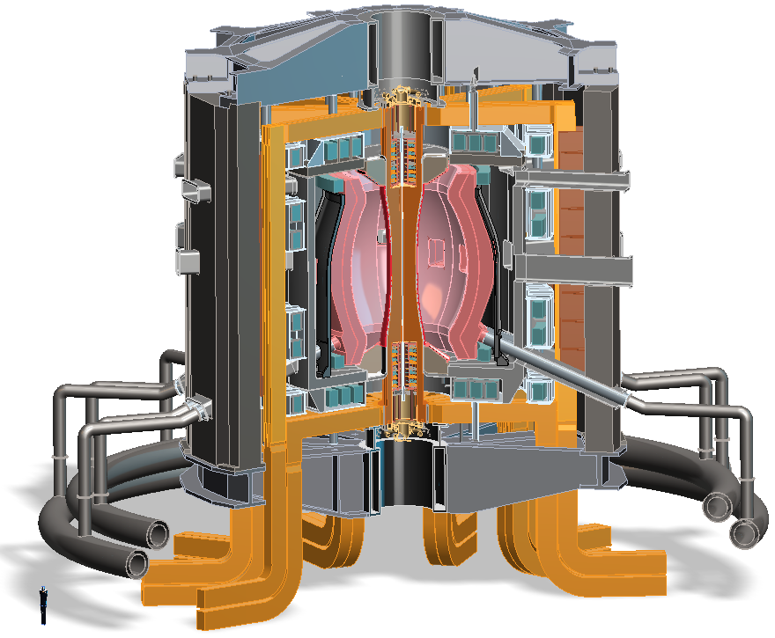
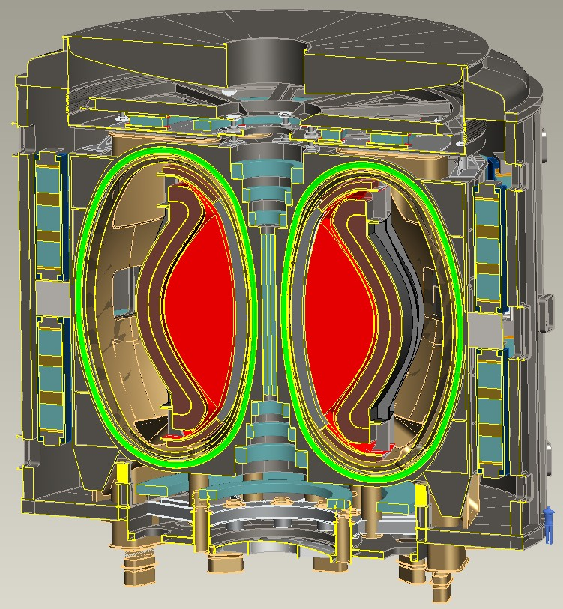
Recent design studies show ST potentially attractive as
Fusion Nuclear Science Facility (FNSF) and Pilot Plant
FNSF: Provide neutron fluence for material/component R&D (+ T self-sufficiency?)
Pilot Plant: Electrical self-sufficiency: Q_{eng} = P_{elec} / P_{consumed} ≥ 1 (+ FNSF mission?)
FNSF with copper TF coils
A=1.7, R₀ = 1.7m, κ_{x} = 2.7, B_{T}=3T
Fluence = 6MWy/m², TBR ~ 1
FNSF / Pilot Plant with HTS TF coils
A=2, R₀ = 3m, κ_{x} = 2.5, B_{T} = 4T
6MWy/m², TBR ~ 1, Q_{eng} ~ 1
Designs integrate ST higher κ , β_{N} and advanced divertors (+ HTS TF for Pilot Plant)

Slide 5
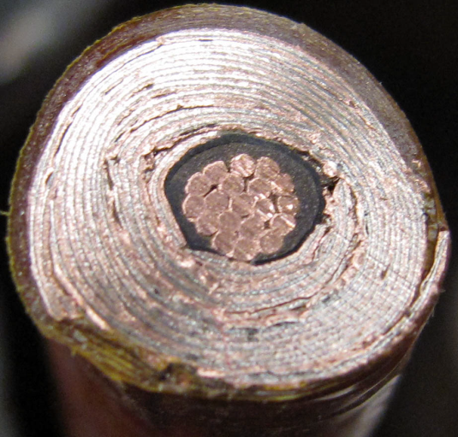
Beyond high-B_{T} capability, HTS cables using REBCO tapes achieving very high winding pack current density
10 mm
Conductor on Round Core Cables (CORC)
J_{WP} ~ 70MA/m² 19T
6 mm
10 mm
7 kA CORC (4.2K, 19 T) cable
Base cable: 50 tapes YBCO Tapes with 38 μm substrate (Van Der Laan, HTS4Fusion, 2015)
7 mm
Base Conductor
He Gas Cooled
8kA,
J_{WP} ~ 160MA/m²
Higher J_{cable} HTS cable concepts under development:
Copper
7 mm
SS conductor jacket for strength

Slide 6
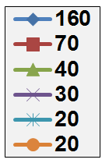
High current density HTS → more compact
TF magnets → lower-A tokamak pilot plants
Pilot: R=3m, P_{NBI} = 50MW, f_{GW}=0.8, f_{NICD} = 1, β_{N}=β_{N-no-wall} (ε), κ=κ(ε), H unconstrained, η_{th} = 0.45
ITER-like TF constraints:
  J_{WP}=20MA/m², B_{max} ≤ 12T
  P_{fusion} ≤ 130MW
  P_{net} < -90MW
J_{WP} ~ 30MA/m², B_{max} ≤ 19T
  P_{fusion} ~ 400MW
  Small P_{net} at A=2.2-3.5
J_{WP} ≥ 70MA/m², B_{max} ≤ 19T
  P_{fusion} ~500-600MW
  P_{net} = 80-100MW at A=1.9-2.3
J_{WP} [MA/m²]
(12T)
A ~ 2 attractive at high J_{WP}

Slide 7
Outline
Motivations for studying “spherical” tokamak (ST)
Mission elements of NSTX-U Research Program
NSTX-U research commissioning status
Key physics issues for ST
  Energy transport
  High-beta stability
  Power exhaust
  Current sustainment and start-up

Slide 8
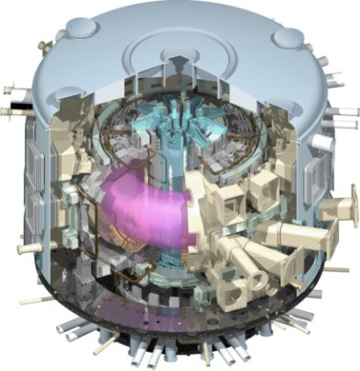
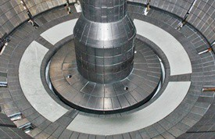
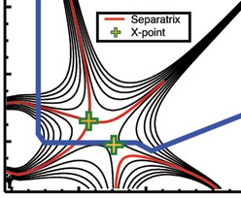
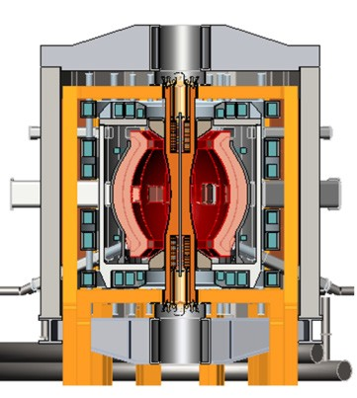
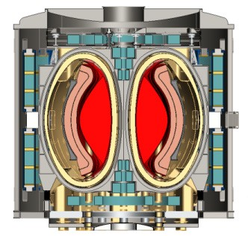
NSTX-U Mission Elements:
Explore unique ST parameter regimes to advance predictive capability - for ITER and beyond
ITER
Develop solutions for plasma- material interface (PMI)
Liquid metals / Lithium
Snowflake/X
ST-FNSF /
Pilot-Plant
Advance ST as Fusion Nuclear Science Facility and Pilot Plant

Slide 9
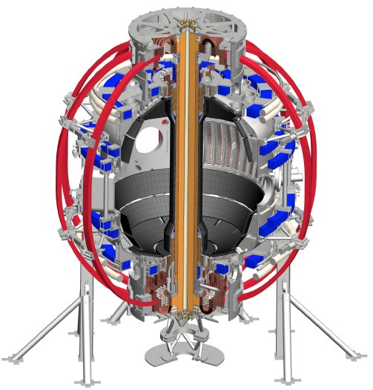
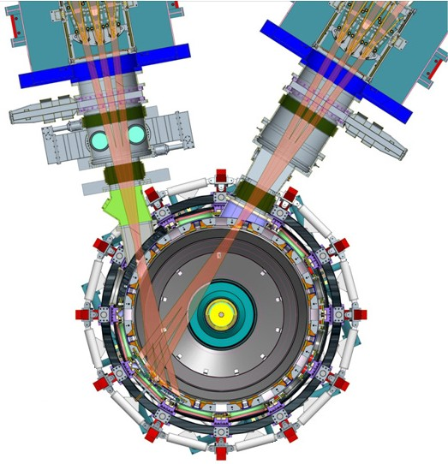
NSTX-U will access new physics with 2 major new tools:
1. New Central Magnet
2. Tangential 2nd Neutral Beam
Higher T, low ν* from low to high β
→ Unique regime, study new transport and stability physics
Full non-inductive current drive
→ Not demonstrated in ST at high-β_{T}
Essential for any future steady-state ST

Slide 10
NSTX-U will have major boost in performance
1. New Central Magnet
2. Tangential 2nd Neutral Beam
2017-2018 goals:
➢2× heating power (5 → 10MW)
Tangential NBI → 2× current drive efficiency
➢4× divertor heat flux (→ ITER levels)
➢Up to 10× higher nTτ_{E} (~MJ plasmas)
➢2× toroidal field (0.5 → 1T)
➢2× plasma current (1 → 2MA)
➢5× longer pulse (1 → 5s)

Slide 11
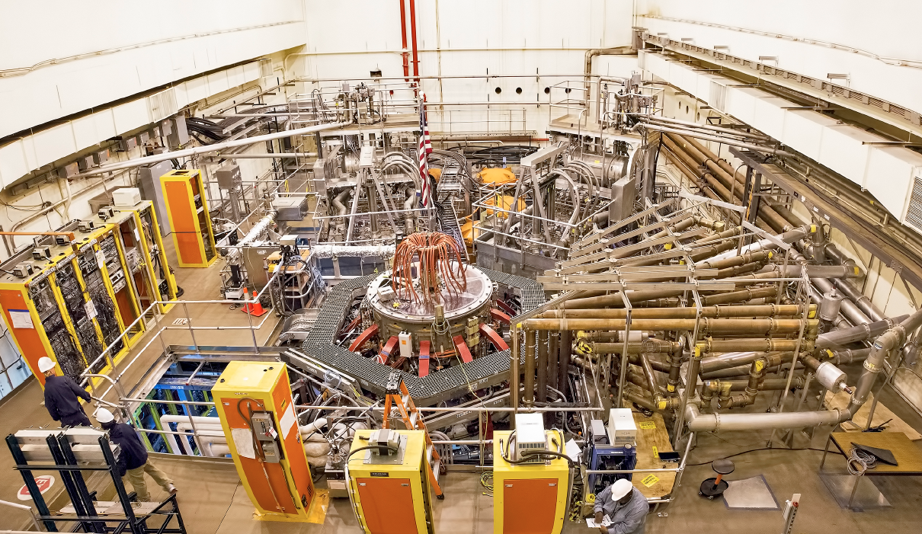
NSTX-U: Operational Research Facility
2nd NBI
1st NBI
NSTX-U
All six NBI sources now operational, supporting high performance experiments

Slide 12
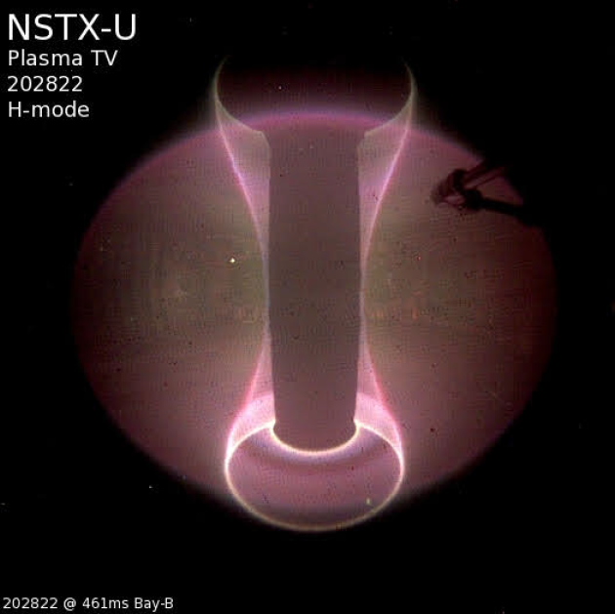
NSTX-U research initiated January 2016
H-mode access achieved during first 2 weeks of operation

Slide 13
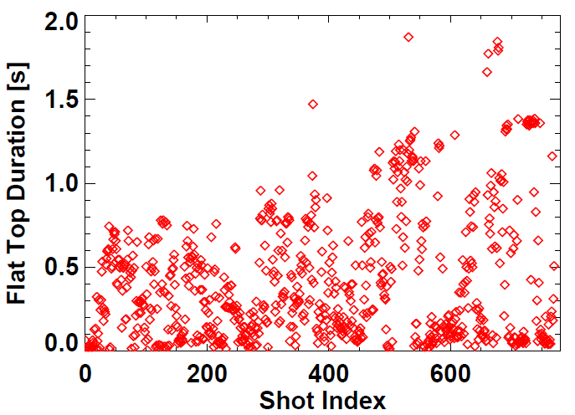
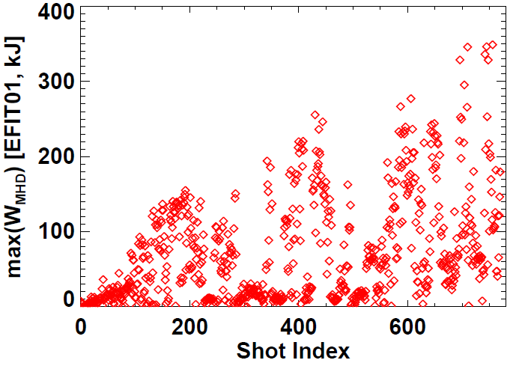
NSTX-U plasma commissioning status
~9 run weeks of ops, I_{P} = 0.5–1MA, boronized PFCs
Nearly all shots at B_{T} = 0.6-0.65T > NSTX max = 0.55T
All 6 NBI injected into plasmas, 5-10MW routinely available
Exceeded NSTX L & H-mode pulse-lengths
using 1MW L-modes (0.65, 0.8MA)
Approaching NSTX W_{TOT} record ~ 430kJ
NSTX record
NSTX record

Slide 14
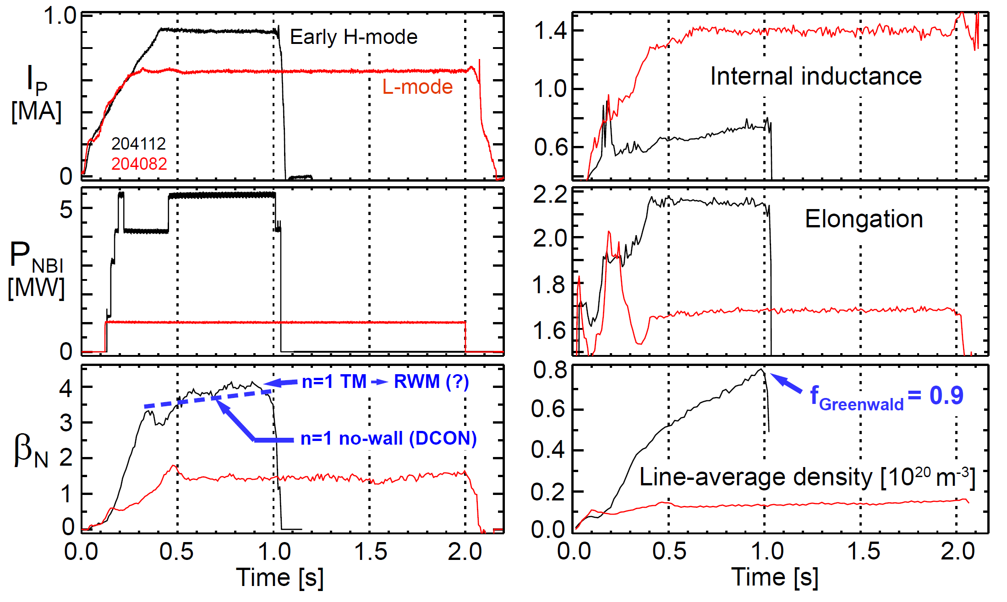
Examples of high-performance
L and H-modes achieved thus far in NSTX-U
(motivates cryo-pump)
NEXT: Increase κ to avoid tearing, active RWM control, trigger ELMs (ΔR_{sep}, granule injector)

Slide 15
Outline
Motivations for studying “spherical” tokamak (ST)
Mission elements of NSTX-U Research Program
NSTX-U research commissioning status
Key physics issues for ST
  Energy transport
  High-beta stability
  Power exhaust
  Current sustainment and start-up

Slide 16
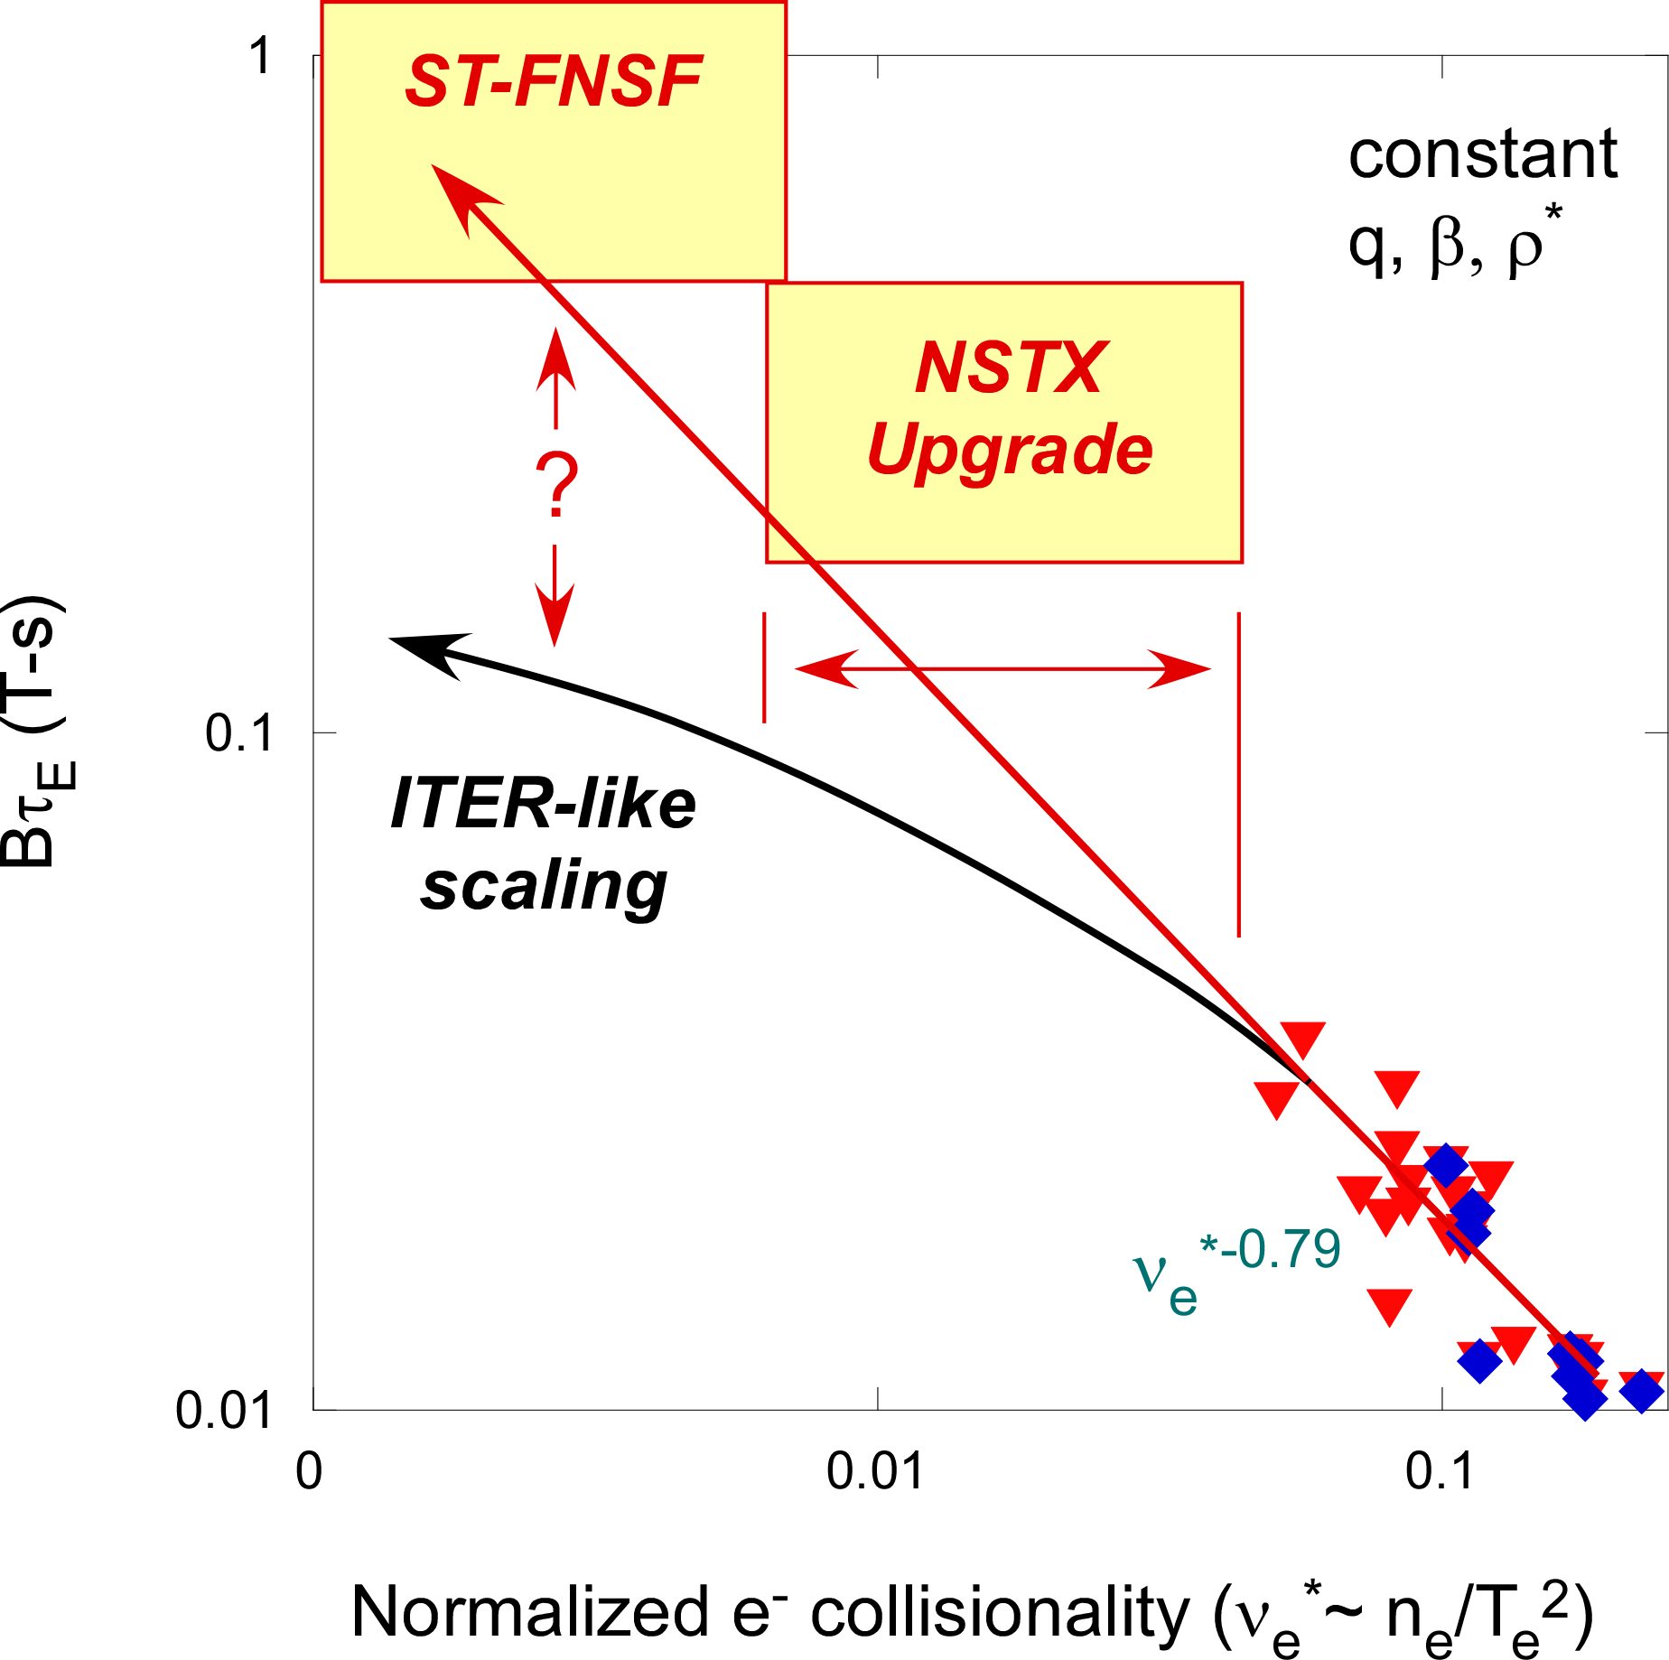
Favorable confinement trend with collisionality and β found in ST experiments
ST scaling observed in NSTX and MAST: τ_{E, th} ∝ ν_{*e}^{-0.8} β^{-0.0}
Tokamak empirical scaling (ITER 98y,2): τ_{E, th} ∝ ν_{*e}^{-0.1} β^{-0.9}
Li wall coatings
Boron wall coatings
Promising scaling to ST-FNSF / Pilot, will trend continue on NSTX-U / MAST-U?

Slide 17
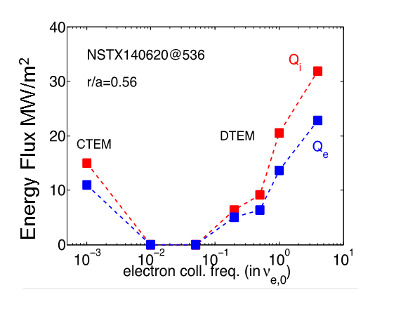
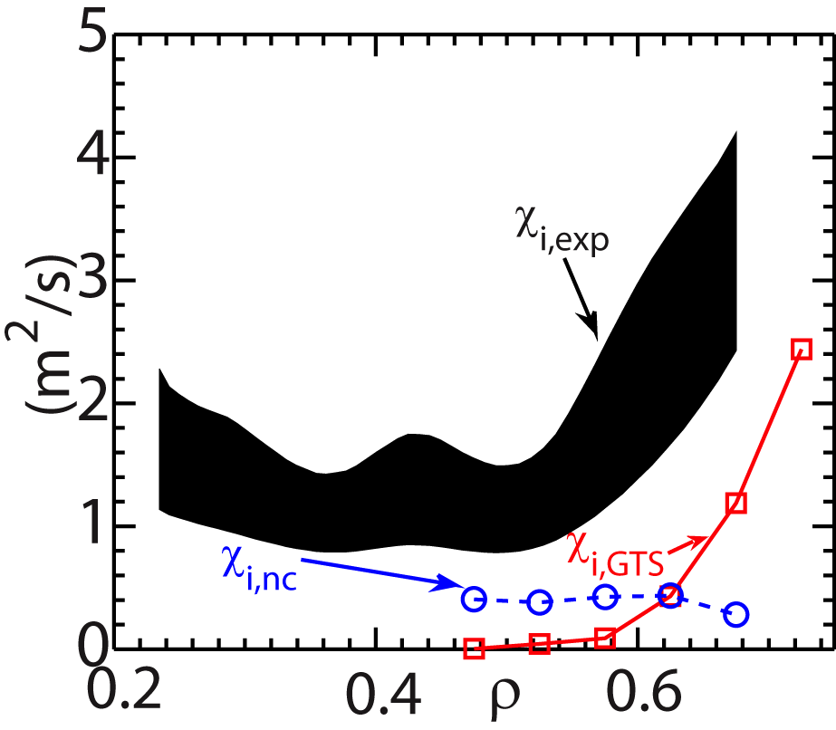
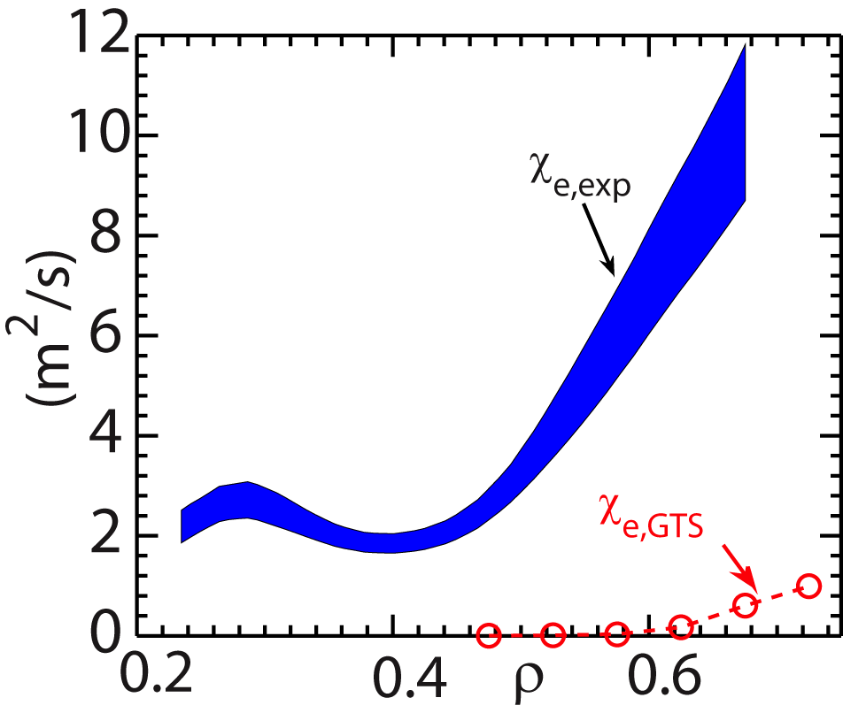
NSTX: Global non-linear GTS gyrokinetic simulations have identified multiple low-k turbulence transport mechanisms
Strong flow shear can destabilize Kelvin-Helmholtz instability
  Non-linear global GTS simulations
  K-H + ITG + Neo ion transport within factor of 2 of expt’l level
  Cannot account for electron transport
Recent GTS simulations have shown possible role of DTEM in contributing to observed favorable collisionality scaling (Bτ_{th}~ν_{*e}^{-0.8})
  In addition to microtearing
  Synergy with DIII-D work
Ions
Electrons
Energy Flux MW/m²
W. Wang et al., NF Letters, PoP (2015)

Slide 18
NSTX: Large inferred anomalous core electron transport in presence of CAE/GAEs
Observation of high frequency Compressional/Global Alfven Eigenmodes (CAE/GAE) modes in plasma core associated with flattening of T_{e} profile (Stutman, Tritz - JHU)
  High level of transport (10-100 m²/s) inferred assuming classical beam physics
BES spectra show mode amplitudes peaking from R=115 to 120 cm (r/a~0.2 to 0.3), in region of enhanced transport
CAE/GAE
~δn amplitude of 738 kHZ CAE/GAE
Stutman
Smith
Is enhanced transport the full picture?

Slide 19
New NSTX-U result: suppression of counter-propagating GAE observed for large R_{TAN} 2nd NBI
Top panel: GAE excited by inboard sources 1B / 1C
Injection of new outboard source 2B starts at 0.192s → suppression of GAE
  Suppression also with 2A, 2C
Observations consistent with model of cyclotron-resonant drive of GAE
Will investigate whether GAE absence impacts electron thermal transport
→ 2nd NBI already powerful new tool for Fast Ion and AE physics

Slide 20
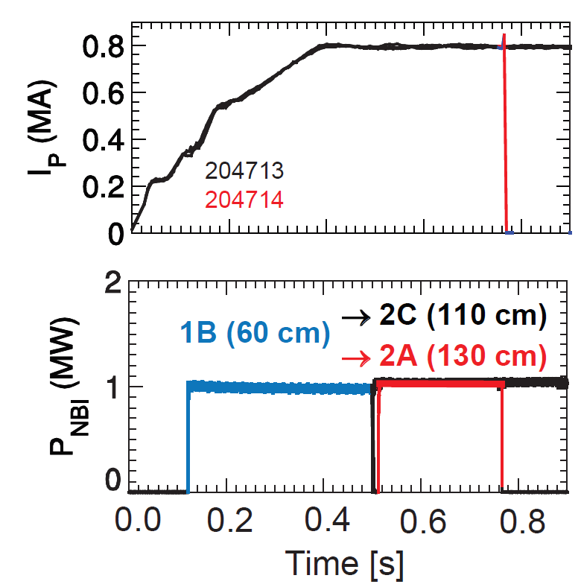
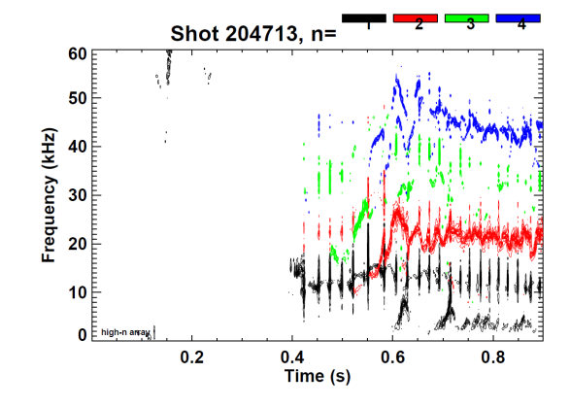
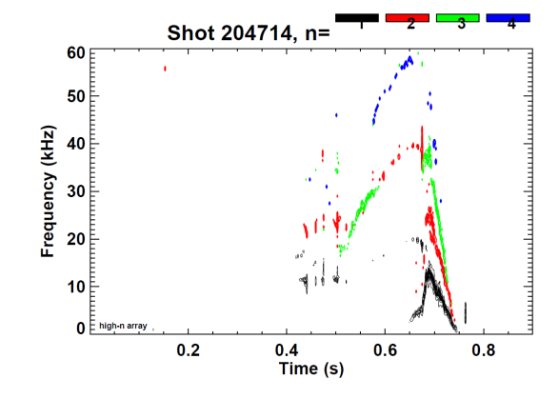
New 2nd NBI: L-mode core sawtooth and tearing dynamics change with source tangency radius
Most
on-axis
2nd NBI
Most
tangential
2nd NBI

Slide 21
Outline
Motivations for studying “spherical” tokamak (ST)
Mission elements of NSTX-U Research Program
NSTX-U research commissioning status
Key physics issues for ST
  Energy transport
  High-beta stability
  Power exhaust
  Current sustainment and start-up

Slide 22
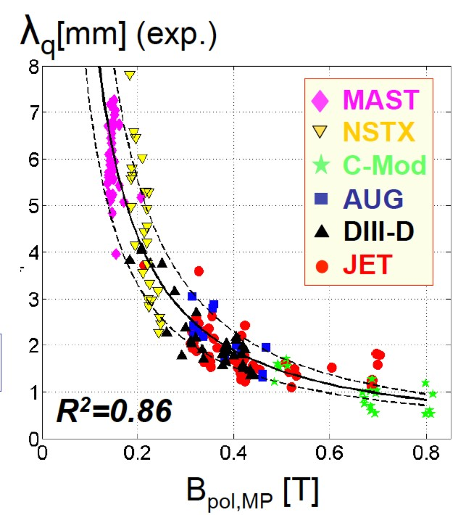
Dedicated tokamak + ST experiments found power exhaust width varies as 1 / B_{poloidal}
ST data breaks aspect ratio degeneracy of data set
Will 1/B_{poloidal} variation continue at higher I_{P}? What about detached conditions?

Slide 23
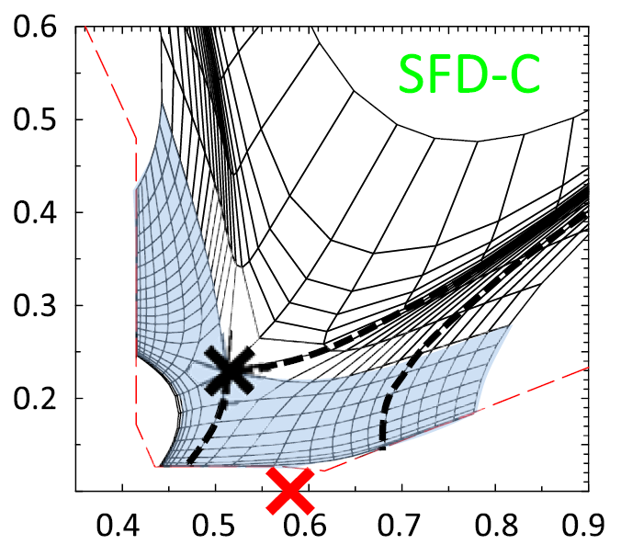
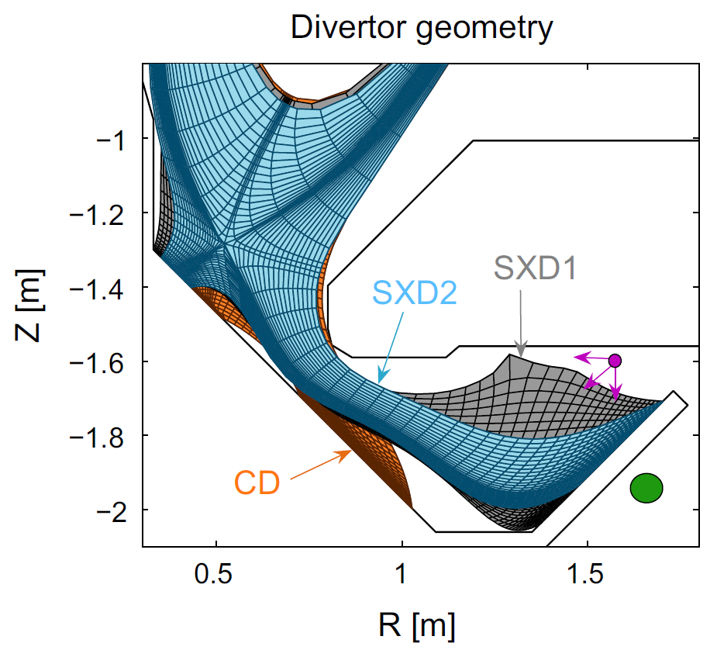
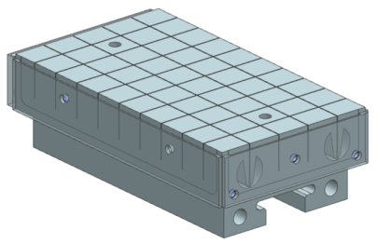
MAST-U and NSTX-U will test radiation and advanced divertors for mitigating high heat-fluxes
Assess impact of flux expansion, line length on detachment
MAST-U: Conventional (CD), Snowflake (SFD), Super-X (SXD)
NSTX-U: Snowflake (SFD) / X-D
Z [m]
R [m]
Longer-term:
  C PFCs→ Liquid Li on high-Z substrates

Slide 24
Outline
Motivations for studying “spherical” tokamak (ST)
Mission elements of NSTX-U Research Program
NSTX-U research commissioning status
Key physics issues for ST
  Energy transport
  High-beta stability
  Power exhaust
  Current sustainment and start-up

Slide 25
Steady-state operation required for ST/AT FNSF or Pilot Plant
NSTX achieved 70% “transformer-less” current drive
NSTX-U designed to achieve 100% (TRANSP):
H_{98y2}
ITER H-mode confinement scaling multiplier
I_{P}=1 MA, B_{T}=1.0 T, P_{NBI}=12.6 MW
Will NSTX-U achieve 100% as predicted by simulations?

Slide 26
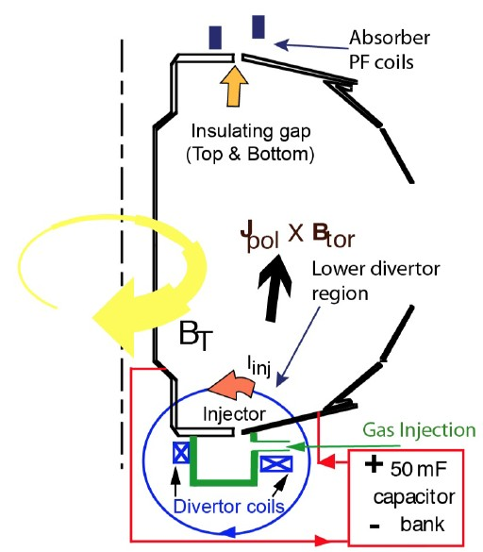
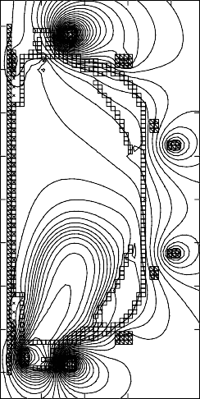
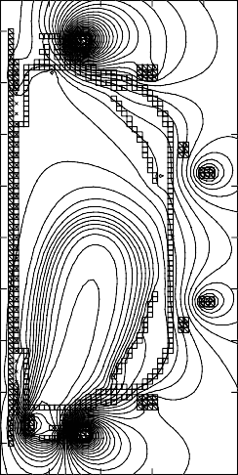
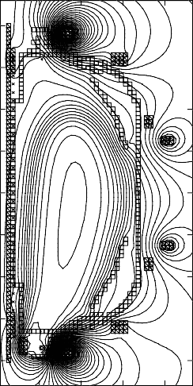
ST-FNSF may need solenoidless current start-up method
Coaxial Helicity Injection (CHI) effective for current initiation
CHI developed on HIT, HIT-II
Transferred to NSTX / NSTX-U
NSTX: 150-200kA closed flux current
NSTX-U: CHI projects to 300-400kA
FNSF: CHI blanket electrodes: 2MA
TSC axisymmetric simulation of CHI startup
1.0 ms 1.6 ms 2.7 ms
2
Z (m)
0
-2
2
0
2
0
R (m)
R (m)
0
R (m)
2
What about 3D effects?
R. Raman et al., PRL 2006

Slide 27
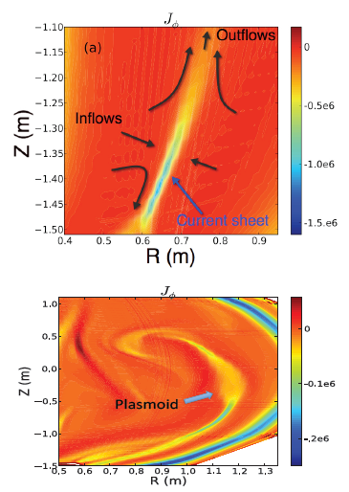
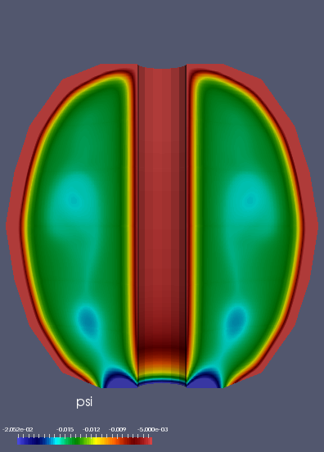
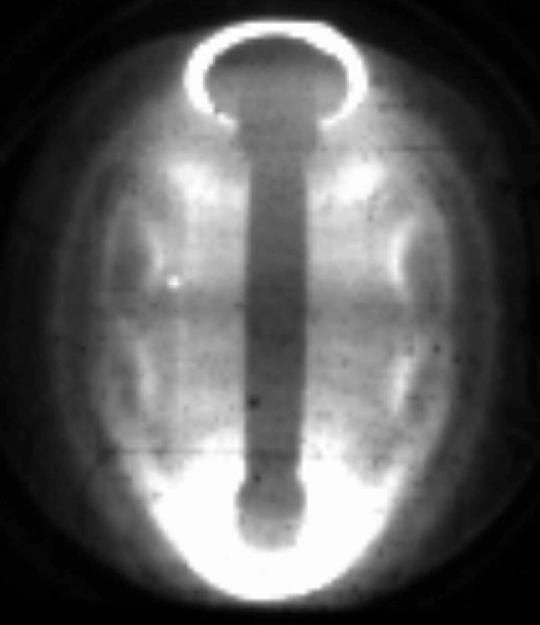
NIMROD simulations: plasmoid-mediated reconnection assists flux closure at high Lundquist number
Sweet Parker (S-P) reconnection in the injector region at low Lundquist number
E
x
p
e
r
i
m
e
n
S
i
m
u
l
atio
t
o
n
P
l
a
s
m
o
i
d
s
At high Lundquist number the S-P current sheet is plasmoid unstable
Plasmoids seen in modelling before found/observed in CHI data!
F. Ebrahimi, et al., PRL (2015)

Slide 28
Summary: ST research making leading contributions to fusion energy development
Support burning plasma research by expanding understanding of energetic particle, thermal transport
Will explore performance and implications of advanced divertor configurations, liquid metals
ST promising as Fusion Nuclear Science Facility
  High J_{WP} of HTS → enables compact lower-A Pilot Plant
NSTX-U operational now!
MAST-U first plasma next year!

Slide 29
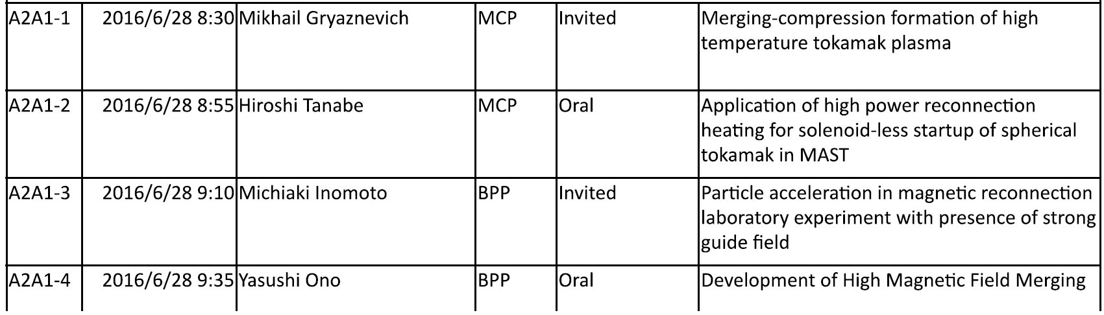
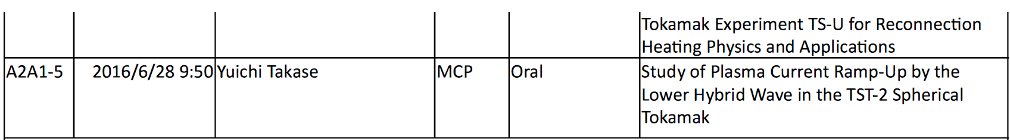
See more ST-related talks this week

Slide 30
Backup Slides - Physics

Slide 31
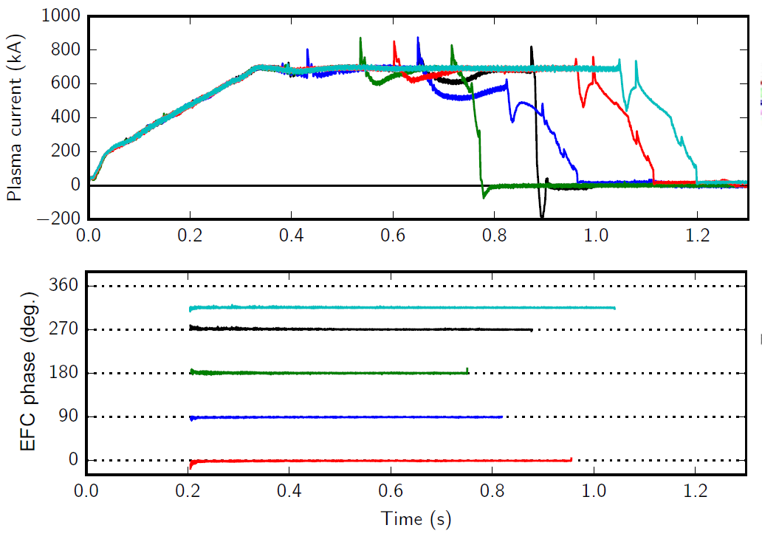
Optimal n=1 error field correction amplitude and phase identified to maximize pulse length, discharge performance
Dominant error-field source: PF5 vertical field coils
Long-pulse L-modes used to identify optimal correction amplitude, phase

Slide 32
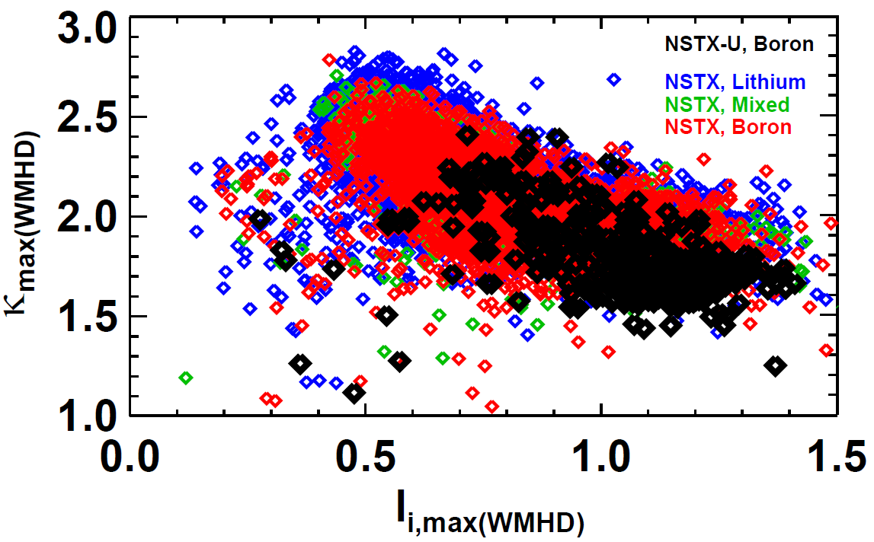
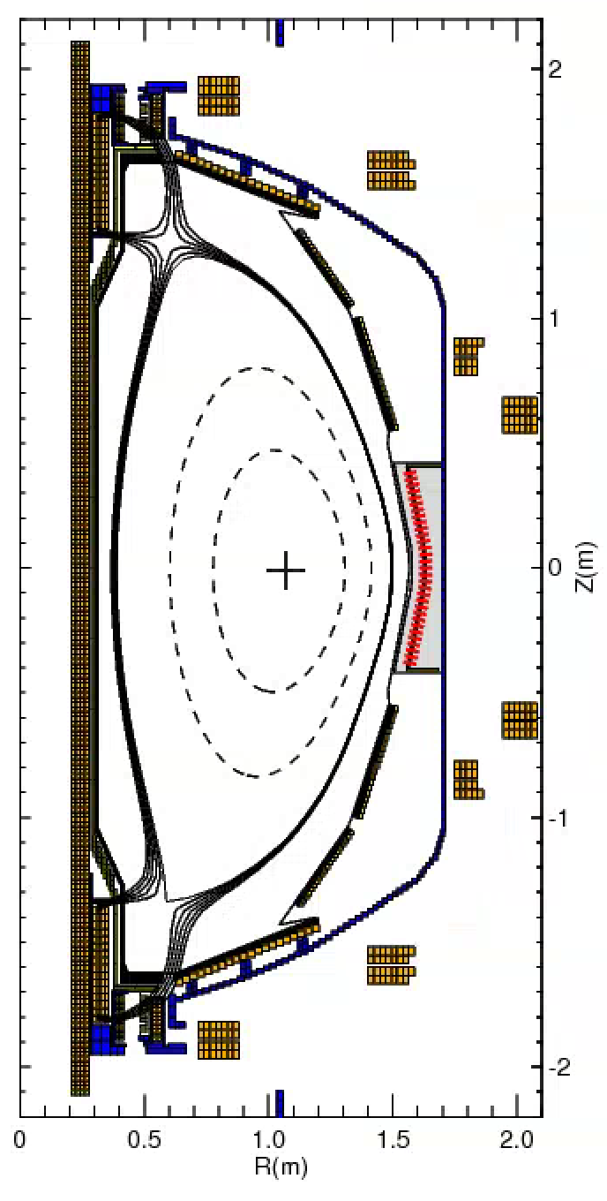
On path to high I_{P} without tearing modes by elevating q_{min} with early heating + H-mode → l_{i}=0.5-0.6, κ=2.5-2.7
Matching NSTX κ at same l_{i} but at higher A
  Real-time EFIT / ISOFLUX (GA collaboration)
  Also utilizing improved vertical motion detection

Slide 33

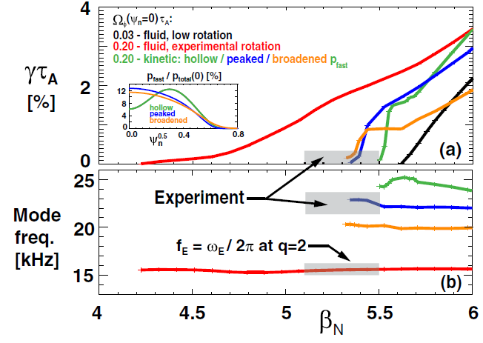
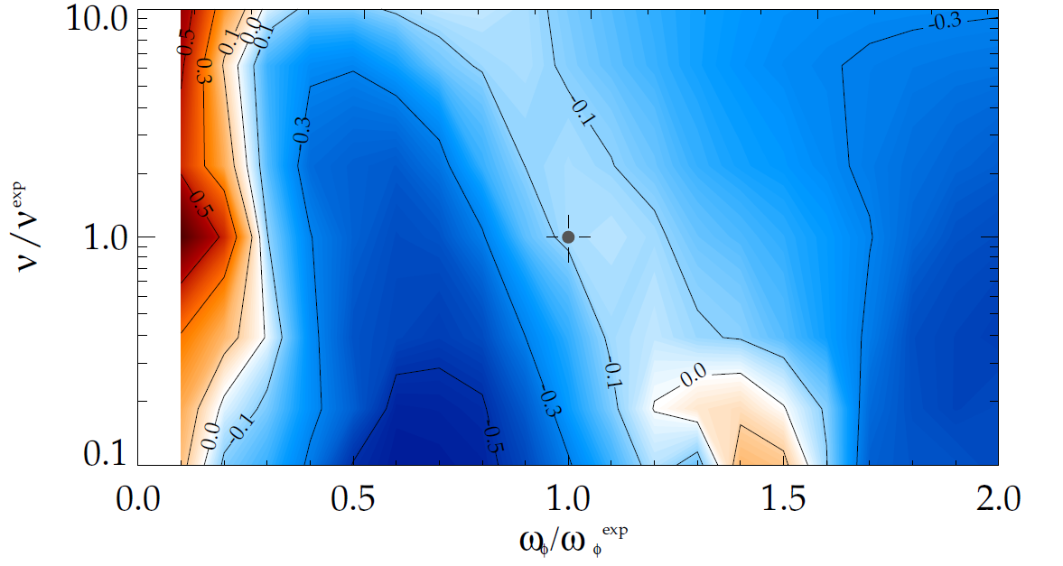
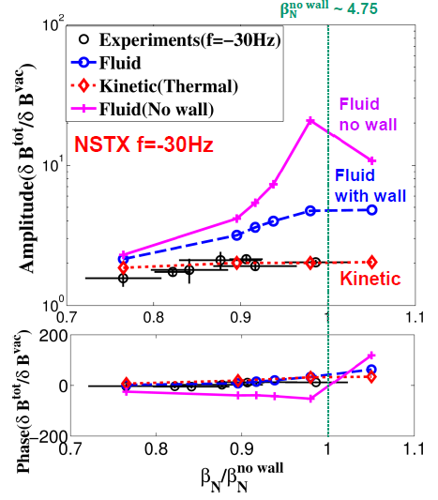
NSTX-Theory collaborations have led the advancement in kinetic global mode stability physics
RWM High-beta stability physics theory
MARS-K: Ideal wall stability (Menard)
(Betti, Berkery,
Sabbagh)
MISK: RWM High-beta stability (Berkery, Sabbagh)
Experiment
MARS-K: Resonant field amp. (Wang)
Precession drift
resonance stabilization
Marginal stability
Bounce/transit
resonance stabilization
instability
(experiment)
RWM physics with M3D-C¹ (Ferraro)
Resistive wall implemented

Slide 34
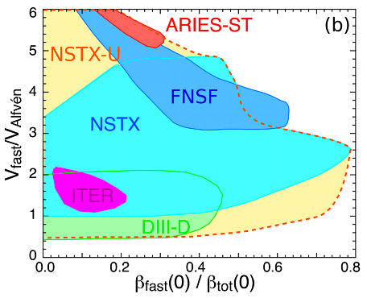
NBI-heated STs excellent testbed for α-particle physics
α-particles couple to Alfvénic modes when V_{α} > V_{Alfvén}~ β^{-0.5} C_{sound}
V_{fast} > V_{A} condition easily satisfied in high-β ST with NBI heating
NSTX-U: large fast-ion dynamic range spanning ST and conventional A
  Toroidal field 2× NSTX → V_{fast} < V_{A} → stabilize modes
  Tangential 2nd NBI → very flexible fast-ion distribution
    Vary pitch angle, pressure profile
Can we find TAE-quiescent, high-performance regimes in NSTX-U?

Slide 35
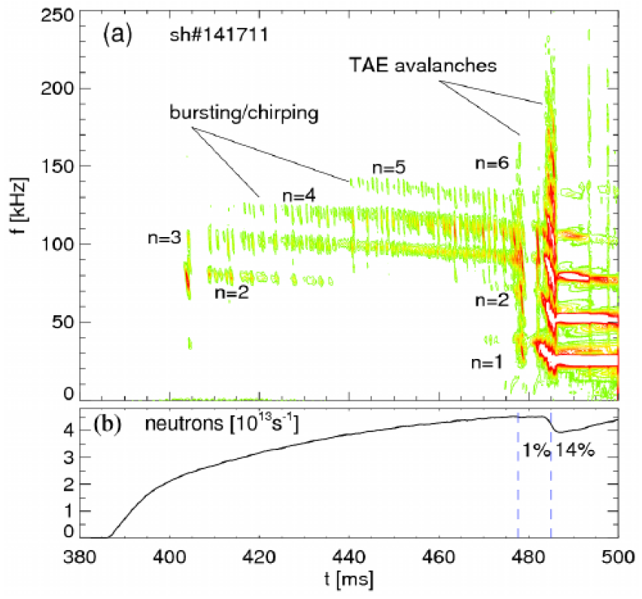
“TAE avalanche” can cause energetic particle loss
Uncontrolled α-particle loss could cause reactor first wall damage
Quasi-linear “Critical Gradient Model” (CGM) consistent with transport before avalanche
“Kick” model (ΔP_{φ} vs ΔE) predicts neutron decrement even during large avalanche events
NSTX 141711
Neutron Deficit %
Time [ms]

Slide 36
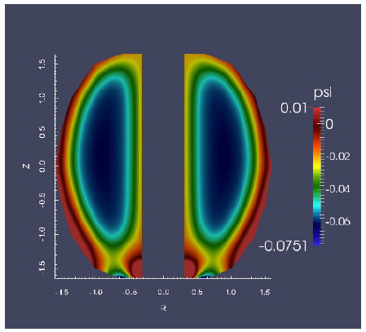
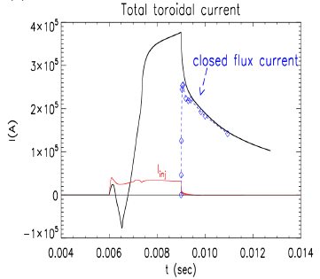
NSTX-U NIMROD projection: high fraction of open flux converted to closed flux with narrow injector flux footprint
CHI in NSTX-U configuration naturally has a narrower injector flux foot-print due to improved Injector coil positioning
Due to higher Lundquist number in NSTX-U CHI simulations, closed flux surfaces form even during the actively injected phase
NIMROD Simulations
F. Ebrahimi, et al., accepted in NF Letters

Slide 37
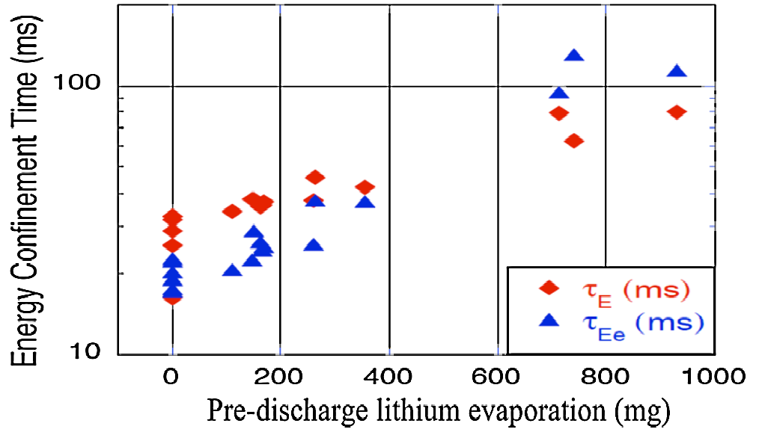
Plasma confinement increased continuously with increasing Li coatings in NSTX – what is limit?
Global parameters improve
  H_{98y2} increases ~0.9 → 1.4
  No core Li accumulation
High H critical for compact FNSF / Pilot Plants
Energy Confinement Time (ms)
Pre-discharge lithium evaporation (mg)
R. Maingi, et al., PRL 107 (2011) 145004
NSTX-U will double Li-wall coverage with upward evaporators
Will further assess contributors to confinement improvement:
  Lower-recycling / reduced neutral source / higher T_{e}
  Edge profile / turbulence changes
  Influence of (low-Z) impurities in pedestal region

Slide 38
NSTX-U boundary / PFC plan: add divertor cryo-pump, transition to high-Z wall, study flowing liquid metal PFCs
5yr goal: Integrate high τ_{E} and β_{T} with 100% non-inductive
10yr goal: Assess compatibility with high-Z & liquid lithium PFCs
2016
2017-18
2018-19
2020-21
2022-23
High-Z tile row
All high-Z FW +
divertors
+ flowing LLD
module
Cryo + full lower outboard high-Z divertor
Cryo + high-Z FW
B+C BN
Li High-Z
Lower OBD
high-Z row of tiles
and OBD
+ liquid Li divertor (LLD)
Downward Li evaporator +
Li granule injector
High-Z tile row
Up + downward Li evaporator, possible pre-filled Li tiles (FY18)
Heatable high-Z PFCs for liquid Li (including pre-filled)
Cryo-pump
or
Flowing Li module (Concept, location, size TBD)
See Maingi, Jaworski talks for more details

Slide 39
Backup Slides – Cu TF FNSF

Slide 40
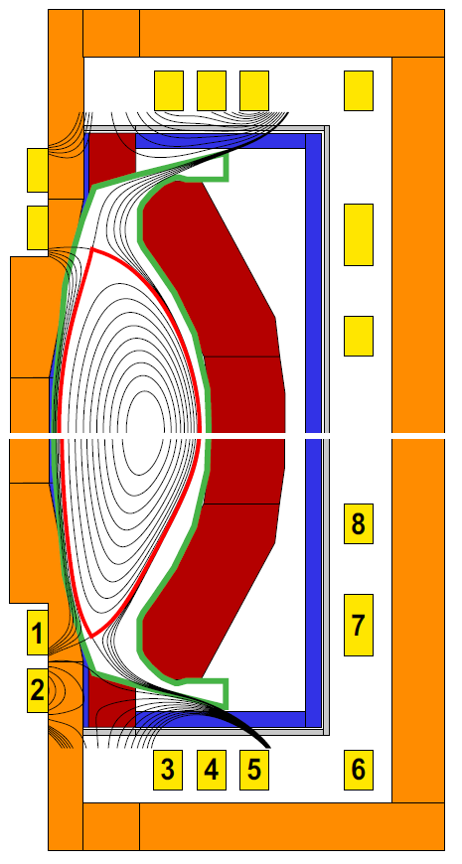
Identified self-consistent configuration for power exhaust, equilibrium flexibility, breeding, maintenance
Components:
TF coil
PF coil
Vessel
Shield
Blanket
κ = 2.55, l_{i} = 0.82
All equilibrium PF coils outside vacuum vessel
Increased strike-point radius reduces B, q||
Strike-point PFCs also shielded by blankets
2nd X-point increases SOL line-length
PF coil set supports wide range of l_{i}: 0.4-0.8
  Elongation and squareness change with l_{i} variation
  Fixed strike-point R, controllable B angle of incidence (0.5-5˚)
No central solenoid in this design
Divertor coils in TF coil ends for equilibrium, high δ
Breeding at top/bottom important for maximizing TBR
κ = 3.0, l_{i} = 0.40

Slide 41
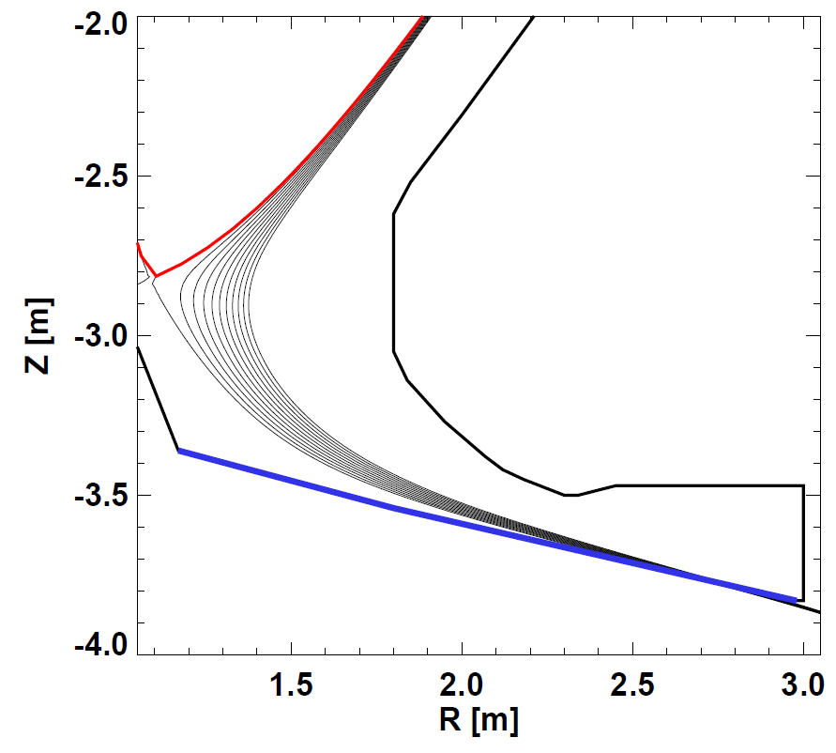



Long-leg divertor reduces heat flux 3×to ~10MW/m²
Also promotes detachment → additional 5-10×reduction
λ_{q-int} = 2mm, 4mm
SOLPS
J. Canik
Peak q⊥ < 10MW/m²

Slide 42

Used free-boundary TRANSP/NUBEAM to specify NBI and simulate 100% non-inductive plasmas with Q_{DT} ~2
Neoclassical χ_{ion}
n_{e} / n_{Greenwald} = 0.7
H_{98,y2} = 1.4
I_{P} = 8.9MA, B_{T} = 2.9T
f_{NICD} = 100%, f_{BS} = 65%
P_{NNBI} = 80MW (0.5MeV)
P_{fus} = 200MW (50-50 DT)
  2.6% alpha bad orbit loss
Q_{DT} = 2.5
β_{N} = 5.5, W_{tot} = 58MJ
  W_{fast} / W_{tot} = 14%
Maintain q_{min} > 2, q(0) / q_{min} controllable via R_{tan} and density

Slide 43

Developed detailed CAD models for 2 different sizes
(R = 1m and 1.7m – most analysis done for R=1.7m configuration)
Design features
Vertical maintenance
TF coils
Cu/SC PF coils housed in VV upper lid
SC PF coils pairs located in common cryostat
VV outer shell w/ shield material
Cu/SC PF coils housed in VV lower shell structure
Ports for TBM, MTM, NBI
Blankets
TF leads
Angled DCLL concentric lines to external header

Slide 44


Conformal blankets + breeding at top/bottom important for tritium breeding ratio TBR ~ 1
ΔTBR = +0.07
0.0004
0.034
R=1.7m configuration
Inner Blanket Segment = 0.81
Outer Blanket Segment = 0.15
Total TBR ~ 1.03 with no penetrations or ports
(heterogenous outboard blanket)
0.034
0.0004

Slide 45






Quantified impact of TBM, MTM, NBI ports on TBR
No ports or penetrations,
homogeneous breeding zones:
TBR = 1.03
Add 4 Test Blanket
Modules (TBMs)
TBR = 1.02 (ΔTBR = -0.01)
TBM
LiPb,
cooling channel,
FCI
Approx. ΔTBR per port:
TBM: -0.25%
MTM: -2.0%
NBI: -0.75%
MTM
Ferritic Steel
1 Materials Test Module (MTM)
TBR = 1.01 (ΔTBR = -0.02)
4 TBM + 1 MTM + 4 NBI
TBR = 0.97

Slide 46



Find R ≥ 1.7m necessary for TBR ≥ 1 at A=1.7
R=1.7m: TBR ≥ 1
R=1.0m: TBR < 1 (≈ 0.9)
TBM
NBI
NBI
TBM
MTM
1m device cannot achieve TBR > 1 even with design changes
Solution: purchase ~0.4-0.55kg of T/FPY from outside sources at $30-100k/g of T, costing $12-55M/FPY
MTM

Slide 47





FNSF center-stack can build upon NSTX-U design and incorporate NSTX stability results
Like NSTX-U, use TF wedge segments (but brazed/pressed-fit together)
  Coolant paths: gun-drilled holes or grooves in side of wedges + welded tube
Bitter-plate divertor PF magnets in ends of TF achieve high triangularity
  NSTX data: High δ > 0.55 and shaping S ≡ q₉₅I_{P}/aB_{T} > 25 minimizes disruptivity
  Neutronics: MgO insulation can withstand lifetime (6 FPY) radiation dose

Slide 48




Bitter coil insert for divertor coils in ends of TF
Insulator
Glidcop plates

Slide 49


MgO insulation appears to have good radiation resistance for divertor PF coils

Slide 50

R=1.7m ST-FNS facility layout
using an extended ITER building
TF center-stack
Upper TF horizontal legs
Full blanket assembly
Upper dome structure located on test cell shield plug
VV lid / PF cryostat enclosure
TF power supplies
JT-60SA NNBI

Slide 51
Backup Slides – HTS TF FNSF

Slide 52
What is optimal A for HTS FNSF / Pilot Plant?
P_{fus} / V ~ ε(β_{N} κ B_{T} )⁴ at fixed bootstrap fraction
β_{N} and κ increase at lower aspect ratio
B_{T} decreases at lower A – depends strongly on:
  Inboard shielding, HTS allowable field and current density
Approach:
Fix plasma major radius and heating power (50MW)
  R₀ = 3m – smallest size for Q_{eng} > 1 and high fluence
Apply magnet & plasma constraints (see backup)
  HTS strain: 0.3%, β_{N}: n=1 no-wall, κ: 0.95×limit, f_{GW} = 0.8
Vary aspect ratio from A = 1.6 to 4
Vary HTS current density, peak field
  Also scan inboard shielding thickness (not shown)
Compute Q_{DT}, Q_{eng}, and required H₉₈ (unconstrained)

Slide 53
Engineering constraints
Magnet constraints
  Maximum stress in TF magnet structure = 0.66 GPa
  HTS tape/cable strain limit 0.3% (equivalent to 0.4 GPa)
  Winding pack current density (CORC 2015) 70 MA/m²
  OH at small R → higher solenoid flux swing for higher A
Shielding / blankets
  HTS fluence limit: 3.5x10²² n/m²
  Shield:10x n-shielding factor per 15-16cm WC for HTS TF
  Include inboard & outboard breeder thickness for TBR ~ 1
    “Effective shield thickness” includes shield + DCLL blanket
Electrical system efficiency assumptions:
  30% wall plug efficiency for H&CD - typical of NNBI
  ≥ 45% thermal conversion efficiency - typical of DCLL
    Also include pumping, controls, other sub-systems
    See Pilot Plant NF 2011 paper for more details

Slide 54


Aspect ratio dependence of limits: κ(ε), β_{N}(ε)
Pilot study uses 0.95×κ value shown here:
NSTX data at low-A
  Also NSTX-U/ST-FNSF modelling
DIII-D, ARIES-AT for higher A
  κ → 1.9 for A → ∞
Profile-optimized no-wall stability limit at f_{BS} ≈ 50%
  Menard PoP 2004
β_{N} → 3.1 for A → ∞
β_{T} ∝ A^{-1/2} (1+κ²) β_{N}² / f_{BS}
→ P_{fus} ∝ ε [κ(ε) β_{N}(ε) B_{T}(ε)]⁴
ε = A⁻¹

Slide 55



Simplified TF magnet design equations
From J. Schwartz, Journal of Fusion Energy, Vol. 11, No. 1, 1992

Slide 56

A=2, R₀ = 3m device TF inboard leg showing
allocated space for case and winding
Current per coil: 6 MA
Winding Cd: 35.9 MA/m²
0.167 m² winding area

Slide 57


CORC Conductor – Achieved now
857 turns @ 7 kA
(848 turns shown; a few additional turns required)
10 mm
10 mm
6 mm
Base Conductor – Helium Gas Cooled
7 mm
Copper
7 mm
750 turns @ 8 kA
(750 turns shown)
SS conductor jacket for strength

Slide 58


HTS performance vs. field and fast neutron fluence

Slide 59



Neutronics analysis for HTS TF shielding

Slide 60

Breeding blanket thickness model

Slide 61
High TF winding-pack current density required to access highest B_{T} at lower A
19T: Present CORC HTS limit
J_{WP} [MA/m²]
12T: ITER-like TF coil limit
(Nb₃Sn, 11.8T)
Coil structure sized to maintain ≤ 0.3% strain on winding pack for all cases shown here

Slide 62




A ≥ 2 pilot plant scenarios have elevated H > 1, f_{BS} ~ 80%, I_{P} = 6-12MA
J_{WP} [MA/m²]

Slide 63

A=2, R₀ = 3m HTS-TF FNSF / Pilot Plant
B_{T} = 4T, I_{P} = 12.5MA
κ = 2.5, δ = 0.55
β_{N} = 4.2, β_{T} = 9%
H₉₈ = 1.8, H_{Petty-08} = 1.3
f_{gw} = 0.80, f_{BS} = 0.76
Startup I_{P} (OH) ~ 2MA
J_{WP} = 70MA/m²
B_{T-max} = 17.5T
No joints in TF
Vertical maintenance
P_{fusion} = 520 MW
P_{NBI} = 50 MW, E_{NBI} = 0.5MeV
Q_{DT} = 10.4
Q_{eng} = 1.35
P_{net} = 73 MW
⟨W_{n}⟩ = 1.3 MW/m²
Peak n-flux = 2.4 MW/m²
Peak n-fluence = 7 MWy/m²
Cryostat volume ~ 1/3 of ITER

Slide 64


Breeding calculations nearly complete for A=2
Outboard TBR ~ 0.92
Step 1- Infinite media of LiPb
Step 2- LiPb confined to OB FW/blanket
Step 3- Assembly gaps added
Step 4- Homogeneous mixture of blanket in upper and lower ends of OB blanket
Step 5- FW material added
Step 6- Side, back, and front walls added
Step 7- Cooling channels added
Step 8- SiC FCI added
Step 9- Stabilizing shells added
Step 10- MTM only inserted (TBR relative to Step #9)
Step 11- 4 TBMs only inserted (TBR relative to Step #9)
Step 12- 4 NBIs only inserted (TBR relative to Step #9)
Step 13- all MTM, 4 TBMs, and 4 NBIs inserted
Step 14 – include inboard breeding blanket
Ongoing: Thin inboard blanket (10 cm) should provide TBR > 1

Slide 65


Exploring liquid metal divertor design similar to flowing water curtain systems
LM injector system can be assembled in a single or double unit
LM containment structure
Shield block
Ferritic steel backing plate

Slide 66


HTS ST-FNSF design with Li flow on divertor and inboard surfaces
Double null liquid metal divertor system
Li flows from upper divertor down the inboard wall, exiting just after the lower inboard divertor.
Separate Li cooling of lower divertor

Slide 67


Another option: Li divertor with shorter outer leg
P_{div} = 9 → 21MW/m² for R_{strike} = 4.2m → 2.5m
Long-leg / Super-X
Shorter leg LM divertor
Geometry also compatible with
“vapor box” concepts (Ono / Goldston)

Slide 68


Benefits of shorter-leg LM high-heat-flux divertor:
Significantly reduce outboard PF coil current
  Reduced PF size, force, structure
Eliminate separate upper cryo-stat (for PF5U)
4
5
3
2
6
1
7
8
Li wall pumping could help increase H (see Maingi talk)

