Slide 1

Liquid Lithium Applications for Solving Challenging Fusion Reactor Issues and NSTX-U Contributions
Masa Ono, M. Jaworski, R. Kaita, T. K. Gray,
Y. Hirooka and the NSTX-U research team
ISLA-4, Granada, Spain
September 28 – 30, 2015

Slide 2
Outline
Introduction – Lithium can improve plasma performance but may solve some of the reactor technology challenges
Compatibility of lithium with reactor
Three major fusion reactor technology issues:
  Solving divertor heat flux issue. Basic idea of the radiative liquid lithium divertor concept
  Dust generation - lithium loop
  Controlling tritium inventory issue – cold trap
Summary

Slide 3
Lithium Improves H-mode Performance via Strong Pumping
Yet, lithium does not appear to contaminate the plasma core
• NSTX tested applications of lithium in diverted H-mode tokamak configuration:
  Electron energy confinement improvement for improved plasma performance (see for example R. Maingi at this symposium)
  Broader pressure and current profile for improved MHD stability
  ELM control through edge electron pressure profile modification
  Reduction in H-mode power threshold
  Lower edge density and impurity control benefited rf heating and non-inductive tokamak start-up
  Lithium is an effective hydrogen/deuterium pump
  Very low lithium core dilution even with heavy lithium divertor application*
  Lithium improved NSTX operational efficiencies
NSTX experimental results suggest potential benefits for near-term and longer term tokamak/ST fusion development path.

Slide 4
Divertor heat load is very challenging for fusion reactors: steady-state as well as transient ones
• Unmitigated steady-state heat flux may exceed 40 MW/m² in ITER size 1GW-e power plant.
• Unmitigated ELM heat flux could reach 1 GW/m².
• Divertor PFCs can be only serviced maybe only once a year or two…
• No solution exists for solid metal PFCs which continuously erode, deteriorate, and even melt…
• Liquid lithium PFCs looks attractive due to renewable surfaces and tolerance to transient events.
Notes:
----- Meeting Notes (11/23/12 09:49) -----
1.0

Slide 5
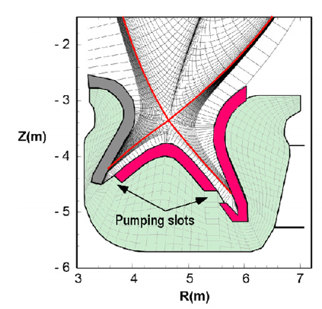
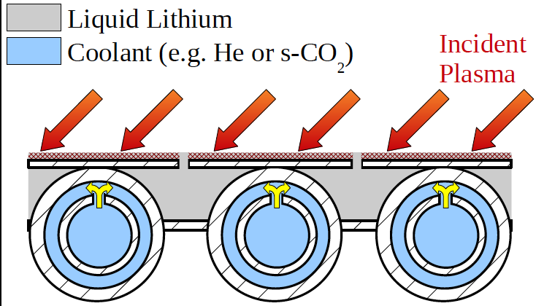
Steady state surface heat removal maybe limited to
~ 5 MW/m² : solid or liquid metal PFCs….
• Solid-based divertor PFC steady-state heat handling capability maybe limited to ~ 5 MW/m² for < 1200°C PFC temperature with >300 °C cooling temperature.
Tobita K. et al 2009 Nucl. Fusion 49 075029
• Even liquid lithium based PFCs may be challenging handle steady-state ~ 5 MW/m² to keep PFC surface temperature to ≤ 500 °C.
M. Jowarski et al., at ISLA-3
Need to handle high heat flux > 5 MW/m² volumetrically
Notes:
----- Meeting Notes (11/23/12 09:49) -----
1.0

Slide 6
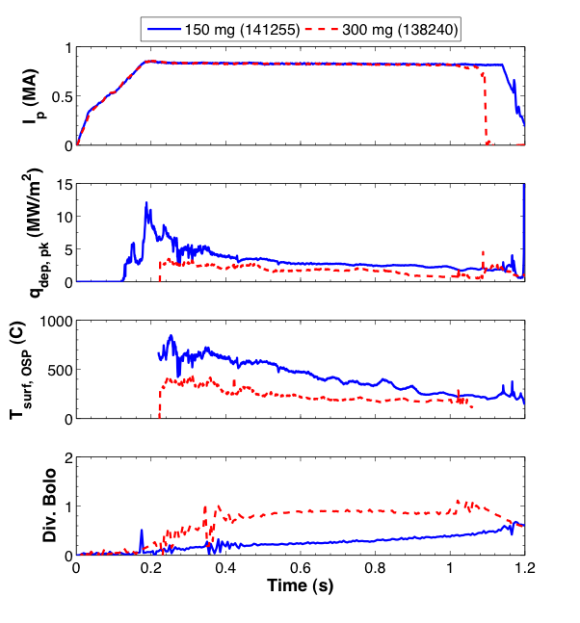
Clear reduction in NSTX divertor surface temperature and heat flux with increased lithium evaporation
2 identical shots (No ELMs)
  I_{p} = 0.8 MA, P_{nbi} ~ 4 MW
  high δ, f_{exp} ~ 20
2, pre-discharge lithium depositions
  150 mg: 141255
  300 mg: 138240
T_{surf} at the outer strike point stays below 400° C for 300 mg of Li
  Peaks around 800° C for 150 mg
Results in a heat flux that never peaks above 3 MW/m² with heavy lithium evaporation
No LLD surface damage observed
a)
b)
Lithiated graphite
c)
d)
H. Kugel FE&D 2012
NSTX-U can perform detailed assessment of Li radiation with LITER
T. Gray NF 2014
Notes:
9.0

Slide 7
Lithium Provides Several Layers of Protection
Vaporization, Ionization, Radiation
Power and particle flux
Divertor
Entrance
This talk emphasis
Li Injection (ARLLD)
~ 100 MJ/mole
T.D. Rognlien et al., PoP 2002
Divertor side wall
Li Radiative Cooling (RLLD)
~ 100 MJ/mole
Radial Transport
Charge Exchange Loss
Li Ionization
1st ionization – 0.5 MJ /mole
2nd ionization – 7.3 MJ /mole
3rd ionization – 11.8 MJ /mole
Li Vapor Shielding
M. Jaworski
Li Vaporization (150 kJ mole)
LLD Tray
T. Abram
F. Scotti, V.A. Soukhanovskii, et al., NF 2013

Slide 8
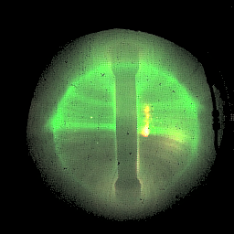
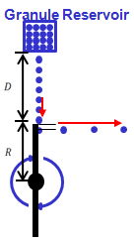
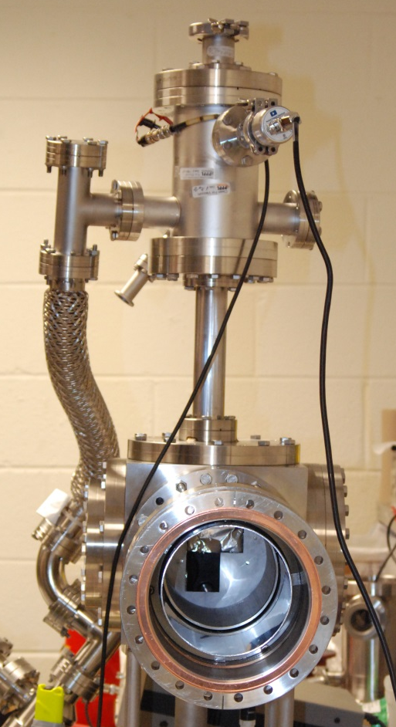
Active Injection of LL as First Line of Defense
Li injection as needed via feed-back control
Li Aerosol in NSTX
Lithium aerosol is introduced by a “droper” at the plasma edge and the ionized lithium tends to flow toward the divertor plate along the field line.
Power and particle flux
Divertor
Entrance
Li Injection
Divertor side wall
Cs/2
Li ionized with Z = 2 and flows toward divertor at Cs/2*.
D. Mansfield FE&D 2010
Li Radiative Mantle
Li granular injector for NSTX-U
R. Lunsford at this symposium
RLLD Tray
*R. Goldston NF 2012
Li granular injector on NSTX-U will provide important data on ARLLD.

Slide 9
Strong (~x100) Li Radiation Level Over Coronal Eq.
Low particle confinement could increase radiation in divertor
Assumed radiation level in the modeling calculation for RLLD
Radiation ~ N-Li/τ, N-Li~ Li-inj τ Radiation ~ Li-inj
~ 100 MJ/mole
Divertor Heat and Particle Flux
τ ~ 100 μs
Li paths
Coronal-Equilibrium Value
LLD Tray
The Li radiation power per one atom and one electron in coronal-quilibrium (n_{e}t = infinity) and non-equilibrium regimes.
S. V. Mirnov, et al., Plasma Phys. Control. Fusion (2006)
Notes:
11:00

Slide 10
Radiative Liquid Lithium Divertor Proposed
Handle divertor heat load volumetrically (3D vs 2D)
RLLD / ARLLD: Lithium provides low recycling radiative divertor
Divertor Heat and Particles Flux
B₀
Liquid Lithium (LL)
~ 1 l/sec for pumping / dust removal
Particle pumping by Li coated wall
Active LL Injection (ARLLD)
~ few mole/sec
Flowing LL Particle Pumping Surfaces
Li⁺⁺⁺
Y. Hirooka at this conference
Li Radiative Mantle
Li⁺⁺
Li wall coating /condensation
Heat Exchanger
Li⁺
Li path
Li Evap. / Ionization (RLLD)
~ few mole/sec
Li⁰
Divertor Strike Point
Reduced Divertor Heat and Particle Flux
LL Purification System to remove tritium, impurities, and dust
M. Ono NF 2013, FE&D 2014
Notes:
16:00

Slide 11
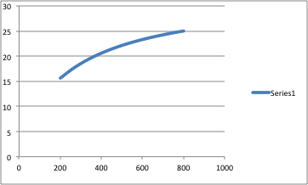
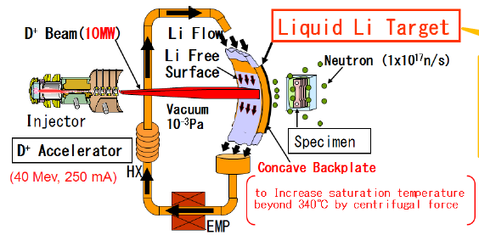
Concerns for lithium in reactor application
Lithium evaporation is too high in reactor PFC temperatures of ~ 600 °C. LL needs to be ≤ 450°C.
Lithium can trap tritium and make the tritium inventory issues worse.
Lithium is volatile and unsafe.
Lithium is corrosive.
Log N-Li / m²-s
Lithium Evaporation Rate
LL operating range
Reactor FW temperature
LL Surface Temp (°C)
IFMIF : International Fusion Materials Irradiation Facility
H. Kondo, et al., , FE&D (2012)
Notes:
----- Meeting Notes (11/23/12 09:49) -----
1.0

Slide 12
Compatibility with liquid lithium with a hot reactor first wall?
RLLD configuration permits operation at lower T < 450 °C
High Temperature First Wall:
High electrical conversion
Cleaner wall – lower T inventory
There are ideas to use lithium for the first all….
Lower RLLD Operating Temperature:
Prevents excessive Li vaporization pressure.
Cooler divertor provides natural collection (pumping) surfaces for entire reactor chamber.
May permit use of iron based material for substrates and structural material.
Reduces Li corrosive issues.
Provides safer LL utilization.
Edge Plasma
000000000000
Core Reacting
Plasma
First Wall / Blanket
At 500°C – 700°C
Scrape Off Layer
Closed RLLD
Flowing LLD Tray
200 – 500 °C
LL In
LL Out
LL In
Notes:
21:00

Slide 13
Liquid lithium could also solve long-standing fusion reactor technology challenges – dust generation and T inventory
Erosion / redeposition from plasma sputtering and disruptions, including dust and flake generation.
Tritium retention and removal. Dust could further aggravate tritium inventory issues.
*G. Federici, C. H. Skinner, et al., NF 􏰀2001􏰁
.
Solution: Liquid lithium loop?!
M. Jaworki , et al., , for NSTX-U at this symposium
 | IFMIF/EVEDA | RLLD Loop
Total LL amount | 2.5 t | 0.5 t
Flow rate | 50 l/s | < 1 l/s
Operation | 25 days | Steady-state
T/Impurity | < 0.01% | <1%
Li target under the IFMIF conditions (15 m/s, 10⁻³ Pa, 250 °C)
H. Kondo, et al., , FE&D (2014)
Notes:
----- Meeting Notes (11/23/12 09:49) -----
1.0

Slide 14
Dust Generation Likely a Serious Issue for Reactor
However, nature and quantity of dust generation unknown
Divertor Heat and Particle Flux
Dust/particle filters are located below divertor and dust are carried to filter by gravity action.
Back to RLLD/ARLLD
Tritium/impurity removal loop
LL
Circulation
Pump
LL 1 l/s
Dust / particle
filter
Purified LL
• Each dust/particle filters when fulll, drained of LL and removed.
• Removed filter processed to recover trapped tritium.
Notes:
19.00

Slide 15
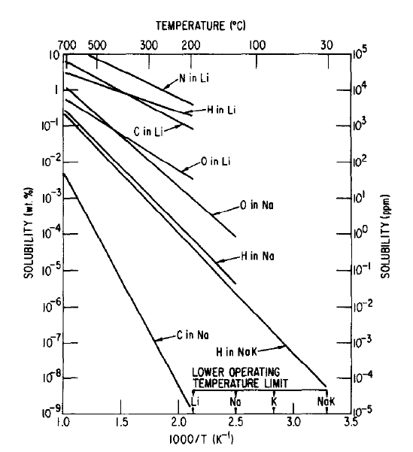
Cold Trap Could Remove T, D, H, and O
Cold trap can be regenerated at higher temperatures
Nearly ~ 10 in solubility
K. Natesan, JNM 1983
• At 200 °C, hydrogen can be reduced toward 0.1% level.
• Oxygen is also effectively reduced with cold trap.
• Nitrogen would require separate hot nitrogen trap.
Notes:
19.00

Slide 16
Realtime Tritium Recovery Needed
~ 0.5 g/sec of tritium must be recovered in real time
T – 0.5 g/s
Tritium Recycling
0.1 l/sec of 1% T LL can carry 0.5 g/s of T
1% T
From dust/particle filter loop
T, D, H, O
Tritium
Separater
Deuterium &
Other impurities as well as dust
200°C
LL
Cold Trap
LL
Cold Trap
Parallel paths to enable regeneration while operation.
Drain liquid lithium before regeneration.
Multiple filters to enable regeneration.
0.1% T
To RLLD/ARLLD
Valves and pumps not shown
Notes:
19.00

Slide 17
Tritium Inventory Control in Fusion Power Plant
Total site inventory maybe ~ 50 days or ~ 20 kg? *
• 1 % (by weight) tritium concentration LL contains ~ 5 g of T / l
• LL inside VV may contain 100 l of LL or 0.5 kg for RLLD/ARLLD
• LL in LL-loop before and in cold traps (~ 1%) may contain 500 l of LL or 2.5 kg
• LL after cold traps (~ 0.1%) may contain 500 l of LL or 0.25kg
• Total tritium inventory in RLLD/ALLD may contains 3.25 kg of T which is about 8 days << 50 days.
LL system may be compatible with the fusion reactor power plant tritium inventory requirements
*M. Nishikawa FST 2010
Notes:
19.00

Slide 18
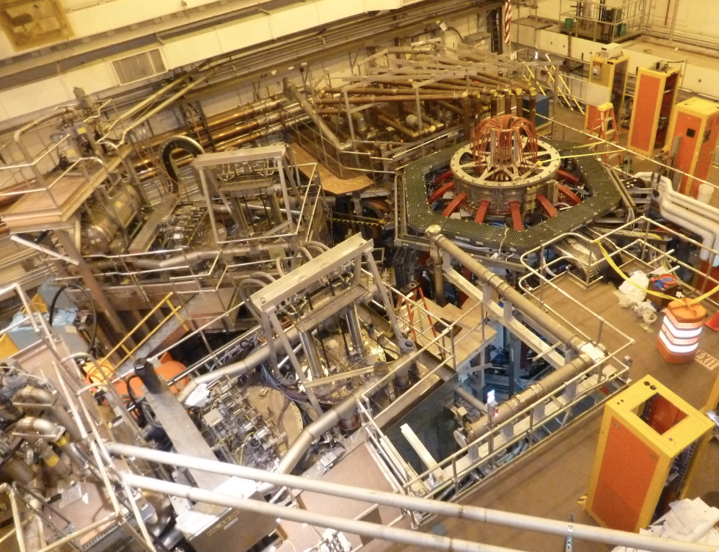
NSTX-U Construction complete
First Plasma on August 10, 2015
HHFW System
NSTX-U
1st NBI
2nd NBI
MPTS Exit Flight Tube

Slide 19
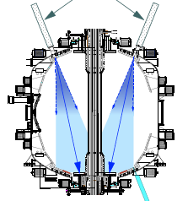
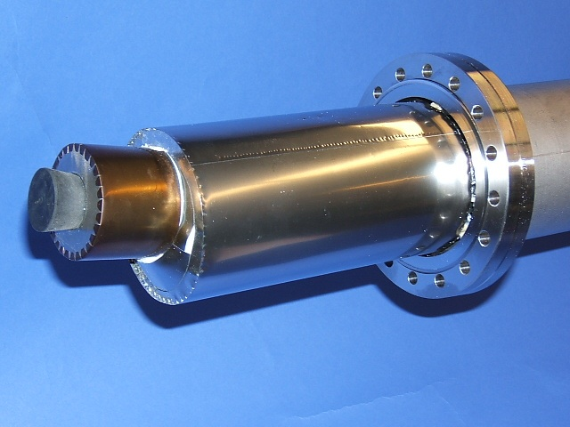
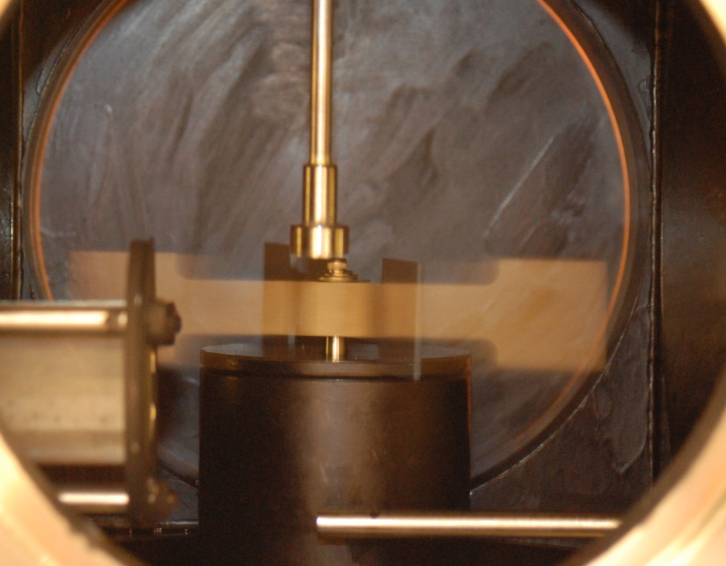
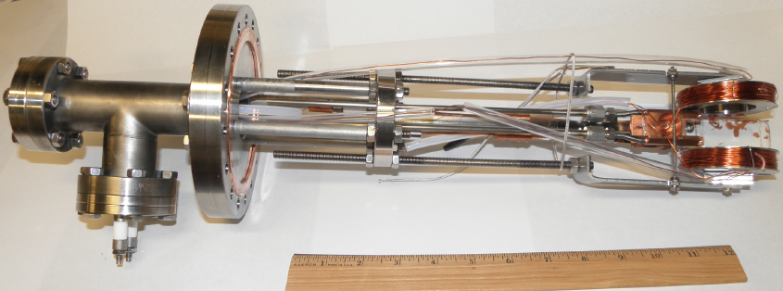
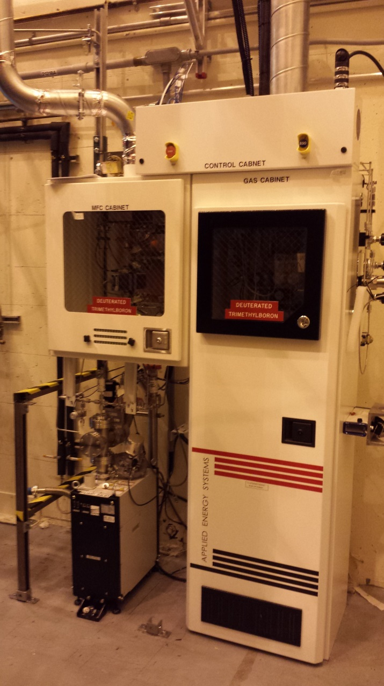
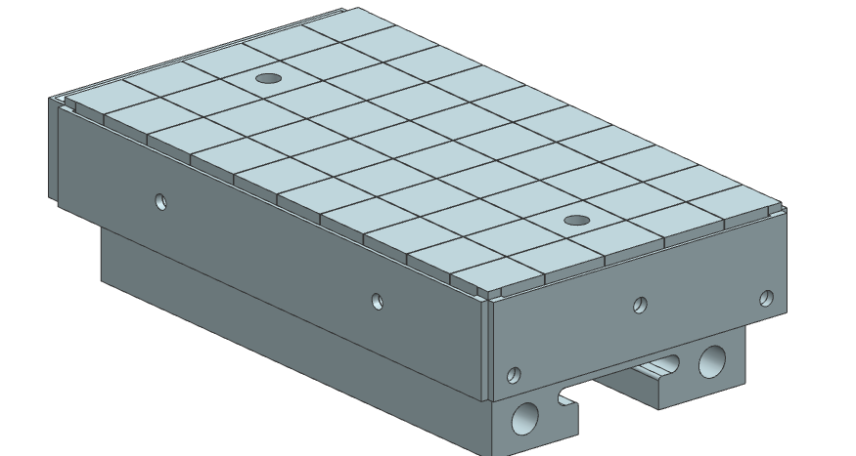
Comprehensive Lithium / Boundary Physics Tools
Boronization, Lithium Evaporators, Granule Injector, High Z tiles
Lithium Evaporator (LITERs)
Granule injector (GI) for ELM pacing
LITERs
Successfully tested
on EAST and DIII-D
Granules: Li, B₄C, C
f ~ up to 500 Hz
Granular Reservoir
Upward Li evaporator
FY 2016
Rotating Impeller
crucible
Boronization System
Electron beam for flash evaporation
High Z Tiles
FY 2016
dTMB Gas Cabinet.
Castellations
T-bar mount

Slide 20
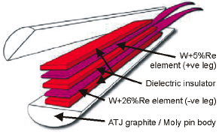
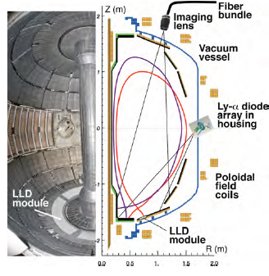
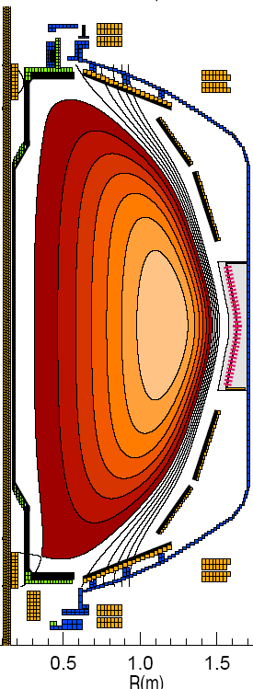
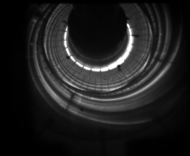
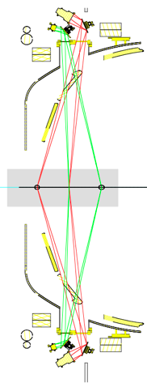
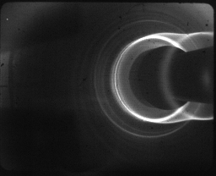
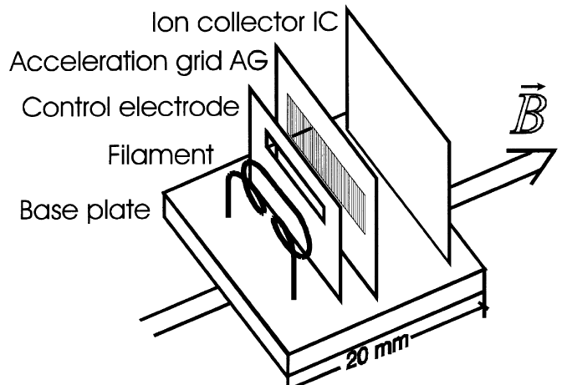
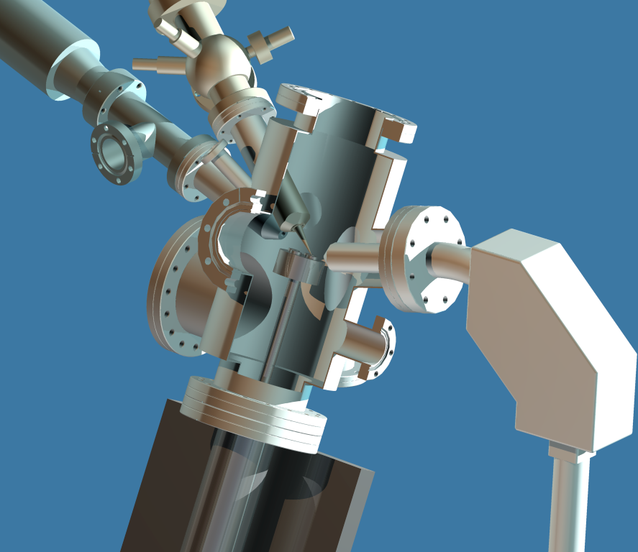
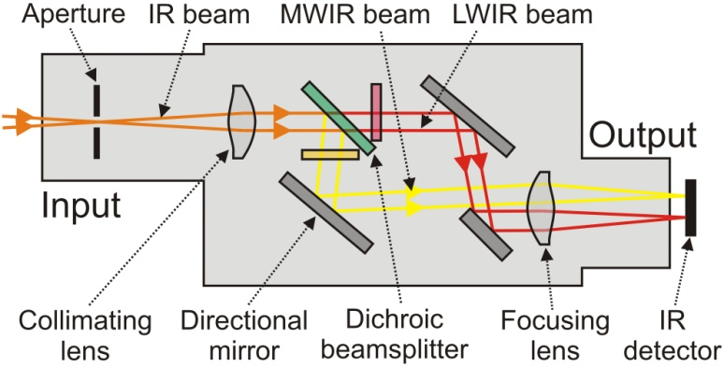
Enhanced Capability for Lithium / PMI Research
Multi-Institutional Contributions
Divertor fast eroding thermocouples
Two fast 2D visible and IR cameras with full divertor coverage
Divertor Imaging
Spectrometer
ORNL
LLNL, ORNL, UT-K
LLNL
Li I
  Lithium CHERS
ORNL
C II
Divertor fast pressure gauges
MAPP probe for between-shots surface analysis – Tested in LTX
Dual-band fast IR Camera
R. Kaita, at this symposium

Slide 21
Summary
Lithium could solve several critical reactor issues
Lithium was observed to improve fusion plasma performance.
Radiative LL Divertor (RLLD) and Active version of RLLD (ARLLD) are proposed to solve divertor heat flux issues.
More experimental data needed to assess effectiveness of lithium radiation. (lithium granular injection in NSTX-U planned.)
Compatibility issues of lithium with fusion reactor were examined.
Dust/particles are collected under divertor by a set of filters mainly by the gravity action.
Tritium is removed in real time with a set of cold traps.
Tritium inventory issue maybe manageable.
NSTX-U is now starting to support lithium program (M. Jaworski)
Notes:
24:00
----- Meeting Notes (11/24/12 10:43) -----Talk to be completed in 25 minutes for 5 minutes of
Q&A

