Slide 1




NSTX-U
NSTX-U
Supported by
Supported by
Resistive Wall Mode Stability in NSTX and Benchmarked Kinetic Physics Calculations with MISK
Coll of Wm & Mary
Columbia U
CompX
General Atomics
FIU
INL
Johns Hopkins U
LANL
LLNL
Lodestar
MIT
Lehigh U
Nova Photonics
ORNL
PPPL
Princeton U
Purdue U
SNL
Think Tank, Inc.
UC Davis
UC Irvine
UCLA
UCSD
U Colorado
U Illinois
U Maryland
U Rochester
U Tennessee
U Tulsa
U Washington
U Wisconsin
X Science LLC
J.W. Berkery¹, S.A. Sabbagh¹, A. Balbaky¹, R.E. Bell²,
R. Betti³, J.M. Bialek¹, A. Diallo², D.A. Gates², S.P. Gerhardt²,
B.P. LeBlanc², Y.Q. Liu⁴, N.C. Logan², J. Manickam², J.E. Menard², J.-K. Park², M. Podestà², Z.R. Wang², H. Yuh⁵
¹Columbia U., ²PPPL, ³U. Rochester, ⁴CCFE, ⁵Nova Photonics
Culham Sci Ctr
York U
Chubu U
Fukui U
Hiroshima U
Hyogo U
Kyoto U
Kyushu U
Kyushu Tokai U
NIFS
Niigata U
U Tokyo
JAEA
Inst for Nucl Res, Kiev
Ioffe Inst
TRINITI
Chonbuk Natl U
NFRI
KAIST
POSTECH
Seoul Natl U
ASIPP
CIEMAT
FOM Inst DIFFER
ENEA, Frascati
CEA, Cadarache
IPP, Jülich
IPP, Garching
ASCR, Czech Rep
18th Workshop on MHD Stability Control
Santa Fe, NM
November 18, 2013

Slide 2
The highest performance plasmas are not the least stable in NSTX
Kinetic stabilization can explain this favorable result
Outline:
Measured stability in experiments using active MHD spectroscopy
  Stability vs. β_{N}/l_{i}
  Stability vs. collisionality
  Stability vs. rotation
MISK kinetic RWM stabilization code analysis
  MISK / MARS-K / PENT benchmarking
  Application of MISK to the above experiments

Slide 3
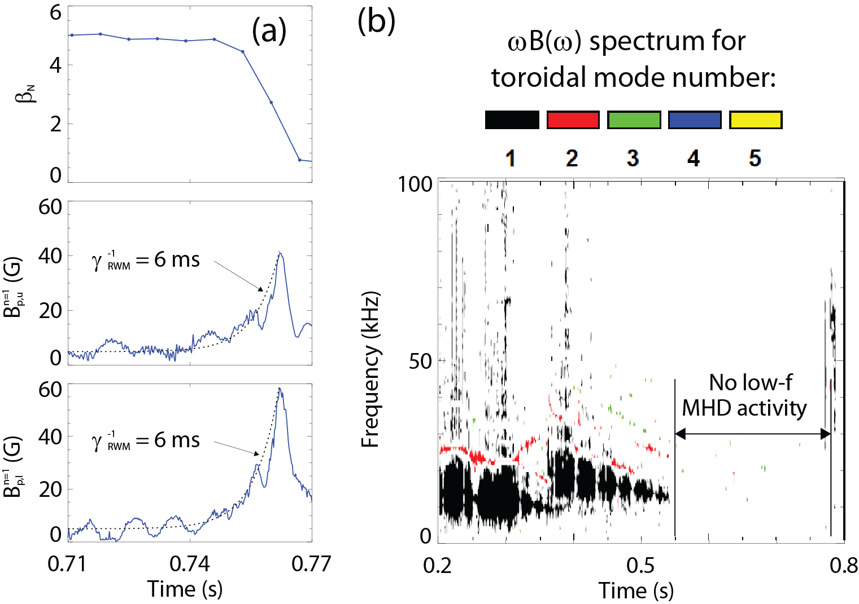
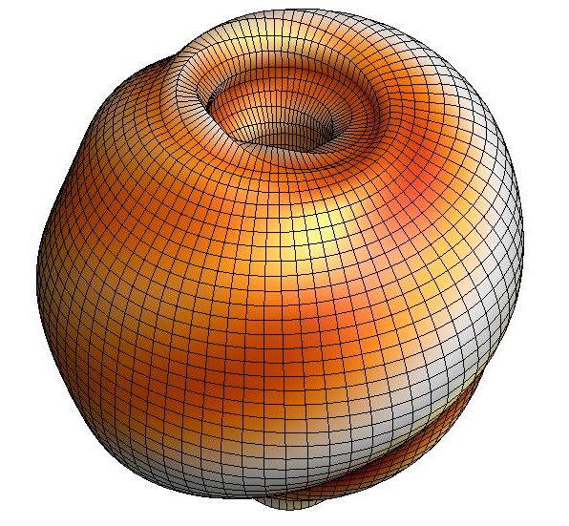



An unstable RWM is an exponential growth of magnetic field line kinking that can be studied with a linear model
The resistive wall mode (RWM) is a kinking of magnetic field lines slowed by penetration through vessel structures
B_{p}
Linear, perturbative model is justified
where
RWMs in NSTX cause a collapse in β, disruption, and termination of the plasma

Slide 4
NSTX reaches high β_{N}, low l_{i} range of next-step STs and the highest β_{N}/l_{i} is not the least stable
β_{N}/l_{i}
14
13
12
11
10
β_{N}/l_{i}
14
13
12
11
10
8
8
Unstable RWM
Stable/Controlled RWM
6
6
β_{N}
β_{N}
4
4
2
β_{N}/l_{i} = 6.7 : computed
NSTX n = 1 no-wall limit
2
0
0
0.0
0.2
0.4
l_{i}
0.6
0.8
0.0
0.2
0.4
l_{i}
0.6
0.8
[S. Sabbagh et al., Nucl. Fusion 53, 104007 (2013)]
[S. Gerhardt et al., Nucl. Fusion 53, 043020 (2013)]
NSTX can reach high β, low l_{i} range where next-step STs aim to operate
The highest β_{N}/l_{i} is not the least stable in NSTX
  In the overall database of NSTX disruptions, disruptivity deceases as β_{N}/l_{i} increases
  Active control experiments reduced disruption probability from 48% to 14%, but mostly in high β_{N}/l_{i}

Slide 5
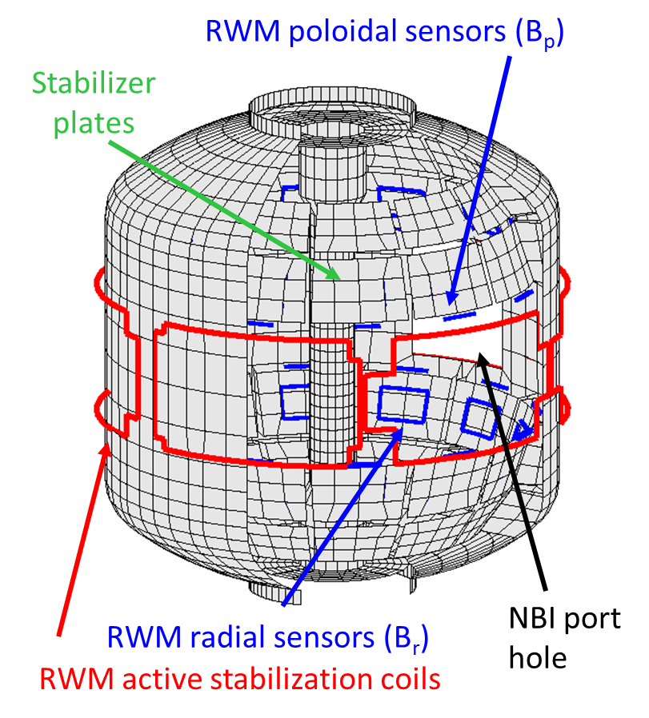
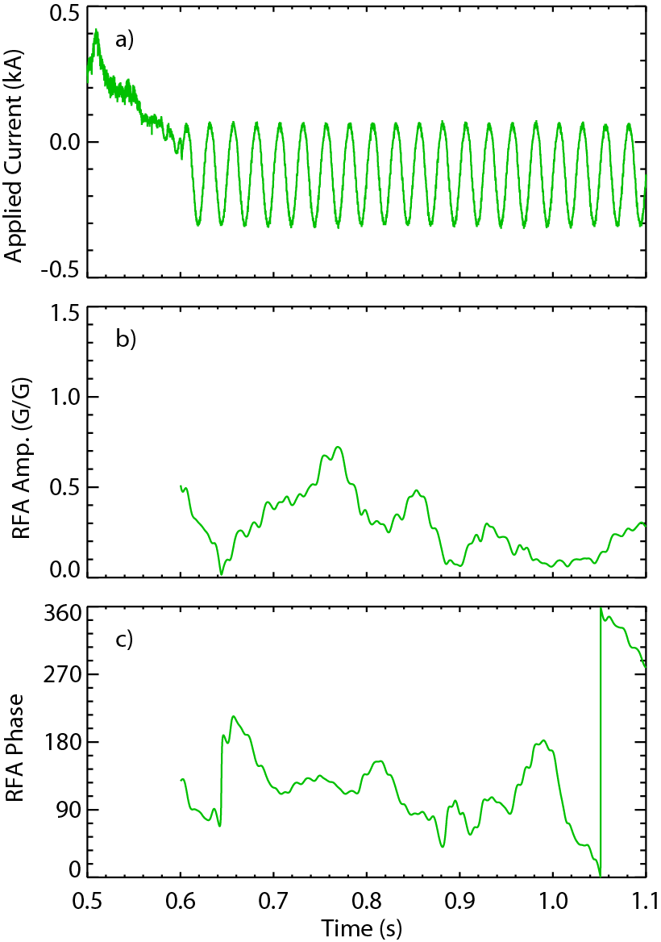
High beta plasma stability is directly measured to test experimental trend of disruptivity
Active MHD spectroscopy is used to measure RWM stability when modes are stable
  Resonant field amplification of n=1 applied AC field is measured
  Increased RFA indicates decreased stability
[H. Reimerdes et al., Phys. Rev. Lett. 93, 135002 (2004)]
RFA = B_{plasma}/B_{applied}
40 Hz n=1 tracer field
n=3 braking
Resonant field amplification (RFA)

Slide 6
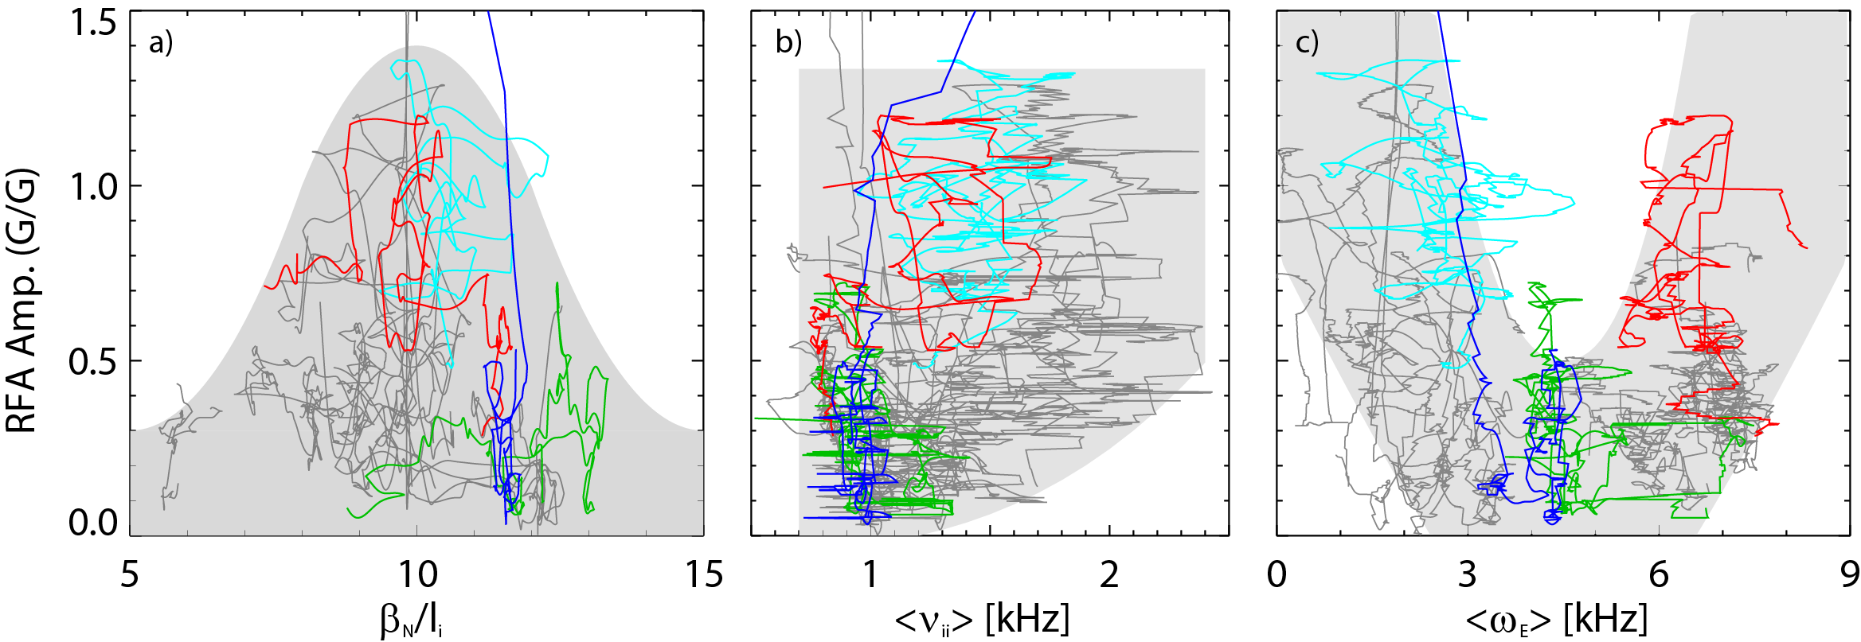
Dedicated NSTX experiments reveal stability dependencies that can not be explained by early theories
Stability increases at the highest β_{N}/l_{i}
Stability is weakest, and unstable plasmas are found, at intermediate β_{N}/l_{i}
How can we explain this behavior?
Compare theory expectations to experimental results
Use the full kinetic calculation of the MISK code for greater insight
A series of 20 discharges was generated in NSTX
  Trajectories of RFA amplitude vs. key parameters for this database shows the stability space

Slide 7
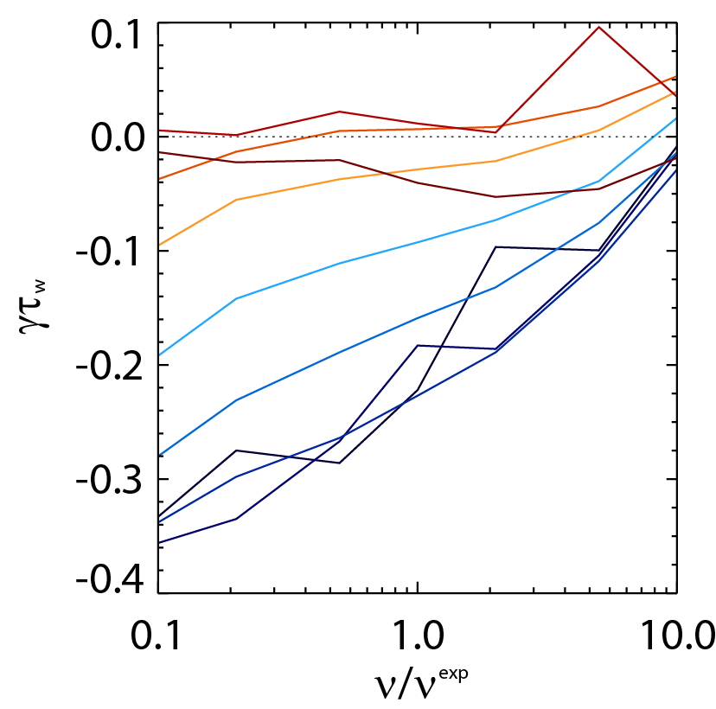
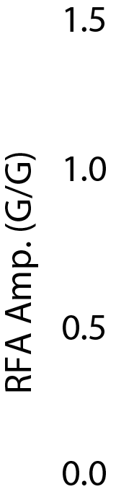

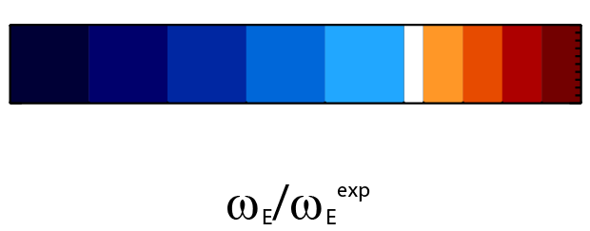
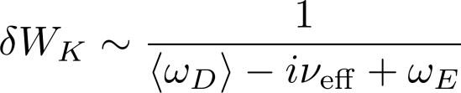
Collisionality affects the strength of kinetic resonances, experimental results consistent with theoretical expectation
unstable
Early theory predicted RWM stability to decrease at low ν
Kinetic RWM stability theory at low ν:
  Stabilizing resonant kinetic effects enhanced (contrasts early theory)
stable
MISK calculations
on-resonance
more stable
γ ~ -1/ν
off-resonance
less stable
γ ~ constant
Precession Drift
Collisionality
0.2
0.4
0.6
0.8
1.0
1.2
1.4
1.3
1.5
~ Plasma Rotation

Slide 8
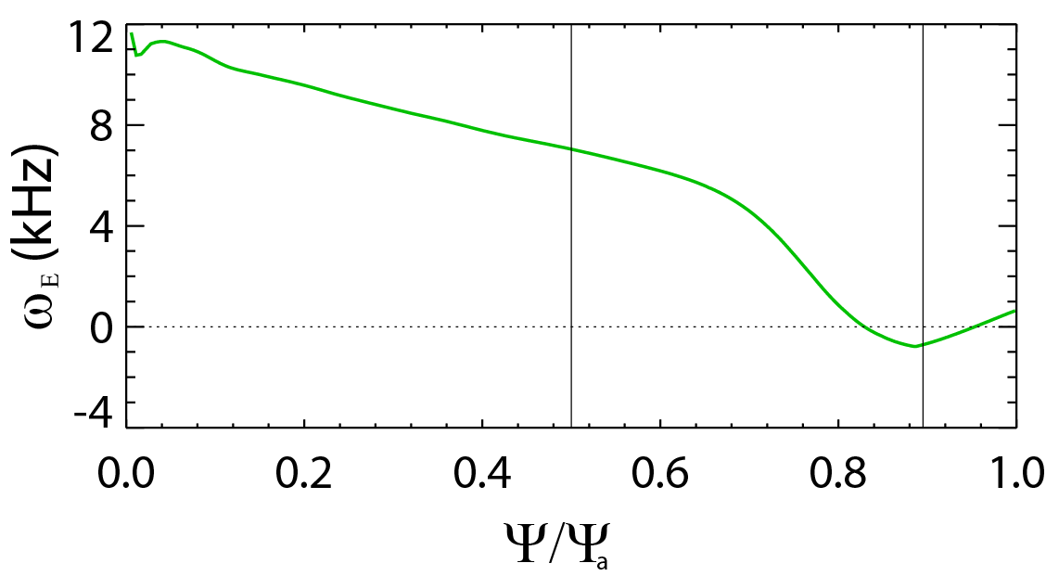

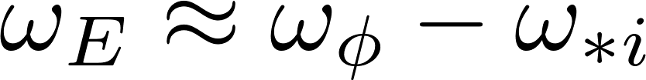
The stability boundary vs. ExB frequency can be explained by kinetic resonances, favorable range found
ExB frequency radial profile
Average range
Pedestal
Evaluate <ω_{E}> inside the pedestal
  Quantity can be evaluated in future real-time systems
  Favorable range, <ω_{E}> ≈ 4-5 kHz, found experimentally
Precession Drift
~ Plasma Rotation

Slide 9
Stability boundaries in NSTX from MHD spectroscopy are explained by kinetic theory, have favorable dependencies
Discharge trajectories for 20 plasmas
a) Stability vs. β_{N}/l_{i}
Stability increases at
the highest β_{N}/l_{i} due to kinetic effects
b) Stability vs. collisionality
Stable plasmas appear to benefit further from reduced collisionality
c) Stability vs. rotation
Precession drift resonance is stabilizing, useful for disruption avoidance

Slide 10
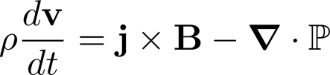


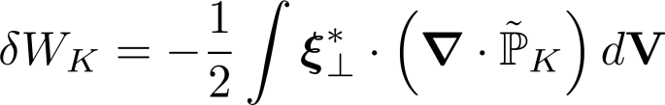

Kinetic effects arise from the perturbed pressure, are calculated in MISK from the perturbed distribution function
Force balance:
leads to an energy balance:
Kinetic Energy
Fluid terms
Change in potential energy due to perturbed kinetic pressure is:
is solved for in the MISK code by using from the drift kinetic equation to solve for
~ Plasma Rotation
Precession Drift
Collisionality

Slide 11
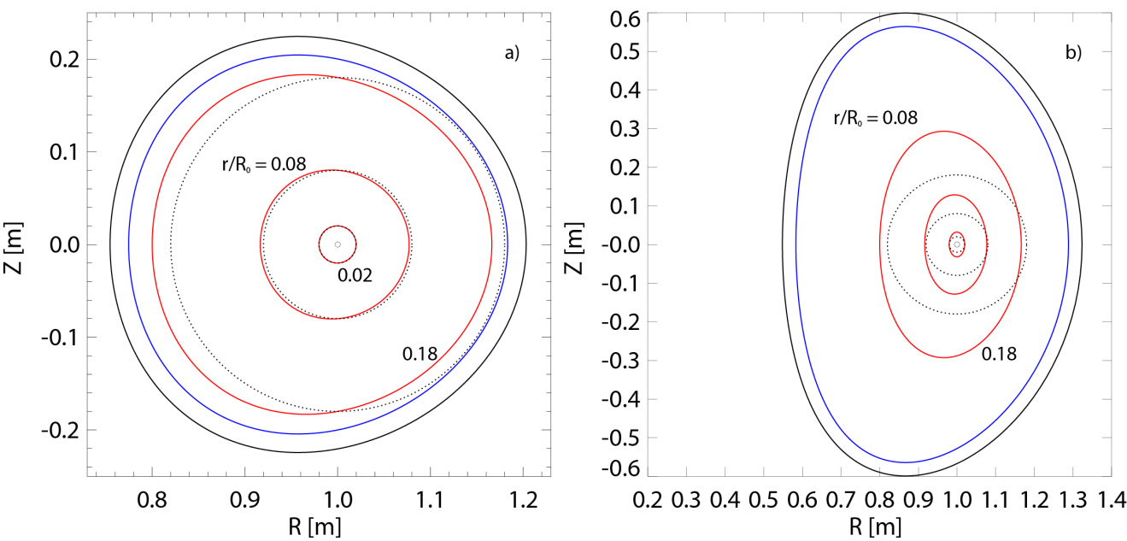
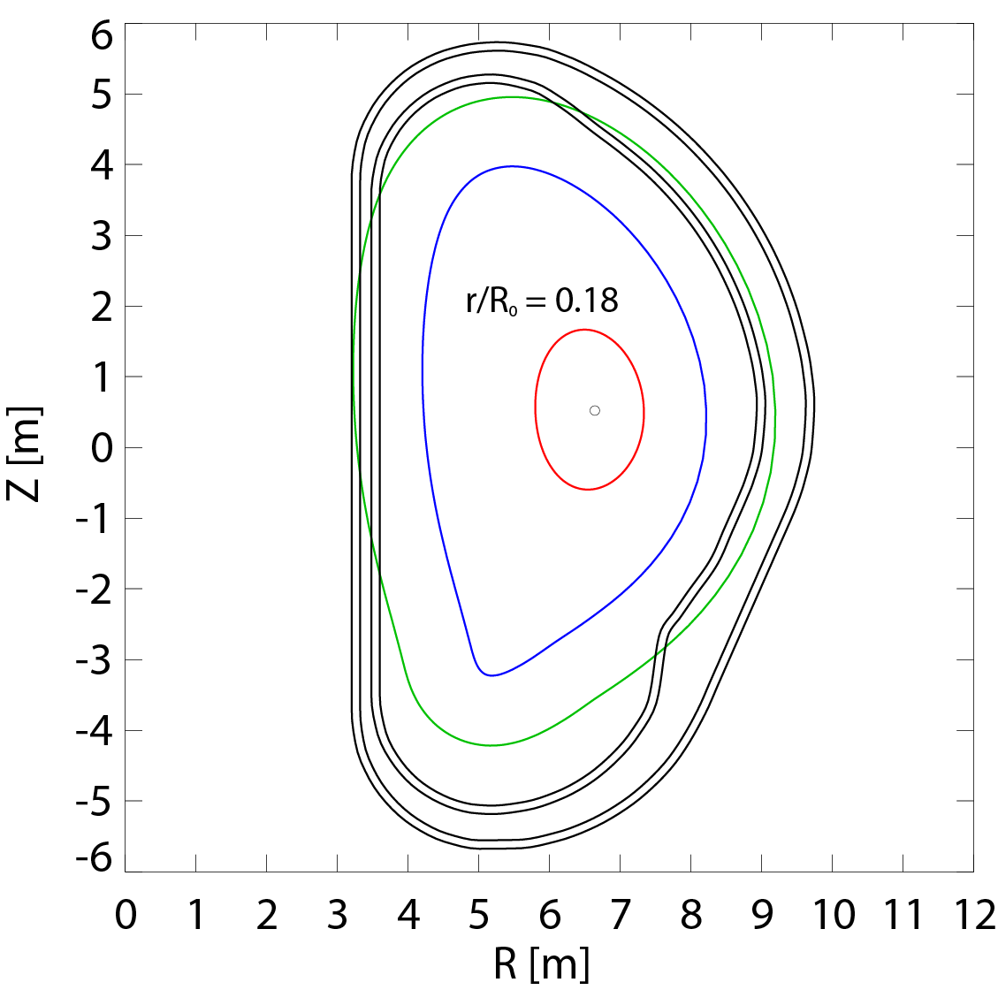
Benchmarking of codes calculating RWM stability was carried out under the ITPA, MDC-2
Calculations of RWM stability with kinetic effects were performed
  with MISK, MARS-K (perturbative), and PENT (interfaces with IPEC)
  without collisions or energetic particles
  for the three cases shown below
Solov’ev 1:
near circular, no rationals
Solov’ev 3:
shaped, q = 2 and 3
ITER:
no alphas, no collisions

Slide 12
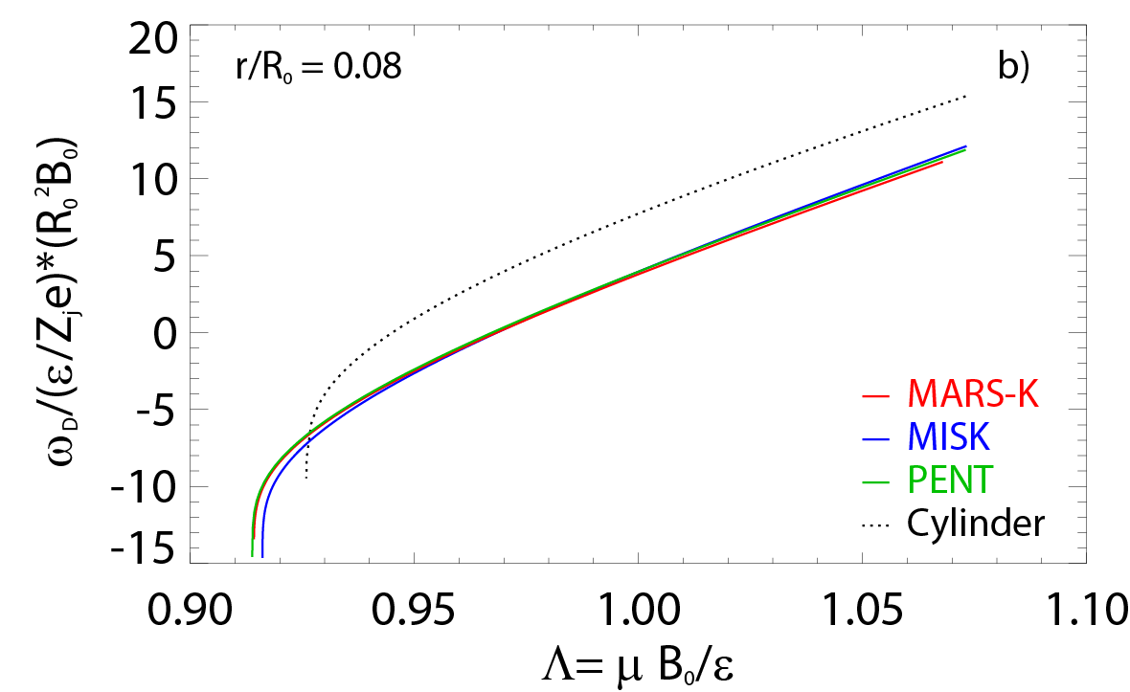
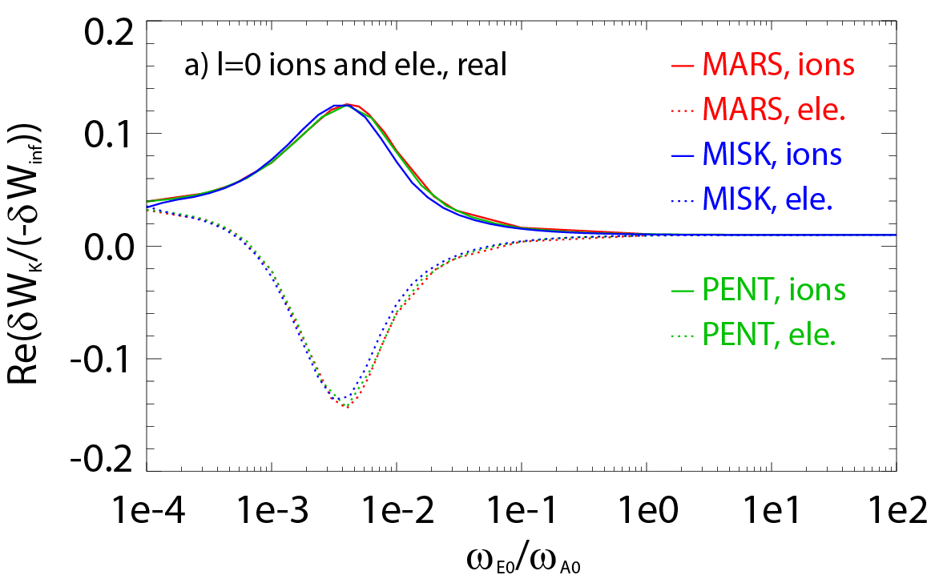
Benchmarking of codes calculating RWM stability was carried out under the ITPA, MDC-2
Calculations of RWM stability with kinetic effects were performed
  with MISK, MARS-K (perturbative), and PENT (interfaces with IPEC)
  without collisions or energetic particles
  for the three cases shown below
Solov’ev 1:
near circular, no rationals
Frequencies,
Energy integrals,
Eigenfunctions,
Lagrangian terms,
δW_{K} profile vs. ψ,
δW_{K} vs. ω_{E}
γτ_{w} vs. ω_{E}

Slide 13
Initial comparison showed disagreement, especially for the ITER case
 | Ideal δW/-δW∞ | Re(δW_{k}) /δW∞ | Im(δW_{k})/ (δW∞) | γτ_{wall} | ωτ_{wall}
Solov’ev 1 (MARS-K) (MISK) | 1.187 1.122 | 0.0256 0.0243 | -0.0121 0.0280 | 0.804 0.850 | -0.0180 -0.0452
Solov’ev 3 (MARS-K) (MISK) | 1.830 2.337 | 0.208 0.371 | -0.343 0.0601 | 0.350 0.232 | -0.228 -0.0273
ITER (MARS-K) (MISK) | 0.682 0.677 | 141.5 0.665 | 2.286 -0.548 | -0.988 0.0709 | 0.00019 0.437
Originally MISK was more consistent with MARS-K self consistent
  MARS-K perturbative numbers very large for ITER

Slide 14
Agreement now found between MISK and MARS-K for all cases considered under MDC-2 Benchmarking
 | Ideal δW/-δW∞ | Re(δW_{k}) /δW∞ | Im(δW_{k})/ (δW∞) | γτ_{wall} | ωτ_{wall}
Solov’ev 1 (MARS-K) (MISK) | 1.187 1.122 | 0.0218 0.0208 | -0.0121 -0.0068 | 0.803 0.861 | 0.0180 0.0189
Solov’ev 3 (MARS-K) (MISK) | 1.830 2.337 | 0.0794 0.0892 | -0.147 -0.090 | 0.471 0.374 | 0.114 0.051
ITER (MARS-K) (MISK) | 0.682 0.677 | 0.241 0.367 | -0.046 -0.133 | 0.817 0.581 | 0.090 0.202
Improvements were made to both codes
  MISK corrected ω_{D} calculation, some minor input changes
  MARS-K correction of error in particle phase factor in bounce resonance

Slide 15
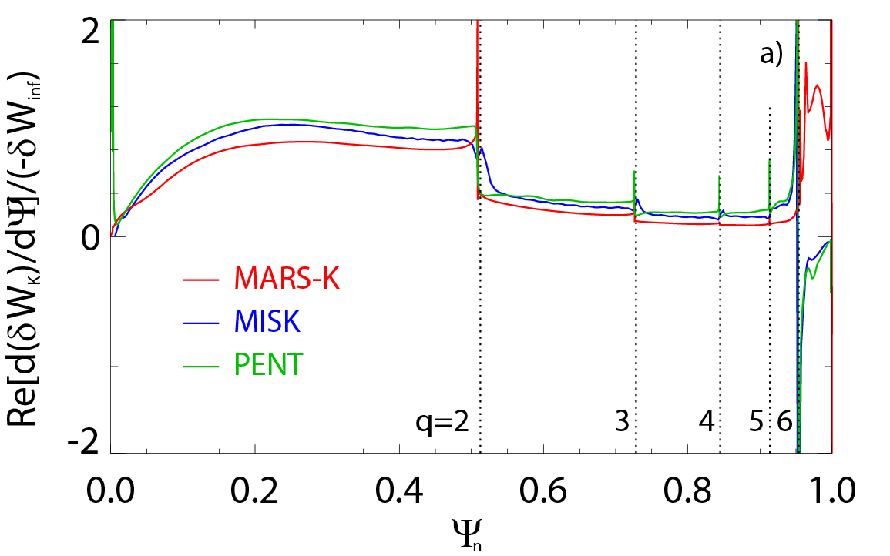
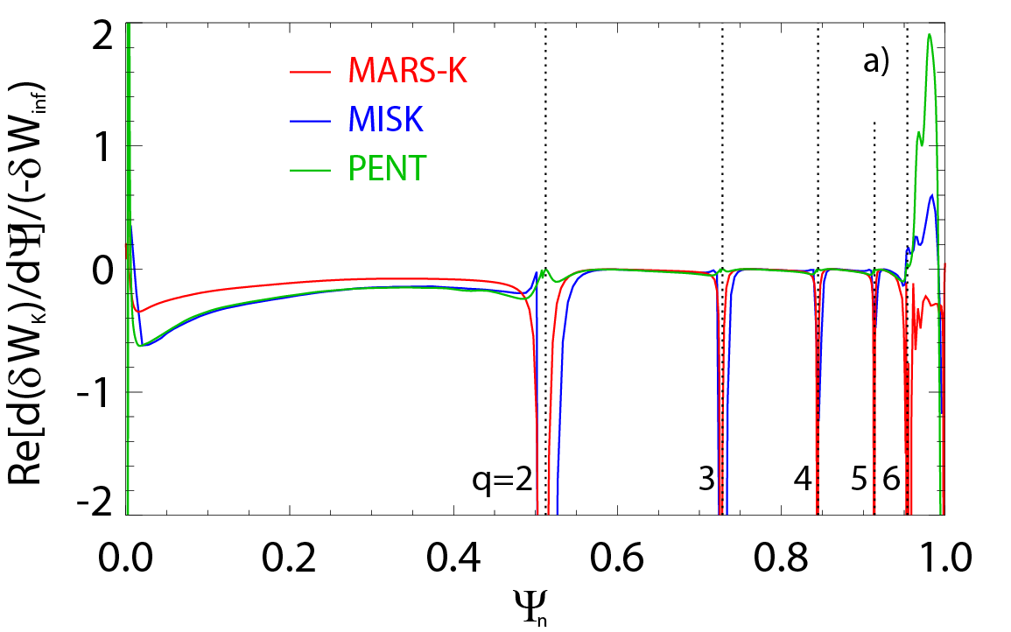
δW_{K} vs radius for ITER case – points to key difference
Precession resonant ions
Bounce resonant ions
Example: d(dW_{k})/dψ vs. ψ shows good agreement between codes
  Except at the plasma edge (work continues)
  Except very close to rational surfaces
Agreement found between MISK and MARS-K when integration is not taken very close to the rationals

Slide 16
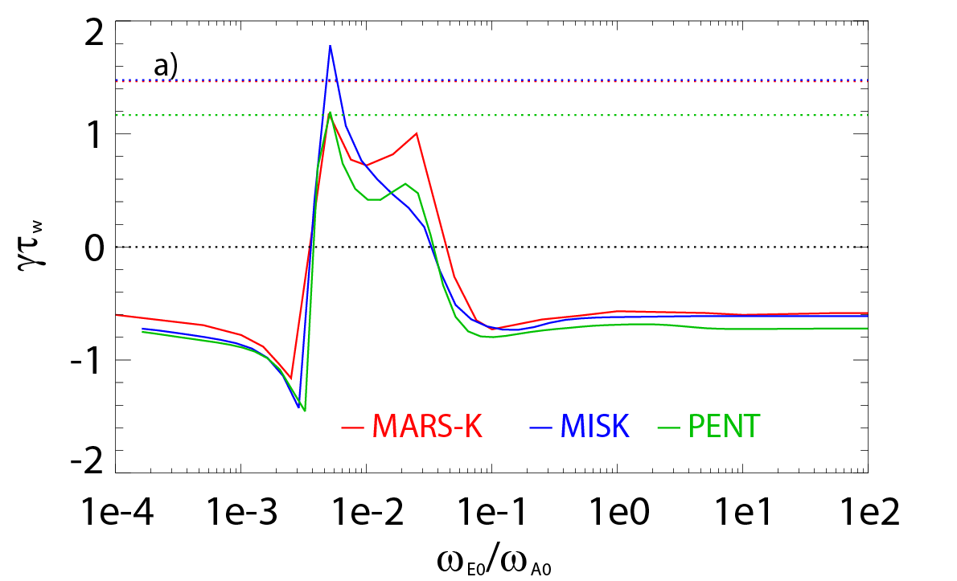
Benchmarking of RWM stability codes through the ITPA was successful; codes agree and support present understanding
The codes support the present understanding that RWM stability can be increased by kinetic effects
  At low rotation through precession drift resonance
  At high rotation by bounce and transit resonances
  Intermediate rotation can remain susceptible to instability
fluid growth rates
ITER case
unstable
stable
fluid plus kinetic growth rates
low rotation
precession
resonance
high rotation
bounce/transit
resonance
The successful benchmarking gives great confidence that these codes are correctly calculating kinetic effects of RWM stability
  To the extent that this model is validated against experimental evidence of RWM stability, one can then project the stability of future devices with greater confidence
[J. Berkery et al., “Benchmarking Kinetic Calculations of Resistive Wall Mode Stability”, Report to the ITPA (2013)]

Slide 17
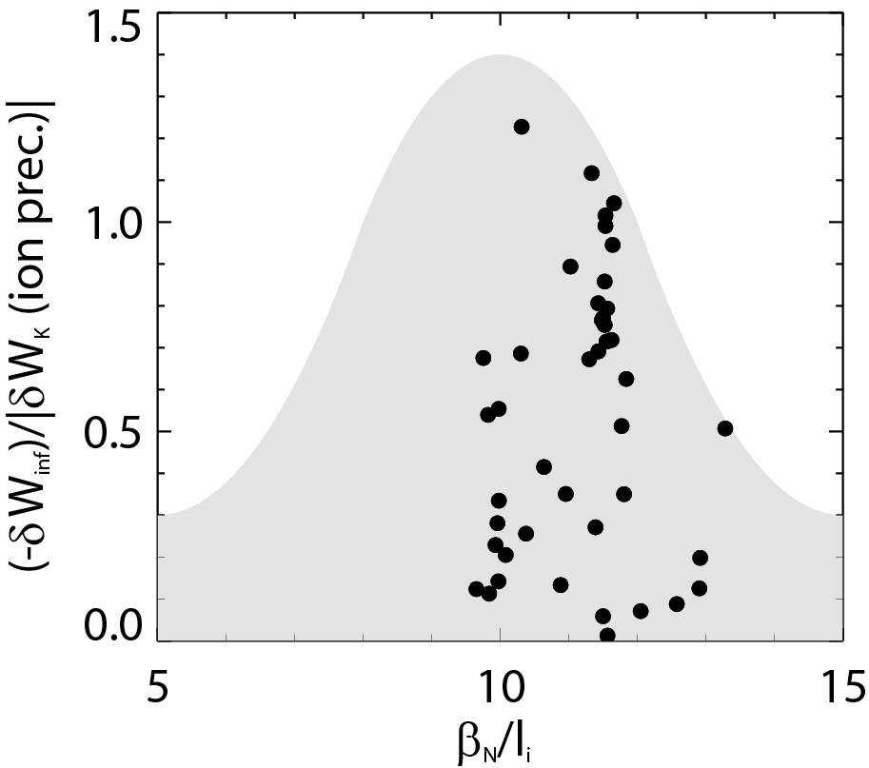
MISK calculations of precession drift resonance of many equilibria are consistent with the measured β_{N}/l_{i} trend
MISK calculations
Less stable
δW_{K} small
More stable
δW_{K} large
MISK code calculation for 44 equilibria from the 20 discharge database
Precession Drift
bounce harmonic l = 0
~ Plasma Rotation

Slide 18
Experimental stability trends in NSTX can be explained by kinetic theory, which benchmarked MISK can calculate
For the first time it has been found in NSTX that disruption probability decreases at the highest β_{N}/l_{i}
Kinetic stability of resistive wall modes can explain this new and highly-favorable result
  Whereas past theory showed low ν to be destabilizing, here stable plasmas appear to benefit further from reduced collisionality (good for future devices)
  Stabilizing precession resonance is useful for disruption avoidance
Benchmarking of RWM stability codes successfully completed
  The codes agree and support present understanding of rotation resonance stabilization

Slide 19
backup slides

Slide 20
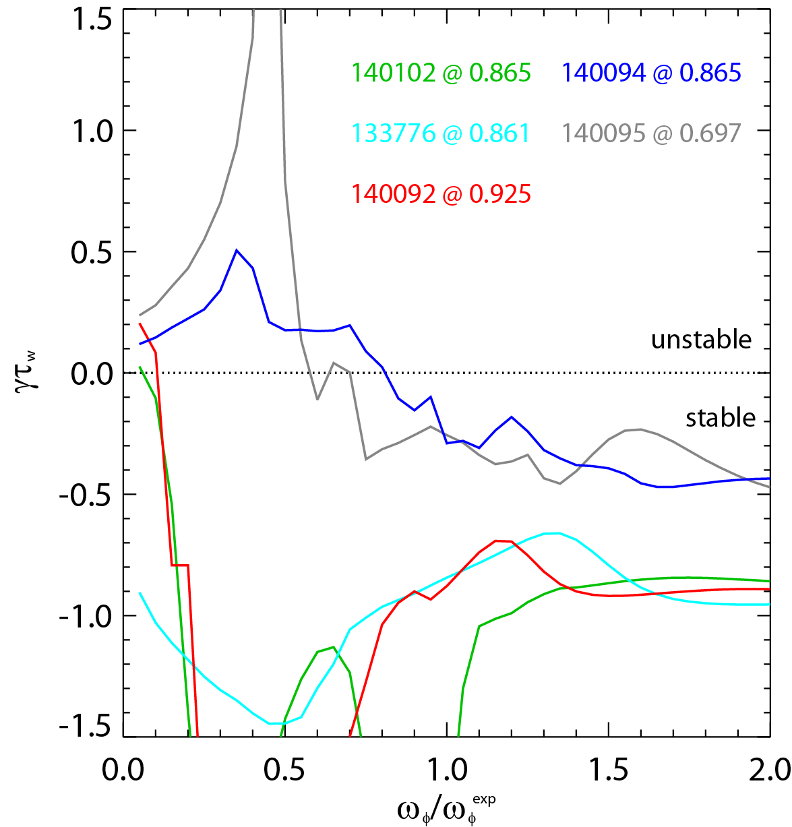
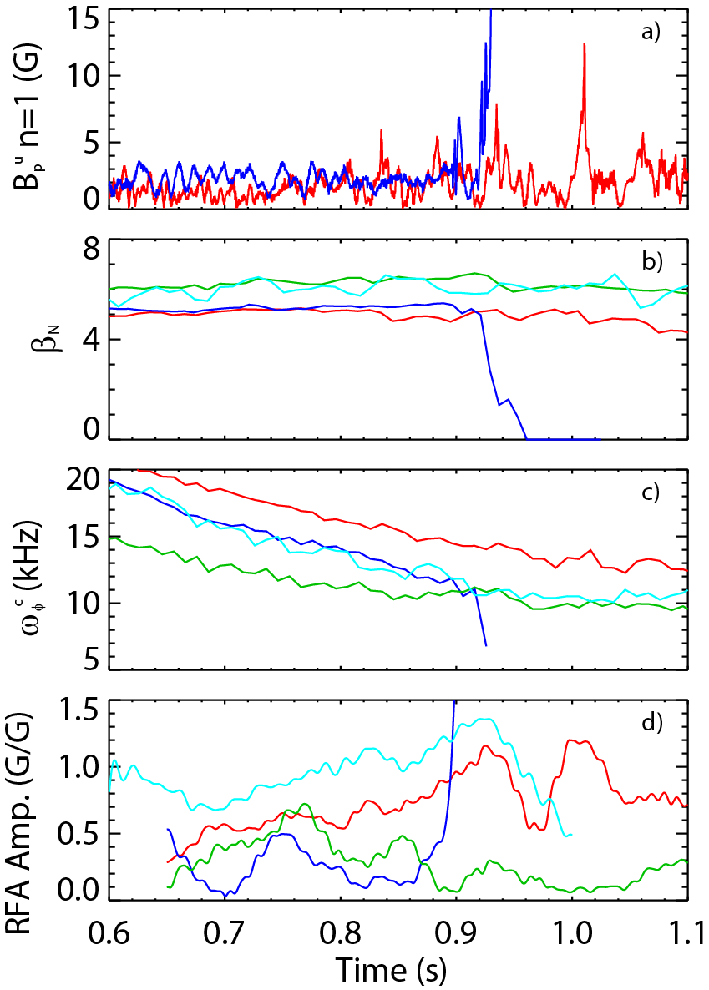
MISK calculations of kinetic RWM growth rate for individual equilibria compares well with marginal stability point
MISK calculations with scaled experimental rotation profiles show:
  Stable discharges calculated as stable
  Marginally stable discharge predicted unstable with 20% reduction in rotation
MISK calculations

Slide 21
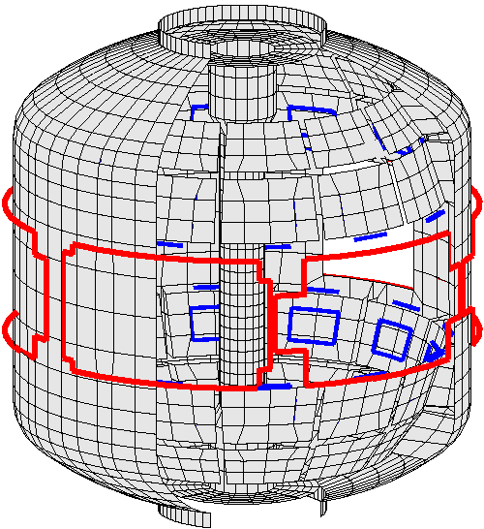
NSTX is a spherical torus equipped to study passive and active global MHD control, rotation variation by 3D fields
High beta, low aspect ratio
  R = 0.86 m, A > 1.27
  I_{p} < 1.5 MA, B_{t} = 5.5 kG
  β_{t} < 40%, β_{N} > 7
Copper stabilizer plates for kink mode stabilization
Midplane control coils
  n = 1 – 3 field correction, magnetic braking of ω_{φ} by NTV
  n = 1 RWM control
Combined sensor sets now used for RWM feedback
  48 upper/lower B_{p}, B_{r}
RWM poloidal sensors (B_{p})
Stabilizer
plates
NBI port hole
RWM radial sensors (B_{r})
RWM active stabilization coils

Slide 22
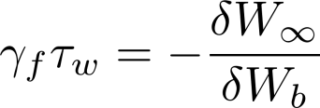
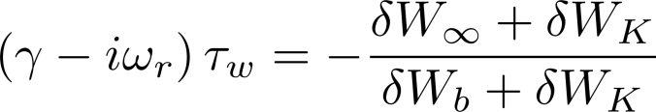
Kinetic effects in the RWM dispersion relation allows for passive stabilization of the RWM, can explain experiments
Resistive Wall Mode (RWM) fluid dispersion relation:
Ideal Kink Mode
Resistive Wall Mode
γ
~τ_{w}⁻¹
0
unstable
with kinetic effects?
τ_{w}⁻¹ is slow enough that active stabilization (feedback) can keep the plasma stable
stable
β_{N}^{no-wall}
β_{N}^{with-wall}
However, NSTX experiments have often operated in this range without active control!
Passive stabilization
  Collisional dissipation
  Rotational stabilization
    Simple models with a scalar “critical rotation” level for stability could not explain experiments
Kinetic Effects
[S. Sabbagh et al., Nucl. Fusion 50, 025020 (2010)]
[B. Hu et al., Phys. Rev. Lett. 93, 105002 (2004)]

Slide 23
NSTX reaches high β_{N}, low l_{i} range of next-step STs and the highest β_{N}/l_{i} is not the least stable
β_{N}/l_{i}
14
13
12
11
10
8
Next-step STs aim to operate at:
  High β_{N} for fusion performance
  High non-inductive fraction for continuous operation
    High bootstrap current fraction -> Broad current profile -> Low internal inductance, l_{i} = <B_{p}²>/<B_{p}>_{ψ}²
This is generally unfavorable for ideal global MHD mode stability
  Low l_{i} reduces the ideal n = 1 no-wall beta limit
ST-Pilot
6
ST-CTF
β_{N}
Recent years with n = 1 RWM feedback in red
4
2
β_{N}/l_{i} = 6.7 : computed
NSTX n = 1 no-wall limit
0
0.0
0.2
0.4
l_{i}
0.6
0.8
[S. Sabbagh et al., Nucl. Fusion 53, 104007 (2013)]
NSTX can reach high β, low l_{i} range where next-step STs aim to operate

Slide 24
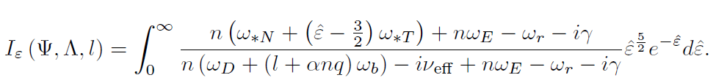
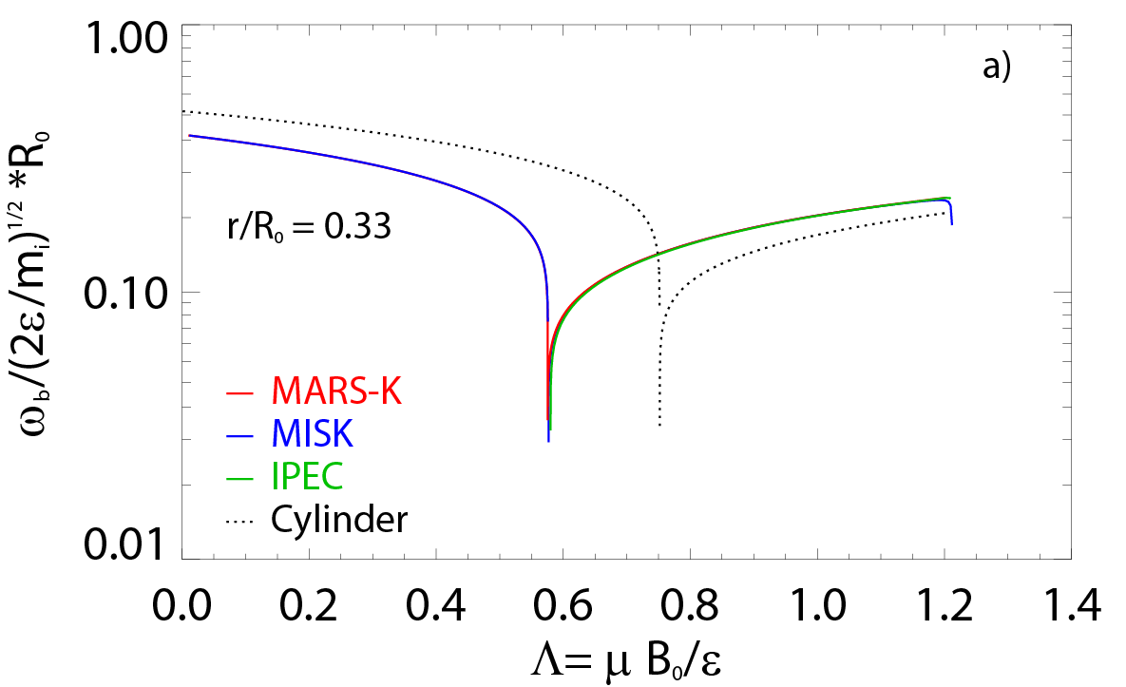
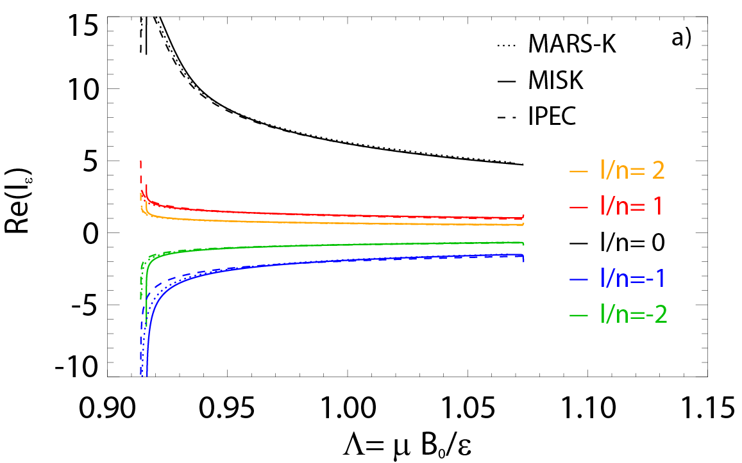
A comparison example: frequency, and energy integral calculations match between codes
Energy
integral
Bounce frequency vs. pitch angle
Re(energy integral) vs. pitch angle
Both numerical and analytical approaches
IPEC PENT being developed: good agreement as well

Slide 25
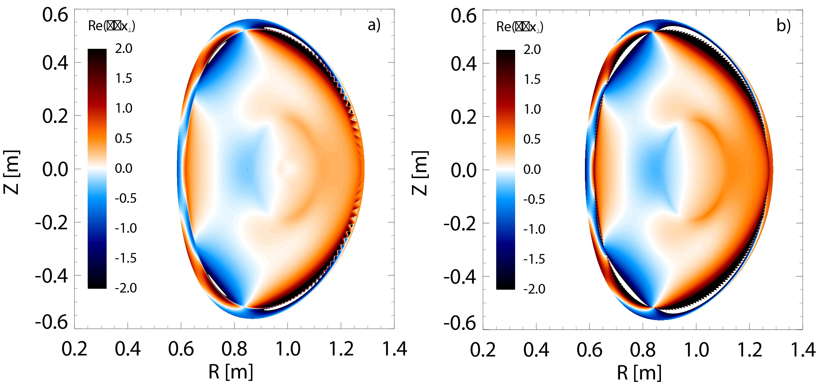
Eigenfunction quantities generally in good agreement between MARS-K and MISK
Solov’ev 3 case
Re(∇•ξ⊥) contours
(MISK)
Re(∇•ξ⊥) contours
(MARS-K)

Slide 26
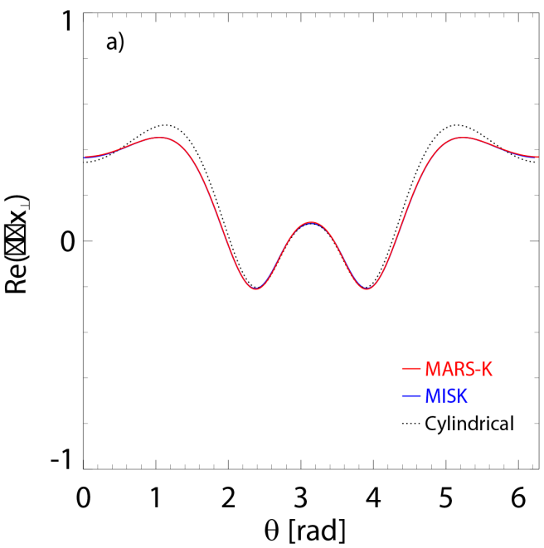
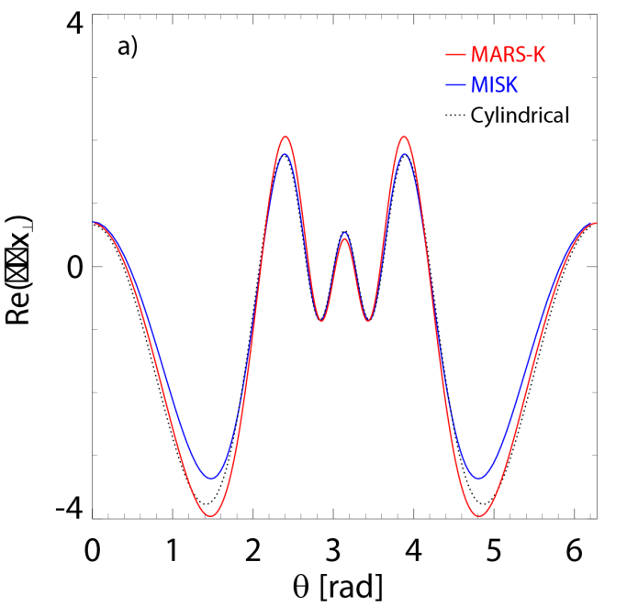
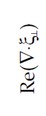
Eigenfunction quantities in very good agreement in core, with some differences in the edge region
Re(∇•ξ⊥) vs. poloidal angle
(ψ_{n} = 0.585)
Re(∇•ξ⊥) vs. poloidal angle
(ψ_{n} = 0.9)

Slide 27
Dedicated NSTX experiments reveal stability dependencies that can not be explained by early theories
Experiments in NSTX measured RFA of high beta plasmas with rotation slowed by n=3 magnetic braking
  Blue: unstable at 0.9 s
  Green: higher β, lower rotation: stable
  Counter-intuitive without invoking kinetic effects

Slide 28
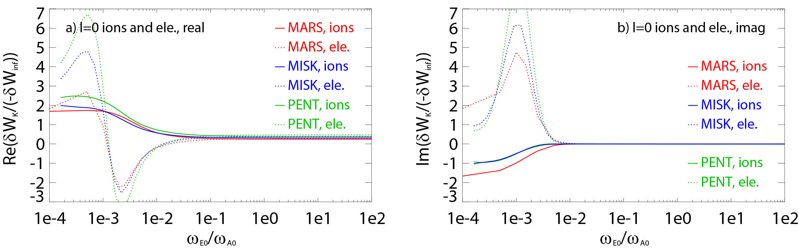
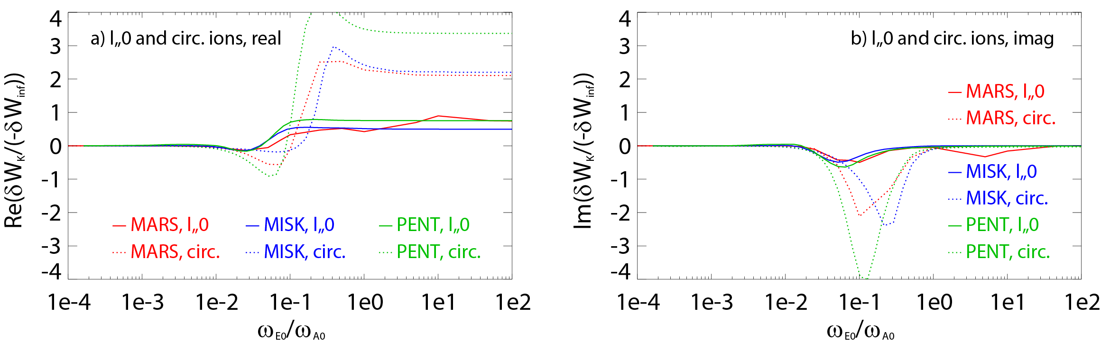
MISK, MARS-K, and PENT agree in δW_{K} vs ω_{E} for ITER
precession resonant ions and electrons
bounce and transit resonant ions

Slide 29
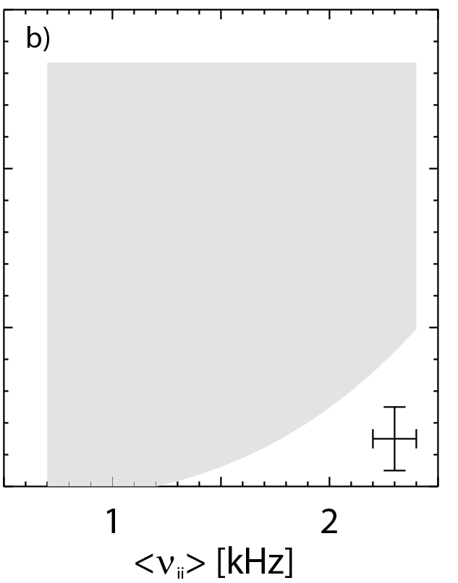
Collisionality affects the strength of kinetic resonances, experimental results consistent with theoretical expectation
unstable
Early theory predicted RWM stability to decrease at low ν
Kinetic RWM stability theory at low ν:
  Stabilizing resonant kinetic effects enhanced (contrasts early theory)
stable
MISK calculations
[J. Berkery et al., Phys. Rev. Lett. 106, 075004 (2011)]
on-resonance
more stable
γ ~ -1/ν
off-resonance
less stable
γ ~ constant
Precession Drift
Collisionality
~ Plasma Rotation
0.2
0.4
0.6
0.8
1.0
1.2
1.4
1.3
1.5

Slide 30
Collisionality affects the strength of kinetic resonances, experimental results consistent with theoretical expectation
unstable
Early theory predicted RWM stability to decrease at low ν
Kinetic RWM stability theory at low ν:
  Stabilizing resonant kinetic effects enhanced (contrasts early theory)
Expectations for lower ν tokamaks (ITER):
  Stronger stabilization near resonances
  Almost no effect off-resonance
stable
MISK calculations
on-resonance
more stable
γ ~ -1/ν
off-resonance
less stable
γ ~ constant
Precession Drift
Collisionality
0.2
0.4
0.6
0.8
1.0
1.2
1.4
1.3
1.5
~ Plasma Rotation

Slide 31
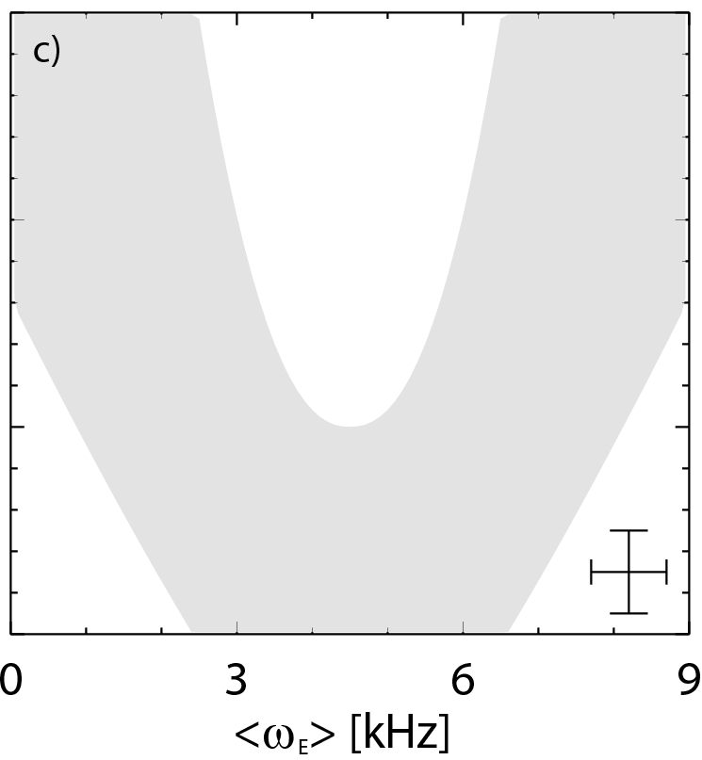
The stability boundary vs. ExB frequency can be explained by kinetic resonances, favorable range found
ExB frequency radial profile
Average range
low rotation
less stable RWMs
intermediate rotation
less
stable RWMs
Pedestal
precession drift
resonance stabilization
Evaluate <ω_{E}> inside the pedestal
  Quantity can be evaluated in future real-time systems
[J. Berkery et al., Phys. Rev. Lett. 104, 035003 (2010)]
Precession Drift
~ Plasma Rotation

Slide 32
The stability boundary vs. ExB frequency can be explained by kinetic resonances, favorable range found
ExB frequency radial profile
Average range
Pedestal
Evaluate <ω_{E}> inside the pedestal
  Quantity can be evaluated in future real-time systems
  Favorable range, <ω_{E}> ≈ 4-5 kHz, found experimentally
Precession Drift
~ Plasma Rotation

