Slide 1




NSTX-U
Supported by
Kinetic effects on the ideal-wall limit
and the resistive wall mode
Coll of Wm & Mary
Columbia U
CompX
General Atomics
FIU
INL
Johns Hopkins U
LANL
LLNL
Lodestar
MIT
Lehigh U
Nova Photonics
Old Dominion
ORNL
PPPL
Princeton U
Purdue U
SNL
Think Tank, Inc.
UC Davis
UC Irvine
UCLA
UCSD
U Colorado
U Illinois
U Maryland
U Rochester
U Tennessee
U Tulsa
U Washington
U Wisconsin
X Science LLC
Jon Menard (PPPL)
Z. Wang, Y. Liu (CCFE), S. Kaye, J.-K. Park,
J. Berkery (CU), S. Sabbagh (CU)
and the NSTX Research Team
Culham Sci Ctr
York U
Chubu U
Fukui U
Hiroshima U
Hyogo U
Kyoto U
Kyushu U
Kyushu Tokai U
NIFS
Niigata U
U Tokyo
JAEA
Inst for Nucl Res, Kiev
Ioffe Inst
TRINITI
Chonbuk Natl U
NFRI
KAIST
POSTECH
Seoul Natl U
ASIPP
CIEMAT
FOM Inst DIFFER
ENEA, Frascati
CEA, Cadarache
IPP, Jülich
IPP, Garching
ASCR, Czech Rep
18th Workshop on MHD Stability Control
November 18, 2013
Santa Fe, New Mexico
*This work supported by US DoE contract DE-AC02-09CH11466

Slide 2
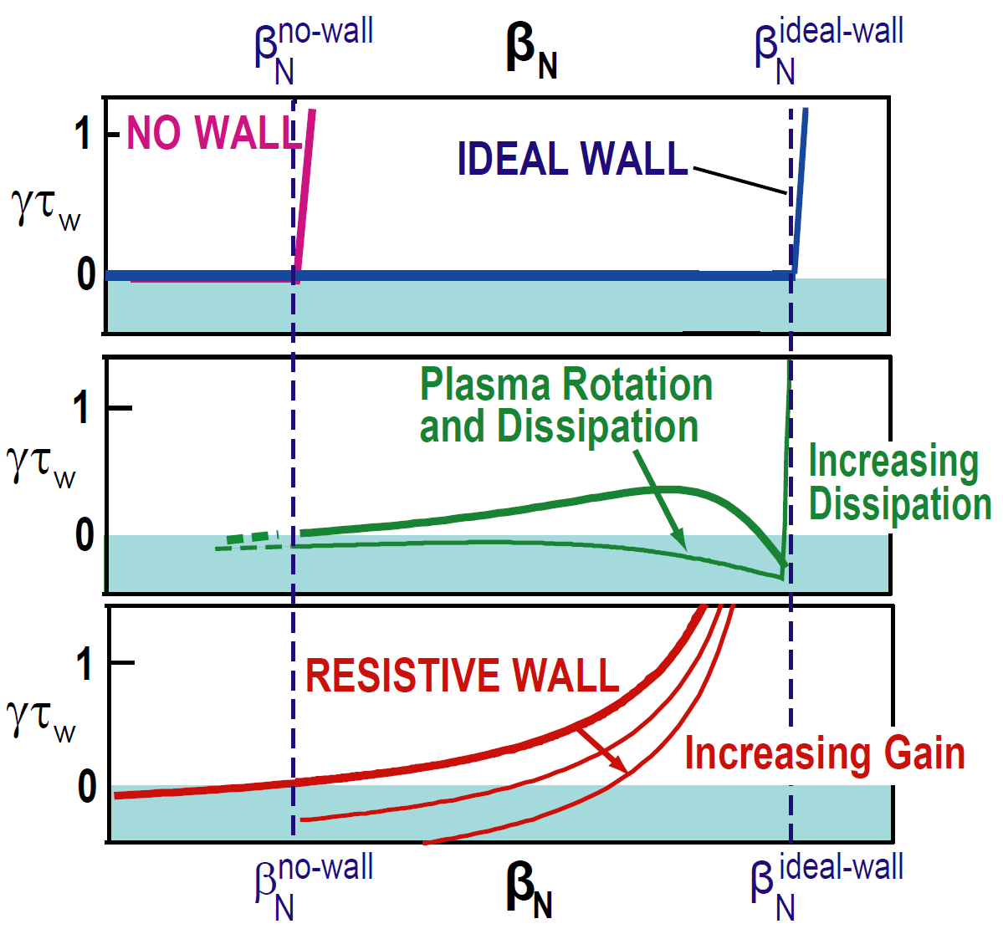
Pressure-driven kink limit is strong physics constraint on maximum fusion performance
P_{fusion} ∝ n²⟨σv⟩ ∝ p² ∝ β_{T}² B_{T}⁴ ∝ β_{N}⁴ B_{T}⁴ (1+κ²)² / A f_{BS}²
Modes grow rapidly above kink limit:
  γ ~ 1-10% of τ_{A}⁻¹ where τ_{A} ~ 1μs
Superconducting “ideal wall” can increase stable β_{N} up to factor of 2
Real wall resistive → slow-growing “resistive wall mode” (RWM)
  γ τ_{wall} ~ 1 →
  ms instead of μs time-scales
RWM can be stabilized with:
  kinetic effects (rotation, dissipation)
  active feedback control
M. Chu, et al., Plasma Phys. Control. Fusion 52 (2010) 123001
Talk focuses on ideal-wall mode (IWM), also treats RWM vs. Ω_{φ}

Slide 3
Background
Characteristic growth rates and frequencies of RWM and IWM
  RWM: γτ_{wall} ~ 1 and ωτ_{wall} < 1
  IWM: γτ_{A} ~ 1-10% (γτ_{wall} >> 1) and ωτ_{A} ~ Ω_{φ}τ_{A} (1-30%) (ωτ_{wall} >> 1)
Kinetic effects important for RWM (J. Berkery invited TI2.02, Thu AM)
  Publications: Berkery, et al. PRL 104 (2010) 035003, Sabbagh, et al., NF 50 (2010) 025020
Rotation and kinetic effects largely unexplored for IWM
  Such effects generally higher-order than fluid terms (∇p, J||, |δB|², wall)
Calculations for NSTX indicate both rotation and kinetic effects can modify both IWM and RWM stability limits
  High toroidal rotation generated by co-injected NBI in NSTX
    Fast core rotation: Ω_{φ} / ω_{sound} up to ~1, Ω_{φ} / ω_{Alfven} ~ up to 0.1-0.3
  Fluid/kinetic pressure is dominant instability drive in high-β ST plasmas

Slide 4
Study 3 classes of IWM-unstable plasmas spanning low to high β_{N}
Low β_{N} limit ~3.5, often saturated/long-lived mode
  q_{min} ~ 2-3
  Common in early phase of current flat-top
  Higher fraction of beam pressure, momentum (lower n_{e})
Intermediate β_{N} limit ~ 5
  q_{min} ~1.2-1.5
  Typical good-performance H-mode, H₉₈ ~ 0.8-1.2
Highest β_{N} limit ~ 6-6.5
  q_{min} ~ 1
  “Enhanced Pedestal” H-mode → high H₉₈ ~ 1.5-1.6
  Broad pressure, rotation profiles, high edge rotation shear

Slide 5


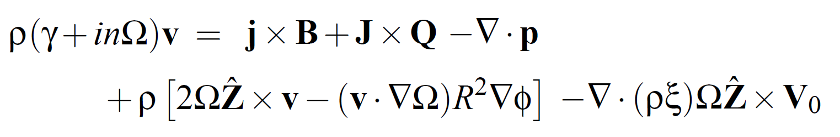
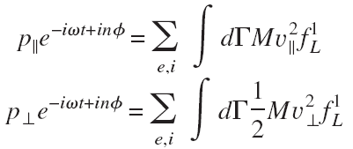

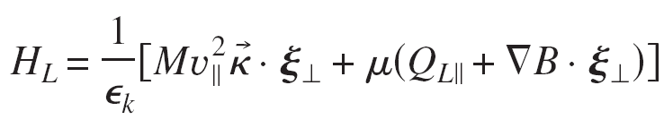
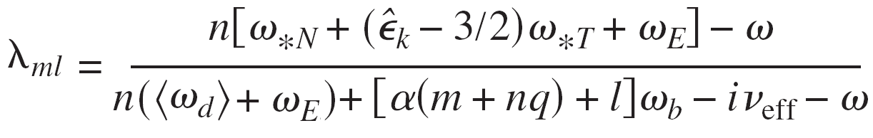
MARS-K: self-consistent linear resistive MHD including toroidal rotation and drift-kinetic effects
Perturbed single-fluid linear MHD:
Y.Q. Liu, et al., Phys. Plasmas 15, 112503 2008
Drift-kinetic effects in perturbed anisotropic pressure p:
Rotation and rotation shear effects:
Diamagnetic
Mode-particle resonance operator:
Precession
ExB
Transit and bounce
Collisions
Fast ions: analytic slowing-down f(v) model – isotropic or anisotropic
This talk
Include toroidal flow only: v_{φ} = RΩ_{φ}(ψ) and ω_{E} = ω_{E}(ψ)

Slide 6
Study 3 classes of IWM-unstable plasmas spanning low to high β_{N}
Low β_{N} limit ~ 3.5, often saturated/long-lived
  q_{min} ~ 2-3
  Common in early phase of current flat-top
  Higher fraction of beam pressure, momentum (lower n_{e})
Intermediate β_{N} limit ~ 5
  q_{min} ~1.2-1.5
  Typical good-performance H-mode, H₉₈ ~ 0.8-1.2
Highest β_{N} limit ~ 6-6.5
  q_{min} ~ 1
  “Enhanced Pedestal” H-mode → high H₉₈ ~ 1.5-1.6
  Broad pressure, rotation profiles, high edge rotation shear

Slide 7
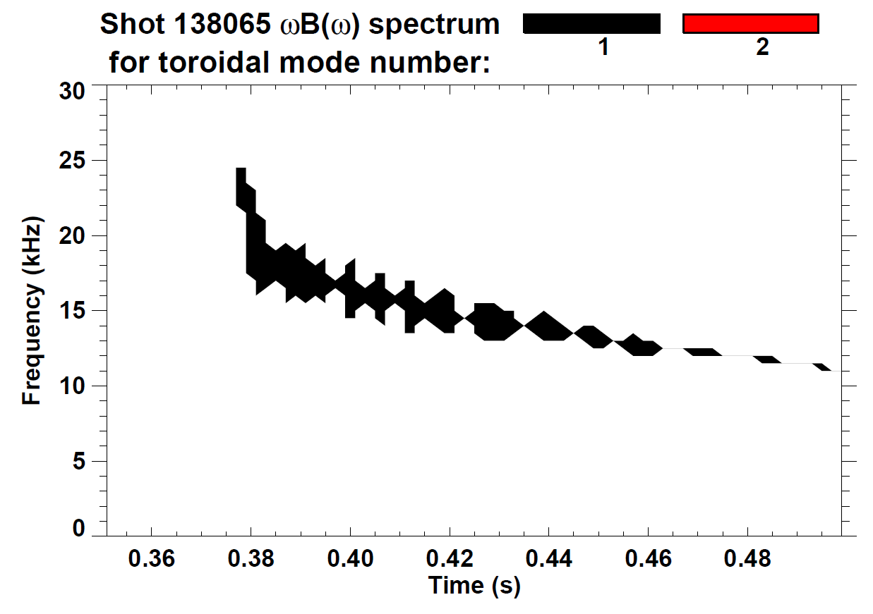
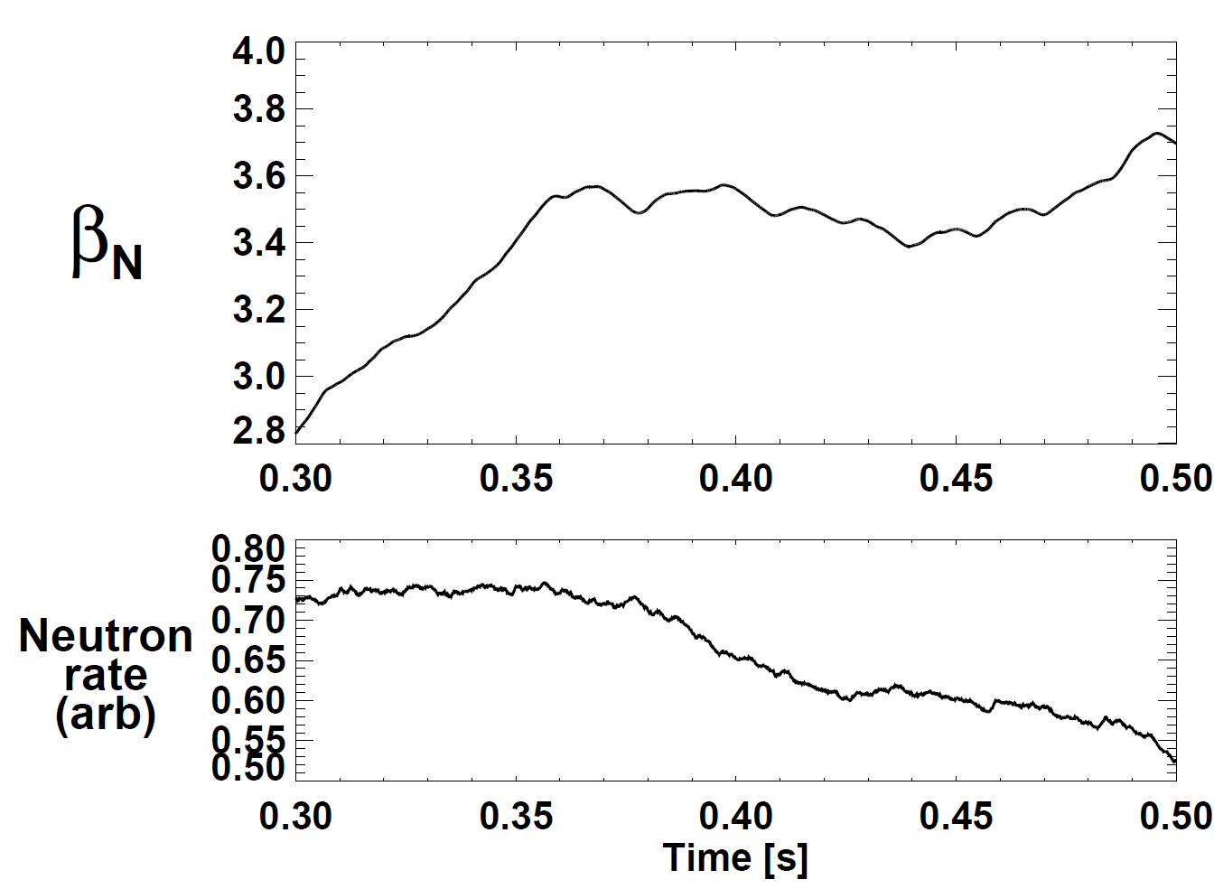
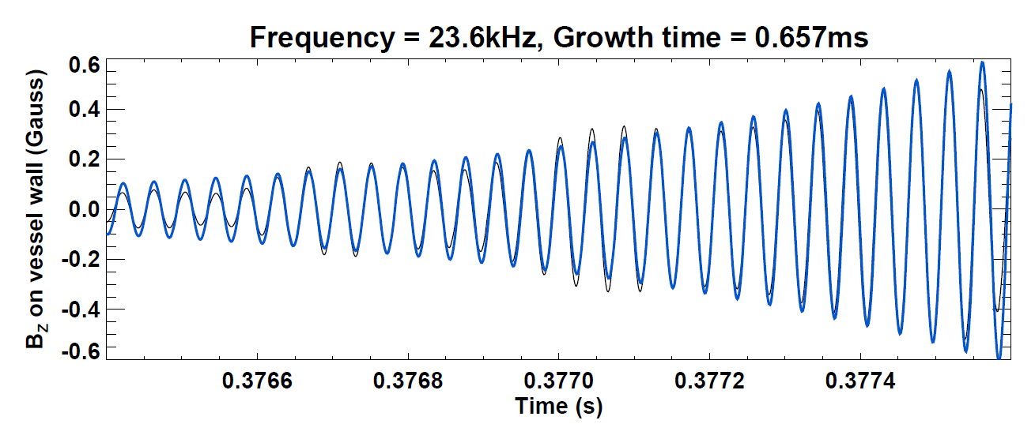
Saturated f=15-30kHz n=1 mode common during early I_{P} flat-top phase
Fixed P_{NBI} = 3MW, I_{P} = 800kA, β_{T}=10-15%
NSTX shot 138065
γ_{eff} τ_{A} ~ 1×10⁻³
Mode clamps β_{N} to ~3.5, reduces neutron rate ~20%
sometimes slows → locks → disrupts

Slide 8
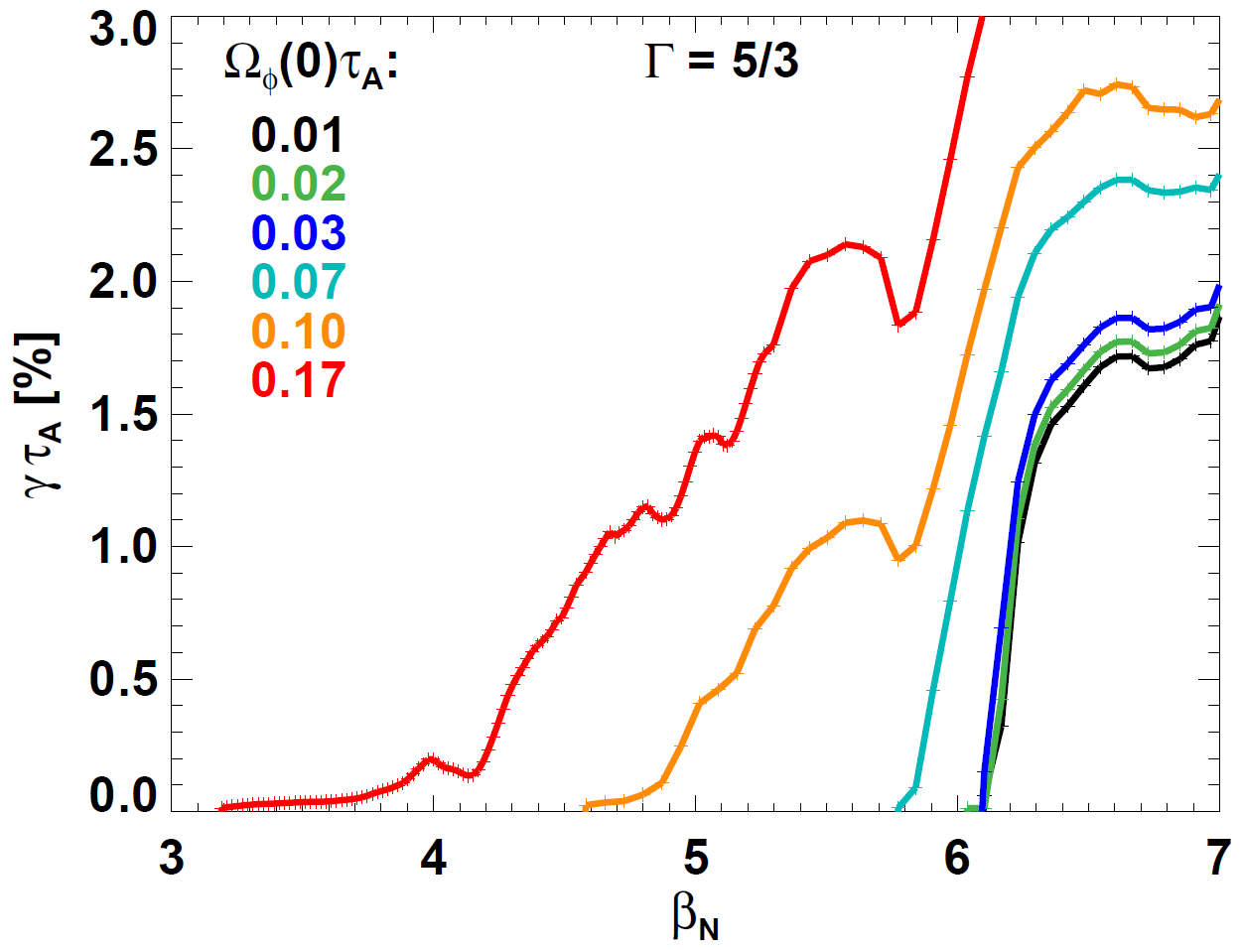
Fluid (non-kinetic) MARS-K calculations find:
Rotation reduces IWL β_{N} = 6 → 3-3.5
NSTX shot 138065, t=376ms
MARS n=1 in fluid limit
experimental value
Experiment
High rotation β_{N} limit ~ 4.5 → 3.2
for Ω_{φ}(0)τ_{A} = 10 → 17% (experimental)
Low rotation β_{N} limit ~ 6
for Ω_{φ}(0)τ_{A} = 1 → 7%
Fluid MARS marginal β_{N} ~ 3 – 4 consistent with experiment

Slide 9
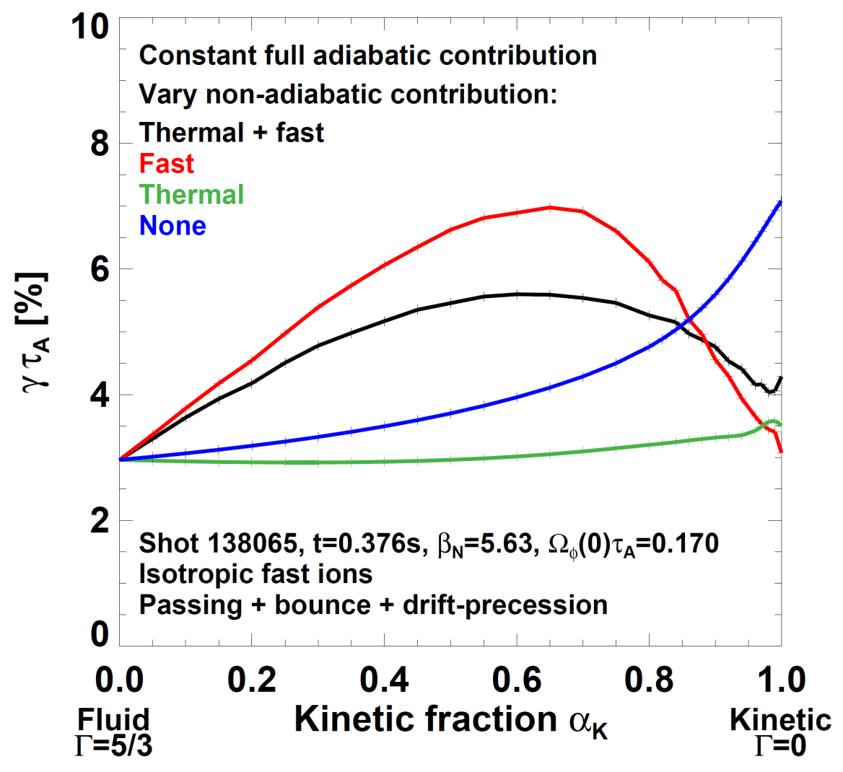
Kinetic mode also destabilized by rotation
Kinetic mode tracked numerically by starting from fluid root and increasing kinetic fraction α_{K} = 0 → 1 as Γ = 5/3 → 0
Experimental rotation
β_{N} = 5.6 < low-rotation IWL
Non-adiabatic δW_{kinetic} fraction varied (α_{K}=0 → 1) including:
No thermal or fast
Thermal and fast
Fast only
Thermal only
γ variation from fluid to kinetic mode can be non-monotonic
Kinetic mode γ ≈ fluid γ implies destabilization results from rotation

Slide 10
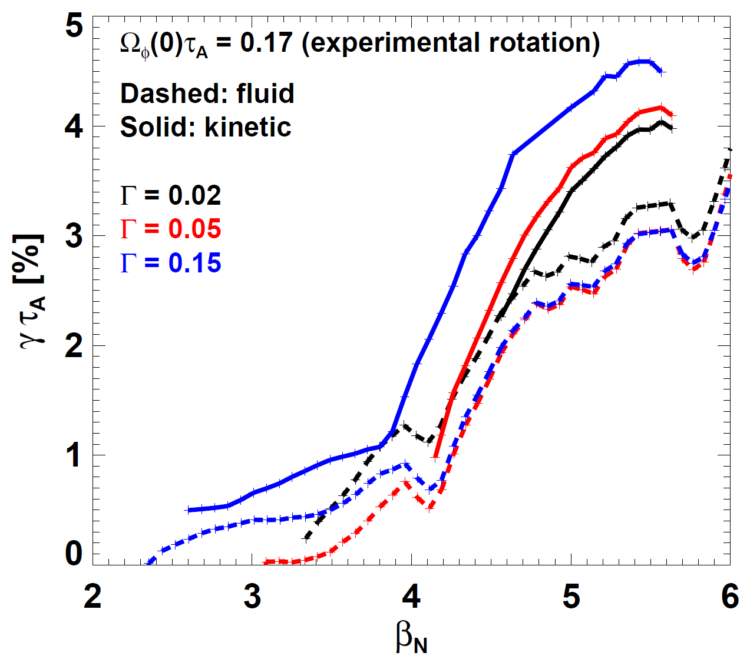
Kinetic stability limit similar to fluid limit:
Marginal β_{N} < 3.5 far below low-rotation β_{N} limit of ~6
NSTX shot 138065, t=376ms
Fluid and kinetic n=1
Solid: Kinetic γ
Dashed: Fluid γ
Convergence issues:
Drift-kinetic MHD model assumes fluid Γ = 0
When Γ = 0, MARS can sometimes track wrong root or find spurious root
Solution: take Γ → 0 limit, monitor eigenfunctions for continuous trend vs. α_{k}, β, Γ
Experimental β_{N} for n=1 mode onset

Slide 11
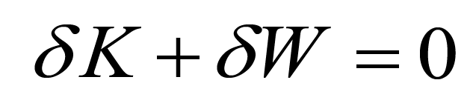
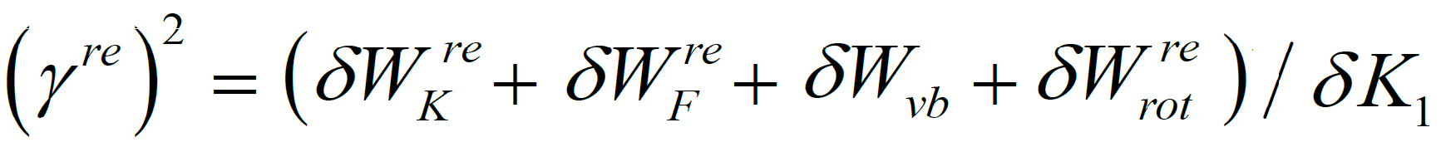
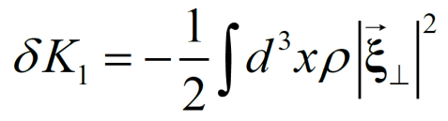
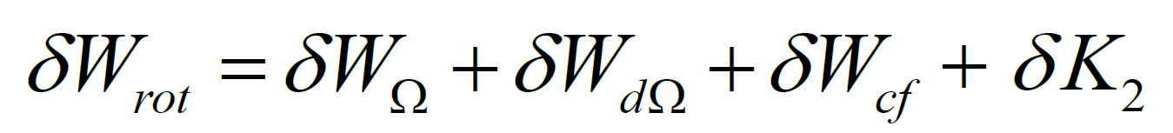
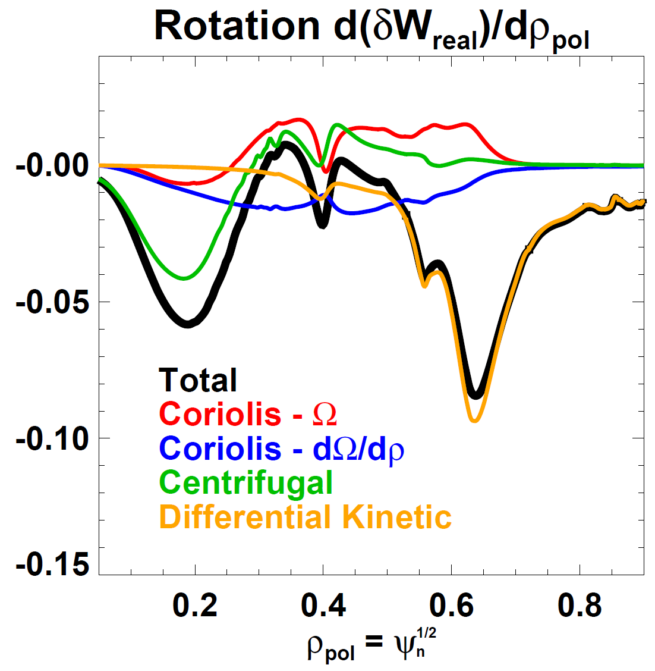
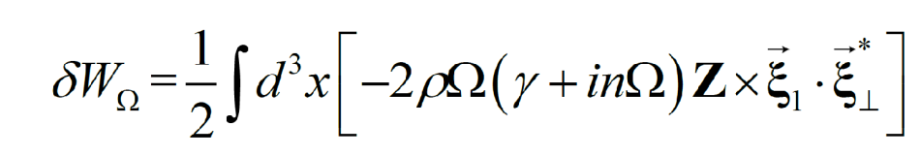
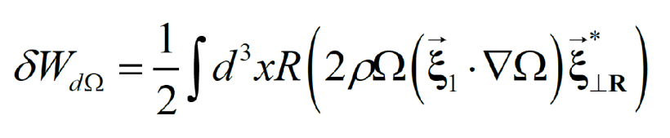
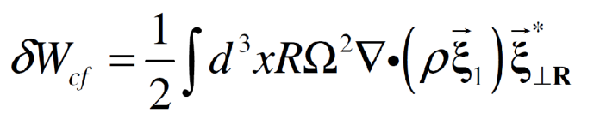
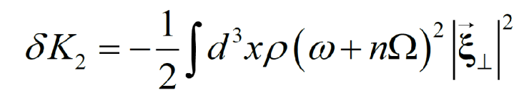
Real part of complex energy functional consistent with rotational destabilization (δW_{rot} ≤ 0) across minor radius
< 0
NSTX shot 138065, t=376ms
Coriolis - Ω
Coriolis - dΩ/dρ
Centrifugal
Differential kinetic (always destabilizing)
–
Destabilization from: Coriolis (dΩ/dρ), centrifugal, differential kinetic

Slide 12
Study 3 classes of IWM-unstable plasmas spanning low to high β_{N}
Low β_{N} limit ~ 3.5, often saturated/long-lived
  q_{min} ~ 2-3
  Common in early phase of current flat-top
  Higher fraction of beam pressure, momentum (lower n_{e})
Intermediate β_{N} limit ~ 5
  q_{min} ~1.2-1.5
  Typical good-performance H-mode, H₉₈ ~ 0.8-1.2
Highest β_{N} limit ~ 6-6.5
  q_{min} ~ 1
  “Enhanced Pedestal” H-mode → high H₉₈ ~ 1.5-1.6
  Broad pressure, rotation profiles, high edge rotation shear

Slide 13
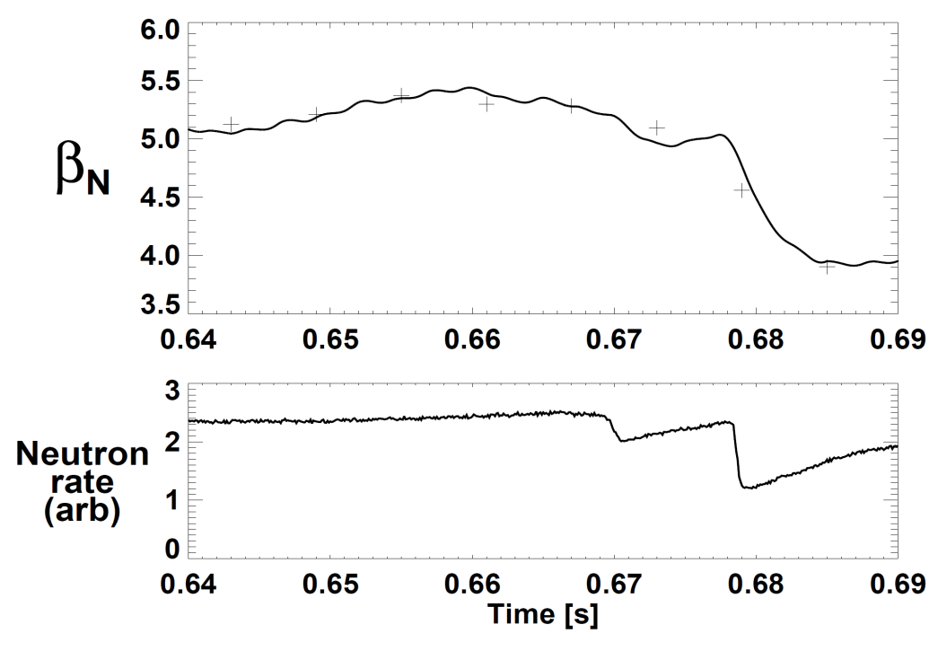
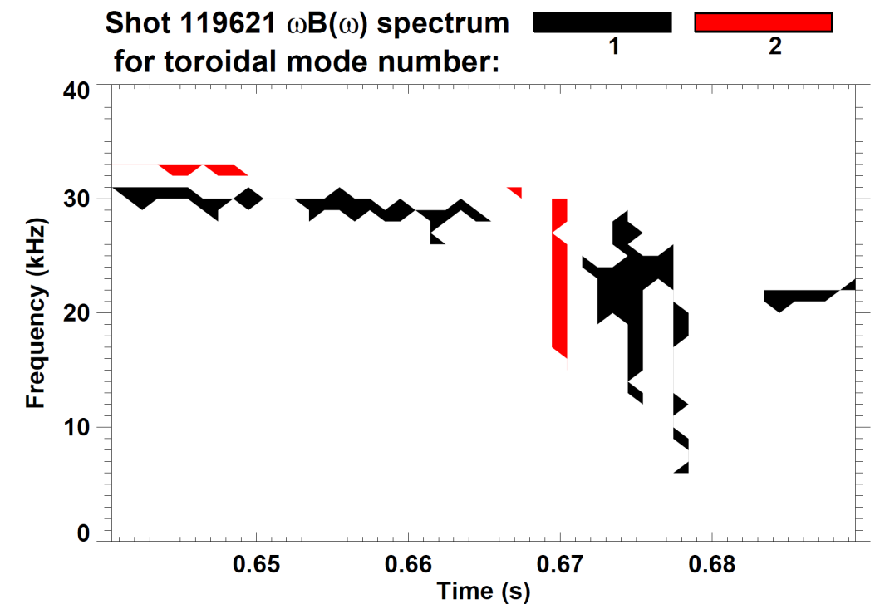
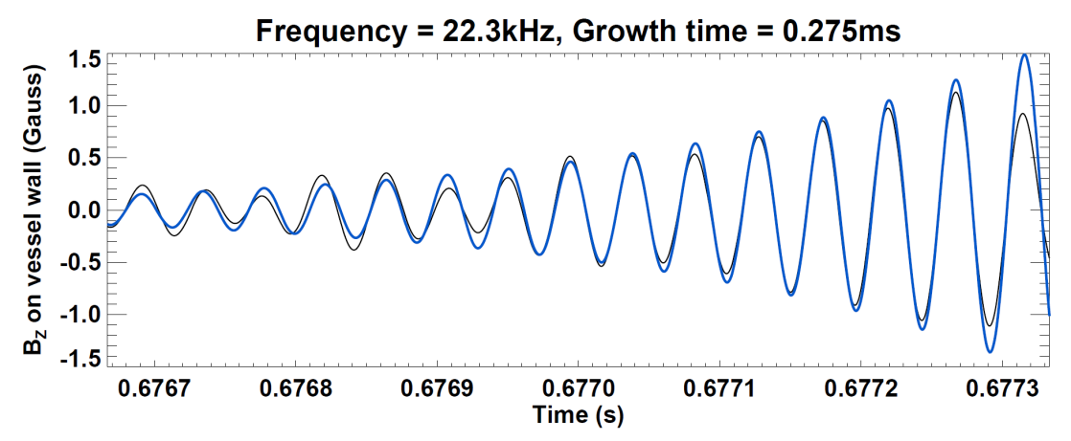
Small f=30kHz continuous n=1 mode precedes larger 20-25kHz n=1 bursts
First large n=1 burst →
20% drop in β_{N}
50% neutron rate drop
Later n=1 modes → full disruption
γ_{eff} τ_{A} ~ 4×10⁻³

Slide 14
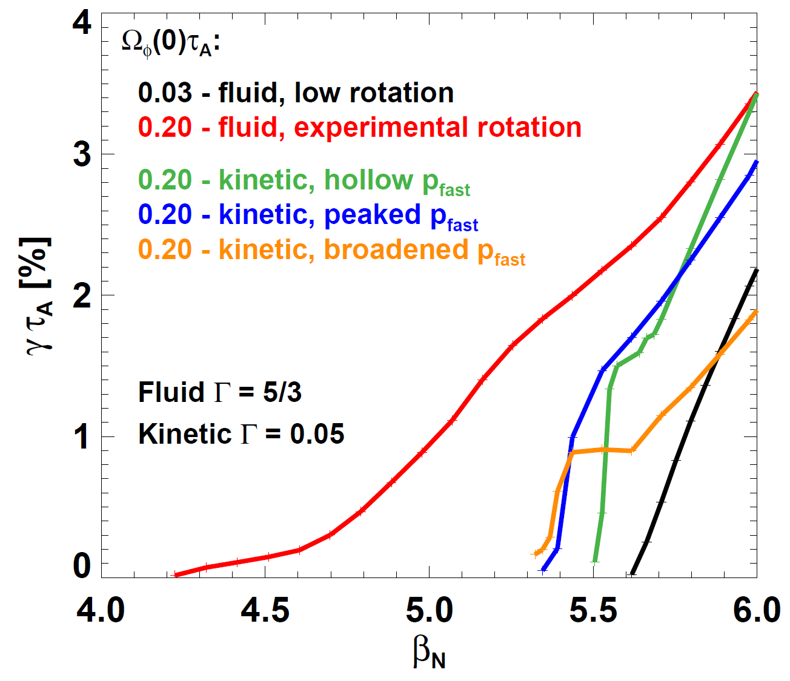
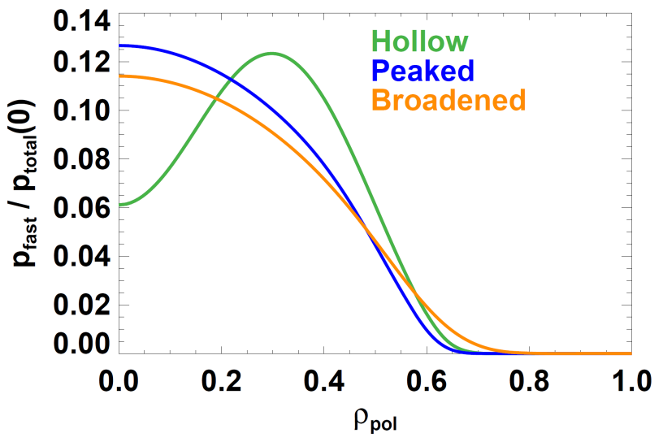
Kinetic IWM β_{N} limit consistent with experiment, fluid calculation under-predicts experimental limit
NSTX shot 119621, t=610ms
Fast-ion p profiles used in kinetic calculations
Fluid β_{N} limit for low Ω_{φ}
Kinetic β_{N} limit for experimental Ω_{φ} (weakly dependent on fast-ion peaking factor)
Experimental β_{N} for n=1 mode onset
Fluid β_{N} limit for experimental Ω_{φ} (Δβ_{N} = -1.4 vs. low rotation)

Slide 15
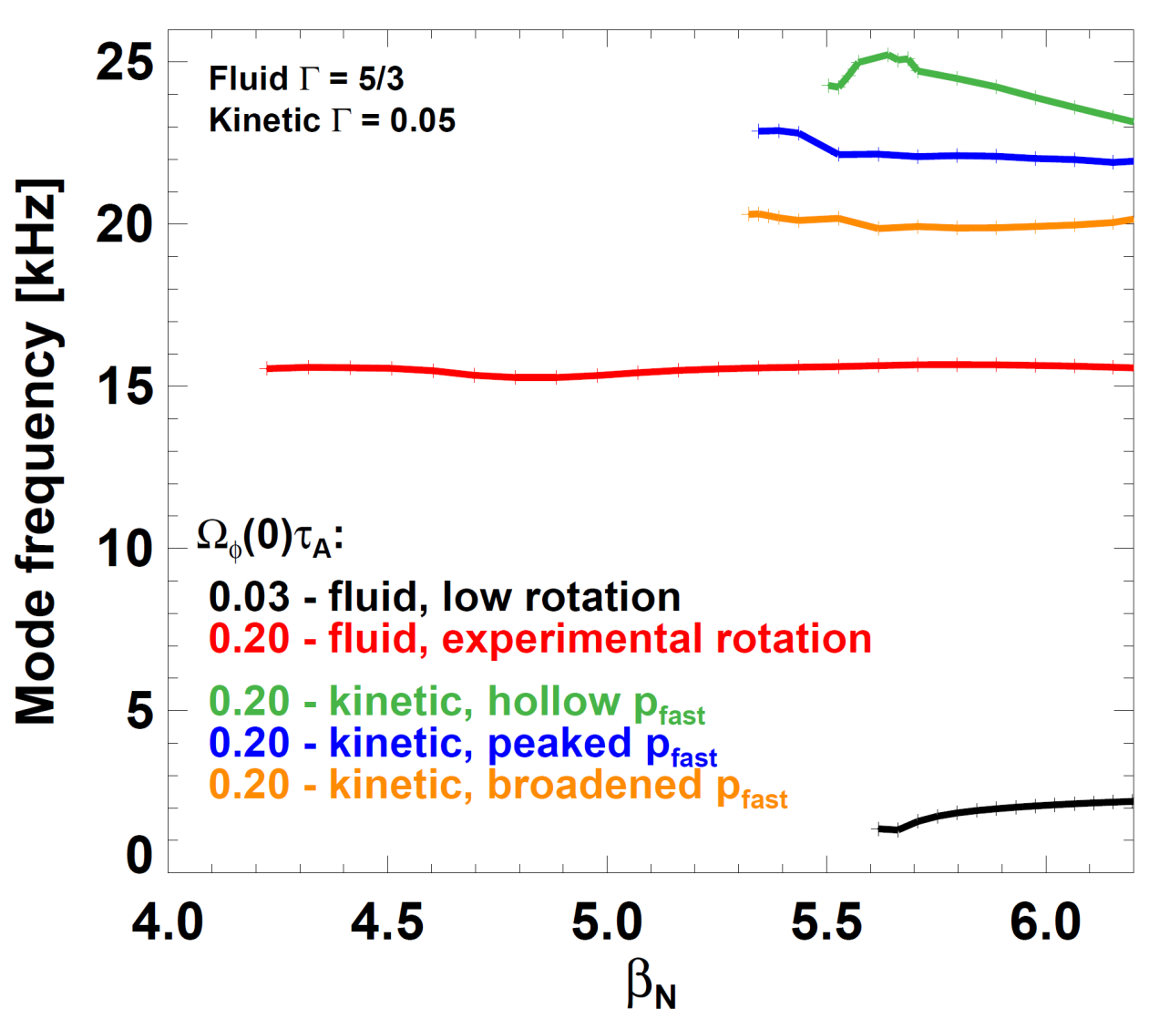
Measured IWM real frequency more consistent with kinetic model than fluid model
Measured mode frequency
NSTX shot 119621, t=610ms
Fast-ion p profiles used in kinetic calculations

Slide 16
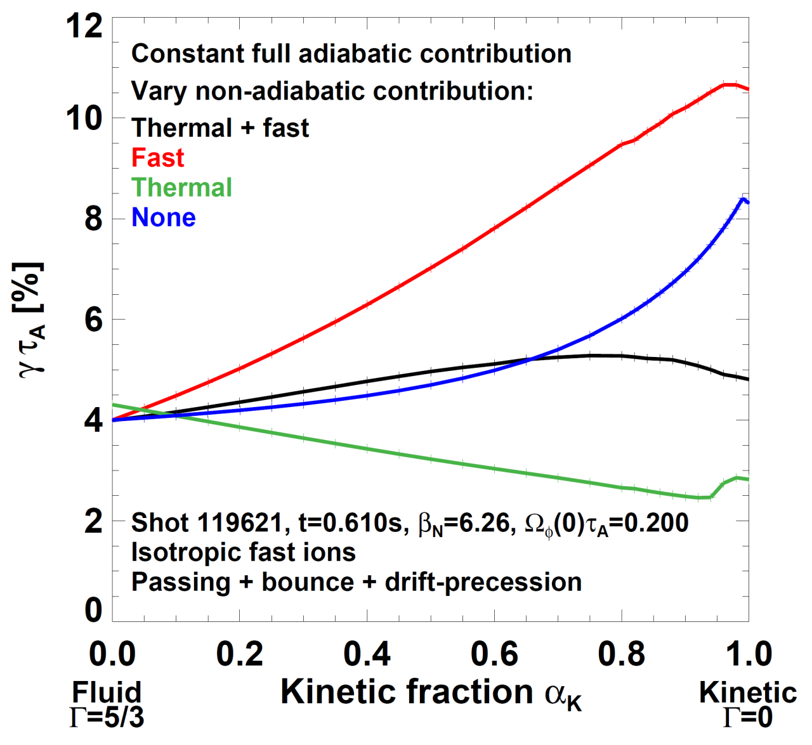
IWM: Kinetic fast-ions destabilizing, thermals stabilizing
Fast ions only: kinetic γ exceeds all other γ values
Kinetic γ with no damping
(non-adiabatic δW_{k} = 0 limit)
Kinetic γ with thermal + fast: similar to fluid γ
Thermals only: stabilizing
Implication: thermal damping stabilizes rotation-driven mode

Slide 17
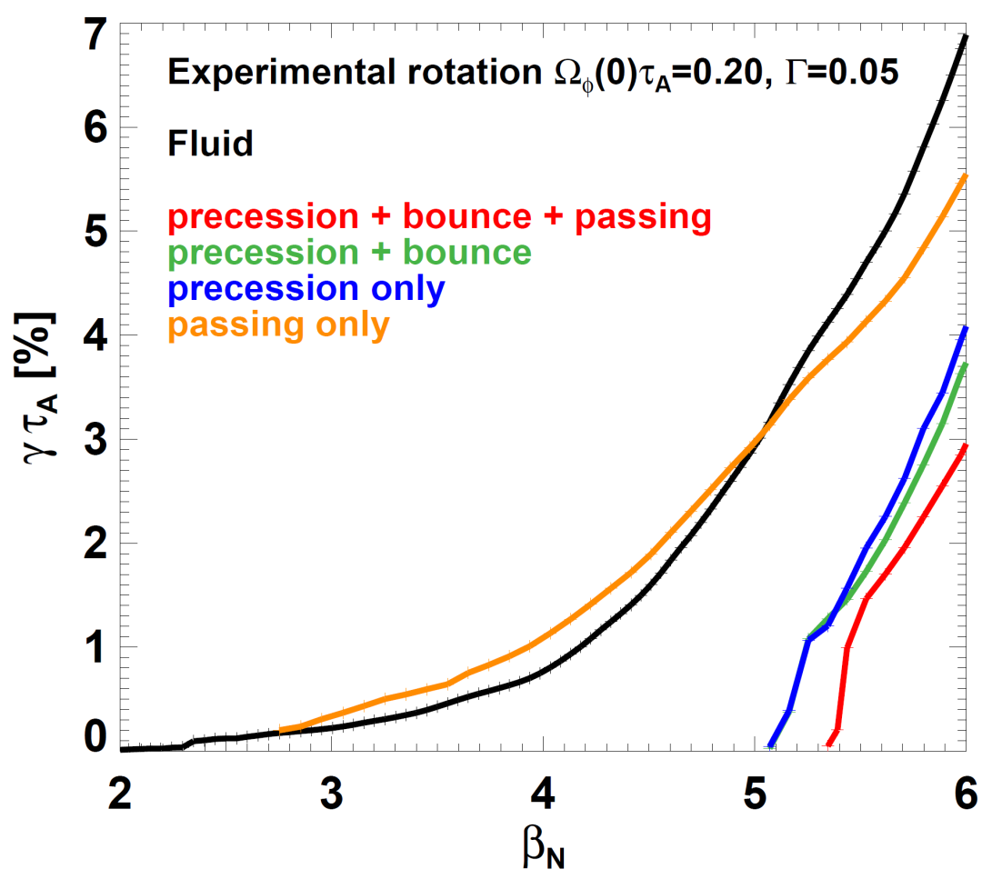
IWM: Precession resonance dominates damping, highest β_{N} requires inclusion of passing resonance
no damping
Passing more important than bounce resonance after precession
Precession resonance provides most stabilization
Resonance occurs near location of ω_{r} = ω_{E} in core (not shown)
Passing resonance alone provides little stabilization: γ ≈ γ_{no-damp}

Slide 18
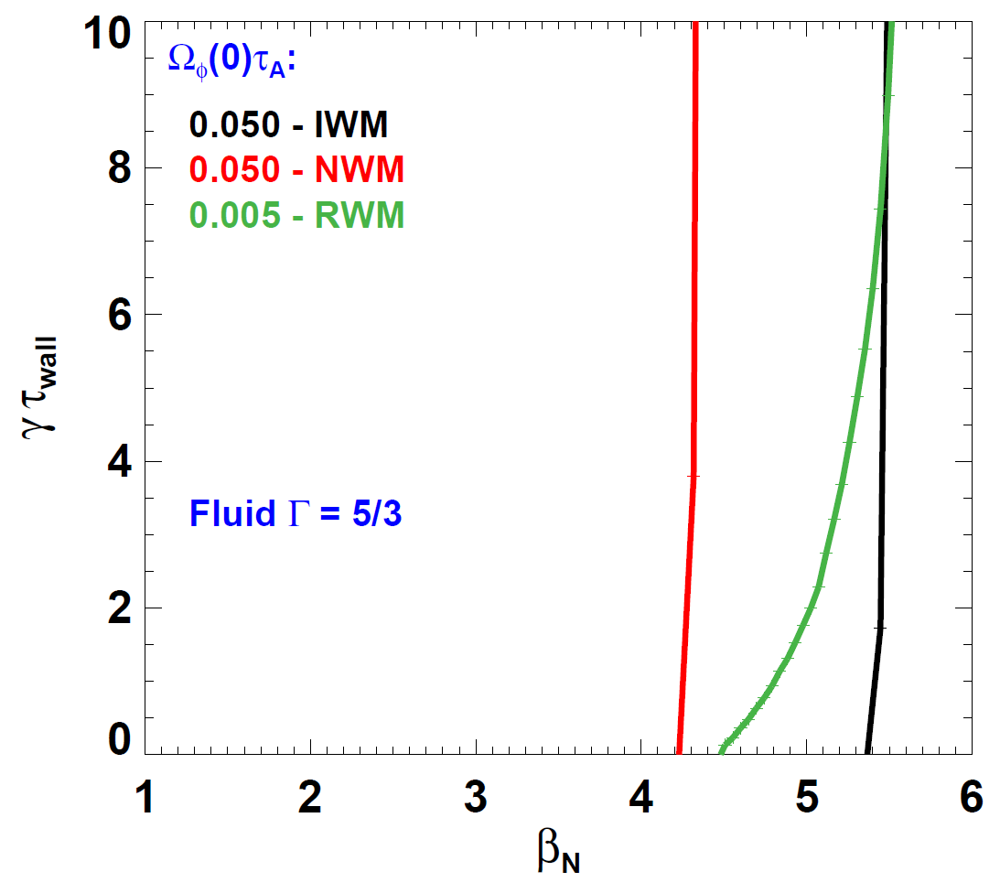
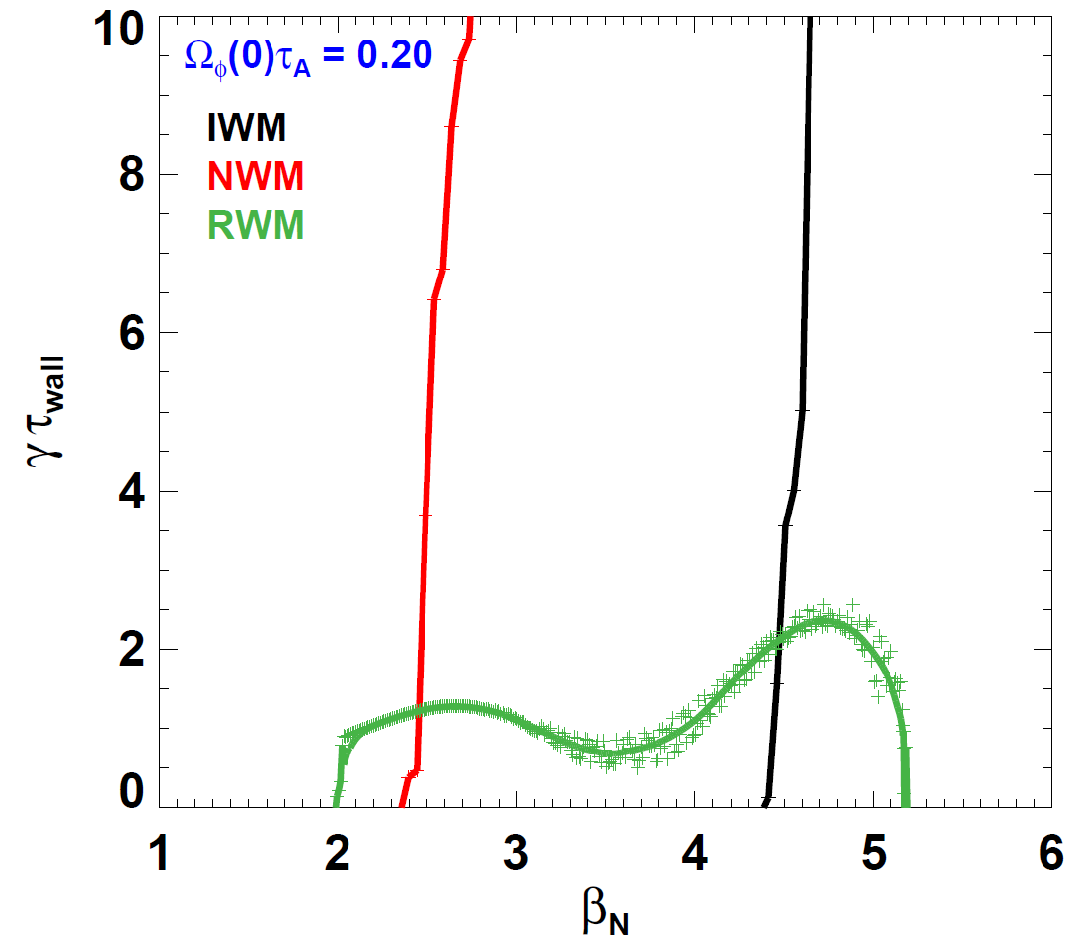
High rotation reduces β_{N} limits for ideal wall mode (IWM), no-wall mode (NWM), and resistive wall mode (RWM)
Fluid limit (no kinetic effects)
Fluid limit (no kinetic effects)
At high rotation, RWM marginal β_{N} limit can extend below fluid NWM limit, above fluid IWM limit, near kinetic IWM limit

Slide 19
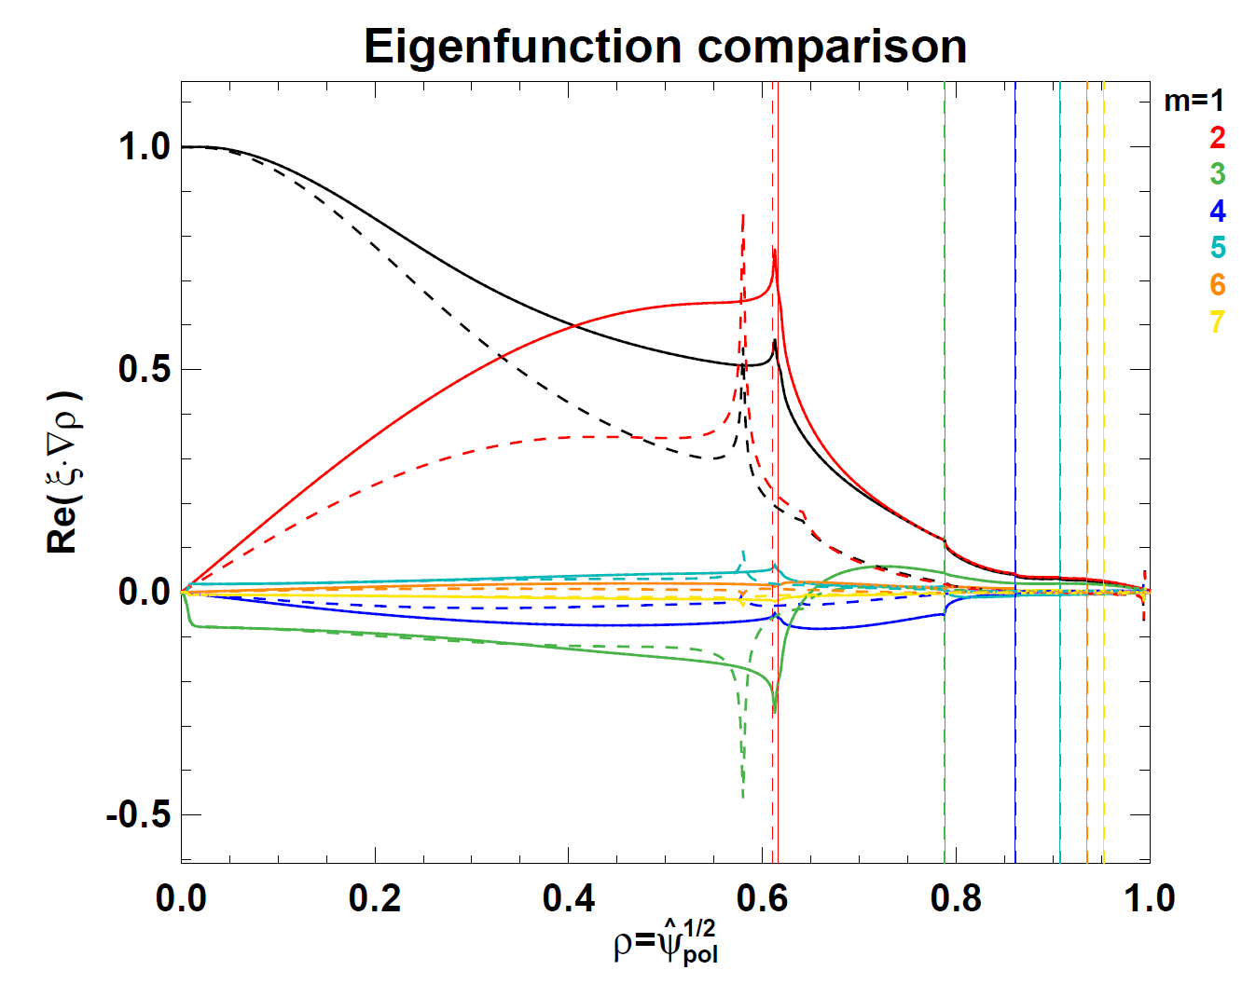
RWM: Rotation can change fluid RWM eigenfunction and move regions of singular displacement away from rationals
Solid: Ω_{φ}(0)τ_{A} = 0.005, Γ=5/3 Dashed: Ω_{φ}(0)τ_{A} = 0.20, Γ=0.0001
Note: β_{N} values are not identical

Slide 20
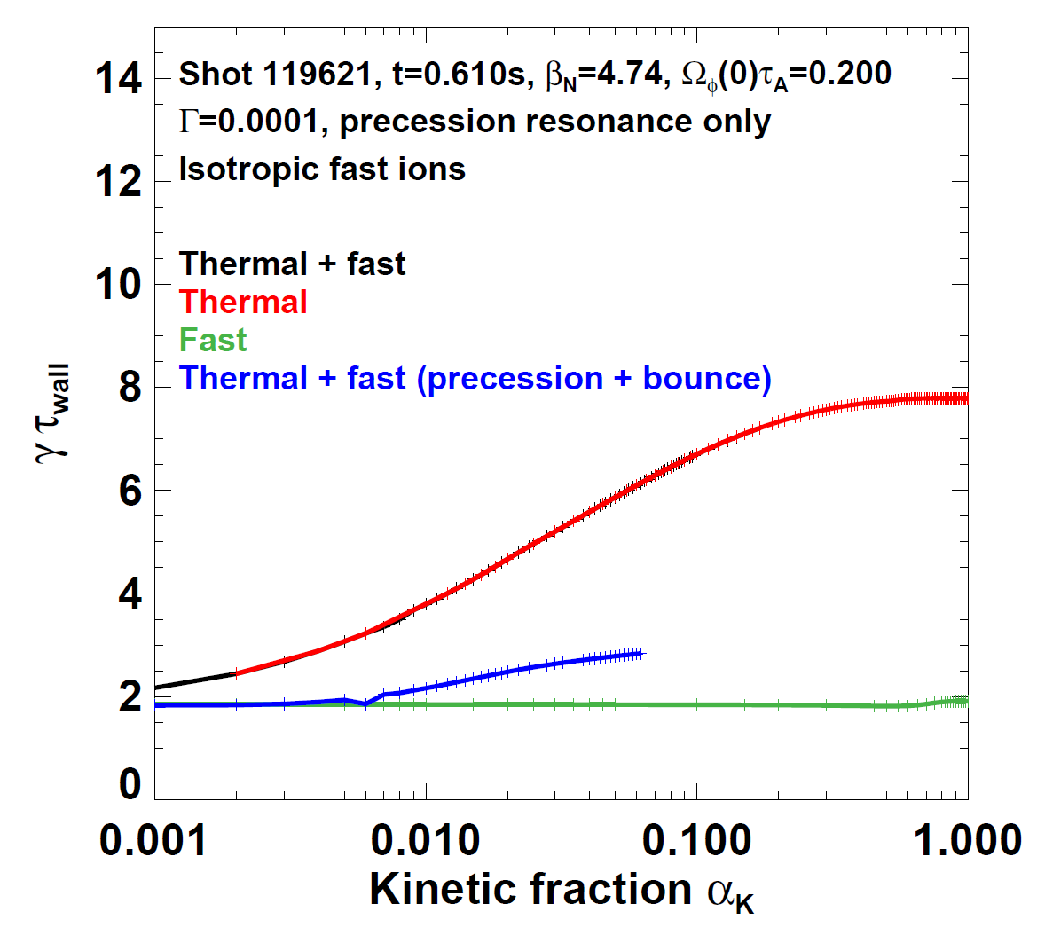
Precession resonance alone cannot provide passive RWM stabilization – next step: include bounce harmonics, passing
Thermals are destabilizing
Fast ion contribution to stability is small
Fast + thermal similar to thermal
Precession + bounce calculations underway → less destabilization

Slide 21
Study 3 classes of IWM-unstable plasmas spanning low to high β_{N}
Low β_{N} limit ~ 3.5, often saturated/long-lived
  q_{min} ~ 2-3
  Common in early phase of current flat-top
  Higher fraction of beam pressure, momentum (lower n_{e})
Intermediate β_{N} limit ~ 5
  q_{min} ~1.2-1.5
  Typical good-performance H-mode, H₉₈ ~ 0.8-1.2
Highest β_{N} limit ~ 6-6.5
  q_{min} ~ 1
  “Enhanced Pedestal” H-mode → high H₉₈ ~ 1.5-1.6
  Broad pressure, rotation profiles, high edge rotation shear

Slide 22
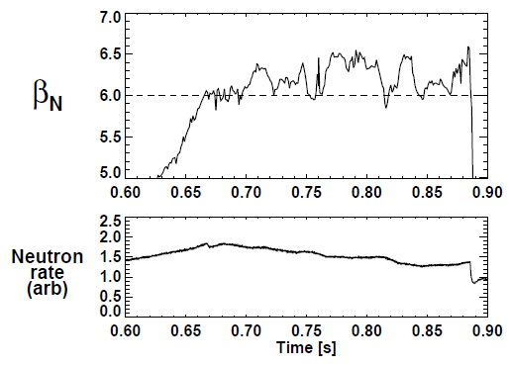
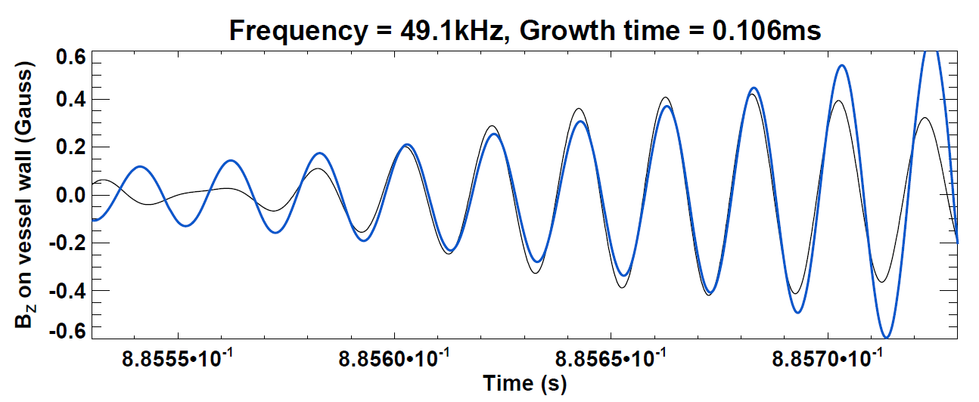
Experimental characteristics of highest-β_{N} MHD
β_{N} = 6-6.5 sustained for 2-3τ_{E}
  Oscillations from ELMs and bottom/limiter interactions
  Possible small RWM activity
  Only small core MHD (steady neutron rate)
NSTX shot 134991, t=760ms
f = 50kHz mode causes 35% β_{N} drop ending high-β phase
  Mode grows very fast (~100μs)
  n-number difficult to determine
  Possible that mode has n > 1
γ_{eff} τ_{A} ~ 1×10⁻²

Slide 23
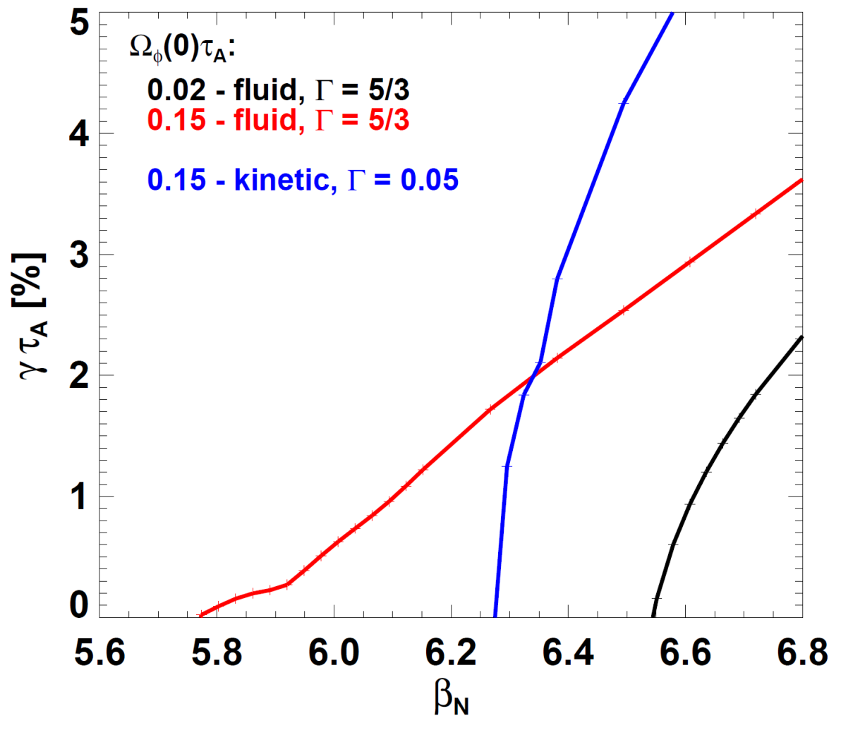
Kinetic IWM stability consistent with access to β_{N} > 6
Fluid calculation under-predicts experimental β_{N}
NSTX shot 134991, t=760ms
Fluid β_{N} limit ~6.55 for low Ω_{φ}
Kinetic β_{N} limit ~ 6.3 for experimental Ω_{φ}
Experimental β_{N} range
Fluid β_{N} limit ~ 5.7 for experimental Ω_{φ}
Rotational de-stabilization weaker (Δβ_{N} = -0.8 vs. low rotation)

Slide 24
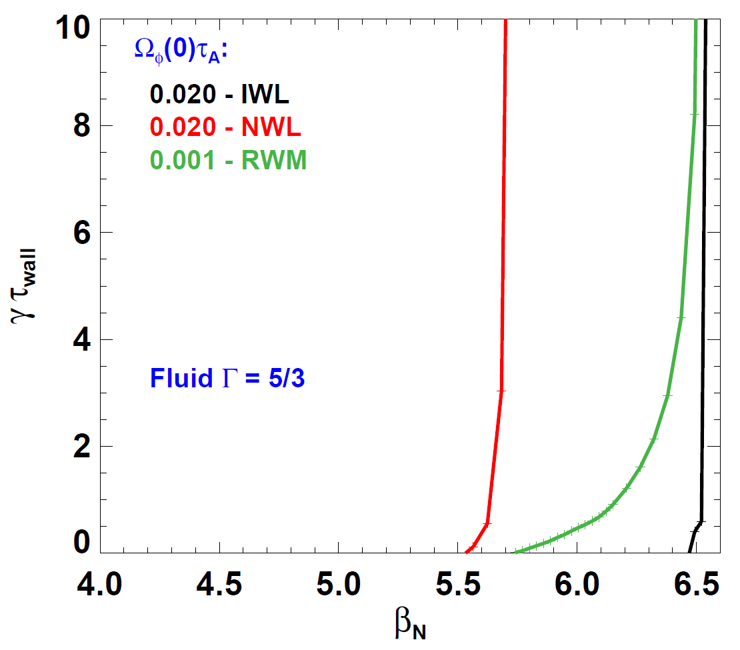
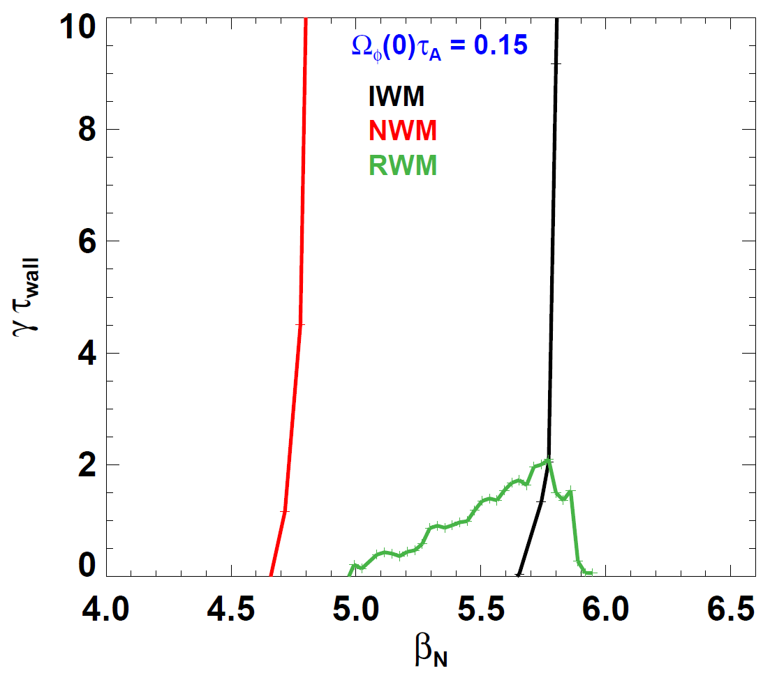
High again rotation reduces β_{N} limits for IWM, NWM, & RWM
Fluid limit (no kinetic effects)
Fluid limit (no kinetic effects)
RWM Γ=10⁻⁴
NSTX shot 134991, t=760ms
Fluid RWM β_{N} limit can extend above the fluid IWM limit
Note: Fluid RWM β_{N} limit is lower than kinetic IWM limit
  Possible operating window at very high β_{N} where fluid RWM stable

Slide 25
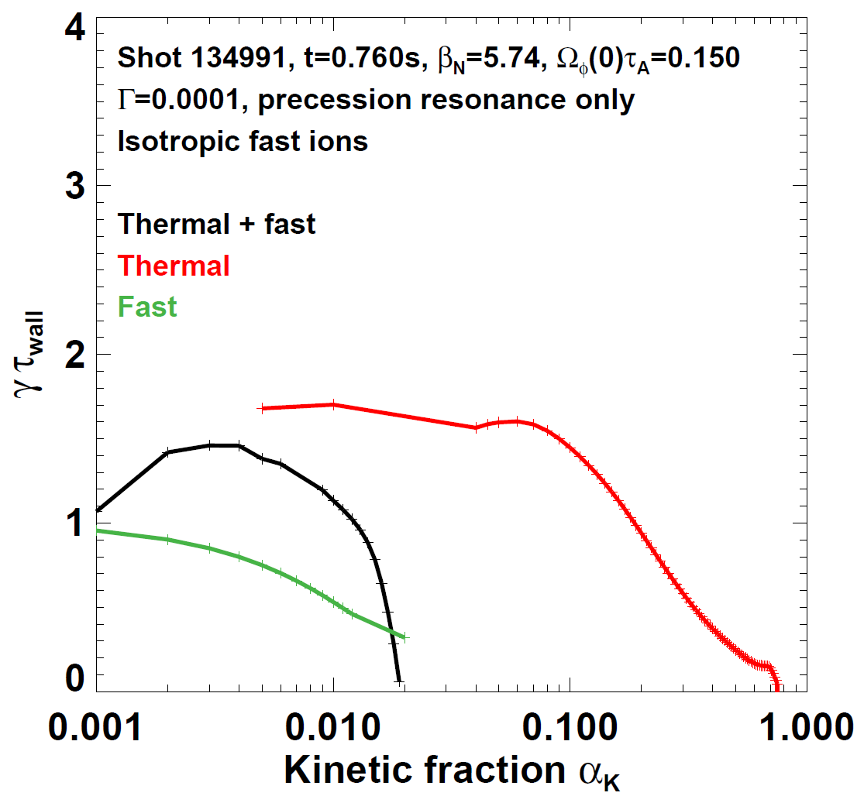
Precession resonance alone provides RWM passive stabilization (passive stability consistent with experiment)
Thermals marginally stabilizing: α_{k-crit} ~ 0.75
Fast ion contribution also stabilizing relative to fluid γ
Fast + thermal contributions strongly stabilizing: α_{k-crit} ~ 0.02

Slide 26
IWM energy analysis near marginal stability elucidates trends from growth-rate scans
All cases: field-line bending+compression balances primarily ∇p
∇•p + δB bending and compression
Vacuum
Parallel current J||
Rotation Ω_{φ}
Note: terms should sum to ≈ zero
Terms in
Re(δW)
δW_{vac-b}
Low β: J|| (low q shear) and high Ω_{φ} strongly destabilizing
Mid β: Reduced destabilization from J|| & Ω_{φ} increases β limit
High β: Large Ω_{φ}ꞌ at edge minimizes Ω_{φ} drive → highest β

Slide 27
Summary
Rotation, kinetic effects can modify IWM & RWM at high Ω_{φ}, β
  (From APS): Rotation effects most pronounced for plasmas near rotation-shear enhanced interchange/Kelvin-Helmholtz (KH) threshold
  High rotation shear near edge is most stable in theory and experiment
Kinetic damping from thermal resonances can be sufficient to suppress rotation-driven IWM → access low-rotation IWL
Fluid RWM β limits follow fluid NW and IW limits with rotation
Kinetic IWM β limits closer to experiment than fluid limits
Future work:
  Understand kinetic damping of rotation-driven modes in more detail
  Test more realistic fast-ion distribution functions – anisotropic / TRANSP
  Assess finite orbit width effects (see next talk) – for fast, edge thermal ions
  Assess modifications to RWM stability from rotation/rotation shear
  Utilize off-axis NBI, NTV in NSTX-U to explore IWM, RWM limit vs. rotation

Slide 28
Backup

Slide 29
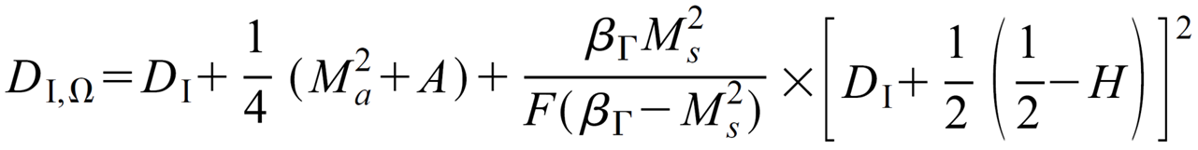
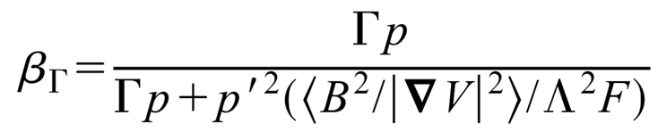

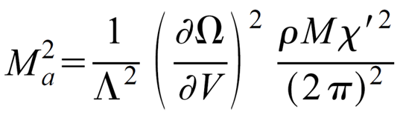
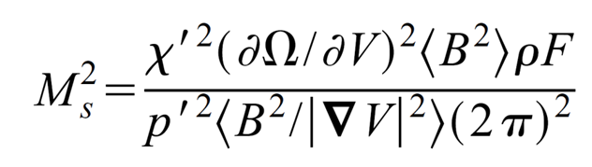
Analytic model of rotational-shear destabilization is being compared to MARS results and experiment
Model: low rotation, high rotation shear (Ming Chu, Phys. Plasmas, Vol. 5, No. 1, (1998) 183)
1. Ideal interchange criterion including rotation shear:
> 0
Ideal interchange index w/o rotation
Glasser, Greene, Johnson – Phys. Fluids (1975) 875
β_{Γ} = compressional Alfvén wave β
2. Kelvin-Helmholtz criterion:
>
M_{a} = (shear) Alfvén wave
excitation Mach number
M_{s} = sound Alfvén wave excitation Mach number
Rotation shear
destabilizes Alfvén wave directly or through sound wave coupling

Slide 30
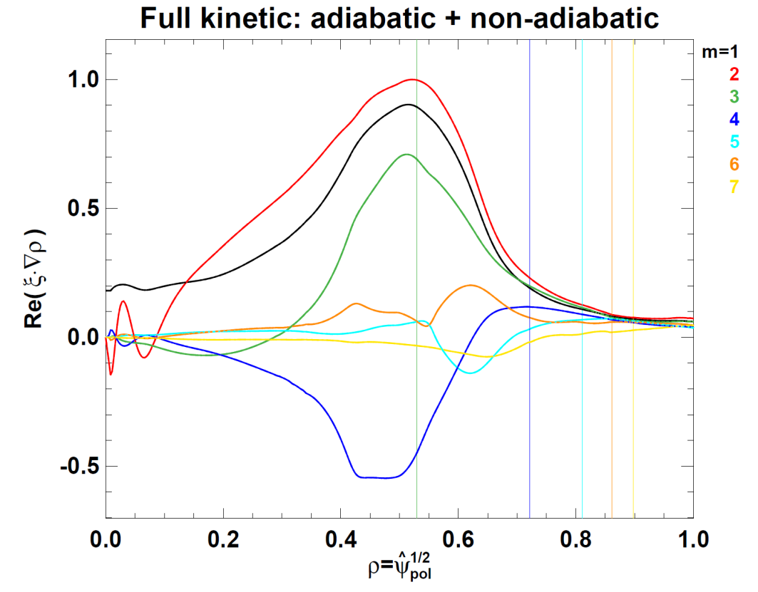
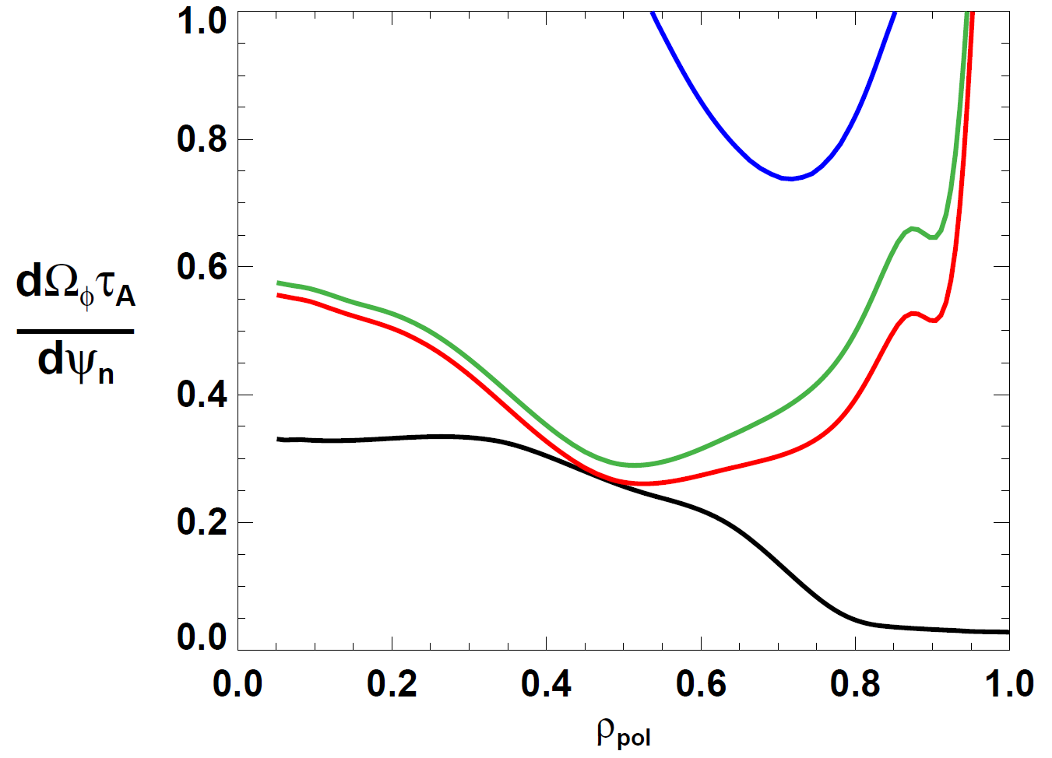
Experiment marginally stable to rotation-driven interchange/Kelvin-Helmholtz near half-radius
Chu model marginal Ωꞌ profiles:
D_{I,Ω} = 0 M_{s}² = β_{Γ} D_{I,Ω} (Γ=0) = 0
∇p dominant KH dominant
MARS full kinetic eigenfunction displacement largest near r/a~0.5
NSTX shot 138065, t=376ms
Experimental Ωꞌ profile
m=2 component dominant (q_{min}~2)

Slide 31
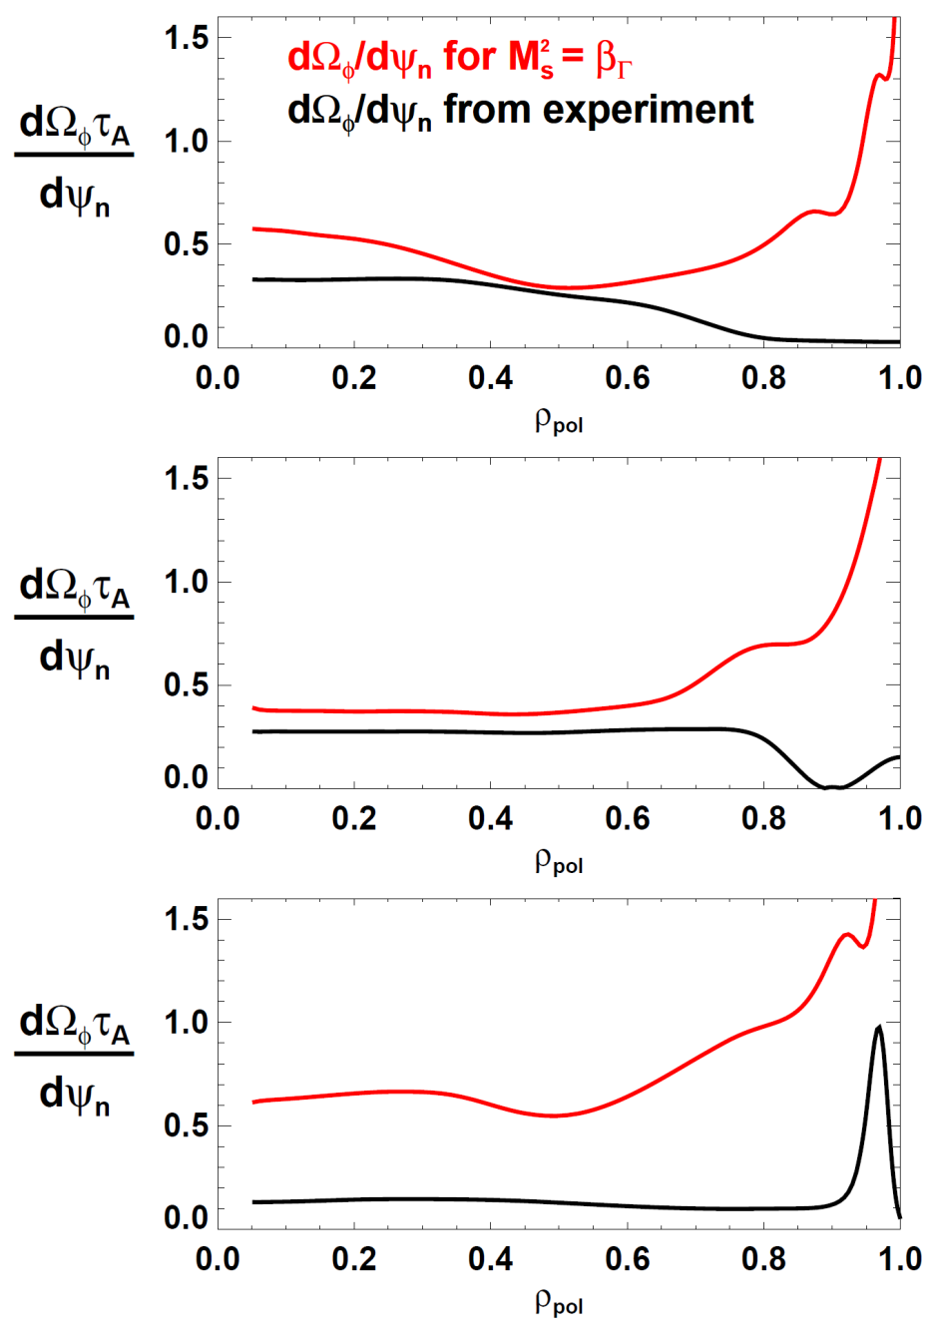
Comparison of cases for KH marginal rotation shear
Low β case
  Rotation shear mode not stabilized kinetically
Medium β case
  Nearly achieve no-rotation IWL via kinetic stabilization
High β case
  High edge rotation shear stabilizing – minimizes needed kinetic stabilization

Slide 32
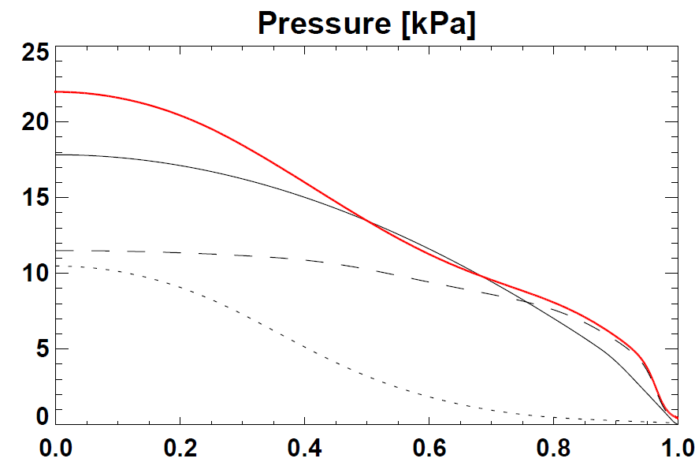
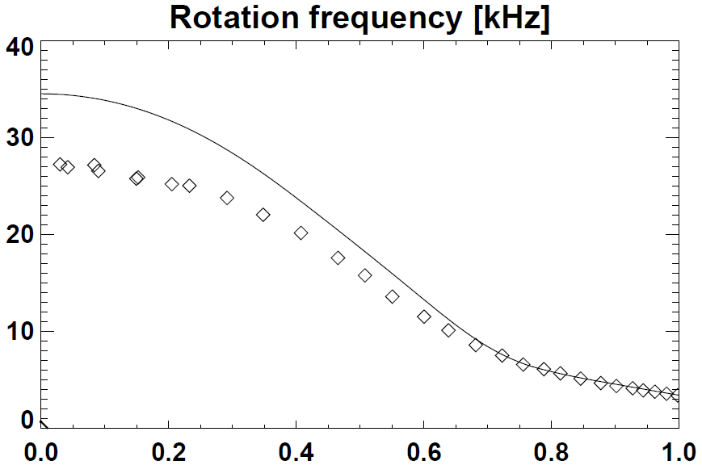
Inclusion of thermal and fast-ions (TRANSP) in total pressure can significantly modify pressure profile shape
Total pressure (thermal + fast)
NSTX shot 138065, t=376ms
Reconstruction
(without kinetic pressure constraint)
Thermal
Fast
Thermal + NBI
(includes fast-ion angular momentum)
Thermal (C⁶⁺)
ρ_{pol}

Slide 33
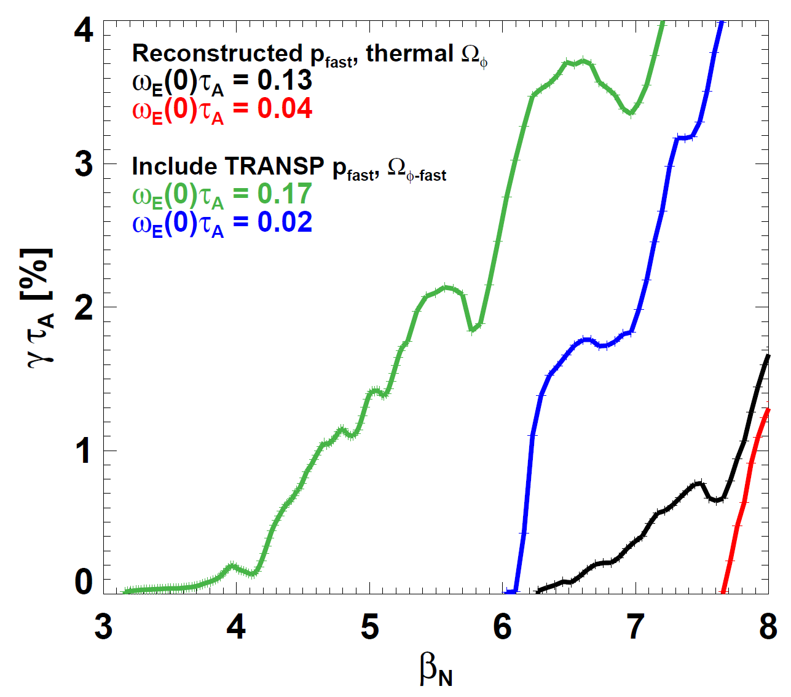
Inclusion of fast-ion pressure and angular momentum (computed from TRANSP) significantly lowers marginal β_{N}
NSTX shot 138065, t=376ms
FLUID CALCULATIONS
Increased pressure profile peaking from fast-ions lowers β_{N} limit from 7.7 to 6.1 at low rotation
Effective β_{N} limit at experimental rotation reduced from 6.3 to ~3.4
Ω_{φ}(0)τ_{A} = 0.13
Ω_{φ}(0)τ_{A} = 0.04
Ω_{φ}(0)τ_{A} = 0.17
Ω_{φ}(0)τ_{A} = 0.02

Slide 34
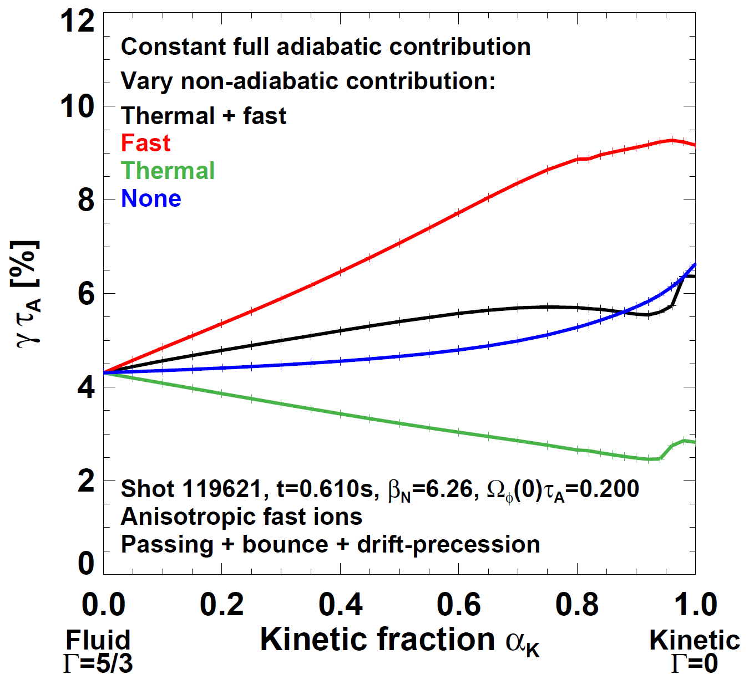
Initial studies find anisotropic fast-ion distribution has damping vs. α_{k}, Γ trends similar to isotropic
Isotropic
Anisotropic
Anisotropic fast-ion passing resonance can cause δW_{K} singularities – investigating…

Slide 35
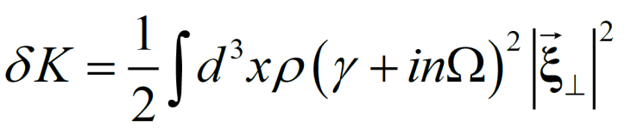


Real part of complex energy functional provides equation for growth-rate useful for understanding instability sources
Dispersion relation
Kinetic energy
Potential energy
Growth rate equation: mode growth for δW^{re} < 0
Coriolis - Ω
Coriolis - dΩ/dρ
Centrifugal
Differential kinetic
Note: n = -1 in MARS

