Slide 1




NSTX-U
Supported by
Active resistive wall mode and plasma rotation control for disruption avoidance in NSTX-U
S. A. Sabbagh¹, J.W. Berkery¹, R.E. Bell²,
J.M. Bialek¹, D.A. Gates², S.P. Gerhardt²,
I.R. Goumiri³, Y.S. Park¹, C.W. Rowley³,Y. Sun⁴
¹Department of Applied Physics, Columbia University, New York, NY
²Princeton Plasma Physics Laboratory, Princeton, NJ
³Princeton University, Princeton, NJ
⁴ASIPP, Hefei Anhui, China
Coll of Wm & Mary
Columbia U
CompX
General Atomics
FIU
INL
Johns Hopkins U
LANL
LLNL
Lodestar
MIT
Lehigh U
Nova Photonics
ORNL
PPPL
Princeton U
Purdue U
SNL
Think Tank, Inc.
UC Davis
UC Irvine
UCLA
UCSD
U Colorado
U Illinois
U Maryland
U Rochester
U Tennessee
U Tulsa
U Washington
U Wisconsin
X Science LLC
Culham Sci Ctr
York U
Chubu U
Fukui U
Hiroshima U
Hyogo U
Kyoto U
Kyushu U
Kyushu Tokai U
NIFS
Niigata U
U Tokyo
JAEA
Inst for Nucl Res, Kiev
Ioffe Inst
TRINITI
Chonbuk Natl U
NFRI
KAIST
POSTECH
Seoul Natl U
ASIPP
CIEMAT
FOM Inst DIFFER
ENEA, Frascati
CEA, Cadarache
IPP, Jülich
IPP, Garching
ASCR, Czech Rep
18th Workshop on MHD Stability Control
November 18th, 2013
Santa Fe, New Mexico
V1.2

Slide 2
Near-complete disruption avoidance in long-pulse tokamak devices is a new “grand challenge” for stability research
Disruption avoidance is an urgent need for the spherical torus (ST), ITER, and tokamaks in general
  Preparing several physics-based control approaches for disruption prediction / avoidance (P&A) in NSTX-U
Disruption categorization (NSTX database)
% Having strong low frequency
n = 1 magnetic precursors
55%
% Associated with large core rotation evolution
46%
Outline (approaches discussed here)
  MHD spectroscopy at high beta
  Kinetic RWM stabilization physics criteria
  Plasma rotation feedback control using NTV
  Model-based active RWM control and 3D coil upgrade
S. Gerhardt et al., NF 53 (2013) 063021

Slide 3
Highly successful disruption P&A needs to exploit several phases to avoid mode-induced disruption
Active RWM control in NSTX
A
B
C
D
A
Pre-instability
  RFA to measure stable γ
  Profile control to reduce RFA
  Real-time stability modeling for disruption prediction
Instability growth
  Profile control to reduce RFA
  Active instability control
Large amplitude instability
  Active instability control
Instability saturation
  Profile control to damp mode
0.5
I_{A}(kA)
0
-0.5
-1.0
-1.5
20
RFA
ΔB_{p}^{n=1}(G)
RFA reduced
B
10
RWM
0
300
Mode rotation
Co-NBI direction
200
φ_{Bp}^{n=1}(deg)
100
C
0
10
0
ΔB^{n=odd}(G)
D
-10
NSTX 128496
0.606
0.610
0.614
t (s)
0.618
S.A. Sabbagh, et al., Nucl. Fusion 50 (2010) 025020

Slide 4
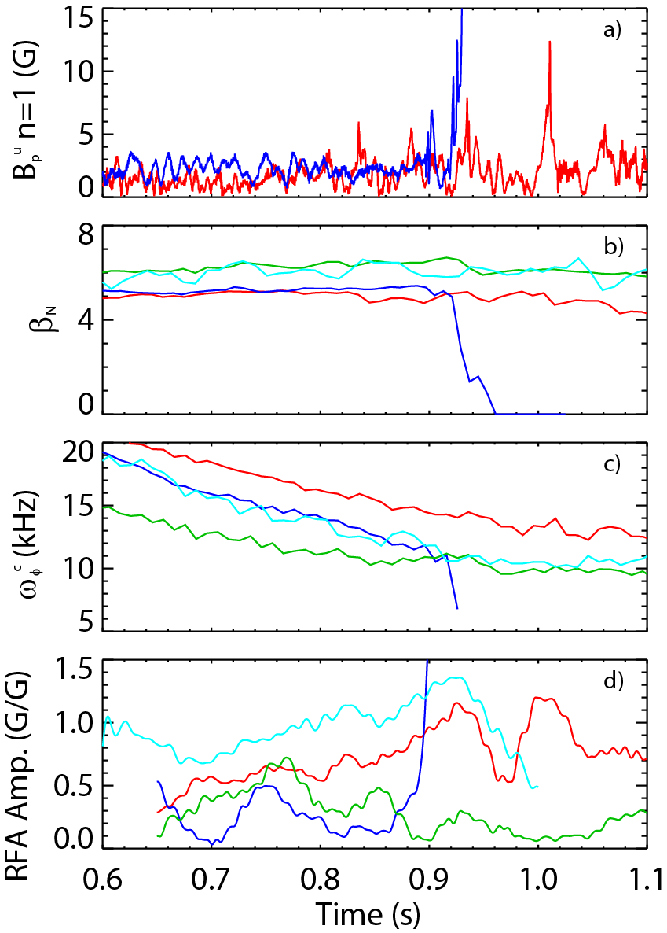
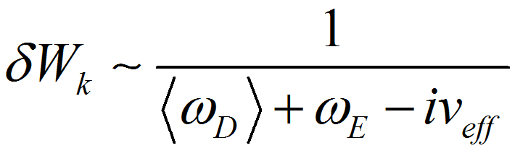
MHD spectroscopy, to be used for disruption P&A, reveals non-intuitive stability dependencies
MHD spectroscopy experiments
  measured resonant field amplification (RFA) of high β_{N} plasmas at varied ω_{φ}
  Higher RFA shows reduced mode stability
Counter-intuitive results:
  Highest β_{N}, lowest ω_{φ} (green): most stable
  Lowest β_{N}, highest ω_{φ} (red): less stable
  Higher β_{N}, highest ω_{φ} (cyan): less stable
  Lowest β_{N}, medium ω_{φ} (blue): unstable
Physics understanding given by kinetic RWM theory (simplified here):
RFA = B_{plasma}/B_{applied}
4
3
2
Precession Drift
~ Plasma Rotation
Collisionality
1

Slide 5
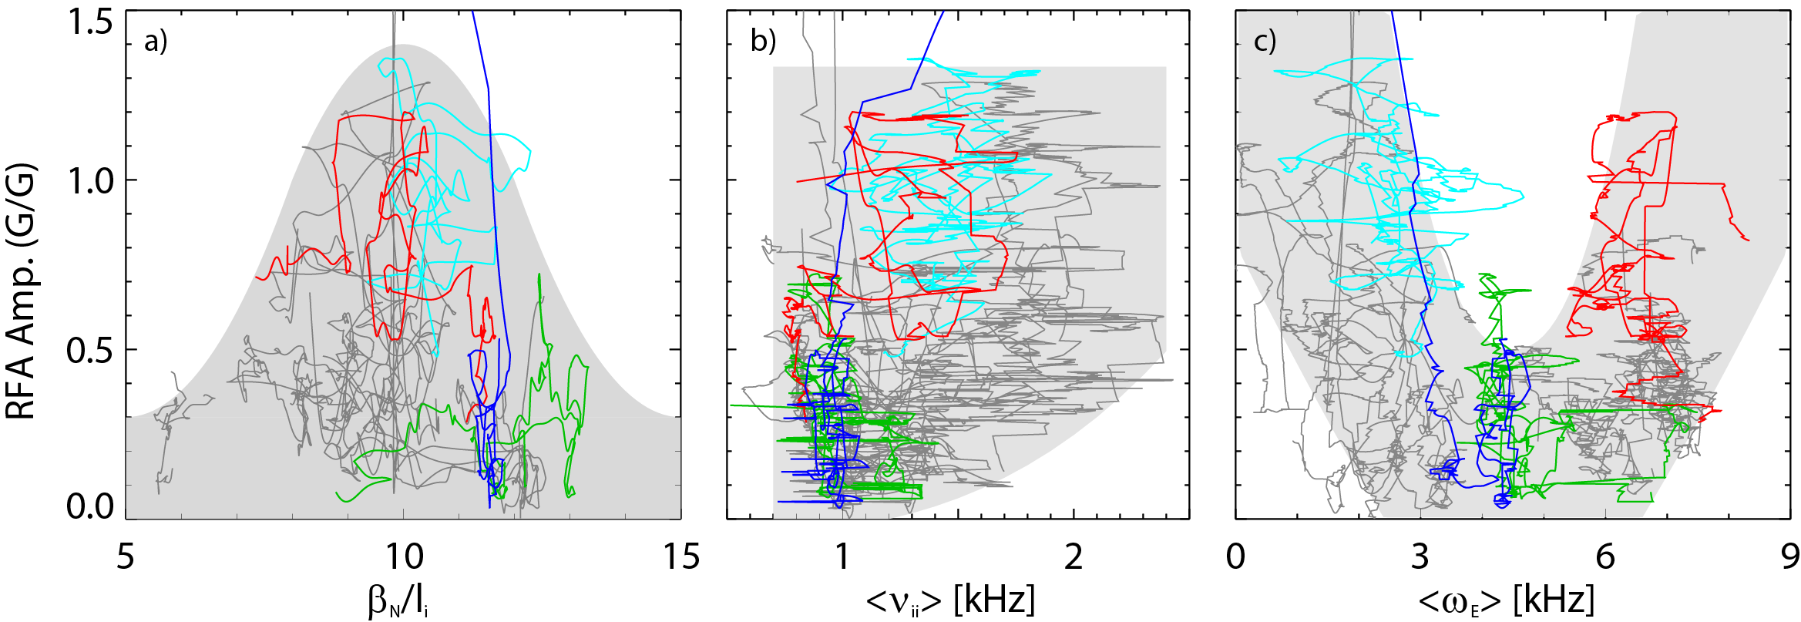
Experiments directly measuring global stability using MHD spectroscopy (RFA) support kinetic RWM stability theory
Resonant Field Amplification vs. β_{N}/l_{i}
RFA vs. rotation (ω_{E})
unstable
RWM
Most
stable
Stability at lower ν
  Collisional dissipation is reduced
  Stabilizing resonant kinetic effects are enhanced
  Stabilization when near broad ω_{φ} resonances; almost no effect off-resonance
(trajectories of 20 experimental plasmas)
Stability vs. rotation
  Largest stabilizing effect from ion precession drift resonance with ω_{φ}
Stability vs. β_{N}/l_{i}
  decreases up to β_{N}/l_{i} = 10, increases at higher β_{N}/l_{i}
  Consistent with kinetic resonance stabilization
Minimize |<ω_{D}> + ω_{E}|
S. Sabbagh et al., NF 53 (2013) 104007
J. Berkery et al., submitted to PRL

Slide 6
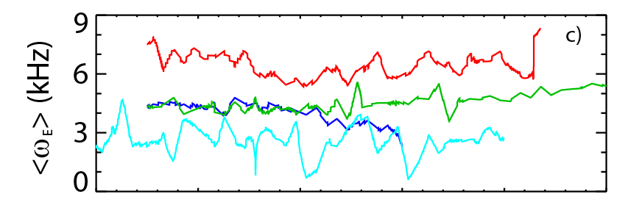
Simple models derived from kinetic RWM physics being developed for real-time disruption prediction / avoidance
Core rotation time evolution
Criteria to increase stability based on kinetic RWM physics
  Real-time measurement of ω_{φ} (and β_{N}) alone is insufficient!
  Precession drift stabilization criterion (minimize |ω_{E} + ω_{D}|) provides better guidance for global mode stability
    Corresponds to <ω_{E}> ~ 4 - 5 kHz
  Avoid disruption by controlling plasma rotation profile toward this condition
    obtain <ω_{E}> from real-time ω_{φ} and modeled n and T profiles
high
<ω_{E}> time evolution
safe
low

Slide 7
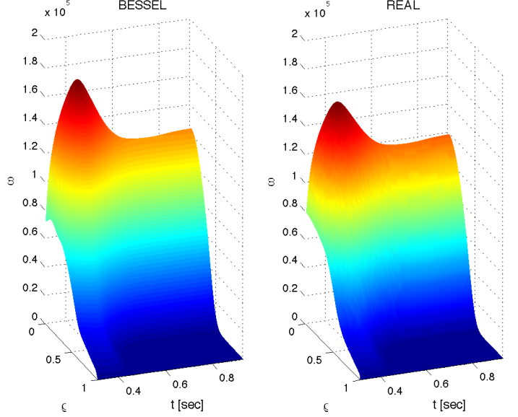
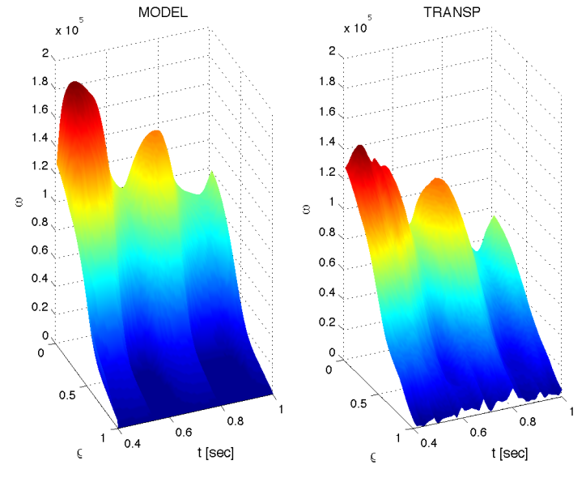
Model-based, state-space rotation controller designed to use Neoclassical Toroidal Viscosity profile as an actuator
Momentum force balance equation
State-space spectral decomposition of ω: Bessel function states
  Typically, 10 states are used
Comparisons of state-space model to solution of full PDE: T_{NBI} + T_{NTV} actuators
State-space model
Full PDE
State-space model
TRANSP run
(based on) 133367
133743
Rotation frequency
Rotation frequency
radius
radius
t(s)
t(s)
t(s)
t(s)

Slide 8
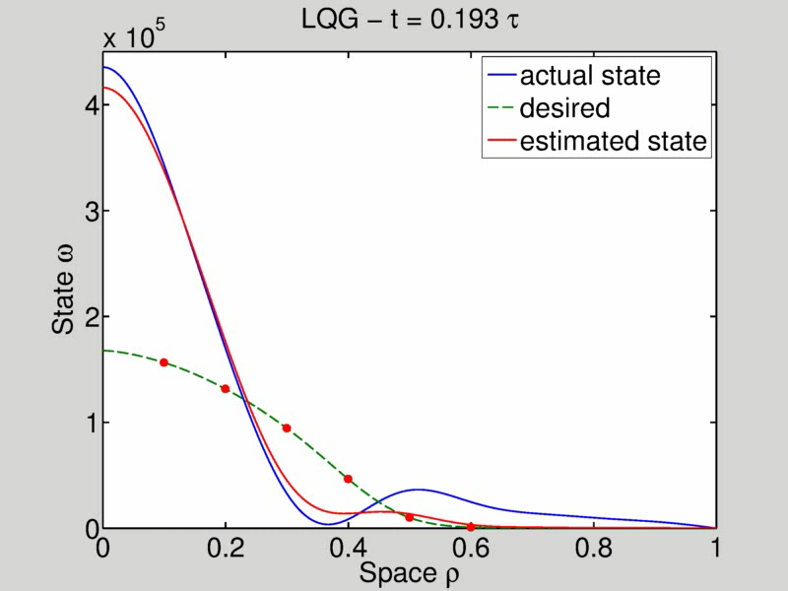
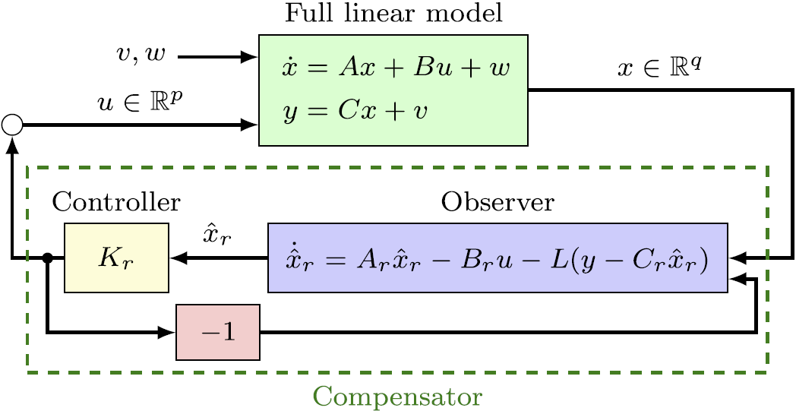
First closed-loop feedback model successful using NTV as the sole actuator
NTV torque is nonlinear – depends on both coil current I and ω:
Result (for “n=3” δB(ρ) spectrum, non-linear model):
Form:
(non-linear)
(linearized)
Desired
Plant
w/ Observer
Schematic of controller design

Slide 9
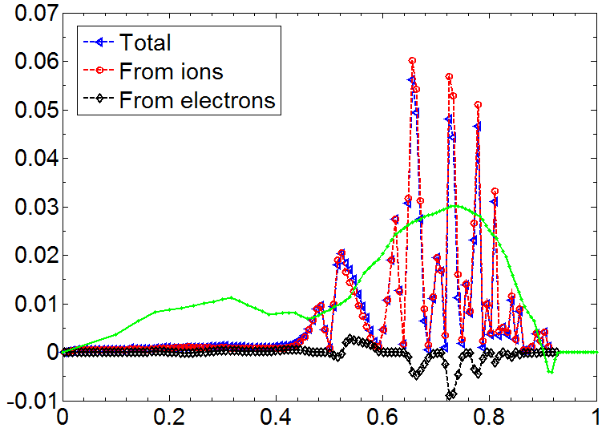
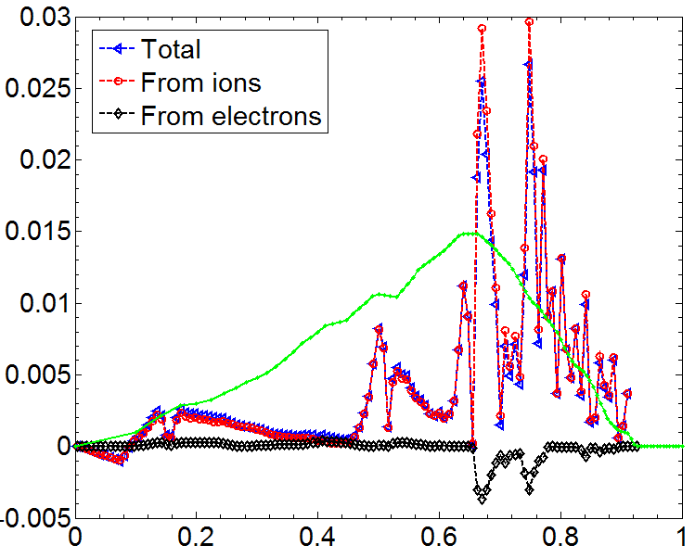
Expanded NTV torque profile model for control being developed from theory/comparison to experimental data
NSTX 3D coils used for rotation control
NTV torque profile (n = 3 configuration)
133726
(t=0.555s)
z(m)
Experimental
-dL/dt
(scaled)
-NTV torque density
y(m)
x(m)
NTVTOK
New analysis: NTVTOK code
  Shaing’s connected NTV model, covers all ν, and superbanana plateau regimes
  Past quantitative agreement with theory found in NSTX for plateau, “1/ν ” regimes
  Full 3D coil specification, ion and electron components considered, no A assumptions
(Sun, Liang, Shaing, et al., NF 51 (2011) 053015)
NTV torque profile (n = 2 configuration)
130723
(t=0.583s)
(Shaing, Sabbagh, Chu, NF 50 (2010) 025022)
Experimental
-dL/dt
(scaled)
-NTV torque density
(Zhu, Sabbagh, Bell, et al., PRL 96 (2006) 225002)
NTVTOK

Slide 10
Model-based RWM state space controller including 3D plasma response and wall currents used at high β_{N}
Full 3-D model
~4000 states
State reduction (< 20 states)
RWM
eigenfunction(2 phases, 2 states)
Balancing
transformation
…
RWM state space controller in NSTX at high β_{N}
Controller model includes
  plasma response
  plasma mode-induced current
Potential to allow more flexible control coil positioning
  May allow control coils to be moved further from plasma, and be shielded (e.g. for ITER)
  Allows inclusion of multiple modes (with n = 1, or n > 1) in feedback
Katsuro-Hopkins, et al., NF 47 (2007) 1157
S.A. Sabbagh, J.-W. Ahn, J. Allain, et al., Nucl. Fusion 53 (2013) 104007

Slide 11
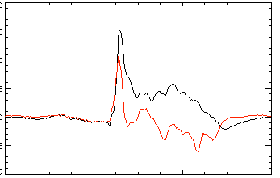
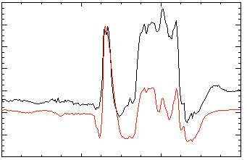
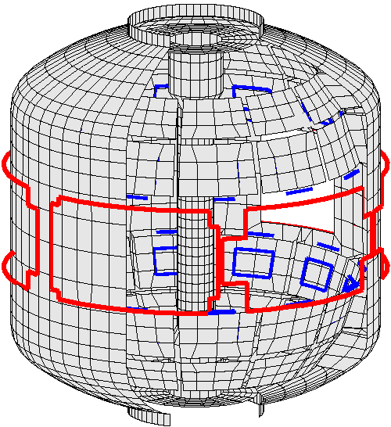
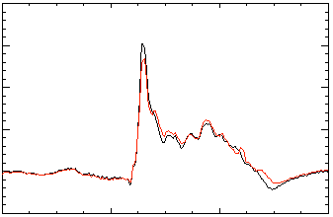
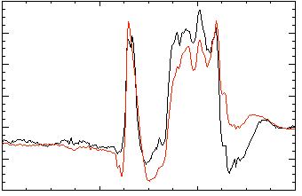
Comparisons between sensor measurements and state space controller show importance of states and 3D effects
A) Effect of Number of States Used
B) Effect of 3D Model Used
2 States
Measurement
No NBI Port
200
δB_{p}¹⁸⁰
RWM
Controller (observer)
80
δB_{p}⁹⁰
100
40
0
0
-100
137722
-40
137722
0.56
0.58
0.60
0.62
0.56
0.58
0.60
0.62
t (s)
t (s)
RWM Sensor Differences (G)
7 States
With NBI Port
200
δB_{p}¹⁸⁰
80
δB_{p}⁹⁰
100
40
0
137722
0
137722
-100
0.56
0.58
0.60
0.62
0.56
0.58
0.60
0.62
t (s)
t (s)
Improved agreement with sufficient number of states (wall detail)
3D detail of model important to improve agreement
S.A. Sabbagh, J.-W. Ahn, J. Allain, et al., Nucl. Fusion 53 (2013) 104007

Slide 12
RWM active control capability will increase significantly when Non-axisymmetric Control Coils (NCC) are added to NSTX-U
Using present midplane RWM coils
NCC 2x12 with favorable sensors, optimal gain
Full NCC
2x12 coils
Performance enhancement
  Present RWM coils: active control to β_{N}/β_{N}^{no-wall} = 1.25
  Add NCC 2x12 coils, optimal sensors: active control to β_{N}/β_{N}^{no-wall} = 1.67
  Partial NCC options also viable
Existing
RWM
coils
VALEN (J. Bialek)

Slide 13
Research shown here is part of a sophisticated disruption prediction-avoidance-mitigation framework for NSTX-U
Predictors (measurements, models)
Shape/position
Eq. properties (β, l_{i}, V_{loop},…)
Profiles (p(r), j(r), ω_{φ}(r),…..)
Plasma response (n=0-3, RFA, …)
Divertor heat flux
General framework & algorithms applicable to ITER
Plasma Operations
Control Algorithms: Steer Towards Stable Operation
Isoflux and vertical position control
LM, NTM avoidance
ω_{φ} state-space controller (by NTV, NBI)
RWM, EF state-space controller
Divertor radiation control
Avoidance Actuators
PF coils
2nd NBI: (q, p, v_{φ} control)
3D fields (upgraded + NCC):
(EF, RWM control,
ω_{φ} control via NTV)
Divertor gas injection
Loss of Control
Disruption Warning
System
Mitigation
Early shutdown
Massive gas injection
Pellet injection

Slide 14
New ITPA MHD Stability joint experiment MDC-21 proposed: “Global mode stabilization physics and control”
Emphasis on applying scientific understanding toward disruption avoidance
Near-term tasks for MDC-21
  Comparison of kinetic RWM stabilization code calculations with experiments
    Follows directly from recent MDC-2 code benchmarking activity
  Comparison of global mode feedback stabilization models with experiments (incl. control)
Future more general scope
  active internal/external kink/ballooning/RWM control
  theoretical stability models and input for disruption warning algorithms
  global mode and disruption precursor analysis
  low frequency MHD spectroscopy for prediction
  active profile control/modeling
  methods of profile control (e.g. rotation alteration by RF, NBI, 3D fields)
  importance of energetic particle effects on stability
  methods for fusion burn control (instability avoidance)
MDC-21 will be proposed at Dec 2013 ITPA Coordinating committee meeting
CONTACT: sabbagh@pppl.gov if interested / would like to join

Slide 15
NSTX-U is addressing disruption prediction and avoidance of global modes with a multi-faceted physics and control plan
MHD spectroscopy at high beta
  Resonant field amplification shows an increase in stability at very high β_{N}/l_{i} > 10 in NSTX
  Stability dependence on collisionality supports kinetic stabilization theory: lower ν can improve stability (contrasts early theory)
Kinetic RWM stability physics models
  Broad precession drift resonance condition to minimize |ω_{E} + ω_{D}| yields increased stability
Plasma rotation control
  First closed-loop feedback of model-based state-space controller successful using NTV as sole actuator
  Expanded NTV profile quantitative modeling underway
Active RWM control
  Demonstrated model-based RWM state space control at high β_{N} > 6
  Planned expansion of 3D coil set on NSTX-U computed to significantly enhance control performance

Slide 17
MHD spectroscopy, to be used for disruption P&A, reveals non-intuitive stability dependencies at high β_{N}
MHD spectroscopy experiments
  measured resonant field amplification (RFA) of applied n = 1 tracer field in high β_{N} plasmas at varied ω_{φ}
  Higher RFA shows reduced mode stability
Counter-intuitive results:
  Highest β_{N}, lowest ω_{φ} (green): most stable
  Lowest β_{N}, medium ω_{φ} (blue): unstable
Physics understanding given by kinetic RWM theory (simplified here):
RFA = B_{plasma}/B_{applied}
2
Precession Drift
~ Plasma Rotation
Collisionality
1

Slide 18
Model-based, state-space rotation controller designed to use Neoclassical Toroidal Viscosity (NTV) profile as an actuator
Momentum force balance – ω_{φ} decomposed into Bessel function states
NTV torque:
(non-linear)
Feedback using NTV: “n=3” δB(ρ) spectrum
State-space model
TRANSP run
133743
Desired
Plant
w/ Observer
Plasma rotation
NTV
region
radius
t(s)
t(s)

Slide 19

Model-based RWM state space controller including 3D plasma response and wall currents used at high β_{N} in NSTX
RWM state space controller in NSTX at high β_{N}
Effect of 3D Model Used
No NBI Port
80
δB_{p}⁹⁰
Measurement
40
Controller
(observer)
0
-40
137722
0.56
0.58
0.60
0.62
t (s)
With NBI Port
80
δB_{p}⁹⁰
40
Potential to allow more flexible control coil positioning
  May allow control coils to be moved further from plasma, and be shielded (e.g. for ITER)
0
137722
0.56
0.58
0.60
0.62
t (s)
3D detail of model is important to improve sensor agreement
Katsuro-Hopkins, et al., NF 47 (2007) 1157
S.A. Sabbagh, et al., Nucl. Fusion 53 (2013) 104007

Slide 20
Extra Slides Follow

Slide 21
Research shown here is part of a sophisticated disruption prediction-avoidance-mitigation framework for NSTX-U
Predictors (measurements, models)
Shape/position
Eq. properties (β, l_{i}, V_{loop},…)
Profiles (p(r), j(r), v_{φ}(r),…..)
Plasma response (n=0-3, RFA, …)
Divertor heat flux
General framework & algorithms applicable to ITER
Plasma Operations
Control Algorithms: Steer Towards Stable Operation
Isoflux and vertical position control
LM, NTM avoidance
V_{φ} state-space controller (by NTV, NBI)
RWM, EF state-space controller
Divertor radiation control
Avoidance Actuators
PF coils
2nd NBI: (q, p, v_{φ} control)
3D fields (upgraded + NCC):
(EF, RWM control,
v_{φ} control via NTV)
Divertor gas injection
Loss of Control
Disruption Warning
System
Mitigation
Early shutdown
Massive gas injection
Pellet injection

Slide 22
MHD spectroscopy, to be used for disruption P&A, reveals non-intuitive stability dependencies
MHD spectroscopy experiments
  measured resonant field amplification (RFA) of high β_{N} plasmas at varied ω_{φ}
  Higher RFA shows reduced mode stability
Counter-intuitive results:
  Highest β_{N}, lowest ω_{φ} (green): most stable
  Lowest β_{N}, medium ω_{φ} (blue): unstable
Physics understanding given by kinetic RWM theory (simplified here):
RFA = B_{plasma}/B_{applied}
2
Precession Drift
~ Plasma Rotation
Collisionality
1

Slide 23
Dedicated MHD spectroscopy reveal stability dependencies that are non-intuitive based on early RWM stabilization theory
Plasma Operations
Predictors
Disruption Warning System
Mitigation
γ contours
Control Algorithms
Avoidance actuators (2nd NBI, 3D fields, for q, v_{φ} , β_{N} control)
MHD spectroscopy experiments
  measured resonant field amplification (RFA) of high β_{N} plasmas at varied plasma rotation
Counter-intuitive results:
  Highest β_{N}, lowest ω_{φ} (green): most stable
  Lowest β_{N}, highest ω_{φ} (red): less stable
  Higher β_{N}, highest ω_{φ} (cyan): less stable
  Lowest β_{N}, medium V_{φ} (blue): unstable
4
3
2
1

Slide 24
Simple models derived from kinetic RWM physics being developed for real-time for disruption prediction / avoidance
Plasma Operations
Predictors
Disruption Warning System
Mitigation
γ contours
Control Algorithms
Avoidance Actuators (q, v_{φ} , β_{N} control)
Criterion to increase stability based on kinetic RWM physics
  Real-time measurement of ω_{φ} (and β_{N}) alone is insufficient!
  Simplified precession drift stabilization criterion (minimize |ω_{E} + ω_{D}|) provides better guidance for global mode stability
    Corresponds to <ω_{E}> ~ 5kHz in the range (0.5 < ψ_{N} < 0.9)
  Avoid disruption by controlling plasma rotation profile toward this condition
    obtain <ω_{E}> from real-time ω_{φ} and modeled n and T profiles
too high
safe
too low

Slide 25
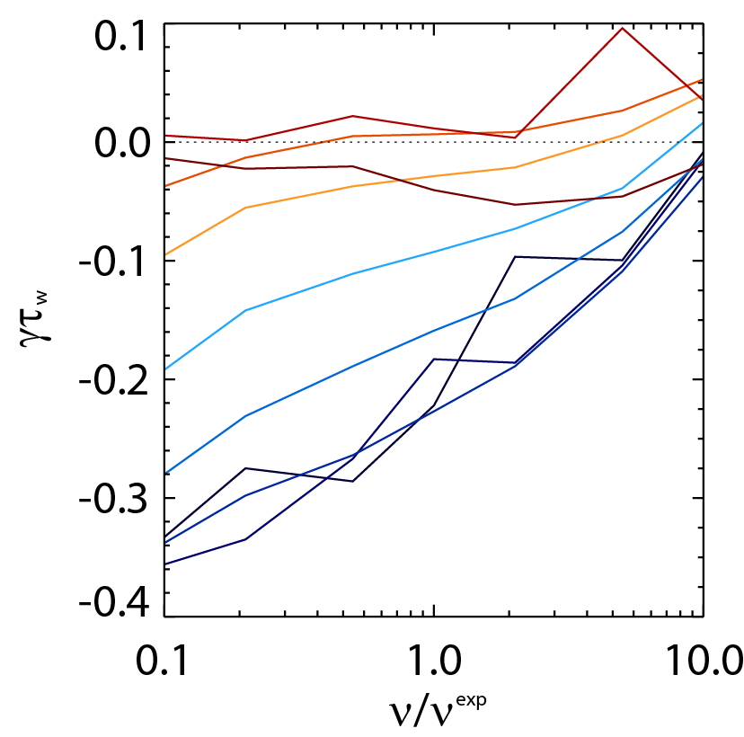

Experiments directly measuring global stability (RFA) using MHD spectroscopy support kinetic RWM stability theory
Resonant Field Amplification vs. β_{N}/l_{i}
RFA vs collisionality
RFA vs collisionality (theory)
off resonance
off resonance
unstable
mode
unstable
on resonance
on resonance
MISK calculations
(trajectories of 20 experimental plasmas)
Stability at lower ν
  Collisional dissipation reduced
  Stabilizing resonant kinetic effects enhanced
  Stabilization near ω_{φ} resonances; almost no effect off-resonance
Stability vs. β_{N}/l_{i}
  decreases up to β_{N}/l_{i} = 10, increases at higher β_{N}/l_{i}
  Consistent with kinetic resonance stabilization
S. Sabbagh et al., NF 53 (2013) 104007

