Slide 1

Advanced divertor configurations with large flux expansion
V. A. Soukhanovskii
Lawrence Livermore National Laboratory, Livermore, California, USA
H. Reimerdes
Ecole Polytechnique Fédérale de Lausanne, Centre de Recherches en Physique des Plasmas, Association Euratom Confédération Suisse, Lausanne, Switzerland
NSTX-U and TCV Research Teams

Slide 2
Acknowledgements
D. D. Ryutov,
A. McLean, E. Meier, T. D. Rognlien, M. V. Umansky (LLNL),
D. Battaglia, R. E. Bell, A. Diallo, S. P. Gerhardt, R. Kaita,
S. M. Kaye, E. Kolemen, B. P. LeBlanc, J. E. Menard, D. Mueller, S. F. Paul, M. Podesta, A. L. Roquemore, F. Scotti (PPPL),
R. Maingi (ORNL),
R. Raman (U Washington)
G.P. Canal, B. Labit, W. Vijvers, S. Coda, B.P. Duval (CRPP)
T. Morgan, J. Zielinski, G. De Temmerman (DIFFER)
B. Tal (WIGNER)

Slide 3
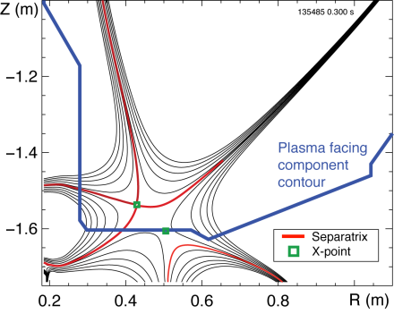

Outline: Experimental studies of snowflake divertor configuration in NSTX and TCV
Tokamak divertor challenge
Snowflake divertor configuration
Snowflake divertor in NSTX and TCV
  Magnetic properties and control
  H-mode confinement and pedestal
  Divertor heat flux mitigation and partitioning
  Modeling
  Conclusions and outlook

Slide 4
Various techniques developed for reduction of heat fluxes q|| (divertor SOL) and q_{peak} (divertor target)
Recent ideas to improve standard divertor geometry
  Snowflake divertor (D. D. Ryutov, PoP 14, 064502 2007)
  X-divertor (M. Kotschenreuther et. al, IC/P6-43, IAEA FEC 2004)
    Local (strike point) flux expansion
  Super-X divertor (M. Kotschenreuther et. al, IC/P4-7, IAEA FEC 2008)
    Local (strike point) flux expansion at large R (major radius)
    Being implemented in MAST Upgrade
    See T. Petrie et al., Talk O36 on Friday, 25 May 2012

Slide 5
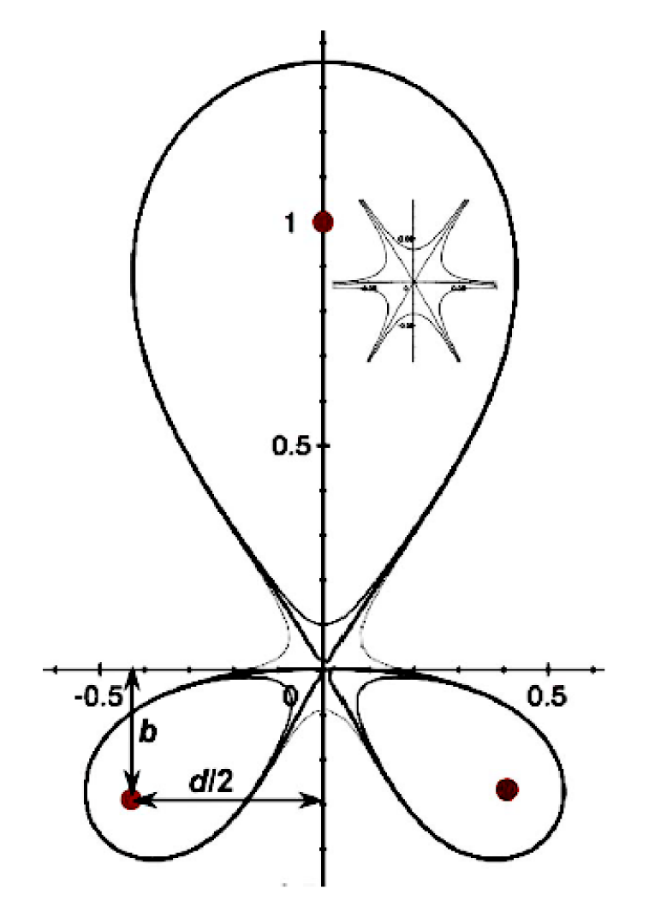
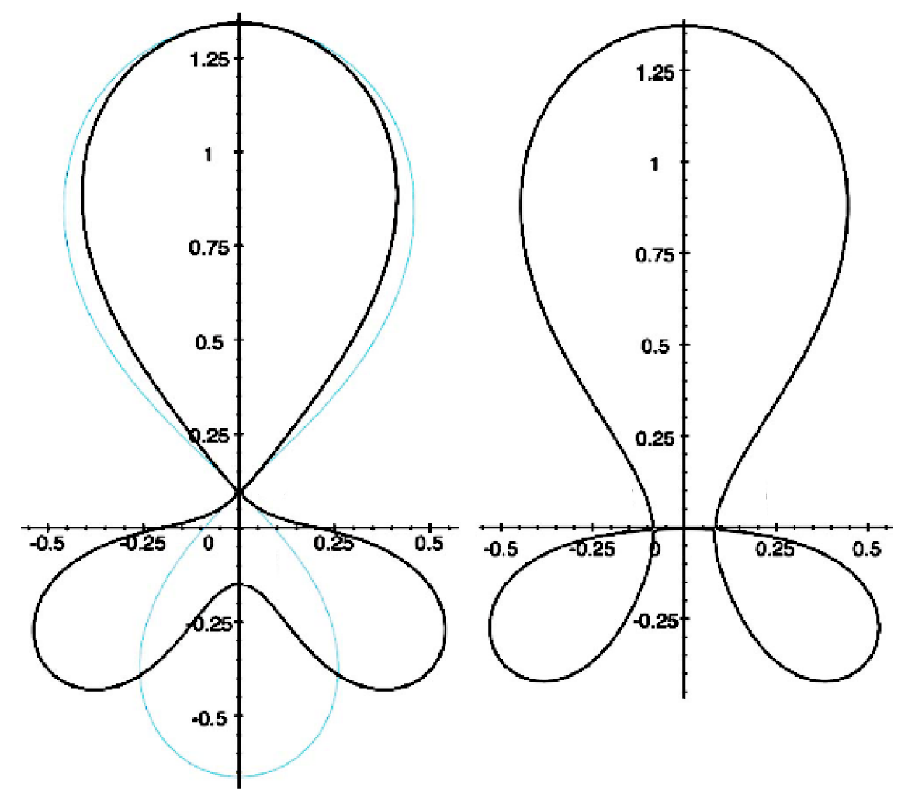
Snowflake divertor geometry is “advanced” w.r.t. standard X-point divertor
Snowflake divertor
  Second-order null
      B_{p} ~ 0 and grad B_{p} ~ 0 (Cf. first-order null: B_{p} ~ 0)
  Obtained with existing divertor coils (min. 2)
  Exact snowflake topologically unstable
  Deviation from ideal snowflake: σ = d / a
    d – distance between nulls, a – plasma minor radius
Predicted geometry properties (cf. standard divertor)
  Increased edge shear: ped. stability
  Add’l null: H-mode power threshold, ion loss
  Larger plasma wetted-area A_{wet} : reduce q_{div}
  Four strike points : share q_{II}
  Larger X-point connection length L_{x} : reduce q_{II}
  Larger effective divertor volume V_{div} : incr. P_{rad} , P_{CX}
Experiments: TCV and NSTX
Exact
snowflake
divertor
*
+
+
+
+
snowflake-minus
snowflake-plus
D. D. Ryutov, PoP 14, 064502 2007

Slide 6
Outline: Experimental studies of snowflake divertor configuration in NSTX and TCV
Tokamak divertor challenge
Snowflake divertor configuration
Snowflake divertor in NSTX and TCV
  Magnetic properties and control
  H-mode confinement and pedestal
  Divertor heat flux mitigation and partitioning
  Modeling
  Conclusions and outlook

Slide 7
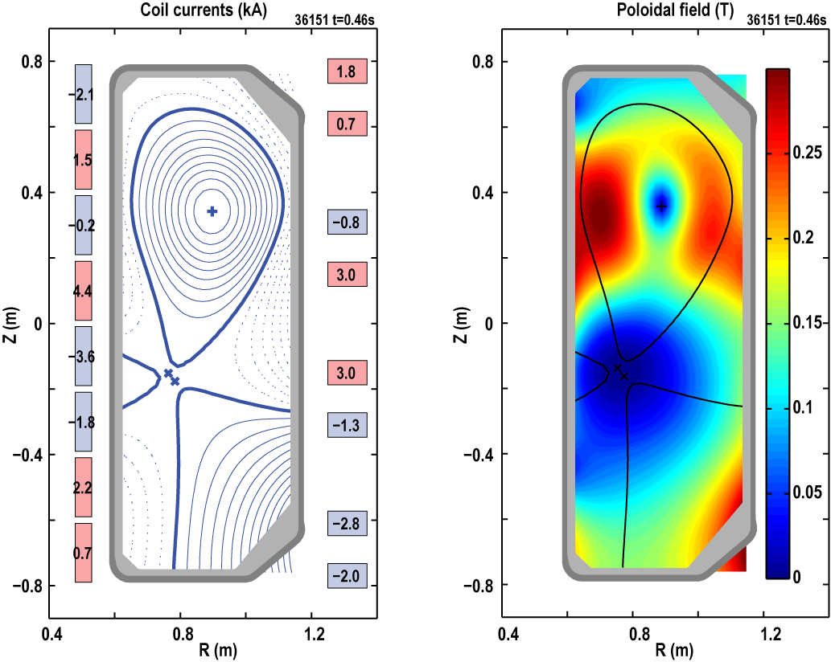

NSTX and TCV: Snowflake divertor configurations obtained with existing divertor coils
TCV
Conventional aspect ratio A=3.5-3.7
I_{p} ≤ 1.0 MA, B_{T} ≤ 1.5 T
P_{in} ≤ 4.5 MW (ECH)
Graphite PFCs
Open divertor (not optimized)
Create magnetic configuration (SF, SF+, SF-) with shaping coils

Slide 8
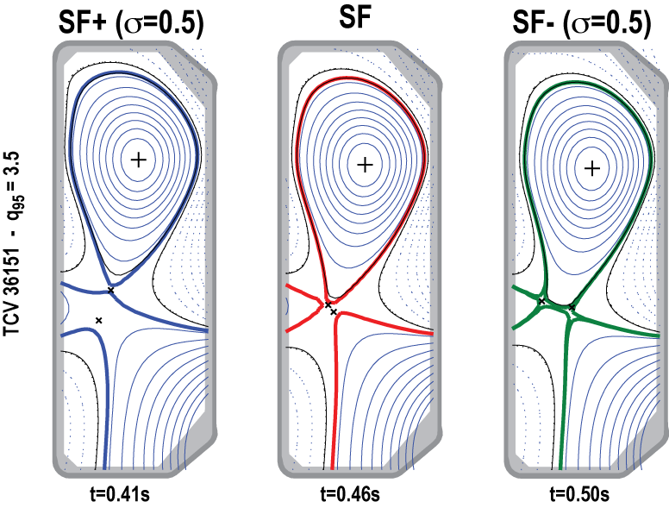
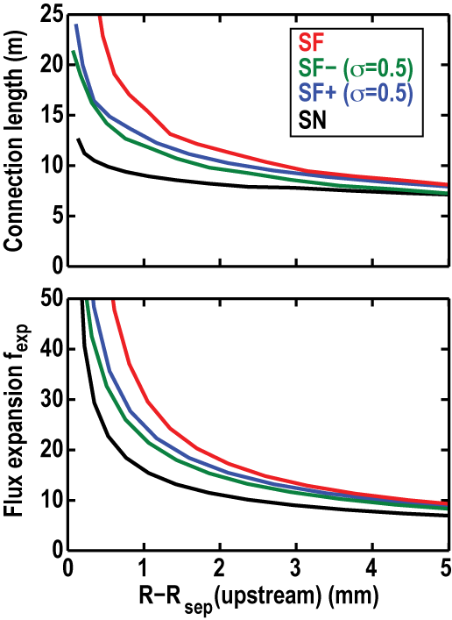
TCV: Investigate the characteristics of the entire range of snowflake configurations
[F. Piras, et al., Plasma Phys. Control. Fusion. 51 (2009) 055009]
Evaluate f_{exp} and CL at location of max. f_{exp}
Variable configuration: vary location of X-points over a wide range
  All configurations are obtained under feed-forward control
  Experiments have so far focused on SF+
Investigate possibility to distribute exhaust power on more than the two strike points

Slide 9

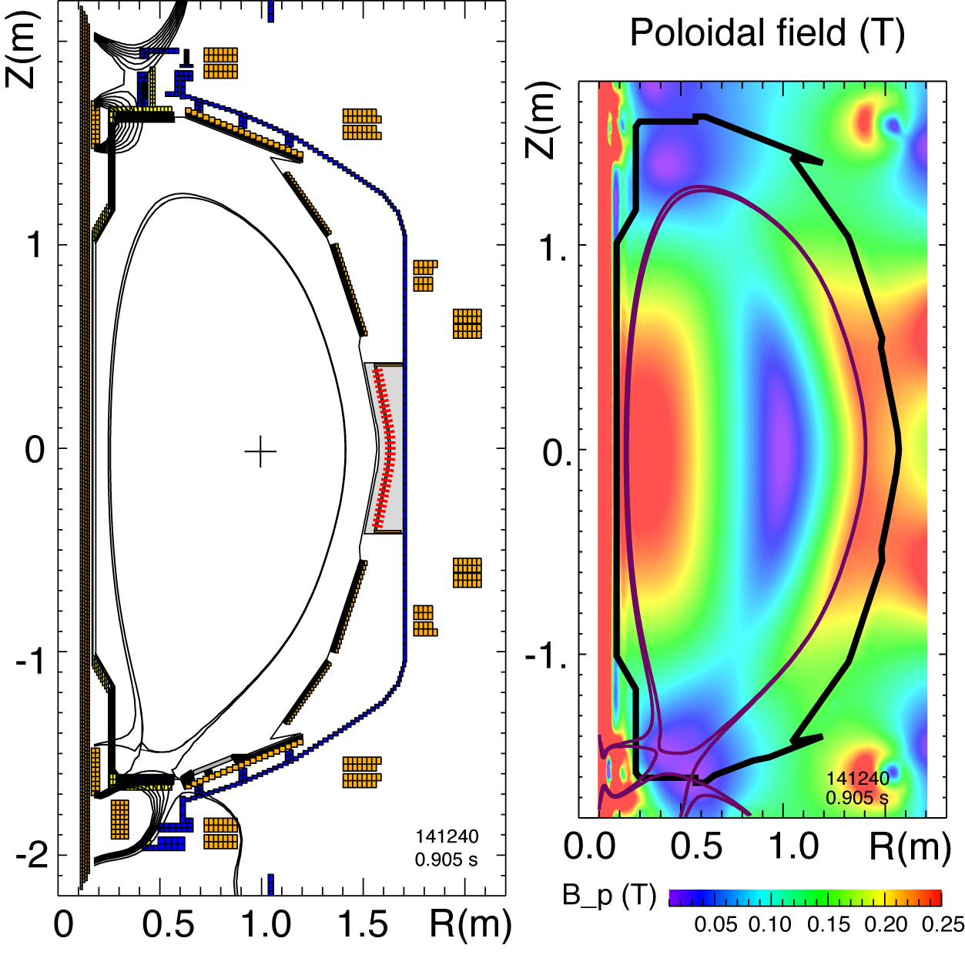
NSTX and TCV: Snowflake divertor configurations obtained with existing divertor coils
Aspect ratio A=1.4-1.5
I_{p} ≤ 1.4 MA, B_{T}= 0.45 T
P_{in} ≤ 7.4 MW (NBI)
λ_{q} = 5-10 mm
High divertor heat flux
  q_{peak} ≤ 15 MW/m²
  q|| ≤ 200 MW/m²
Open divertor
Graphite PFCs with lithium coatings
Asymmetric snowflake-minus σ = 0.4-0.5

Slide 10
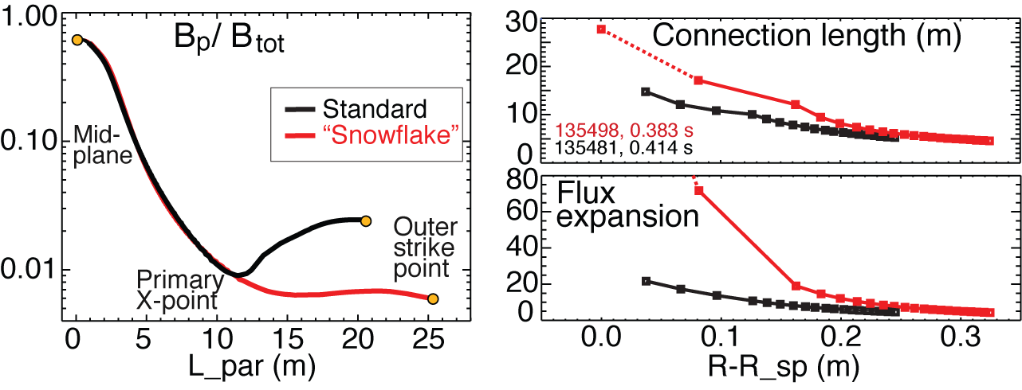
NSTX: Plasma-wetted area and connection length are increased by 50-90 % in snowflake divertor
These properties observed in first 30-50 % of SOL width (λ_{q}~6 mm)
B_{tot} angles in the strike point region: 1-2º, sometimes < 1º
  Concern for hot-spot formation and sputtering from divertor tile edges
  Can be alleviated by q|| reduction due to radiative detachment and power partitioning between strike points

Slide 11
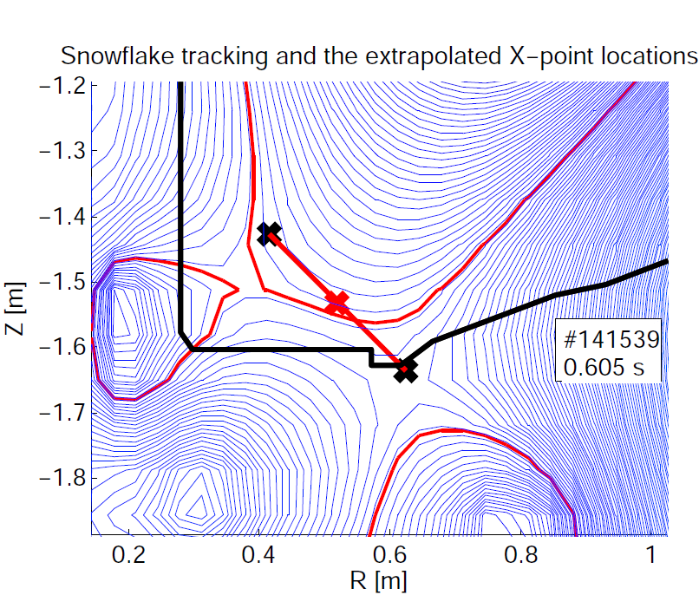
Close-loop feedback control of divertor coil currents is desirable for steady-state snowflake
  All configurations are obtained reproducibly under feed-forward control in TCV and NSTX
  In NSTX
  Developed X-point tracking algorithm that locates nulls and centroid
  Algorithm tested on NSTX snowflakes successfully
  Implementing snowflake control in digital plasma control system
    Collaboration between NSTX-U and DIII-D
M.A. Makowski & D. Ryutov, “X-Point Tracking Algorithm for the Snowflake Divertor”

Slide 12
Outline: Experimental studies of snowflake divertor configuration in NSTX and TCV
Tokamak divertor challenge
Snowflake divertor configuration
Snowflake divertor in NSTX and TCV
  Magnetic properties and control
  H-mode confinement and pedestal
  Divertor heat flux mitigation and partitioning
  Modeling
  Conclusions and outlook

Slide 13
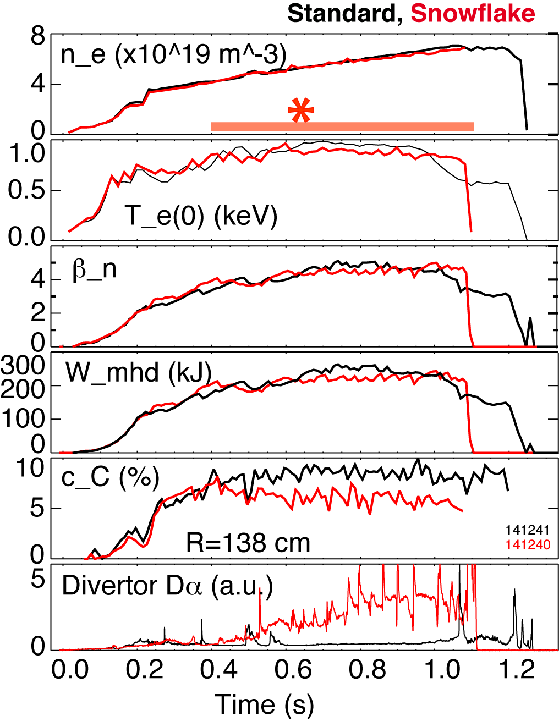
  NSTX: good H-mode confinement properties and core impurity reduction obtained with snowflake divertor
0.8 MA, 4 MW H-mode
κ=2.1, δ=0.8
Core T_{e} ~ 0.8-1 keV, T_{i} ~ 1 keV
β_{N} ~ 4-5
Plasma stored energy ~ 250 kJ
H98(y,2) ~ 1 (from TRANSP)
ELMs
  Suppressed in standard divertor H-mode via lithium conditioning
  Re-appeared in snowflake H-mode
Core carbon reduction due to
  Type I ELMs
  Edge source reduction
    Divertor sputtering rates reduced due to partial detachment

Slide 14
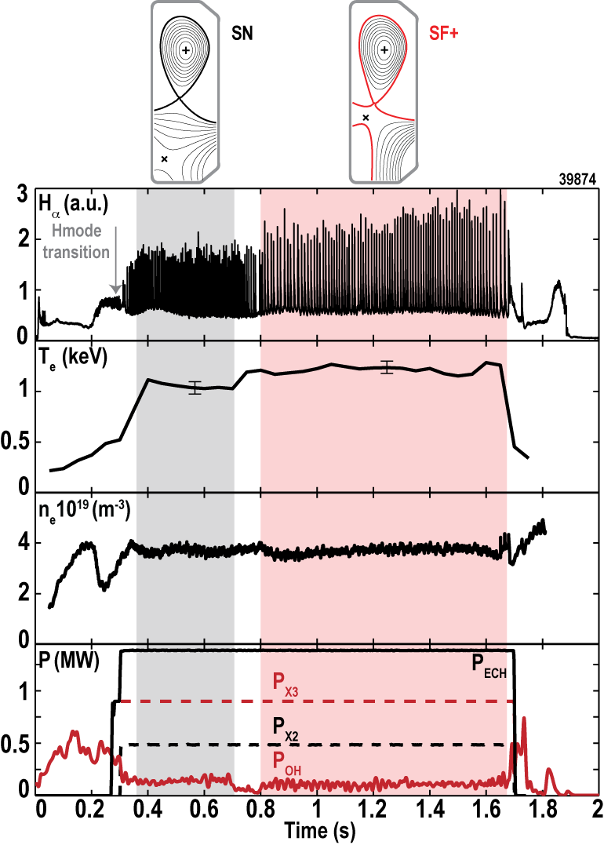
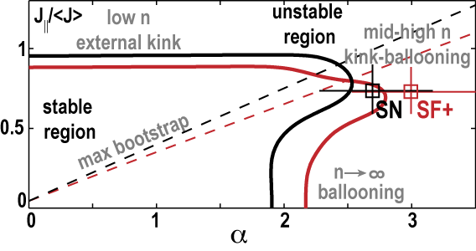
TCV: Snowflake configuration leads to an improved kink-ballooning stability
[F. Piras, et al., Phys. Rev. Lett. 105 (2010) 155003]
H-mode threshold unchanged (power and density dependence)
Modest confinement improvement (may be due to increased core shaping)
Frequency of type-I ELMs decreases
  Experiment consistent with improved kink-ballooning stability
  Even though energy loss per ELM increase, the average energy lost through ELMs decreases significantly

Slide 15
Outline: Experimental studies of snowflake divertor configuration in NSTX and TCV
Tokamak divertor challenge
Snowflake divertor configuration
Snowflake divertor in NSTX and TCV
  Magnetic properties and control
  H-mode confinement and pedestal
  Divertor heat flux mitigation and partitioning
  Modeling
  Conclusions and outlook

Slide 16
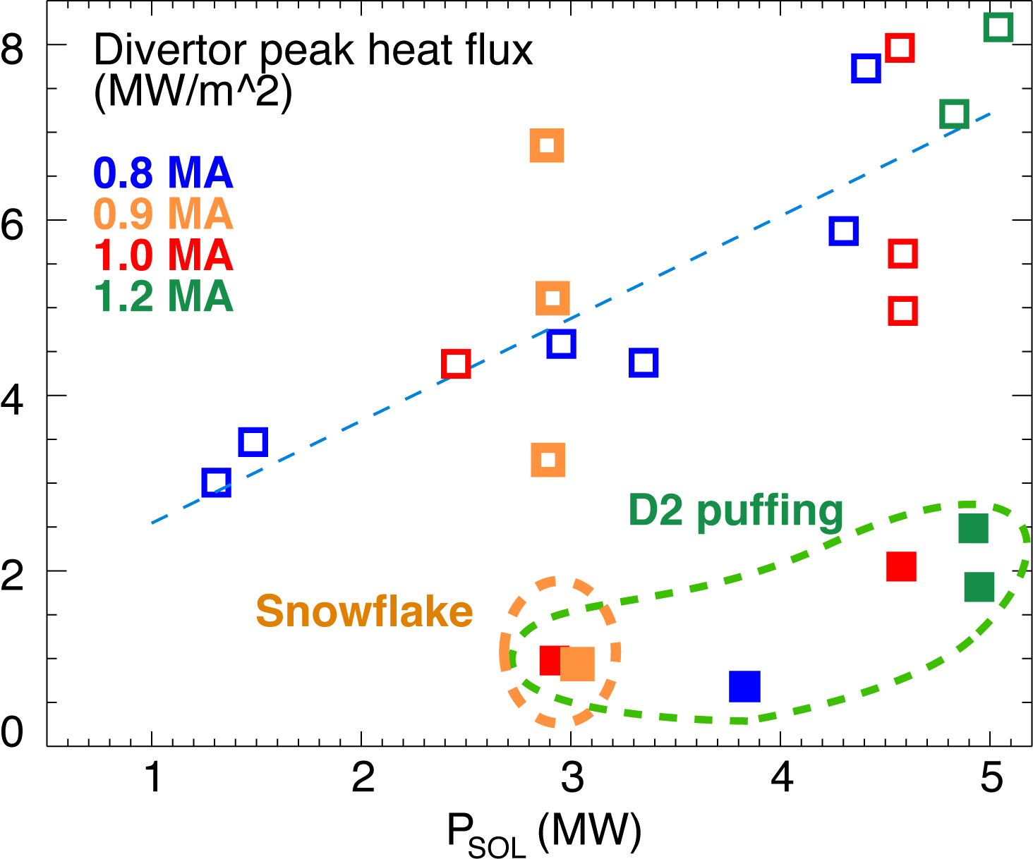
NSTX: Access to radiative detachment with intrinsic carbon in snowflake divertor facilitated
Snowflake divertor (*): P_{SOL}~3-4 MW, f_{exp}~40-60, q_{peak}~0.5-1.5 MW/m²
  Low detachment threshold
  Detachment characteristics comparable to PDD with D₂ or CD₄ puffing

Slide 17
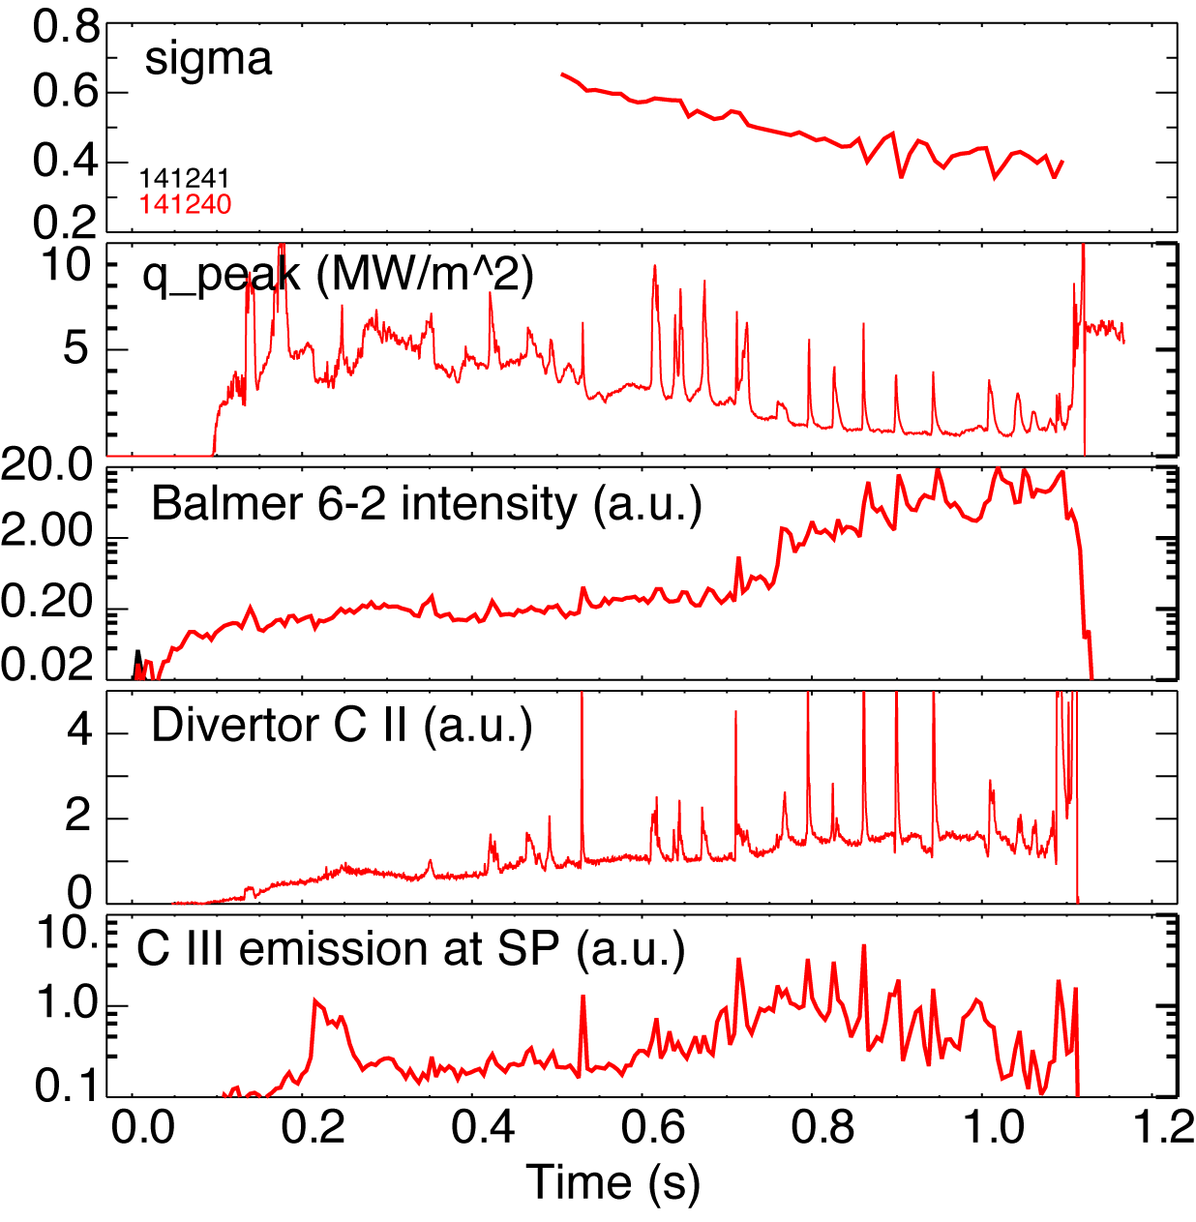
NSTX: Significant reduction of divertor heat flux observed between ELMs in snowflake divertor
Divertor C III and C IV brightness profiles broaden
Attached standard divertor -> snowflake transition -> snowflake + detachment
P_{SOL} ~ 3 MW (P_{NBI} = 4 MW)
Q_{div} ~ 2 MW -> Q_{div} ~ 1.2 MW -> Q_{div} ~ 0.5-0.7 MW

Slide 18
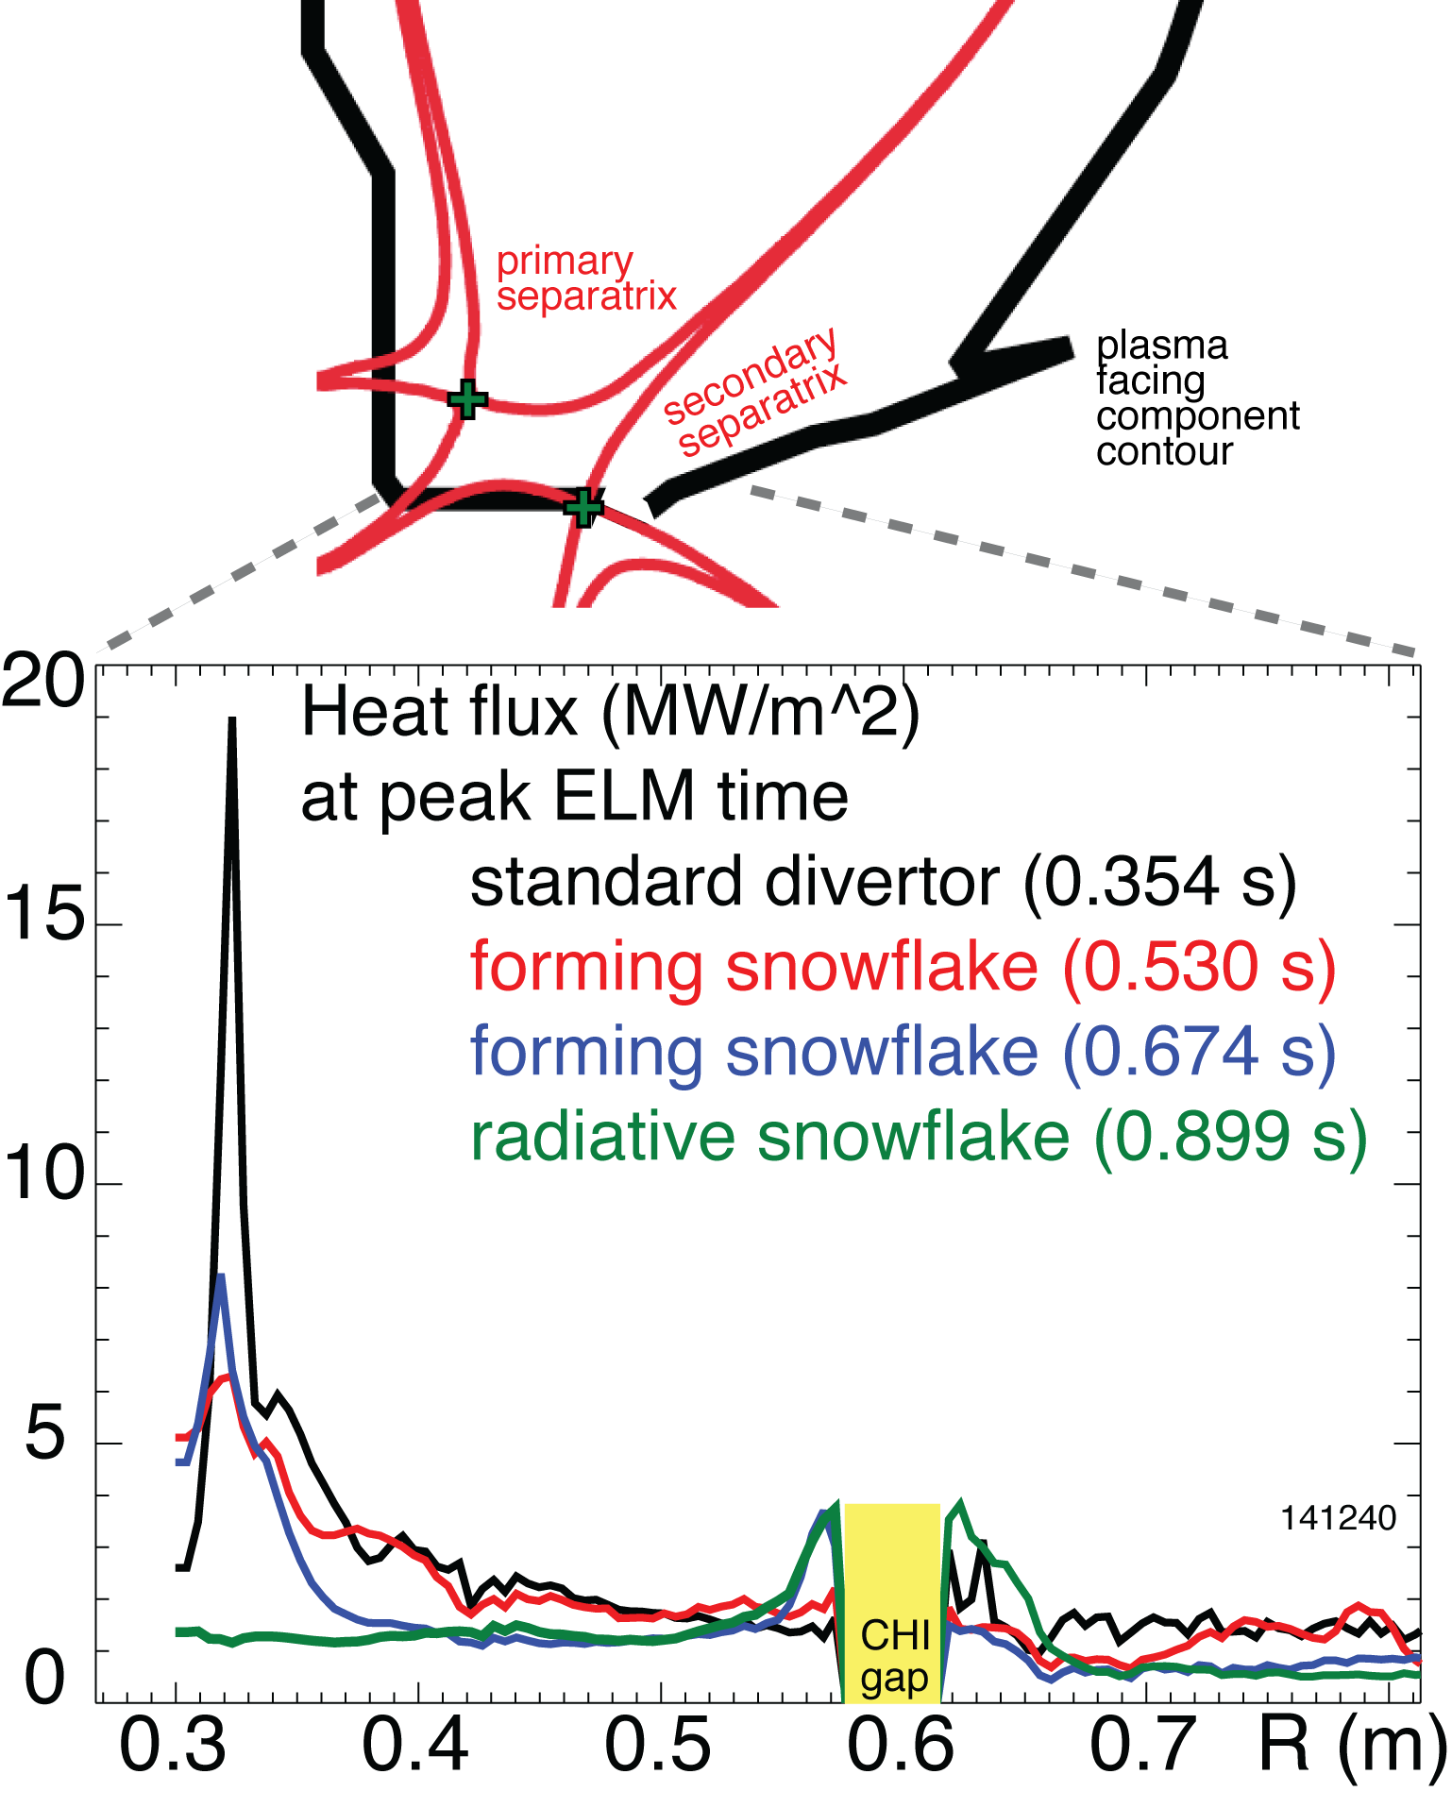
NSTX: Impulsive heat loads due to Type I ELMs are mitigated in snowflake divertor
H-mode discharge, W_{MHD} ~ 220-250 kJ
  Type I ELM (ΔW/W ~ 5-8 %) re-appeared
ELM peak heat flux decreased
Theory and modeling highlight (T. D. Rognlien et al., P1-031)
  Reduced surface heating due to increased ELM energy deposition time
  Convective mixing of ELM heat flux in null-point region -> heat flux partitioning between separatrix branches

Slide 19
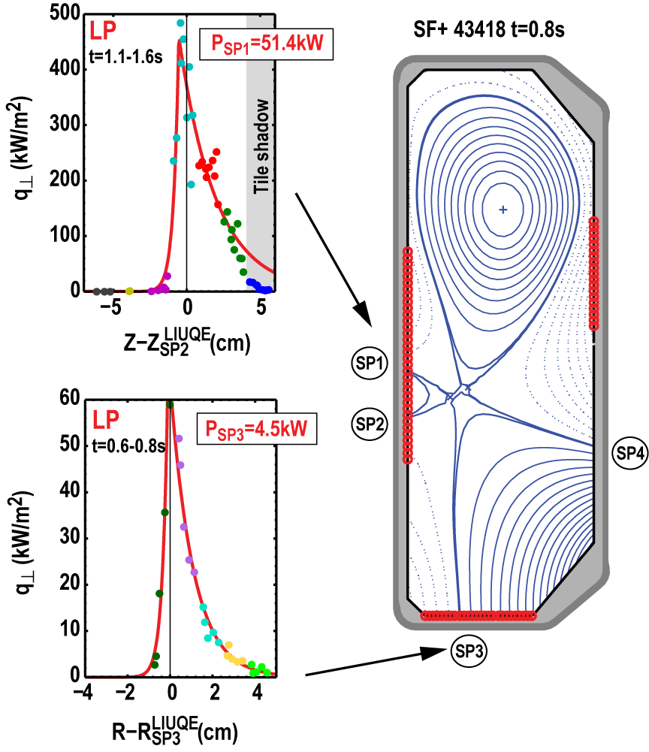
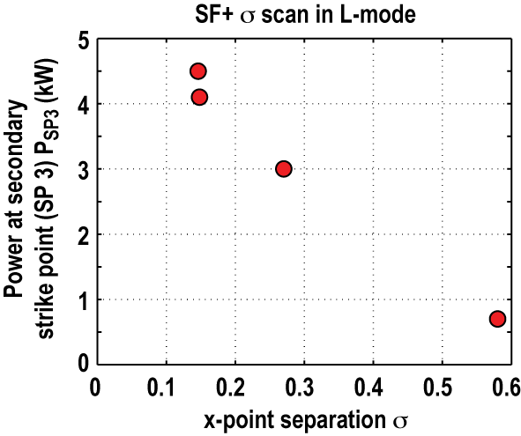
TCV: In L-mode σ has to be small to activate a secondary strike point
Heat flux estimate from Langmuir probes (LP)
SF+ configuration: secondary strike points are in the private flux region of the primary separatrix
Sigma scan in Ohmic L-mode shows activation of the secondary strike points (P_{SP3}/P_{SP1}~10%) only for small values of sigma (σ<0.2)

Slide 20
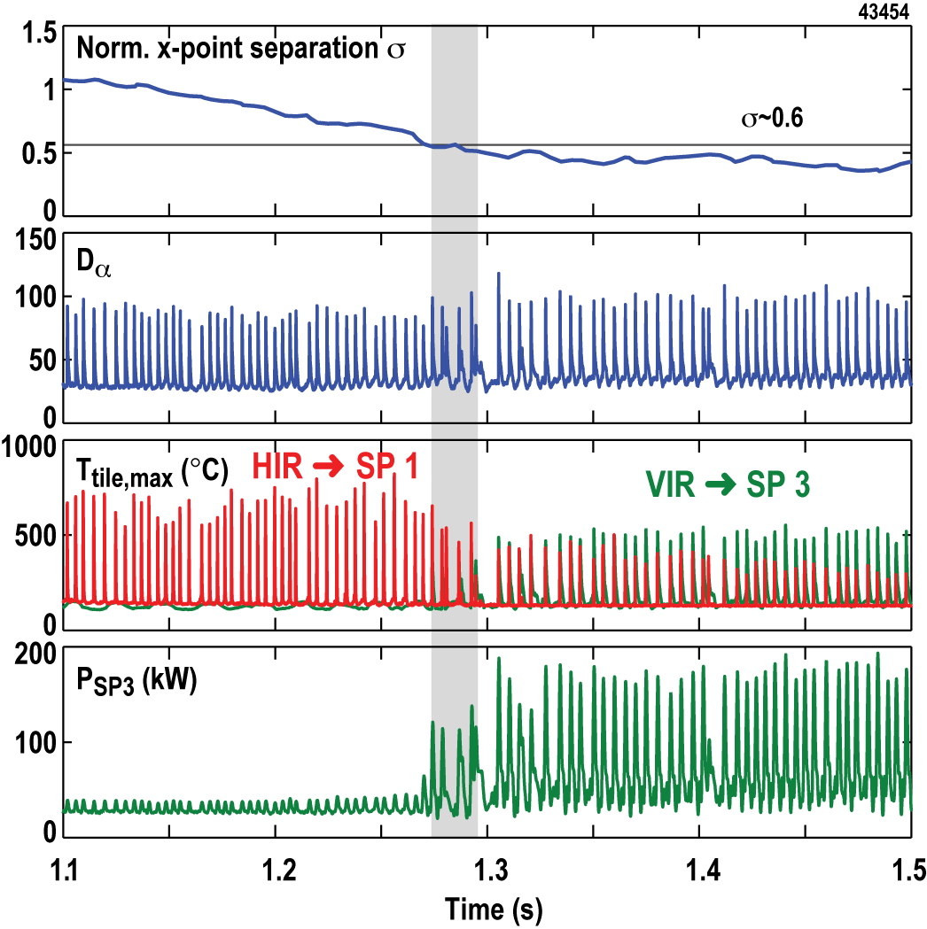
TCV: ELMs activate secondary strike points at larger values of σ
Measure transient heat fluxes during ELMs in ECH H-modes with fast infra-red (IR) cameras
  Sampling time ≥ 40μs
Secondary strike point (SP3) receives significant power at relatively large values of sigma
Power redistribution during ELMs consistent with poloidal beta-driven convection around the null-point
[D.D. Ryutov, et al., APS DPP 2011]

Slide 21
Outline: Experimental studies of snowflake divertor configuration in NSTX and TCV
Tokamak divertor challenge
Snowflake divertor configuration
Snowflake divertor in NSTX and TCV
  Magnetic properties and control
  H-mode confinement and pedestal
  Divertor heat flux mitigation and partitioning
  Modeling
  Conclusions and outlook

Slide 22
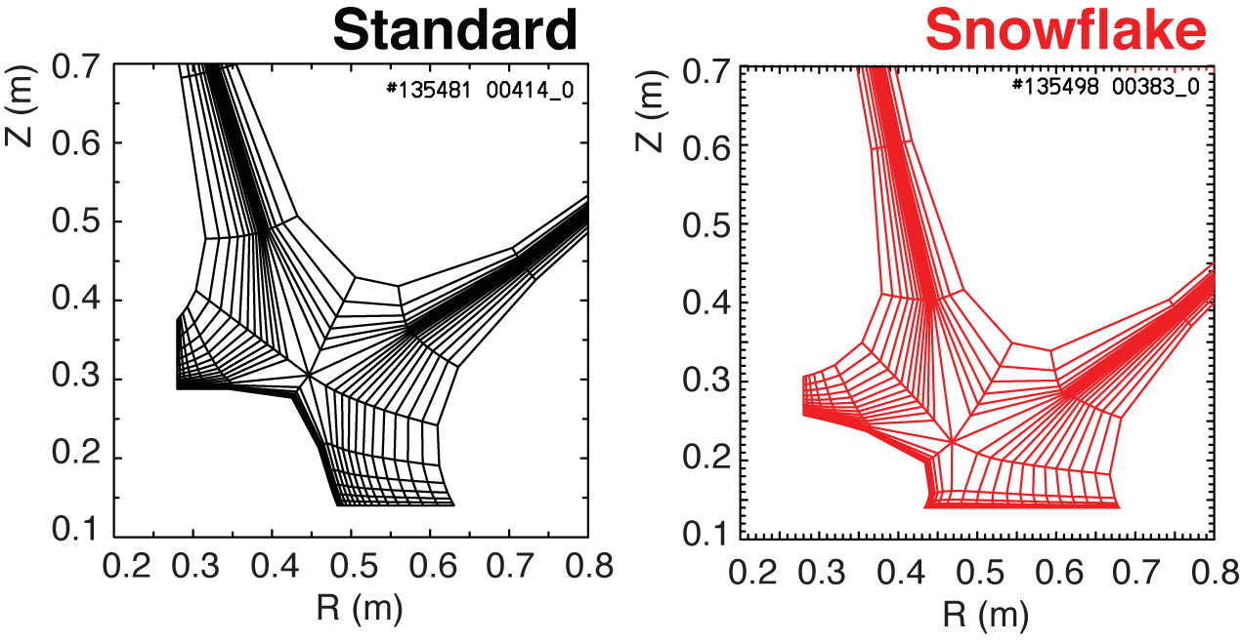
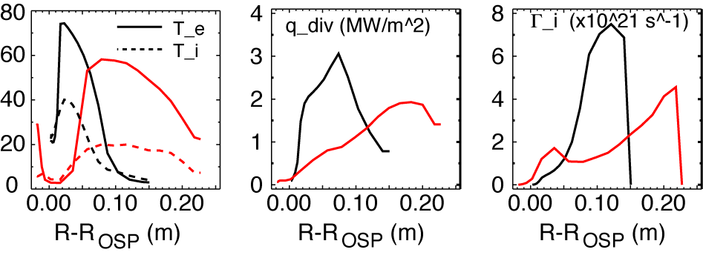
UEDGE modeling shows a trend toward reduced temperatures, heat and particle fluxes in snowflake divertor
2D multi-fluid code UEDGE
  Fluid (Braginskii) model for ions and electrons
  Fluid for neutrals
  Classical parallel transport, anomalous radial transport
    D = 0.25 m²/s
    χ_{e,i} = 0.5 m²/s
  Core interface:
    T_{e,i} = 120 eV
    n_{e} = 4.5 x 10¹⁹
  R_{recy} = 0.95
  Carbon 3 %

Slide 23

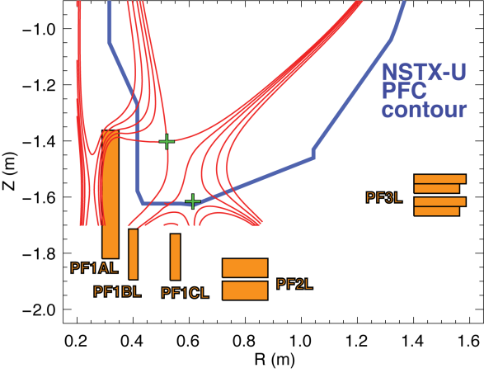
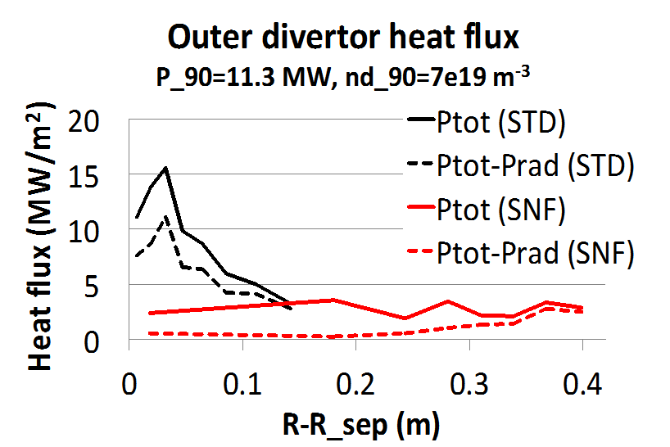
Snowflake geometry is a leading heat flux mitigation candidate for NSTX-U
Challenge for NSTX-U divertor
  2-3 X higher input power (P_{NBI} < 12 MW, I_{p} < 2 MA
  30-50 % reduction in n/n_{G}
  3-5 X longer pulse duration
    Projected NSTX-U peak divertor heat fluxes up to 25-40 MW/m²
    Snowflake divertor projections to NSTX-U optimistic
      UEDGE modeling shows radiative detachment of all snowflake cases with 3% carbon and up to P_{SOL}~11 MW
      q_{peak} reduced from ~15 MW/m² (standard) to 0.5-3 MW/m² (snowflake)
NSTX-U
snowflake
simulation

Slide 24
TCV and NSTX studies suggest the snowflake divertor configuration may be a viable divertor solution for present and future tokamaks
  NSTX
    Core H-mode confinement unaffected, core carbon reduced
    Pedestal stability modified: Type I ELMs re-appeared
    Divertor heat flux significantly reduced
        Steady-state reduction due to geometry and radiative detachment
        ELM heat flux reduction due to power sharing, radiation and geometry
    Proposing experiments and control development at DIII-D, planning snowflake divertor for NSTX-U
  TCV
    Can create a wide range of snowflake configurations
    Heat flux at a secondary strike point increases with decreasing σ
    ELMs activate secondary strike point at larger values of σ
    Improved edge stability leading to less frequent Type I ELMs
    Current upgrades will improve heat flux measurements at the target
      Additional Langmuir probe array will also cover LFS strike point
      Improved IR system will allow ELM resolved measurements

Slide 25
Backup slides

Slide 26
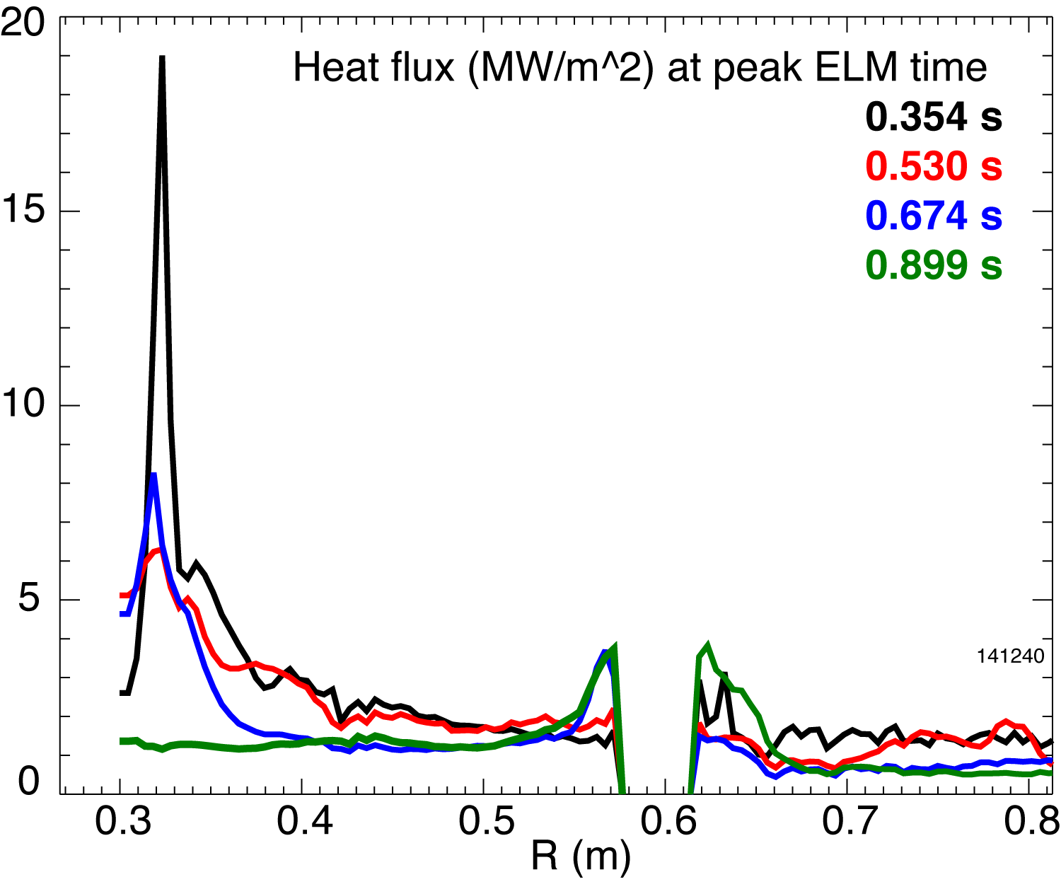
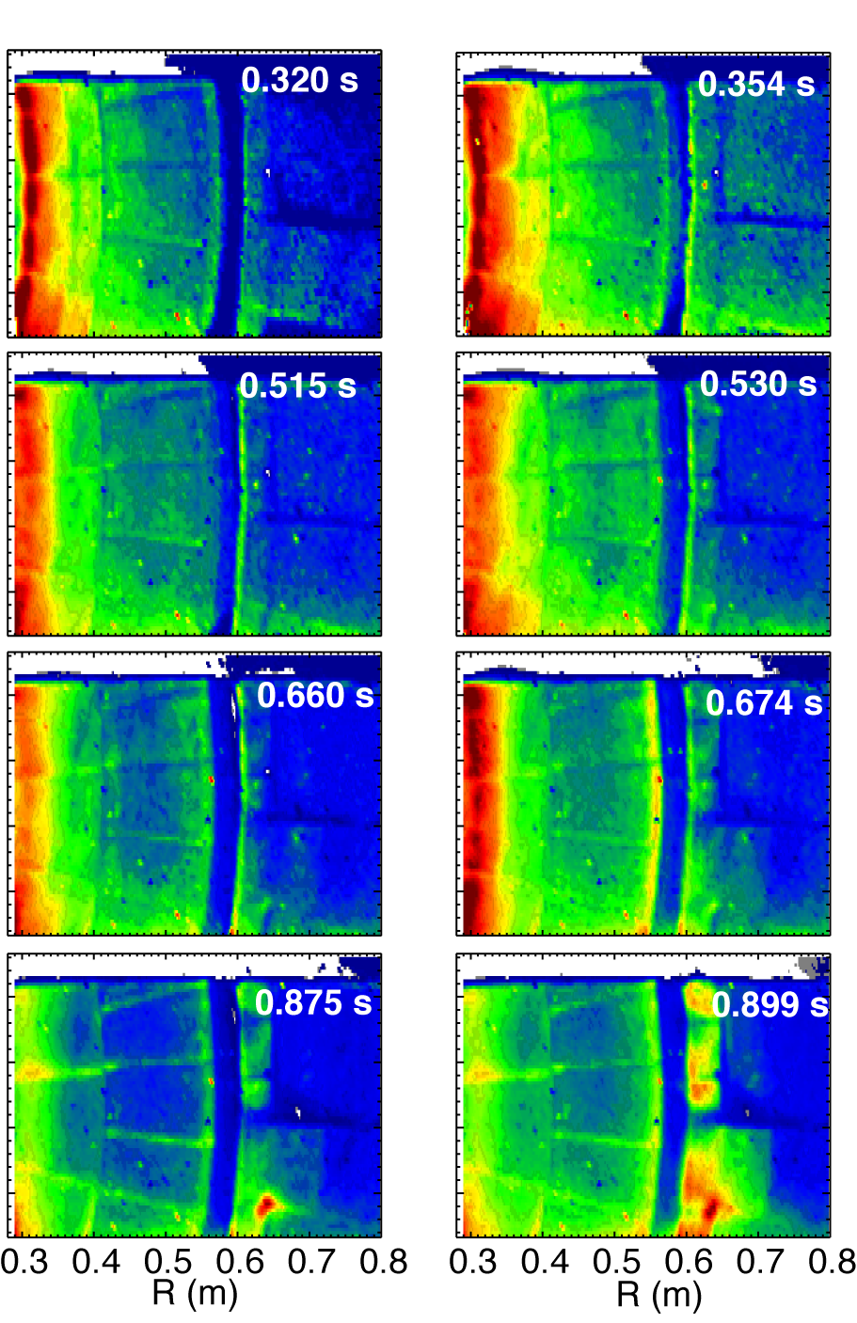

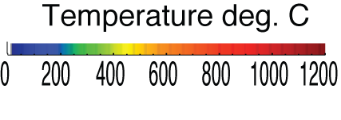
Impulsive heat loads due to Type I ELMs are mitigated in snowflake divertor
Steady-state At ELM peak
H-mode discharge, W_{MHD} ~ 220-250 kJ
  Type I ELM (W/ΔW ~ 5-8 %)

